Slide 1
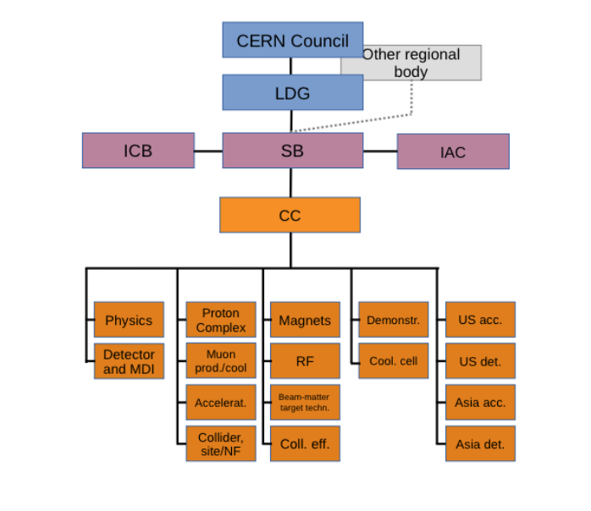
The Steering Board
The SB is composed of:
The lead representative of the Host Organisation (for CERN the ATS director Mike Lamont)
Up to two additional members appointed by the Host Organisation, Gianluigi Arduini, Steinar Stapnes (Chair)
Up to three members appointed by the ICB
Dave Newbold (STFC), Mats Lindroos (ESS), Pierre Vedrine (CEA)
  Director of National laboratories and Particle Physics, STFC and Leader of the LDG
  ESS Head of Accelerator Division and Accelerator sub-project
  Head of Accelerators, Cryogenics and Magnetism Division (DACM), CEA – IRFU
The Study Leader, Deputies, ICB chair
Also appointed but interim this year, Beate Heinemann, Director for Particle Physics DESY
Invited from the US:
Mark Palmer (BNL), Sergo Jindariani (FNAL), Sridhara Dasu (Wisconsin),
Diktys Stratakis (FNAL)

Slide 2
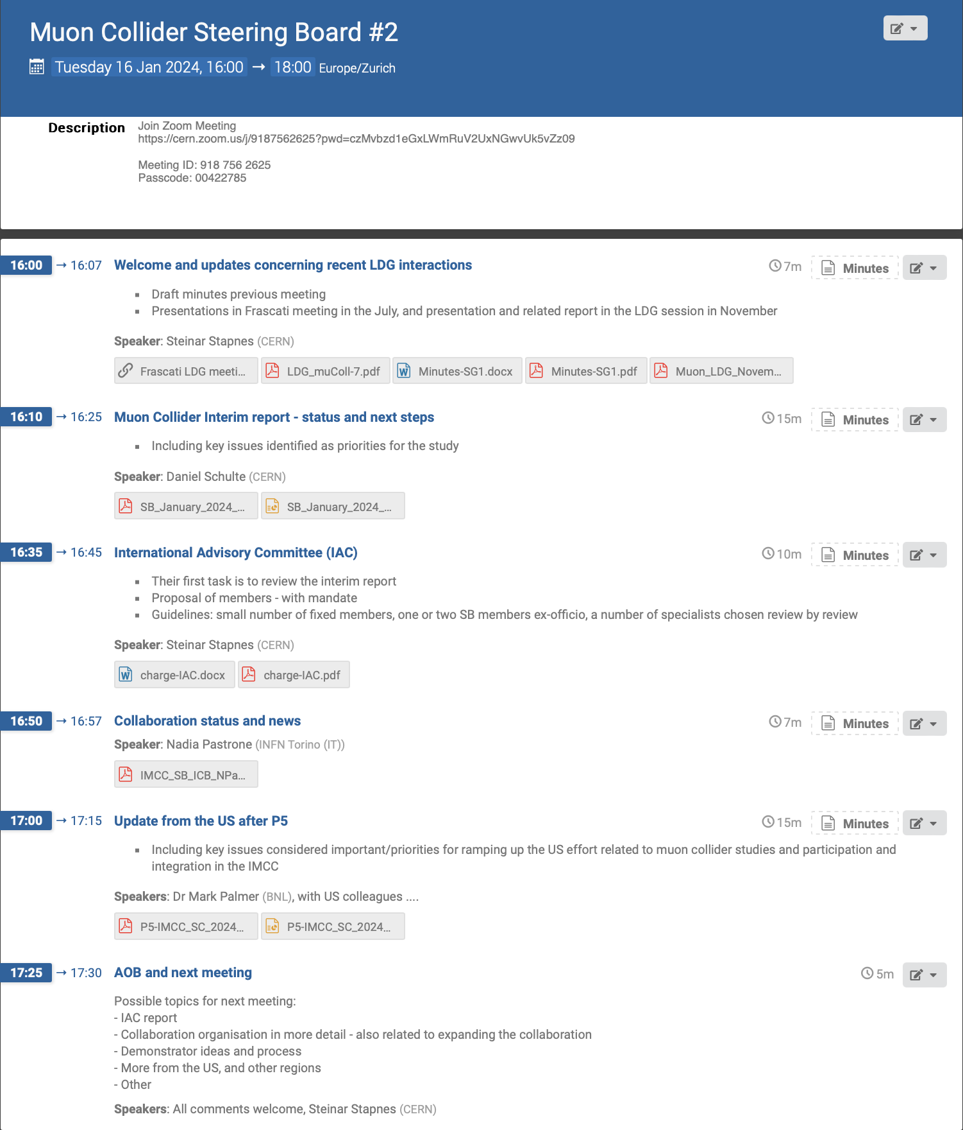

Slide 3
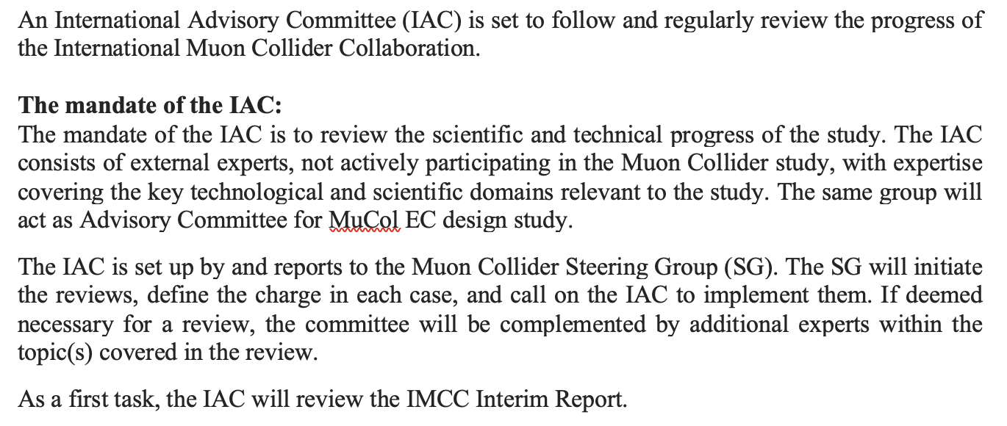
IAC

Slide 4
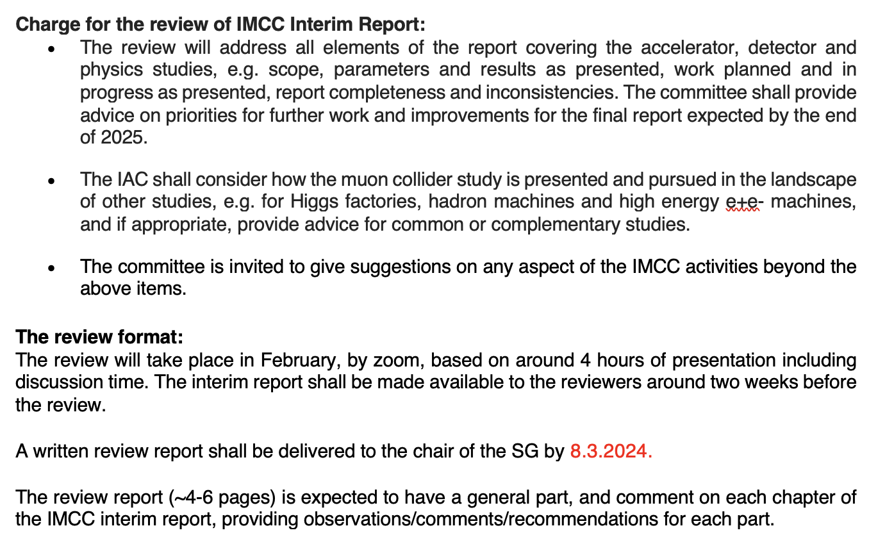
This review

Slide 5
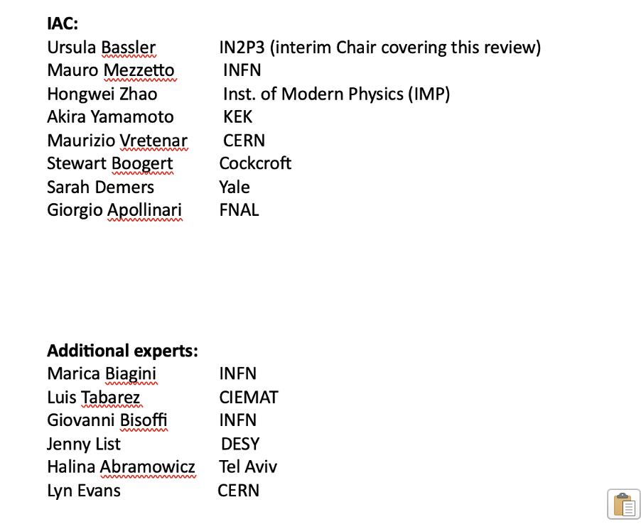
IAC and additional experts

Slide 6
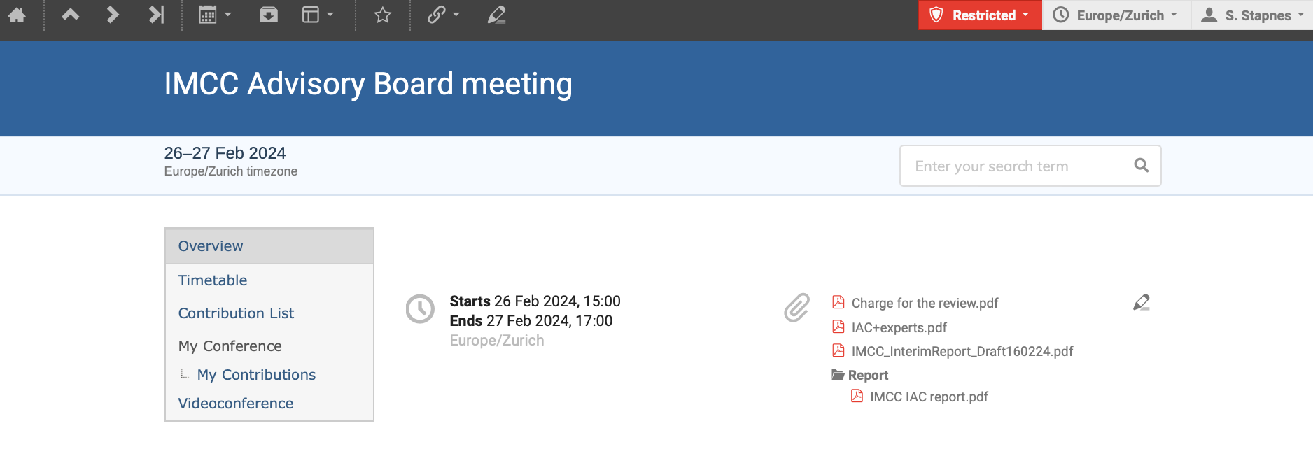
https://indico.cern.ch/event/1383018/overview (password protected)
Contains:
Report as of 16.2 (in the meantime it has developed) given to the IAC
Their review report received 8.3
Both internal, not in the public domain
Additionally, the IAC members have provided more detailed comments on Overleaf and in a Google document.
These documents are not only available for the IMCC to improve the current report, but also to shape/advice further work and contents of future report(s)

Slide 7
Overall comments
Most important for Interim Report – to be fully developed for final report:
“Pedagogical” introduction of the muon collider, including main progress since MAP, and main goals/challenges (more on US goals) – and a short EXEC summary
Overall resource shortage estimate, and “work” opportunities in all chapters
Clearer on physics results (level of details and references), refer to luminosity measurements, and explore opportunities related to “radical” technology improvements and AI/ML
Clearer on timeline and staging (technology driven) – already in intro and reflected in magnet chapter. A side-remark for future reports: a clear expressed feeling that the muon collider timeline is more important than reaching the ultimate performance (e.g. luminosity).
Longer term:
Explore - with common “studies” - synergies & complementarities with Higgs factories, Muon Collider and Hadron Collider, wrt physics primarily,
but also to encourage/stimulate common work on detectors, software and a widening community

