Slide 1
Fermilab Proton Complex &
Planning for Muon Collider Proton Driver
Jeff Eldred
IMCC 2024 Annual Meeting
March 13rd 2024

Slide 2
2
2
Fermilab Proton Complex Plan through ~2033
(LBNF, PIP-II, and ACE-MIRT)
2
Jeffrey Eldred | Fermilab Proton Complex & Muon Collider Planning
3/11/2024
Notes:
2
2
2
2
2
2

Slide 3
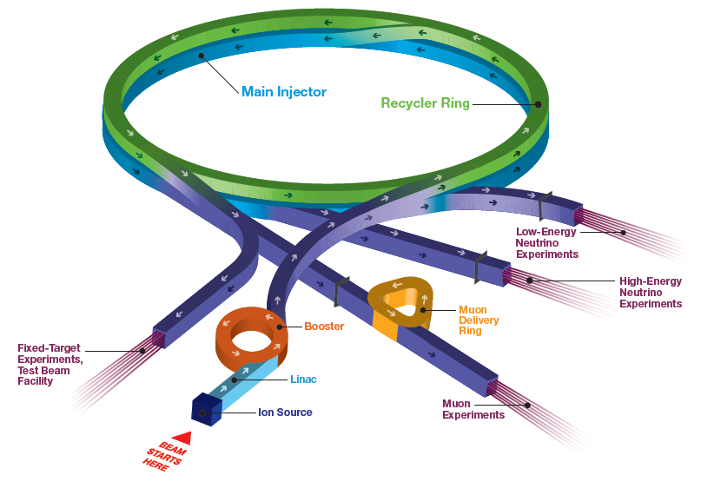
Accelerator Complex
Short Baseline Neutrino:
ICARUS, ANNIE, SBND
SwitchYard120:
test beam (FTBF),
SpinQuest
Long Baseline Neutrino:
NOvA
Muon Campus:
g-2 (completed),
Mu2e (commissioning)
Irradiation Test Area (ITA) in Linac
3
Jeffrey Eldred | Fermilab Proton Complex & Muon Collider Planning
3/11/2024

Slide 4
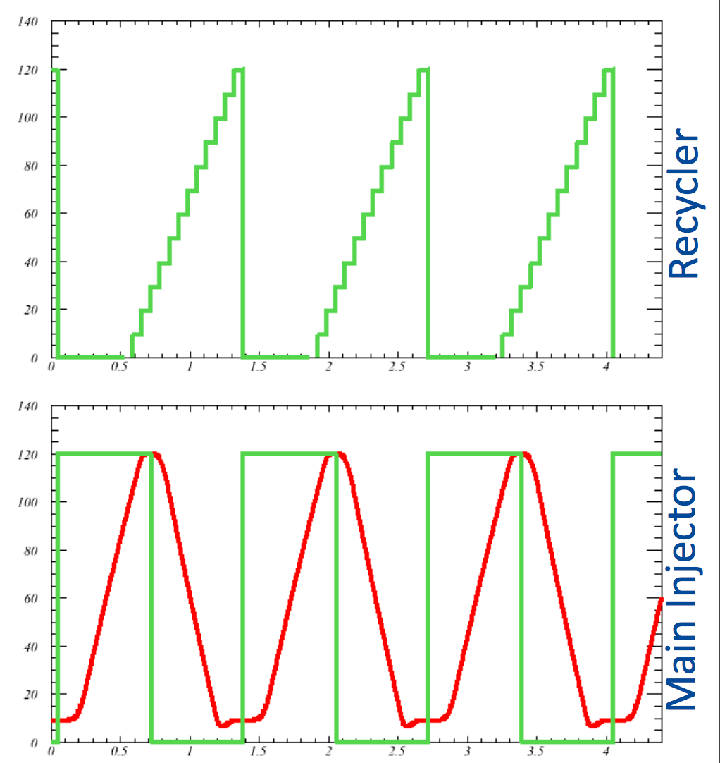

Introduction to Fermilab accelerators
$$\frac{1}{15Hz}=0.067 s$$
H⁻ linac (1970, 1993, 2012)
  - 400 MeV linac ~20mA
Booster synchrotron (1970)
  - H⁻ stripping injection (1978)
    16 turns to ~4.7x10¹² p per pulse
  - Ramp from 0.4 to 8 GeV at 15 Hz
Recycler (1998)
  - 3.3 km permanent magnet 8 GeV ring
  - Slip-stacking 12 Booster batches, ~56x10¹² p
  - Also re-bunches beam for Muon Campus
Main Injector (1998)
  8 to 120 GeV ramp, cycle time 1.133s
1.33s cycle shown
4
Jeffrey Eldred | Fermilab Proton Complex & Muon Collider Planning
3/11/2024

Slide 5
Accelerator Complex in PIP-II / LBNF era (pre ACE plan)
Proton Complex
Booster, Recycler Main Injector
PIP-II Linac
8-GeV, 2mA, CW
LBNF Beamline
to DUNE experiment
120 GeV, 1.2-2.4 MW
5
Jeffrey Eldred | Fermilab Proton Complex & Muon Collider Planning
3/11/2024

Slide 6
PIP-II Major Milestones
Mar 2018
Approve Alternative
Selection (CD-1)
Dec 2020
Approve Scope, Cost,
Schedule (CD-2)
Oct 2026
Shutdown Complex
Operations For
Booster Connection
2018
2019
2020
2021
2022
2023
2024
2025
2026
2027
2028
Mar 2021
Approve Long-Lead
Procurements (CD-3a)
Sep 2024
Linac Tunnel
Occupancy
Jan 2027
SRF Linac
Comm. Begins
Jul 2020
Cryoplant Bldg.
Construction
Approved
Dec 2028
Project Completion
Start of Operations
(Early CD-4)
Apr 2022
Approve Technical
Construction (CD-3)
Mar 2019
Linac Complex
Ground-Breaking
6
Jeffrey Eldred | Fermilab Proton Complex & Muon Collider Planning
3/11/2024

Slide 7
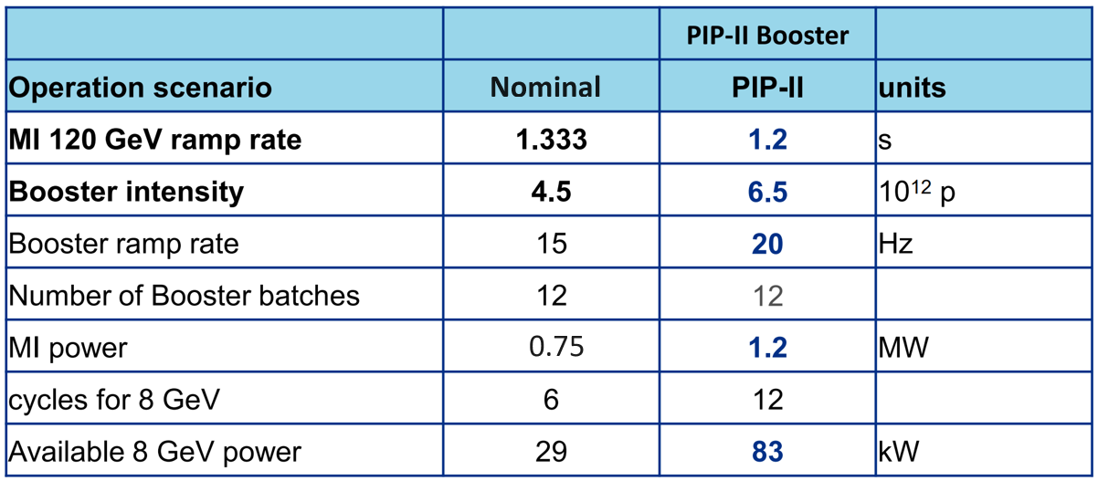
Accelerator Complex in PIP-II / LBNF era (pre ACE plan)
PIP-II Project provides
  New SRF linac for injection into Booster at 800 MeV (present 400 MeV).
  Booster cycle rate upgraded to 20 Hz from 15 Hz.
  Increased proton beam intensity for 1.2 MW beam power from MI.
Demonstrated
1.133 s
4.7-4.9 e12
0.96 MW
7
Jeffrey Eldred | Fermilab Proton Complex & Muon Collider Planning
3/11/2024

Slide 8
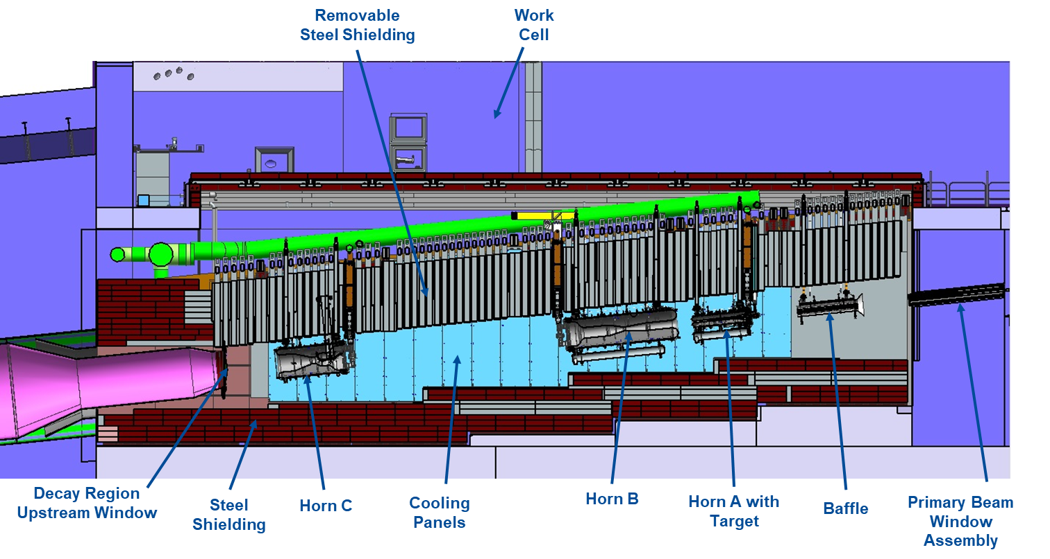
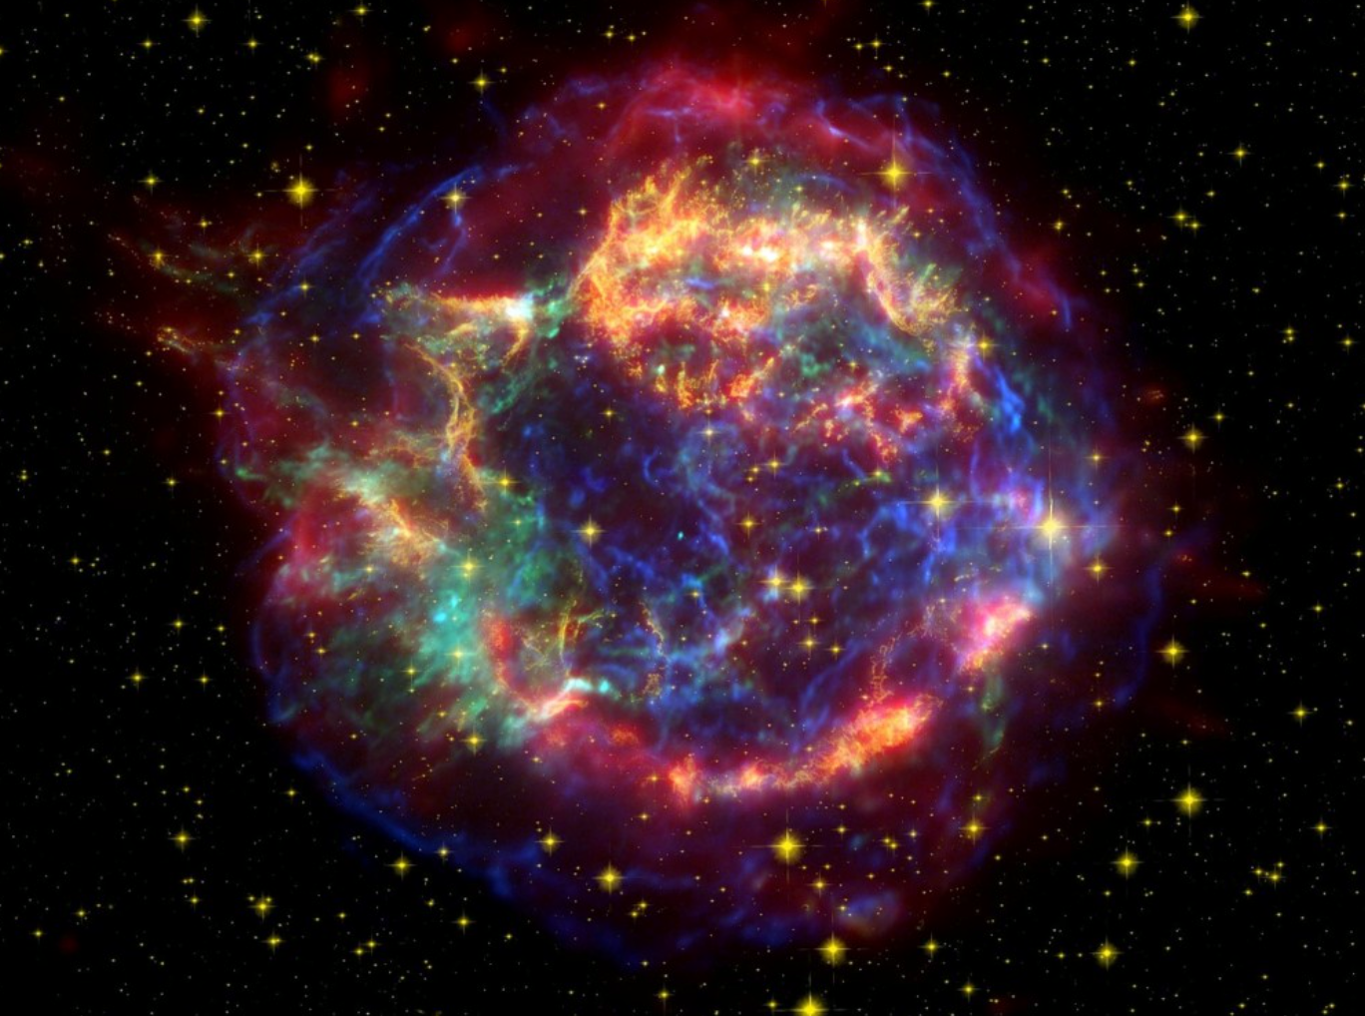
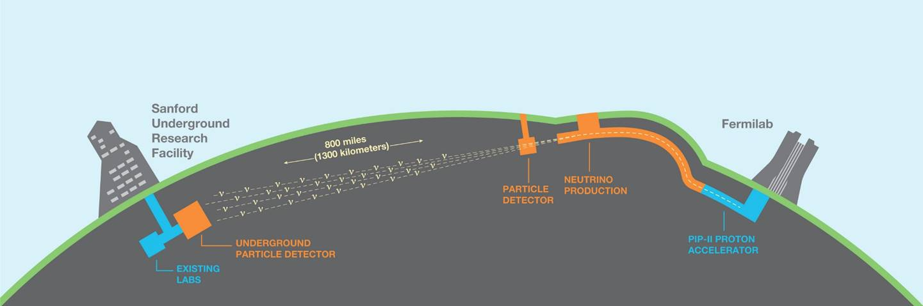
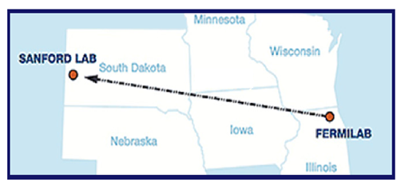
Accelerator Complex in PIP-II / LBNF era
LBNF/DUNE-US Project provides
  New proton beamline for up to 2.4 MW
  Target systems for 1.2 MW
  Shielding and absorber for up to 2.4 MW
8
Jeffrey Eldred | Fermilab Proton Complex & Muon Collider Planning
3/11/2024

Slide 9
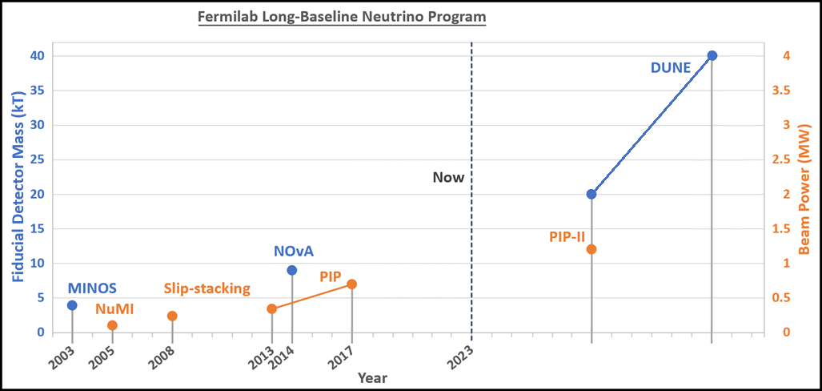
Past & Future Long Baseline Neutrino Program
Updated from J. Eldred, JINST 2019
PIP-II upgrade will provide proton power of 1.2 MW (at most 1.35 MW).
9
Jeffrey Eldred | Fermilab Proton Complex & Muon Collider Planning
3/11/2024

Slide 10
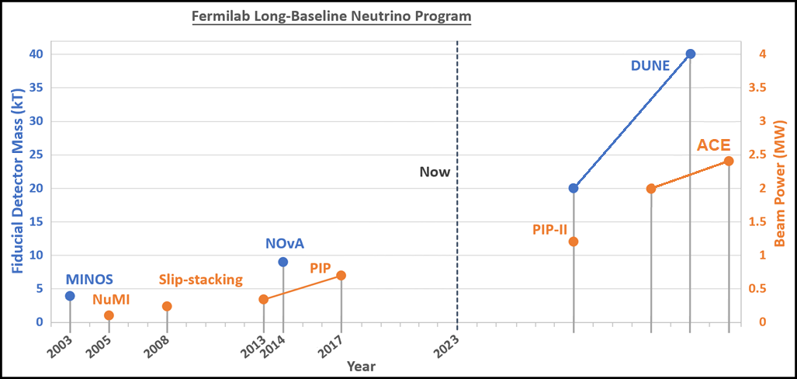
Past & Future Long Baseline Neutrino Program (with ACE)
Proposed
Updated from J. Eldred, JINST 2019
PIP-II upgrade will provide proton power of 1.2 MW (at most 1.35 MW).
ACE upgrade to 2+ MW will make best use of the 40 kT DUNE detector.
10
Jeffrey Eldred | Fermilab Proton Complex & Muon Collider Planning
3/11/2024

Slide 11
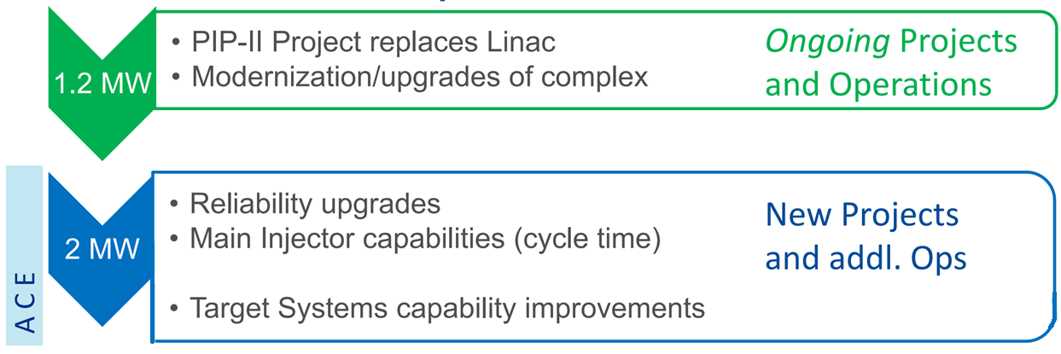
Accelerator Complex Evolution (ACE) plan
ACE-MIRT
Main Injector Ramp & Targetry
11
Jeffrey Eldred | Fermilab Proton Complex & Muon Collider Planning
3/11/2024

Slide 12
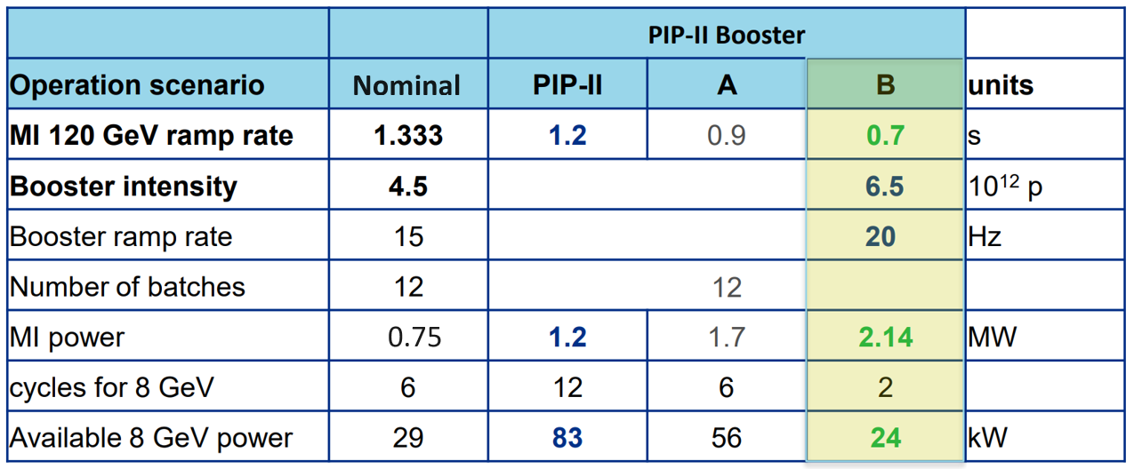
ACE MIRT – Main Injector Ramp & Targetry
PIP-II is 1.2 MW for DUNE/LBNF program with 1.2s Main Injector cycle
ACE-MIRT proposed to reduce Main Injector cycler to ~0.65s to increase beam power
Main Injector magnets and RF upgraded by factor of two.
12
Jeffrey Eldred | Fermilab Proton Complex & Muon Collider Planning
3/11/2024

Slide 13
LBNF target systems
2.4 MW
2.4 MW
1.2 MW
>1.2 MW?
>1.2 MW?
>1.2 MW?
>1.2 MW?
2.4 MW
2.4 MW
2.4 MW
1.2 MW
13
Jeffrey Eldred | Fermilab Proton Complex & Muon Collider Planning
3/11/2024

Slide 14
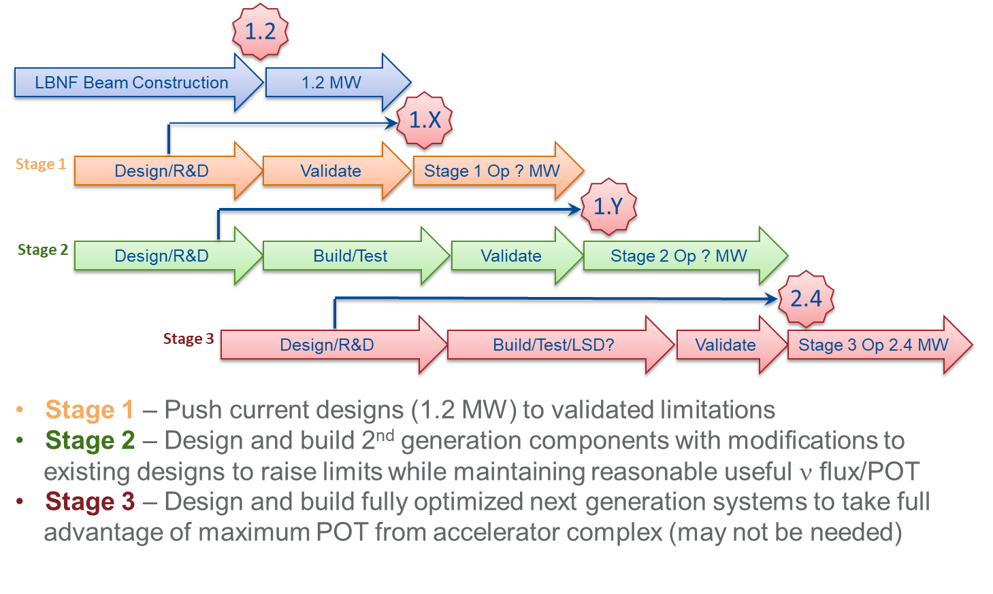
Target development staged approach
Materials R&D results needed to inform design modifications
for higher beam power
14
Jeffrey Eldred | Fermilab Proton Complex & Muon Collider Planning
3/11/2024

Slide 15
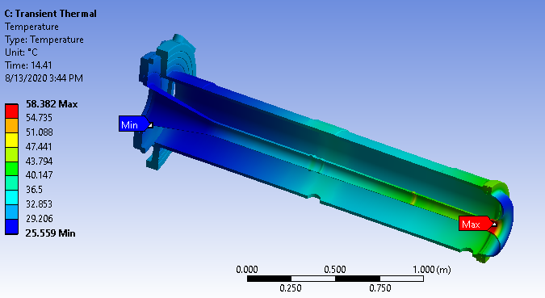
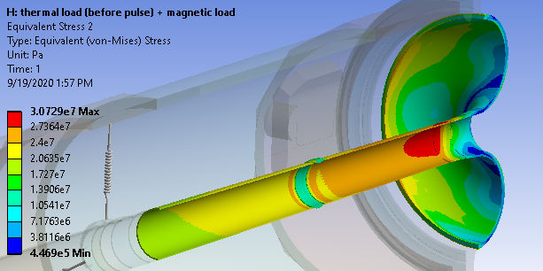
Horns for 2.4 MW performance
Horn A requires reanalysis and likely redesign
  1.2 MW analysis indicates 2.7 safety factor on fatigue endurance limit
  Likely redesign to:
    Avoid beam heating in critical locations
    Strengthen structure in critical locations
Horns B&C see less beam heating
  Safety factor: 7.3 for 1.2 MW operation
  Require reanalysis, but less likely redesign
15
Jeffrey Eldred | Fermilab Proton Complex & Muon Collider Planning
3/11/2024

Slide 16
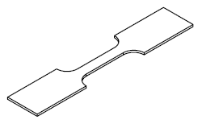
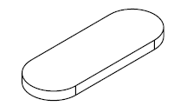

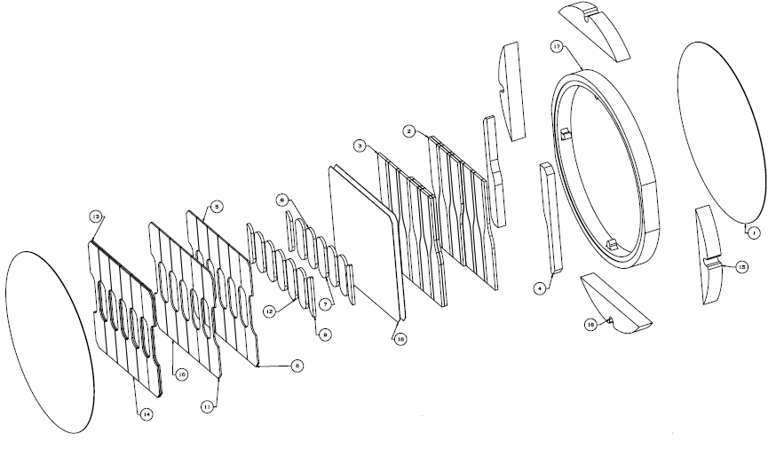
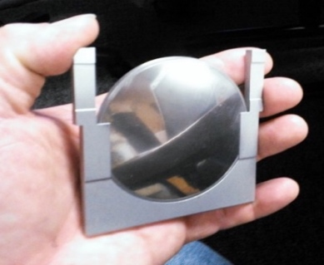
Target materials R&D on critical path to 2+ MW target
Identify candidate materials
High-energy proton irradiation of material specimens to reach expected radiation damage
Pulsed-beam experiments of irradiated specimens to duplicate loading conditions of beam interactions
Non-beam PIE (Post-Irradiation Examination) of specimens
Five-year cycle needs to start ASAP
Scope not defined yet – can we integratate high-Z target R&D?
Tensile specimens
Microstructural analysis specimens
Fatigue specimens
70mm
16
Jeffrey Eldred | Fermilab Proton Complex & Muon Collider Planning
3/11/2024

Slide 17
17
17
Recent Design Work on “Booster Replacement”
17
Jeffrey Eldred | Status and Recent Developments at the Fermilab Accelerator Complex
3/11/2024
Notes:
17
17
17
17
17
17

Slide 18
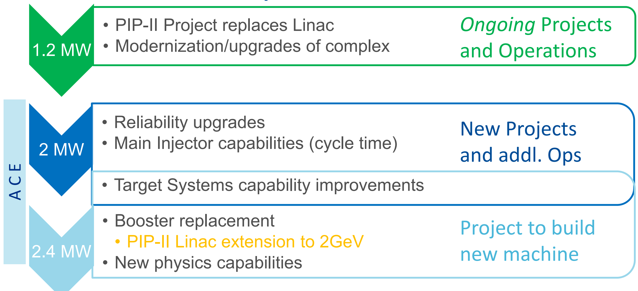
Accelerator Complex Evolution (ACE) plan
ACE-MIRT
Main Injector Ramp & Targetry
ACE-BR
Booster Replacement
18
Jeffrey Eldred | Fermilab Proton Complex & Muon Collider Planning
3/11/2024

Slide 19
Example Booster replacement options and possible add-ons
2GeV Linac + 2-8GeV RCS
or
8GeV Linac + 8GeV AR
Beam to Mu2e-II
2 GeV pulsed
2 GeV pulsed
2 GeV CW
8 GeV to MI or BNB
19
Jeffrey Eldred | Fermilab Proton Complex & Muon Collider Planning
3/11/2024

Slide 20
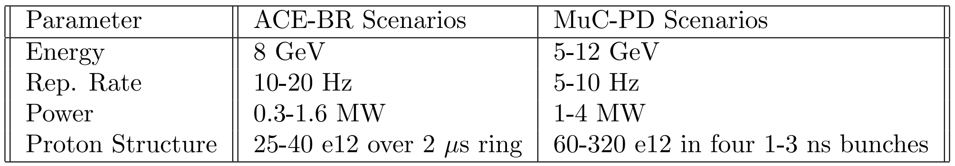
Path to Muon Collider
The ACE BR scenarios are mature accelerator designs
- Core focux on performance of neutrino program.
- Risk and cost analysis performed.
But, we need to develop new scenarios specifically oriented towards Muon Collider Proton Driver.
- Some of that prior design work will be instructive.
20
Jeffrey Eldred | Fermilab Proton Complex & Muon Collider Planning
3/11/2024

Slide 21
21
21
2024 P5 Report
Recommendations
21
Jeffrey Eldred | Fermilab Proton Complex & Muon Collider Planning
3/11/2024
Notes:
21
21
21
21
21
21

Slide 22
P5 Recommendations
Affirms PIP-II, DUNE/LBNF, and ACE-MIRT:
Rec. 1 As the highest priority independent of the budget scenarios, complete construction projects and support operations of ongoing experiments and research to enable maximum science. We reaffirm the previous P5 recommendations on major initiatives: 1b The first phase of DUNE and PIP-II to determine the mass ordering among neutrinos, a fundamental property and a crucial input to cosmology and nuclear science.
Rec. 2: Construct a portfolio of major projects that collectively study nearly all fundamental constituents of our universe and their interactions, as well as how those interactions determine both the cosmic past and future. These projects have the potential to transcend and transform our current paradigms. They inspire collaboration and international cooperation in advancing the frontiers of human knowledge. 2b Re-envisioned second phase of DUNE with an early implementation of an enhanced 2.1 MW beam (ACE-MIRT), a third far detector, and an upgraded near-detector complex as the definitive long-baseline neutrino oscillation experiment of its kind.
Area Rec. 13: Assess the Booster synchrotron and related systems for reliability risks through the first decade of DUNE operation, and take measures to preemptively address these risks.
22
Jeffrey Eldred | Fermilab Proton Complex & Muon Collider Planning
3/11/2024

Slide 23
P5 Recommendations
Calls for Accelerator R&D, especially for collider projects:
Rec. 4: Support a comprehensive effort to develop the resources—theoretical, computational and technological—essential to our 20-year vision for the field. This includes an aggressive R&D program that, while technologically challenging, could yield revolutionary accelerator designs that chart a realistic path to a 10 TeV pCM collider.
Area Rec. 8: Increase annual funding to the General Accelerator R&D program by $10M per year in 2023 dollars to ensure US leadership in key areas.
Area Rec. 9: Support generic accelerator R&D with the construction of small scale test facilities. Initiate construction of larger test facilities based on project review, and informed by the collider R&D program.
Area Rec. 10: To enable targeted R&D before specific collider projects are established in the US, an investment in collider detector R&D funding at the level of $20M per year and collider accelerator R&D at the level of $35M per year in 2023 dollars is warranted.
23
Jeffrey Eldred | Fermilab Proton Complex & Muon Collider Planning
3/11/2024

Slide 24
P5 Recommendations
Calls to Develop a New Vision for US Collider Program:
Rec. 4g: Develop plans for improving the Fermilab accelerator complex that are consistent with the long-term vision of this report including neutrinos, flavor, and a 10 TeV pCM collider.
Rec. 6: Convene a targeted panel with broad membership across particle physics later this decade that makes decisions on the US accelerator-based program at the time when major decisions concerning an off-shore Higgs factory are expected, and/or significant adjustments within the acceleratorbased R&D portfolio are likely to be needed. A plan for the Fermilab accelerator complex consistent with the long-term vision in this report should also be reviewed. 4a The level and nature of US contribution in a specific Higgs factory including an evaluation of the associated schedule, budget, and risks once crucial information becomes available. 4b Mid- and large-scale test and demonstrator facilities in the accelerator and collider R&D portfolios. 4c A plan for the evolution of the Fermilab accelerator complex consistent with the long-term vision in this report, which may commence construction in the event of a more favorable budget situation.
Area Rec. 12: Form a dedicated task force, to be led by Fermilab with broad community membership. This task force is to be charged with defining a roadmap for upgrade efforts and delivering a strategic 20-year plan for the Fermilab accelerator complex within the next five years for consideration. Direct task force funding of up to $10M should be provided.
24
Jeffrey Eldred | Fermilab Proton Complex & Muon Collider Planning
3/11/2024

Slide 25
25
25
Some Recent Thinking on
Fermilab Muon Collider
25
Jeffrey Eldred | Fermilab Proton Complex & Muon Collider Planning
3/11/2024
Notes:
25
25
25
25
25
25

Slide 26
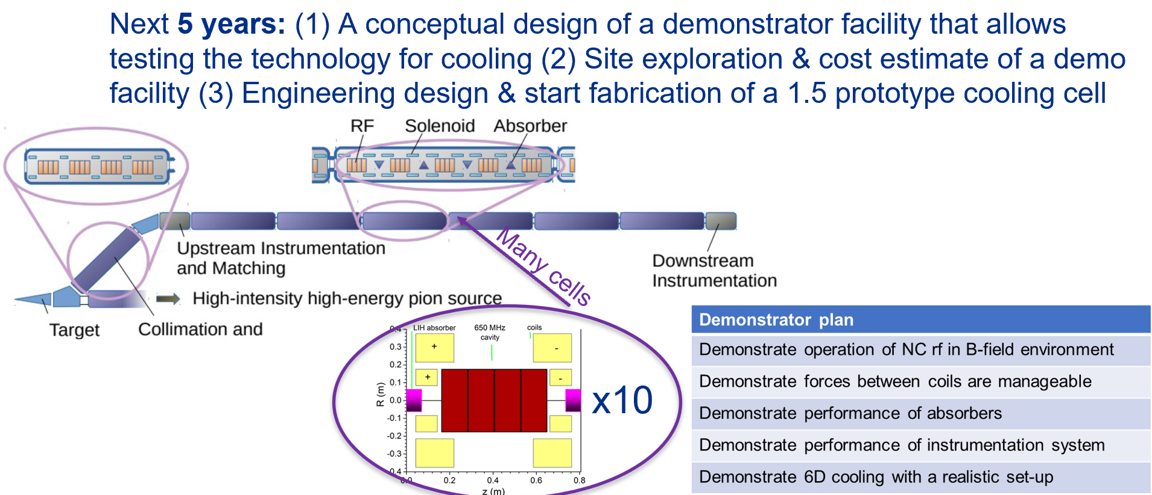
Muon Cooling Demonstrator Proposal
Credit: Yonehara (FNAL)
We are exploring Fermilab’s Muon Campus (8-GeV protons / 3-GeV muons) as a possible site for this proposed muon cooling demonstrator.
26
Jeffrey Eldred | Fermilab Proton Complex & Muon Collider Planning
3/11/2024

Slide 27
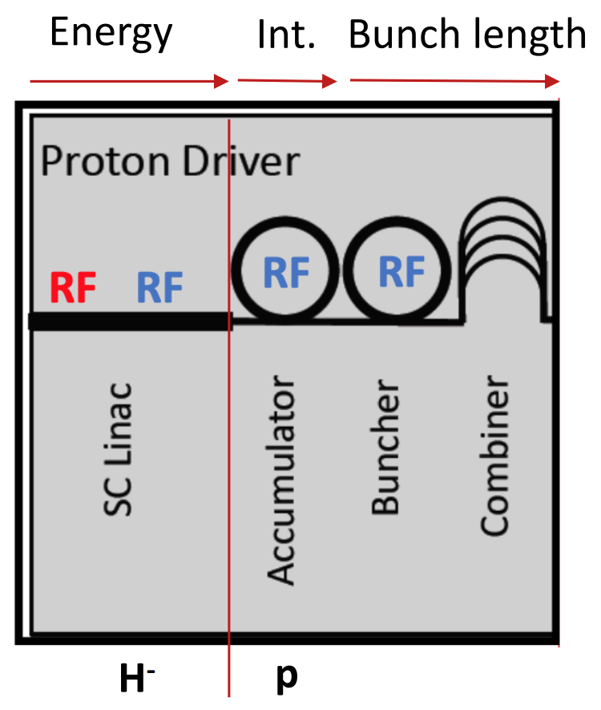
Example FNAL MuC Proton Driver Scenario
Existing ACE design for an 8-GeV Linac
- 10 Hz x 5 mA x 2 ms x 8 GeV = 0.8 MW
- ILC style cavity, LCLS-II style cryomodule, E-XFEL style RF power.
- Use higher linac current of 6-25mA, that becomes 1-4 MW.
H⁻ Injection in 8-GeV Accumulator Ring (AR)
- Ideally, use laser-stripping H⁻ injection
- Valuable R&D ongoing at SNS & J-PARC rings.
Transfer to Compressor Ring (CR)
- Four ~3-10ns bunches compressed into four ~1-3ns bunches.
Next to four bunch combiner, targetry, muon-side.
- What is the best staging towards ultimate performance?
27
Jeffrey Eldred | Fermilab Proton Complex & Muon Collider Planning
3/11/2024

Slide 28
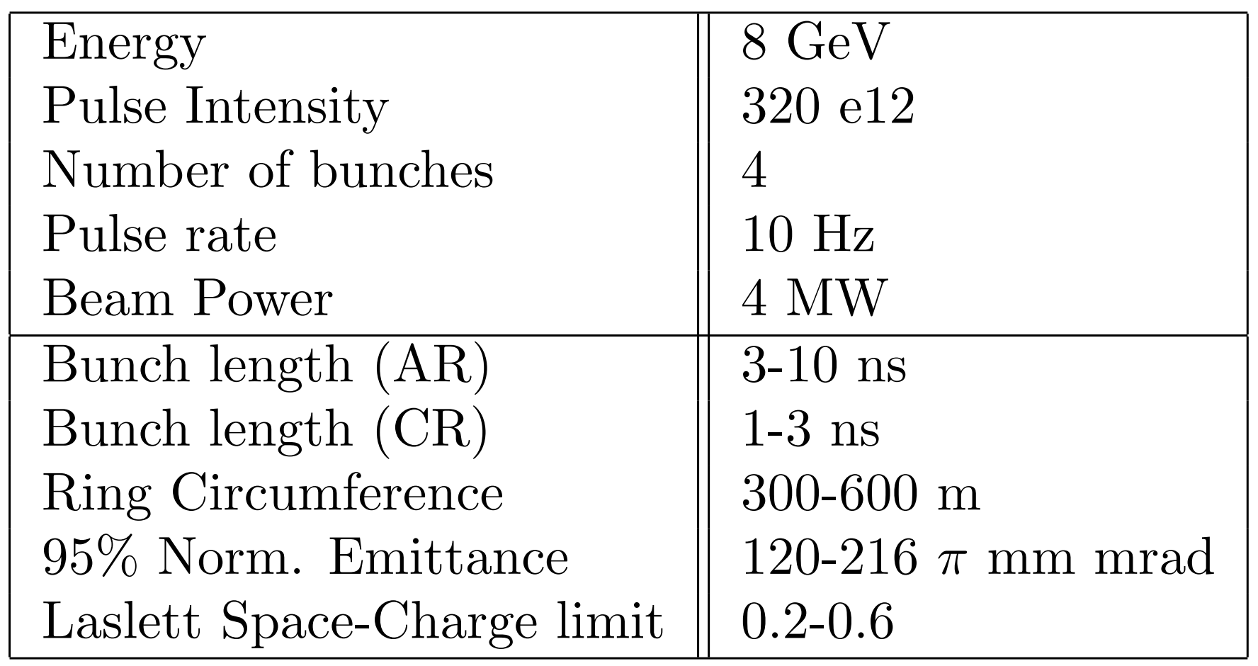
Example FNAL Proton Driver Scenario
MuC Proton Driver (AR/CR):
Superconducting magnets may be necessary for 300m compact ring design.
Choose two of the four parameters:
1) shortest bunch (1 ns)
2) smallest emittance (120 π mm mrad)
3) moderate space-charge (0.2)
4) full beam power (4 MW)
Bunch compression at extreme space-charge limit as a valuable R&D topic for MuC
- Possible acc. R&D experiment at FAST/IOTA or another intense storage ring.
- Can we do any bunch compression in the four-bunch combiner line?
We are at the preliminary stages, this is only what I have proposed.
28
Jeffrey Eldred | Fermilab Proton Complex & Muon Collider Planning
3/11/2024

Slide 29
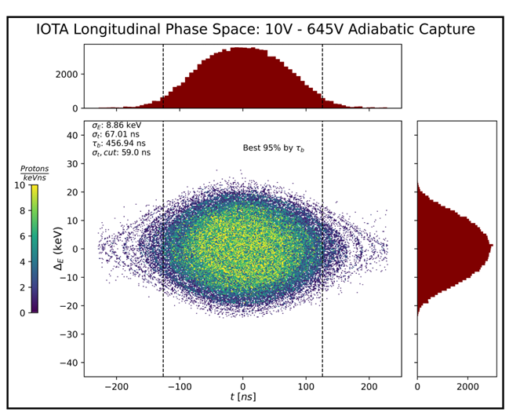
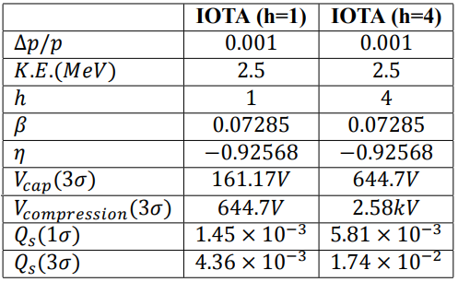
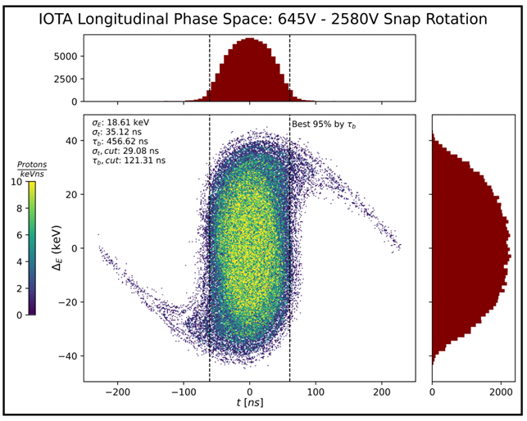
Bunch Compression at FAST/IOTA (Simulation)
Proposed IOTA proton experiment
Snap bunch rotation with intense space-charge.
IOTA h=4,
RF Capture:
IOTA h=4,
RF Rotate:
RF voltage requirements for a factor of two bunch compression ratio is shown for h=1 and h=4 case.
Credit: Simons (NIU)
29
Jeffrey Eldred | Fermilab Proton Complex & Muon Collider Planning
3/11/2024

Slide 30
Summary
Fermilab Accelerator upgrades PIP-II / LBNF / ACE-MIRT through approx. 2033.
- New 0.8 GeV, 2 mA, CW SRF linac.
- 2+ MW beam power operation of the LBNF.
- Infrastructure upgrades, targetry R&D program.
New initiatives in accelerator R&D and demonstrators for future colliders.
- Proposal for Muon Cooling Demonstrator under development.
- Many other MuC R&D topics (fast-ramping magnets, high gradient RF, etc.)
- For proton driver R&D, H⁻ laser stripping & bunch compression under extreme space-charge.
New 20-year strategic plan for Fermilab to be developed in next five years.
- There should be significant design work on muon collider scenarios, look for IPAC24 papers.
- Other science opportunities and program synergies will be examined.
30
Jeffrey Eldred | Fermilab Proton Complex & Muon Collider Planning
3/11/2024

Slide 31
31
31
Backup Slides
(ACE-Era Experimental Program)
31
Jeffrey Eldred | Status and Recent Developments at the Fermilab Accelerator Complex
3/11/2024
Notes:
31
31
31
31
31
31

Slide 32
ACE BR – Booster Replacement
The Fermilab Booster will be over 60 years old.
- Booster intensity limited by the injection region and transition-crossing.
ACE BR is a new accelerator that will be greater reliability and intensity.
- Either a 2-GeV Linac + a 2-8 Rapid-Cycling Synchtron (RCS)
- Or an 8-GeV SRF Linac + an 8-GeV Accumulator Ring (AR)
ACE-BR will provide 2.4 MW to LBNF.
Potential new science beamlines (‘spigots’):
  2 GeV Continuous Wave (CW)
  2 GeV Pulsed Beam (~ 1MW)
  8 GeV Pulsed (~ 1MW)
Platform for collider R&D; upgradeable to front-end for future Muon Collider.
Recent ACE-BR Science Workshop in June 2023.

Slide 33
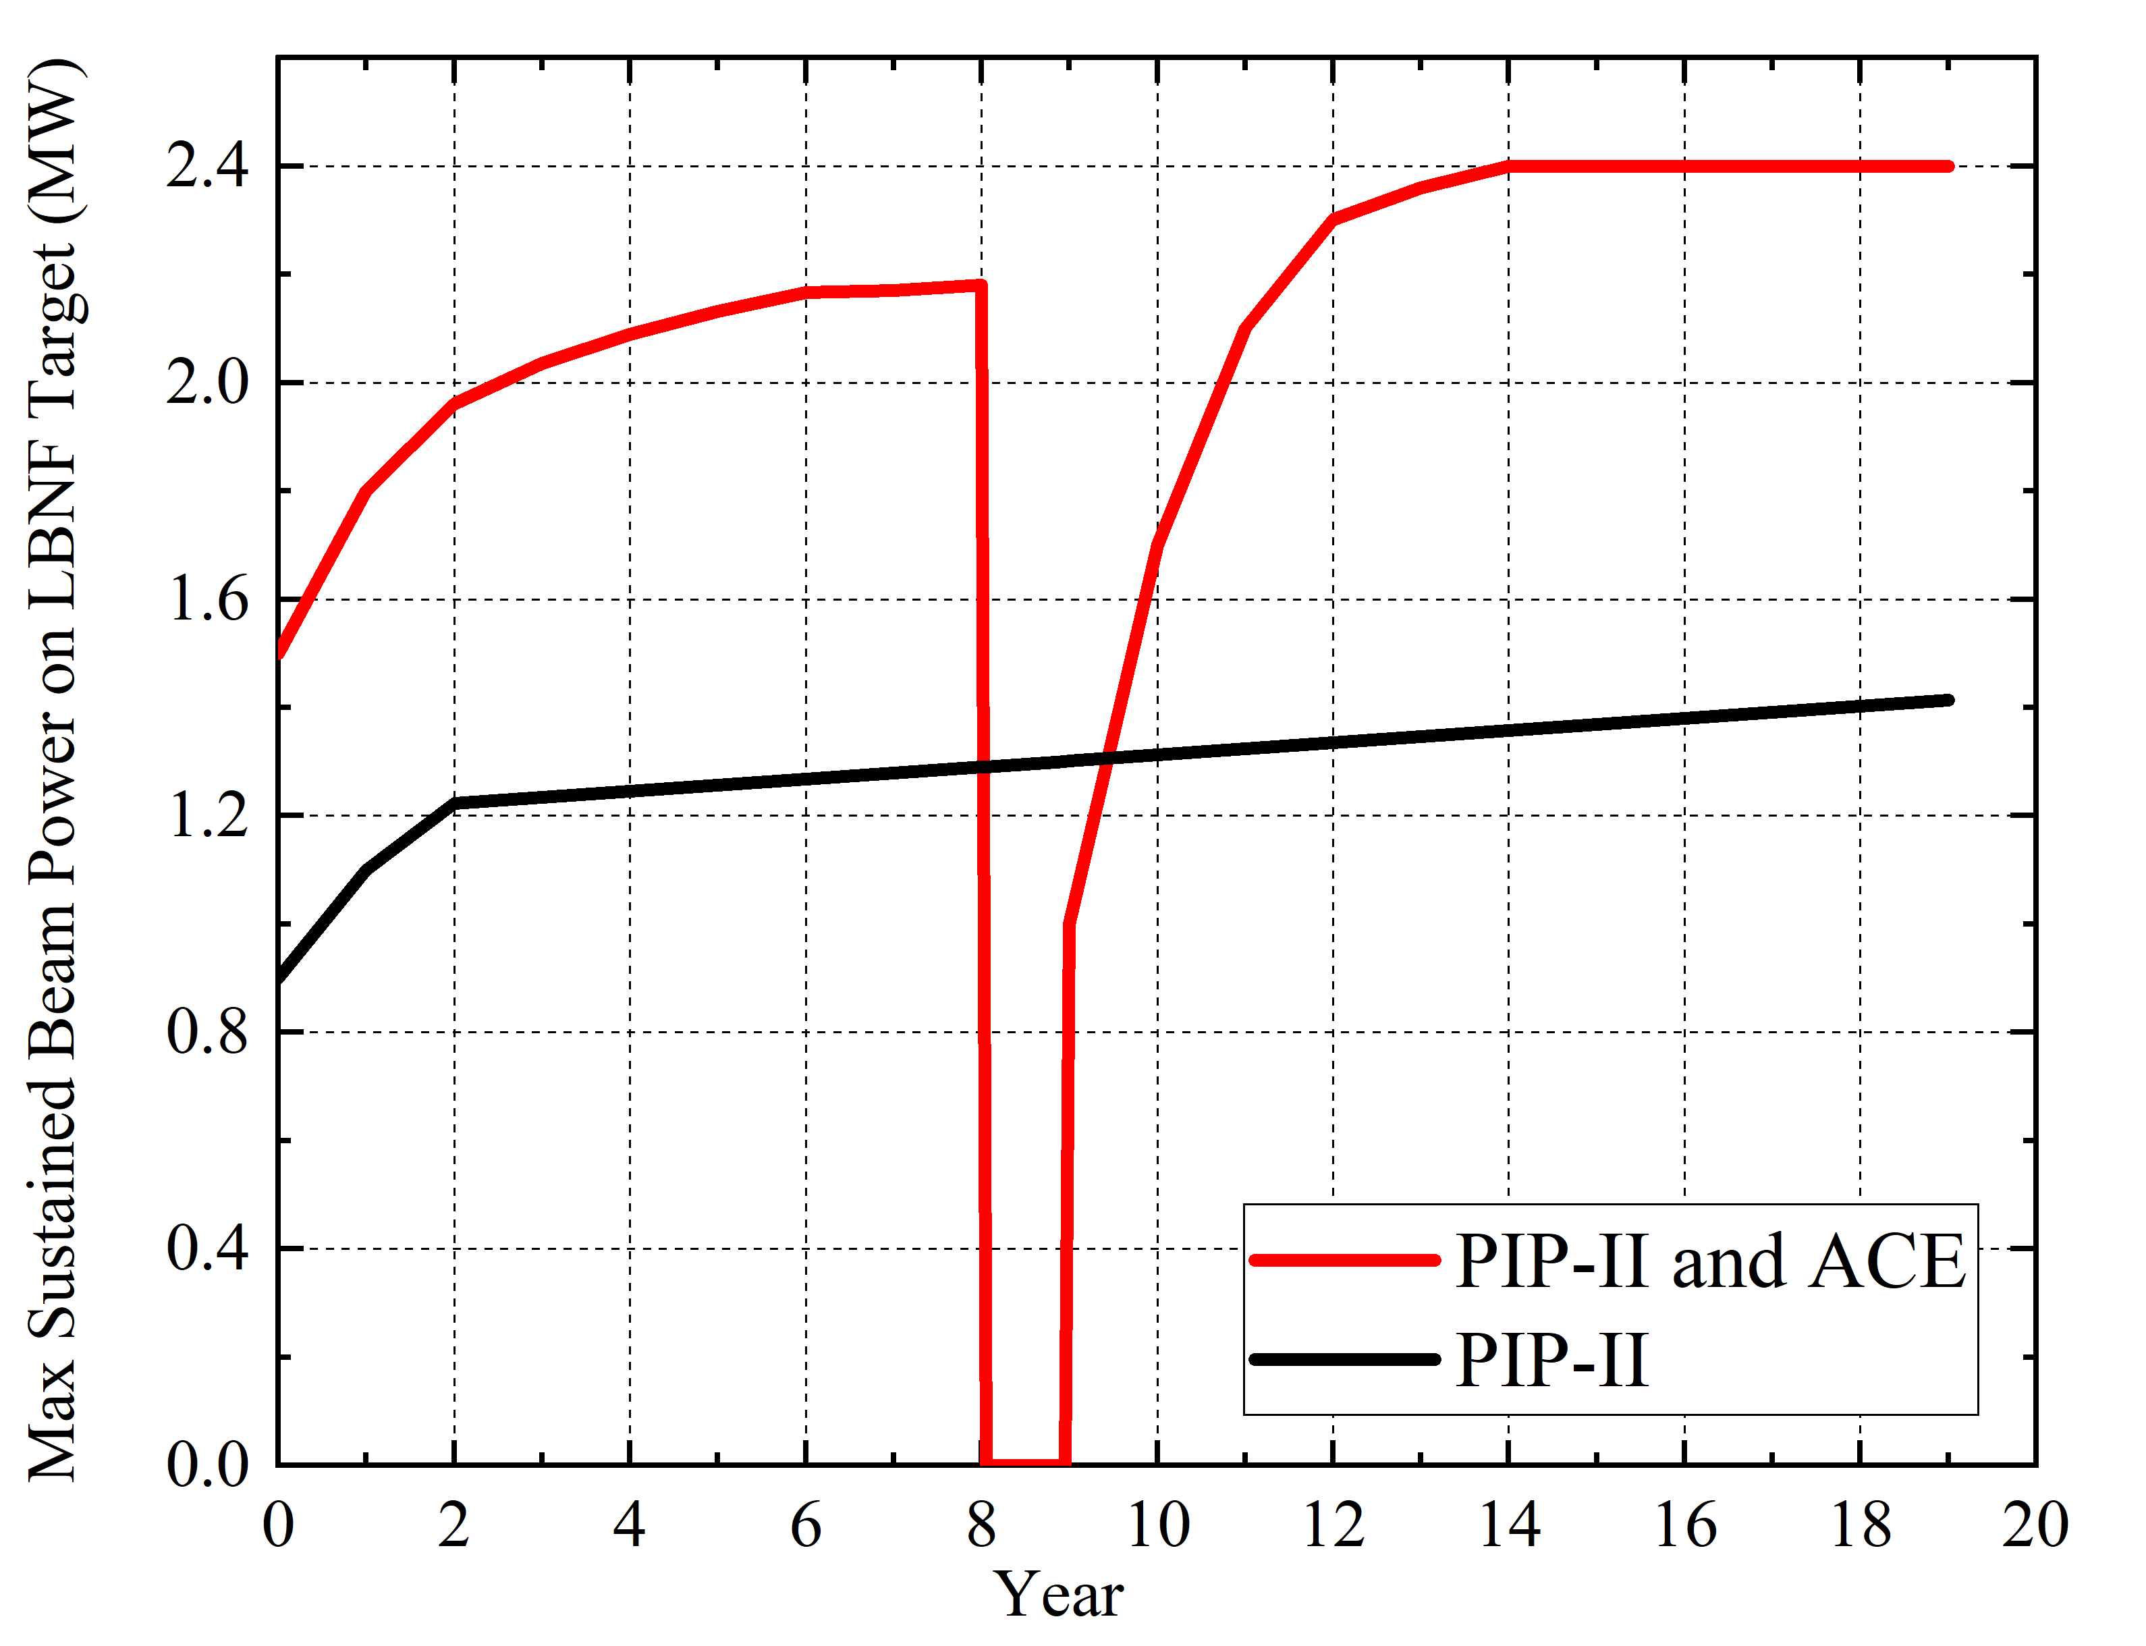
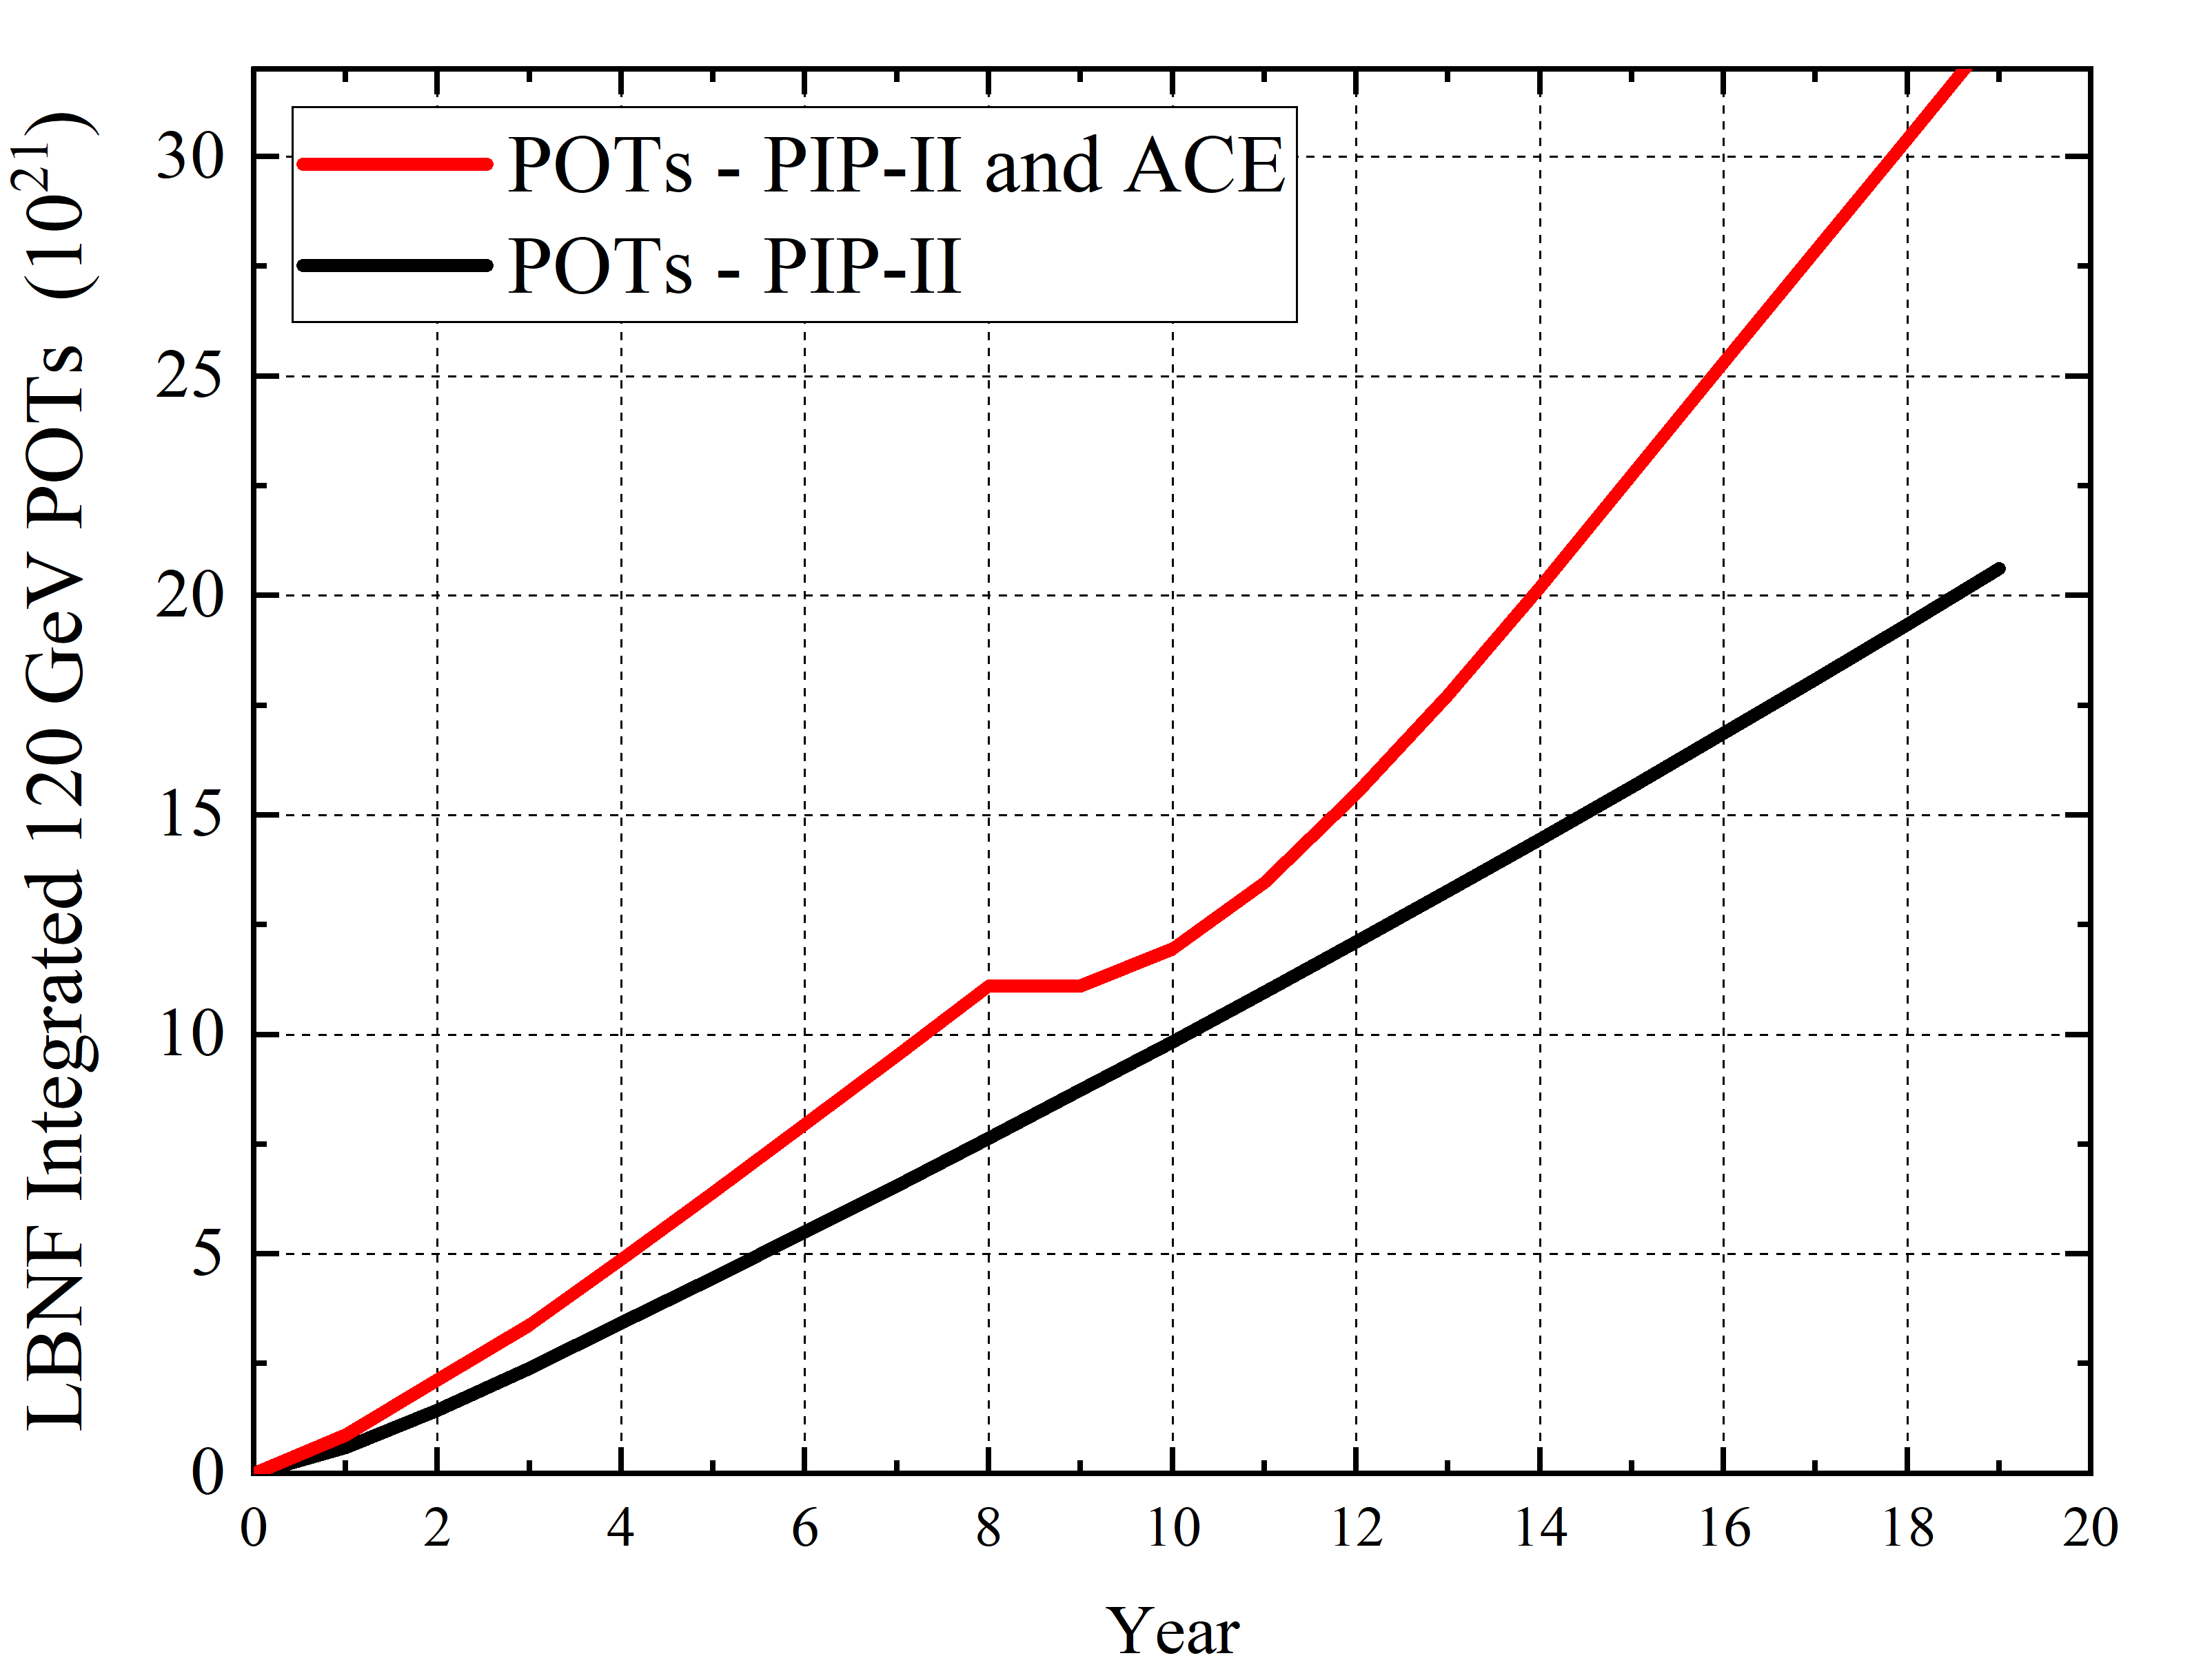
DUNE Power and Protons-on-Target (POTs)
Booster replacement
Mu2e complete in 2033
(Mu2e restarts 2029)

Slide 34
Booster replacement options
Extend SRF Linac to higher energy or construct new Rapid-Cycling Synchrotron
Looked at 3 representative options of each type
All six configurations require an extension of the SRF Linac to 2 GeV
  The RCS option will benefit from the reduced space charge at the increased energy
  The high-energy linac option will need the beam with an approximate energy of 2 GeV to take advantage of higher frequency, β = 1, high-gradient cavities that can be grouped and fed from a single, high-power klystron.
Parameters can be re-optimized based on future experimental program.
Rapid-Cycling Synchrotron (RCS)
v1: 10 Hz: Metallic vacuum chamber
v2: 20 Hz: Ceramic vacuum chamber, larger aperture magnets, accumulator ring
v3: 20 Hz: (C1b) with high-current linac, no accumulator ring
SRF Linac and Accumulator Ring
v1: Basic: small increase in PIP-II current, using demonstrated XFEL RF
v2: High current (5mA) and some RF R&D
v3: High current and significant RF R&D

Slide 35
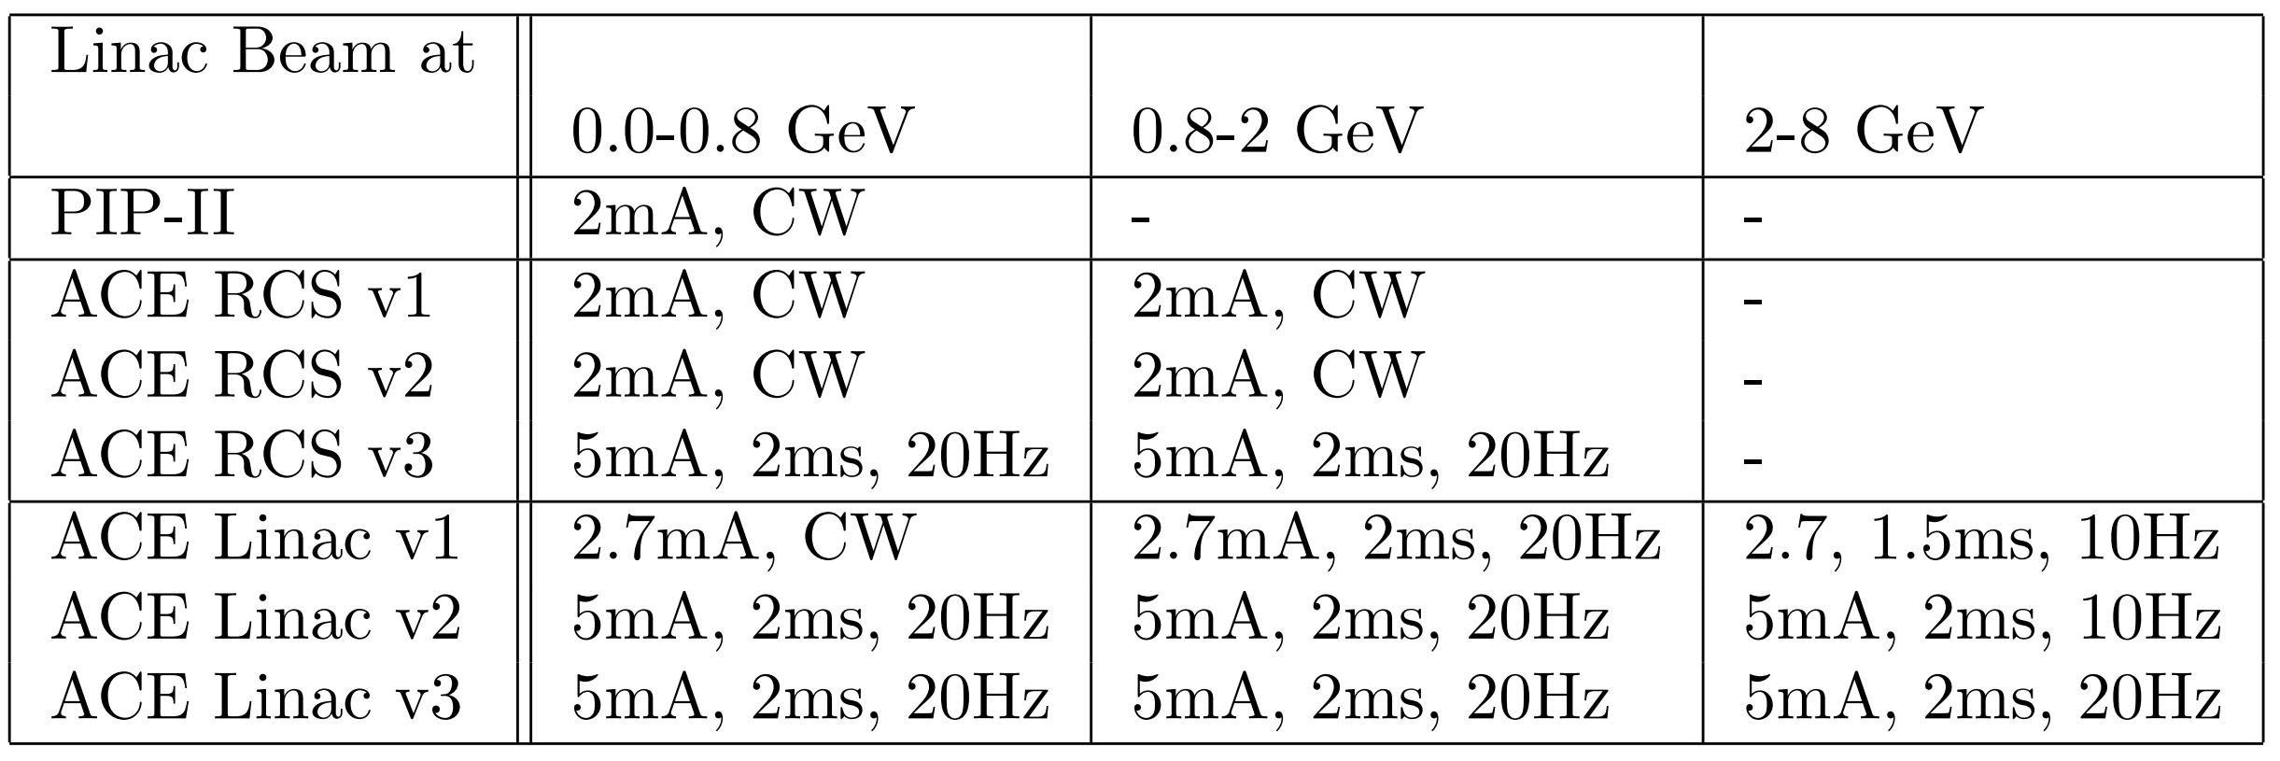
Linac Beams with ACE-BR
RCS v1, RCS v2 extend CW linac out to 2 GeV
RCS v3, Linac v2, Linac v3 may lose CW capability for enhanced pulsed linac.
Linac v1 upgrades CW linac at 0.8 GeV, pulsed thereafter.

Slide 36
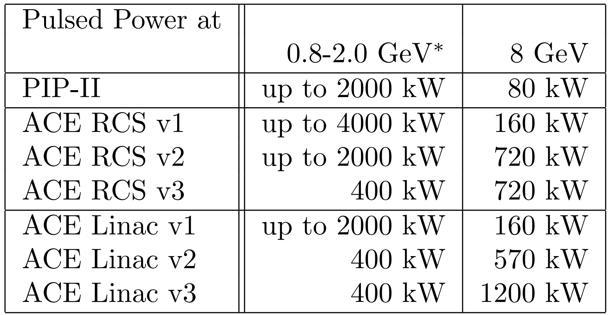
Pulsed Beam Power Available with ACE-BR
0.8-2.0 GeV Power*: Pulsed power only if there is an accumulator ring, and only up to the capabilities of the accumulator ring.
8 GeV Power: What is available after serving DUNE/LBNF program.
ACE-BR has a major impact on the 8-GeV power!

Slide 37
Challenges and R&D Topics
H⁻ Foil Injection (RCS, Linac)
- Foil overheating, particles scattering off foil, unstripped H, overall chicane length.
- Greatest challenge for RCS and Linac scenarios (although not for PIP-II Booster).
- Laser H⁻ stripping injection could be the way forward.
SRF Technology (Linac)
- Improve accelerating gradient and Q-factors.
- Develop XFEL-style klystrons with 3ms long pulses.
Metallized Ceramic Beampipe (RCS)
- Can metallized ceramic beampipe (like at J-PARC, ISIS) be deployed with a smaller aperture, reduced impedance, and greater replaceability.
Space-Charge (RCS)
- Bunch-lengthening RF and injection painting, but also electron-lenses?

Slide 38
Summary
The ACE plan includes the following key components
  Upgrades to Main Injector accelerator systems and infrastructure to enable beam power above 1.2MW through faster cycle time and efficient operations of the complex with the aim of achieving DUNE goals as fast as possible, upgrades between 2024 and 2032
  Accelerated profile of high-power target system R&D to enable above 1.2MW operations in DUNE Phase I
  Establishment of a Project for Booster Replacement with superior capacity, capability, and reliability to be tied to the accelerator complex at a time determined by the DUNE physics
Neutrino beam challenges and R&D areas
  Near-term: high-power targetry, reliability, controls, ML.
  Next-gen: H- injection, SRF gradients, machine impedance, space-charge.

