Slide 1
Update on
Muon Collider Target Magnets Layout
13 March 2024
A. Portone, P. Testoni

Slide 2
Muon Collider target magnets “specs”
Target solenoids: 2 T<B<20 T, ∅≥ 1.2 m, L ≅ 18 m
(B-profile as per H. K. Sayed and J. S. Berg, 2014)
)
RCS

Slide 3
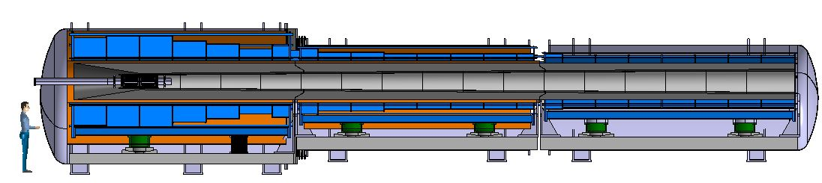
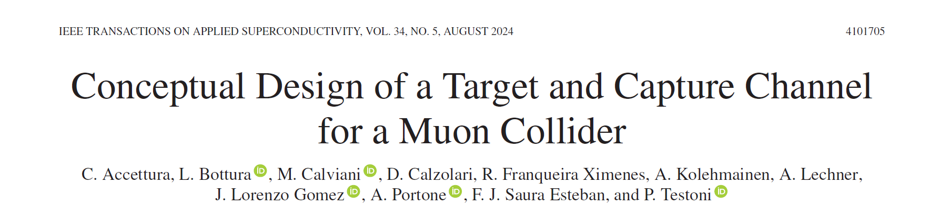
Muon Collider target magnets assembly

Slide 4
Outline
Recall present layout design point (Dec23 baseline)
Updates on magnet layout design
Magnetic shielding conceptual study
Conclusions and next steps

Slide 5
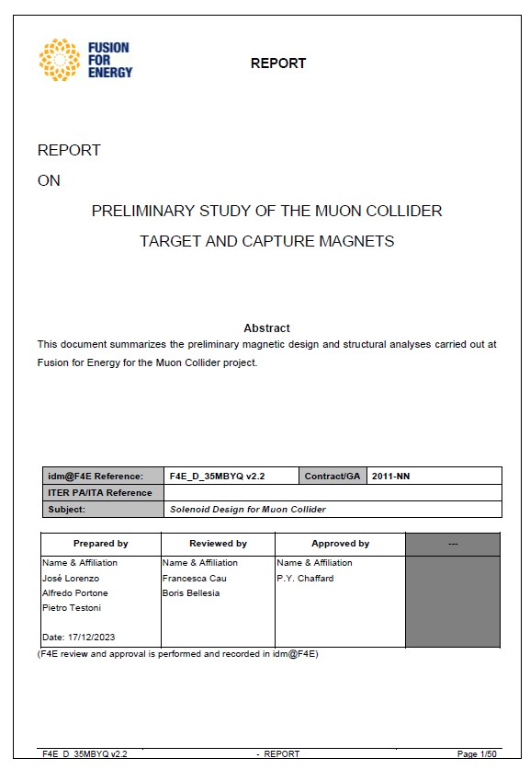
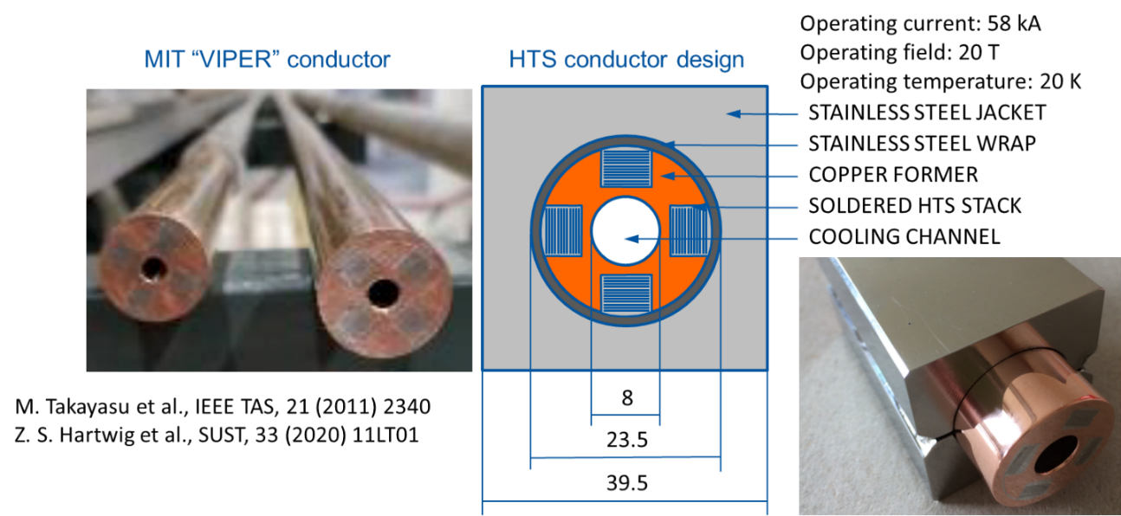
Design point: December 2023
Common building block for all solenoid coils:
VIPER-like HTS conductor
F4E_D_35MBYQ - Conceptual magnetic design for the IMCC Target Magnets

Slide 6
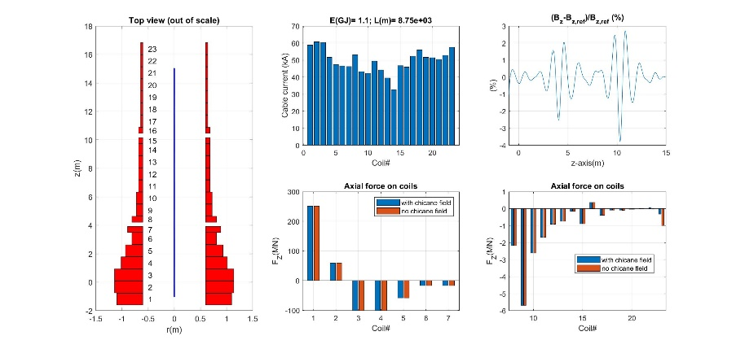
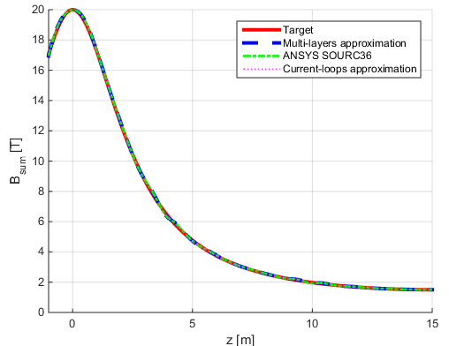
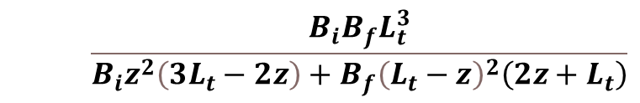
Design point: December 2023
Magnets channel bore = 1.2 m diameter
23 solenoidal coils, 3 sections, ≅ 5.5 m long each, 0.3 m gaps between sections
Magnetic energy ≅ 1.1 GJ, VIPER cable ≅ 8.75 km, ≅ 30.2 t, steel jacket ≅ 79 t
Good fitting of Sayed-Berg profile |δB/B|≅3.8%, |δB|≅0.18 T on 16 m channel
No cumulative repulsive axial forces among solenoids
$$\frac{B_{i}B_{f}L_{t}^{3}}{B_{i}z^{2}\left(3L_{t}−2z\right)+B_{f}{\left(L_{t}−z\right)}^{2}\left(2z+L_{t}\right)}$$
F4E_D_35MBYQ - Conceptual magnetic design for the IMCC Target Magnets

Slide 7
Design point: December 2023
Magnets channel bore = 1.2 m diameter
23 solenoidal coils, 3 sections, ≅ 5.5 m long each, 0.3 m gaps between sections
Magnetic energy ≅ 1.1 GJ, VIPER cable ≅ 8.75 km, ≅ 30.2 t, steel jacket ≅ 79 t
Good fitting of Sayed-Berg profile |δB/B|≅3.8%, |δB|≅0.18 T on 16 m channel
No cumulative repulsive axial forces among solenoids
F4E_D_35MBYQ - Conceptual magnetic design for the IMCC Target Magnets

Slide 8
Design point: December 2023
Coil | Rc [m] | Zc [m] | DR [m] | DZ [m] | N_{R} | N_{Z} | I [A] | It [MAt]
1 | 0.849 | -1.185 | 0.498 | 0.830 | 12 | 20 | 58905 | 14.137
2 | 0.870 | -0.335 | 0.540 | 0.830 | 13 | 20 | 60710 | 15.785
3 | 0.870 | 0.515 | 0.540 | 0.830 | 13 | 20 | 60392 | 15.702
4 | 0.808 | 1.365 | 0.415 | 0.830 | 10 | 20 | 51654 | 10.331
5 | 0.766 | 2.215 | 0.332 | 0.830 | 8 | 20 | 47469 | 7.595
6 | 0.704 | 3.065 | 0.208 | 0.830 | 5 | 20 | 46504 | 4.650
7 | 0.745 | 3.708 | 0.291 | 0.415 | 7 | 10 | 46293 | 3.240
8 | 0.704 | 4.423 | 0.208 | 0.415 | 5 | 10 | 53168 | 2.658
9 | 0.662 | 5.065 | 0.125 | 0.830 | 3 | 20 | 43280 | 2.597
10 | 0.662 | 5.915 | 0.125 | 0.830 | 3 | 20 | 42146 | 2.529
11 | 0.642 | 6.765 | 0.083 | 0.830 | 2 | 20 | 49452 | 1.978
12 | 0.642 | 7.615 | 0.083 | 0.830 | 2 | 20 | 44183 | 1.767
13 | 0.642 | 8.465 | 0.083 | 0.830 | 2 | 20 | 39567 | 1.583
14 | 0.642 | 9.315 | 0.083 | 0.830 | 2 | 20 | 32713 | 1.309
15 | 0.642 | 9.958 | 0.083 | 0.415 | 2 | 10 | 46717 | 0.934
16 | 0.642 | 10.673 | 0.083 | 0.415 | 2 | 10 | 45905 | 0.918
17 | 0.621 | 11.315 | 0.042 | 0.830 | 1 | 20 | 52310 | 1.046
18 | 0.621 | 12.165 | 0.042 | 0.830 | 1 | 20 | 56056 | 1.121
19 | 0.621 | 13.015 | 0.042 | 0.830 | 1 | 20 | 51602 | 1.032
20 | 0.621 | 13.865 | 0.042 | 0.830 | 1 | 20 | 51376 | 1.028
21 | 0.621 | 14.715 | 0.042 | 0.830 | 1 | 20 | 50471 | 1.009
22 | 0.621 | 15.565 | 0.042 | 0.830 | 1 | 20 | 52861 | 1.057
23 | 0.621 | 16.415 | 0.042 | 0.830 | 1 | 20 | 57438 | 1.149
F4E_D_35MBYQ - Conceptual magnetic design for the IMCC Target Magnets

Slide 9
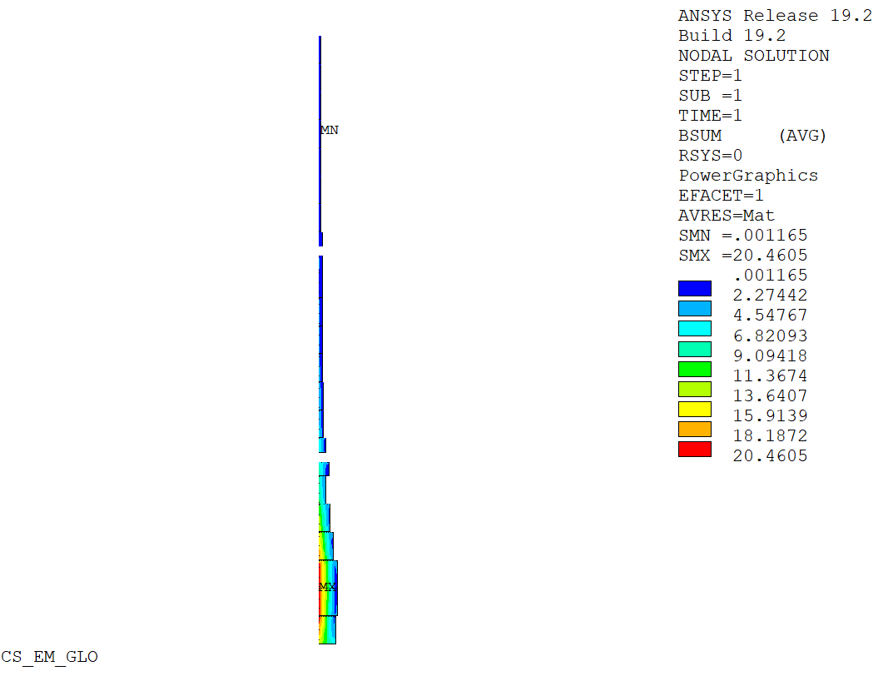
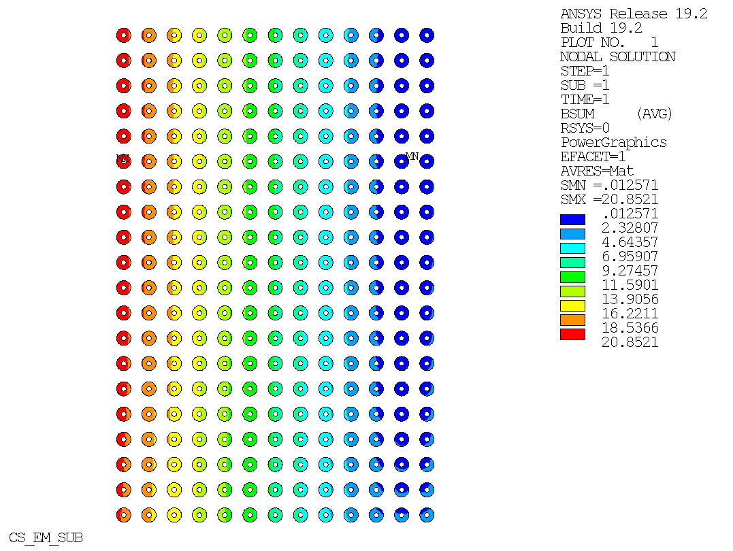
Design point: December 2023
Magnets channel bore = 1.2 m diameter
23 solenoidal coils, 3 sections, ≅ 5.5 m long each, 0.3 m gaps between sections
Magnetic energy ≅ 1.1 GJ, VIPER cable ≅ 8.75 km, ≅ 30.2 t, steel jacket ≅ 79 t
Good fitting of Sayed-Berg profile |δB/B|≅3.8%, |δB|≅0.18 T on 16 m channel
No cumulative repulsive axial forces among solenoids
F4E_D_35MBYQ - Conceptual magnetic design for the IMCC Target Magnets

Slide 10
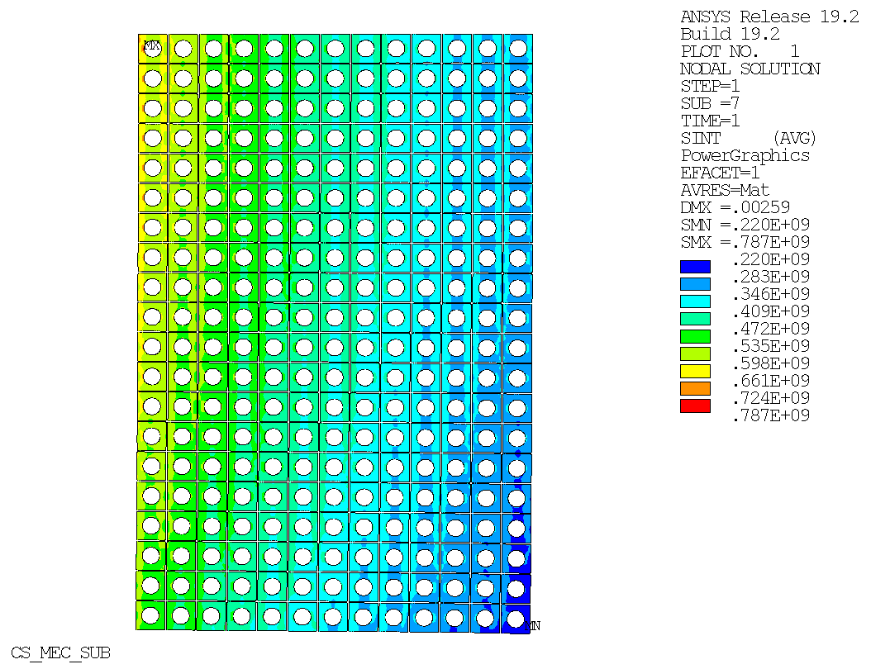
Design point: December 2023
Magnets channel bore = 1.2 m diameter
23 solenoidal coils, 3 sections, ≅ 5.5 m long each, 0.3 m gaps between sections
Magnetic energy ≅ 1.1 GJ, VIPER cable ≅ 8.75 km, ≅ 30.2 t, steel jacket ≅ 79 t
Good fitting of Sayed-Berg profile |δB/B|≅3.8%, |δB|≅0.18 T on 16 m channel
No cumulative repulsive axial forces among solenoids
F4E_D_35MBYQ - Conceptual magnetic design for the IMCC Target Magnets

Slide 11
Design issues
Main Issues:
Increase space between sections for mechanical structure (→ gaps = 480 mm or more)
Increase coils in (high field) collision region (→ bore diameter = 1.3 mm or more)
Reduce coils power supply cost/complexity (→ all coils currents I ≅ 60 kA)
Assess impact on B_{Z} due to chicane coils current
Assess stray field outside gallery
Define beam extraction path from target region channel (pending)

Slide 12
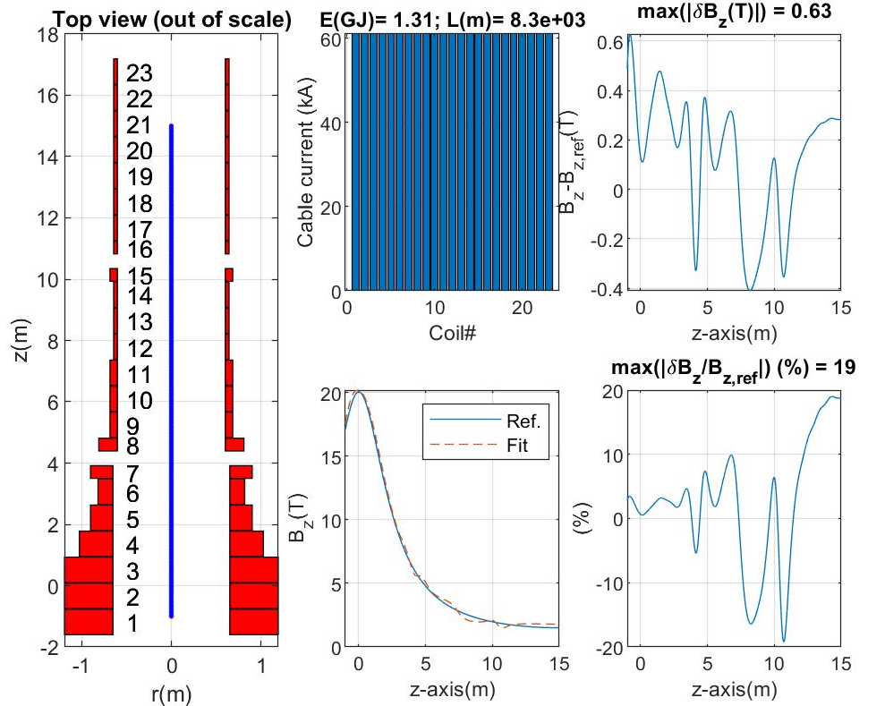
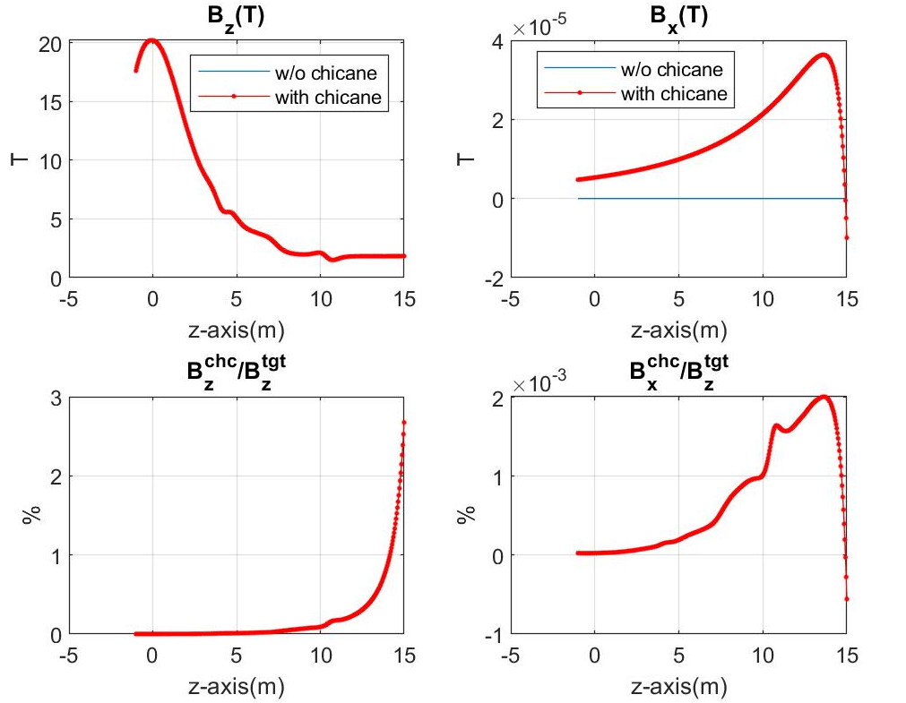
Design evolution: February 2024
ALL COILS CURRENTS = 61kA
Magnets channel bore = 1.3 m diameter, 0.48 m gaps between sections
23 solenoidal coils, 3 sections, ≅ 5.5 m long each (same as previous option)
Magnetic energy ≅ 1.31 GJ, VIPER cable ≅ 8.30 km, ≅ 28.7 t, steel jacket ≅ 74.8 t
Fair fitting of Sayed-Berg profile |δB/B|=19%, max(|δB|)=0.63 T over 16 m channel axis

Slide 13
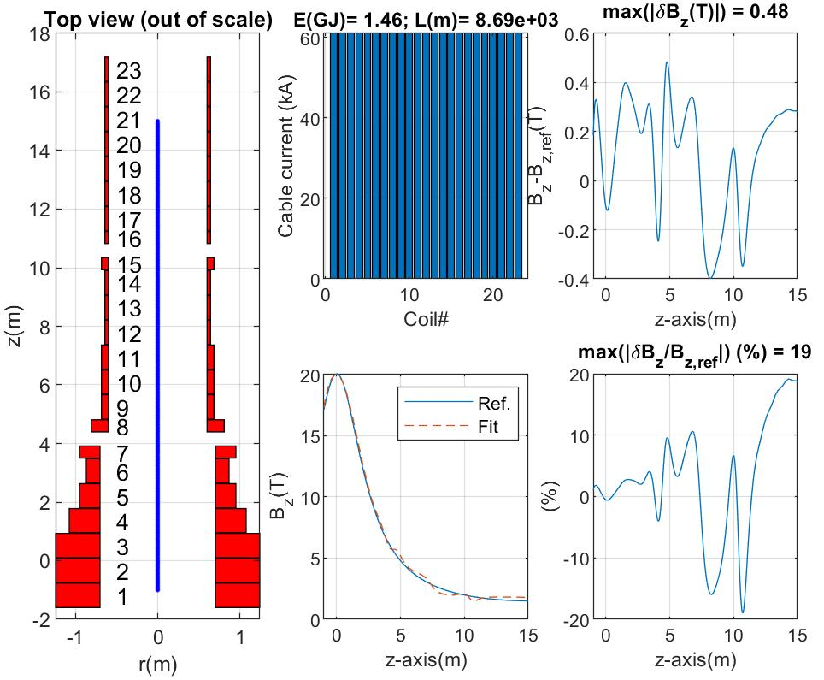
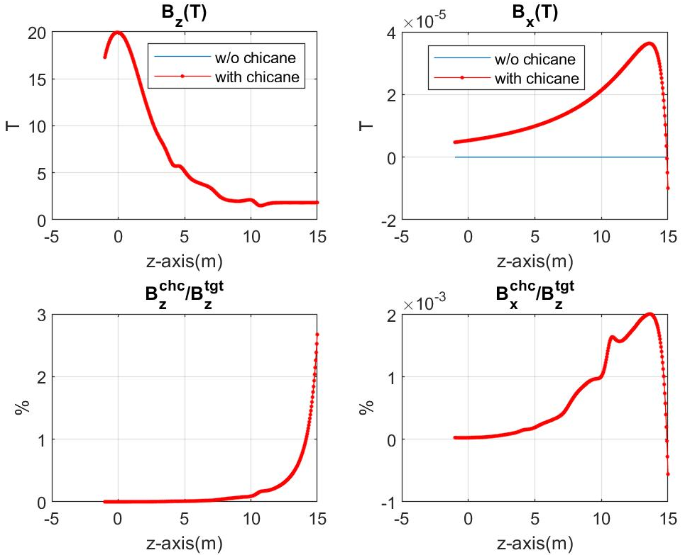
Design evolution: February 2024*
ALL COILS CURRENTS = 61kA
Magnets channel bore = 1.4 m diameter, 0.48 m gaps between sections
23 solenoidal coils, 3 sections, ≅ 5.5 m long each (same as previous option)
Magnetic energy ≅ 1.46 GJ, VIPER cable ≅ 8.69 km, ≅ 30 t, steel jacket ≅ 78.3 t
Fair fitting of Sayed-Berg profile |δB/B|=19%, max(|δB|)=0.48 T over 16 m channel axis

Slide 14
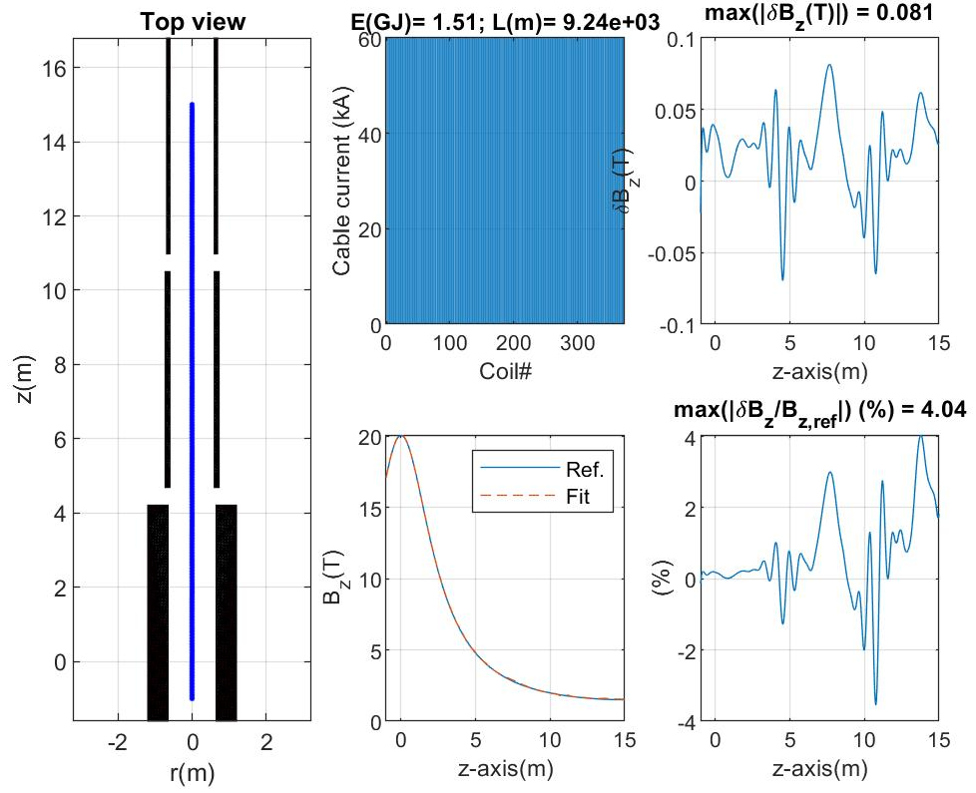
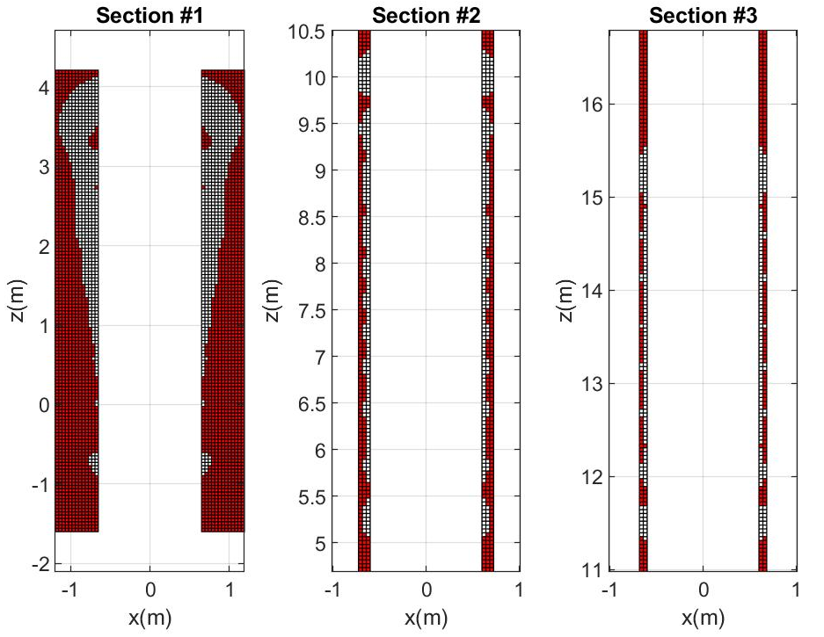
Design evolution: March 2024
ALL COILS CURRENTS = 60kA
Magnets channel bore = 1.3 m diameter, 0.48 m gaps between sections
3 sections, ≅ 5.8 m long each (0.3 m longer than previous options)
Magnetic energy ≅ 1.51 GJ, VIPER cable ≅ 9.24 km, ≅ 31.9 t, steel jacket ≅ 83.2 t
Good fitting of Sayed-Berg profile |δB/B|=4%, max(|δB|)=0.08 T over 16 m channel axis

Slide 15
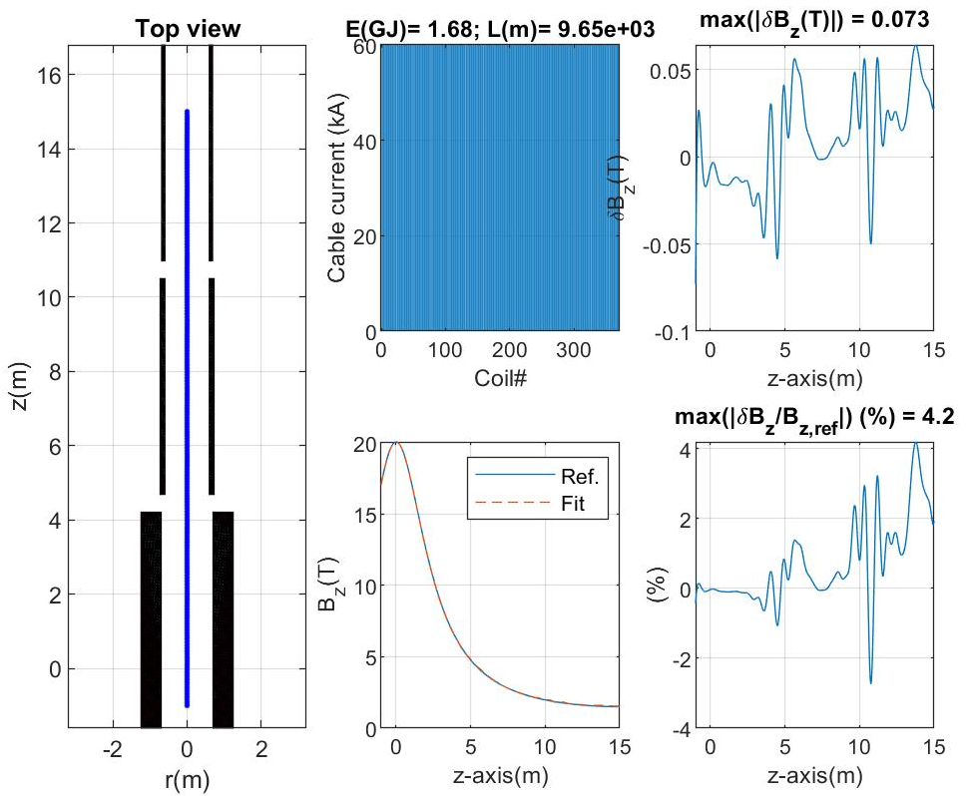

Design evolution: March 2024*
ALL COILS CURRENTS = 60kA
Magnets channel bore = 1.4 m diameter, 0.48 m gaps between sections
3 sections, ≅ 5.8 m long each (0.3 m longer than previous options)
Magnetic energy ≅ 1.68 GJ, VIPER cable ≅ 9.65 km, ≅ 33.3 t, steel jacket ≅ 87 t
Good fitting of Sayed-Berg profile |δB/B|=4.2%, max(|δB|)=0.07 T over 16 m channel axis

Slide 17
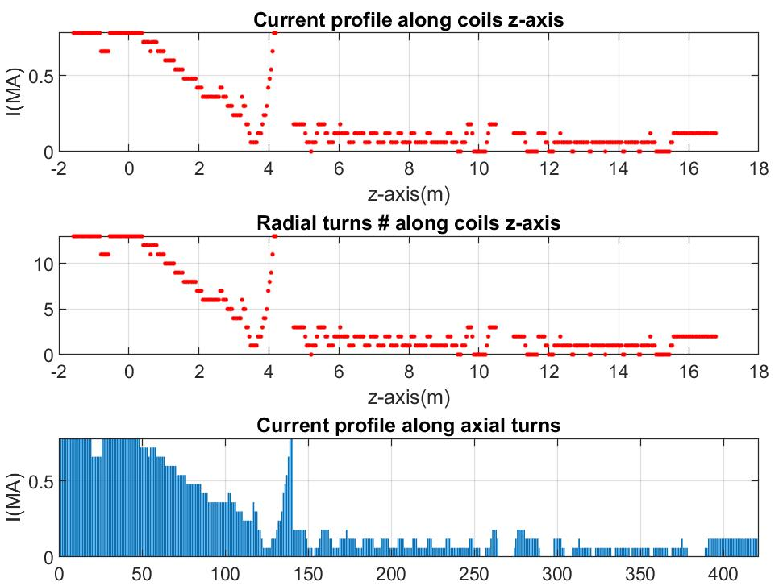
sections gap
sections gap

Slide 18
Design layouts summary
 | Dec-23 | Feb-24 | Feb-24* | Mar-24 | Mar-24*
Bore diameter (m) | 1.2 | 1.3 | 1.4 | 1.3 | 1.4
Conductor current (kA) | 33<I<61 | 61 | 61 | 60 | 60
Sections gap (m) | 0.3 | 0.48 | 0.48 | 0.48 | 0.48
Number of solenoids | 23 | 23 | 23 | TBD | TBD
Maximum field error (T) | 0.18 | 0.63 | 0.48 | 0.08 | 0.07
Maximum field error (%) | 3.8 | 19 | 19 | 4.0 | 4.2
Magnetic energy (GJ) | 1.1 | 1.31 | 1.46 | 1.51 | 1.68
Conductor length (km) | 8.75 | 8.30 | 8.69 | 9.24 | 9.65
Coils length (m) | 3 x 5.5 | 3 x 5.5 | 3 x 5.5 | 3 x 5.8 | 3 x 5.8
Cable mass (t) | 30.2 | 28.7 | 30.0 | 31.9 | 33.3
Jacket mass (t) | 79 | 74.8 | 78.3 | 83.2 | 87.0

Slide 19
Shielding effect of the tunnel concrete rebars

Slide 20
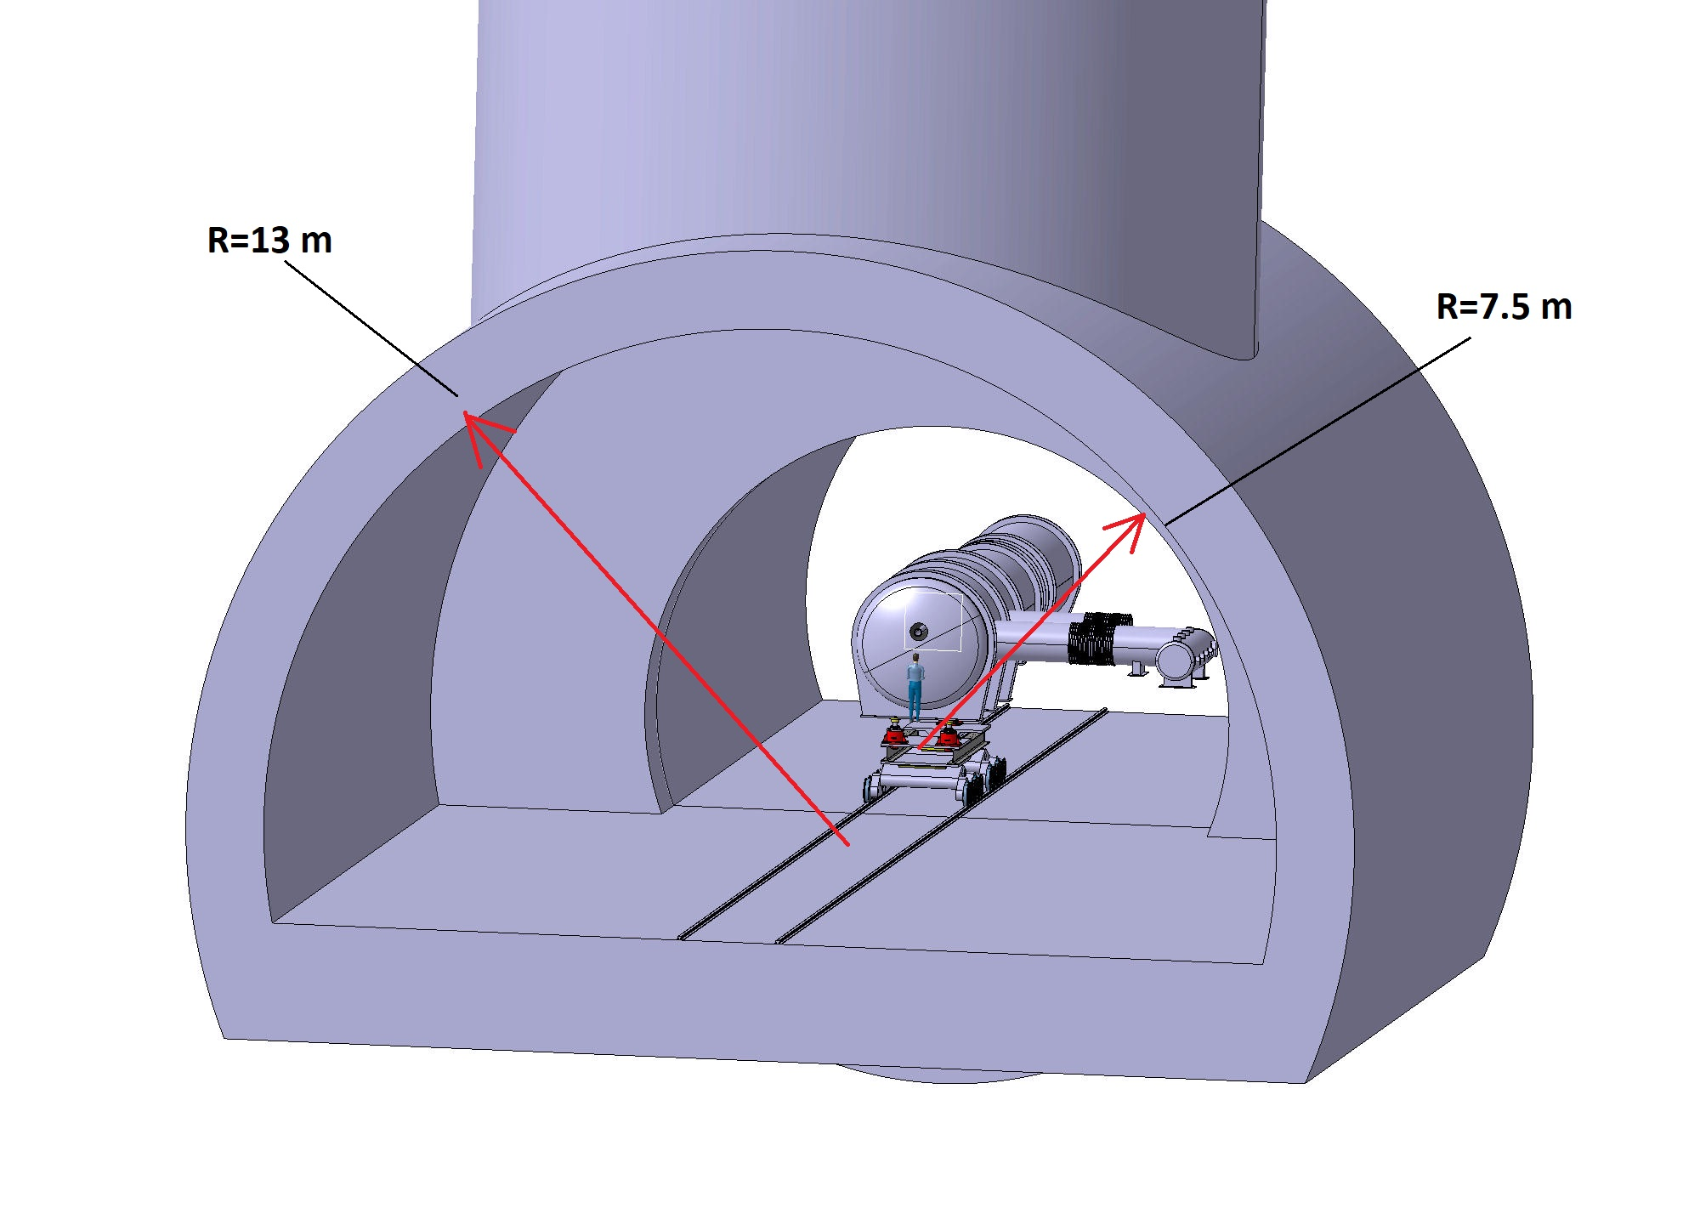
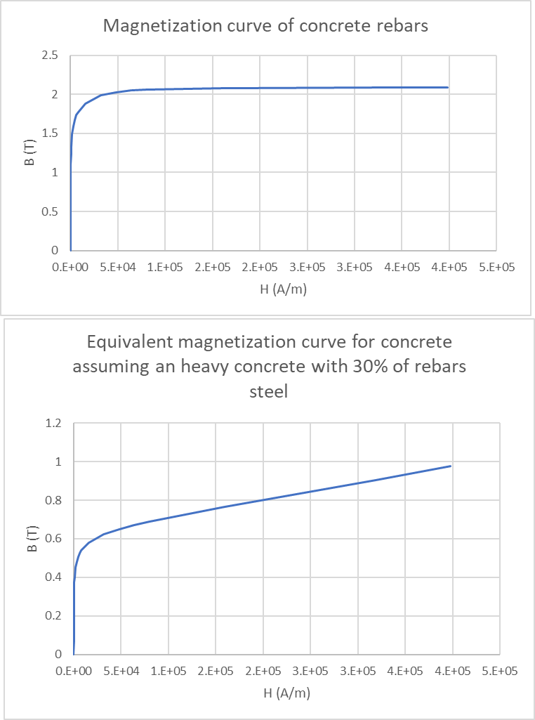
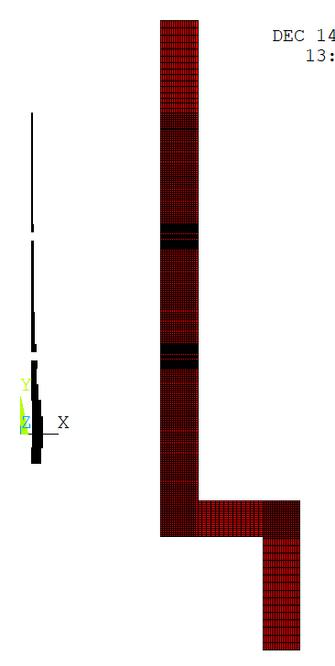
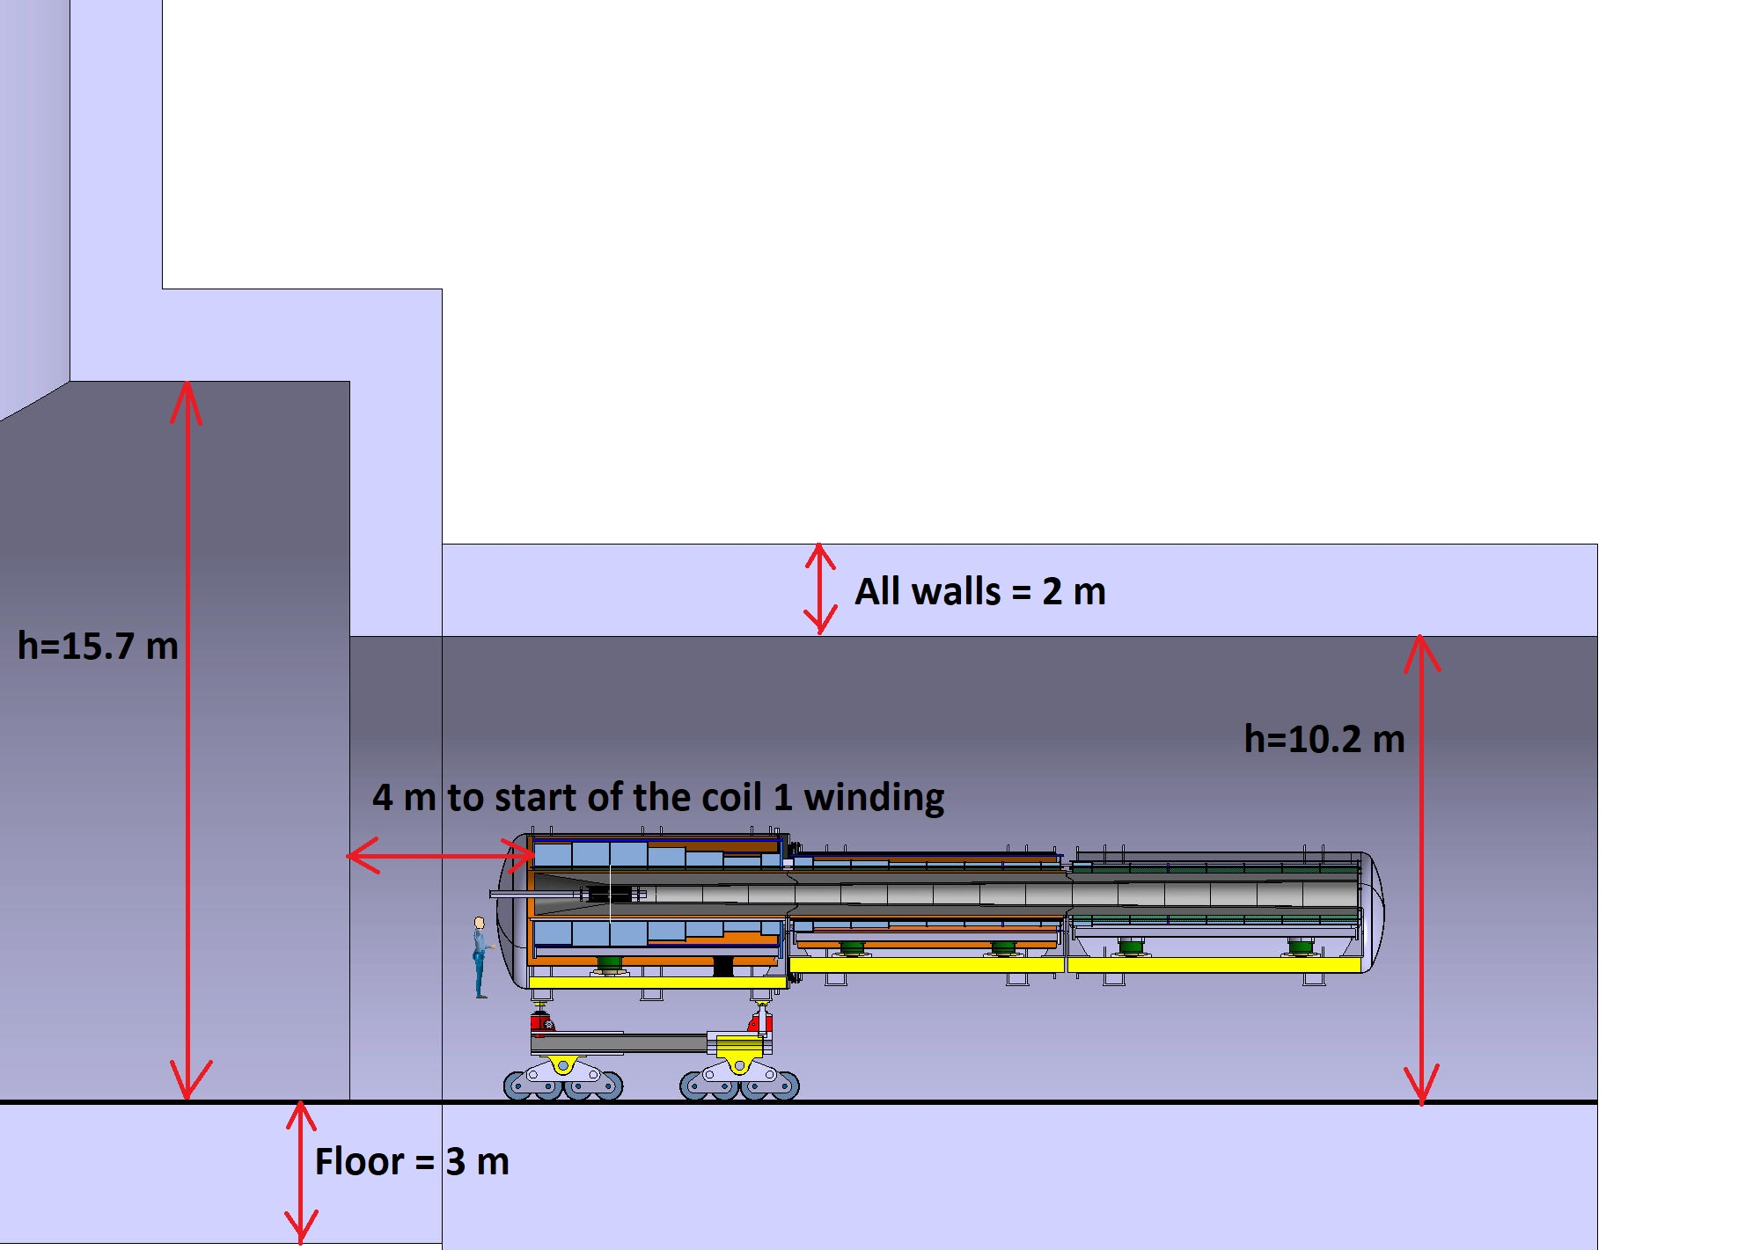
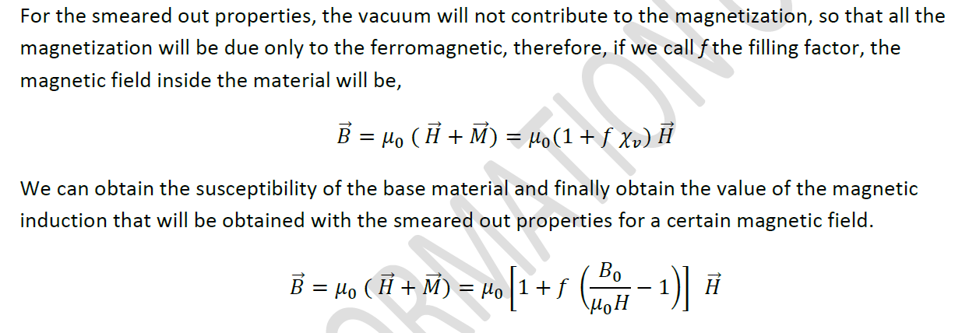
Equivalent axisymmetric
model

Slide 21
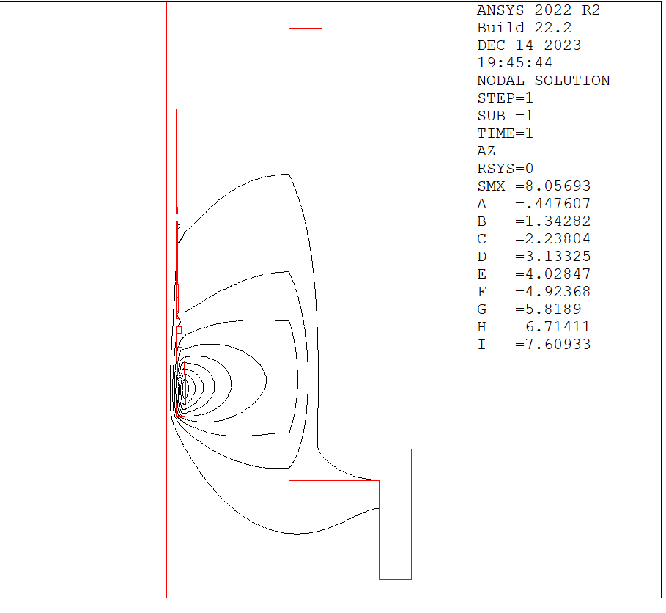
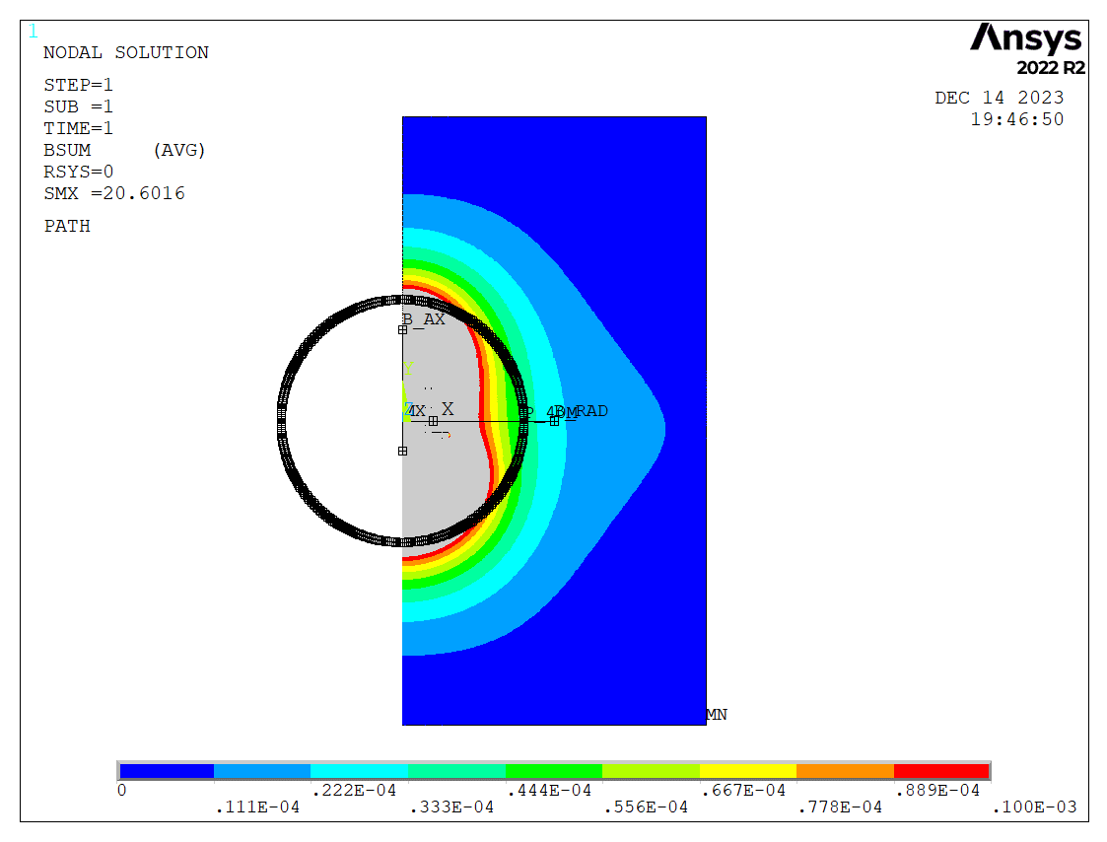
Field lines and maps

Slide 22
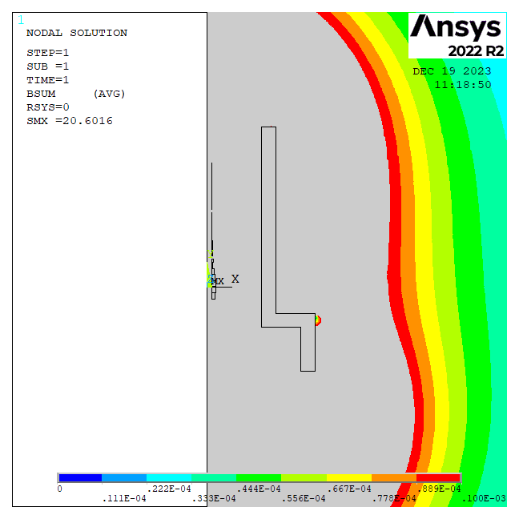
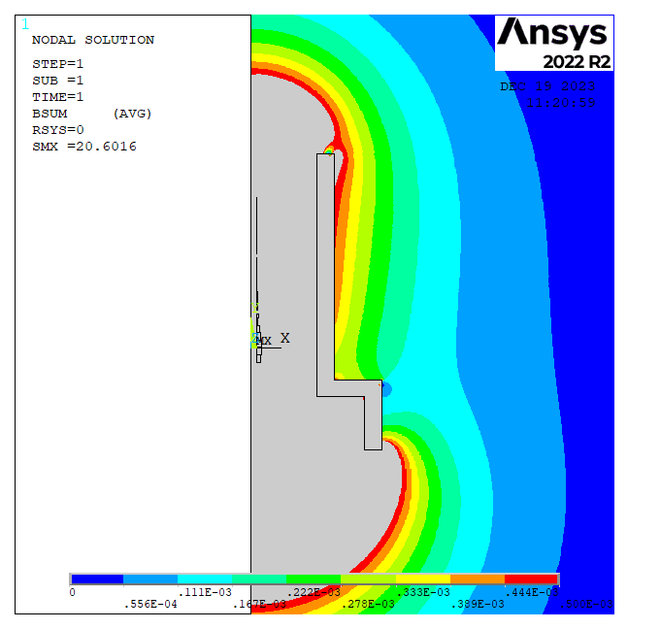
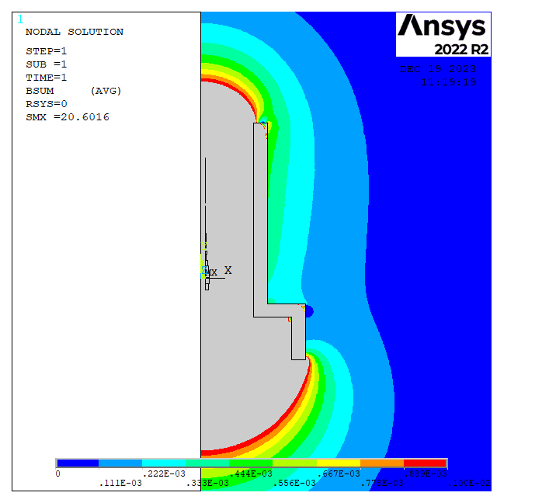
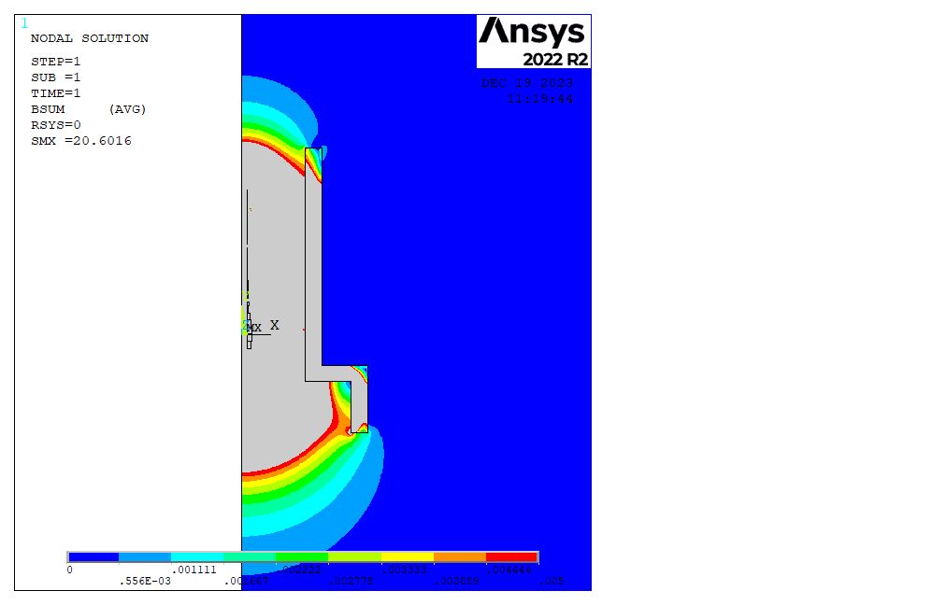
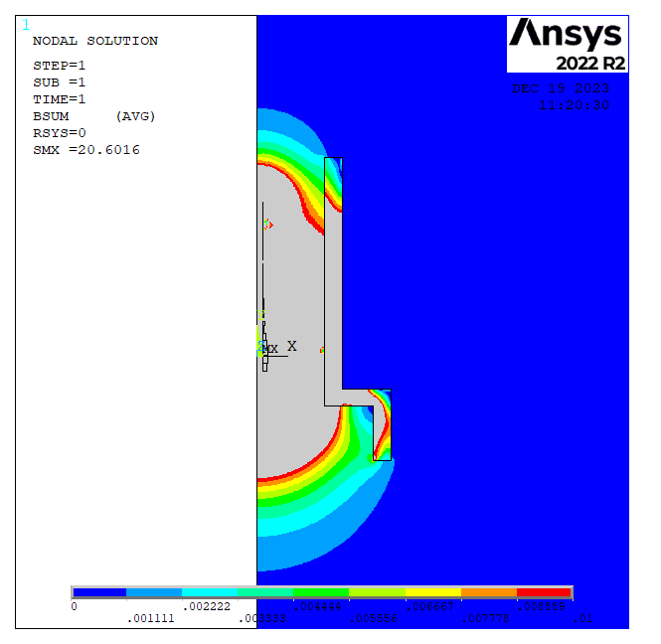
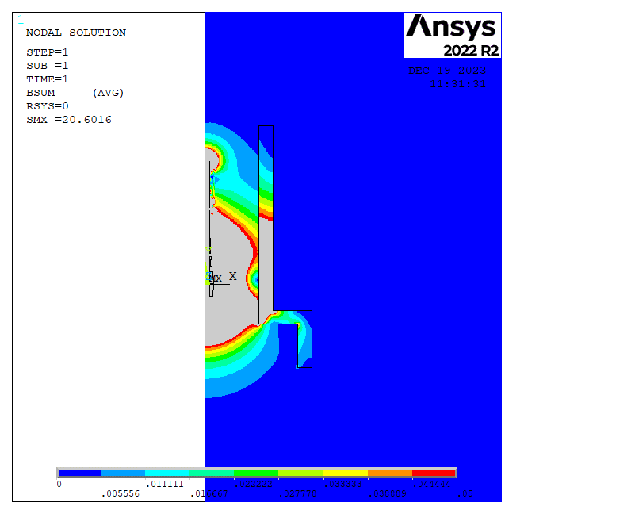
Maps with field limits
0.1 mT
0.5 mT
1 mT
5 mT
10 mT
50 mT

Slide 23
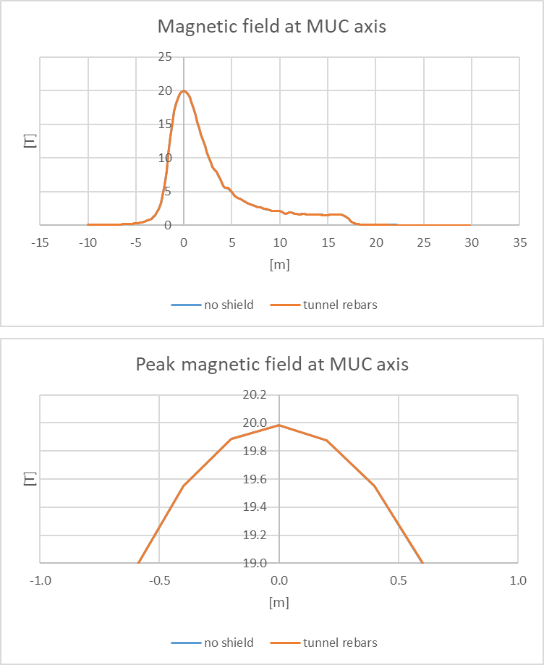
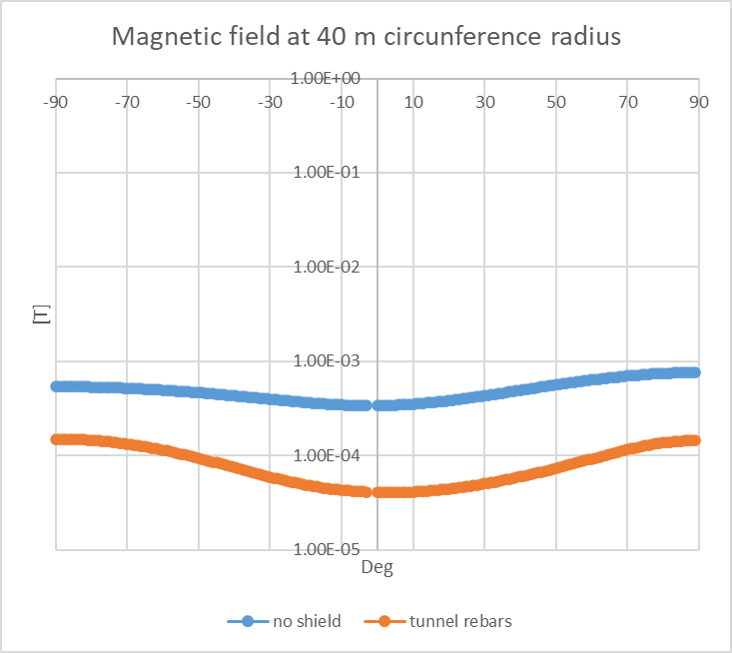
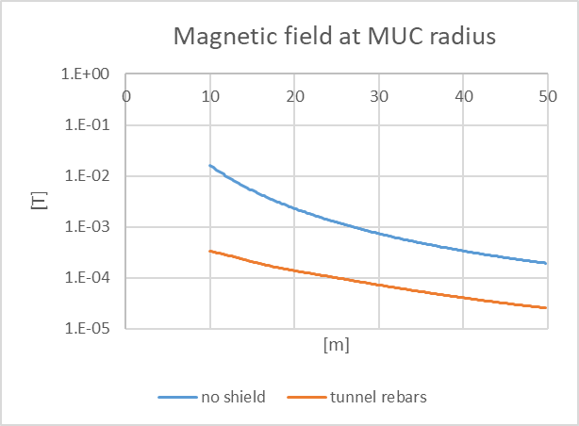
Magnetic field along paths

Slide 24
Conclusions and Next Steps
New design points developed for target solenoids carrying all same currents, wider bore and larger sections gap
Latest layout bring significant advantages in field accuracy and possible paths for beam extraction at the cost of 5% increase in cable length (w.r.t. Dec23 baseline)
Effects of chicane field negligible from field and forces standpoint
N0t easy to shield the region inside the tunnel: in the region outside the tunnel iron rebars provide an important shielding effect
Further steps
  Finalize solenoid coils layout (which option?)
  Carry out stress analysis and thermo-hydraulic of new reference layout
  Develop 3D model of concrete tunnel if material properties of iron rebars and % is known (30%?50%?...)
  Issue a new target coils design point report by end of 2024 (?)

Slide 25
Thank You for the attention

Slide 26
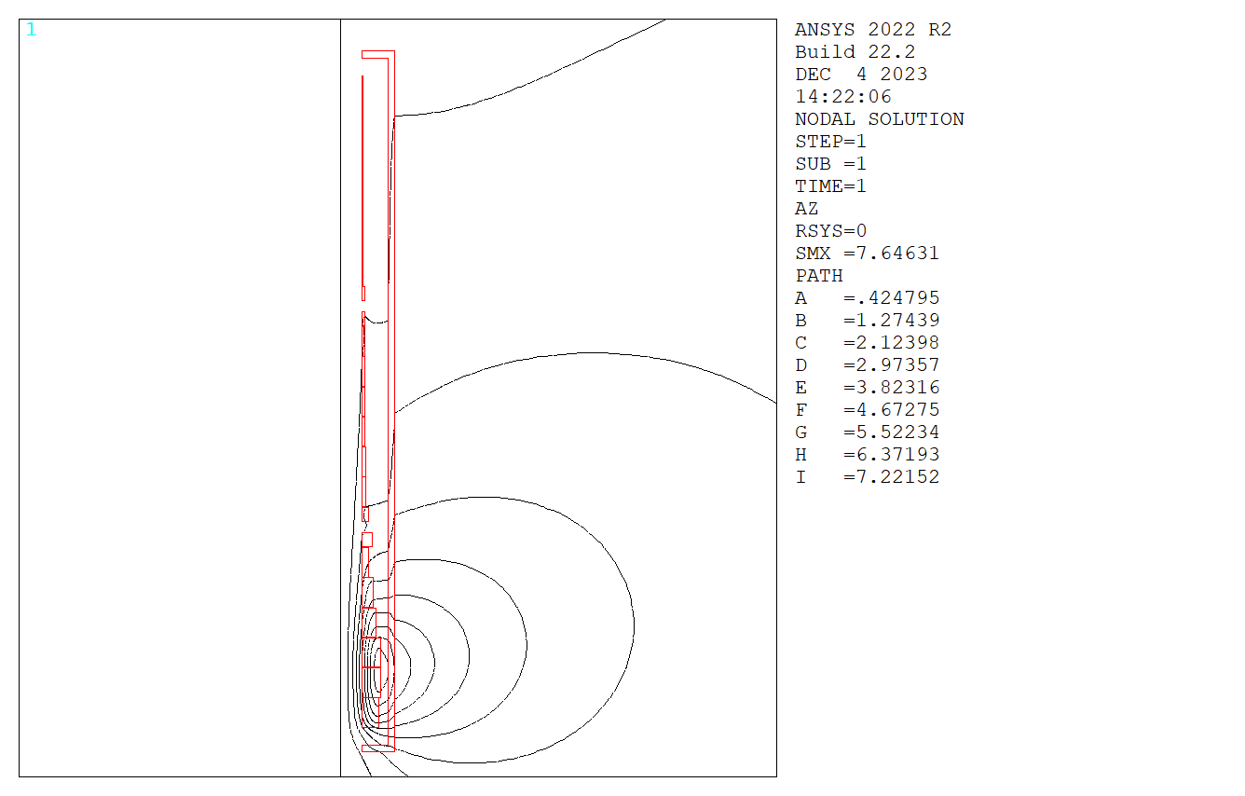
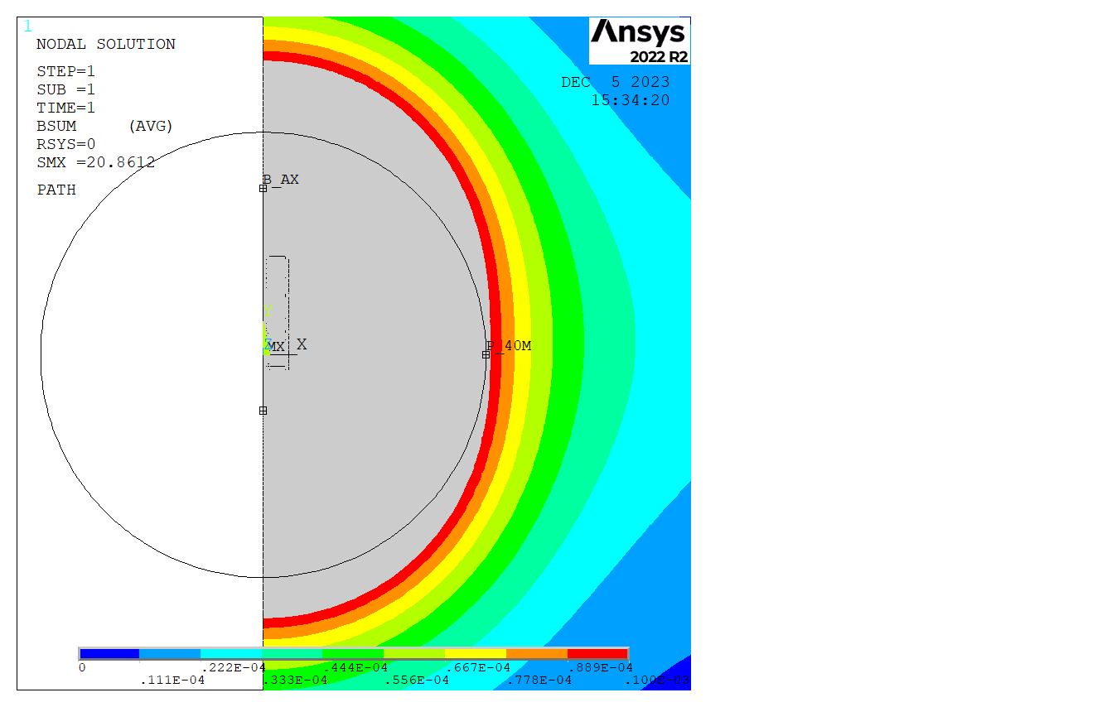
C shape
Two different shield inner radii
Variable Shield thickness
Magnetic field is computed
at MUC axis
At 40 m radius circumference

Slide 27
First configuration
0.2 m

Slide 28
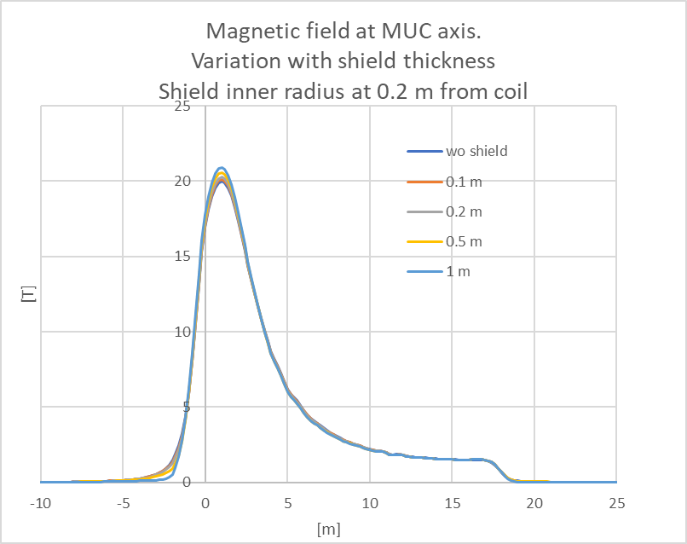
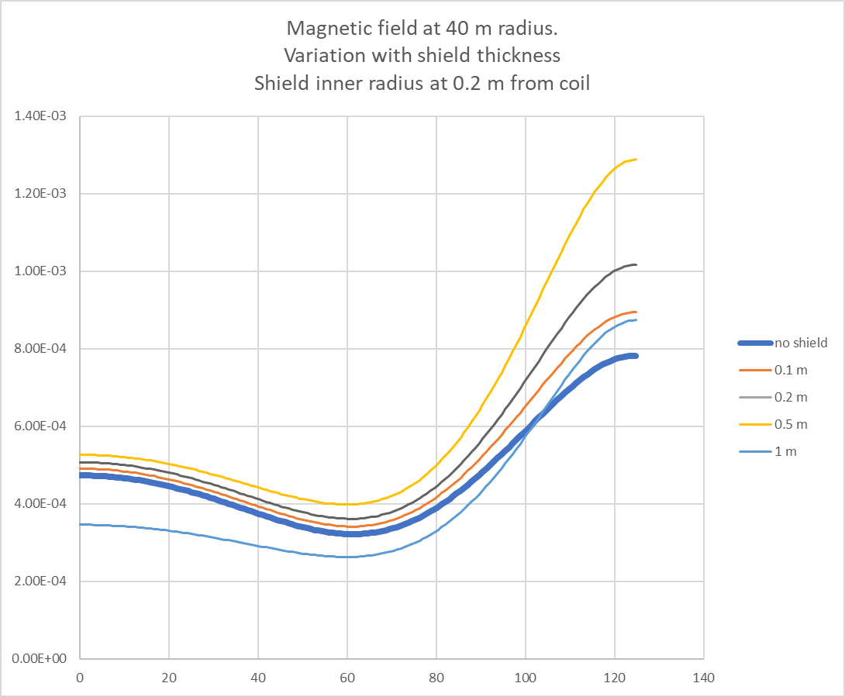
Maximum of magnetic field increases at MUC axis as thickness increases
At 40 m radius circumference magnetic field decreases only when the thickness approaches to 1 m

Slide 29
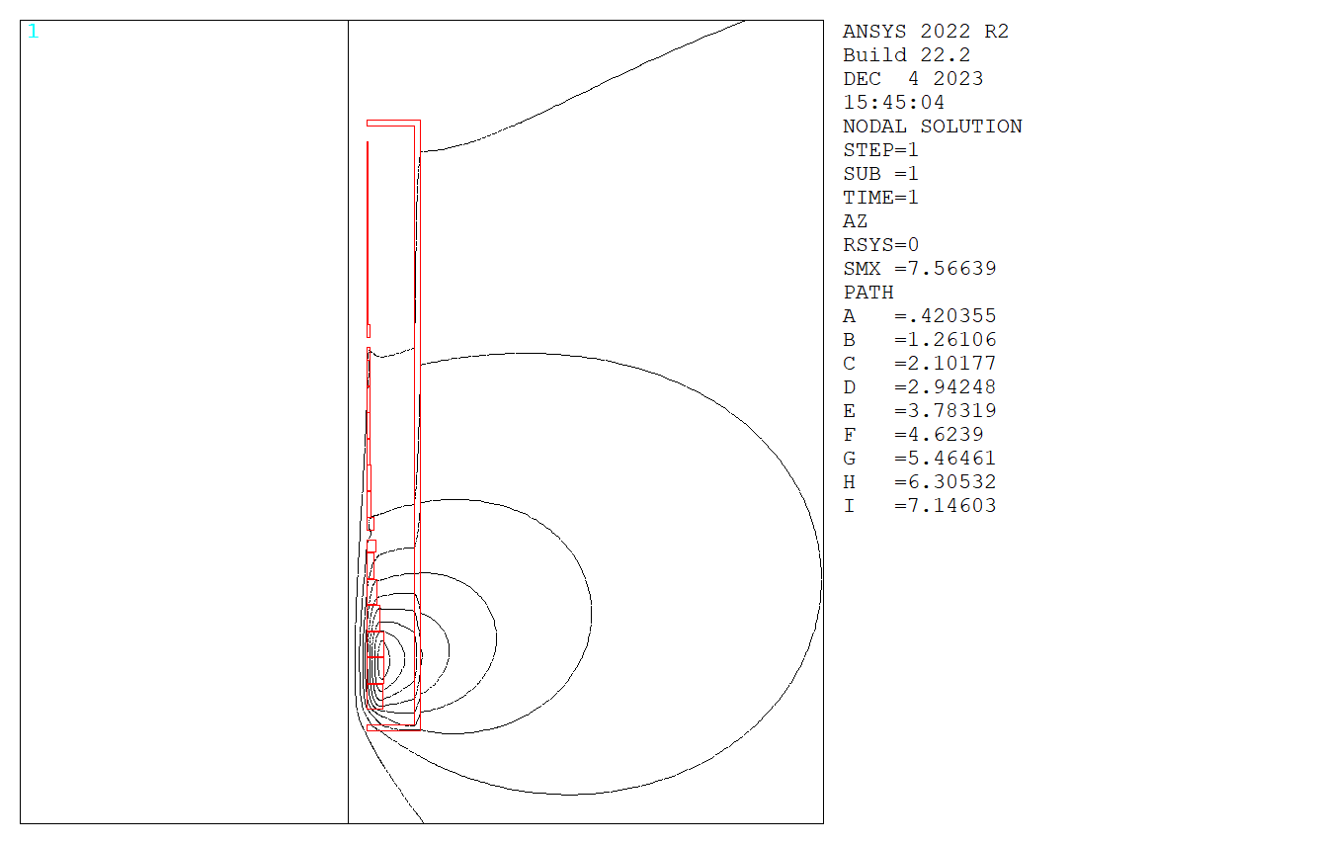
Second configuration
1 m

Slide 30
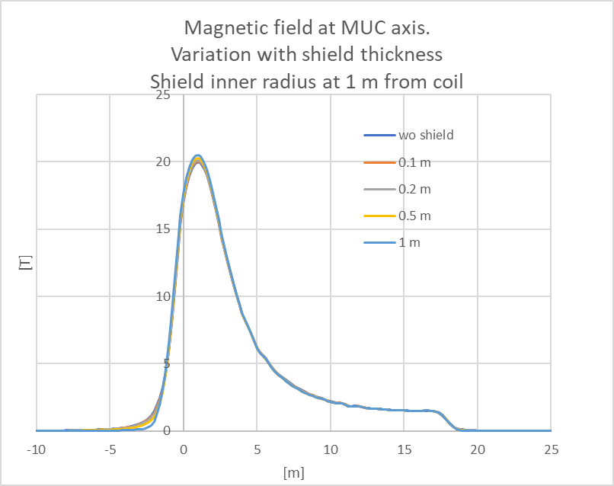
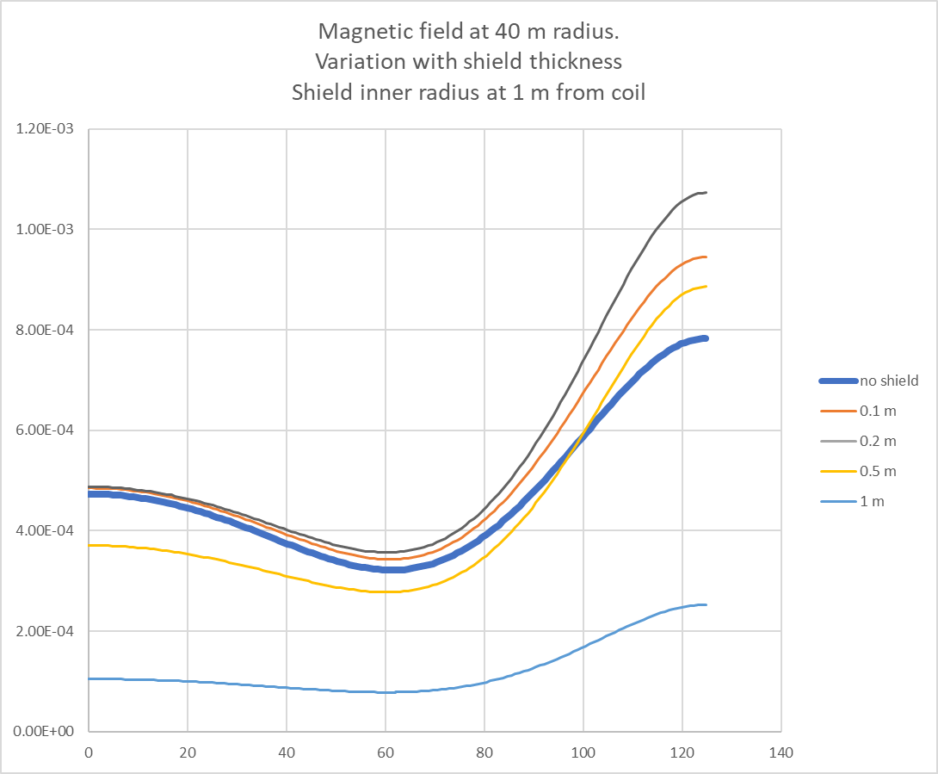
Maximum of magnetic field increases at MUC axis as thickness increases but less than in configuration 1
At 40 m radius circumference magnetic field decreases when thickness approaches to 0.5 m. With 1 m thickness there is an important shielding effect

Slide 31
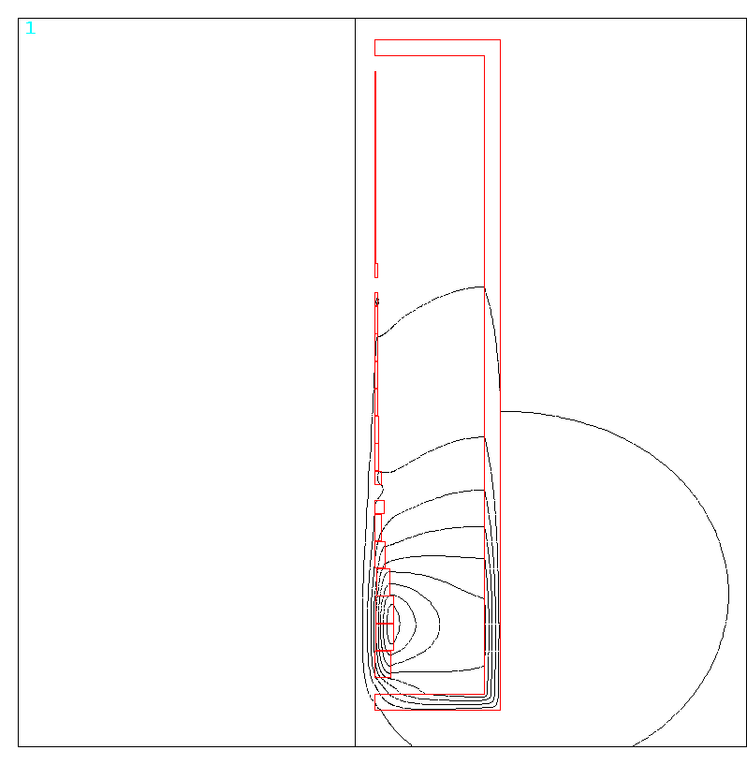
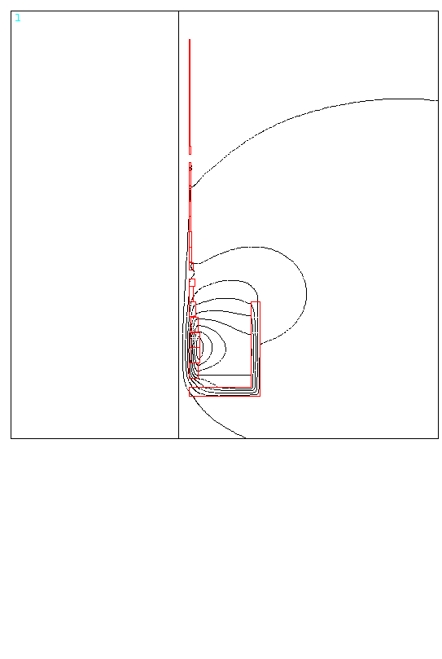
Two different geometries studied:
C shape
L shape
Two different shield inner radii:
3 m
4 m
Shield thickness 0.5 m
Magnetic field is computed
at MUC axis
At 40 m radius circumference

Slide 32
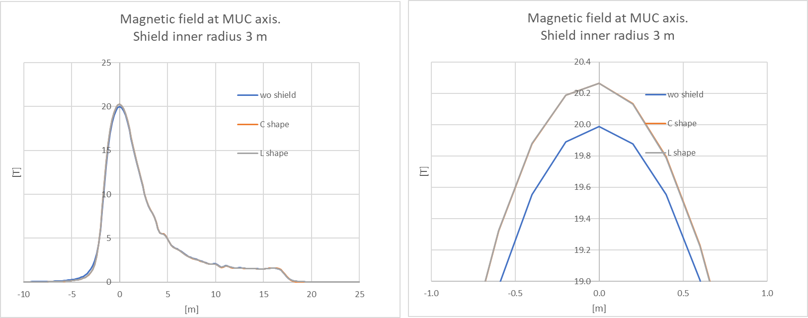
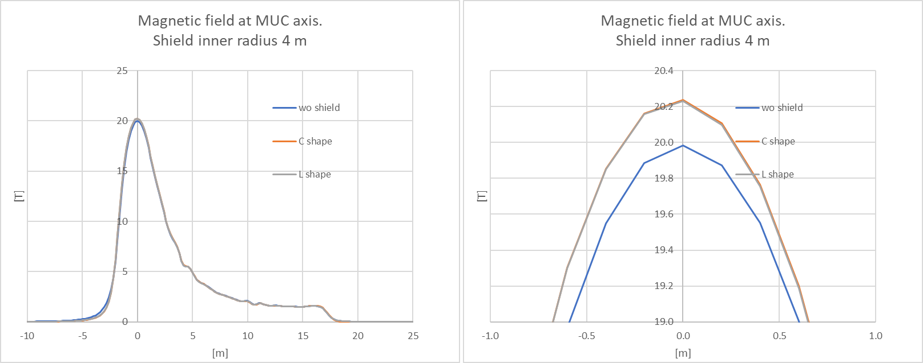

Slide 33
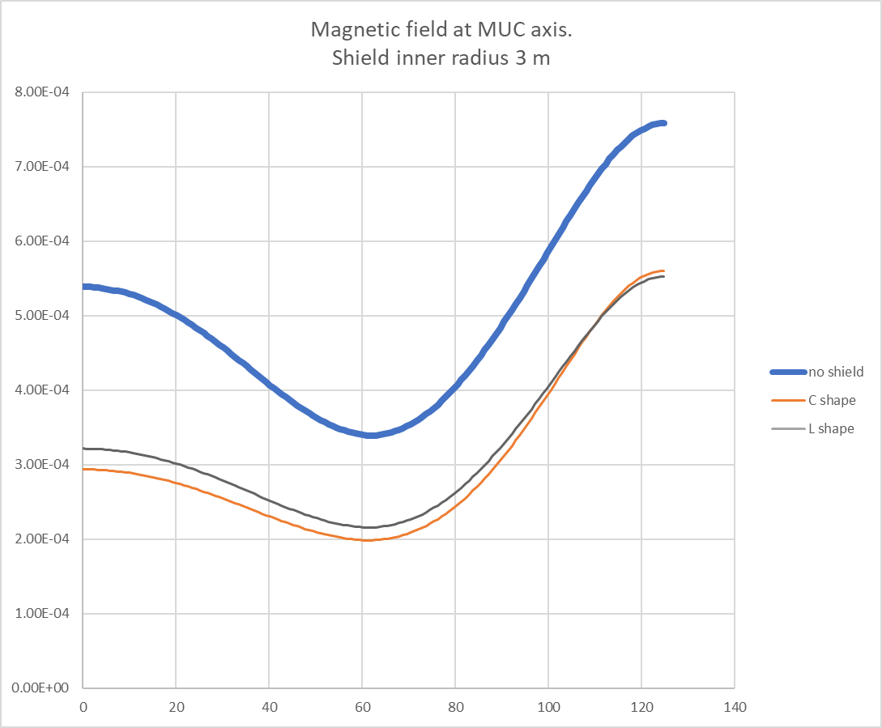
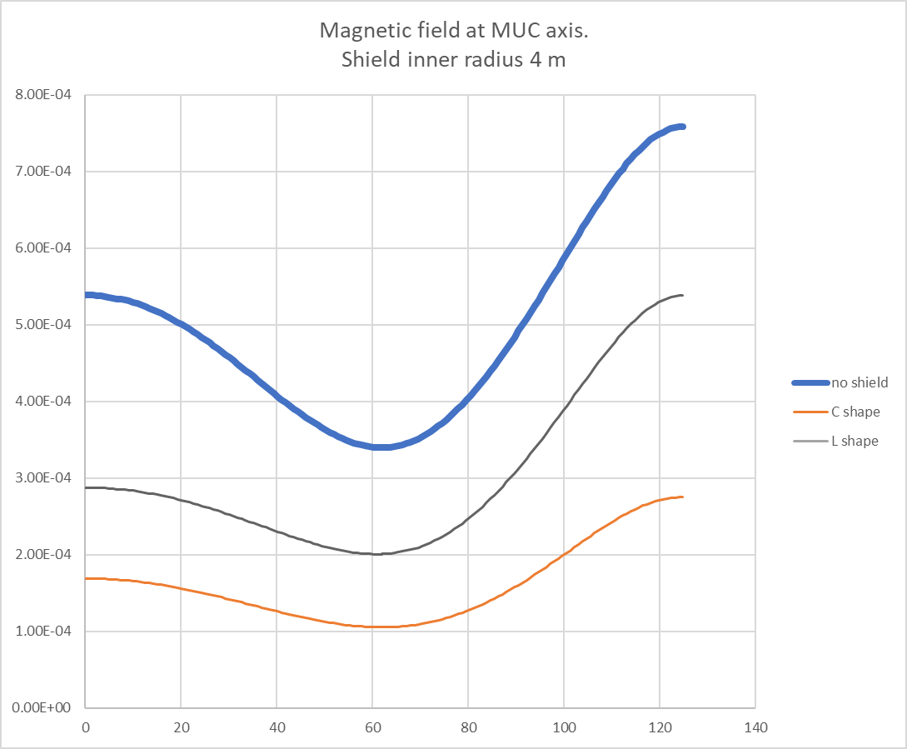

Slide 34
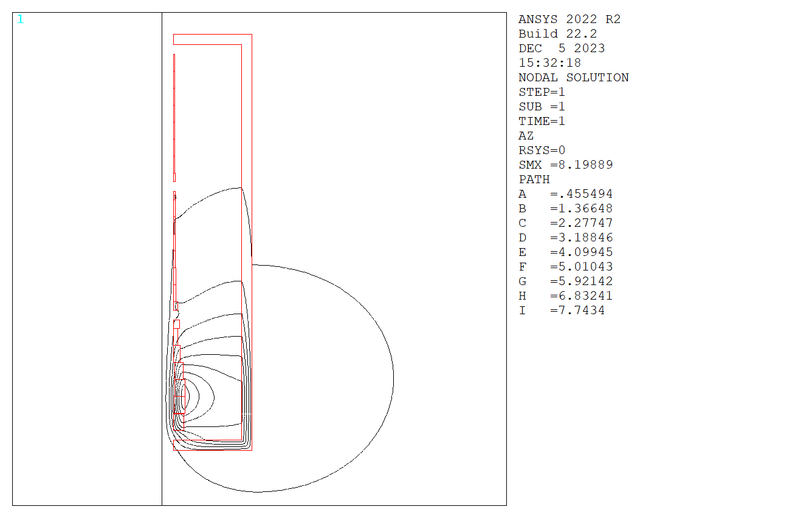
Field lines and magnetic field map for R=4m and thickness 0.5 m

Slide 35
Ideal but unfeasible configuration

Slide 36
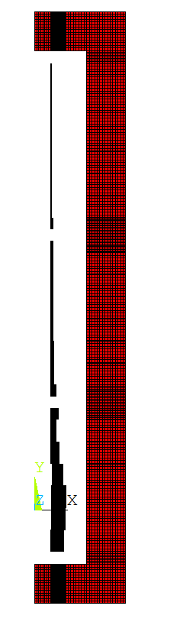
Ideal but unfeasible configuration
2m
Variable thickness

Slide 37
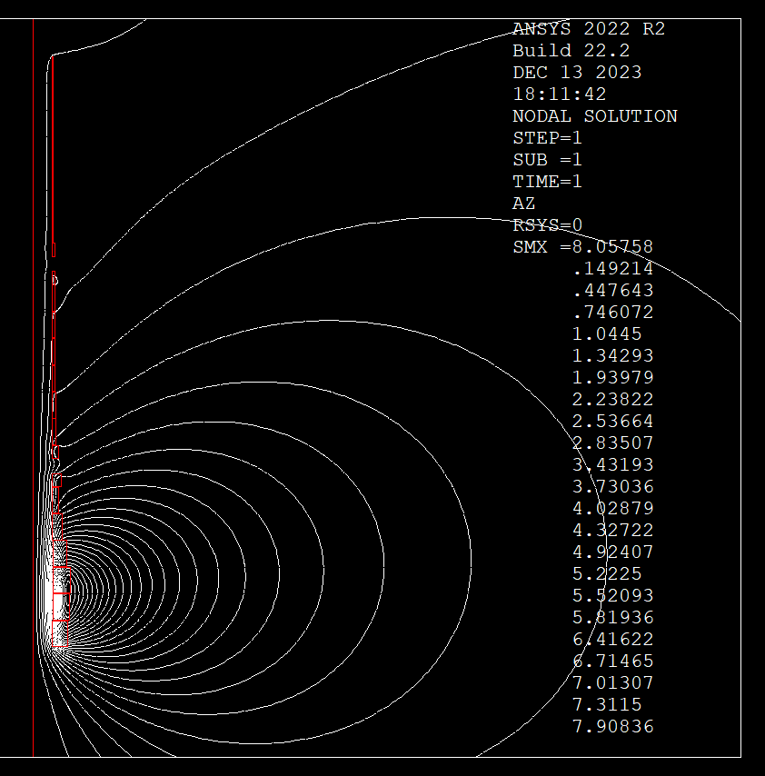







No shield
1 m
1.5 m
2 m

