Slide 1



Absorbers (and windows) for final cooling
Jose A. Ferreira, Bernd Stechauner, Valentina Giovinco, Anthony Harrison, Marco Morrone, et al.
IMCC and MuCol Annual Meeeting 2024

Slide 2
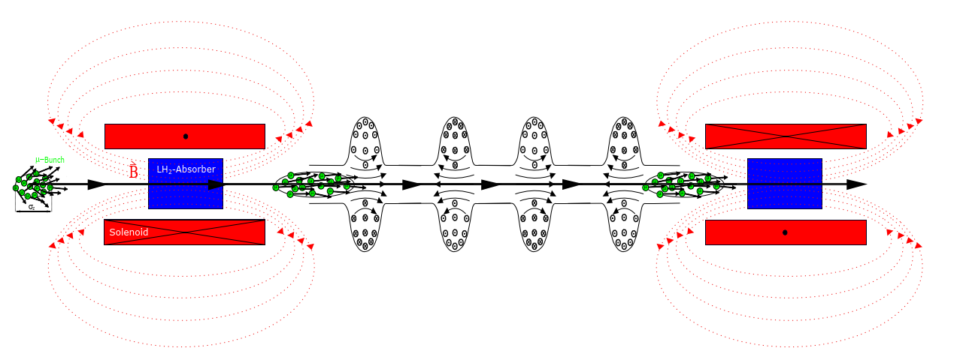
Introduction
[1]

Slide 3
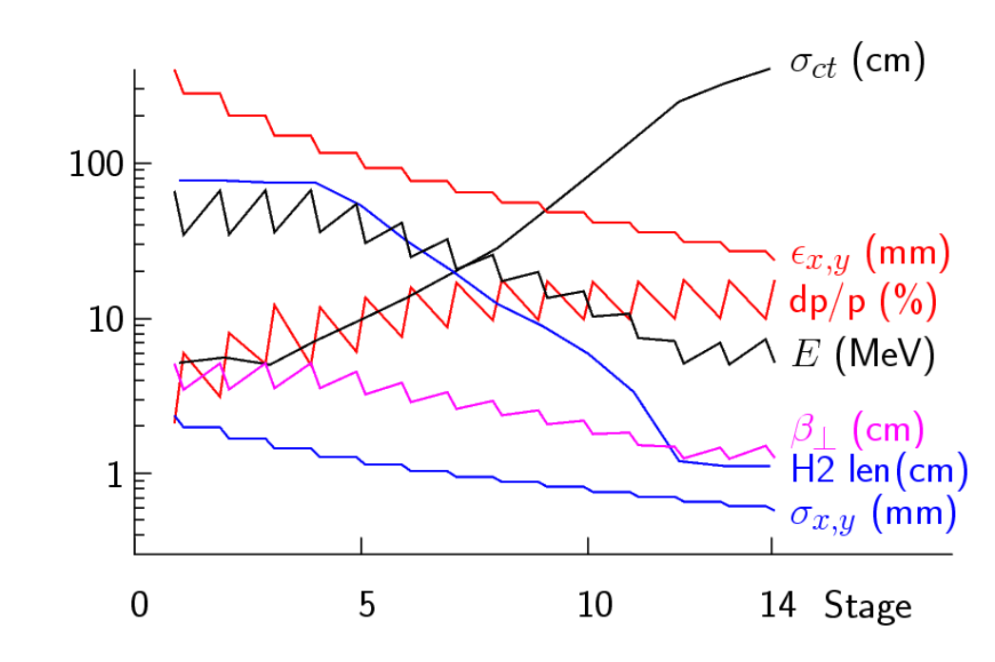
Final Cooling
[1]
Palmer’s paper [2] used as reference for the final cooling channel
Saturated liquid hydrogen was the reference absorber
Starting at approx. 65 MeV and reaching approx. 5 MeV as minimum kinetic energy
ε⊥ from 400 μm to 25 μm
The length of the absorber starts at 75 cm down to 1 cm

Slide 4
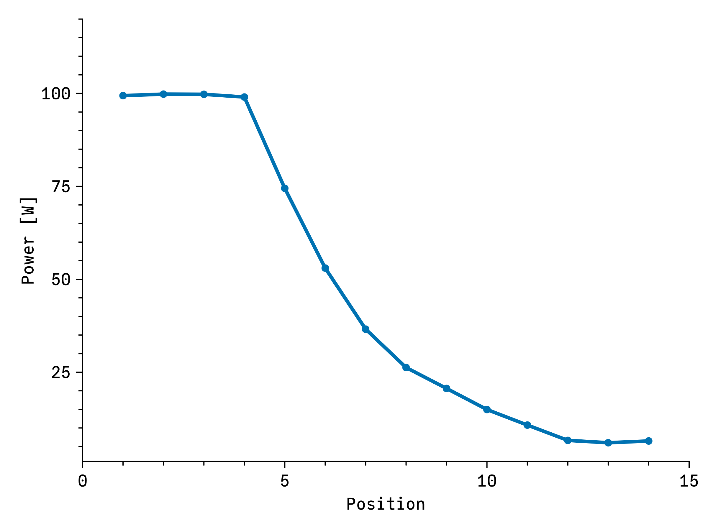
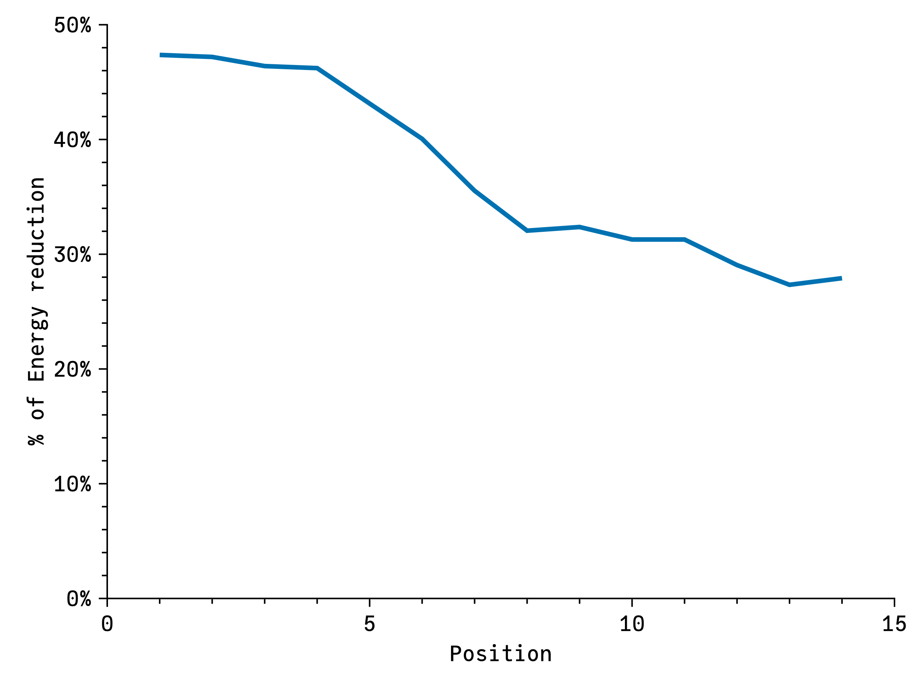

Power absorbed
$$Power=q_{e}\left(T_{1}−T_{2}\right)⋅I_{MC}⋅f_{MC}$$
Most of the power is absorbed in the first stages, decreasing towards the end (100 W vs 6 W).
The fraction of kinetic energy absorbed per step is between 50% and 30%

Slide 5
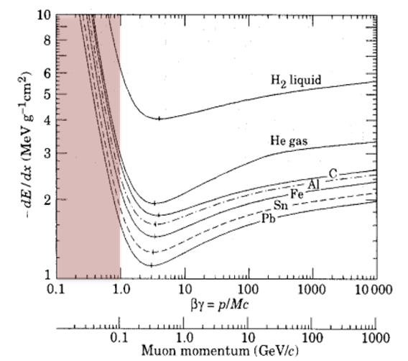
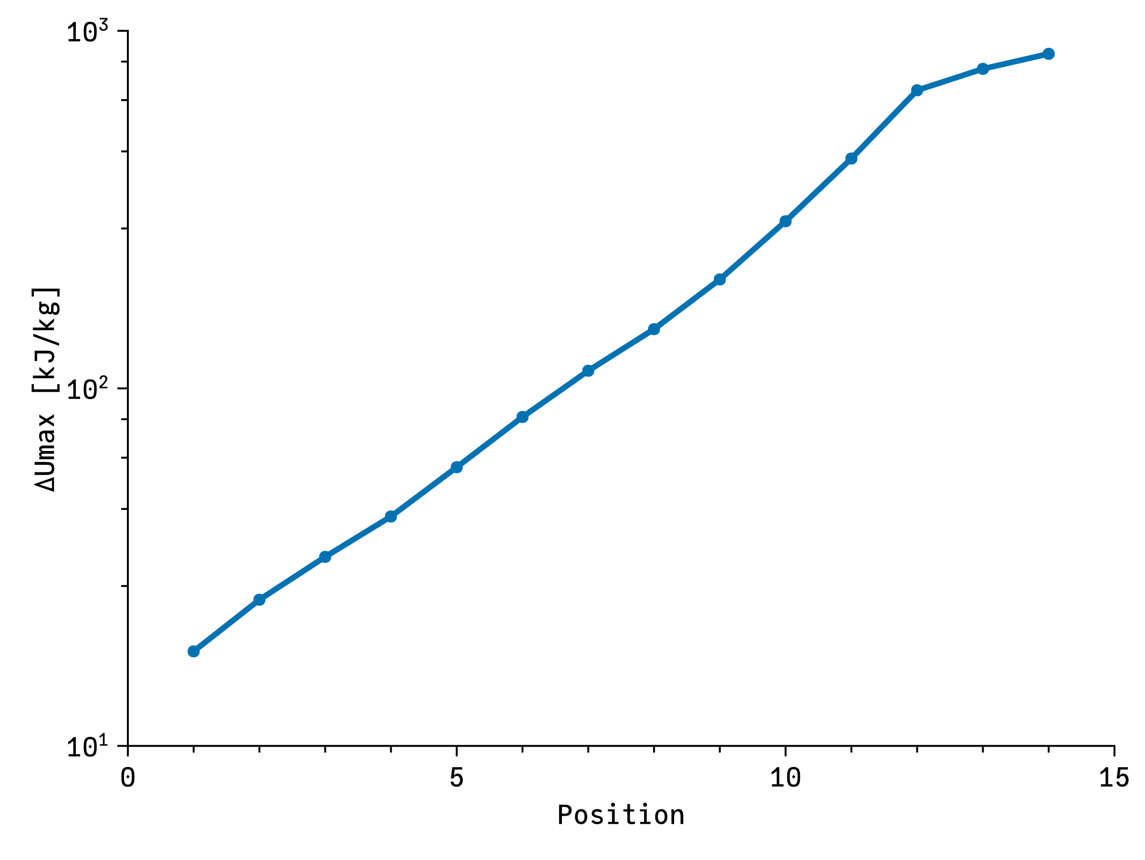
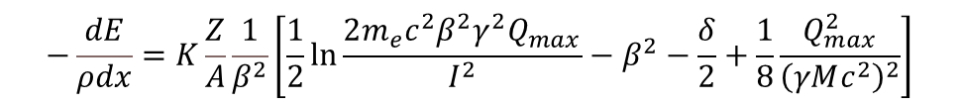
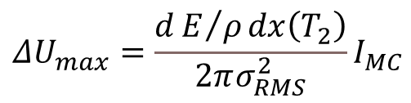
Power intensity
$$−\frac{dE}{ρdx}=K\frac{Z}{A}\frac{1}{β^{2}}\left[\frac{1}{2}\ln{\frac{2m_{e}c^{2}β^{2}γ^{2}Q_{max}}{I^{2}}}−β^{2}−\frac{δ}{2}+\frac{1}{8}\frac{Q_{max}^{2}}{{\left(γMc^{2}\right)}^{2}}\right]$$
Using the Bethe-Bloch equation [3][4] it is possible to calculate the amount of energy taken from the beam
Assumption: All the energy absorbed from the beam is deposited locally => Pessimistic assumption (some energy lost as photons, etc.)
The maximum amount of energy depends on the stopping power, beam current and beam size (strongly)
The maximum energy deposition => centre of the exit of the absorber
$$\begin{aligned}&ΔU_{max}=\frac{dE/ρdx\left(T_{2}\right)}{2πσ_{RMS}^{2}}I_{MC}\end{aligned}$$

Slide 6
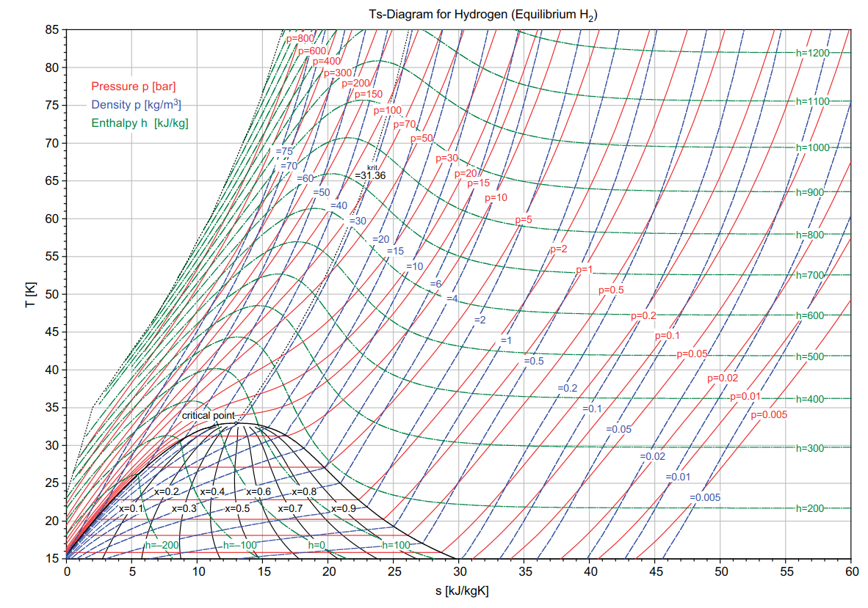

Slide 7
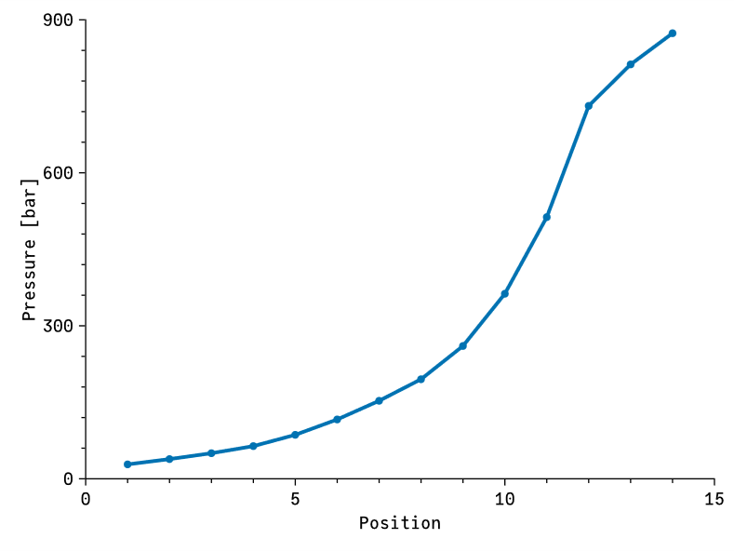
For normal hydrogen using CoolProp to calculate the thermodynamic properties [5]
> 100 bars after step 5

Slide 8


First stages are 75 cm long => Why not all of them?
Let’s check what happens if we reduce the density and keep length constant
Stopping power almost does not depend on density
One step should keep $Lρ$ constant to absorb the same power
$$Lρ=\int_{T_{2}}^{T_{1}}{\frac{1}{\frac{dE}{ρdx}}dT}$$
For normal hydrogen using CoolProp to calculate the thermodynamic properties [3]
> 100 bars after step 5

Slide 9
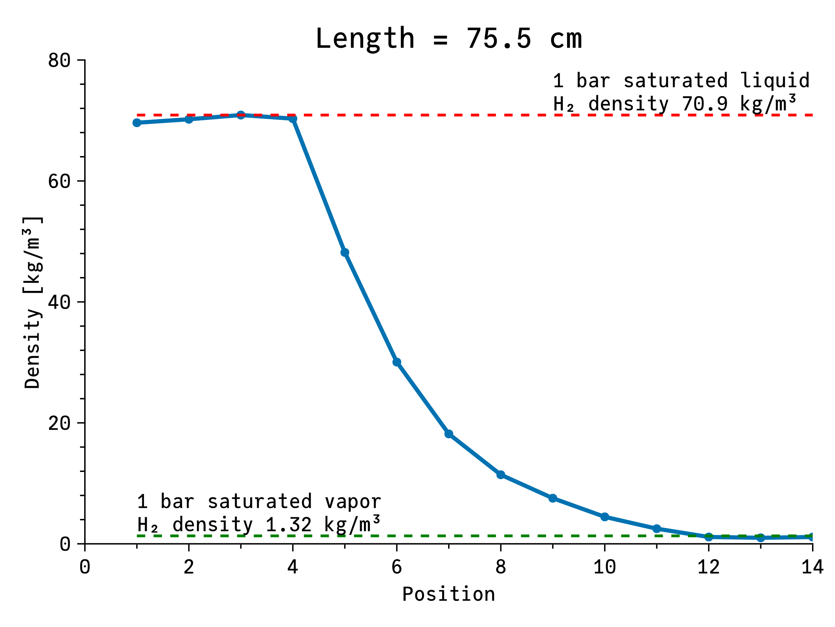
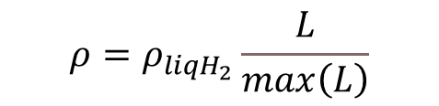
Density variation
$$ρ=ρ_{liqH_{2}}\frac{L}{max\left(L\right)}$$
First stages density equal to liquid hydrogen at 1 bar
Last stages can have 1 bar hydrogen saturated vapor

Slide 10
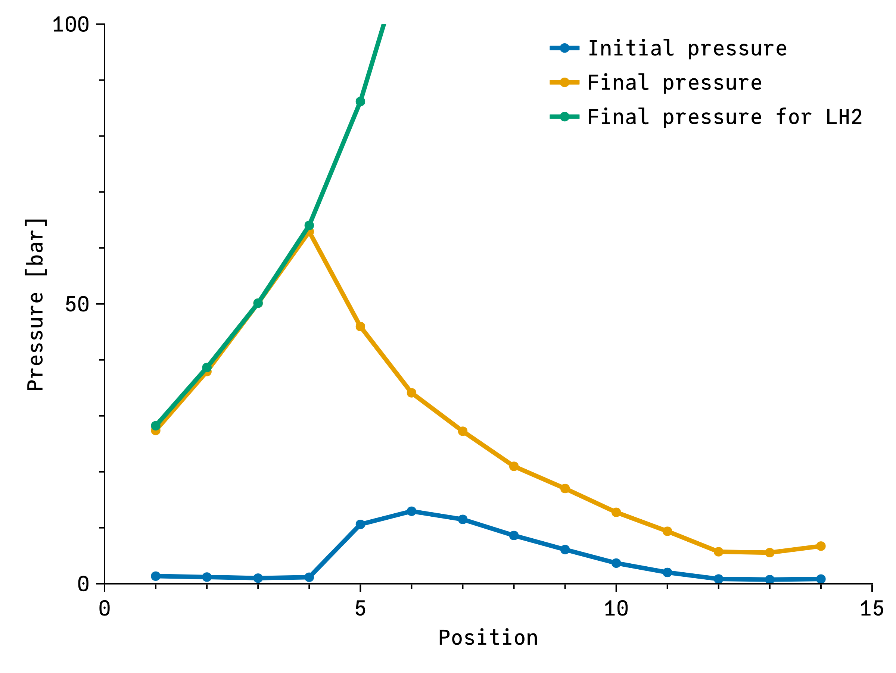
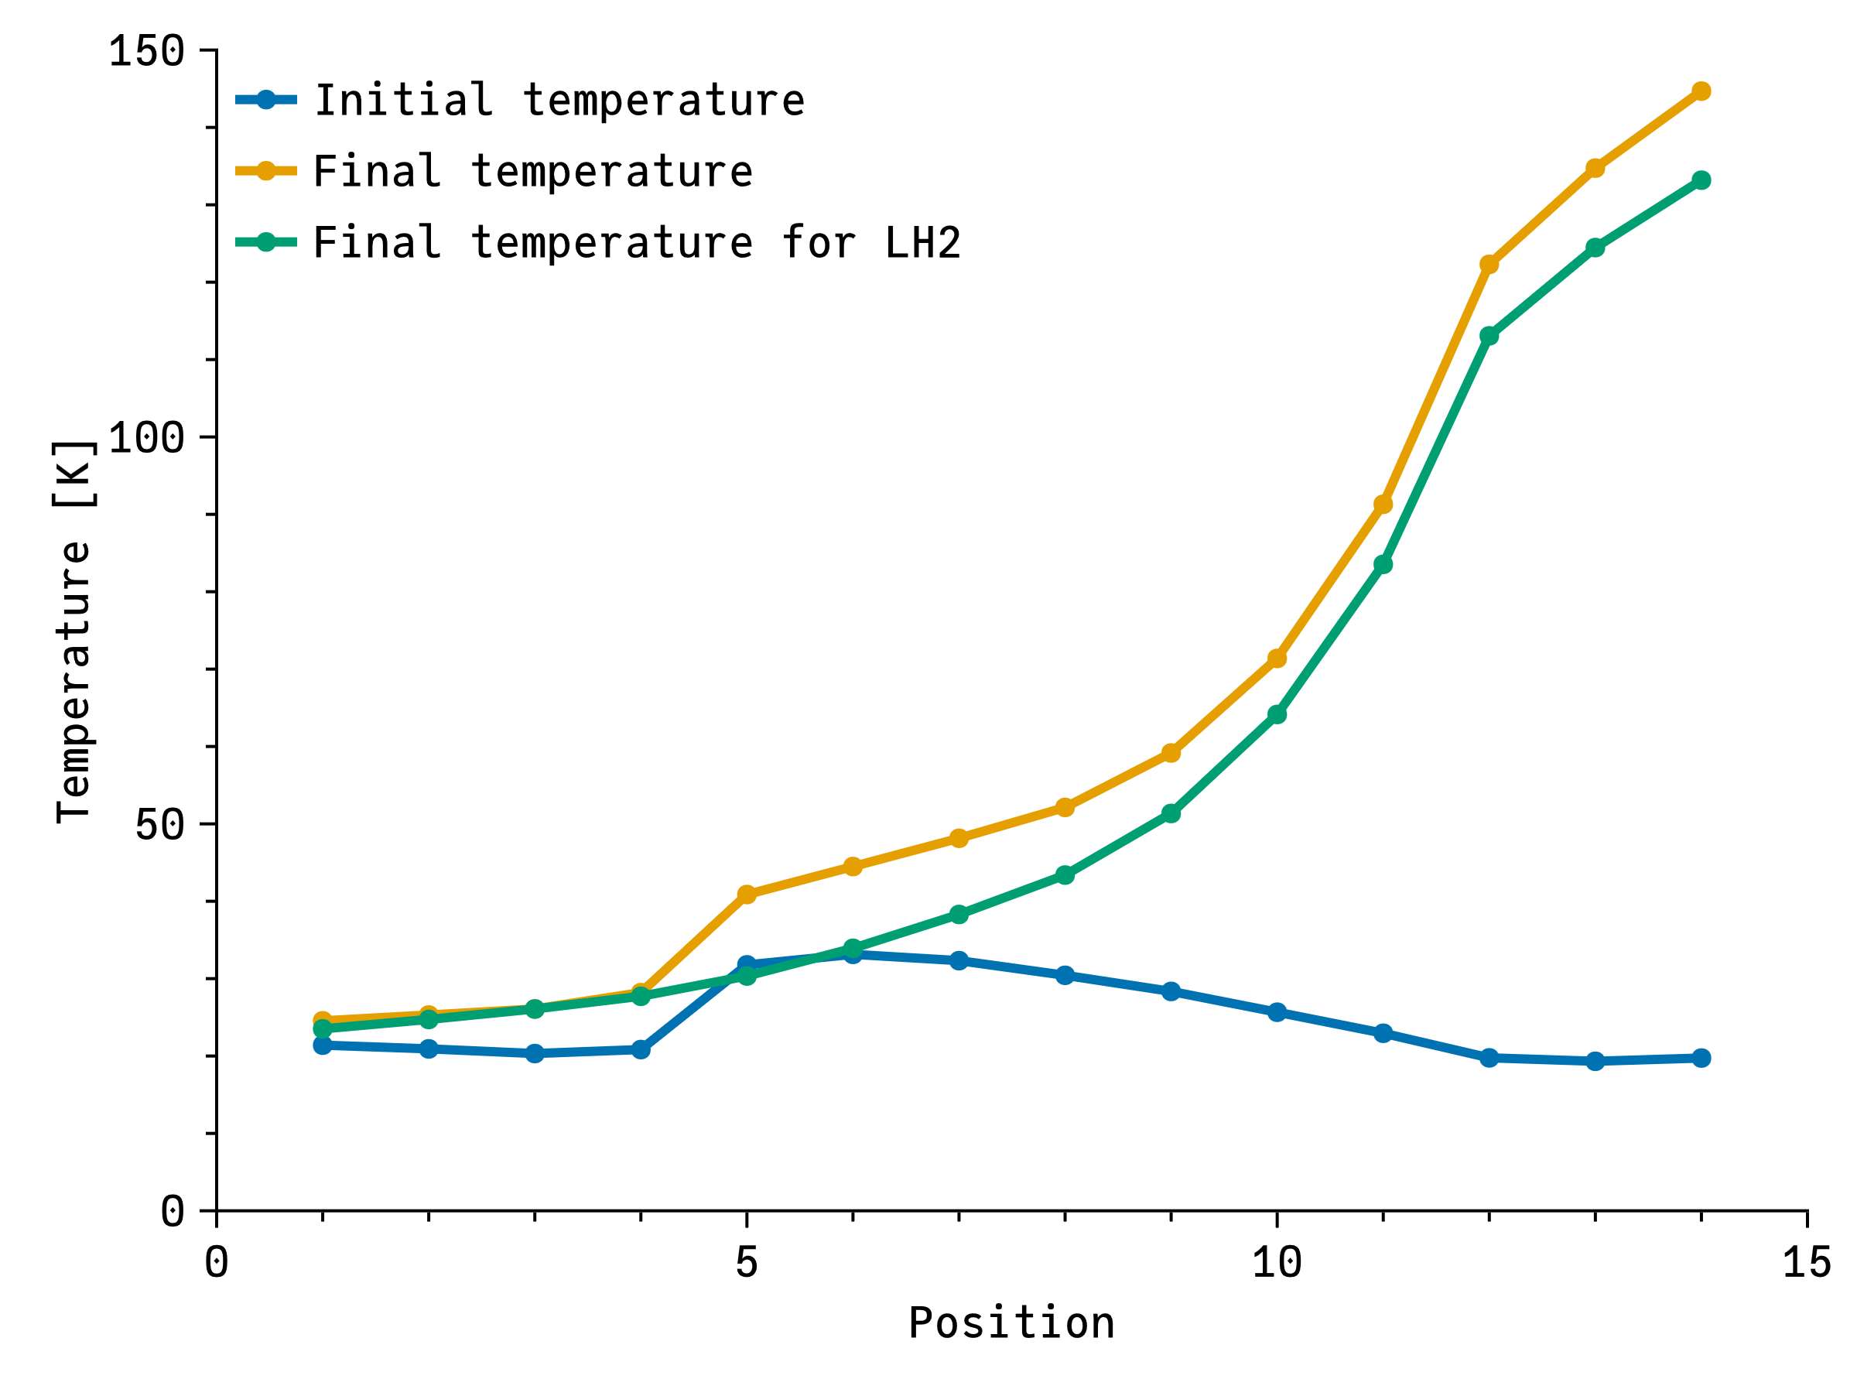
Pressure and temperature increases
Maximum pressure is now 63 bar vs 874 bar keeping same energy absorbed
Last stages are no longer a problem! P<10 bar
To ensure one phase, initial pressure as high as critical pressure (13 bar)
Reminder: Assuming all power is deposited locally!

Slide 11
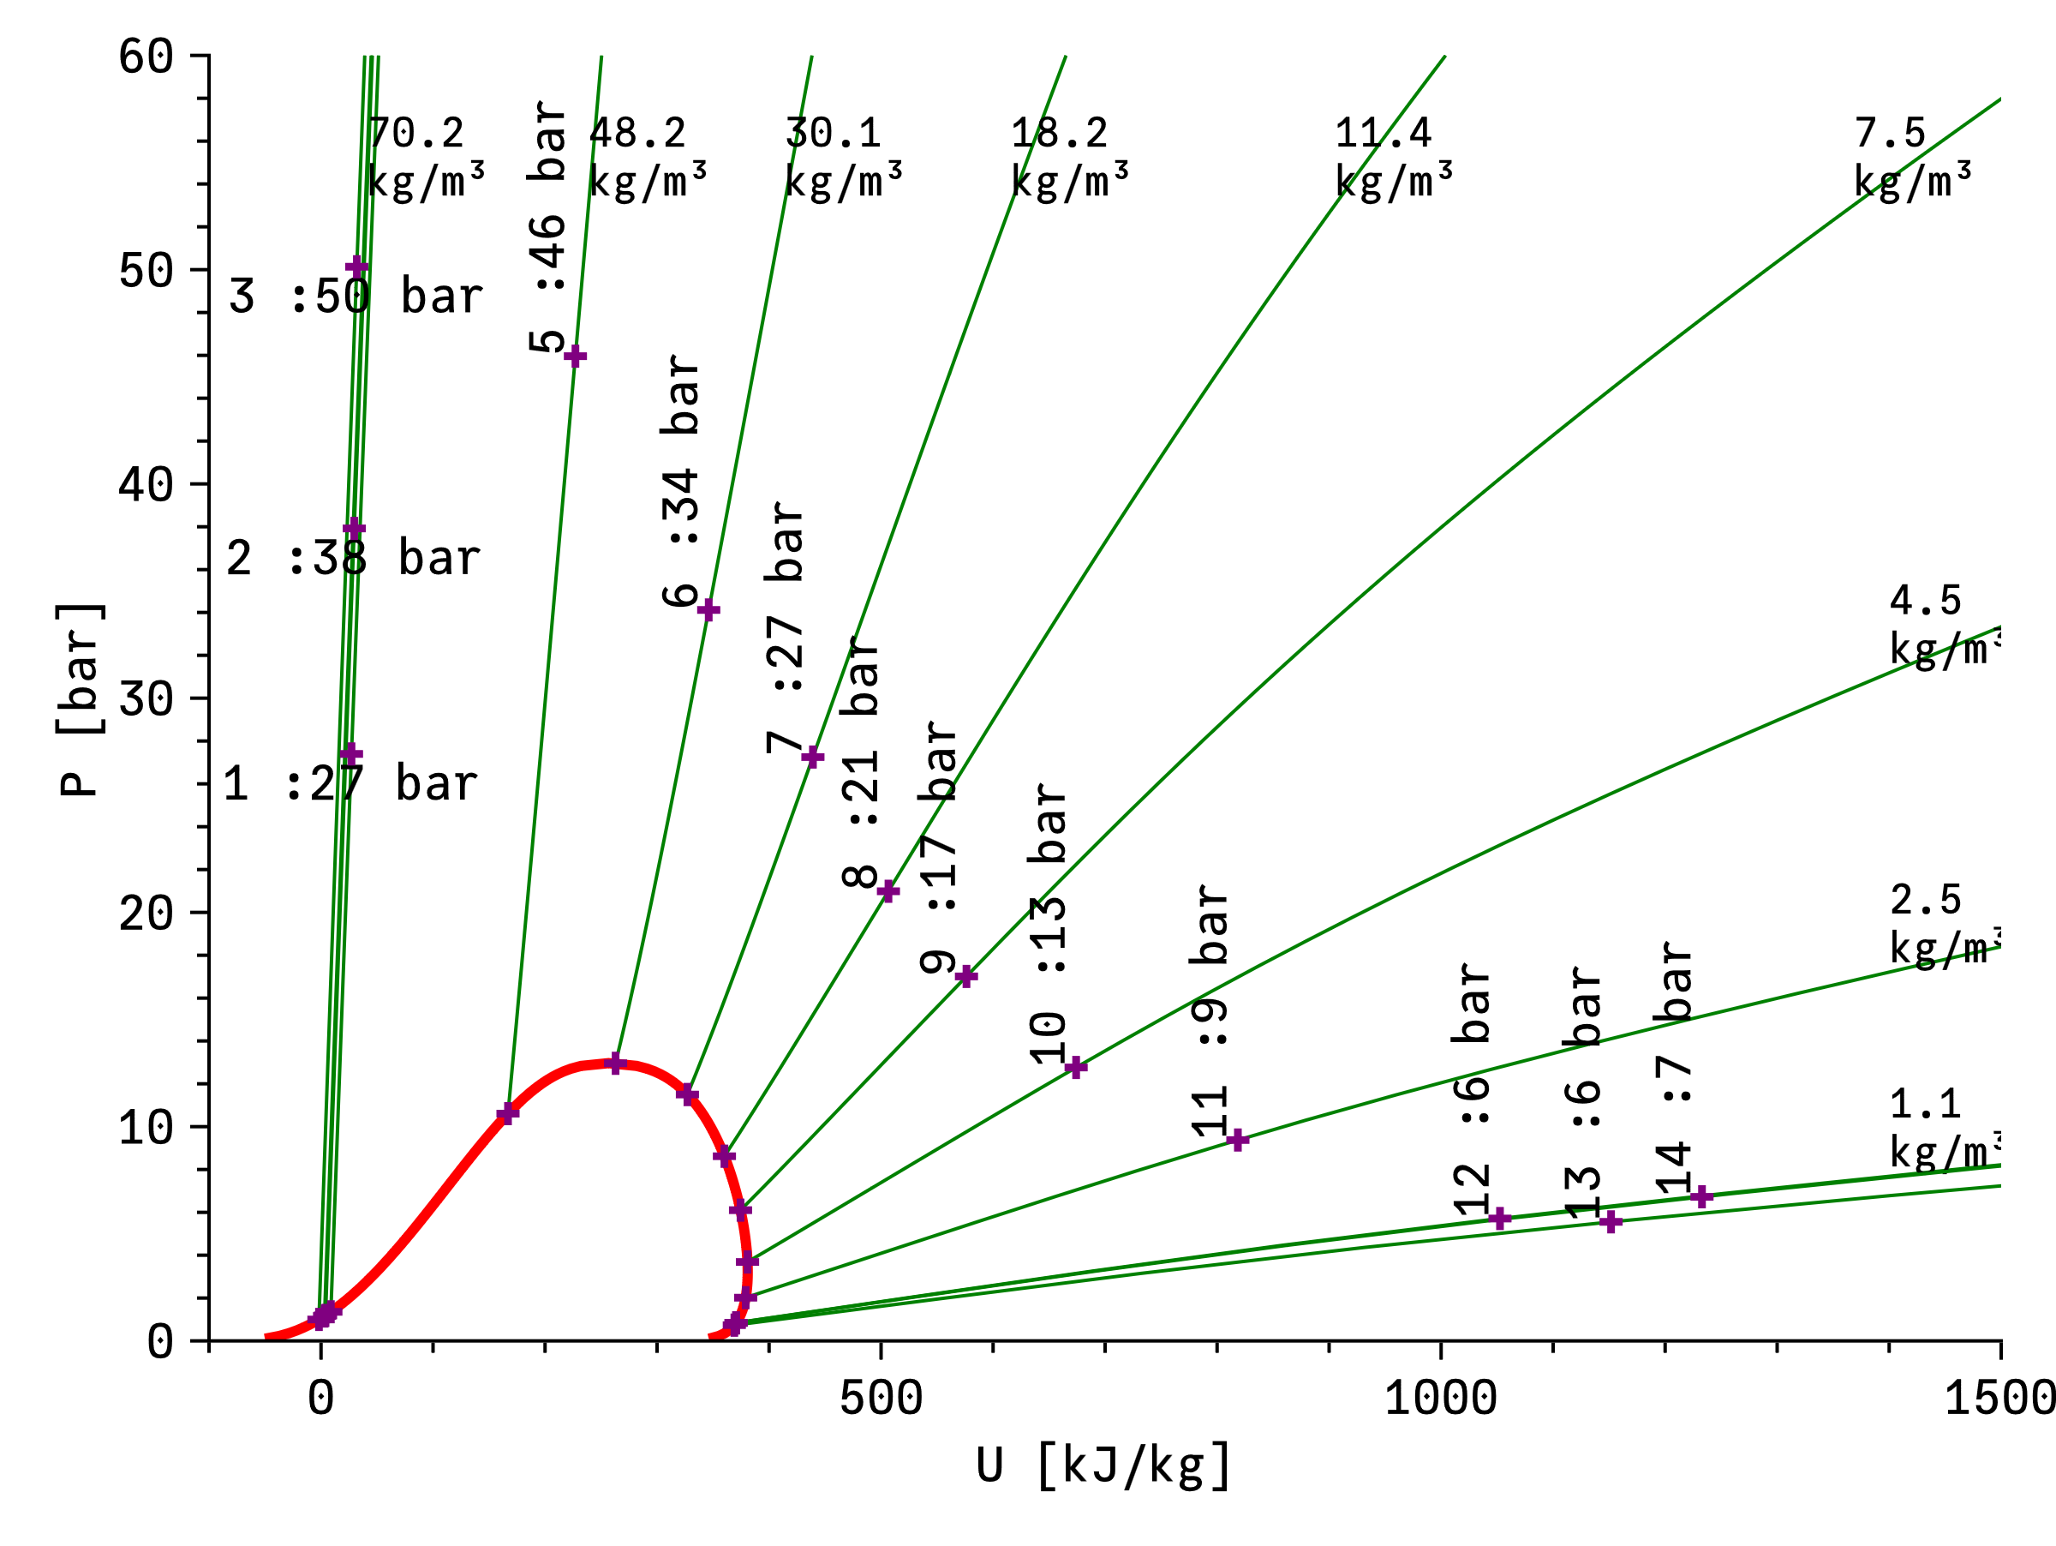

Slide 12
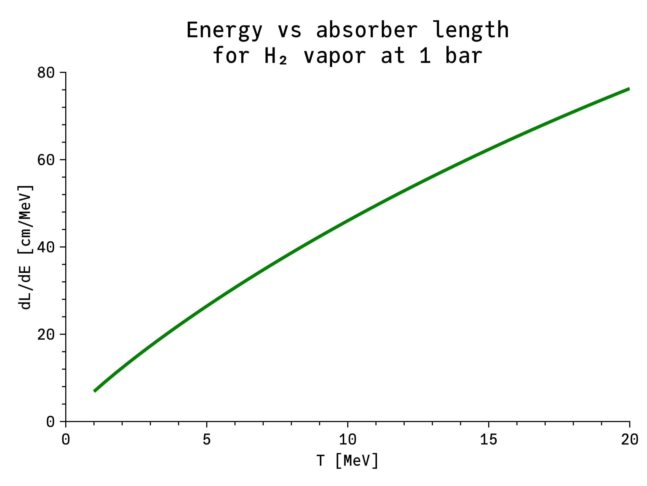
Last stages are now more favourable
The use of saturated vapor instead of liquid depends on the energy reduction and beam kinetic energy
Effective if T < 20 MeV for a reasonably short absorber

Slide 13
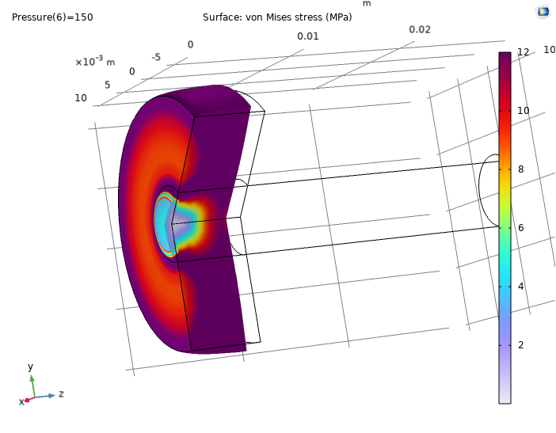
Frist stages are now more difficult than the last ones
Kinetic energy is higher on those stages
Is it possible to contain the hydrogen in between thicker windows?
Is it possible to build thick LiH windows?
Marco Morrone

Slide 14
Preliminary results
77 cm Liquid H₂
Initial E_{k} = 66 MeV
End E_{k} = 34 MeV
Initial ε⊥ = 400 μm
End ε⊥ = 280 μm
Initial ε_{L} = 1.1 mm
End ε_{L} = 2.0 mm
ε⊥⋅ε_{L} = 0.56 mm²
Thanks to Bernd Stechauner

Slide 15
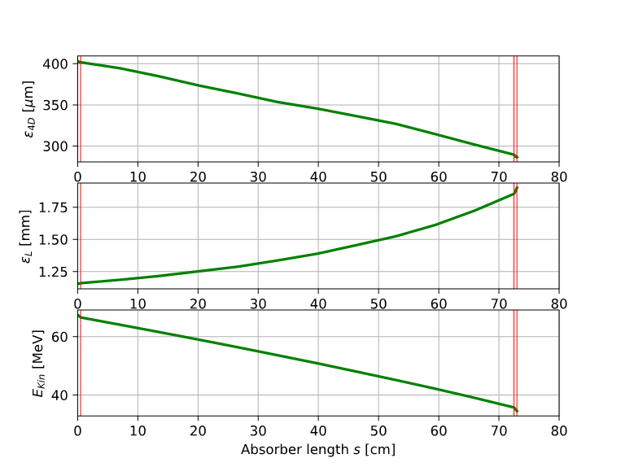
Preliminary results
72 cm Liquid H₂ with 2×5 mm LiH windows
Initial E_{k} = 66 MeV
End E_{k} = 34 MeV
Initial ε⊥ = 400 μm
End ε⊥ = 282 μm
Initial ε_{L} = 1.1 mm
End ε_{L} = 1.9 mm
ε⊥⋅ε_{L} = 0.54 mm²
Thanks to Bernd Stechauner

Slide 16
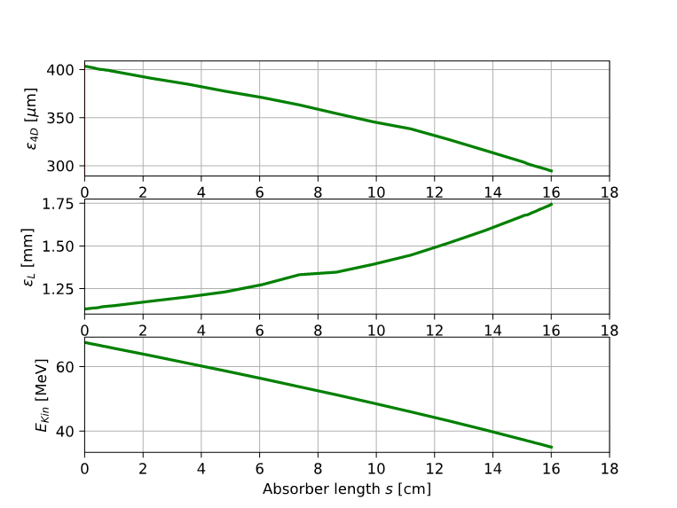
Preliminary results
16 cm LiH
Initial E_{k} = 66 MeV
End E_{k} = 34.5 MeV
Initial ε⊥ = 400 μm
End ε⊥ = 295 μm
Initial ε_{L} = 1.1 mm
End ε_{L} = 1.74 mm
ε⊥⋅ε_{L} = 0.51 mm²
Could LiH in the first stage(s) be more effective?
Thanks to Bernd Stechauner

Slide 17
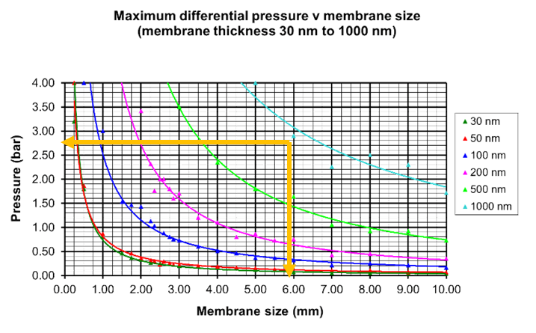
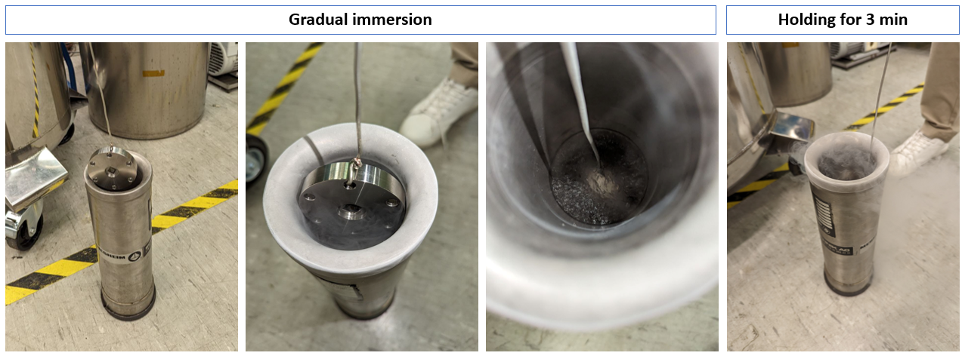
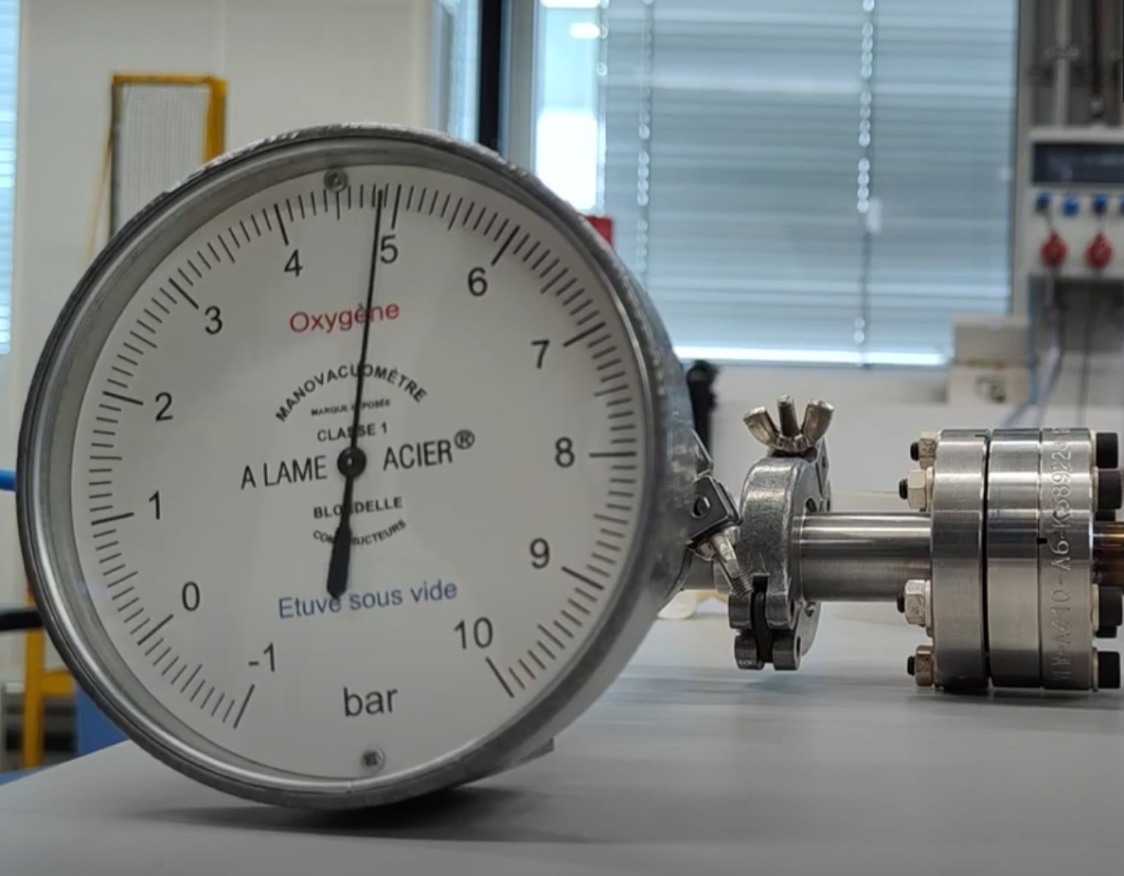
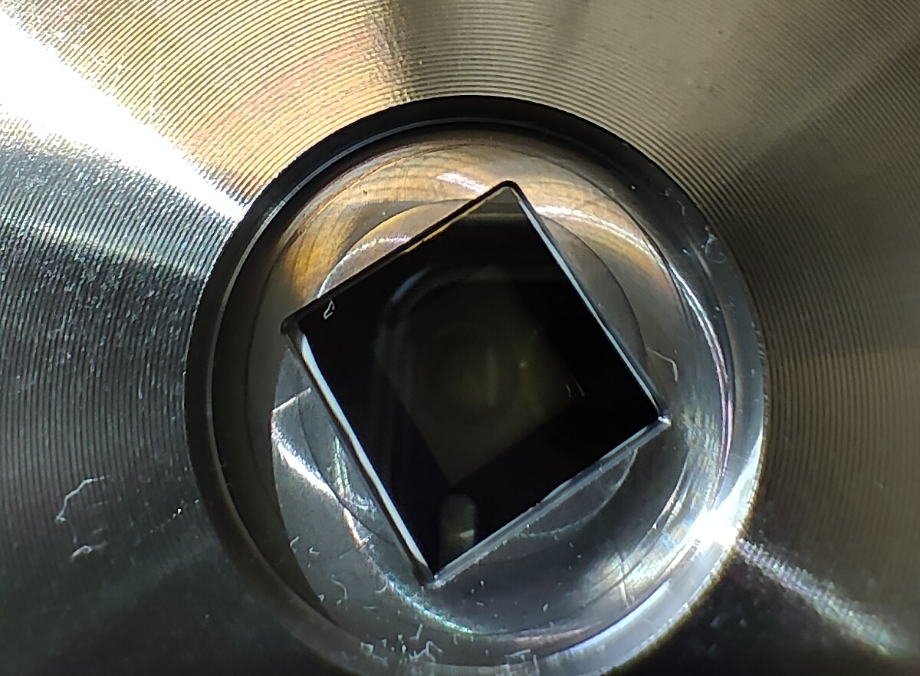
Absorber at low energy requires thin windows
First candidate Si₃N₄ windows [6][7]:
  Study of mechanical properties from 200°C to cryogenic temperature (77K)
  Study under proton irradiation with high brightness beams
Other possible materials: Be, SiC, C, etc.
First tests with 1 μm 6×6 mm

Slide 18
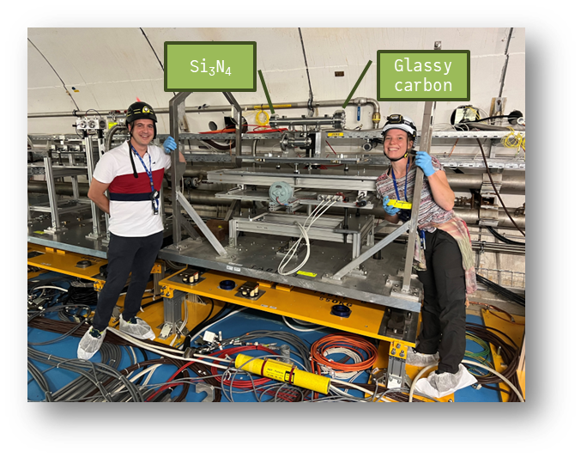
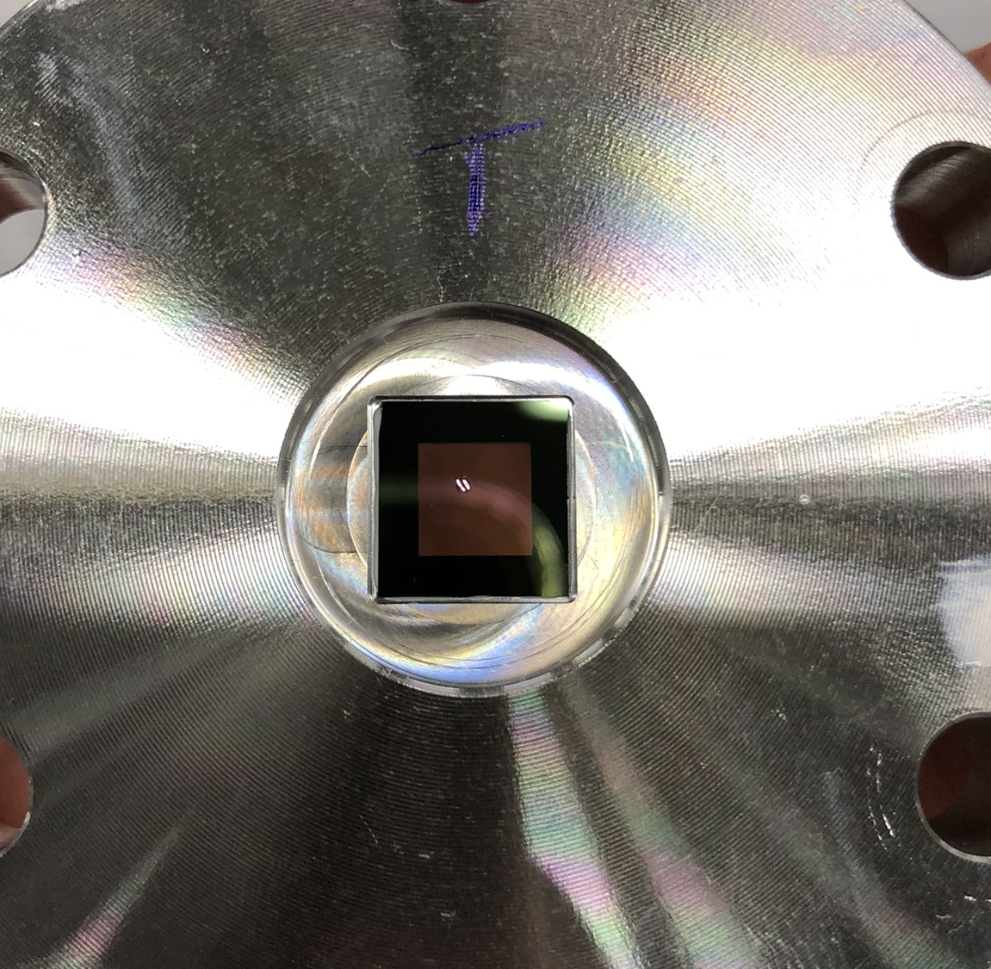
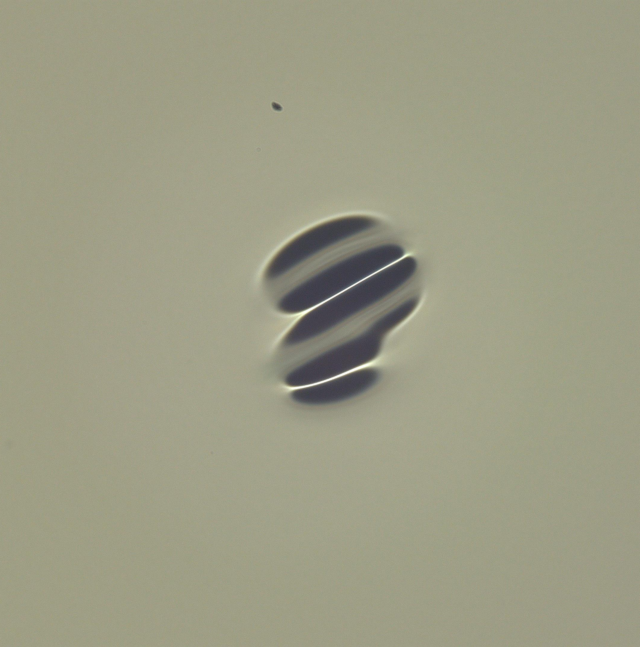

Test of 1μm thick Si₃N₄ window in HiRadMat (Baby-SMAUG)
Test one membrane irradiated under vacuum
4×10¹² muons/pulse at 5MeV σ_{RMS}=0.6 mm → Maximum power deposited 0.89 kJ/cm³
p⁺ equivalent with σ_{RMS}=0.25 mm at 440 GeV → 3.2×10¹² p⁺/pulse that corresponds to 2.6×10¹³ p⁺/mm²
Objective: Few shots increasing intensity up to failure. Optics Fp2 0.25 mm
SMAUG2 approved for 2024 (continuation)
$\text{Brightness}≡\frac{N_{b}I_{b}}{σ_{x}^{2}+σ_{y}^{2}} p^{+}/mm^{2}$ [8]

Slide 19
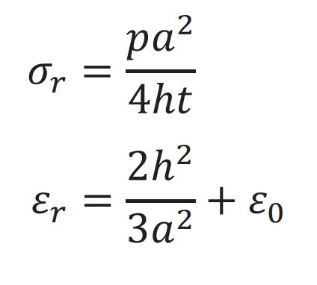
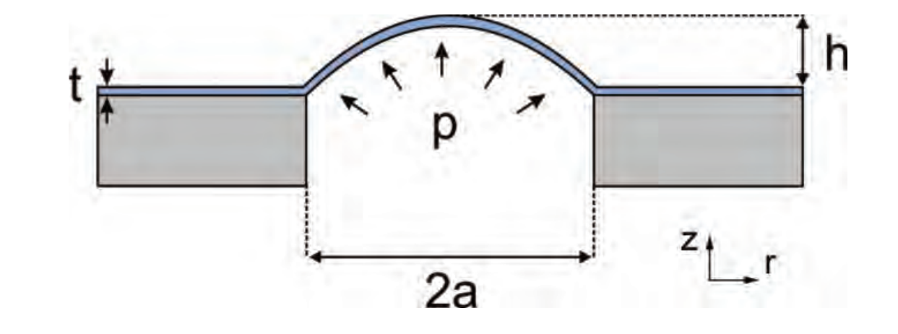
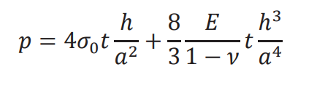
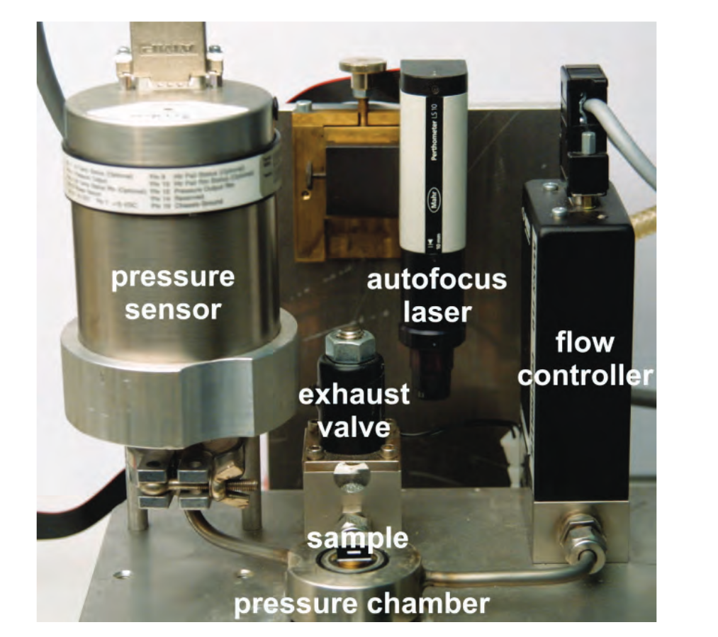
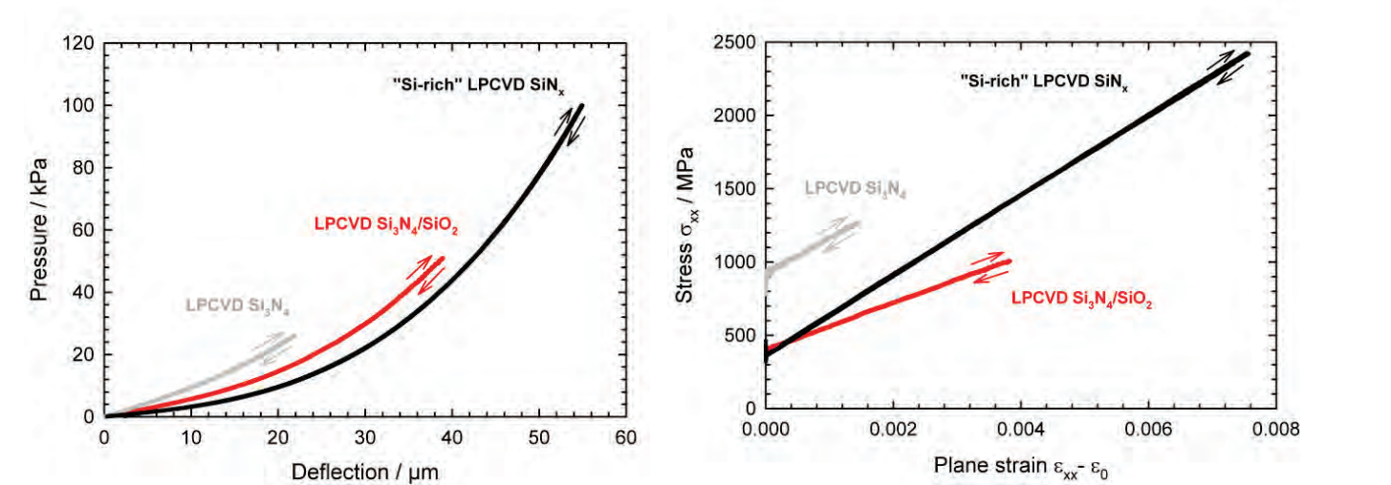
Mechanical tests
Mechanical characterization of Si₃N₄ membranes at different temperatures (from cryogenic to high temperature) → Use inputs to better validate thermomechanical models
For thin membranes Bulge testing is the easiest setup. Measurements of Si₃N₄ membranes at room temperature in [9][10]

Slide 20
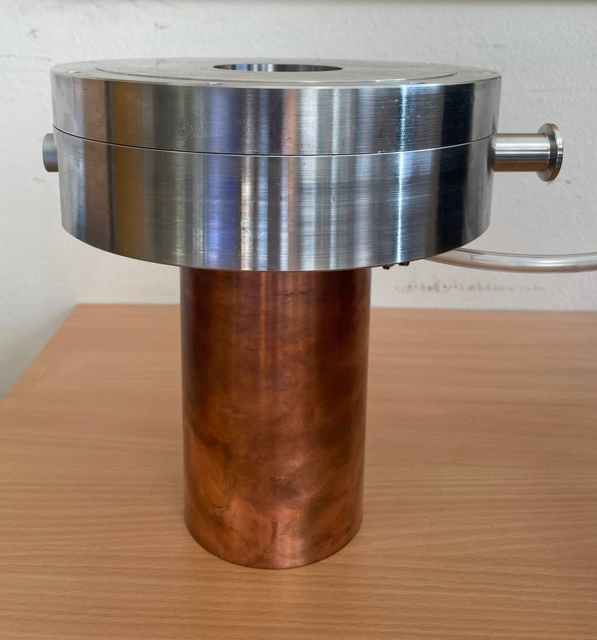
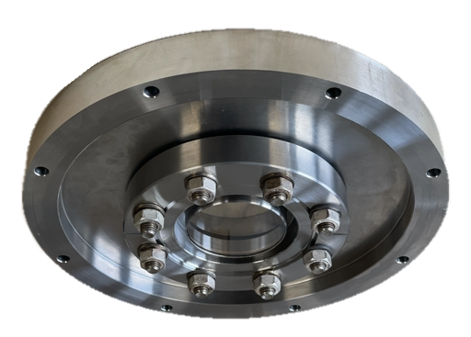
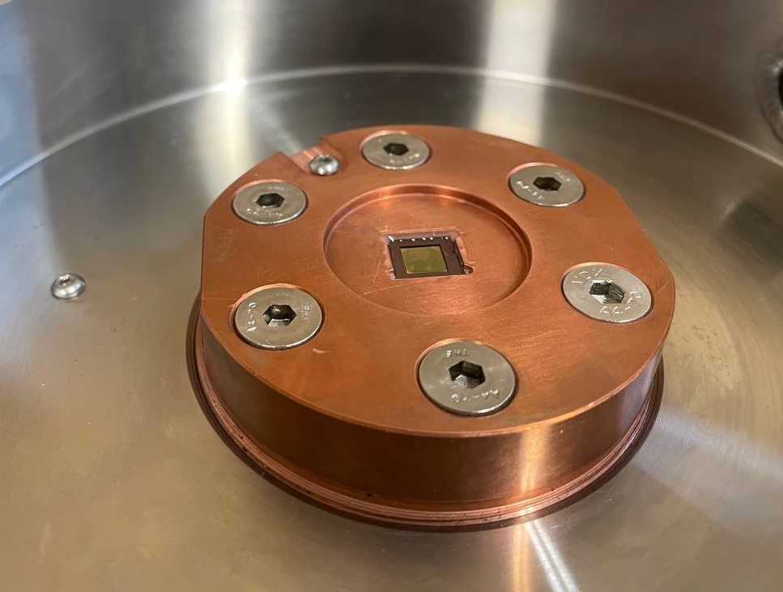
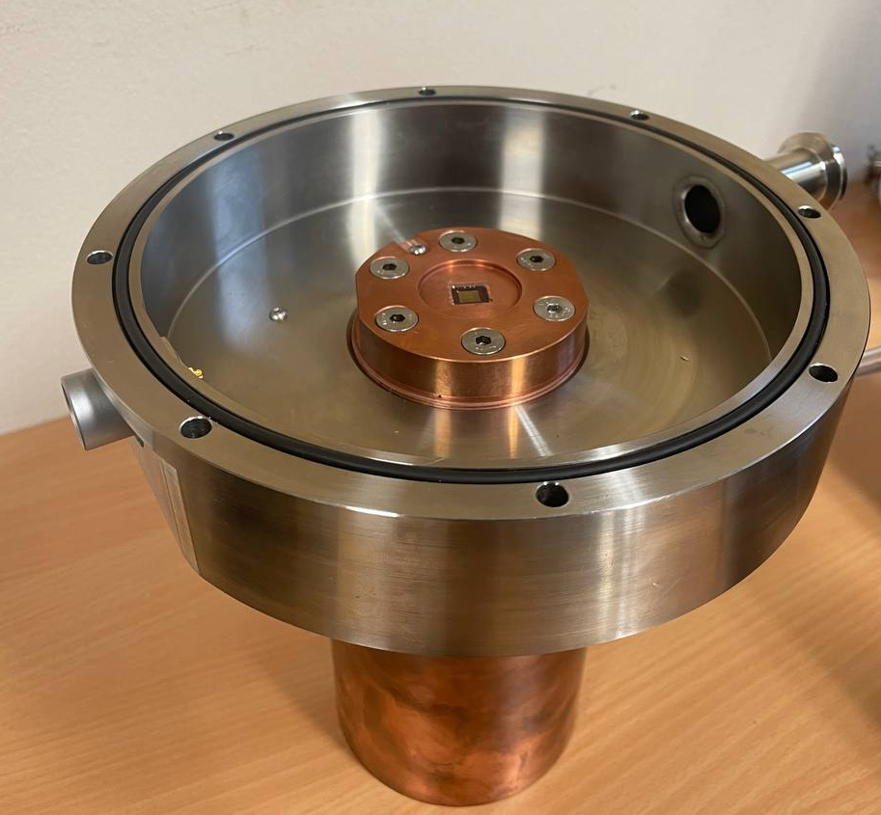
Mechanical tests
STEEL FLANGE
Viewport
Viewport
PT100 slots
Membrane
COPPER FLANGE

Slide 21
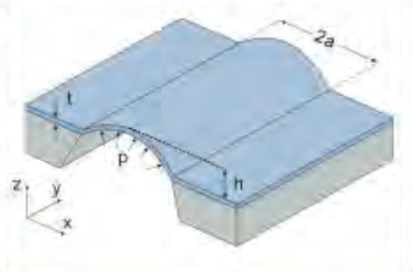
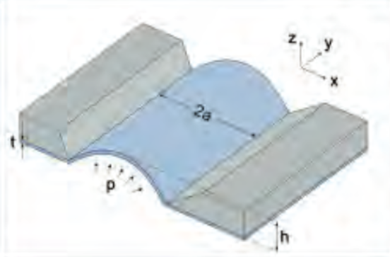
Mechanical tests
Membrane orientation
New adhesives for different temperature tests
Repeatibility of results
Two different ways to mount the membrane were investigated: negative and positive orientation.
Different glues were used to bond the sample to the copper flange. This considerably affects the mechanical response of the membrane against the maximum pressure it can withstand.
The performance of the glue changes depending on the testing temperature.
Preliminary results are given in the table below:
Next step: define a test protocol to improve the repeatability of results.
NEGATIVE ORIENTATION
POSITIVE ORIENTATION
Orientation | Adhesive | Temp. | Pressure @ failure
POSITIVE | Araldite RAPID bi-component (curing time: 2 h @RT) | RT | 5±1 bars
 | Araldite RAPID bi-component (curing time: 2 h @RT) | -190°C | <1 bars
 |  | 80°C | 2.5 bars
POSITIVE | Araldite STANDARD bi-component (curing time: 24 h @RT) | RT | 5±1 bars
 |  | -190°C | 2 bars
 |  | 80°C | 2.5 bars
POSITIVE | DP190 bi-component (curing time: 24 h @RT) | RT | 5±1 bars
 |  | -190°C | 5±1 bars
POSITIVE | STYCAST 2850FT CAT27 (curing time: 4h at 120 °C) | RT | 2 bars
 |  | 140 °C | 3.5 bars
Orientation | Adhesive | Temp. | Pressure @ failure
NEGATIVE | Acrylic glue (instantaneous) | RT | < 1 bar
POSITIVE | Acrylic glue (instantaneous) | RT | ~2 bars

Slide 22
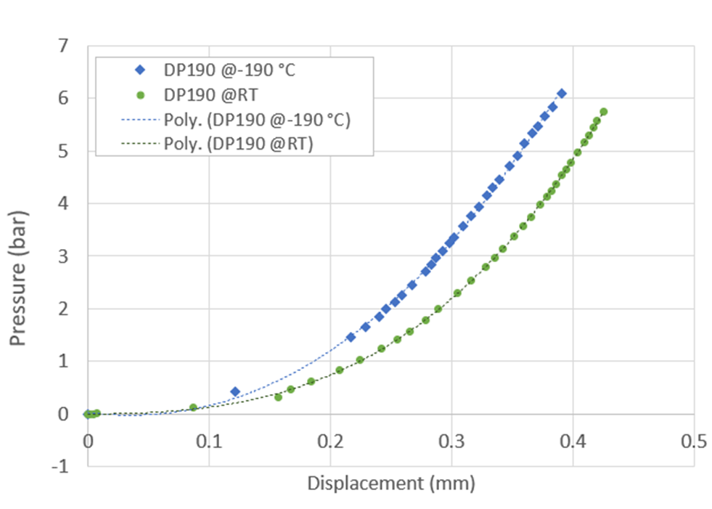
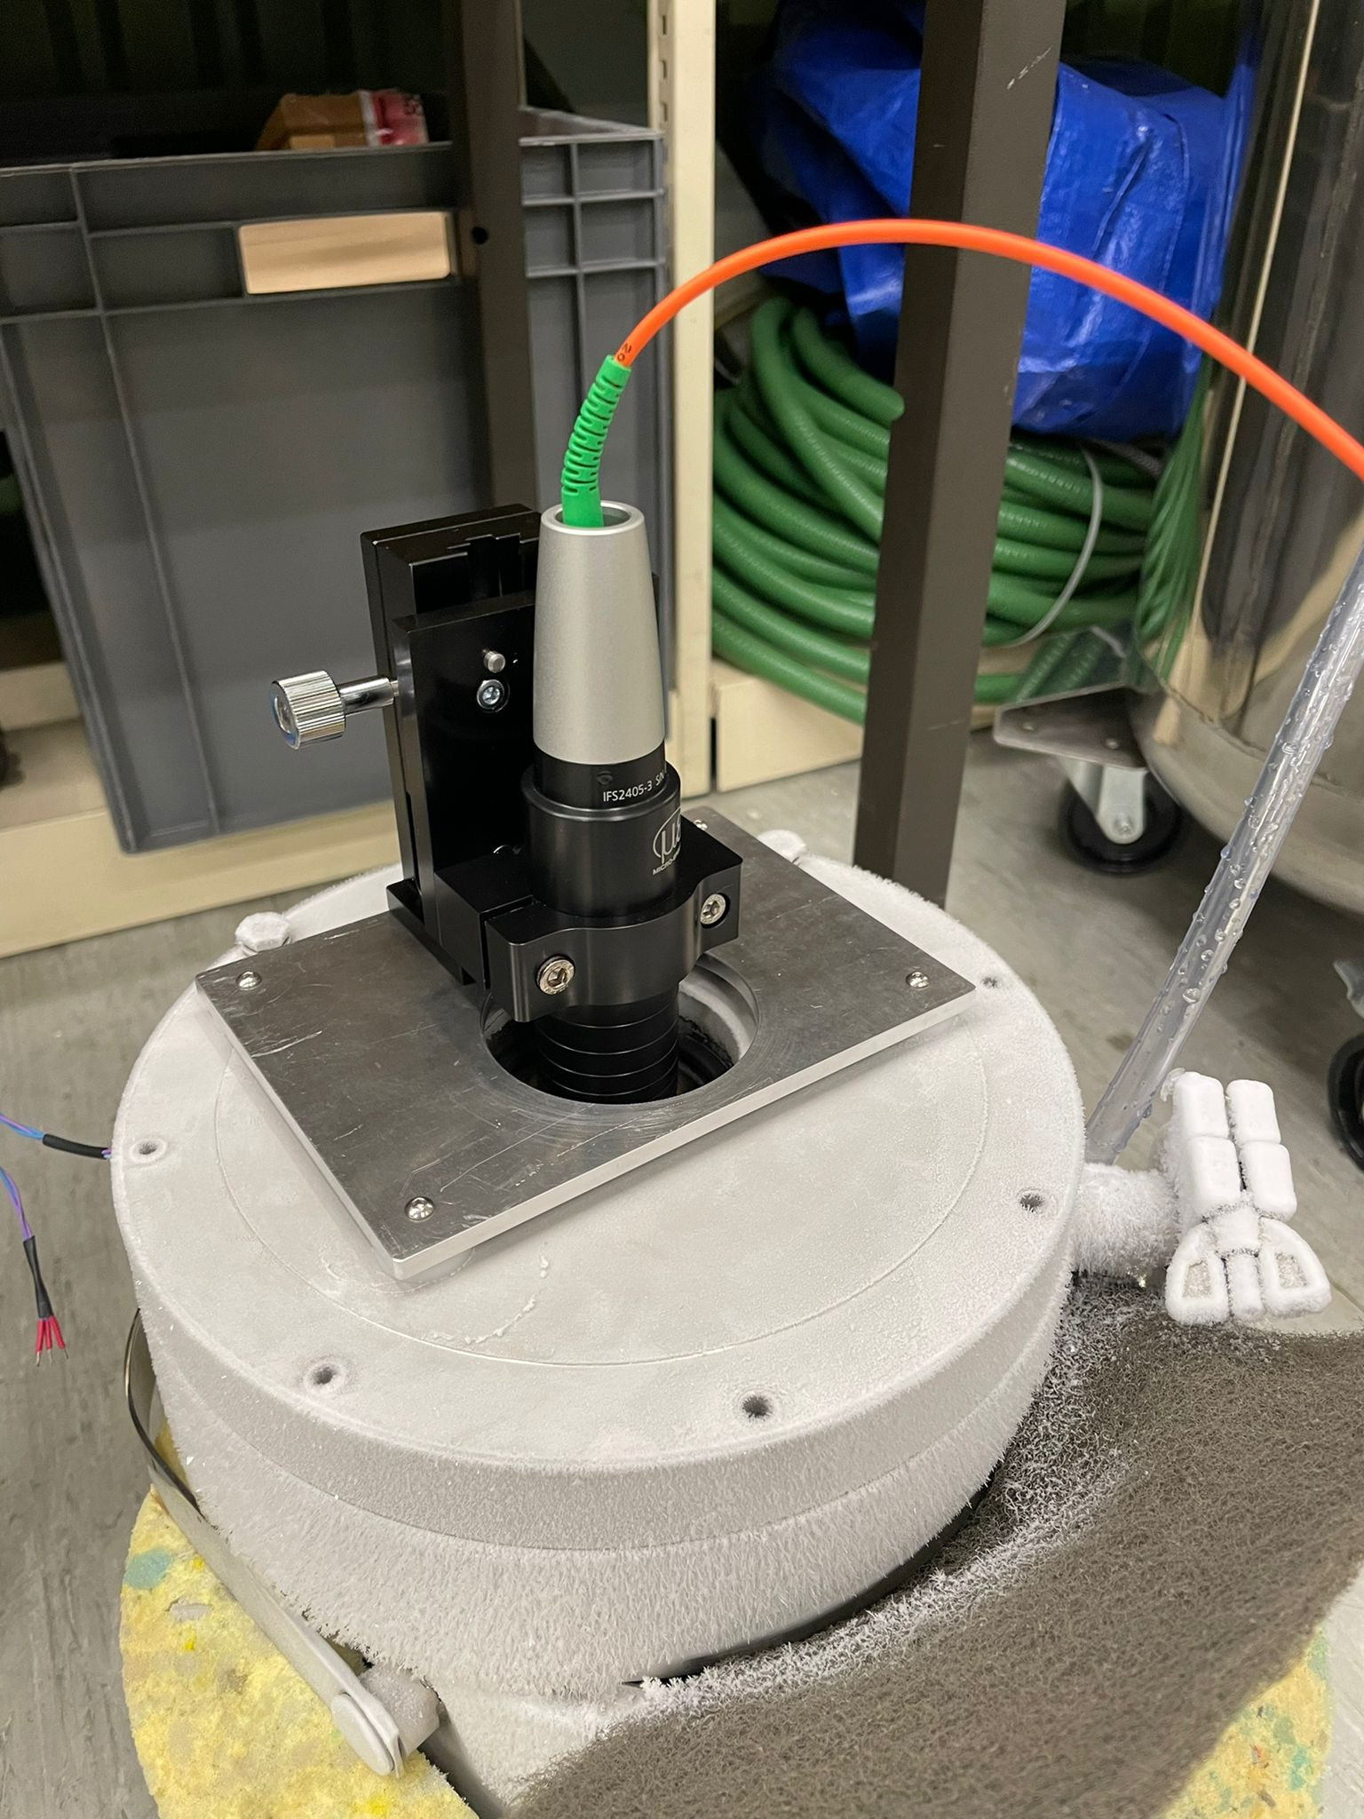
Mechanical tests
1 μm thick 6×6 mm window
Valentina Giovinco

Slide 23
Summary
Keeping a constant length allows to reduce density towards the end of the cooling channel
In some schemes this could displace the focus from the low energy stages
At “high” energy LiH or combinations of LiH with liquid H₂ could give some margin for larger power deposition
It is necessary the optimization of the cooling channel considering the thermodynamics and FLUKA simulations for a better estimation of the energy deposited in the absorber
Thin windows able to support >5 bar with just 1 µm thick window => Thicker windows may be able to cope with higher pressure excursions (not available as a commercial product => no tested yet)
Radial space for absorber will be limited. Cold absorber better integrated inside superconducting solenoid => Save space for thermal insulation
Part of the radial space will be taken for injection/extraction of absorber fluid

Slide 24
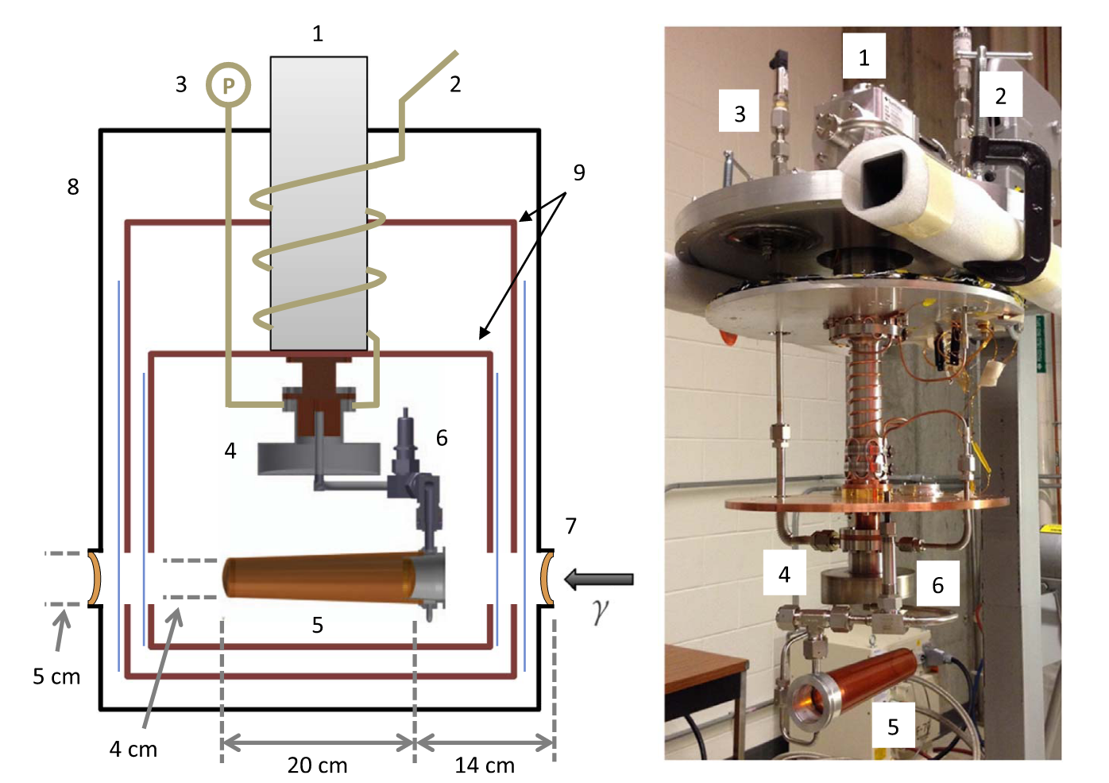
Experimental proposal? [11]
Build small target with liquid H₂ and or vapor
Relevant power with proton beam
Instrumented to measure pressure excursions, temperature, etc.
FLUKA and CFD simulations to evaluate power deposition and shockwave formation
Test thin windows + absorber?

Slide 25
Thank you for your attention!

Slide 26
References
[1] B.M. Stechauner, Final cooling scheme for muon colliders: a door opener for future discovery machines, TU Vienna, 2021.
[2] R.B. Palmer, R.C. Fernow, J.L. Lederman, Muon Collider Final Cooling in 30-50 T Solenoids, Conf. Proc. C 110328 (2011) 2061–2063.
[3] D.E. Groom and S.R. Klein, Eur. Phys. J. C 15, 163 (2000).
[4] AtomicNuclear Properties (lbl.gov)
[5] I.H. Bell, J. Wronski, S. Quoilin, V. Lemort, Pure and Pseudo-pure Fluid Thermophysical Property Evaluation and the Open-Source Thermophysical Property Library CoolProp, Ind. Eng. Chem. Res. 53 (2014) 2498–2508. https://doi.org/10.1021/ie4033999.
[6] Silson - Differential Pressure Windows
[7] P.T. Törmä, J. Kostamo, H. Sipilä, M. Mattila, P. Kostamo, E. Kostamo, H. Lipsanen, C. Laubis, F. Scholze, N. Nelms, B. Shortt, and M. Bavdaz, IEEE Transactions on Nuclear Science 61, 695 (2014).
[8] N. Solieri et al, TF3: Beam-Intercepting Devices final report, EDMS 2754370
[9] R.L. Edwards, G. Coles, and W.N. Sharpe, Experimental Mechanics 44, 49 (2004).
[10] B. Merle, Mechanical Properties of Thin Films Studied by Bulge Testing (FAU University Press, Erlangen, 2013)
[11] D.P. Kendellen, M.W. Ahmed, E. Baird, G. Feldman, N. Perreau, P.W. Wallace, H.R. Weller, A cryogenic target for Compton scattering experiments at HIγS, Nucl. Instrum. Methods Phys. Res. Sect. Accel. Spectrometers Detect. Assoc. Equip. 840 (2016) 174–180. https://doi.org/10.1016/j.nima.2016.10.016.

