Slide 1
Design Optimization Approach for the 6D Cooling Magnets
Siara Fabbri, Luca Bottura

Slide 2
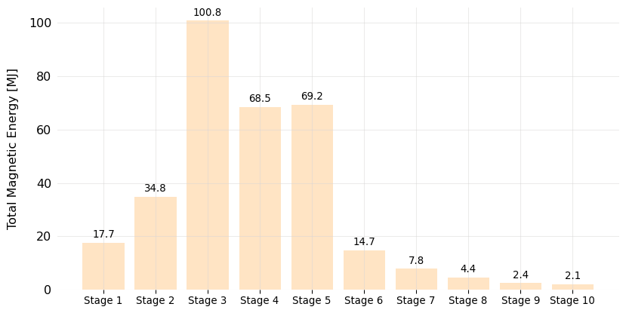
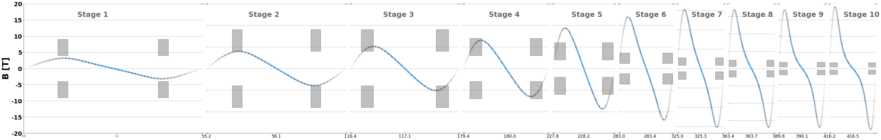
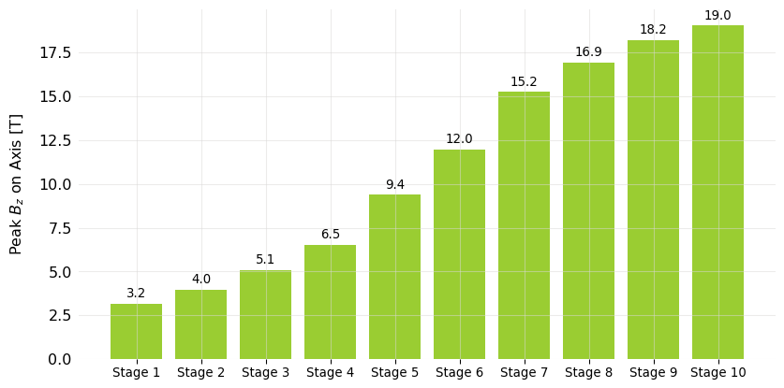

Motivation
Beam Optics Ideal Constrained Set of Magnets
Magnet Engineering Analysis (*Optimization)
*Initial Constraint Space of Magnets
Beam Optics Ideal Set of Magnets
Magnet Engineering Analysis (OK, not OK)

Slide 3
Motivation
How to best iterate with beam optics
  (Ex. constrain the feasible peak field on axis for an allowed space)
  Set of guidelines for coil dimensions (Ex. Longer over thicker)
How to best optimize a configuration of solenoids given a desired on-axis field.
  US-MAP Solenoids display big challenges such as large stresses, forces, stored energy…

Slide 4
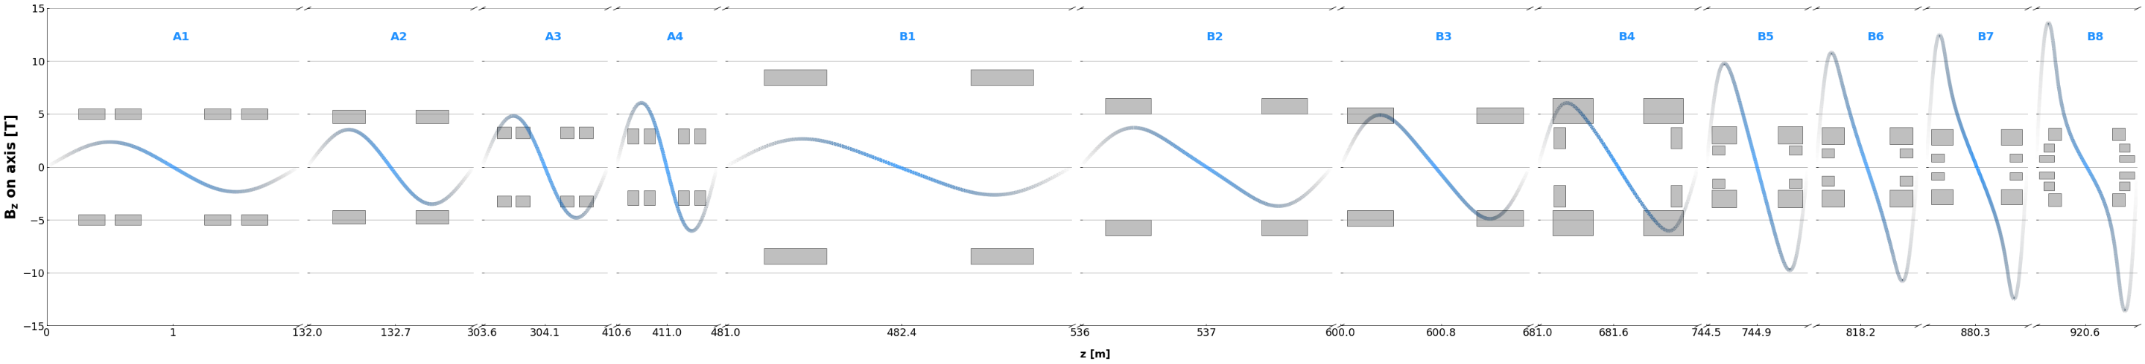
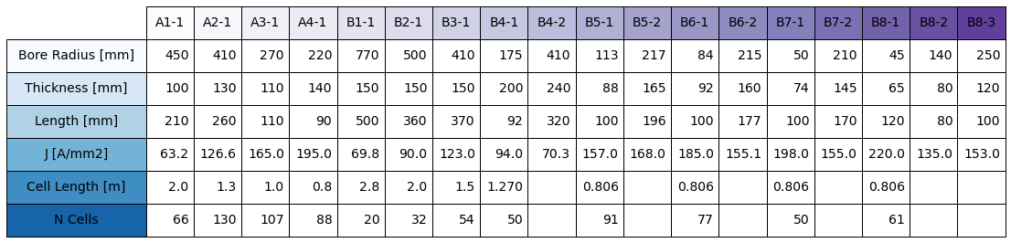
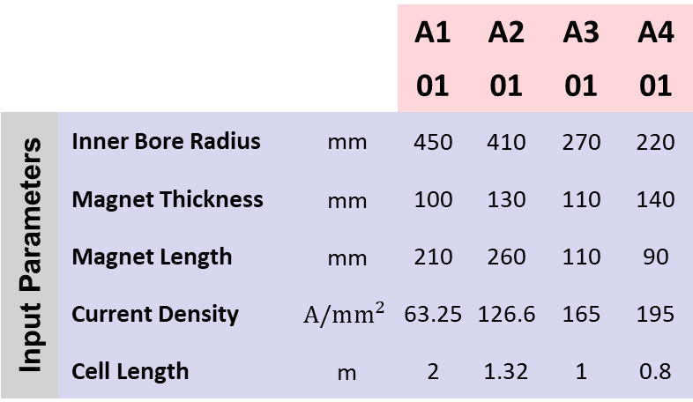
Review: US-MAP Cells
18 unique coil types (2 to 6 coils per cell)
B4 has 2 unique coil types: B4-01, B4-02
…
B8 has 3 unique coil types: B8-01, B8-02, B8-03
2954 Solenoids
 |  |  | A1 | A2 | A3 | A4
 |  |  | 01 | 01 | 01 | 01
Input Parameters | Inner Bore Radius | mm | 450 | 410 | 270 | 220
 | Magnet Thickness | mm | 100 | 130 | 110 | 140
Geometry | Magnet Length | mm | 210 | 260 | 110 | 90
 | Current Density | $$A/mm^{2}$$ | 63.25 | 126.6 | 165 | 195
 | Cell Length | m | 2 | 1.32 | 1 | 0.8
B1 | B2 | B3 | B4 |  | B5 |  | B6 |  | B7 |  | B8
01 | 01 | 01 | 01 | 02 | 01 | 02 | 01 | 02 | 01 | 02 | 01 | 02 | 03
770 | 500 | 410 | 175 | 410 | 113 | 217 | 84 | 215 | 50 | 210 | 45 | 140 | 250
150 | 150 | 150 | 200 | 240 | 88 | 165 | 92 | 160 | 74 | 145 | 65 | 80 | 120
500 | 360 | 370 | 92 | 320 | 100 | 196 | 100 | 177 | 100 | 170 | 120 | 80 | 100
69.8 | 90 | 123 | 94 | 70.3 | 157 | 168 | 185 | 155.1 | 198 | 155 | 220 | 135 | 153
2.75 | 2 | 1.5 | 1.27 |  | 0.806 |  | 0.806 |  | 0.806 |  | 0.806

Slide 5
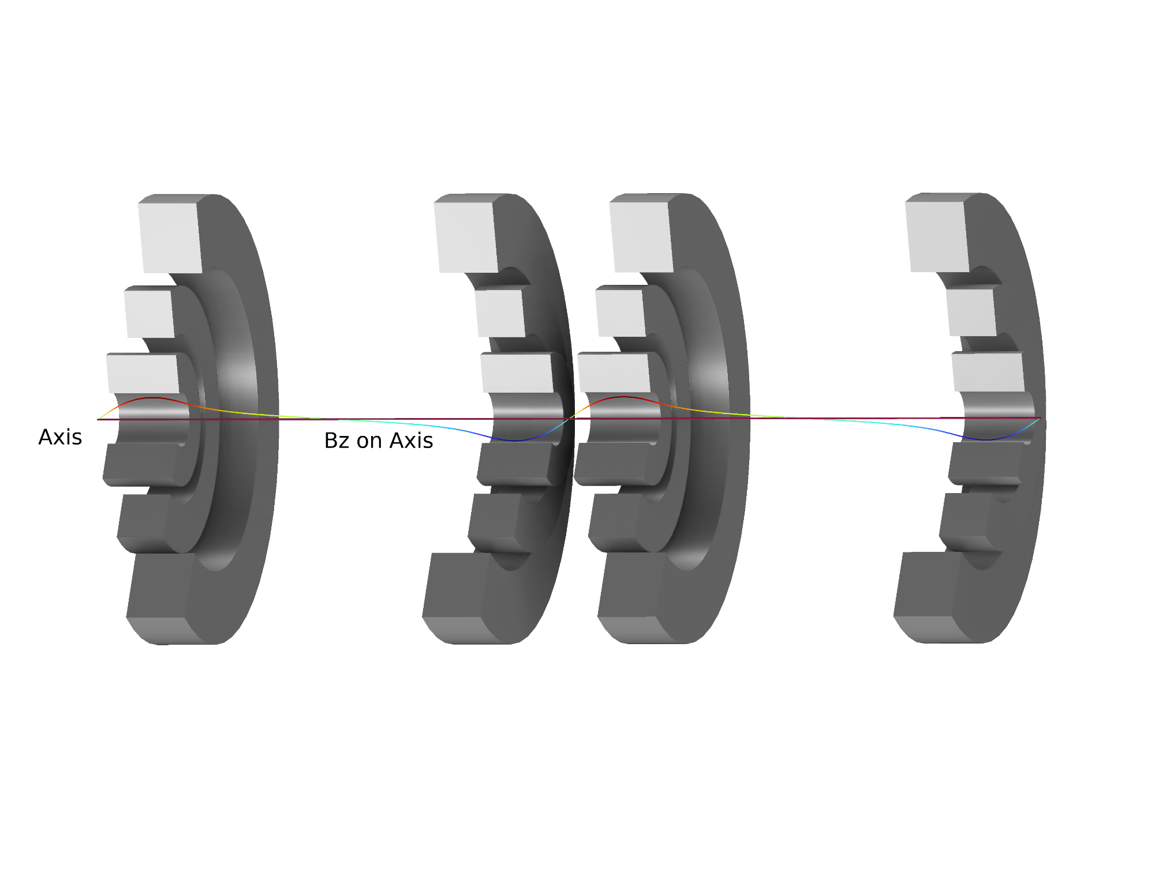
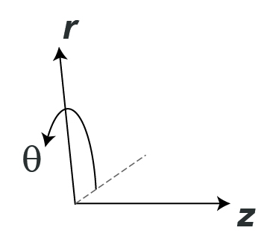
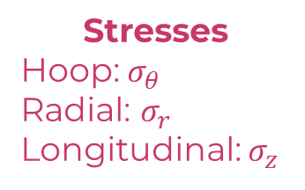
Review: US-MAP Cells
Cell B8
Stresses
Hoop: $σ_{θ}$
Radial: $σ_{r}$
Longitudinal: $σ_{z}$
Repeating cells…

Slide 6
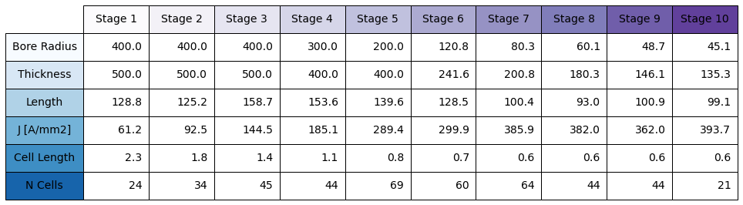
New Optics Initial Draft
898 Solenoids

Slide 7
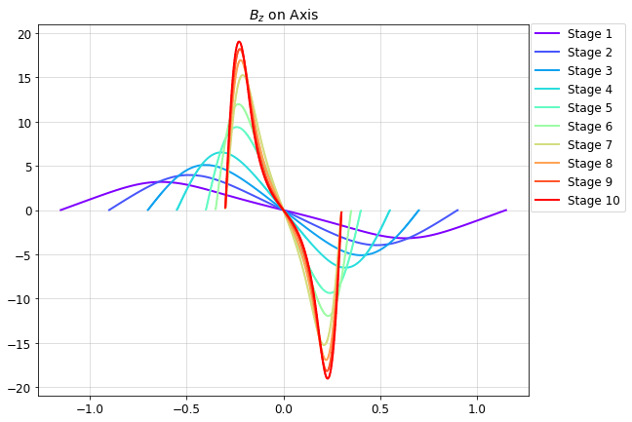
New Optics Initial Analysis

Slide 8
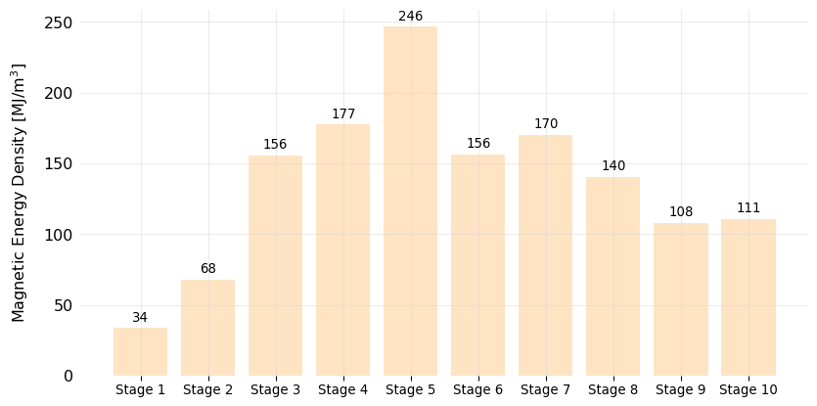
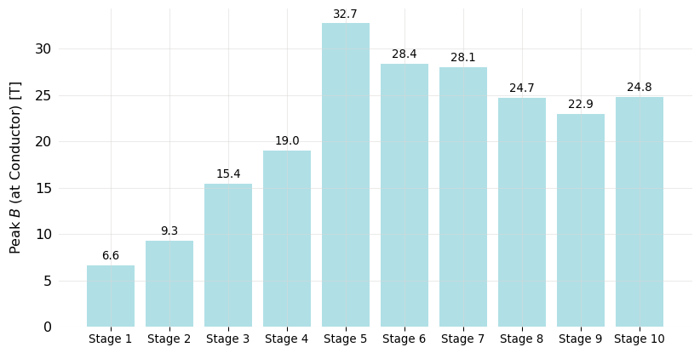

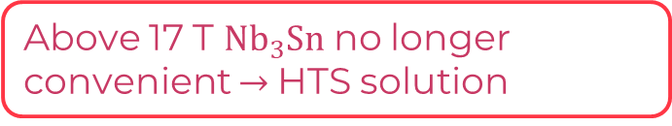
New Optics: Magnetic Properties (Lattices)
100 MJ/$m^{3}$ typical HiLumi magnets
US-MAP maximum
Above 17 T ${Nb}_{3}Sn$ no longer convenient $→$HTS solution
US-MAP maximum
US-MAP maximum

Slide 9
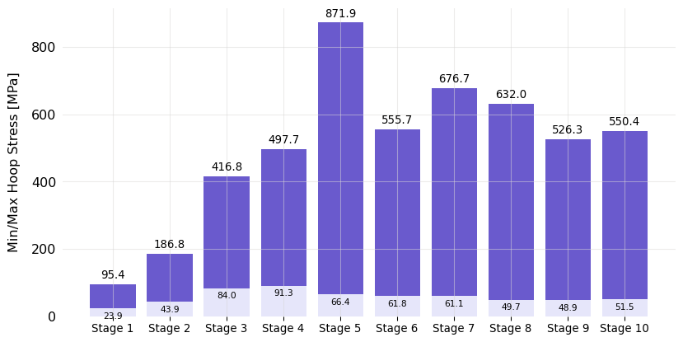
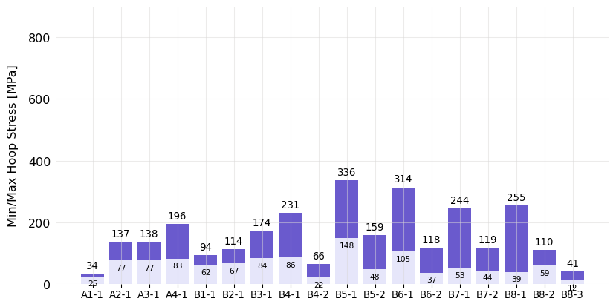
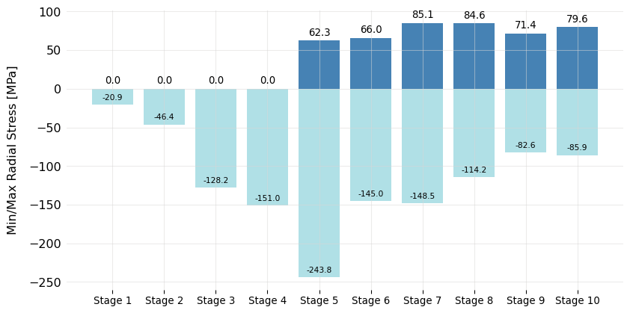
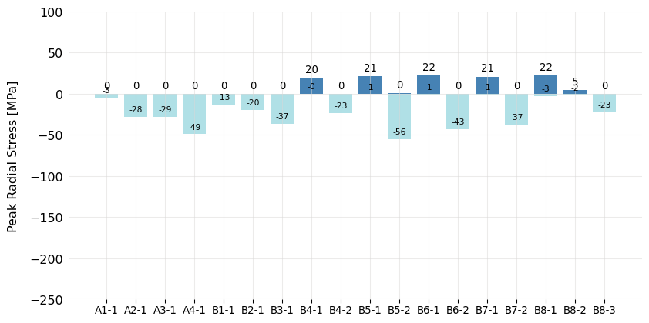

New Optics: Mechanical Calculations (Lattices)
300 MPa hoop stress is current limit for FC solenoid, corresponds to peak $\sim$600 MPa in SS/alloy part of conductor
US-MAP
US-MAP

Slide 10
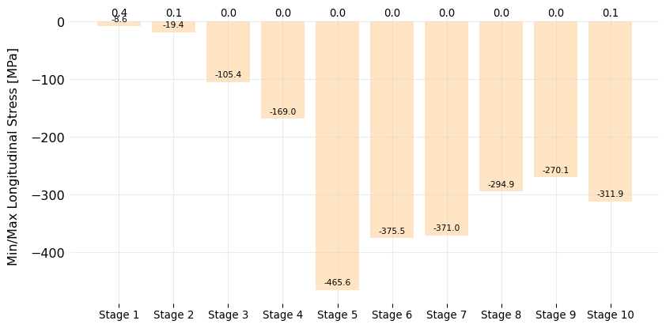
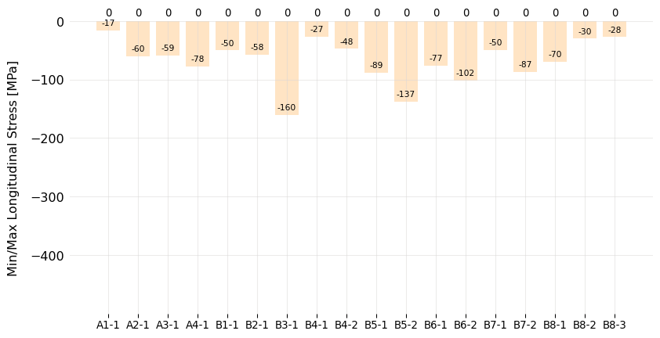
New Optics: Mechanical Calculations (Lattices)
US-MAP

Slide 11
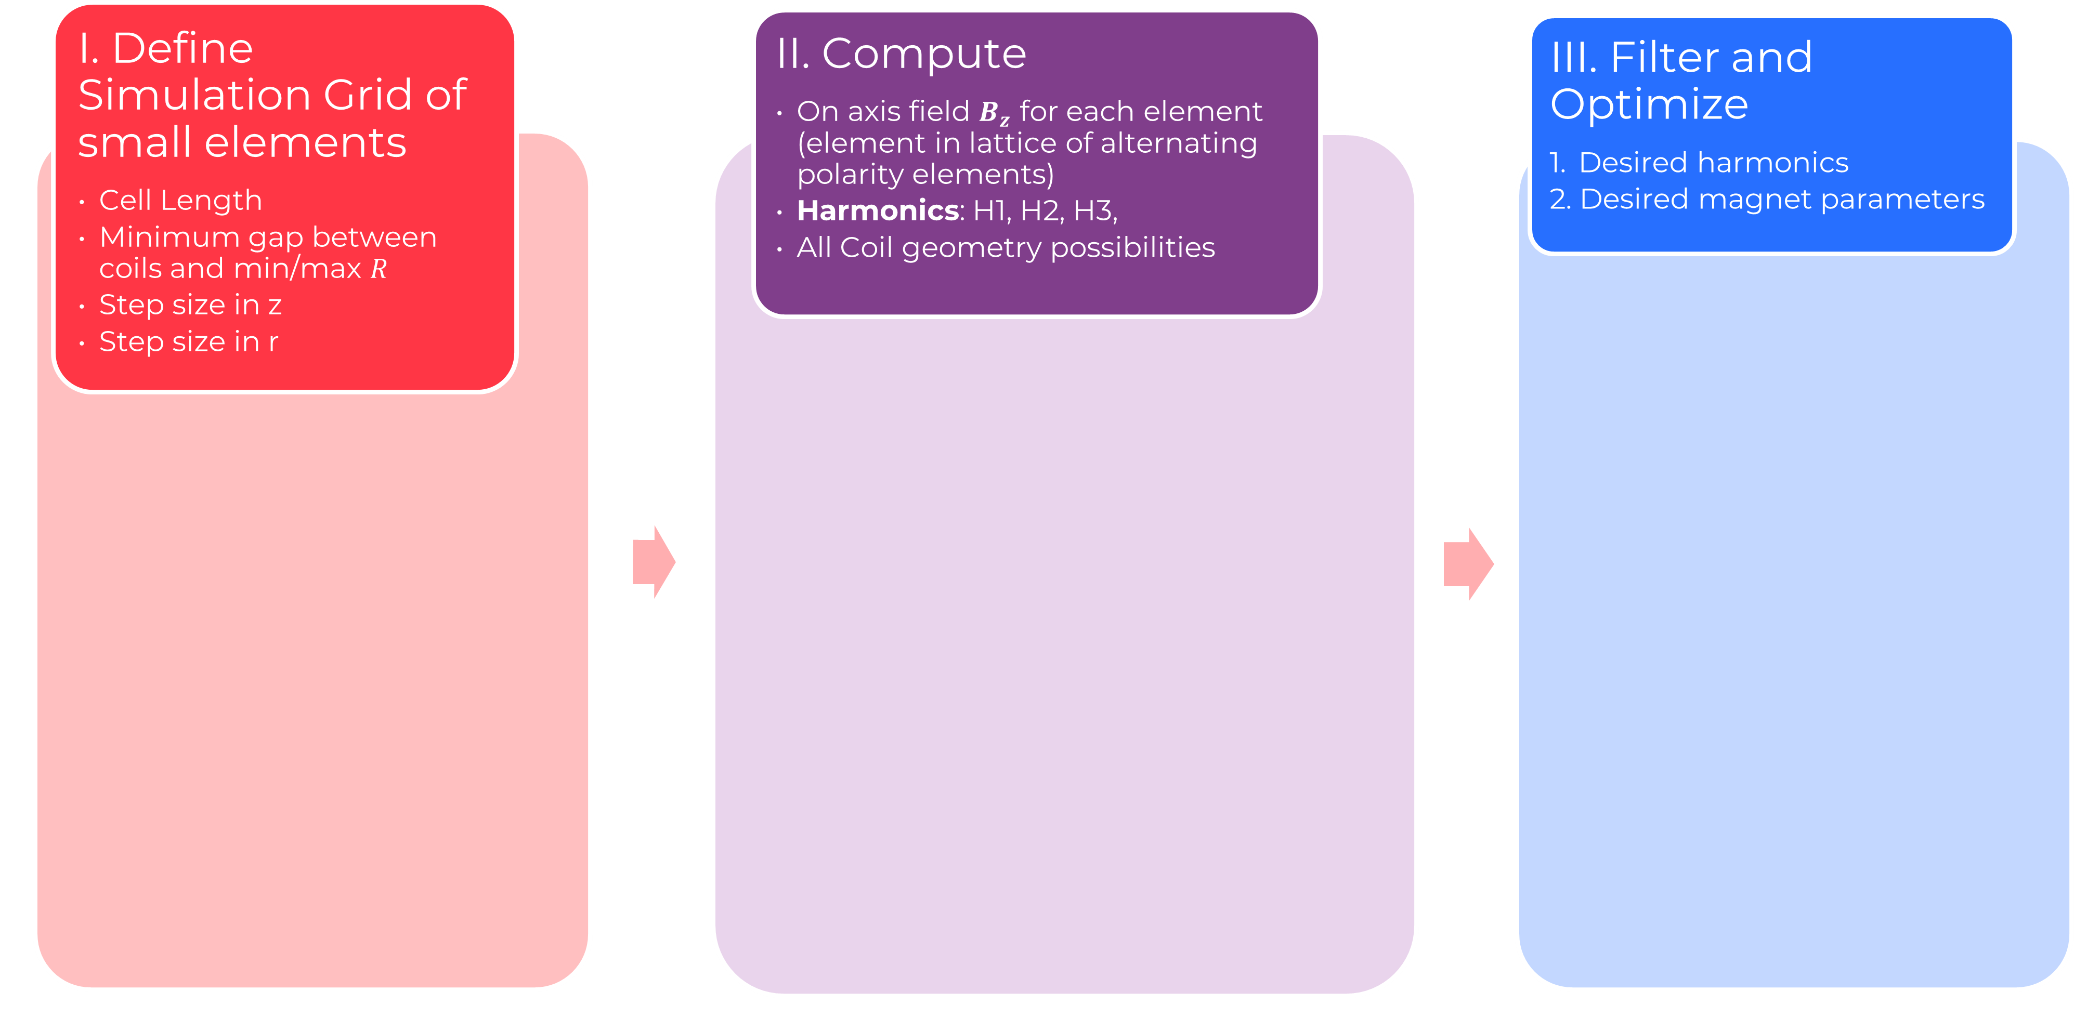
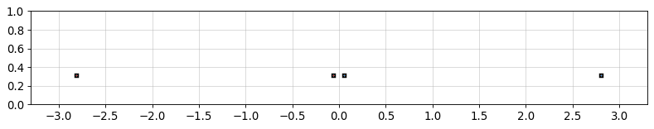
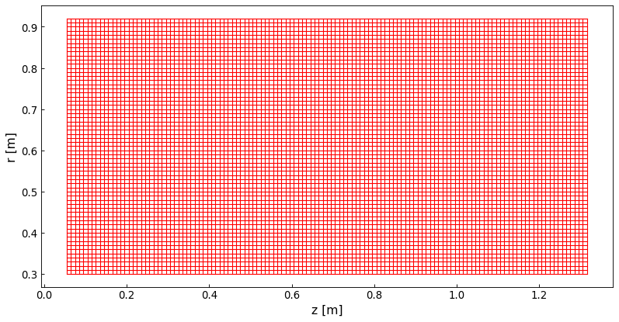
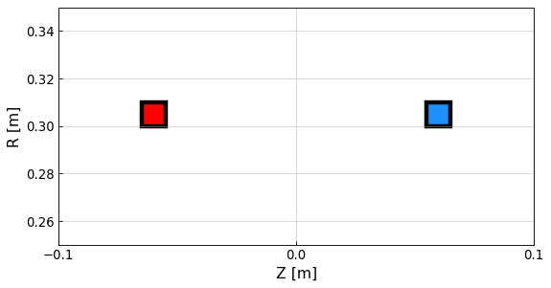
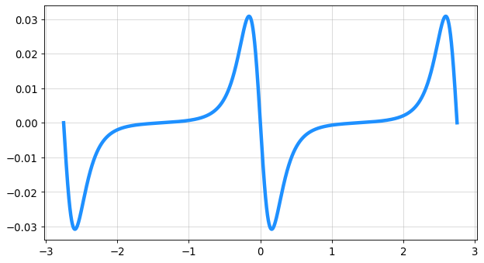



Solenoid in Cell Optimization program (SiCO)
I. Define Simulation Grid of small elements
Minimum gap between coils and min/max $R$
Minimum gap between coils and min/max 𝑅
II. Compute
On axis field $B_{z}$ for each element (element in lattice of alternating polarity elements)
On axis field 𝑩_𝒛 for each element (element in lattice of alternating polarity elements)
Harmonics: H1, H2, H3,
III. Filter and Optimize
Desired harmonics
Desired magnet parameters
Step size in z
Step size in r
All Coil geometry possibilities
Cell Length
Small pixel elements in lattice
$\frac{H2}{H1 }=(Target) ±1\%$,
$\frac{H3}{H1 }=(Target)±1\%$,
…
(*) values given by beam physics
Example filter parameters
$$J_{min }, J_{max }=50, 700 A/mm^{2}$$
(volume, peak stresses, forces, …)
$B_{z}$ on axis
Current limitations (*to be implemented in future):
*2 solenoids per cell only
*No off-axis components
Peak fields/stresses in conductor for single coils, full cell in COMSOL
FFT
H1, H2, H3, …

Slide 12
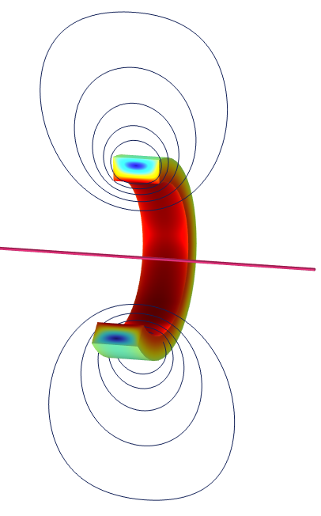
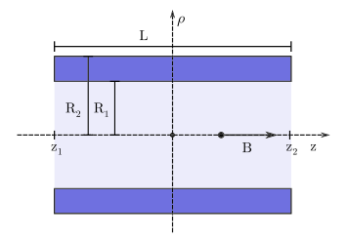
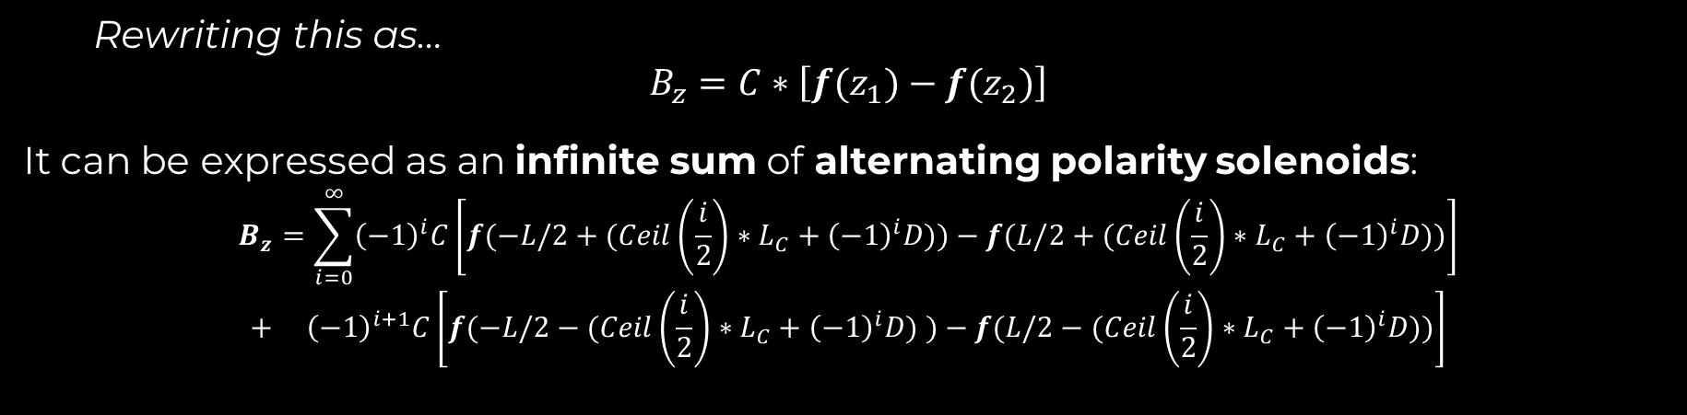
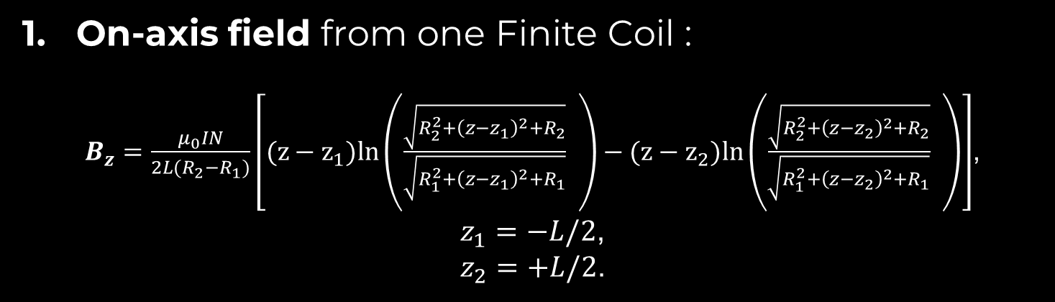
Brief review: Key Analytic Equations
On-axis field from one Finite Coil :
$B_{z}=\frac{μ_{0}IN}{2L(R_{2}−R_{1})}\left[(z−z_{1})ln\left(\frac{\sqrt{R_{2}^{2}+{\left(z−z_{1}\right)}^{2}+R_{2}}}{\begin{aligned}\sqrt{R_{1}^{2}+{\left(z−z_{1}\right)}^{2}+R_{1}} \\ \end{aligned}} \right)−(z−z_{2})ln\left(\frac{\sqrt{R_{2}^{2}+{\left(z−z_{2}\right)}^{2}+R_{2}}}{\begin{aligned}\sqrt{R_{1}^{2}+{\left(z−z_{2}\right)}^{2}+R_{1}} \\ \end{aligned}} \right)\right]$,
$z_{1}=−L/2$,
$z_{2}=+L/2$.
Rewriting this as…
$$B_{z}=C∗\left[f(z_{1})−f(z_{2})\right]$$
It can be expressed as an infinite sum of alternating polarity solenoids:
$$B_{z}=\sum_{i=0}^{∞}{{\left(−1\right)}^{i}C\left[f(−L/2+(Ceil\left(\frac{i}{2}\right)∗L_{C}+{\left(−1\right)}^{i}D\text{)})−f(L/2+(Ceil\left(\frac{i}{2}\right)∗L_{C}+{\left(−1\right)}^{i}D\text{)})\right]}$$
$$+ {\left(−1\right)}^{i+1}C\left[f(−L/2−(Ceil\left(\frac{i}{2}\right)∗L_{C}+{\left(−1\right)}^{i}D\text{)} )−f(L/2−(Ceil\left(\frac{i}{2}\right)∗L_{C}+{\left(−1\right)}^{i}D\text{)})\right]$$
Validated

Slide 13
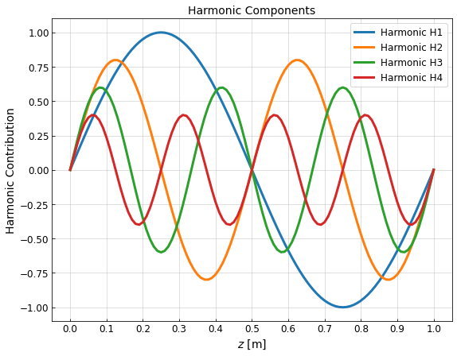
Brief review: Field Analysis
FFT
Oscillating field from a lattice

Slide 14
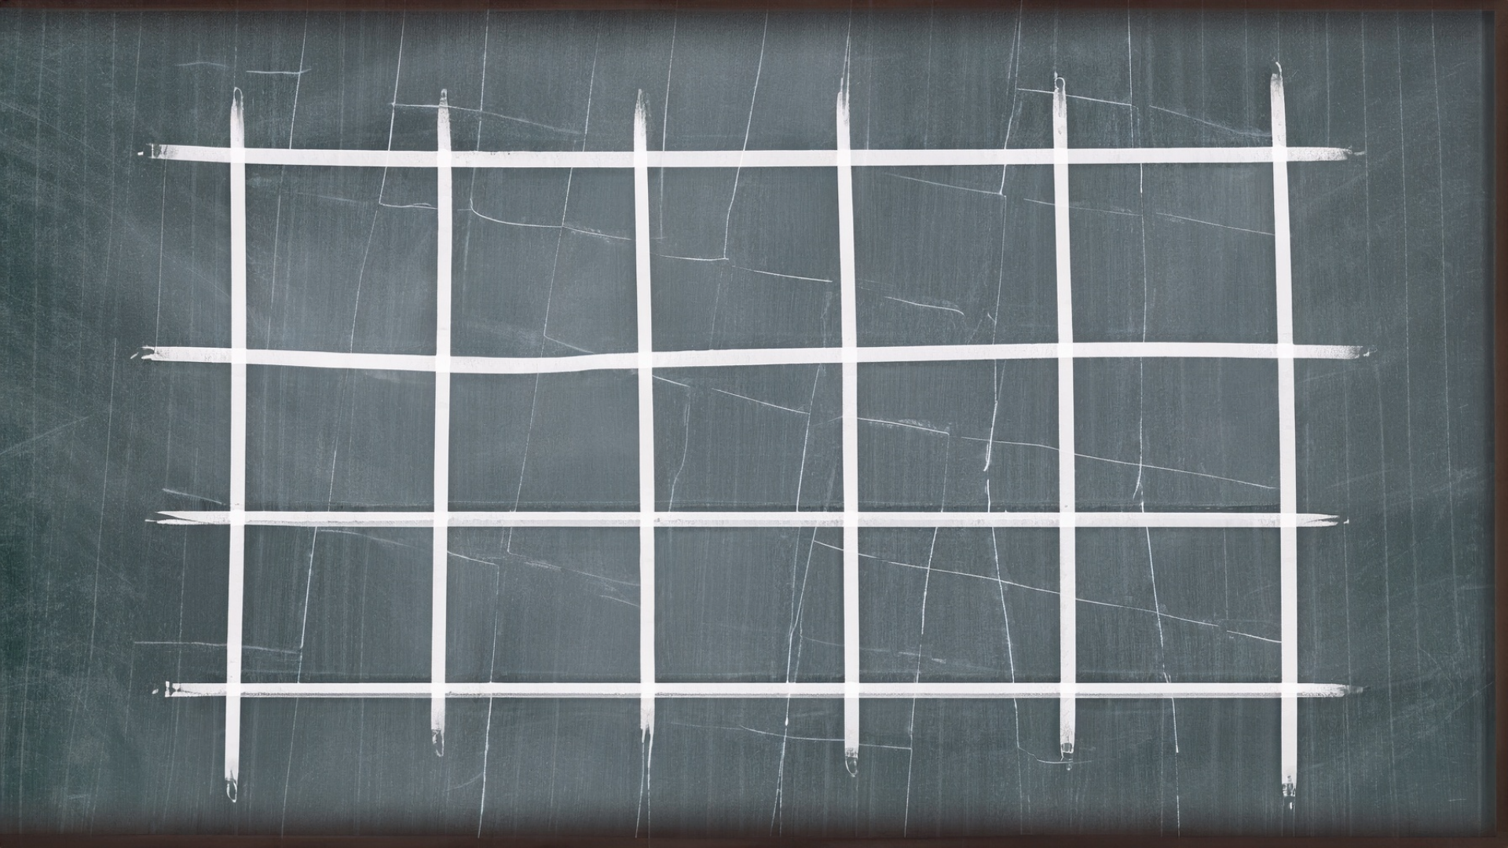
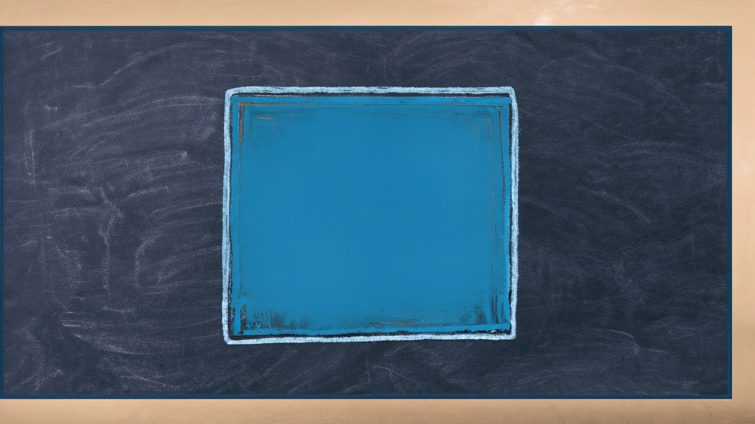
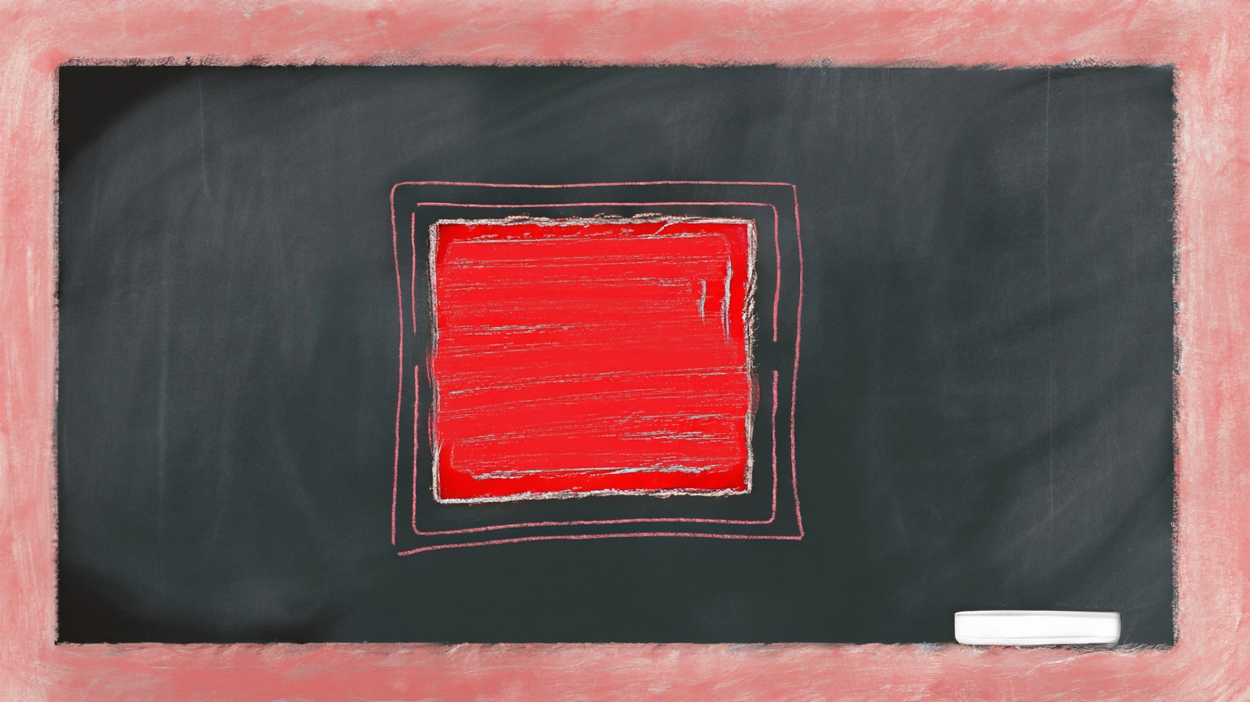
Define grid & simulate small elements of same current density
-
+
-
+

Slide 15
Define grid & simulate small elements of same current density

Slide 16
Calculate summed field for each possible coil block arrangement
Example

Slide 17
More Examples
In this 3x5 grid, 90 possible rectangle configurations!

Slide 18
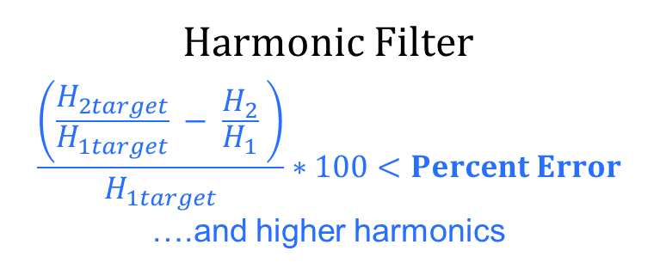
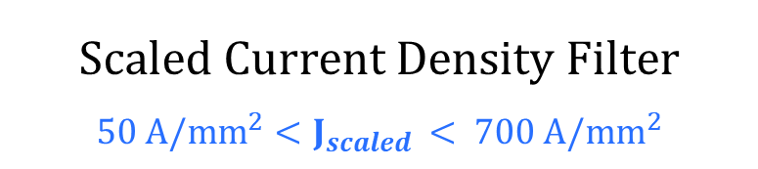
Filter
Harmonic Filter
$$\frac{\left(\frac{H_{2target}}{H_{1target}} − \frac{H_{2}}{H_{1}} \right)}{H_{1target}}∗100<Percent Error$$
….and higher harmonics
Scaled Current Density Filter
$50 A/{mm}^{2}$ $<J_{scaled }< 700 A/mm^{2}$

Slide 19
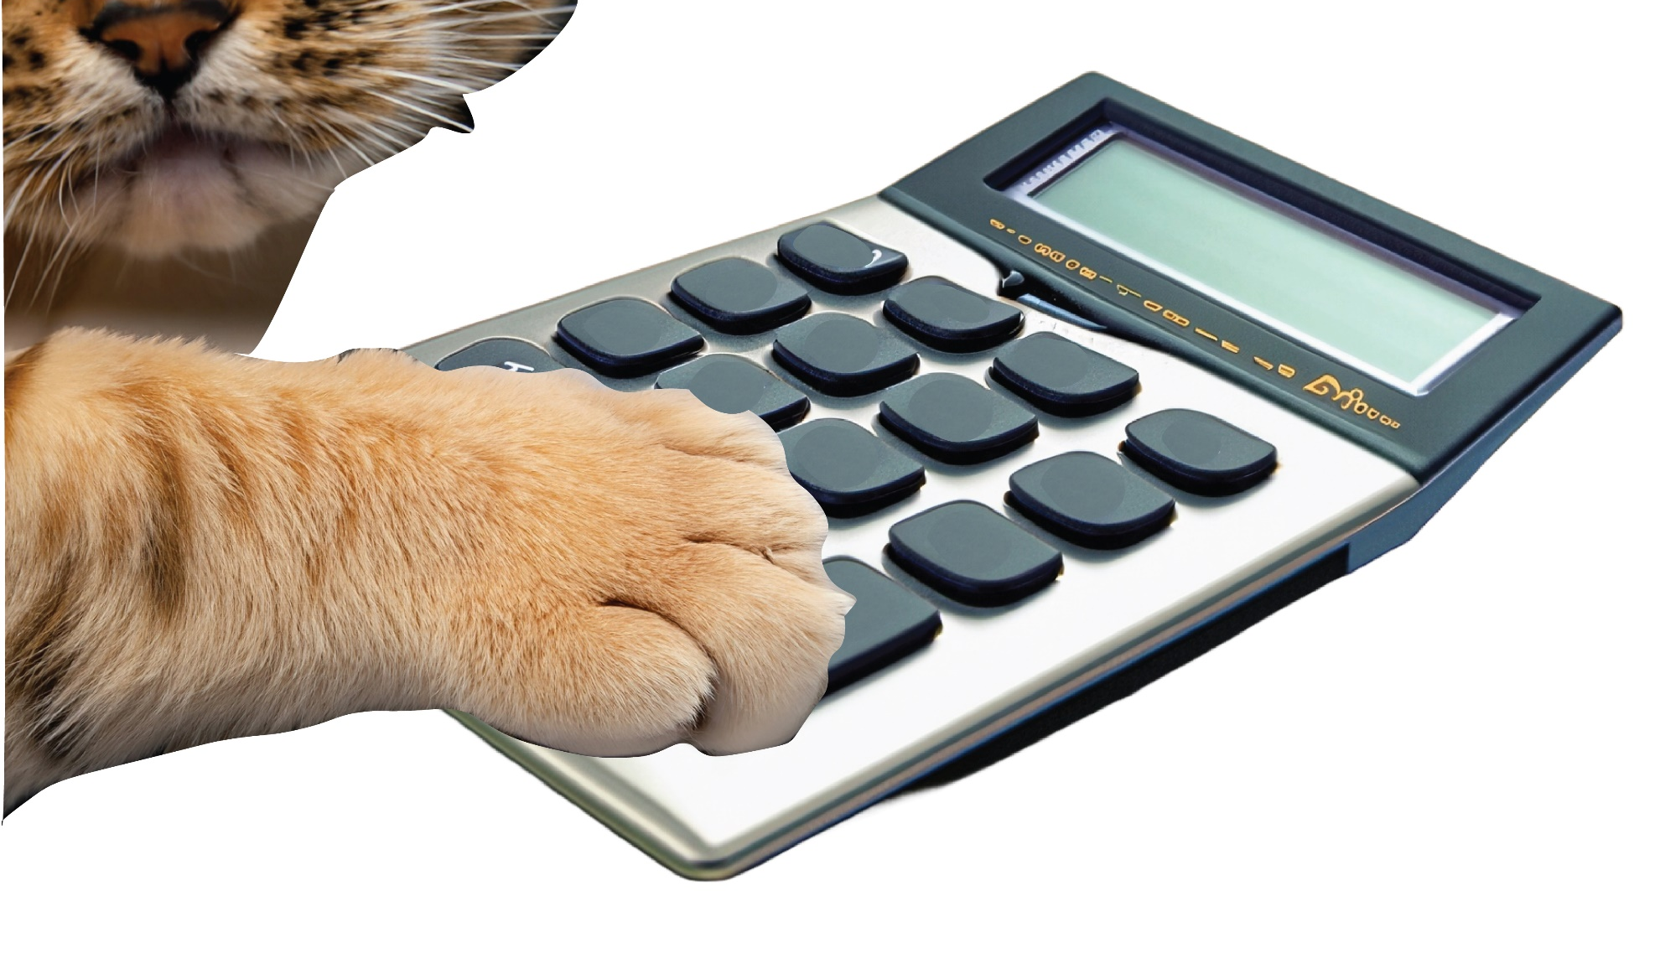
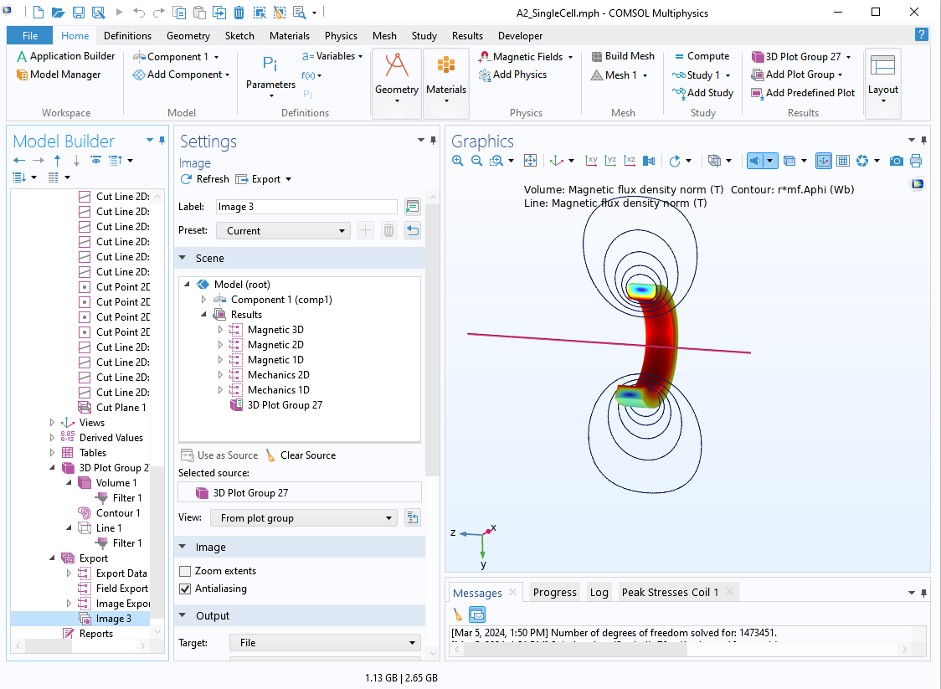











Cell/Coil Parameter Calculator
Full-Cell Calculations:
Stored Magnetic Energy
Total Coil Volume
Single Coil Calculations:
Peak Fields
Stresses
$$B$$
Th
$$L$$
$$R_{i}$$
$$E_{m}$$
$$L_{M}$$
$$F_{z}$$
$$V$$
$$σ_{z}$$
$$B_{z}$$
$$σ_{r}$$
$$σ_{θ}$$
COMSOL
Full-cell stress and field calculations
Limitations: calculation of peak fields and therefore stresses make semi-empirical assumptions and can be inaccurate when coil length is small compared to inner radius (see additional slides)

Slide 20
What to optimize around?
Stored Magnetic Energy
Cost
Stresses

Slide 21
SIMULATIOn Example
Cell B1

Slide 22
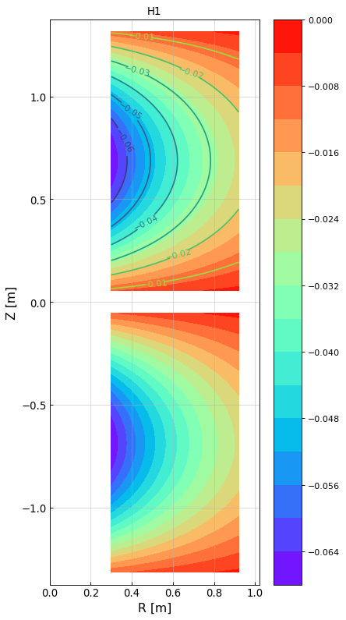
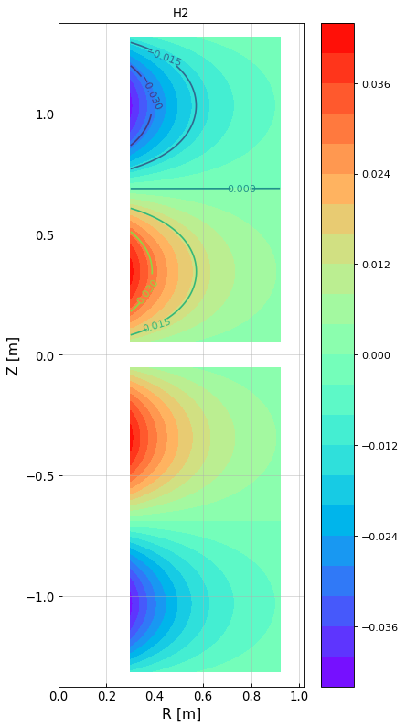
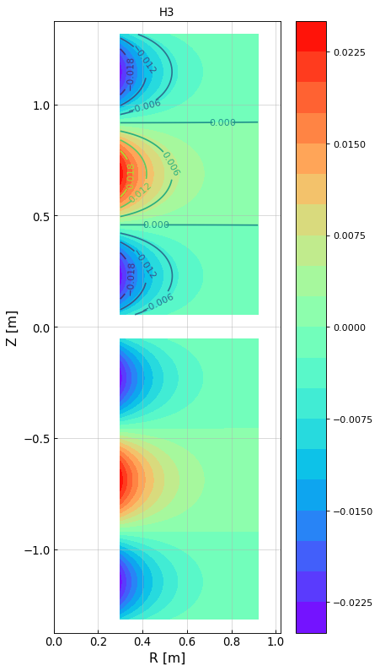
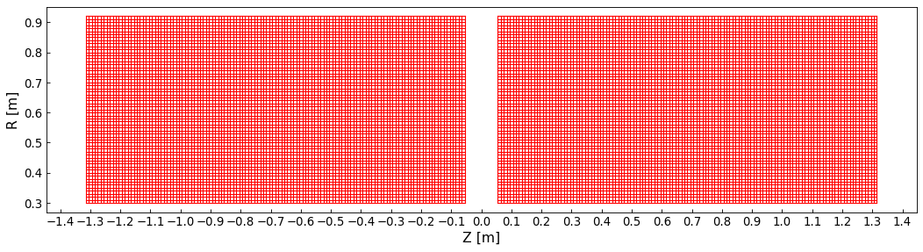
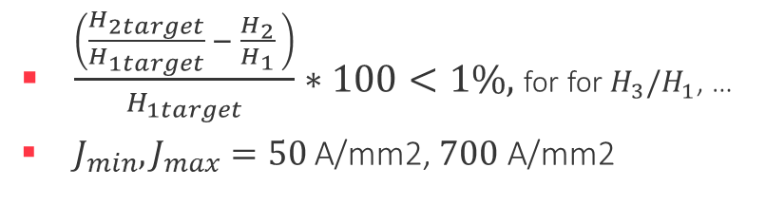

Simulation Example, Cell B1
1. Define your grid
Grid element sizes: dz = 10 mm, dr = 10 mm
Minimum gap between two neighboring coil surfaces = 100 mm
Min $R_{i}=300$mm, Max $R_{f}=920$mm
2. Compute field/ harmonic contribution of each element
3. Generate unique rectangle combinations from grid
B1 Coil
How many unique rectangles can be made from this grid?
  16,386,048
With smart size constraints & 1h later: 5.4 M unique rectangles
4. Filter
$\frac{\left(\frac{H_{2target}}{H_{1target}} − \frac{H_{2}}{H_{1}} \right)}{H_{1target}}∗100<1\%,$for for $H_{3}/H_{1}$, …
$J_{min}, J_{max}=50$A/mm2, $700$ A/mm2
63x127 squares = 8001 tiny squares of current
Number of geometries accepted: 29k

Slide 23
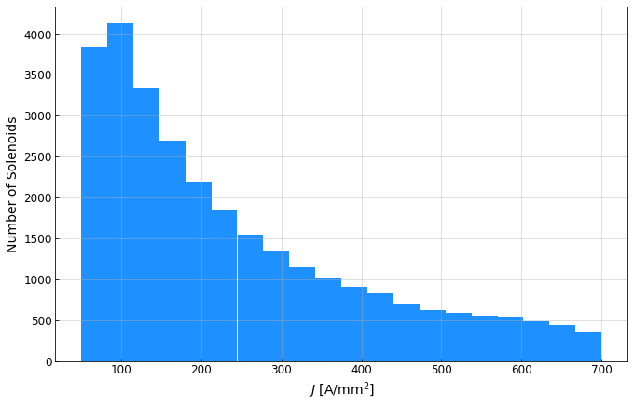
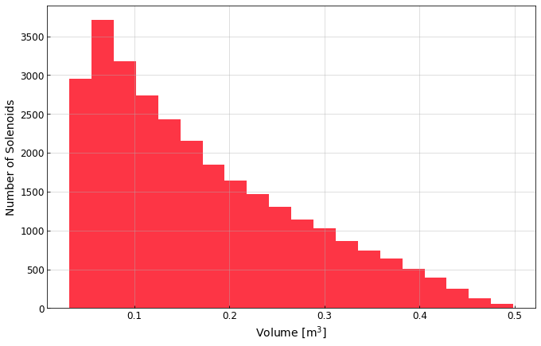
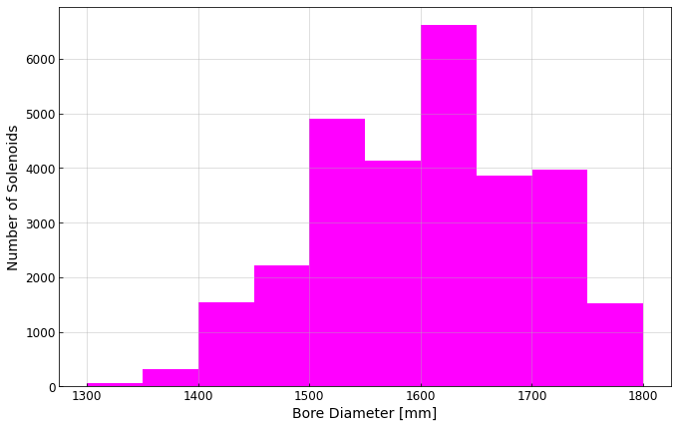
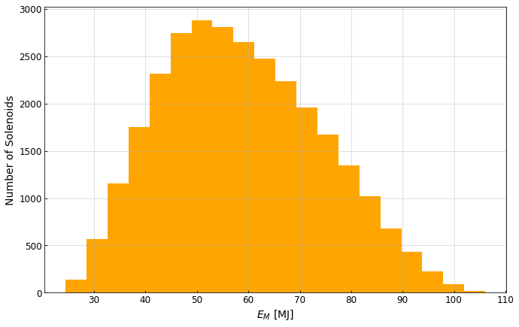
B1 Select Distributions
B1 baseline values
(single coil)
(1 Cell)

Slide 24
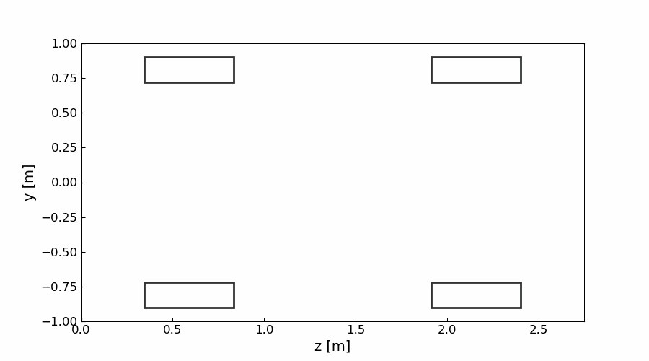

B1 Select Geometries and On-Axis Fields
Select on-axis field from 10 geometries

Slide 25
Results: All US-MAP Cells (in Lattice)

Slide 26


Results
Stored Magnetic Energy
Cost
Stresses
Volume of Coils / Cell
SiCO

Slide 27


Results
Stored Magnetic Energy
Cost
Stresses
Stored Magnetic Energy (1 Cell)
SiCO

Slide 28


Results
Stored Magnetic Energy
Cost
Stresses
Hoop stresses
SiCO

Slide 29




Results
Stored Magnetic Energy
Cost
Stresses
Radial stresses
Tensile
SiCO
Compressive
SiCO

Slide 30




Example: on-axis field and coil geometry comparison using minimum hoop stress solutions
US-MAP
US-MAP + SiCO
US-MAP
SiCO
coil geom
$B_{z}$ on axis
coil geom
$B_{z}$ on axis

Slide 31






New Optics: Initial Optimization of Stage 5 and 10 Analysis
Radial Stress
Volume
$$E_{m}$$
Peak Hoop Stress

Slide 32
Next Steps
Iteration with beam optics
Define allowed parameter ranges (peak stresses, fields), and complexity (more than two solenoids for high field cells? Multiple conductor types?)
Define guideline for initial solenoid creation
Simulation program
More constraints: RF Cavity sizes, structural and cryo space required around a coil
Factor in off-axis field quality
Integrate quench detection considerations

Slide 33
Thank you!

Slide 34



Simulation Study: Analytic Formulas for a Single Coil
Parameter | Parameter | Equation | References /comments
1 | Self Inductance $L$ | $$L= \frac{aN^{2}}{μ_{0}}\left[log\left(\frac{8a}{R}\right) \left(1+\frac{3R^{2}}{16a^{2}}\right) −\left(2+\frac{R^{2}}{{16a}^{2}}\right)\right]$$ | [1] where, $$R=0.2235(a+L)$$
2 | Radial Stress $σ_{r}$ | $σ_{r}$ = $\frac{JBz\left(R_{i},0\right)R_{i}}{α−1}\left[\frac{2+ν}{3}\left(α−κ\right)\left(\frac{α^{2}+α+1 −\frac{α^{2}}{ρ^{2}}}{α+1}−ρ\right)−\frac{3+ν}{8}\left(1−κ\right)\left(α^{2}+1 −\frac{α^{2}}{ρ^{2}}−ρ^{2}\right)\right]$ | [2] and [3]
3 | $$\text{Hoop} \text{Stress} σ_{θ}$$ | $σ_{θ}$ =$\frac{JBz\left(R_{i},0\right)R_{i}}{α−1}\left\{\left(α−κ\right)\left[\frac{2+ν}{3}\left(\frac{α^{2}+α+1+\frac{α^{2}}{ρ^{2}}}{α+1}\right)−\frac{1+2ν}{3}ρ\right]−\left(1−κ\right)\left[\frac{3+ν}{8}\left(α^{2}+1+\frac{α^{2}}{ρ^{2}}\right)−{\frac{1+3ν}{8}ρ}^{2}\right]\right\}$ | [2] and [3]
5 | Peak field at $(r=0, z=0)$of a single ideal coil | $$B_{0}= μ_{0}JR_{i}βln\left[\frac{α+\sqrt{α^{2}+β^{2} }}{1+\sqrt{1+β^{2}}}\right]$$ | [3]
6 | Peak field at inner radius of a single ideal coil | $$B=B_{0}\left[1 −\frac{1}{2}E_{2}\left(α, β\right){\left(\frac{r}{R_{i}}\right)}^{2}+\frac{3}{8}E_{4}\left(α, β\right){\left(\frac{r}{R_{i}}\right)}^{4}−\frac{5}{16}E_{6}\left(α, β\right){\left(\frac{r}{R_{i}}\right)}^{6}+ …\right]$$ | [3]
7 | Mutual Inductance | $$M=μ_{0}\sqrt{a_{1}a_{2}}\left[\left(\frac{2}{k}−k\right)F−\frac{2}{k}E\right]+corrections$$ | [1] Eqs. 1, 29 and 33
$$α=\frac{R_{f}}{R_{i}}, β=\frac{L}{2R_{i}}$$
[1] Rosa, Edward Bennett, and Frederick Warren Grover. Formulas and tables for the calculation of mutual and self-inductance. No. 169. US Government Printing Office, 1948.
[2] Wilson, Martin N. "Superconducting magnets." (1983).
[3] Iwasa, Yukikazu. Case studies in superconducting magnets: design and operational issues. Springer science & business media, 2009.

Slide 35

Technology Options – Table of Stages and Coils

Slide 36




Cell B5
r
141 mm
524 mm
 |  |  | B5
 |  |  | 01 | 02
Input Parameters | Inner Bore Radius | mm | 113 | 217
 | Magnet Thickness | mm | 88 | 165
Geometry | Magnet Length | mm | 100 | 196
 | Current Density | $$A/mm^{2}$$ | 157 | 168
 | Cell Length | m | 0.806
02
01
98 mm
610 mm
z
113 mm
217 mm
100 mm
$88$mm
196 mm
$165$mm
$806$mm

Slide 37



Results Part 1: Characterization of all Coil Types 3/4
Mechanical Properties
(+) Tension
(-) Compression
(-) Compression

Slide 38




Results Part 3: Characterization of all Stages, 1/4
Magnetic Properties – Cells and Lattices
For comparison purposes an LHC dipole stores ~7 MJ
Above 17 T (B5 to B8), highest performance required & difficult for ${Nb}_{3}Sn$

Slide 39

Results Part 3: Characterization of all Stages, 2/4
Mechanical Calculations in Lattices
Maximum and minimum values of hoop stress $σ_{θ}$
Coils with >150MPa will probably require reinforcement
Multi-radius-coil cells (B4-1, B5-1, B6-1, B7-1, B8-1, B8-2): the hoop stress decreases monotonically radially
For all other coils (A1 to B3, B4-2, B5-2, B6-2, B7-2, B8-3): there is a local minimum in hoop stress

Slide 40


Results Part 3: Characterization of all Stages, 2/4
Mechanical Calculations in Lattices
Maximum and minimum values of radial stress $σ_{r}$
Multi-radius-coil cells (B4-1, B5-1, B6-1, B7-1, B8-1, B8-2): tensile saddle-like profile on inner coil. To go towards a compressive stress profile $→$these coils would need to be wound in independent layers!
For all other coils (A1 to B3, B4-2, B5-2, B6-2, B7-2, B8-3): compressive ‘parabolic-like’ profile, with a minimum stress in the center

Slide 41

Results Part 3: Characterization of all Stages, 2/4
Mechanical Calculations in Lattices – Longitudinal Stress
Maximum and minimum values of longitudinal stress $σ_{z}$
As expected, the stresses are all compressive based on the roller positioning

Slide 42

Results Part 3: Characterization of all Stages, 2/4
Mechanical Calculations in Lattices - Forces
A support structure for a 37 MN axial force (3700 tons) will be a design challenge

Slide 43

B1

Slide 44

I. Define grid of tiny coil elements
Example:
Grid element sizes: dz = 10 mm, dr = 10 mm
Minimum gap between two neighboring coil surfaces = 100 mm
Min $R_{i}=300$mm, Max $R_{f}=920$mm
Grid for small coil elements symmetrically placed at opposite polarity
B1 Coil
B1 Coil

Slide 45


I. Harmonic Profile of each Grid Element

Slide 46

II. Rectangle (Coil) Possibilities in the space
How many unique rectangles can be made from this grid?
  16,386,048
Every unique rectangle represents a unique configuration of alternating polarity coils
r
63x127 squares = 8001 tiny squares of current
With imposed constraints:
  $500 mm≥ L≥36$mm
  $195 mm ≥ Th>15$ mm
  $→$1h later: 5.4 M unique rectangles
Examples
z

Slide 47

III. Parse the Geometries
Harmonic Acceptance:
$\frac{\left(\frac{H_{2target}}{H_{1target}} − \frac{H_{2}}{H_{1}} \right)}{H_{1target}}∗100<1\%$
… same for $H_{3}/H_{1}$, $H_{4}/H_{1}$, $H_{5}/H_{1}$
Constraints:
$J_{min}, J_{max}=50$A/mm2, $700$ A/mm2
Number of geometries accepted: 29k

