Slide 1
MuCool RF R&D for Muon Ionization Cooling
Katsuya Yonehara
IMCC Collaboration Meeting
3/14/2024

Slide 2
RF parameter for ionization cooling
High accelerating gradient RF cavities immersed into strong magnetic fields for muon ionization cooling
  Peak RF gradient: > 20 MV/m
  RF frequency range: 200 – 1,300 MHz
  Magnetic field strength: 2 – 15 Tesla

Slide 3
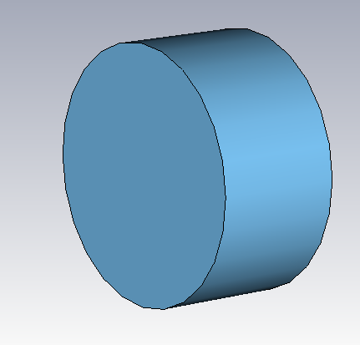
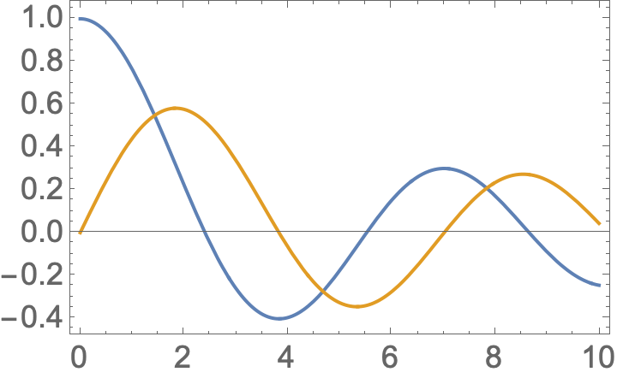
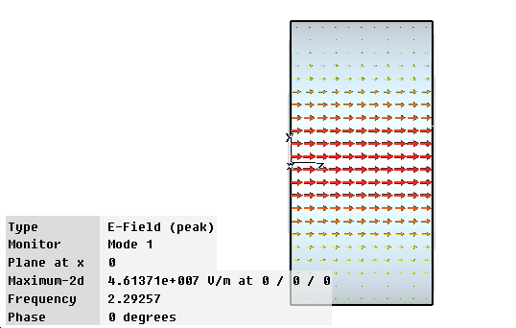



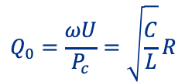

Fundamental for Pillbox RF cavity
Commonly use Pillbox RF cavity model in cooling simulation
For lowest resonance mode TM₀₁₀
Cutoff frequency
$$J_{m}\left(k_{t}r\right)$$
$$\frac{ω}{c}R=2.405$$
$$m=0$$
Q factor
$$m=1$$
$$Q_{0}=\frac{ωU}{P_{c}}=\sqrt{\frac{C}{L}}R$$

Slide 4
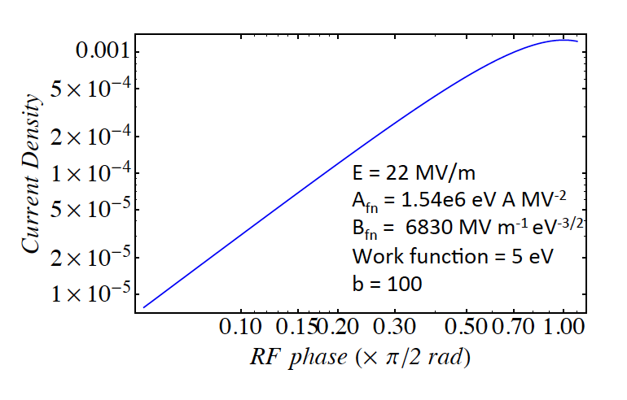


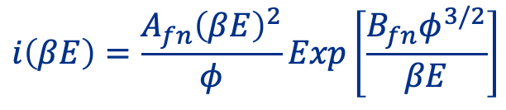



Surface emission electron (BD Model Step 1)
Surface emission electron current density (Fowler-Noldheim formula)
$$E(t)$$
$$i\left(βE\right)=\frac{A_{fn}{\left(βE\right)}^{2}}{φ}Exp\left[\frac{B_{fn}φ^{3/2}}{βE}\right]$$
$$e^{−}$$
$β$: field enhancement factor (see next slide)
$φ$: Work function
$A_{fn}, B_{fn}:$ FN Coefficients
FN formula is based on a tunneling effect
External E field changes the surface potential

Slide 5
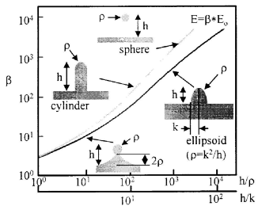

Field enhancement (BD Model Step 2)
Field enhancement factor β vs. Asperity shape
$$E(t)$$
$$e^{−}$$
Asperity
(scale is typically μm)
Current flow in conductor
Current flow in conductor is enhanced at the asperity which induces stronger magnetic field → electric field
Local flow increases temperature of the asperity
Therefore, asperity grows with the number of RF cycles

Slide 6
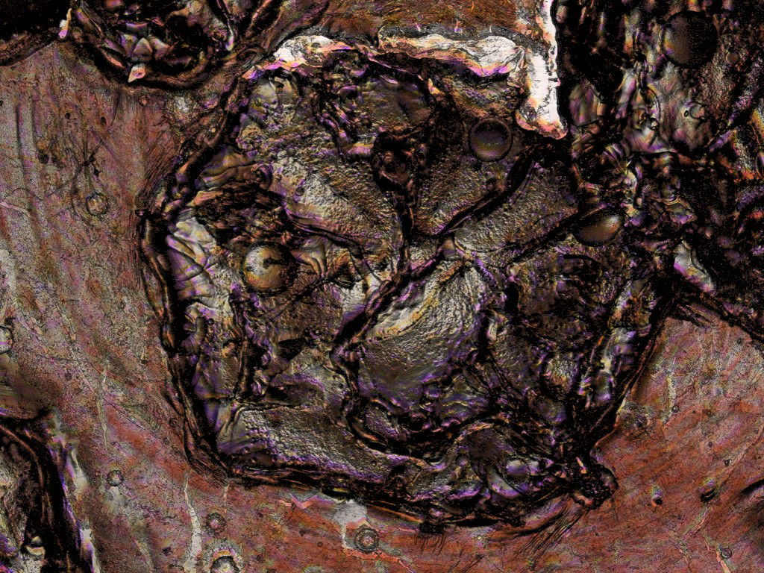

Magnetic Field enhancing BD (BD Model Step 3)
Surface electrons are accelerated by RF electric fields and bound by an external static magnetic field (Larmor motion)
The current density becomes high with strong B and high E
High energy electrons hit on other end of cavity wall and heat the wall by energy deposition
$$B$$
$$E(t)$$
Energy deposition
> 10 J/mm²
Heated by electrons
The heated wall becomes soft and is deformed by Lorentz force → Forming new asperity → Catastrophic process
Image of breakdown damage

Slide 7
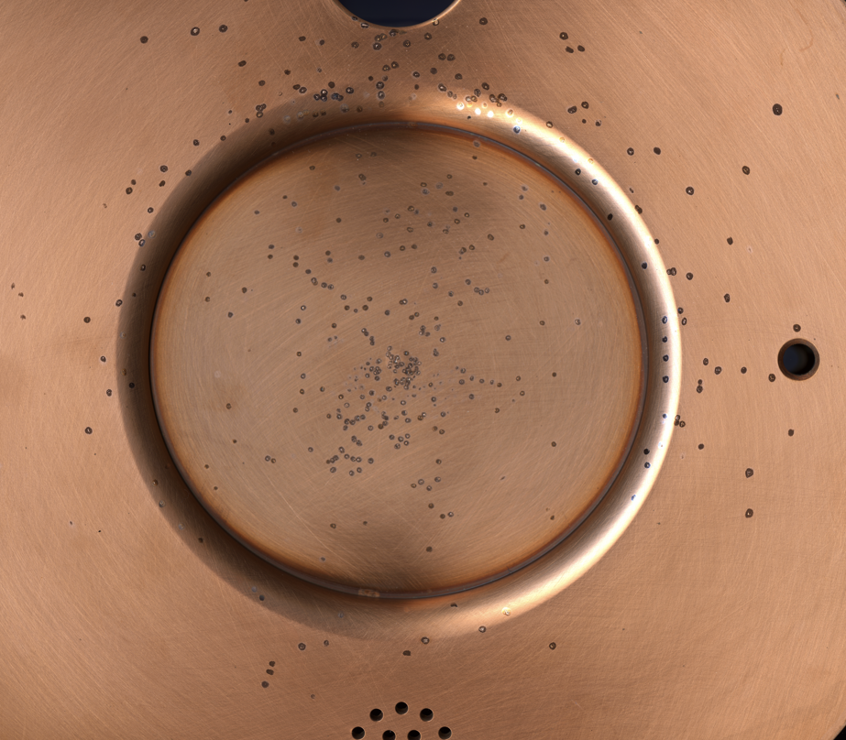
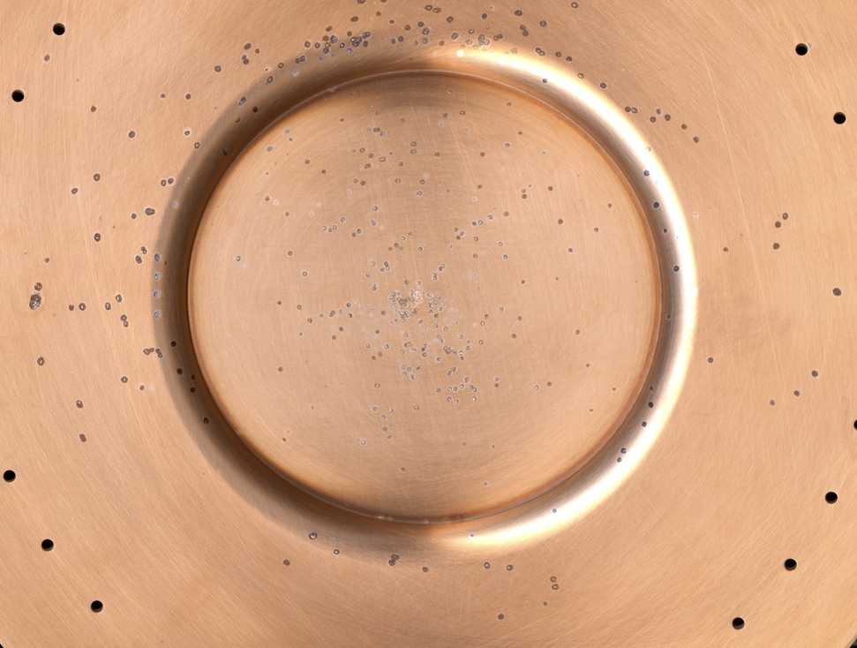
Map of breakdown damage on cavity wall
All season cavity (805 MHz): Copper plates for this analysis
63.5 mm
Upstream wall
Downstream wall
Expect that BD damages on both walls must be a mirror image if the catastrophic process happens

Slide 8
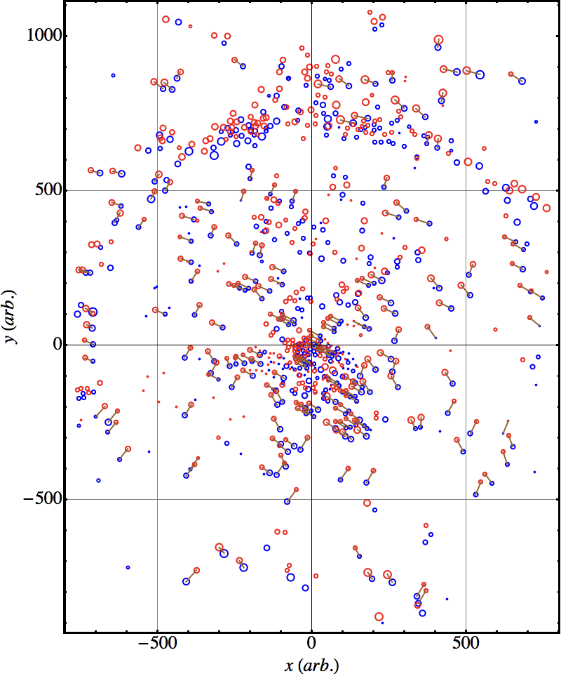


Image analysis by using all season cavity
Red: Damage point on upstream wall
Blue: Damage point on downstream wall
This is the first damage analysis to observe the position correlation between the upstream and downstream cavity walls
Correlations are clearly seen
We also noticed that there are two specific orientations, one is around 60 degrees and other one is 150 degrees
$$60°$$
$$150°$$

Slide 9
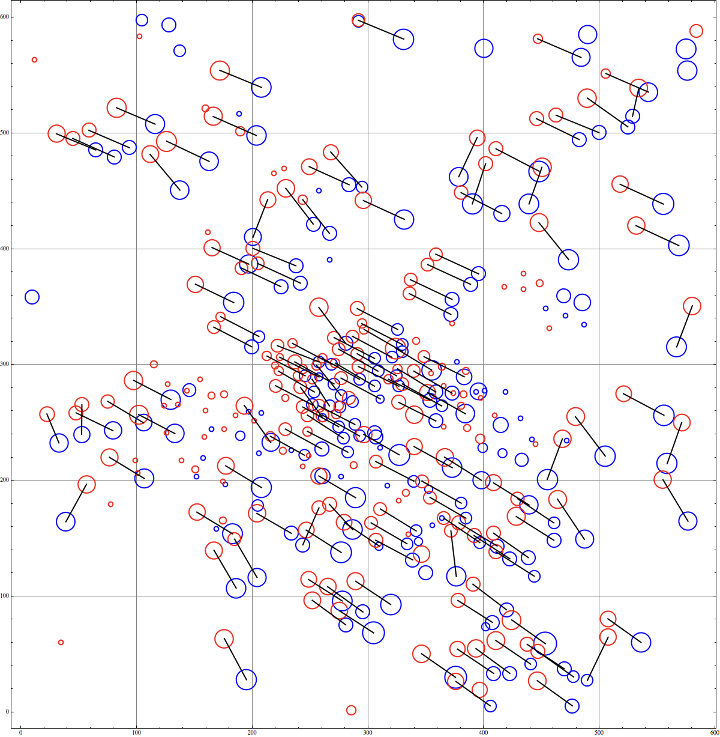
Enlarged image
Around the cavity axial center
150 degrees orientation becomes more events than 60 degrees
The cavity was powered and several breakdowns were induced without magnetic fields
Static B field applied and many breakdowns were induced
Probably, 150 degree events were created with B field and 60 degrees events were created without B field
No further analysis was done
30.11 mm
-28.96 mm
28.96 mm
-30.11 mm

Slide 10
Proposed solutions to mitigate B focusing effect
Apply RF field across the static magnetic field (magnetic insulation)
  805 MHz box cavity
Special surface treat (common clean method for SRF cavity)
  201 MHz MICE cavity
Use low Z and high yield stress material
  805 MHz modular cavity
Fill hydrogen gas
  805 MHz Hydrogen gas filled cavity

Slide 11
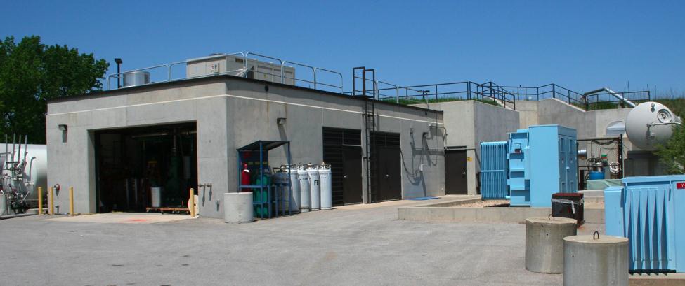
Mucool Test Area
RF power stations (13 MW at 805 MHz, 4.5 MW at 201 MHz)
Superconducting solenoid magnet (up to 3 Tesla for the latest RF breakdown test)
Cryogenic plant
400 MeV proton beam
Allow flammable gas operation

Slide 12
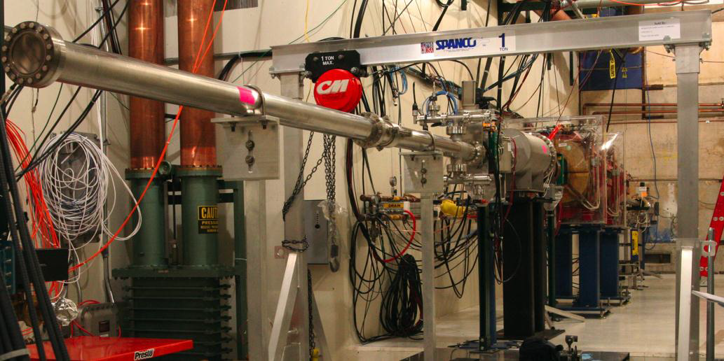
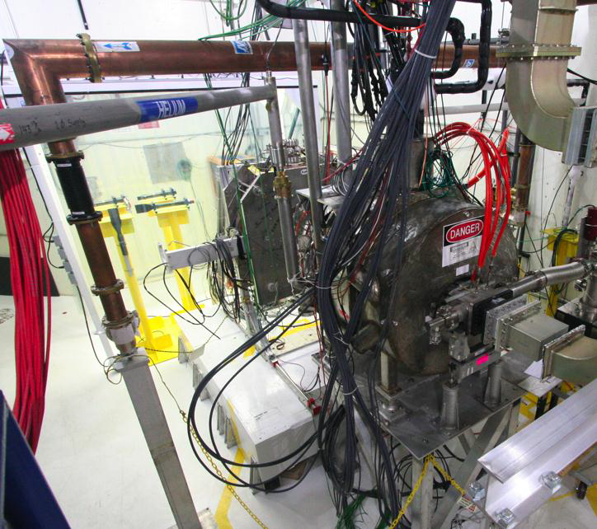
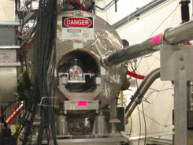
MTA Hall
400 MeV Proton beam line
201 MHz MICE cavity
3-Tesla solenoid
3-Tesla solenoid

Slide 13
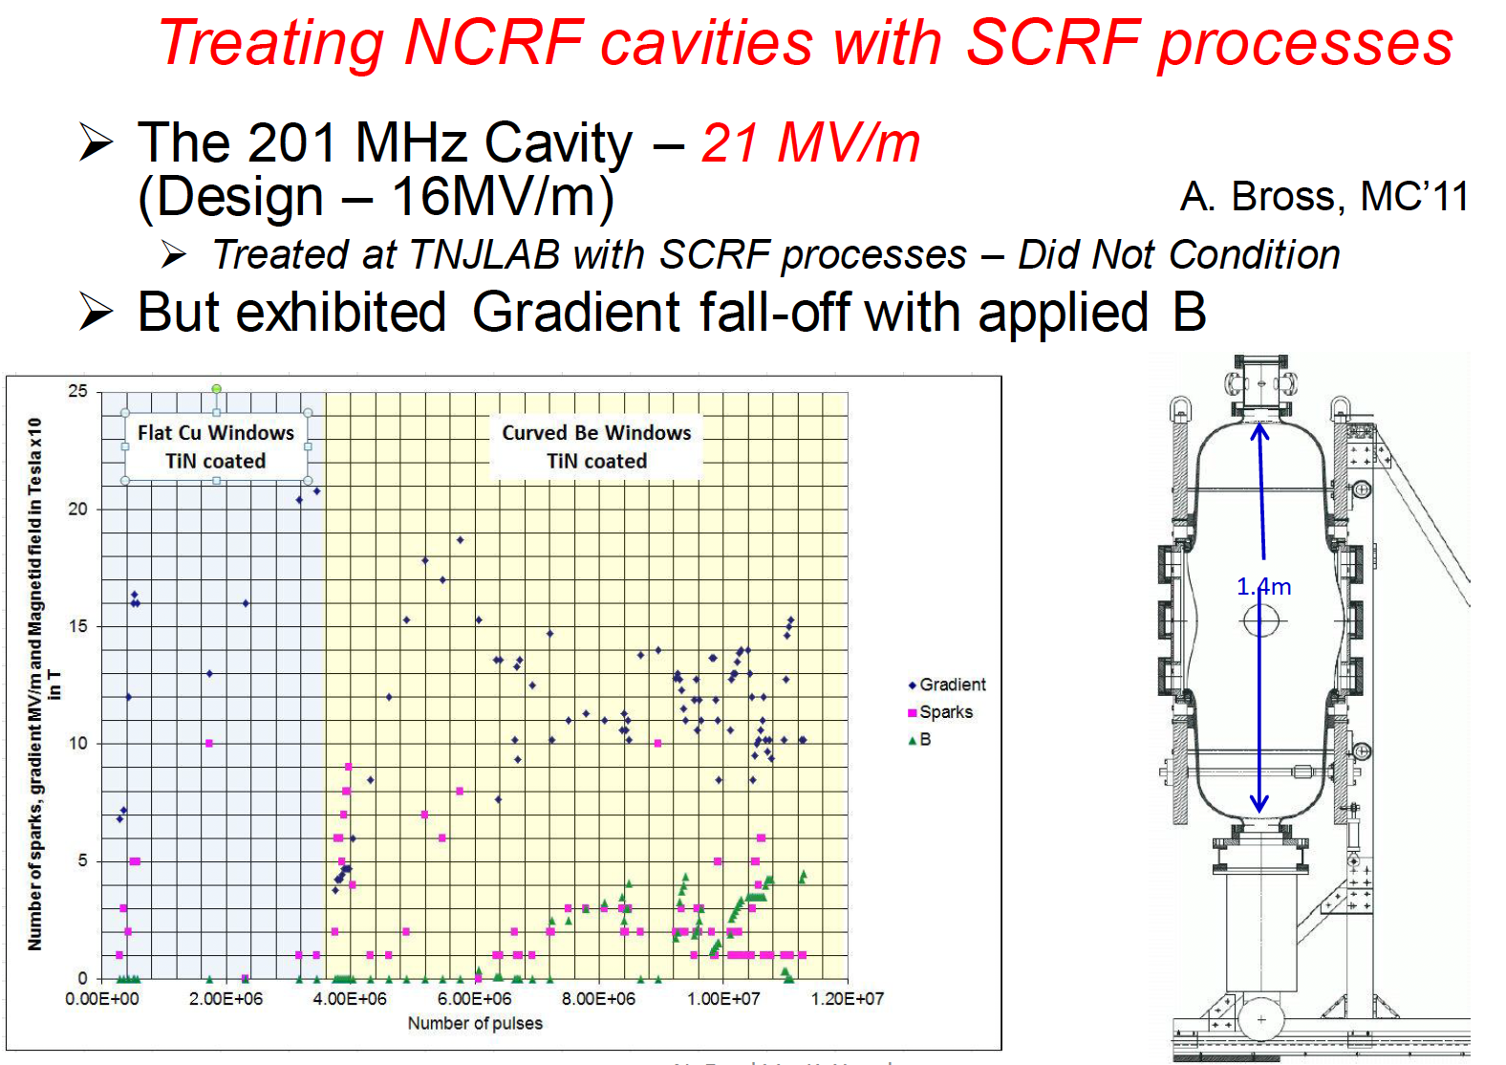
Testing MICE 201 MHz cavity

Slide 14
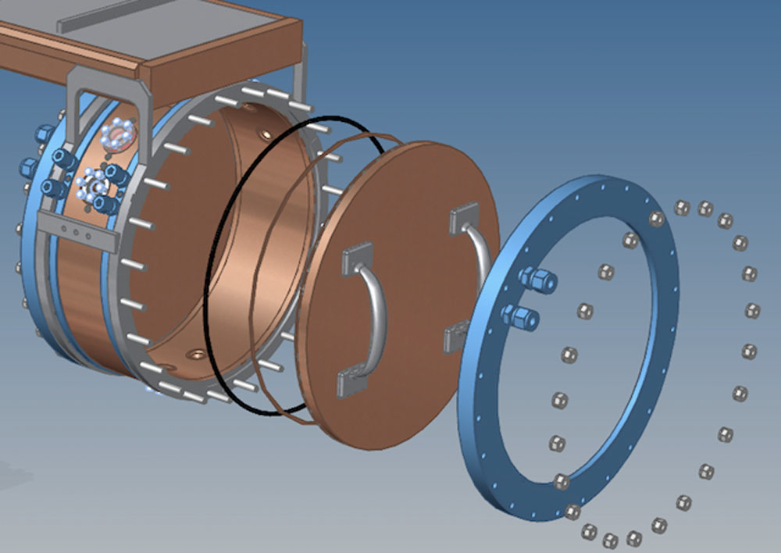
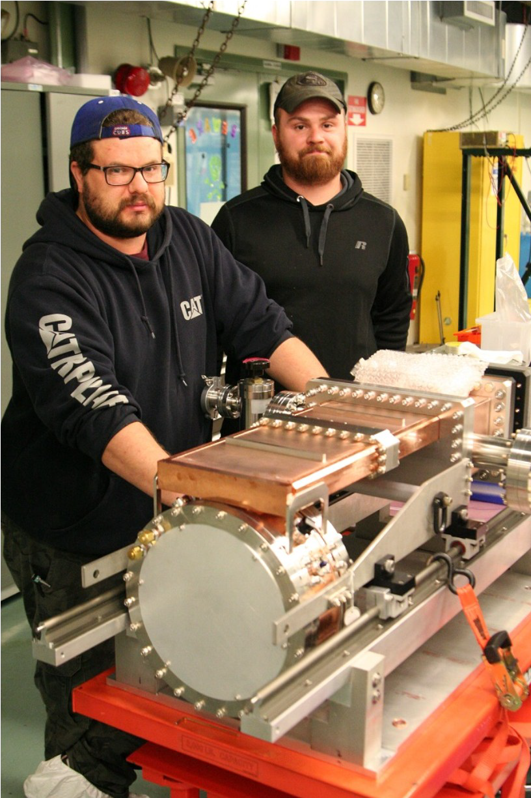
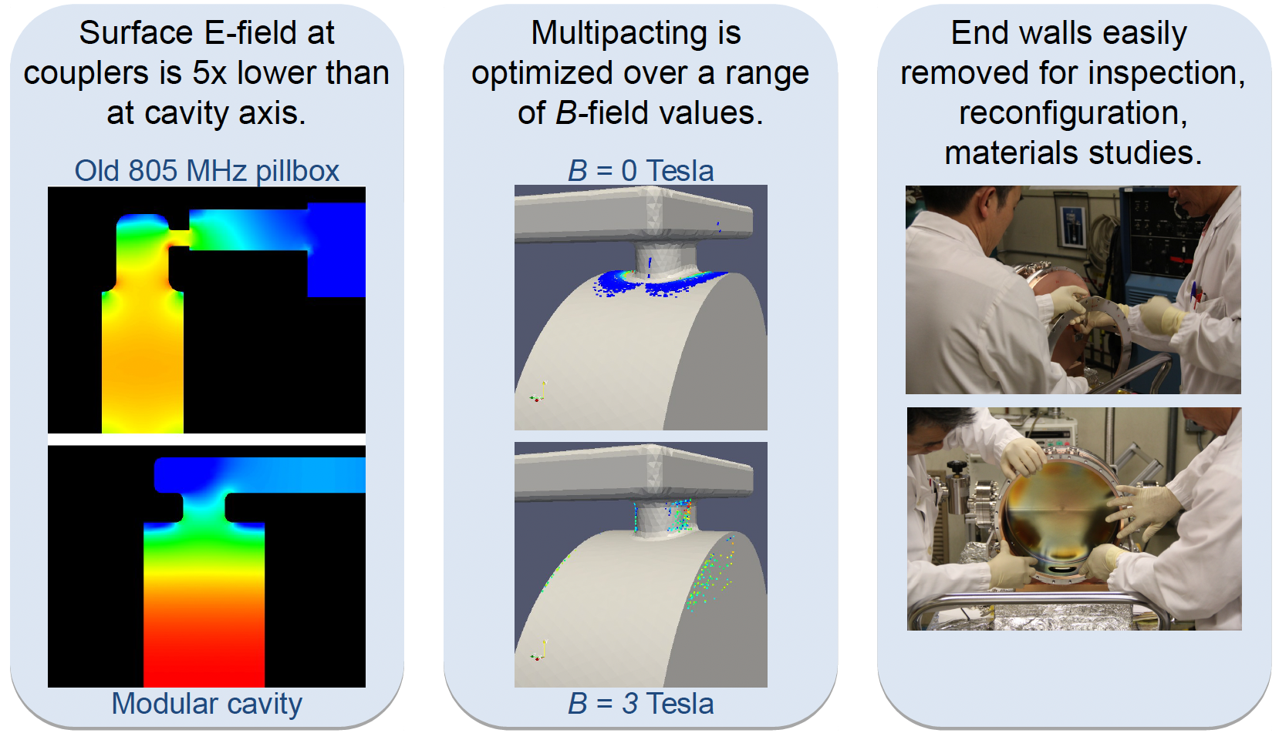
805 MHz Modular Cavity
Cavity walls are replaceable
  Copper and Beryllium were tested

Slide 15
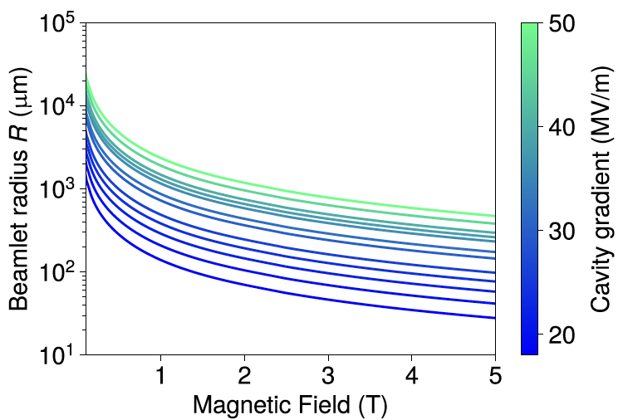
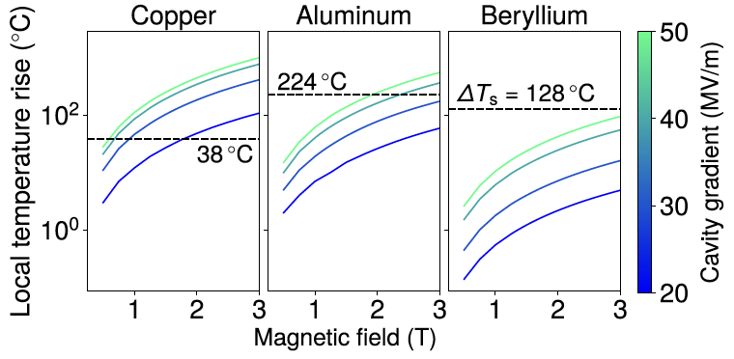
Expected operational peak RF in magnetic fields
Simulated beamlet radius as functions of E and B
Smaller beamlet → Higher edep
Simulated temperature increment as functions of E and B
Horizontal value is the expected plastic deformation temperature

Slide 16
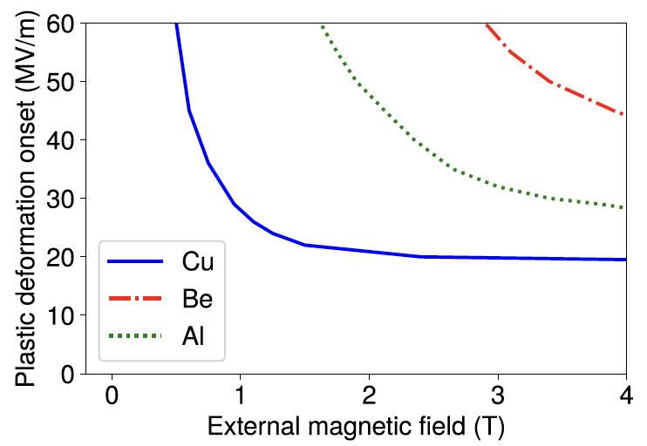
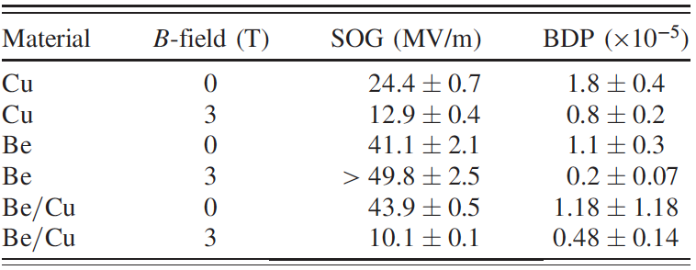
Prediction vs Measurement
Solid curve: Prediction
Circle: Measurement value (no error bar)
Table shows the measurement
Note that the cavity was not sufficiently conditioning at zero field to avoid extra damage due to breakdown
Nevertheless, Be wall shows high safe operational gradient (SOG)

Slide 17
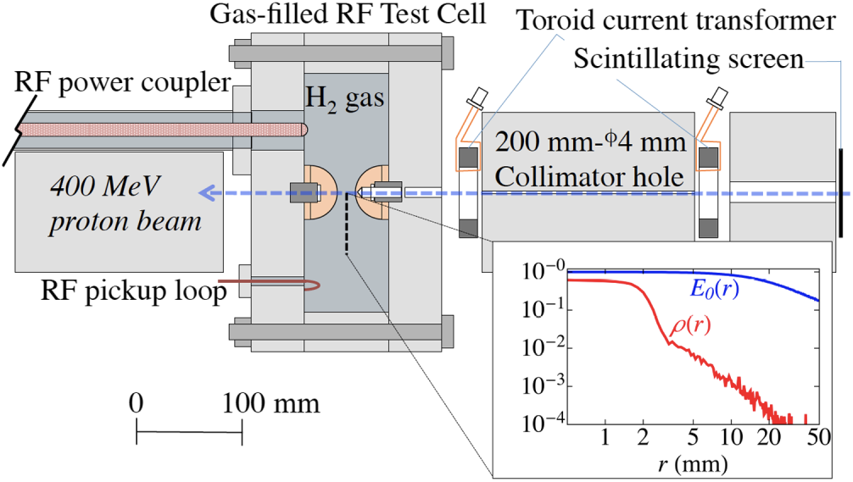
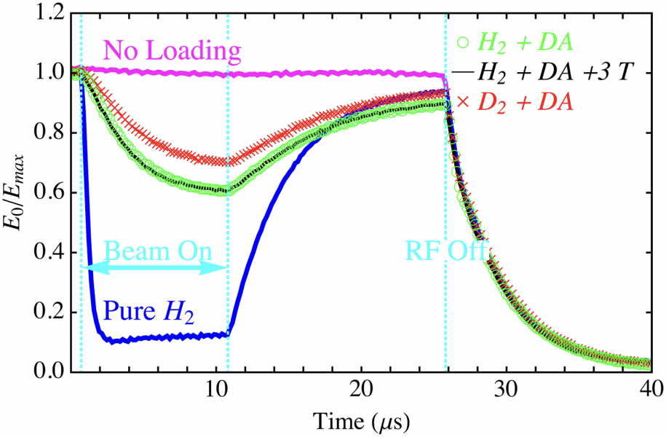
805 MHz H Gas Filled RF Test
Hydrogen gas
  Room temperature
  Up to 100 atm
Proton beam
  K = 400 MeV
  Bunch length: 10 μs
  Bunch gap: 5 ns
  Proton intensity: 10¹²
Observed RF envelope
Magenta: No Beam, 3-T is on
Blue: Pure H2, 3-T is on
Green: H2+Dry Air, no B field
Black: H2+Dry Air, 3-T is on
Red: D2+Dry Air, 3-T is on

Slide 18
Gas plasma measurements
Gas-plasma dynamics predicts the measurement very well
  Gas density effect
  Plasma chemistry including electronegative
RF power deposition in plasma can be estimated accurately
  Head-Tail beam dynamics needs to be simulated
Collective effect in gas plasma
  Muon beam charge neutralization in gas cavities is predicted
  Plasma focusing is induced, which needs to be investigated

Slide 19
Summary
Breakdown model works well
  Most test cavities showed improvement
    However, prediction is not perfect
    So, we are still missing some processes
Programs were physics rich
  Many PhD programs
Remaining
  Modular cavity test
    Material dependence
    Magnetic field dependence
    Frequency dependence
  Gas filled cavity test
    Test using a real pillbox cavity
    Study Beam-Gas-Plasma dynamics

