Slide 1


Slide 2

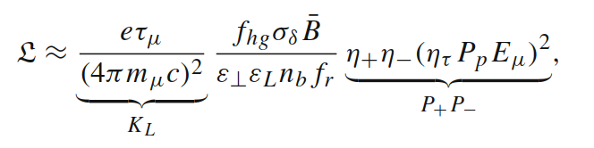
Initial Target Parameters
Parameter | Unit | 3 TeV | 10 TeV | 14 TeV
L | 10³⁴ cm⁻²s⁻¹ | 1.8 | 20 | 40
N | 10¹² | 2.2 | 1.8 | 1.8
f_{r} | Hz | 5 | 5 | 5
P_{beam} | MW | 5.3 | 14.4 | 20
C | km | 4.5 | 10 | 14
<B> | T | 7 | 10.5 | 10.5
ε_{L} | MeV m | 7.5 | 7.5 | 7.5
σ_{E} / E | % | 0.1 | 0.1 | 0.1
σ_{z} | mm | 5 | 1.5 | 1.07
β | mm | 5 | 1.5 | 1.07
ε | μm | 25 | 25 | 25
σ_{x,y} | μm | 3.0 | 0.9 | 0.63
CLIC at 3 TeV
Target integrated luminosities
Note: currently focus on 10 TeV, also explore 3 TeV
Tentative parameters based on MAP study, might add margins
Achieve goal in 5 years
FCC-hh to operate for 25 years
Aim to have two detectors
2 (6)
28
2

Slide 3
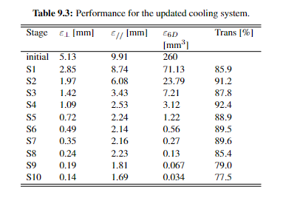
Rectilinear cooling

Slide 4
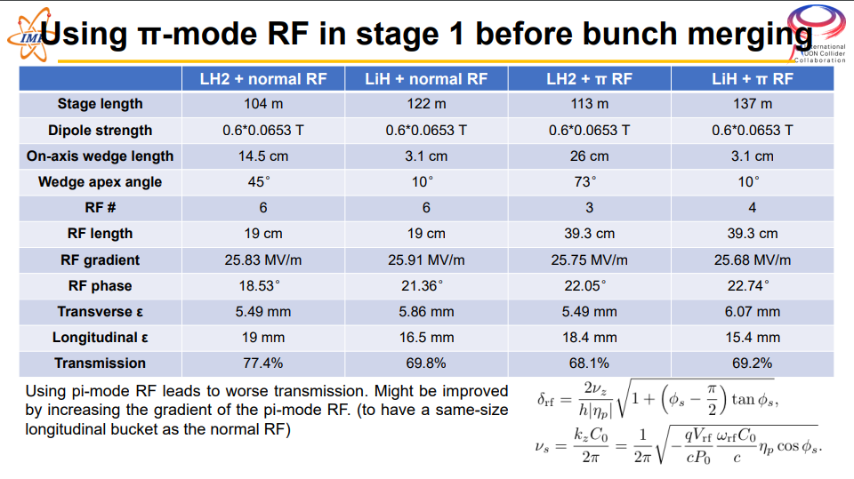

Slide 5




Geometry of the cavity
$$\vec{B}$$
$$\vec{B}$$
$$\vec{B}$$
max
surface 1
surface 2
surface 1
surface 2
$$E$$
min
surface 1
surface 2
Elliptical.
Smaller emitting area.
Asymmetrical
Electrons are emitted by the high E field area of surface 1… and do not hit the high E field area of surface 2.
Pillbox. Large emitting area.
Electrons are emitted by the high E field area of surface 1… and hit the high E field area of surface 2.

Slide 6
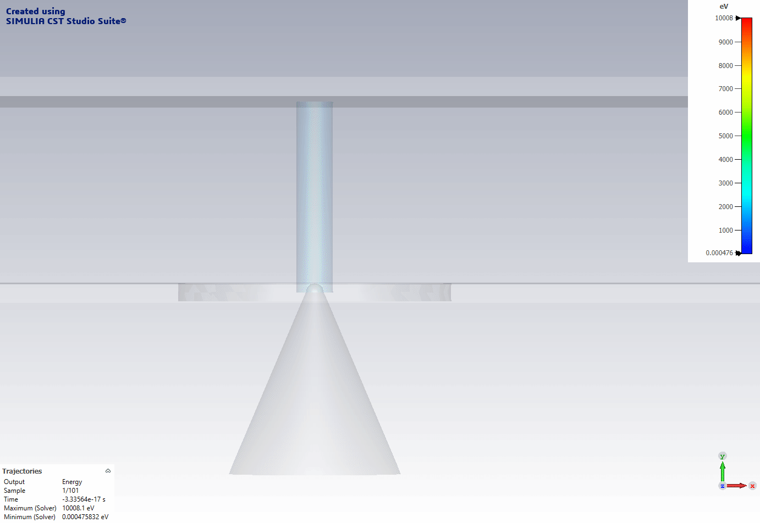
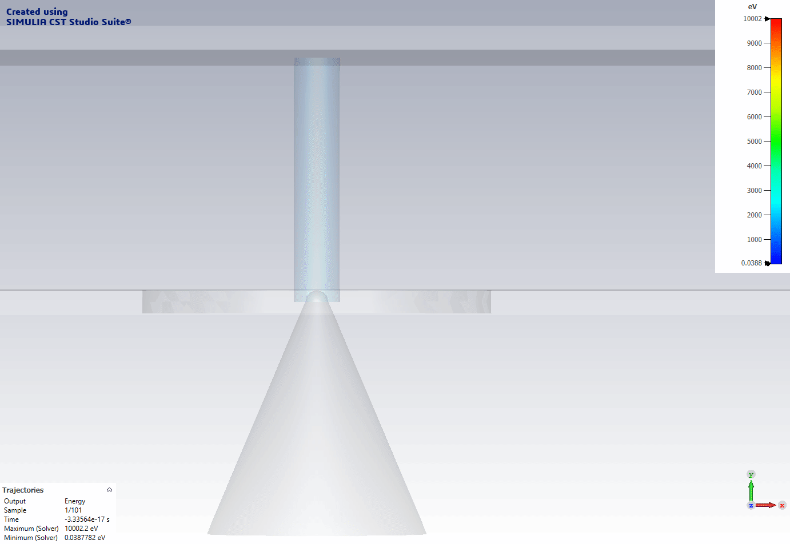
Simulation between two close plates with CST.
No magnetic field
With magnetic field
B field

Slide 7
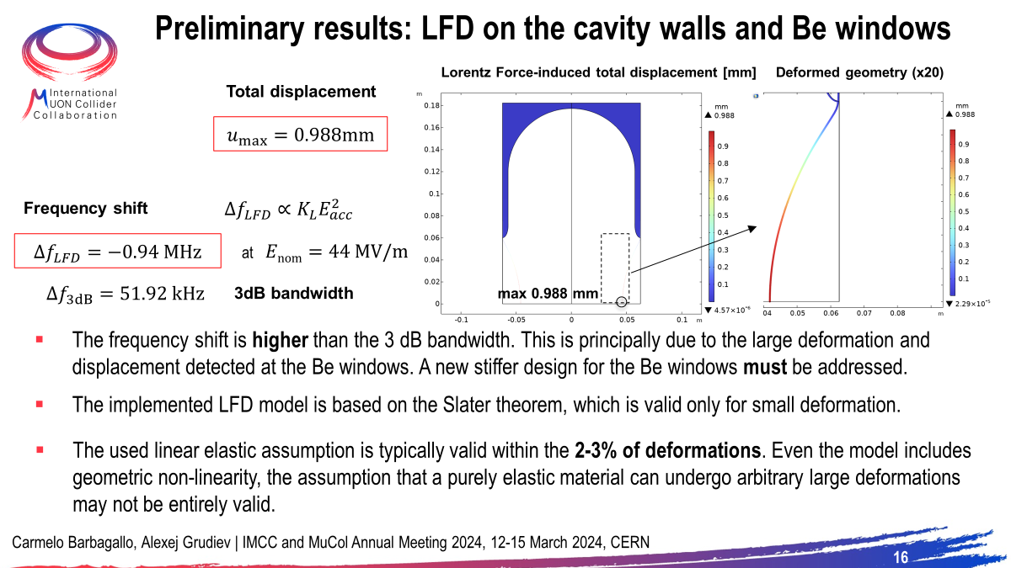

Slide 8
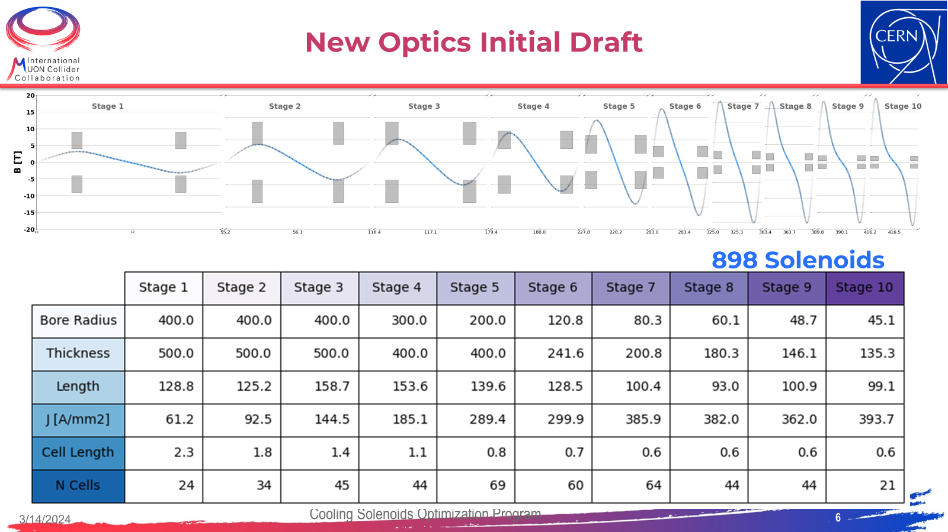

Slide 9
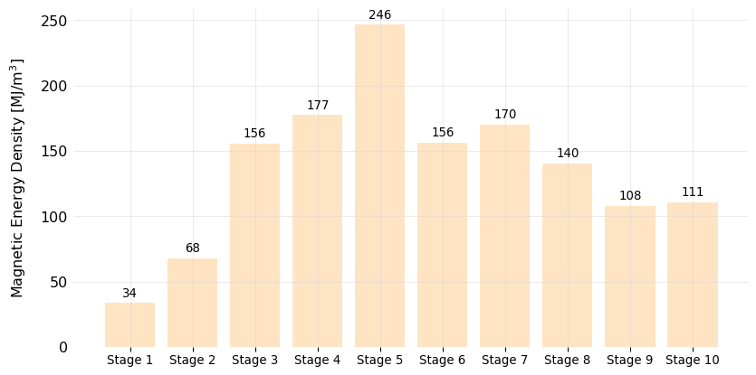
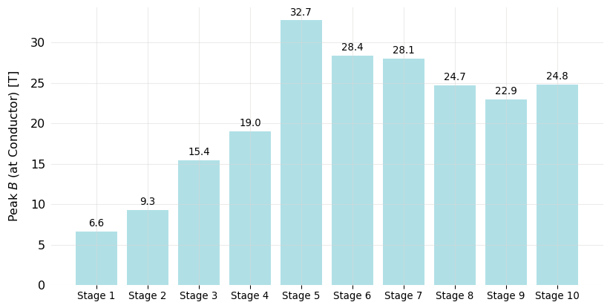
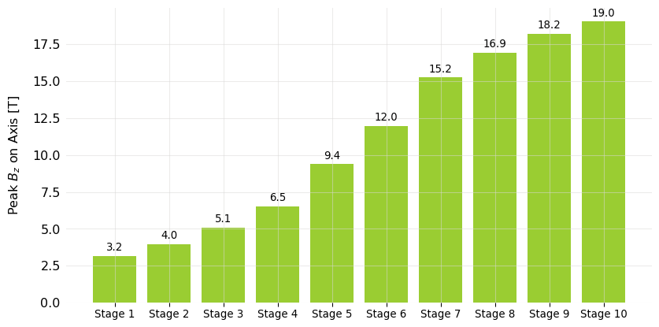


New Optics: Magnetic Properties (Lattices)
100 MJ/$m^{3}$ typical HiLumi magnets
US-MAP maximum
Above 17 T ${Nb}_{3}Sn$ no longer convenient $→$HTS solution
US-MAP maximum
US-MAP maximum

Slide 10
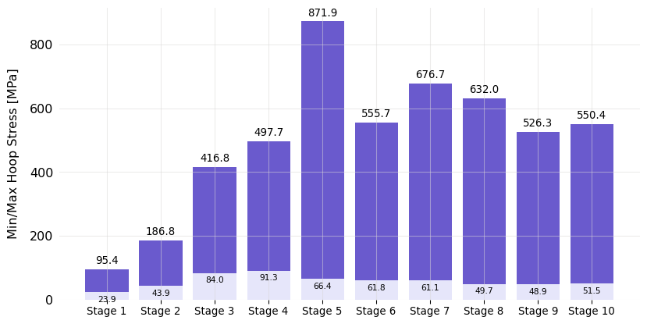
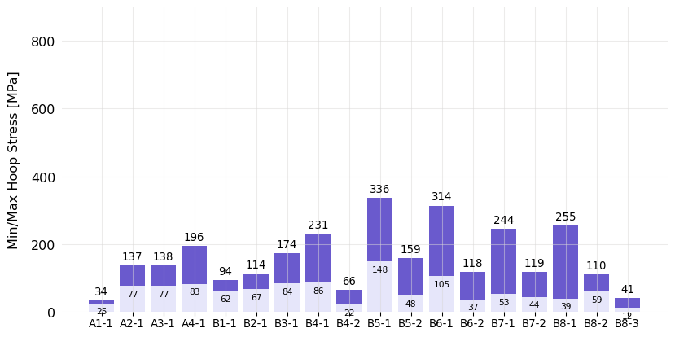
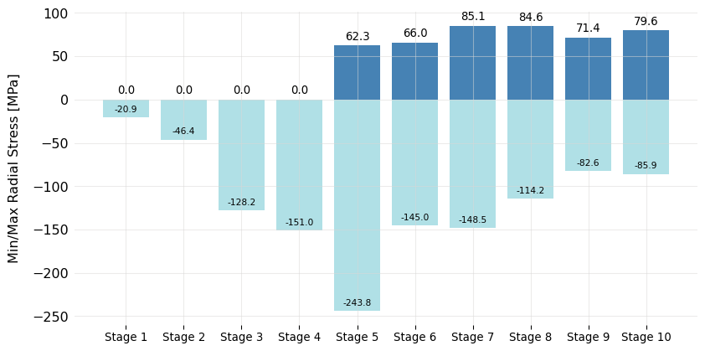
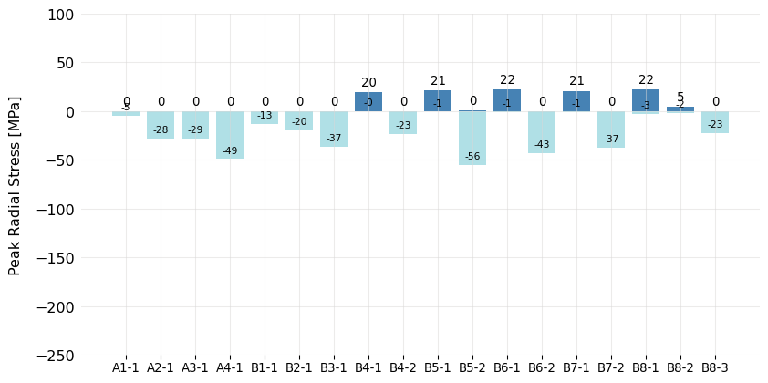

New Optics: Mechanical Calculations (Lattices)
300 MPa hoop stress is current limit for FC solenoid, corresponds to peak $\sim$600 MPa in SS/alloy part of conductor
US-MAP
US-MAP

