Slide 1

Target System
IMCC and MuCol Annual Meeting 2024
12-15 March 2024, CERN
Rui Franqueira Ximenes | CERN-SY-STI-TCD
rui.Franqueira.Ximenes@cern.ch
M. Calviani, D. Calzolari, A. Lechner, F. Saura, J. Manczak, C. Mucher et al
CERN – Systems Department, Sources Targets Interaction (STI), Targets Collimators Dumps (TCD)

Slide 2
Content
Target studies
Carbon Target system overview & status update
  C-Target
  P+ Beam Window
  Target Shielding
Conclusions and prospects

Slide 3
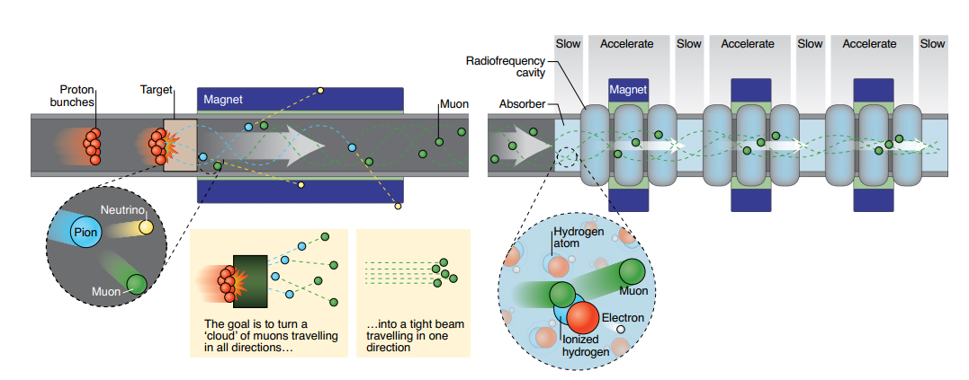
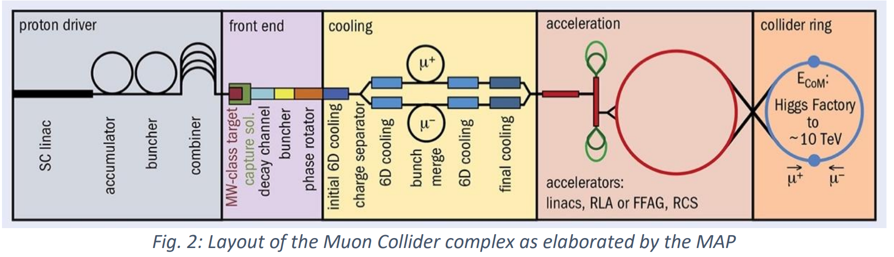
Target system
WP4.2 - Target system development
Establish a baseline target
Identify technological limits and R&D.
Define a system conceptual design
Estimate pion yield, target lifetime, heat load on the surrounding magnets.
Define the required shielding and associated magnet aperture

Slide 4
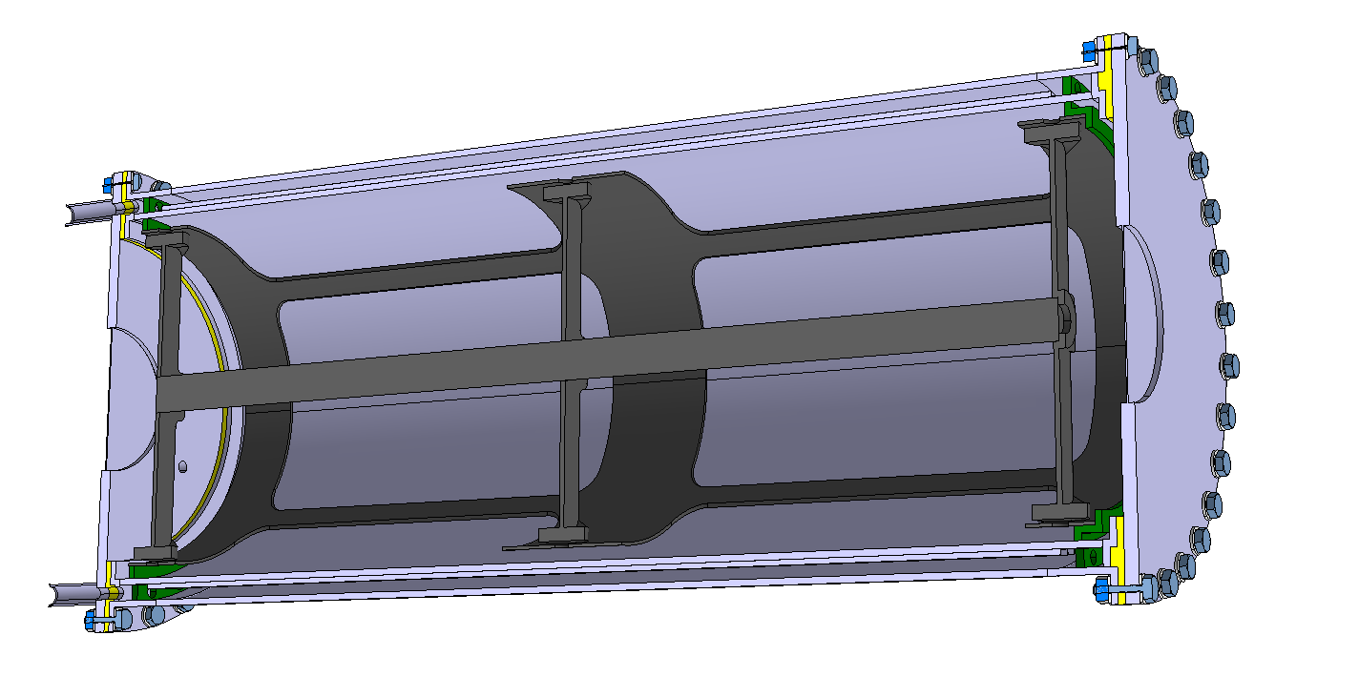
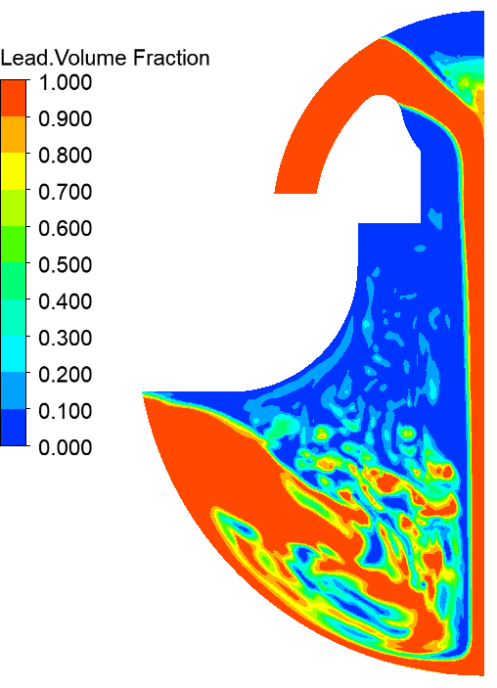
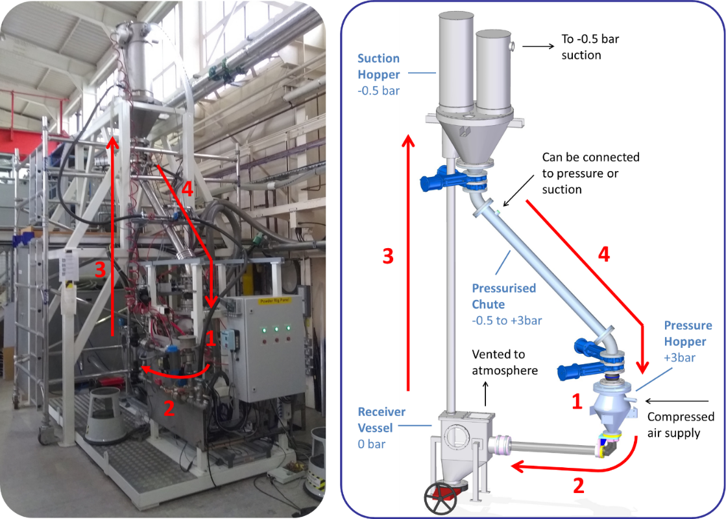
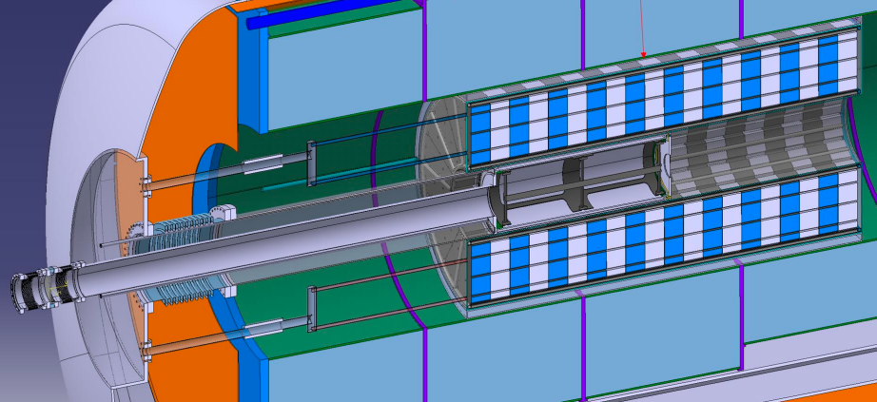
Targetry options
CERN leading C-Target system studies & liquid-Pb option with ENEA. RAL & Warwick University leading fluidized W option.
C-Target & target system
CERN
Liquid Pb Target
ENEA & CERN
Fluidized W-Target
RAL & Warwick Uni.
R. F. Ximenes, M. Calviani, D. Calzolari, A. Lechner, F. Saura, J. Manczak, C. Mucher et al
C. Carrelli, M. Tarantino, I.Di Piazza, P.C. Puviani et al.
C. Densham, J.J. Back, W. Bishop, D. Wilcox, et al.

Slide 5
Targetry options
Pb-Liquid Target
Opportunities
Known liquid-Pb / LBE thermo-hydraulics
Cooling outside vacuum chamber.
Radioisotopes mostly retained.
No degradation of target material.
Synergies between different projects at CERN such as FCCee.
Challenges
Liquid-Pb containment vessel and windows (material, temperatures, DPA).
MHD interaction.
Cavitation-induced erosion.
Temperature and dynamic effects.
Dynamic multi-phase flow simulation complexity
Conceptual designs
Pipe flow.
Vertical curtain.
Jet stream.
C. Carrelli, M. Tarantino, I.Di Piazza, P.C. Puviani et al.

Slide 6
Targetry options
W-Fluidized Target
Advantages
No cavitation, corrosion, radiochemistry damage.
High thermal-shock resistance.
Heat removal.
Challenges
Erosion management & powder handling.
Reduced experience in operational facilities
Offline tests at RAL & HiRadMat beam test
Test rig built and operated at Rutherford Appleton Laboratory from 2009-2018
C. Densham, J.J. Back, W. Bishop, D. Wilcox, et al.
Response of various size spherical tungsten particles to 2x10¹¹ p+ at HiRadMat (CERN)

Slide 7
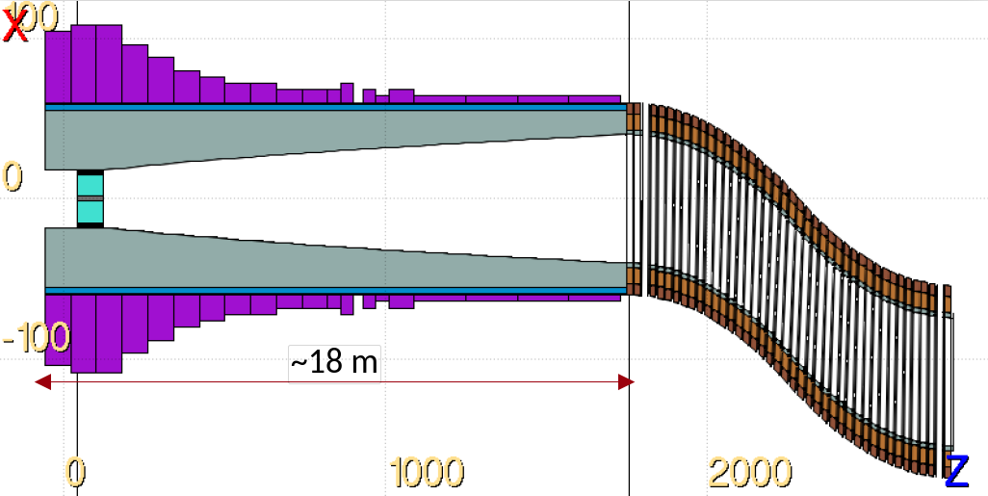
Carbon target
& target systems considerations
  Energy deposition & dpa studies on the Target, windows, shielding, magnets, chicane
  Parameterization study in view of pion/muon yield optimization
  Conceptual Engineering study of Target & Target Systems, shielding, p+ dump -> feasibility
  ++ iteration loops with p+ driver, magnets, cooling
Production target
Eventually p+ dump
Chicane
Tapering region

Slide 8
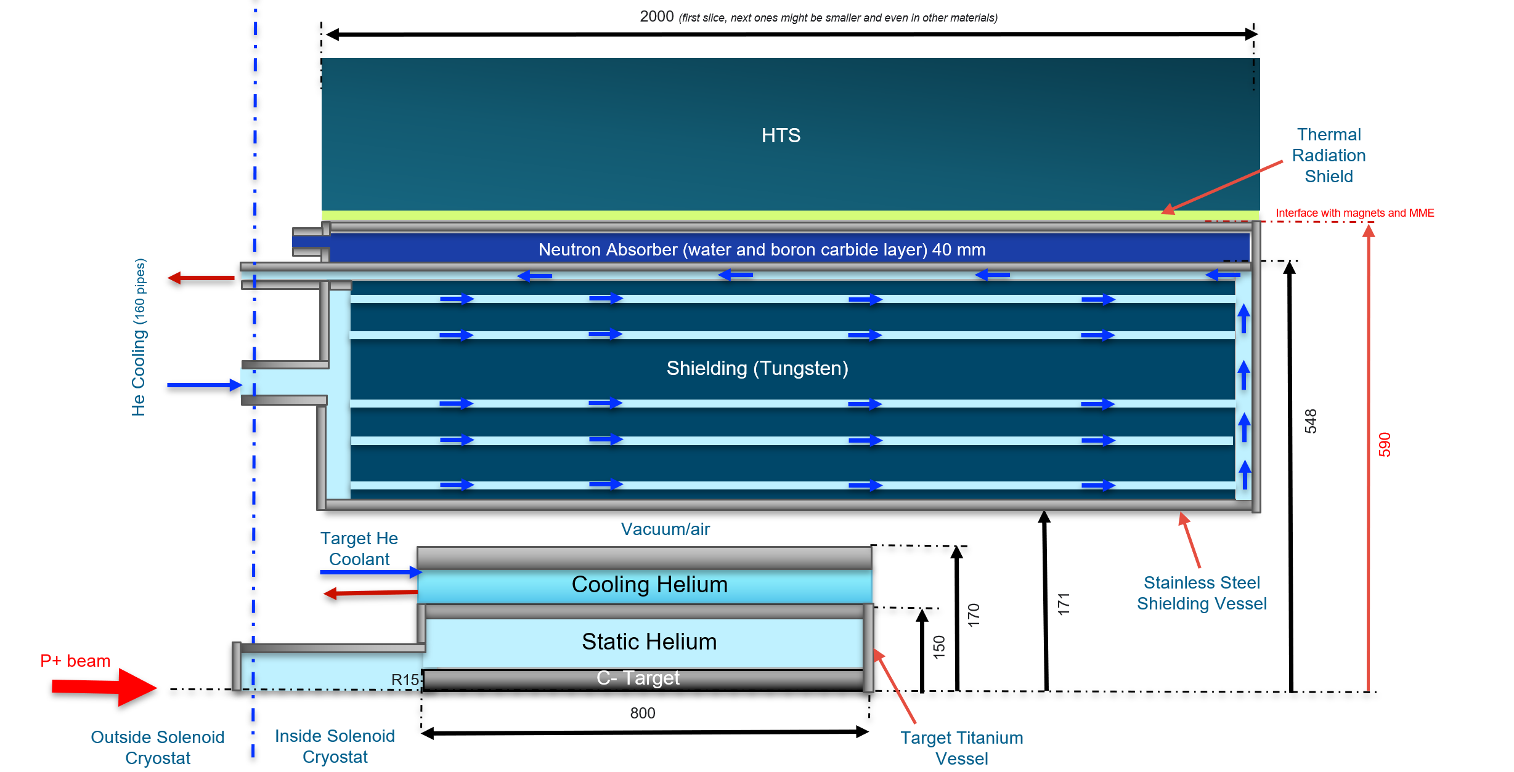
Carbon Target System
MuC target & shielding schematic (not at scale) [units in mm]

Slide 9
Carbon Target System

Slide 10
C-Target

Slide 11
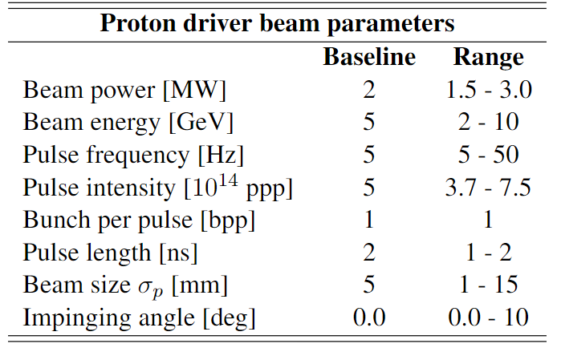
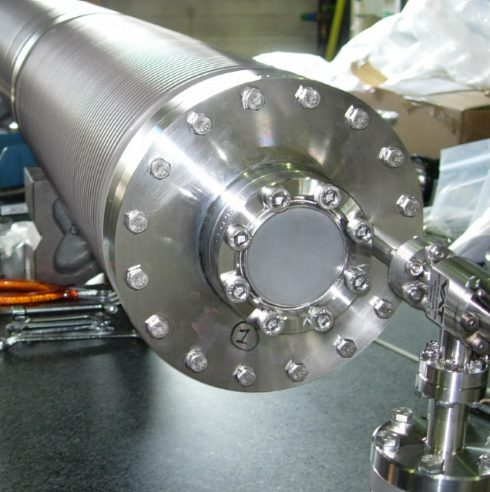
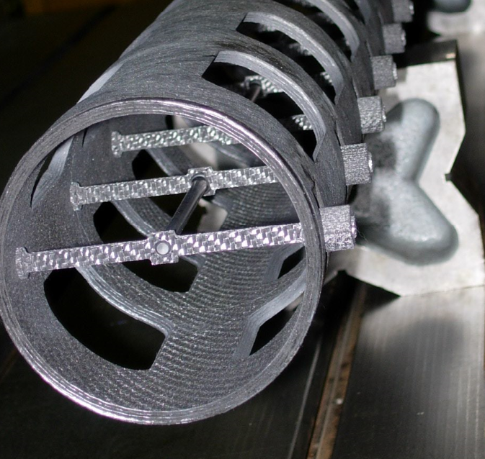
C-Target
Target Baseline parameters (recap)
Pion-yield studies (reported in at the 2023 annual meeting) + target engineering calculations converged into a set of baseline parameters
CERN’s CNGS Target
Pion yield studies by Daniele Calzolari:
https://indico.cern.ch/event/1250075/contributions/5342888/attachments/2668976/4625922/target_calzolari_annual_meeting_2023.pdf

Slide 12
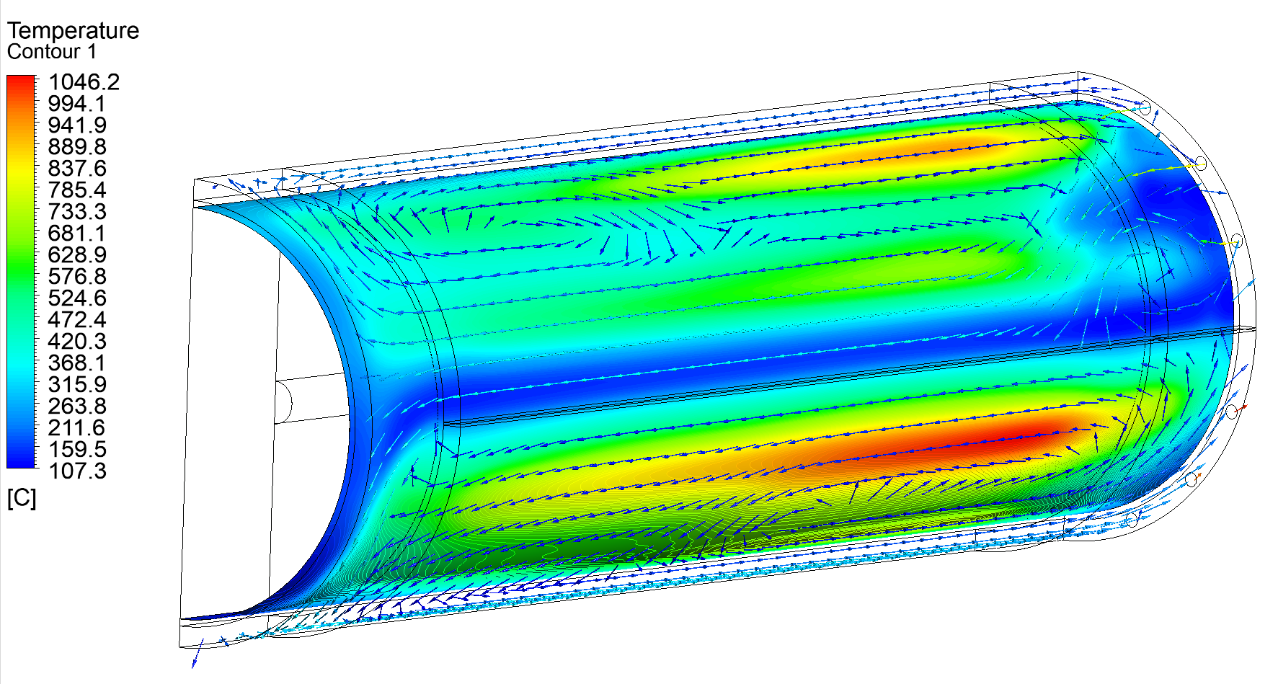
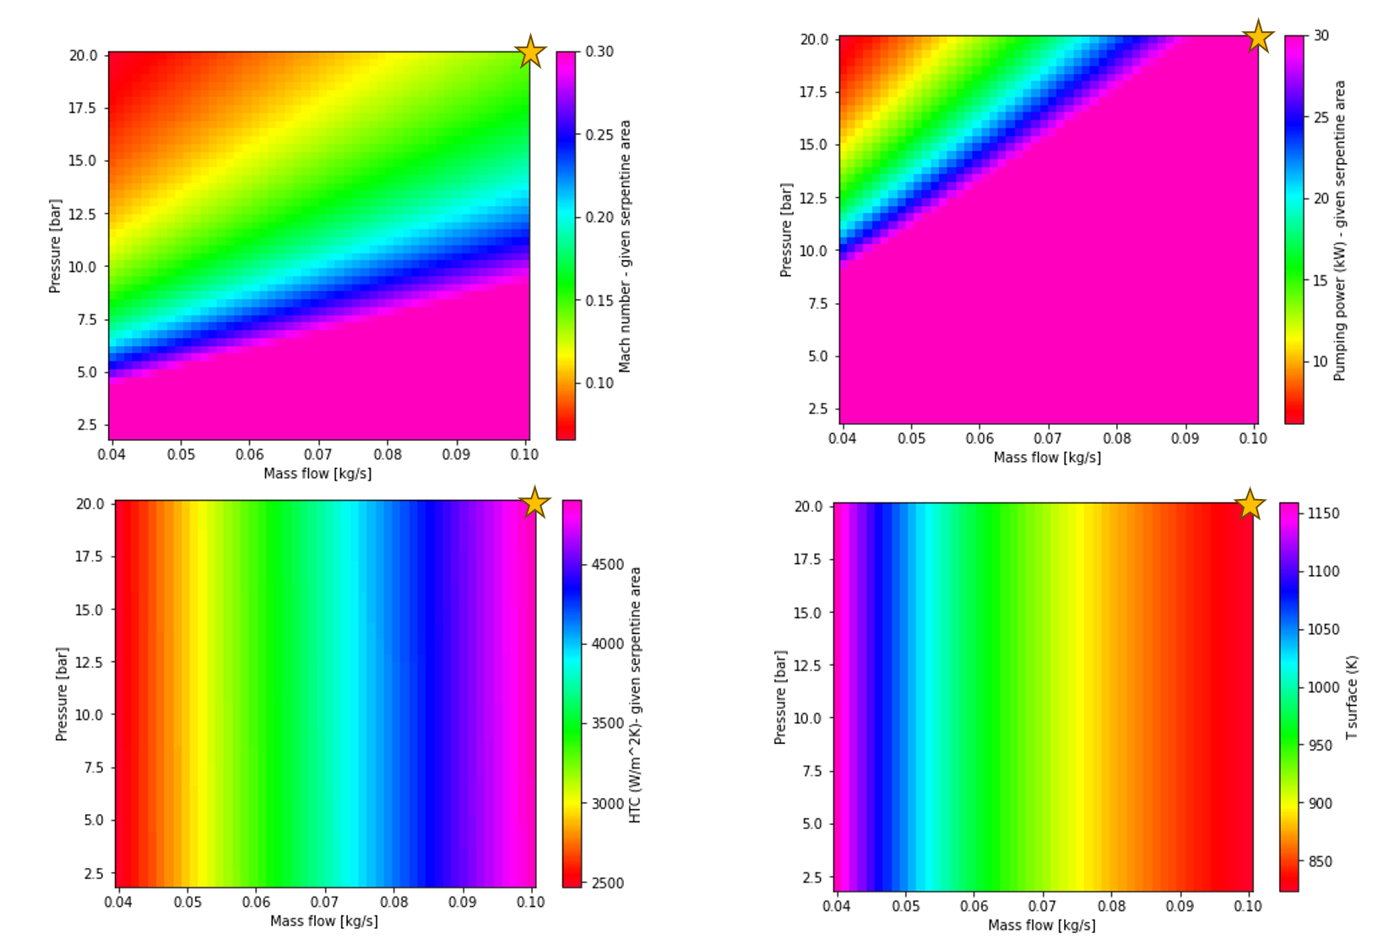
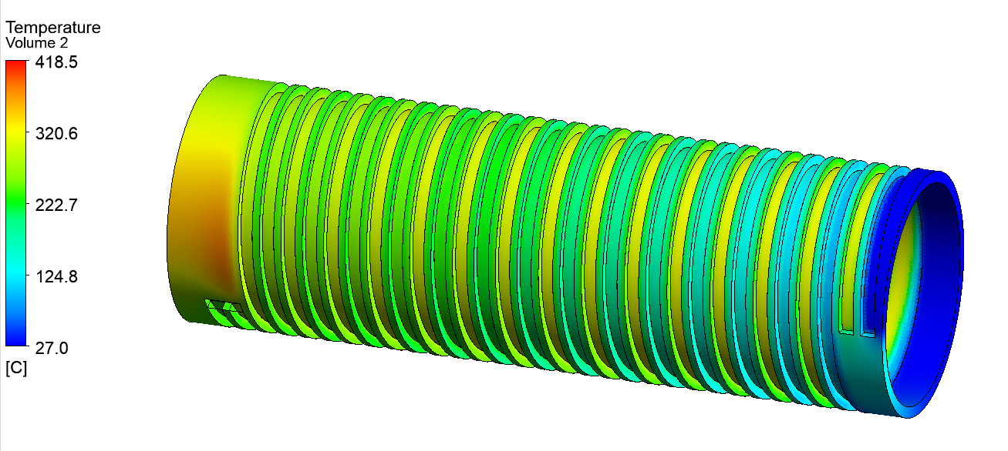
C-Target
Vessel Temperature & velocity vectors – Flow separator concept
Target Cooling CFD study
Flow separator: (Initial concept)
  Simple. Low pumping power
  High recirculation and hotspots
Serpentine concept:
  Mapped HTC, Mach nr, pumping power and wall temperature Vs mass flow & pressure. He at 20 bar, 0.1 kg/s
  More complex. Pumping power around 37 kW
  Temperatures reduced by a factor of 2
  Thermo-structural static safety factor = 1.68 (cantilever fixation)
Map Mach number, pumping power, HTC, wall temperature f (P, mf)
Vessel Temperature – Serpentine Concept

Slide 13

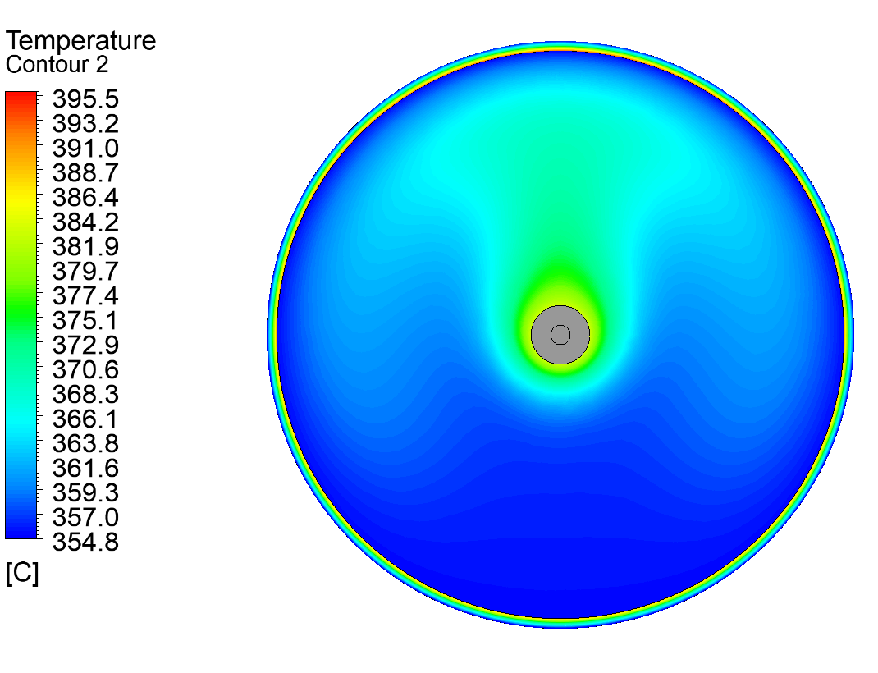
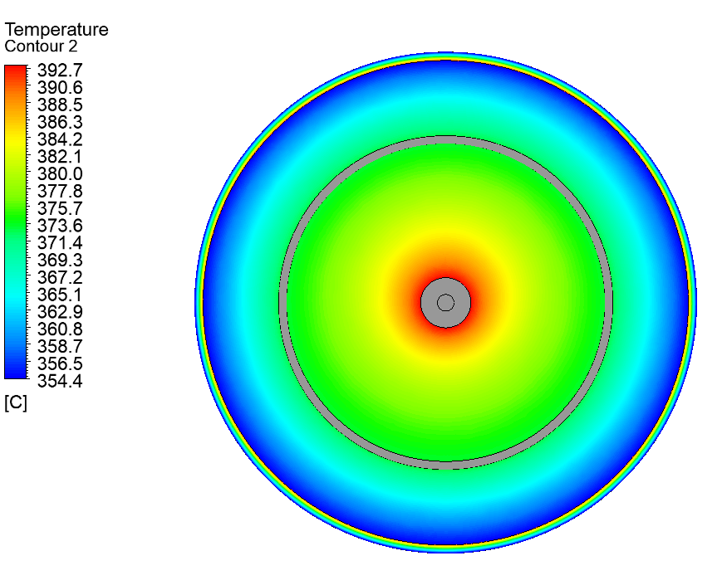
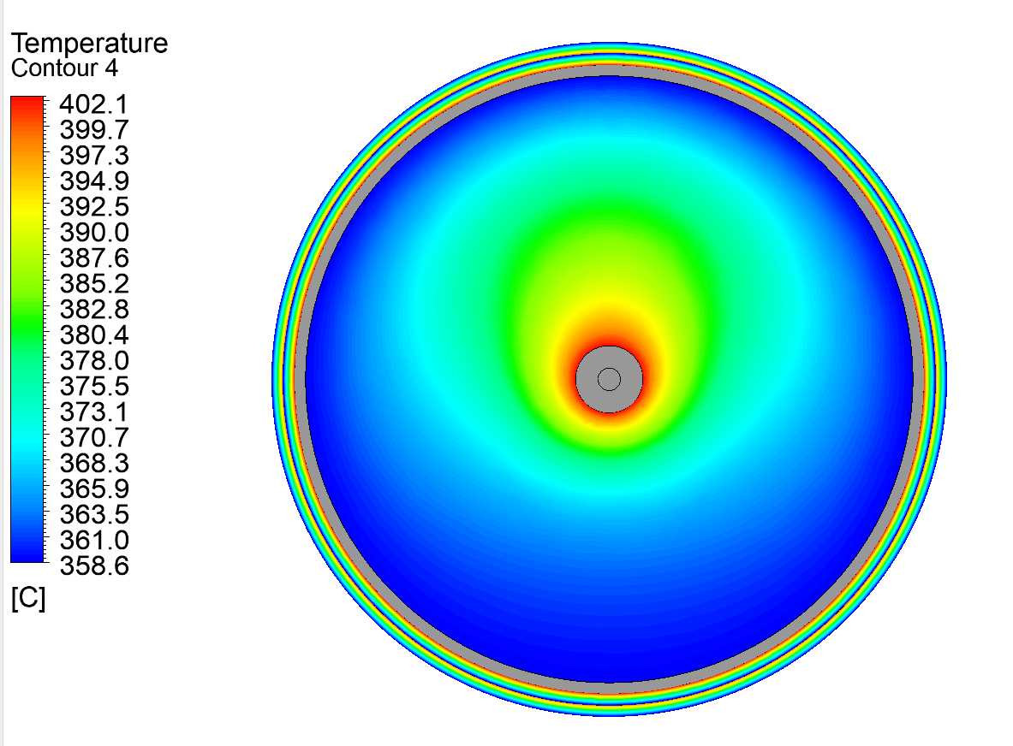
C-Target
Target Cooling CFD study
Possibility of protecting the titanium vessel from the target radiative heat
Use of the carbon support substructure
Assumed external serpentine cooling with uniform HTC
Heat deposition on internal thermal radiation shield (ITRS) was not included
No significant differences were found because of the high emissivity of carbon
Low emissivity surface: ↓T vessel but ↑↑ T target
Not a meaningful solution to reduce the vessel temperature
Target vessel 3D concept
Vessel T – without ITRS
Vessel T – with medium ITRS
Vessel T – with large ITRS

Slide 14
P+ beam window

Slide 15
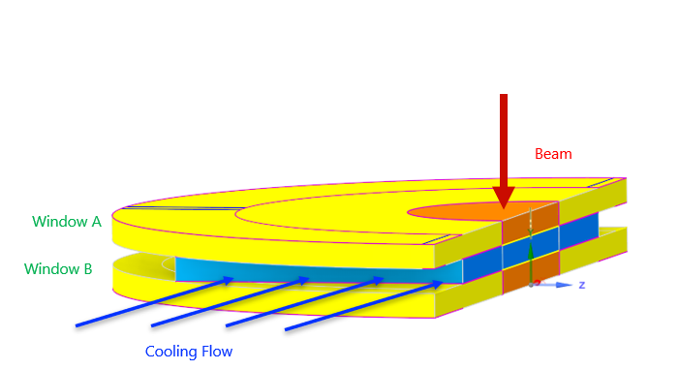
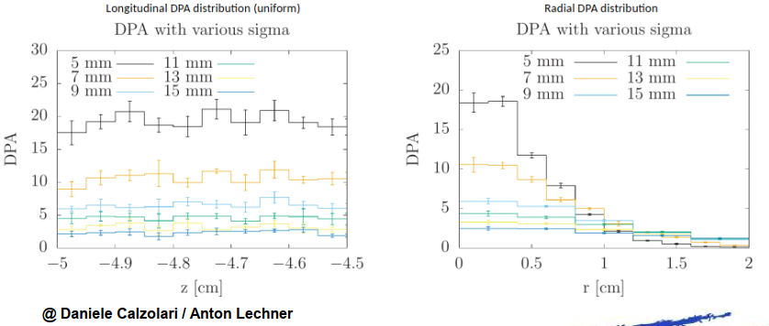
P+ beam window
Convection cooling concept
Double layer window concept
Cooling helium at 1 bar & 5 g/s
Parametric study for Ti & Be windows (0.1 - 1 mm)
  More thickness, better mechanical resistance but higher energy deposited and temperature
  250 microns best compromise
  Beryllium has a higher safety factor & less radiation damage
Vacuum side
-Vacuum
-Radiation
116 W (0.25 mm)
Helium side
-1 bar
-High Helium Temperature
-Natural convection
-Radiation
1 bar, 5 g/s
Parametric analysis in steady state. Thickness & Material
DPA on Ti windows for 1 MW and baseline proton beam parameters

Slide 16
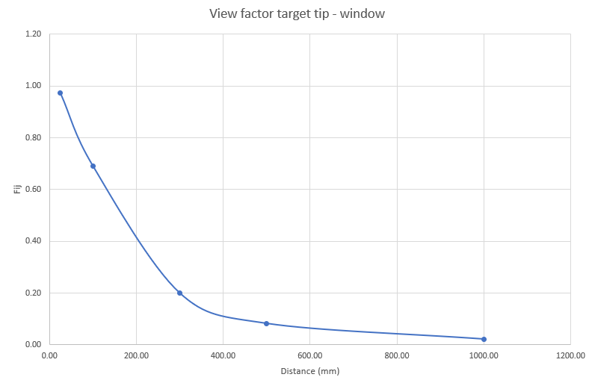
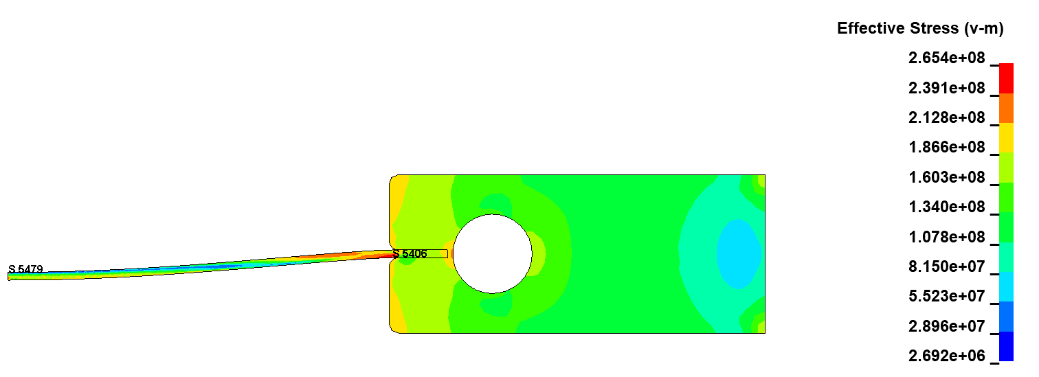
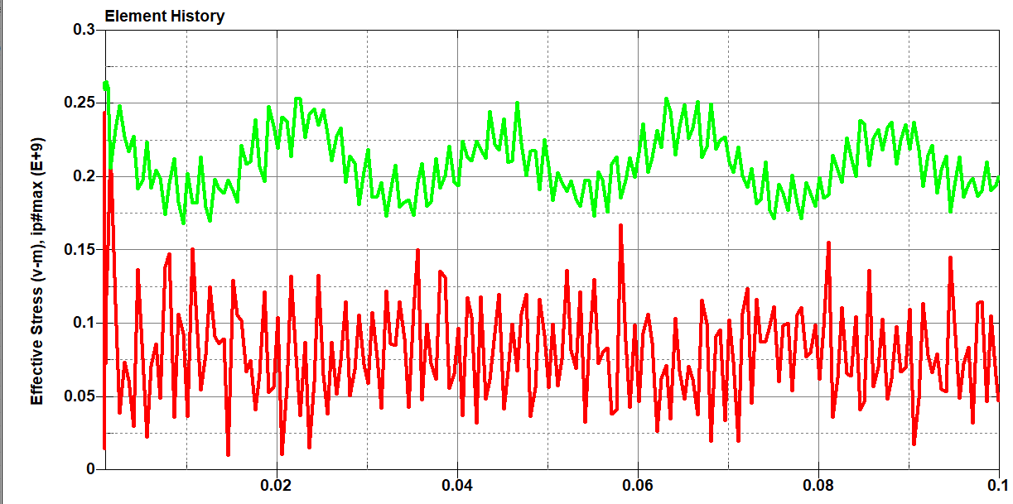
P+ beam window
Single window concept
Conduction cooling from He cooled support
Beryllium window
Single beam shot far from failure (SF =1.17)
Pulling window away from target helps reducing the radiative heating from the target
Smaller window radius bring closer the heat sink to the beam and reduce maximum temperature
Helium side
-1 bar
-High Helium Temperature
-Natural convection
-Radiation
Cooling Flow 2.5 bar, 0.5 g/s
Radiative heat
from target
44 W (0.25 mm)
Window
Beam
Vacuum side
-Vacuum
-Radiation
Support
Conduction cooling concept
Point max T
Point max stress
Window dynamic response

Slide 17
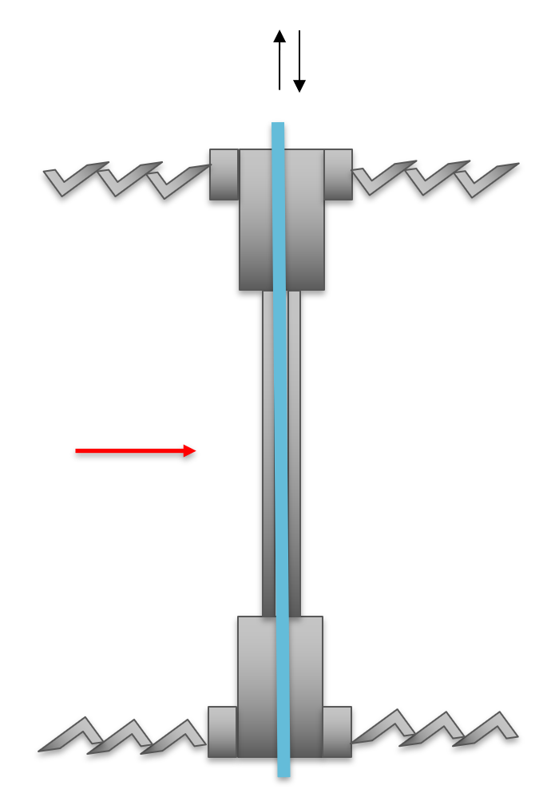
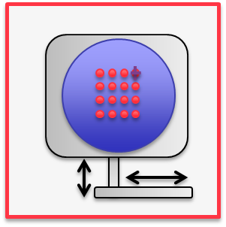
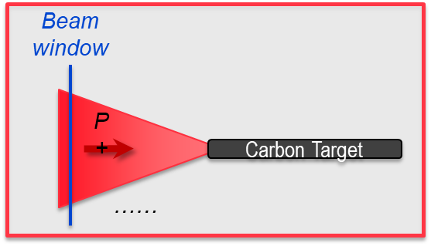
P+ beam window
Beam dilution at the p+ window
Still work to be done to assess the fatigue (at high temperature and after irradiation)
Radiation damage is a challenge. Dilution mechanisms to be explored

Slide 18
Target Shielding

Slide 19
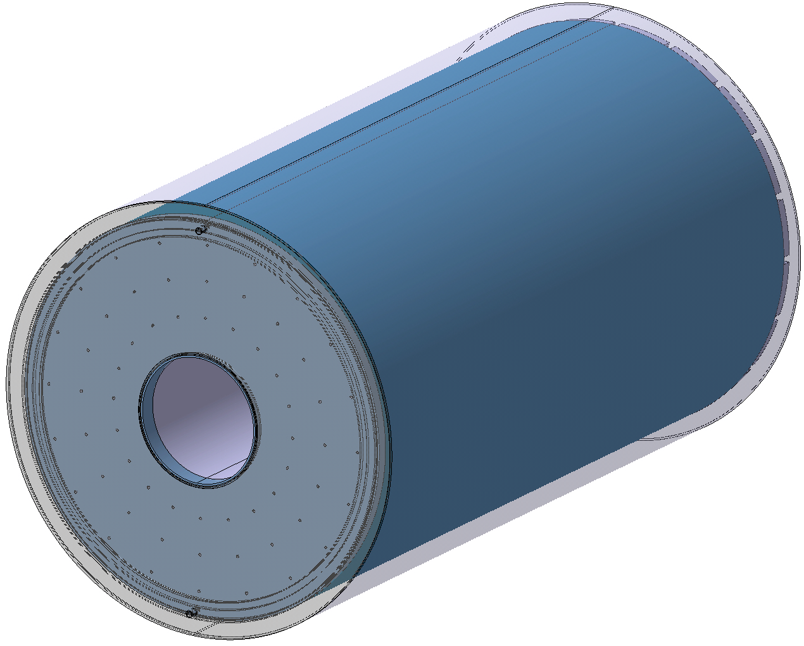
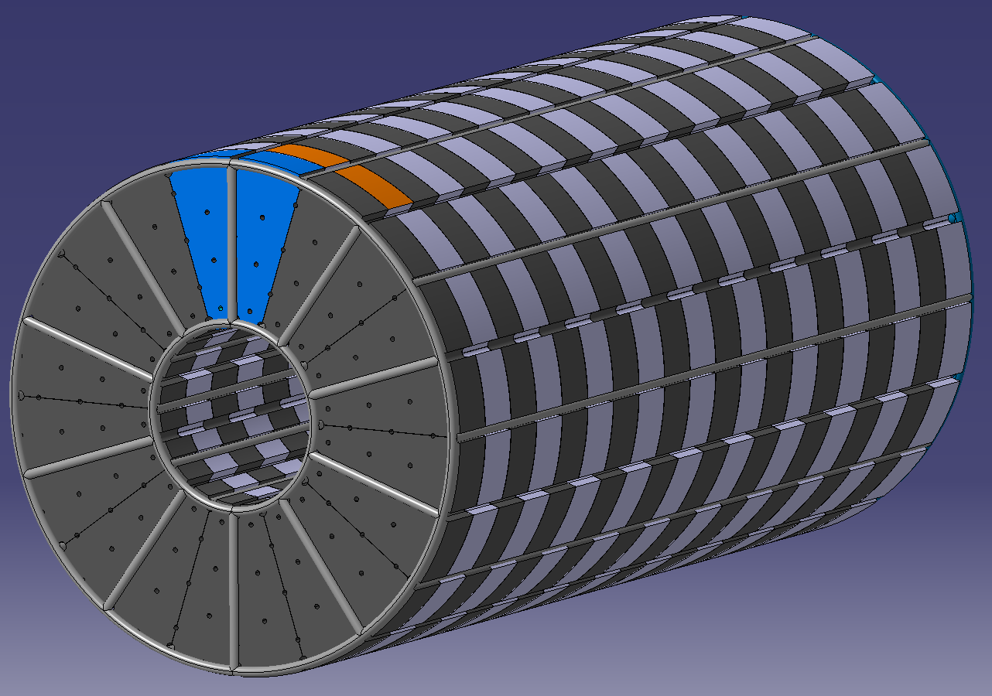
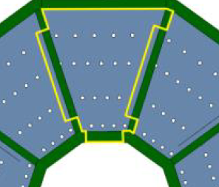
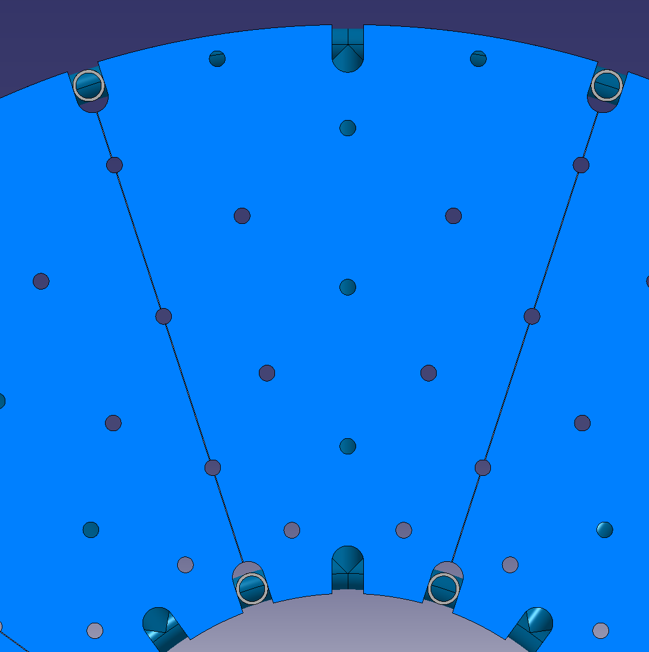
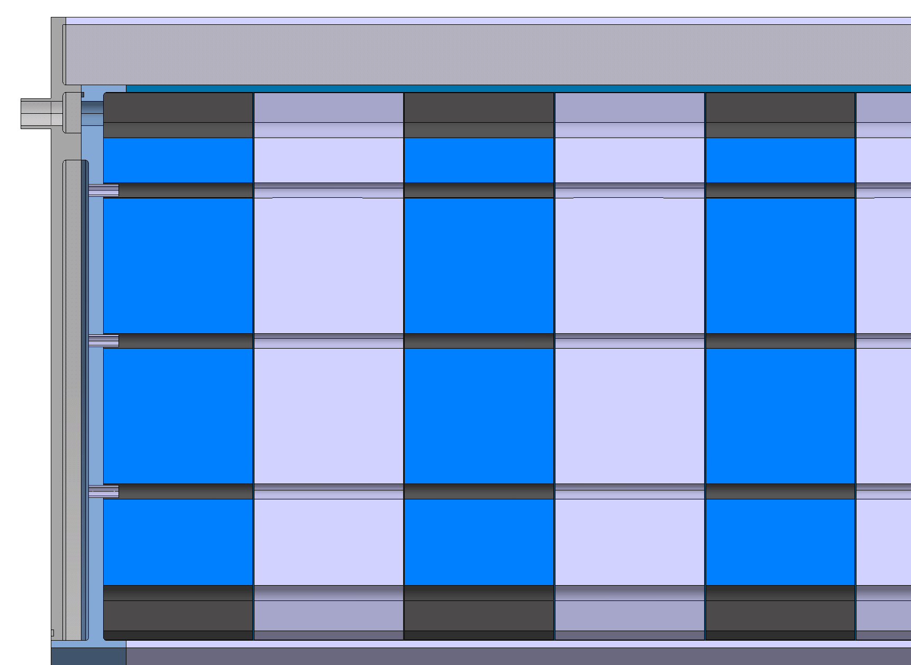
Target Shielding
Boron carbide
H2O moderator
Conceptual Design
Holding the assembly (23 t).
  Self-holding assembly, e.g. puzzle-like shape.
  Alignment pins & structural rods
He distribution
Water moderator & neutron absorber
He return outlet
Inlet guide plate & tubes
He plenum
19

Slide 20
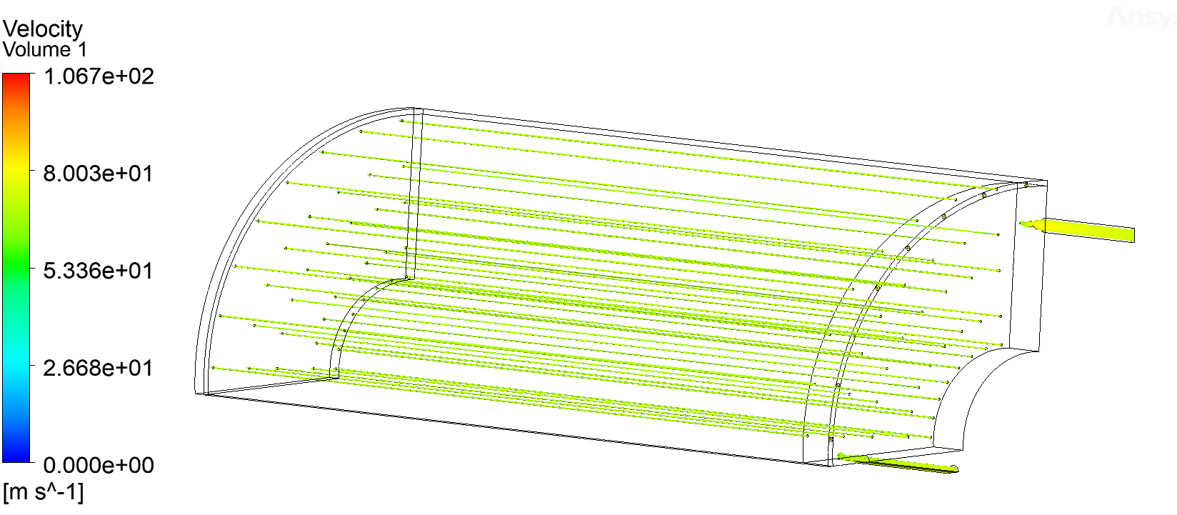
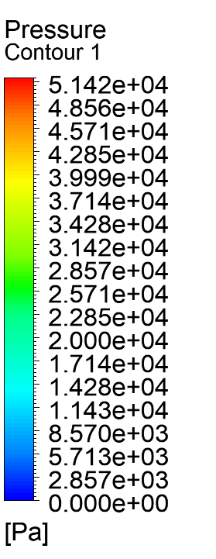
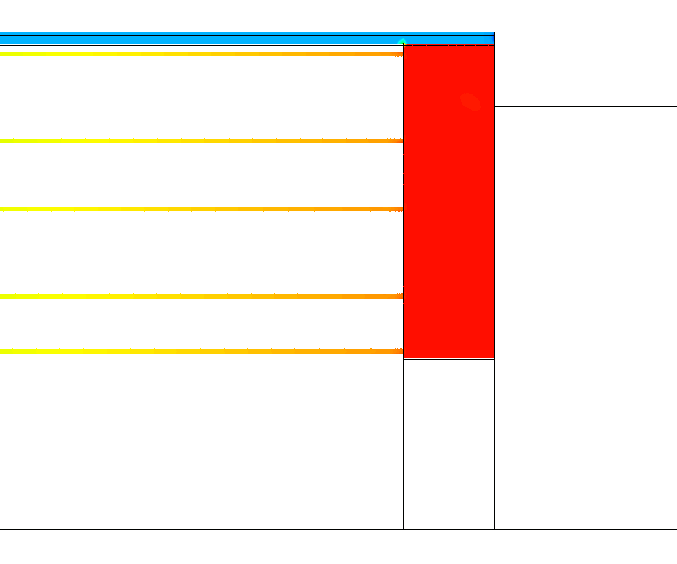
Target Shielding
Target Shielding CFD
RT Helium cooling
Plenum optimization in view of:
Study the effect of:
  Having homogeneous flow
  Study the effect of plenum size
  Define location of cooling return
Pressure loss: 52.4 kPa
Not coupled with thermal solver
  ∆T on coolant is high, but the HTC change is not so important
Useful insights to validate the use of analytical tools to estimate flow properties
  Thermal analysis using fluid cell elements to capture fluid T change
Helium velocity on pipes across shielding
Helium distribution
Pressure distribution

Slide 21
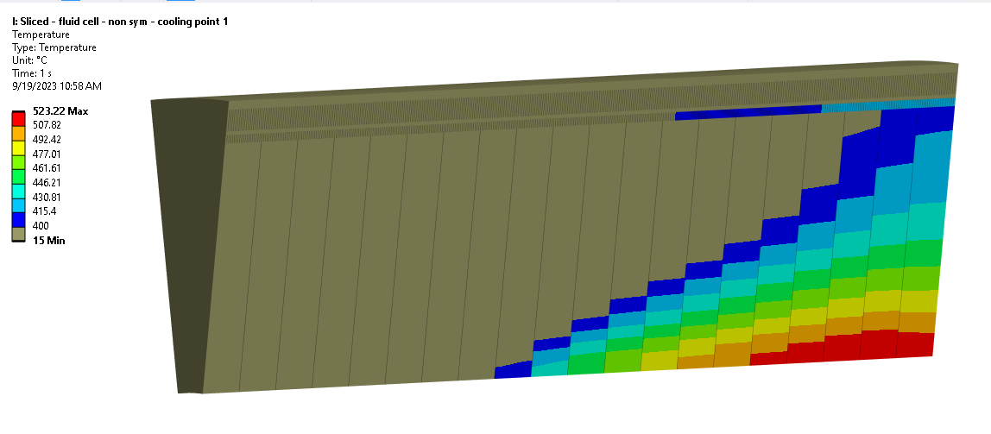
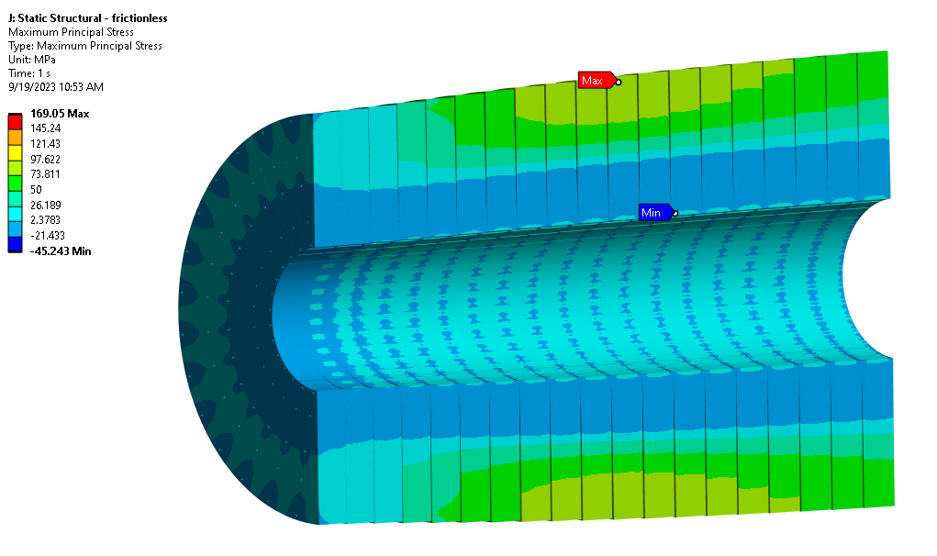
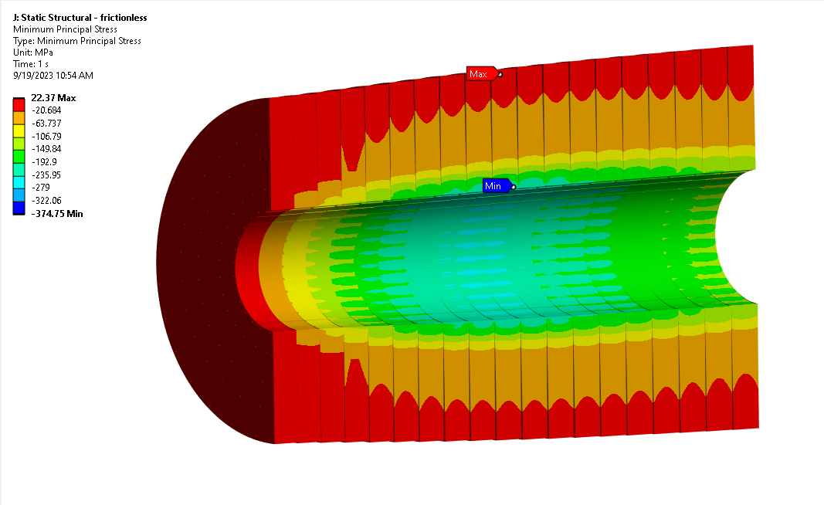
Target Shielding
Target shielding: thermo-mechanical study
Only thermal load (weak springs BC)
Longitudinally segmented slices (TCC ~100 W/m²K - frictional contacts)
At T < 400 °C , tungsten behaves as brittle (looking at failure via max principal stress)
Temperatures in acceptable range
  Interface temperature with solenoid reasonable
Slicing helps to decrease stresses
Shielding Temperature > 400 °C
Max stress on external cooling pipe (169 MPa) center
Min stress on internal cooling pipe (374 Mpa) center
# Tungsten yield @ 500°C = 854 MPa
# Tungsten ultimate tensile stress @ 15°C = 1432 MPa

Slide 22
Conclusions & Prospects
Status/Updates
Target vessel cooling ongoing and soon finalized. Further studies foreseen to better reduced Titanium vessel temperature.
P+ Beam window advancing towards a single window cooled with He.
Target shielding cooling study converging into a design proposal, although further refinement is still required.
What is in the pipeline to have a complete concept for the C-Target system ?
Dynamic response of the Target + supporting structure + target vessel
Complete modelling of Target cooling, particularly with integrated piping
Design of the target vessel support in the cryostat/target shielding.
Conceptualization of the target alignment
Complete target shielding cooling studies & vessel design.
Detail the structural assessment of the target shielding

Slide 23
Conclusions & Prospects
What is in the pipeline to have a complete concept for the C-Target system ?
Detail the thermo-mechanical study of the window and do its conceptual design
Installation/maintenance & handling study of the target systems in the cryostat.
More in-depth study on radiation damage and fatigue considerations for the target system components and materials. -> Define R&D needed
What else?
Definition of the radiation shielding and cooling requirements for the chicane
Definition of the proton dump extraction
Proton dump conceptual design.
Studies on other frontend absorbers (as required such as masks, p+ absorber at the start of cooling section, etc)
Support the studies for alternative target concepts (as required)
Keep actively working on integration with the magnets team
Pursue alternative target options (Liquid Pb Target and Fluidized W Target)
Special thanks to Francisco and his key contributions these last 3 years ☺

Slide 24
Many thanks!
Special thanks to Francisco and his key contributions these last 3 years ☺

Slide 25
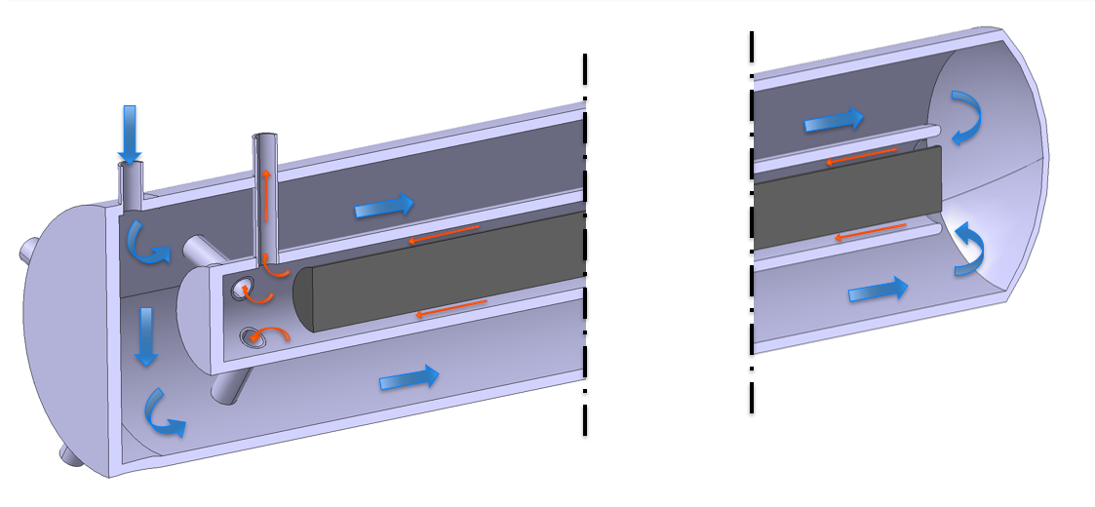
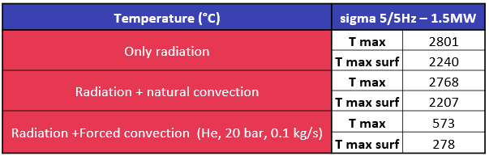
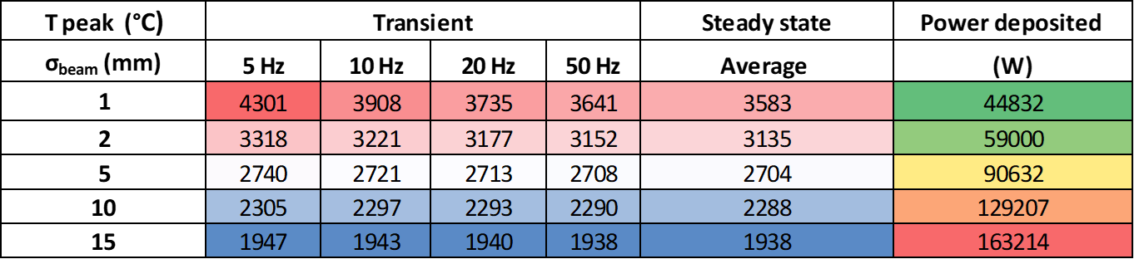
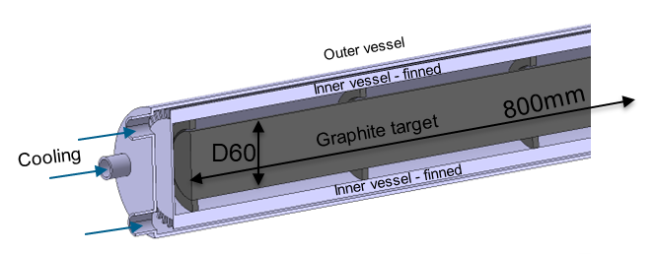
Carbon Target: engineering feasibility
Direct cooling considerations
Maximum temperature and power deposition for 1.5 MW as function of the beam sigma.
Old concepts
  Target Cooling
  Due to high T and sublimation of graphite, an enclosed ‘pressurized’ atmosphere is required.
  However, active cooling can be made indirectly. Heat dissipation mostly via radiation and natural convection. → target confinement / separation of cooling system is advantageous (maintenance, RP, disposal, cooling services requirements).

Slide 26
Carbon target & target systems considerations
Target Physics requirements
Solenoid / Double Horn
Shielding
P+
µ
Cooling &
Capture
Target Engineering requirements
Proton driver
Carbon Target
Production
Pulse intensity
Pulse length
Pulse frequency
Beam size
Beam energy
Pion/Muon yield
Emittance
++…
++ Other requirements
Dynamic load
High temperature & average power
Fatigue
Radiation damage
Integration
Operation / Maintenance / Disposal
Design
Cooling
Sing/multiple rods
Length / λ
Diameter
Tilt
Target vessel size
Beam windows
Type of cooling
Passive/active
Parameters
Dedicated/shared
Material
Radio Protection
Material / alloy
Availability
Properties
Radiation damage
Services

