Slide 1


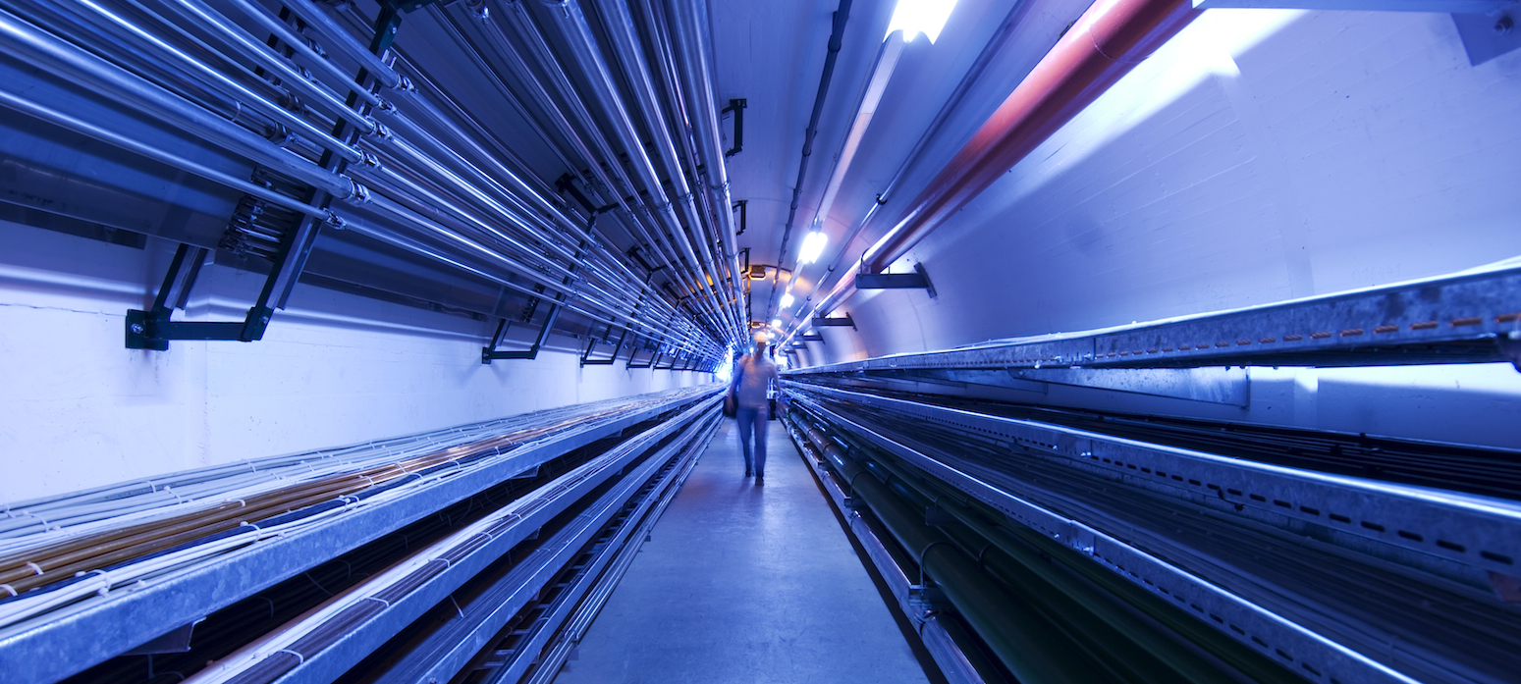

IMCC Annual Meeting 2024 – CERN
Liquid metal target concept development
13/03/2024
Carlo Carrelli¹
L. Tricarico³, P. Cioli Puviani², I. Di Piazza¹, G. Clai¹
¹ ENEA – FSN, ²Politecnico di Torino , ³Università di Bologna

Slide 2
Outline
Intro - recap
Liquid target options
Hydraulics modelling
Beam-lead interaction
Next steps

Slide 3
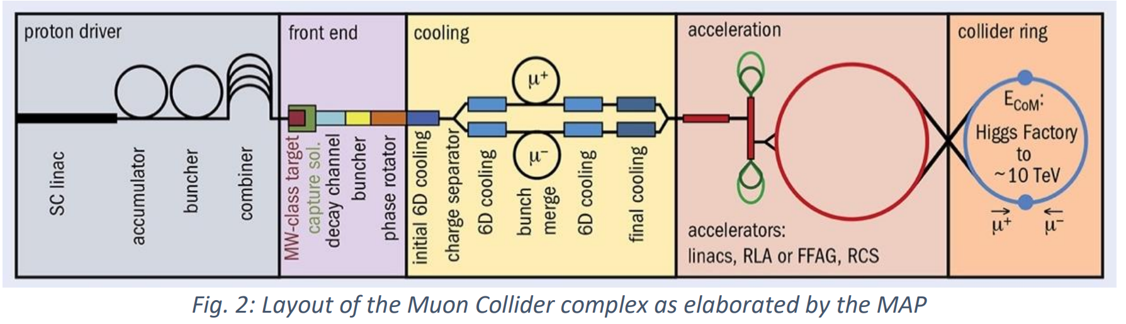
Intro
  WP 4.2 – Target system development
  Solutions for 2-4 MW class liquid-lead target
    p⁺ beam: 2 ns, 5 Hz, 2 MW_{AVE}
    Available space: R < 170mm
    20 T magnetic field

Slide 4
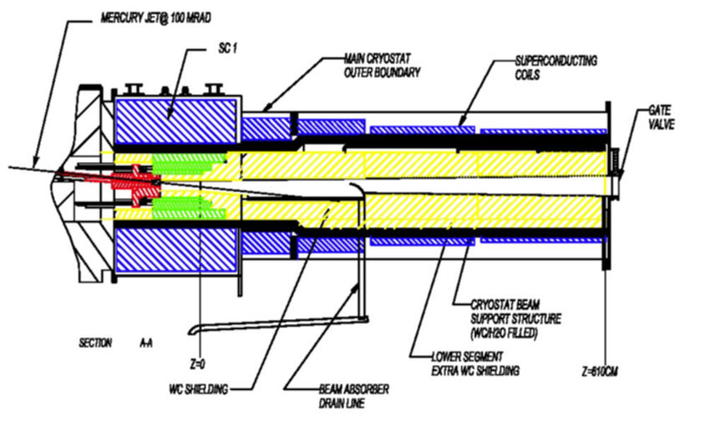
Liquid Lead Target
Recap
Liquid-lead properties:
Density: 10660~9000 kg m⁻³
Melts: 600 K
Boils: ~2020 K
Technological aspects:
Steel corrosion at T > 450°C (slow process, 10³ hrs)
Stagnation areas in loop to be avoided (O₂ accumulation, local freezing)
Ambient pressure operation
Target volume: D30 x L509 mm
Limited system external access
Options:
Pipe
  Failed thermo-mech assessment
  On hold
Curtain
  Current baseline
  Hydraulics modelling
Jet
  Backup solution
  Explored with Hg

Slide 5
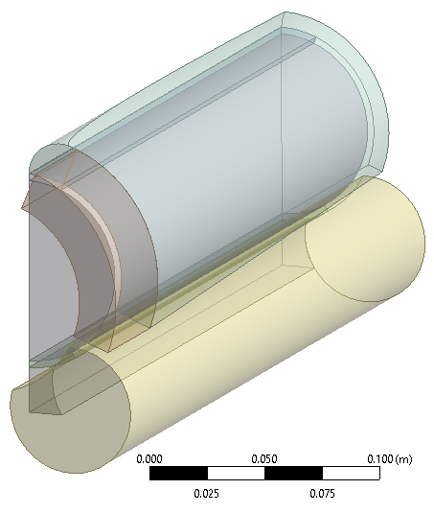
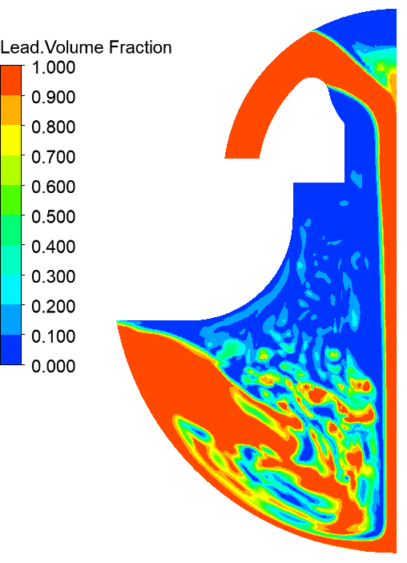
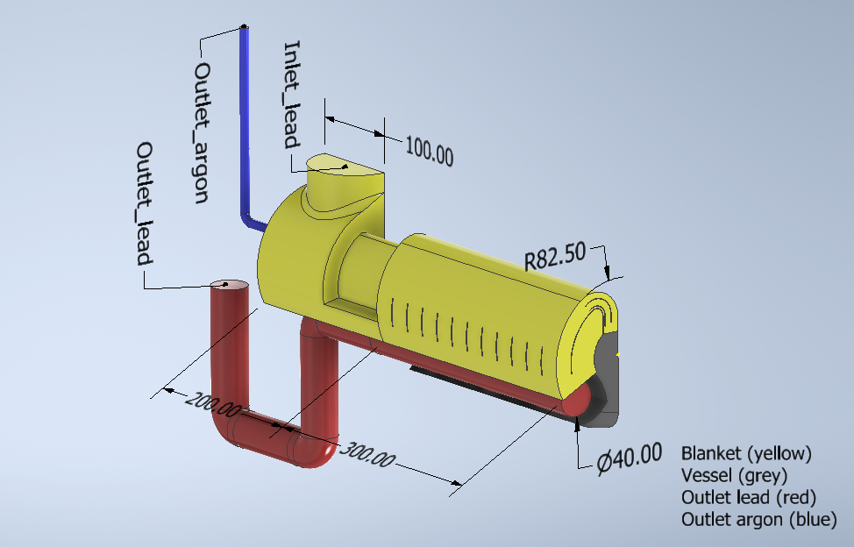
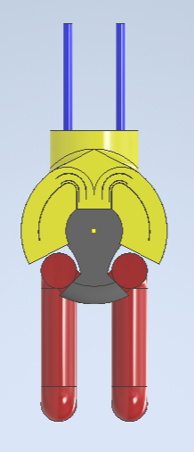
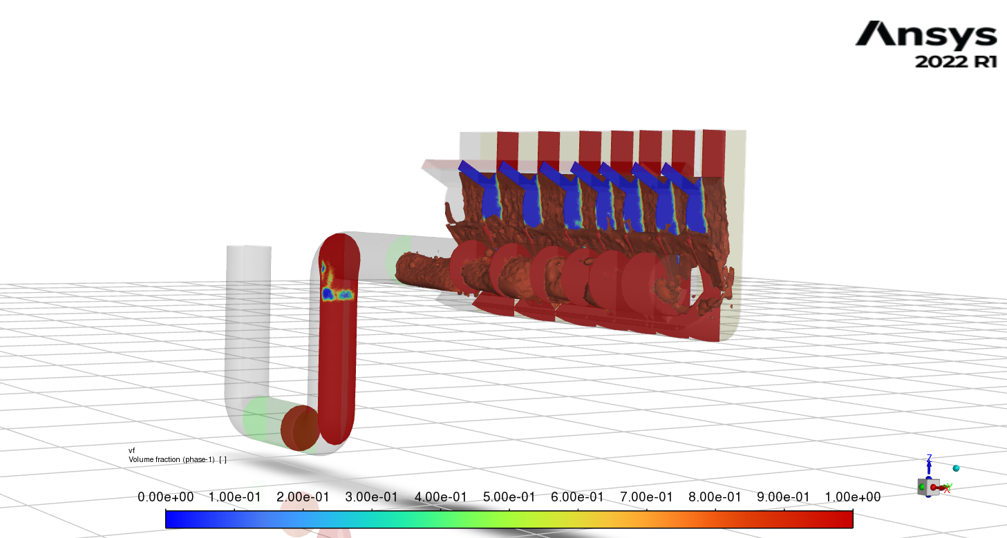
Liquid-lead curtain target concept
Time evolution
509 mm
2022
2023
SYMMETRY
INLET
p⁺ beam
Opportunities:
  Decoupling of target vessel & beam windows
    Good for thermo-mech and MHD
  Robust against lead flashing
    Fast curtain regeneration after beam interaction
Challenges:
  Hydraulic modelling
    Multi-phase CFD
  Curtain steady-state stability
    Very high mass flow rate required
  Beam interaction modelling
    Cavitation, shockwaves, tunnelling..
OUTLET
2024

Slide 6



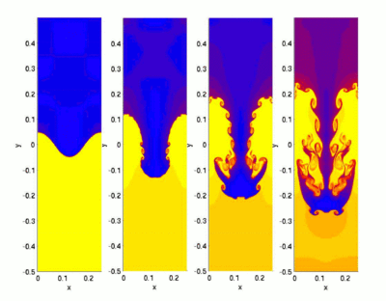





Liquid-lead target – Progress
Curtain stability
$$x$$
Tentative hand calcs:
$$z0$$
$$z$$
$$y$$
Not included:
  Rayleigh-Taylor instability (interface between two fluids of different densities)
  Kelvin-Helmholtz instability (velocity difference across the interface between two fluids)
$$z_{1}$$

Slide 7
Liquid-lead target – Progress
Curtain parameters
Parametric analysis:
Beam-nozzle distance
Avoid fluid thread separation
Tentative value: 25 mm
Mass flow rate
Limited by pumping capacity
Tentative value: 100 kg/s*
Nozzle aperture
Maintain steady-state stability
Tentative value: 20 mm

Slide 8
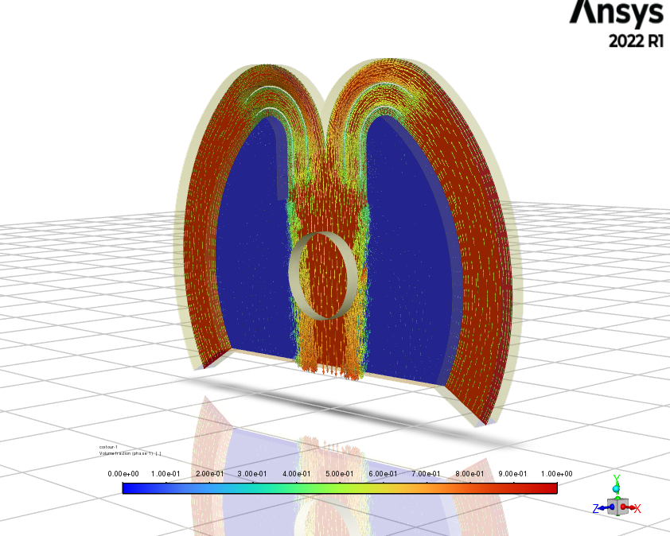
Liquid-lead target – Progress
Target Hydraulics
To model the curtain the commercial CFD code Ansys Fluent has been adopted
Two phase CFD model: VOF (Eulerian approach)
2D CFD simulations confirm the theoretical results identifying a mass flow per unit length to have the necessary curtain dimension
To move from a 2D to 3D model of the curtain, a separate effect approach has been adopted studying different parts of the system singularly
  Inlet distribution system
  3D curtain analysis
  Outlet plenum and extraction system

Slide 9
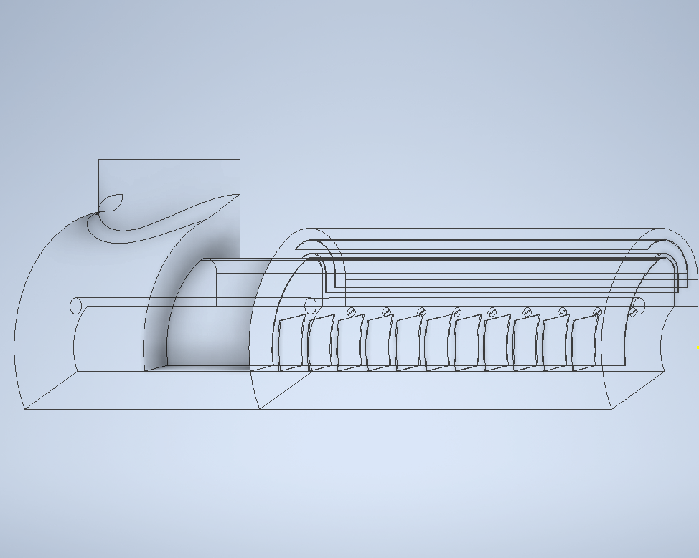
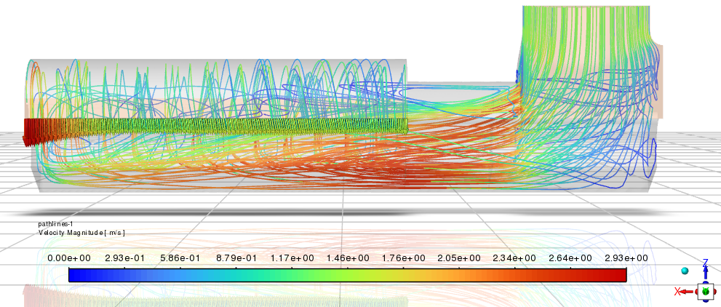
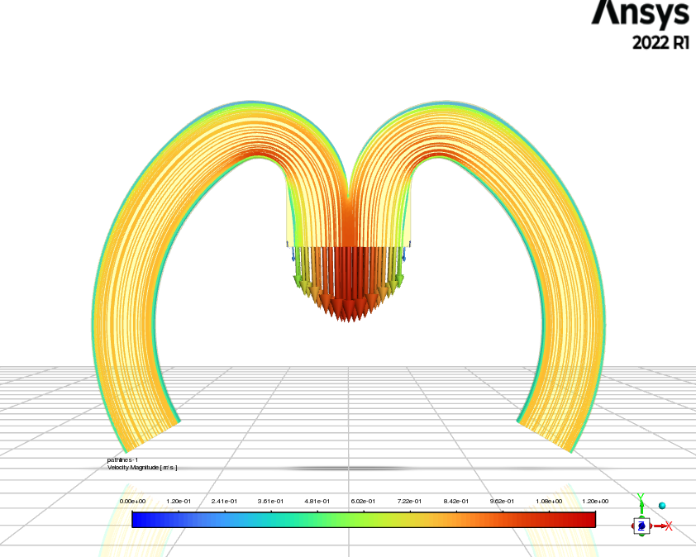
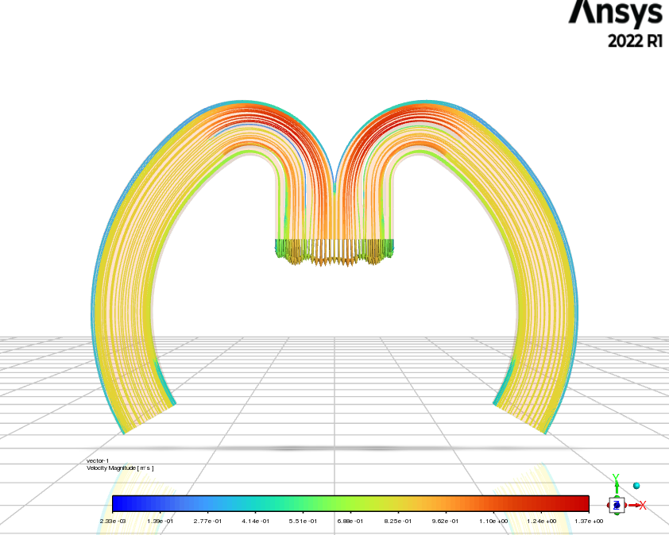
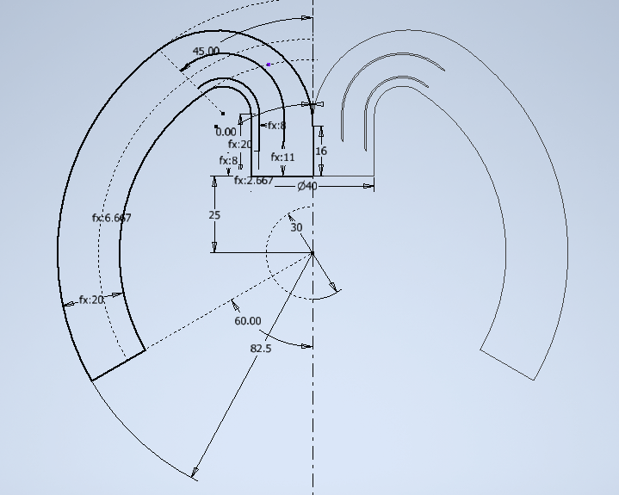
Liquid-lead target – Progress
Inlet distribution system
Goals:
Baffles to redirect the axial inlet flow in radial direction
Baffles to obtain a uniform velocity on the curtain spring
Axial velocity distribution
p⁺ beam
Inlet baffles
p⁺ beam
p⁺ beam
Free inlet: uneven velocity
Baffled inlet: uniform velocity
Liquid lead flow

Slide 10
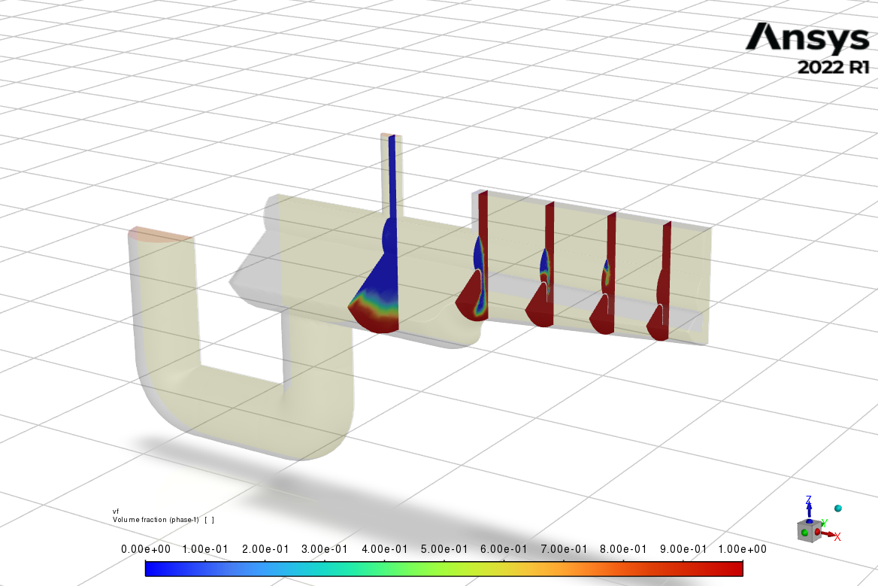
Liquid-lead target – Progress
Outlet
Goals:
Exhaust liquid lead from outlet plenum
Avoid stagnation and internal recirculation
Inlet mass flow lead: 100 kg/s
Outlet relative pressure: 0 Pa
Opening on the argon conduit at relative pressure: 0 Pa
UDF on outlet section to obtain monophase lead in the momentum source subdomain for numerical stability
Momentum source calibrated to have steady state condition
Adaptive mesh refinement
Adaptive timestep higher than 1e-5s
p⁺ beam
Pb flow
Ar flow
Momentum source
UDF section
*inlet distributor not modelled

Slide 11
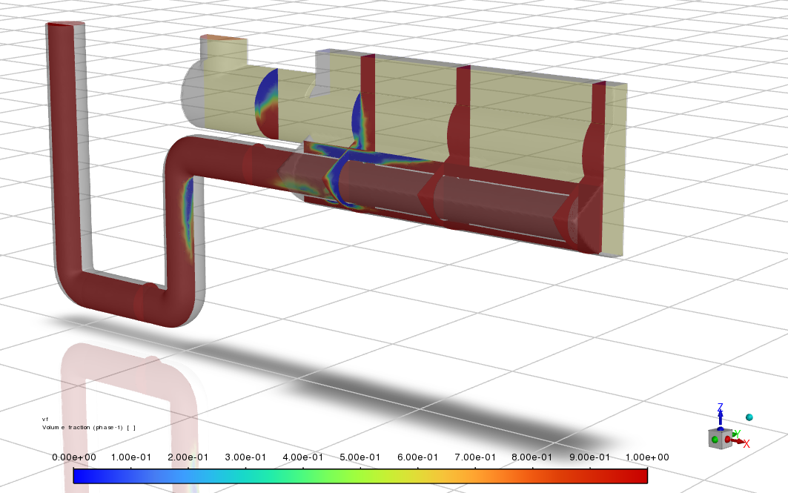
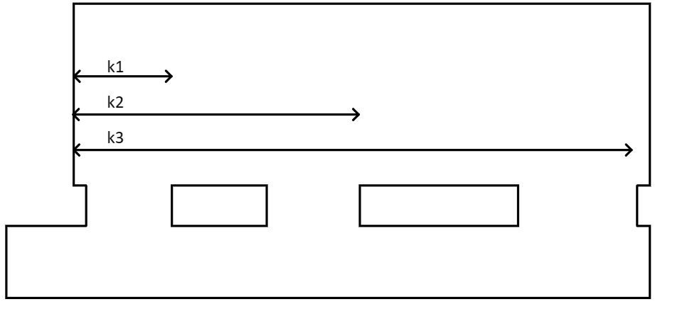
Liquid-lead target – Progress
Outlet
Goals:
Exhaust liquid lead from outlet plenum
Avoid stagnation and internal recirculation
# 1
# 2
p⁺ beam
p⁺ beam
Simplest solution
Issues with emptying the system uniformly
Too high argon velocity in the domain
Introduction of a calibrated suction conduit
Issues with emptying the system uniformly, but more control
Too high argon velocity in the domain
Pb flow
Ar flow
*inlet distributor not modelled

Slide 12
Liquid-lead target – Progress
Outlet
Goals:
Exhaust liquid lead from outlet plenum
Avoid stagnation and internal recirculation
# 3
p⁺ beam
z
x
y
Pb flow
Ar flow
*inlet distributor not modelled
Complete lead extraction
Uniform axial curtain behavior
Low argon velocity in the domain

Slide 13
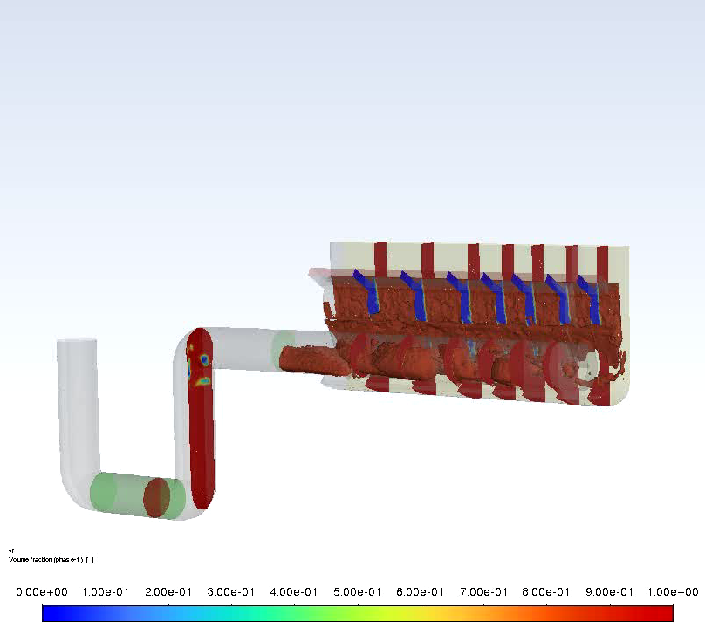
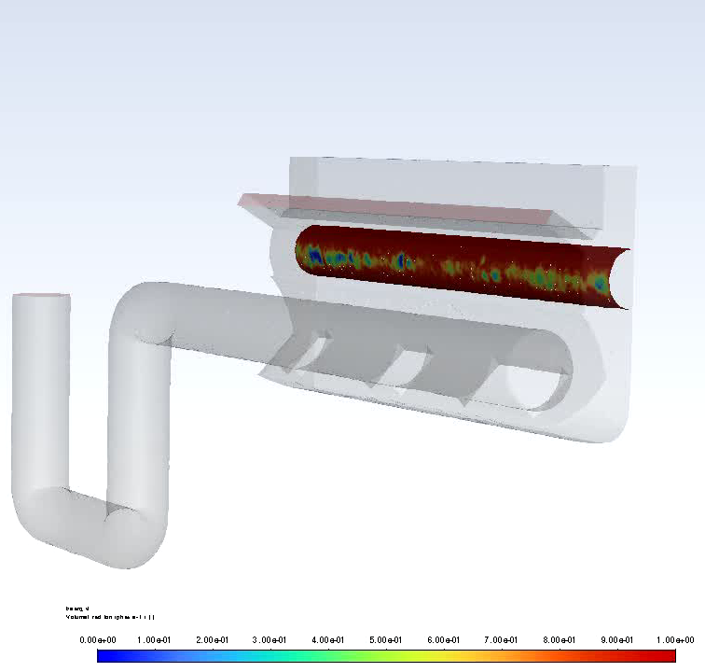
Liquid-lead target – Progress
Target hydraulics
VOF iso-surface
Beam enclosure “wetting”
z
x
y
z
x
y

Slide 14
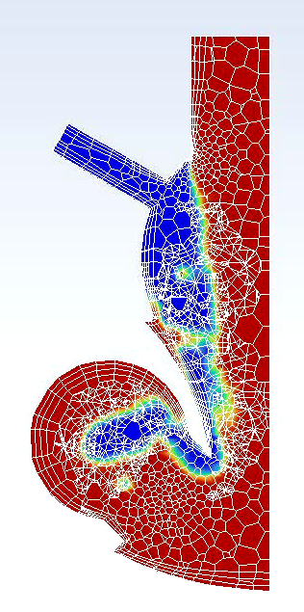
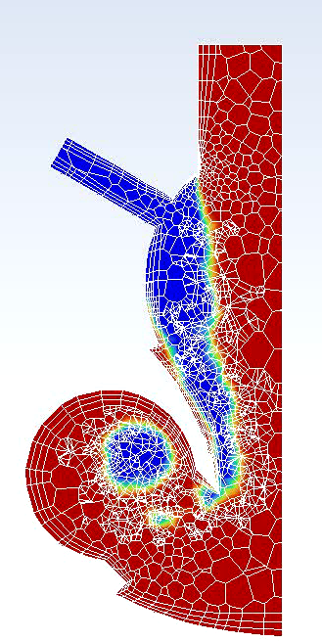
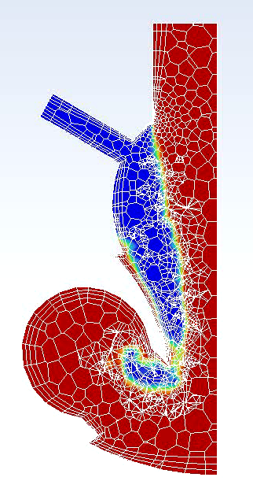
Liquid-lead target – Progress
Target hydraulics
Curtain stability and uniformity along beam axis
Some Ar extracted along with Pb
Total simulation time t = 0.22 s
y = 50mm
y = 150mm
y = 250mm
z
x
z
z
p⁺ beam
x
y
x

Slide 15

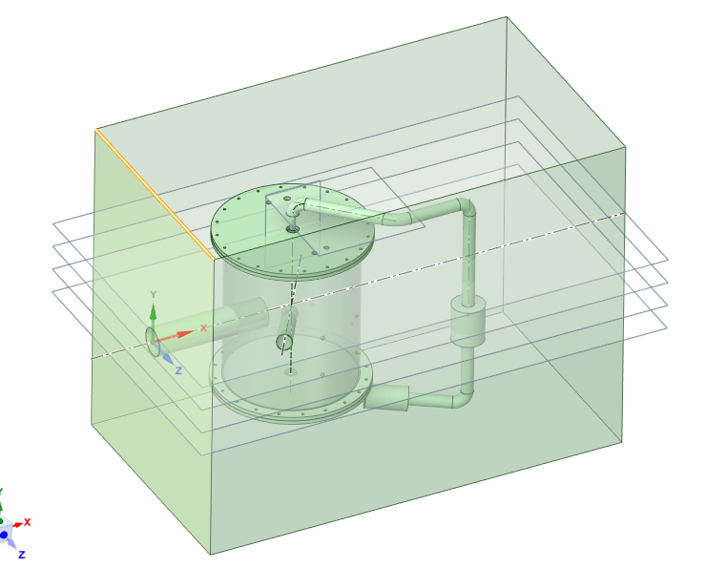
Liquid-lead target – Progress
Beam-lead interaction
Simulation:
  Explicit dynamics solvers (e.g. LS-DYNA)
  ALE solvers (e.g. DualSPHysics)
  Potential issue with Pb vapour EOS (i.e. lack of data)
Shockwaves:
  Rapid thermal expansion leads to shockwaves as fast as 10⁴ to 10⁵ ms⁻¹
  Experience on underwater detonation show that wavefront velocity converges exponentially towards speed of sound
  No simplified / semi-empiric modelling – only models are dimensionally inconsistent, referring to detonation charge mass and quality
Cavitation:
  Previous experiences with liquid Hg¹ and LBE² show cavitation damage
  Free-flowing curtain likely dissipates shockwave energy before reaching target vessel walls
Experiments:
  Lab test in HiRadMat facility proposal under development
  Shockwave/cavitation impact on structures
  Combined free-flow and beam interaction test
¹Winder et al, 2021
²Noah et al, 2012

Slide 16
Next Steps
Target hydraulics:
  Study the 500 mm axially long configuration
  Improve numerical stability of the model
  Optimization of the design
    Location of beam center in relation with the curtain
    Uniformity of the inlet region
    Reduction of pressure drops in the outlet region
  Evaluation of the pressure drops in the system
  Lead mass flow rate optimization
    Evaluate with CERN experts the opportunity to shrink the curtain towards the end of the interaction length
Interaction with magnetic field:
  Start 3D MHD studies
  Vessel coatings / insulating materials
Structural parts:
  Target vessel materials
  Baffles materials and anchoring
  Beam windows materials
  Thermo-mechanical evaluations

Slide 17


Thank you

