Slide 1

  C. Bartoli¹, M. Breschi¹, A. Macchiagodena¹, P. L. Ribani¹, H. De Gersem², D. Moll², F. Boattini³, L. Bottura³
  ¹Alma Mater Studiorum – Università di Bologna, Italy
  ²University of Darmstadt, Germany
  ³CERN, Geneva, Switzerland

Slide 2


Outline
Options of fast-ramped resistive magnets for the accelerator
Advances in the modeling of the H-type magnet
Advances in the dynamic modeling of the resistive magnets
Preliminary thermal analysis of the hourglass magnet

Slide 3
Outline
Options of fast-ramped resistive magnets for the accelerator
Advances in the modeling of the H-type magnet
Advances in the dynamic modeling of the resistive magnets
Preliminary thermal analysis of the hourglass magnet

Slide 4
Analyzed configurations
Magnet specifications: 1) Magnetic field in the aperture 1.8 T 2) Good field region (30 mm * 100 mm) 3) 1 ms ramp from −1.8 to + 1.8 T
Two magnet configurations identified by optimization of the total magnet energy
Vacoflux 48
Vacoflux 48 or M235-35A
Hourglass H-magnet
M235-35A
M235-35A

Slide 5
Outline
Options of fast-ramped resistive magnets for the accelerator
Advances in the modeling of the H-type magnet
Advances in the dynamic modeling of the resistive magnets
Preliminary thermal analysis of the hourglass magnet

Slide 6
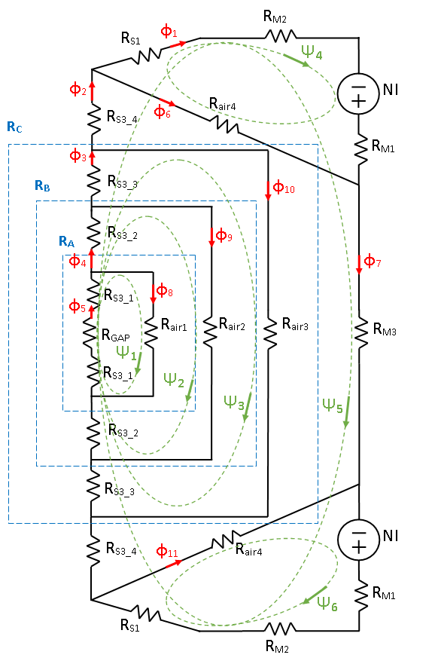
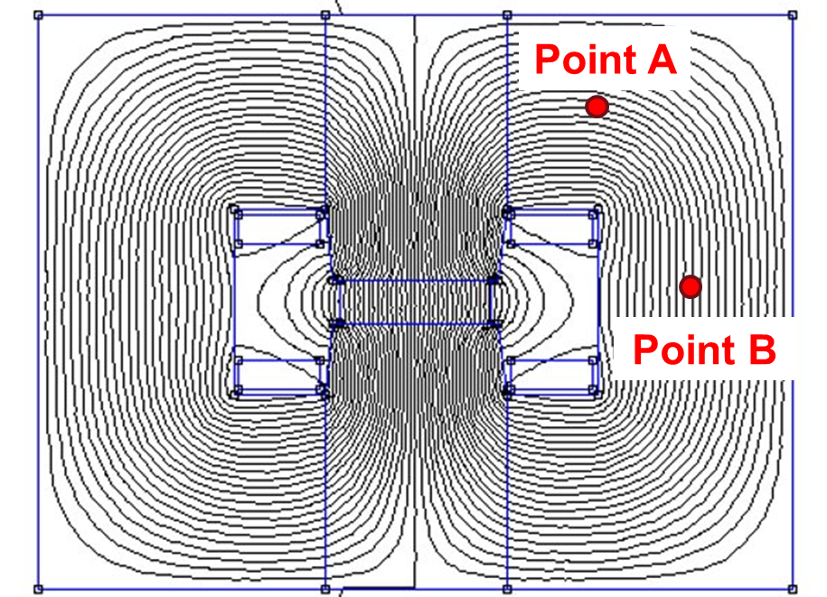
Magnetic circuit model of the H-type magnet
To reduce the computation time wrt the FEM model, an equivalent circuit model of the H-type magnet was developed
The circuit was solved with mesh analysis

Slide 7
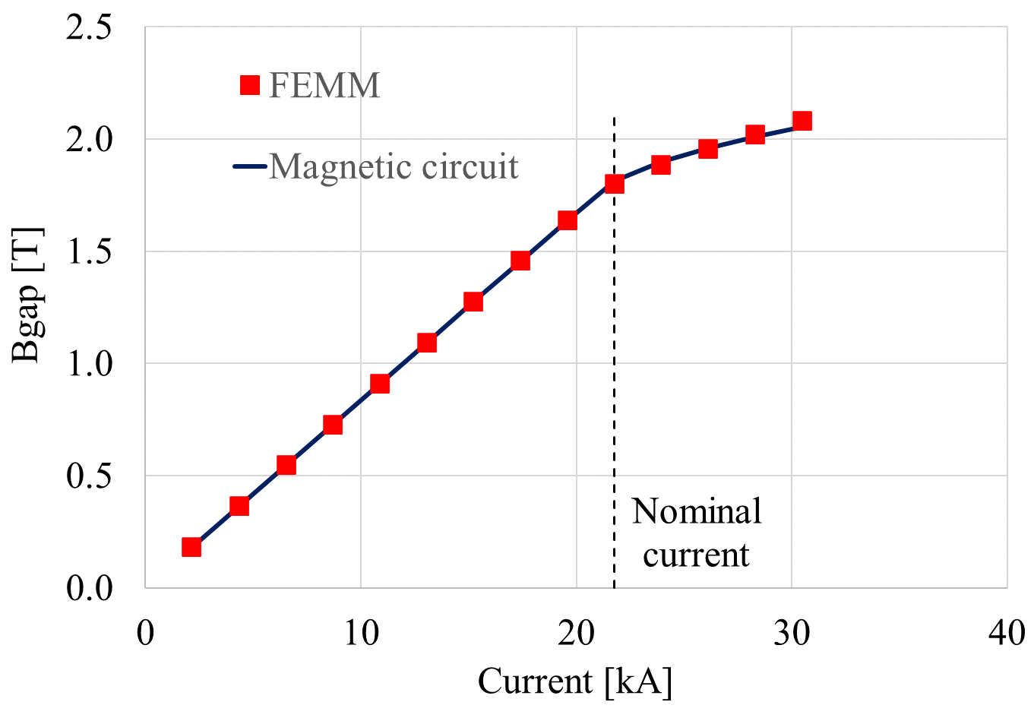
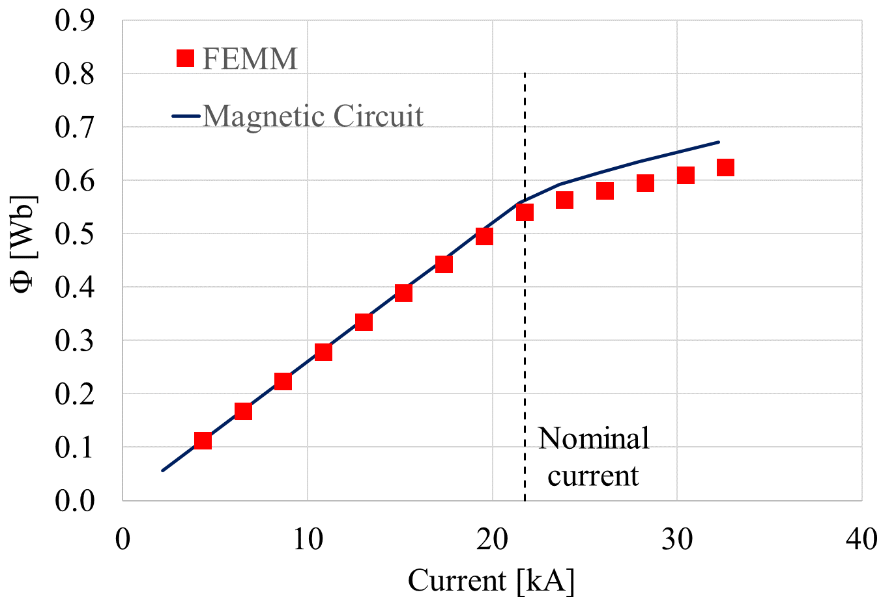
Magnetic circuit model of the H-type magnet
The field in the gap and the total flux linked to the winding were computed with both the magnetic circuit and a 2D FEM model (FEMM), obtaining a good agreement.
Field Flux

Slide 8
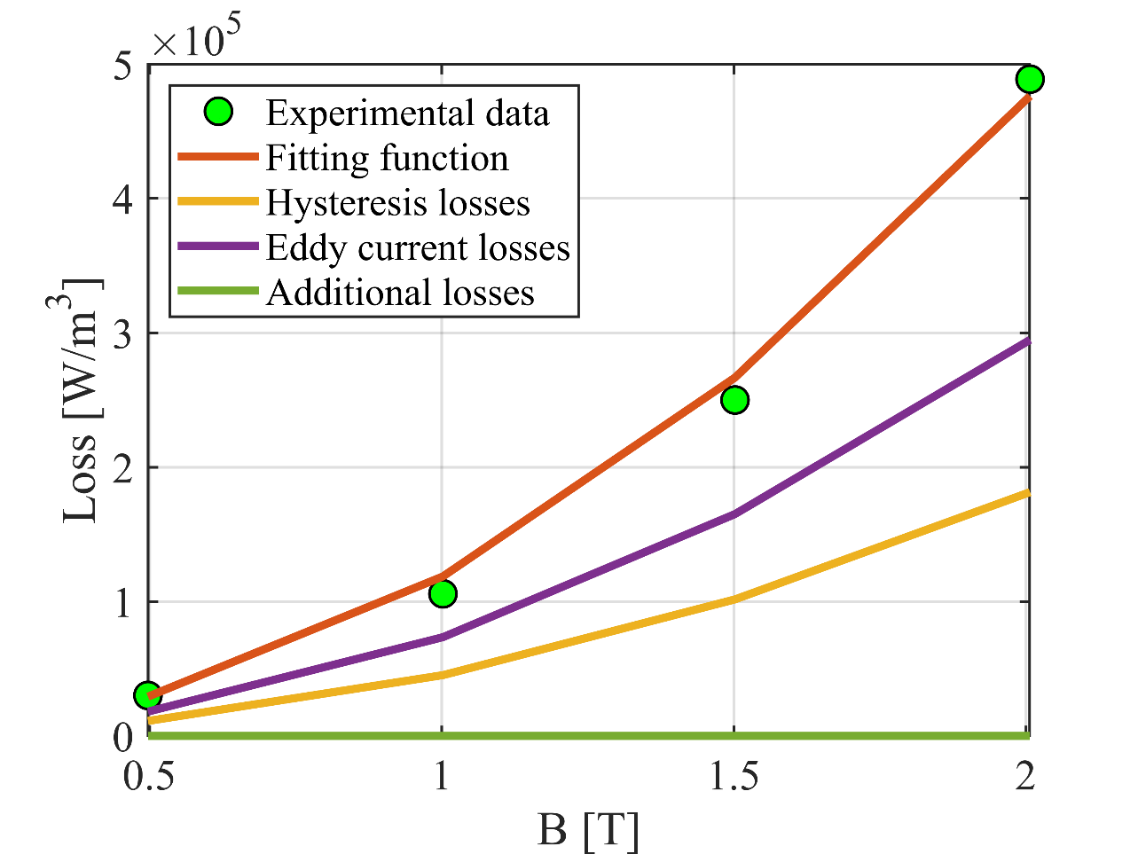
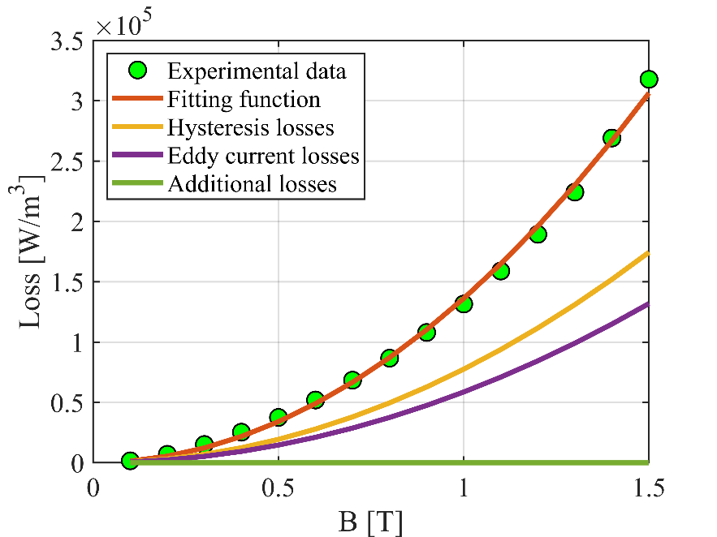
Analytical assessment of iron losses
The losses measured in the two selected ferromagnetic materials were fitted by Bertotti formula to retrieve the values of k_{hyst}, k_{eddy}, and k_{addit} parameters.
The parameters were found at f = 400 Hz
Vacoflux 48
M235-35A

Slide 9
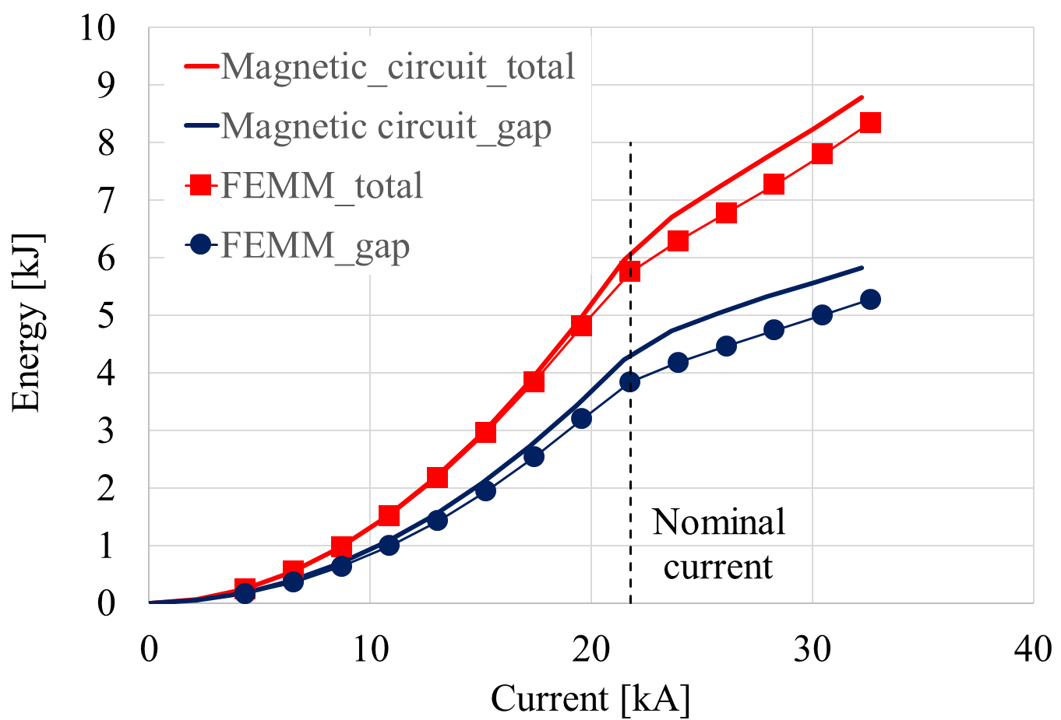
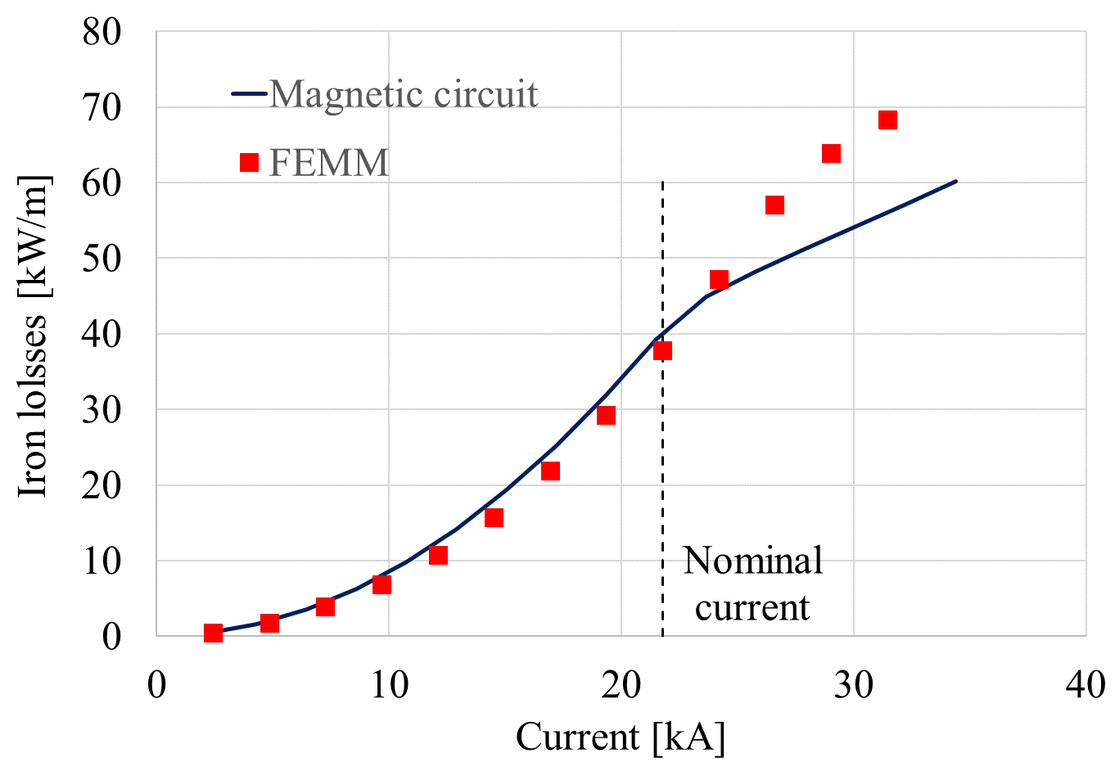
Magnetic circuit model of the H-type magnet
The magnetic energy and total losses in the iron were also computed with the FEMM model and the magnetic circuit.
FEMM linearization
Energy Iron losses

Slide 10
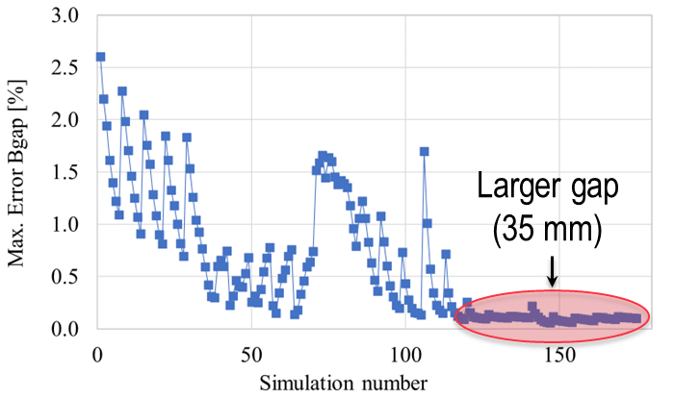
Comparison between magnetic circuit and FEMM
A parametric study was launched to compare FEMM and magnetic circuit with different geometries.
175 configurations studied, computing the maximum error with 10 values of transport current on Bgap, Etot, Φ.
13% peak error on the flux
Computation time is reduced from 177 s to 1.5 s
 | Min. (mm) | Max (mm) | Number of values
Gap width | 80 | 120 | 5
Gap height | 25 | 35 | 5
Coil width | 39.5 | 69.5 | 7

Slide 11
Outline
Options of fast-ramped resistive magnets for the accelerator
Advances in the modeling of the H-type magnet
Advances in the dynamic modeling of the resistive magnets
Preliminary thermal analysis of the hourglass magnet

Slide 12
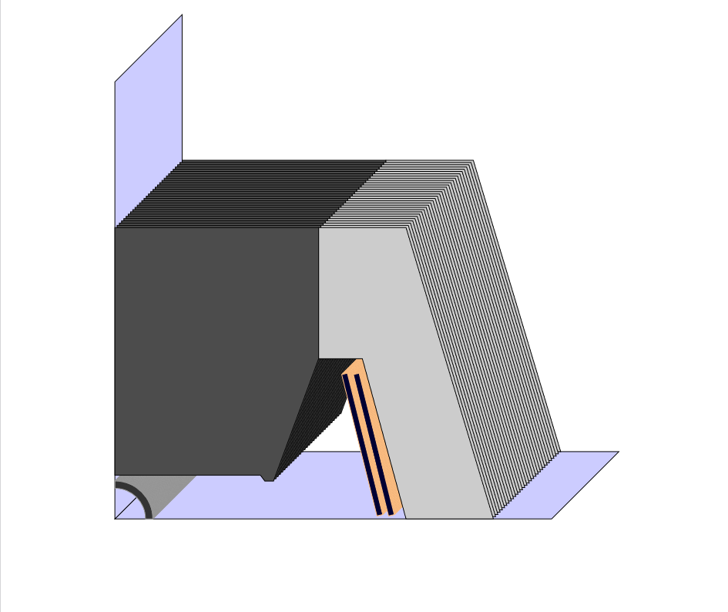
Dynamic modeling
Objective: Simulate fast-ramped magnets
PRESENT
2D FEM
Transient solver
Circuit coupling
  Magnet as multi-port element
Calculation of
  Coil losses
  Core losses
  …
FUTURE
Temperature effects
Hysteresis
3D end effects
Software:
Pyrit

Slide 13
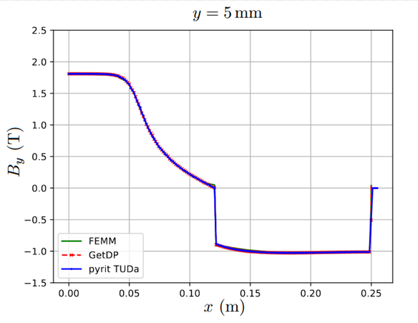
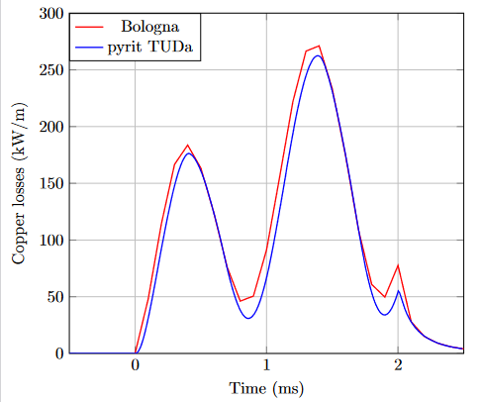
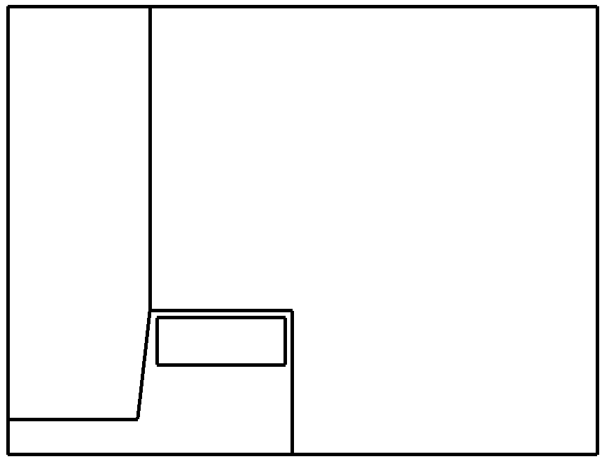
Verification
Static Transient
H-Type
model_000

Slide 14
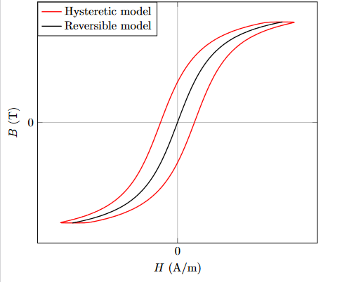
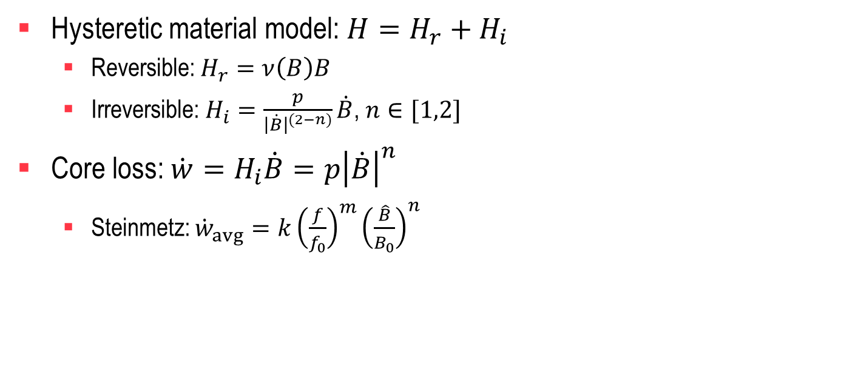
Core losses
Hysteretic material model: $H=H_{r}+H_{i}$
  Reversible: $H_{r}=ν\left(B\right)B$
  Irreversible: $H_{i}=\frac{p}{{\left|\dot{B}\right|}^{(2−n)}}\dot{B}$, $n∈[1,2]$
Core loss:$\dot{w}=H_{i}\dot{B}=p{\left|\dot{B}\right|}^{n}$
  Steinmetz: ${\dot{w}}_{avg}=k{\left(\frac{f}{f_{0}}\right)}^{m}{\left(\frac{\hat{B}}{B_{0}}\right)}^{n}$

Slide 15
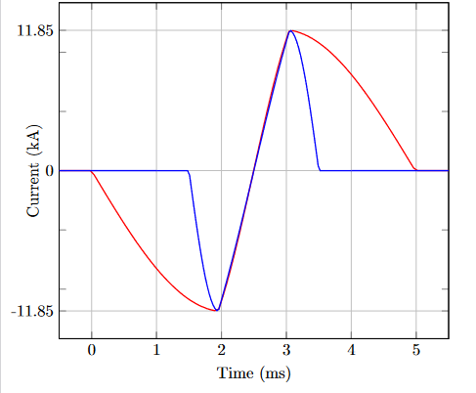
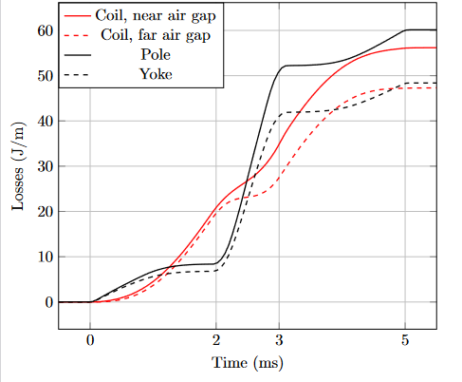
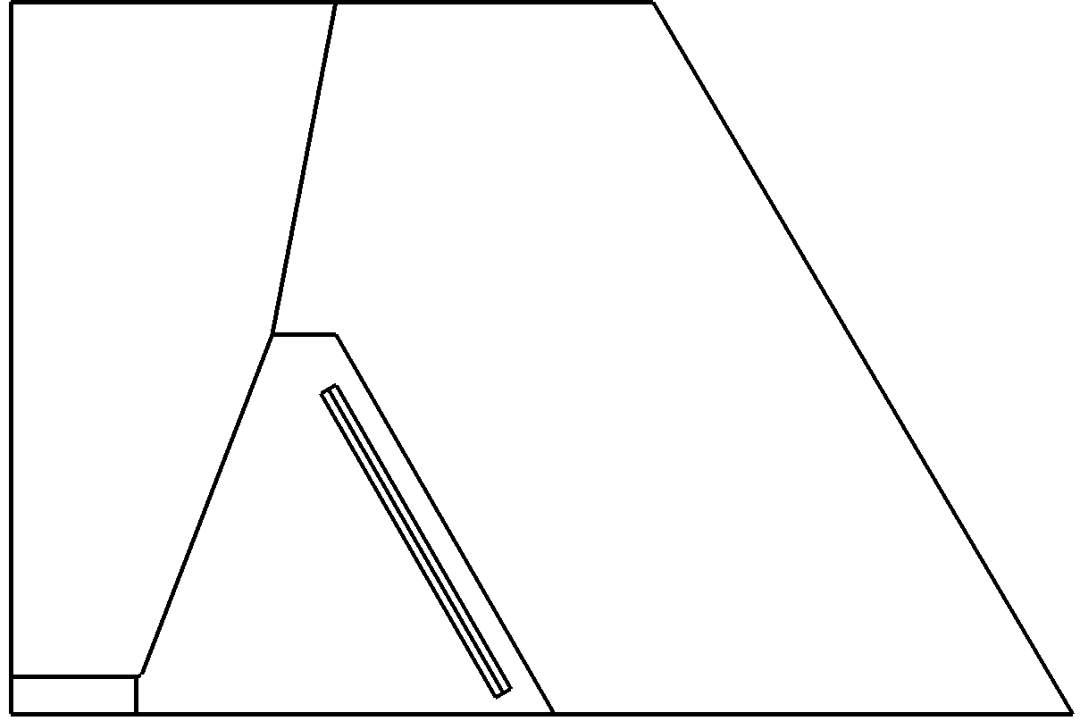

Pulse duration & losses
Long pulse $→$ low core losses
Short pulse $→$ low coil losses
$⇒$ Total losses uneffected: 240 J/cycle/m
Hourglass model_002

Slide 16
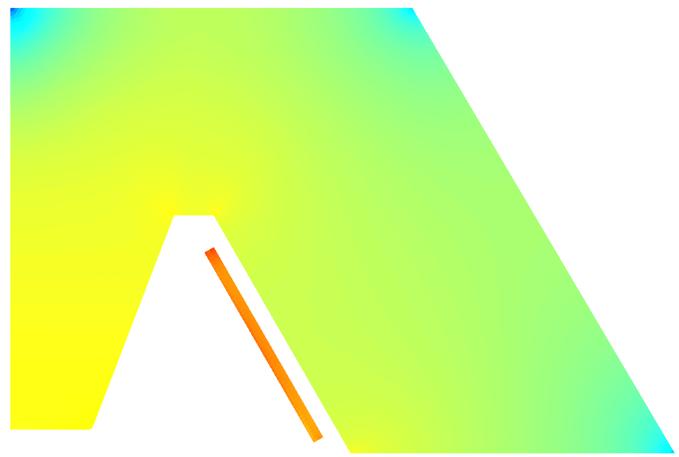
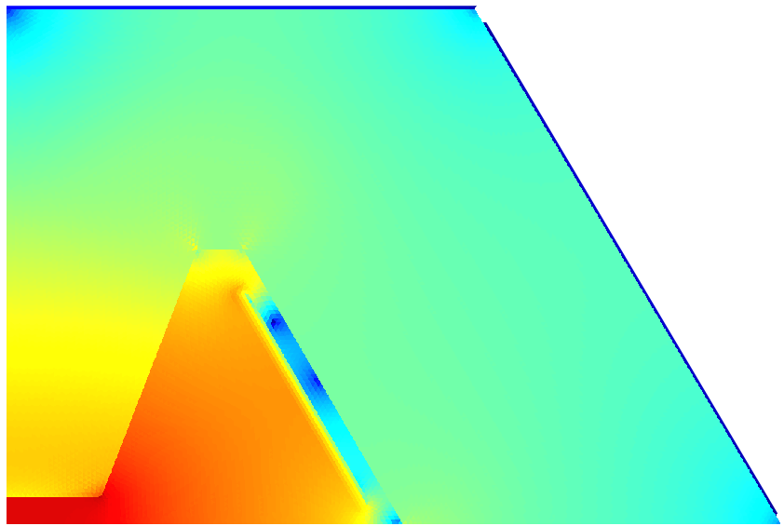
Energy densities
Losses for one cycle (J/m³) Max. stored energy (J/m³)
5ms pulse

Slide 17
Outline
Options of fast-ramped resistive magnets for the accelerator
Advances in the modeling of the H-type magnet
Advances in the dynamic modeling of the resistive magnets
Preliminary thermal analysis of the hourglass magnet

Slide 18
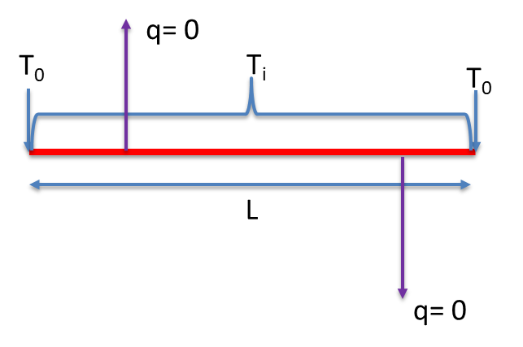
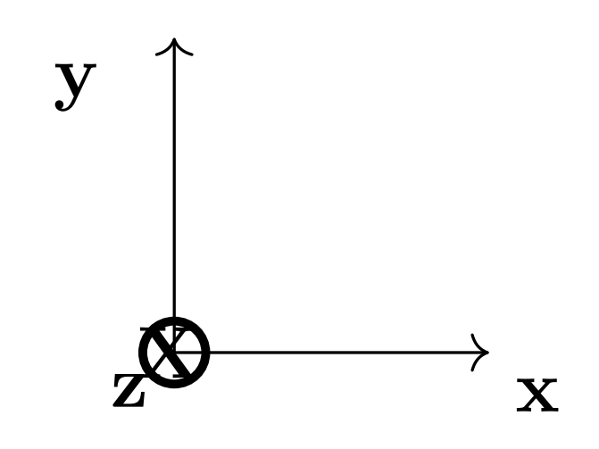
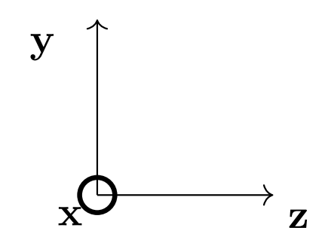
Thermal model of the hourglass magnet
To study the conduction cooling from the magnet ends, a 1D model (THEA) was developed. Only one copper bar is simulated, neglecting the interaction with other magnet parts.
Bar Width | Bar Thickness | Magnet Length (L) | Initial temperature (T_{i}) | Cooling edges temperature (T₀)
0.1403 m | 0.007 m | 1 - 2 m | 293 - 283 K | 293 K

Slide 19
Thermal model results
To reduce the computation time, the heat generated during the pulsed operation is averaged over the cycle and treated as a constant value.
The analytical solution at steady state regime is in agreement with the numerical simulation.
Temperature rise above 150 degrees for L = 2 m: challenging for conduction cooling from the magnet ends.
L = 1 m L = 2 m
Pulse = 5 ms, ∆T_{max} = 41 K
P = 129 W/m
Pulse = 5 ms, ∆T_{max} = 157 K
P = 129 W/m

Slide 20
Conclusions
The design of fast ramped resistive magnets for the Muon Collider accelerator is ongoing
A magnetic circuit model of the H-type magnet was developed, which includes the analytical computation of the iron losses
Transient 2D FEM models of both H-type and hourglass type magnet were developed, which allow coupling with the external circuit
In perspective, analytical formulae for the losses in the copper windings will be added to the circuit model
Temperature effects, 3D end effects and hysteresis will be added to the FEM models

Slide 22
Additional slides

Slide 23
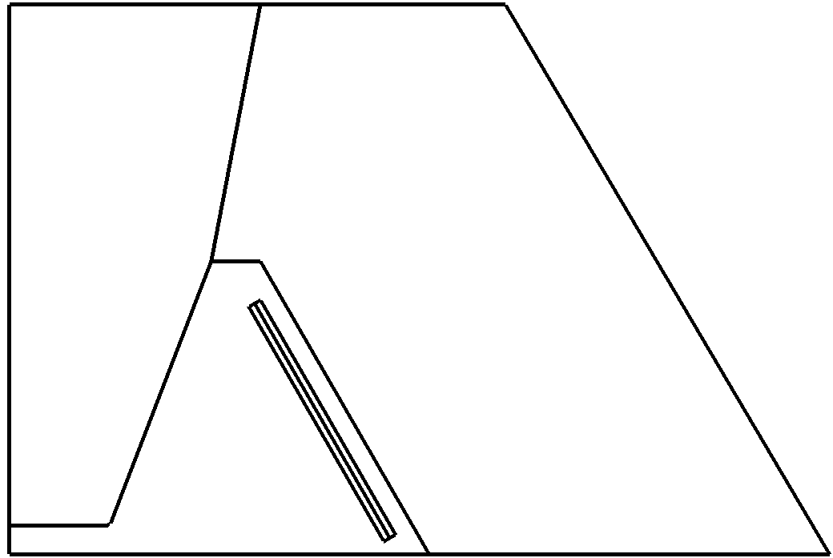
Considered geometries
Hourglass H-Type

Slide 24
Pulse duration
Map Dipole | Transient T=5ms | Harmonic f=200Hz | Transient T=2ms | Harmonic f=500Hz
Bgap [T] | 1.8 | 1.8 (Static) | 1.8 | 1.8 (Static)
Mmf [kAt] | 47.4 | 47.4 | 47.4 | 47.4
Core losses (yoke) [J/cycle-m] (M235-35A, k=9e-3, m=1.3, n=1.9) | 48.4 | 64.3 | 83.4 | 84.6
Core losses (pole) [J/cycle-m] (M235-35A, k=9e-3, m=1.3, n=1.9) | 60.1 | 71.6 | 102.5 | 94.3
Coil Losses [J/cycle-m] | 56.2+47.3=103.5 | 60.5+52=112.5 | 32.2+18.8=51 | 43.8+23.8=67.6
Total losses [J/cycle-m] | 212 | 248 | 238 | 247
Stored energy (total / gap) [J/m] | 6720 / 3800 | 6720 / 3800 (Static) | 6720 / 3800 | 6720 / 3800 (Static)

Slide 25
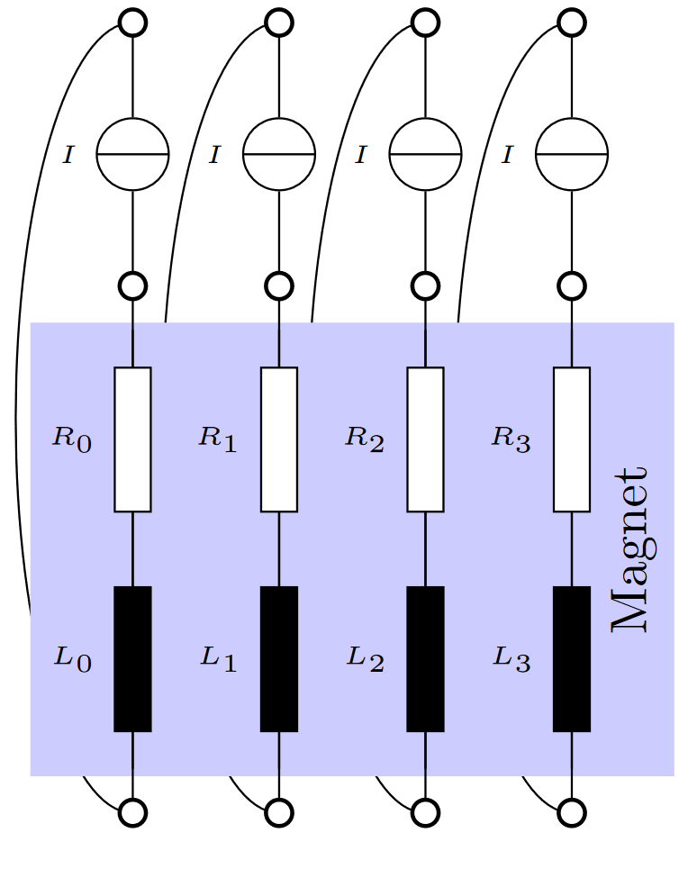
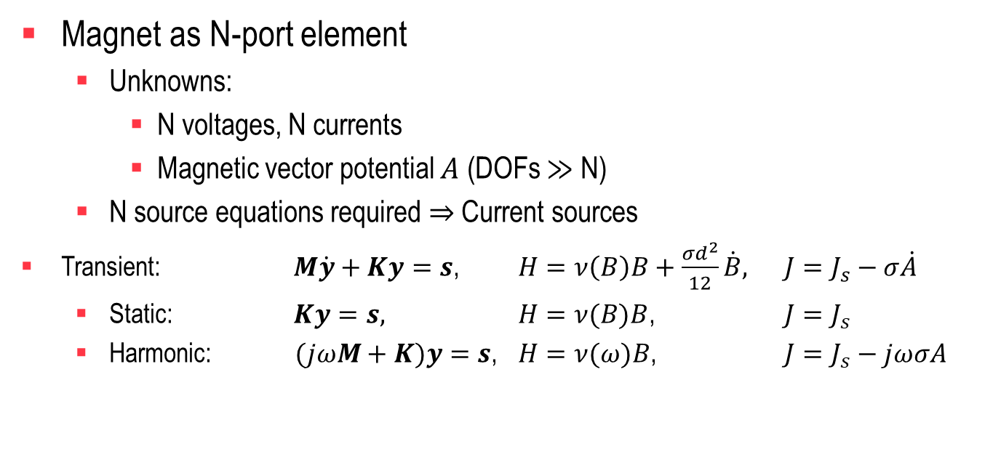
Magnet simulation
Magnet as N-port element
  Unknowns:
    N voltages, N currents
    Magnetic vector potential $A$ (DOFs $≫$ N)
  N source equations required $⇒$ Current sources
Transient: $M\dot{y}+Ky=s$, $H=ν\left(B\right)B+\frac{σd^{2}}{12}\dot{B},$ $J=J_{s}−σ\dot{A}$
  Static: $Ky=s,$ $H=ν(B)B$, $J=J_{s}$
  Harmonic: $(jωM+K)y=s$, $H=ν(ω)B$, $J=J_{s}−jωσA$

Slide 26
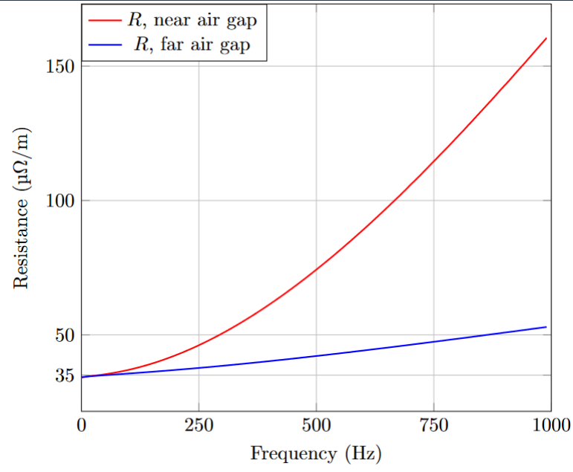


Coil losses
Power density: $\dot{w}=\frac{1}{σ}{\left|J\right|}^{2}$
Statics: $J=J_{s}∝I=GV$
Dynamics: $J=J_{s}−σ\dot{A}$
  Skin effect

Slide 27
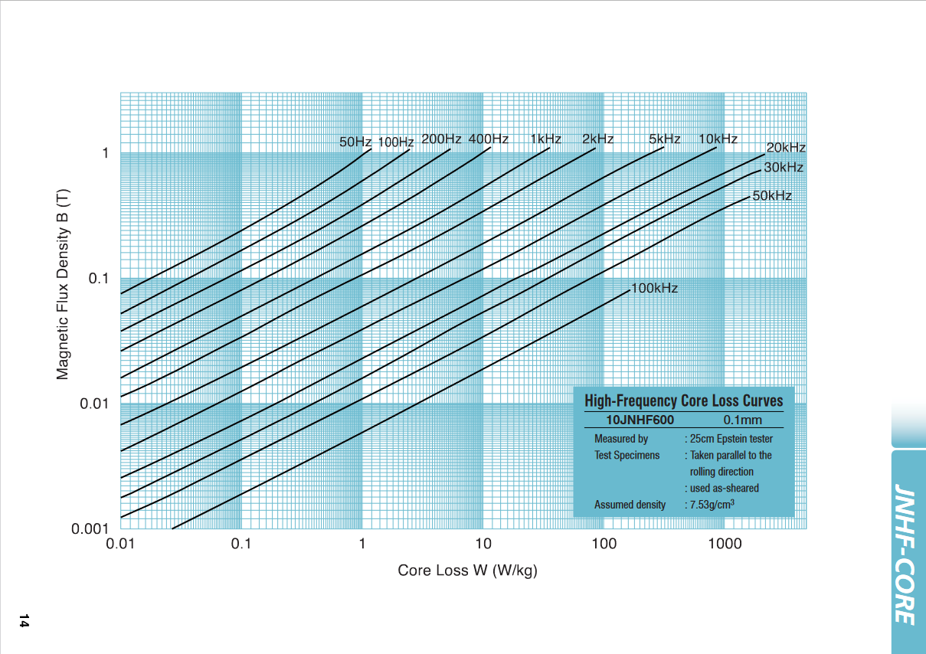

Core losses - post-processing
$B$ and $H$: pair on hysteresis loop
  Distinct elements = distinct hysteresis loops
Steinmetz formula: ${\dot{w}}_{avg}=k{\left(\frac{f}{f_{0}}\right)}^{m}{\left(\frac{\hat{B}}{B_{0}}\right)}^{n}$
  Post-processing
  Only for sinusoidal quantities
  No phase lag or amplitude effect
  attributed to hysteresis

Slide 28
Thermal model assumptions
To reduce the computation time, the heat generated during pulsing operation conditions is averaged in the cycle period and treated as a constant value.
P= 129 W/m
Pulse time = 5 ms,
peak power loss = 5.175 kW/m

Slide 29
Thermal model results
Magnet lengths above 1 m determine temperature rises above 150 degrees and seem challenging for the conduction cooling from the magnet ends.
Energy [J/cycle/m] | Pulse duration [ms] | Conductor length [m] | Initial temperature [K] | ∆T_{max} [K]
12.75 | 2 | 1 | 293 | 20.3
25.875 | 5 | 1 | 293 | 41.3
12.75 | 2 | 2 | 293 | 77
25.875 | 5 | 2 | 293 | 157
12.75 | 2 | 1 | 283 | 20.3
25.875 | 5 | 1 | 283 | 41.3

