Slide 1

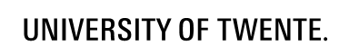

AC loss calculation for RCS 1.8 T magnet (ReBCO-HTS option)
Simon Otten, Anna Kario, Herman ten Kate
With contributions of: H. Piekarz, M. Breschi and F. Boattini
Muon Collider Collaboration Meeting, CERN, 13th of March 2024

Slide 2
Outline
Hysteresis loss calculations, 2 case studies:
  ReBCO-HTS magnet design by FNAL (H. Piekarz et al.)
  Modified magnet design by Unibo/CERN
  (M. Breschi, F. Boattini et al.)
Outlook: possible methods for AC loss reduction

Slide 3
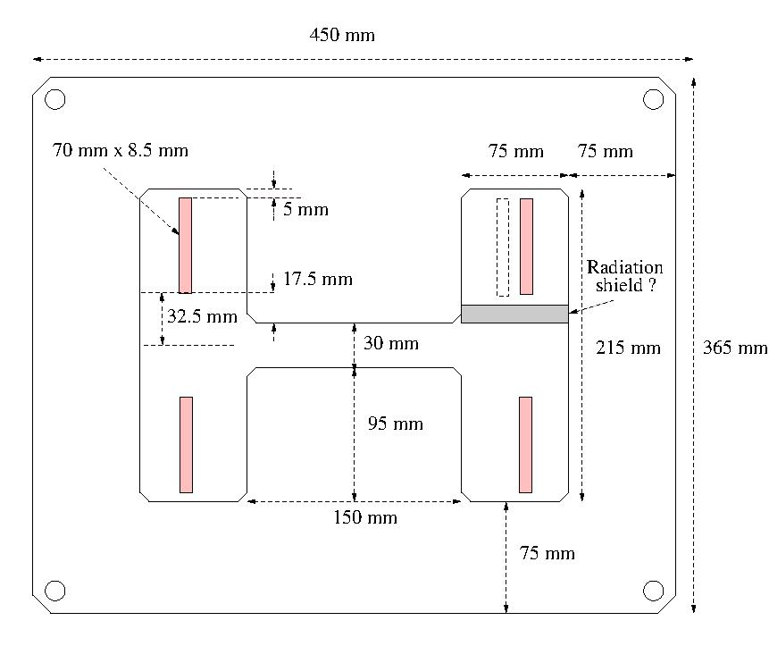
Conceptual magnet design by H. Piekarz et al. (Fermilab)
Magnet cross-section
Warm core with H-shaped hole
30 mm pole gap for beam pipe
Target gap field ± 2 T
ReBCO coils 72 kA-turns
HTS coil
2x6 sub-cables
6 kA per sub-cable
Sub-cable
2-mm-wire REBCO tapes (12x)
Two layers, six tapes per layer
ReBCO tapes
water-cooled iron core
stainless steel cooling pipe
3.5 mm inner radius
4.0 mm outer radius
HTS coils
72 kA-turns
Image by H. Piekarz

Slide 4
AC hysteresis loss calculation approach
Two steps:
Magnetostatic FEM:
  calculate core magnetic field as function of current
Network model:
  calculate AC loss for six parallel REBCO cables with applied magnetic field and current
  https://doi.org/10.1109/TASC.2024.3364120
Network model assumptions
2D geometry based on cross-section
each sub-cable has 12 strands in 2 layers
layer radii are 4.05 and 4.15 mm
tape width 2 mm
0.5 mm gaps between tapes within a layer
gaps in successive layers are never aligned
zero tape thickness
40 elements per tape
angle dependent J_{c}(B) for SuperPower tape (Robinson database)
power law E(J) relation with n = 30
each tape carries the same current
no coupling loss
no current redistribution
no eddy current loss
no core loss

Slide 5
Core - magnetic field calculation
I = 36 kA
Core magnetic field calculated by subtraction of the cable’s magnetic field
Calculation done at I = 1, 2, 3, …, 40 kA to generate interpolation data

Slide 6
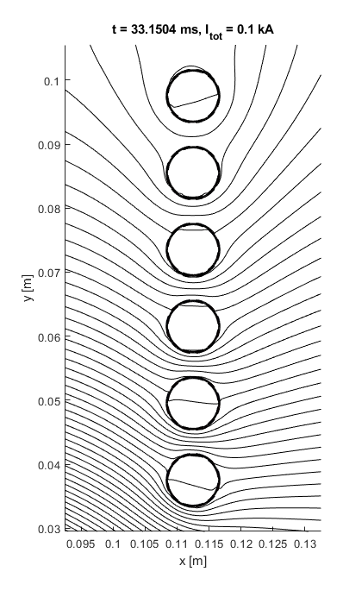
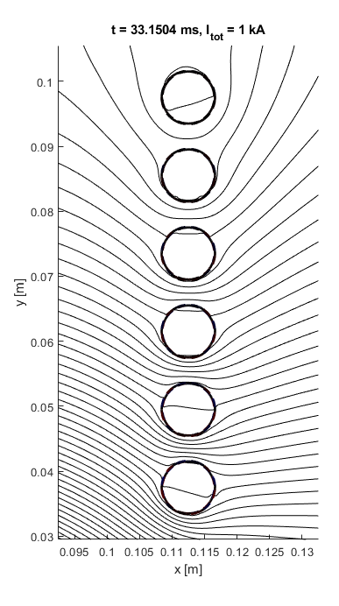
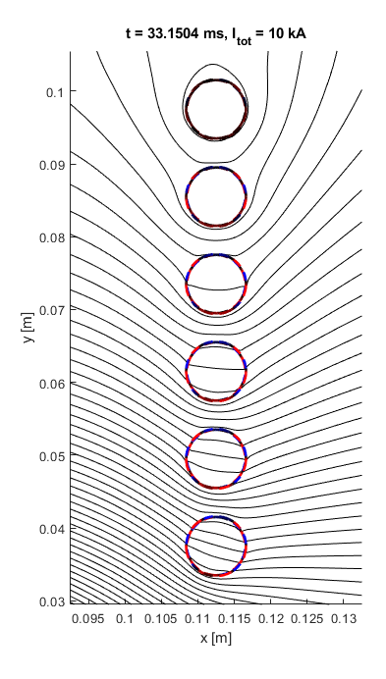
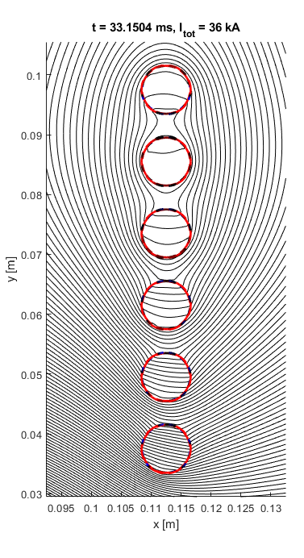
Some magnetic field plots
Magnetic field expelled at low amplitudes
Magnetic field penetrates at high amplitudes
sub-cable 6
|B| = 0.19 T
sub-cable 5
|B| = 0.07 T
sub-cable 4
|B| = 0.08 T
sub-cable 3
|B| = 0.17 T
sub-cable 2
|B| = 0.27 T
sub-cable 1
|B| = 0.43 T

Slide 7
AC loss for a ramp from -36 to +36 kA
Used Jc(B) data of SuperPower AP tape measured at 20 K.
+36 kA
Negligible dependence on ramp rate
(hysteresis only!)
+1.70 T
-1.70 T
1 kT/s ramp
-36 kA
t_{ramp} = 6 ms
integration window for Q
12.3 J/m per quarter magnet
--> 49 J/m for the full magnet
--> ~ 0.5 kW/m with 5 Hz repetition rate!

Slide 8
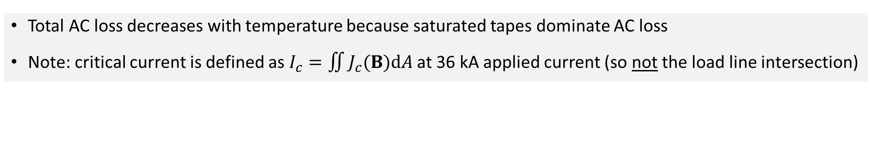
AC loss as a function of temperature
Sub-cable critical current as function of temperature
Hysteresis AC loss as function of temperature
6 kA sub-cable current
Total AC loss decreases with temperature because saturated tapes dominate AC loss
Note: critical current is defined as $I_{c}=\iint{J_{c}(B)dA}$ at 36 kA applied current (so not the load line intersection)

Slide 9
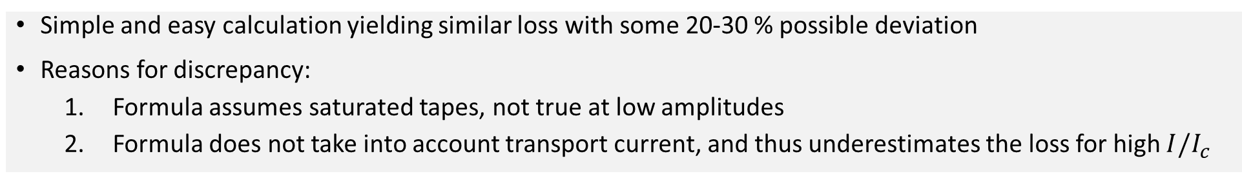
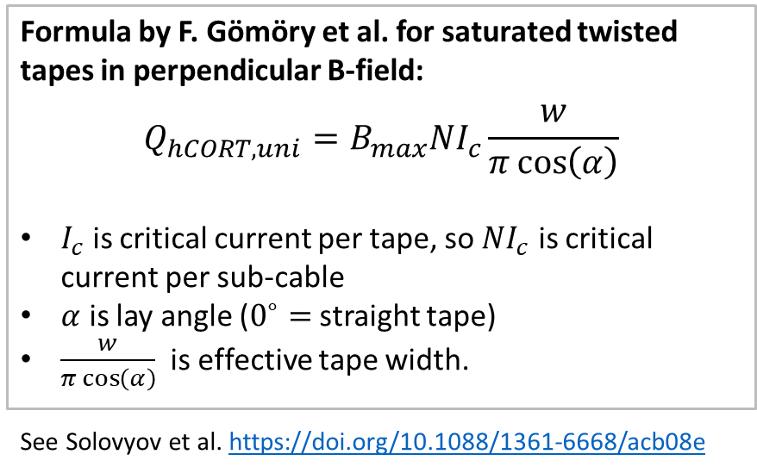
Comparison with simple analytical loss estimate
Formula by F. Gömöry et al. for saturated twisted tapes in perpendicular B-field:
$$Q_{hCORT,uni}=B_{max}NI_{c}\frac{w}{π\cos\left(α\right)}$$
$I_{c}$ is critical current per tape, so $NI_{c}$ is critical current per sub-cable
$α$ is lay angle ($0^{∘}=$ straight tape)
$\frac{w}{π\cos\left(α\right)}$ is effective tape width.
See Solovyov et al. https://doi.org/10.1088/1361-6668/acb08e
Hysteresis AC for the quarter magnet (6 sub-cables)
Simple and easy calculation yielding similar loss with some 20-30 % possible deviation
Reasons for discrepancy:
  Formula assumes saturated tapes, not true at low amplitudes
  Formula does not take into account transport current, and thus underestimates the loss for high $I/I_{c}$

Slide 10
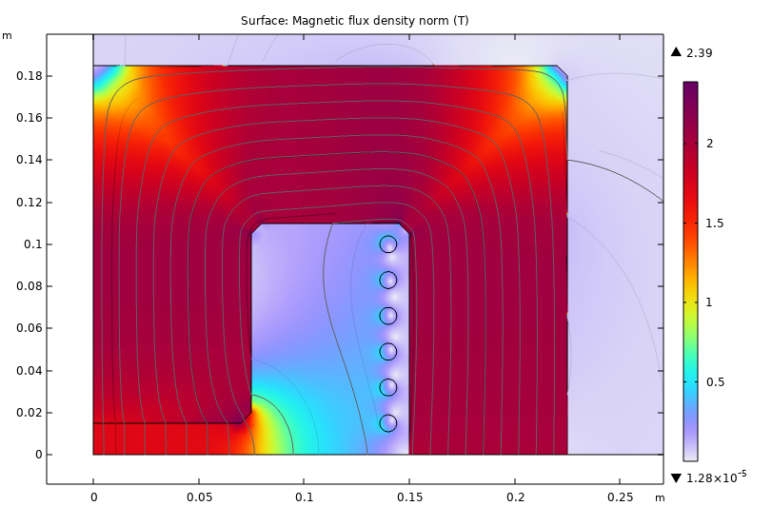
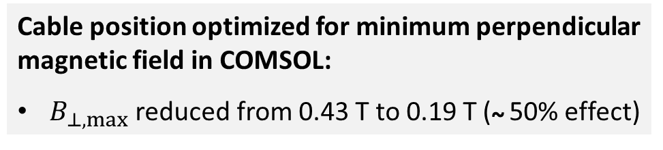
Hysteresis loss reduction by changing conductor position
Cable position optimized for minimum perpendicular magnetic field in COMSOL:
$B_{⊥,max}$ reduced from 0.43 T to 0.19 T (~ 50% effect)
AC loss per half cycle reduced from 12.3 to 7.6 J/m
(-38% !)
+36 kA
+1.71 T
-1.71 T
1 kT/s ramp
-36 kA

Slide 11
Outline
Hysteresis loss calculations, 2 case studies:
  ReBCO-HTS magnet design by FNAL (H. Piekarz et al.)
  Modified magnet design by Unibo/CERN (M. Breschi, F. Boattini et al.)
Outlook: possible methods for AC loss reduction

Slide 12
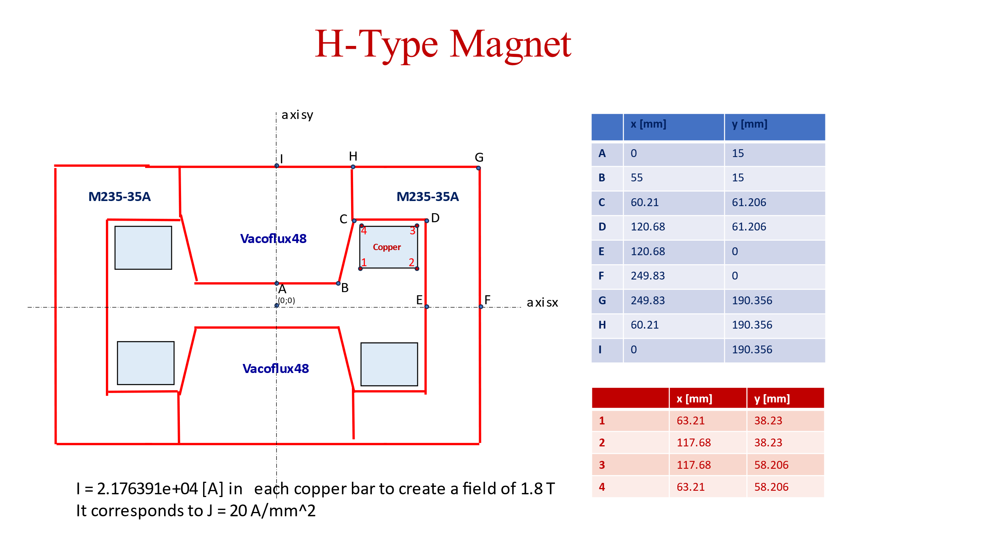
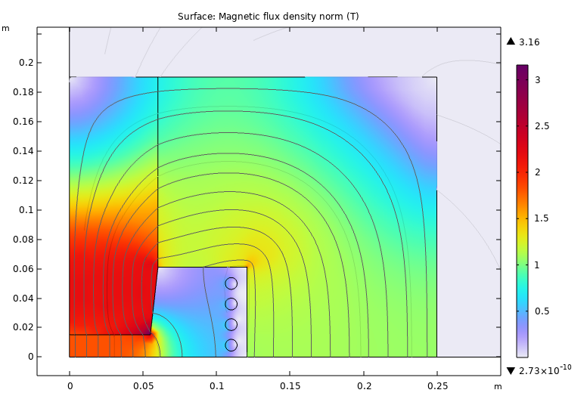
Modification of 1.8 T resistive magnet
H-type resistive magnet by Breschi et al.
Modified magnet:
Same core geometry and material
Cu conductor replaced by ReBCO-HTS conductor
Conductor loss estimation 2 kW/m
(F. Boattini et al., “Recent progress on the models of power converters and resistive magnets”, https://indico.cern.ch/event/1374333/ )
5.44 kA
4x cooling pipe with ReBCO conductor (12x2 mm)

Slide 13
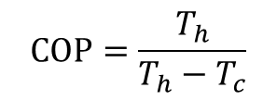
Comparison of AC hysteresis loss
Similar loss level for both designs (within 10%)
(critical state estimation)
Minimum refrigeration power exceeds loss of resistive option for T_{c} < 30 K
$$COP=\frac{T_{h}}{T_{h}−T_{c}}$$
ascf

Slide 14
Conclusion
Hysteresis loss estimate of considered designs is 0.2 – 0.5 kW/m in the cold
ReBCO conductor loss is below resistive Cu option (2 kW/m), however, refrigerator power is excessive for T < 30 K and needs to be included
Outlook: possible ways to reduce loss of the ReBCO-HTS option
  Adapt magnet layout to reduce perpendicular field on coated conductor
  Adaptation of the conductor layout, e.g. filamentization
  Increasing operation temperature for lower refrigerator power.

