Slide 1






Magnet plan muon beam production
Marco Statera, INFN-MI LASA
Alfredo Portone, Fusion for Energy
Stefano Sorti, UMIL and INFN-MI LASA
Bernardo Bordini Luca Bottura, Siara Fabbri and Carlotta Accentura CERN
Funded by the European Union (EU). Views and opinions expressed are however those of the author only and do not necessarily reflect those of the EU or European Research Executive Agency (REA). Neither the EU nor the REA can be held responsible for them.

Slide 2
Outline
Price assumptions
Schedule, cost and people
  Target solenoid
  6D cooling
  Final cooling
Recap

Slide 3
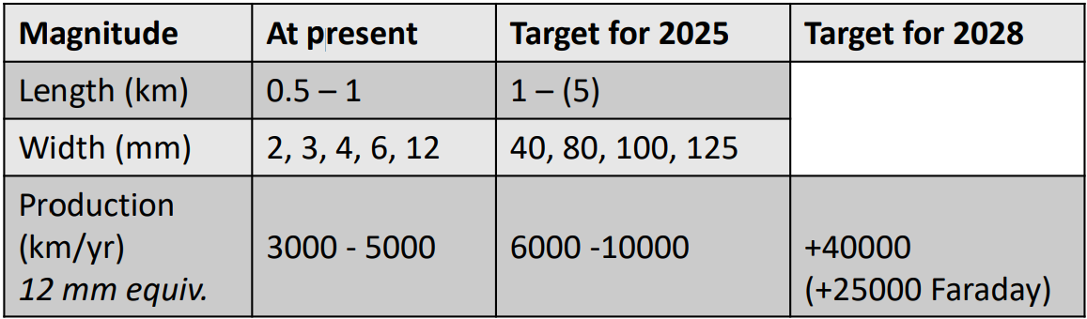
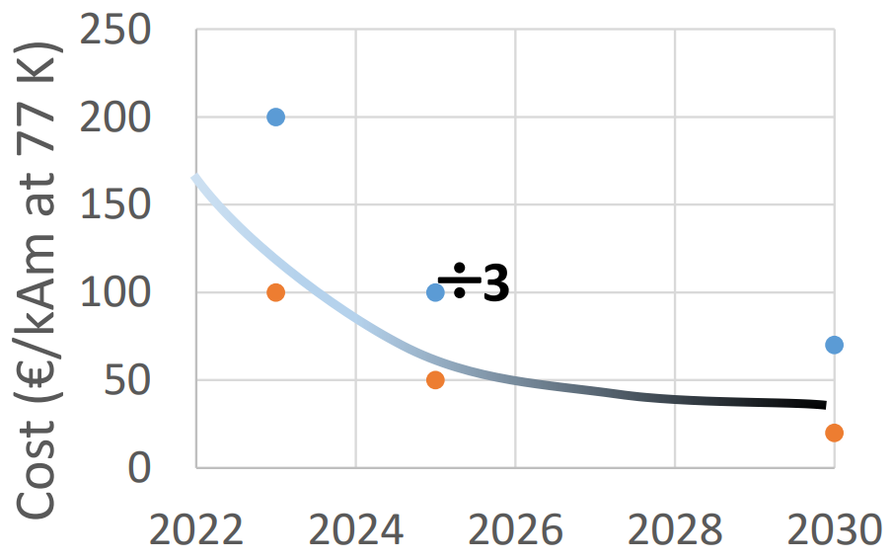
Price assumption
A more complete work should also propagate uncertainty!
Consider cost metric for superconductors, dollars per kiloampere-meter ($/kA-m), at 77 K in self-field (~ 20 K, 20 T). Three steps:
  Today 100-200 $/kAm
  Projection from electric power market: 50 $/kAm
  Long-term large-scale production:
  10 $/kAm
  Source: A. Molodyk and C. Larbalestier, Science, 2023
Industries are pushing for larger productions
See figures on the right
  Source: T. Puig, Plenary presentation given at EUCAS 2023
Assumption of costs for Muon Collider:
we have 50 $/kAm from the actual market situation. If MuCol is built, huge demand for REBCO.
Still, let’s avoid extreme cases: 25$/kAm

Slide 4
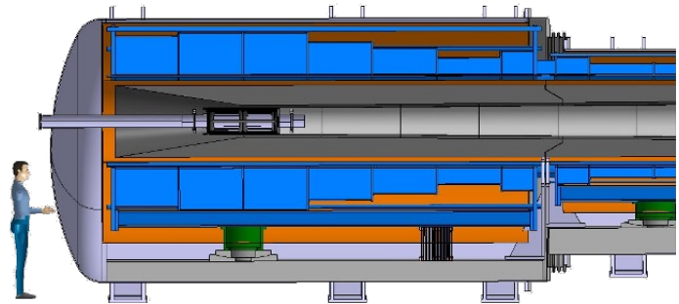
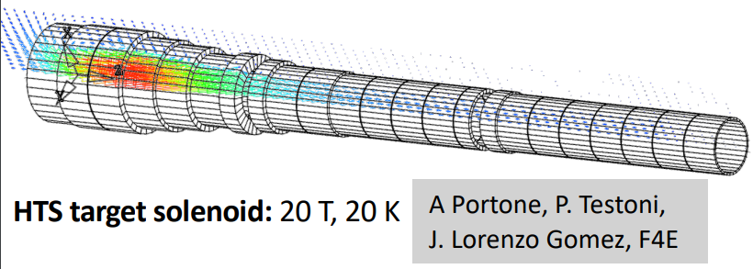
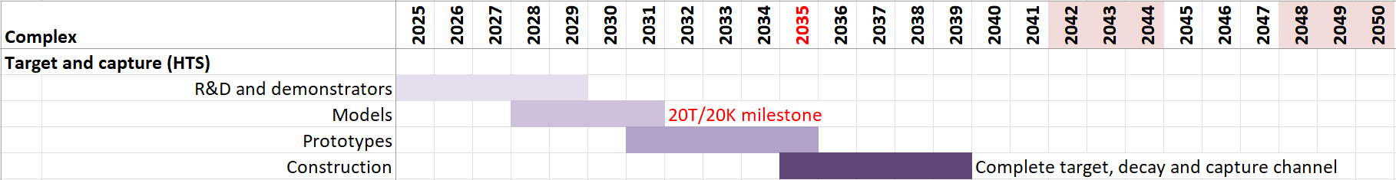
Target solenoid cost estimation
Conductor total 40% of magnet
Mechanics, cryostat, assembly: 60%
Grand total: 1.3%
No criticalities in time scheduling:
1 FTE+1TECH
1 FTE+1TECH

Slide 5
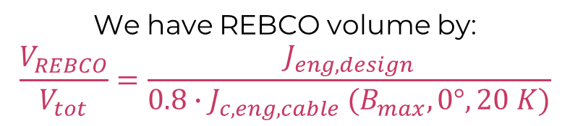
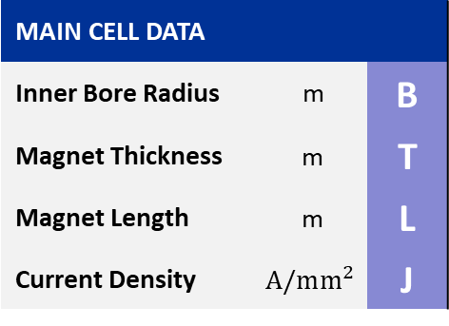
6D Cooling Magnet design “conversion”
We are currently following the Nb₃Sn design from US
How to convert it into 20 K REBCO design with no re-design?
“Distributed pancakes” assumption: the volume is filled with REBCO 2XHTS+MI 12 mm coil grid at 20% critical current margin. Thus:
  Poorly efficient coils, each block has the J_{c} of the worst point
  (should shrink coils and perform grading or multi-width);
  The max B on conductor is approximately still valid
r
We have REBCO volume by:
$$\frac{V_{REBCO}}{V_{tot}}=\frac{J_{eng,design}}{0.8{∙J}_{c,eng,cable}(B_{max},0°,20 K)}$$
MAIN CELL DATA
Inner Bore Radius | m | B
Magnet Thickness | m | T
Magnet Length | m | L
Current Density | $$A/mm^{2}$$ | J
z
Inner Bore Radius
Standard production from Faraday Factory, 2022
B||c
Magnet Length
Magnet Thickness

Slide 6
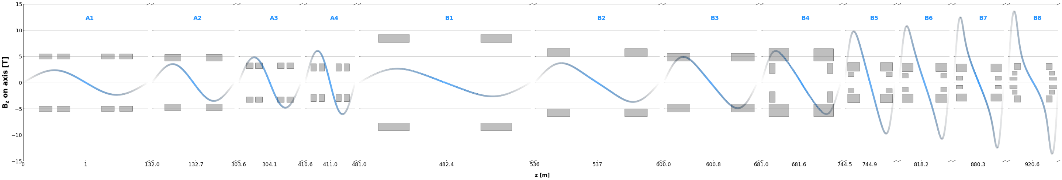
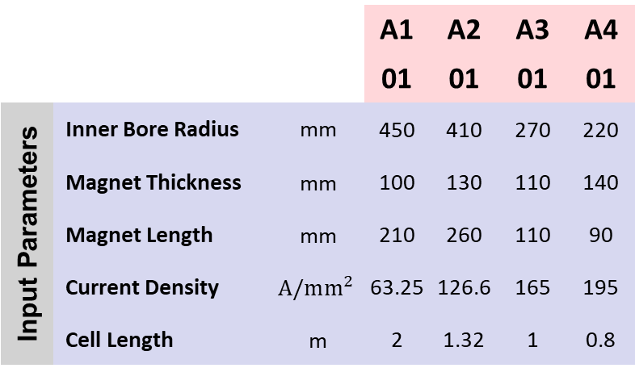
All Cells and the Distance they cover
Courtesy of Siara Fabbri
Unique cell type
 |  |  | A1 | A2 | A3 | A4
 |  |  | 01 | 01 | 01 | 01
Input Parameters | Inner Bore Radius | mm | 450 | 410 | 270 | 220
 | Magnet Thickness | mm | 100 | 130 | 110 | 140
Geometry | Magnet Length | mm | 210 | 260 | 110 | 90
 | Current Density | $$A/mm^{2}$$ | 63.25 | 126.6 | 165 | 195
 | Cell Length | m | 2 | 1.32 | 1 | 0.8
B1 | B2 | B3 | B4 |  | B5 |  | B6 |  | B7 |  | B8
01 | 01 | 01 | 01 | 02 | 01 | 02 | 01 | 02 | 01 | 02 | 01 | 02 | 03
770 | 500 | 410 | 175 | 410 | 113 | 217 | 84 | 215 | 50 | 210 | 45 | 140 | 250
150 | 150 | 150 | 200 | 240 | 88 | 165 | 92 | 160 | 74 | 145 | 65 | 80 | 120
500 | 360 | 370 | 92 | 320 | 100 | 196 | 100 | 177 | 100 | 170 | 120 | 80 | 100
69.8 | 90 | 123 | 94 | 70.3 | 157 | 168 | 185 | 155.1 | 198 | 155 | 220 | 135 | 153
2.75 | 2 | 1.5 | 1.27 |  | 0.806 |  | 0.806 |  | 0.806 |  | 0.806
Unique coil type

Slide 7
Results in terms of conductor consumption
A more complete work should also propagate uncertainty!
Weighted-average cell conductor cost:
25€/kAm X 0.6 kA X 31 km = 472 k€

Slide 8
Some insights to check and comment
SANITY CHECK: Log-log, two straight lines are plotted (red and blue). Note that the proportionality between L and V is mediated by the field. I.e. for the same volume, if B is higher, more conductor is needed (lower J_{c})
INSIGHT: The cells with higher fields have also higher J (colours) but the lowest J_{c}
In fact, for instance, coil B8-1 is the one with the highest filling of volume (about 50%).

Slide 9
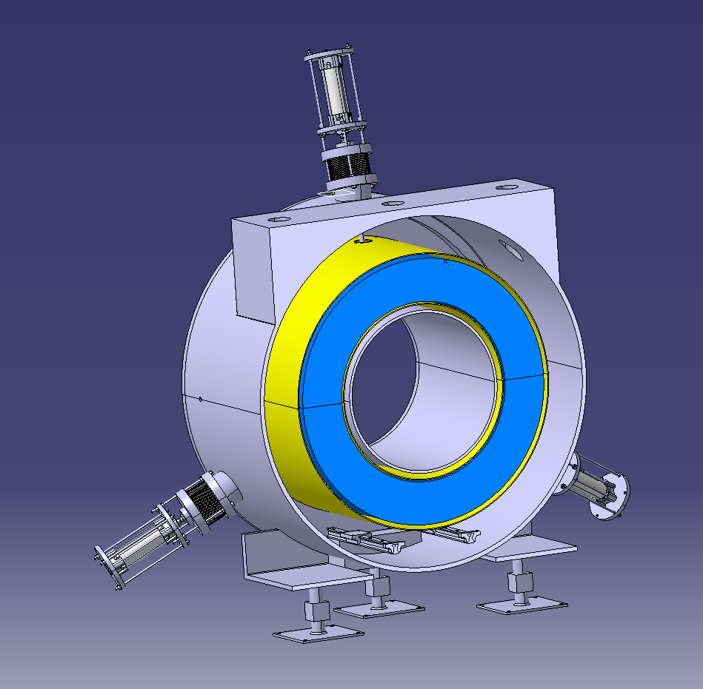
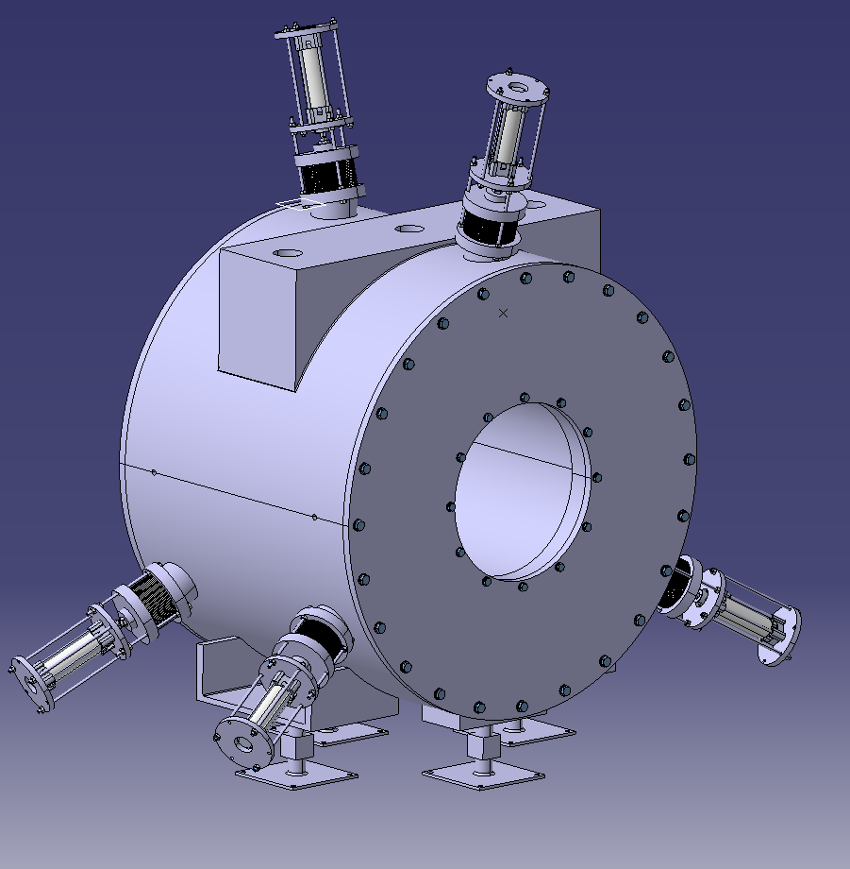
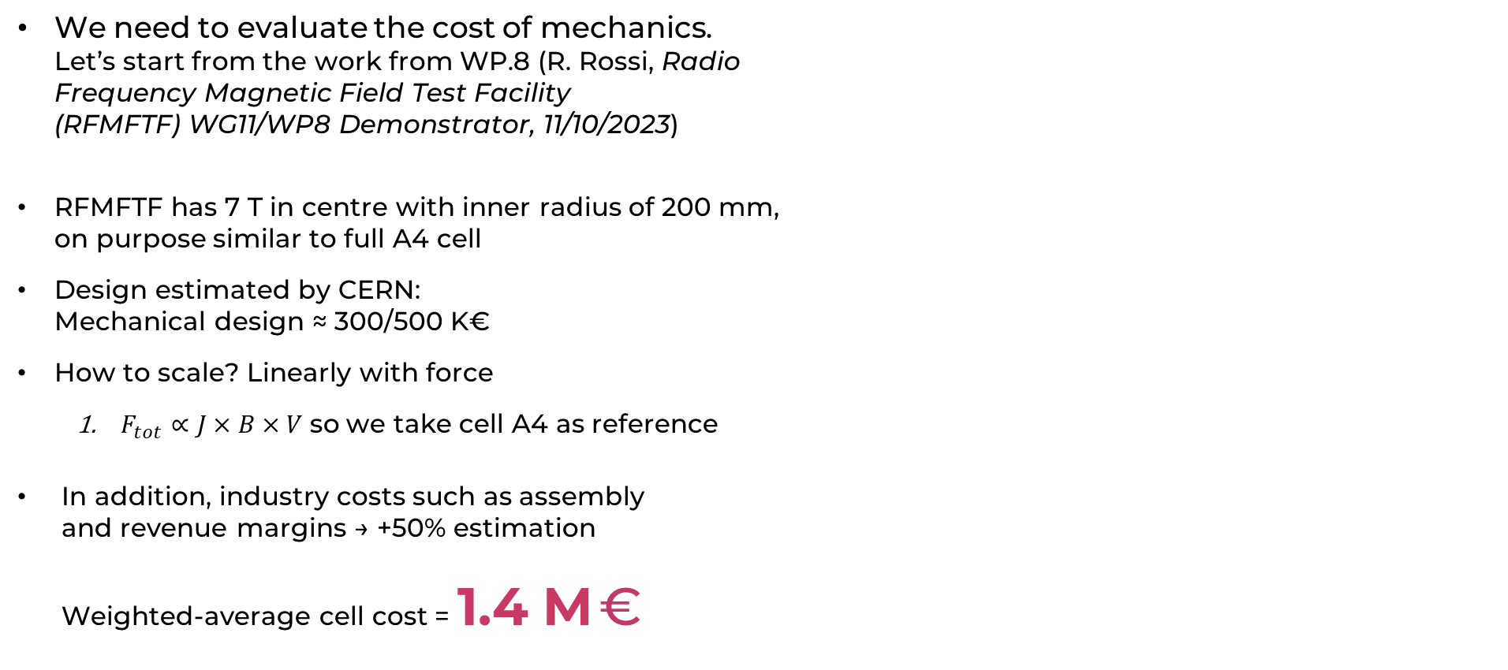
6D Cooling mechanical cost estimation
A more complete work should also propagate uncertainty!
We need to evaluate the cost of mechanics.
Let’s start from the work from WP.8 (R. Rossi, Radio
Frequency Magnetic Field Test Facility
(RFMFTF) WG11/WP8 Demonstrator, 11/10/2023)
RFMFTF has 7 T in centre with inner radius of 200 mm,
on purpose similar to full A4 cell
Design estimated by CERN:
Mechanical design ≈ 300/500 K€
How to scale? Linearly with force
  $F_{tot}∝J×B×V$ so we take cell A4 as reference
In addition, industry costs such as assembly
and revenue margins → +50% estimation
Weighted-average cell cost = 1.4 M €
I take 300, but then add 100 for all other system
(cooling, sensors, etc..)
Scaling factor

Slide 10
One + one km of 6D cooling
826 cells
mechanical support
Power leads
cryostat
2432 single coils
winding
components
Impregnation (?)
assembly
Grand total 2 km
22% of total cost
Grand total
2864 single coils
1652 cells (12 types)
+8% if REBCO costs as today
+4% if REBCO costs twice

Slide 11
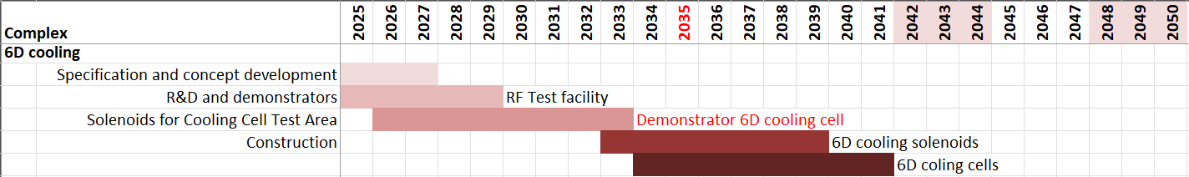
6D Cooling Schedule and people
1 FTE+2 TECH
3 FTE+4 TECH
3 FTE+4 TECH
2 FTE+2 TECH
2 FTE+2 TECH
For test area construction 1 team for solenoids and 1 team for cells
1 team/firm
2 teams/firms
6D cooling solenoids | 7 Years | 336 weeks | 7.2 coils/week 1 km | 14.5 coils/week 2 km
6D cooling cells | 8 Years | 384 weeks | 2.2 cell/week 1km | 4.3 cell/week 2 km
2 teams/firms
4 teams/firms
Strong effort by industry

Slide 12
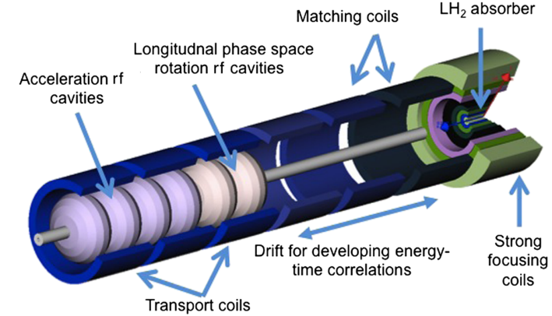
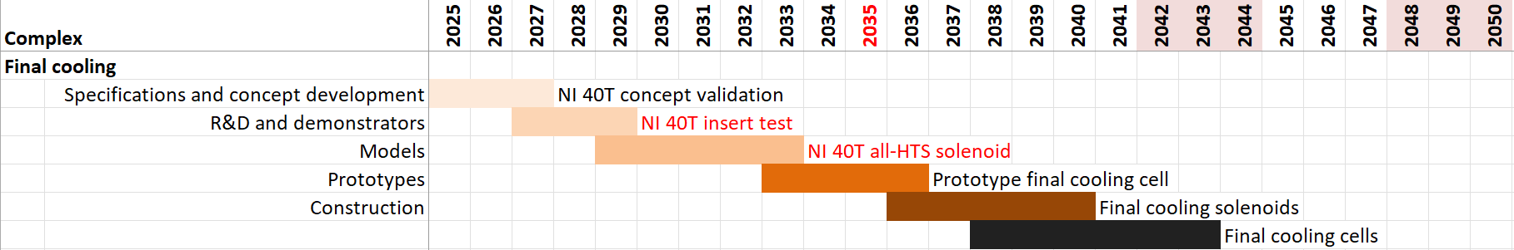
Final Cooling cost estimation
Even with less-optimistic estimations for conductor cost,
estimated 0.3% (R&D not included)
No criticalities in time scheduling:
UHF solenoid
B. Bordin and C. Accentura
1 FTE+1TECH
1 FTE+1TECH

Slide 13
Recap
Target solenoid and final cooling solenoids seem feasibile as for scheduling
6D cooling magnets may fit the foreseen schedule
A strong effort of industry has to be foreseen: 4 production teams
Schedule for production of cooling demonstrator seems reasonable, cost about 1% of the total cost
Follow up activities seem reasonable
These considerations assume that the R&D work is successful and on time
Bernardo Bordini Luca Bottura, Siara Fabbri and Carlotta Accentura, CERN
Alfredo Portone, Fusion for Energy
Stefano Sorti, UMIL and INFN-MI LASA
Marco Statera, INFN-MI LASA

