Slide 1




Magnet systems development and production schedule & cost estimate
B. Caiffi², A. Bersani², S. Farinon²,
S. Mariotto³ , D. Novelli^{1,2} , A. Pampaloni ², T. Salmi⁴ , L. Bottura⁵, ...
¹Sapienza University of Rome , ²INFN – Genoa , ³INFN – Milan , ⁴Tampere University , ⁵CERN

Slide 2
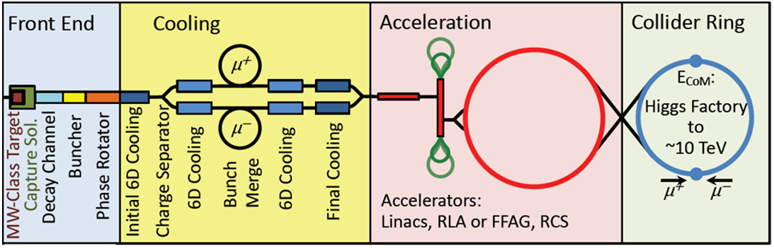
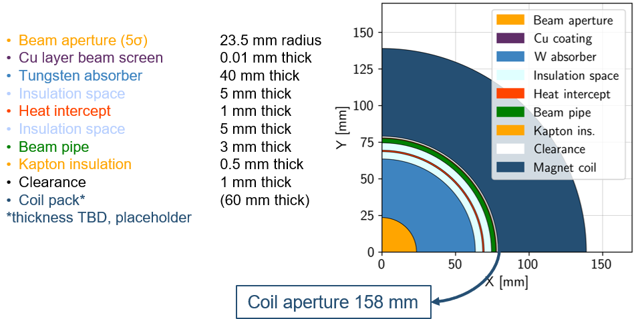
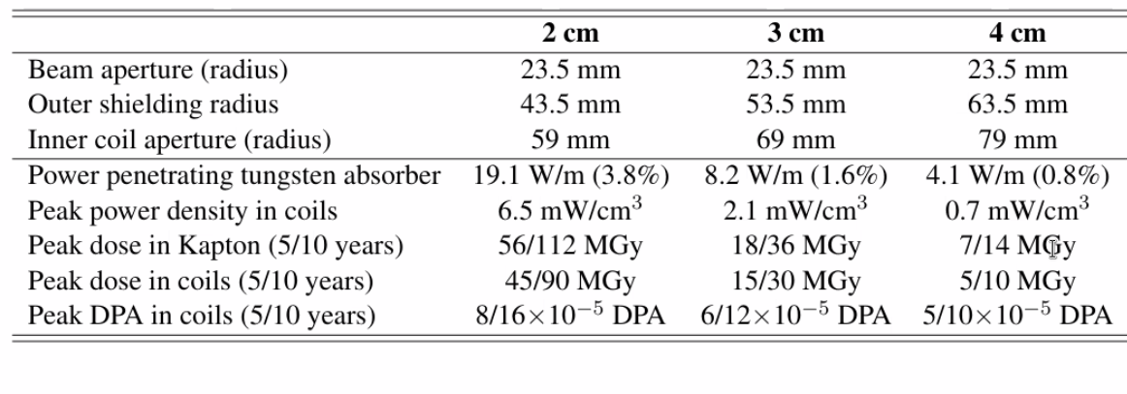

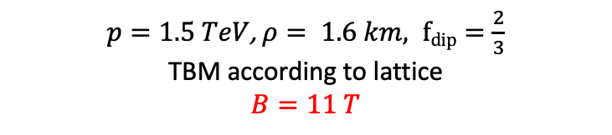
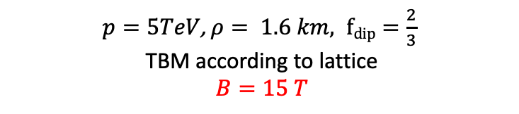
Magnet requirements
Task 7.4 Collider Ring Magnets (INFN)
10 TeV collider (10 km ring):
15T /150 mm (REBCO, hybrid)
5 m length
1200 magnets
$$B\left[T\right]ρ\left[km\right]=3.3 × p[TeV]$$
$p=5TeV$, $ρ= 1.6 km, fdip=\frac{2}{3}$
TBM according to lattice
$B=15 T$
3 TeV collider (5 km ring):
11T/150 mm (Nb₃Sn)
5 m length
600 magnets
$p=1.5 TeV$, $ρ= 1.6 km, fdip=\frac{2}{3}$
TBM according to lattice
$$B=11 T$$
Radial build
Courtesy of Anton Lechner
With REBCO @ 20 K W_{abs} can be 3 cm thick (P<10 W/m)
What about 2 cm? Would the dose be acceptable?
138 mm
Courtesy of Patricia Borges de Sousa
https://indico.cern.ch/event/1250075/contributions/5357594/

Slide 3
Tentative Schedule (3 TeV collider)
  ARC DIPOLES 11T/158mm
  (quadrupoles and IR still not included)
  Initial proposal
R&D and
demonstrators
3 years
demonstrator
Models
Prototypes
Pre-series
Series
 | 2025 | 2026 | 2027 | 2028 | 2029 | 2030 | 2031 | 2032 | 2033 | 2034 | 2035 | 2036 | 2037
5 years
models
Aggressive time schedule, 13 years from R&D to end of construction
4 years
full length prototypes
3 years
3x90 dipole magnets
4 years
3x200 dipole magnets
  Revised proposal
+ 4 years
R&D and
demonstrators
4 years (+1)
Models
Prototypes
Pre-series
Series
 | 2025 | 2026 | 2027 | 2028 | 2029 | 2030 | 2031 | 2032 | 2033 | 2034 | 2035 | 2036 | 2037 | 2038 | 2039 | 2040 | 2041
demonstrator (1)
6 years (+ 1)
models (10)
17 years from R&D to end of construction
5 years (+ 1)
full length prototypes (5)
4 years (+ 1)
3x30 dipole magnets
4 years
3x200 dipole
magnets
Nb3Sn demonstrator program $\sim$ 6 years
LHC: 13 short models in 11 years, 6 prototypes in 4 years, pre-series 4 years, series 4 years

Slide 4
Tentative Schedule (10 TeV collider)
  ARC DIPOLES 15T/138 mm
  (quadrupoles and IR still not included)
  Initial proposal
Specifications and concept development
23 years from R&D to end of construction
3 years
Models
Prototypes
Pre-series
Series
 | 2025 | 2026 | 2027 | 2028 | 2029 | 2030 | 2031 | 2032 | 2033 | 2034 | 2035 | 2036 | 2037 | 2038 | 2039 | 2040 | 2041 | 2042 | 2043 | 2044 | 2045 | 2046 | 2047
R&D and demonstrators
5 years
demonstrator
7 years
models
6 years
full length prototypes
3 years
3x30 dipole magnets
5 years
3x400 dipole magnets
+3 years
  Revised proposal
Specifications and concept development
4 years (+1)
R&D and demonstrators
Models
Prototypes
Pre-series
Series
 | 2025 | 2026 | 2027 | 2028 | 2029 | 2030 | 2031 | 2032 | 2033 | 2034 | 2035 | 2036 | 2037 | 2038 | 2039 | 2040 | 2041 | 2042 | 2043 | 2044 | 2045 | 2046 | 2047 | 2048 | 2049 | 2050
6 years (+1)
26 years from R&D to end of construction
demonstrator model ( 1 per concept)
8 years (+1)
models (10)
5 years (-1)
full length prototypes (5)
4 years (+1)
3x30 dipole magnets
4 years (-1)
3x400 dipole magnets
More emphasis on demonstrator and short model phase (REBCO or hybrid solutions still to be studied)

Slide 5
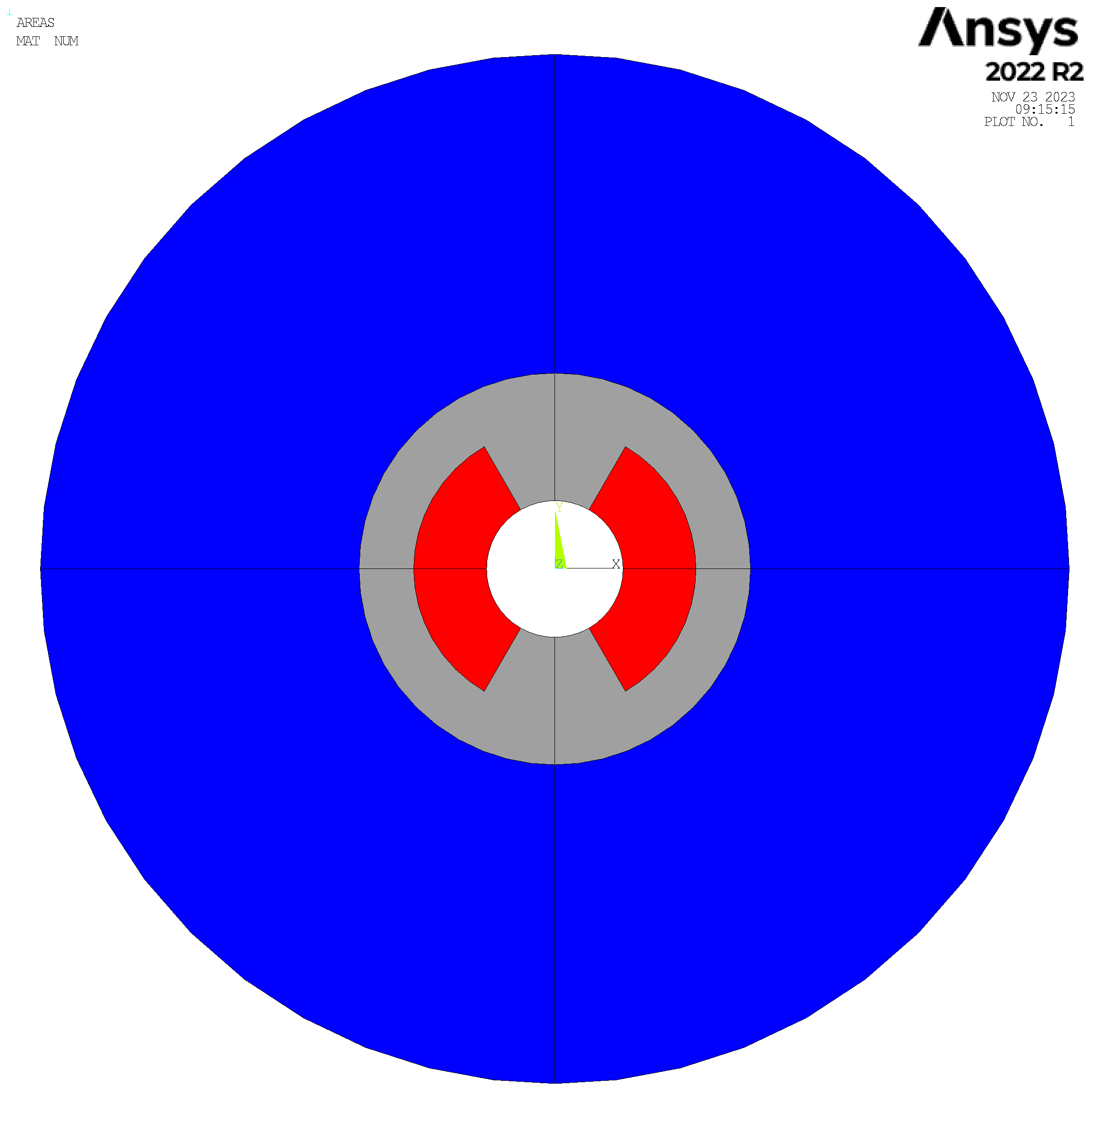

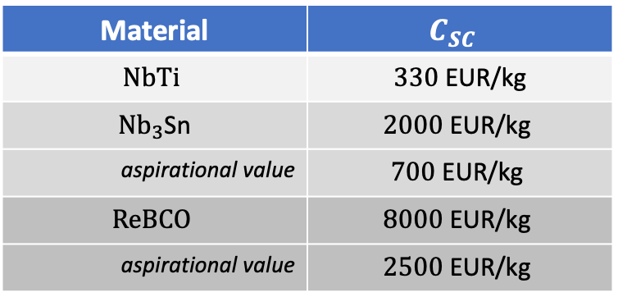
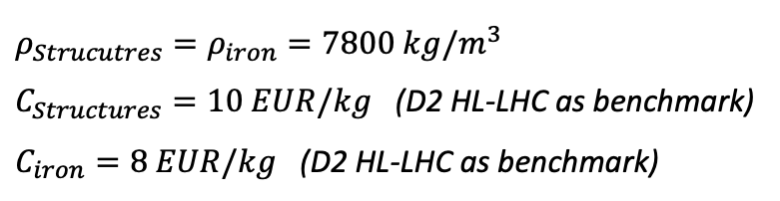
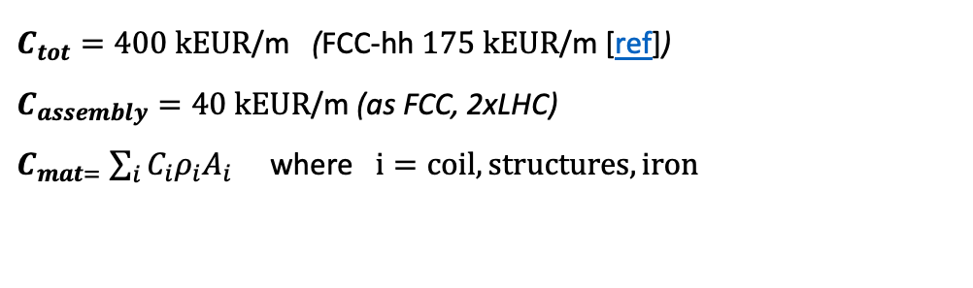
Cost Model
Optimization of the cross section still ongoing.
Cost estimate performed on a simplified geometry with a sector coil dipole and iron and steel structure modelled as circular crowns.
R _{bore}, w_{coil}, w_{iron} and w_{struct} optimized to fulfil beam optics requirements, margin on the load line, acceptable stress on the conductor and effectiveness of the quench protection (see D. Novelli presentation [ref])
$C_{tot}=400 \text{k}\text{EUR}\text{/}\text{m}$ (FCC-hh $175 \text{k}\text{EUR}\text{/}\text{m}$ [ref])
$C_{assembly}=40 \text{k}\text{EUR}\text{/}\text{m}$ (as FCC, 2xLHC)
$C_{mat=}$ $\sum_{i}{C_{i}ρ_{i}A_{i}}$ where $i=coil, structures, iron$
$$ρ_{Strucutres}=ρ_{iron}=7800 kg/m^{3}$$
$C_{Structures}=10 EUR/kg$ (D2 HL-LHC as benchmark)
$C_{iron}=8 EUR/kg$ (D2 HL-LHC as benchmark)
Bore
Coil
Structures
Iron
$$ρ_{coil}=8000 kg/m^{3}$$
Material | $$C_{SC}$$
$$NbTi$$ | $330 \text{EUR}\text{/}\text{kg}$
${Nb}_{3}$Sn | $$2000 \text{EUR}\text{/}\text{kg}$$
aspirational value | $$700 \text{EUR}\text{/}\text{kg}$$
$$ReBCO$$ | $$8000 \text{EUR}\text{/}\text{kg}$$
aspirational value | $$2500 \text{EUR}\text{/}\text{kg}$$
Escalated price in 2016
The right value in 2016
Corresponds to the FCC target
The value of today (2023)
A realistic projection for the next years

Slide 6

Cost Estimate (3TeV)
Dipoles of the arc for the series production
(quadrupoles and IR not included)
  11T /158 mm (Nb₃Sn)
€/kg iron | €/kg struct | €/kg conductor *
8 | 10 | 700
* 7€/kAm, FCC target 5€/kAm
Iron [Kg/m] | Structure [kg/m] | Coil [kg/m]
6587 | 450 | 223
Iron cost [k€/m] | Structure cost [ k€/m] | Coil cost [k€/m]
53 | 4.5 | 156
Tot. Material = (C_{iron}+ C_{struct})*f_{struct}
f_{struct} = 1.5
Tot. Material k€/m | 84 | 30%
Tot. Assembly k€/m | 40 | 14%
Tot. Conductor k€/m | 156 | 56%
Tot. Cost k€/m | 280
R_{bore}= 79 mm
w_{coil}= 80 mm
w_{struct}= 50 mm
w_{iron}=350 mm
200 k€/magnet ( $\sim$2FTE)
Coordination, design and follow-up: 4 FTE x 4 years= 16 FTE-years (1.6 MEur)
TOTAL COST: 6.7% O.M.B. (overall magnets budget)
Disclaimer: cryostat, specific tooling (e.g. oven for thermal treatment of Nb3Sn) W absorber not taken into account
Notes:
J= 3 e8

Slide 7
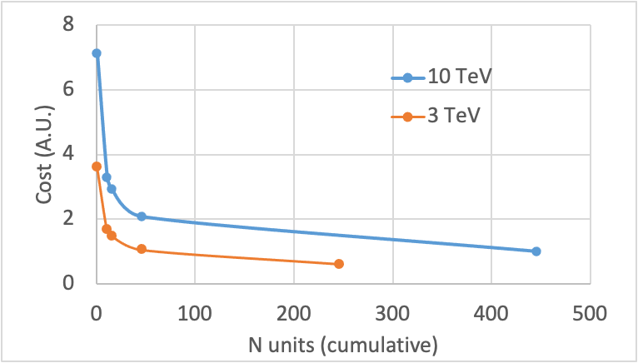

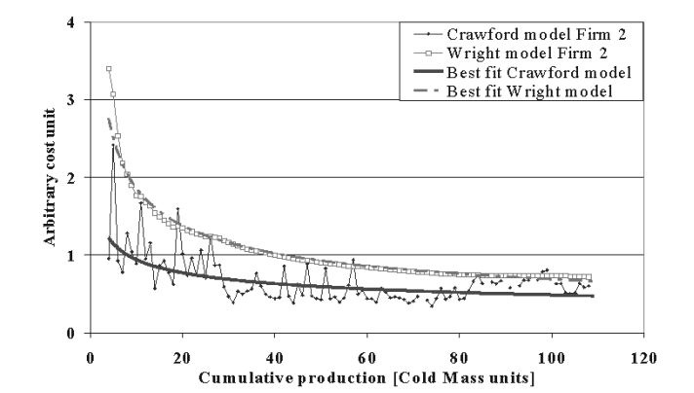
Cost reduction learning curve
How to rescale for the other steps (pre-series, prototypes, short models, demonstrators)?
Learning curve
Wright's law
b: learning percentage
Applied to LHC magnets works perfectly! [ref]
 | 3 TeV |  | 10 TeV
 | N units (cumulative) | cost (A.U.*) | N units (cumulative) | cost (A.U.*)
demostrator | 1 | 3.36 | 1 | 7.13
short model | 11 | 1.55 | 11 | 3.29
proto | 16 | 1.38 | 16 | 2.92
pre series | 46 | 0.98 | 46 | 2.08
series | 246 | 0.57 | 446 | 1.00
b=0.8
*w.r.t. cost of 10 TeV series magnet

Slide 8
Cost Estimate (3TeV)
Pre-series
Prototypes
Iron cost [k€/m] | Structure cost [ k€/m] | Coil cost [k€/m]
91 | 8 | 269
Iron cost [k€/m] | Structure cost [ k€/m] | Coil cost [k€/m]
127 | 11 | 377
Tot. Material k€/m | 144 | 30%
Tot. Assembly k€/m | 69 | 14%
Tot. Conductor k€/m | 269 | 56%
Tot. Cost k€/m | 481
Tot. Material k€/m | 201 | 30%
Tot. Assembly k€/m | 96 | 14%
Tot. Conductor k€/m | 377 | 56%
Tot. Cost k€/m | 674
N units | length [m] | N years | cost FTE-y [k€] | Total cost [o.m.b*]
90 | 5 | 4 | 1600 | 1.70%
N units | length [m] | N years | cost FTE-y [k€] | Total cost [o.m.b*]
5 | 5 | 5 | 2000 | 0.15%
Short Models
Demonstrators
Iron cost [k€/m] | Structure cost [ k€/m] | Coil cost [k€/m]
143 | 12 | 425
Iron cost [k€/m] | Structure cost [ k€/m] | Coil cost [k€/m]
310 | 27 | 919
Tot. Material k€/m | 227 | 30%
Tot. Assembly k€/m | 109 | 14%
Tot. Conductor k€/m | 425 | 56%
Tot. Cost k€/m | 761
Tot. Material k€/m | 491 | 30%
Tot. Assembly k€/m | 235 | 14%
Tot. Conductor k€/m | 919 | 56%
Tot. Cost k€/m | 1645
N units | length [m] | N years | cost FTE-y [k€] | Total cost [o.m.b*]
10 | 1.5 | 6 | 3000 | 0.11%
N units | length [m] | N years | cost FTE-y [k€] | Total cost [o.m.b*]
1 | 1.5 | 4 | 12000 | 0.03%
*overall magnets bugdet

Slide 9
Cost Estimate (10 TeV)
Dipoles of the arc for the series production
(quadrupoles and IR not included)
  15T /138 mm (REBCO)
€/kg iron | €/kg struct | €/kg conductor *
8 | 10 | 2500
  *50 €/kAm: 1/3 of today prize (150€/kAm)
  Also based on projection of ref
  A. Molodyk and C. Larbalestier, Science, 2023
Iron [Kg/m] | Structure [kg/m] | Coil [kg/m]
4512 | 209 | 121
Iron cost [k€/m] | Structure cost [ k€/m] | Coil cost [k€/m]
36 | 2.1 | 304
Tot. Material = (C_{iron}+ C_{struct})*f_{struct}
f_{struct} = 1.5
Tot. Material k€/m | 56 | 14%
Tot. Assembly k€/m | 40 | 10%
Tot. Conductor k€/m | 304 | 76%
Tot. Cost k€/m | 400
R_{bore}= 69 mm
w_{coil}= 58 mm
w_{struct}= 30 mm
w_{iron}= 300 mm
200 k€/magnet ( $\sim$2FTE)
Coordination, design and follow-up: 4 FTE x 4 years= 16 FTE-years (1.6 MEur)
TOTAL COST: 19.0% O.M.B. (overall magnets budget)
Disclaimer: cryostat, specific tooling, W absorber not taken into account
Notes:
J=3.5 10^8 A/m2

Slide 10
Cost Estimate (10TeV)
Pre-series
Prototypes
Iron cost [k€/m] | Structure cost [ k€/m] | Coil cost [k€/m]
75 | 4.3 | 633
Iron cost [k€/m] | Structure cost [ k€/m] | Coil cost [k€/m]
105 | 6.1 | 888
Tot. Material k€/m | 116 | 15%
Tot. Assembly k€/m | 42 | 5%
Tot. Conductor k€/m | 632 | 80%
Tot. Cost k€/m | 790
Tot. Material k€/m | 163 | 15%
Tot. Assembly k€/m | 58 | 5%
Tot. Conductor k€/m | 888 | 80%
Tot. Cost k€/m | 1109
N units | length [m] | N years | cost FTE-y [k€] | Total cost [o.m.b*]
90 | 5 | 4 | 1600 | 2.80%
N units | length [m] | N years | cost FTE-y [k€] | Total cost [o.m.b*]
5 | 5 | 5 | 2000 | 0.24%
Short Models
Demonstrators
Iron cost [k€/m] | Structure cost [ k€/m] | Coil cost [k€/m]
119 | 7 | 1000
Tot. Structure k€/m | 185 | 15%
Iron cost [k€/m] | Structure cost [ k€/m] | Coil cost [k€/m]
257 | 15 | 2168
Tot. Material k€/m | 183 | 15%
Tot. Assembly k€/m | 66 | 5%
Tot. Conductor k€/m | 1000 | 80%
Tot. Cost k€/m | 1250
Tot. Material k€/m | 397 | 15%
Tot. Assembly k€/m | 143 | 5%
Tot. Conductor k€/m | 2168 | 80%
Tot. Cost k€/m | 2708
N units | length [m] | N years | cost FTE-y [k€] | Total cost [o.m.b*]
10 | 1.5 | 8 | 4000 | 0.18%
N units | length [m] | N years | cost FTE-y [k€] | Total cost [o.m.b*]
1 | 1.5 | 6 | 24000 | 0.05%
*overall magnets bugdet

Slide 11
Tentative Schedule (3 TeV collider)
  ARC DIPOLES 11T/150mm
  (quadrupoles and IR still not included)
4 years
R&D and
demonstrators
Models
Prototypes
Pre-series
Series
 | 2025 | 2026 | 2027 | 2028 | 2029 | 2030 | 2031 | 2032 | 2033 | 2034 | 2035 | 2036 | 2037 | 2038 | 2039 | 2040 | 2041
4 FTE/y, 0.08 ‰ o.m.b.*
6 years
5 FTE/y, 0.19‰ o.m.b.*
5 years
4 FTE/y, 0.30‰o.m.b.*
4 years
4 FTE/y, 4.31 ‰ o.m.b.*
4 years
4 FTE/y,16.6 ‰ o.m.b.*
TOTAL: 8.67% o.m.b.*
*overall magnets bugdet

Slide 12
Tentative Schedule (10 TeV collider)
  ARC DIPOLES 15T/150 mm
  (quadrupoles and IR still not included)
4 years
Specifications and concept development
2 FTE/y, 0.016‰ o.m.b.*
R&D and demonstrators
Models
Prototypes
Pre-series
Series
 | 2025 | 2026 | 2027 | 2028 | 2029 | 2030 | 2031 | 2032 | 2033 | 2034 | 2035 | 2036 | 2037 | 2038 | 2039 | 2040 | 2041 | 2042 | 2043 | 2044 | 2045 | 2046 | 2047 | 2048 | 2049 | 2050
6 years
4 FTE/y, 0.09‰ o.m.b.*
8 years
5 FTE/y, 0.22‰ o.m.b.*
5 years
4 FTE/y, 0.47‰ o.m.b.*
4 years
4 FTE/y, 7.06‰ o.m.b.*
4 years
4 FTE/y, 47.5‰ o.m.b.*
TOTAL: 22.3% o.m.b.*
*overall magnets bugdet

Slide 13
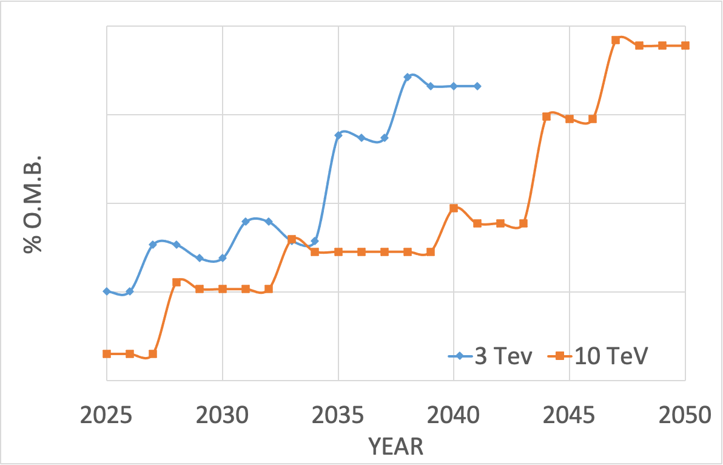
Cost Profile
8
0.8
0.08
0.008
*overall magnets bugdet

Slide 14
R&D priorities
Our goal: make magnets! Our R&D must be magnet- oriented!
We want to achieve the desired magnetic field and gradient but keeping the stress acceptable and the protection feasible!
How we deal with stress?
  Which concept (block, cos-theta)?
  Which mechanical structure (bladder & key,
  collaring, stress management)?
  Which cable (Roebel, CORC, tape)?
How we protect the magnet?
  Insulated, not insulated, metal insulated?
  At which T_{op}?
DEMOSTRATORS CONSTRUCTION AND TEST of paramount importance to validate design choices!
R&D on the cable
  Improve reproducibility and uniformity in batch length beyond 1 km
  Optimization of industrial HTS tape mechanical and thermal properties
  Improvement of robustness and reproducibility of cable concept (CORC, ROEBEL)
  Development of novel technique of control of the inter-turn resistance
If we work at 20/30K, can we use indirect cooling or forced gas cooling solutions ?
Not only REBCO! (e.g Iron-based? Xxx?)

Slide 15
Thank you for your attention

Slide 17
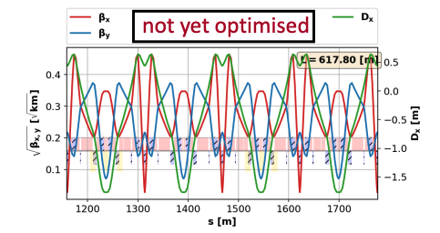
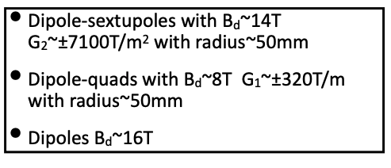
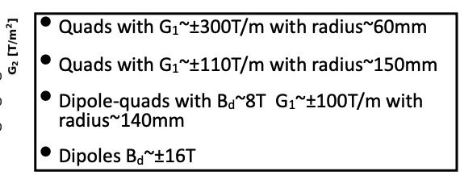
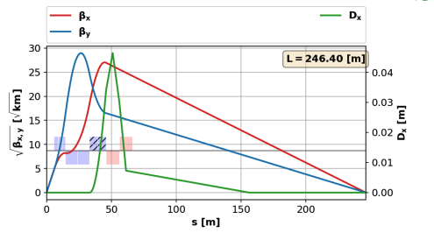
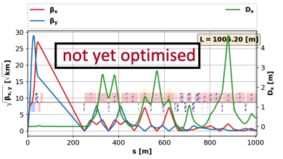
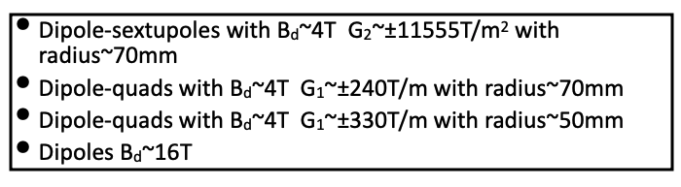
Magnet requirements for Lattice
10TeV collider[ref] - preliminary
ARC
Final Focusing
Chromatic correction
Courtesy of Kyriakos Skoufaris
Several magnet typology needed (dip, quad, combined, etc) , but optimization & definition of requirements still on going

