Slide 1
MuCol and HFM Synergies
B. Auchmann, E. Todesco
March 13, 2024

Slide 2
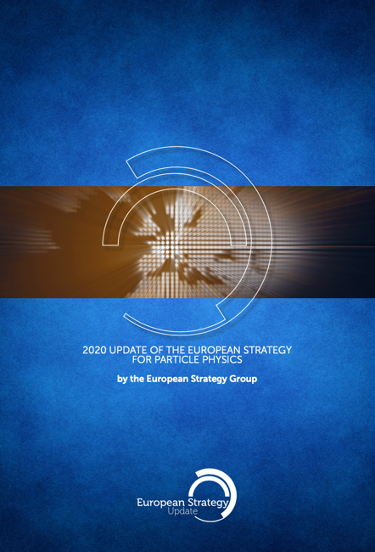
Origins of HFM
  “Europe, together with its international partners, should investigate the technical and financial feasibility of a future hadron collider at CERN with a centre-of-mass energy of at least 100 TeV and with an electron-positron Higgs and electroweak factory as a possible first stage. “
  “The technologies under consideration include high-field magnets, high-temperature superconductors, plasma wakefield acceleration and other high-gradient accelerating structures, bright muon beams, energy recovery linacs.
  The European particle physics community must intensify accelerator R&D and sustain it with adequate resources.
  A roadmap should prioritise the technology, taking into account synergies with international partners and other communities such as photon and neutron sources, fusion energy and industry.
  Deliverables for this decade should be defined in a timely fashion and coordinated among CERN and national laboratories and institutes.“
http://cds.cern.ch/record/2721370

Slide 3
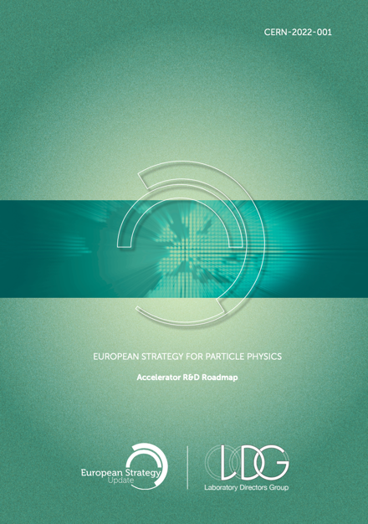
Origins of HFM
  “Europe, together with its international partners, should investigate the technical and financial feasibility of a future hadron collider at CERN with a centre-of-mass energy of at least 100 TeV and with an electron-positron Higgs and electroweak factory as a possible first stage. “
  “The technologies under consideration include high-field magnets, high-temperature superconductors, plasma wakefield acceleration and other high-gradient accelerating structures, bright muon beams, energy recovery linacs.
  The European particle physics community must intensify accelerator R&D and sustain it with adequate resources.
  A roadmap should prioritise the technology, taking into account synergies with international partners and other communities such as photon and neutron sources, fusion energy and industry.
  Deliverables for this decade should be defined in a timely fashion and coordinated among CERN and national laboratories and institutes.“
https://arxiv.org/abs/2201.07895

Slide 4
Origins of HFM
  “Europe, together with its international partners, should investigate the technical and financial feasibility of a future hadron collider at CERN with a centre-of-mass energy of at least 100 TeV and with an electron-positron Higgs and electroweak factory as a possible first stage. “
  “The technologies under consideration include high-field magnets, high-temperature superconductors, plasma wakefield acceleration and other high-gradient accelerating structures, bright muon beams, energy recovery linacs.
  The European particle physics community must intensify accelerator R&D and sustain it with adequate resources.
  A roadmap should prioritise the technology, taking into account synergies with international partners and other communities such as photon and neutron sources, fusion energy and industry.
  Deliverables for this decade should be defined in a timely fashion and coordinated among CERN and national laboratories and institutes.“
HFM
High Field Magnets
Programme
https://cern.ch/hfm

Slide 5
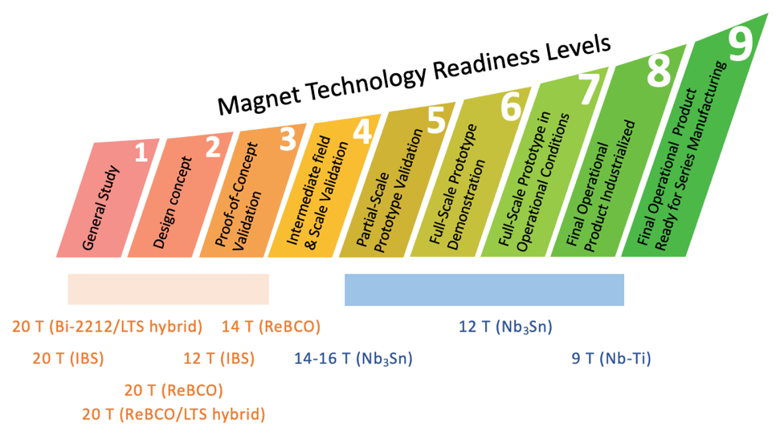
Present R&D Targets of HFM
A ~14 T operational field LTS dipole magnets for FCC-hh
  Establish the operational margins
  Select the magnet design among multiple variants
  Scale to 14-m-long magnets
A ~20 T operational field HTS or hybrid dipole magnet for FCC-hh
  Close Technology-Readiness-Level Gap with LTS
    Establish HTS technology-stack variants
    Demonstrate accelerator quality
  Establish the operational margins
  Select the magnet design among multiple variants
  Scale to 14-m-long magnets

Slide 6




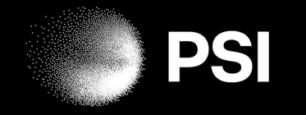








HFM Network
Magnets
Conductors
Enabling
Technologies

Slide 7
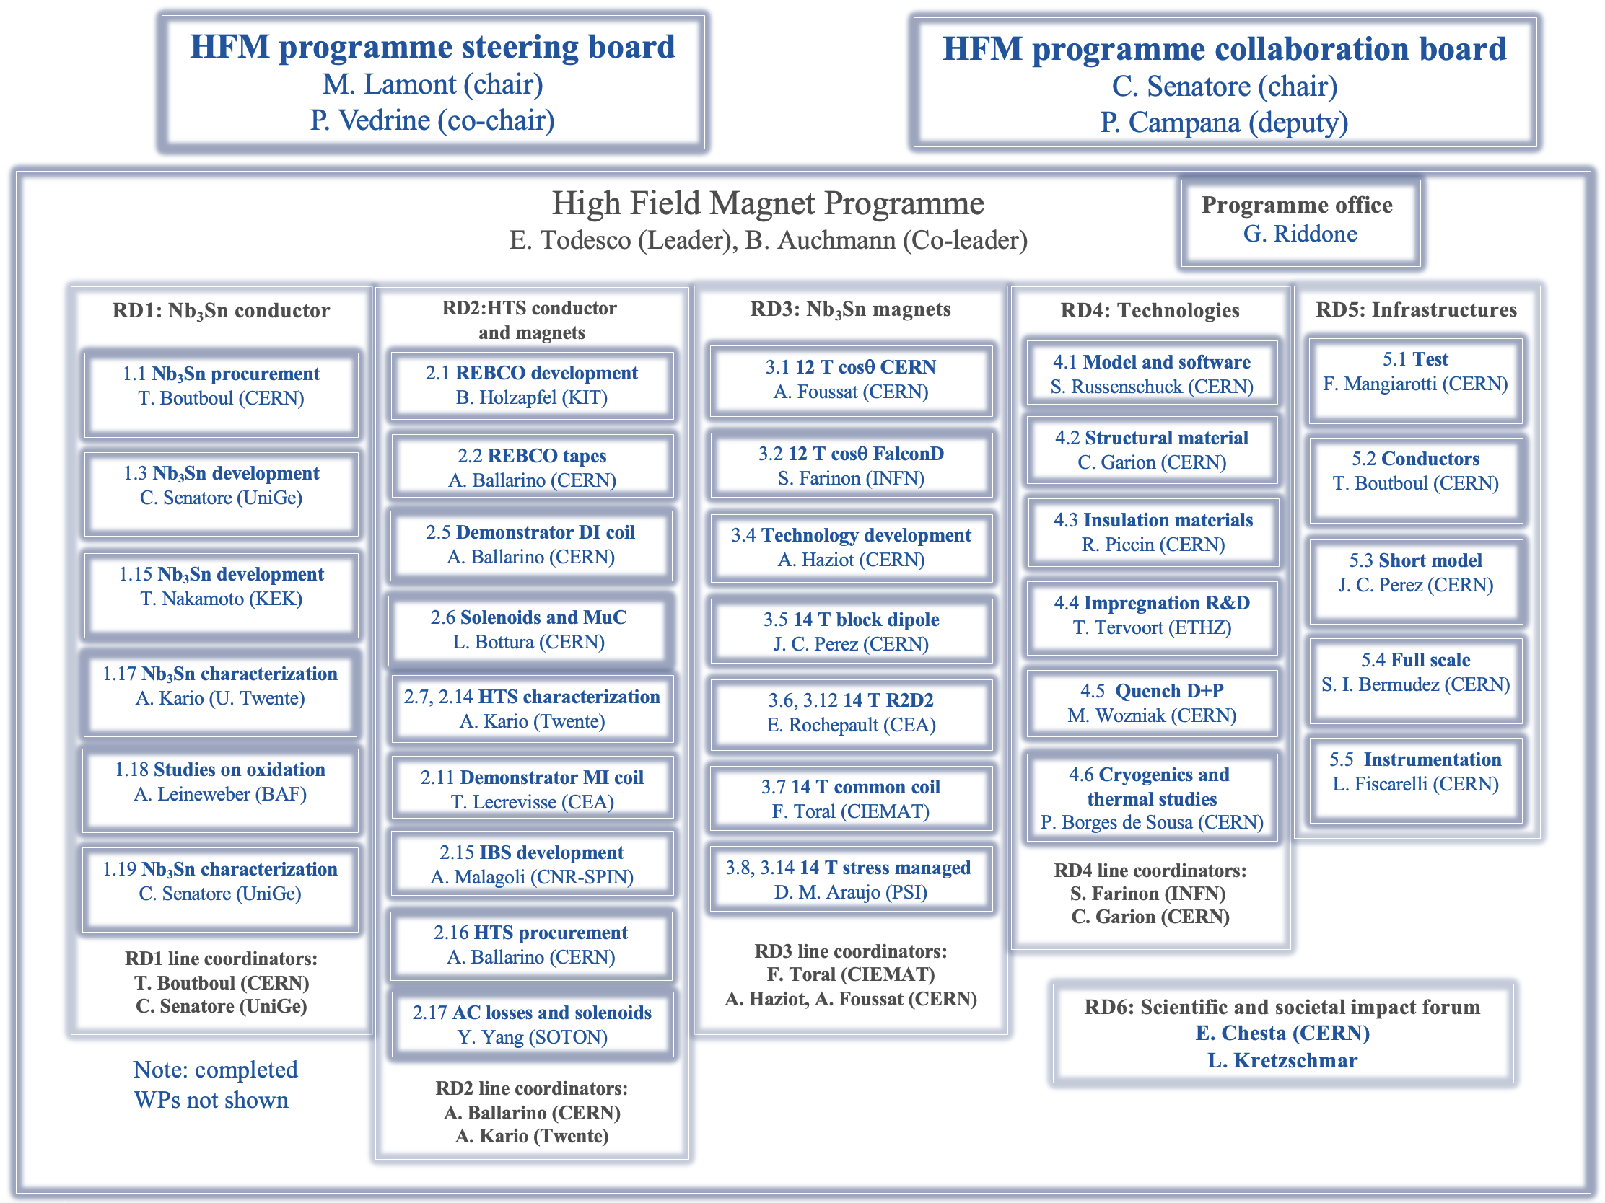
HFM Structure

Slide 8
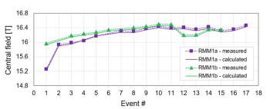
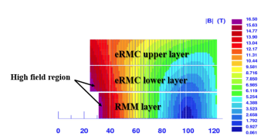
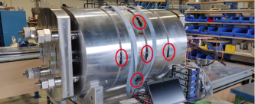
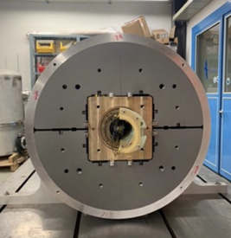
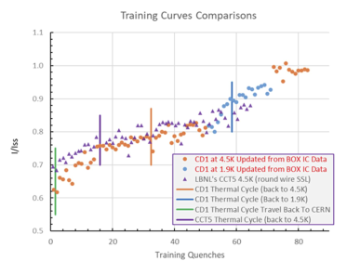
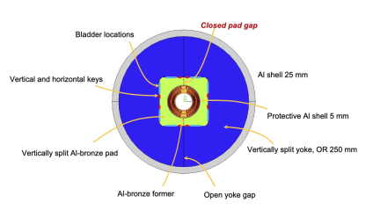


HFM LTS Progress
2023: RMM block dipole Nb3Sn technology reaches 16 T bore field (without the complexity of flared ends)
2022: Nb3Sn CCT magnet reaches 10 T bore field, 100% Iss at 4.5 K
  Long training but no retraining
E. Gautheron, et al., IEEE TAS 33 (2023) 4004108
B. Auchmann, et al., IEEE TAS 34 (2024) 4000906

Slide 9

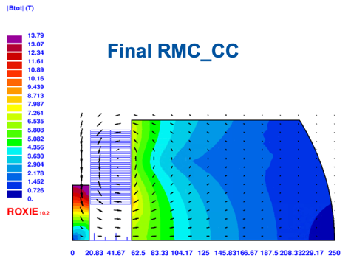
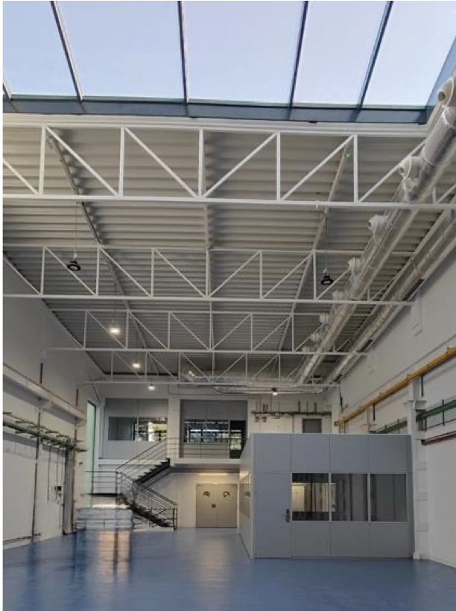
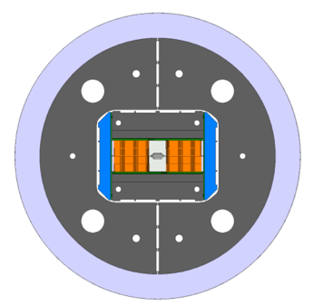
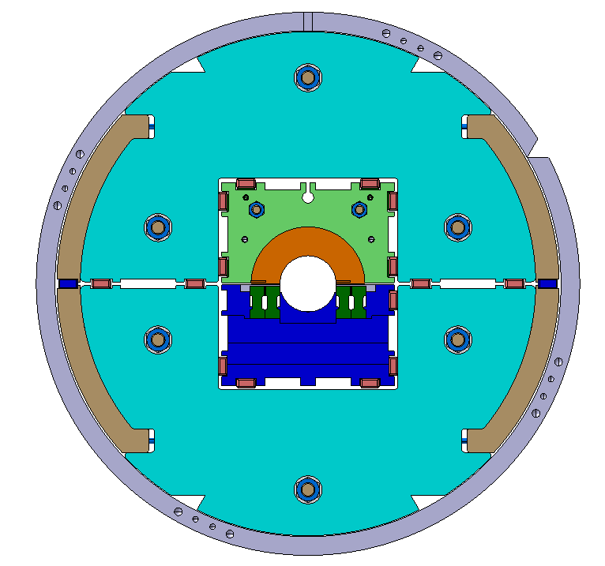
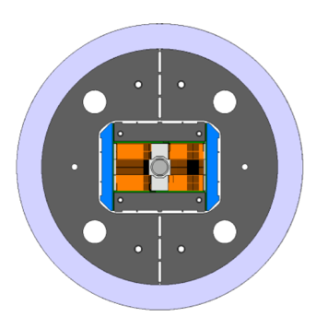
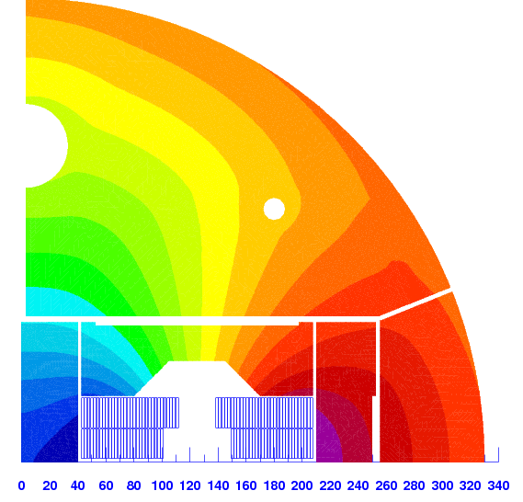



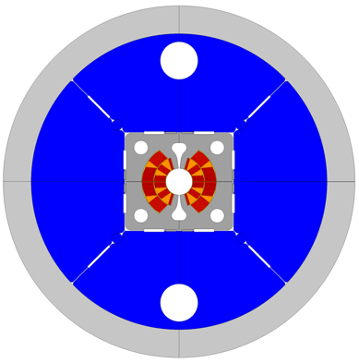
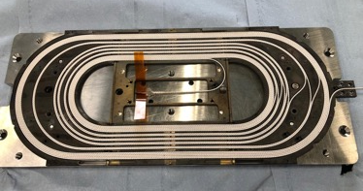
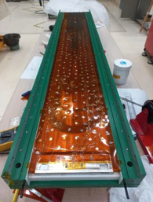
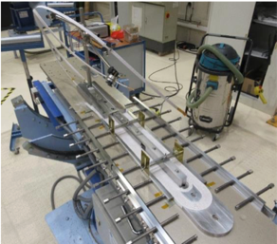

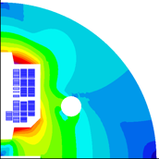
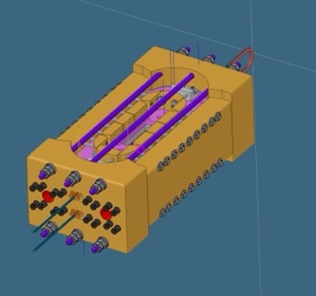
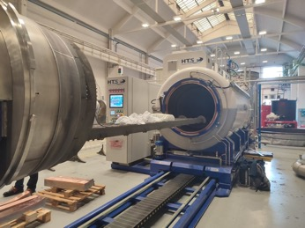
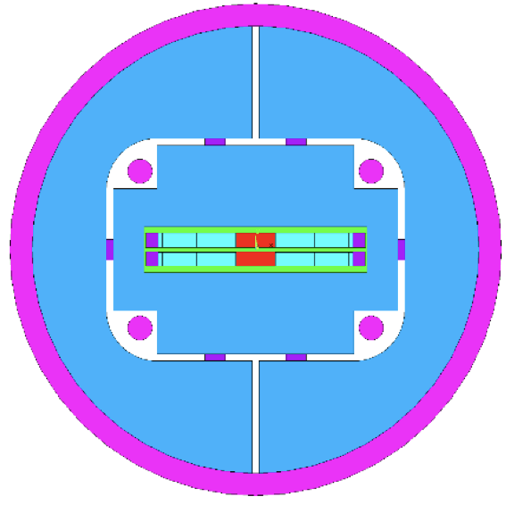
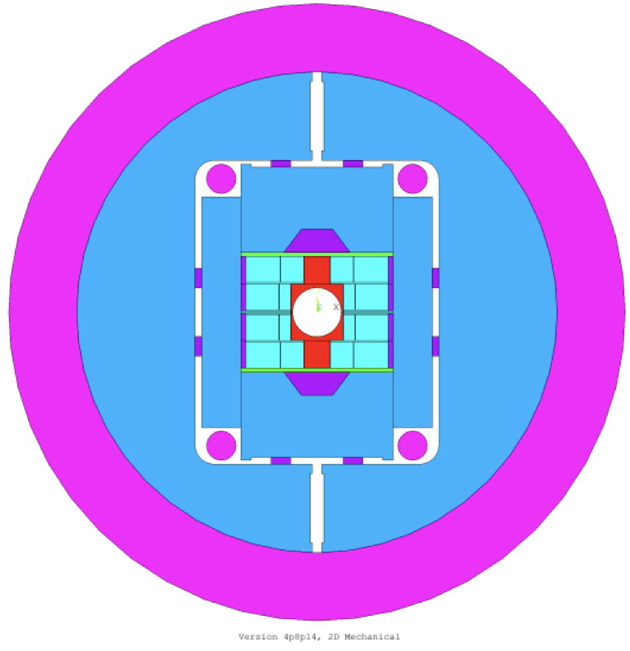
HFM LTS Progress
WPLs A. Foussat, J. C. Perez
ISAAC
ERMC
12 T CosTheta
WPL F. Toral
RMM
14 T no-grading block coil
subSMCC
WPL S. Farinon, M. Sorbi
R2D2
F2D2
WPL E. Rochepault
SMACC
WPL D. M. Araujo
RMM1
Notes:
RMM and CD1 results

Slide 10
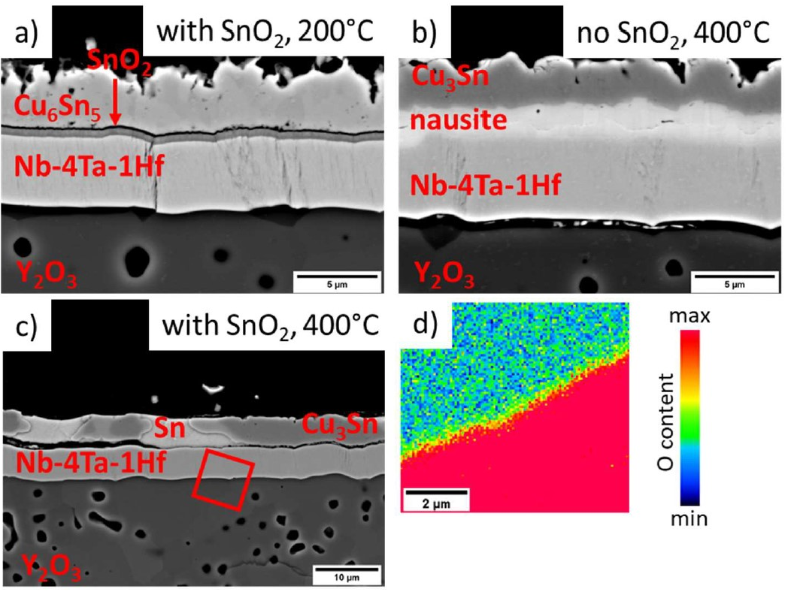

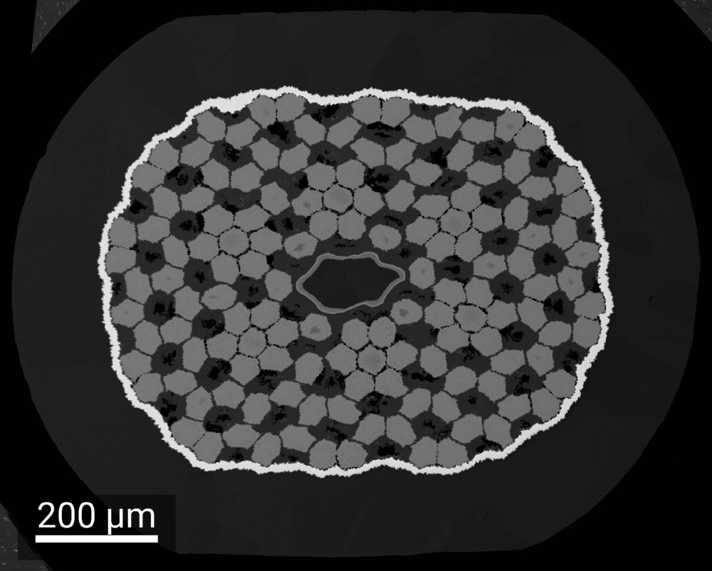
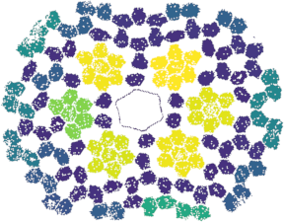
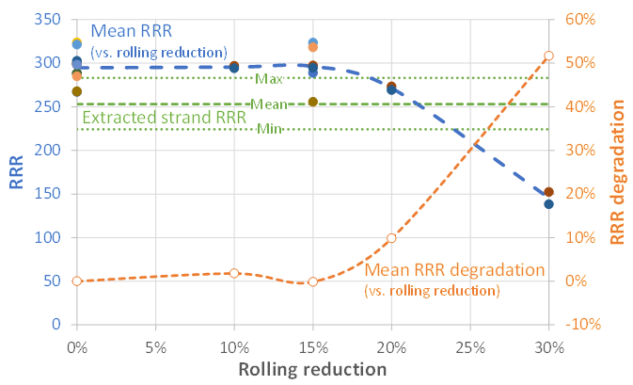

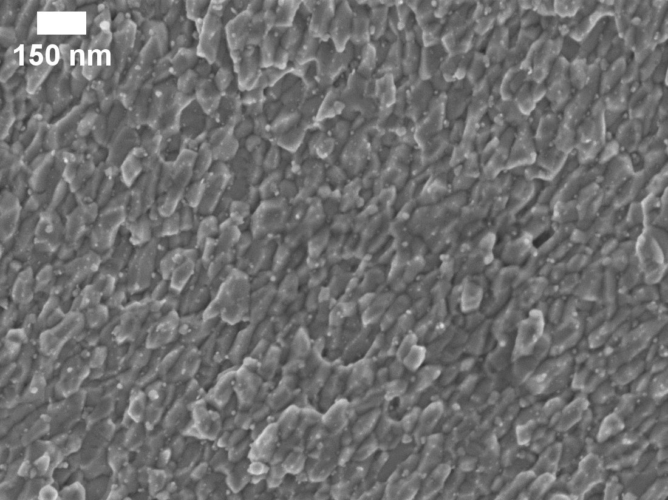
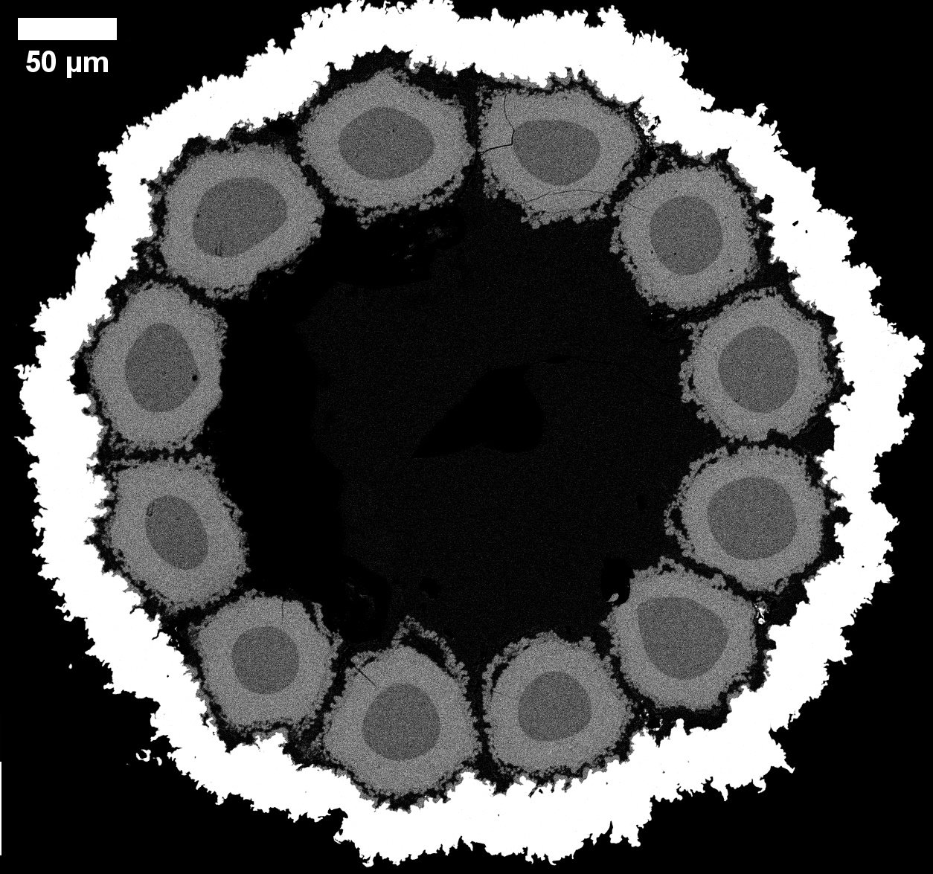

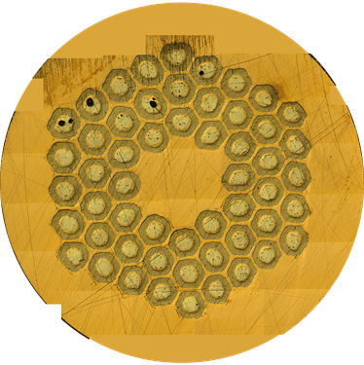
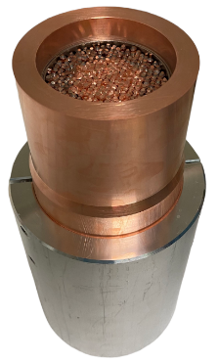
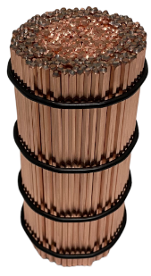
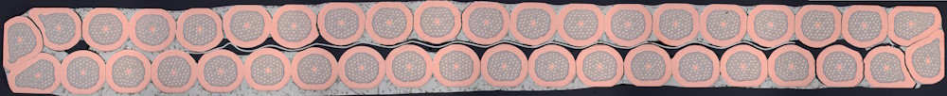
HFM LTS Conductor Progress
WPL A. Leineweber
15 %
WPL T. Boutboul
WPL C. Senatore

Slide 11
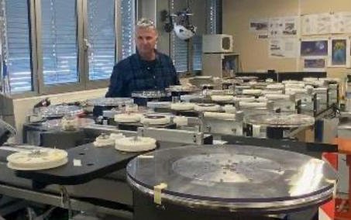
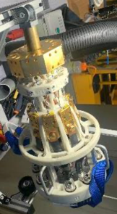

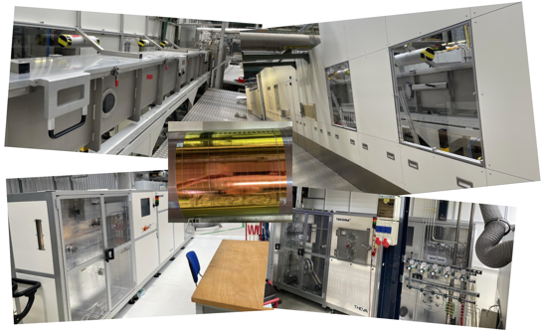
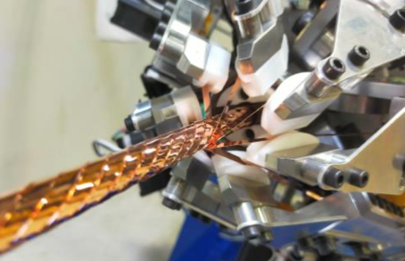
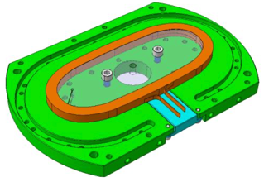


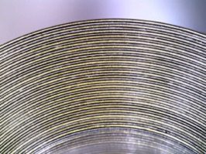


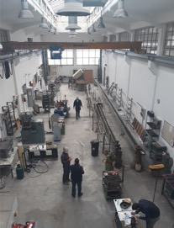
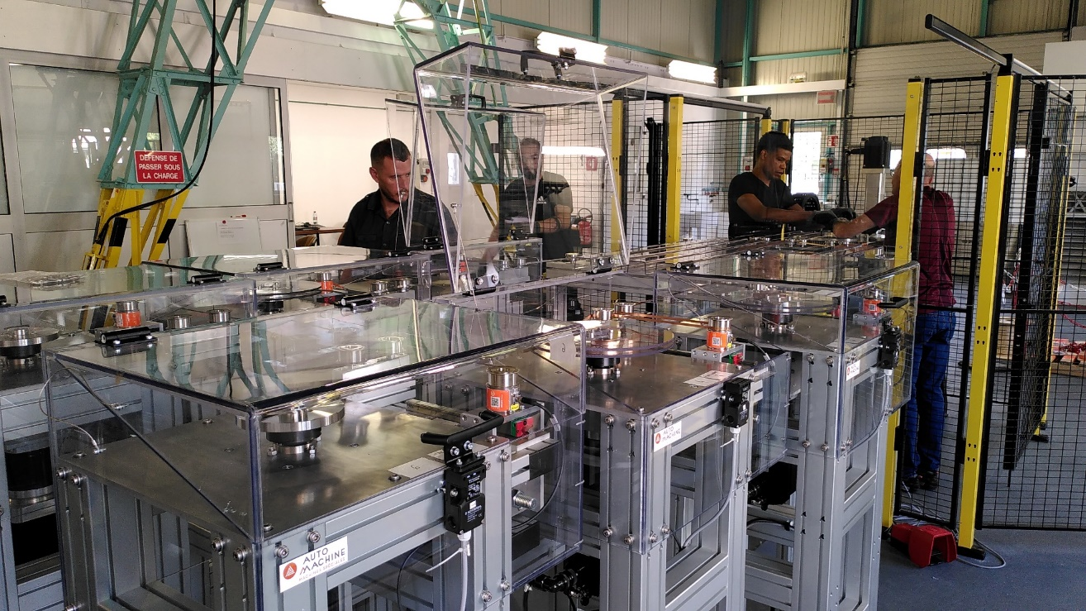
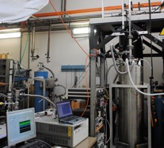
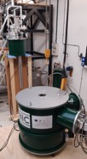
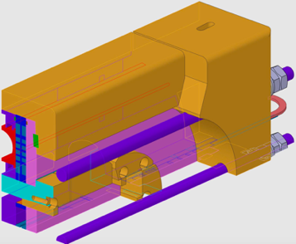

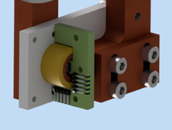
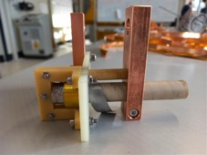
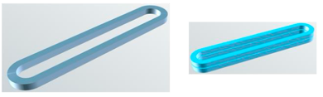
HFM HTS Progress
WPL A. Ballarino
WPL B. Holzapfel
Winding table, round
cable fabrication
Tape
characterization
Insulated dry tape-
stack racetrack
Coated Conductor R&D Line Commissioned
WPL T. Lecrevisse
WPL D. M. Araujo
IBS PIT R&D started
Hybrid subscale
common coil
Insulated soldered tape-
stack dynamic tests
WPL A. Malagoli
Metal-Insulated Racetrack Stack
RMM1

Slide 12















HFM Tech Progress
WPL R. Piccin
WPL M. Wozniak
WPL S. Russenschuck
WPL T. Tervoort
WPL P. Borges de Sousa
ROXIE CAD Engine
RMM1

Slide 13
HFM Organization
HFM Forum
LTS demo team 1
Cryogenis & thermal properties
HTS demo team 1
LTS Coil Composite WG
LTS coil composite
LTS demo team 2
Instrumen-tation, detection
HTS demo team 2
Common Coils WG
Testing
HTS Modeling WG
LTS demo team 3
Nb3Sn Conductor and Cable
Protection
HTS Cable
HTS demo team 3
Quench and Transient Effects Analysis WG
Insulation materials
LTS demo team …
HTS modeling
HTS demo team …
ReBCO Cables and Dynamic Effects WG
LTS modeling workflow
LTS demo team i
…
HTS demo team j
RD3
RD1
RD4
RD2

Slide 14






Muon Collider magnets
HTS !
20 T, 200 mm
Radiation heat load ≈ 5…10 kW
Radiation dose: 80 MGy
NC ±1.8 T, 400 Hz 100 mm x 30 mm
SC < 10T
100 mm x 30 mm
HTS ?
SC dipole
NC dipole
NC dipole
SC dipole
RCS
> 40 T, 60 mm
16 T peak, 150 mm
Radiation heat load ≈ 5 W/m
Radiation dose ≈ 20…40 MGy
HTS ?
HTS !
Slides courtesy of L. Bottura for the for the Muon Magnets Working Group

Slide 15
MuCol-HFM Synergies
Different specifications (field strength, field quality, coil geom, AC/DC, etc.)
often need a different technology stack (cable, insulation, coil geometry, protection, cryogenics, mechanics, powering, etc.).
Synergies among MuCol and HFM are manifest in areas of
  HFM FCC-hh magnets and MuCol Collider-Ring magnets
    Key difference: AC vs. DC (ramp losses, current-field tacking).
  Technology development (numerical techniques, protection, detection, smart insulation, instrumentation, joints/soldering, cryogenics) carried out by overlapping teams of experts.
    Where sensible, integrate each-other’s “working groups” to avoid proliferation of meetings and benefit from joint competencies.
  Testing infrastructure above LHe temperature.
  Education and work opportunities → increase the pool of experienced magnet builders.

Slide 16






“Associated” Programs
FCC, HiLumi, US-MDP, IRIS, CHART, MuCol, (EuMAHTS)
Association, here, is an informal, commutative property: programs with separate funding and accountability share common goals and technological challenges.
To make practical sense of association, we may use some of the following tools:
  Shared “working groups”
  Shared infrastructure
  Pooled procurement
  Balance sheets for exchanged goods/services
  Liaison persons
  Exchange programs

Slide 17
Take-Aways
HFM and MuCol magnet R&D have important synergies in collider-ring magnets, enabling technologies, testing, and education.
HFM, MuCol, US-MDP (and others) are naturally “associated” programs.
We must actively promote collaboration and exchange and learn to do so effectively and efficiently.
Integrating each other’s technology “working groups” may be a starting point to maximize our R&D impact.

