Slide 1
US-MDP - Towards an implementation of the
P5 recommendations and opportunities for collaboration
Presentation to the 2024 Muon Collider Collaboration Meeting
Soren Prestemon
Director, US Magnet Development Program
Lawrence Berkeley National Laboratory
For the US MDP Team

Slide 2






Outline
The US Magnet Development Program: Mission and Goals
Key messages from the US P5 report
Key Muon Collider magnet needs
Additional areas of synergistic research
Current MDP focus areas & plans for P5 alignment
Future ideas that are being discussed

Slide 3
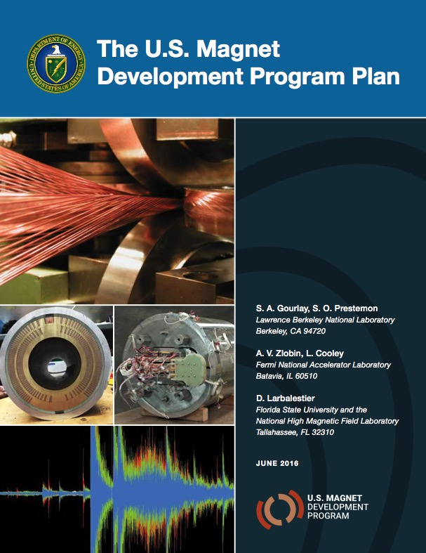
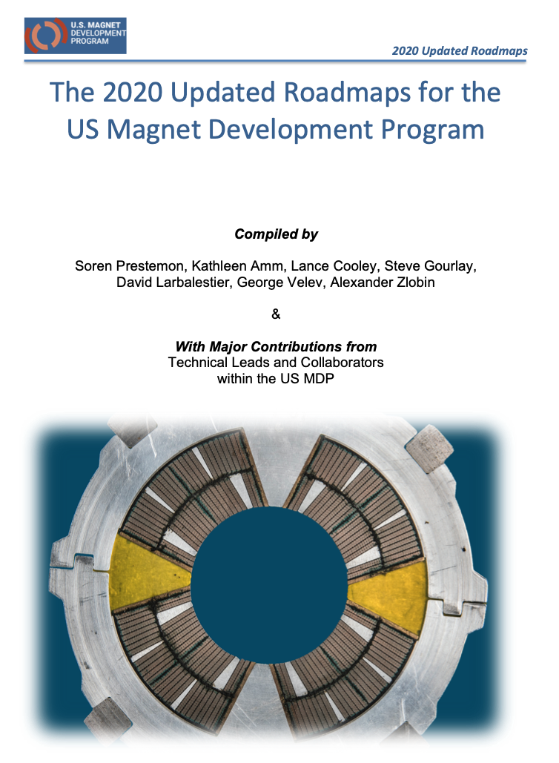
US MDP vision
Maintain and strengthen US Leadership in high-field accelerator magnet technology for future colliders
Focus on the four primary goals identified in the the original MDP Plan
  Explore the performance limits of Nb₃Sn accelerator magnets…
  Develop and demonstrate an HTS accelerator magnet with a self-field of 5T or greater…
  Investigate fundamental aspects of magnet design and technology…
  Pursue Nb₃Sn and HTS conductor R&D …
Further develop and integrate the teams across the partner laboratories and Universities for maximum value and effectiveness to the program
Identify and nurture cross-cutting / synergistic activities with other programs to more rapidly advance progress towards our goals
https://arxiv.org/abs/2011.09539

Slide 4
Central themes / focus of current MDP magnet R&D
Use fast turn-around platforms (subscale magnets, mirror magnets, etc)
Develop and apply advanced diagnostics, modeling
Explore “Quench Current-boosting”, high-Cp concepts, etc.
Understanding the disturbance spectrum and its control
  Study training, operating margin, and means to mitigate/reduce
Develop stress-management concepts to enable high-field accelerator magnets with strain-sensitive materials (Nb3Sn, HTS)
Develop and demonstrate REBCO and Bi2212 magnet technologies
Explore the viability of hybrid HTS/LTS magnets for efficient high-field accelerator magnets
Work with industry to advance superconductors tailored to HEP needs
Focus on developing conductor / cable / coil / magnet processes, identifying key issues
Leverage elements above to design optimized high-field configurations
Longstanding nexus between Labs, Universities, and industry in the US
  Example: Annual Low Temperature Superconductor Workshop >40+ years!

Slide 5
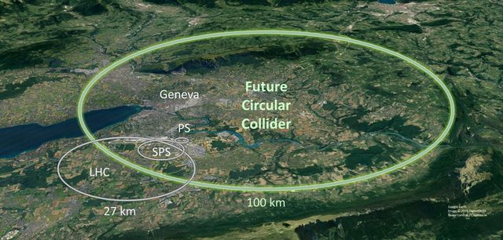
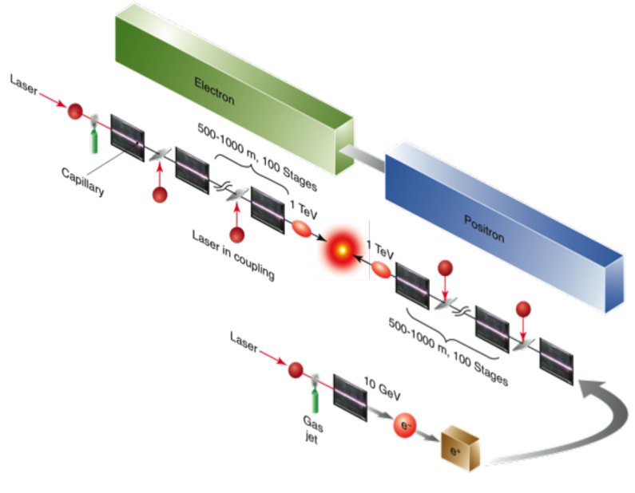
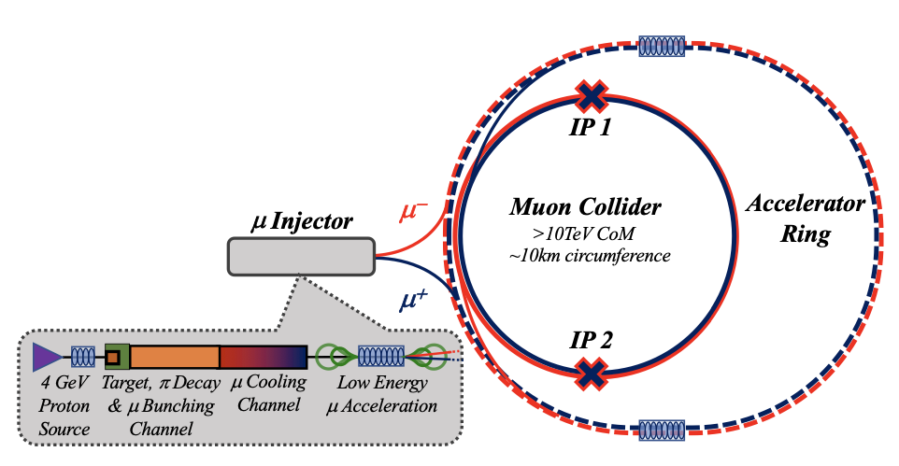
The P5 report had a clear message – 10 TeV pCM colliders!
Precision studies of the Higgs self-interaction and searches for possible new spin- less particles related to the Higgs require much larger energies per fundamental particle (parton) interaction than previously considered: on the order of 10 TeV or more.
Theoretical and experimental studies indicate that a comprehensive study of the electroweak scale requires colliders with energy of at least 10 TeV pCM, larger than previously assumed.
Revealing the secrets of the Higgs boson, characterizing WIMP dark matter, and searching for direct evidence of new particles ultimately requires access to the electroweak scale provided by a collider with pCM energy of 10 TeV.
We do not yet have a technology capable of building a 10 TeV pCM energy machine, but the case for one is clear. Extensive R&D is required to develop cost-effective options. Possibilities include proton beams with high-field magnets, muon beams that require rapid capture and acceleration of muons within their short lifetime, and conceivably electron and positron beams with wakefield acceleration. All three approaches have the potential to revolutionize the field.
Wakefield collider
~10 km at 15 TeV

Slide 6
The P5 report provides critical guidance for the US MDP
All options for a 10 TeV pCM collider are new technologies under development and R&D is required before we can embark on building a new collider.
Recommendation 4: Support a comprehensive effort to develop the resources—theoretical, computational, and technological—essential to our 20-year vision for the field. This includes an aggressive R&D program that, while technologically challenging, could yield revolutionary accelerator designs that chart a realistic path to a 10 TeV pCM collider.
Expand the General Accelerator R&D (GARD) program within HEP, including stewardship
Conduct R&D efforts to define and enable new projects in the next decade
This is why we recommend pursuing revolutionary R&D in areas such as high- field magnets, a multi-megawatt proton driver, wakefield accelerator technology, and muon cooling (Recommendation 4a).
We note that there are many synergies between muon and proton colliders, especially in the area of development of high-field magnets. R&D efforts in the next 5-year timescale will define the scope of test facilities for later in the decade, paving the way for initiating demonstrator facilities within a 10-year timescale (Recommendation 6).

Slide 7
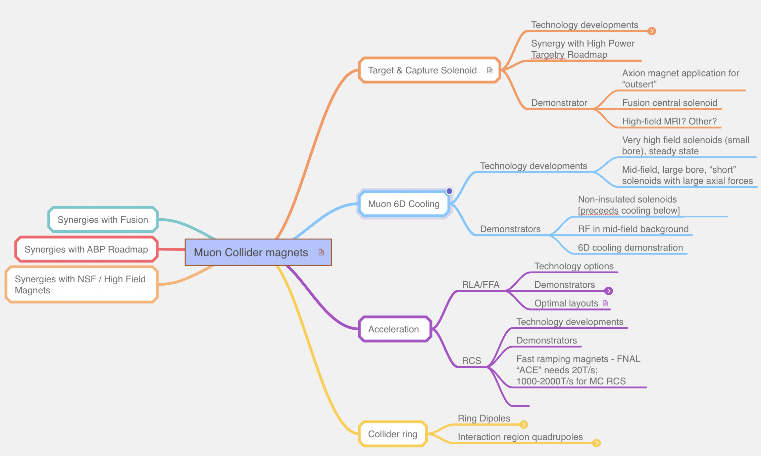
A Muon Collider has serious magnet challenges
A plethora of technologies are needed:
  Large bore solenoids for front end
  RF in field + high-field solenoids for cooling
  Fast ramping / FFAG for acceleration
  Large bore dipoles for storage
  High field quads for IR
“Time is of the essence” in a muon collider

Slide 8
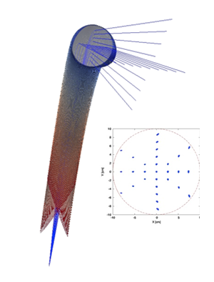
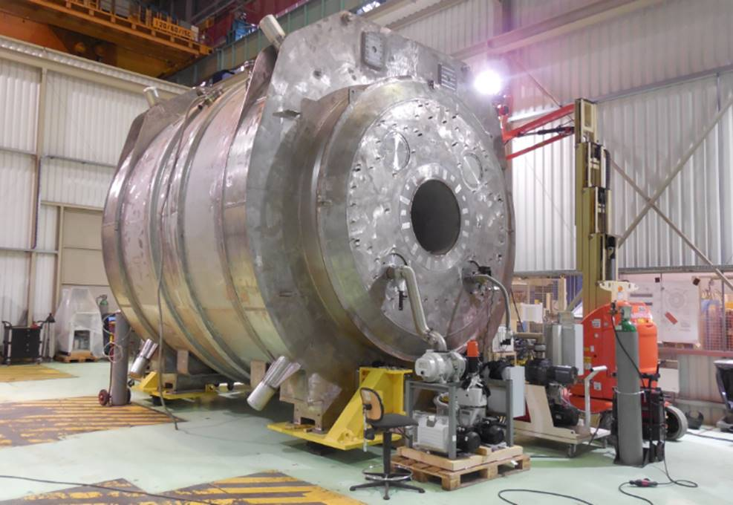
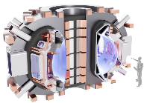

Muon collider design is providing guidance on key parameters
Lots of synergies:
Courtesy Kathleen Amm, Steve Gourlay, Mark Palmer, recent Princeton workshop on Muon Colliders

Slide 9
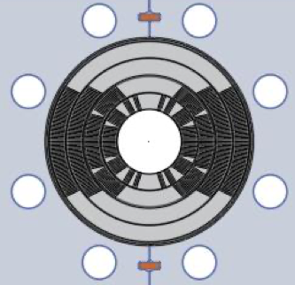
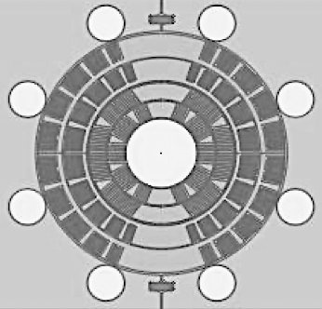
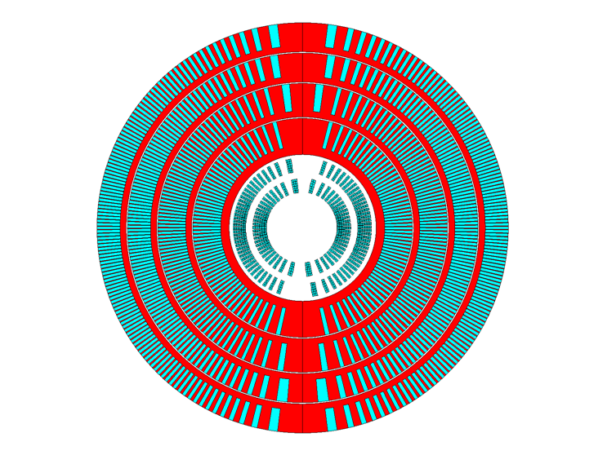
Managing mechanical stresses is key to higher fields
– MDP is exploring stress-managed structures
“Traditional” Cos-theta
- Midplane stress due to azimuthal force accumulation
“Stress-managed” Cos-theta
- Groups of turns, azimuthal forces intercepted by support
MDP stress-managed hybrid magnets are under development
Critical for strain sensitive Nb₃Sn & HTS conductors
Characterized by significant interfaces
Nb₃Sn outsert
These “stress-managed” structures may enable combined function high-field accelerator magnets, which are subject to complex force distributions
Serves as good candidate for muon collider ring dipole
HTS insert

Slide 10
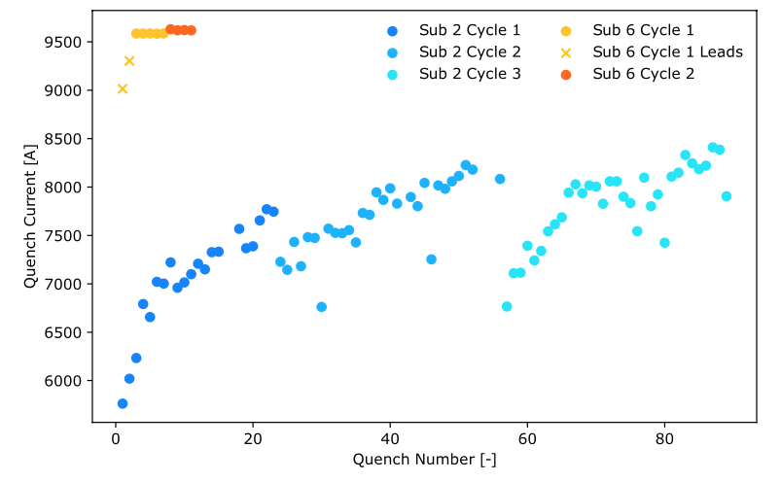
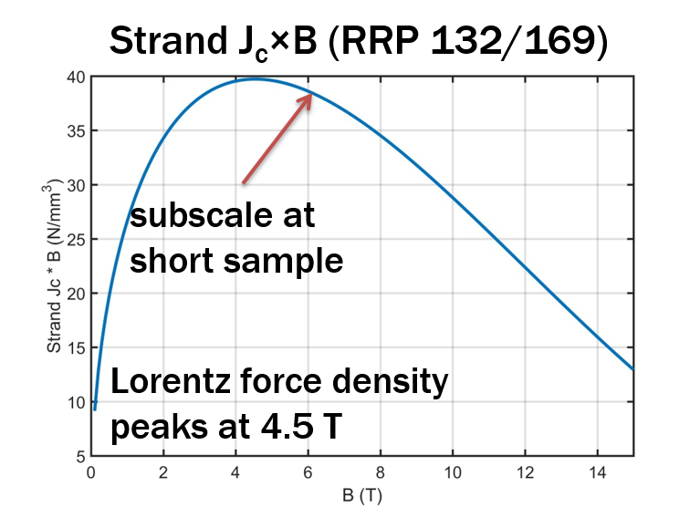
Subscale magnets are used to evaluate impregnation materials – the return of Paraffin Wax!
A subscale CCT (CCT_sub_6) was built with two coils, both impregnated with Paraffin wax
Dramatic impact on training and margin
  Only two ”training” quenches, located in leads
  Highly reproducible quench current (~9500A)
  Held field (no quench) for 7 minutes at I_{q}-30A
  Thermal cycle showed no degradation
Excellent example of international collaboration
  Motivating studies using PSI “BOX” test platform
    Data indicated wax reduced/eliminated training
    Daly et al 2022 ,SUST 35 055014
Recent tests using Telene (on a different “platform”) also suggest dramatic reduction/elimination of training
  Collaboration between FNAL, ANL and NIMS
E. Barzi et al 2024 Supercond. Sci. Technol. 37 045008
First test performed at LBNL Aug 29th, 2023
Arbelaez et al, submitted to Supercond. Sci. Technol.

Slide 11
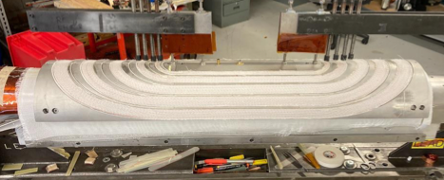
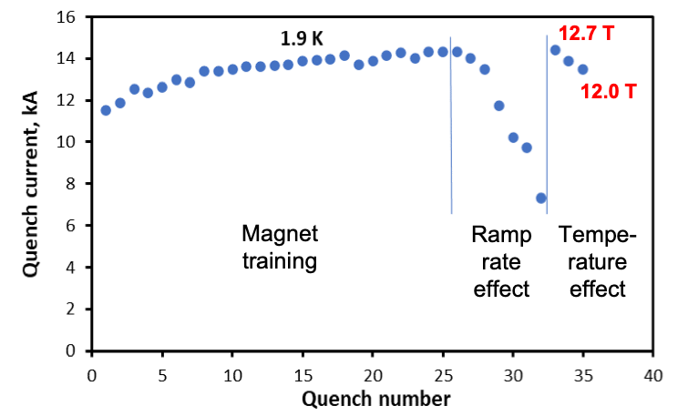
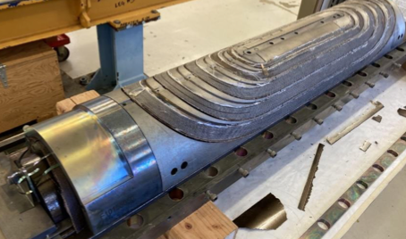
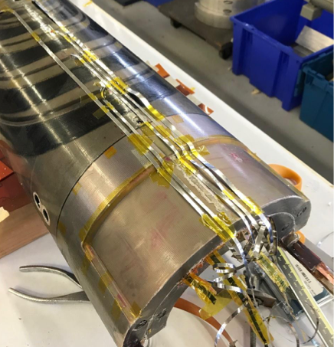
Strong progress on the Stress—managed Cos-theta (SMCT)
Mirror coil fabricated and tested
  Solid Initial training to B_{max}=12.7T
  Indication reached conductor limit (~90% SS)
Assembled magnet included inner 2 layers from 15T
  Recently wired in series and tested – results pending

Slide 12
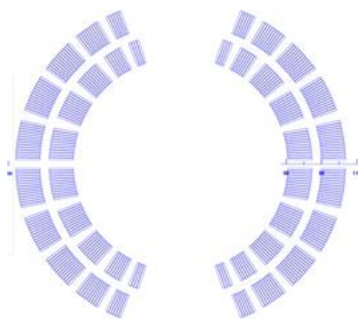
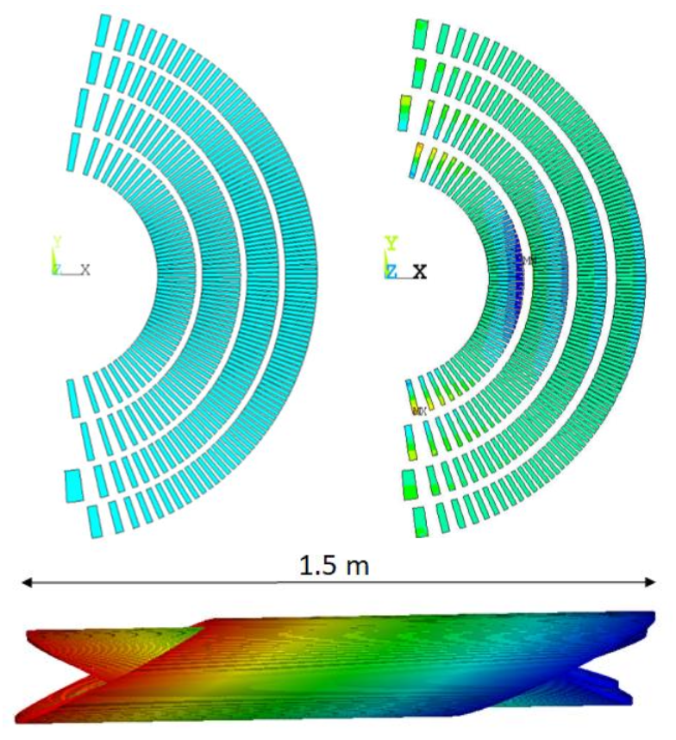
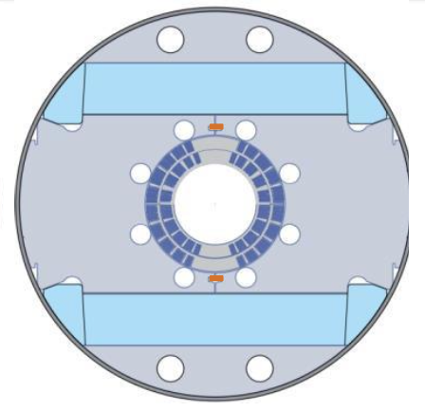
A priority now is to build the Nb₃Sn outserts
Canted Cosine theta:
  4 layers
    Bore field of 12 T / 13 T for standalone operation
    Bore diameter: 120 mm
Stress-managed Cosine Theta:
  2 layers
    Bore field of 11 T
    Bore diameter: 120mm
SMCT
CCT
These are two variants on stress-management
CCT is a “limiting case” of maximal SM
SMCT is a more efficient design

Slide 13
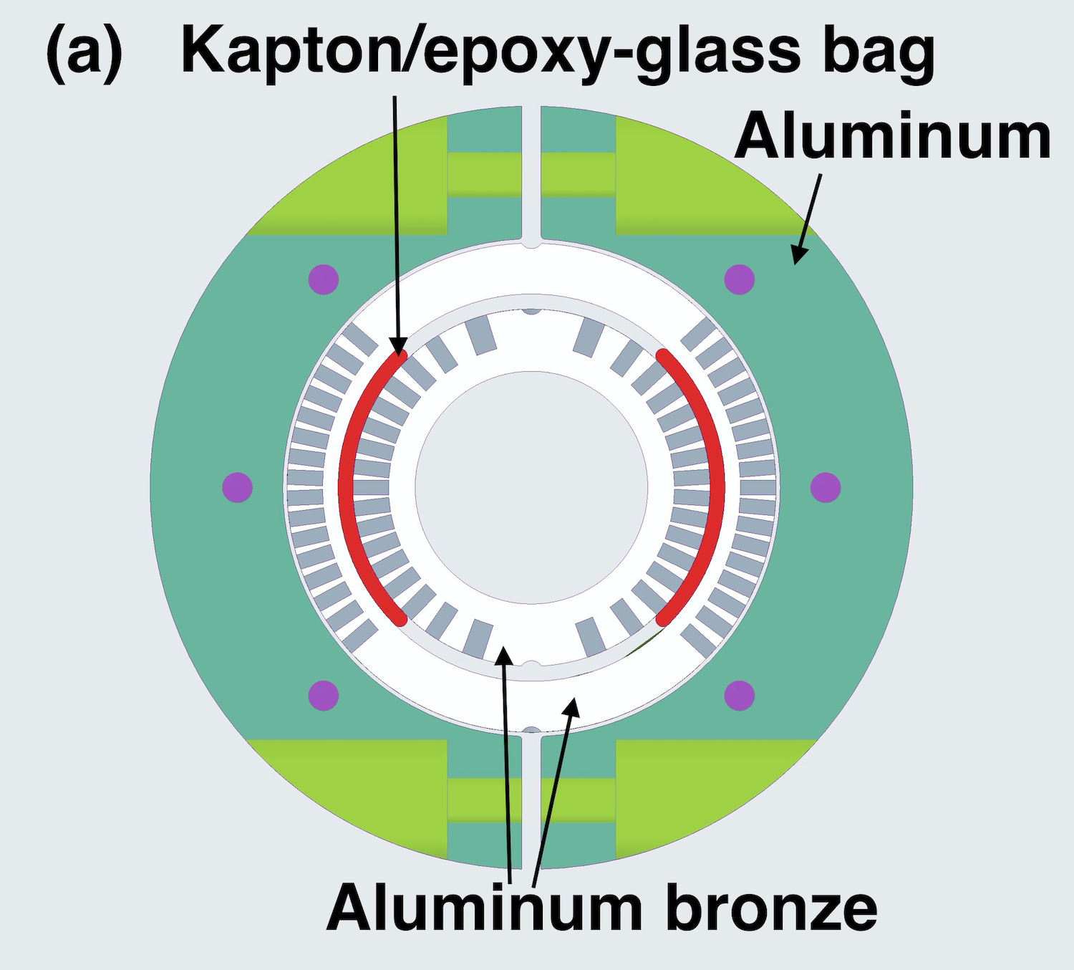
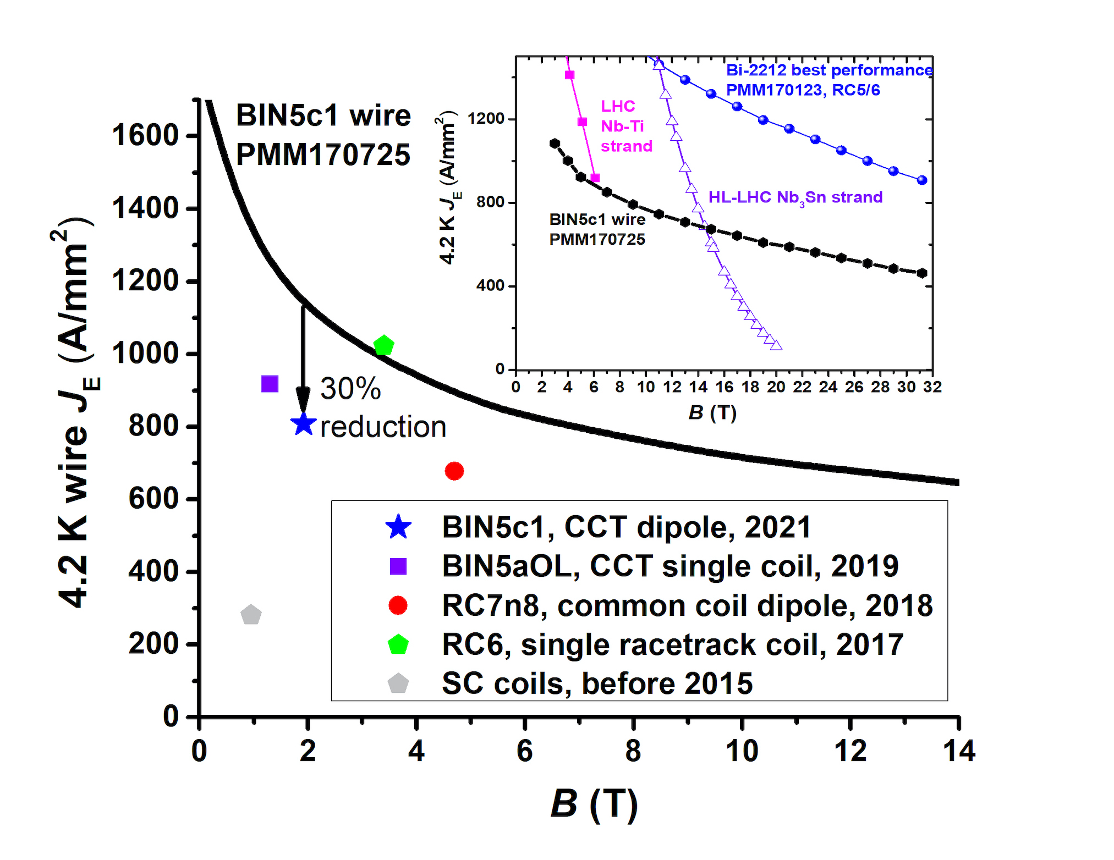
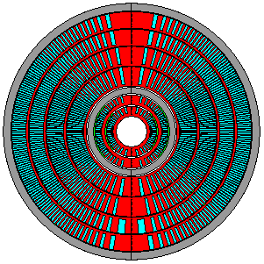
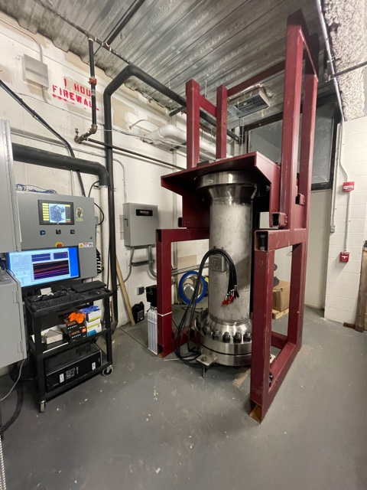
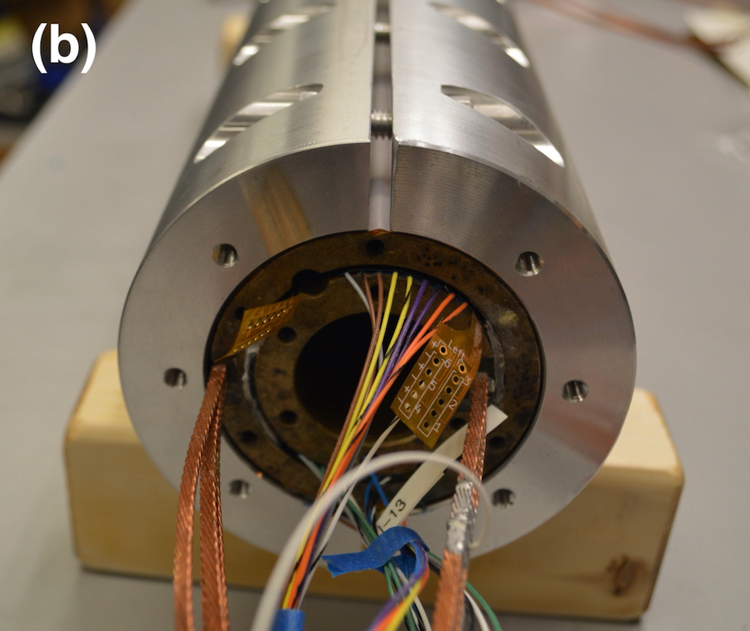
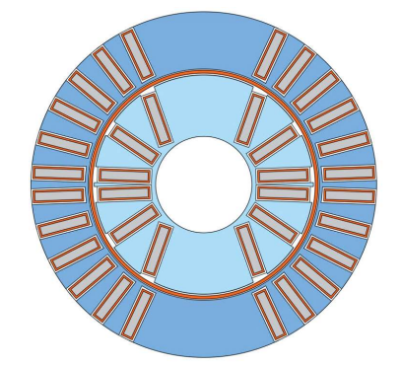
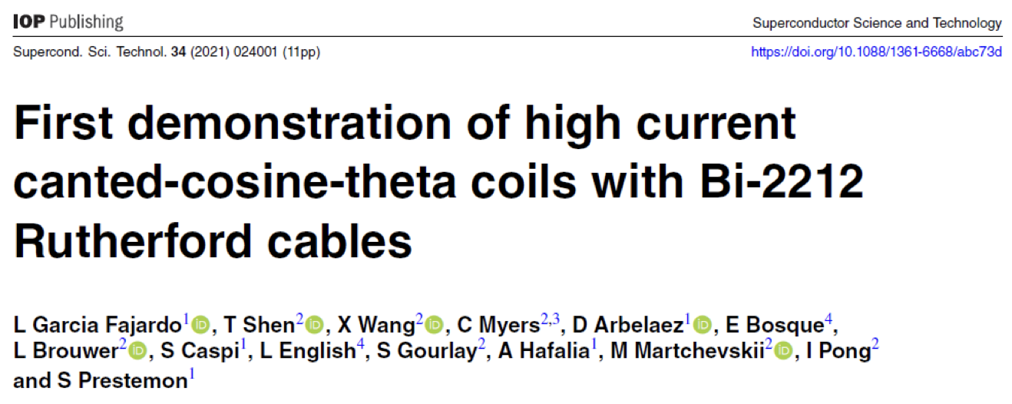
Bi2212 shows strong promise – being readied for hybrids
CCT6-Bi-CCT1
ID 40mm
OD 95mm
SSL 5T
17-strand
0.8mm diameter
3 coils at FSU, ready for reaction
CCT6-Bi-CCT2
ID 40mm
OD 115mm
SSL 6.8T
23-strand
1.0mm diameter
Renegade furnace

Slide 14
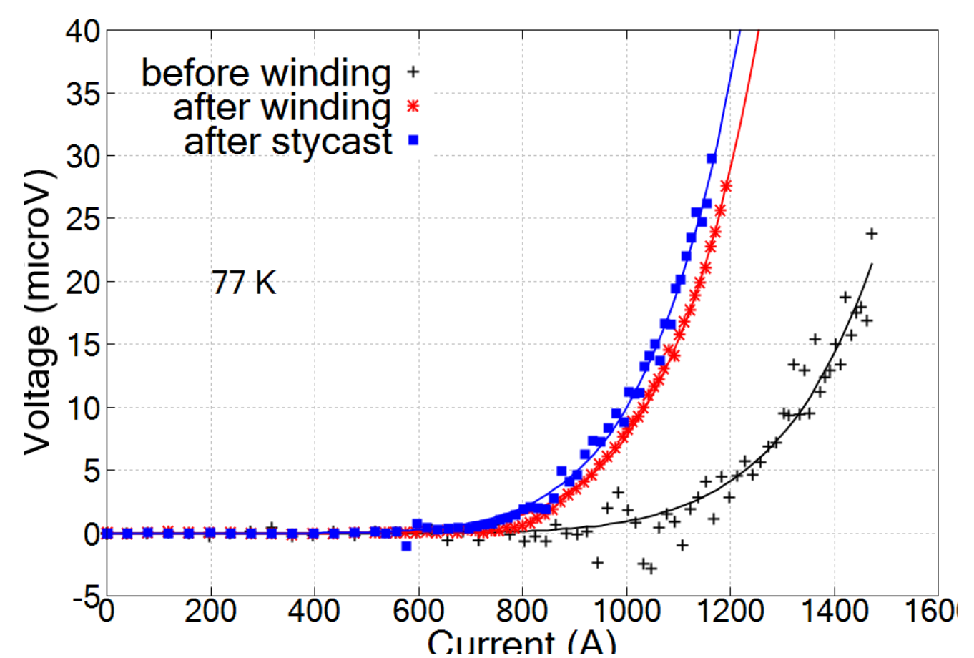
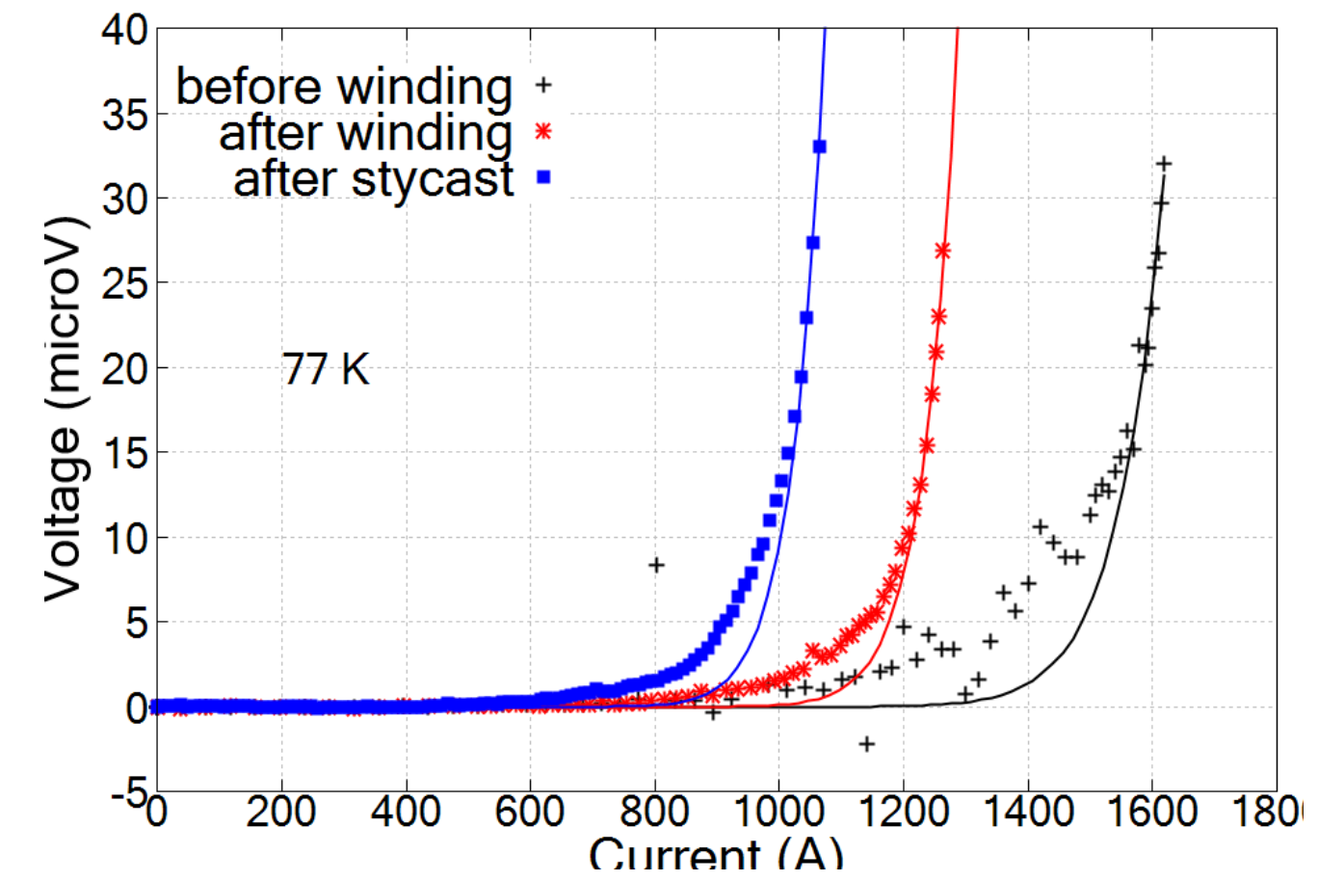
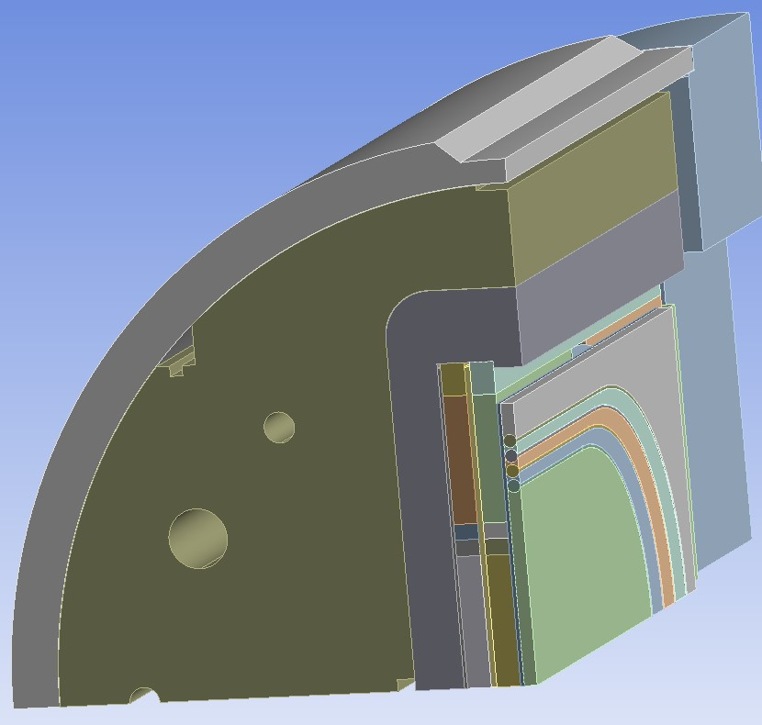
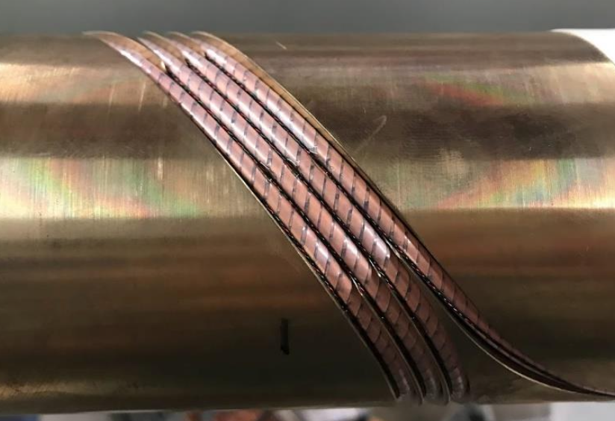
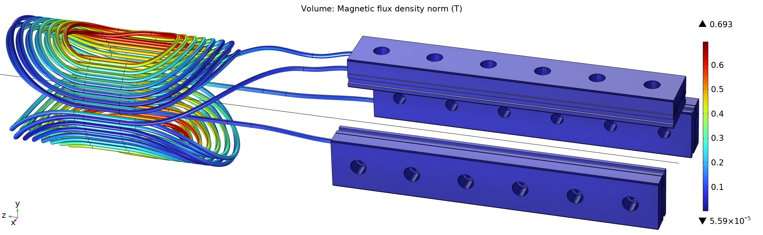
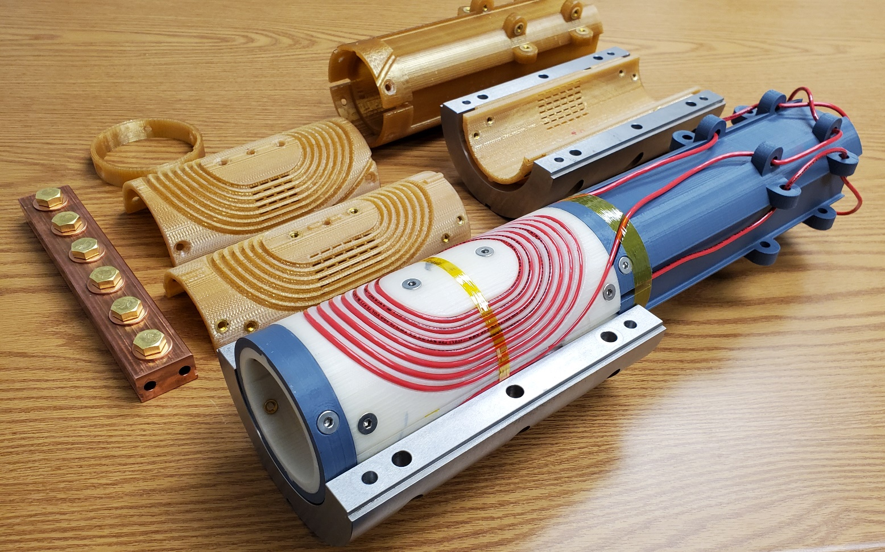
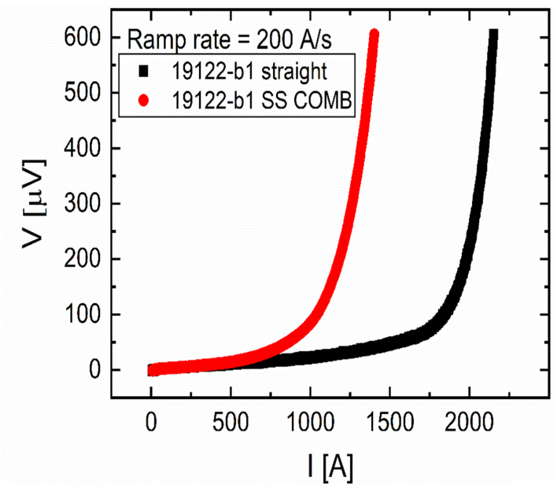
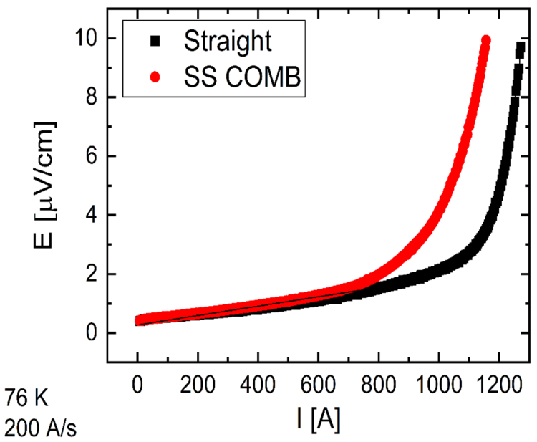
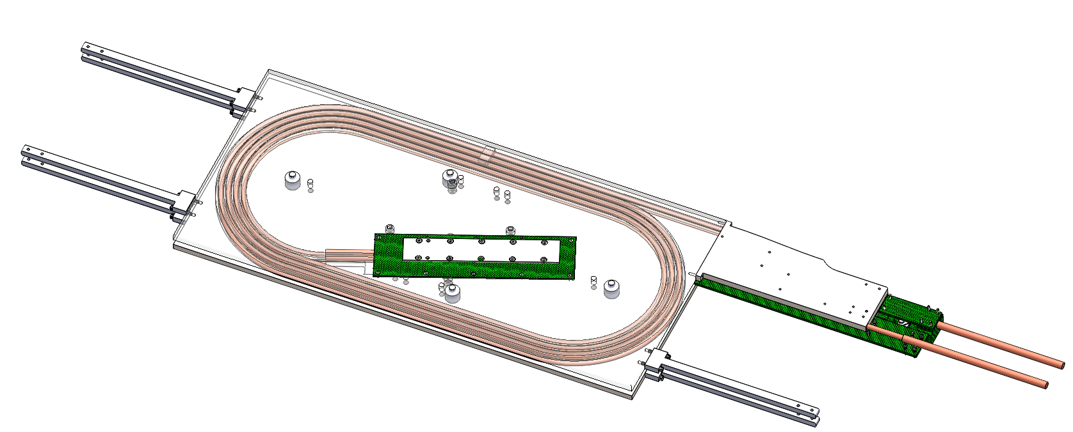
REBCO makes steady progress – MDP focuses on CORC® & STAR®
Test CORC in-field at BNL in the common-coil test facility
Next deliverable – “C3”
      Generate 5 T
      6-layer CCT using CORC® wires
      Tapes & cable in-hand
Layer 1
Layer 2
3-turn practice windings are done for each layer
“COMB” design advancing as a test platform
“Early” CORC
Improved CORC

Slide 15
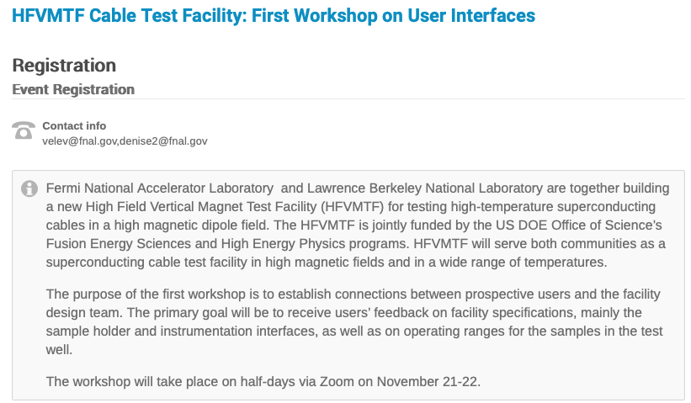
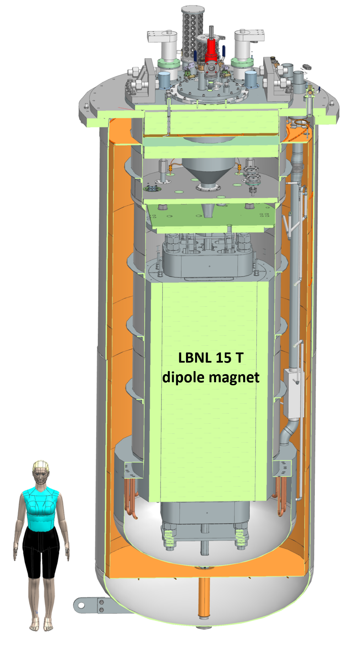
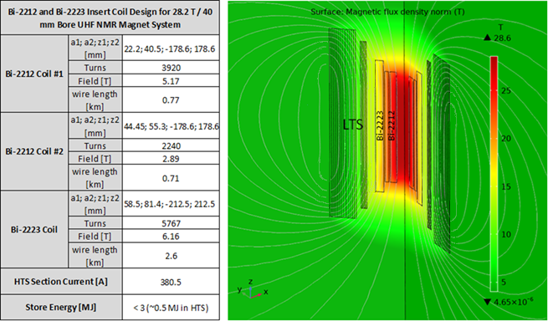
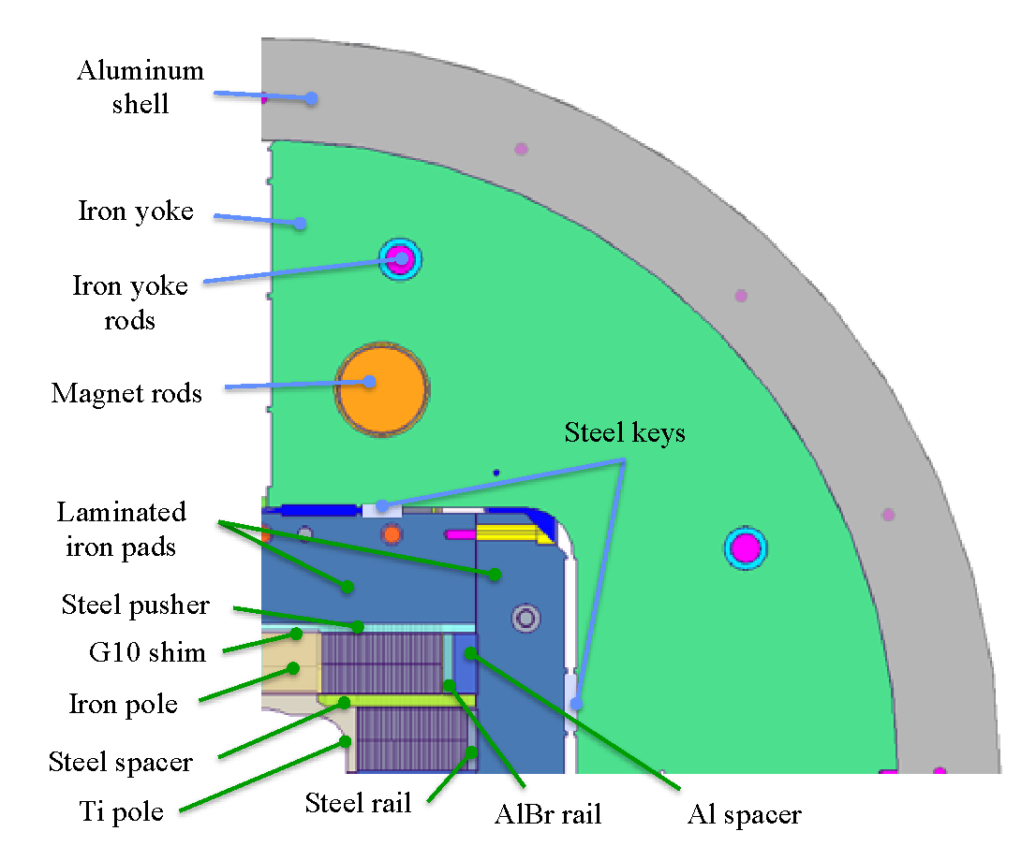

There are significant synergies to be leveraged to support Muon Collider magnet development
ASC/NHMFL partnered with two magnet manufacturers, Cryomagnetics Inc. and Oxford Instruments
Compact general science magnets in the 25 T range
high homogeneity magnets >30 T
Use substantial amount of Bi-2212
DOE Offices of HEP & FES jointly funding a large-bore cable test facility
Will provide 15T dipole field over 750mm good-field, 1.9-50K on-sample
Cryostat will enable testing of high-field hybrid magnets
Being located at FNAL
LTS

Slide 16
Some thoughts on areas for enhanced studies for Muon Collider magnets, beyond current MDP focus areas
C. Reis et al, IEEE TAS, vol. 33, no. 5
Radiation is a major consideration:
  Study tradeoff in aperture/bore+shielding vs magnet radiation hardness
  Further advance understanding of radiation hardness of superconductors and magnet materials
Rapid acceleration is critical:
  Study fixed-field booster options where applicable
  Further investigate high dB/dt magnet concepts
  Evaluate acceleration (particularly low-energy) schemes in an integrated approach
Large thermal loads suggest higher-temperature operation (i.e. all-HTS)
  Explore facility and operational cost models
Leverage strong synergies with fusion and High-Field magnets (e.g. condensed matter):
  Fastest development path for very challenging target and cooling magnets
Example: “A collaboration framework to advance high- temperature superconducting magnets for accelerator facilities” (US-Japan Science and Technology Cooperation Program)
L. Brouwer, PRAB 27, 022402
H. Piekarz et al., IEEE TAS vol. 32, no. 6

Slide 17
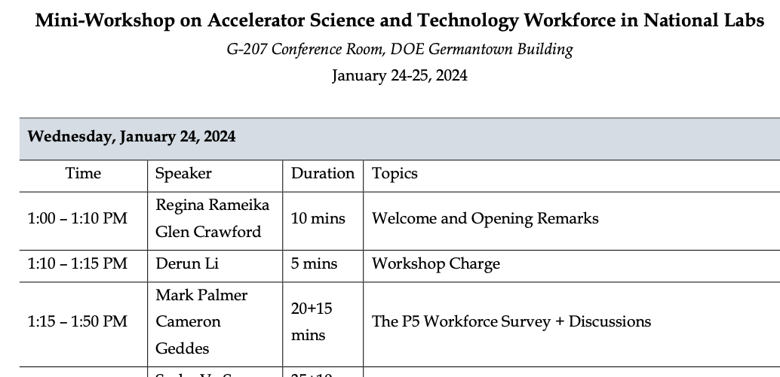
US MDP approach for P5 alignment – work closely with DOE OHEP and with the collider community
Understand the P5 report
  Detailed read of the language used
  Insight into the full intent of the committee
Work with DOE OHEP:
  Understand their timeline for implementation
  Provide critical data for decision making
    Resources available
    Technical progress, impact
Prepare updated MDP Roadmap over coming year
Maintain & increase presence/engagement at:
International Muon Collider Collaboration
FCC-week
Associated workshops (e.g. HFM, etc.)

Slide 18
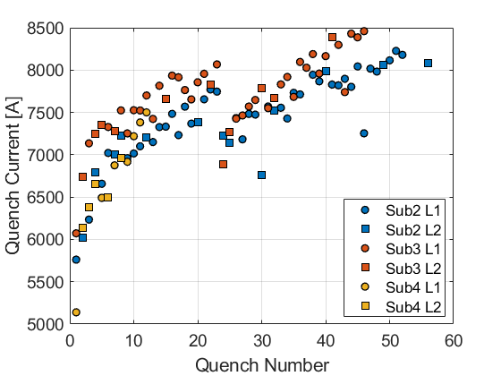
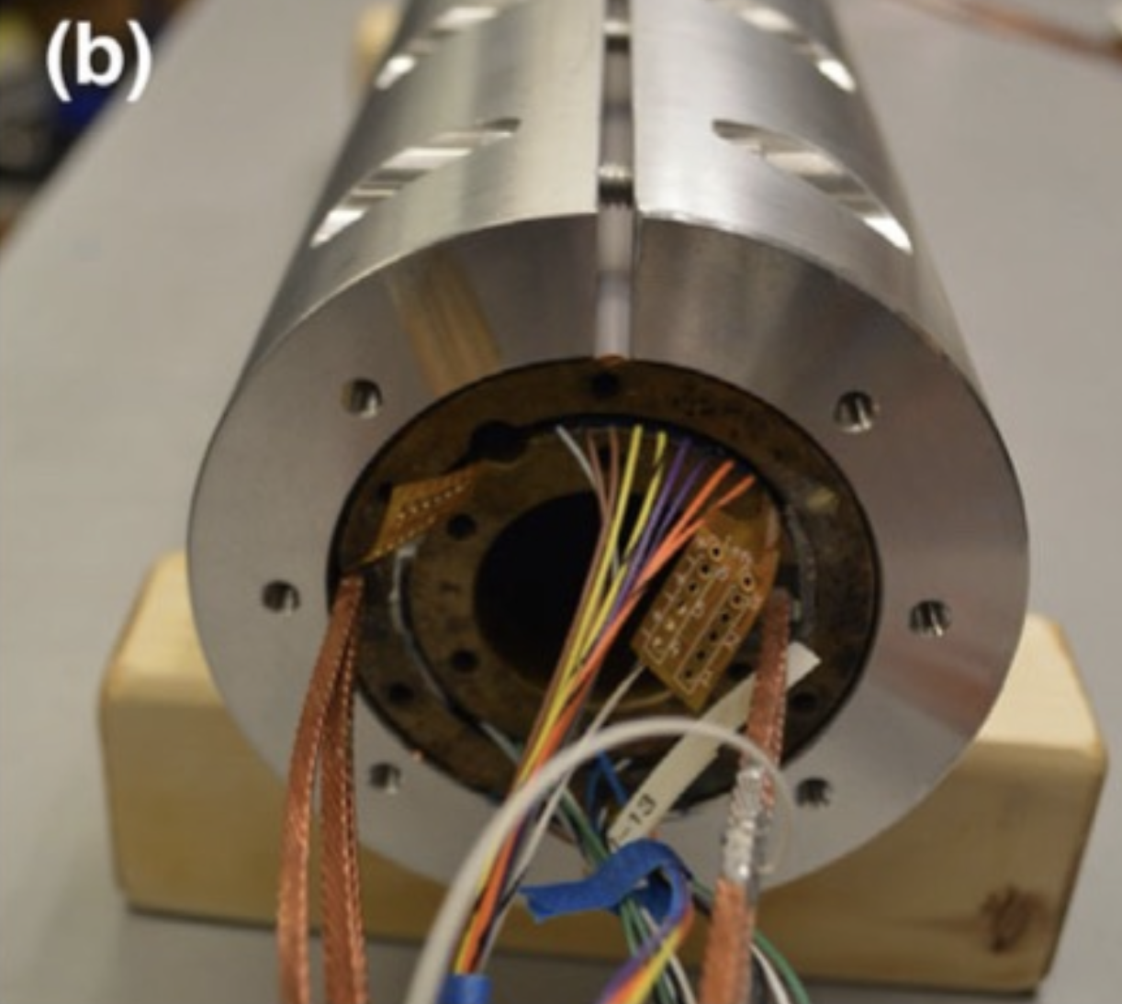
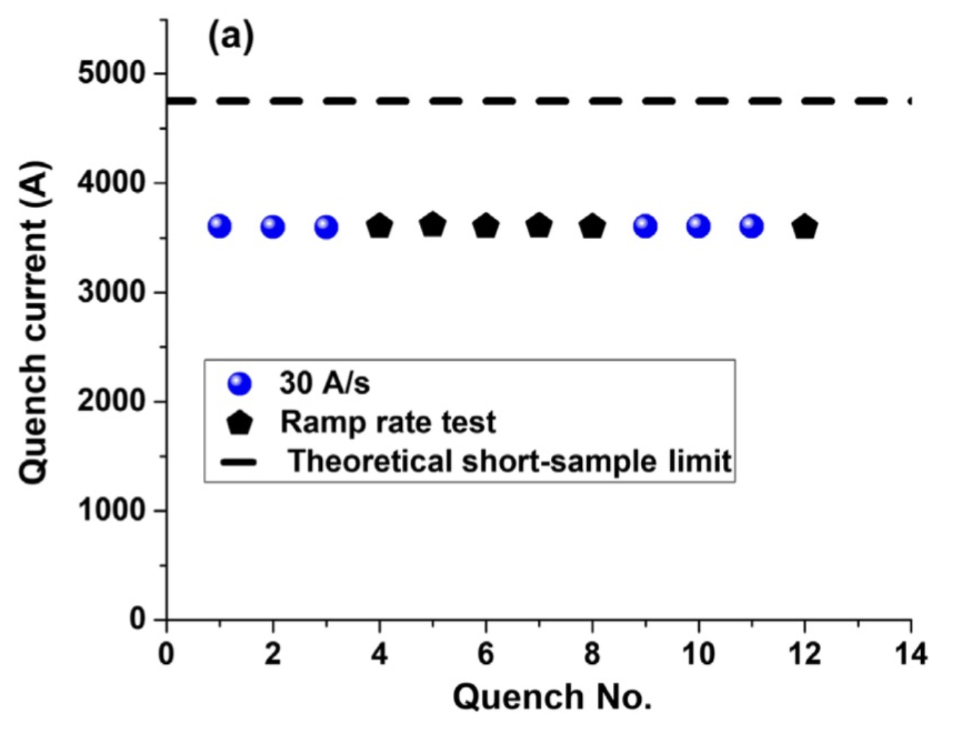
New paradigms: quench-free HTS magnet designs?
Traditional superconducting magnet design ensures magnet can survive quenches
  Motivation:
    spontaneous quenches => lack of reliable precursor, not controllable
    Training => potential for improved performance after quenching
Can we contemplate a new paradigm for HTS?
Higher MQE => not (?) susceptible to spontaneous quenches => no “random” behavior
So far no indication that HTS magnets exhibit training => no performance enhancement
Design to eliminate run-away quenching !?
“Typical” Nb₃Sn CCT magnet training
T. Shen et al., PHYS. REV. ACCEL. BEAMS 25, 122401 (2022)
“Rapid” training to ~75% short-sample, then rate changes
“Fair” memory after thermal cycle
Sub 2/3 thermal cycle
“Thermal runaway criterion as a basis for the protection of high-temperature superconductor magnets”
M Marchevsky and S Prestemon 2024 SUST. 37 035012

Slide 19
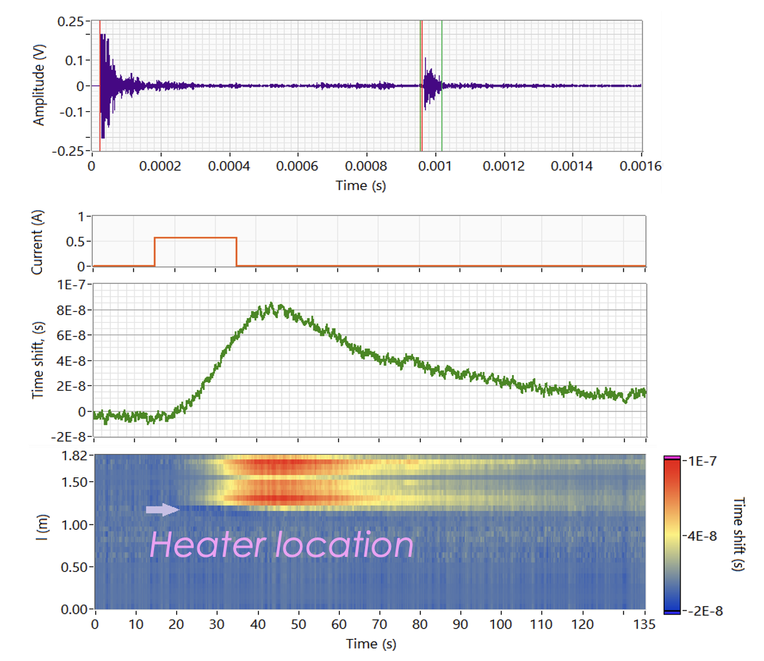
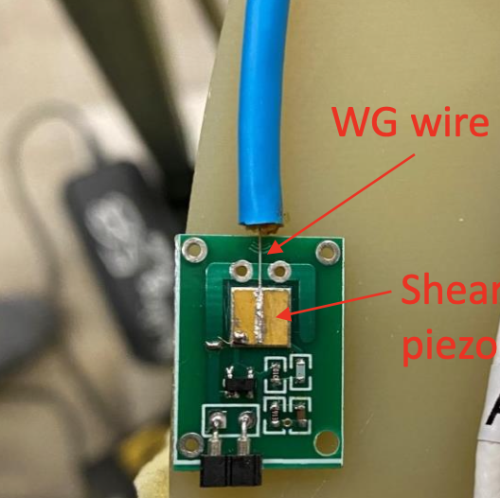
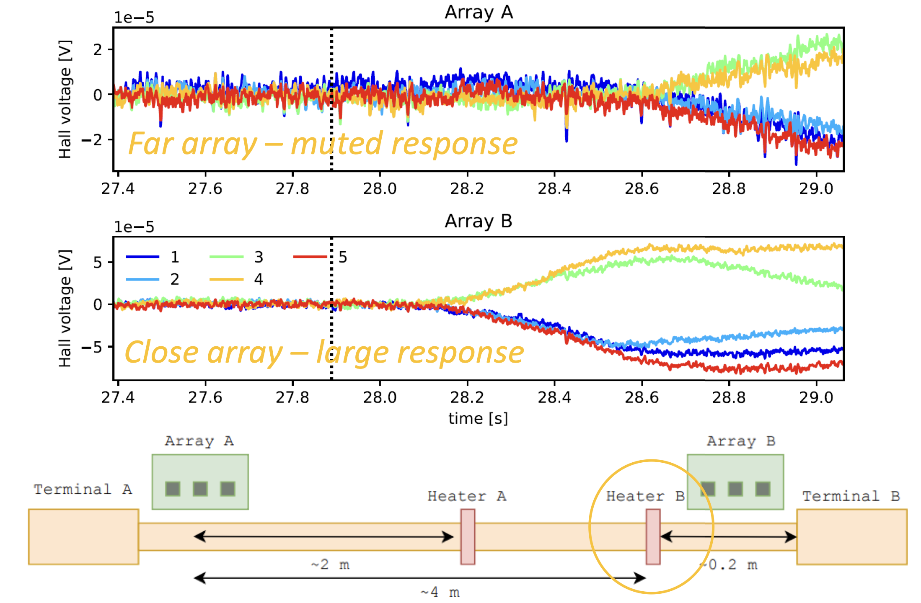
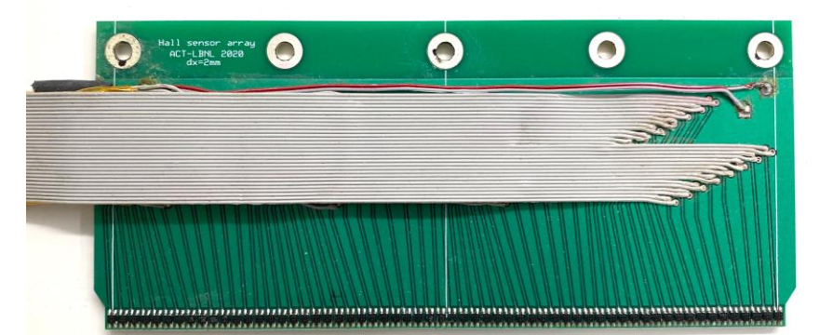
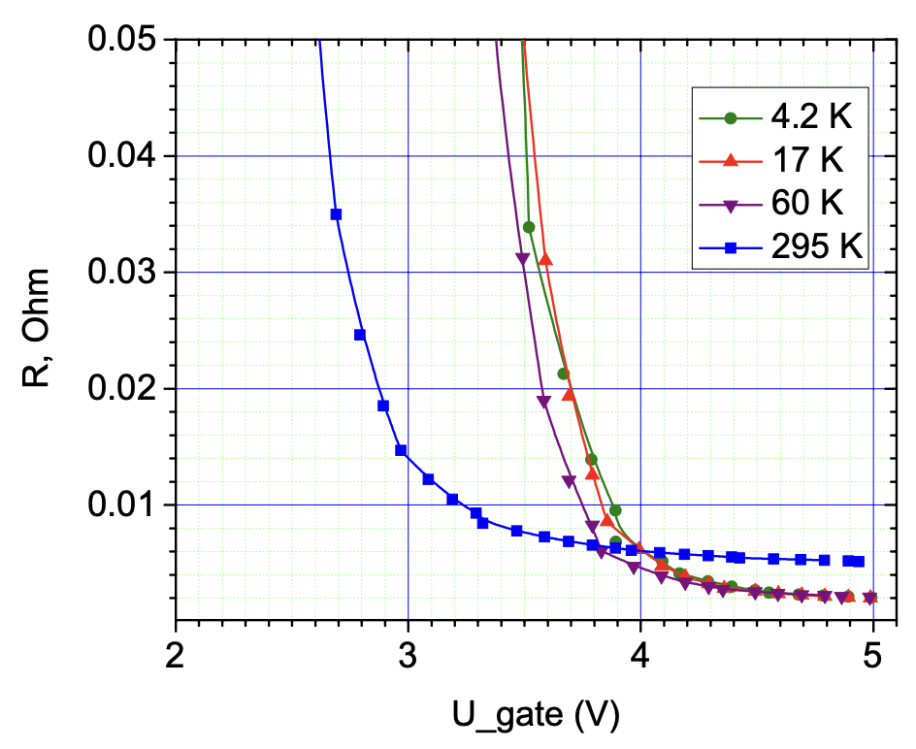

New paradigms – Active/dynamic local powering of magnets for safety, field quality, etc?
Key to enable HTS “Quench-free” paradigm
High bandwidth diagnostics coupled to in-situ FPGA data analysis
Multiple “physics-independent” diagnostics - analyzed & cross correlated
AI/ML utilized to weed out irrelevant data, identify critical events/behavior
Most data acquisition, analysis, decision-making ”below the header”
  Only digital data sent “out”, e.g. via redundant fiberoptics (non-conductive)
Stored diagnostics data monitored/analyzed for system integrity checks
  Modeling coupled to diagnostics => digital twin corelates cause and effect
Cryo-power electronics (MOSFETS, IGBTs, etc) developed to actively control/route power => become integral to magnet protection
Notes:
[also show MOSFET plot? Dsitributed temperature sensing, current sharing sensing, controls]

Slide 20
New paradigms: Liquid hydrogen cooled collider?
Hydrogen has critical advantages:
  Plentiful => not supply limited
  Carnot + liquefaction efficiency => dramatic improvement in ”wall-plug efficiency”
  Strong investments from other societal uses => cost, storage/shipping evolving rapidly
But there are concerns/issues:
  Safety => highly combustible in presence of oxygen
  Materials compatibility => some restrictions due to embrittlement/corrosion
  Limits superconductor option => only REBCO maintains significant transport current at 20K
Sustainability will be a driving consideration in any future international physics experiment - our community needs to make a strong, dedicated effort to explore liquid hydrogen for future colliders

Slide 21
Summary
MDP is performing research that is highly relevant to a Muon Collider
  The process of alignment of the program with the P5 will strengthen this
The magnet R&D programs remain underfunded, given the P5 challenge
Leveraging synergies with Fusion, high field NMR, etc. will be critical
International collaboration is vital to advance our research rapidly

Slide 22
Backup

Slide 23
Main magnet research areas for a muon collider
MDP research is highly relevant to a subset of muon collider magnet R&D:
  the storage ring & IR arena (large-bore)
  HTS development is relevant to the high-field solenoids
  FFAG/non-ramping acc. Solutions

Slide 24
A Muon collider has unique characteristics that drive magnets
“Time is of the essence” in a muon collider – capture and rapidly accelerate precious muons!
The MAP study identified key R&D challenges:
  Central elements: high field solenoids, large-bore dipoles, fast ramping, radiation env.
Issues
Status

Slide 25





Muon Collider dipole magnets have unique requirements
Dipoles must address significant heat load as well as radiation load
  Open midplane or shielding (e.g. Tungsten)
  Example: 2TeV (4TeV c-m) study suggested 2kW/m deposition
  Must extract most heat at higher temperature in order to be feasible
Challenge for high field magnets
  Aperture is “costly” at high field
  Open midplane complicates field quality
Muon collider feasibility study 1997, LBNL-38946
Novitski et al., TAS 2011

Slide 26



Interaction region magnets have similarities to Hadron colliders
IR quads operating at ~11-12T
  Large bore (~150mm)
  Parameters are similar to HL-LHC quads
IR Dipoles
  Need to tolerate high radiation
  =>Large bore, or open midplane
Alexahin et al., PTSTAB 14,2011

Slide 27




International collaboration supports MDP developments
PSI “BigBox” experiment designed to probe stress-management
  Leverages BNL 10T common-coil test facility
  Single-turn wax-impregnated sample (PSI & U. Twente)
  Provides “knob” to vary transverse force on cable
Original “BOX” samples

Slide 28





Current MDP focus areas and key challenges
Can stress-management provide a viable means of accessing high-field and/or large bore dipole magnets without risk of conductor degradation?
Can hybrid LTS/HTS magnets deliver on the promise of efficient high-field dipoles
  Will they inherit the “best of both” or the “worst of both”
Advance HTS magnet technology to a respectable level of maturity
=> make it “real”
Advance diagnostics and modeling to further enhance our insight into magnet performance and issues
Overcome the advanced Nb₃Sn architecture issues and mature them to industrial levels
Provide a substantial and timely quantity of conductor for magnet research and feedback to conductor development
Reed Teyber et al 2020 SUST. 33 095009
X. Wang et al SUST 34 (2021) 015012

Slide 29



Subscale magnets as a platform for rapid development
”Canted Cosine Theta” (CCT) is limiting case of stress-management
  Every turn supported – minimal azimuthal accumulation of force
  Subscale probes relevant stress state
Test demonstrated that the subscale magnet exhibits similar training to “full scale”
CCT4 – Epoxy filled interface (CTD 101k)
CCT5 – Bend and shim interface (FSU Mix 61)

Slide 30
The US MDP strives to be open and collaborative
We are a mature and vibrant integrated multi-lab research program focused on developing accelerator magnet technology for the next energy frontier collider
This is an international endeavor, and we are eager to collaborate and join forces to rapidly advance the field
High field accelerator magnets are essential for the next collider – the onus is on us to deliver!
We strive to…
  provide a clear vision for magnet development & conductor properties/performance we would like to see
be open with our results and progress so others can benefit from our advances
  identify and benefit from the achievements and progress of others
  be good collaborators – we recognize the strengths and enthusiasm residing in the broader community!

