Slide 1
Status of Recirculating Linacs (RLAs)
Avni Aksoy

Slide 2
Collider Concept
Acceleration
from 0.25 GeV to 63 GeV
Short, intense proton bunch
Ionisation cooling of muon in matter
Acceleration to collision energy
Collision
Protons produce pions which decay into muons, muons are captured
Fully driven by muon lifetime

Slide 3
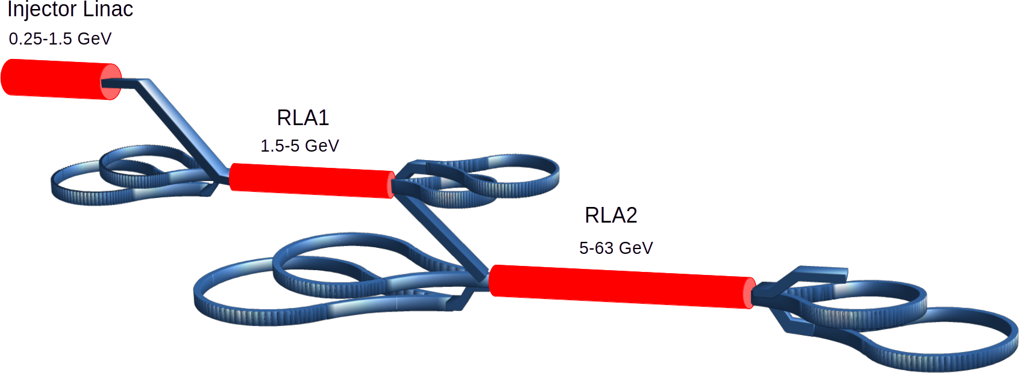
Low Energy Acceleration Complex

Slide 4
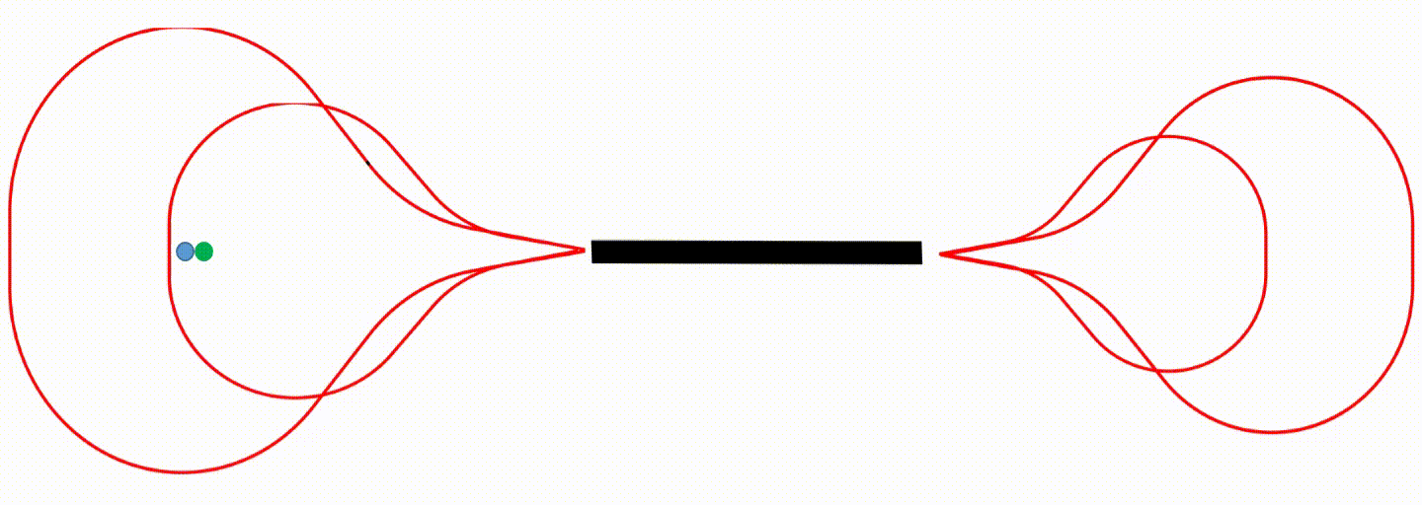
High efficient low cost acceleration for low energy Muons
‘Dogbone’ Recirculating Linear Accelerator is proposed to accelerate beam at low energy (Alex Bogacz)
Single linac is used to accelerate consecutive µ- and µ+ bunches in one RF pulse with many passes
Independent arcs due to large energy variation between passes.

Slide 5
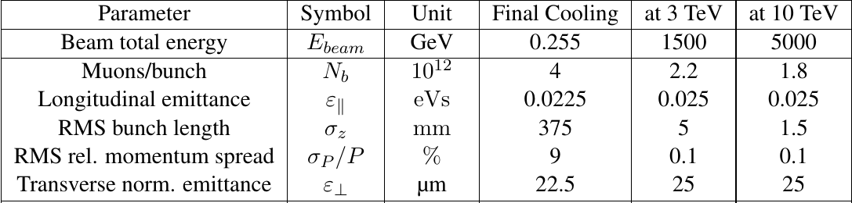
Beam Parameters along the acceleration chain
Very large energy spread
  Chromatic aberrations even by quadrupoles at low energy
Both longitudinal and transverse emittance has to be preserved
  Quasi-Isochronous arcs are necessary (with flexible momentum compaction)
Consecutive two bunches with opposite charge
  Good matching for both bunches (i.e. round beam at injection/extraction to arcs)
Very high bunch charge
  Minimization of beam loading and wakefield..
Rapid acceleration
...
Very long bunch after final coolling (375 mm)
  One can use induction linacs in injection. However bunch needs to be compressed at least by factor 10.
10 % emittance growth in the transverse and longitudinal planes, both for 3 and 10 TeV.
  Very tight tolerance with given longitudinal emittance!

Slide 6
Previous study for RLA2

Slide 7
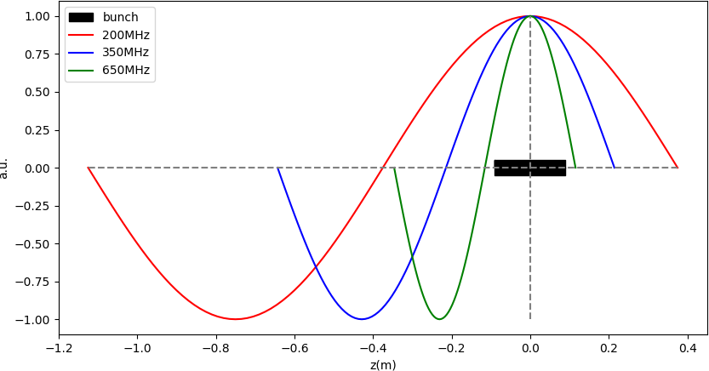
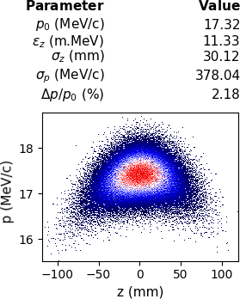
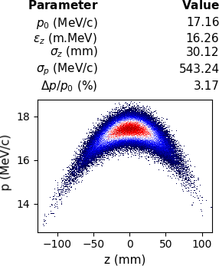
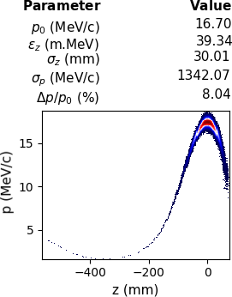
Choice of RF frequency in linacs
If we have RMS ~ 30 mm Gaussian bunch → 200 mm full length
Typically the total bunch length should be < 10% of λRF
To preserve longitudinal emittance lower frequency is preferable but we can use linearizers
Reasonable frequency would be SC 352 MHz cavity (LEP cavity)
200MHz
350MHz
650MHz

Slide 8
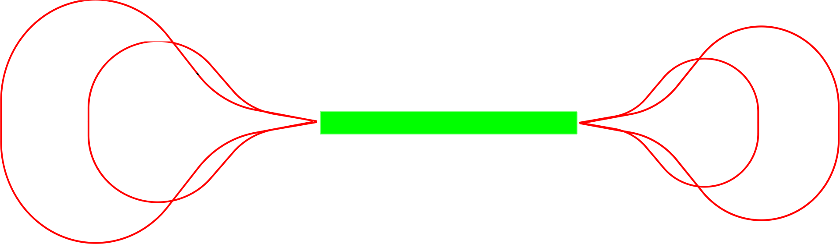
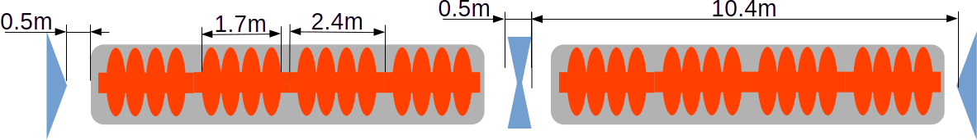
RLA2
The goal is accelerating two bunches (μ+,μ-) spaced by λRF (n-1/2) from 5 to 63 GeV
5-pass RLA 5-63 GeV
μ+
μ+
51.4 GeV
28.2 GeV
16.6 GeV
39.8 GeV
μ-
μ-
Energy gain : 11.6GeV / pass
Total acceleration time ~25 μs
  No RF parameters are possible to change within one RF pulse
Minimum number of pulsed magnets
  Preferred not to use any
FODO type lattice with fixed gradient quadrupoles in linac

Slide 9
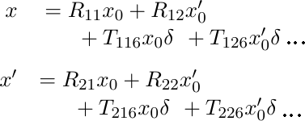
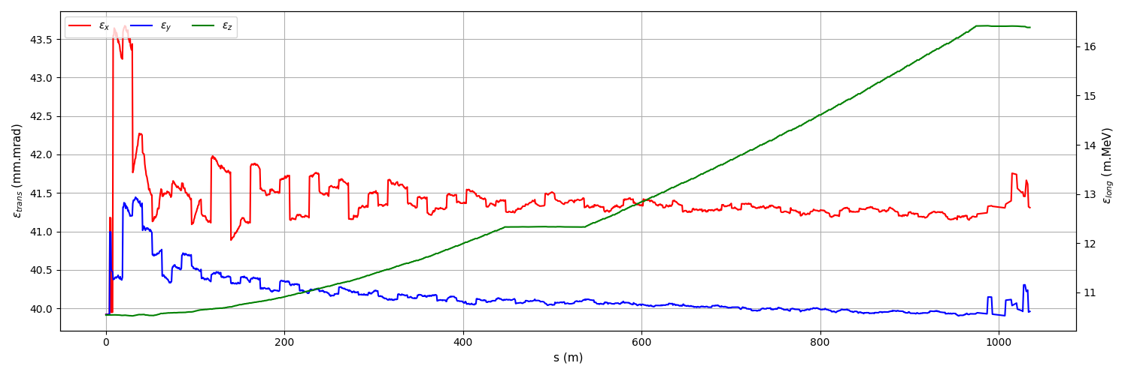
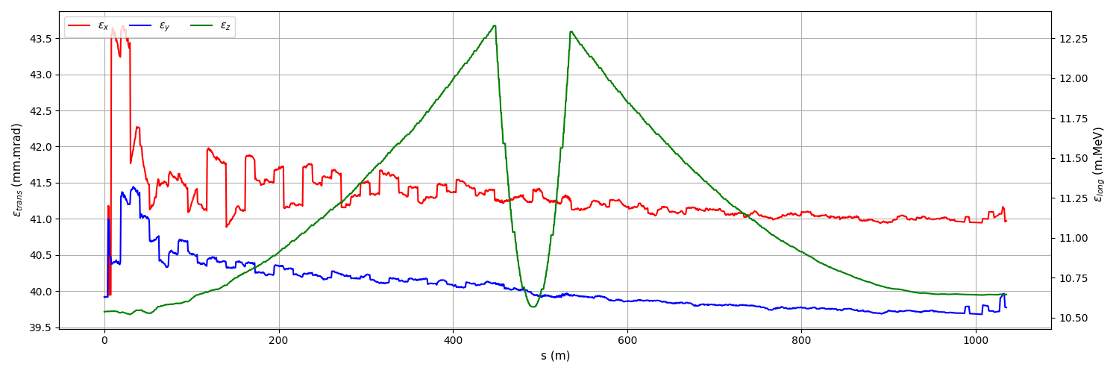
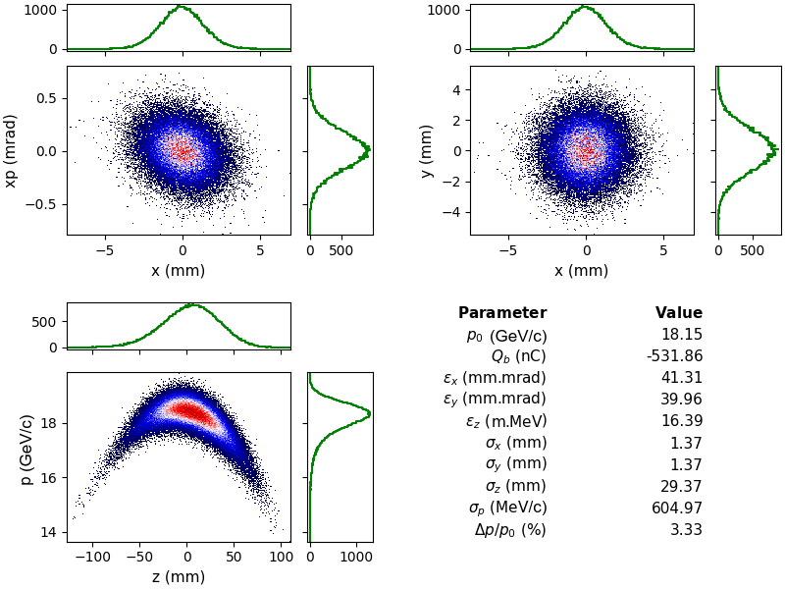
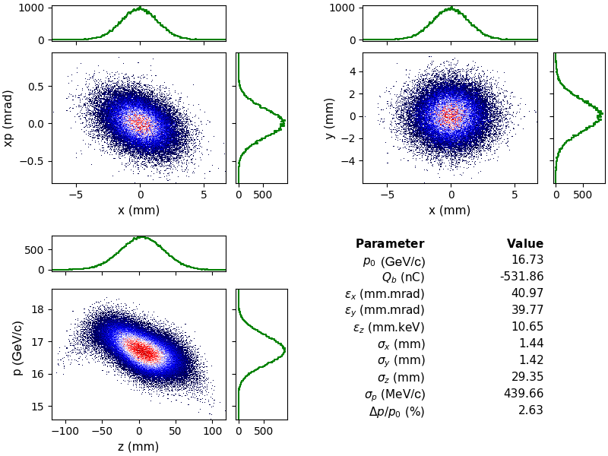
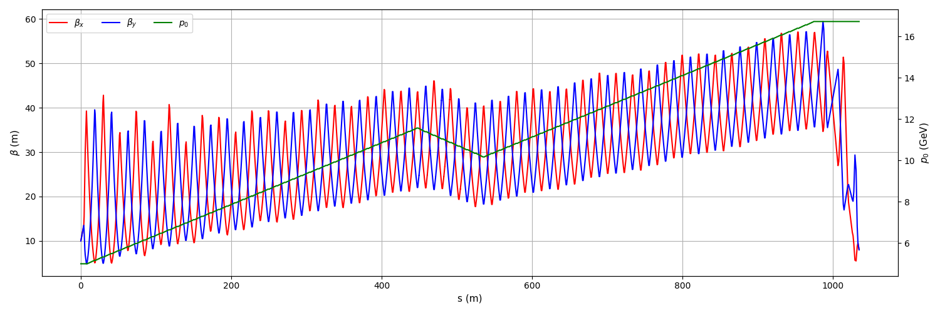
Beam Dynamics in Linac
Large initial energy spread causes emittance growth due to chromatic effects by quadrupoles
We need to use weak quadrupoles to preserve emittance
  Drawback: Sensitive to transverse wakefield effects
W/O linearizer
With linearizer

Slide 10
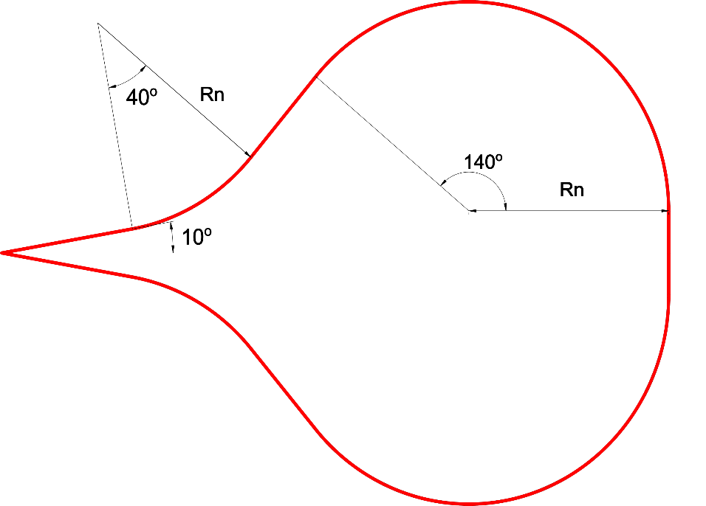
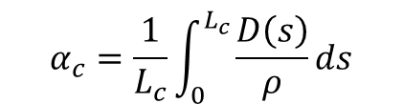
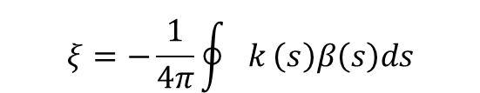

Droplet Arcs
Arcs consists of two symmetric sections (-50º and 140º) and total turn is 380º, net turn is 180º
The curvature changes with energy
Large energy acceptance
  we still have large energy spread at the exit of first pass
    σΔp ~ 500 MeV → σΔp/p 3% (16.6 GeV ± 1.2 GeV)
Longitudinal emittance ≤≥ bunch length needs to be preserved/controlled
  Small Momentum compaction factor (R56 ≈ L αc)
We also need small dispersion in bending magnets to preserve transverse emittance
Small betatron oscillation to minimize chromaticity
$$α_{c}=\frac{1}{L_{c}}\int_{0}^{L_{c}}{\frac{D\left(s\right)}{ρ}}ds$$
$$H=γ_{x}D_{x}^{2}+2α_{x}D_{x}D_{x}′+βD_{x}′^{2}$$
$$ξ=−\frac{1}{4π}\oint{k}\left(s\right)β\left(s\right)ds$$

Slide 11
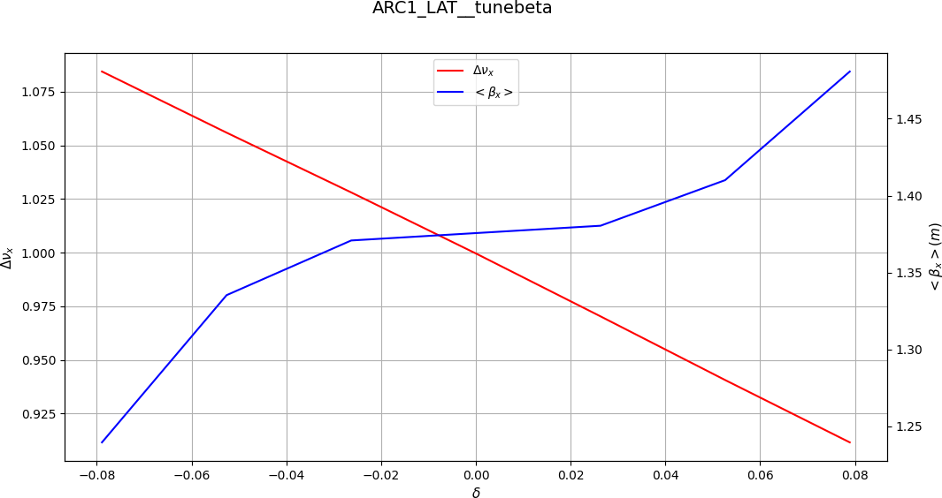
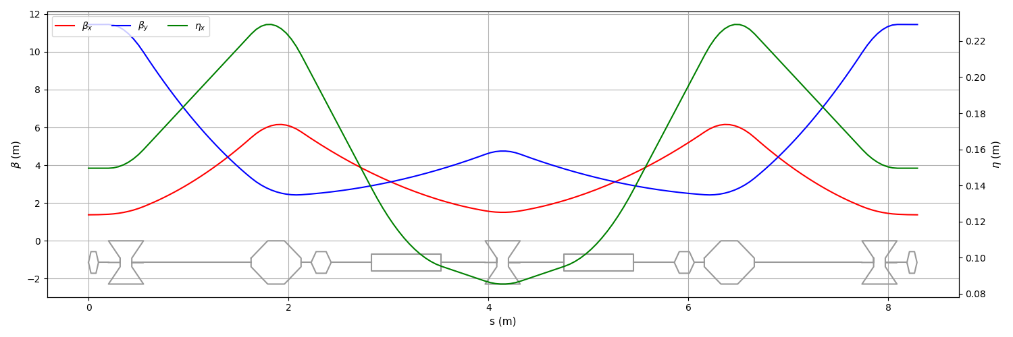
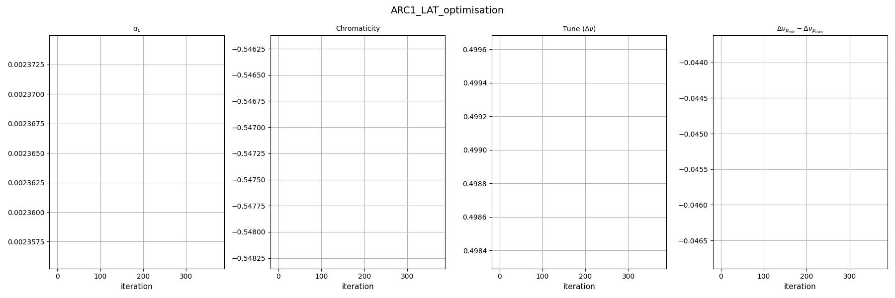
Basic arc cell
Different lattice configuration has been studied
  FODO, Triplet. TME : The sign of R₅₆ is fixed. Control of bunch length can be done only with RF.
DB(A)-lattice allows to control R₅₆ with quadrupole strength as well as the chromaticity (Flexible Momentum compaction)
Basic cell for arcs
Bending angle/cell =10º
B_{max} =7T
Aperture =50mm

Slide 12
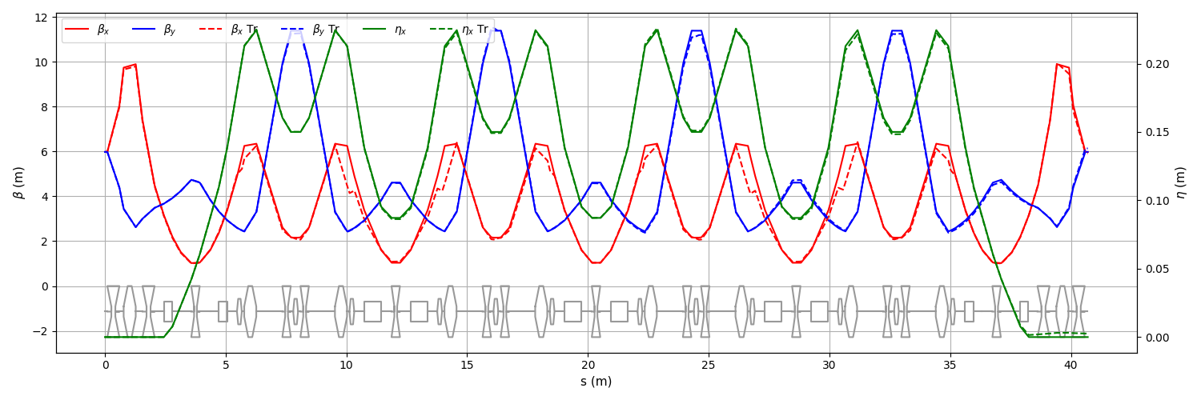
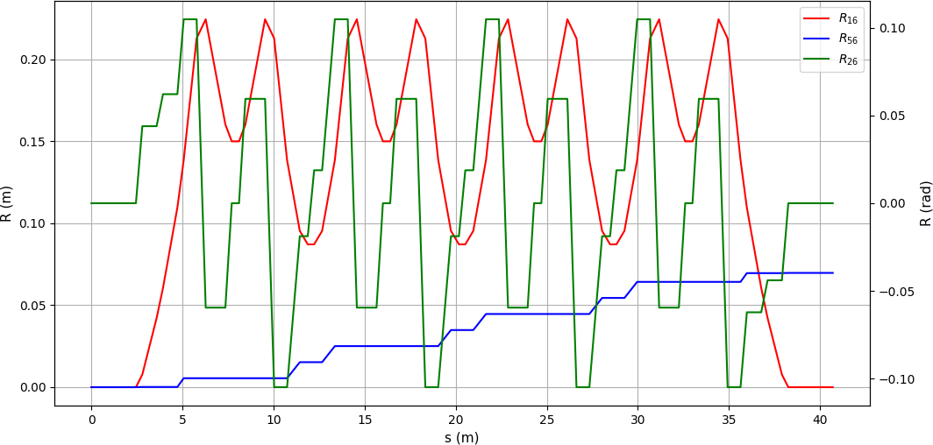
Arc Lattices
40º bending section of first arc
Dispersion suppression and matching
Basic cell
Dispersion is suppressed with half bending angle
Sextupoles are optimized with second order optics.

Slide 13
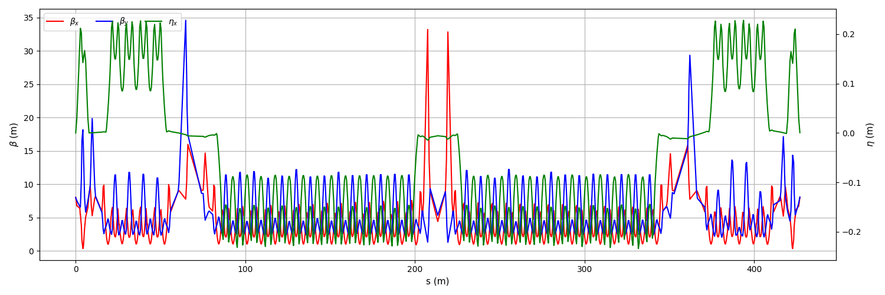
Beam dynamics in arcs
Start to end simulation in first arc (tracking)
Extraction
Straight section
µ-
40º bending
140º bending
By-pass section
µ+

Slide 14
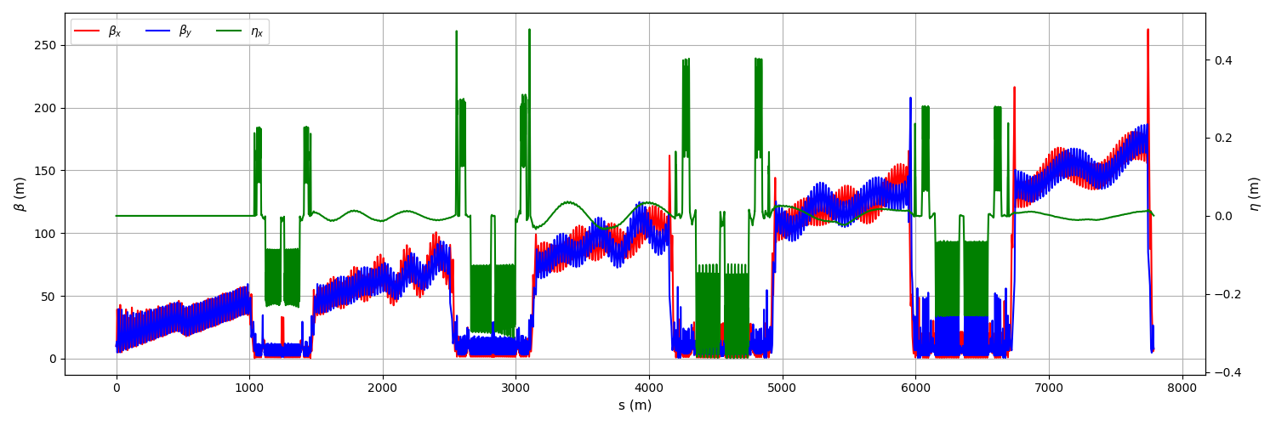
Start to end RLA2
1st pass
1st arc
2nd pass
….
4th arc
5th pass

Slide 15
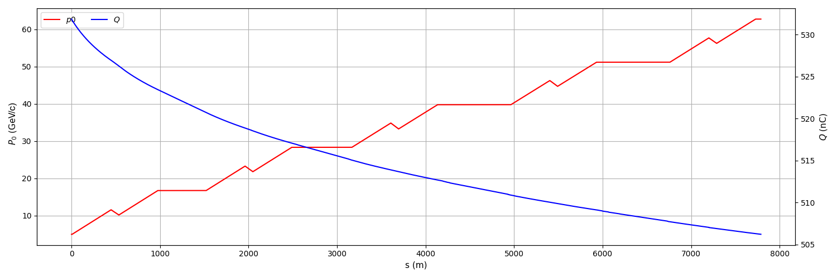
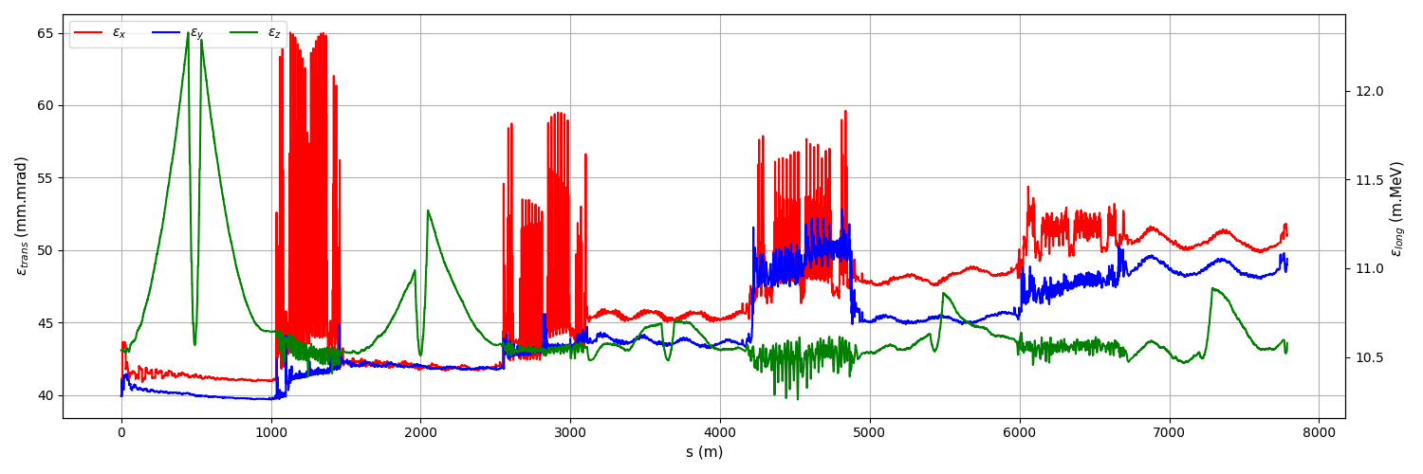
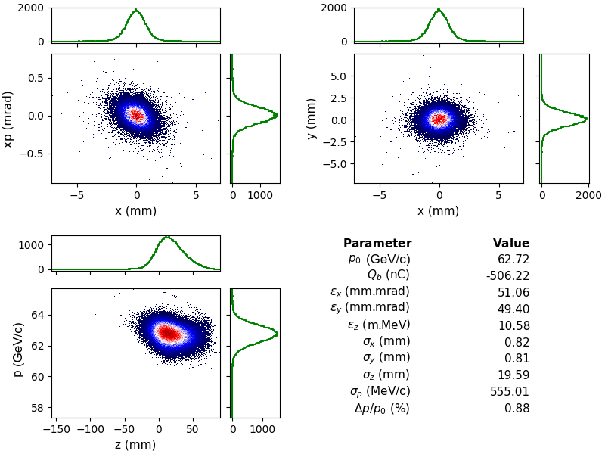
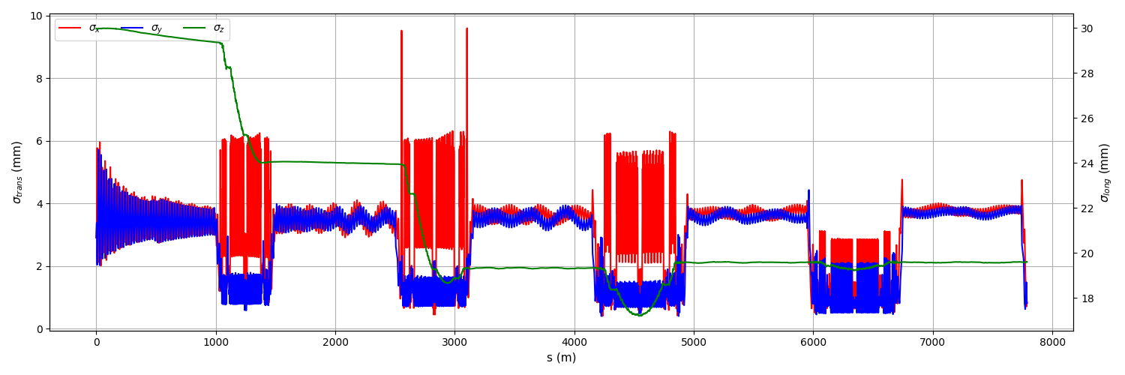
Start to end simulation for RLA2

Slide 16
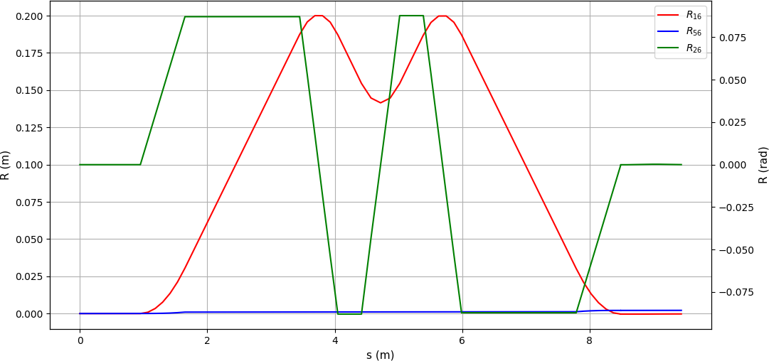
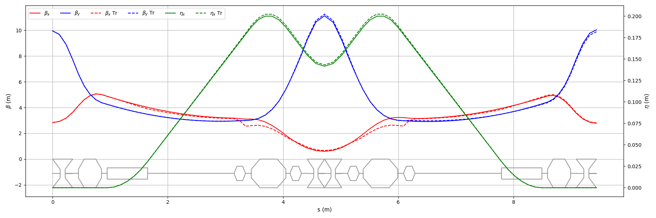
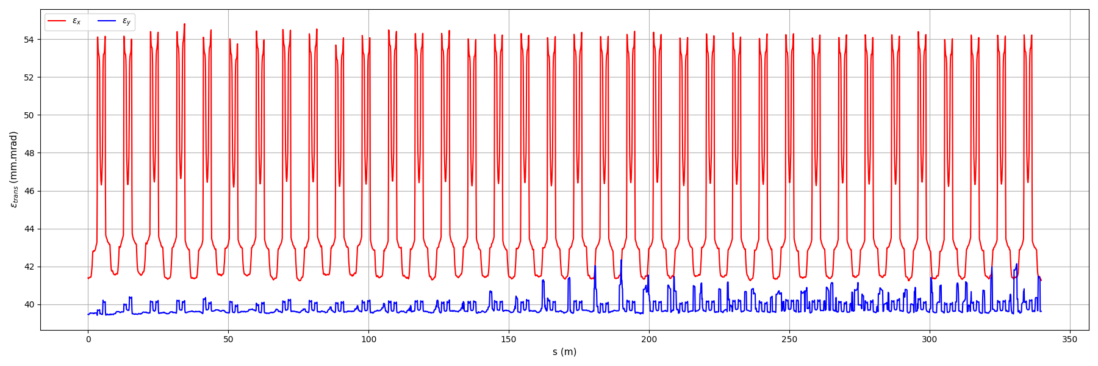
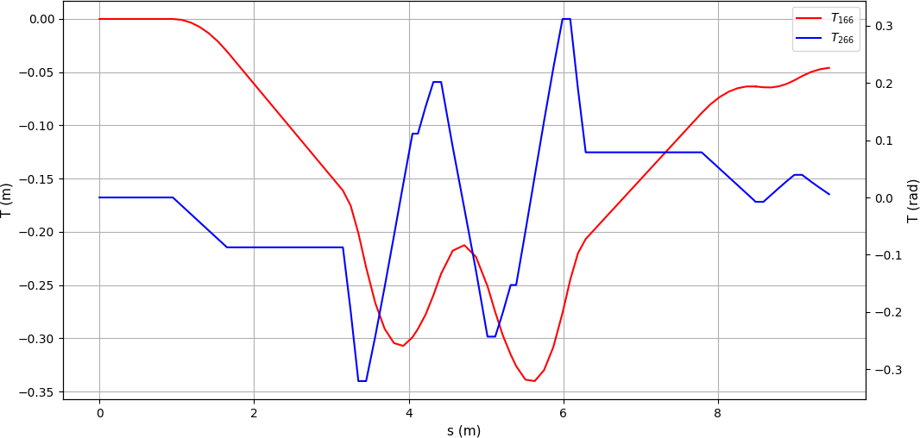
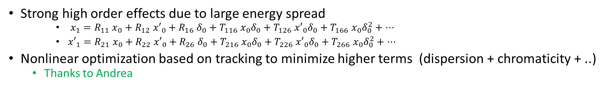
New DBA Lattice for Arcs
Strong high order effects due to large energy spread
    $x_{1}=R_{11} x_{0}+R_{12} {x′}_{0}+R_{16} δ_{0}+T_{116} x_{0}δ_{0}+T_{126} {x′}_{0}δ_{0}+T_{166} x_{0}δ_{0}^{2}+…$
    ${x′}_{1}=R_{21} x_{0}+R_{22} {x′}_{0}+R_{26} δ_{0}+T_{216} x_{0}δ_{0}+T_{226} {x′}_{0}δ_{0}+T_{266} x_{0}δ_{0}^{2}+…$
Nonlinear optimization based on tracking to minimize higher terms (dispersion + chromaticity + ..)
  Thanks to Andrea
Emittance evaluation for 360º turn

Slide 17
Injector study

Slide 18
Low Energy Acceleration Layout
In order to use more realistic particle distribution in RLAs we focused on injector.
Expected beam parameters from final cooling channel
E_{K} = 255 MeV
ε_{z} = 0.0225 eVs
σ_{z} = 400 mm
ε_{x,y} = 20 mm.mrad

Slide 19
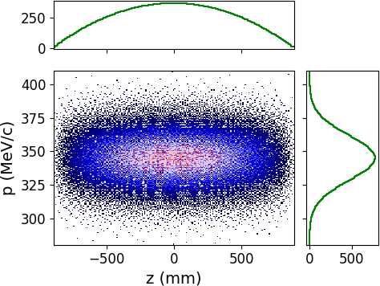
Initial beam distribution
Parameter | Unit | Value
Initial beam energy | MeV | 255
Final beam energy | GeV | 1.5
Initial bunch charge | nC | 650
Transverse emittance | μm.rad | 20
Longitudinal emittance | eVs (m.MeV) | 0.0255 (6.75)
Initial RMS (full) bunch length | mm | 400 (~1800)
Final RMS bunch length | mm | < 30
Final energy spread | % | <10
Very long bunch needs to use “very” low frequency
Maximum transmission
  Rapid acceleration
...

Slide 20
Considerations
Accelerator frequencies in RLA1 and RLA2 is 352 MHz ➔ We can use sub-harmonic frequencies i.e. 88 MHz and 176 MHz as well as 352 MHz
Low initial energy ➔ We can use solenoids up to a reasonable beam energy
Bunch compression
  Velocity compression, magnetic compression
Very high bunch charge
  Relatively large beam when the beam has low energy
High transmission requirement
  Avoid beam loss (minimize tails) and minimize long drifts…
…

Slide 21
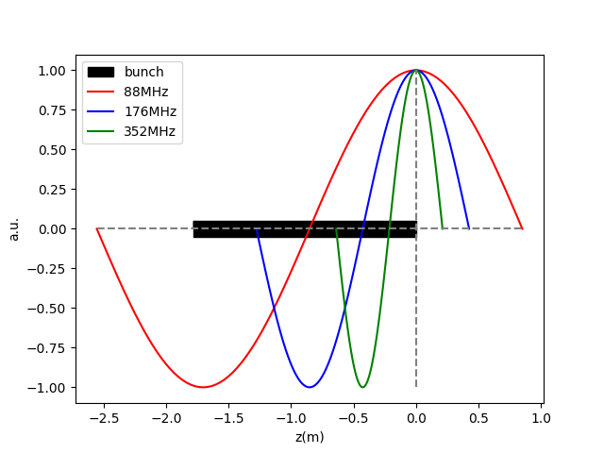
Frequency choice
The bunch length 1800 mm requires more than 88 MHz
  For RF @88MHz the length of Δφ =±90 deg is ~ 1.7 m
  Lower is preferable but 44 MHz would have very low gradient??
Instead of using single frequency one can use combination of frequencies to control longitudinal emittance and force bunch synchrotron motion in RF bucket

Slide 22
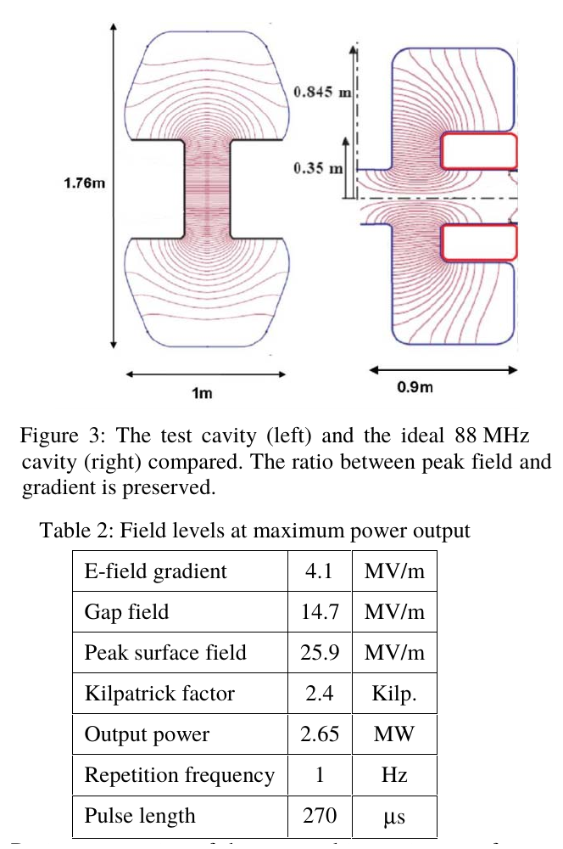
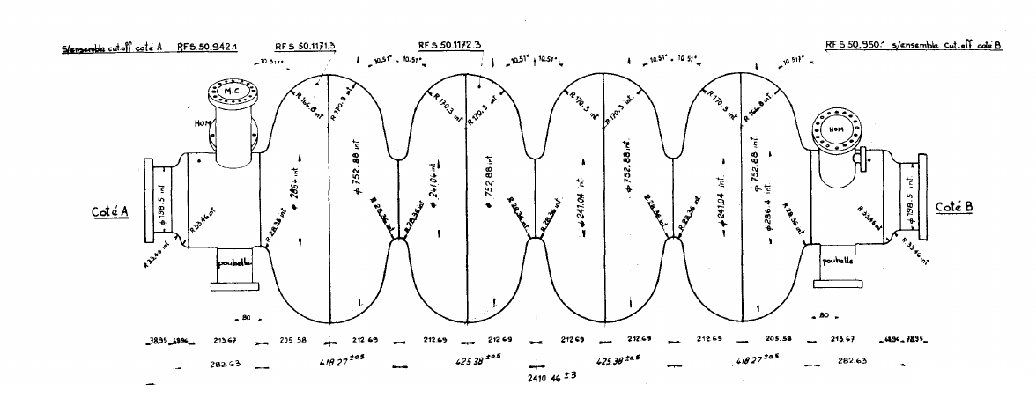
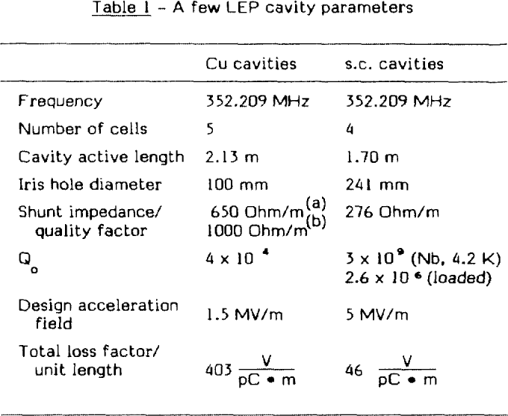
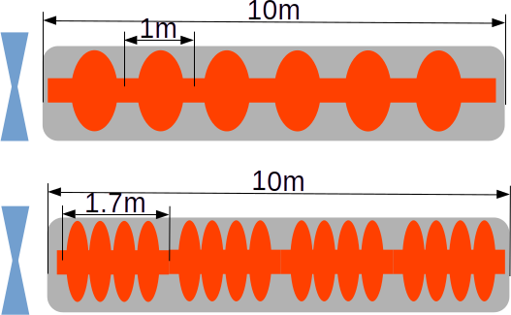
RF cavities
G. Arnolds-Mayer et.al. 'RADIO FREQUENCY SUPERCONDUCTIVITY AT CERN: A STATUS REPORT', The Third Workshop on RF Superconductivity, Argonne National Laboratory, Illinois, USA
C. Rossi, et.al. "HIGH GRADIENT TESTS OF AN 88 MHZ RF CAVITY FOR MUON COOLING" , Proceedings of EPAC 2006, Edinburgh, Scotland
The 176 MHz also assumed to be single cell with same length of 88 MHz
The gradients
  15 MV/m for 352 MHz
  9 MV/m for 176 MHz
  5 MV/m for 88 MHz
88 and 176 MHz
352MHz

Slide 23
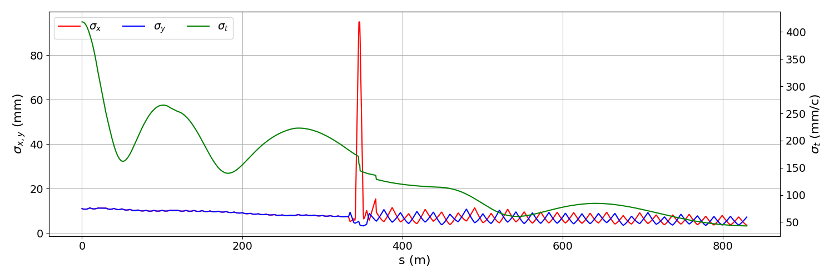
Injector simulations
Different frequencies are distributed along beamline
Magnetic bunch compressor is also used
Solenoid focusing
88 MHz & 176 MHz
Magnetic
Compressor
FODO focusing
88,176 & 352MHz

Slide 24
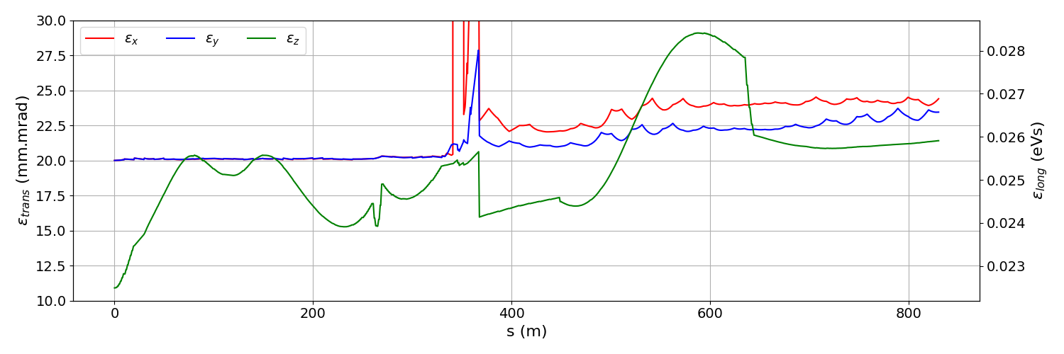
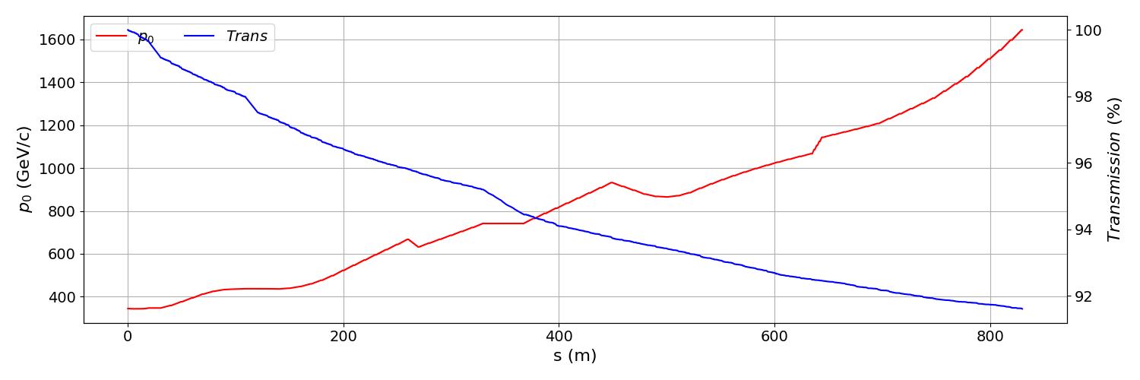
Injector simulations
Very low average acceleration due to manipulation of the phase space
>90% muon survival

Slide 25
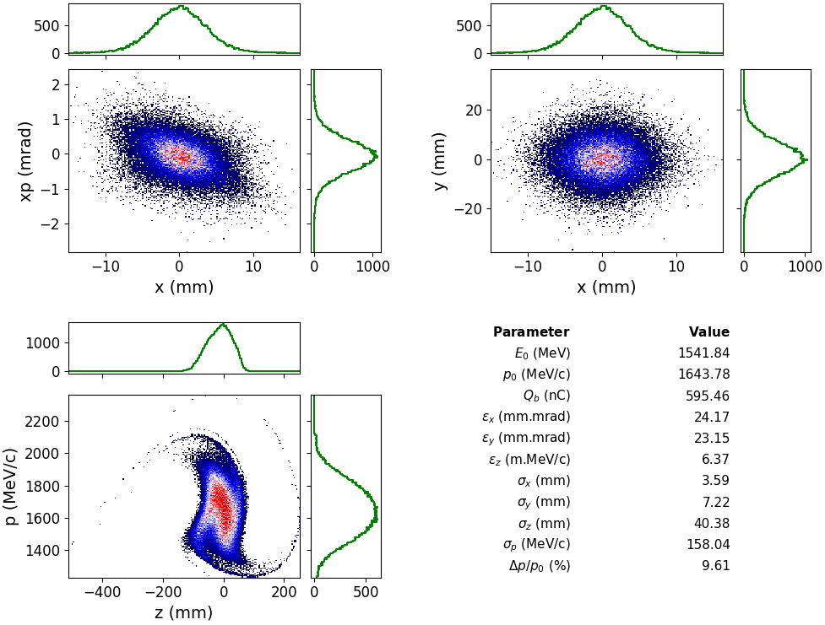
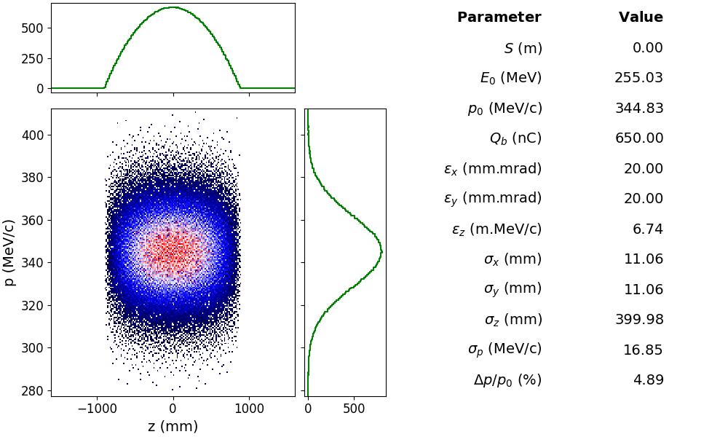
Injector simulations
Achieved bunch length : 40 mm
Longitudinal emittance is more less preserved

Slide 26
Conclusion
In addition to improve arc lattice we focused on injector simulation to find out a “realistic” bunch distribution at the entrance of first RLA
  First iteration has been performed.
Due to long bunch length we started with 88 MHz acceleration frequency and used combination of higher frequencies.
The final bunch length and longitudinal emittance is still beyond acceptance of 352 MHz cavity
  ~ 20 % higher than we need in terms of bunch length..
Due to acceleration about zero-cross we have very low effective acceleration in the injector which causes low transmission.
  ~1.25 MeV/m
Relaxing longitudinal emittance (i.e. 10-20%) would increase the performance of injector significantly
  Better transmission, shorter machine etc..
We will continue optimization until we reach target beam parameters.

Slide 27
Thank you for your attention.

