Slide 1

RF parameters in the high energy muon acceleration chain
Leonard Thiele (University of Rostock, CERN), Fabian Batsch
A. Aksoy, D. Amorim, R. Calaga, H. Damerau, M. Gast, A. Grudiev, I. Karpov, U. van Rienen, S. Udongwo

Slide 2
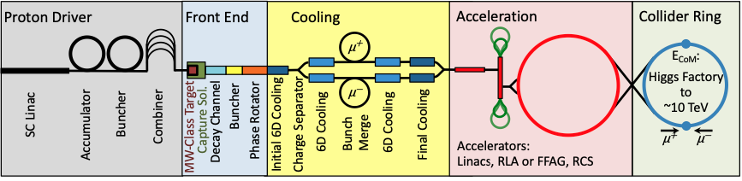

Content
Introduction to beam loading in RF cavities
Assumptions for the RF parameters
RF parameters in the Rapid Cycling Synchrotron (RCS) chain and the 2nd Recirculating Linear Accelerator (RLA)
Limitations of the calculated parameters
Integration of the computations into the RCSparameters Python package

Slide 3
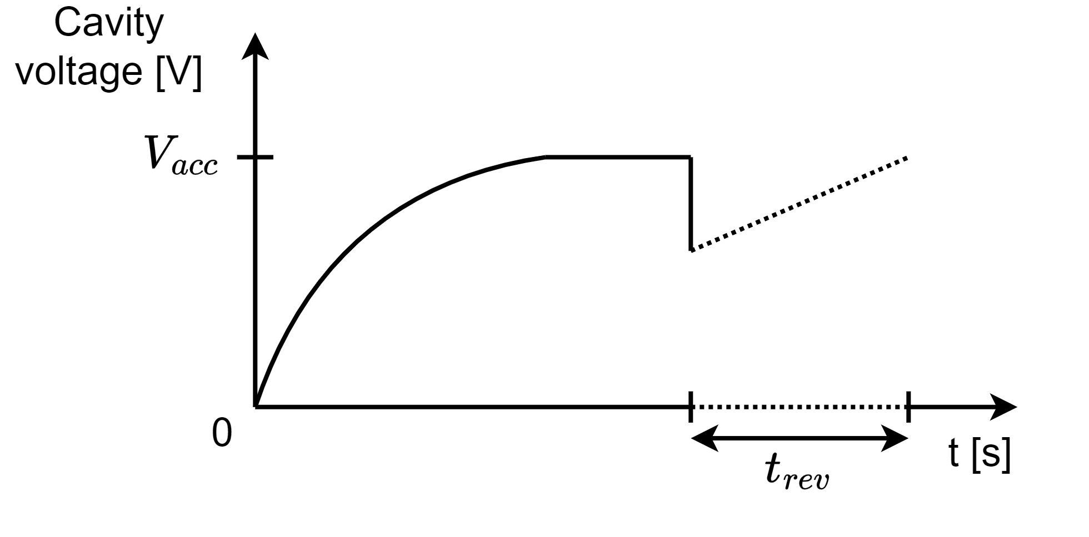
Introduction to beam loading in RF cavities
After filling the cavity with a certain generator current, a voltage will build up.
The bunch passage will then decrease this voltage as parts of the energy are transferred to the bunch.
This effect has to be compensated for, as otherwise, the beam will see less voltage on the next passage → Beam loading compensation
The input power for the ideal compensation can be computed from an equivalent circuit model [1] J. Tückmantel, CERN-ATS-Note-2011-002 TECH

Slide 4
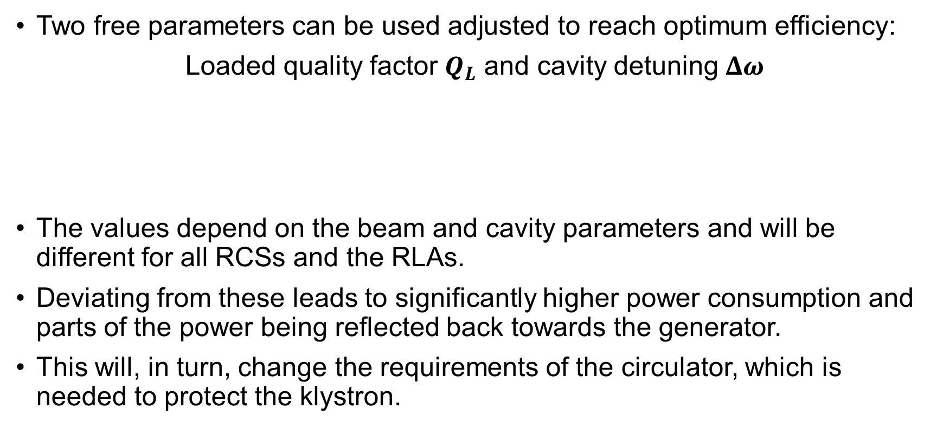
Beam loading compensation I
Two free parameters can be used adjusted to reach optimum efficiency:
Loaded quality factor $Q_{L}$ and cavity detuning $Δω$
The values depend on the beam and cavity parameters and will be different for all RCSs and the RLAs.
Deviating from these leads to significantly higher power consumption and parts of the power being reflected back towards the generator.
This will, in turn, change the requirements of the circulator, which is needed to protect the klystron.
Reduces imaginary part of reflected and generator power
Reduces real part of reflected and generator power

Slide 5
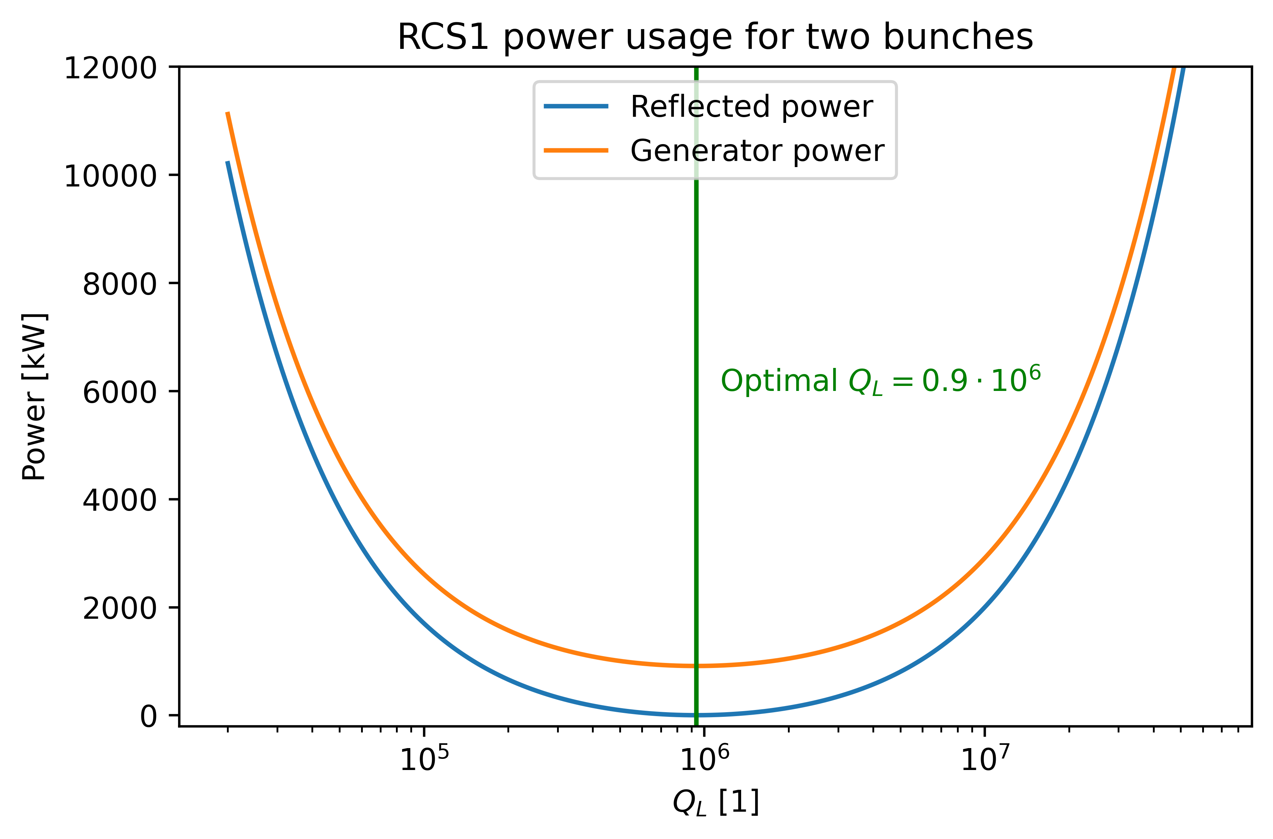
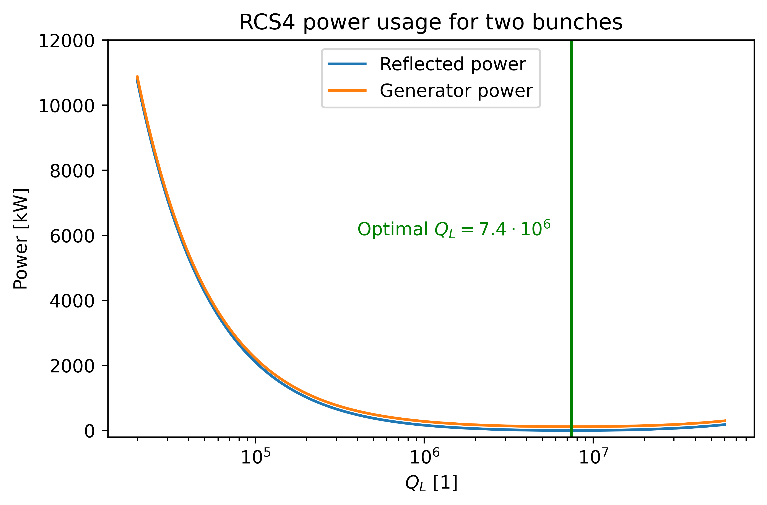
Beam loading compensation II
The power consumption is calculated based on the formulas derived in [1].

Slide 6
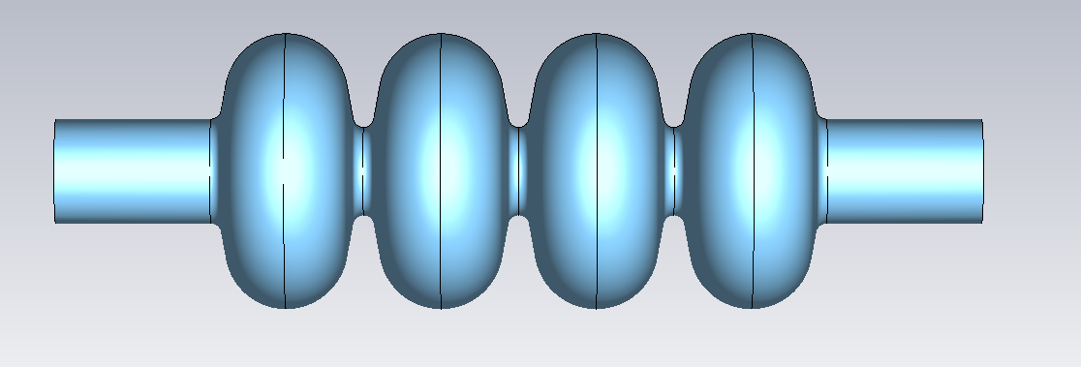
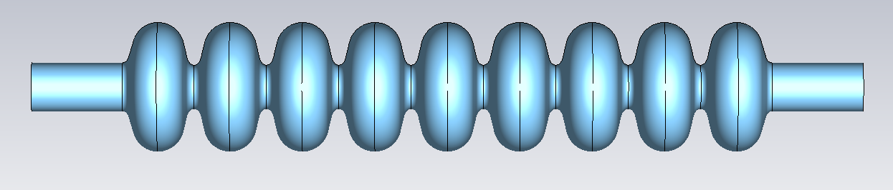
RF parameters in RLA2 and the RCSs
 | Unit | RLA2 | RCS1 | RCS2 | RCS3 | RCS4
Assumed existing cavity type | - | LEP2 | TESLA | TESLA | TESLA | TESLA
Synchronous phase | [°] | 95 | 135 | 135 | 135 | 135
Bunch population at injection | [1 x 10¹²] | 3.6 | 2.7 | 2.4 | 2.2 | 2.0
Revolution time | [μs] | - | 20 | 20 | 36 | 117
Combined avg. beam current (μ⁺ and μ⁻) | [mA] | 153 | 43.3 | 39.0 | 19.8 | 5.49
External Q-factor | [1 x 10⁶] | 0.33 | 0.94 | 1.04 | 2.05 | 7.42
Optimal cavity detuning | [kHz] | -0.04 | -0.69 | -0.62 | -0.32 | -0.09

Slide 7
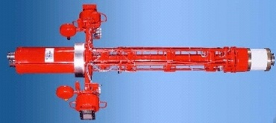
RF parameters in the high-energy chain
Klystron assumptions
Klystron and distribution losses are assumed to be the same as for the ILC DKS (Distributed Klystron Scheme) [2]
In this scheme, the klystrons are located underground next to the accelerator tunnel and close to the cavities
Repetition rate and fundamental frequency are equal to muon collider RCS chain
Klystron Parameter | Value
Max. power [MW] | 10
Wall plug efficiency [%] | 65
Repetition rate [Hz] | 5
RF pulse length [ms] | 1.65
RF duty factor [%] | 0.83
Power distribution losses in DKS [%] | 32
Output frequency [GHz] | 1.3
Thales TH1801, picture from [3],
parameter values from [2]

Slide 8
RF parameters in the high-energy chain
Cavity powering
 | Unit | RCS1 | RCS2 | RCS3 | RCS4
Beam acceleration time | [ms] | 0.34 | 1.1 | 2.37 | 6.37
Cavity filling time | [ms] | 0.23 | 0.25 | 0.50 | 1.81
RF pulse length | [ms] | 0.57 | 1.35 | 2.87 | 8.18
RF duty factor | [%] | 0.29 | 0.68 | 1.44 | 4.09
FPC peak power | [kW] | 911 | 818 | 416 | 297
Total peak RF power (incl. power distribution losses) | [MW] | 850 | 410 | 300 | 460
Average RF power (incl. power distribution losses) | [MW] | 2.42 | 2.76 | 4.27 | 19.0
Average wall plug power (incl. klystron eff.) | [MW] | 3.72 | 4.25 | 6.56 | 29.2
Number of klystrons | - | 88 | 42 | 30 | 47
Cavities per klystron | - | 8 | 9 | 18 | 64
RLA2
0.04
0.3
0.34
0.02
4900
2350
0.41
0.63
365
1

Slide 9
RF parameters in the high-energy chain
Limitations
RCSs: Assumption of linear ramp shape → not feasible for magnets
  Overvoltage will be necessary for certain parts of the ramp, which is not included in the powering simulation → reflected power.
Assumption of static average beam current:
  RLA: “beam current” will change from pass to pass, as the arcs have different lengths.
    Optimal parameters are not feasible → reflected power
Only static beam loading is being included for the powering requirements.
The impact of an optimal quality factor on beam dynamics is under investigation.
Klystron technology for LEP2 cavities needs to be adapted in frequency.
Cavity detuning due to orbit length change is not included.

Slide 10
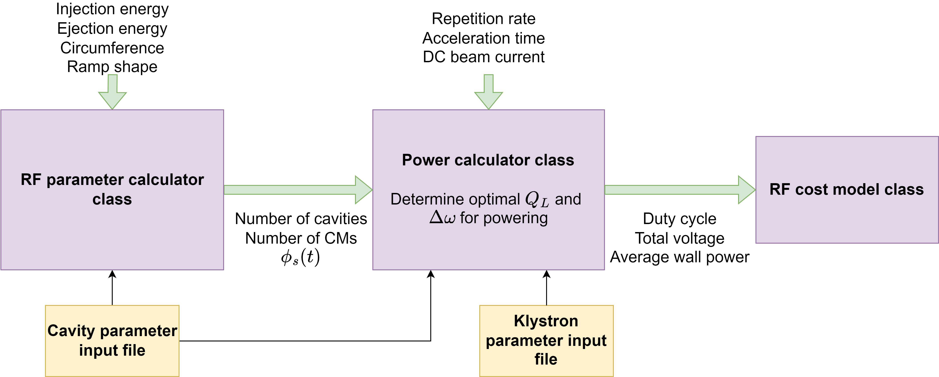
RF parameters in the high-energy chain
Integration into the software package
  RCSParameters package is on CERN Gitlab (see the presentation of D. Amorim for more details)
  → Allows for the fast simulation of RF parameters for a certain RCS geometry.

Slide 11
Summary and outlook
RLA2 values seem quite extreme for the fundamental power coupler.
  The impact of using different parameters to reduce the power requirements needs to be studied.
Optimal parameters for the static beam loading compensation calculated for RCS1-4.
  With non-linear ramping, the optimal parameters will change during the acceleration, leading to higher power consumption and reflected power.
  As a follow-up, a transient beam loading simulation is planned.
Values for the RCSs look feasible, except for the RF pulse length in RCS3 & 4.
Power and cost calculations are integrated into the RCSparameters Python package to allow for a global optimization.

Slide 13
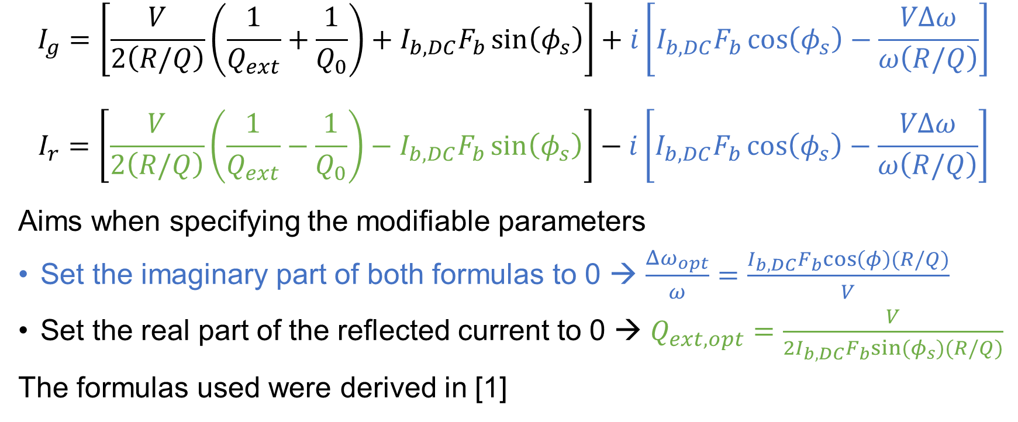
Appendix
Generator and reflected current
$$I_{g}=\left[\frac{V}{2\left(R/Q\right)}\left(\frac{1}{Q_{ext}}+\frac{1}{Q_{0}}\right)+I_{b,DC}F_{b}\sin\left(φ_{s}\right)\right]+i\left[I_{b,DC}F_{b}\cos\left(φ_{s}\right)−\frac{VΔω}{ω\left(R/Q\right)}\right]$$
$$I_{r}=\left[\frac{V}{2\left(R/Q\right)}\left(\frac{1}{Q_{ext}}−\frac{1}{Q_{0}}\right)−I_{b,DC}F_{b}\sin\left(φ_{s}\right)\right]−i\left[I_{b,DC}F_{b}\cos\left(φ_{s}\right)−\frac{VΔω}{ω\left(R/Q\right)}\right]$$
Aims when specifying the modifiable parameters
Set the imaginary part of both formulas to 0 → $\frac{Δω_{opt}}{ω}=\frac{I_{b,DC}F_{b}cos\left(φ\right)(R/Q)}{V}$
Set the real part of the reflected current to 0 → $Q_{ext,opt}=\frac{V}{2I_{b,DC}F_{b}sin⁡(φ_{s})(R/Q)}$
The formulas used were derived in [1]

Slide 14
References
[1]: Cavity-Beam-Transmitter Interaction Formula Collection with Derivation: http://cds.cern.ch/record/1323893/files/CERN-ATS-Note-2011-002%20TECH.pdf
[2]: ILC TDR: https://linearcollider.org/files/images/pdf/Acceleratorpart2.pdf
[3]: https://www.desy.de/xfel-beam/mlin_klyst.html

