Slide 1
Magnet and power converter optimization
IMCC and MuCol Annual Meeting 2024
CERN, 14/03/2024
Marco Gast (KIT, CERN), Fulvio Boattini (CERN)

Slide 2
Outline
Introduction
  Dipole magnet
  Power converters for the dipole magnets
Optimization process in Python
Sensitivity analysis
  Initial magnet model
  Water-cooled conductors and their positioning
  Magnet current variation
Conclusion

Slide 3
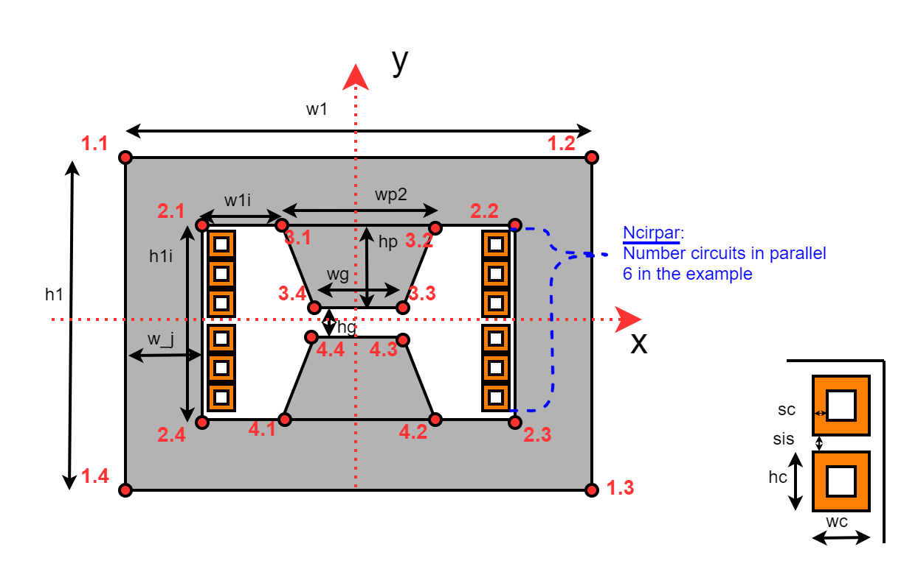
Introduction - Magnet
*Basic layout taken from “Resistive magnets design and optimization” by Marco Breschi
H-type magnet*
Water-cooled coils
Magnet yoke and pole made of steel M235-35A
Each parallel coil is connected to a separate parallel PE circuit to keep the maximum current of each power electronic cell low

Slide 4
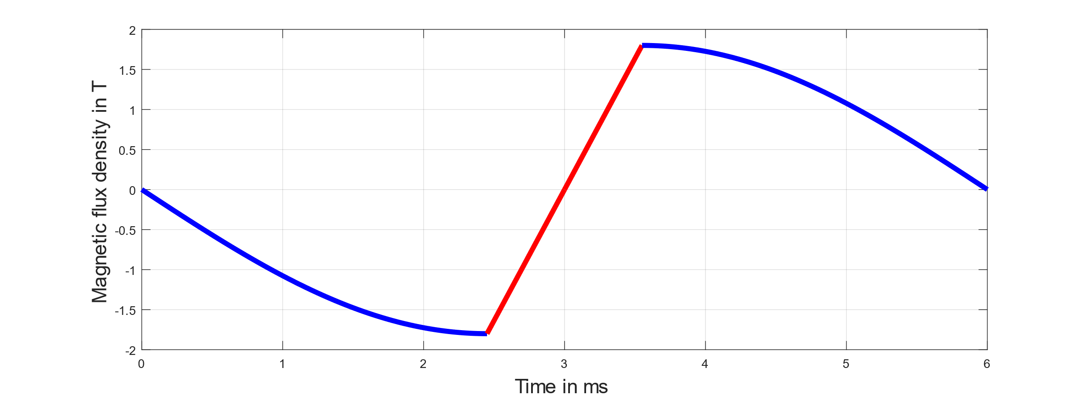
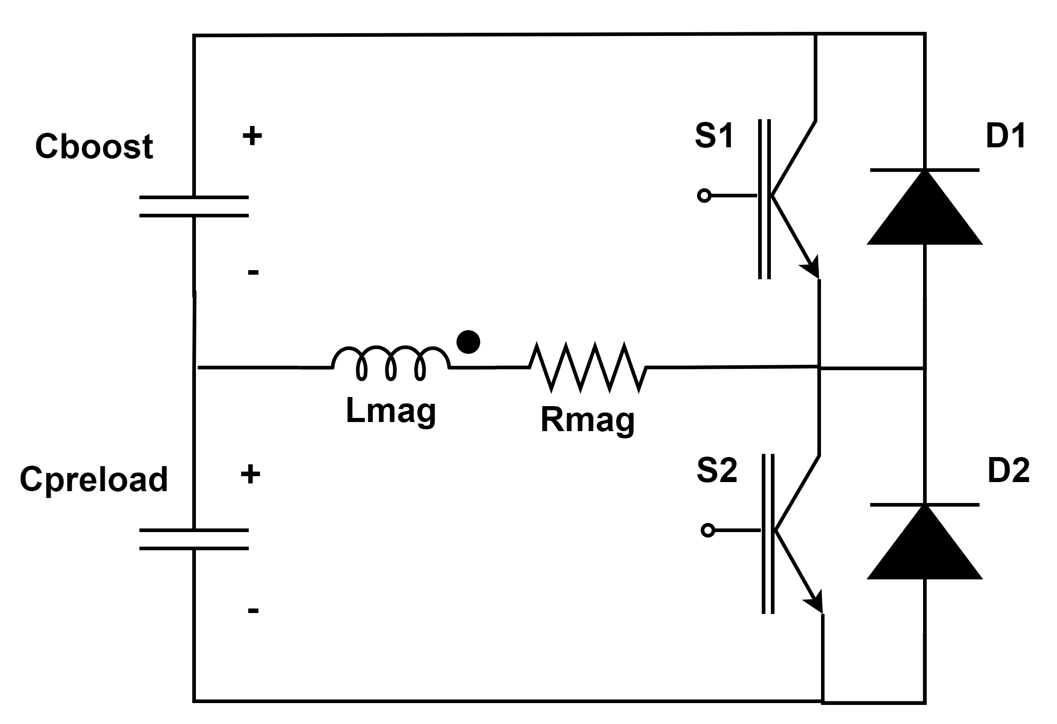
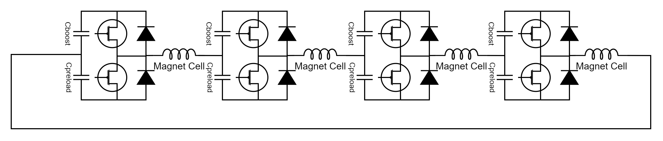
Introduction – Power Converters
Power converter cell
“One” IGBT/diode shown in the circuit diagram can hold several IGBTs/diodes connected in parallel and series.
Bref
Preload
Boost
Magnet
T_{pulse}
Preload
Connection of the magnets and the power cells
The preload capacitor precharges the magnet to the injection field Binj.
The boost capacitor generates the desired magnetic field ramp for the muons.
Splitting the cell into two circuits allows more degrees of freedom, so that, for example, the pulse time Tpulse and the maximum magnetic field gradient Bdot,max can be set.

Slide 5
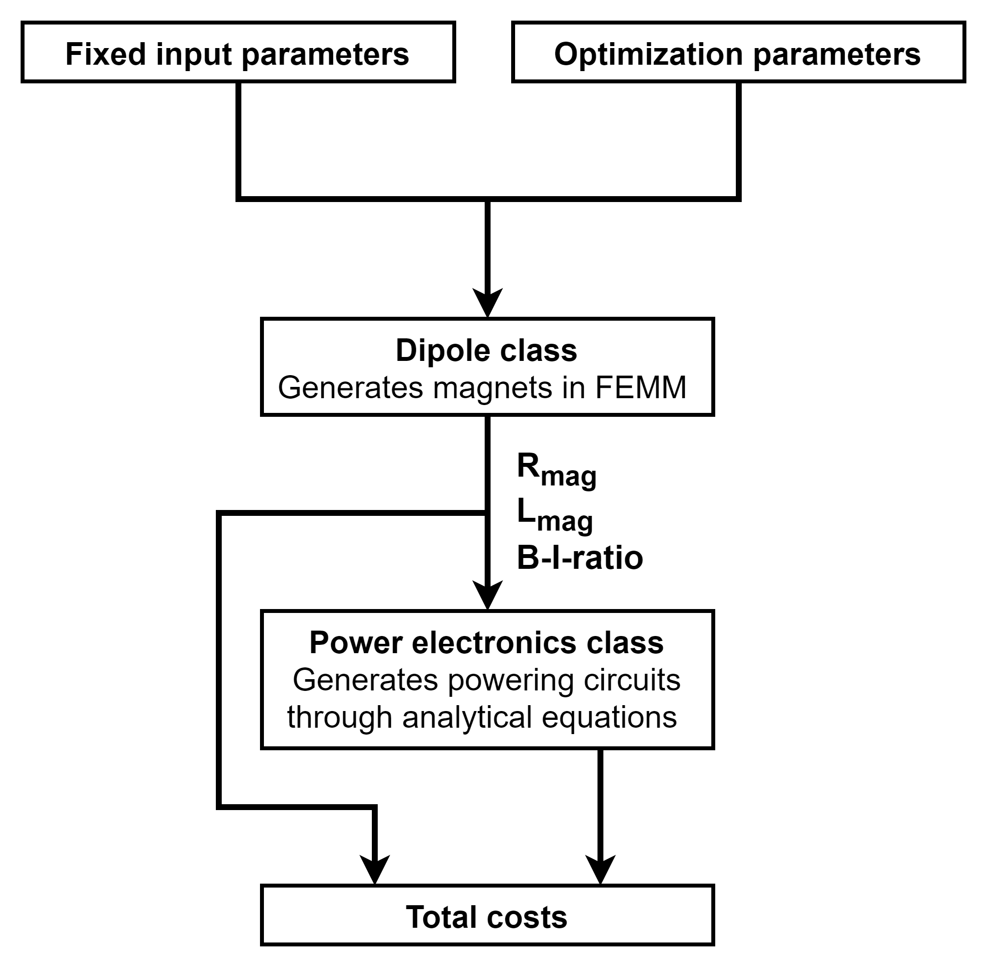
Optimization Process in Python
In this presentation the following aspects are shown:
  Identify the possible optimization parameters of the magnets and power electronics and their effects on the system and costs
  Show the influences of the magnet parameters on the power electronics and vice versa
Some input parameters are fixed because they come from different systems or the overall accelerator design. To ensure a flexible optimization for varying accelerator designs, these input parameters come from the Python classes of the other systems.
The detailed explanation of the setup can be found in the presentation “Software tools” by David Amorim.
The goal of the optimization is minimizing the overall costs. The following costs are included:
  Magnet costs (material + manufacturing)
  Capacitor costs including containers
  Power electronics cost including peripherals and building (no cables)
  Operational costs (Losses in magnets and IGBTs, and energy needed for cooling of the coils) for 20 years of operation with 6000h per year
The detailed overview of the cost models is described in the presentation “Magnet and power systems plan – accelerators” by Fulvio Boattini.
- Add that Cost model is in Fulvio’s presentation
- Input parameters?

Slide 6
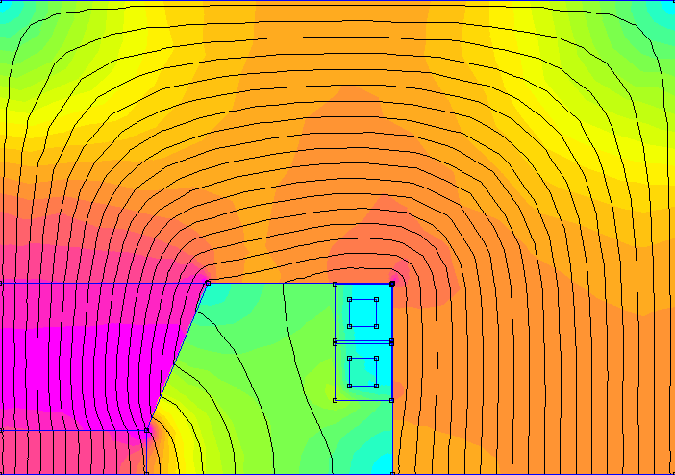
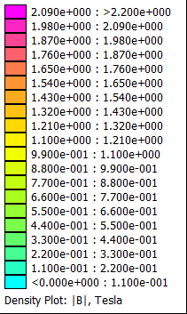
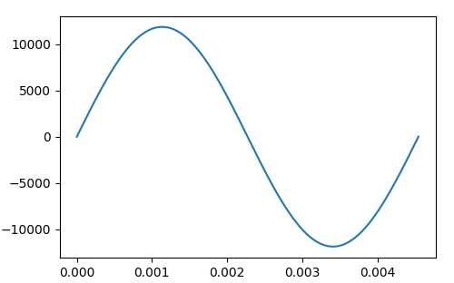
Initial Magnet Model for the Sensitivity Analysis
This magnet and the associated power electronics are used as the basis for the sensitivity analyses. The magnet and its PE comes from a previous cost optimization of the whole system.
More detailed information: Muons Magnets Working Group (15 February 2024) · Indico (cern.ch)
All cost data in this presentation is shown in comparison to the total cost of this system.
230 mm
External dimensions [mm x mm] | 460 x 322
Yoke cross section [dm²] | 11.35
Pole cross section [dm²] | 1.21
Coil cross section [mm²] | 285.39
Number of parallel coils | 4
Bgap [T] | 1.80
Gap size [mm x mm] | 100 x 30
MMF [kAt] | 47.49
Sigma_RMS (pulse) [A / mm²] | 29.41
Sigma_RMS (cycle) [A / mm²] | 4.41
Iron losses (yoke) [J / (cycle * m)] | 48.29
Iron losses (pole) [J / (cycle * m)] | 10.22
Coil losses [J / (cycle * m)] | 447.47
Total losses [J / (cycle * m)] | 505.98
Energy (total) [J / m] | 6386.12
Energy (gap) [J / m] | 3830.48
96 mm
Steel M235-35A
71 mm
161 mm
Steel
M235-35A
9.2 mm
19.2 mm
50 mm
96 mm
Coil current of
AC analysis
The magnet losses reported in this presentation are computed with an AC simulation. Only the first harmonic of the PE current with the same amplitude is used.
A transient analysis would be necessary to simulate the proper losses.
T_{pulse} = 4.5 ms
I_{peak} = 11.87 kA

Slide 7

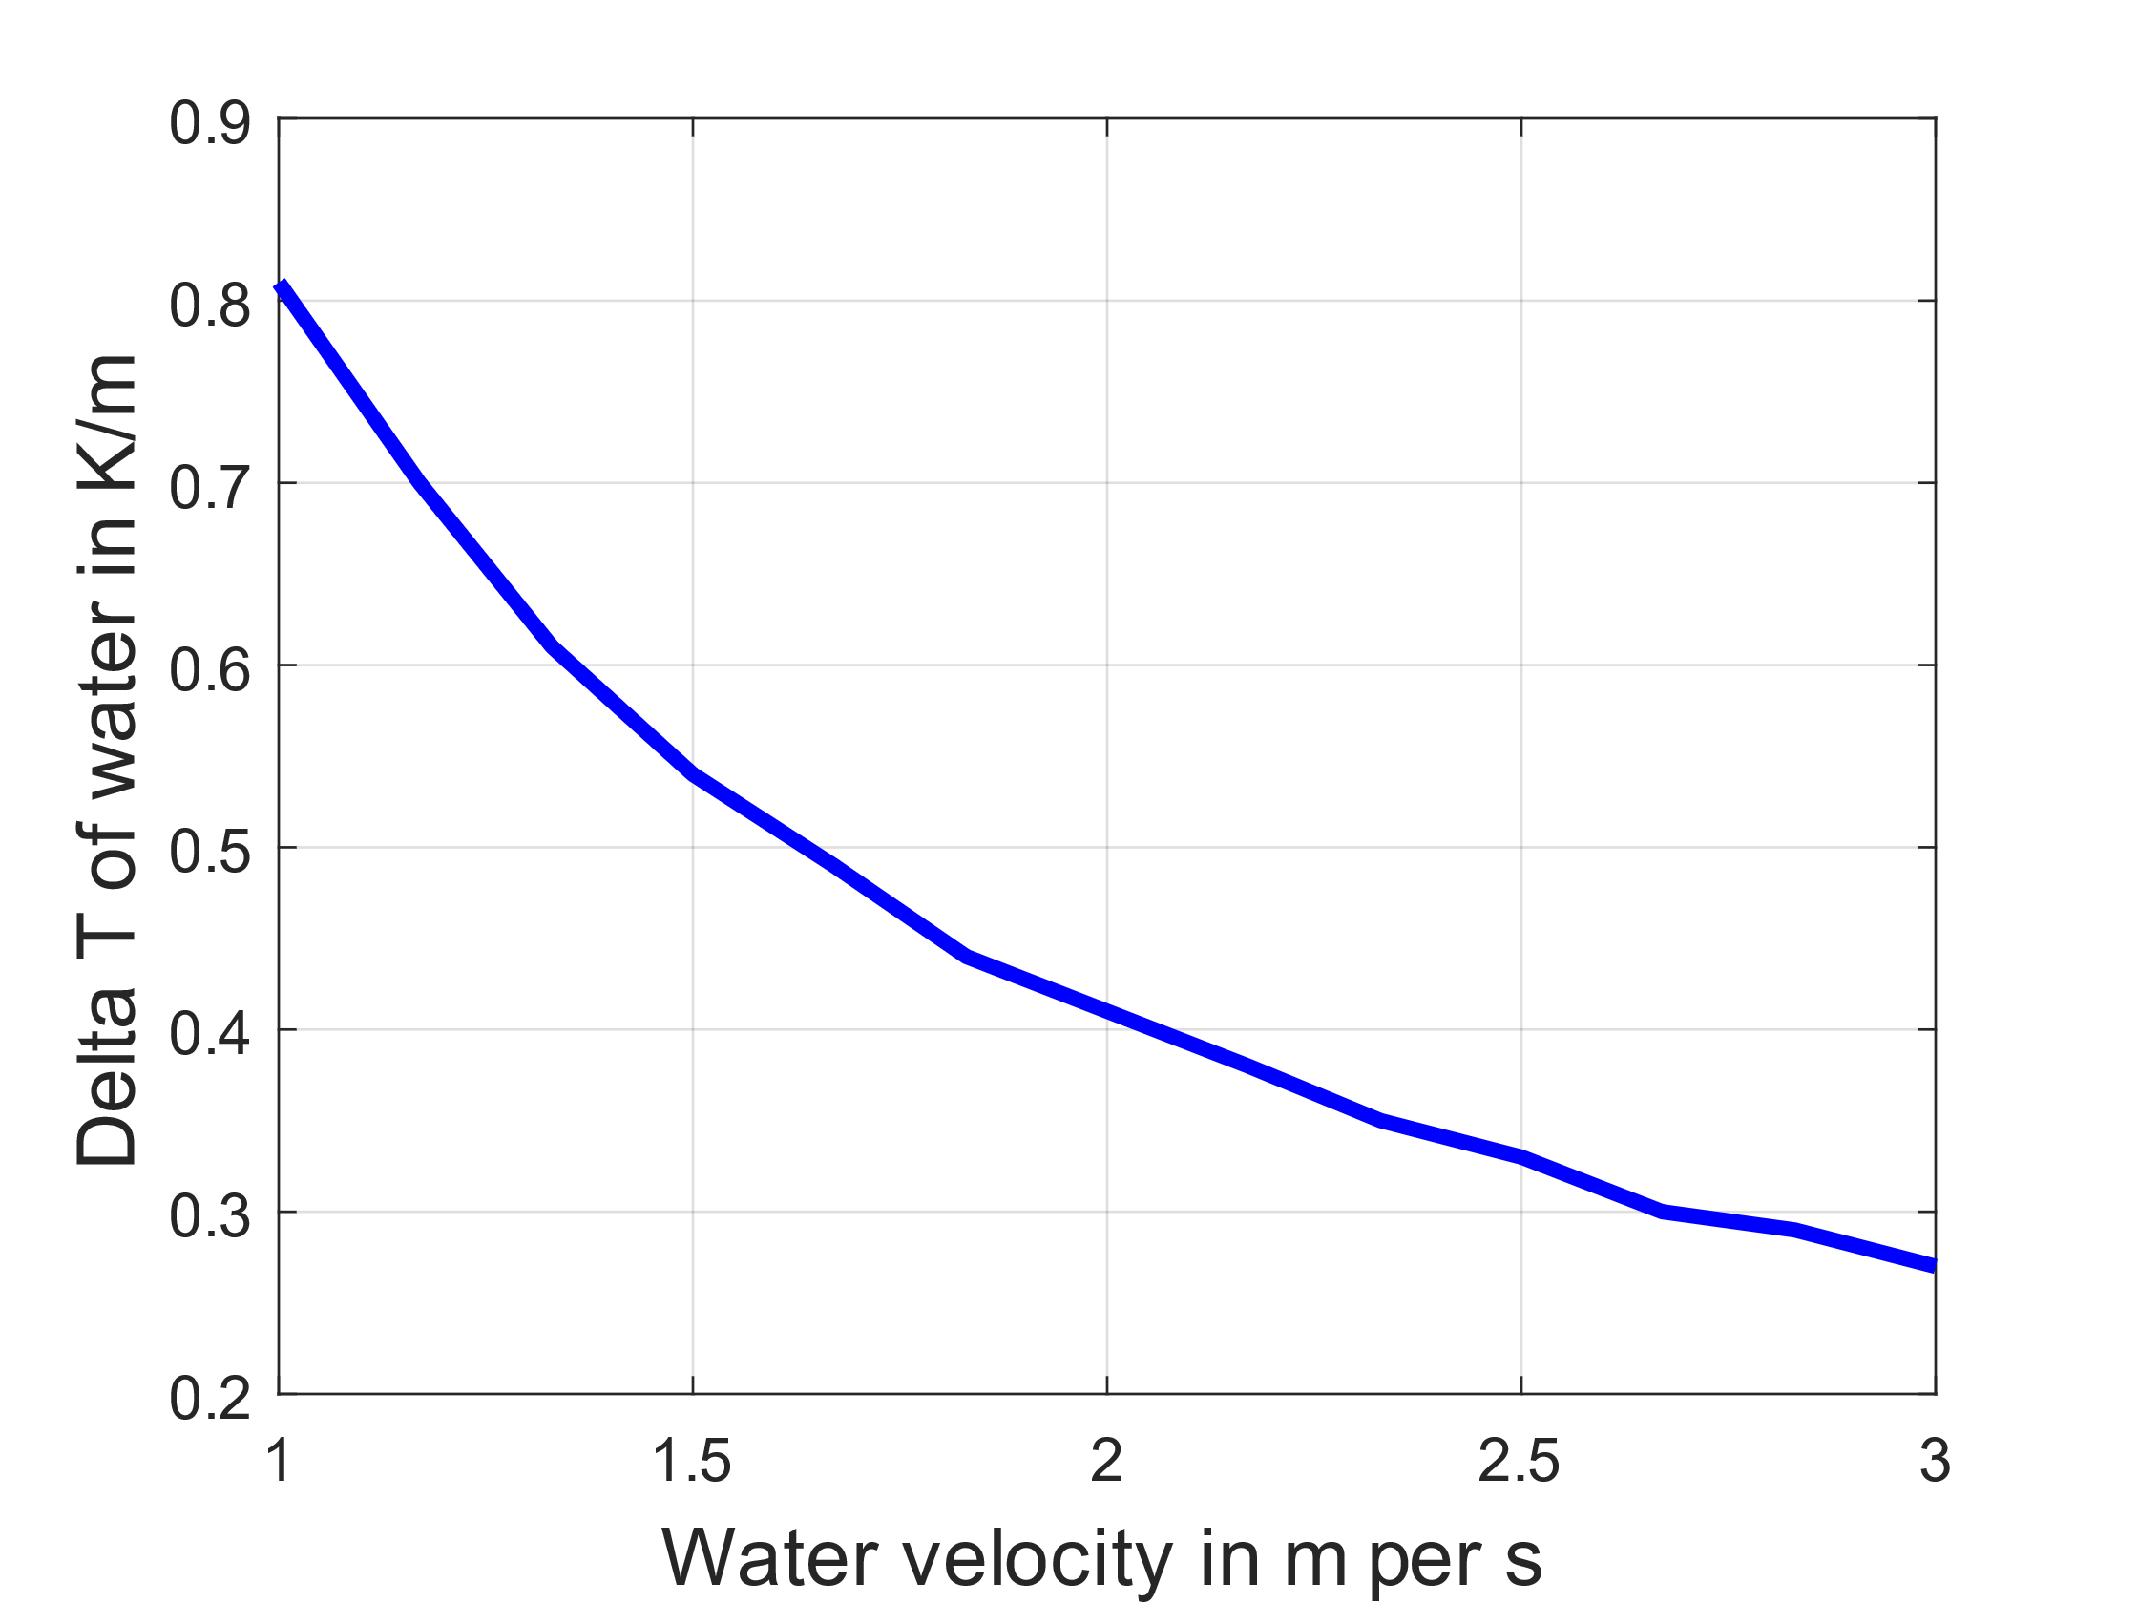
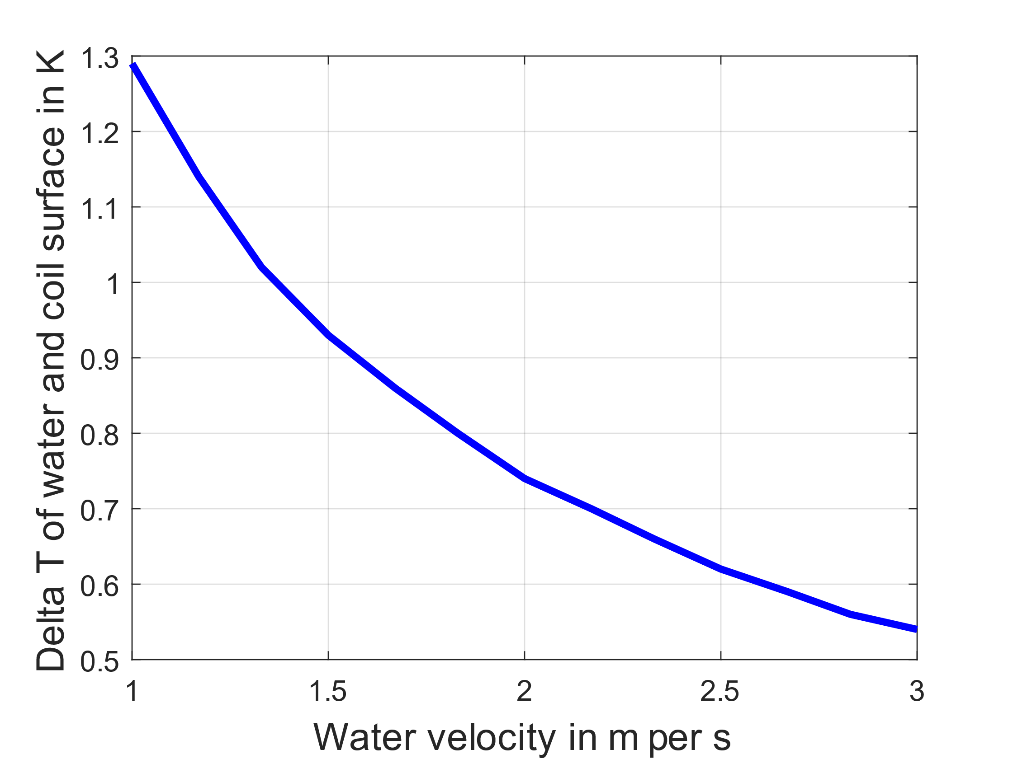
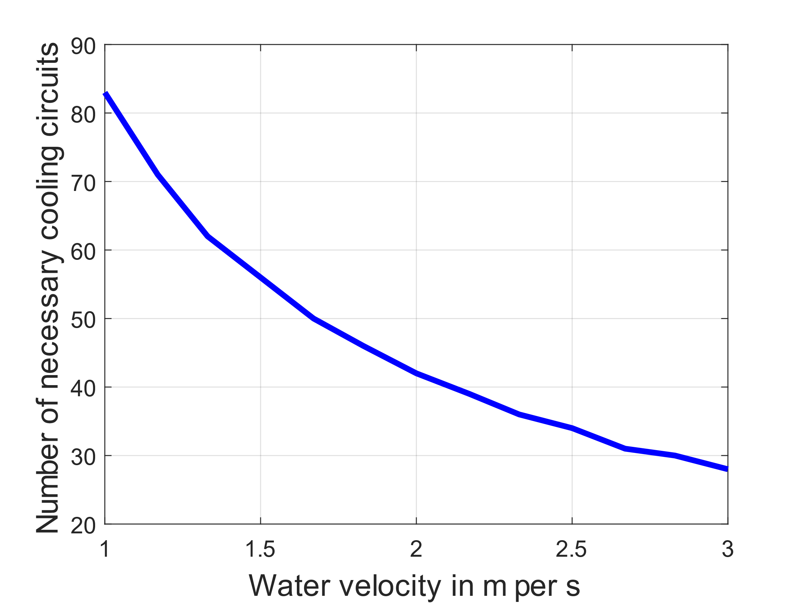
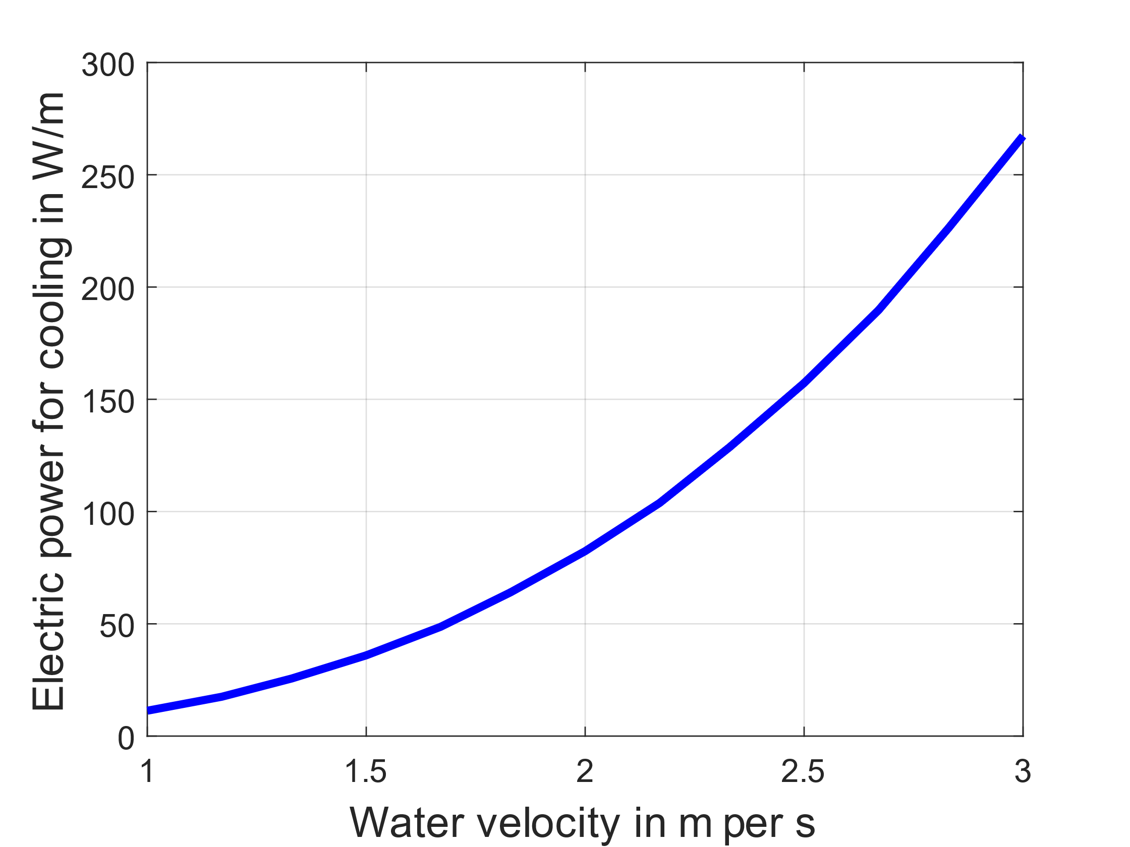

Sensitivity Analysis –
Flow Speed of Water Cooling
Derivation of cooling power:
Heating of the conductor is also dependent on flow speed of the water as the losses in the conductor need to be removed by the water
$$P_{elec}=\frac{P_{mech}}{η_{mech}⋅η_{elec}}$$
$$P_{mech}=V_{fluid}⋅ΔP_{pipe}$$
Depending on pipe surface and fluid flow speed
Depending on friction, fluid density, pipe diameter and fluid flow speed
1) + 3) Linear dependency between maximum heating of water and its flow speed. To keep maximum water temperature at 65 °C by assuming an input temperature of 40 °C, the number of cooling circuits can be calculated (in 3).
2) The temperature difference between the conductor surface and the water is also linearly dependant on its flow speed. This temperature increase is so small that it can almost be neglected.
4) Total electric power for cooling* of RCS2 with 2540 m of normal conducting magnets
v = 1 m/s: P_{elec} = 28.70 kW
v = 2 m/s: P_{elec} = 209.22 kW
v = 3 m/s: P_{elec} = 679.02 kW
The electrical power required for water cooling is almost dependent on the third power of the flow velocity.
=> To find the optimum for the water cooling, the operational costs and the capital costs need to be considered and the maximum temperatures need to be respected.
1)
2)
3)
4)
Comparison:
Magnet losses = 2617 W/m
*Comparison:
Total Magnet loss power = 6.65 MW

Slide 8
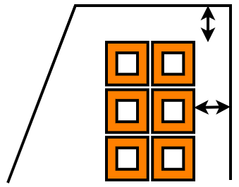
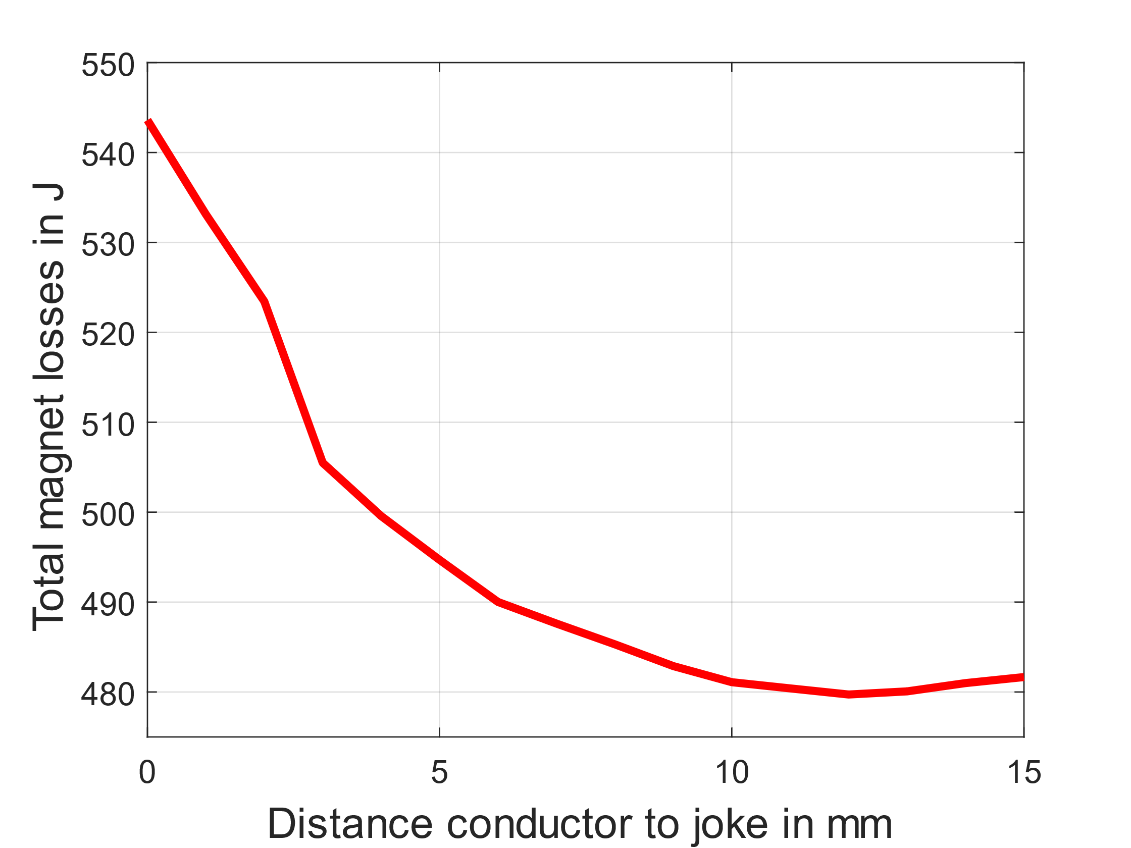
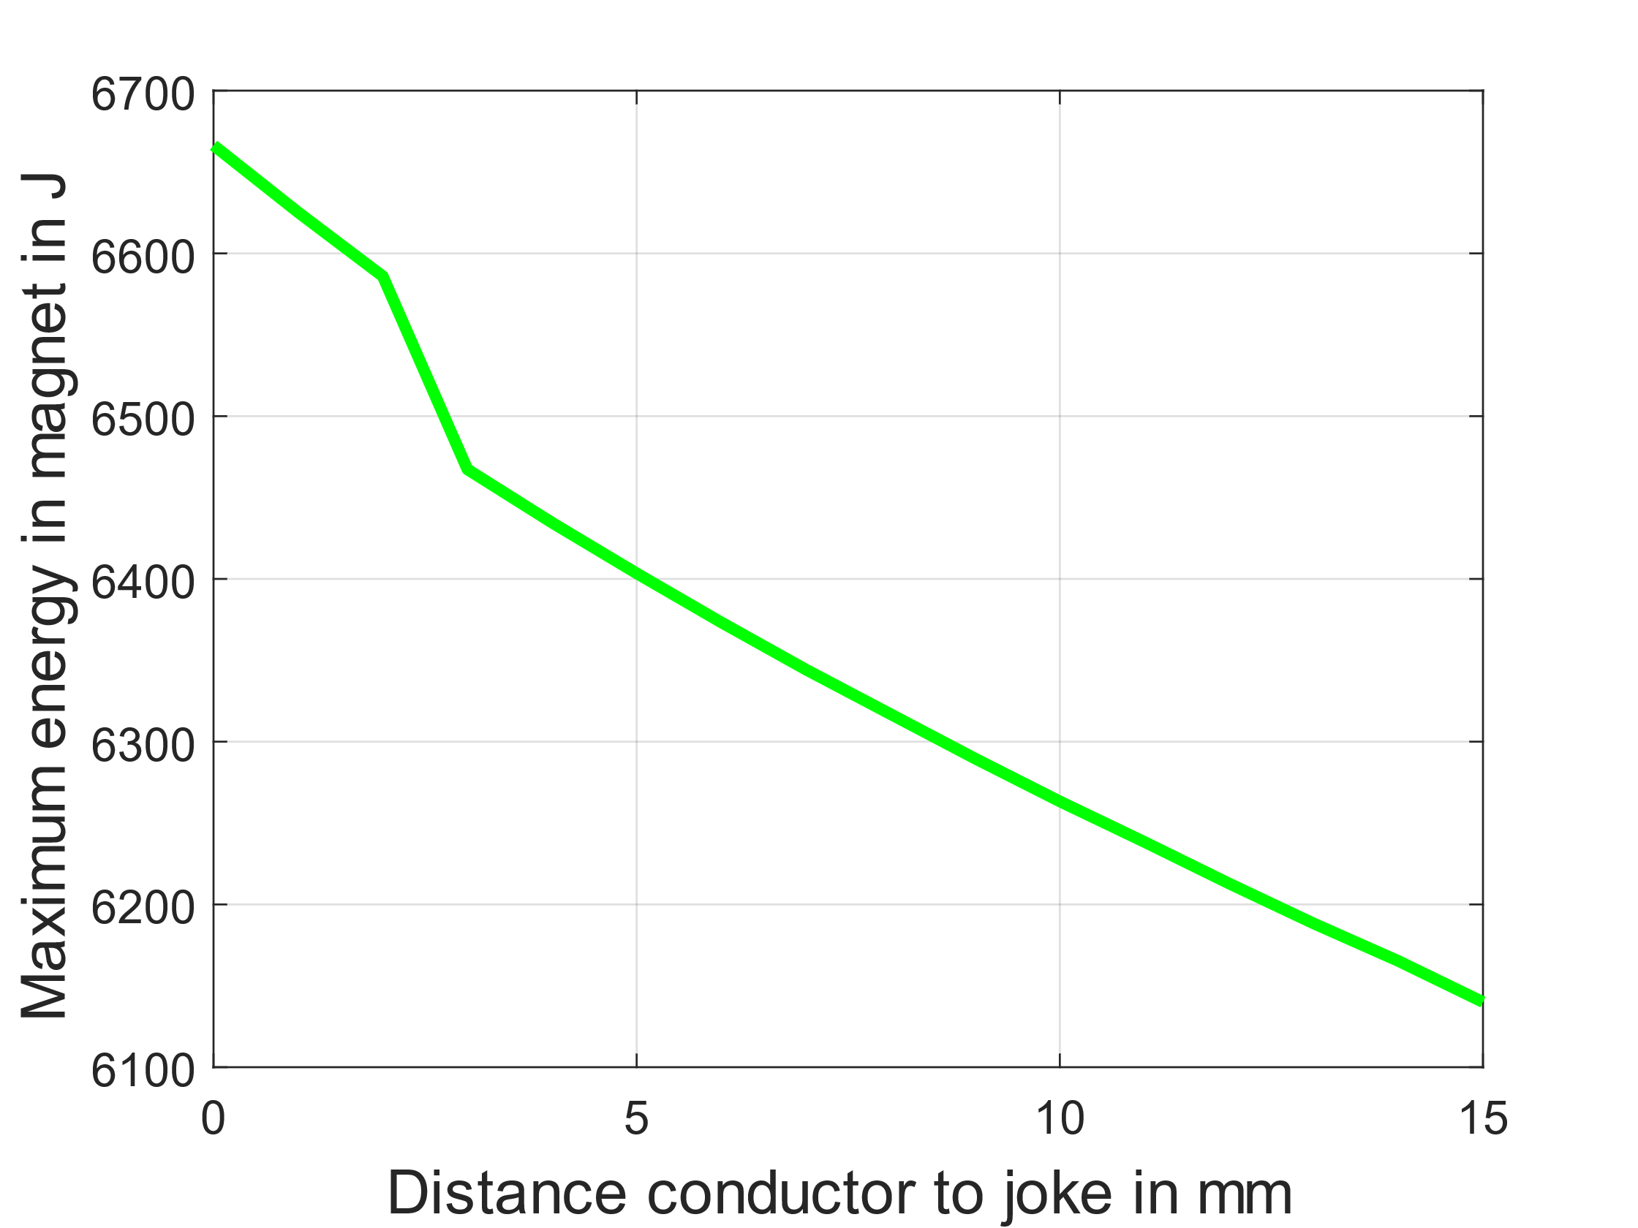
Sensitivity Analysis –
Distance between Conductor and Yoke
*Costs are normalized to the total system costs of the basic magnet
Distance to yoke
Distance to yoke [mm] | Total magnet losses [J/(m*cycle)] | Maximum energy in the magnet [J/m] | Magnet hardware costs* | PE hardware costs* | Operational costs*
1 | 533.13 | 6625.25 | 0.139 | 0.696 | 0.174
3 | 505.49 | 6467.32 | 0.139 | 0.545 | 0.173
5 | 494.69 | 6403.43 | 0.139 | 0.544 | 0.170
7 | 487.61 | 6344.31 | 0.139 | 0.526 | 0.167
9 | 482.88 | 6289.60 | 0.139 | 0.525 | 0.165
11 | 480.40 | 6238.40 | 0.139 | 0.525 | 0.164
13 | 480.07 | 6188.30 | 0.139 | 0.525 | 0.164
15 | 481.66 | 6140.02 | 0.139 | 0.524 | 0.164
Losses per meter and cycle
Max energy in magnet per meter
Increasing the distance between the conductors and the magnet yoke leads to:
  Decrease of the magnet losses by up to 10%
  Leads to a decrease in the operational costs
  Decrease of the total magnet energy by up to 7%
  Leads to a decrease in the PE hardware costs

Slide 9
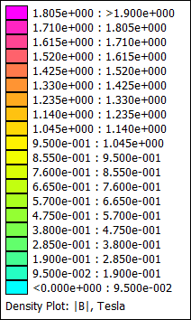
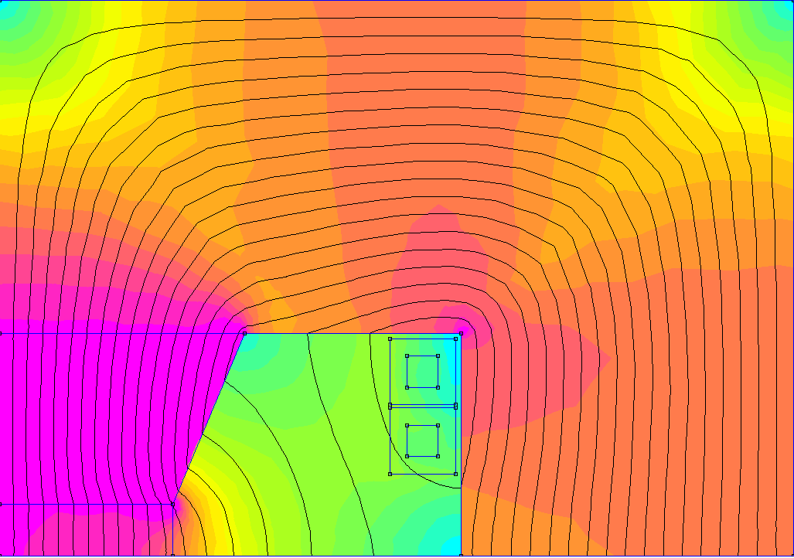
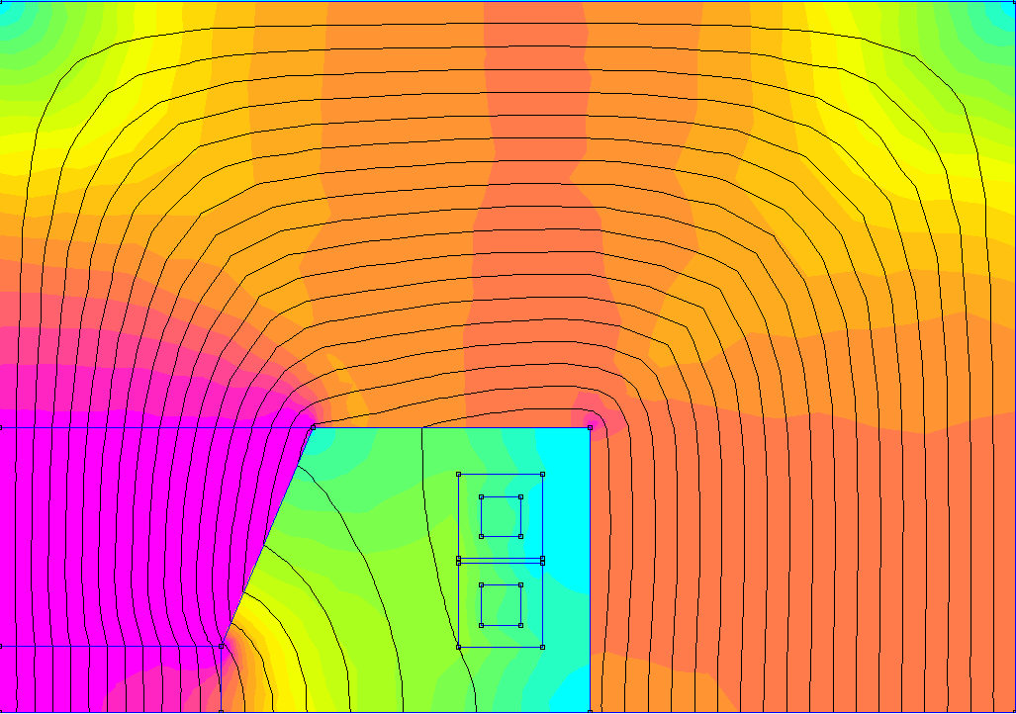
Sensitivity Analysis –
Distance between Conductor and Yoke
Distance to yoke = 1 mm
Distance to yoke = 10 mm
229 mm
229 mm
Steel M235-35A
Steel M235-35A
161 mm
161 mm
71 mm
71 mm
Steel M235-35A
Steel M235-35A
9 mm
19 mm
9 mm
15 mm
15 mm
19 mm
50 mm
96 mm
50 mm
96 mm
T_{pulse}= 4.5 ms
σ_{rms}= 4.7 A/mm2
mmf= 49137 At
E_{lossIron}= 59.9 J/m/pulse
E_{losscu}= 473.2 J/m/pulse
NRG_{stored}= 6625 J/m
T_{pulse}= 4.5 ms
σ_{rms}= 4.6 A/mm2
mmf= 48374 At
E_{lossIron}= 56.2 J/m/pulse
E_{losscu}= 424.9 J/m/pulse
NRG_{stored}= 6263 J/m
A greater distance between the conductors and the yoke lowers the magnetic flux density of the marked spot in the magnet yoke.

Slide 10
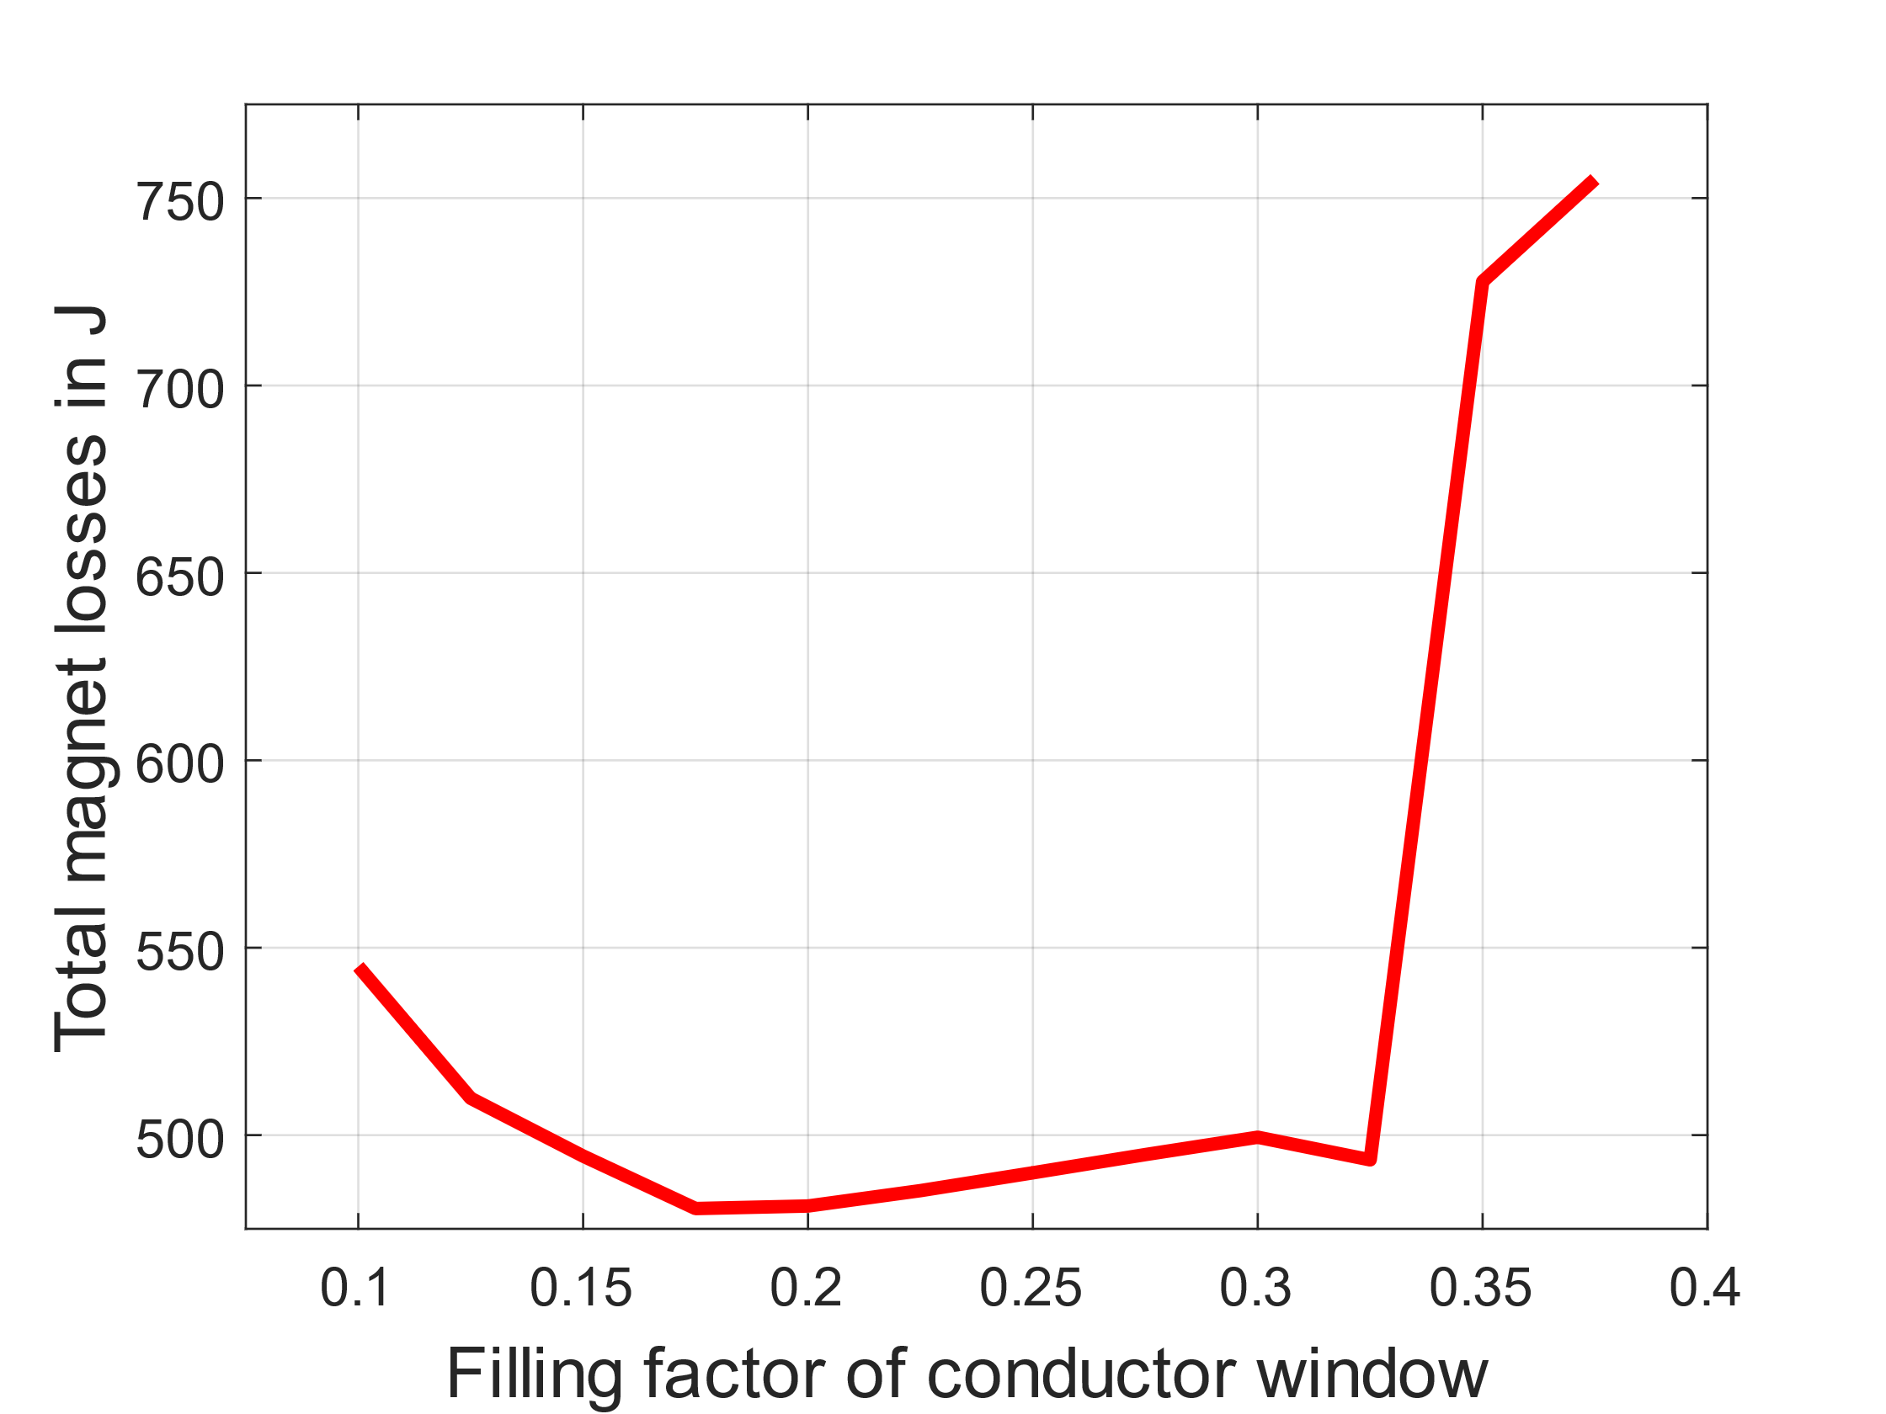
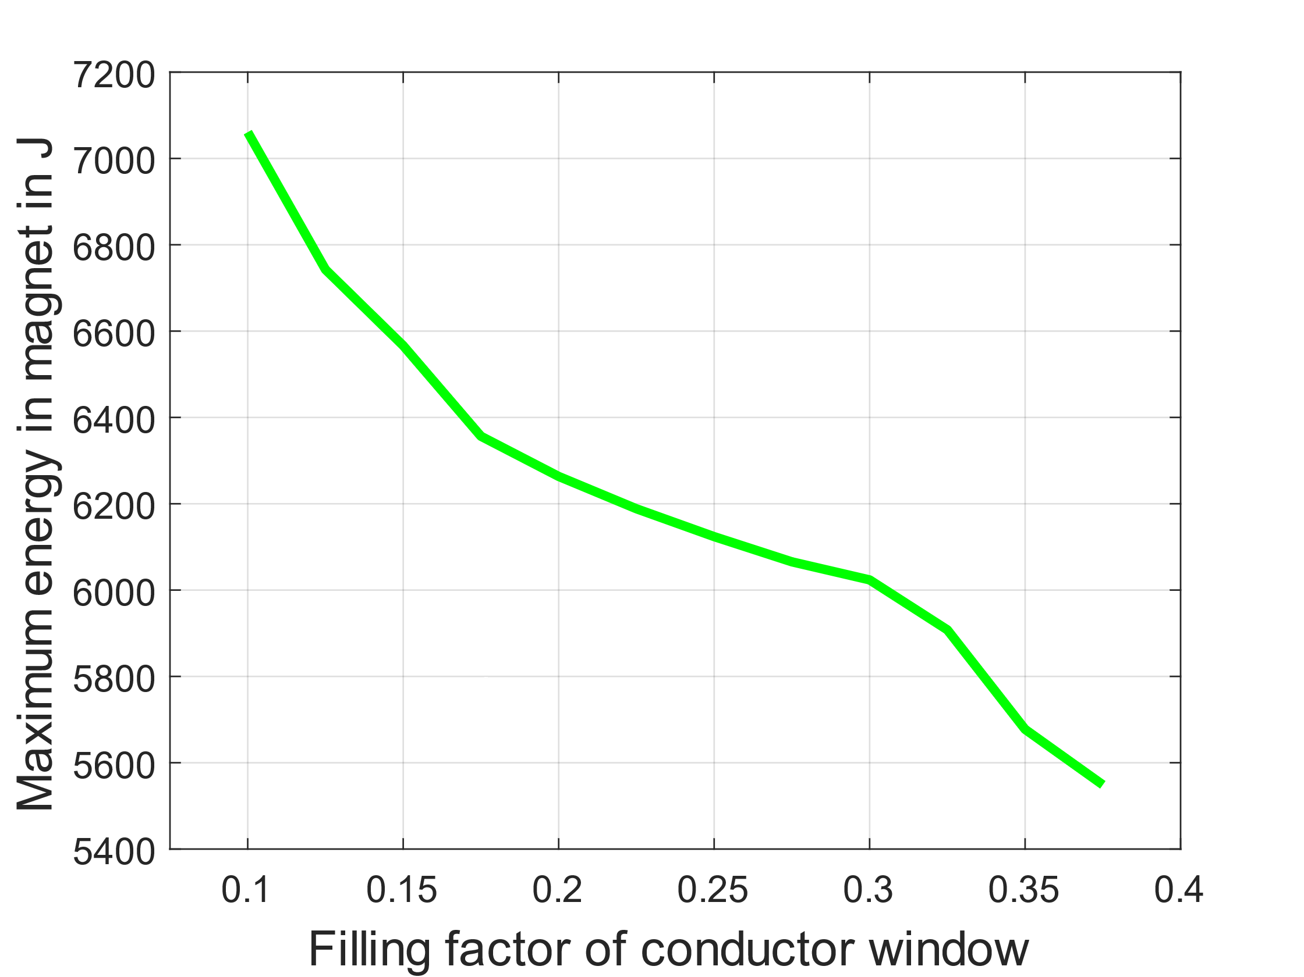
Sensitivity Analysis –
Filling Factor of Conductor Window
Filling factor | Total magnet losses [J/(m*cycle)] | Losses in conductor 1 [J/(m*cycle)] | Losses in conductor 2 [J/(m*cycle)] | Maximum energy in the magnet [J/m]
0.100 | 545.02 | 108.19 | 358.91 | 7060.87
0.150 | 494.41 | 114.92 | 314.81 | 6566.37
0.200 | 481.09 | 129.02 | 295.84 | 6263.30
0.250 | 489.95 | 150.69 | 288.06 | 6123.83
0.300 | 499.44 | 176.99 | 274.74 | 6023.59
0.350 | 727.73 | 12.18 | 672.06 | 5677.35
On the one hand, when the filling factor gets too high, the losses in the conductor rise sharply. This is because one conductor gets too close to the stray field of the air gap which increases the Proximity effect significantly.
On the other hand, the higher the filling factor is the smaller the maximum energy of the magnet gets.
Therefore, the optimization finds the ideal point between small magnet losses and small maximum energy.

Slide 11
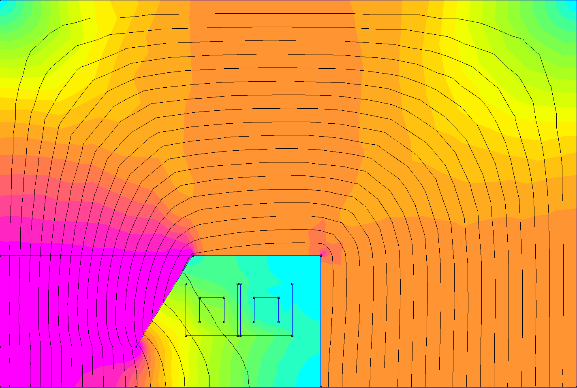
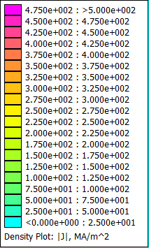

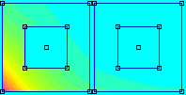
Sensitivity Analysis –
Filling Factor of Conductor Window
Filling factor = 0.2
Filling factor = 0.35
229 mm
Map of current density of conductors
212 mm
Map of magnetic flux density
Map of magnetic flux density
Steel M235-35A
Steel M235-35A
142 mm
161 mm
71 mm
71 mm
Steel M235-35A
Steel M235-35A
9 mm
9 mm
19 mm
15 mm
15 mm
19 mm
50 mm
94 mm
50 mm
96 mm
T_{pulse}= 4.5 ms
σ_{rms}= 4.6 A/mm2
mmf = 48374 At
E_{lossIron}= 56.2 J/m/pulse
E_{losscu}= 424.9 J/m/pulse
NRG_{stored}= 6263 J/m
T_{pulse}= 4.5 ms
σ_{rms}= 4.4 A/mm2
mmf = 46657 At
E_{lossIron}= 44.0 J/m/pulse
E_{losscu}= 684.2 J/m/pulse
NRG_{stored}= 5677 J/m
When the filling factor gets too high, the coils cannot be placed in a sufficient distance from the pole to keep the Proximity effect due to the stray field of the magnet low.
The current density in the conductor depends on the magnetic flux density acting on this point. As the magnetic flux density in one conductor is considerably higher in the diagram on the right, its current density is also higher at these points and the losses increase significantly.

Slide 12
Sensitivity Analysis –
Pulse Time
Pulse time [ms] | Total magnet losses [J/(m*cycle)] | IGBT losses for one meter magnet* [J/(m*cycle)] | Number of required IGBTs for the full RCS | Voltage of preload capacitor for one meter magnet [V] | PE hardware costs | Operational costs
3.00 | 410.76 | 87.2869 | 9216 | 335.34 | 0.645 | 0.142
4.00 | 455.45 | 94.5446 | 7424 | 220.42 | 0.568 | 0.156
5.00 | 502.45 | 106.4245 | 6656 | 164.37 | 0.507 | 0.172
6.00 | 548.59 | 123.1022 | 6400 | 131.16 | 0.489 | 0.189
7.00 | 592.59 | 138.0739 | 6144 | 109.19 | 0.471 | 0.205
8.00 | 634.04 | 157.9306 | 6144 | 93.57 | 0.471 | 0.221
9.00 | 673.00 | 177.7537 | 6144 | 81.89 | 0.471 | 0.237
10.00 | 709.73 | 197.5459 | 6144 | 72.83 | 0.471 | 0.253
Preload
Bref
Boost
T_{pulse}
Preload
* The real output current of the power electronics is used for the calculation of the IGBT losses (not the first harmonic as in the magnet).
Due to a discrete power electronics model, a further reduction in voltage does not lead to a lower number of IGBTs.
The voltage of the boost capacitor is 485.44 V per meter of magnet, in contrast the voltage change of the preload capacitor is small.
On the one hand, increasing the pulse time leads to an increase in losses in the magnet and IGBT, as the current flows through the conductors and IGBTs for longer and as a result the current integral increases.
On the other hand, the maximum voltage required by the preload capacitor is reduced as it has more time to build up the injection current in the magnet. This results in a lower reverse voltage for the IGBTs, so that fewer can be used.
To minimise the costs, a pulse time is selected that sets the optimum between the total operating costs and the capital costs of the power electronics.

Slide 13
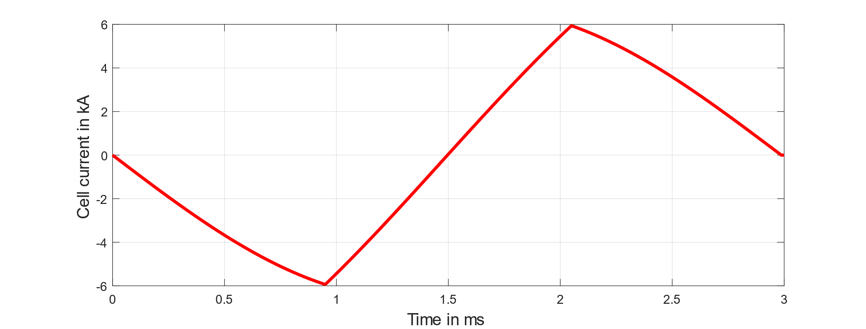
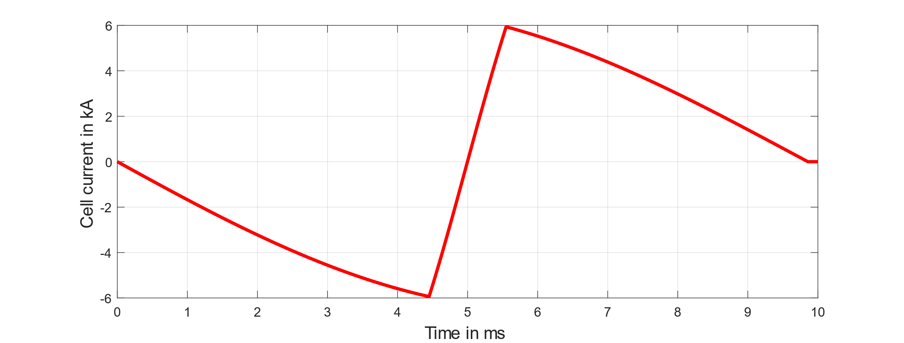
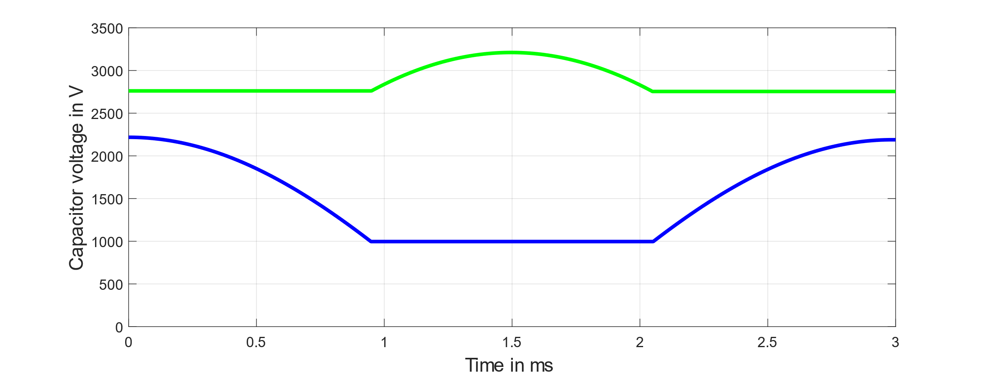
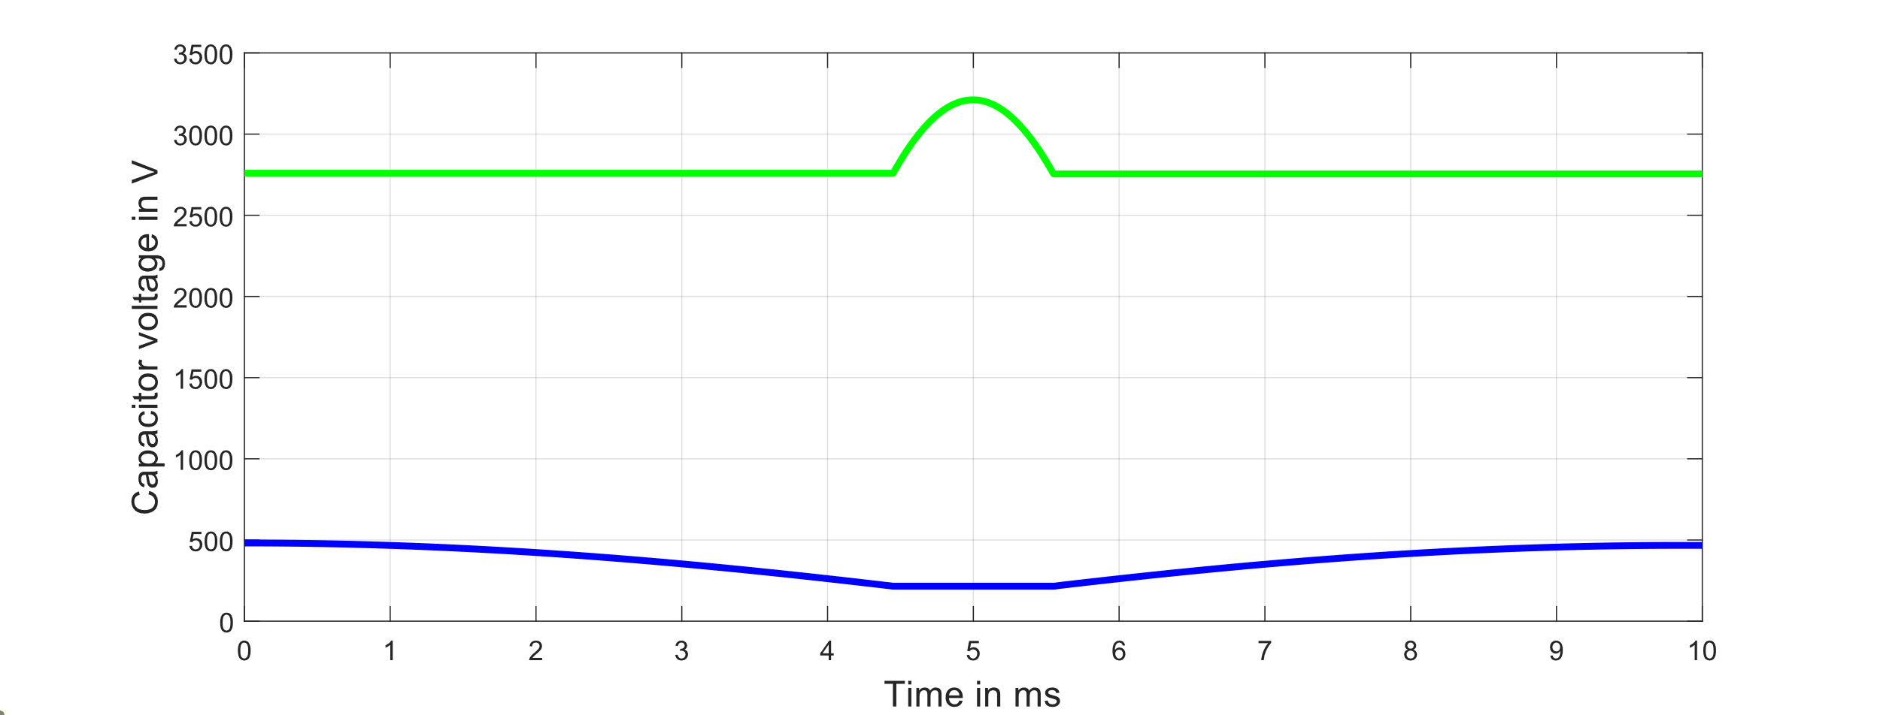
Sensitivity Analysis –
Pulse Time
Pulse time = 3 ms
Pulse time = 10 ms
N_{cells}= 3072
N_{IGBTs,ser} = 3 per cell
N_{IGBTs,par} = 1 per cell
I_{RMS,repetition} = 447.12 A
E_{cap,boost} = 19.01 kJ per cell
E_{cap,preload} = 6.35 kJ per cell
N_{cells}= 3072
N_{IGBTs,ser} = 2 per cell
N_{IGBTs,par} = 1 per cell
I_{RMS,repetition} = 826.03 A
E_{cap,boost} = 19.00 kJ per cell
E_{cap,preload} = 6.50 kJ per cell

Slide 14
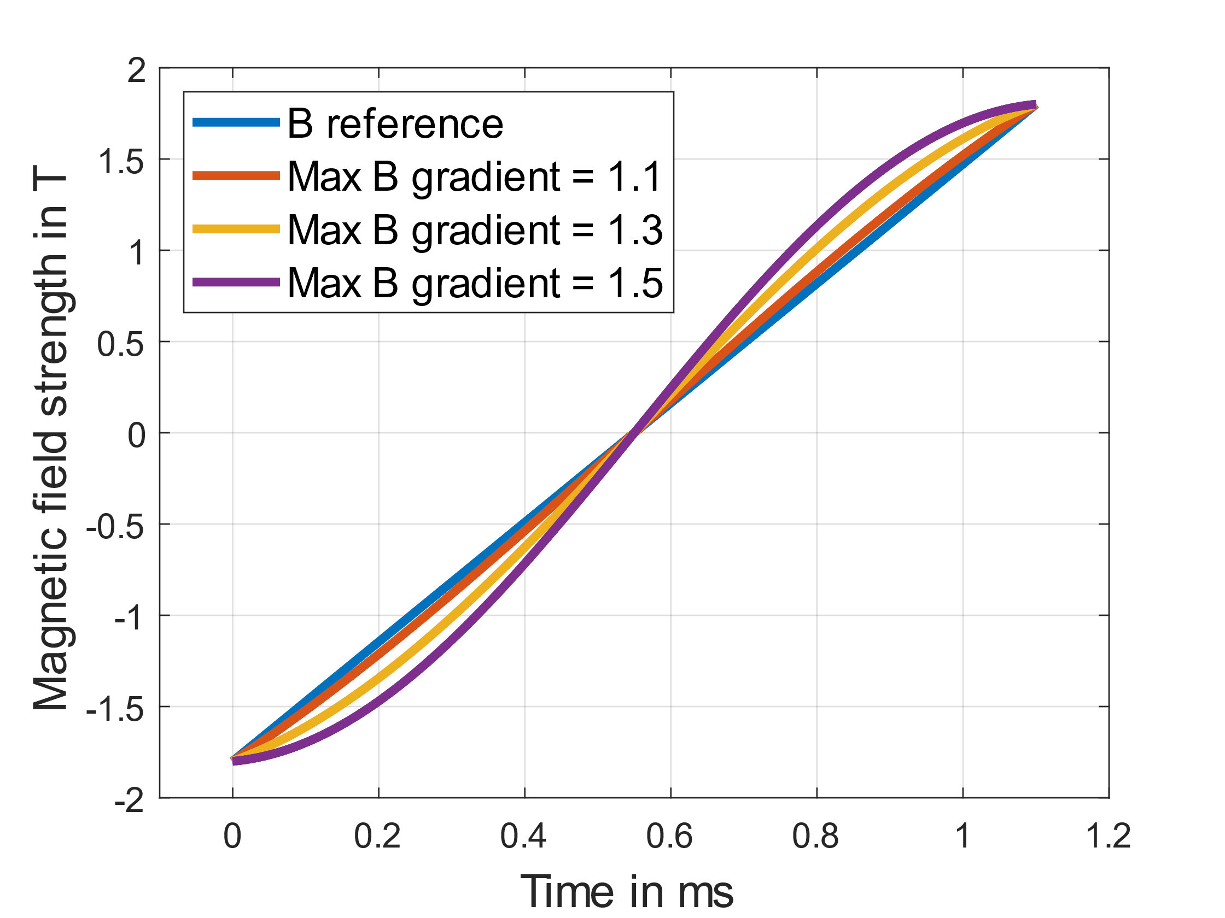
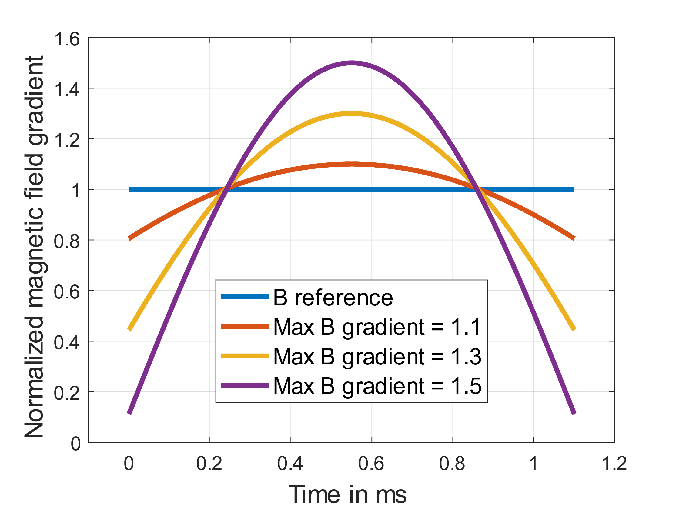
Sensitivity Analysis –
Max Gradient of B Field
An ideally linear magnetic field ramp in the magnet and therefore current ramp of the power electronics can only be achieved with classical power converters. However, these are significantly more expensive than the resonance circuit presented. When using resonant circuits, a sinusoidal magnetic field ramp is created. An important factor of the sinusoidal ramp is the maximum gradient, as this determines the maximum voltage of the RF system.

Slide 15
Sensitivity Analysis –
Max Gradient of B Field
Max B gradient | Max Voltage of boost capacitor for one meter magnet [V] | Min Voltage of boost capacitor for one meter magnet [V] | Number of required IGBTs for the full RCS | Maximum energy of boost capacitor for one meter magnet [kJ] | PE hardware costs
1.02 | 473.74 | 445.85 | 7168 | 53.02 | 0.588
1.04 | 483.03 | 427.41 | 7168 | 27.92 | 0.551
1.06 | 492.32 | 409.15 | 6912 | 19.59 | 0.520
1.08 | 501.61 | 391.07 | 6656 | 15.46 | 0.496
1.10 | 510.90 | 373.16 | 6912 | 12.99 | 0.510
…
1.20 | 557.34 | 285.77 | 7424 | 8.23 | 0.539
1.30 | 603.79 | 200.86 | 7936 | 6.82 | 0.573
On the one hand, when the maximum B gradient is increased, the maximum required energy of the boost capacitor can be reduced. This increases the costs of the capacitors.
On the other hand, the maximum voltage of the boost capacitor increases with an increased maximum B gradient. Depending on the minimal voltage and the voltage of the preload capacitor, this leads to a change in the number of IGBTs.
In order to make a meaningful optimization, the costs of the RF system must be included.

Slide 16
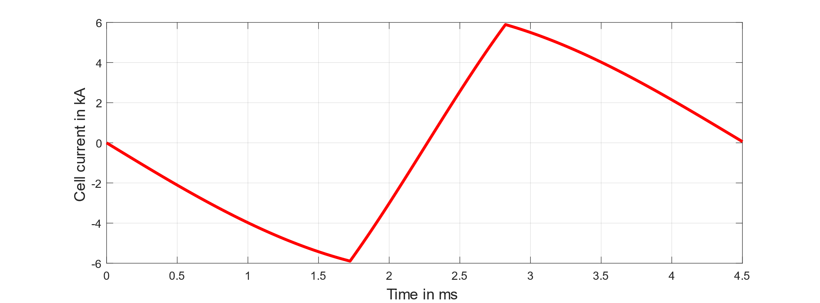
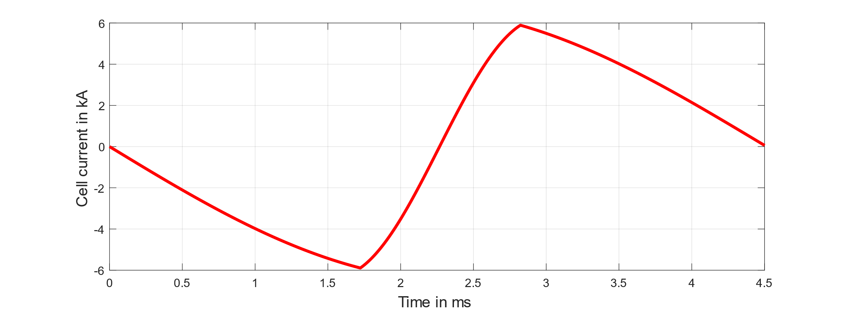
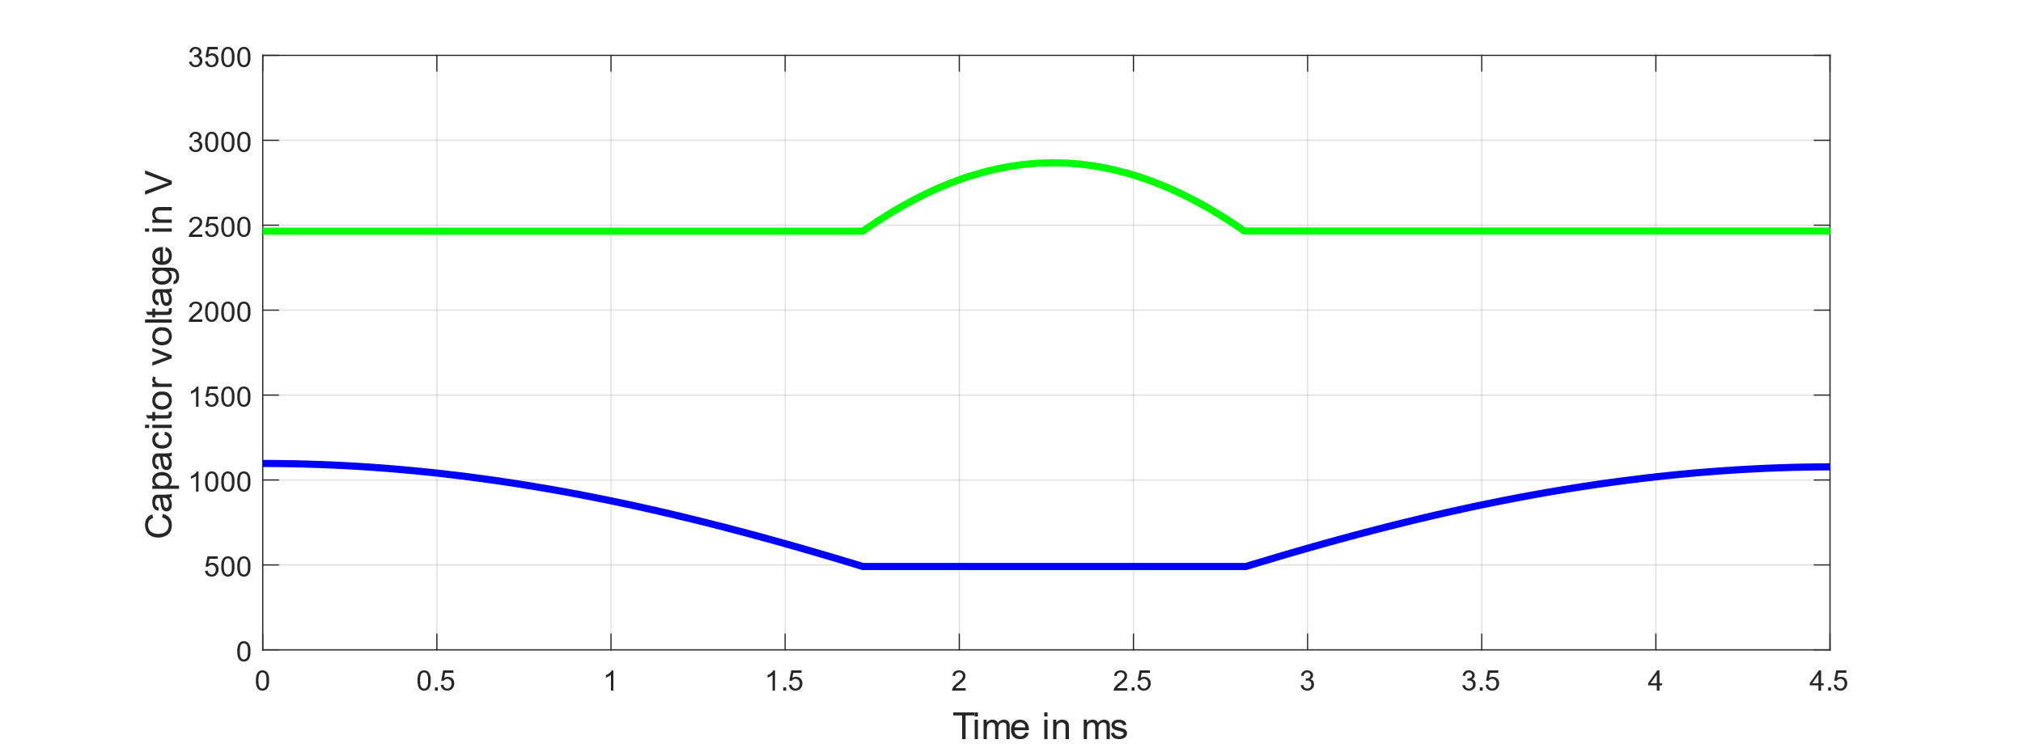
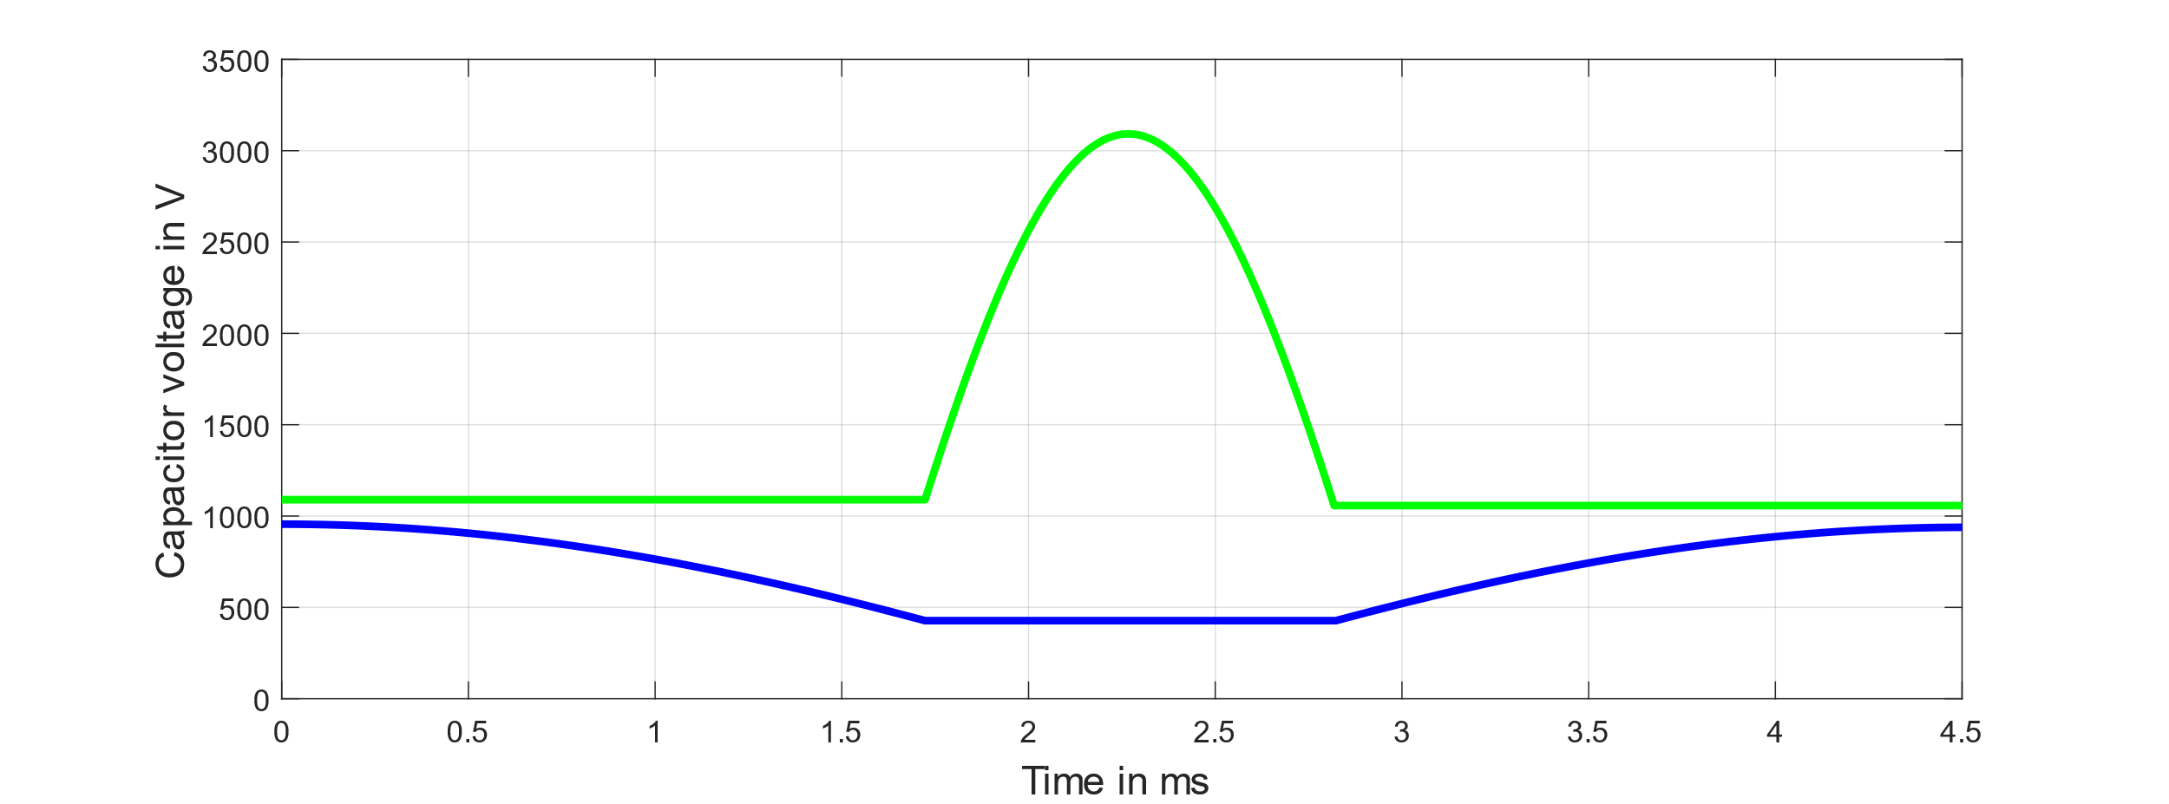
Sensitivity Analysis –
Max Gradient of B Field
Maximum B gradient = 1.05
Maximum B gradient = 1.30
*Due the different number of cells, the energy of the preload capacitors per cell is different. Nevertheless, the total energy of the preload capacitors is the same because the maximum B gradient doesn’t influence the preload capacitor.
N_{cells}= 3456
N_{IGBTs,ser} = 2 per cell
N_{IGBTs,par} = 1 per cell
I_{RMS,repetition} = 550.11 A
E_{cap,boost} = 16.84 kJ per cell
E_{cap,preload} = 5.66 kJ per cell*
N_{cells}= 3968
N_{IGBTs,ser} = 2 per cell
N_{IGBTs,par} = 1 per cell
I_{RMS,repetition} = 562.21 A
E_{cap,boost} = 4.37 kJ per cell
E_{cap,preload} = 4.93 kJ per cell*

Slide 17
Conclusion
A combined optimization process for the dipole magnets and their power electronics was implemented in Python.
The optimal placement of the conductors and the sizing of the conductor window is depending on the stray field of the air gap and therefore of the design of the magnet poles.
A higher-level optimization between RF and magnets is required, as the shape of the magnetic field ramp influences both systems.

