Slide 1



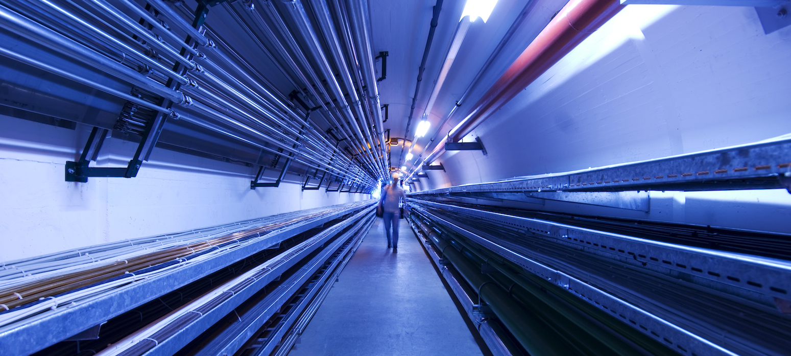
A preliminary design of a 704 MHz cavity and related power coupler for the MC demonstrator
Juliette Plouin
CEA Paris-Saclay
On behalf of D. Giove, D. Sertore, M.R. Masullo
INFN Milano-LASA and Napoli
Guillaume Ferrand, Claude Marchand, Juliette Plouin
CEA-Saclay
IMCC Meeting 12-15 march 2024

Slide 2
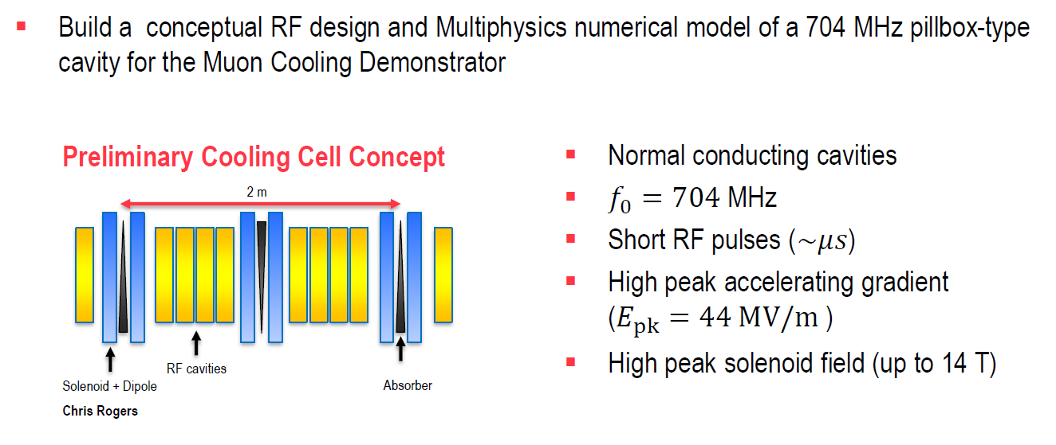
RF cavities for muon cooling cells
Carmelo Barbagallo,
Real estate gradient is 22 MV/m
Average on the whole cell
Half of the length is not for RF

Slide 3
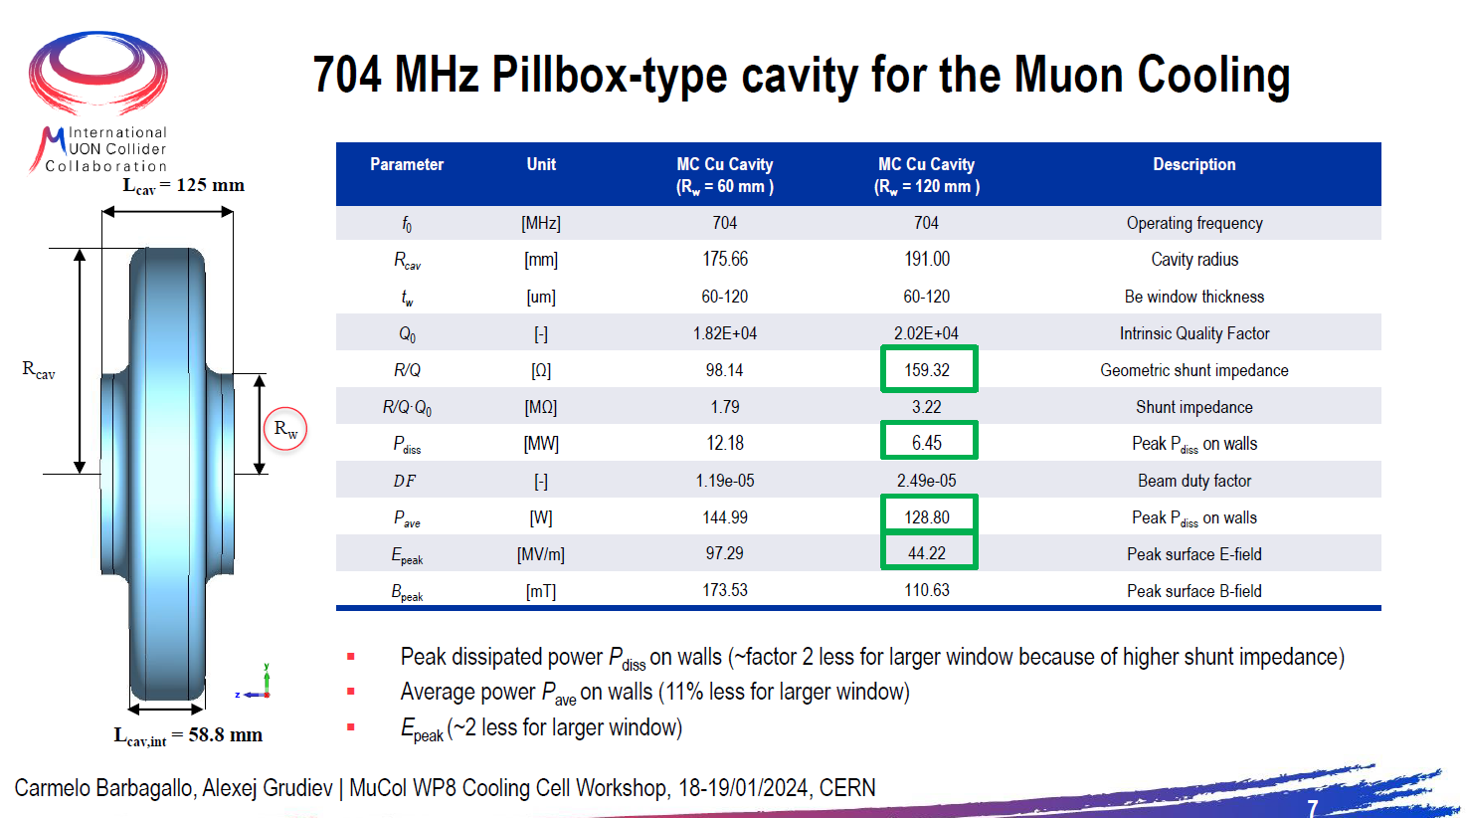
▪
Vacuum model simulated in CST according to the beam dynamics specification given by
Chris Rogers.
Transit time factor is 0.83
E_{nom} = 44 MV/m means
E_{acc} = 36.44 MV/m

Slide 4
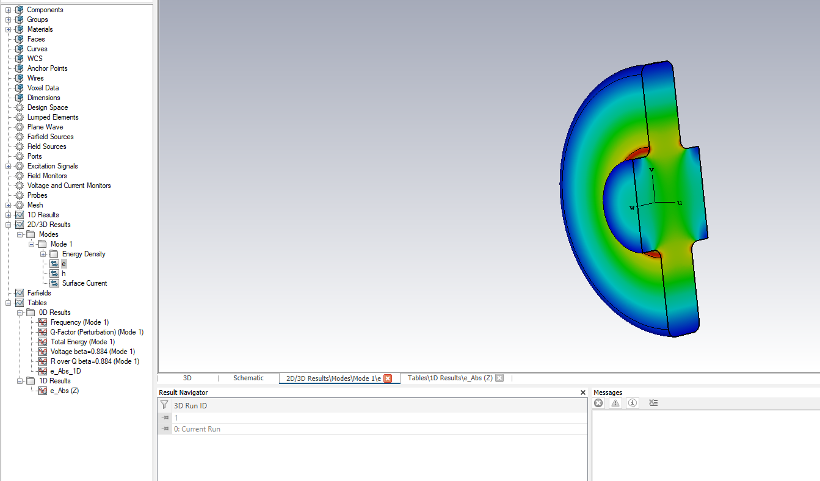
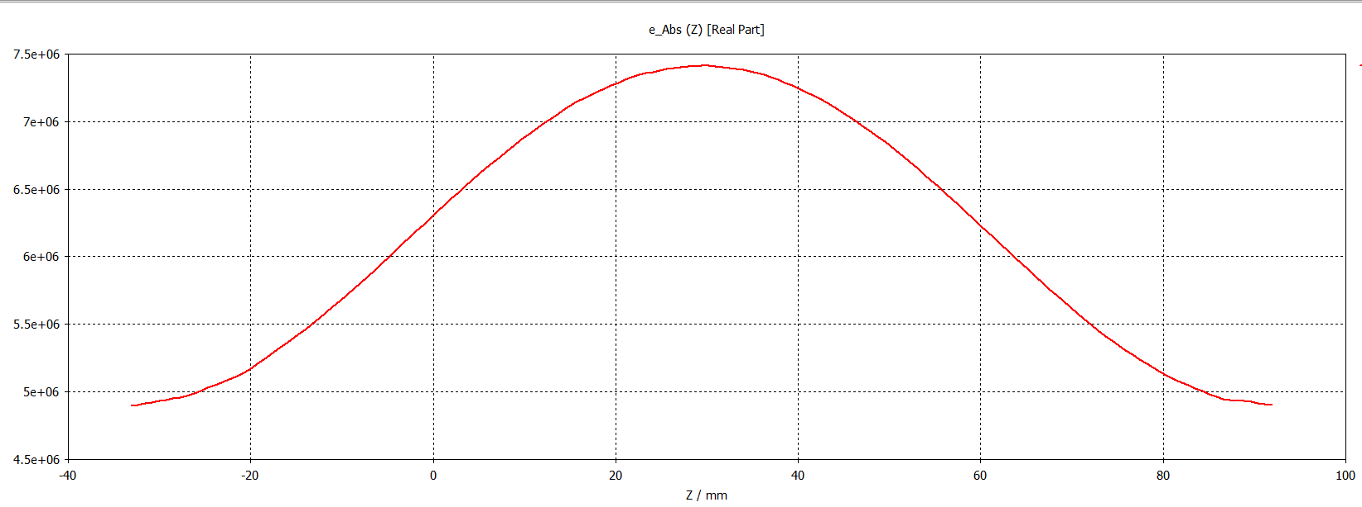
Pill box type cavity simulated by INFN
Window radius Rw = 60 mm
In the last weeks at INFN we developed few tools (Ansys and CST based) to carry out the design of a 704 MHz cavity for the first proposal of a cooling channel for the MC demonstrator.
This work has been dictated by the requirement to provide a contribution to the overall analysis of the congruence of the BD requirements vs the technological constrains due to this kind of cavities.
It has been used to verify our tools with a positive result.
Cavity in copper
Without beryllium window
E_{max}
2/3 x E_{max} at the iris
Field on axis
D. Giove, D. Sertore, M.R. Masullo
INFN Milano-LASA and Napoli

Slide 5
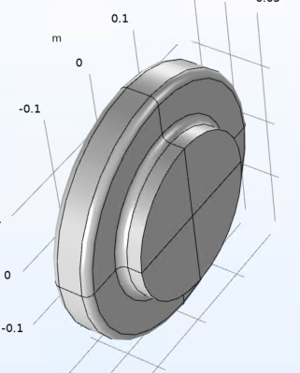
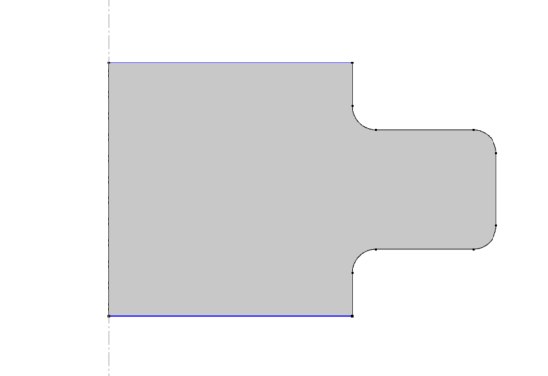
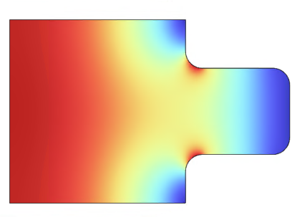
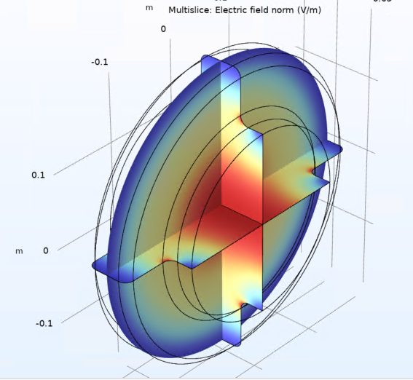
Pill-box type cavity simulated by CEA
Window radius Rw = 120 mm
2D with losses
 | 2D with losses | 3D w/o losses | Carmelo
Frequency (MHz) | 702,72 | 702,72 | 704
beta | 0,884 | 0,884 | 0,884
Transit time factor | 0,83 | 0,83
shunt impedance (Ω) | 157,87 | 157,85 | 159,32
quality factor | 20262 | Inf | 20200
Emax/Eacc | 1,21 | 1,53
Emax @36,44 MV/m | 44,1 | 55,8 | 44,22
Bmax/Bacc (mT/MV/m) | 3,06 | 3,07
Bmax @36,44 MV/m | 111 | 111 | 110,63
3D w/o losses
copper
beryllium

Slide 6
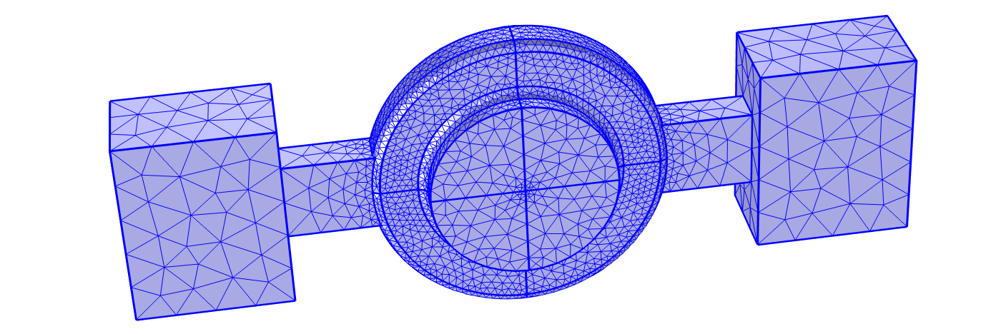
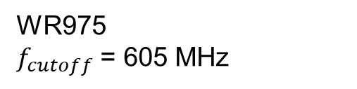
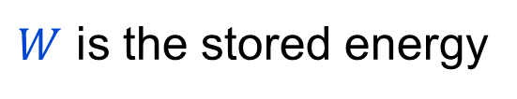
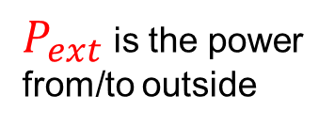
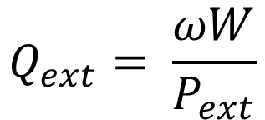
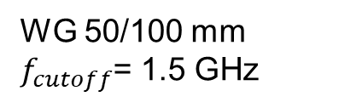
External coupling
External coupling calculation
(2 ports for S-parameters calculations)
$W$ is the stored energy
$P_{ext}$is the power
from/to outside
WG 50/100 mm $f_{cutoff}$= 1.5 GHz
WR975
$f_{cutoff}$ = 605 MHz
$$Q_{ext}= \frac{ωW}{P_{ext}}$$

Slide 7
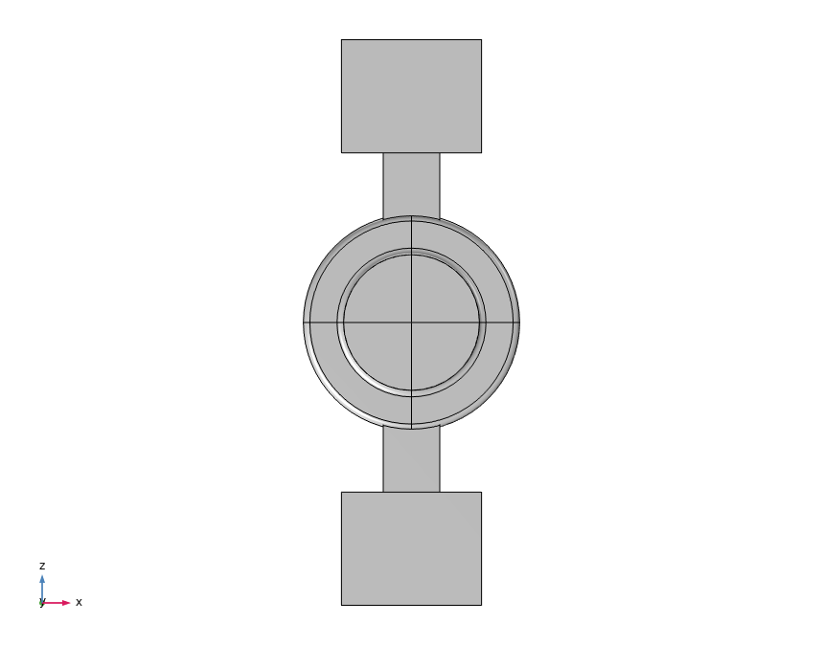
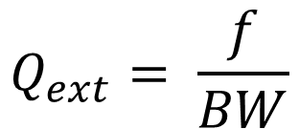

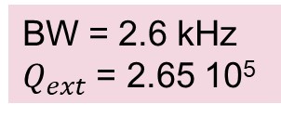
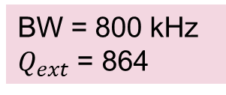

Qext calculations
L =10 mm
L =100 mm
$$BW$$
BW = 800 kHz
$Q_{ext}$ = 864
BW = 2.6 kHz
$Q_{ext}$ = 2.65 10⁵
$$Q_{ext}= \frac{f}{BW}$$
$$Q_{ext}∝exp\left(\frac{4π}{c}\sqrt{{f_{c}}^{2}−{f_{0}}^{2}}×L\right)⁡$$

Slide 8
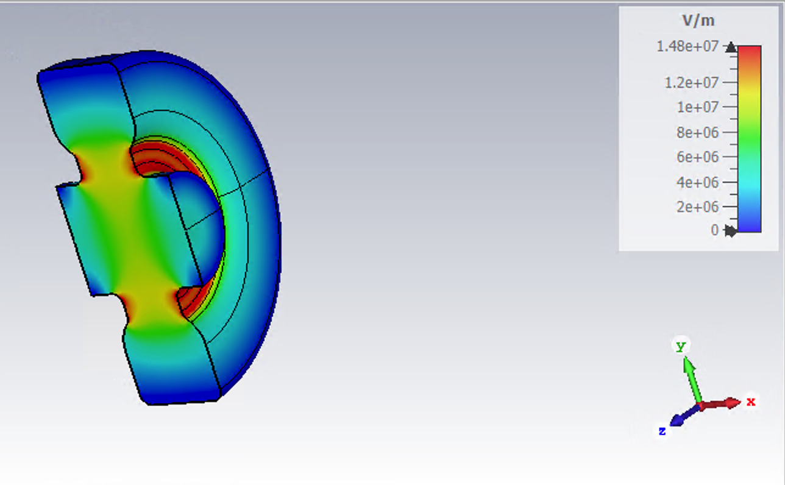
A study for a preliminary “nose” version of a cavity @ 704 MHz
beta=0,884
f | 704.06 | MHz | gap=60mm
Q | 21394 |  | height=153 mm
Rsh/Q | 127.15 | Ohm | bore radius= 50 mm
Rsh | 2.72 | MOhm/m | length=125 mm with two piece of pipes
Ratio Emax/E0 axis | 1.86
E_{max}
1/2 x E_{max} at the iris
D. Giove, D. Sertore, M.R. Masullo
INFN Milano-LASA and Napoli

Slide 9
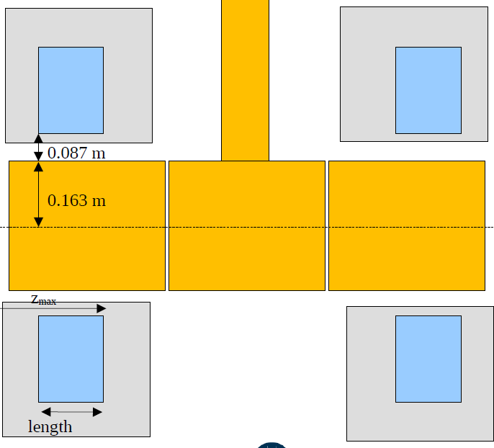
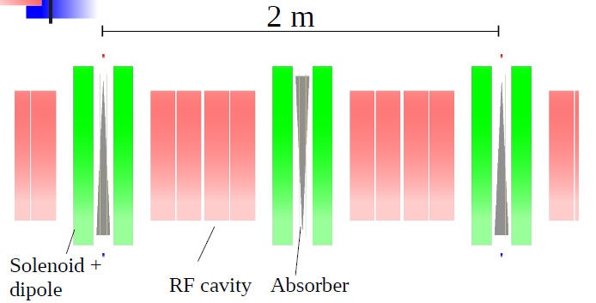
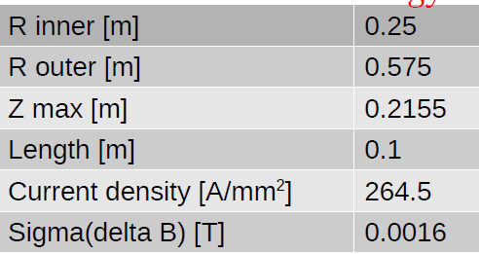
Cavity implementation in the cooling cell
1 m
Chris Rogers,
WP8 Meeting #16
05/03/2024
0.125 x 4 =0.5 m
E_{peak} = 44 MV/m

Slide 10
Cavity implementation in the cooling cell
1 m
Chris Rogers,
WP8 Meeting #16
05/03/2024
0.125 x 3 ~ 0.4 m
E_{peak} = 55 MV/m

Slide 11
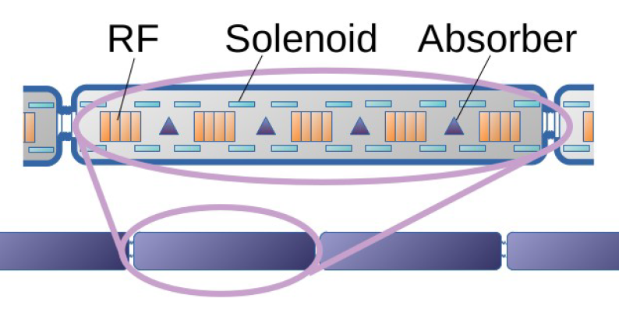
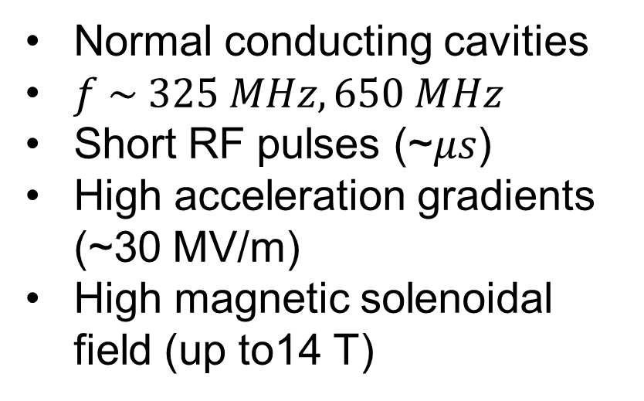
Magnetic field on cavity
Normal conducting cavities
$f \sim 325 MHz, 650 MHz$
Short RF pulses (~𝜇𝑠)
High acceleration gradients (~30 MV/m)
High magnetic solenoidal field (up to14 T)
Creates problematics of break-down that needs to be mitigated
See talk from Claude Marchand

Slide 12




Cavity shape must minimize electron emission risks
$$\vec{B}$$
$$\vec{B}$$
$$\vec{B}$$
max
surface 2
surface 1
surface 1
surface 2
$$E$$
min
surface 1
surface 2
Electrons are emitted by the high E field area of surface 1 … and do not hit the high E field area of surface 2
Electrons are emitted by the high E field area of surface 1 … and hit the high E field area of surface 2

Slide 13
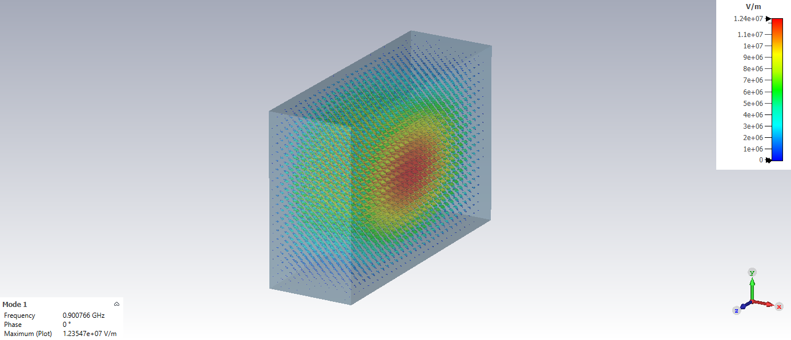
Calculations of electron emission in presence of an RF field with CST particle studio
Very simple cavity model at 900 MHz
200 mm
300 mm
100 mm

Slide 14
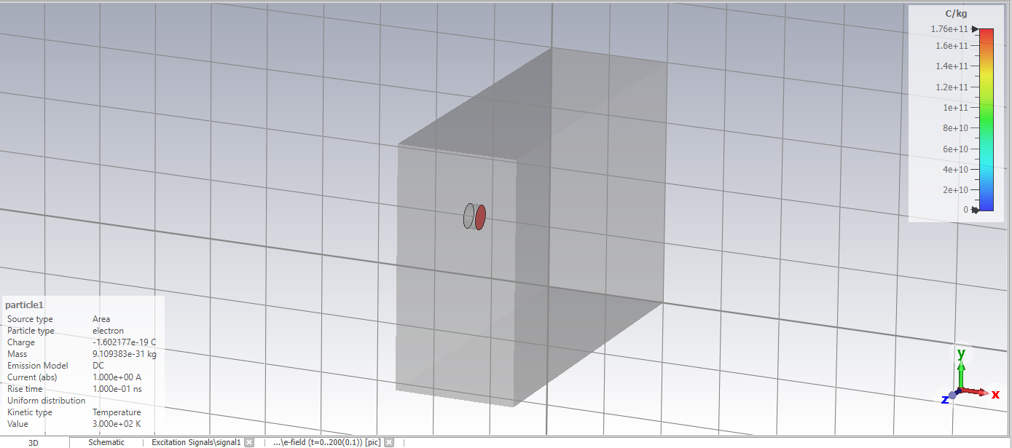
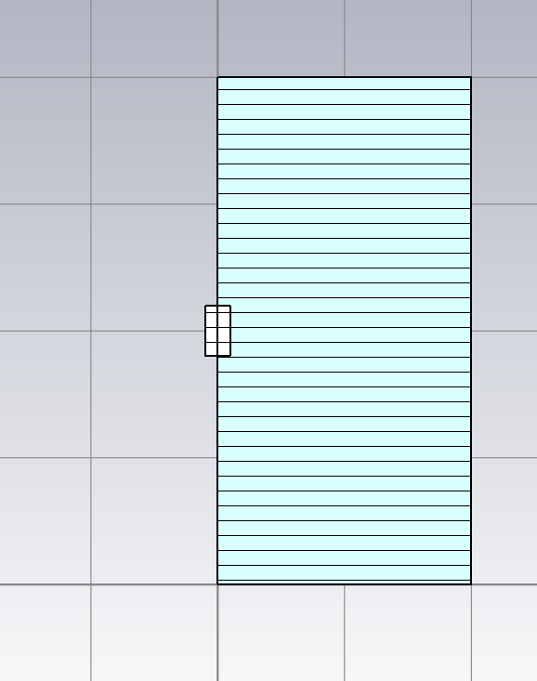
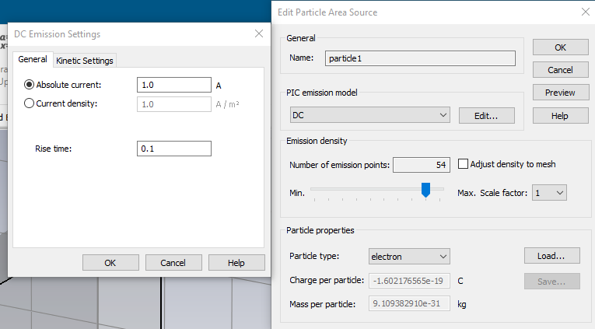
Emission of a DC current
Face 2
Face 2
Face 1 (emission)
Face 1 (emission)
10 mm

Slide 15
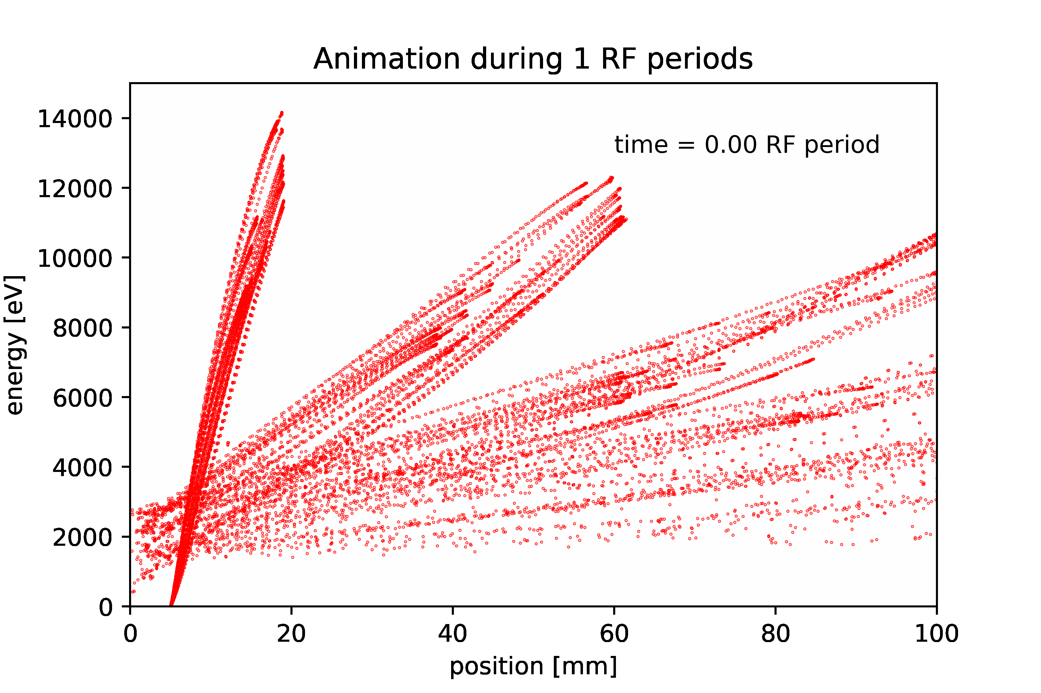
Oscillation of the electrons in the RF field
Face 1 (emission)
Face 2
Some electrons never hit Face 2
The number of electrons arriving on Face 2 depends on RF field pattern

Slide 16
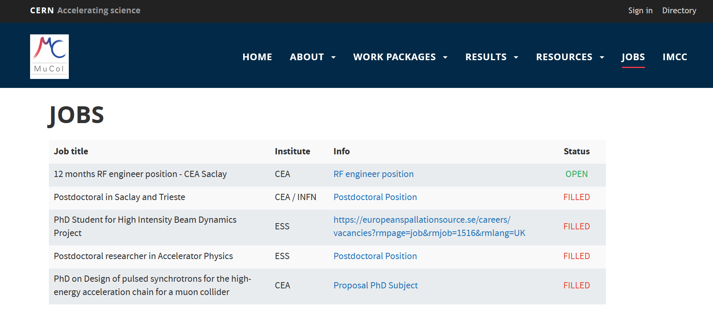
RF engineer position @ CEA-Saclay see MuCol website

