Slide 1






Funded by the European Union (EU). Views and opinions expressed are however those of the author only and do not necessarily reflect those of the EU or European Research Executive Agency (REA). Neither the EU nor the REA can be held responsible for them.
704 MHz cavity studies for the Muon Cooling Demonstrator
Carmelo Barbagallo, Alexej Grudiev
IMCC and MuCol Annual Meeting 2024
12-15 March 2024, CERN

Slide 2
Outline
Introduction
  Motivation of the study
Eigenmode RF simulations in CST Studio Suite®
  704 MHz pillbox cavity
  704 MHz cavity for the Muon Cooling Demonstrator
RF-thermo-mechanical simulations in COMSOL Multiphysics®
  Coupled RF-thermo-mechanical studies on the cavity
  Lorentz Force Detuning (LFD) analysis
Conclusions and Perspectives

Slide 3
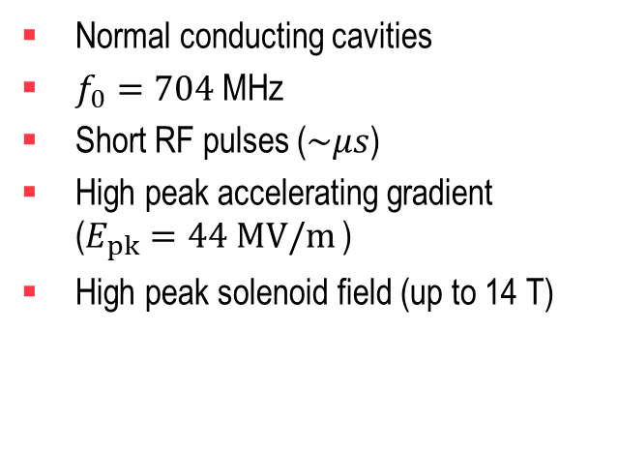
Motivation of the study
Build a conceptual RF design and Multiphysics numerical model of a 704 MHz pillbox-type cavity for the Muon Cooling Demonstrator
Preliminary Cooling Cell Concept
Normal conducting cavities
$f_{0}=704$MHz
Short RF pulses ($\sim μs$)
High peak accelerating gradient ($E_{pk}=44 MV/m$)
High peak solenoid field (up to 14 T)
2 m
RF cavities
Solenoid + Dipole
Absorber
Chris Rogers

Slide 4
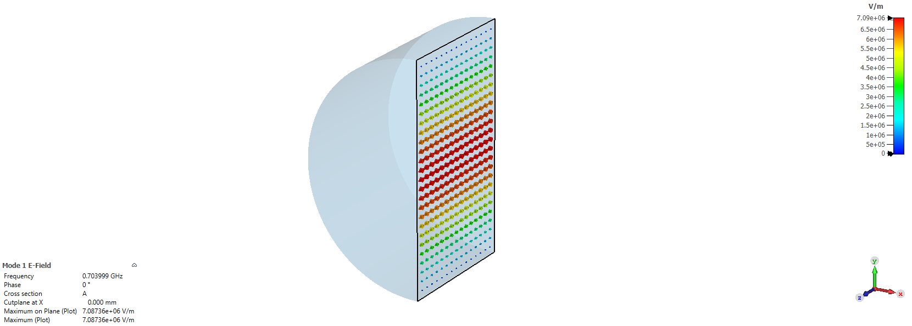
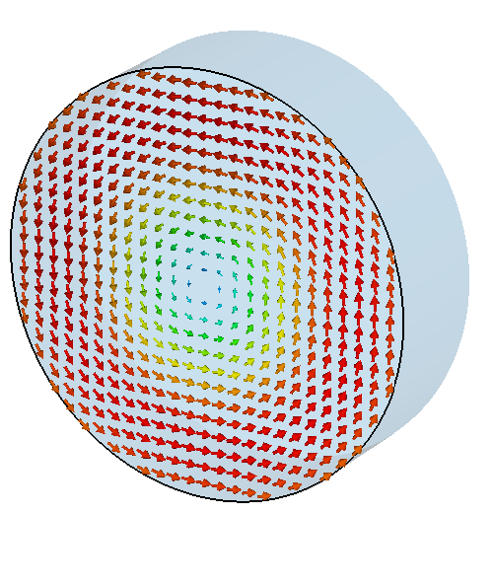

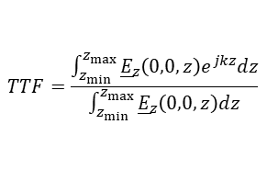
704 MHz Pillbox cavity
Vacuum model simulated in CST according to the beam dynamics specification given by Chris Rogers.
Beam dynamics specifications
L_{cav}
Parameter | Unit | Pillbox - Cu | Description
f₀ | [MHz] | 704 | Operating frequency
L_{cav} | [mm] | 125 | Cavity length
R_{cav} | [mm] | 163.10 | Cavity radius
E_{nom} | [MV/m] | 44 | Average Nominal gradient
V_{nom} | [MV] | 5.50 | Nominal voltage
β | [-] | 0.884 | Relativistic beta
TTF | [-] | 0.83 | Transit-time factor
V_{acc} | [MV] | 4.56 | Accelerating voltage
E_{acc} | [MV/m] | 36.44 | Accelerating gradient
R_{cav}
E-field
H-field
Transit-Time factor
Nominal and accelerating voltage
$$TTF=\frac{\int_{z_{min}}^{z_{max}}{{\underline{E}}_{z}\left(0,0,z\right)e^{jkz}dz}}{\int_{z_{min}}^{z_{max}}{{\underline{E}}_{z}\left(0,0,z\right)dz}}$$
$$k =\frac{ω}{βc}$$
$$V_{nom} =E_{nom}L_{cav}$$
with
$$V_{acc} =TTFV_{nom}$$

Slide 5
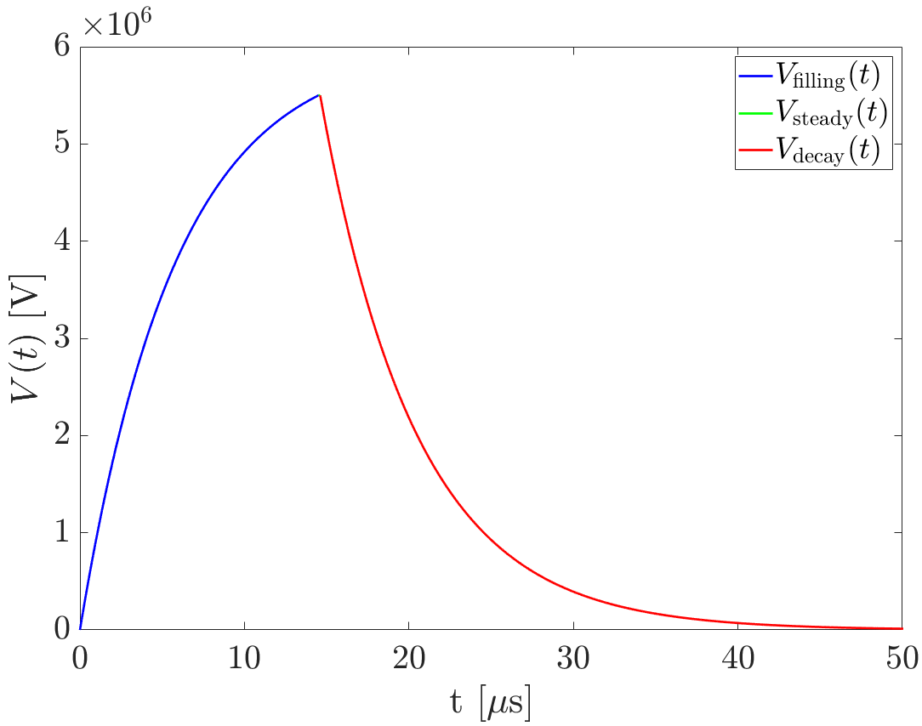
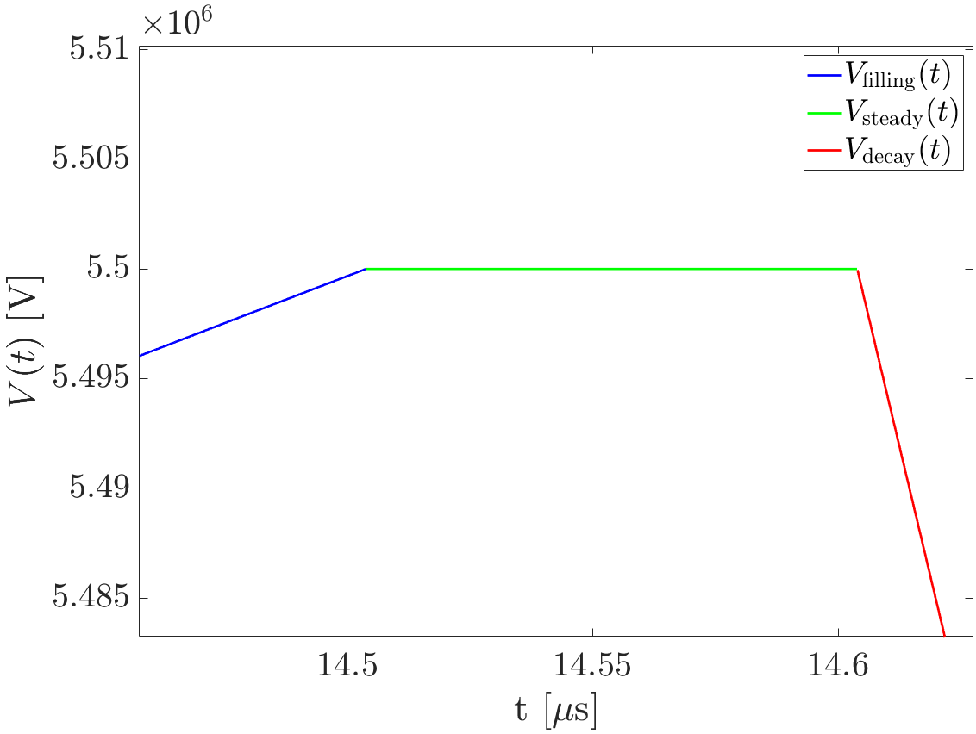
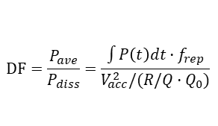



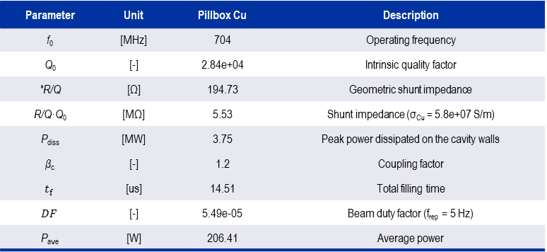

704 MHz Pillbox cavity – Pulse shape and power dissipation
The voltage profile was calculated for a short beam pulse, considering the coupling factor β_{c}=1.2
The average power dissipation was computed from the obtained duty factor (DF)
$$V_{nom} =5.5 MV$$
$$V=V_{nom}·e^{−\frac{ωt}{2Q_{L}}}$$
Parameter | Unit | Pillbox Cu | Description
f₀ | [MHz] | 704 | Operating frequency
Q₀ | [-] | 2.84e+04 | Intrinsic quality factor
*R/Q | [Ω] | 194.73 | Geometric shunt impedance
R/Q·Q₀ | [MΩ] | 5.53 | Shunt impedance (σ_{Cu} = 5.8e+07 S/m)
P_{diss} | [MW] | 3.75 | Peak power dissipated on the cavity walls
β_{c} | [-] | 1.2 | Coupling factor
$$t_{f}$$ | [us] | 14.51 | Total filling time
$$DF$$ | [-] | 5.49e-05 | Beam duty factor (f_{rep} = 5 Hz)
$$\text{P}\text{ave}$$ | [W] | 206.41 | Average power
$$V=V_{nom}$$
_{Bunch train}
$$t_{b}=0.1 us$$
$$t_{f}$$
$$V=V_{nom}\frac{2β_{c}}{1+β_{c}}\left(1−e^{−\frac{ωt}{2Q_{L}}}\right)$$
Filling time and injection time
Duty factor
$$t_{f}≈\frac{2Q_{L}}{ω_{0}}ln\left(\frac{2β_{c}}{β_{c}−1}\right)=t_{inj}$$
$$DF=\frac{P_{ave}}{P_{diss}}=\frac{\int{P\left(t\right)dt·f_{rep}}}{V_{acc}^{2}/(R/Q·Q_{0})}$$

Slide 6
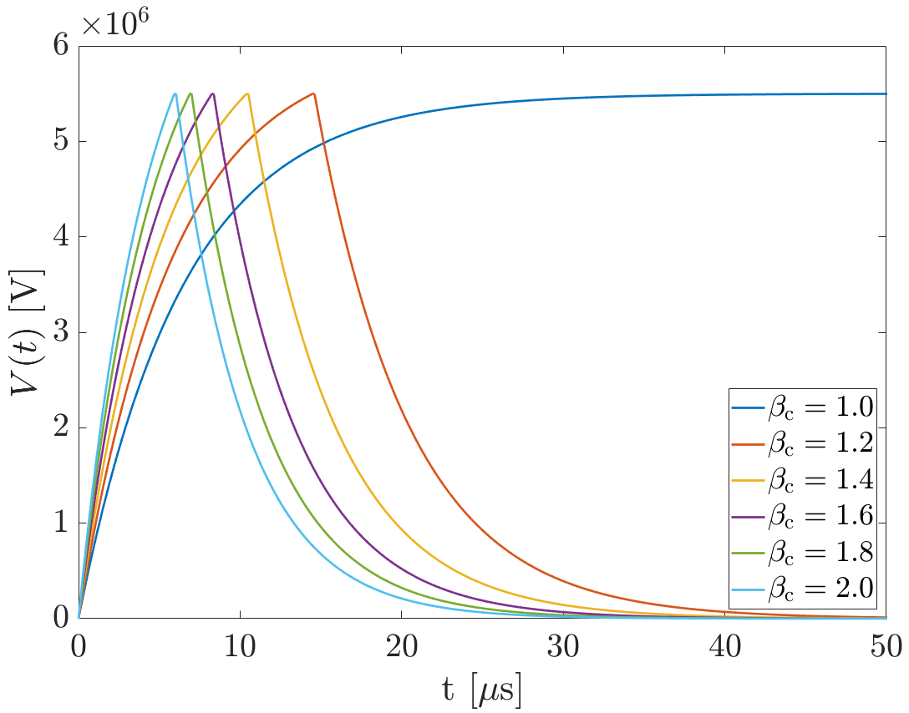
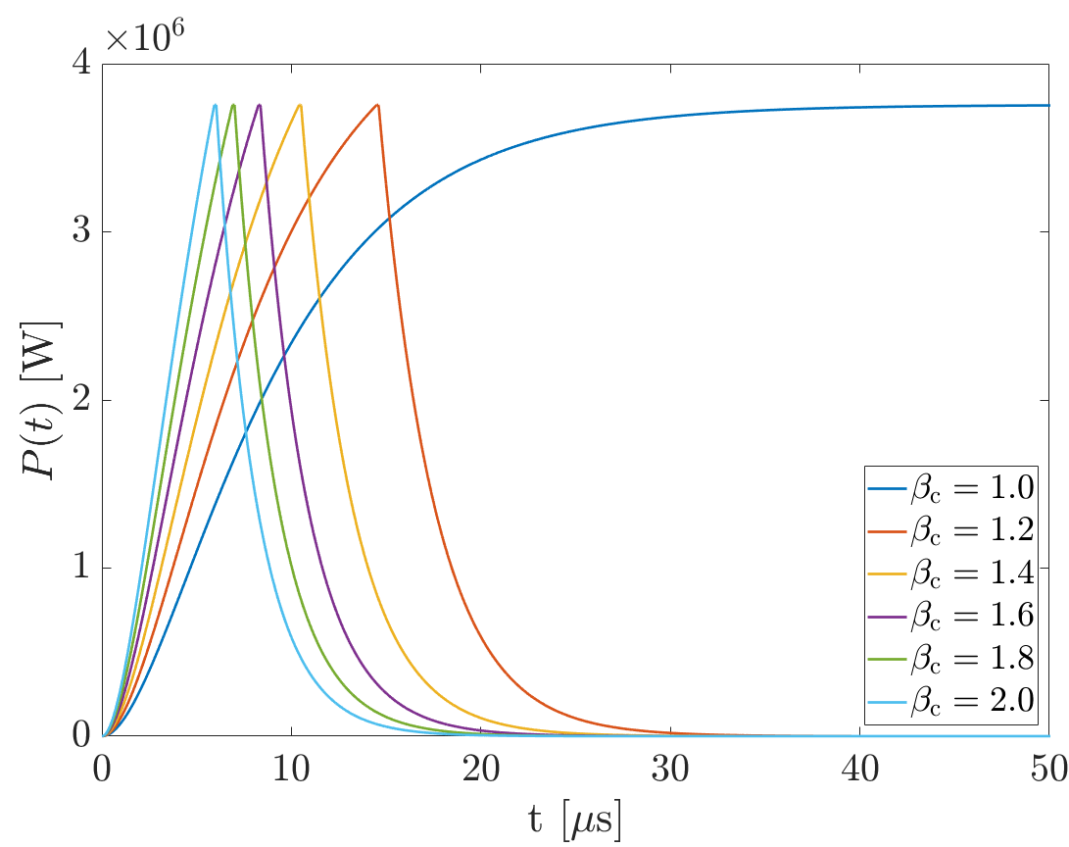
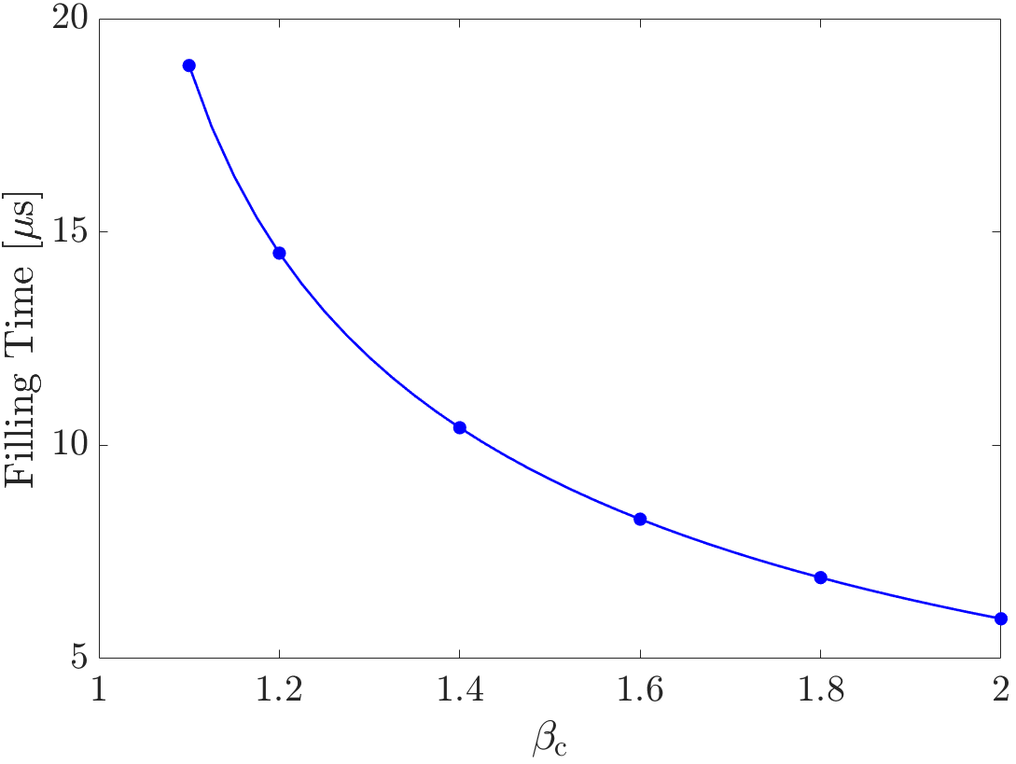
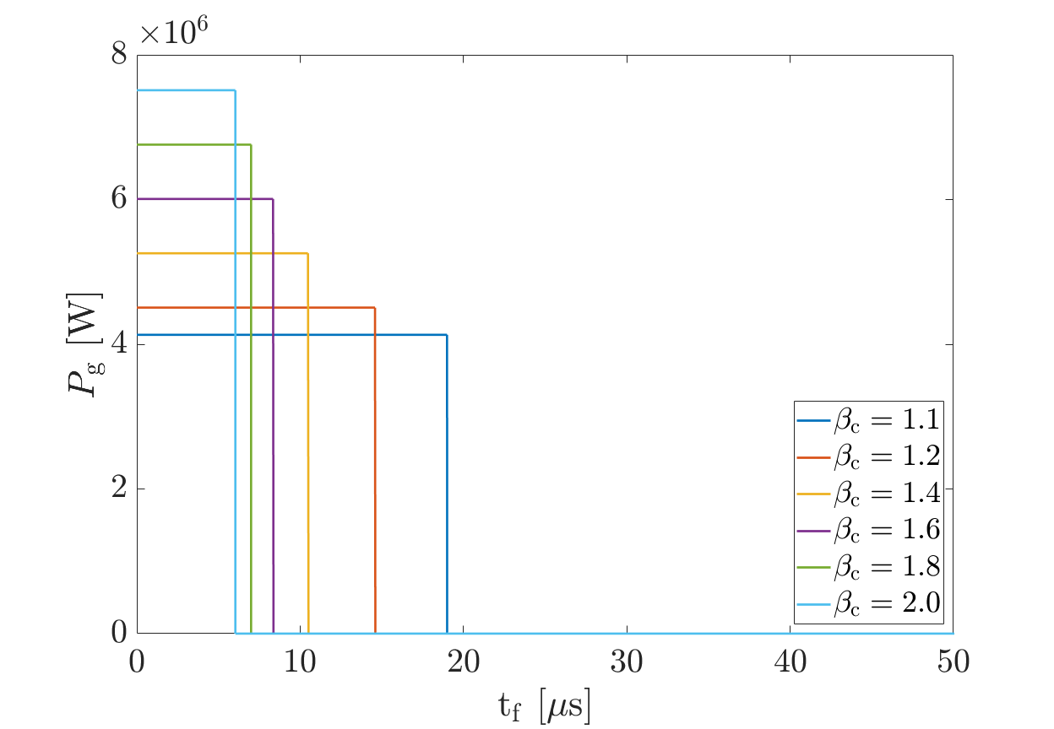
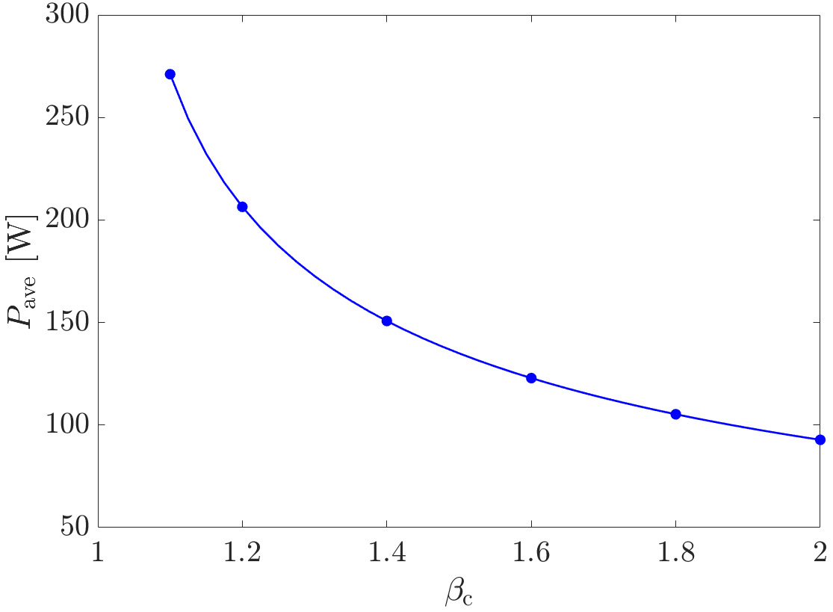
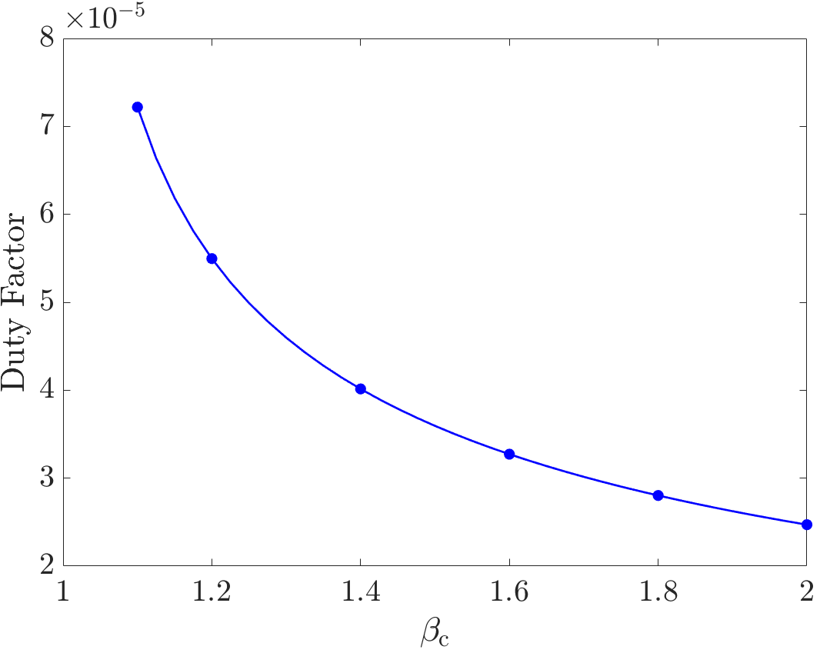
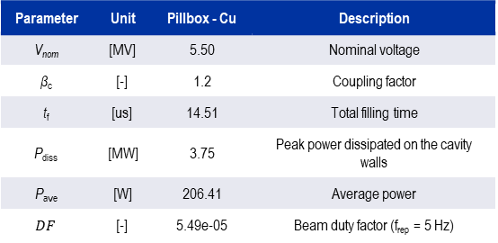
704 MHz Pillbox cavity – Pulse shape and β_{c} dependency
Voltage and power profiles for different coupling factor β_{c}. Higher β_{c} means lower filling time t_{f}
$$V_{nom} =5.5 MV$$
$$P_{diss} =3.75 MW$$
Higher β_{c} means lower average power P_{ave} and duty factor DF for the cavity
Parameter | Unit | Pillbox - Cu | Description
V_{nom} | [MV] | 5.50 | Nominal voltage
β_{c} | [-] | 1.2 | Coupling factor
t_{f} | [us] | 14.51 | Total filling time
P_{diss} | [MW] | 3.75 | Peak power dissipated on the cavity walls
$$\text{P}\text{ave}$$ | [W] | 206.41 | Average power
$$DF$$ | [-] | 5.49e-05 | Beam duty factor (f_{rep} = 5 Hz)
Notes:
Higher beta means lower filling time, but also lower average power and duty factor

Slide 7
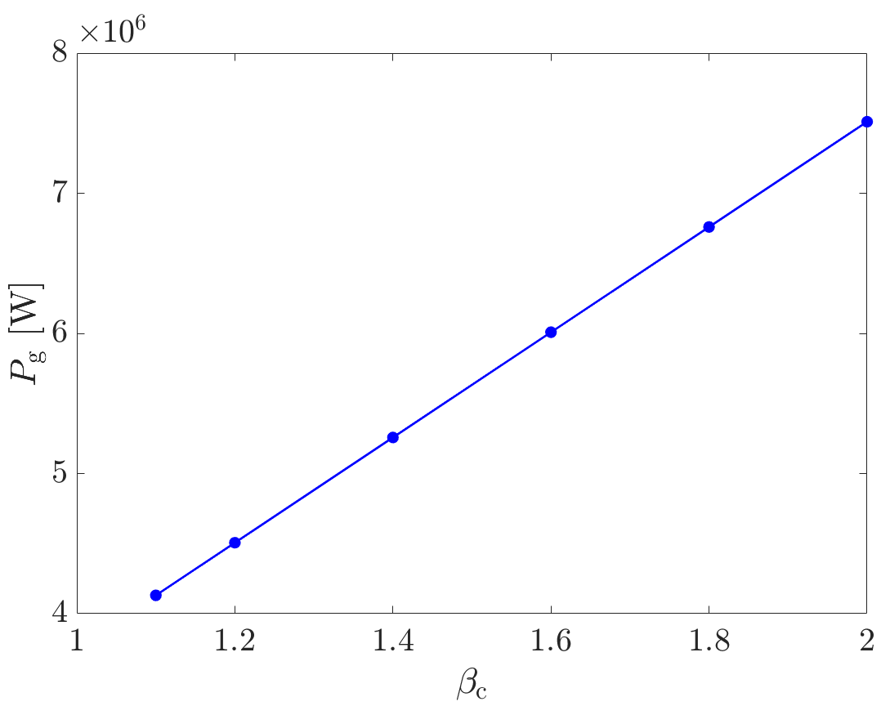
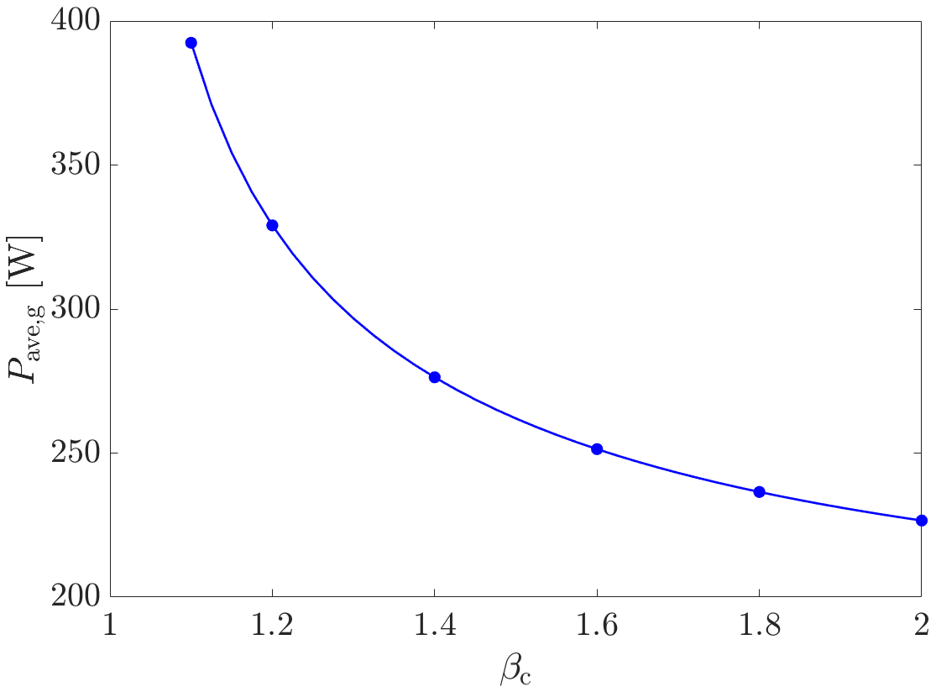
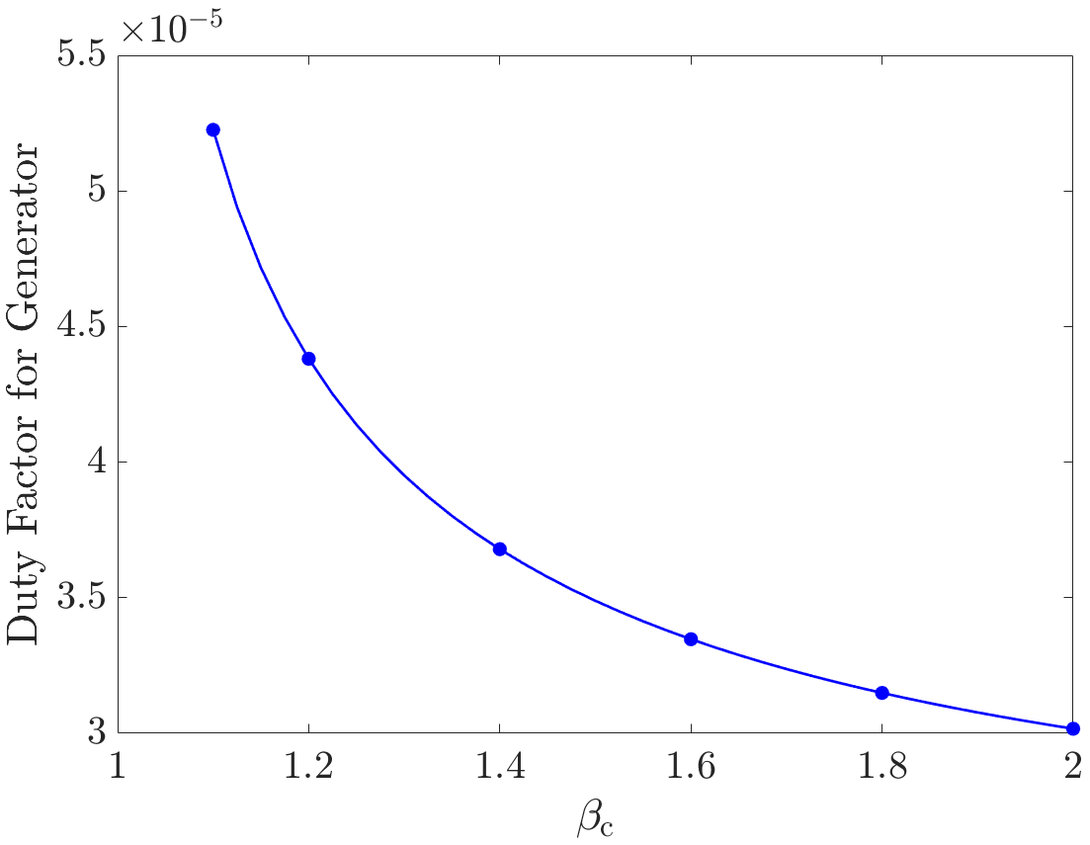
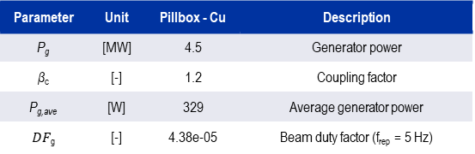

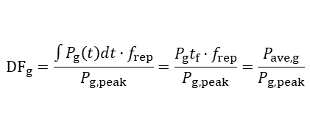
Power from the generator - 704 MHz Pillbox cavity
For higher β_{c} (lower filling time), more power is required from the generator to fill the cavity faster
Parameter | Unit | Pillbox - Cu | Description
P_{g} | [MW] | 4.5 | Generator power
β_{c} | [-] | 1.2 | Coupling factor
P_{g,ave} | [W] | 329 | Average generator power
$DF$_{g} | [-] | 4.38e-05 | Beam duty factor (f_{rep} = 5 Hz)
Power required from the generator
$$P_{g}=β_{c}P_{diss}$$
Generator Duty Factor
$${DF}_{g}=\frac{\int{P_{g}\left(t\right)dt·f_{rep}}}{P_{g,peak}}=\frac{P_{g}t_{f}·f_{rep}}{P_{g,peak}}=\frac{P_{ave,g}}{P_{g,peak}}$$
β_{c}=1.2 is a reasonable compromise between average dissipated power and power required from the generator.
Notes:
From the other hand

Slide 8
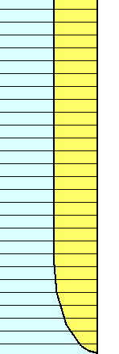
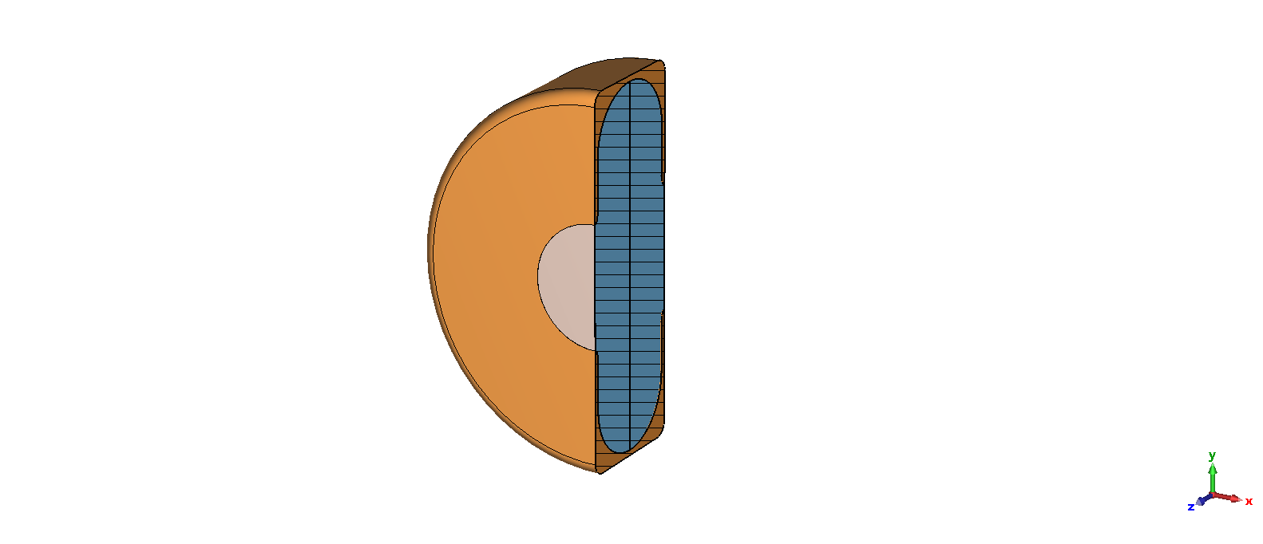
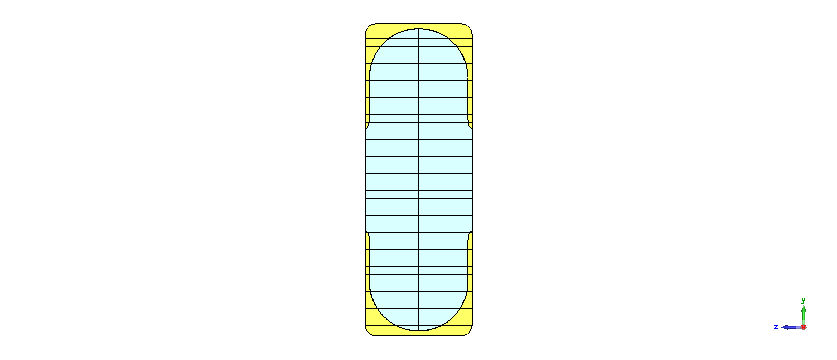
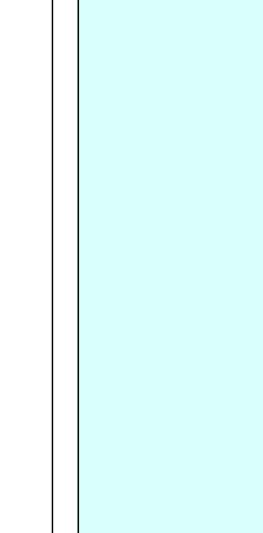
704 MHz cavity for the Muon Cooling Demonstrator
Proposed design: 704 MHz cavity with circular profile on the high-magnetic field region and elliptical profile on the iris to lower the local surface field.
Beryllium (Be) window:
  60 mm (3σ_{beam}) radius
  60 um thickness (t_{w}) (very thin to minimize the beam scattering)
RF cavity
Copper
L_{acc}
b
R_{c}
a
R_{cav}
Why do we need a cavity with closed apertures?
Pros
  Cavity design close to pillbox
  Preserve the E-field on axis
  Maximize the geometrical shunt impedance
Cons
  High mechanical deformations under Lorentz Force leading to cavity frequency detuning
  Risk of cavity contamination in case of rupture under fatigue
Vacuum
t_{w}
R_{i}
Be window
R_{v}
Be window

Slide 9
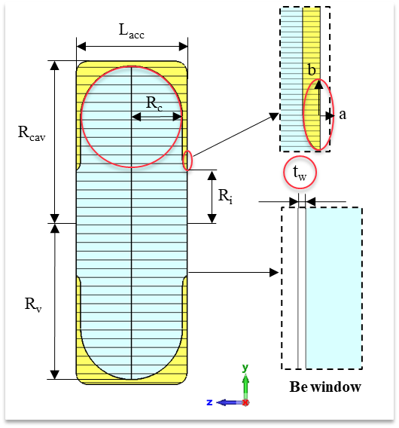
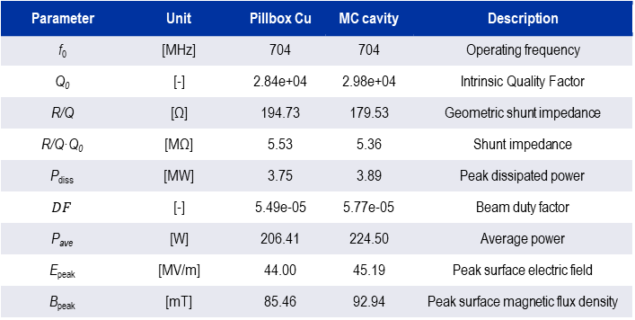
704 MHz cavity for the Muon Cooling (MC) Demonstrator
Parameter | Unit | Pillbox Cu | MC cavity | Description
R_{cav} | [mm] | - | 195.06 | Cavity radius
R_{v} | [mm] | 163.10 | 177.33 | Vacuum radius
R_{i} | [mm] | - | 60 | Iris radius
L_{acc} | [mm] | 125 | 125 | Accelerating length
R_{c} | [mm] | - | 57.5 | Radius of the circular profile
a | [mm] | - | 5 | Minor semi-axis of iris ellipse
b | [mm] | - | 11 | Major semi-axis of iris ellipse
R_{w} | [mm] | - | 60 | Window radius
t_{w} | [um] | - | 60 | Window thickness
Geometrical parameters
Parameter | Unit | Pillbox Cu | MC cavity | Description
f₀ | [MHz] | 704 | 704 | Operating frequency
Q₀ | [-] | 2.84e+04 | 2.98e+04 | Intrinsic Quality Factor
R/Q | [Ω] | 194.73 | 179.53 | Geometric shunt impedance
R/Q·Q₀ | [MΩ] | 5.53 | 5.36 | Shunt impedance
P_{diss} | [MW] | 3.75 | 3.89 | Peak dissipated power
$$DF$$ | [-] | 5.49e-05 | 5.77e-05 | Beam duty factor
P_{ave} | [W] | 206.41 | 224.50 | Average power
E_{peak} | [MV/m] | 44.00 | 45.19 | Peak surface electric field
B_{peak} | [mT] | 85.46 | 92.94 | Peak surface magnetic flux density
Similar performance to the ideal pillbox
R/Q is 7% lower than pillbox
P_{ave} 8% higher than pillbox
E_{peak} 2.6% higher and B_{peak} 8% higher than pillbox
RF figures of merit
Notes:
Update duty factor based on the recent calculations

Slide 10
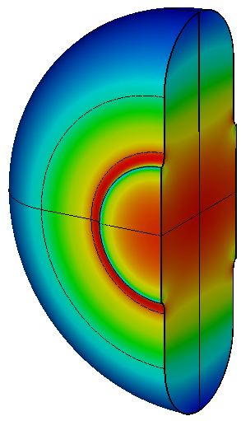
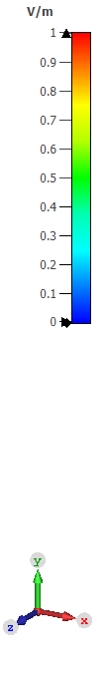
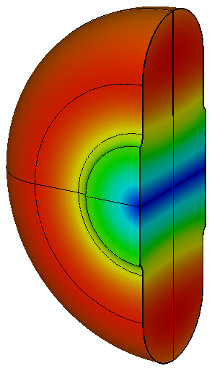



Peak E and H fields on the cavity
Maximum E-field is localized on the cavity iris, while maximum H-field on the upper part of the cavity
Peak E-field needs to be minimized to reduce the risk of RF-breakdown
Peak H-field needs to be reduced for the RF-heating
$$|\left|E\right||/{|\left|E\right||}_{max}$$
$$|\left|H\right||/{|\left|H\right||}_{max}$$
E-field
H-field

Slide 11
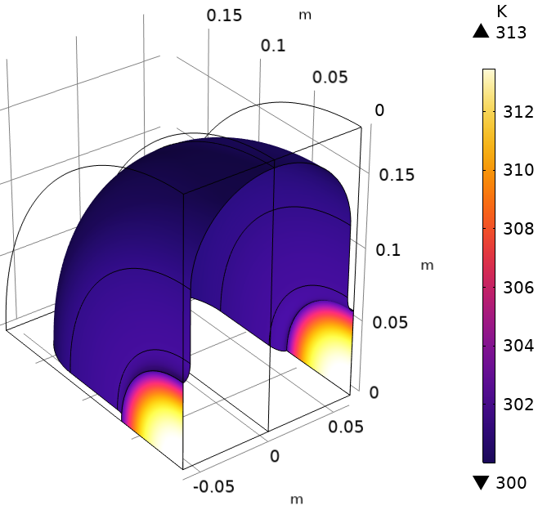
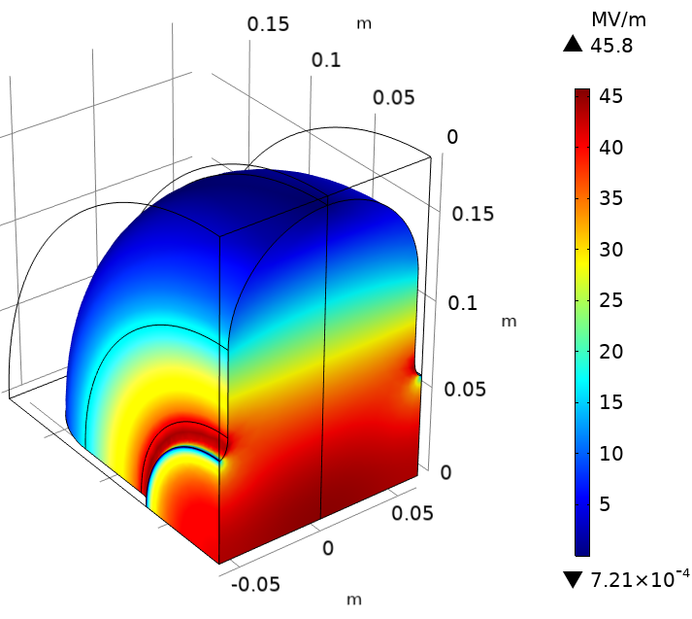
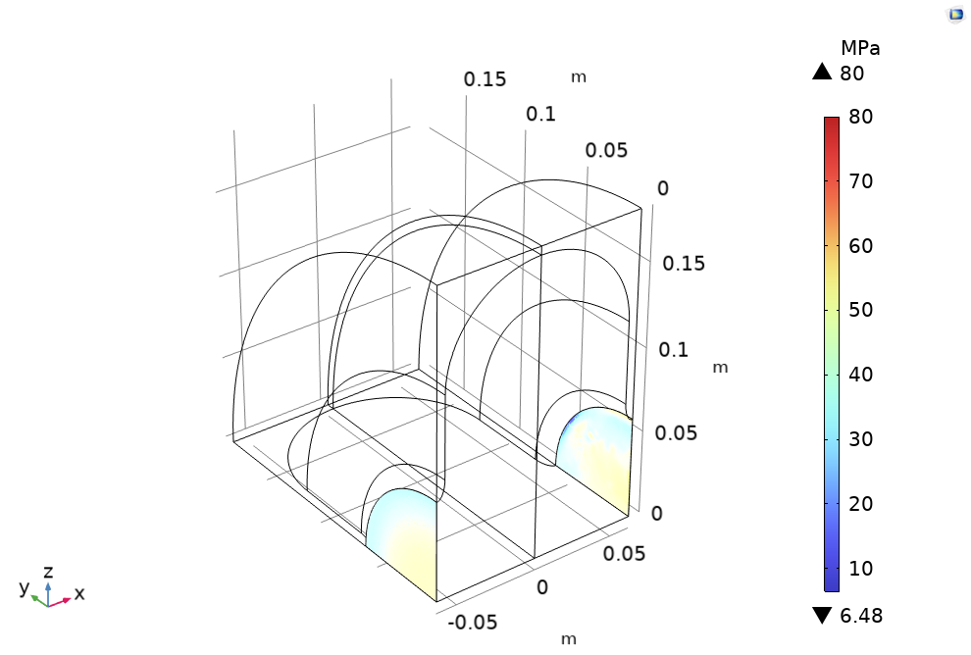






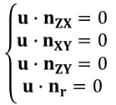





RF-thermo-mechanical simulations
Stationary thermal simulation
$$T$$
Power losses
(Heat source on lossy walls)
$$T_{c}$$
Thermal expansion
$$\frac{∂P_{diss}}{∂A}≈\frac{1}{2}{DF∙R}_{s}\left(T,f_{0}\right)H∙H^{∗}$$
$$ε_{th}=α\left(T\right)\left(T−T_{c}\right)$$
with
$T_{c}=300K$ (upper walls)
Non-linear thermo-mechanical simulation
RF eigenmode
$$E=(E_{x},E_{y},E_{z})$$
$$f_{0}$$
$$u=(u_{x},u_{y},u_{z})$$
Displacement field
$$s=(s_{x},s_{y},s_{z})$$
Spatial mesh displacement
Lossy walls
2nd RF Eigenmode
$$E=(E_{x},E_{y},E_{z})$$
$$f_{0,th}$$
$$Δf_{th}=f_{0,th}−f_{0}$$
PMC (symmetry planes)
$$\left\{\begin{aligned}u∙n_{ZX}=0 \\ u∙n_{XY}=0 \\ u∙n_{ZY}=0 \\ u∙n_{r}=0 \end{aligned}\right.$$
On symmetry planes
Roller condition

Slide 12
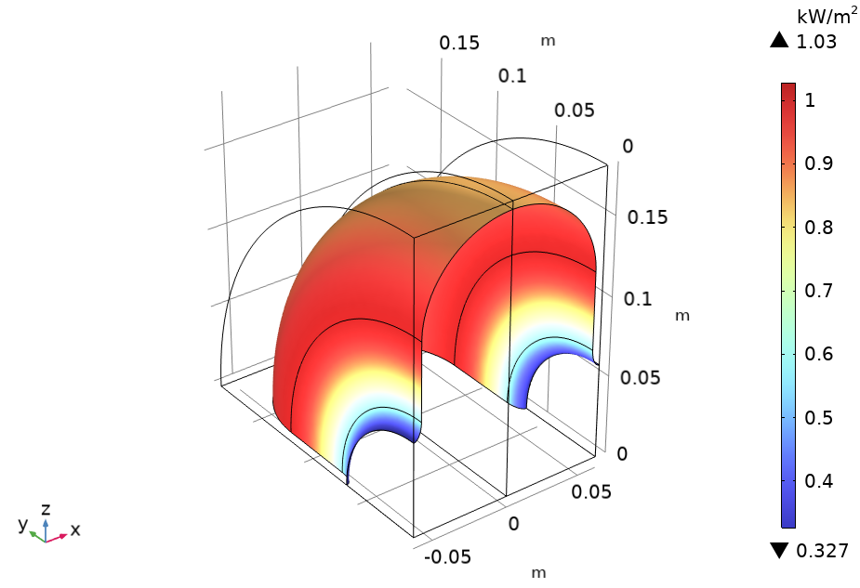
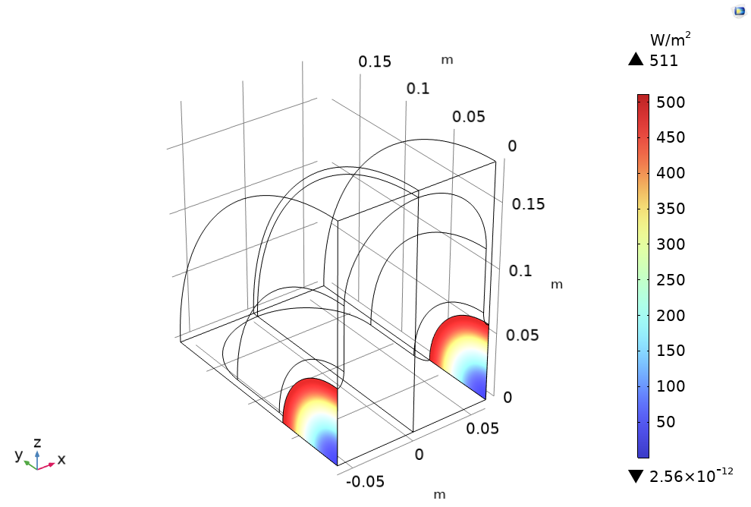



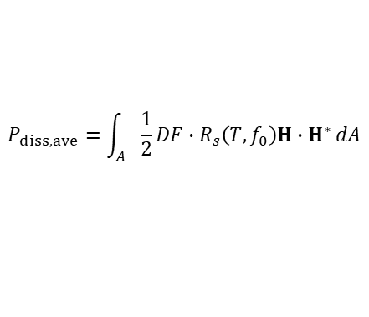
Power loss and Temperature Gradient
Power loss on the cavity walls [kW/m²]
Power loss on the windows [W/m²]
Average power losses
$$P_{diss,ave}=\int_{A}{\frac{1}{2}{DF∙R}_{s}\left(T,f_{0}\right)H∙H^{∗}}dA$$
P_{diss,ave,walls}=217.94 W
at
$$Enom=44 MV/m$$
P_{diss,ave,Windows}=2.33 W
Temperature gradient
Temperature [K]
T_{max}=313 K
$$T_{c}$$
$$Enom=44 MV/m$$
T_{c}=300 K
at
ΔT = 13 K

Slide 13
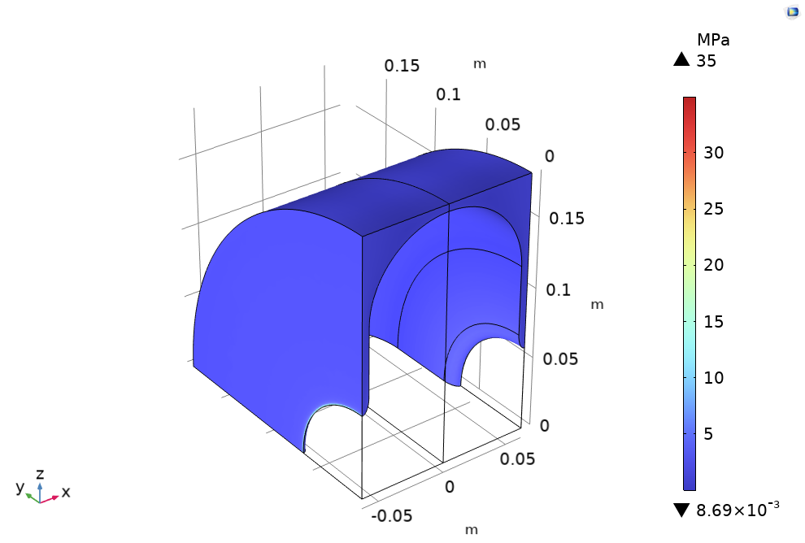
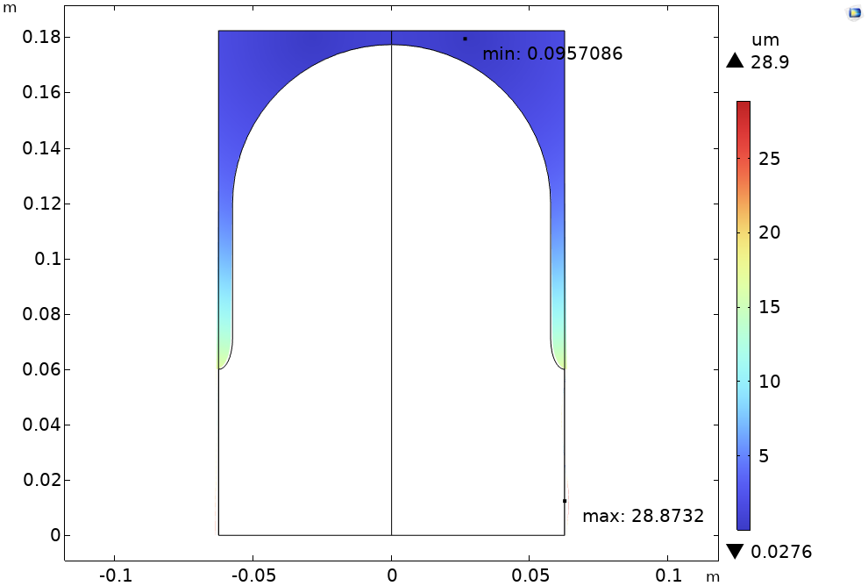
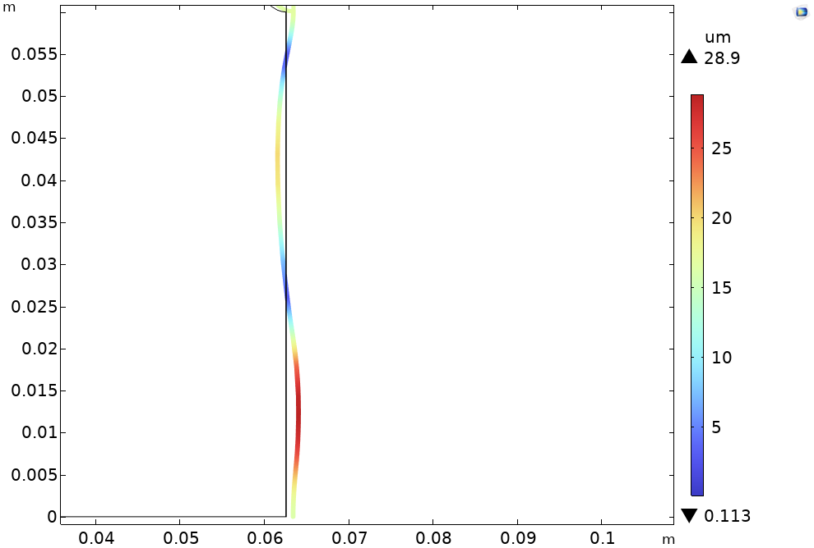



Thermal stress, displacement and frequency shift
von Mises Stress on the cavity walls [MPa]
von Mises Stress on the windows [MPa]
von Mises Stress vs Yield strength
$$σ_{Mises,Cu}=35 MPa<250−350 MPa=σ_{Yield,Cu}$$
$$σ_{Mises,Be}=80 MPa<240 MPa=σ_{Yield,Be}$$
No plastic deformations, good safety margin to failure.
MAX
Thermally induced total displacement
Total displacement [um]
$$u_{th,max}=28.9 μm$$
Thermally-induced frequency shift
$$Δf_{th}=39.77 kHz$$
$$Δf_{3dB}=51.92 kHz$$
The frequency shift is lower than the 3 dB bandwidth.

Slide 14
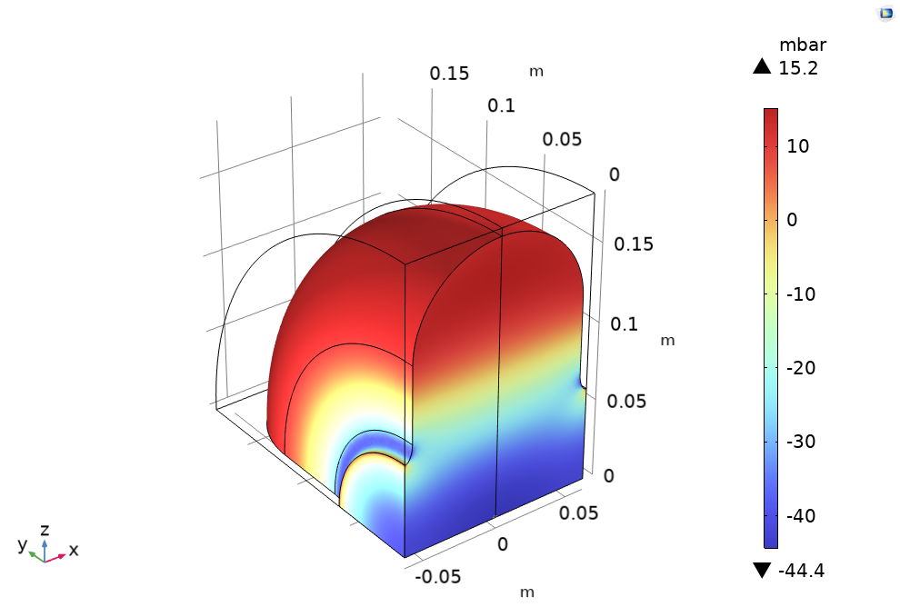
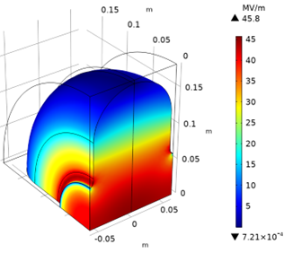
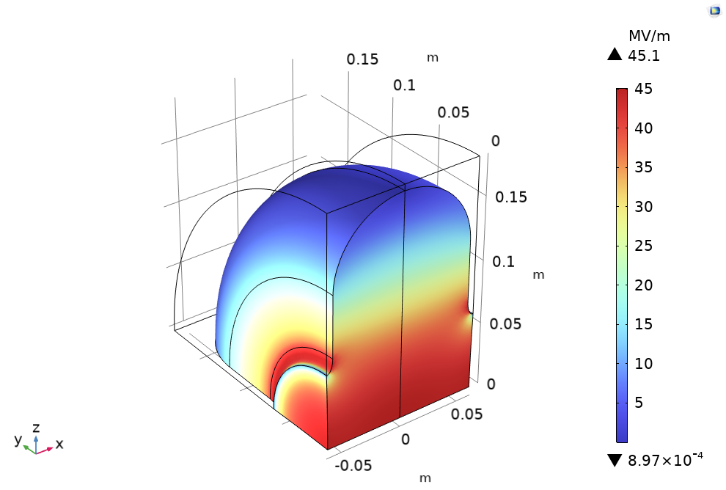



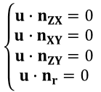



Lorentz Force Detuning (LFD) - RF-mechanical simulations
RF field pressure
(Boundary load walls)
Non-linear mechanical simulation
$$u=(u_{x},u_{y},u_{z})$$
Displacement field
$$P_{RF}=\frac{1}{4}\left(μ_{0}H^{2}−ε_{0}E^{2}\right)$$
$$s=(s_{x},s_{y},s_{z})$$
Spatial mesh displacement
$$P_{RF}$$
RF eigenmode
$$f_{0}$$
2nd RF Eigenmode
$$E=(E_{x},E_{y},E_{z})$$
$$E=(E_{x},E_{y},E_{z})$$
$$f_{0,LFD}$$
$$Δf_{LFD}=f_{0,LFD}−f_{0}$$
Lossy walls
$$\left\{\begin{aligned}u∙n_{ZX}=0 \\ u∙n_{XY}=0 \\ u∙n_{ZY}=0 \\ u∙n_{r}=0 \end{aligned}\right.$$
On symmetry planes
Roller condition
PMC (symmetry planes)

Slide 15
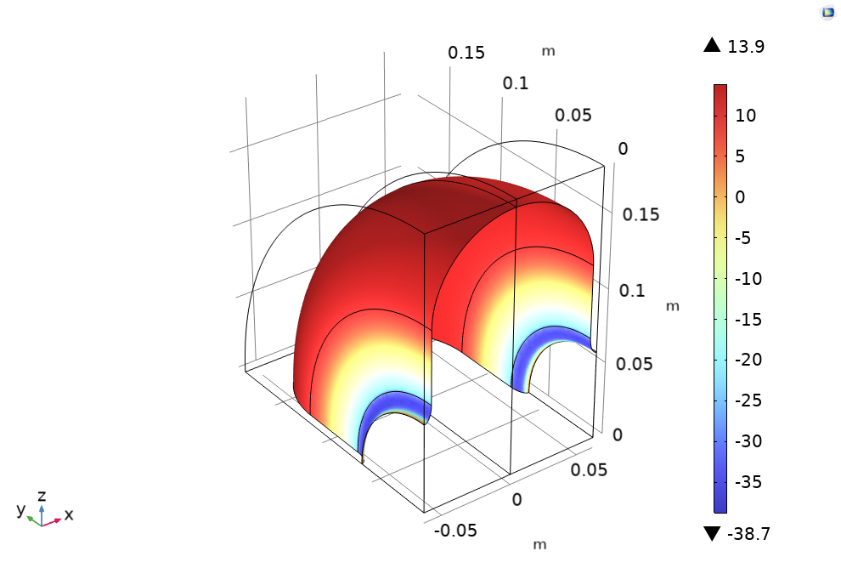
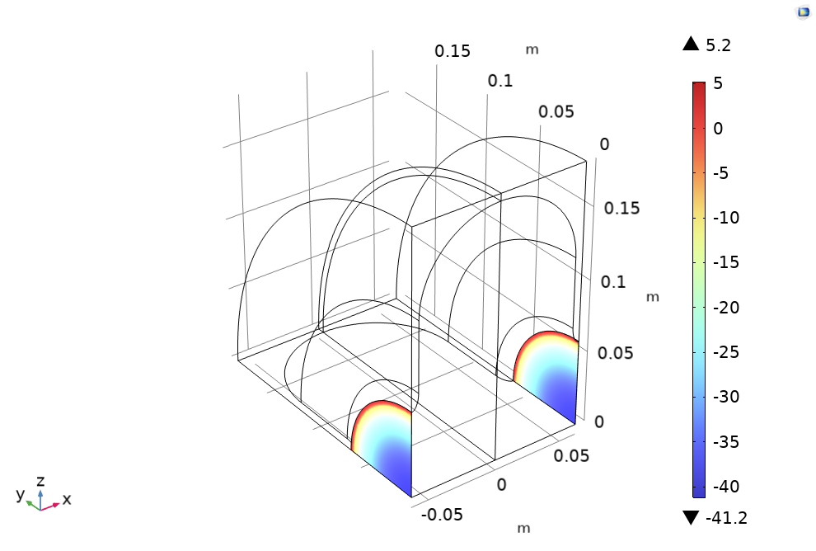
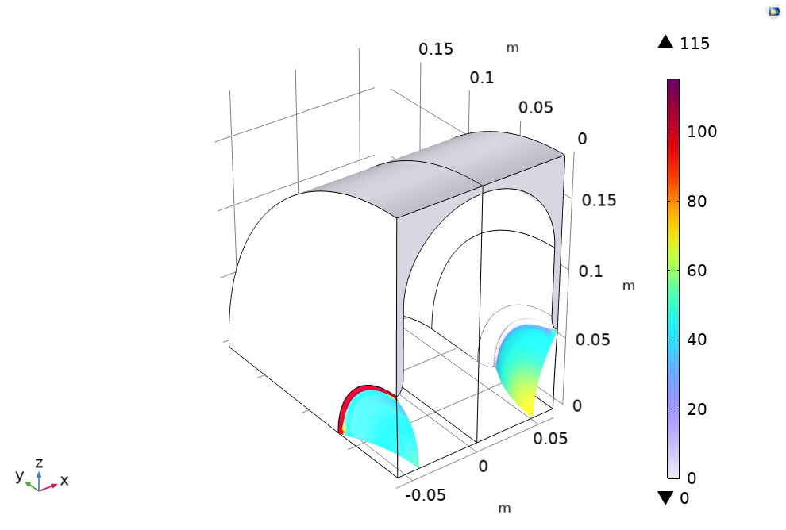




Lorentz Force Detuning: RF field pressure and stress
Radiation pressure on the cavity walls [mbar]
Radiation pressure on the windows [mbar]
RF field pressure
$$P_{max,walls}=13.9 mbar$$
(Compression)
$$P_{min,walls}=−38.7 mbar$$
(Traction)
$$P_{max, window}=5.2 mbar$$
(Compression)
$$P_{min window}=−41.2 mbar$$
(Traction)
Significant pressure on the 60 mm thick windows
von Mises Stress vs Yield strength
$$σ_{Mises,Cu}=1 MPa<250−350 MPa=σ_{Yield,Cu}$$
$$σ_{Mises,Be}=115 MPa<240 MPa=σ_{Yield,Be}$$
No plastic deformations. Only factor two margin in the interconnection between the window and the cavity (risk of failure under fatigue)

Slide 16
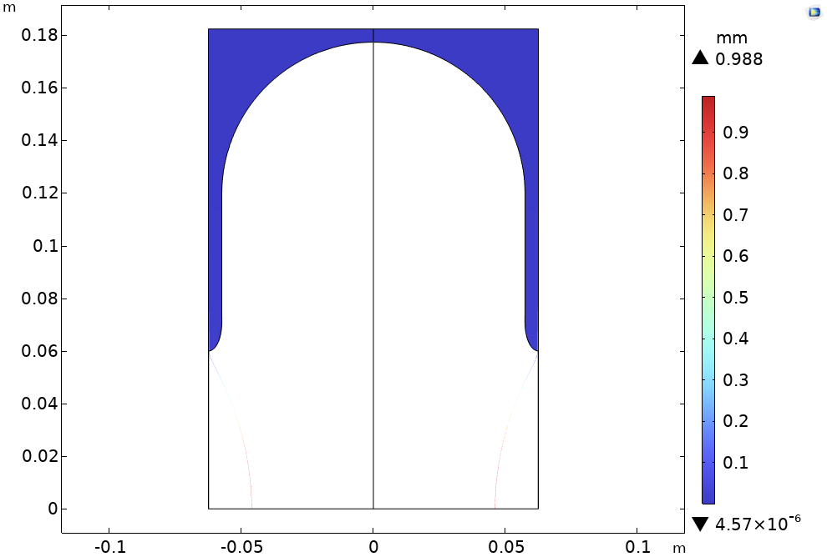
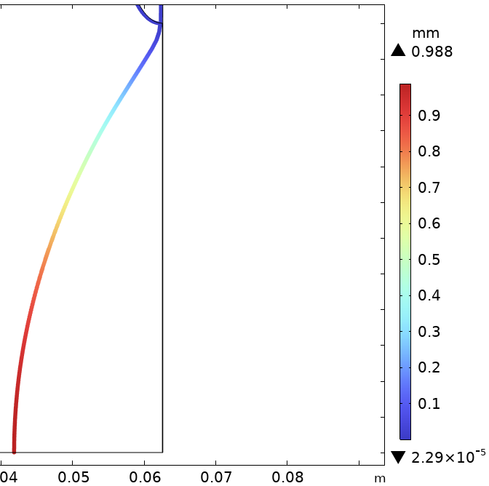





Preliminary results: LFD on the cavity walls and Be windows
Lorentz Force-induced total displacement [mm]
Deformed geometry (x20)
Total displacement
$$u_{max}=0.988mm$$
$$∆f_{LFD}∝K_{L}E_{acc}^{2}$$
Frequency shift
$$∆f_{LFD}=−0.94 MHz$$
$$Enom=44 MV/m$$
at
$$Δf_{3dB}=51.92 kHz$$
3dB bandwidth
max 0.988 mm
The frequency shift is higher than the 3 dB bandwidth. This is principally due to the large deformation and displacement detected at the Be windows. A new stiffer design for the Be windows must be addressed.
The implemented LFD model is based on the Slater theorem, which is valid only for small deformation.
The used linear elastic assumption is typically valid within the 2-3% of deformations. Even the model includes geometric non-linearity, the assumption that a purely elastic material can undergo arbitrary large deformations may not be entirely valid.

Slide 17
Conclusions and Perspectives
A conceptual RF design and Multiphysics model of a copper 704 MHz cavity operating at 44 MV/m for the Muon Cooling Demonstrator was built based on beam dynamics specification.
RF figures of merit were computed for a design including Be windows, having 60 mm radius and 60 u thickness. The design show similar performance to the ideal pillbox.
RF thermo-mechanical and Lorentz Force Detuning simulations:
  Most of the power is dissipated on the Cu cavity walls (217.94 W), while 2.33 W are dissipated on the Be windows. The maximum temperature of 313 K is reached on the window under ideal cooling condition (T_{c} = 300 K).
  The maximum thermally-induced total displacement is 28.9 μm on the Be window. The von Mises stress is lower than the yield stress for both materials (no risk of rupture). The thermally-induced frequency shift is 39.77 kHz, which is lower than the cavity bandwidth.
  A significant RF field pressure of ranging from -41.2 mbar to 5.2 mbar was detected on the Be window.
  The von Mises stress is lower than the yield stress for both materials. However, only factor two margin for the Be window (risk of failure under fatigue)
  The maximum total displacement induced by Lorentz forces is 0.988 mm on the Be window, which induces a frequency shift of 0.94 MHz, which is higher than the bandwidth.
Larger Be window and mechanical deformations need to be addressed. The implementation of a more accurate numerical model for simulating Lorentz Forces in the large deformation regime might be necessary.

Slide 18
Thank you
for your attention

Slide 19
Additional studies

Slide 20


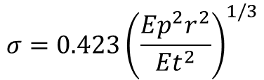




Maximum displacement on a thin and flexible membrane
Roark's Formulas for Stress and Strain for a thin flexible circular membrane
Deflection y (mm) (verify that $y>t/2$)
r = membrane radius (mm)
p = applied pressure (MPa)
E = Young’s modulus (MPa)
t = thickness (mm)
$$\frac{pr^{4}}{Et^{4}}=3.44{\left(\frac{y}{t}\right)}^{3}$$
$$y=0.662∙r{\left(\frac{pr}{Et}\right)}^{1/3}$$
Stress $σ$ (MPa) (verify that $σ<S$)
S = maximum allowed stress (MPa)
$$\frac{σr^{2}}{Et^{2}}=0.965{\left(\frac{y}{t}\right)}^{2}$$
$$σ=0.423{\left(\frac{Ep^{2}r^{2}}{Et^{2}}\right)}^{1/3}$$
$S =min\left(0.9·σ_{Y} ;0.5·σ_{U}\right)$ (Fermilab)

Slide 21











Maximum displacement on a thin and rigid membrane
Roark's Formulas for Stress and Strain for a thin rigid circular membrane
Deflection y (mm) (verify that $y>t/2$)
$v$ = Poisson’s ratio
$$\frac{pr^{4}}{Et^{4}}=K_{1}\frac{y}{t}+K_{2}{\left(\frac{y}{t}\right)}^{3}$$
$$K_{1}=\frac{5.33}{1−v^{2}}$$
$$K_{2}=\frac{2.6}{1−v^{2}}$$
with
Stress $σ$ (MPa) (verify that $σ<S$ at the edge)
$$K_{3}=\frac{2}{1−v}$$
at the center
$$K_{4}=0.976$$
$$\frac{σr^{2}}{Et^{2}}=K_{3}\frac{y}{t}+K_{4}{\left(\frac{y}{t}\right)}^{2}$$
with
$$K_{3}=\frac{4}{1−v^{2}}$$
at the border
$$K_{4}=1.73$$

Slide 22
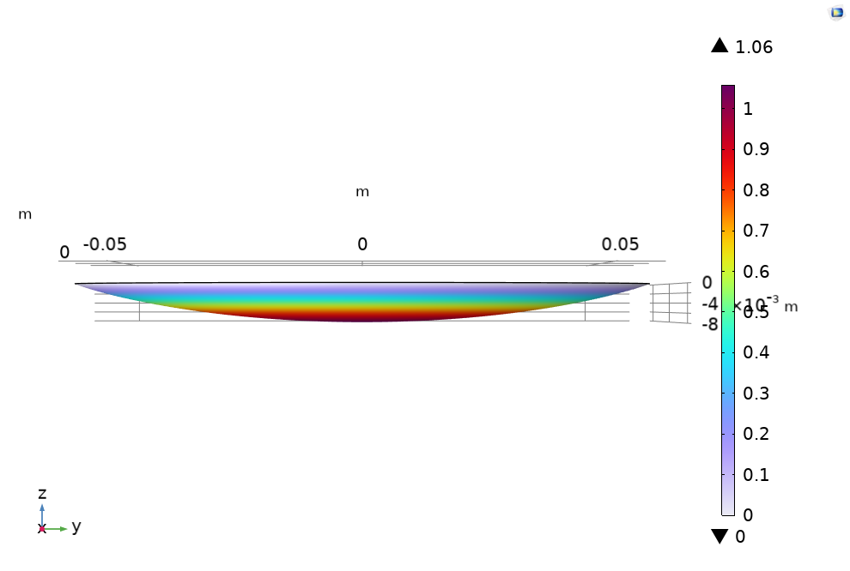




Maximum displacement on a thin and flexible membrane
Roark's Formulas for Stress and Strain for a thin flexible circular membrane
(under uniform pressure p)
r = 60 mm (membrane radius)
p = 4.21e-03 MPa (applied pressure)
E = 303 GPa (Young’s modulus)
t = 0.06 mm (membrane thickness)
Deflection y (mm) (verify that $y>t/2$)
$$y_{flexible}=0.948 mm$$
$$y_{rigid}=0.8170 mm$$
$y_{COMSOL}=$ 1.06 mm (linear elastic model under uniform pressure p)
The found deflection in the simplified model is roughly the same of the one found in the cavity window.

