Slide 1
Test facilities for RF cavities embedded in strong magnetic field
Dario Giove
INFN-LASA -Milano

Slide 2
Cooling Cell Scheme

Slide 3
Muon collider and RF system challenges
The main challenge of the Muon Collider is finite ~2us lifetime of the muons.
Normal conducting RF for capture and cooling
  High-gradient cavities in high magnetic field
  High charge, Huge beam size, Important beam losses
  Peak RF power
Everything must be fast ! ----------------------------------------→ High Gradient !!!

Slide 4
Cooling Channel
Objectives
The RF cavities for the cooling channel of the MuCol project require a medium/high electric field (nominally 28-30 MV/m) in high magnetic fields (13-15 T)
This call for a deep understanding of the breakdown phenomena in NC RF cavities taking into account the influence of the magnetic field
The subject is complicated by the wide range of conditions foreseen in the design and by the inherent difficulties of designing experimental test stands

Slide 5
State of the Art
Challenges:
High Gradient
High magnetic field
High radiation
Technology far from been common
Freq.
804 MHz
Freq.
800 MHz

Slide 6
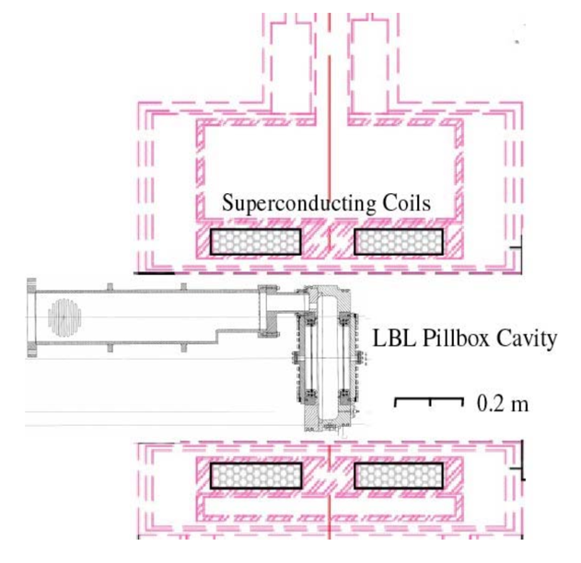
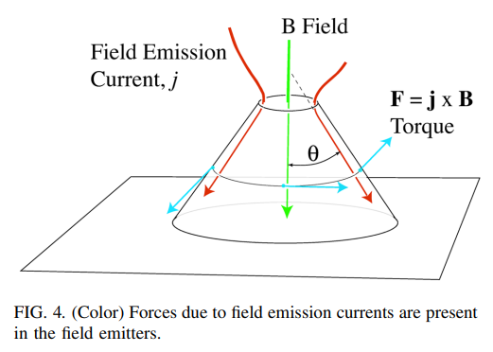

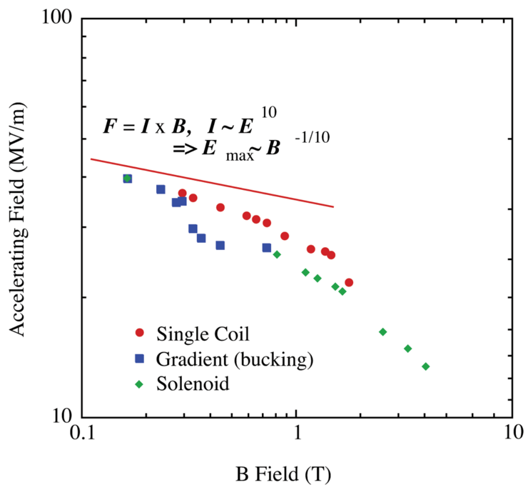
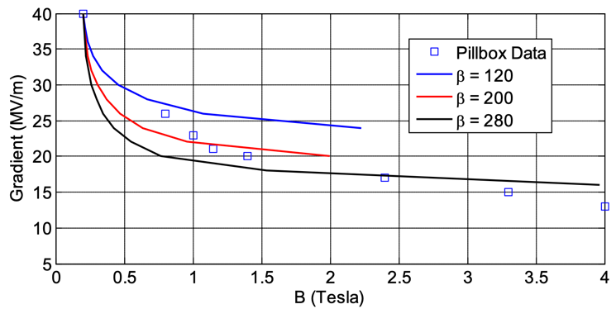
Initial Results for 805 MHz Pillbox
Moretti et al., Effects of high solenoidal magnetic fields on rf accelerating cavities, Phys.Rev.Acc.Beams 8, 072001 (2005)
Fowler-Nordheim Field Emission current:

Slide 7
Kilpatrick’s Criterion

Slide 8
Kilpatrick’s Criterion
1989

Slide 9
Kilpatrick’s Criterion

Slide 10
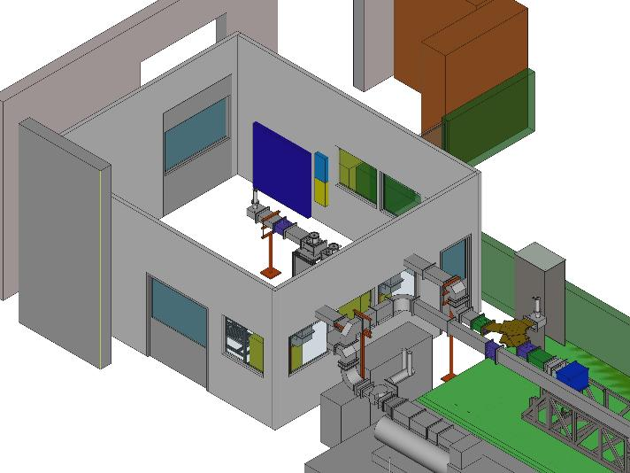
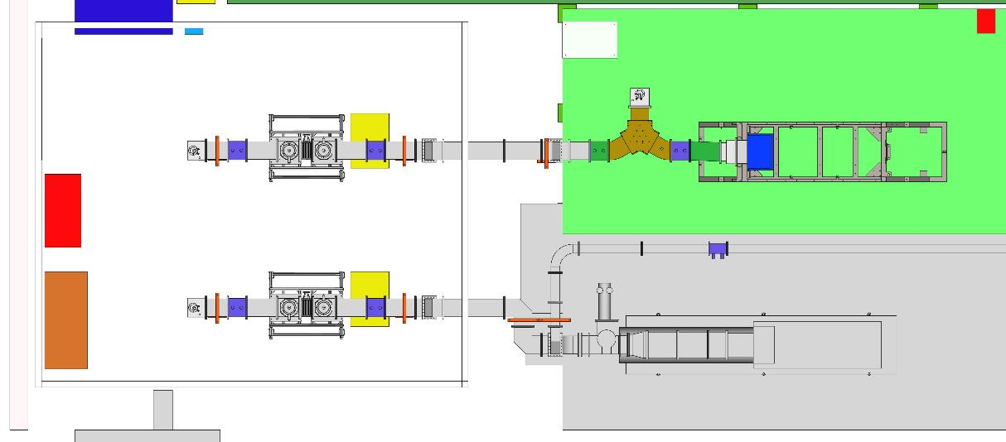
Test Stand Proposals: CEA
3D view
Top view
Thales 2182A 1.6 MW peak
CPI VKP7952A 1.2 MW peak
Miniboth (FPC test room)

Slide 11
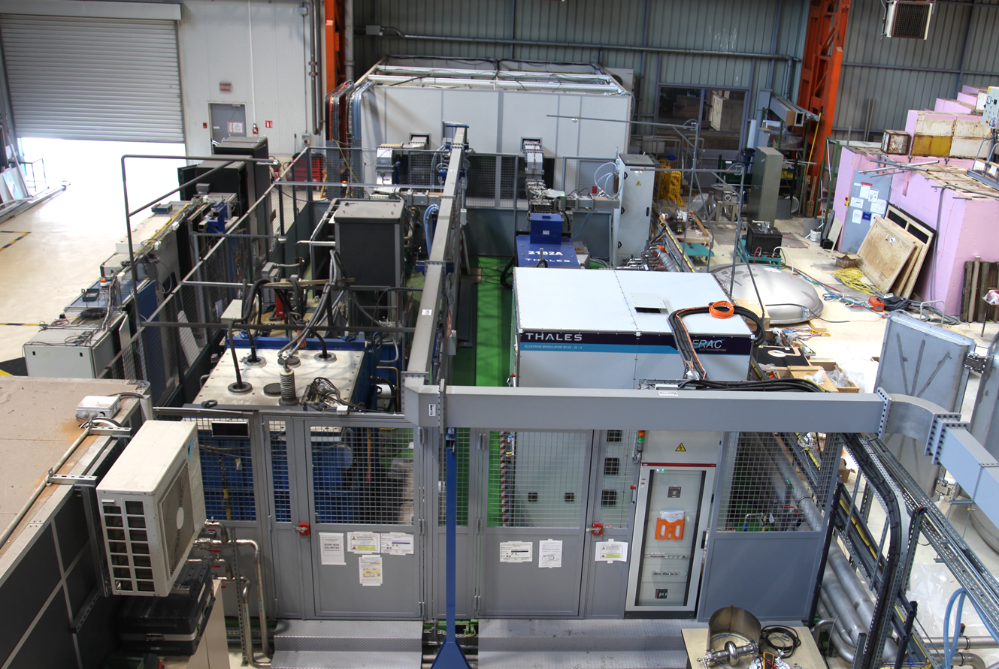
Test Stand Proposals: CEA
Miniboth (FPC test room)
CPI VKP7952A 1.2 MW peak
Thales 2182A 1.6 MW peak

Slide 12
Test Stand Proposals: CEA
To build
Already exists
Magnet
(MICE 4T)
Klystrons (f=704 MHz)
6m+4m
Thales 2182A 1.6 MW peak
2.8 MW
magic tee
CPI VKP7952A 1.2 MW peak
pulse compressor

Slide 13
Test Stand Proposals: CEA
Scenario for testing two 704 MHz prototype cavities for muon cooling at CEA
Tests up to 2-3 T, up to 50+ MV/m
using MICE solenoid (3T max, 2T max used at MICE, 47 cm bore)
Investment tasks and costs:
- refurbish the solenoid: 50 k€
- transport the solenoid: 50 k€
- solenoid cryogenics: 200 k€
- solenoid quench protection: 30 k€
- solenoid power supply: 70 k€
- construct a dedicated magnetically shielded bunker: 1 M€
- control room construction and equipment: 200 k€
- waveguide lines, circulators, loads, magic tee: 400 k€
- fabricate 2 cavities + pumping systems, input couplers, cavity holder: 300 k€
- pulse compressor R&D (prototype) and fabrication: 500 k€
- testing for 4 years (electricity, cryogenics, infrastructure depreciation): 100 k€
- total investment cost : 2.9 M€

Slide 14
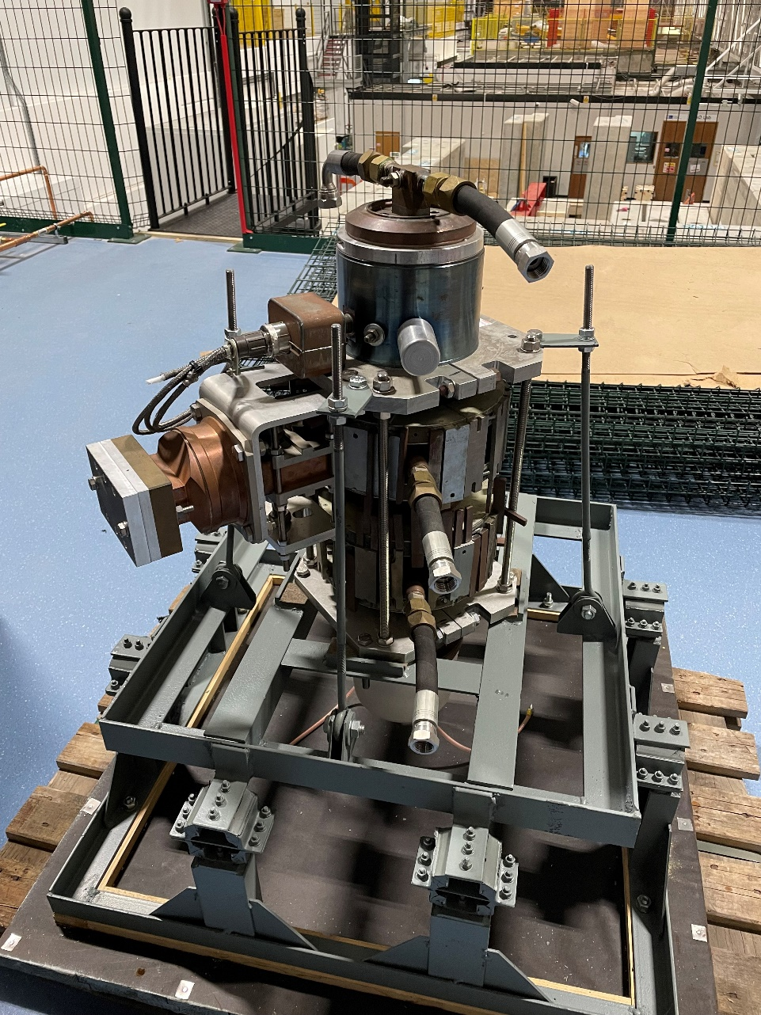
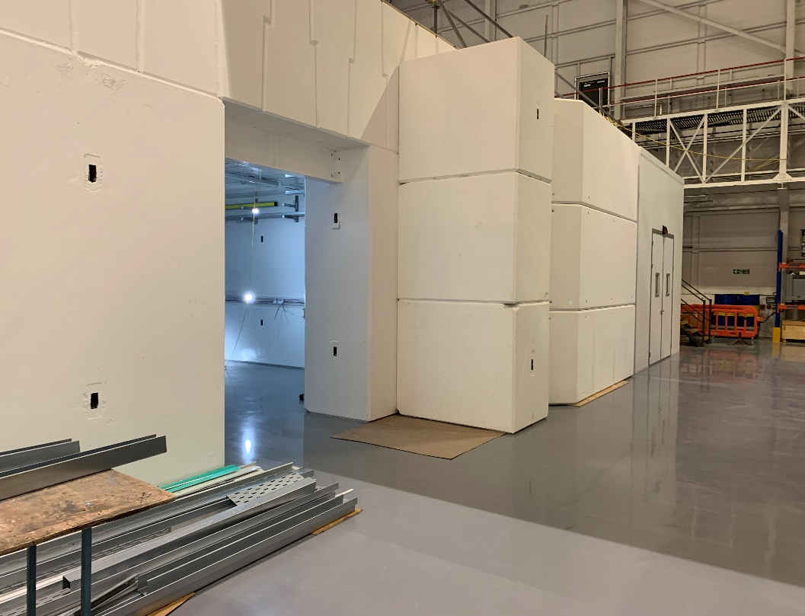
Test Stand Proposals: UK
Radiation test bunker complete and handed over
Have taken shipment of an 8 MW S-band klystron and modulator on loan from CERN.
Circulator also on site, awaiting some waveguide. System should be operating by summer 2024
Investigating the possibility of a SC magnet to do muon collider relevant research on breakdown in high magnetic fields

Slide 15
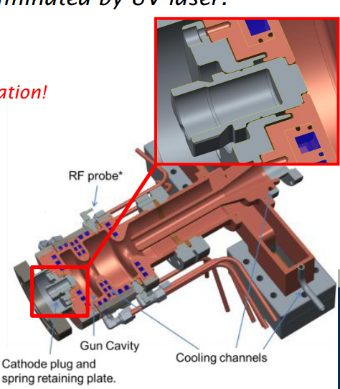
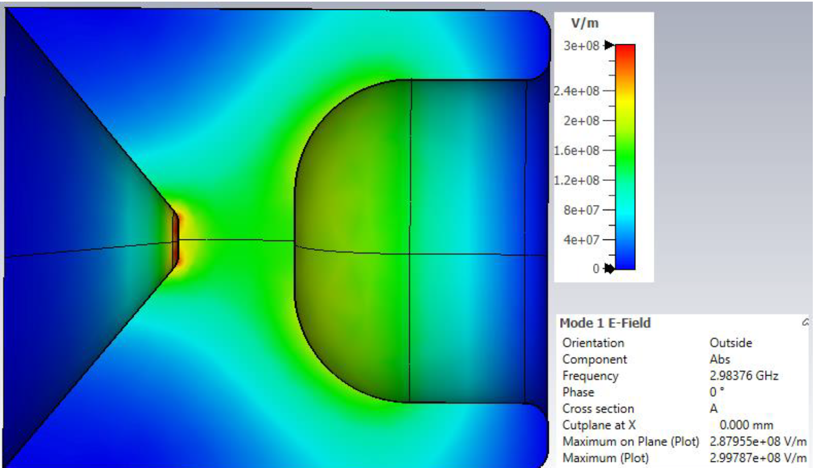
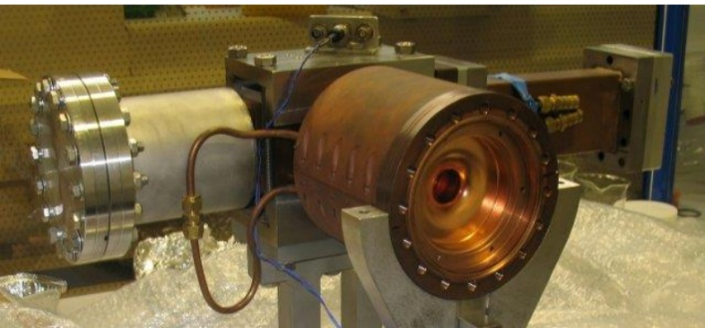
Test Stand Proposals: UK
Plan to replicate something like our RF guns where we have removable back plates or plugs
Can design to maximise peak fields on the removable part while keeping most of the cavity the same
Can test different materials, and fields
Possibility to test same sample with DC
As its only 3 GHz we can use a smaller bore magnet (~10-15 cm)
Have requested funds to manufacture this cavity in 2025.

Slide 16
Test Stand Proposals : INFN
We are in an advanced phase of design related to a couple of tests stands:
A DC HV test stand with pulsed capabilities embedded in 1 T magnetic field
A high power (10 MW) S band RF test stand to power a RF cavity installed in the bore of a SC magnet.
The DC Test Stand will be put into operation by the beginning of 2024 (orders are underway) in an existing experimental area @ LASA. This test stand is very similar in the basic design to a reference one designed and installed at CERN (S. Calatroni and the researchers of his group). We added the possibility to have a parallel magnetic field.
The S band RF test stand may be installed @ LASA (see final slides of this talk).

Slide 17
DC based experimental test stand
Why we are proposing to carry out tests in a DC based environment ?
Simple setup with respect to a RF based one
Tests faster and more flexible
Study on materials and surface treatments
Additional input for further RF based experimental campaigns
Field levels of the order of 100 MV/m (over max. 0.1 mm gp)
Energy similar to the one involved in RF
UHV conditions
BD initial phenomena very similar
We already have a possible setup (magnet @ 1 T with a 120 mm bore and HV power supplies, radiation detectors, experience on data and image acquisition and competence in material treatments )
study of innovative materials to create electrodes to be tested with a high DC static field in the presence of a magnetic field of at least 1 T or higher
study of surface finishing, coating and cleaning techniques for the above materials
DC high static field test in the presence of a magnetic field of at least 1 T or higher

Slide 18
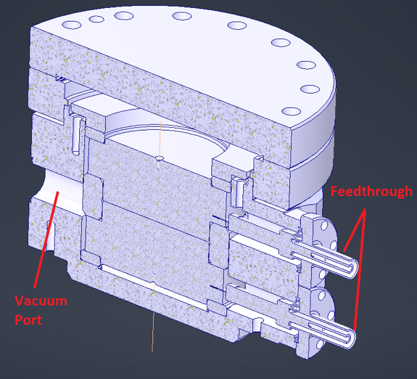
DC based LASA Test Stand
The PVX-4110 pulse generator is a direct coupled, air cooled, solid state half-bridge (totem pole) design, offering equally fast pulse rise and fall times, low power dissipation, and virtually no over-shoot, undershoot or ringing. It has overcurrent detection and shutdown circuitry to protect the pulse generator from potential damage due to arcs and shorts in the load or interconnect cable.

Slide 19
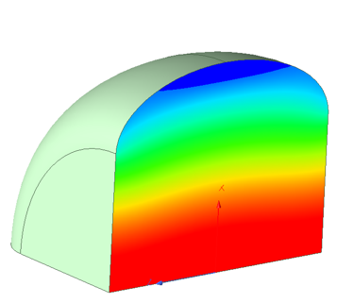
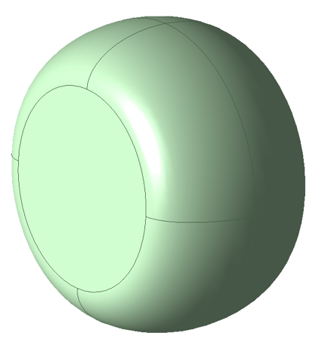
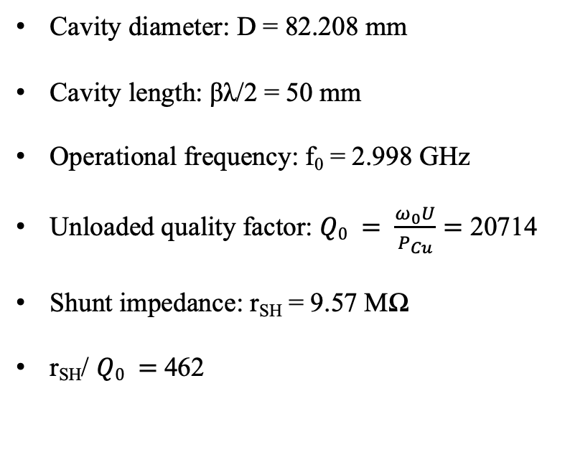
A 3 GHz Proposal for a LASA Test Facility
Cavity diameter: D = 82.208 mm
Cavity length: βλ/2 = 50 mm
Operational frequency: f₀ = 2.998 GHz
Unloaded quality factor: $Q0 = \frac{ω_{0}U}{P_{Cu}}=$ 20714
Shunt impedance: r_{SH} = 9.57 MΩ
r_{SH}/ $Q0 =$462
The simulated models consist of a vacuum volume with finite conductivity (copper) boundary condition

Slide 20
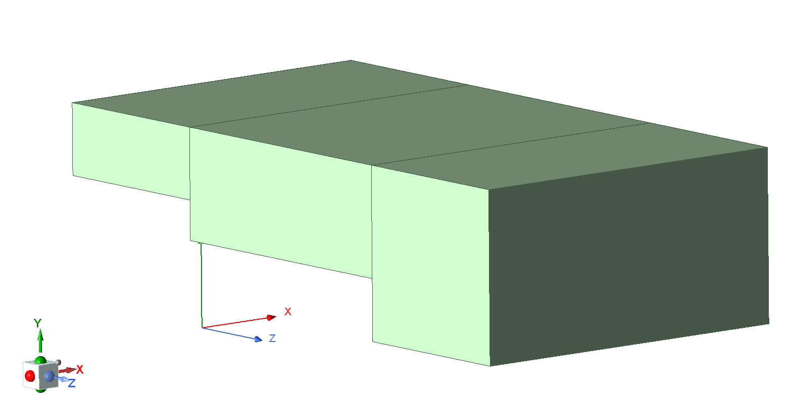
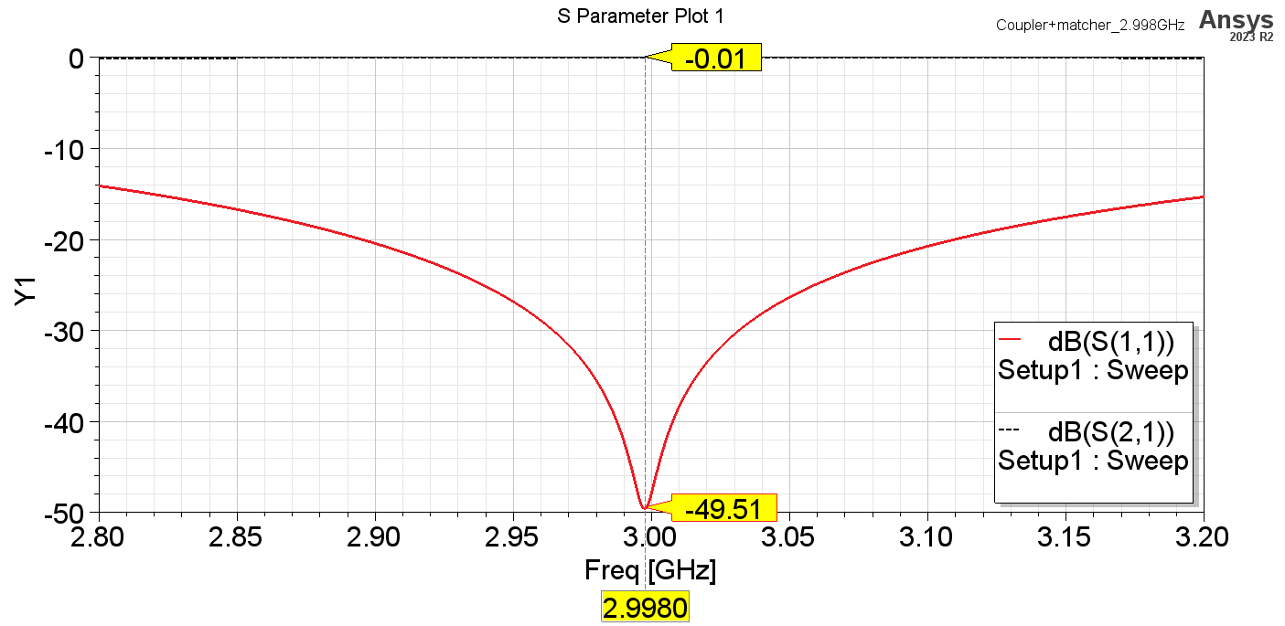
A 3 GHz Proposal for a LASA Test Facility
Waveguide coupler with standard WR229 input.
λ_{g}/4 central section in order to improve the matching between first and last sections.
λ_{g}/4
OUTPUT
WAVE-PORT

Slide 21
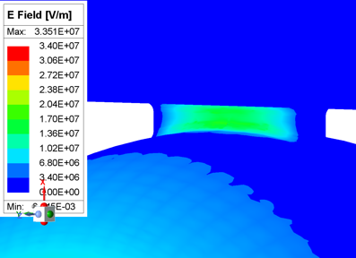
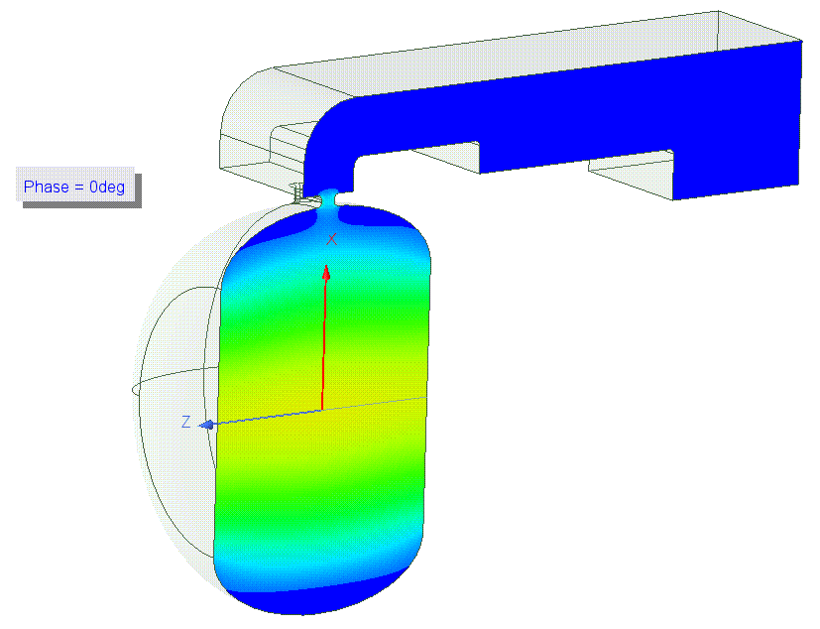
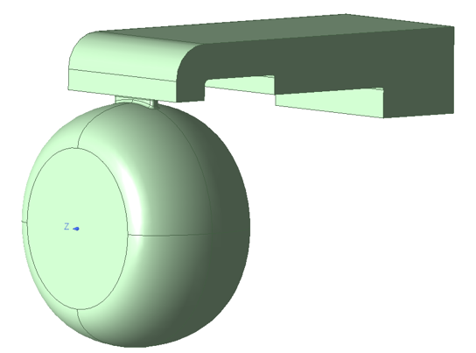
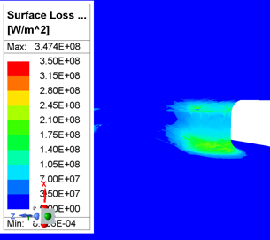
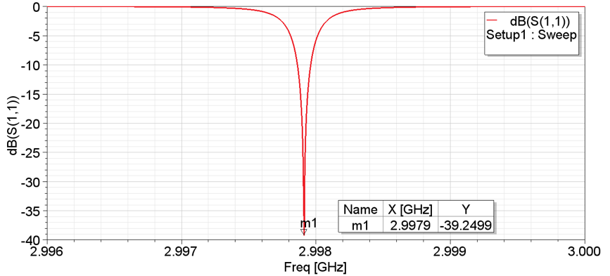
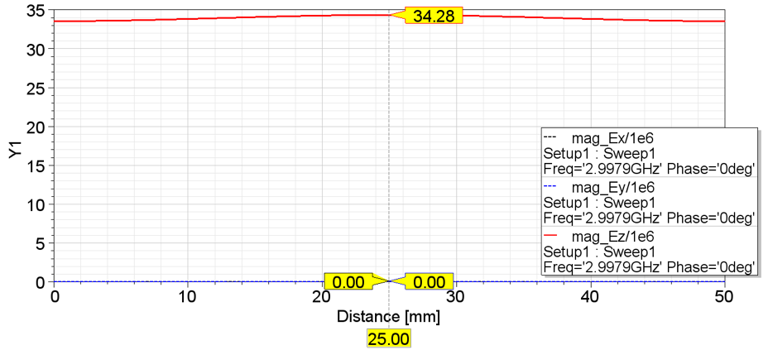
A 3 GHz Proposal for a LASA Test Facility

Slide 22
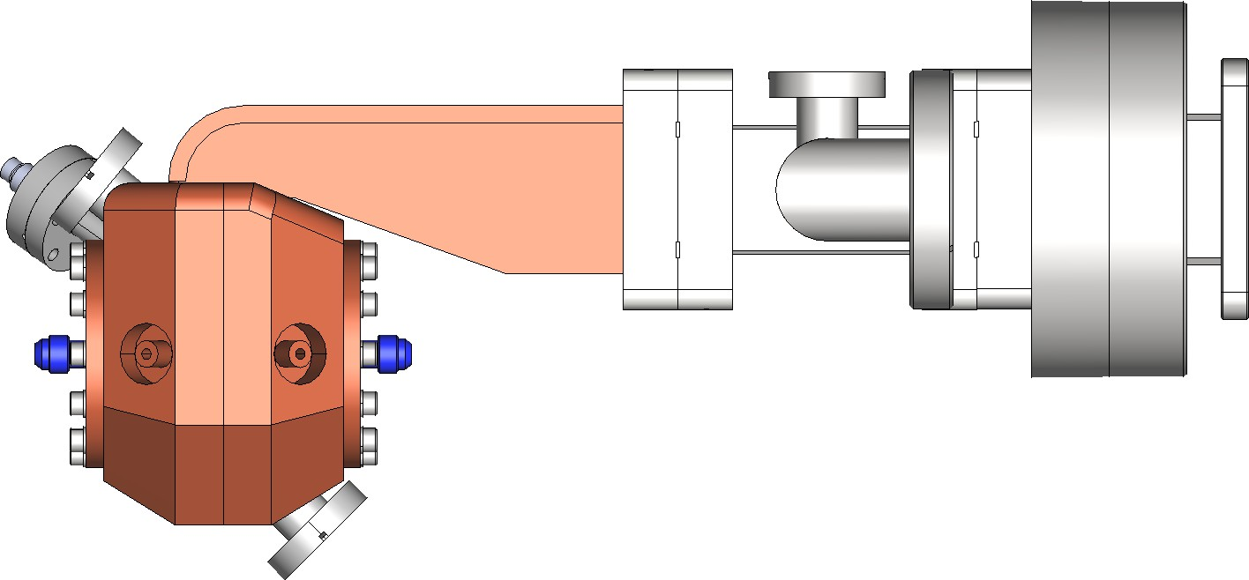
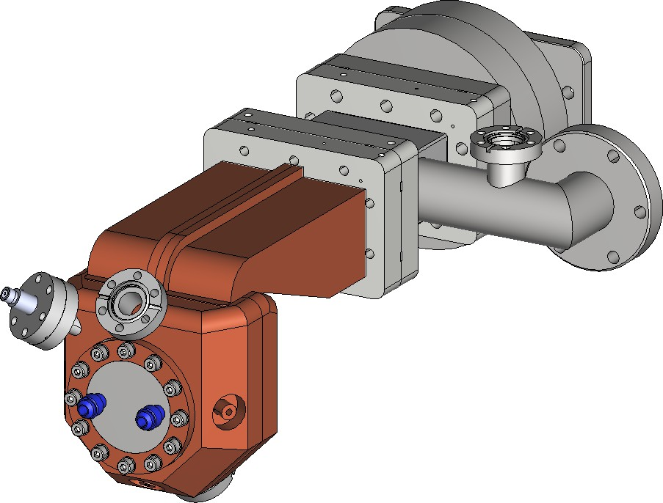
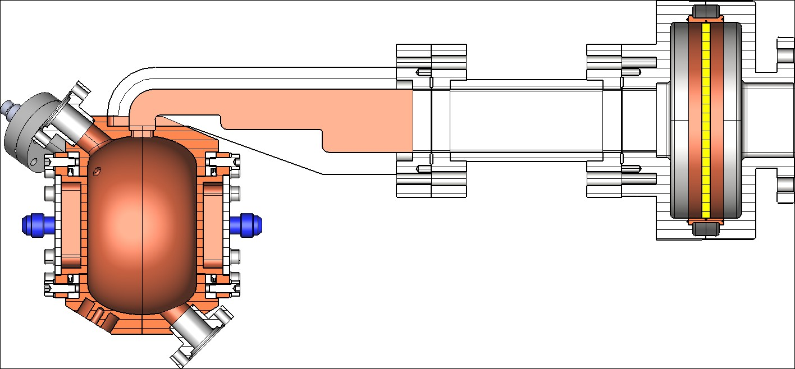
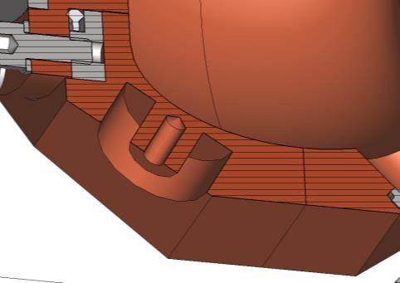
A 3 GHz Proposal for a LASA Test Facility
~ 364 mm

Slide 23
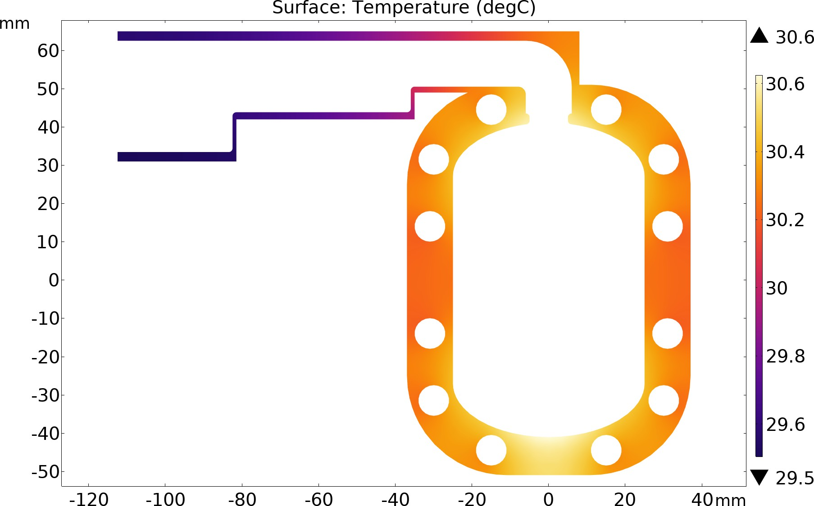
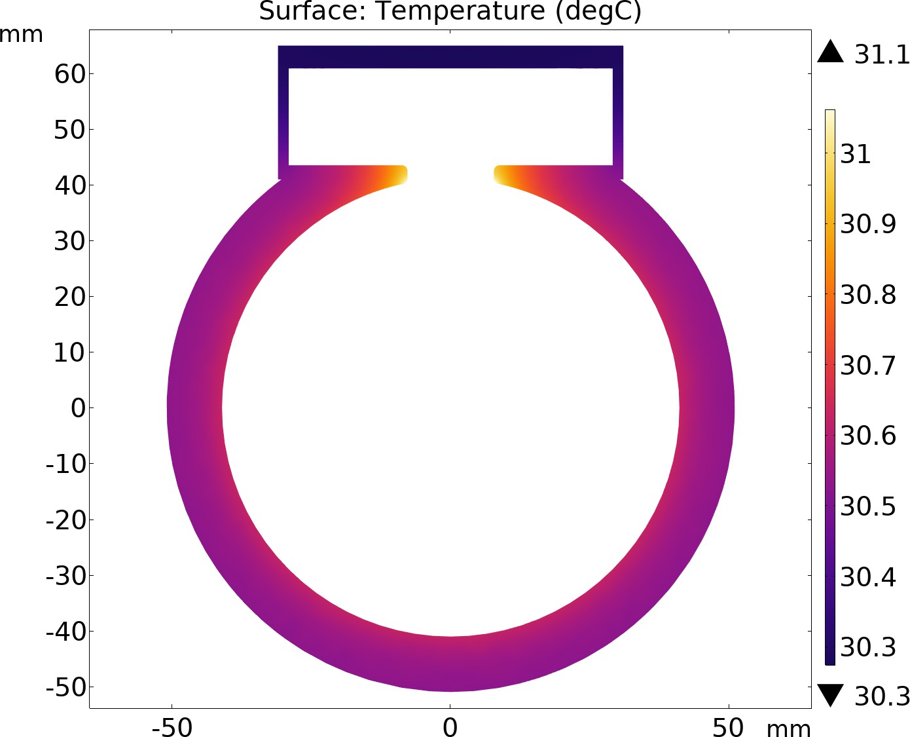
A 3 GHz Proposal for a LASA Test Facility
We considered a RF Duty Factor DF = 5e-4 (t_{pulse} = 5 µs, rep. rate = 100 Hz) → P_{avg} = 150 W
ΔT ~ 0.5 °C on cavity volume

Slide 24
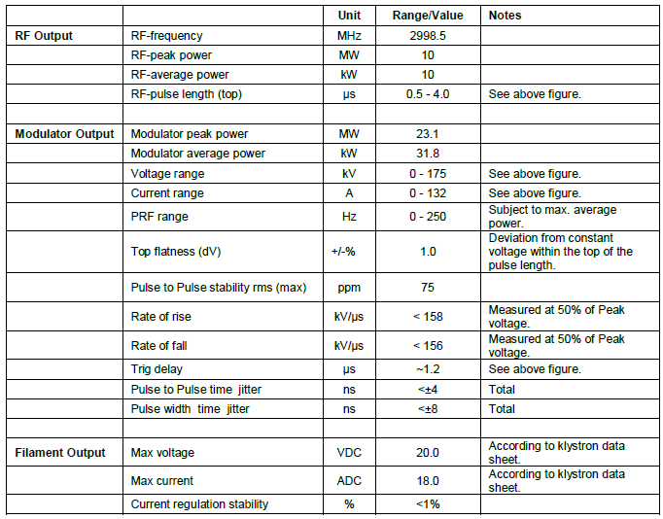
Scandinova and Canon Power Plant
5MW K100, PRF 100Hz and pulse length 2-3us, equipped with Canon E3779,B
Price of the order of 500-700 kEuro (+ taxes)

Slide 25
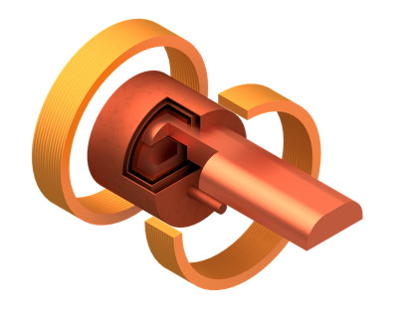
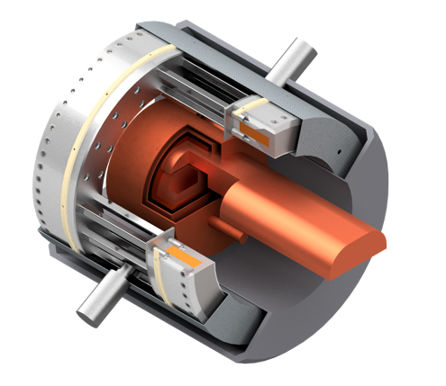
RF Cavity tested within a SC magnet
Two stage
cryocooler
SC HTS coils
Coil support structure
Thermal shield
Tie rods for repulsion and compression forces
Pillbox test cavity
RF Wave guide
Vacuum vessel
HTS coils
The construction of a test bed is an important push toward the definition of a baseline technology
Beside being a key tool for RF tests. However the first rough evaluation was in the 4 M€ range…
Courtesy of L. Rossi

Slide 26
RF Cavity tested within a SC magnet
Redesign to 350 mm free bore
  → coil dia. ∼ 400 mm
  → good for 3 GHz test or higher frequency
  7 T, parallele and antiparallel coil excitation
Try to optimize solution for cost saving
Redesign by end of 2023
  Conclude the 600 mm design
  Detailed design of the 350 mm → cost target < 2 M€
Courtesy of L. Rossi

Slide 27
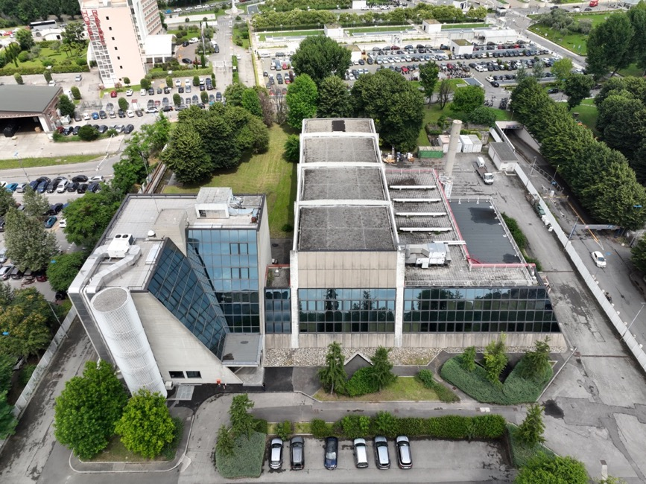
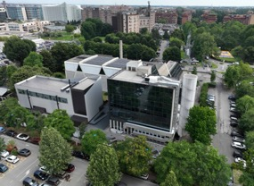
A 3 GHz Proposal for a LASA Test Facility
As part of the PNRR-IRIS program and with a significant specific contribution provided by the INFN in 2023, the construction of an extension based on two laboratories will begin within the LASA premises: one called SML (Superconducting Magnet Laboratory) and the other AATF (Advanced Accelerator Test Facility) for a total of 2100 m² spread over an underground bunker and two external floors.
These new laboratories will be available in 2025.

Slide 28
Thanks for your attention !

