Slide 1






RF breakdown studies:
Physical models and Experimental studies
Guillaume Ferrand
Claude Marchand
CEA Paris-Saclay
IMCC and Mucol Annual Meeting 2024
Funded by the European Union (EU). Views and opinions expressed are however those of the author only and do not necessarily reflect those of the EU or European Research Executive Agency (REA). Neither the EU nor the REA can be held responsible for them.

Slide 2
Outline
Issues of NC RF cavities break-down (BD) in magnetic fields
Model(s) that explain BD results in magnetic field
Existing experimental studies and further tests needed to consolidate simulations end explore new BD mitigation solutions

Slide 3
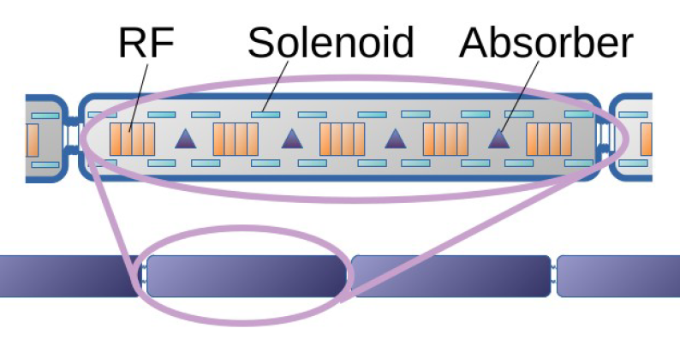
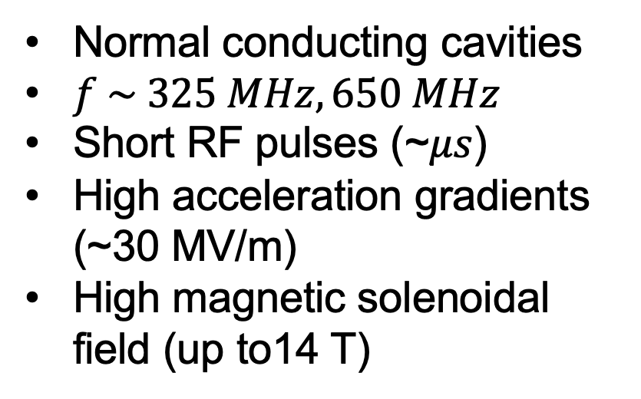
RF cavities for muon cooling cells
Normal conducting cavities
$f \sim 325 MHz, 650 MHz$
Short RF pulses (~𝜇𝑠)
High acceleration gradients (~30 MV/m)
High magnetic solenoidal field (up to14 T)
Creates problematics of break-down that needs to be mitigated

Slide 4
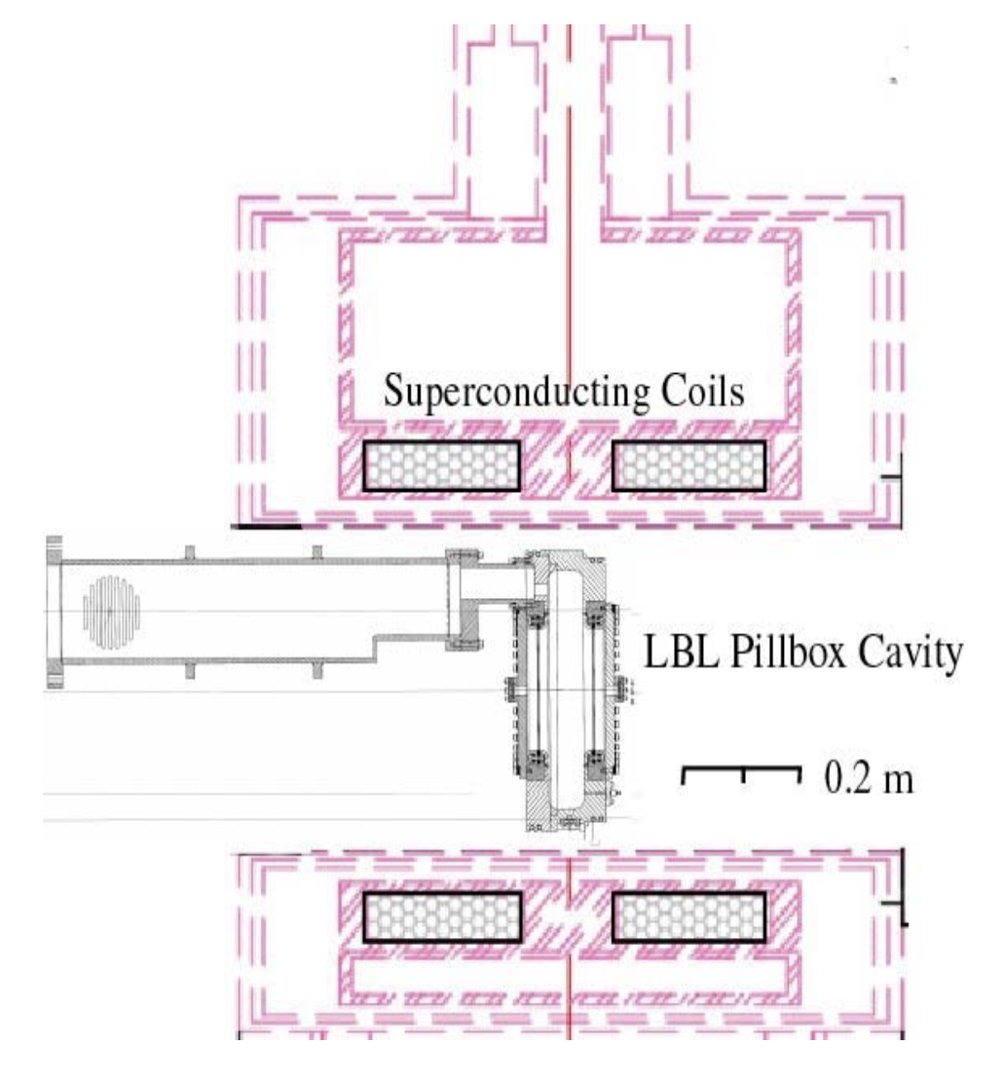
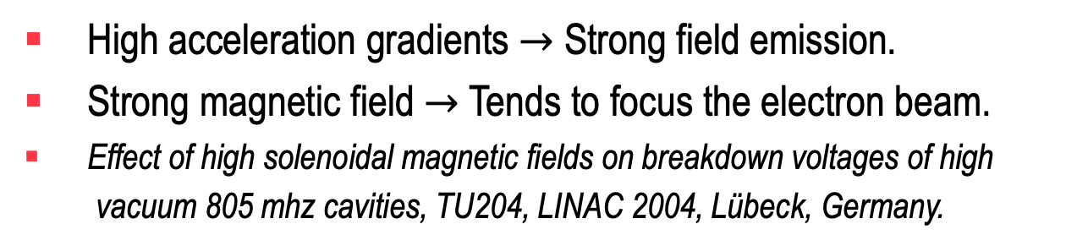
What is the issue with strong magnetic fields?
High acceleration gradients $→$ Strong field emission.
Strong magnetic field $→$ Tends to focus the electron beam.
Effect of high solenoidal magnetic fields on breakdown voltages of high
vacuum 805 mhz cavities, TU204, LINAC 2004, Lübeck, Germany.
A. Moretti et al., Phys.Rev.Acc.Beams 8, 072001 (2005)
Conclusion: « In general the breakdown limit is much lower when a solenoidal magnetic field is applied. In addition the dark current and x-ray emissions are much larger after the occurrence of sparking at very high electric and magnetic field levels […]. Even after long RF commissioning runs, the cavity does not return to the previous recorded low background level.

Slide 5
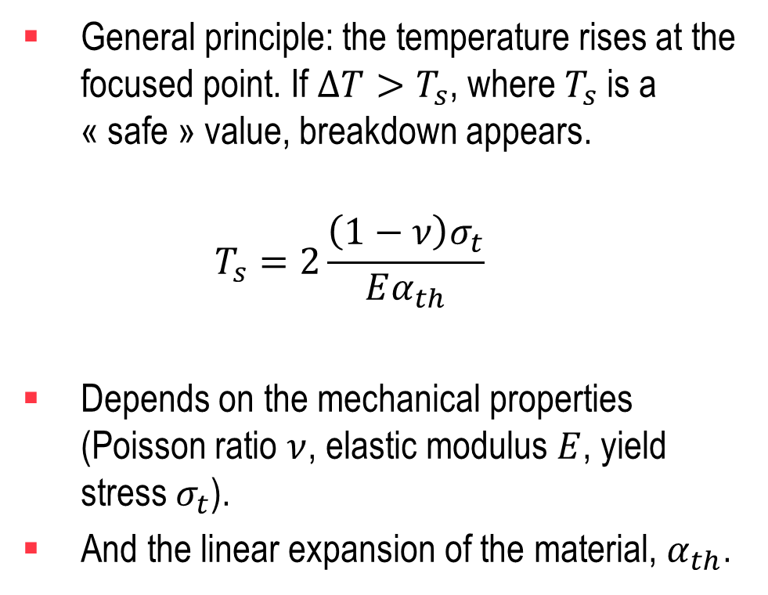
Some models to explain it
A thermal model was proposed by different laboratories:
  RB Palmer et al. RF Breakdown with external magnetic fields in 201 and 805 MHz cavities. PRAB, 12, 031002 (2009).
  D Stratakis et al. Effects of external magnetic fields on the operation of high-gradient accelerating structures, NIMA, 620, 147-154 (2010).
General principle: the temperature rises at the focused point. If $ΔT>T_{s}$, where $T_{s}$ is a « safe » value, breakdown appears.
  $$T_{s}=2\frac{\left(1−ν\right)σ_{t}}{Eα_{th}}$$
Depends on the mechanical properties (Poisson ratio $ν$, elastic modulus $E$, yield stress $σ_{t}$).
And the linear expansion of the material, $α_{th}$.

Slide 6

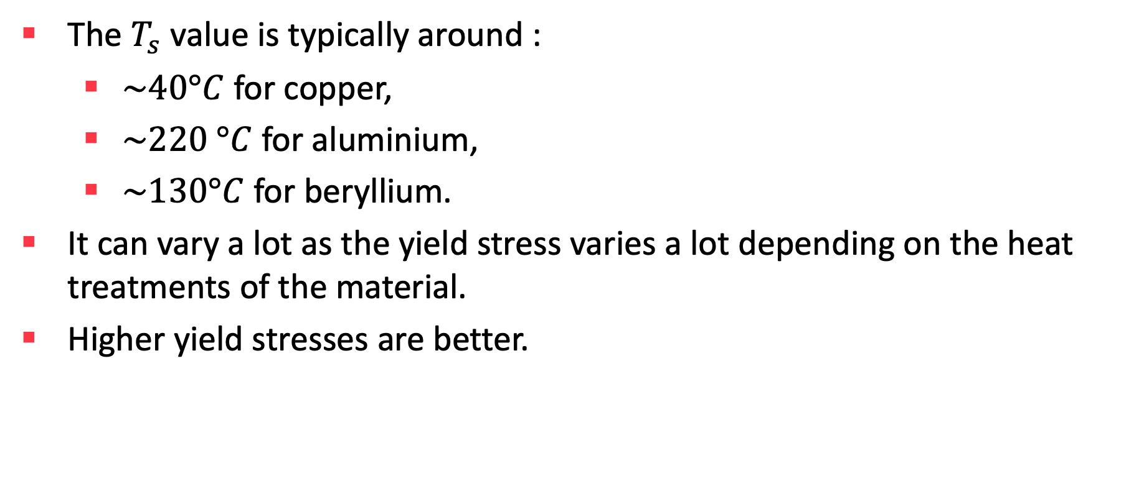
Typical $T_{s}$values.
The $T_{s}$ value is typically around :
  $\sim 40°C$ for copper,
  $\sim 220 °C$ for aluminium,
  $\sim 130°C$ for beryllium.
It can vary a lot as the yield stress varies a lot depending on the heat treatments of the material.
Higher yield stresses are better.

Slide 7
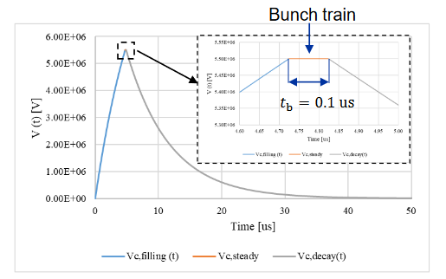
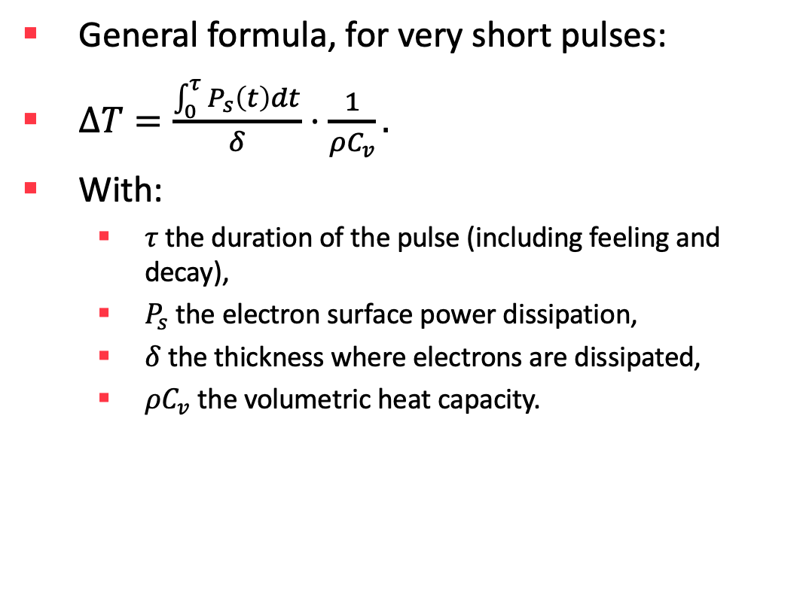
How to simulate the local temperature increase due to electrons?
General formula, for very short pulses:
$ΔT=\frac{\int_{0}^{τ}{P_{s}\left(t\right)dt}}{δ}⋅\frac{1}{ρC_{v}}.$
With:
  $τ$ the duration of the pulse (including feeling and decay),
  $P_{s}$ the electron surface power dissipation,
  $δ$ the thickness where electrons are dissipated,
  $ρC_{v}$ the volumetric heat capacity.
Typical RF pulse (credit C. Barbagallo)

Slide 8


Examples of electron dissipation
See V. Lazurik et al. « Average Depths of Electron Penetration: Use as Characteristic Depths of Exposure », IEEE Trans. Nuclear Science, June 1998.
$$δρ$$
The $δρ$ is around 0.2 $g/cm^{2}$

Slide 9
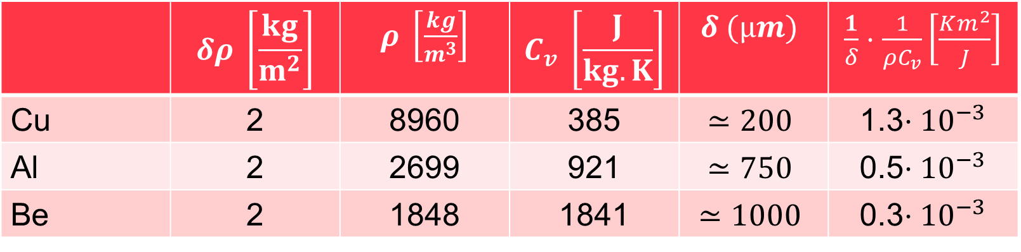

Typical values
If we consider a $δρ$ around 0.2 $g/cm^{2}$ ($2 kg/m^{2}$).
Beryllium is less affected than copper and aluminium for this $δρ$.
 | $$δρ \left[\frac{kg}{m^{2}}\right]$$ | $ρ \left[\frac{kg}{m^{3}}\right]$ | $$C_{v} \left[\frac{J}{kg.K}\right]$$ | $$δ (µm)$$ | $\frac{1}{δ}⋅\frac{1}{ρC_{v}}\left[\frac{Km^{2}}{J}\right]$
Cu | 2 | 8960 | 385 | $$≃200$$ | 1.3$⋅{10}^{−3}$
Al | 2 | 2699 | 921 | $$≃750$$ | 0.5$⋅{10}^{−3}$
Be | 2 | 1848 | 1841 | $$≃1000$$ | 0.3$⋅{10}^{−3}$

Slide 10

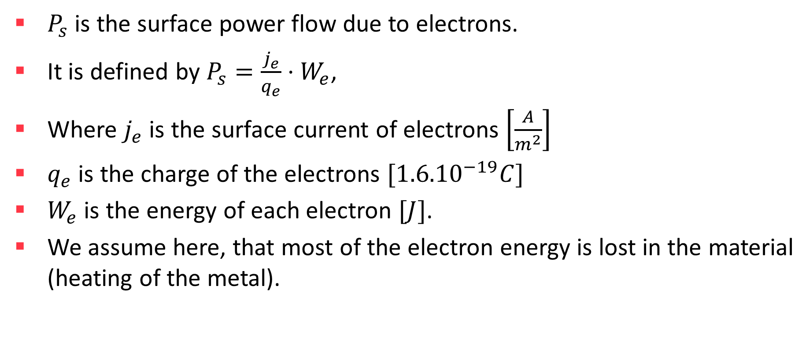
Calculation of $P_{s}$
$P_{s}$ is the surface power flow due to electrons.
It is defined by $P_{s}=\frac{j_{e}}{q_{e}}⋅W_{e}$,
Where $j_{e}$ is the surface current of electrons $\left[\frac{A}{m^{2}}\right]$
$q_{e}$ is the charge of the electrons $[{1.6.10}^{−19}C]$
$W_{e}$ is the energy of each electron $[J]$.
We assume here, that most of the electron energy is lost in the material (heating of the metal).

Slide 11


Calculation of $j$
In order to calculate $j$ at the emission point, we can use the Fowler-Nordheim equation (cf. D. Bowring, PRAB 23, 2020):

Slide 12
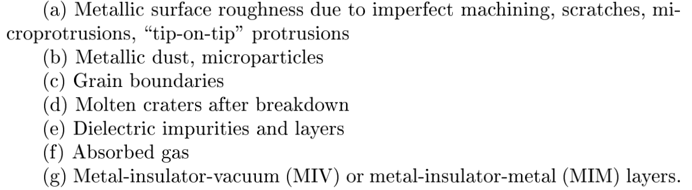
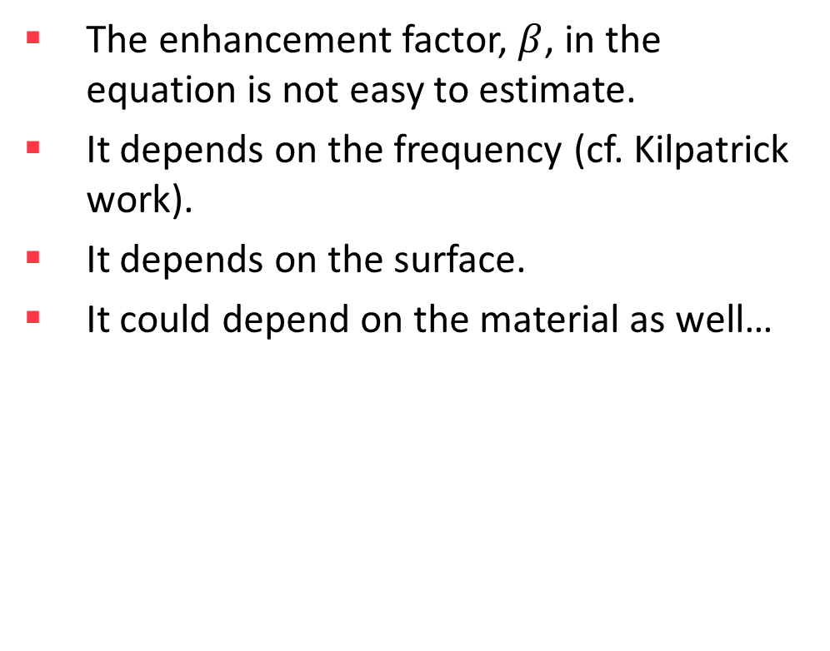
Enhancement factor
The enhancement factor, $β$, in the equation is not easy to estimate.
It depends on the frequency (cf. Kilpatrick work).
It depends on the surface.
It could depend on the material as well…

Slide 13
And what is the current on the opposite surface ?
It will depend, of course, of the trajectory of the electrons.
AND : the magnetic field decreases the dispersion of the electrons.
This leads to very hot spots on the opposite surface.

Slide 14
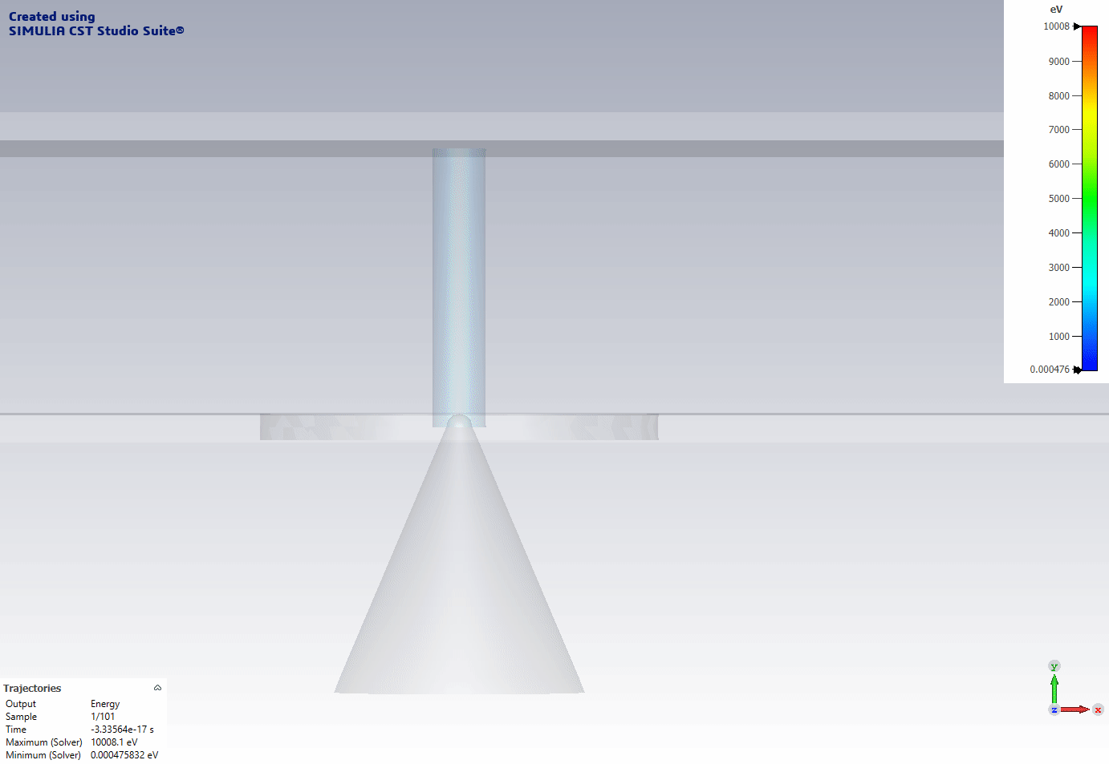
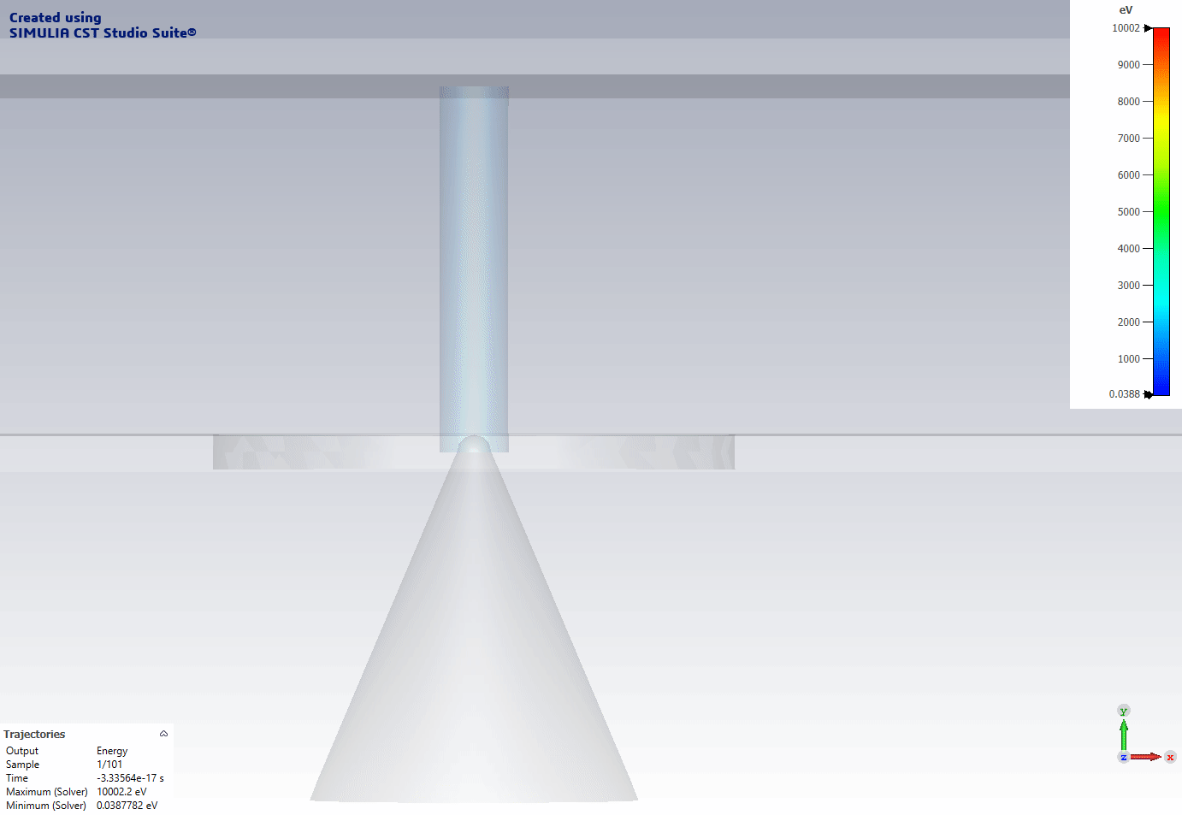
Simulation between two close plates with CST.
No magnetic field
With magnetic field
B field

Slide 15




Geometry of the cavity
$$\vec{B}$$
$$\vec{B}$$
$$\vec{B}$$
max
surface 2
surface 1
surface 1
surface 2
$$E$$
min
surface 1
surface 2
Elliptical.
Smaller emitting area.
Asymmetrical
Electrons are emitted by the high E field area of surface 1… and do not hit the high E field area of surface 2.
Pillbox. Large emitting area.
Electrons are emitted by the high E field area of surface 1… and hit the high E field area of surface 2.

Slide 16
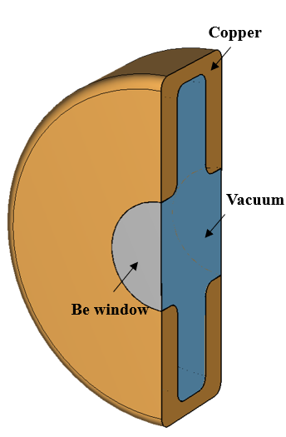
Direction of the B field
$$\vec{B}$$
$$\vec{B}$$
Cavity design for a cooling cell by C. Barbagallo.
max
surface 2
surface 1
$$E$$
min
surface 1
surface 2
Cavity with a beam tube.
A small B field angle can reduce the beamlet effect.
If the B field is not perfectly parallel to the beam axis, the problem is maybe less critical for « real cavities ».
Perfect pillbox with no beam tube.
A small B field angle does not really solve the issue.

Slide 17
Experimental study: D. Bowring, PRAB 23, 2020
Pillbox cavity at 805 MHz.
Max available gradient: 50 MV/m.
In a magnet field from 0 to 3.5 T. B-field parallel to Eacc.
Two walls in copper or beryllium.
Beryllium shows a higher « safe » Ts.
On the left: diagram of the experimental device.
On the right: predicted behaviour.

Slide 18
Conclusions
The beryllium cavity is significantly better than the copper cavity. And is not significantly affected by the magnetic field.
Magnetic field affects the trajectory of the electrons, as we can expect.
More details see K. Yonehara talk on Thursday
Results from Bowring et al. PRAB 23, 072001, 2020.
Magnetic field affects significantly the performances (breakdown probability) of the full copper cavity.

Slide 19
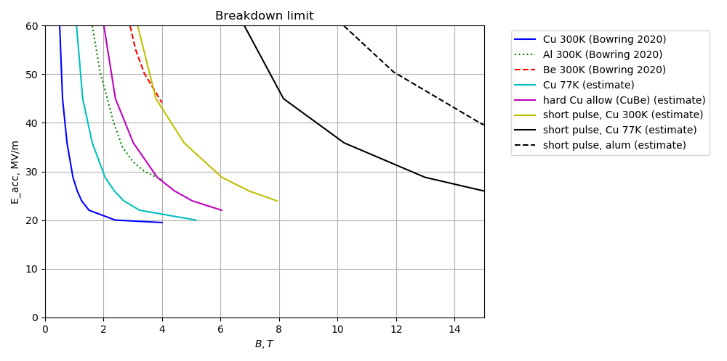
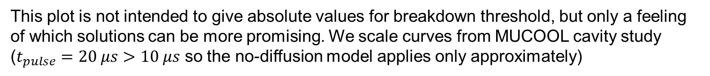
Comparing breakdown mitigation ideas
This plot is not intended to give absolute values for breakdown threshold, but only a feeling of which solutions can be more promising. We scale curves from MUCOOL cavity study ($t_{pulse}=20 μs$ $>10 μs$ so the no-diffusion model applies only approximately)
Benefits of short pulse and aluminum multiply
Aluminum cavity with a short pulse looks very promising

Slide 20
Further experiments
Points to be tested experimentally:
  What about very short pulses?
  What about the materials?
  What about the geometry of the cavity?
  What about cooling the cavity?

Slide 21
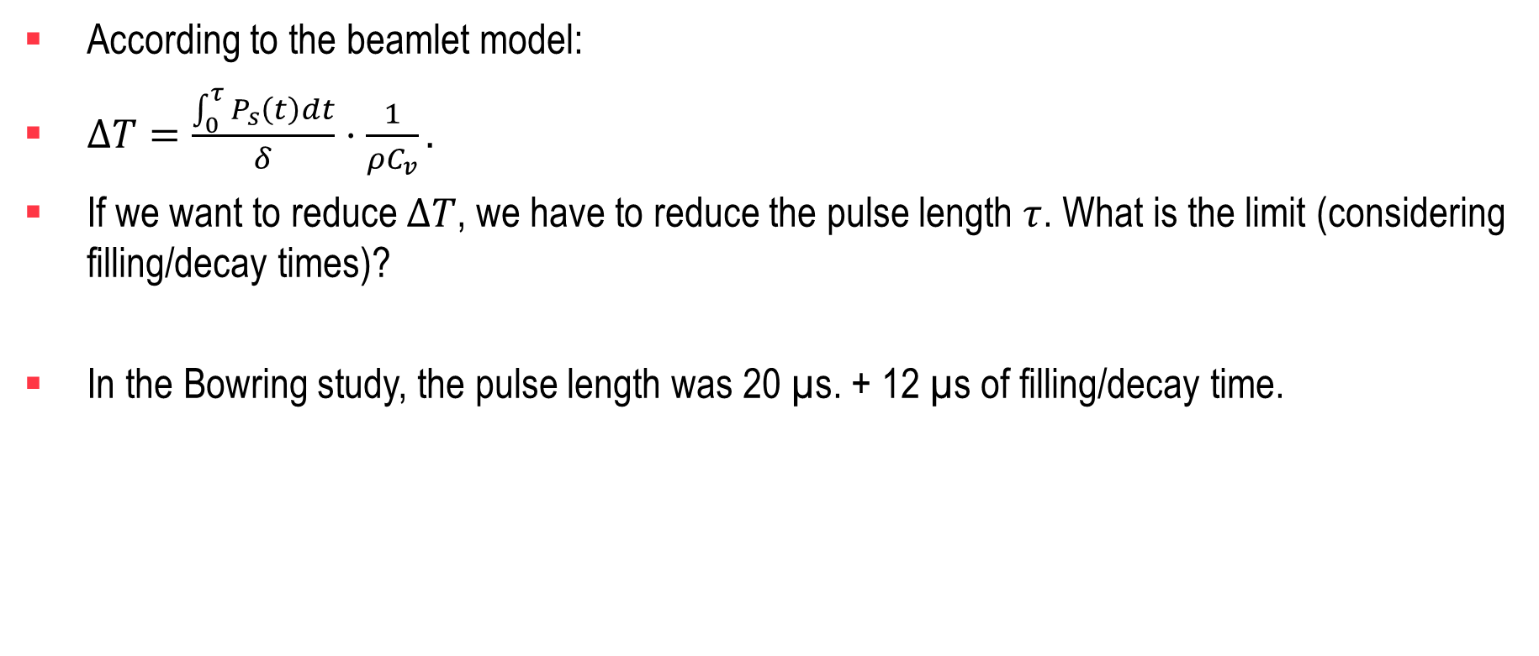
Discussion : short pulses
According to the beamlet model:
$ΔT=\frac{\int_{0}^{τ}{P_{s}\left(t\right)dt}}{δ}⋅\frac{1}{ρC_{v}}.$
If we want to reduce $ΔT$, we have to reduce the pulse length $τ$. What is the limit (considering filling/decay times)?
In the Bowring study, the pulse length was 20 µs. + 12 µs of filling/decay time.

Slide 22
Discussion : material
It seems clear that some materials are better than other ones.
Especially beryllium.
But:
  Toxicity: Very high. See Berylliosis. Chronic lung diseases due to beryllium poisoning.
  Well known carcinogen (CIRC 1).
Aluminium could be a compromise between copper and beryllium.
To be tested.

Slide 23
Multicell cavities
For multicell cavities, the B field shape can be different for each cell.
If the breakdown rate increase is highly dependent of the B field shape, maybe some cells will be affected, and some cells will not.
→Realistic BD simulations based on Comsol models must be integrated with cooling cell cavity design, in order to see if some shapes are « better » than others.
  Work in progress in collaboration between INFN/CEA/CERN (cf. J. Plouin talk).

Slide 24
Thank you
for attention

