Slide 1



IMCC & MuCol
Annual Meeting, CERN, 13.03.2024
First study of beam-beam interactions
Bernd Stechauner^{1,2}, Daniel Schulte² & Jochen Schieck^{1,3}
¹University of Technology, Vienna
²CERN, Geneva
³Institute of High Energy Physics (HEHPY), Vienna

Slide 2
Outline
Luminosity of a muon collider
Overview of final cooling
Effects of cooled muon beams on luminosities

Slide 3
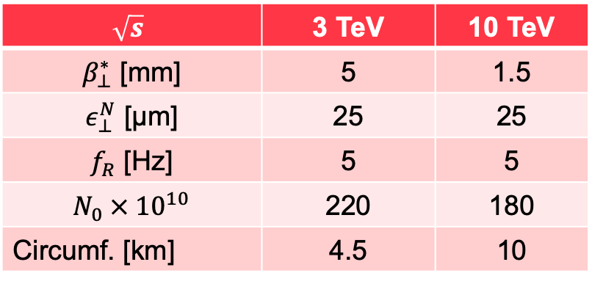
The Luminosity of a muon collider, round beam
*
[1]
[2]
Parameter list
$$\sqrt{s}$$ | 3 TeV | 10 TeV
$β_{⊥}^{∗}$ [mm] | 5 | 1.5
$ε_{⊥}^{N}$ [µm] | 25 | 25
$f_{R}$ [Hz] | 5 | 5
$$N_{0} × {10}^{10}$$ | 220 | 180
Circumf. [km] | 4.5 | 10
Requirements:
Small collider circumferences.
High beam intensities.
Small beam sizes at the interaction point (IP).
* Equation for one Experiment (i.e. one IP)

Slide 4
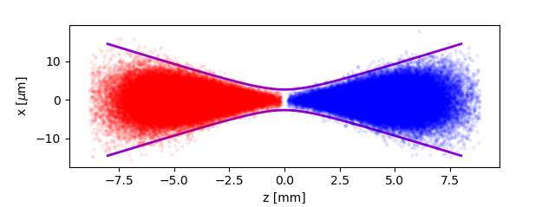
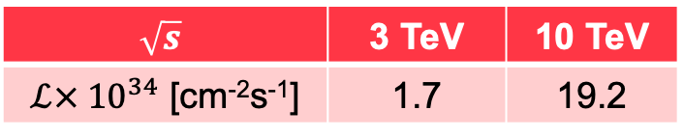
The Luminosity of a muon collider, Hourglass
[2]
The beam waist has the shape of an hourglass.
Not all muons collide at the IP
The luminosity reduces:
MC study:
$$\sqrt{s}$$ | 3 TeV | 10 TeV
$ℒ× {10}^{34}$ [cm⁻²s⁻¹] | 1.7 | 19.2

Slide 5
The Luminosity of a muon collider, Pinch effect
-
-
Two bunches with opposite charges approach each other and generate focusing forces.
These forces include electric and magnetic forces [4].
Synchrotron radiation is (almost) negligible due to the heavier mass of the muon (NO beamstrahlung assumed).
The center of mass energy at the IP remains constant.
The beam’s transverse size reduces, leading to a reduction of the luminosity
+
+
+
-
-
+
-
-
+
+
+
-
+
-
-
+
+
+
-
-
-
+

Slide 6
Beam-Beam simulations
[4,5] GUINEA-PIG*
PhD Thesis from D.Schulte.
Code recently modified for muons.
Simulates beam interaction of one single collision of two colliding beams.
Includes:
  Pinch effect
  Hourglass effect
  Beamstrahlung (negligible for this talk)
  Incoherent pair production (negligible for this talk)
  Etc.
*Generator of Unwanted Interactions for Numerical Experiment Analysis- Programme Interfaced with Geant

Slide 7
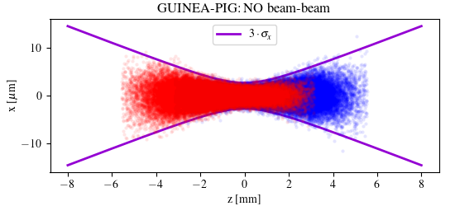

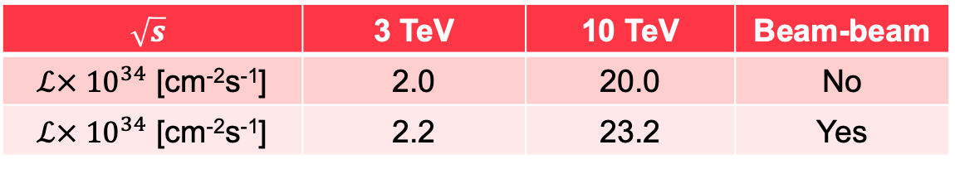


Pinch effect simulations
GUINEA-PIG comparisons: with and without beam-beam interactions at collision
$σ_{x,rms}=0.91$ µm
$σ_{x,rms}=0.88$ µm
$$\sqrt{s}$$ | 3 TeV | 10 TeV | Beam-beam
$ℒ× {10}^{34}$ [cm⁻²s⁻¹] | 2.0 | 20.0 | No
$ℒ× {10}^{34}$ [cm⁻²s⁻¹] | 2.2 | 23.2 | Yes

Slide 8
How do ionized cooled beams affect luminosities?

Slide 9
Overview of ionization cooling , Part I
Transverse momentum reduction:

Slide 10
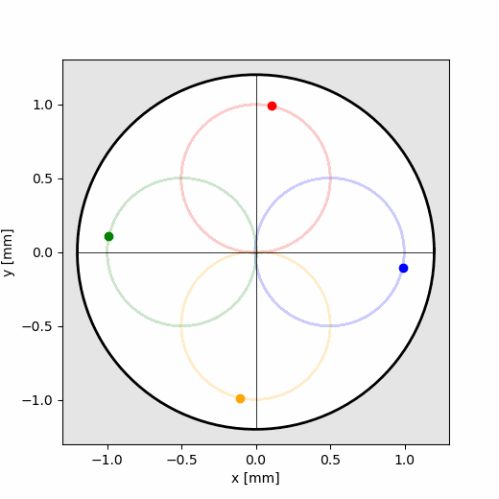
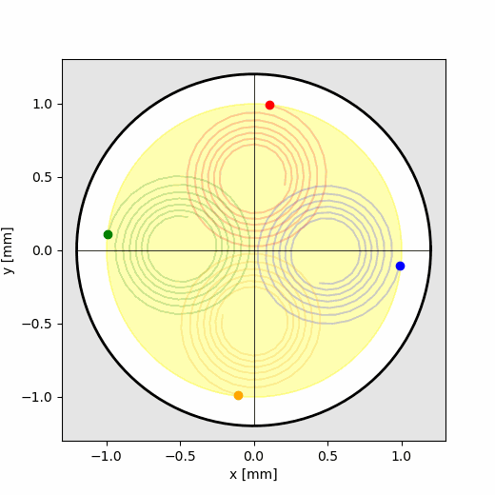
Overview ofionization cooling, Part II
Transverse offset reduction:
No absorber
With absorber
Particle trajectories in solenoids

Slide 11
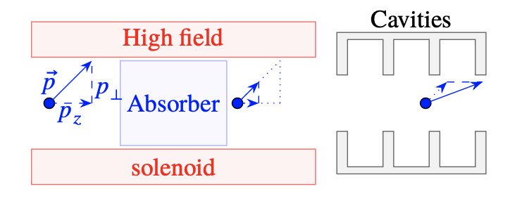
Liquid hydrogen as an absorber
The final cooling channel consists of approximately 8-14 cooling cells (studies and optimizations are ongoing, see also talk by E. Fol) https://indico.cern.ch/event/1325963/contributions/5792978/
Scatterings with nuclei causes emittance heating
Particles experience the least scattering in liquid hydrogen, which possesses high stopping forces.
…….
Simulation tools
Cell 1
Cell 2
Cell N
Tool to simulate ionization cooling at CERN: RF-Track
Physics interactions implemented and benchmarked with ICOOL & G4Beamline.
RF-Track employs a rapid Semi-Gauss algorithm for scattering, parameterized to the Wentzel scattering theory

Slide 12
Beam physics of MeV muons in matter
Benchmark of transvers scattering distributions*
Liq. Hydrogen
Bethe-Bloch
Tails in the longitudinal plane
Tails in the transverse plane
In the final cooling, the muon bunch develops tails in its phase space distribution.
*More information on my talk at Thursday : https://indico.cern.ch/event/1325963/contributions/5793008/

Slide 13
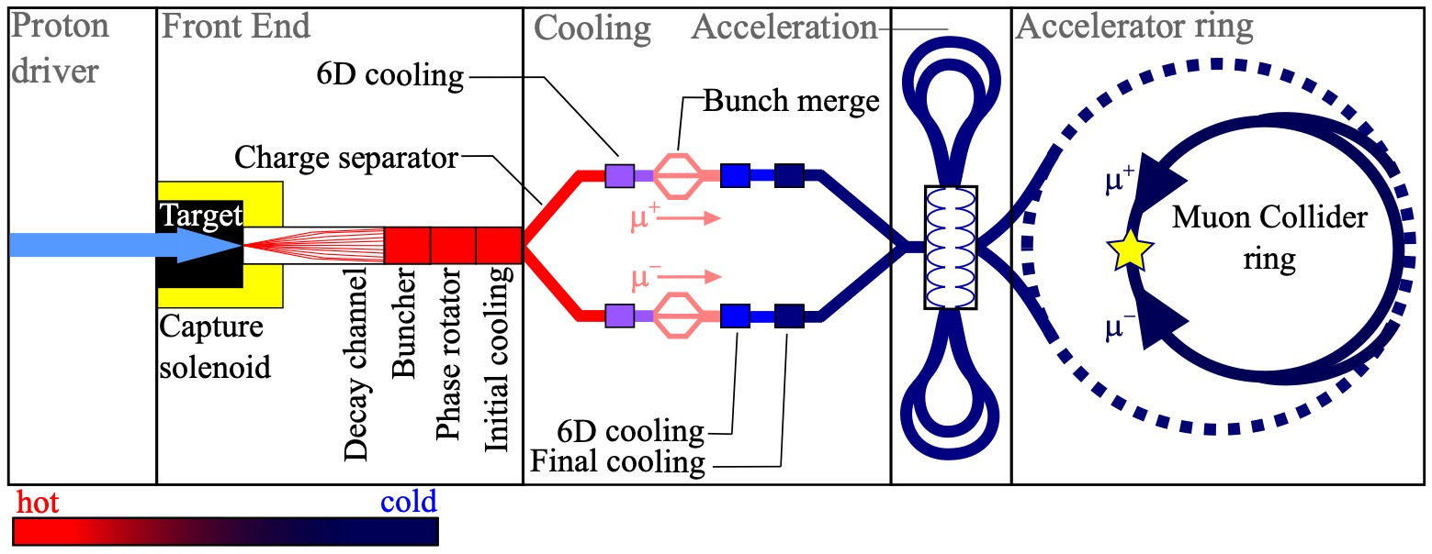
Muon collider complex
Final cooling
Interaction Point

Slide 14
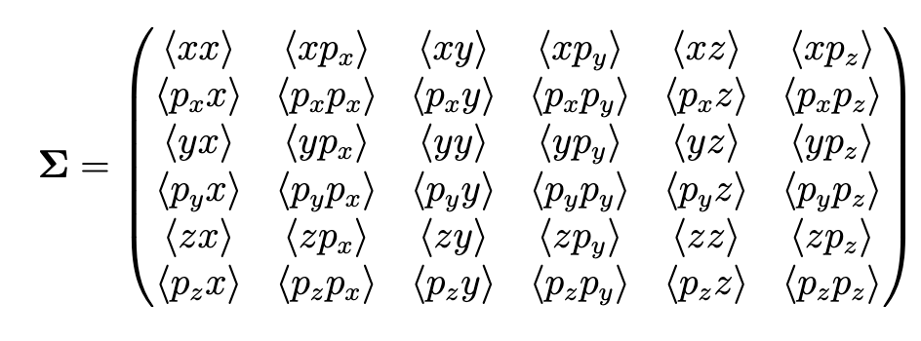
Bunch transformation: From cooling to IP
First step:
Decouple betatron coupling.
Decouple dispersive coupling.
This can be done numerically or analytically [6].
Second step:
Decouple correlation terms in each plane
Transformation into normalized coordinates
Rotation and back transformation in physical coordinates
Third step:
Lorentz boost from final cooling channel to interaction point

Slide 15
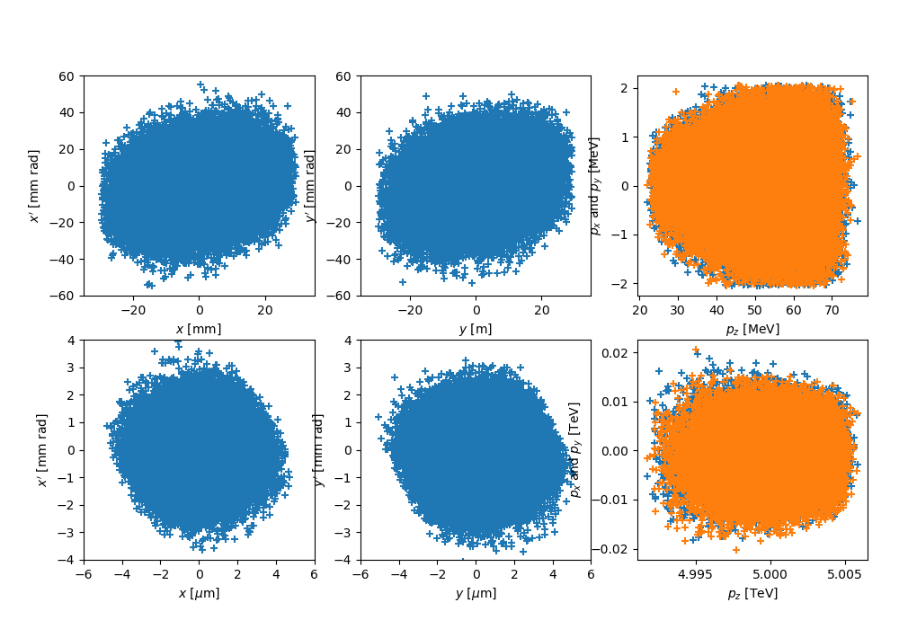
Phase spaces
After final cooling
@ IP

Slide 16
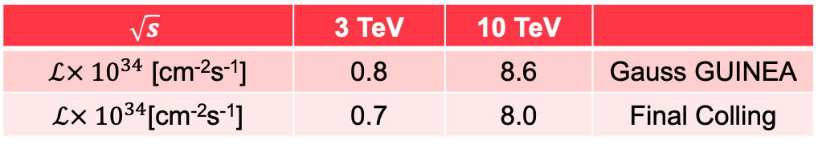


Impact of a cooled beam on the luminosity
Final cooling beam is not Gaussian.
This comes mostly from tail cuts.
The charge density is not centrally located.
Reduced pinch effects
Slightly smaller luminosity
Luminosity comparison:
The optimizing of final cooling is an ongoing process.
For example:
$ε_{⊥}^{N}=60$ µm
$ε_{L}^{N}=30$ mm
$$\sqrt{s}$$ | 3 TeV | 10 TeV
$ℒ× {10}^{34}$ [cm⁻²s⁻¹] | 0.8 | 8.6 | Gauss GUINEA
$ℒ× {10}^{34}$[cm⁻²s⁻¹] | 0.7 | 8.0 | Final Colling

Slide 17
Conclusion
First beam-beam collision studies for muon colliders were performed.
  Beamstrahlung is negligible due to the muon mass for luminosity calculations.
  The hourglass effect and pinch effect provide a realistic description of the luminosity.
The beam distributions from the final cooling channel are not Gaussian.
This is a result of beam-matter interactions from ionization cooling.
This effect reduces the Luminosity of a few percent compared to Gaussian beams

Slide 18
Outlook
Investigate the final cooled beam’s behavior under various emittances.
Assess the impact of integration of beam windows into the final cooling section on the luminosity performance.
Examine how the presence of hydrogen gas absorbers at final cooling affects luminosity? [7]

Slide 19
References
[1] B. Stechauner, Master Thesis, 10.34726/hss.2022.97540
[2] IMCC parameter list, https://cernbox.cern.ch/s/NraNbczzBSXctQ9
[3] W. Herr, https://www.cockcroft.ac.uk/wp-content/uploads/2014/12/luminosity-werner.pdf
[4] D. Schulte, PhD Thesis,
[5] https://gitlab.cern.ch/clic-software/guinea-pig
[6] M. Pivi, https://uspas.fnal.gov/materials/11ODU/Beam-Beam.pdf
[6] Schur decomposition: https://en.wikipedia.org/wiki/Schur_decomposition
[7] B. Stechauner, Thermodynamicl characteristics of hydrogen absorbers in an ionization cooling channel for muon colliders, IPAC2023, Venice

Slide 20

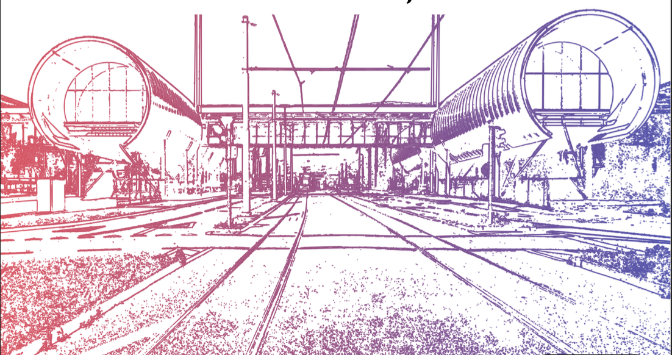
Thank you for your attention

