Slide 1

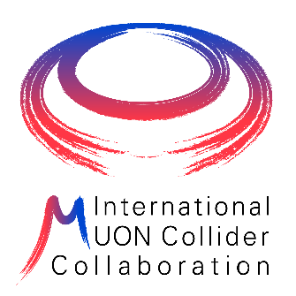

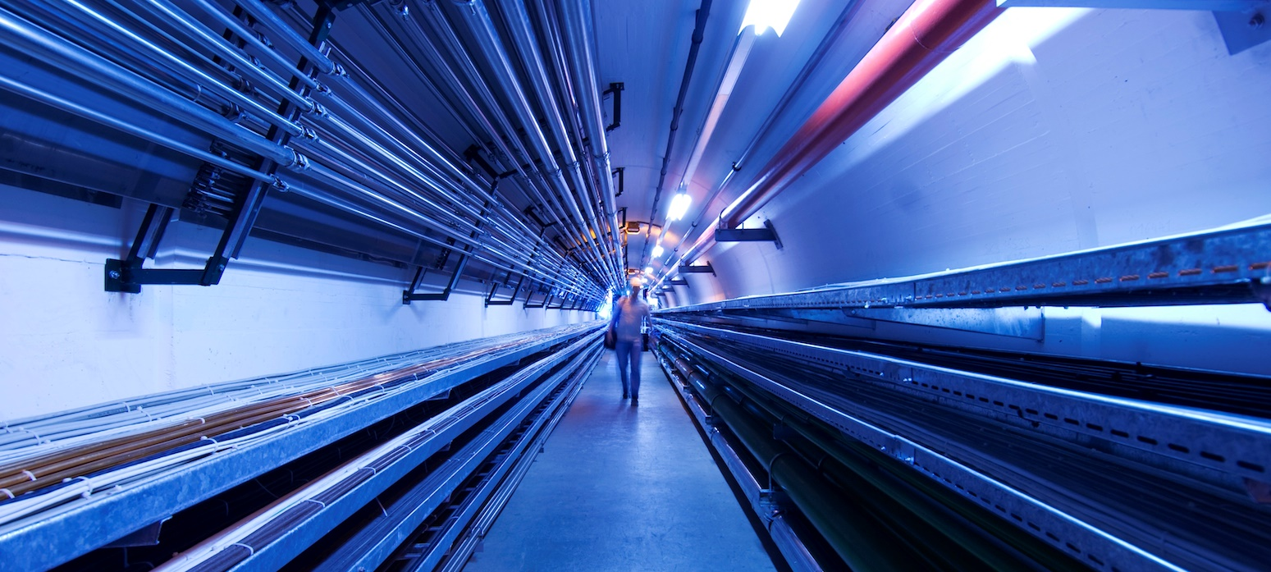
GeoProfiler: Tool for siting and locating neutrino flux
C. Desponds, Y. Robert
14/03/2024

Slide 2
The GeoProfiler Tool
Goal: Exploratory analysis of particle accelerator scenario feasibility and impact
Input
Accelerator Scenario
Geological data
Geodetic and Geographical data
Radiological data
Positioning parameters (editable)
Output
Geological analysis (construction effort, risk, …)
Radiological analysis (neutrino flux, dose, …)
Environmental analysis (protected zones, …)
Land analysis (jurisdiction, urbanization, …)
…
Exploratory: fast iterative studies to help guide expensive in-depth efforts
Data-rich environment to inform decision, planning and presentation
Configurable, Interactive and Responsive

Slide 3
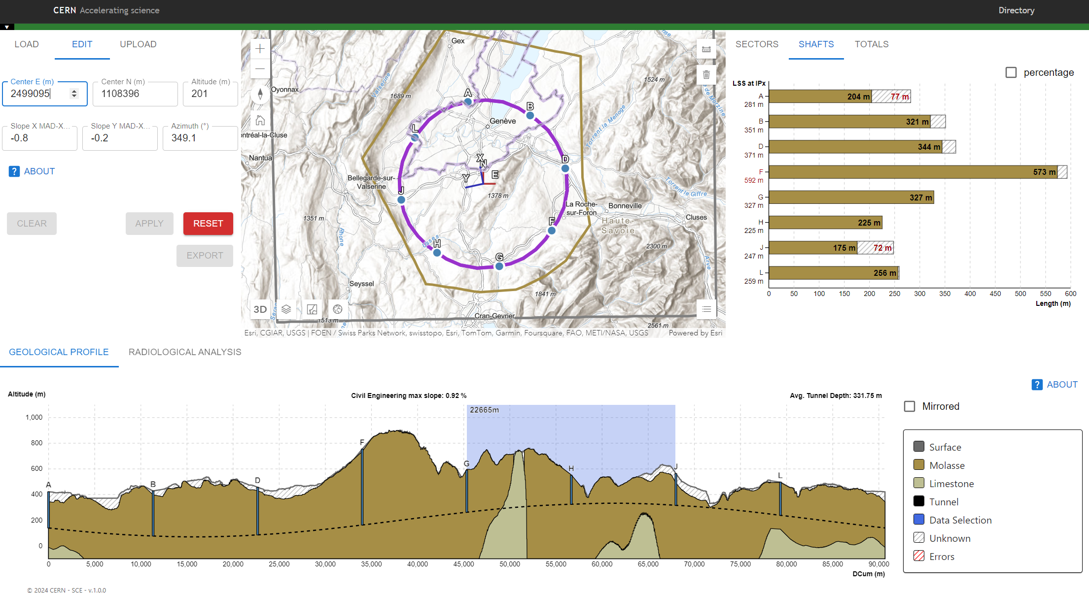
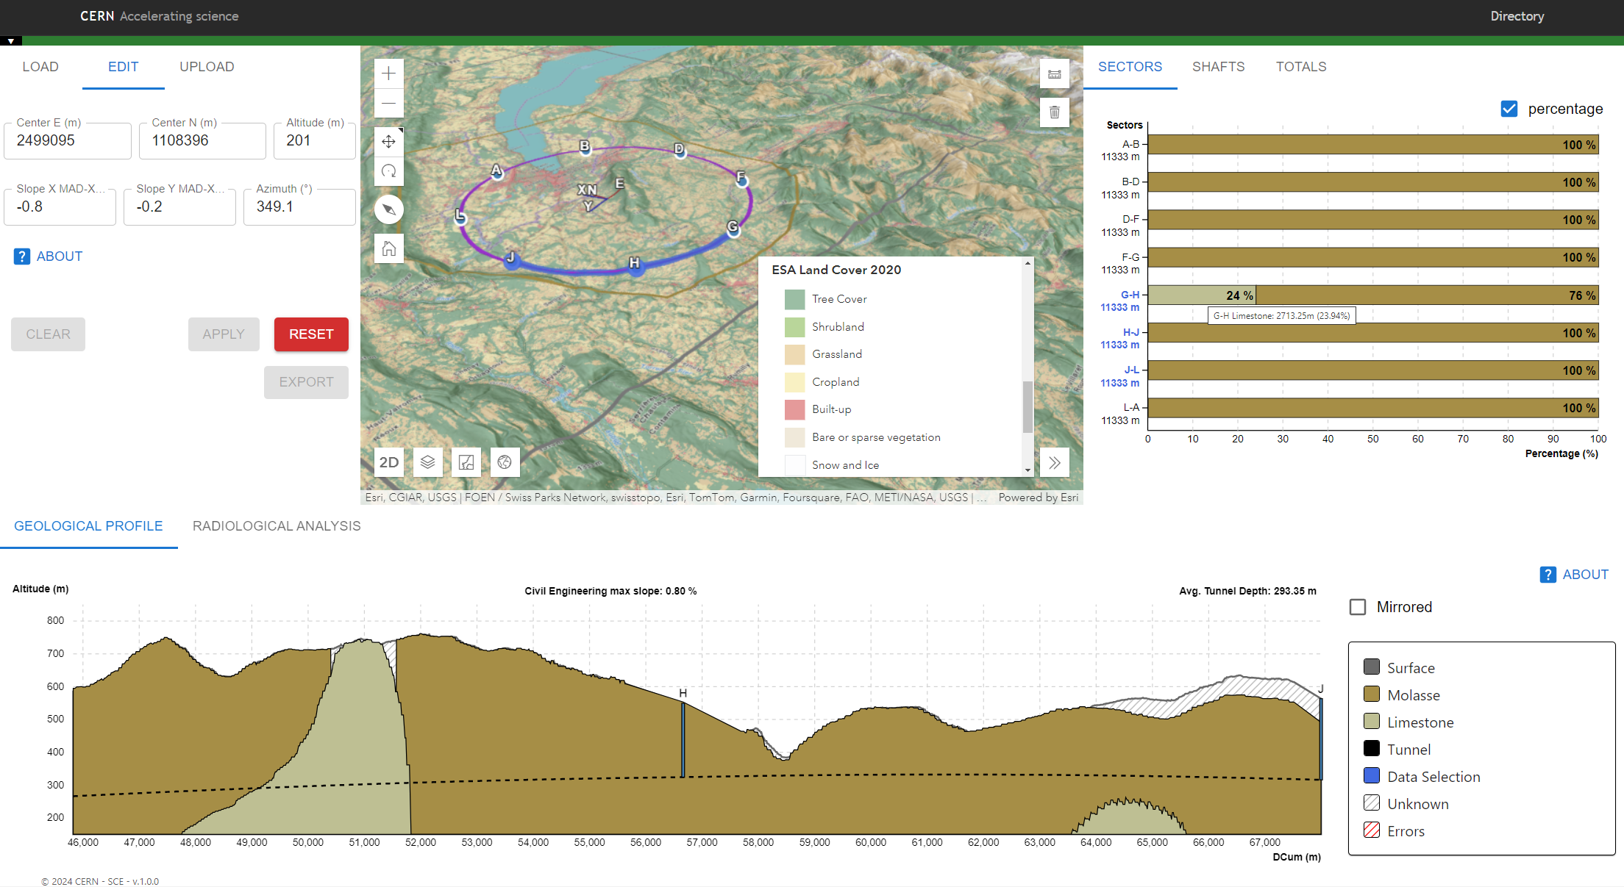
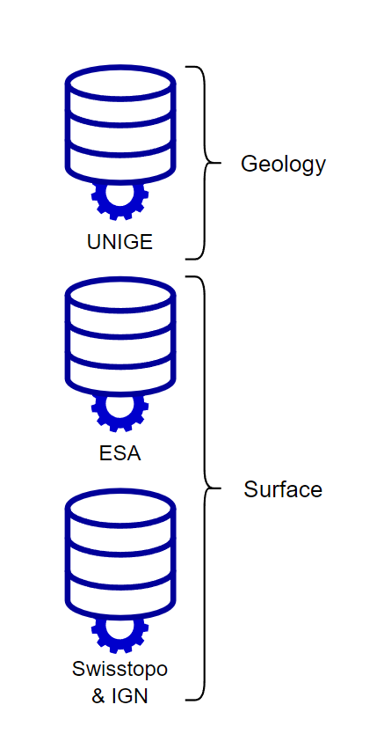
The GeoProfiler Tool

Slide 4
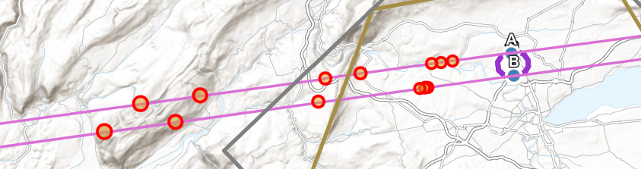
Radiological Analysis
Task: Geolocate neutrino flux affected surface for a given accelerator scenario.
Issue: Large study area and complex calculations in geolocation and dose estimation.
Problem needs to be simplified and the solution approximated as best as possible!
Proposal: Focus on geolocation of affected regions instead of complete dose model.
Initial Approach: Track directions of intense flux using simple line models.
* Unrealistic positioning, for illustrative purposes only!
Notes:
Geometry, geodesy and geography concerns separate from detailed beam physics and radiation protection concerns
More in-line with team expertise and exploratory nature of the tool
Later seek to integrate estimations and refined dose model
Allow analysts flexibility to select study points within the accelerator trace
Long straight sections surrounding interaction points expected to produce the most intense flux
Ensure negligible impact or potentially well-defined experimental areas

Slide 5
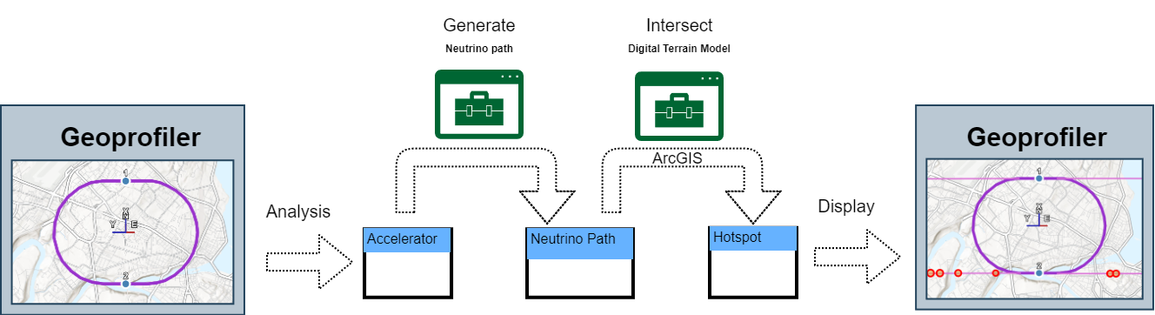
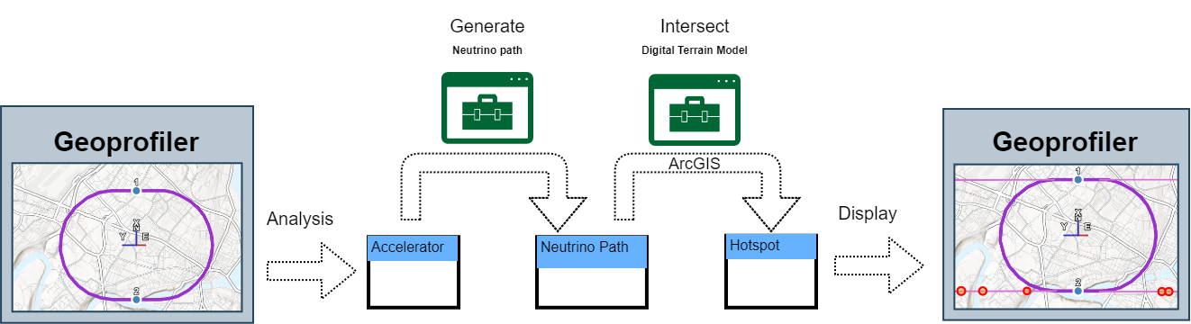
Radiological Analysis – Workflow
Main
Bottlenecks
Main
Bottleneck

Slide 6
Radiological Analysis – Exploration Example
Notes:
~18 m depth delta for 1% around X axis
~13 m depth delta for 1% around Y axis

Slide 7
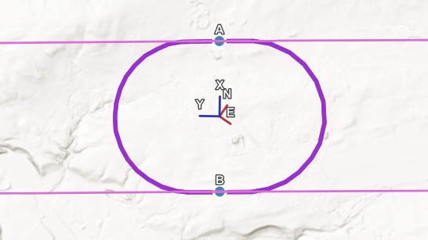
Radiological Analysis – Exploration Example
Example (not a realistic case / solution)
Check geometry
Neutrino path directions
Estimate regions for neutrino flux mitigation
Aligned with each strongest neutrino paths
Inspect local area
Identify optimal planimetric positions
Optimize geology, surface site and accelerator depth
Match hotspots to regions with depth and tilt
Depth ⇒ uniformly affects distance
Tilt ⇒ more pronounced effect but directional
Avoid “scraping” and hotspot clusters
Check, assess and refine hotspot areas
Check map and land cover for proximity of urban areas
Check distance and area estimate (not realistic yet!)
Check clearance in 3D, above and below ground
Racetrack shape, 10km long
Radius [1273, 1773] m →
~2.5km distance between shaft
Bidirectional parallel paths along Y axis →
Slope around X axis most significant
Slope around Y axis for adjustments
Notes:
~18 m depth delta for 1% around X axis
~13 m depth delta for 1% around Y axis

Slide 8
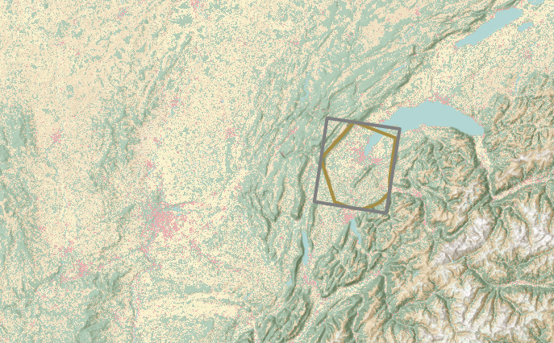
Radiological Analysis – Exploration Example
Example (not a realistic case / solution)
Check geometry
Neutrino path directions
Estimate regions for neutrino flux mitigation
Aligned with each strongest neutrino paths
Inspect local area
Identify optimal planimetric positions
Optimize geology, surface site and accelerator depth
Match hotspots to regions with depth and tilt
Depth ⇒ uniformly affects distance
Tilt ⇒ more pronounced effect but directional
Avoid “scraping” and hotspot clusters
Check, assess and refine hotspot areas
Check map and land cover for proximity of urban areas
Check distance and area estimate (not realistic yet!)
Check clearance in 3D, above and below ground
Looking for 2 opposite areas →
Geneva lake center
Mountains near Le Puy-en-Velay

Slide 9
Radiological Analysis – Exploration Example
Example (not a realistic case / solution)
Check geometry
Neutrino path directions
Estimate regions with low occupancy rates
Aligned with each strongest neutrino paths
Inspect local area
Identify optimal planimetric positions
Optimize geology, surface site and accelerator depth
Match hotspots to regions with depth and tilt
Depth ⇒ uniformly affects distance
Tilt ⇒ more pronounced effect but directional
Avoid “scraping” and hotspot clusters
Check, assess and refine hotspot areas
Check map and land cover for proximity of urban areas
Check distance and area estimate (not realistic yet!)
Check clearance in 3D, above and below ground
Zone in blue is within local area and well aligned
Notes:
One side is close to CERN but also lake
Other side is farther from lake but close to mountain limestone

Slide 10
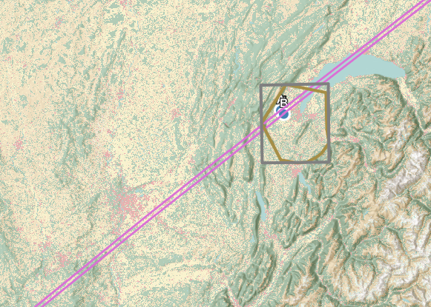
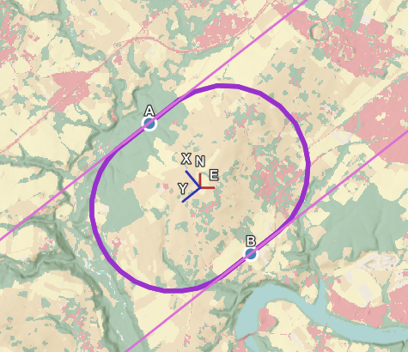
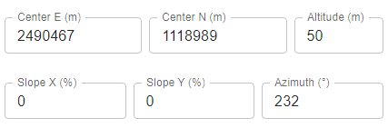
Radiological Analysis – Exploration Example
Example (not a realistic case / solution)
Check geometry
Neutrino path directions
Estimate regions for neutrino flux mitigation
Aligned with each strongest neutrino paths
Inspect local area
Identify optimal planimetric positions
Optimize geology, surface site and accelerator depth
Match hotspots to regions with depth and tilt
Depth ⇒ uniformly affects distance
Tilt ⇒ more pronounced effect but directional
Avoid “scraping” and hotspot clusters
Check, assess and refine hotspot areas
Check map and land cover for proximity of urban areas
Check distance and area estimate (not realistic yet!)
Check clearance in 3D, above and below ground

Slide 11
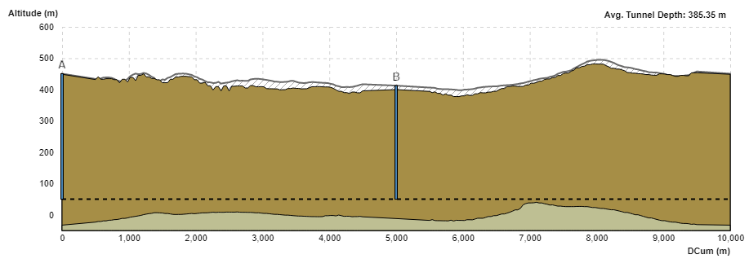
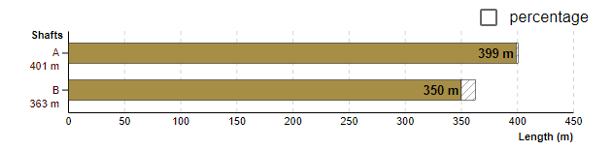
Radiological Analysis – Exploration Example
Example (not a realistic case / solution)
Check geometry
Neutrino path directions
Estimate regions for neutrino flux mitigation
Aligned with each strongest neutrino paths
Inspect local area
Identify optimal planimetric positions
Optimize geology, surface site and accelerator depth
Match hotspots to regions with depth and tilt
Depth ⇒ uniformly affects distance
Tilt ⇒ more pronounced effect but directional
Avoid “scraping” and hotspot clusters
Check, assess and refine hotspot areas
Check map and land cover for proximity of urban areas
Check distance and area estimate (not realistic yet!)
Check clearance in 3D, above and below ground
Near CERN
Viable non-urban surface sites
Low geology uncertainty
No limestone intersected
Shafts not overly deep
Notes:
When positioning go for:
Underground tunnel, only molasse along it
Viable surface sites, ideally not urbanized
Minimize uncertain geology along tunnel and shafts
Identify acceptable altitude range:
Where tunnel within molasse without overly long shafts
Account for tilt range in depth extremes
Shafts not overly deep in range
Altitude range means flexibility for tilts

Slide 12
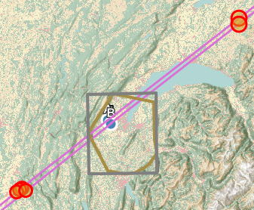
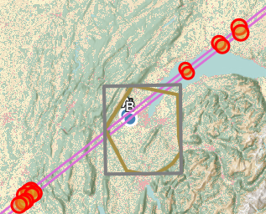
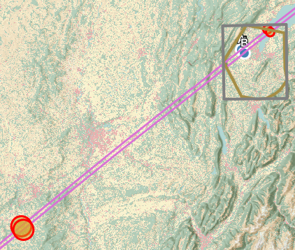
Radiological Analysis – Exploration Example
Example (not a realistic case / solution)
Check geometry
Neutrino path directions
Estimate regions for neutrino flux mitigation
Aligned with each strongest neutrino paths
Inspect local area
Identify optimal planimetric positions
Optimize geology, surface site and accelerator depth
Match hotspots to regions with depth and tilt
Depth ⇒ uniformly affects distance
Tilt ⇒ more pronounced effect but directional
Avoid “scraping” and hotspot clusters
Check, assess and refine hotspot areas
Check map and land cover for proximity of urban areas
Check distance and area estimate (not realistic yet!)
Check clearance in 3D, above and below ground

Slide 13
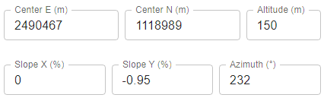
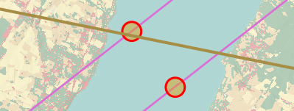
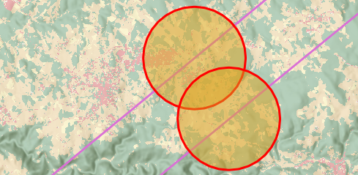
Radiological Analysis – Exploration Example
Example (not a realistic case / solution)
Check geometry
Neutrino path directions
Estimate regions for neutrino flux mitigation
Aligned with each strongest neutrino paths
Inspect local area
Identify optimal planimetric positions
Optimize geology, surface site and accelerator depth
Match hotspots to regions with depth and tilt
Depth ⇒ uniformly affects distance
Tilt ⇒ more pronounced effect but directional
Avoid “scraping” and hotspot clusters
Check, assess and refine hotspot areas
Check map and land cover for proximity of urban areas
Check distance and area estimate (not realistic yet!)
Check clearance in 3D, above and below ground

Slide 14
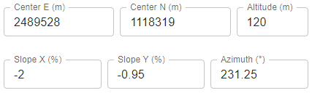
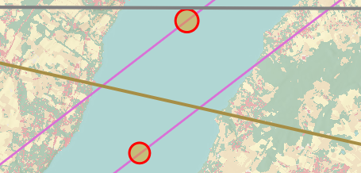
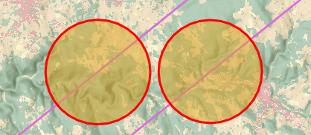
Radiological Analysis – Exploration Example
Example (not a realistic case / solution)
Check geometry
Neutrino path directions
Estimate regions for neutrino flux mitigation
Aligned with each strongest neutrino paths
Inspect local area
Identify optimal planimetric positions
Optimize geology, surface site and accelerator depth
Match hotspots to regions with depth and tilt
Depth ⇒ uniformly affects distance
Tilt ⇒ more pronounced effect but directional
Avoid “scraping” and hotspot clusters
Check, assess and refine hotspot areas
Check map and land cover for proximity of urban areas
Check distance and area estimate (not realistic yet!)
Check clearance in 3D, above and below ground

Slide 15
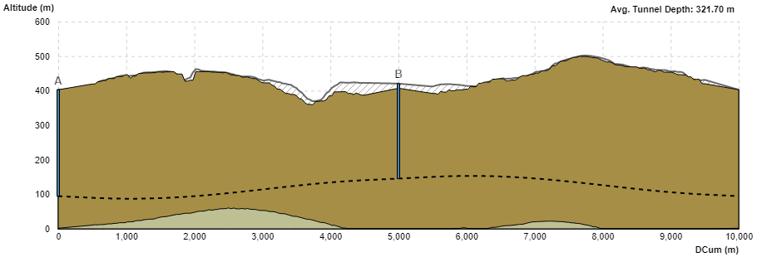
Radiological Analysis – Exploration Example
Example (not a realistic case / solution)
Check geometry
Neutrino path directions
Estimate regions for neutrino flux mitigation
Aligned with each strongest neutrino paths
Inspect local area
Identify optimal planimetric positions
Optimize geology, surface site and accelerator depth
Match hotspots to regions with depth and tilt
Depth ⇒ uniformly affects distance
Tilt ⇒ more pronounced effect but directional
Avoid “scraping” and hotspot clusters
Check, assess and refine hotspot areas
Check map and land cover for proximity of urban areas
Check distance and area estimate (not realistic yet!)
Check clearance in 3D, above and below ground

Slide 16
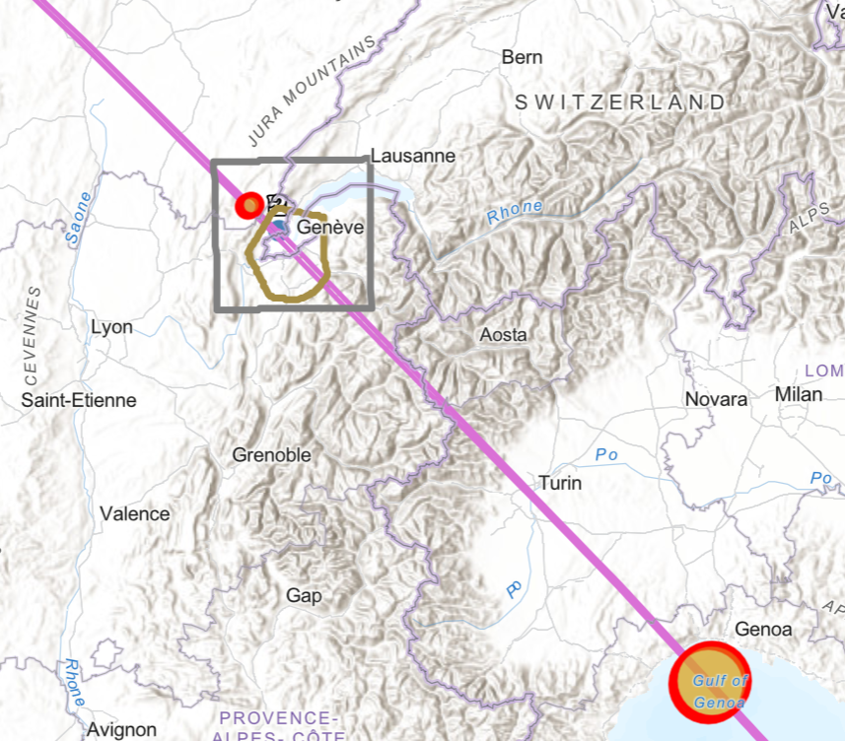
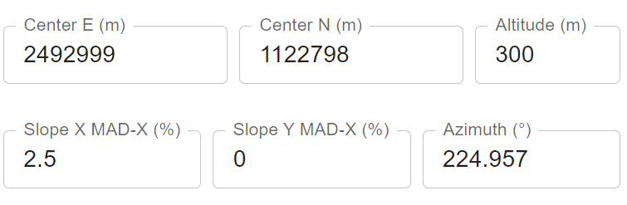
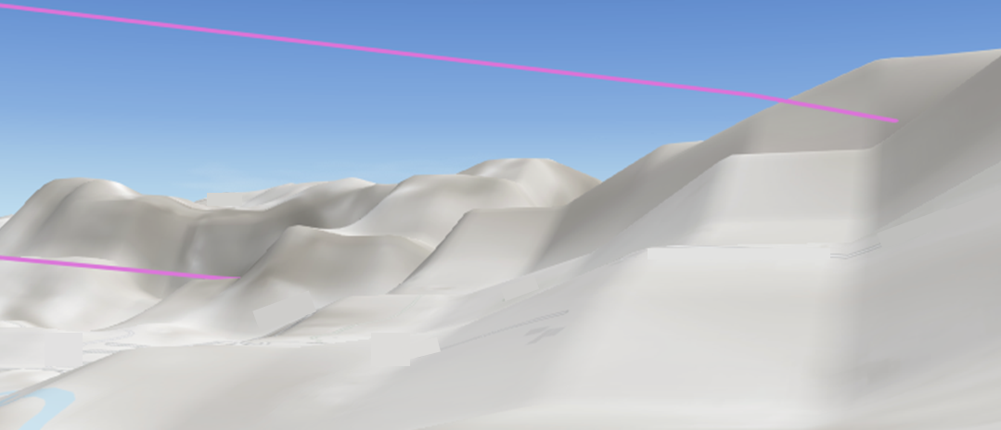
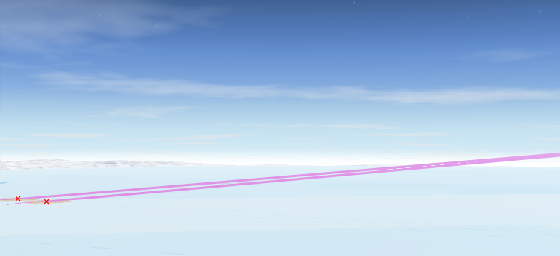
Radiological Analysis – Potential placement
Two exit points (hotspot size not realistic):
Jura
Mediterranean sea

Slide 17
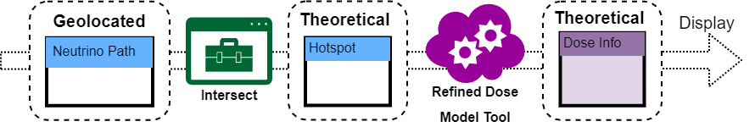
Radiological Analysis – Future Developments
  Geolocation model
  Height clearance instead of hotspot
  Uncertainty measures
  Flux divergence – realistic estimate of affected area
  Lower flux intensity zones (arcs, …)
    Complete accelerator plane intersection?
  Dose analysis
  Realistic indicators and estimates of dose
  Refined dose model integration
More detailed civil engineering studies by the SCE-SAM-FS team will follow once the design of the tunnels is more mature
(i.e. technical feasibility, geology, cost, schedule etc).
Notes:
Missing illustrations

Slide 18

Questions?

Slide 19
Thank you
for listening!

