Slide 1





Update of the PLACET2 tracking code for the simulation of the Recirculating Linacs of the initial acceleration stage of the MC
Paula Desire Valdor (Univ. of Groningen and CERN), Andrea Latina (CERN), Raul Costa (Univ. of Uppsala)
14th of March, 2024

Slide 2
Introduction:
  Brief overview of the initial acceleration stage of Muon Collider.
  Why PLACET2? What are the needed updates?
2) Description of the new implementations and updates.
  Discussion on the importance on non-ultrarelativistic dynamics.
3) Benchmark.
4) Conclusions and Future work.

Slide 3
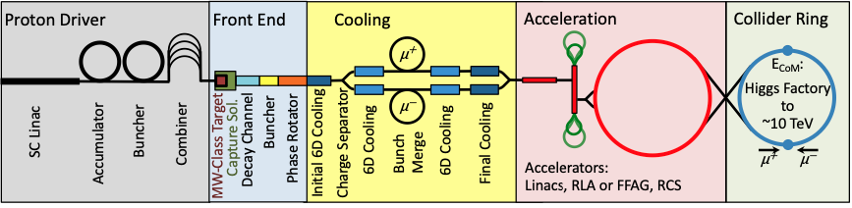
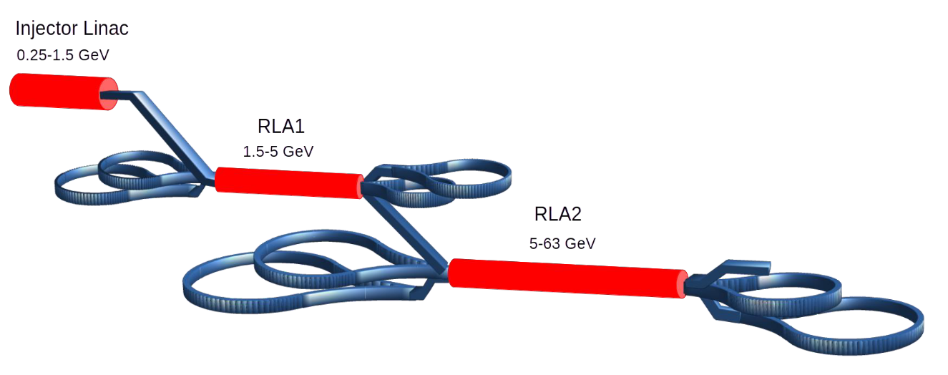
INTRODUCTION – Initial acceleration of Muon Collider (0.25 - 63) GeV
Short lifetime of muons (around ms), requires high average accelerating gradient.
Large transverse (22.5 µm) and especially longitudinal emittances (0.0225 eVs) after the cooling.
Challenges
Low RF (350 MHz) SC cavities (SRF)
Best solution
Proposed architecture:
Single pass linac (0.25 – 1.5 GeV)
Accelerates muons to sufficient relativistic velocities for efficient acceleration in RLAs.
Maintains phase space volume.
+
Recirculating linacs (RLAs) + droplet arcs layout
RLA: Compact and cost-saving layout for SRF.
Multipass linac + independent arcs, designed for different energies due to different passes.
Proposed by A. Bogacz for Neutrino factory.
RLA1 (1.5 - 5 GeV) + RLA2 (5 – 63 GeV).
Courtesy of A.Aksoy
1

Slide 4
INTRODUCTION – PLACET2
PLACET2 provides optimal simulation tools for recirculating architectures in linacs.
PLACET
CERN Tracking code developed for the simulation of linear accelerators developed by D.Schulte and later A.Latina.
Simulates multi-particles bunches and computes CSR, wakefields.
Used in the design of CLIC and ILC.
Benchmarked against multiple codes and tested in several experimental facilities.
PLACET2
Upgrade of PLACET that, apart from maintaining its advantages, allows to simulate several bunches of ultrarelativistic electrons in recirculating machines with complex technologies.
By A.Latina, R.Costa and D.Pellegrini.
Used in the design of the CLIC Drive Beam Recombination Complex (DBRC) and energy recovery linacs (LHeC and Perle).
Next step: Simulation of the RLAs in the Muon Collider.
2

Slide 5
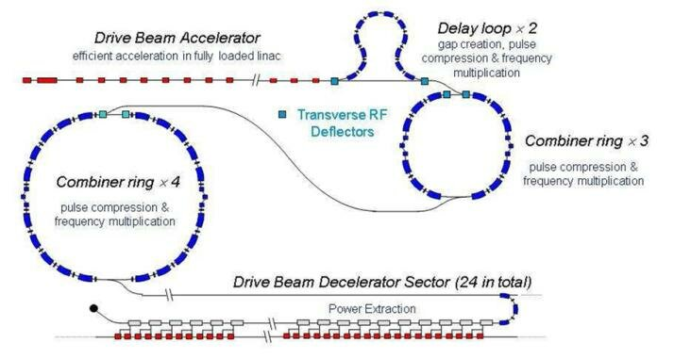
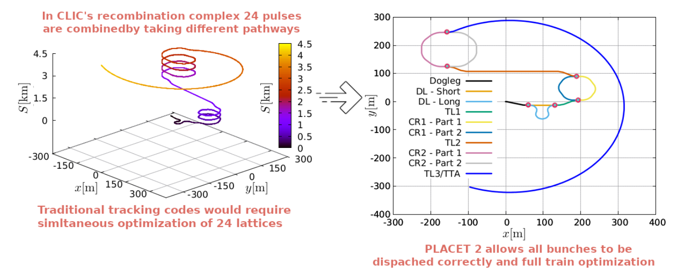
INTRODUCTION – PLACET2 Example: CLIC DBRC
PLACET2 was used in the simulation of CLIC Drive Beam Recombination Complex (CLIC DBRC).
CLIC DBRC recombines 24 bunches for different paths, i.e. some bunches will do 4 turns in the CR1, others do 3 turns... and so on.
Courtesy of R.Costa
PLACET (and other LINAC codes)
Define 24 different lattices.
No possible to simulate long range bunch-to-bunch effects.
PLACET2
Defines the machine only once and runs the bunches simultaneously.
Can simulate realistically long range bunch-to-bunch effects.
3

Slide 6
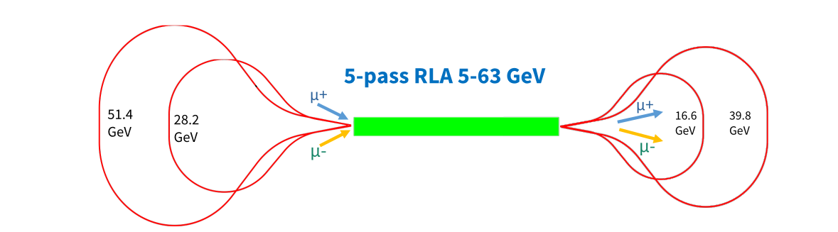
INTRODUCTION – Dogbone subsytem.
To understand better the RLA layout, let's analyse in deep RLA2.
The RLA proposed layout is characterized by the following statements:
Interleaved µ+ µ- bunches, separated by half RF wavelength. We have different bunches of different particles.
2) Same beamline for µ+ and µ-.
RLA: µ+ µ- bunches with same direction.
While a µ+ bunch feels a focusing effect, a µ- bunch feels a defocusing effect.
Droplet arc: µ+ and µ- bunches with opposite direction. Crossing points.
They will feel the same optics, as they have different sing and direction.
3) Non-ultrarelativistic muons.
4) High intensity beams.
Courtesy of A.Aksoy
4

Slide 7
INTRODUCTION – Challenges.
Simulation challenges and updates needed to overcome them
PLACET2, that was thought for simulating ultrarelativistic electrons in linear accelerators with complex topologies, has to be upgraded in able to meet the following requirements:
Simulation of non-ultrarelativistic muons.
  1.1 Update of dynamics descriptions of PLACET2, which assumed ultra-relativistic behaviour (especially longitudinal).
  1.2 Muon decay implementation.
Simulation of particles of different species and charge.
Backwards tracking implementation (in arcs they travel in opposite direction).
Existence of crossing points → Beam-beam interactions.
High intensity beams →Intra-beam scattering, space-charge, beam-loading.
In blue, the topics covered by this work.
5

Slide 8
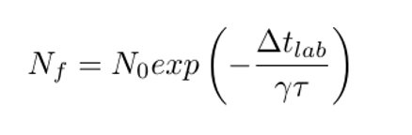
CODE UPDATES AND NEW IMPLEMENTATIONS
PLACET2 that was initially thought for ultra-relativistic electrons, so in order to simulate non ultra-relativistic muons, the equations of motion had to be updated and muon decay was implemented.
Main updates:
Simulation of non-ultrarelativistic particles → Correction of a lot of assumptions in the tracking descriptions.
  Examples: Relativistic β appears P ~ Pz and v ~ vz incorrect, Taylor expansions no longer accurate...
Introduction of bunch charge, to simulate µ+ and µ- bunches simultaneously.
Introduction of bunch mass, to simulate different species.
Revision of constants (sometimes assumed m=me or v=c).
Updated code elements:
Drift, dipole, quadrupole, sextupole, multipole, RF-cavities.
The short and long wakefields, both longitudinal and transversal descriptions.
ISR and CSR implementations.
More detailed description in my IMCC design talk (30/10/23)
New feature: Particle decay
PLACET2 has been updated to compute the decay of any particle with a certain lifetime.
The decay expression includes time dilation.
Implemented as a reduction of the macroparticle weight.
Has been added to the tracking of all the thick elements: drifts, quadrupoles, dipoles, RF-cavities...
6

Slide 9
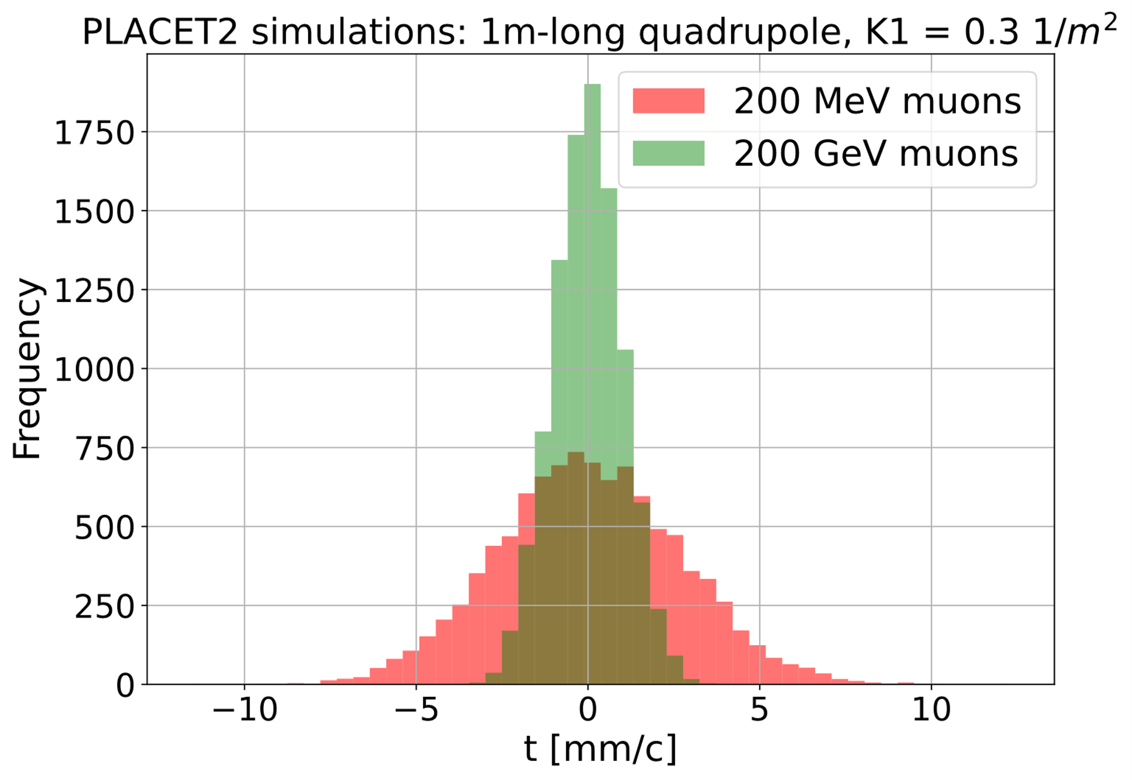
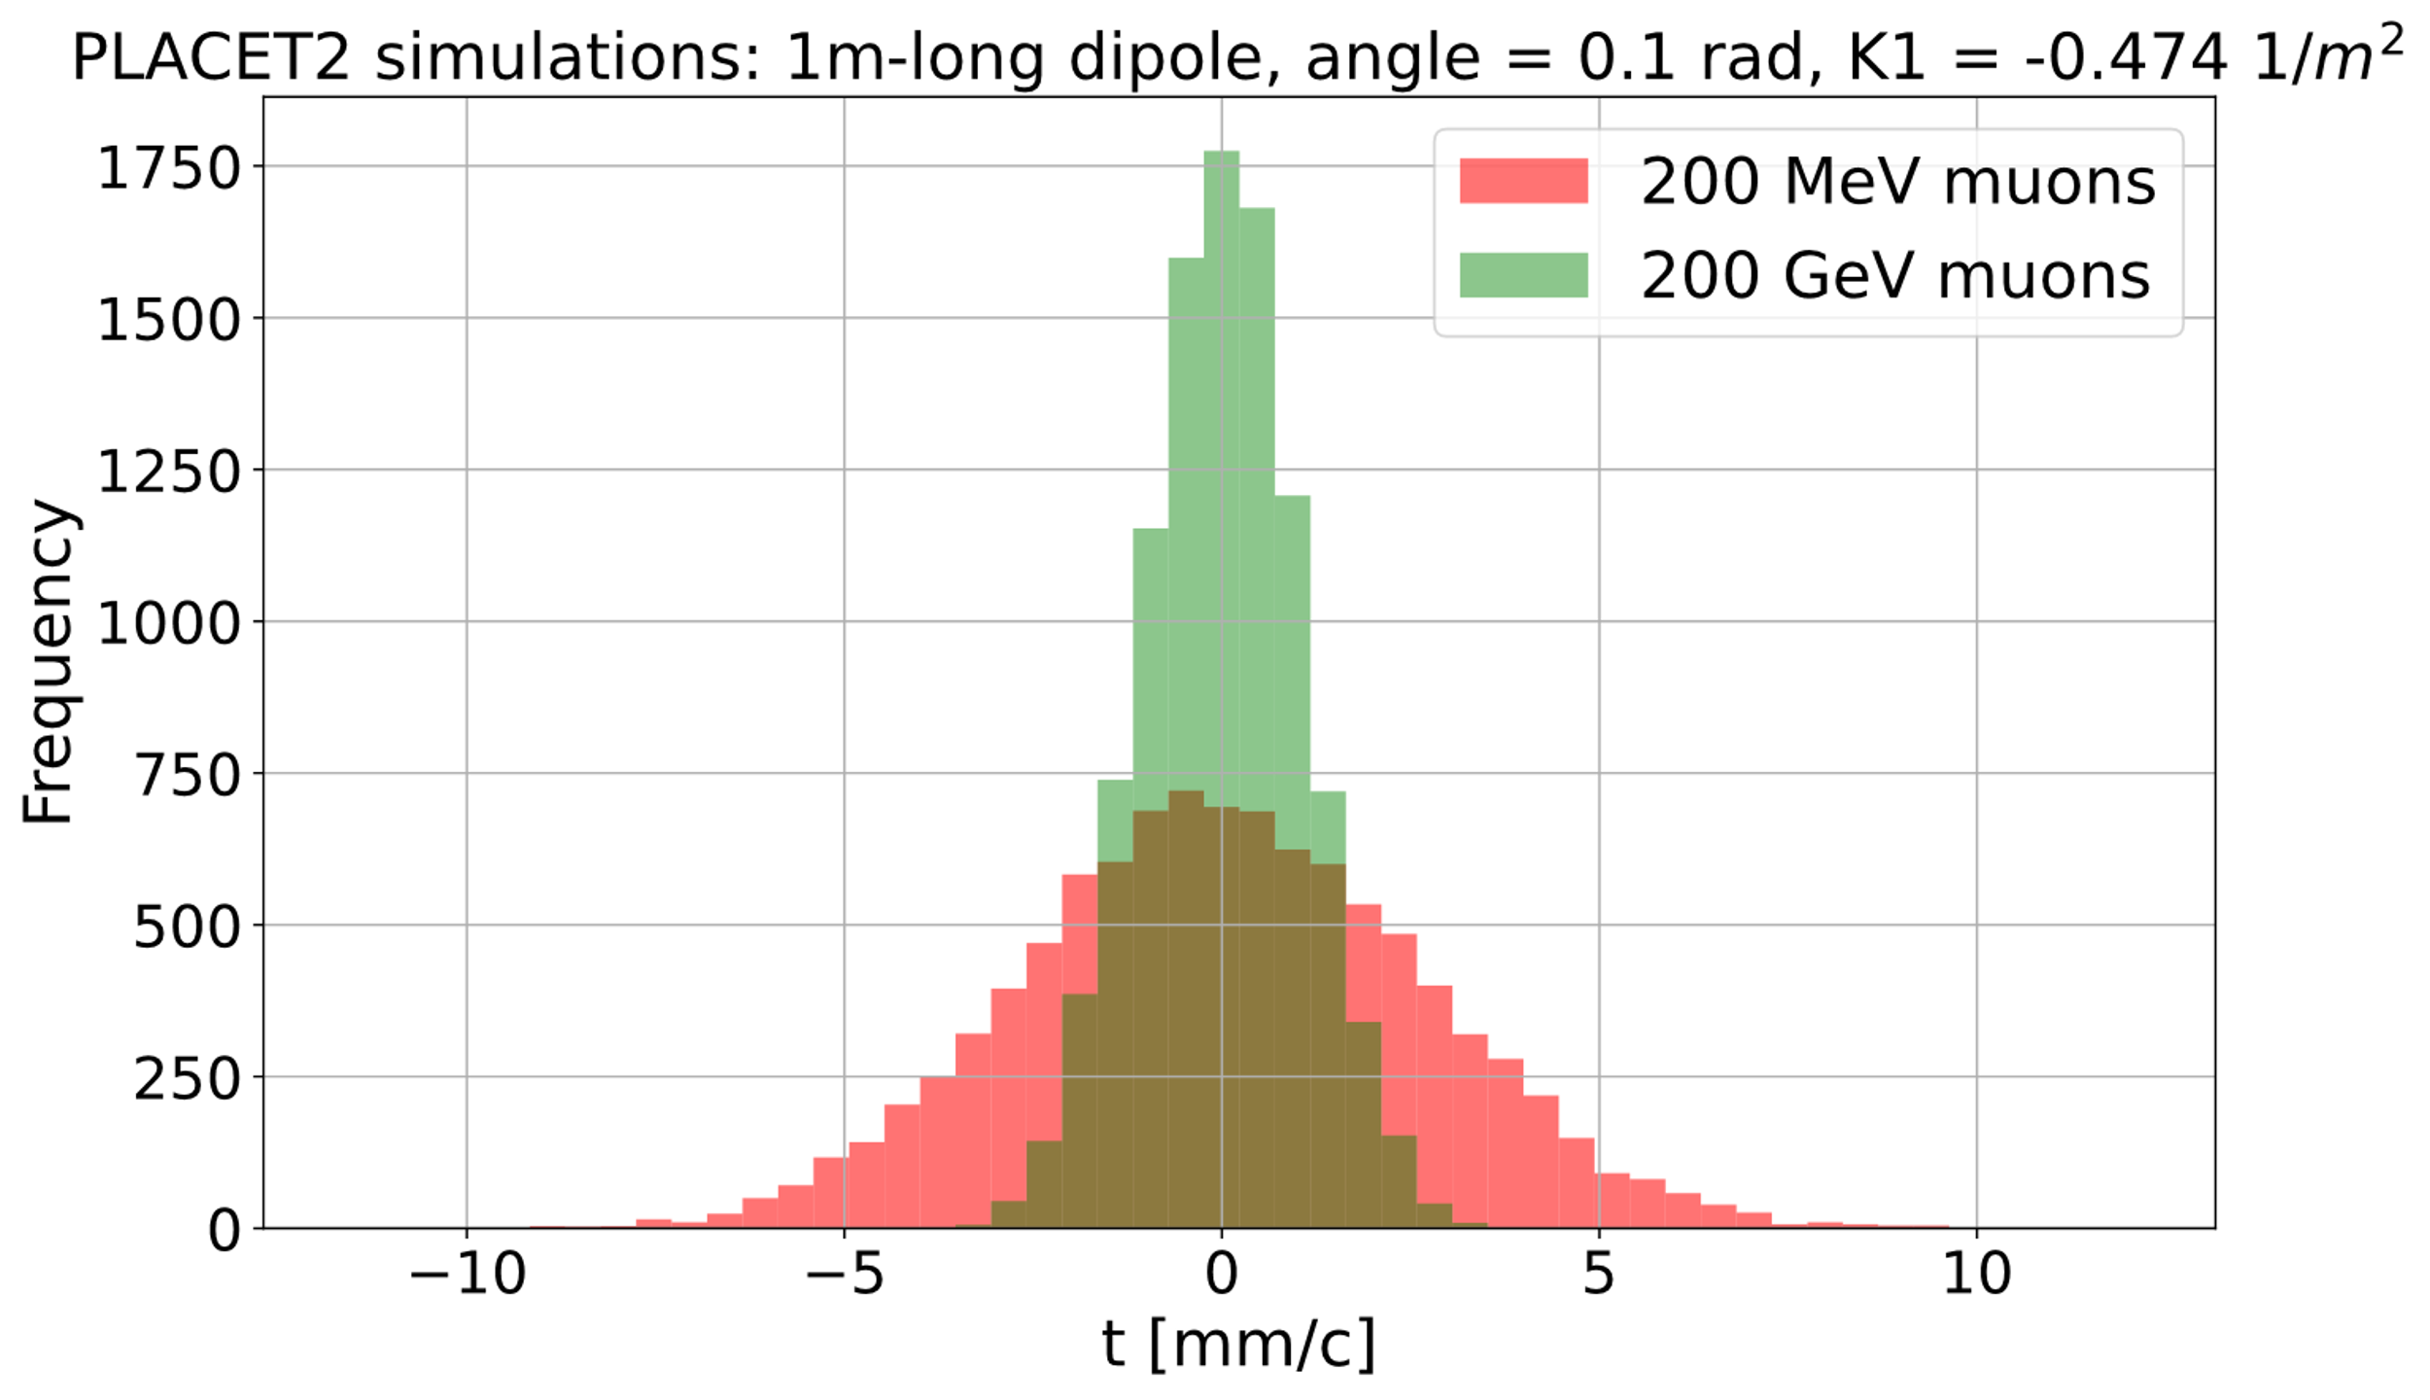
IMPORTANCE OF NON-RELATIVISTIC TREATMENT
The objective of the updates is to simulate the initial acceleration stage of the Muon Collider after the cooling, that covers the range from 250 MeV to 63 GeV muons, so non-ultrarelativistic. How important is this difference?
The updates allowed to simulate non-ultrarelativistic particles and analyze its different behaviour from the ultrarelativistic particles, the only ones able to be simulated before.
K.Energy | β rel. | γ rel.
250 MeV | 0.9548 | 3.366
63 GeV | 0.9999989 | 596.31
Note: The performed simulations have a momentum spread of 10%, similar to the one after the cooling.
The performed update was necessary and well-justified, as longitudinal dynamics suffer a drastic change which needs to be taken into account
8

Slide 10
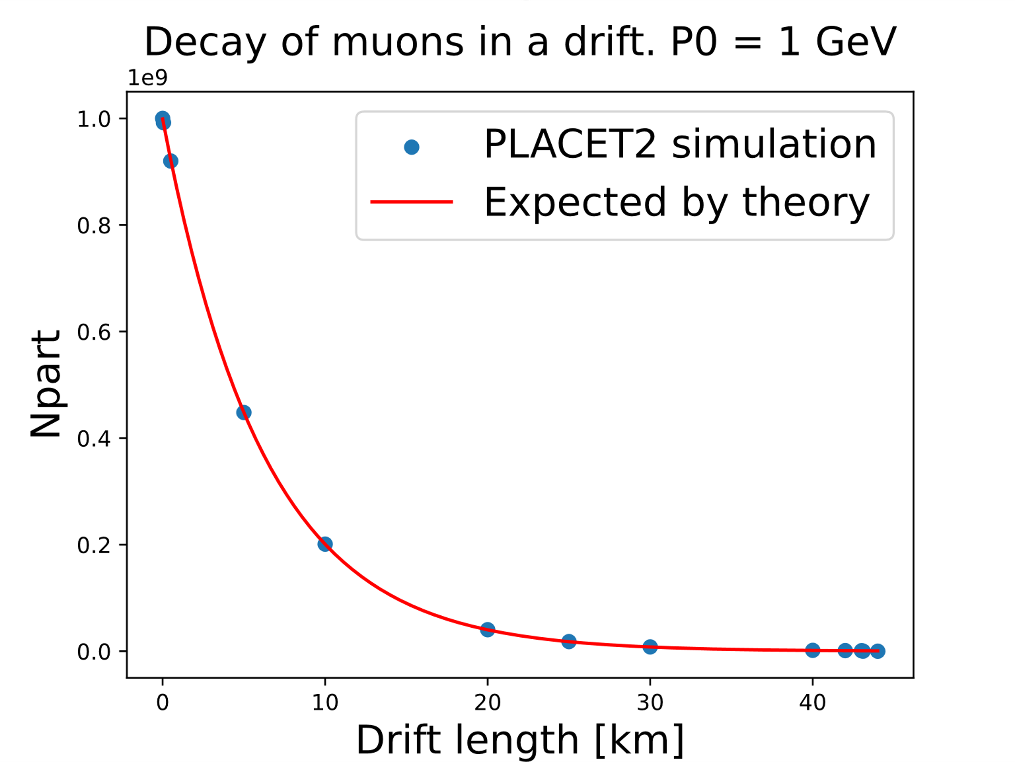
BENCHMARK 1
RF-Track is a tracking code optimized for linear accelerators developed by A.Latina, already introduced in this session.
It is able to simulate non-ultrarelativistic muons.
Not optimal for recirculating geometries → Not chosen, but still the arcs can be used for benchmark.
RF-Track was used as the code to test the performed updates of PLACET2 with.
Performed tests:
Single element tests: The phase space of different bunches of particles after passing through different elements (dipole, a drift, a quadrupole or a multipole) was compared with the one of RF-Track (See next slide).
Muon decay tests: The loss of particles matches the theory predictions.
Simulation of the 1st droplet arc of the RLA2 of Muon Collider (next slides).
9
Notes:
Mention Elena and Bernd’s work with RF-Track
ISR test: on a single element
(1) use electrons so that the effect is visible
(2) use 100’000 macro particles in the beam to average out stochastic effects
(3) Small convergence study to get a stable result (I would say not more than 100)

Slide 11
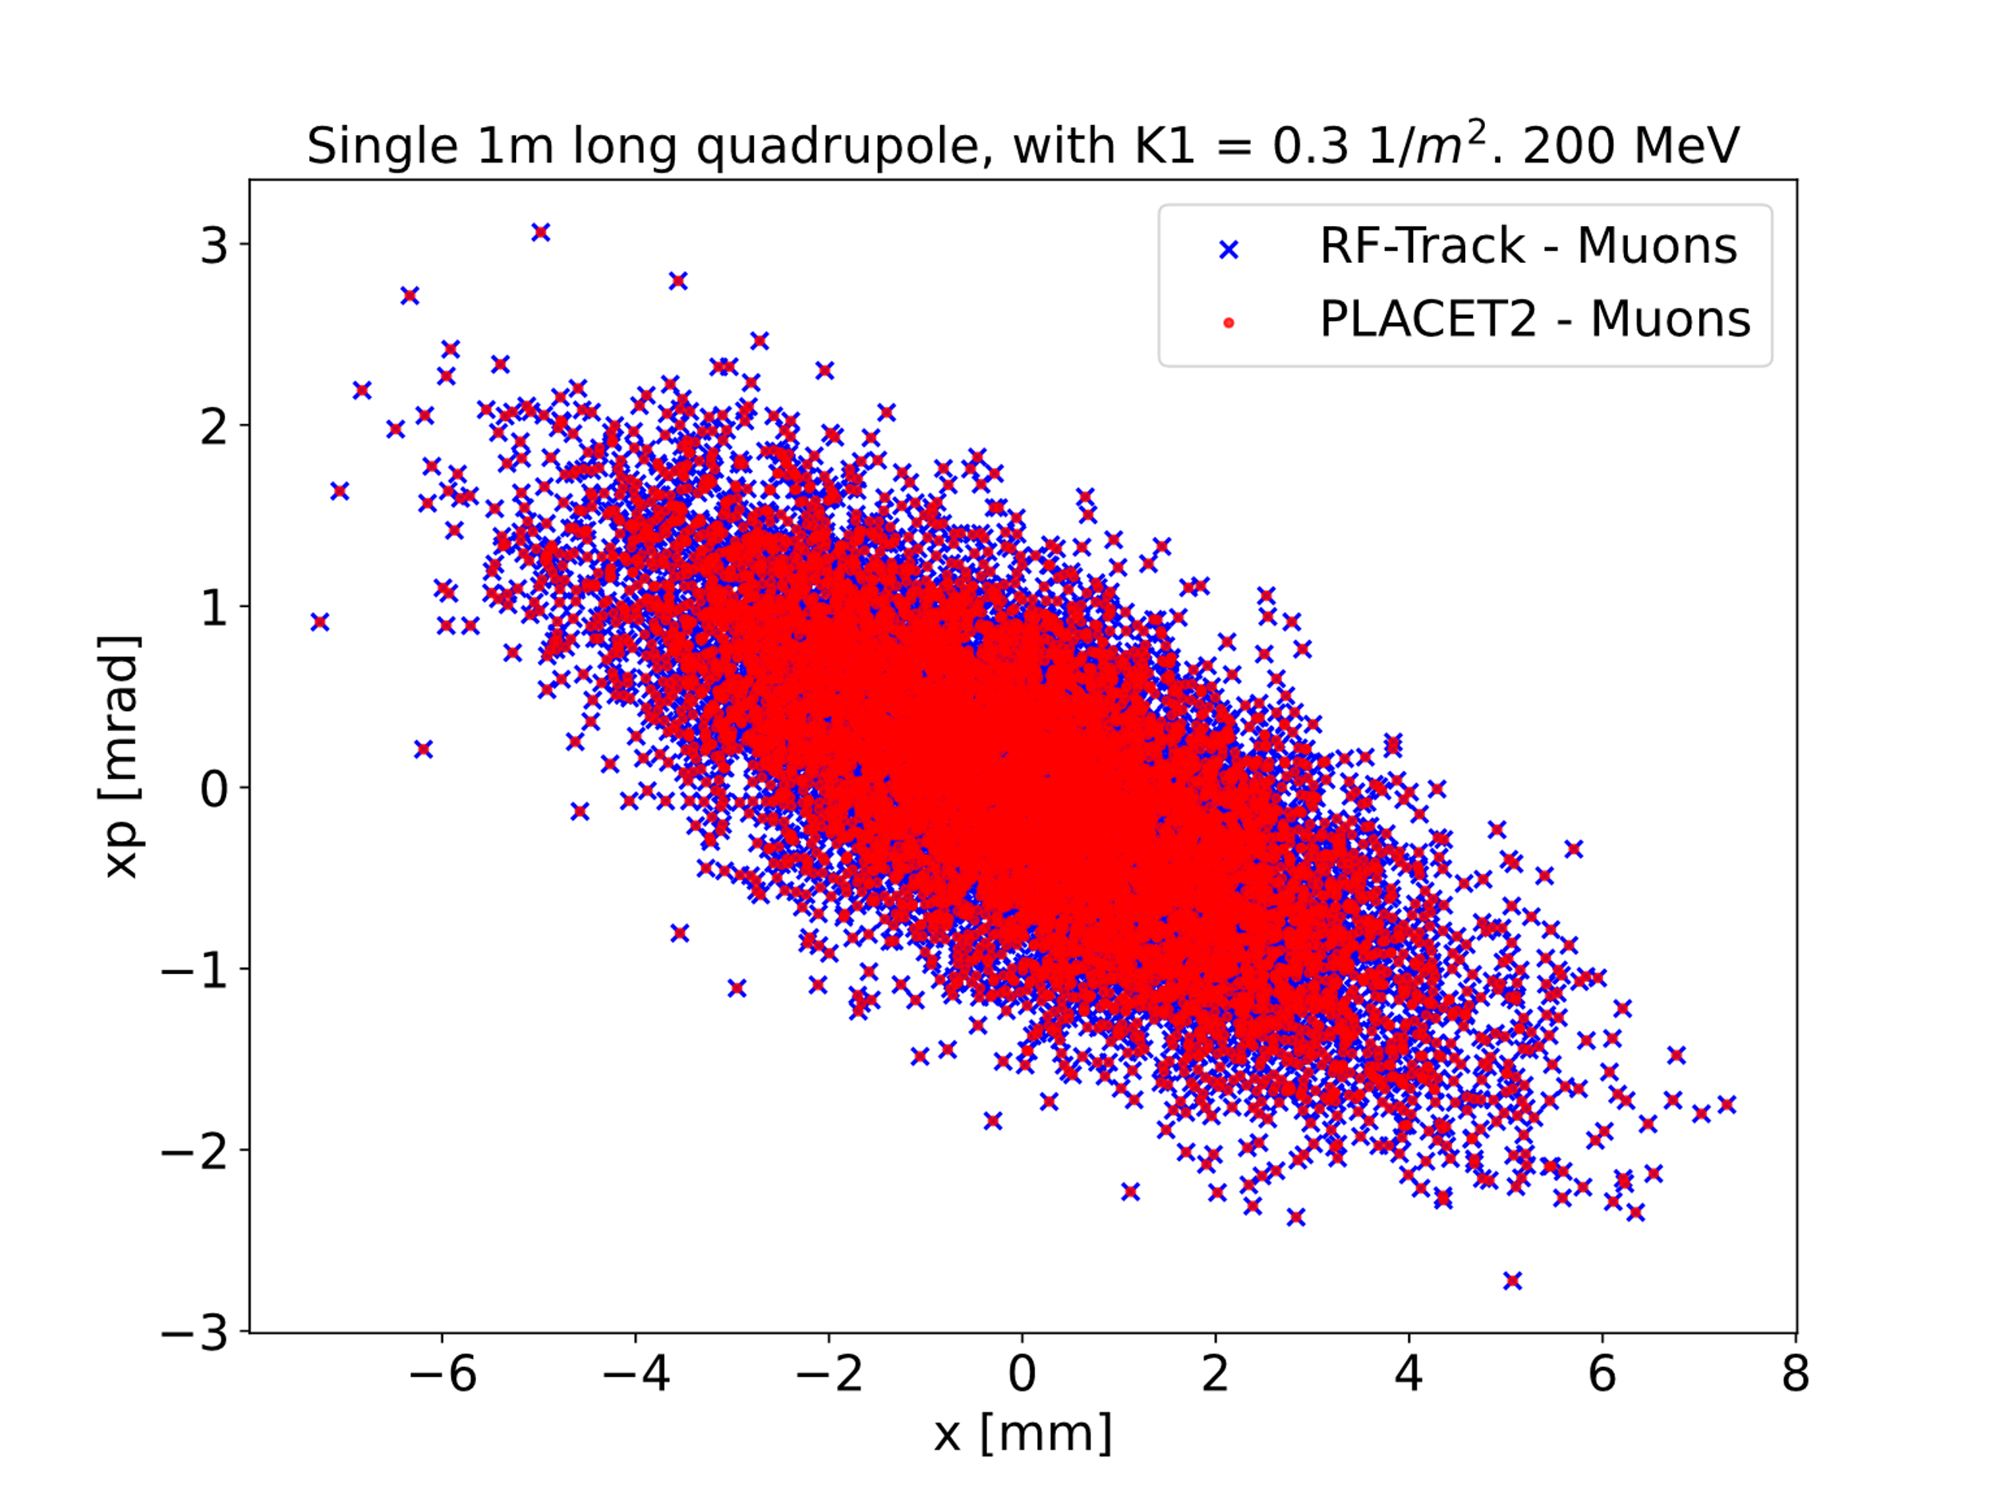
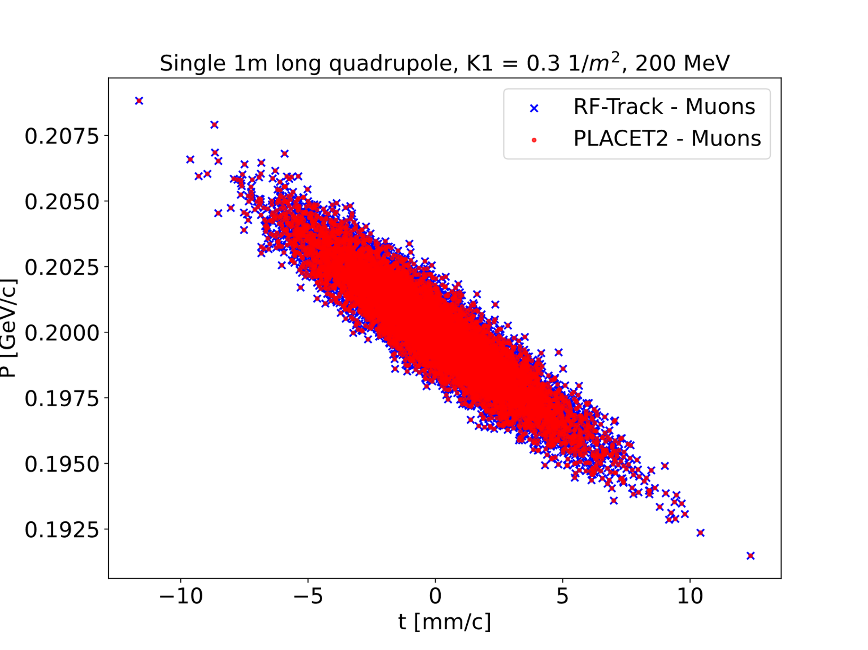
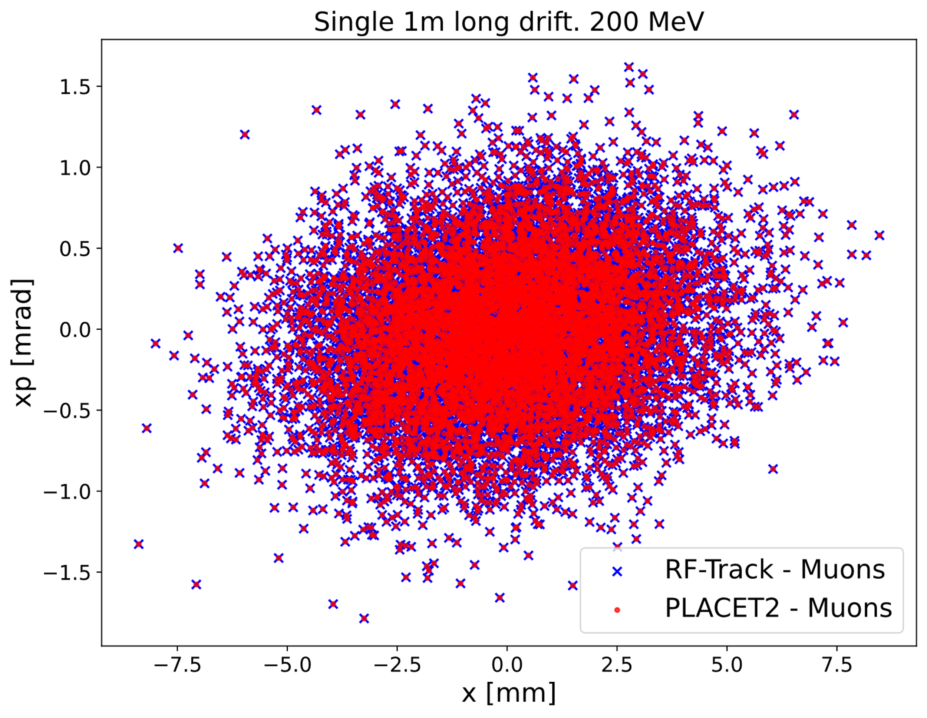
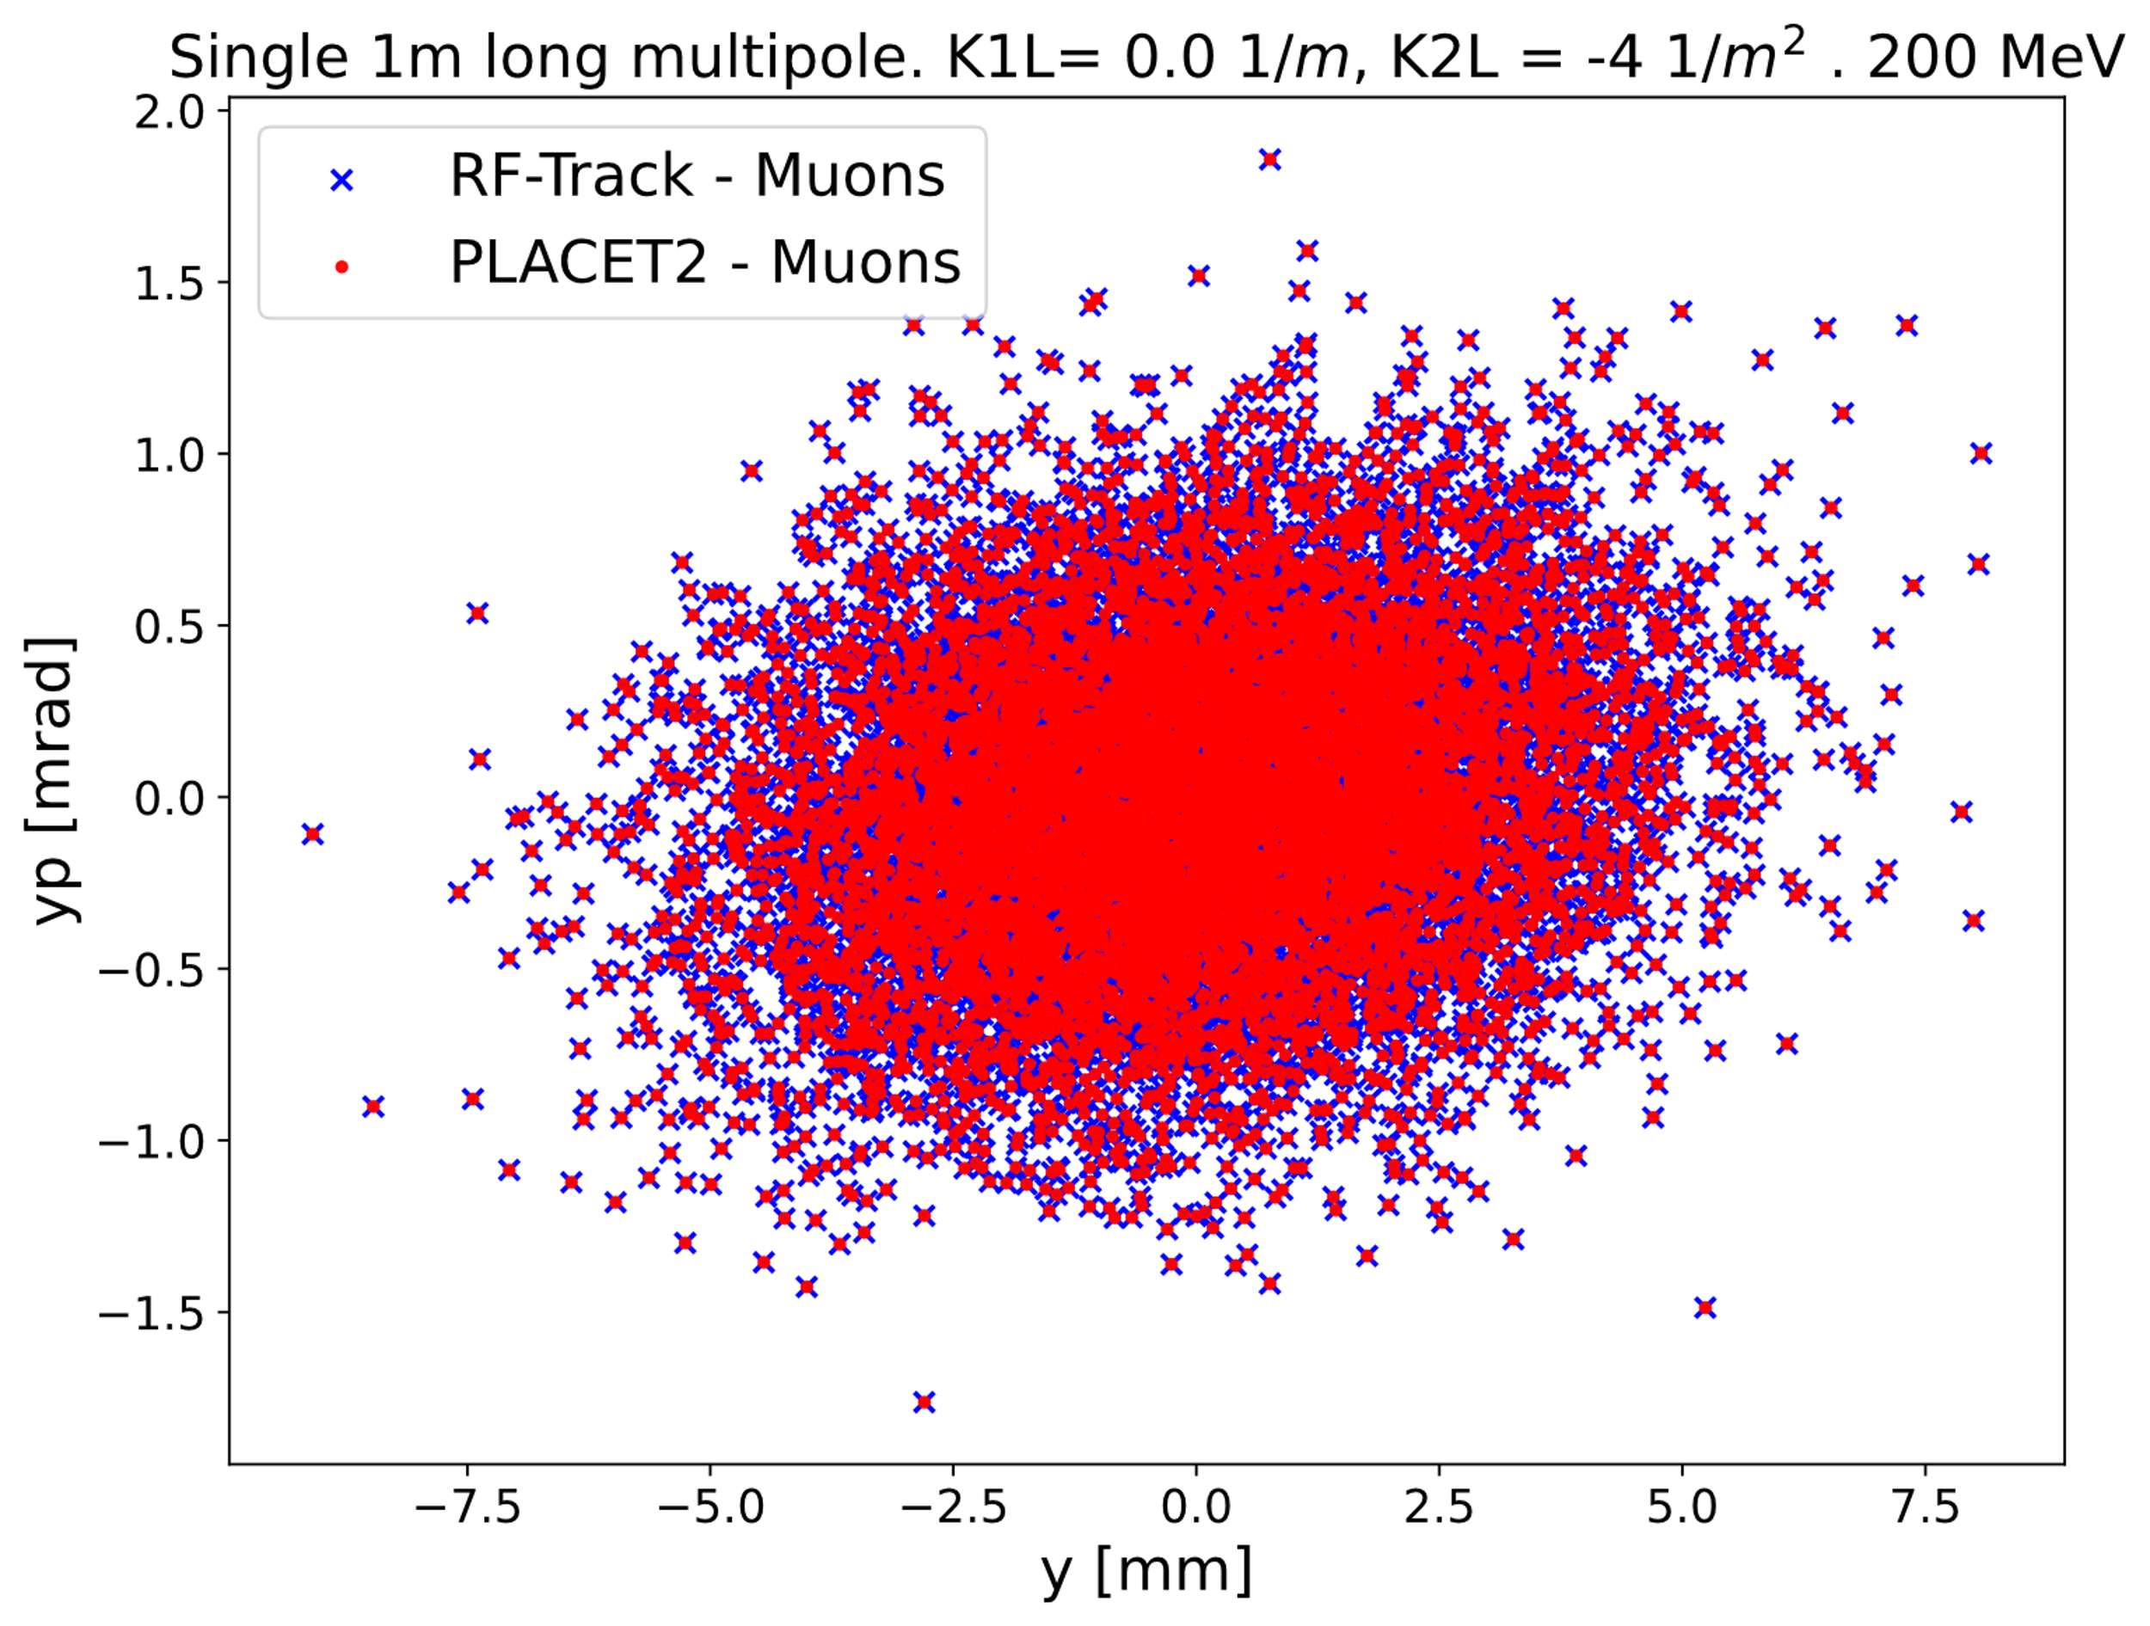
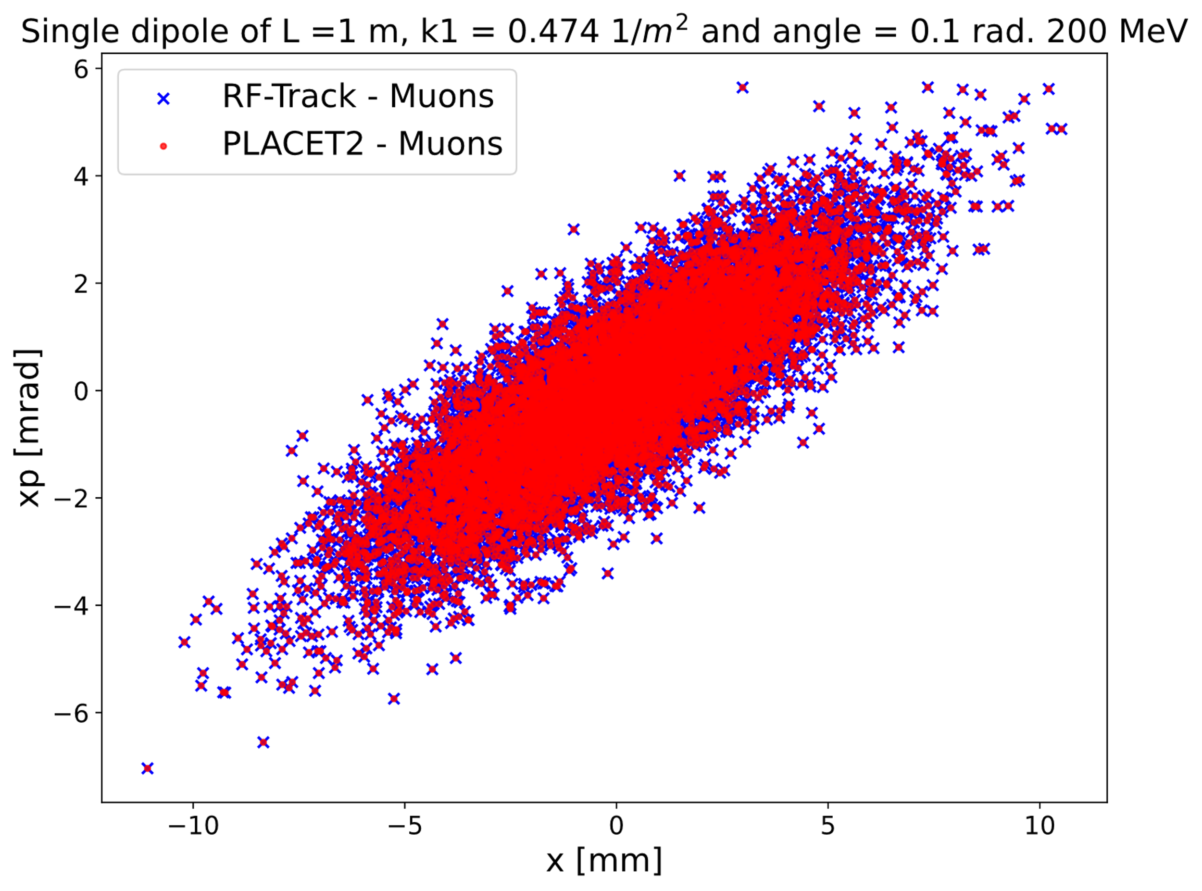
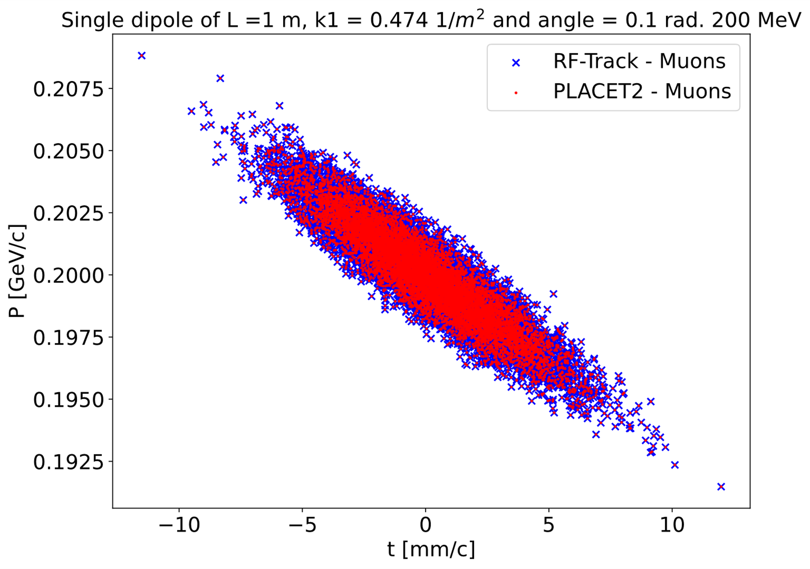
BENCHMARK 2 – Single element tests
The transversal and longitudinal phase space of non-ultrarelativistic muon after passing through 1m-long different elements provided by RF-Track and PLACET2 were compared. The results showed an excellent accordance, providing a benchmark of the performed updates.
Single drift
Single quadrupole
Single dipole
Single multipole
10
Notes:
Mention Elena and Bernd’s work with RF-Track
ISR test: on a single element
(1) use electrons so that the effect is visible
(2) use 100’000 macro particles in the beam to average out stochastic effects
(3) Small convergence study to get a stable result (I would say not more than 100)

Slide 12
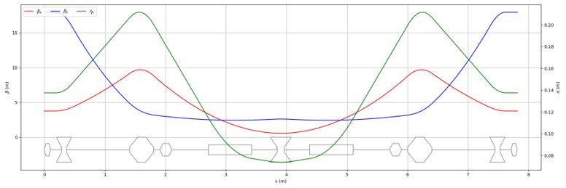
BENCHMARK 3 – Simulation of 1st droplet arc (16.6 GeV) of RLA2
The mentioned implementations were used to simulate the first droplet arc (16.6 GeV) in RLA2, (5 to 63 GeV). The arc does not have a recirculating topology so it was also simulated with RF-Track, providing an excellent benchmark for the simulation of non-linear lattices.
The lattice used in this work was provided by A.Aksoy. A detailed description can be seen in his presentation in his talk during this conference.
  As a resume, is a non-linear lattice with approx. 100 dipoles, 200 quadrupoles and 135 sextupoles, which apart from the periodic cell, includes matching sections due to the change of curvature.
Performed tests:
Comparing the phase space of the particles after the lattice with both codes.
Comparing the beta-functions.
Courtesy of A.Aksoy
Courtesy of A.Aksoy
11

Slide 13
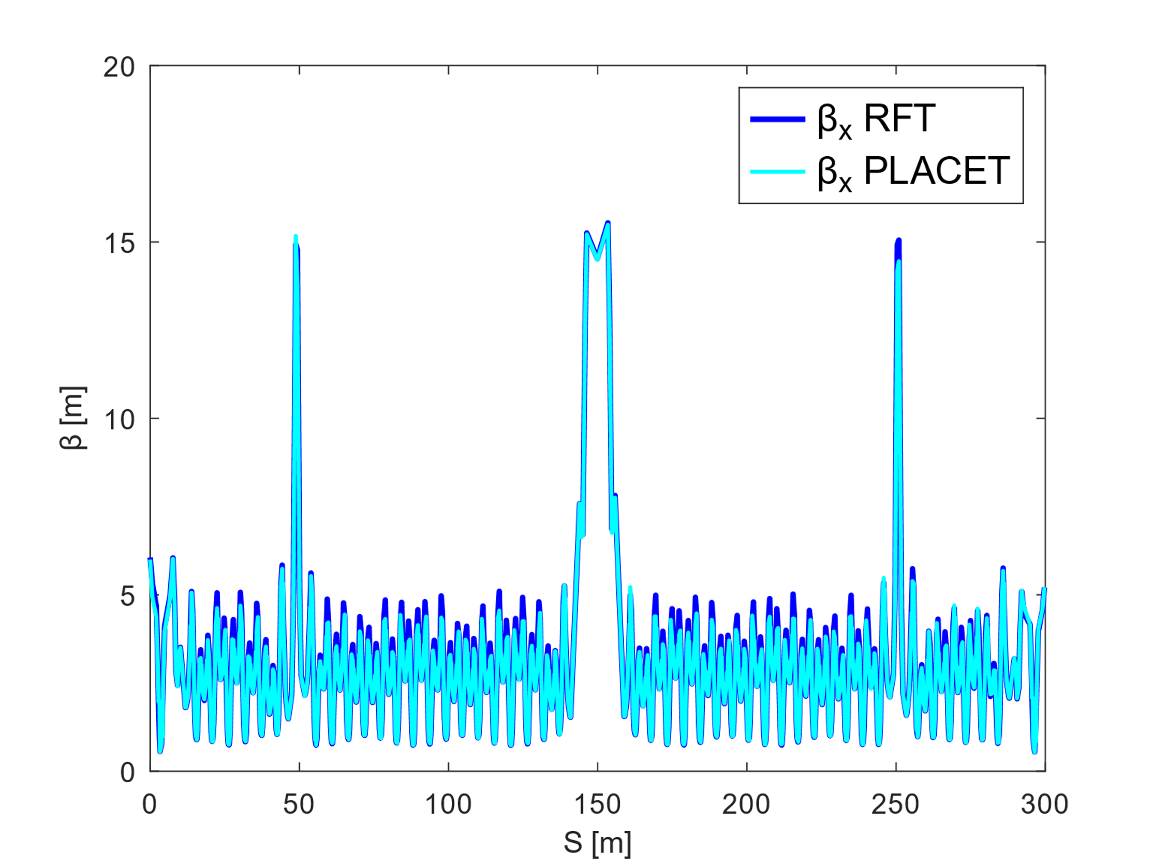
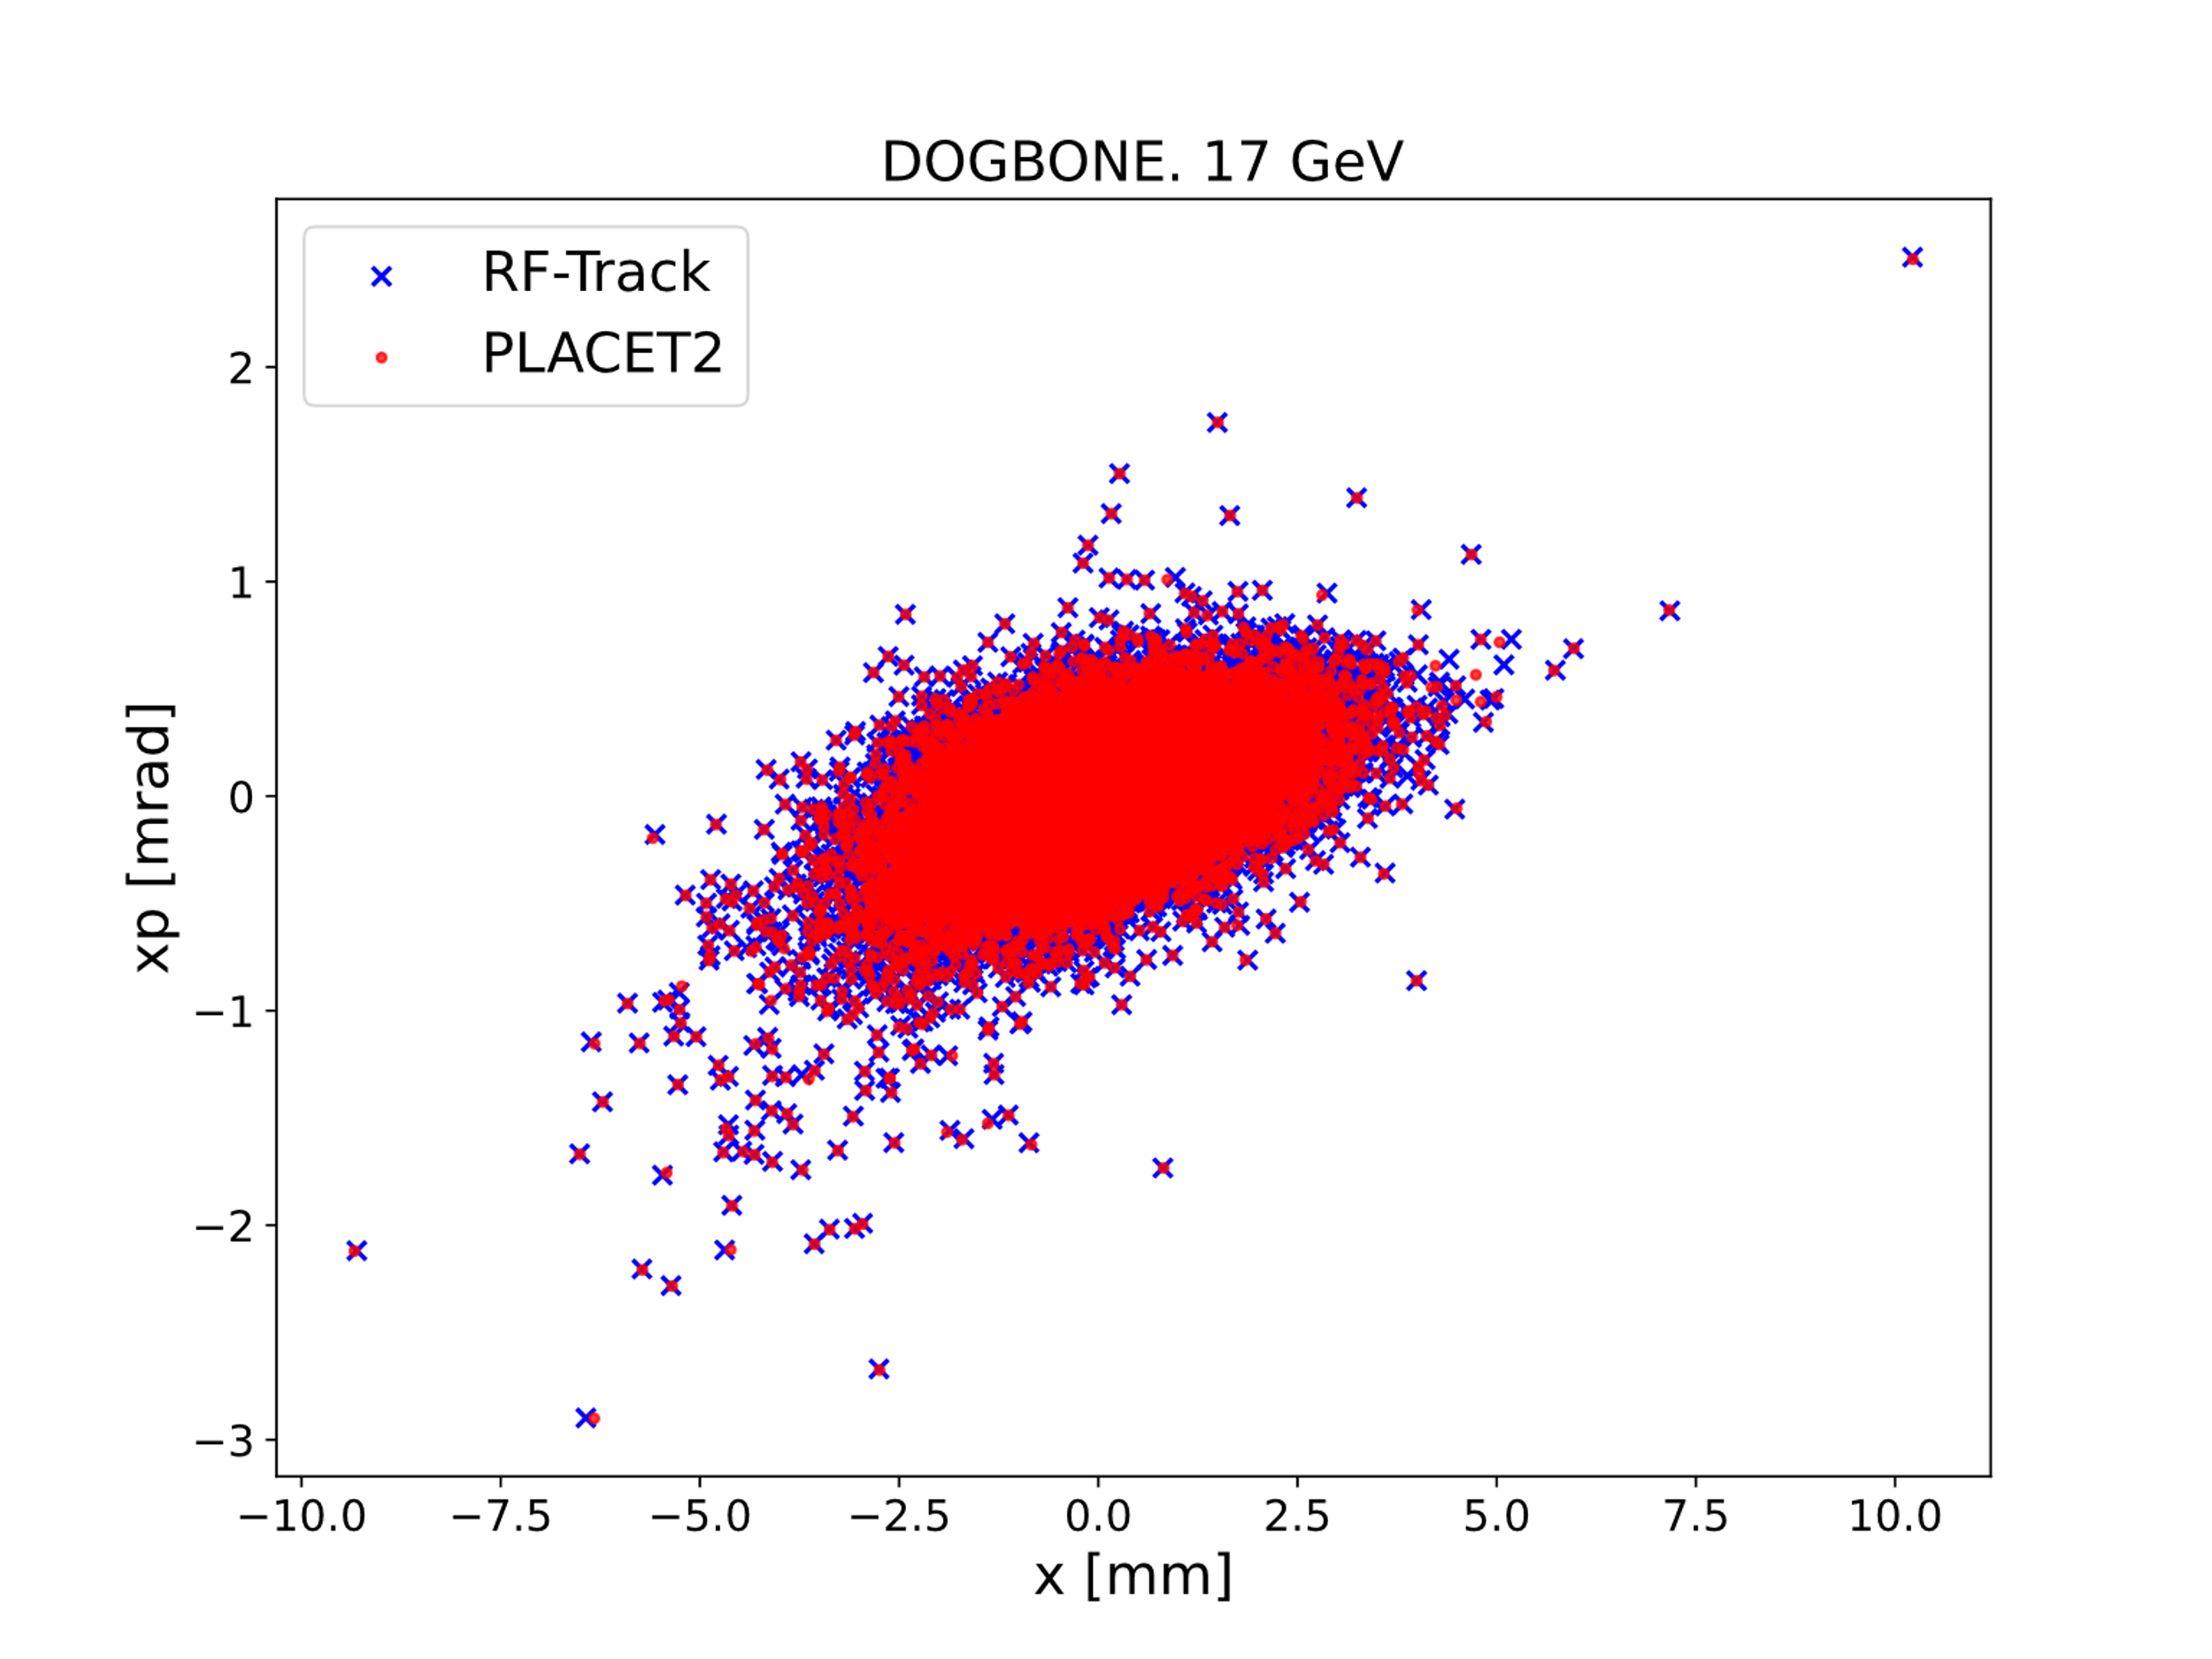
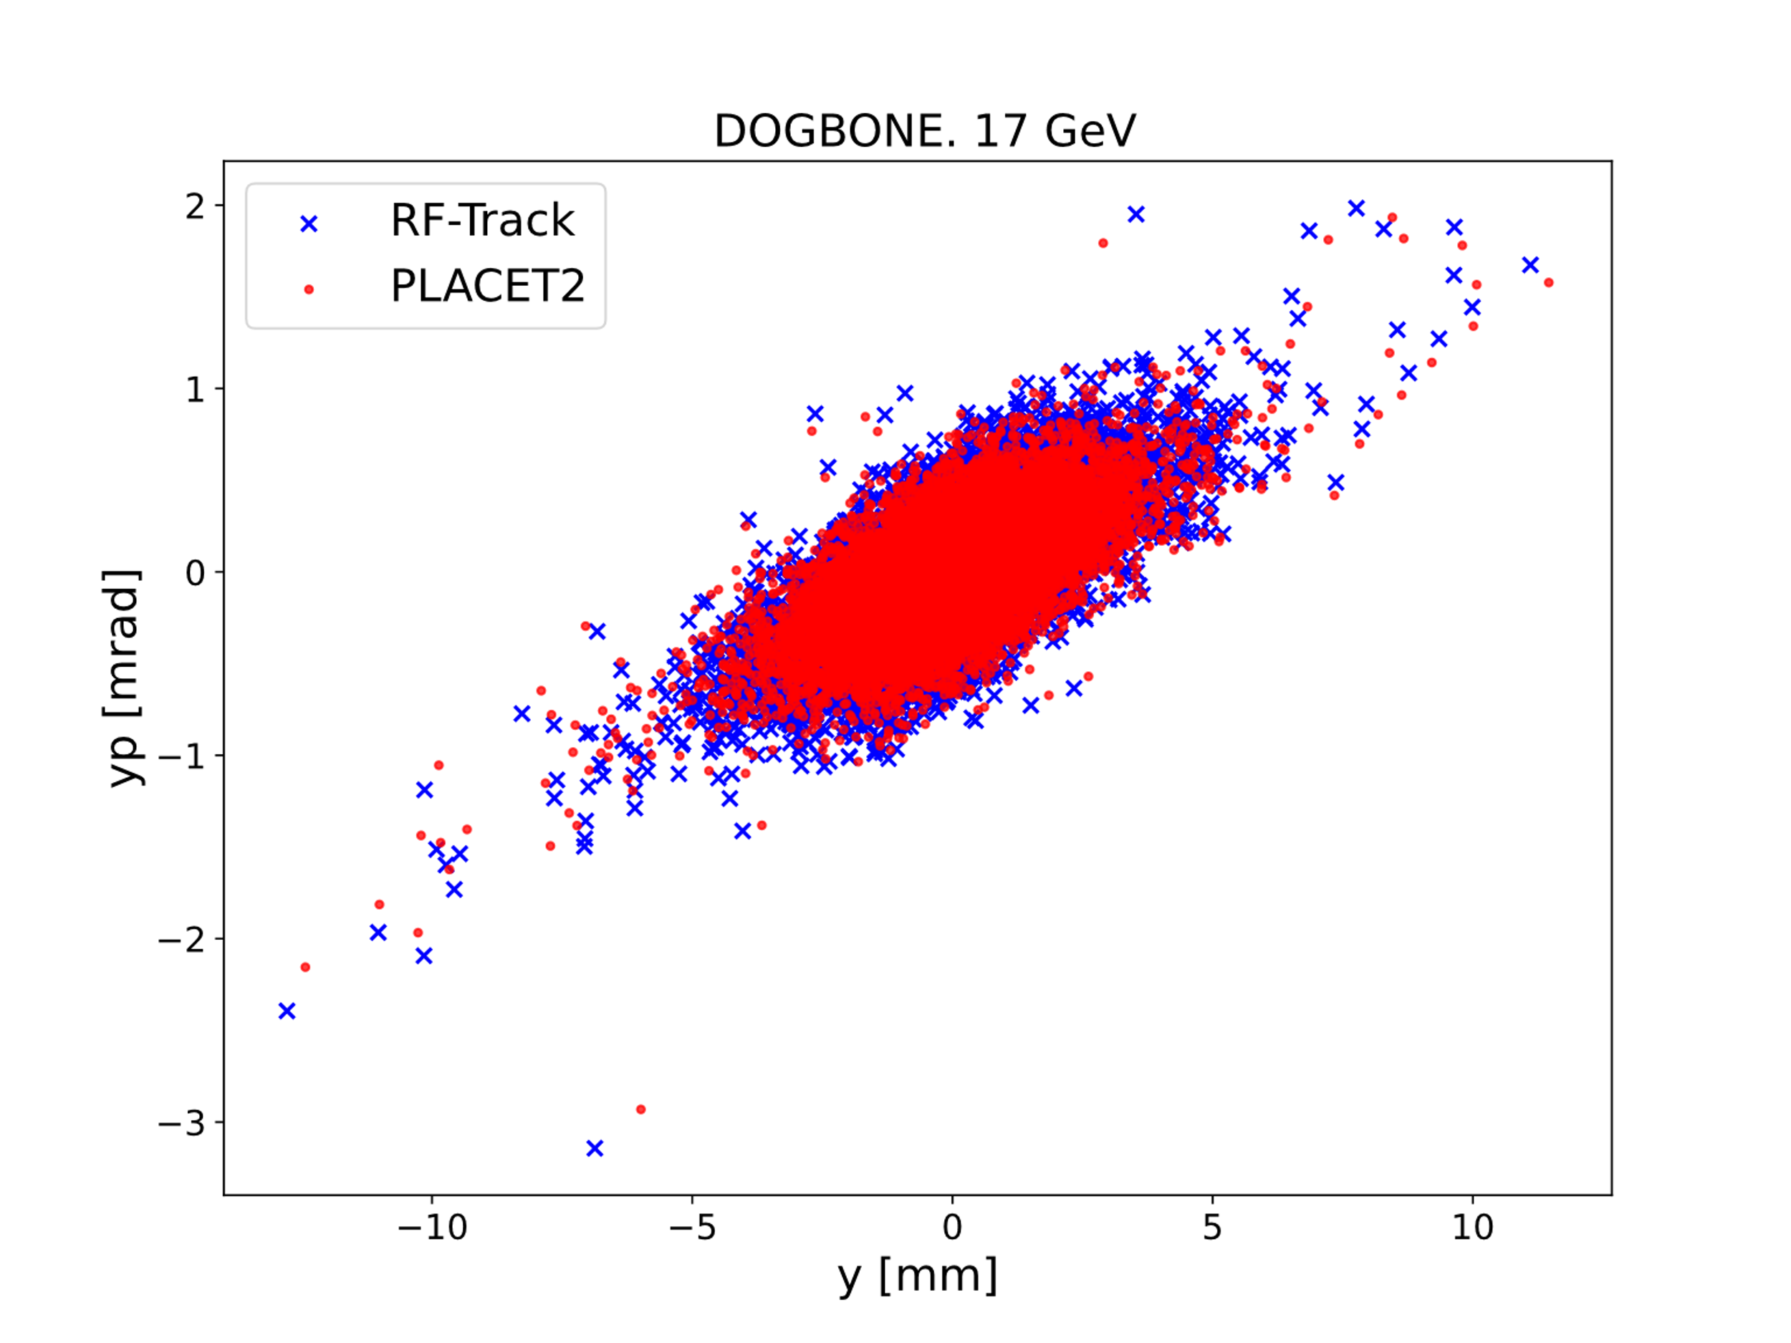
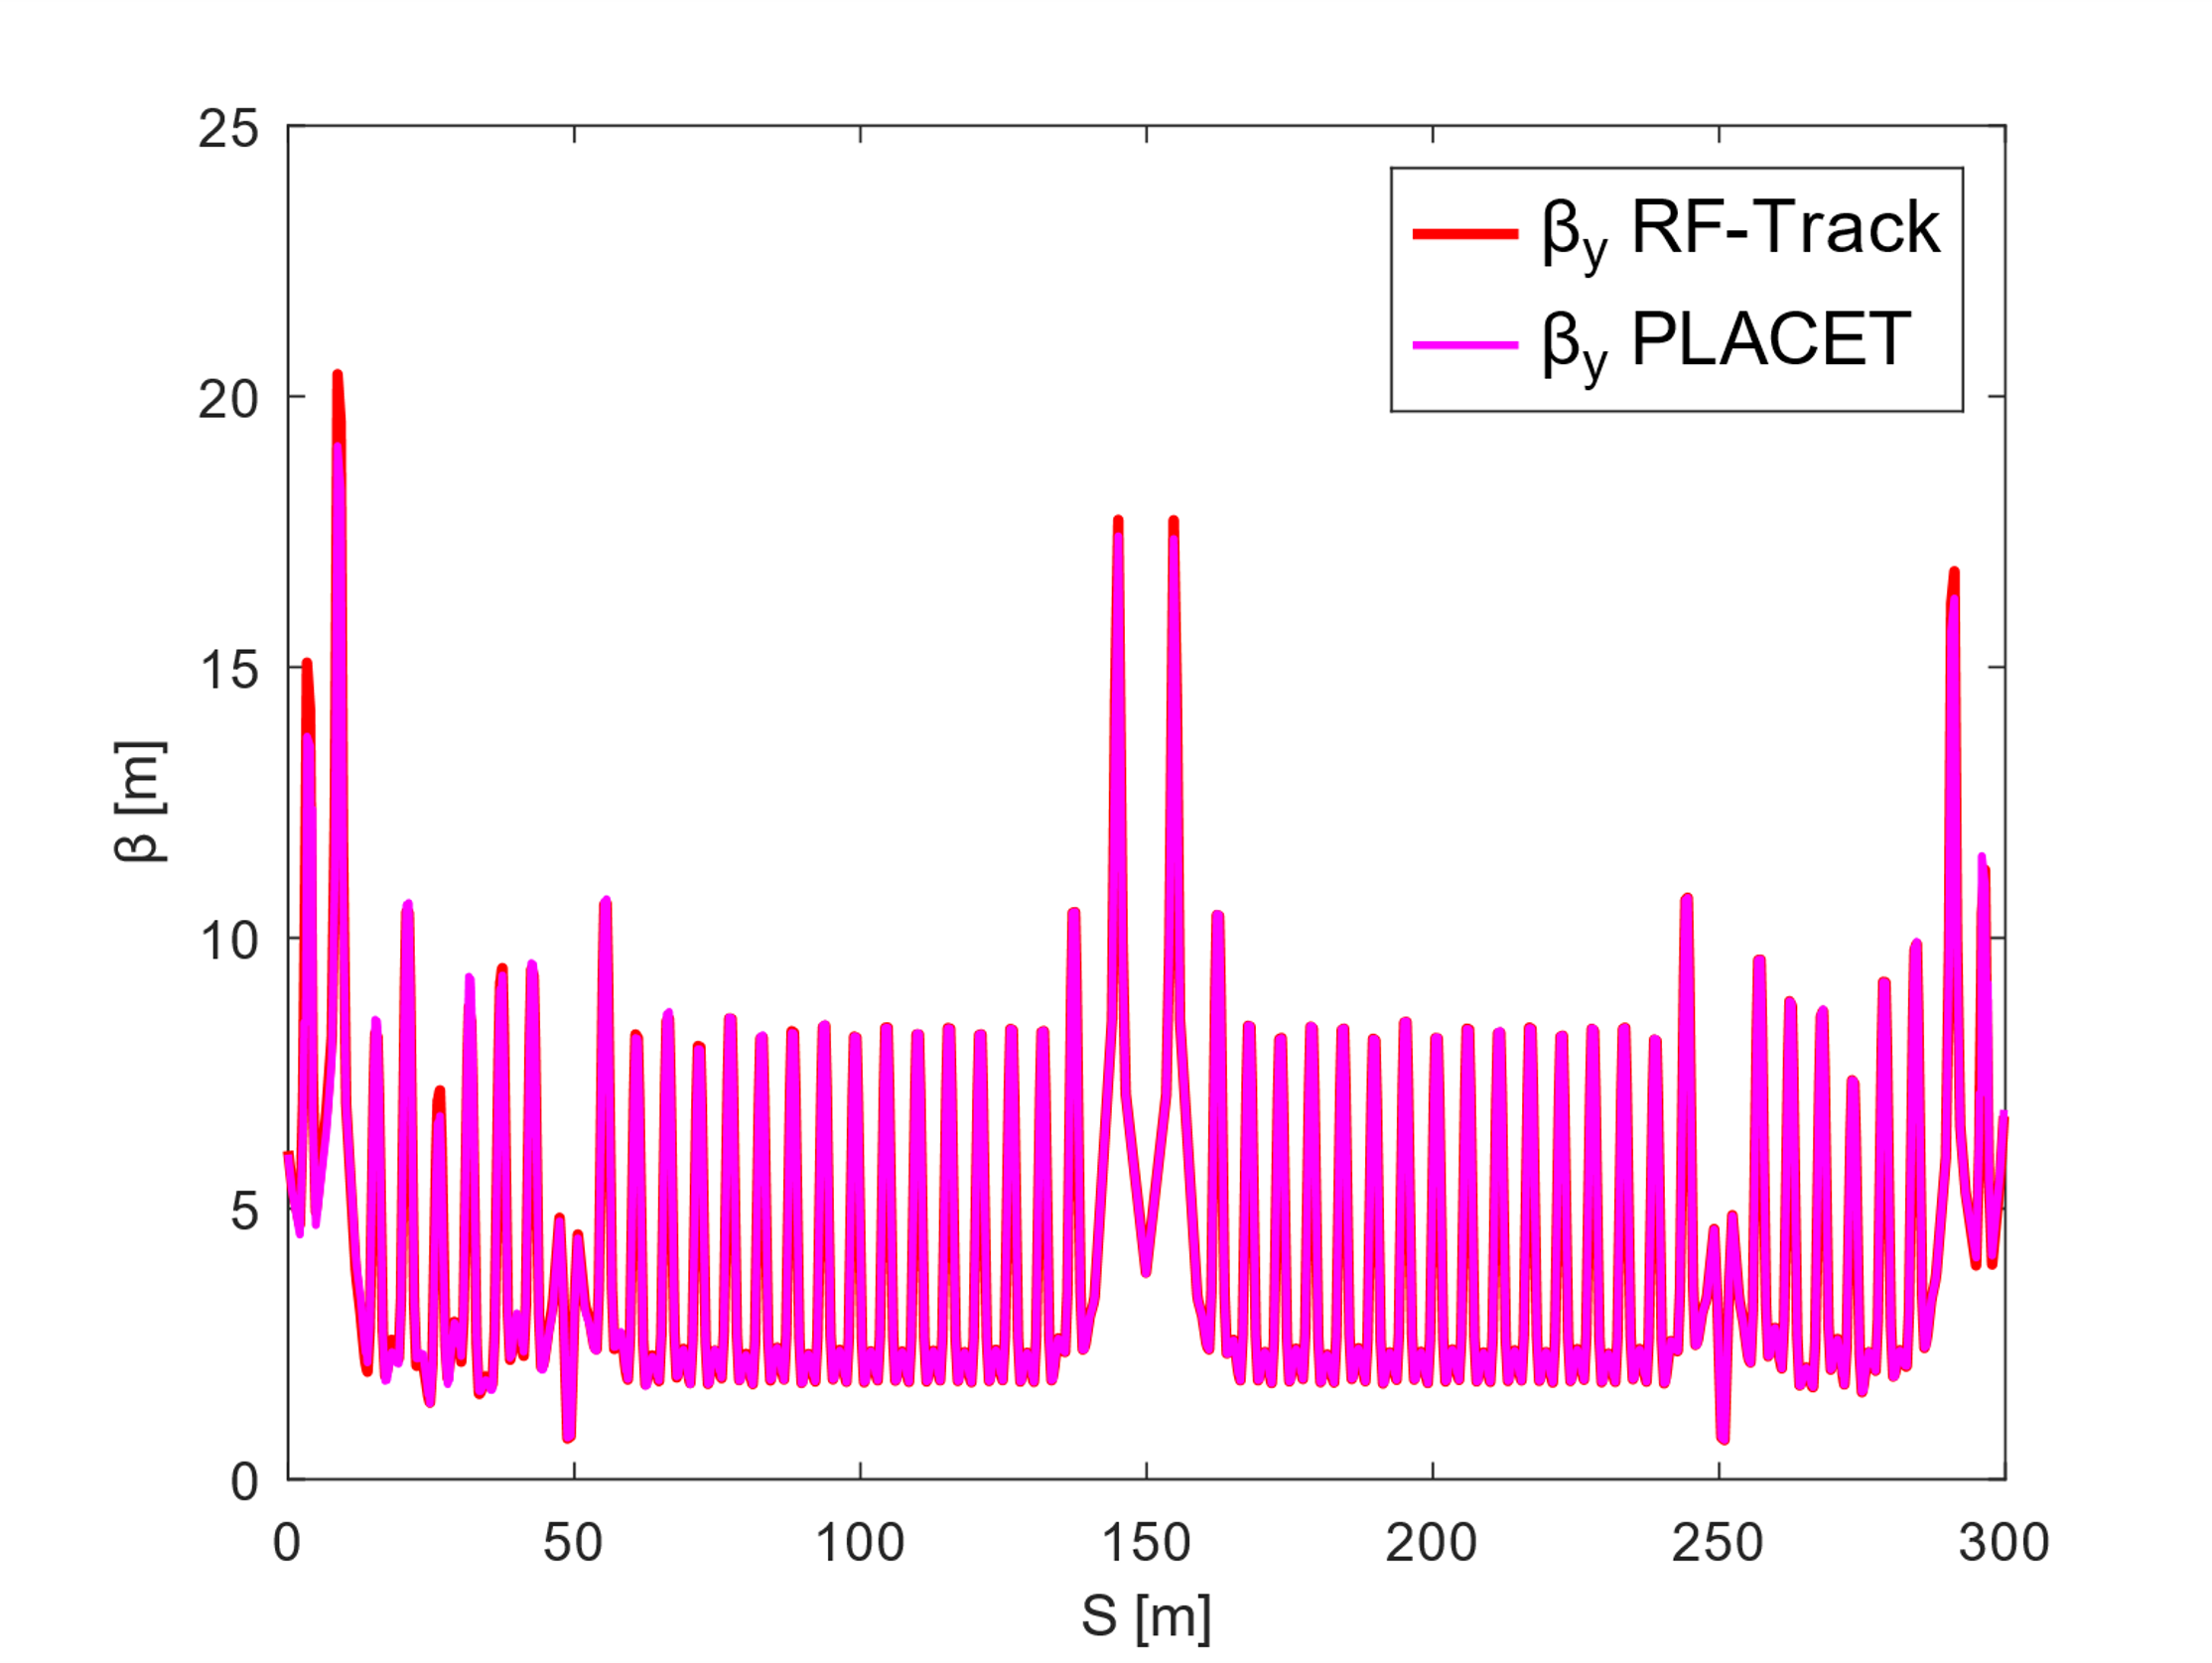
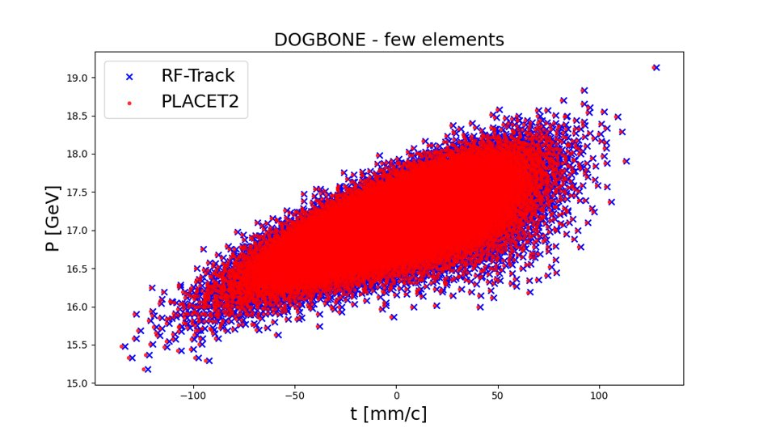
BENCHMARK 3 – Simulation of 1st droplet arc (16.6 GeV) of RLA2
Beta functions along the lattice
Phase space coordinates after the simulation
The small discrepancies in the results, which are more notorious in {y, yp}, come from second order corrections in dipole fringes, only included in RF-Track.
The great agreements allow
to verify the implementations.
12

Slide 14
CONCLUSIONS
PLACET2 tracking expressions, as well as the ones of wakefields and synchrotron radiation (ISR and CSR) have been updated to satisfy the conditions of the initial acceleration stage of the Muon Collider.
  Now, it can simulate particles at any velocity. In particular, non-ultrarelativistic particles.
  Now, it can simulate particles of different species. In particular, muons.
  Now, the individual charge of the particle is included. It can describe µ+ and µ-at the same time.
The decay of particles has been implemented, a new feature of PLACET2.
The performed updates have been successfully benchmarked against RF-Track.
The first arc of the RLA2 of the Muon Collider was simulated and provided an excellent benchmark of the performed updates.
13

Slide 15
FUTURE WORK
Going back to the slide of challenges, there is still a lot of work to do (in red) for performing a complete simulation of the initial acceleration complex.
Simulation of non-ultrarelativistic muons.
  1.1 Update of dynamics descriptions of PLACET2, which assumed ultra-relativistic behaviour (especially longitudinal).
  1.2 Muon decay implementation.
Simulation of particles of different species and charge.
Backwards tracking implementation (in arcs they travel in opposite direction).
Existence of crossing points → Beam-beam interactions.
High intensity beams →Intra-beam scattering (IBS, work in progress in the moment), space-charge, beam-loading.
Possible future idea: Merging the two mentioned linac code simulations: RF-Track and PLACET2.
RF-Track is able to simulate space-charge, beam-beam interactions and beam loading.
However, none of them is able to simulate IBS, so its implementation was settled as priority.
14

Slide 16
Thank you
for your attention

