Slide 1
Muon Collider Magnets
Beginning of a plan
L. Bottura, M. Statera, F. Boattini, S. Mariotto, B. Caiffi, S. Fabbri
IMCC Annual Meeting, 14 March 2024

Slide 2
How did we build the schedule
Divide the plan in phases:
  Conceptual study
  Engineering, demonstration, models
  Full size prototypes
  Pre-series
  Series
  Test
  Installations
Estimate quantities, time and parallel lines based on previous experience (LHC, HL-LHC)
CAVEAT: this is not a formal, self-consistent, nor complete schedule

Slide 3
We have a plan
Muon beam production
Muon beam acceleration
Collider options

Slide 4
Muon beam production – 1/3
Target, decay and capture
Seems feasible, no criticality identified with the schedule
Technology is rather evolved (from fusion) and resorts on “standard” fabrication techniques (TRL=5)
Muon target, decay and capture channel could be built by Y15

Slide 5
Muon beam production – 2/3
6D cooling
Seems feasible, but the number of components is large and will require parallel manufacturing lines
Technology is not yet ready for the high field end (e.g. from stage B5 downwards) (TRL=3)
Integration is a considerable effort
2864 single coils, 1652 cells of 12 types (based on US-MAP)
At least 2 firms for coil production
At least 4 teams for cooling cell integration
The 6D cooling cells could be built by Y17

Slide 6

Muon beam production – 2/3
Final cooling
Seems feasible, no criticalities identified in the schedule
Technology is not yet ready (TRL=2…3)
Performance is the main focus, cost may be less of an issue (small percentage of total cost)
The final cooling cells could be built by Y19

Slide 7
Muon beam acceleration
Pulsed (NC) system
NC magnet construction requires optimization and demonstration, but does not appear to be critical, technology known (TRL=7…8)
Power converter schedule is critical because of the large number of units
Energy storage and power conversion will require development, engineering and demonstration (string test), but relatively known technology (TRL 6…7)
Pulsed (NC) system could be built by Y13 (up to RCS3) and Y17 (RCS4)

Slide 8
Muon beam acceleration
Steady (SC) system
SC magnet construction depends on technology choice, but likely to be HTS (beam losses and field reach)
Schedule is tight w/r to the pulsed system
Technology requires development, engineering and demonstration (TRL=3)
Steady (SC) system could be built by Y18 (up to RCS3) and Y22 (RCS4)

Slide 9
Muon beam acceleration
LTS collider magnets (Nb₃Sn) – 3 TeV
Schedule has been estimated based on LHC and HL-LHC experience
Technology still requires development, but relies on HFM and US-MDP advances (TRL=5…6)
LTS collider magnets could be built by Y17

Slide 10
Muon beam acceleration
HTS collider magnets (REBCO) – 10 TeV
Schedule accommodates relatively long study and demonstration phase
Technology is not yet ready (TRL=2…3)
HTS collider magnets could be built by Y26

Slide 11
Final words on the plan
A plan is a living entity, it is made to be changed
A plan is a tool to facilitate our work
A plan is a powerful instrument to set work objectives and priorities
To work well, a plan needs to be shared and integrated

Slide 12

Hic Svnt Dracones

Slide 13
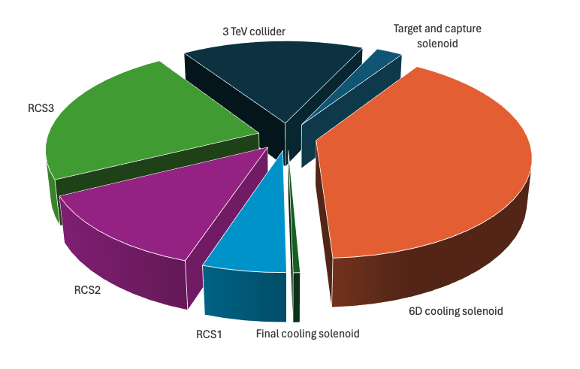
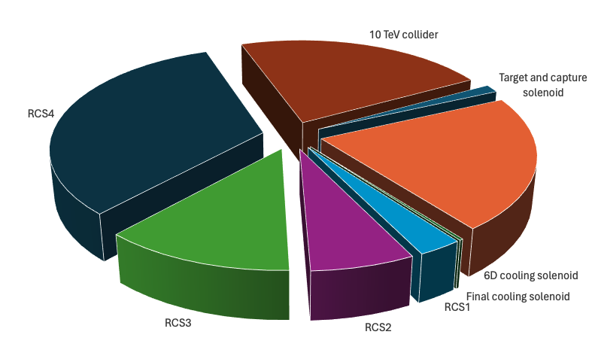
We have a cost estimate
3 TeV
Share in percentage of total cost for the magnet and powering systems
10 TeV
Share in percentage of total cost for the magnet and powering systems
The 6D cooling and accelerator (RCS) are the largest cost positions
RCS4 is the largest single cost item in the 10 TeV collider option
Target and capture (largest stored energy single magnet in the system) and final cooling (largest nominal field) only represent a few % of the total cost

