Slide 1
Front End
Buncher and φ-E Rotator
David N
IMCC
Mars 2024

Slide 2
Outline
Introduction + history
  Motivation:
    Proton beam on Hg target –small
    Drift + Rotate to small δE for cooling
    High- frequency buncher and phase rotator
IDS “Neutrino Factory” 200 MHz (2011)
Front End for MAP - Muon Collider (2014)
  325 MHz baseline
Major changes
  Chicane and absorber –C Rogers
  Helical Snake 6-D Cooler Y. Alexahin
Optimization
Inverse phase-energy rotator
  Bunch recombiner
Future Variations

Slide 3
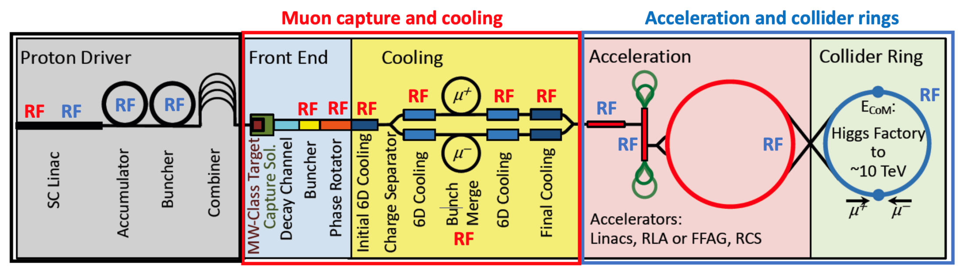
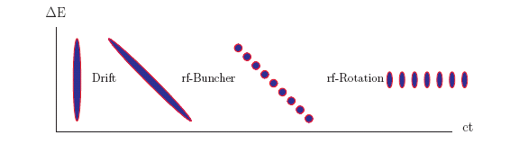
(v⁻¹)

Slide 4
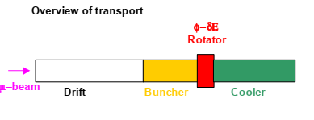
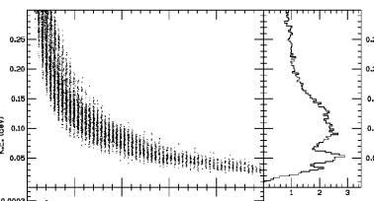
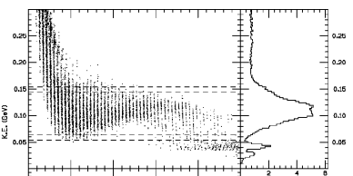
INTRODUCTION
Drift + “rf” Buncher after target
  R. Palmer -1994
    Short bunch, large δE → long bunch, small δE
    But long bunch means low freq. rf (< ~20 MHz)
  High frequency rf forms train of bunches (>200 MHz)
    match rf phase, mismatch frequency ??- 2000
  Fixed frequency Rotator → adiabatic vernier rotator
    D Neuffer – A. van Ginneken PAC 2001 TPPH16
  Works for both signs μ⁺ μ⁻ !!

Slide 5
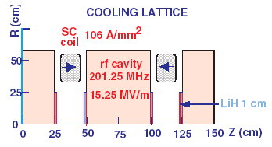
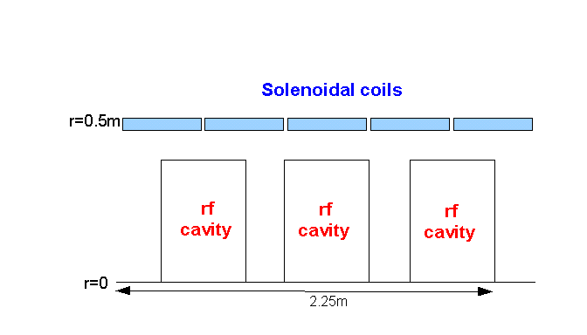
IDS Baseline Buncher and φ-E Rotator
Drift (π→μ)
“Adiabatically” bunch beam first (weak 320 to 232 MHz rf)
Φ-E rotate bunches – align bunches to ~equal energies
  232 to 202 MHz, 12MV/m
Cool beam 201.25MHz ~15 MV/m rf
Captures and Cools both μ⁺ and μ⁻
p
π→μ
FE Target
Solenoid
Drift
Buncher
Rotator
Cooler
18.9 m
~60.7 m
~33m
42 m
~80 m

Slide 6
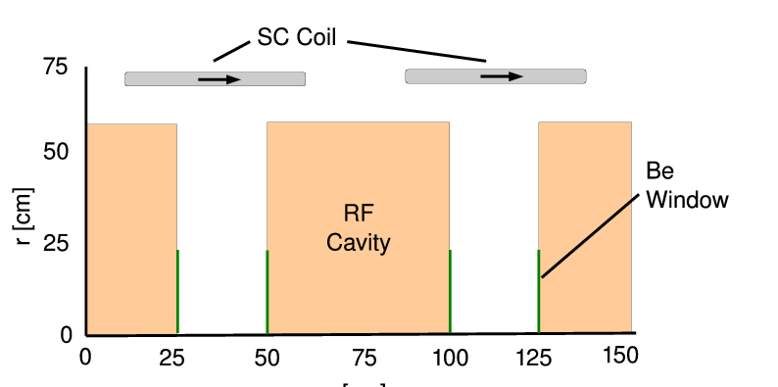
325MHz System “Collider”-MAP
Drift
  20T→ 2T
Buncher
  P_{o}=250MeV/c
  P_{N}=154 MeV/c; N=12
  V_{rf} : 0→ 15 MV/m
    (2/3 occupied)
  f_{RF} : 490→ 365MHz
Rotator
  V_{rf} : 20MV/m
    (2/3 occupied)
  f_{RF} : 364→ 326MHz
  N=12.045
  P_{0,} P_{N}→245 MeV/c
Cooler
  245 MeV/c
  325 MHz
  25 MV/m
  2 1.5 cm LiH absorbers
  /0.75m

Slide 7
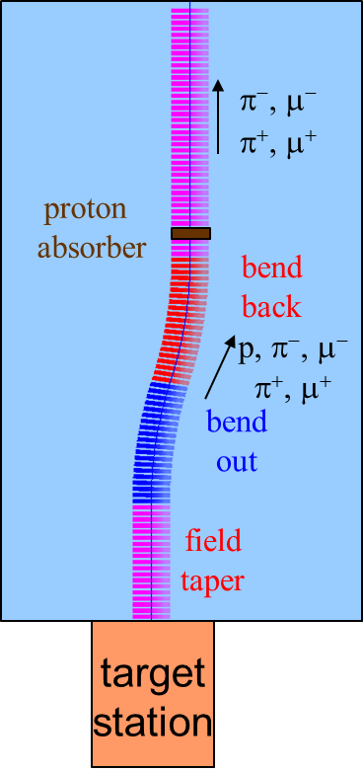
Chicane
Initial version was open from target to cooler
  Accepts μ⁺, μ⁻ at ~250 MeV/c
  Also accepts everything else p, e⁺⁻
Introduce chicane + absorber to filter out unwanted particles (C. Rogers, et al.)
  Chicane cuts out P > 500 MeV/c
  Absorber stops protons, electrons, pi, ….
    30 cm Be
Can we introduce without destroying front end ??
SREGION ! Bent solenoid
6.5 1 1e-2
1 0. 1.0
BSL
1 2.0 0.0 1 0.283 0.0 0.058181 0.0 0.0 0.0 0. 0. 0. 0. 0.
VAC
NONE
0. 0. 0. 0. 0. 0. 0. 0. 0. 0.

Slide 8
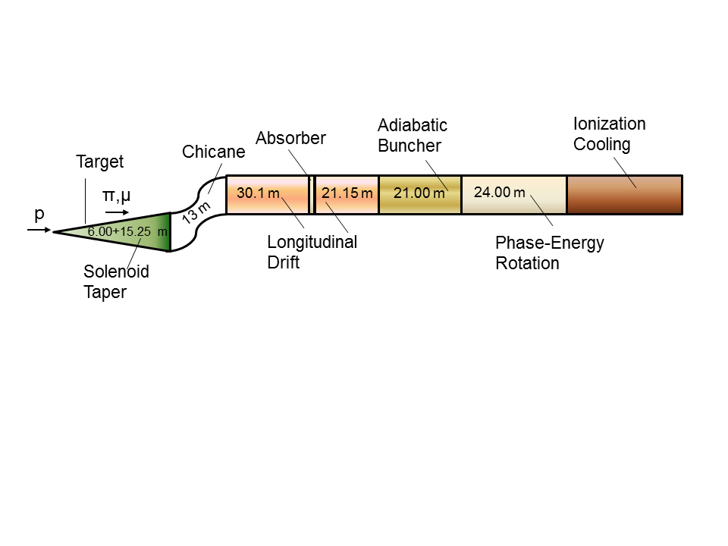
325 “Collider “ w Chicane/Absorber
Chicane + Absorber
Add 30 m drift after chicane
  *6.5m → +21.67°,-21.67º
Add chicane + absorber
    particle 1-283 MeV/c
    particle 2-194 MeV/c
  absorber at 54m
    10cm Be
    particle 1-250 MeV/c
    particle 2-154 MeV/c
  Bunch (N=12) 0→15 MV/m :490→ 365 MHz
  Rotate (N=12.045 )– 20MV/m : 365 → 326.5 MHz
  Cool -325MHz -25 MV/m
    p_{ref}=245 MeV/c

Slide 9
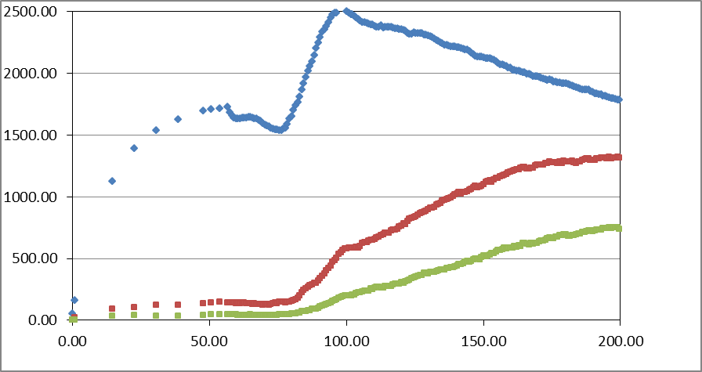
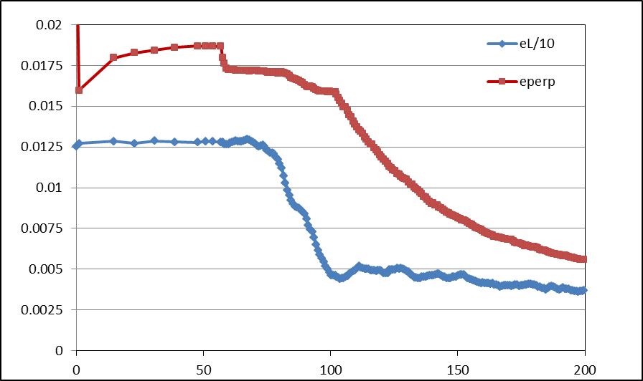
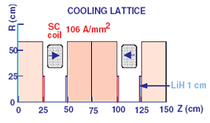
Simulation Results
Simulation obtains
  ~0.12 μ/p within acceptances
  ~2014 MARS
  8 GeV proton source
FOFO cooling
  Cools transversely
  By factor of 3
    ~10× in 6-D phase space
N :0.15<P<0.35 GeV/c
N: ε_{T}<0.03; A_{L}<0.2
N: ε_{T}<0.015; A_{L}<0.2
Useful
cooling

Slide 10
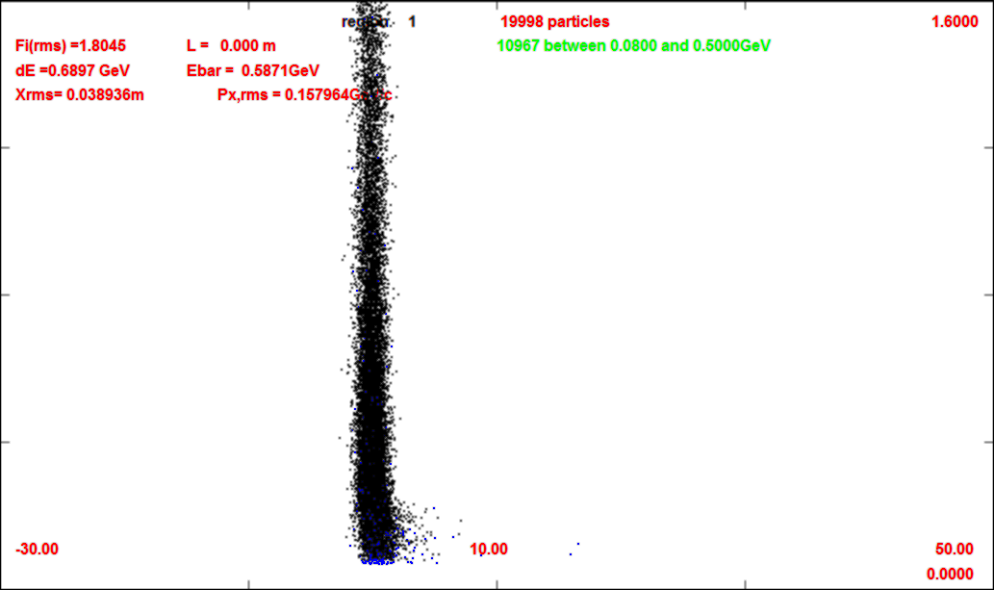
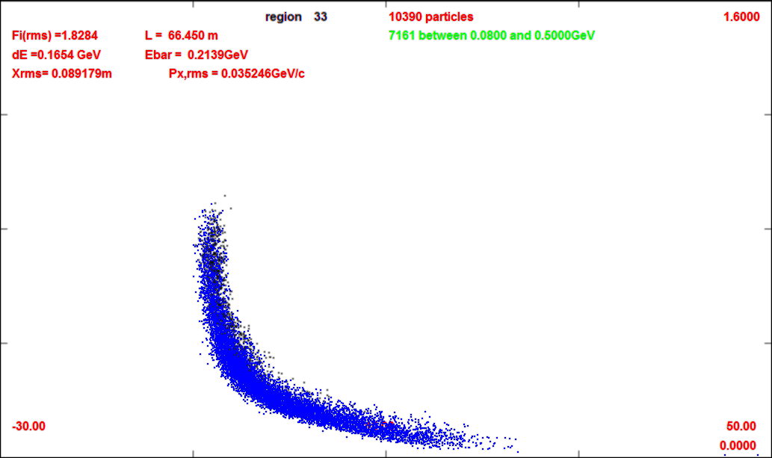
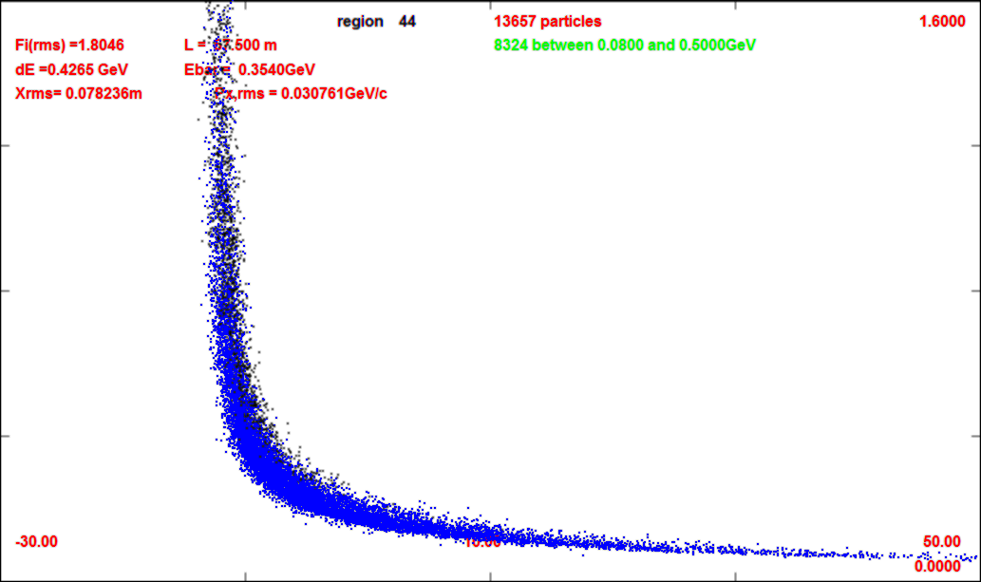
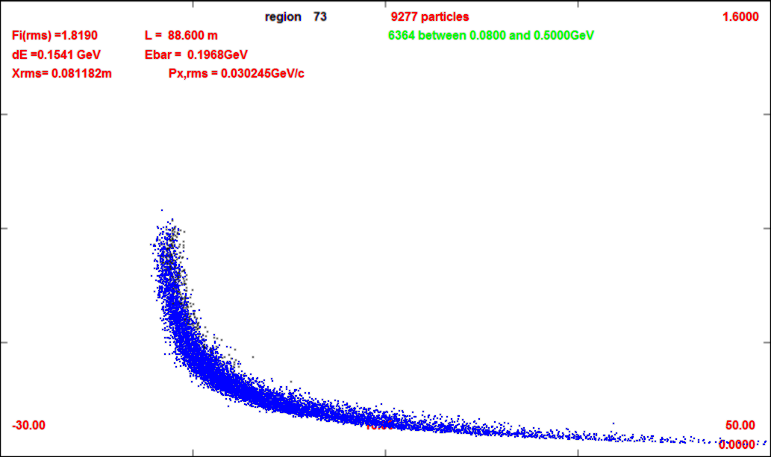
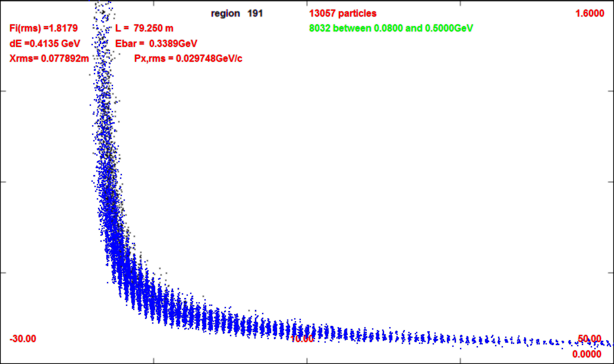
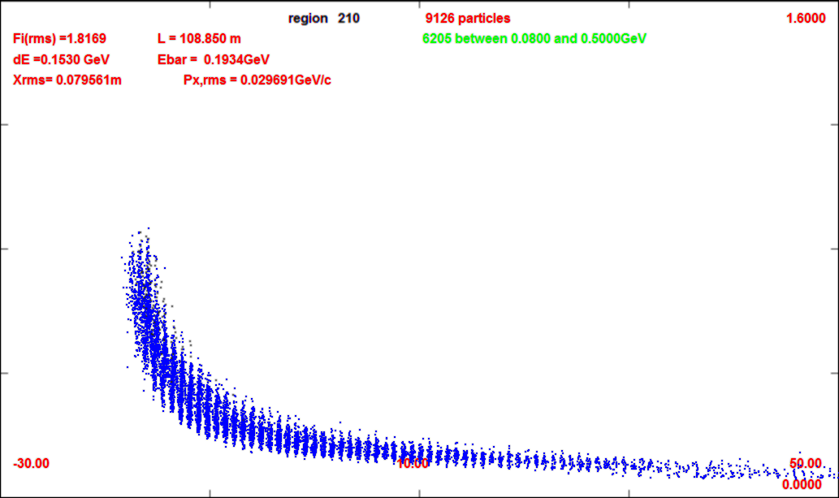
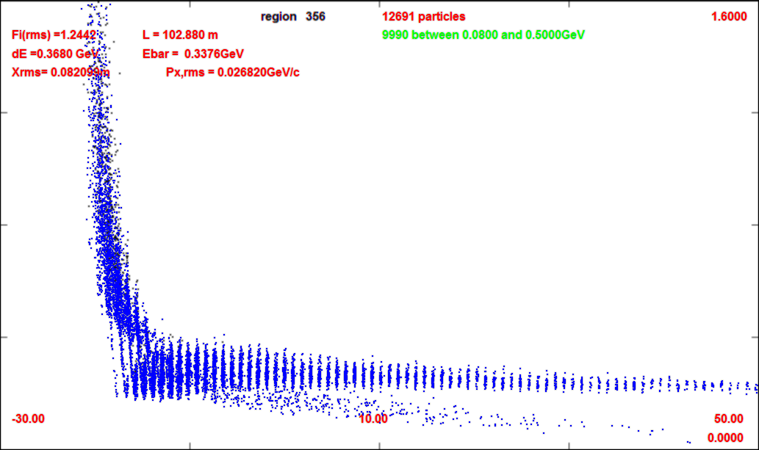
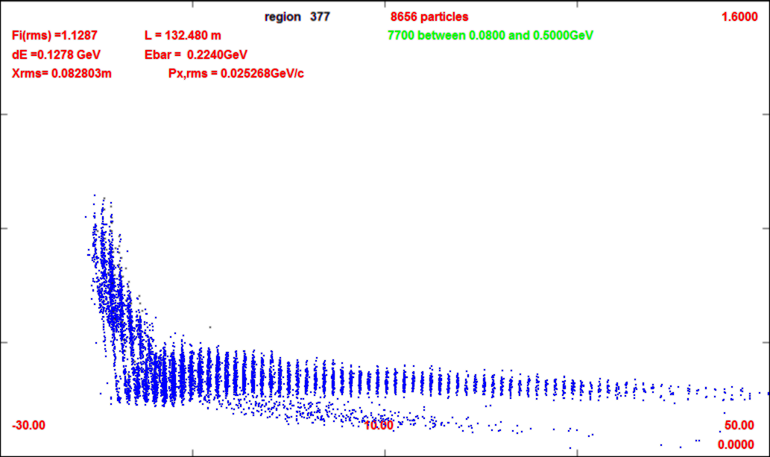
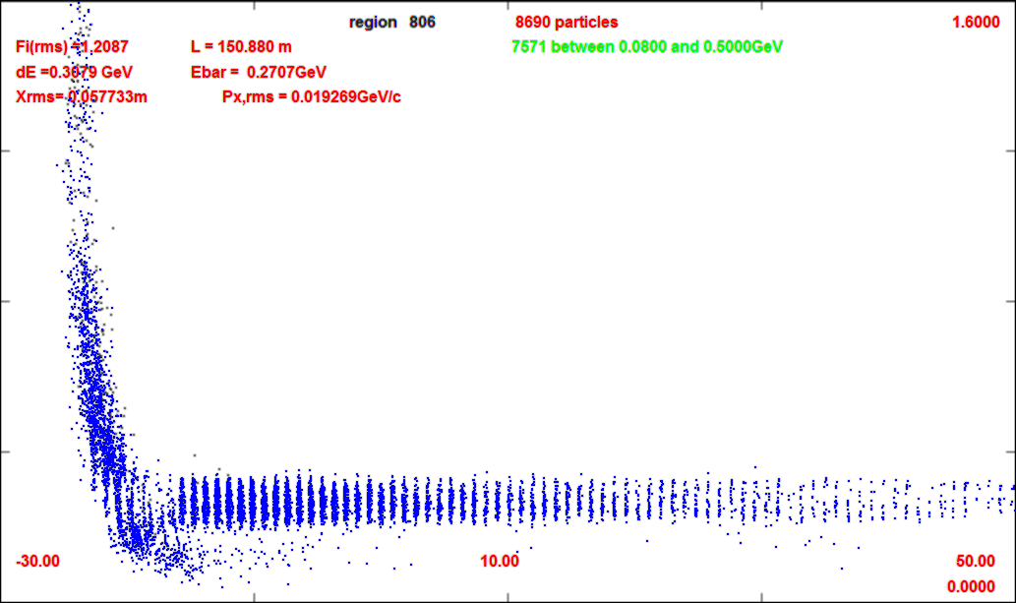
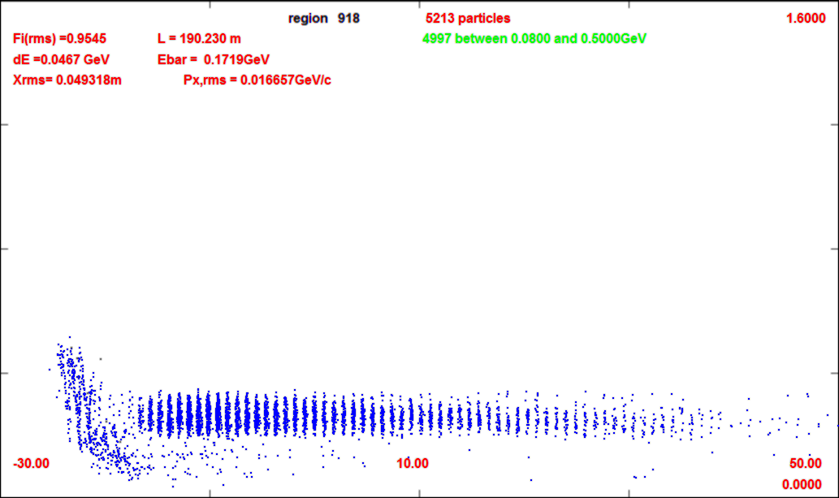
Compare without/with chicane
0m (production target)
-30m
-50m
1600 GeV/c
0m
66m (after chicane/absorber)
1600 GeV/c
0 GeV/c
57m
88m (after drift)
0 GeV/c
109m (after buncher)
79m
102m
-30m
132m (after rotator)
50m
21 bunches for Collider
152m
190m (after cooling)

Slide 11
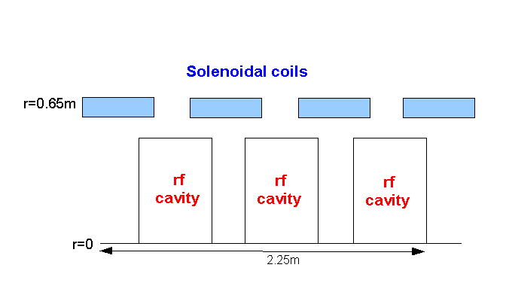
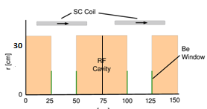
Rf Buncher/Rotator requirements
Buncher -21m → 17.5 m
  37 cavities (14 frequencies)
  13 power supplies (~1—3MW)
RF Rotator -24m
  64 cavities (16 frequencies)
  20 MV/m, 0.25m
  ~2 MW (peak power) per cavity
Cooling System – 325 MHz
  200 0.25m cavities (75m cooler), 25MV/m
  ~4MW /cavity
Front End section | Length | #rf cavities | frequencies | # of freq. | rf gradient | rf peak power requirements
Buncher | 21m | 42 | 484 to 365 | 14 | 0 to 16 | 0—1.34 MW/cavity
Rotator | 24m | 56 | 364to 326 | 16 | 20 | ~2.4 MW/cavity
Cooler | 75m | 200 | 325 | 1 | 25 MV/m | ~3.7MW/cavity
Total df+bxr+rttr | ~134m | 93 |  | 30 | ~500MV | 140MW
6-D cooler | 126m | 360 | 325 MHz | 1 | 25 MV/m | ~3.7 MW

Slide 12
Simulation Results
Simulation obtains
  ~0.12 μ/p within acceptances
  ~2014 MARS
  8 GeV proton source
FOFO cooling
  Cools transversely
  By factor of 3
    ~10× in 6-D phase space
N :0.15<P<0.35 GeV/c
N: ε_{T}<0.03; A_{L}<0.2
N: ε_{T}<0.015; A_{L}<0.2
Useful
cooling

Slide 13
Table of rf cavities, power
Buncher frequency (MHz) | Buncher gradient (MV/m) | RF Power /cavity (MW) (4 cavities)
488.42 | 0.80 | 0.001
478.17 466.42 455.24 444.56 434.45 424.70 | 1.33/1.87 2.40/2.94 2.94/3.48 4.55/5.08 5.62/6.15 6.64/7.23 | 0.007 0.015 0.053 0.086 0.13 0.19
415.39 | 7.76/8.30 | 0.27
406.49 397.97 389.80 381.95 374.42 | 8.83/9.37 9.90/10.4 11.2/11.5 12.0/12.6 13.1/13.7 | 0.35 0.46 0.58 0.71 0.86
367.18 | 14.2/14.8 | 1.0
Rotator frequency (MHz) | Rotator gradient (MV/m) | RF Power /cavity (MW) (4 cavities)
361.67 | 20 | 2.06
355.70 350.60 346.23 342.48 339.27 336.54 | 20 20 20 20 20 20 | 2.1 2.14 2.19 2.23 2.26 2.28
334.23 | 20 | 2.30
332.27 330.62 329.35 328.30 327.50 | 20 20 20 20 20 | 2.31 2.32 2.33 2.34 2.35
326.92 | 20 | 2.36
326.54 | 20 | 2.37
326.37 | 20 | 2.37
First few buncher cavities are very low gradient;
should be removed, grouped or increased in strength

Slide 14
Table of rf cavities 352 match
Buncher frequency (MHz) | Buncher gradient (MV/m) | RF Power /cavity (MW) (4 cavities)
502.96 489.98 477.65 465.93 | 2.94/3.48 4.55/5.08 5.62/6.15 6.64/7.23 | 0.053 0.086 0.13 0.19
454.76 | 7.76/8.30 | 0.27
444.12 433.97 424.27 414.99 406.11 | 8.83/9.37 9.90/10.4 11.2/11.5 12.0/12.6 13.1/13.7 | 0.35 0.46 0.58 0.71 0.86
398.35 | 14.2/14.8 | 1.0
Rotator frequency (MHz) | Rotator gradient (MV/m) | RF Power /cavity (MW) (4 cavities)
391.39 | 20 | 2.06
384.81 379.21 374.42 370.37 366.84 363.88 | 20 20 20 20 20 20 | 2.1 2.14 2.19 2.23 2.26 2.28
361.37 | 20 | 2.30
359.28 357.56 356.18 355.60 354.67 | 20 20 20 20 20 | 2.31 2.32 2.33 2.34 2.35
353.99 | 20 | 2.36
353.55 | 20 | 2.37
353.35 | 20 | 2.37
25 frequencies

Slide 15
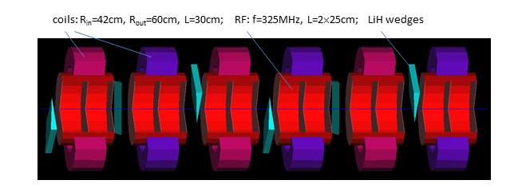
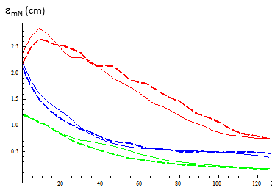
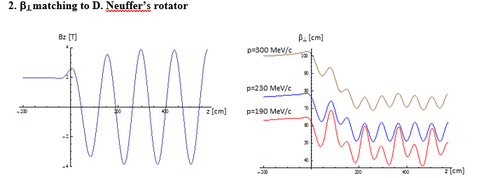
6-D Alexahin cooler
Initial version had transverse-only cooler
Helical FOFO snake
  Alternating tilted solenoids
126 m long
  2 cavities every 0.7m
  160 0.25m cavities 25 MV/m
Cools longitudinally and transversely
  ε_{L} × 1/3, ε₁ × 1/6 , ε₂× 1/5
  ~1/100 × (6-D cooling)
Cools both μ⁺ and μ⁻

Slide 16
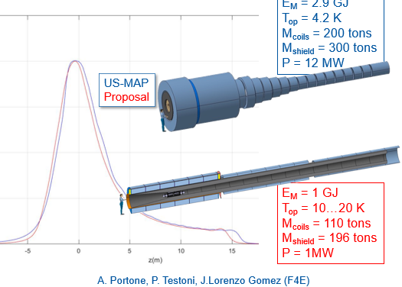
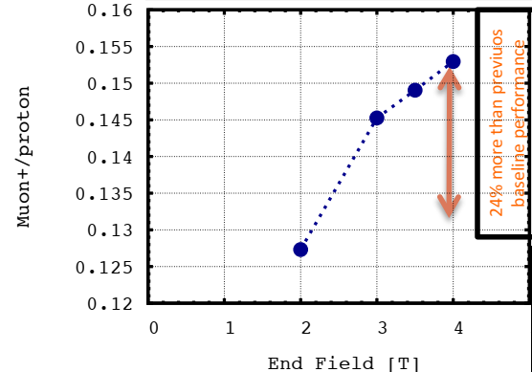
Some Optimizations (H. Sayed)
Adiabatic transition from high-field to low field ?
  20T → 2 T in 15m?
  Shorter transition is better
Focusing field in channel
  2T constant field in baseline
More Field is better
  2→3→4 T
  Alternating gradient ?

Slide 17
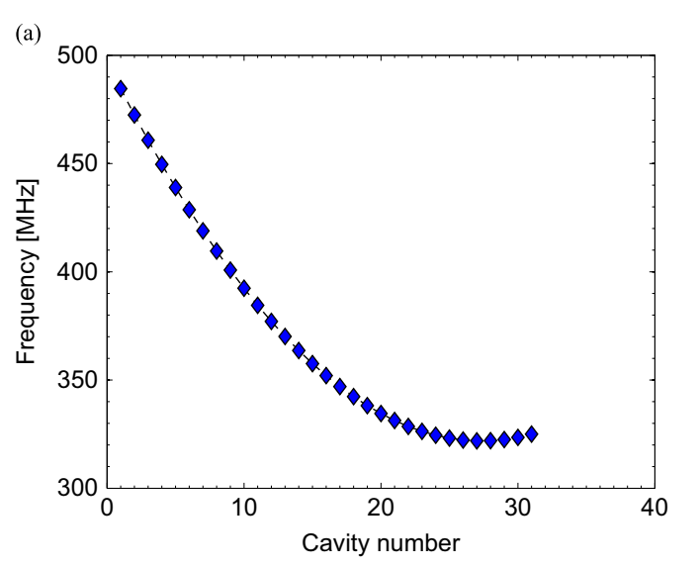
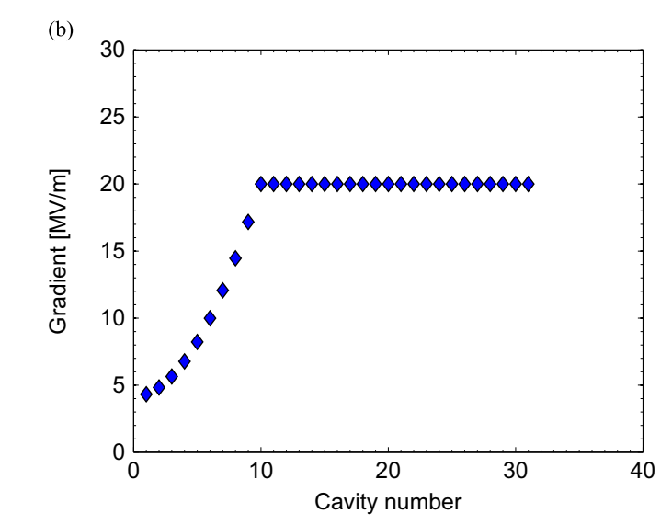
Optimization (H. Kamal Sayed)
H. Kamal Sayed, NIM A 794 (2015) 193–199
Buncher +Rotator-31 cavity sets
  Changed frequency, rf gradient
Optimized using NERSC supercomputer using evolutionary optimization algorithm, 100’s of simulations
  Increase E_{rf} in Buncher
    By ~4 MV/m
    Higher gradient better
      10—20 MV/m Buncher ~5—10% more
  Rf reaches 325 MHz faster …
    Could use shorter system ?
    Could start further downstream
Rotator
Buncher

Slide 18
Recombiner options
MAP 2014
  3 longitudinal
  7 transverse

Slide 19
Summary Front End Design
Buncher/Rotator scenario parameters developed semiempirically
  Guided by simulations, extrapolation, intuition
Neutrino Factory Scenarios, Muon Collider scenarios done similarly
Tweaked to include chicane absorber
Should develop less empirically ??

Slide 20
Scenario Construction
Parameters available in ICOOL constrain method
Start with final rf frequency
  325 MHz
Select 2 reference particles
  Initial momentum 250 MeV/c / 180 MeV/c
Select number of bunches (between references)
  n = 12
Buncher length, rf gradients
  21 m 0→16 MV/m
Rotator length, rf gradient
  N =12.05, 24m, 20 MV/m
  Icool parametrization not ideal
    Ref particle accelerations → 245 MeV/c
Adjust lengths to match
Match to cooling

Slide 21
Large number of parameters
Target + collection magnet
  20 T → 2? T
Chicane + absorber
  Location, strength of
  Chicane and Absorber
Buncher / Rotator
  B = const or alternating solenoid ?
Match into cooling
  Initial cooling
    4-D or 6-D
    Alexahin-type

Slide 22
Thank you
for your attention

Slide 23
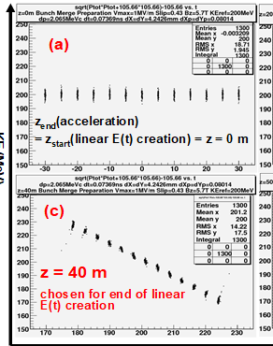
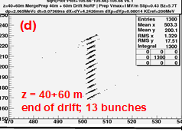
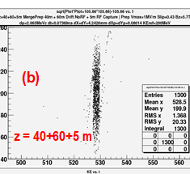
Time –reversed version
Bunch-Recombiner
  Start with train of bunches
    Cooled beam after initial cooler
  Vernier rf to bunch train
Can recombine bunch train after initial cooler to single bunch for final cooler
Looks cleaner than Front-end
  Starts with cold muons-only
  C. Yoshikawa, C. Ankenbrandt, D. Neuffer, K. Yonehara
  IPAC2012, TUPPD013
  MuCOOL note 548 (2010)

Slide 24
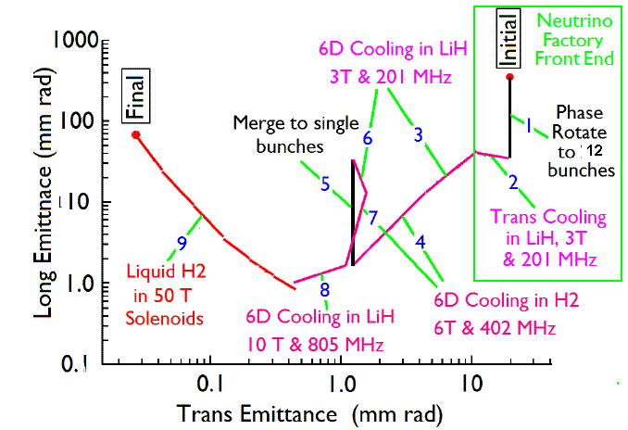
Bunch merge
Longitudinal Merge
Compare 1-D bunch merge
  And 3-D
Bunch
Merge
Transverse Merge
ε_{T}
Trans
σ_{t}

