Slide 1
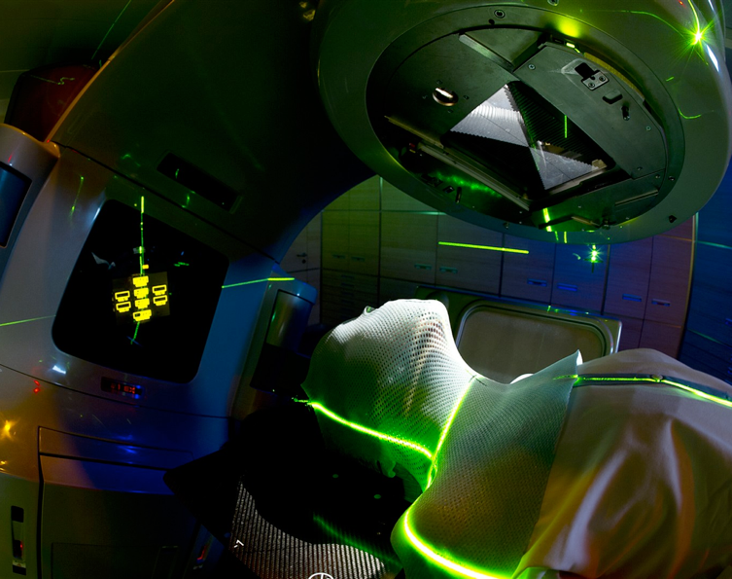



From Fundamental Research To MedTech
CERN Knowledge Transfer Group – Medical Applications

Slide 2
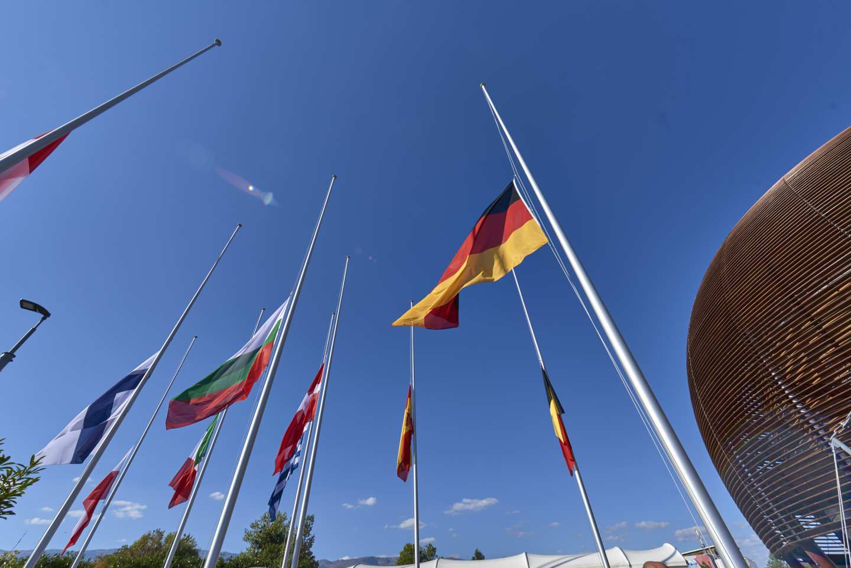

Conseil Européen pour la Recherche Nucléaire
European Organization for Nuclear Research

Slide 3


Slide 4
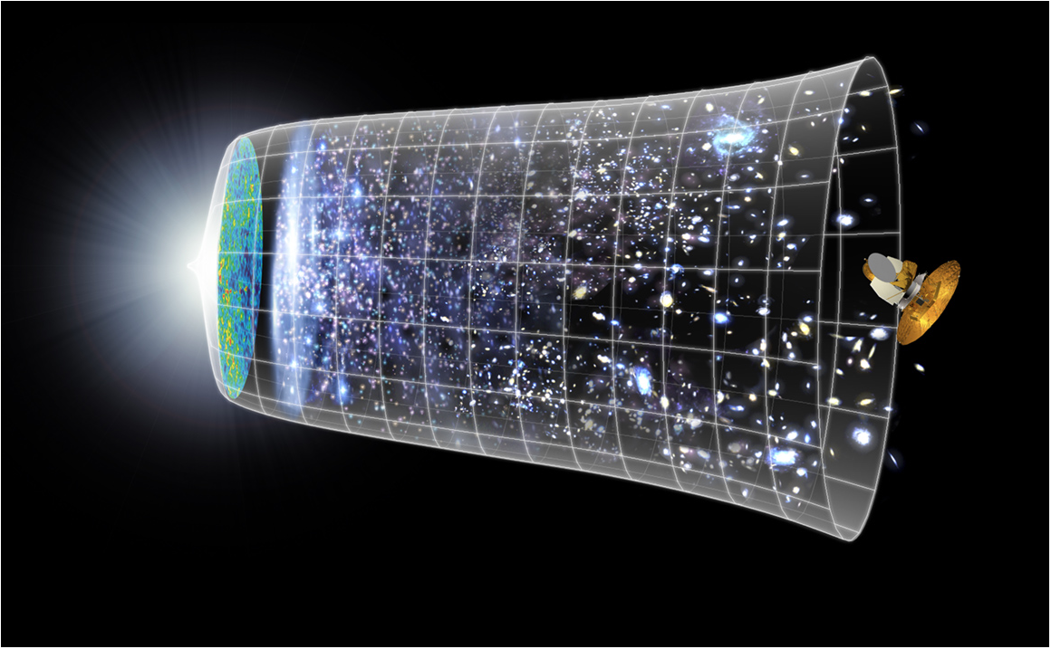
CERN mission
13.7 billion years
Today
10²⁸ cm

Slide 5
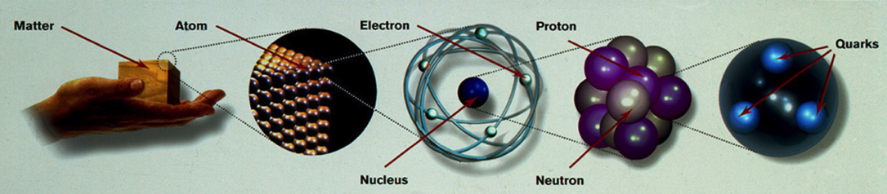
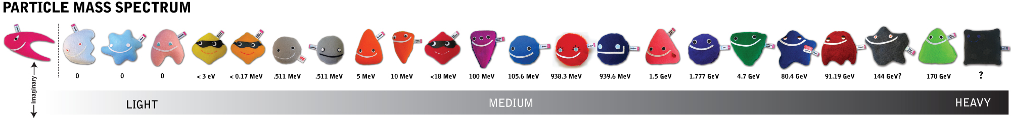
Fundamental Physics

Slide 6
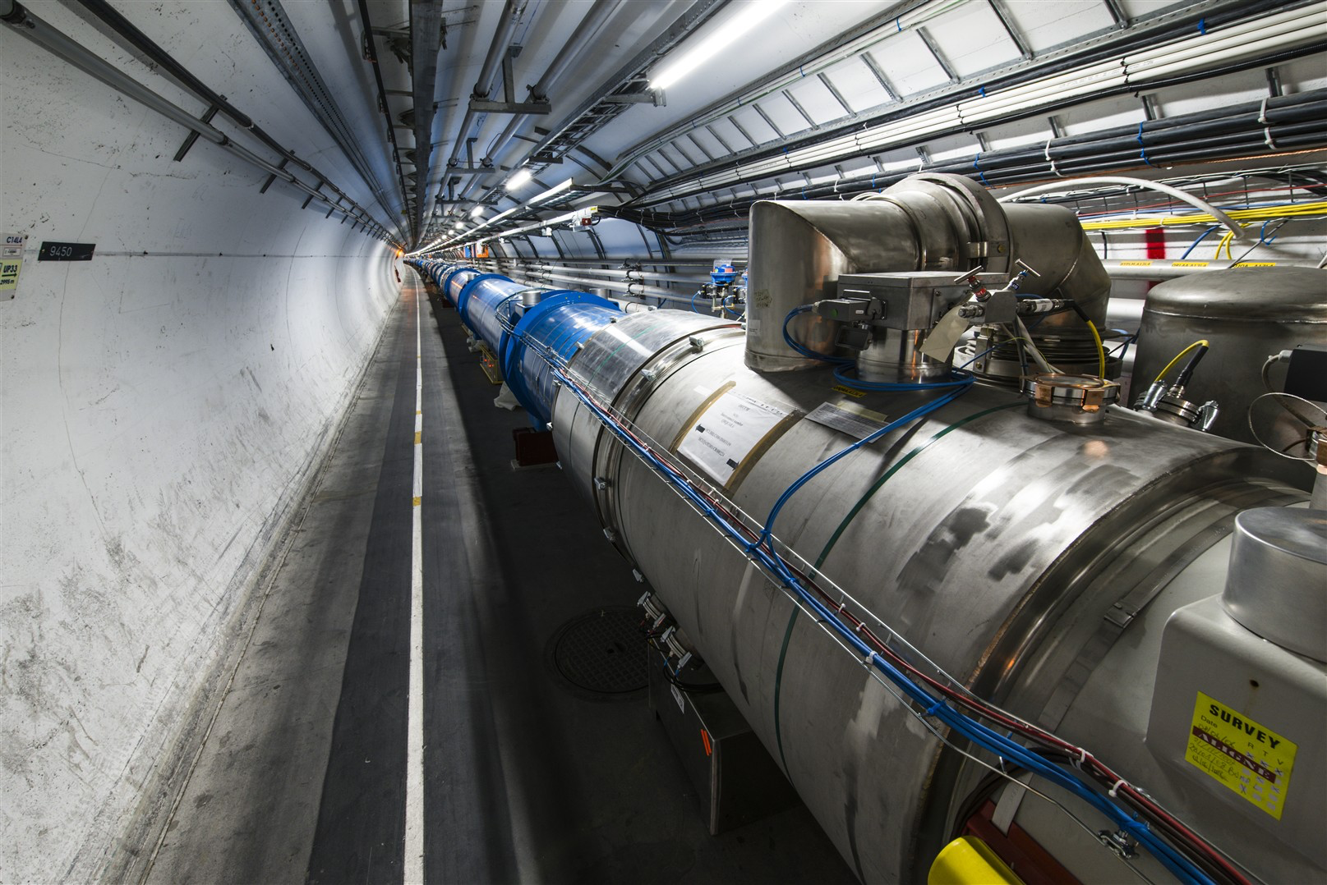
Accelerators

Slide 7

Detectors

Slide 8
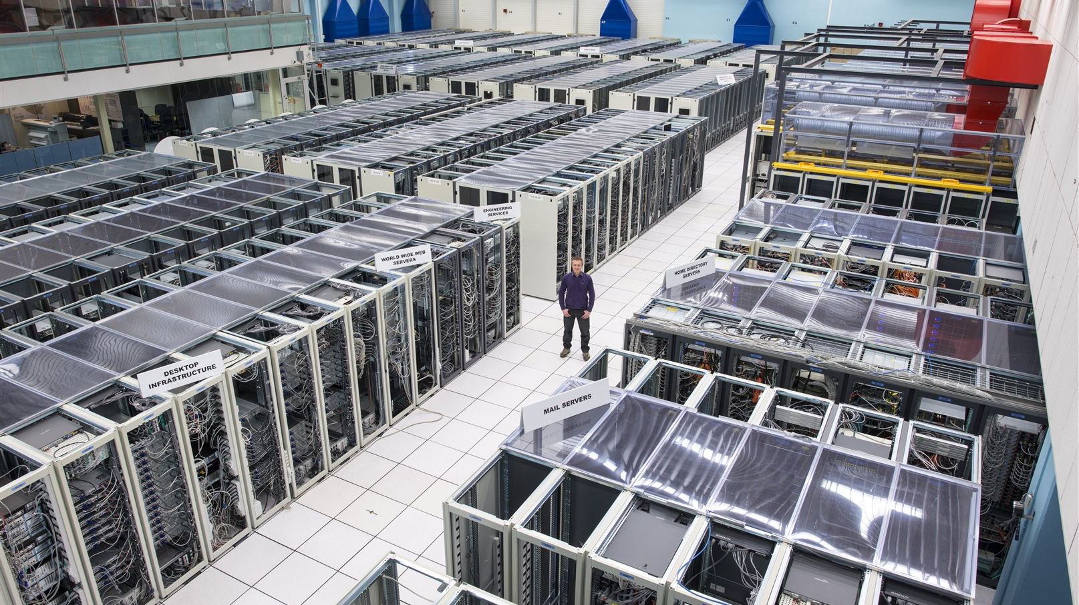
Computing

Slide 9
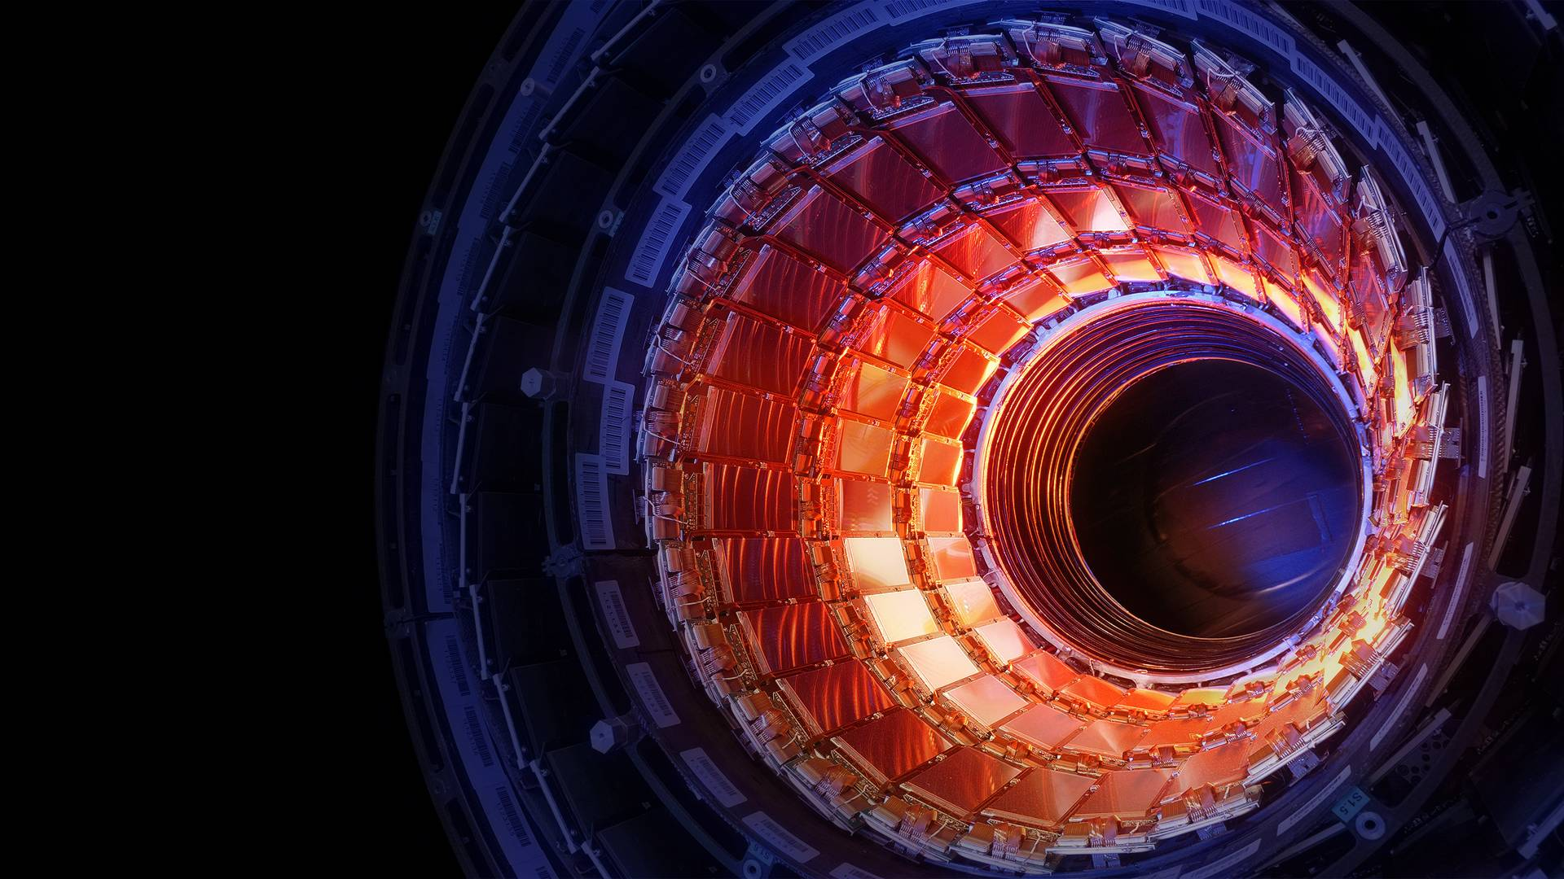
RESEARCH
TECHNOLOGY
TRAINING
COLLABORATION

Slide 10
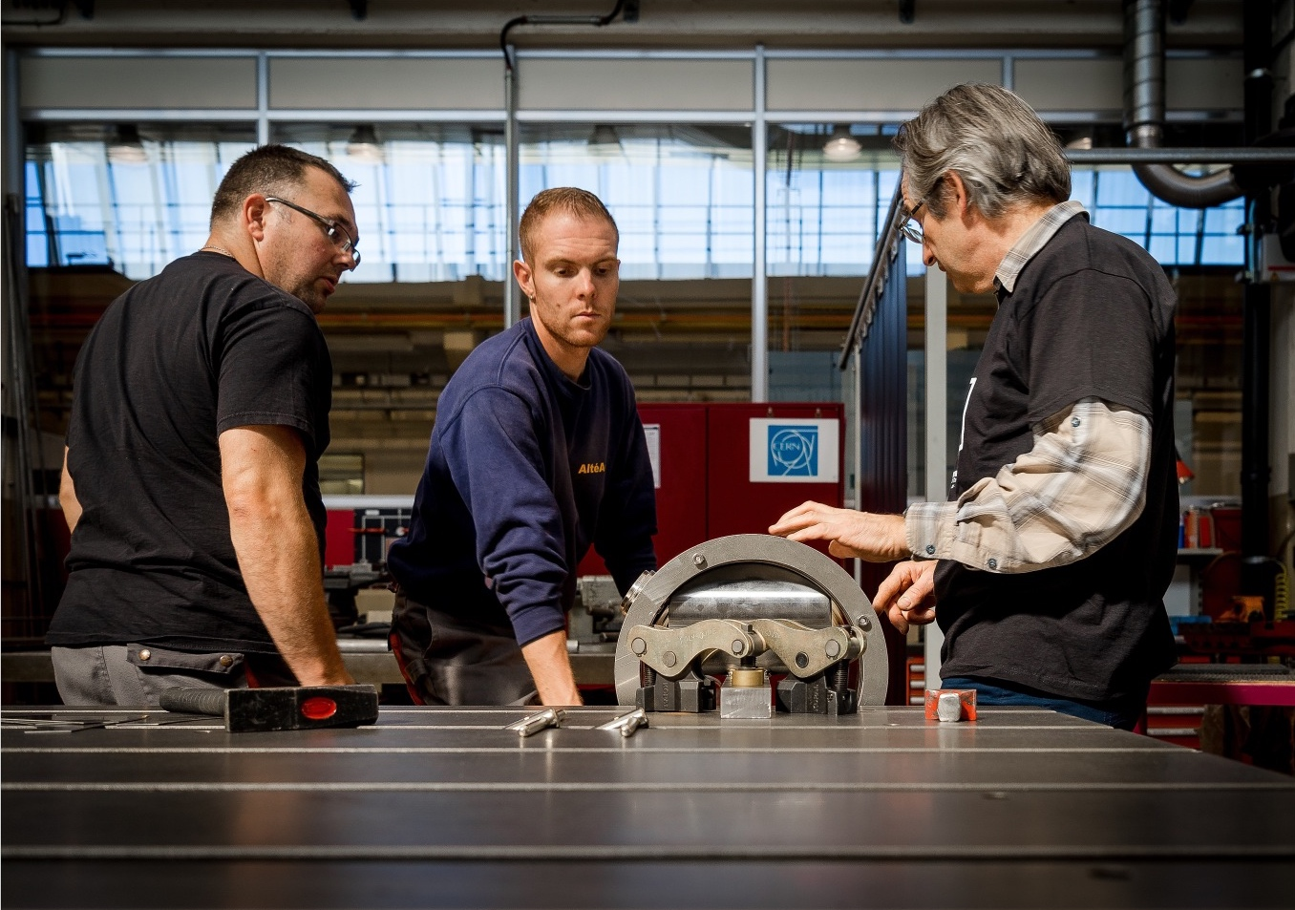
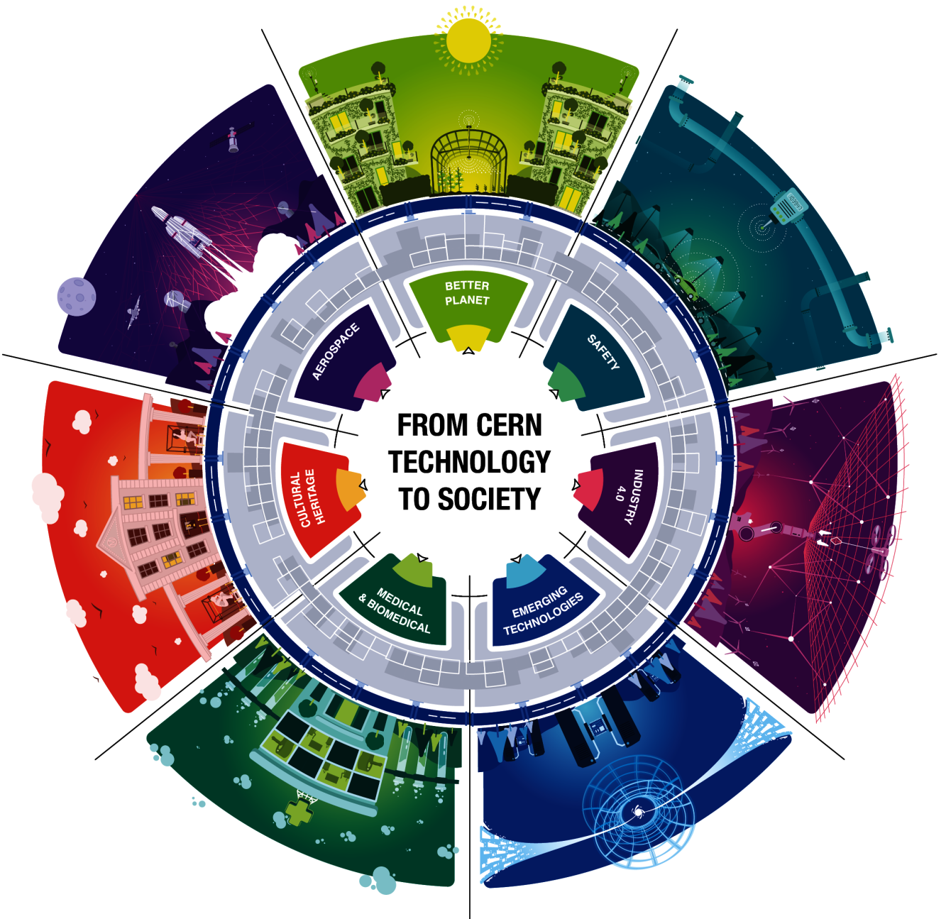
Knowledge Transfer

Slide 11
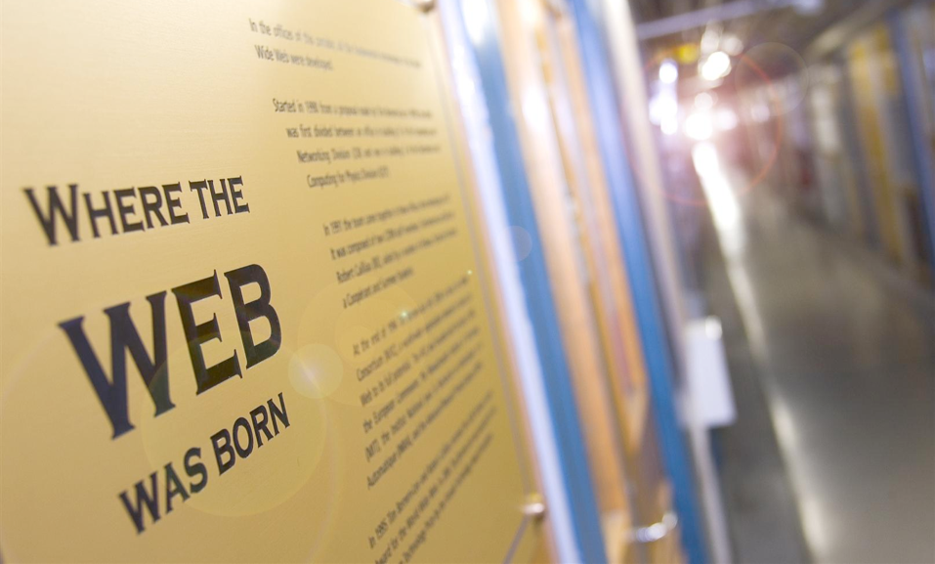
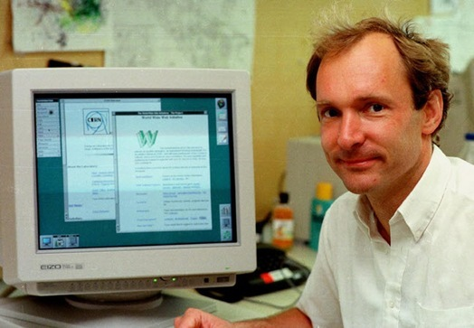

Slide 12
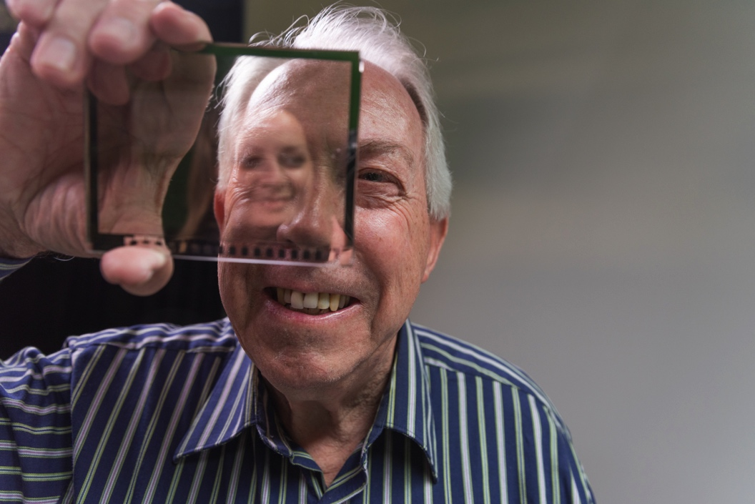
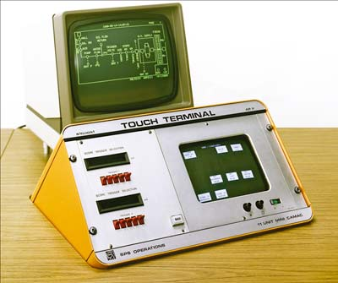

Slide 13
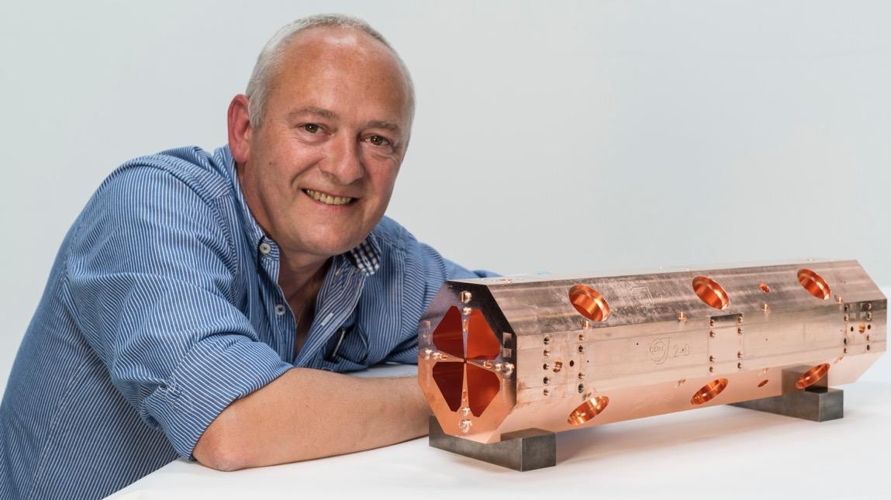
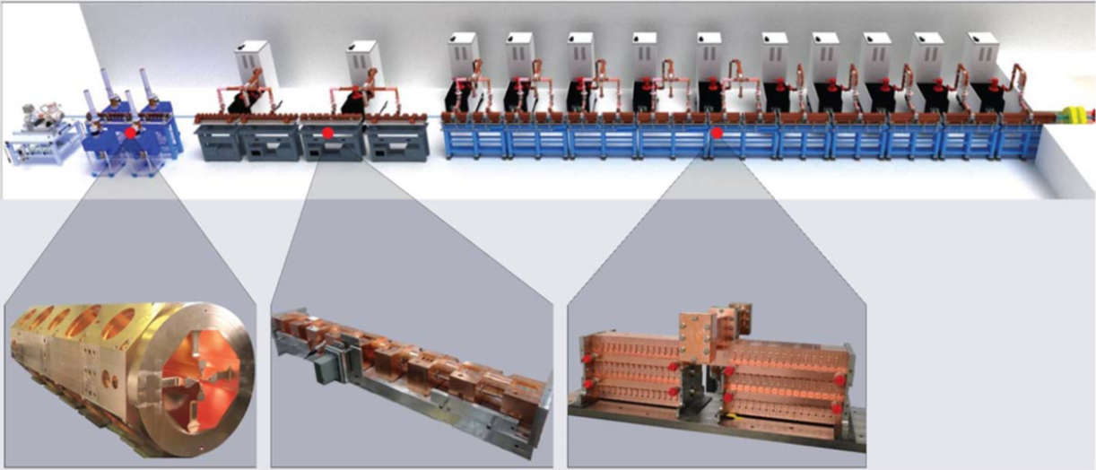
Accelerators
ADAM/AVO
Photo: CERN

Slide 14
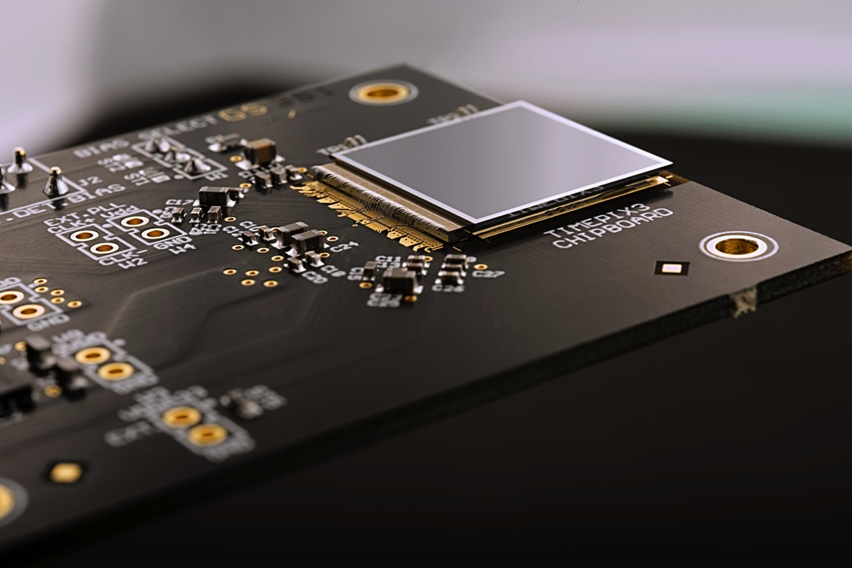
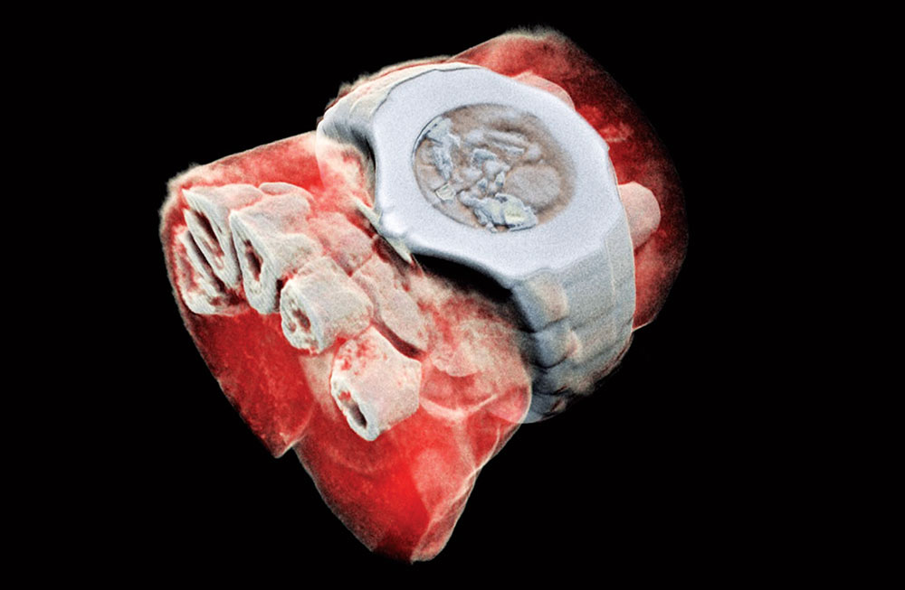
Detectors
MARS Bioimaging

Slide 15
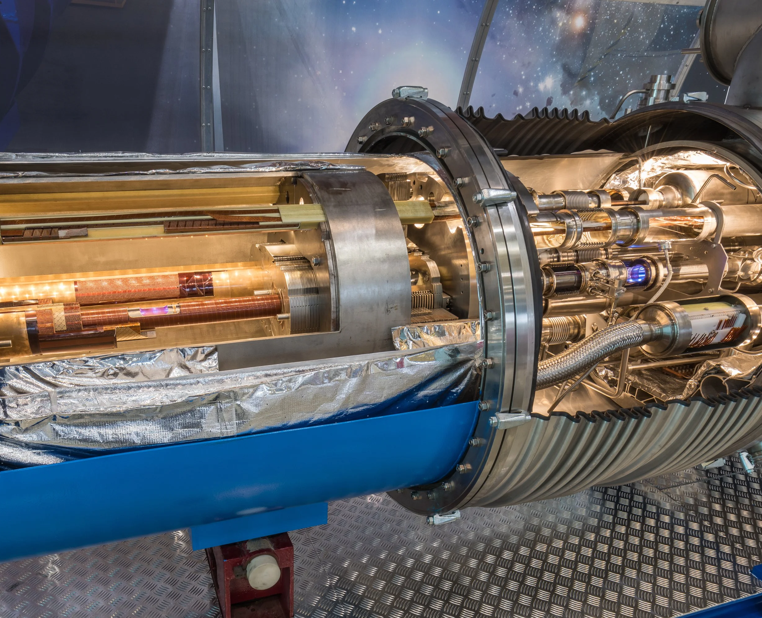
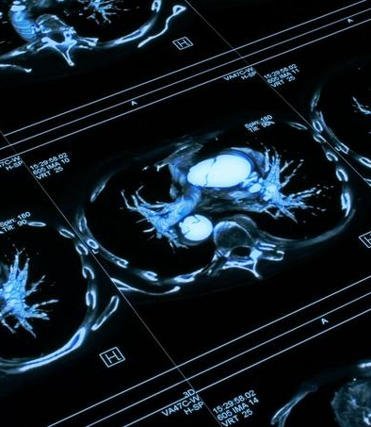
Computing

Slide 16
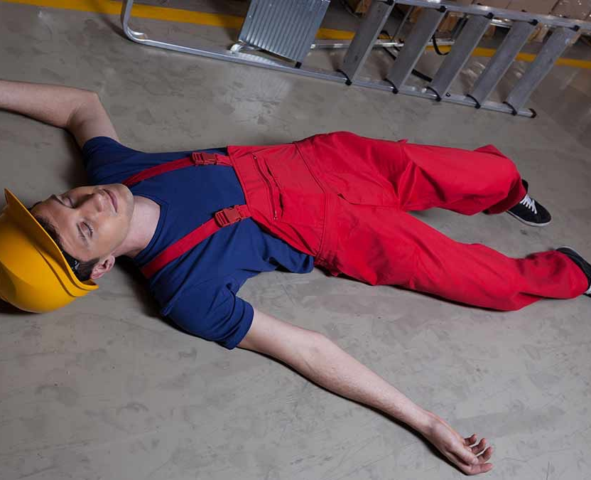
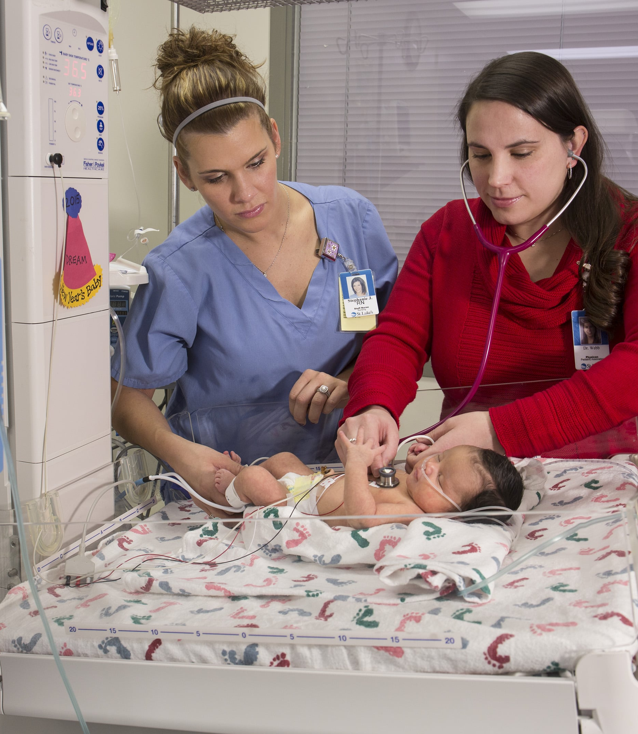
Computing

Slide 17
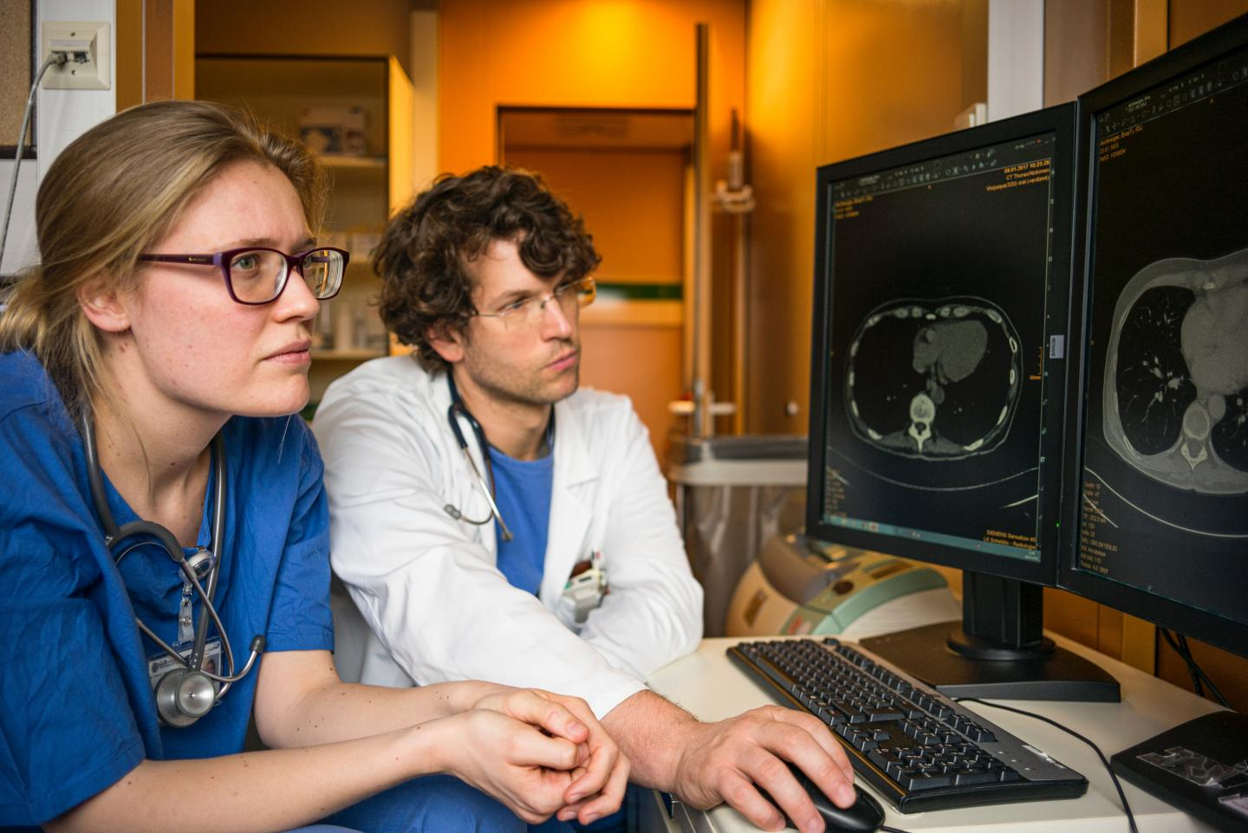
Collaboration

Slide 18
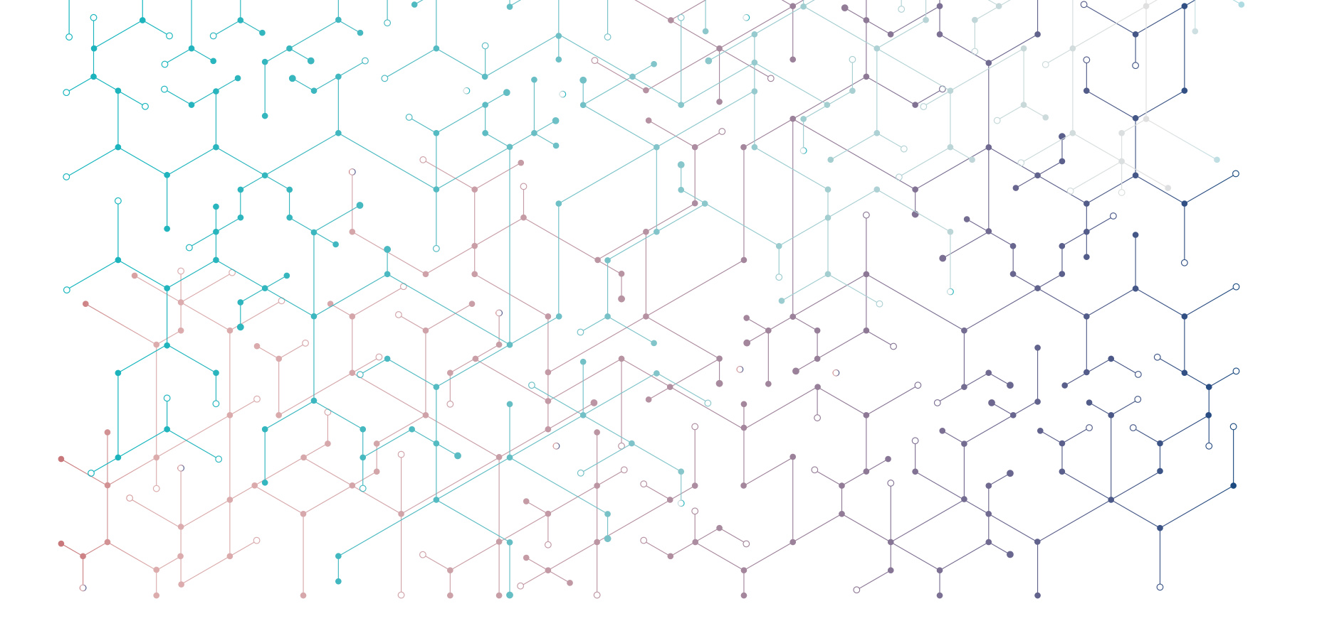

Thank you!
  Questions?
Subscribe the KT newsletter
@cern-innovation-partnerships
@CERNVenture
Find out more at kt.cern
Follow us on social media
#CERNKT
Notes:
https://kt.cern
https://kt.cern/newsletter

