Slide 1

Co-Development Workshop
Global Health
Dr Alessandro Raimondo, Dr Ana Rita Pinho, Dr Eric Comte
October 2023

Slide 2
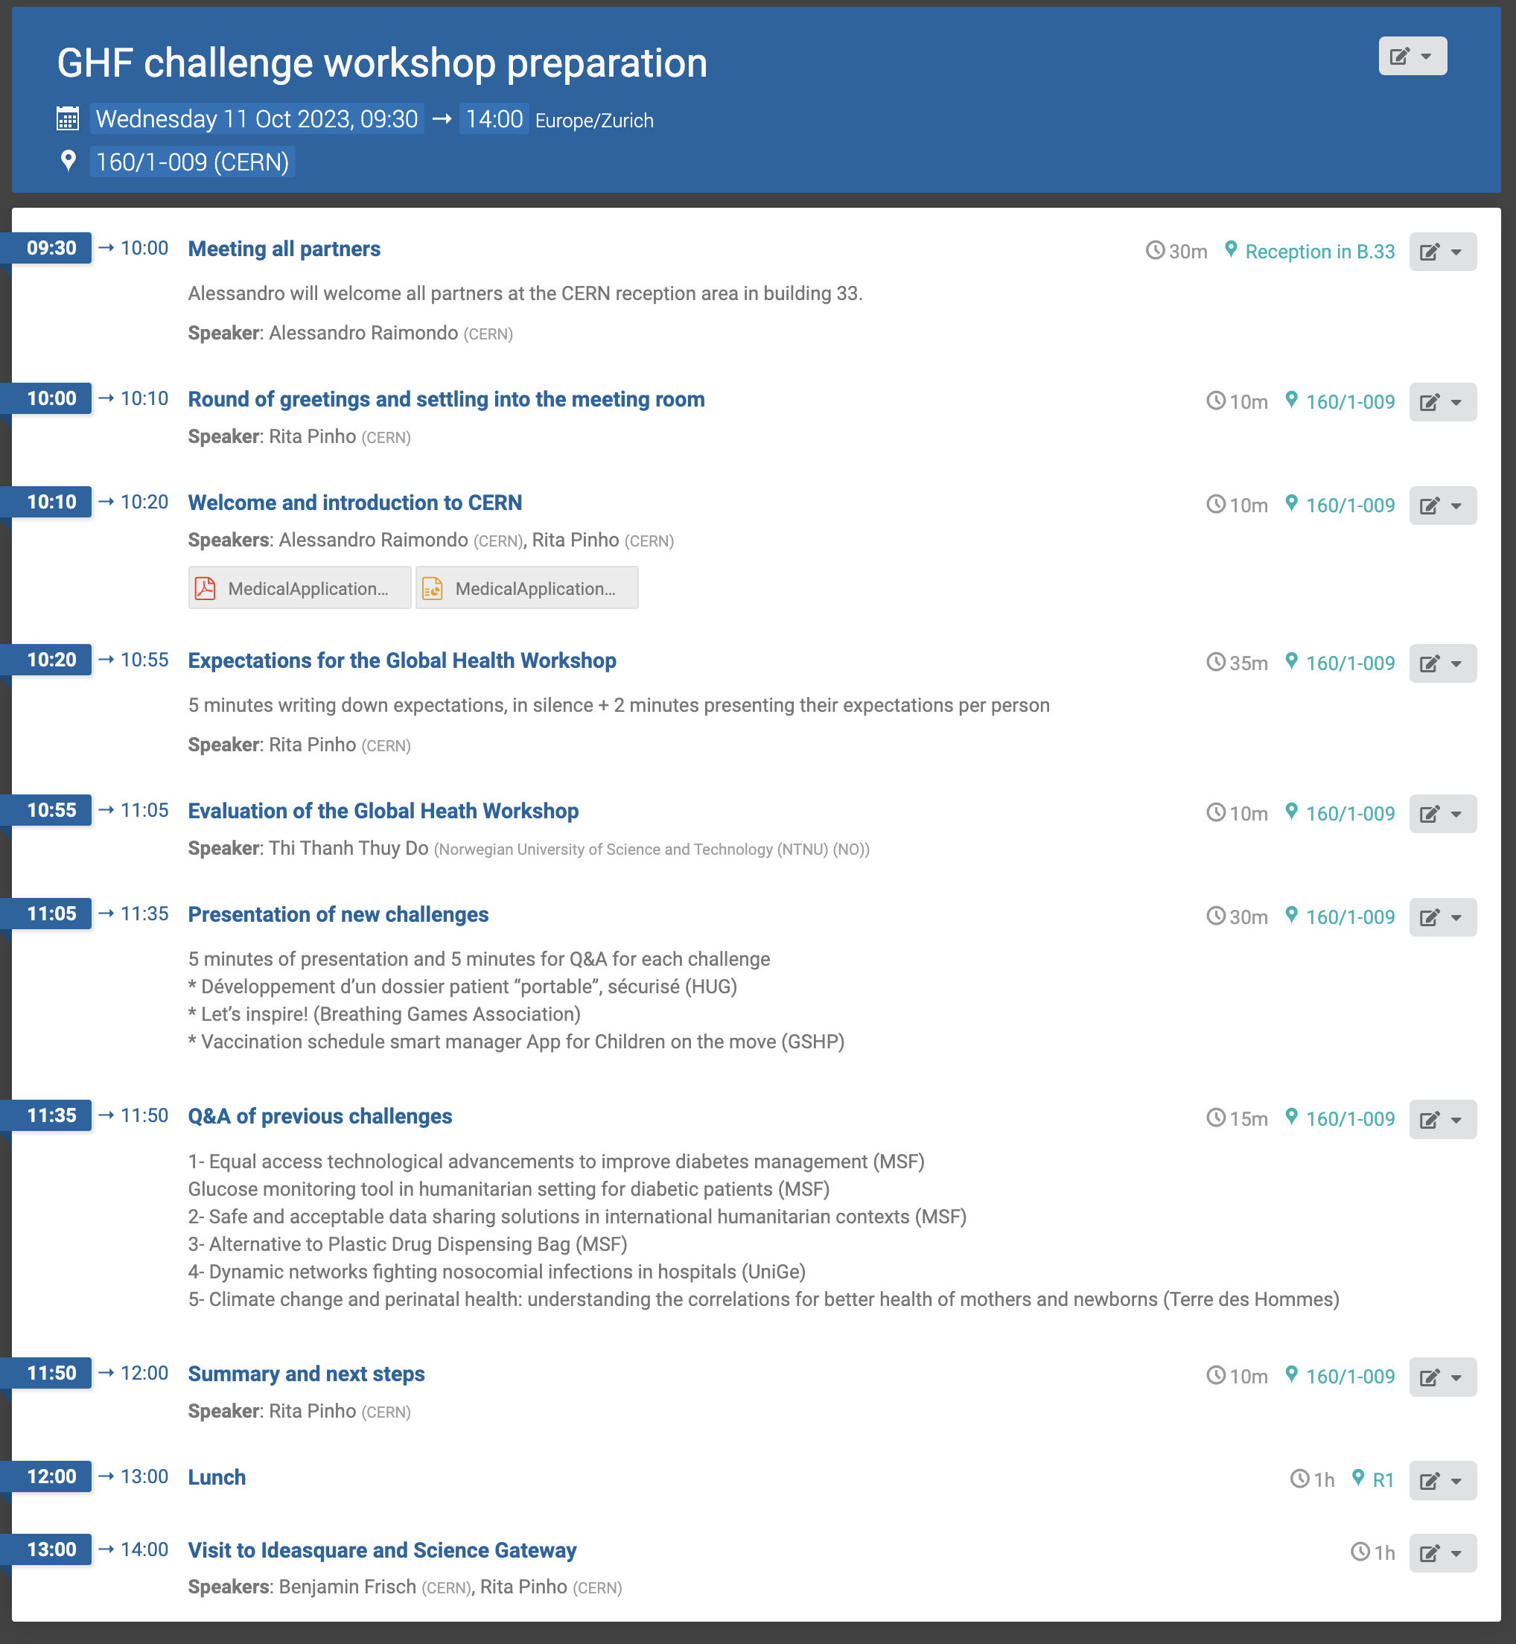
Agenda

Slide 3
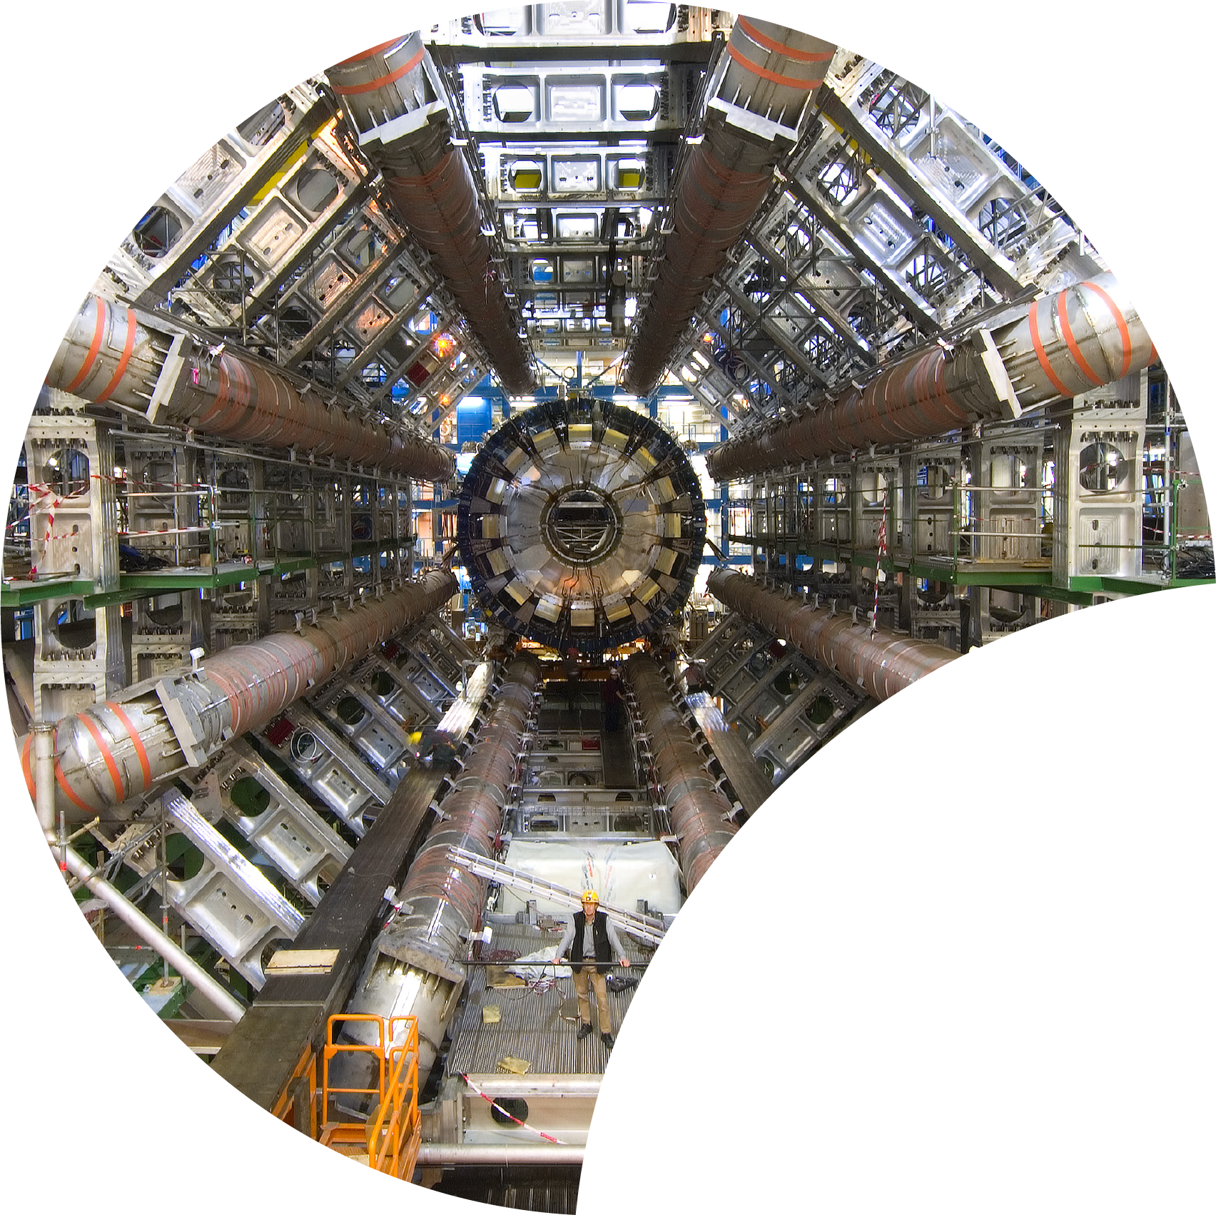
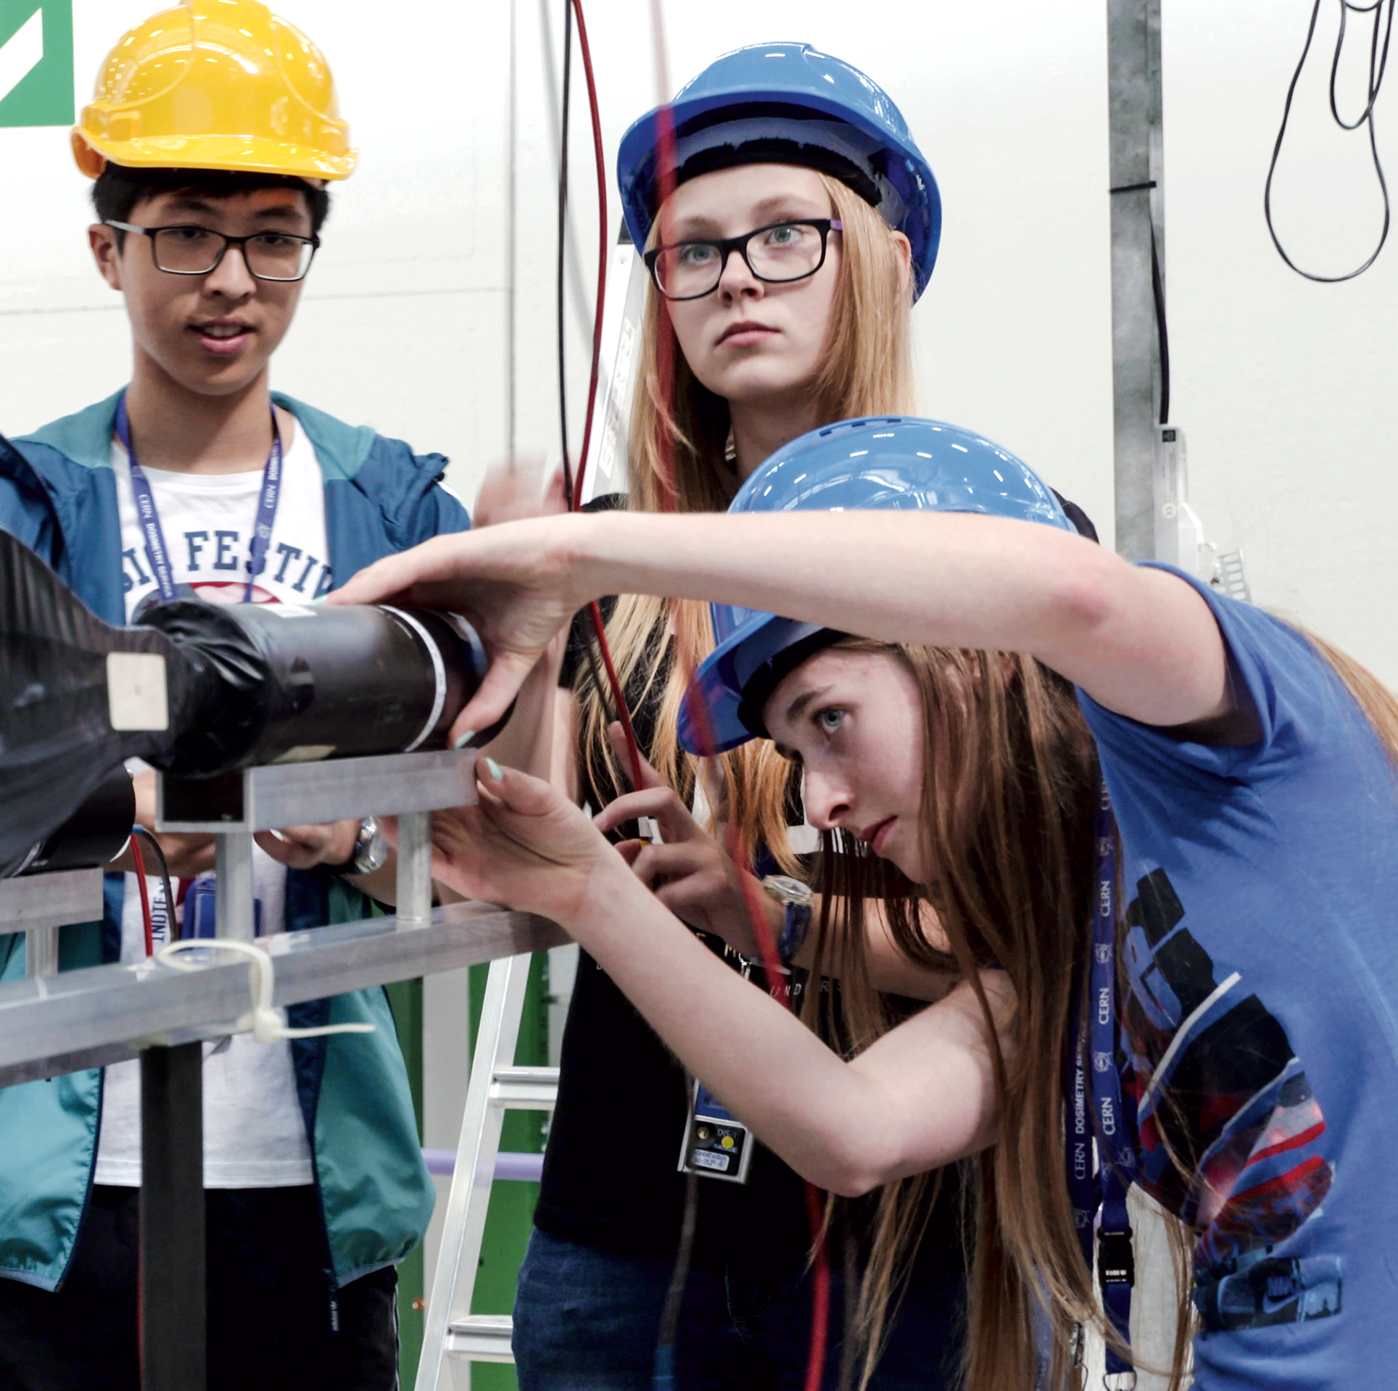

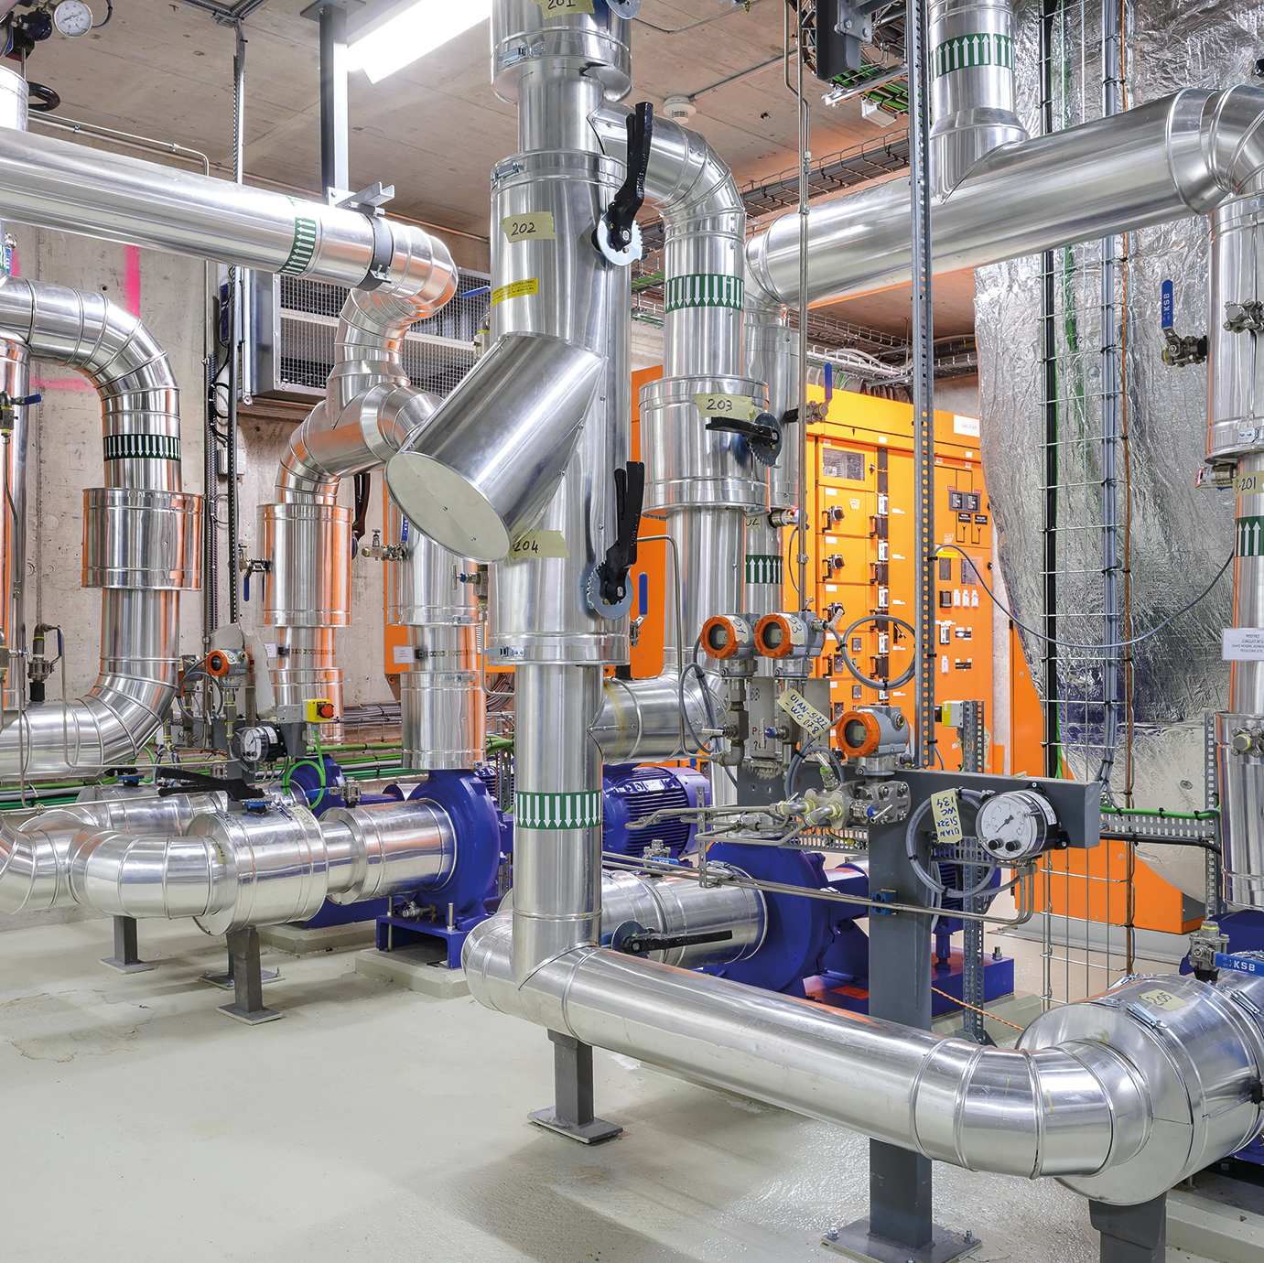

Four pillars underpin CERN’s mission
RESEARCH
EDUCATION
& TRAINING
COLLABORATION
TECHNOLOGY
& INNOVATION
Notes:
CERN’s mission extends beyond science: it also aims to advance the frontiers of technology, to train the next generation of scientists and engineers, and to bring nations together.
Science, technology, training and collaboration are the 4 main pillars of CERN.
All these have a positive impact on society.
Additional resources:
https://home.cern/about/who-we-are/our-mission

Slide 4
TECHNOLOGY & INNOVATION

Slide 5



KT’s Mission
Maximise the technological and knowledge return to society, in particular through Member States industry
Promote CERN as a centre of excellence for technology and innovation
Demonstrate the importance and impact of fundamental research investments
Notes:
The Knowledge Transfer group at CERN aims to engage with experts in science, technology and industry in order to create opportunities for the transfer of CERN’s technology and know-how.
The ultimate goal is to accelerate innovation and maximise the global positive impact of CERN on society. This is done by promoting and transferring the technological and human capital developed at CERN.
The CERN KT group promotes CERN as a centre of technological excellence, and promotes the positive impact of fundamental research organisations on society.
Additional resources:
https://kt.cern/about-us

Slide 6
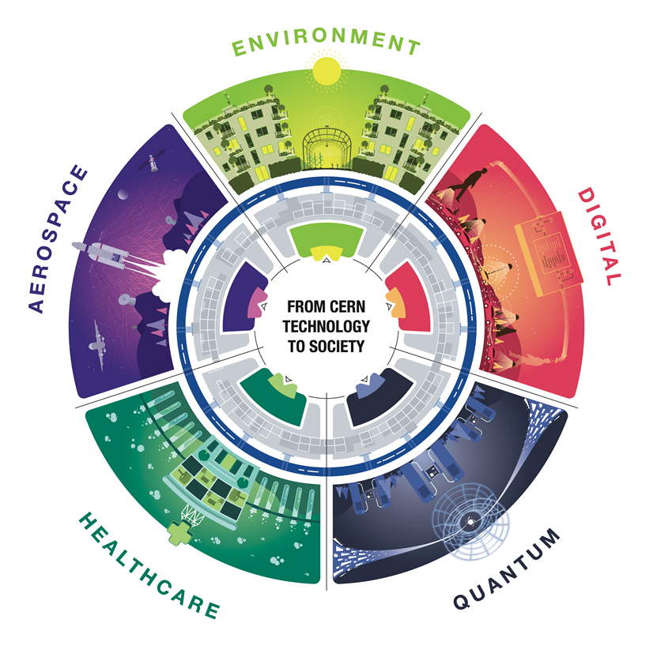
CERN as trusted non-commercial innovation partner

Slide 7
What we have in mind….
The 5 Ws:
Who– Who is your target audience?
  All relevant stakeholders, from policymakers to 3rd sector, from industry to users.
What– What is the main take away for this event? ...
  Co-development of research ideas to be the basis of a new project addressing an identified need.
When– When will this event take place? 23rd of February 2024
Where– Where is your event going to take place? CERN ideaSquare
Why– Everything you do for your event will have a purpose.
  New area of focus for CERN. We want to find possible applications where our technologies can help.

Slide 8
What we need from you as partners?
4 or 6 partners.
Several partners can work on the same idea.
Each partner must propose a coordinator for the workshop:
  Propose a theme
  Propose a list of participants
  Lead the work on their theme
  Facilitate discussions
  Participate in reporting work
Themes should concern global health issues in humanitarian contexts.

Slide 9
Provisional schedule :
September 13: First coordination meeting with project presentation (videoconference meeting)
October 11: Coordination meeting to present theme proposals and first list of possible participants (face-to-face meeting)
November 15: Coordination meeting to define the final list of themes and additional participant proposals.
January 31: Finalization of participant teams, presentation of theme preparation document
February 23: Workshop
March 23: Review of outcomes
May 29: final report and presentation of each outcome.

Slide 10
Challenges Presentations
By partners

Slide 11
Challenges
5 Challenges already presented in September
Equal access technological advancements to improve diabetes management (MSF)
  Glucose monitoring tool in humanitarian setting for diabetic patients (MSF)
Safe and acceptable data sharing solutions in international humanitarian contexts (MSF)
Alternative to Plastic Drug Dispensing Bag (MSF)
Dynamic networks fighting nosocomial infections in hospitals (UniGe)
Climate change and perinatal health: understanding the correlations for better health of mothers and newborns (Terre des Hommes)
3 new challenges
Développement d’un dossier patient “portable”, sécurisé (HUG)
Let’s inspire! (Breathing Games Association)
Vaccination schedule smart manager App for Children on the move (GSHP)

Slide 12
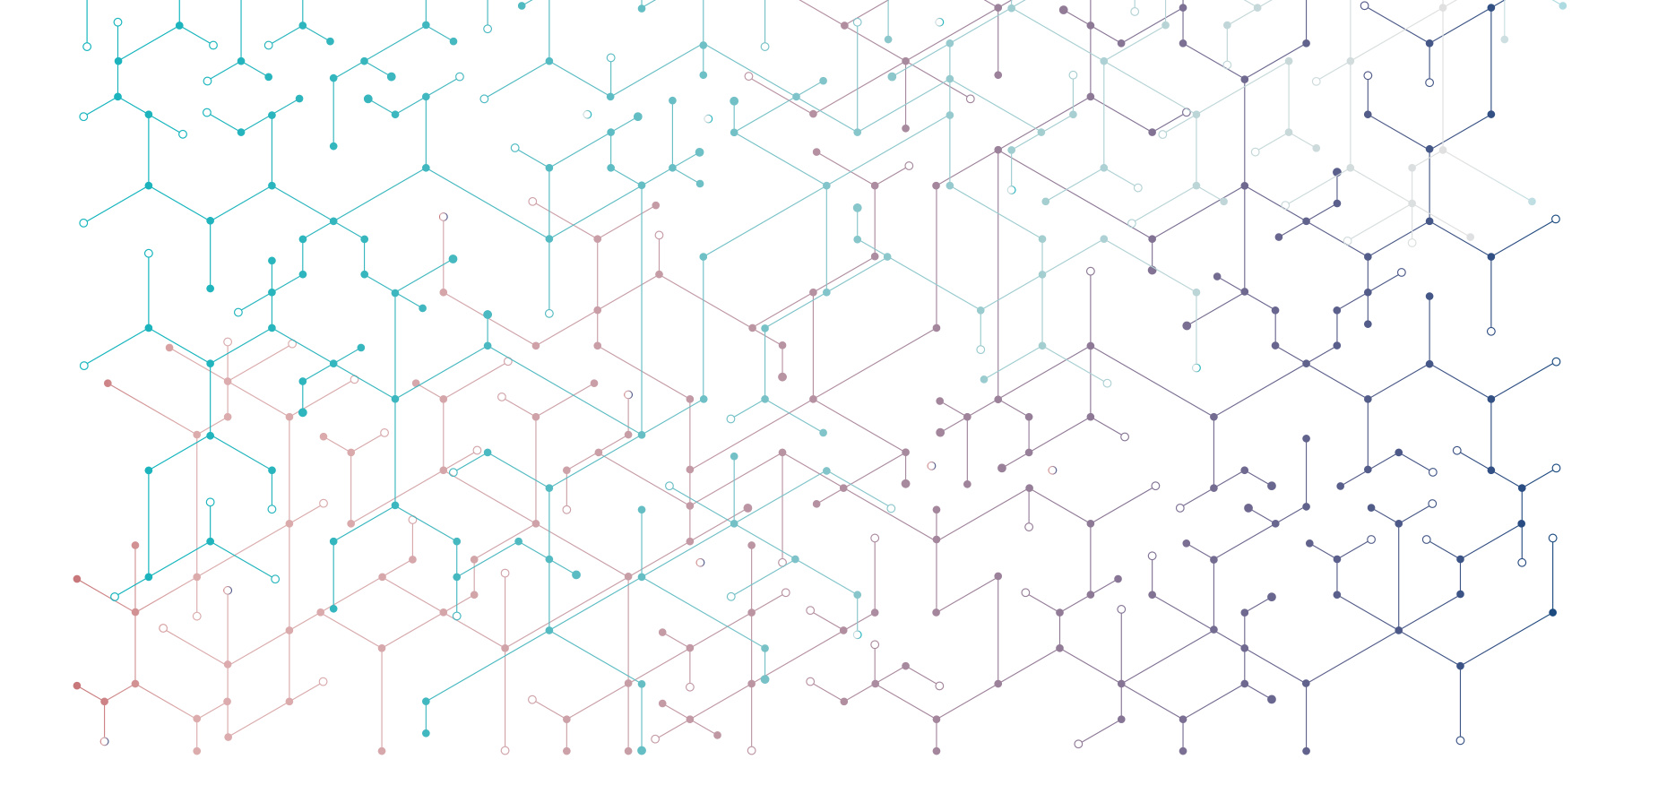


Thank you!
  Questions?
  ana.rita.pinho@cern.ch
Subscribe the KT newsletter
@cern-innovation-partnerships
@CERNVenture
Find out more at kt.cern
Follow us on social media
#CERNKT
Notes:
https://kt.cern
https://kt.cern/newsletter

