Slide 1

GLOCAL VACCINATION CARD SMART MANAGER
GENEVA HEALTH FORUM (GHF) CHALLENGE
DANIEL MARTINEZ GARCIA / ANIK PATEL
GLOBAL SOCIETY OF HUMANITARIAN PAEDIATRICS – GENEVA UNIVERSITY HOSPITALS

Slide 2
MIGRANT / REFUGEES VACCINATION
Globally, an estimated 67 million children missed out entirely or partially on routine immunization from 2019 to 2021.
Populations in the move face a myriad of challenges to access health care and it is fragmented.
Many vaccines and health records are missing, some will be duplicated.
Many come from areas where national vaccination programs are weak or face frequent shortages.
A lack of appropriate vaccination coverage in these populations will increase the risks of outbreaks
https://pubmed.ncbi.nlm.nih.gov/28165878/

Slide 3
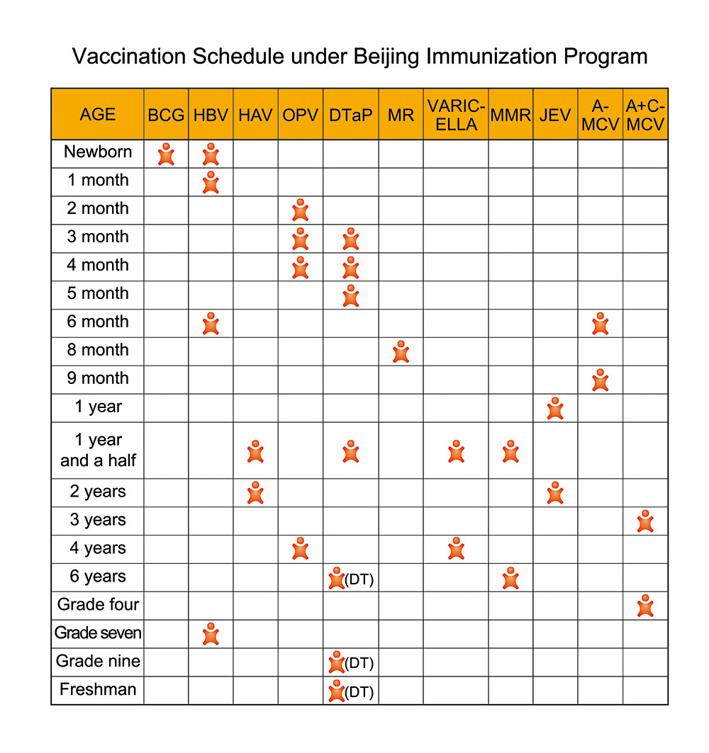
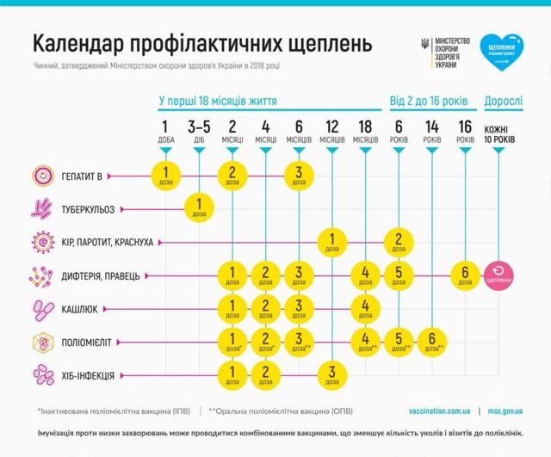
PROBLEM 1: vaccine schedules compatibility / language

Slide 4
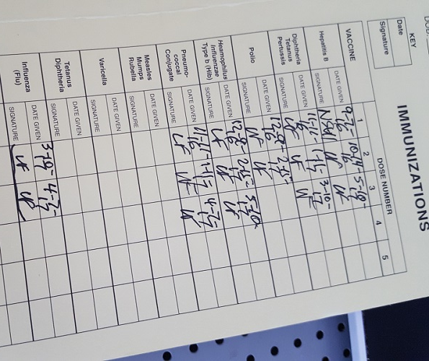
PROBLEM 2: DIGITALIZATION

Slide 5
CURRENT APPROACH
https://immunizationdata.who.int/pages/schedule-by-country/afg.html?DISEASECODE=&TARGETPOP_GENERAL=
Manual comparison of countries vaccination schedules using WHO and each country specific vaccination schedules.
Manual verification of information if vaccination card is available
Manual translation of information using online softwares (deepl, google translate, etc) with high risk of errors.
Lengthy and cumbersome process.

Slide 6
PARTIAL SOLUTIONS: COUNTRY SPECIFIC COMPARISON TOOLS
India |  |  |  |  | General recommendation for India |  |  |  |  |  |  |  | General recommendation for United Kingdom
 |  |  |  |  |  |  |  |  |  |  |  |  | Recommendation for specific groups only for United Kingdom
(return to list of countries)
 | Birth | 1m | 6w | 2m | 10w | 3m | 14w | 4m | 5m | 6m | 8m | 9m | 12m | 15m | 16m | 18m | 2 yrs | 3 yrs | 4 yrs | 5 yrs | 6 yrs | 7 yrs | 8 yrs
Tuberculosis (टीबी) | BCG (1 )
 | BCG
Rotavirus gastroenteritis (रोटावायरस) |  |  |  | ROTA |  | ROTA
 |  |  | ROTA (10) |  | ROTA (10) |  | ROTA (10)
Diphtheria (डिप्थीरिया) |  |  |  | DTaP |  | DTaP |  | DTaP |  |  |  |  |  |  |  |  |  | DTaP
Pentavalent (DTP-HepB-Hib) at 6, 10 and 14 weeks |  |  | DTaP |  | DTaP |  | DTaP |  | DTaP |  |  |  |  |  | DPT |  |  |  |  | DPT
Tetanus (धनुस्तंभ) |  |  |  | DTaP |  | DTaP |  | DTaP |  |  |  |  |  |  |  |  |  | DTaP
Pentavalent (DTP-HepB-Hib) at 6, 10 and 14 weeks |  |  | DTaP |  | DTaP |  | DTaP |  | DTaP |  |  |  |  |  | DPT |  |  |  |  | DPT
Pertussis (काली खांसी) |  |  |  | DTaP |  | DTaP |  | DTaP |  |  |  |  |  |  |  |  |  | DTaP
Pentavalent (DTP-HepB-Hib) at 6, 10 and 14 weeks |  |  | DTaP |  | DTaP |  | DTaP |  | DTaP |  |  |  |  |  | DPT |  |  |  |  | DPT
Poliomyelitis (पोलियो) |  |  |  | IPV |  | IPV |  | IPV |  |  |  |  |  |  |  |  |  | IPV
 | OPV |  | OPV andIPV |  | OPV |  | OPV |  |  |  |  |  |  |  | OPV
Haemophilus influenzae type b (हिब) |  |  |  | Hib |  | Hib |  | Hib |  |  |  |  | Hib
Pentavalent (DTP-HepB-Hib) at 6, 10 and 14 weeks |  |  | Hib |  | Hib |  | Hib
Hepatitis B (हेप बी) | HepB (2) |  |  | HepB |  | HepB |  | HepB
Pentavalent (DTP-HepB-Hib) at 6, 10 and 14 weeks | HepB |  | HepB |  | HepB |  | HepB
Hepatitis A (हेप ए)
Pneumococcal (न्यूमोकोकल) |  |  |  | PCV |  |  |  | PCV |  |  |  |  | PCV
Meningococcal (मेनिंगोकोक्सल) |  |  |  | Men B |  |  |  | Men B |  |  |  |  | Men B
 |  |  |  |  |  |  |  |  |  |  |  |  | Men C
 |  |  |  |  |  |  |  |  |  | Men A |  | Men A
Measles (खसरा) |  |  |  |  |  |  |  |  |  |  |  |  | MMR |  |  |  |  | MMR
 |  |  |  |  |  |  |  |  |  |  |  | M/MR (11) |  |  | M/MR (11)
Mumps (कण्ठमाला का रोग) |  |  |  |  |  |  |  |  |  |  |  |  | MMR |  |  |  |  | MMR
Rubella (रूबेला) |  |  |  |  |  |  |  |  |  |  |  |  | MMR |  |  |  |  | MMR
 |  |  |  |  |  |  |  |  |  |  |  | M/MR (11) |  |  | M/MR (11)
Varicella (चेचक)/Shingles (शिंगल्स) |  |  |  |  |  |  |  |  |  |  |  |  |  |  |  |  | Varicella (3)
Human papillomavirus (एचपीवी)
Influenza (इंफ्लुएंजा) |  |  |  |  |  |  |  |  |  |  |  |  |  |  |  |  | LAIV (4 )
Japanese Encephalitis (JE) (जापानी मस्तिष्ककोप)
 |  |  |  |  |  |  |  |  |  |  |  | JE (12) |  |  | JE (12)
UK: https://www.gov.uk/government/publications/uk-and-international-immunisation-schedules-comparison-tool
Germany: https://www.sciencedirect.com/science/article/pii/S2211335517300049

Slide 7
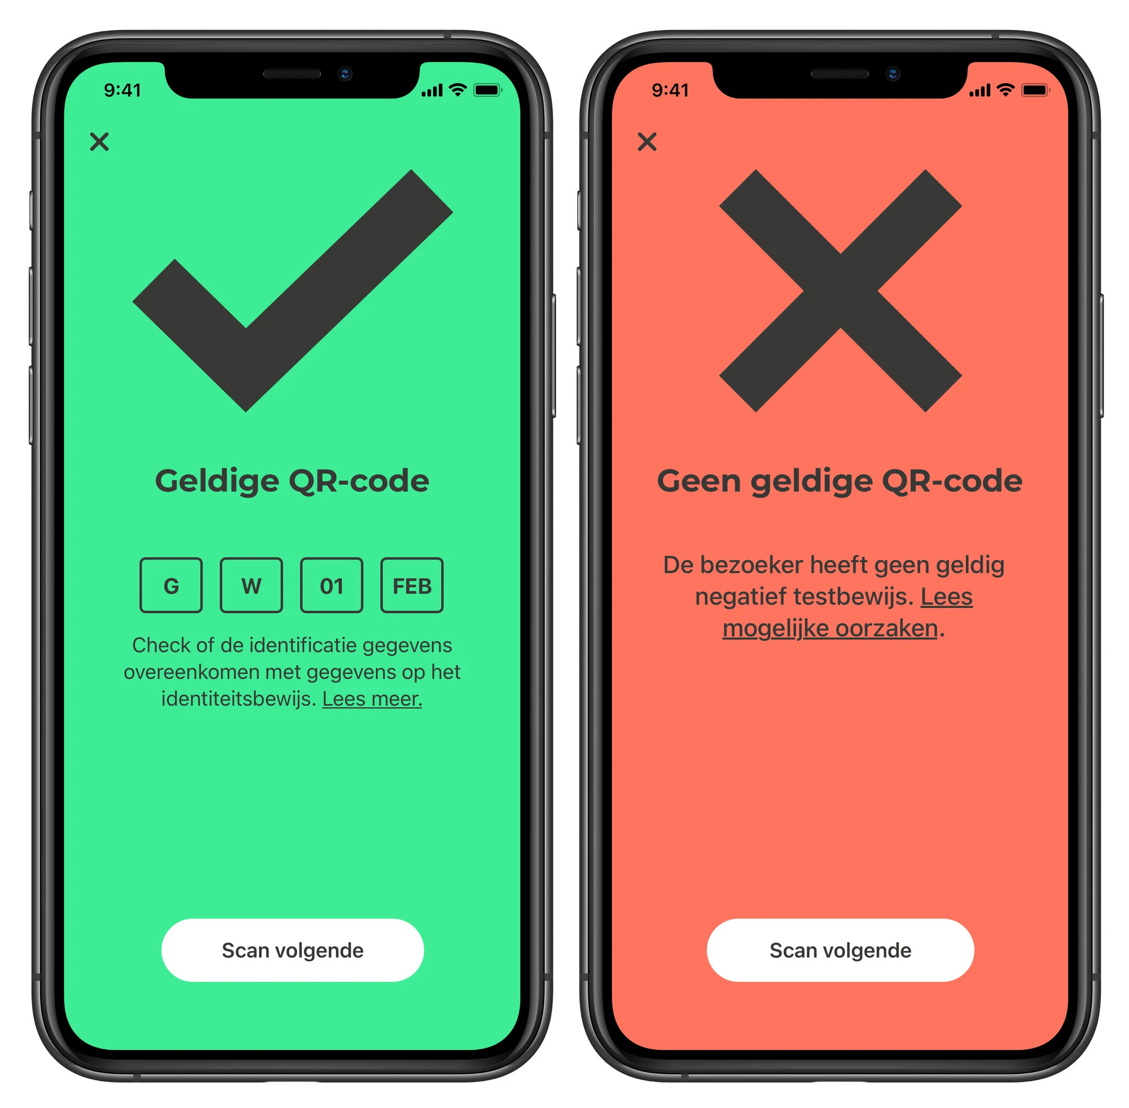
SOLUTIONS BRINGING MORE PROBLEMS?
Vaccination passports ?
Data protection and storage?
Security?
Technological compatibility?
Language barriers ?
Literacy of patients?
Offline capacity / internet coverage?
Software updates?

Slide 8
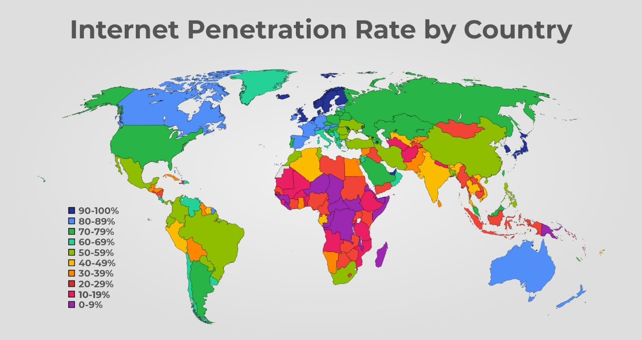
GLOBAL DIGITAL GAP
https://www.internetadvisor.com/key-internet-statistics

Slide 9

A PRAGMATIC SOLUTION:
A GLOCAL VACCINATION CARD DIGITAL SMART MANAGER

Slide 10

AI TECHNOLOGY FOR THE GOOD
Software development – web-based or App / offline capacity?
Storage of all national vaccination schedules / regularly updated
Able to read / interpret paper and digital vaccination cards / records
GDPI compliant for data protection & security
Compatibility with translation softwares or online tools
Easy to expert / convert to pdfs / mail
Country comparison: origin, transit & destination schedules
Able to adjust vaccine recommendations according to patient and vaccines availability

Slide 11

PARTNERSHIP PROPOSED
Collaboration with CERN and the Geneva University Paediatric Hospital – Migrant Child Health Clinic (SAMI) & Youth Health Clinic (CASAA) :
- https://www.hug.ch/enfants-ados/specialites-medicales-chirurgicales/soins-aux-enfants-migrantes-migrants
- https://www.hug.ch/enfants-ados/specialites-medicales-chirurgicales/sante-ados
Key partners: Geneva Health Forum, Geneva Digital Hub, Global Society of Humanitarian Paediatrics (GSHP) , Médecins sans Frontières (MSF)

