Slide 1


Why addressing NCDs in fragile environments is important?
Data for Noncommunicable diseases in low- and middle-income countries and humanitarian crises
Sigiriya Aebischer Perone Senior Resident Division of Tropical and Humanitarian Medicine Geneva University Hospitals Focal Point Non-communicable diseases Health Unit International Committee of the Red Cross | David Beran Assistant Professor Division of Tropical and Humanitarian Medicine University of Geneva and Geneva University Hospitals

Slide 2
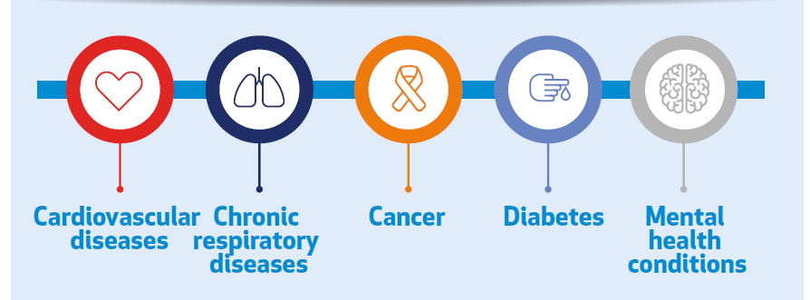
Global burden of Noncommunicable diseases
41 million deaths per year, equivalent to 71% of all deaths globally
  77% of all NCD deaths are in low- and middle-income countries
  15 million people die from a NCD between the ages of 30 and 69 years
    85% of these "premature" deaths occur in low- and middle-income countries
Mortality by disease
  Cardiovascular diseases: 17.9 million
  Cancers: 9.3 million
  Respiratory diseases: 4.1 million
  Diabetes: 1.5 million
    These four groups of diseases account for over 80% of all premature NCD deaths
NCD Alliance; WHO 2021

Slide 3
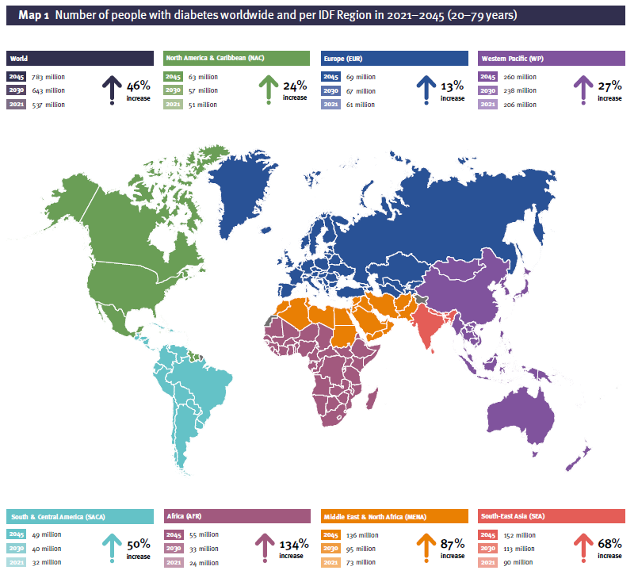
Global burden of Noncommunicable diseases
International Diabetes Federation, 2021

Slide 4
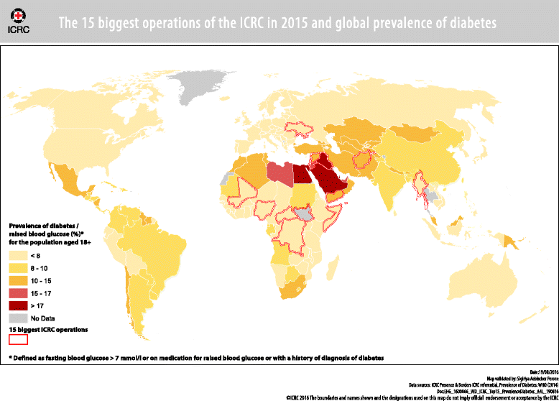
NCDs and humanitarian emergencies
H.E.L.P. course
Aebischer Perone et al. 2017
Notes:
15 biggest operations of the ICRC in 2015 and global prevalence of diabetes

Slide 5






Information is a key piece of the health system puzzle
Service delivery
Human resources
Information
Medicines and supplies
Financing
Leadership and governance
  WHO 2000

Slide 6
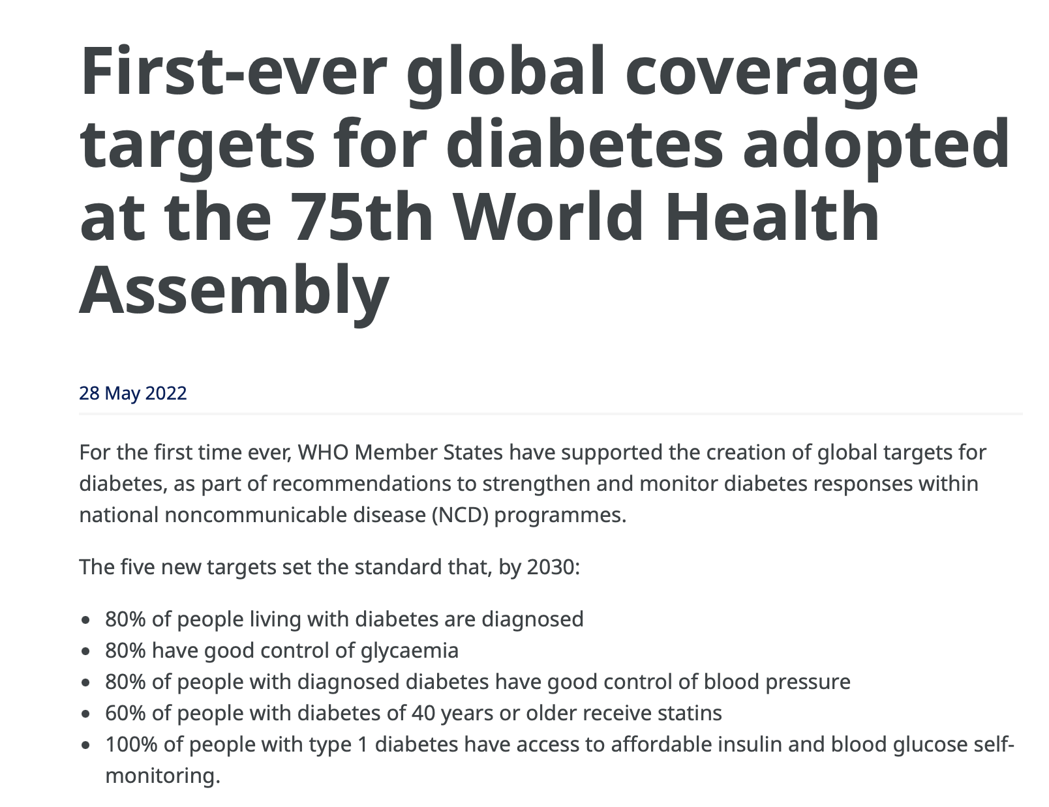
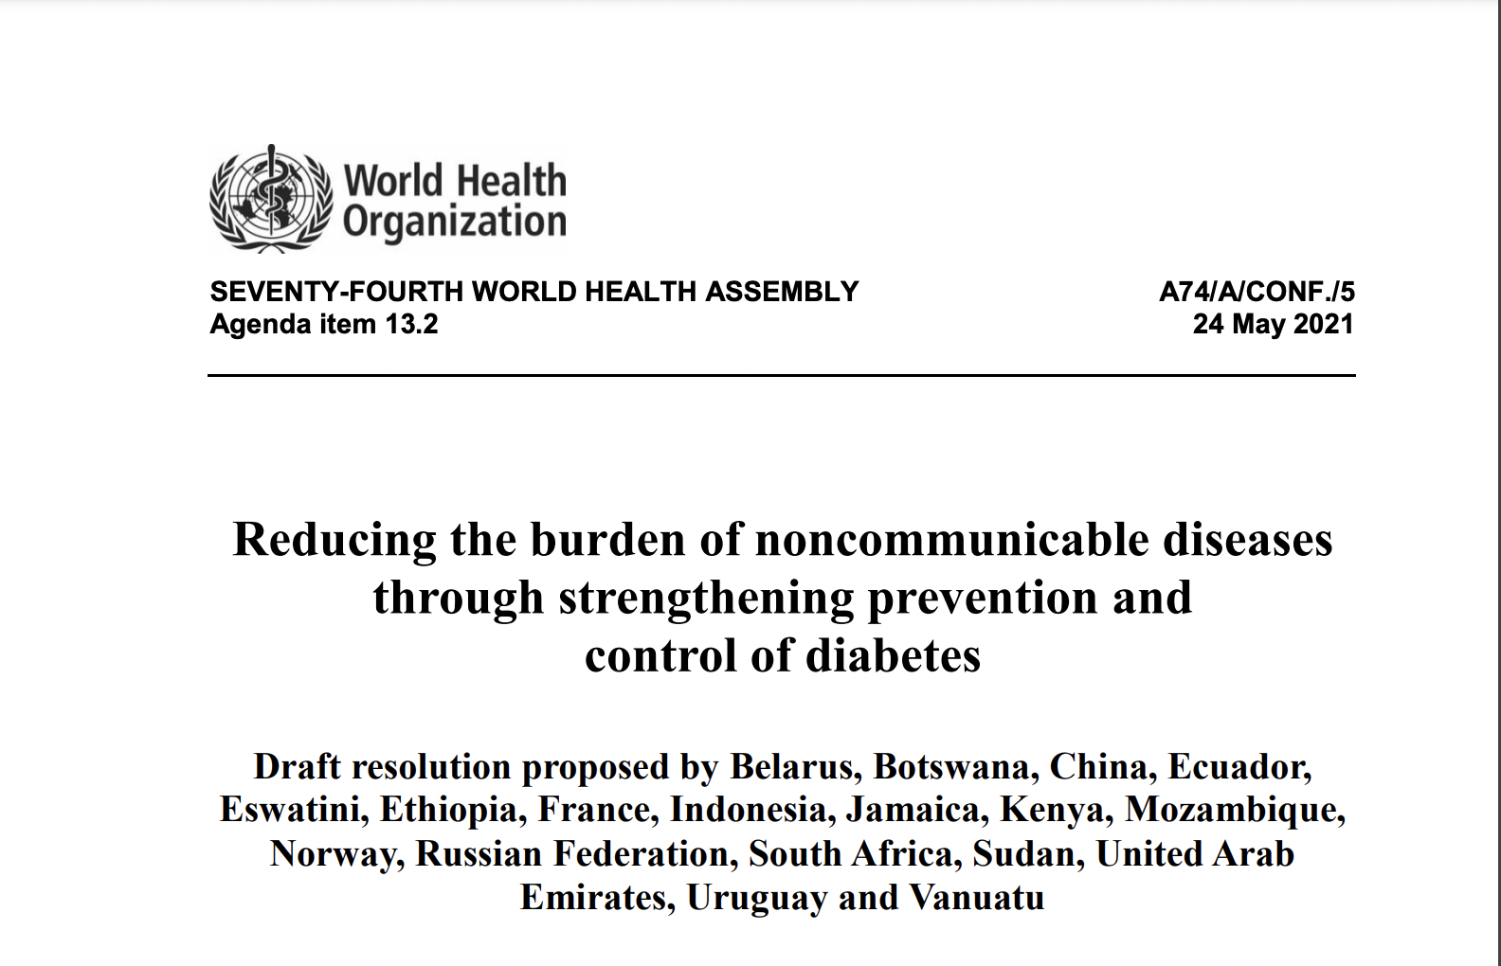
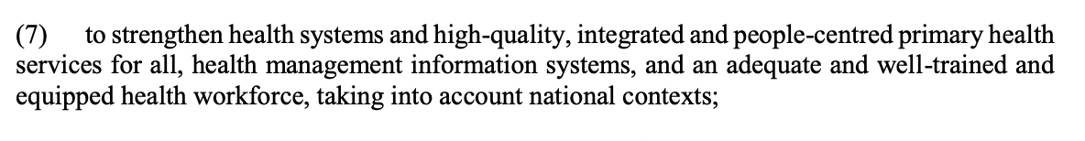
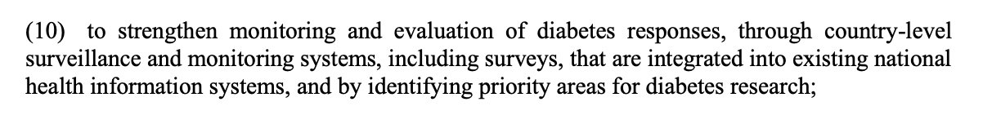
Need for data: on the global agenda

Slide 7
Multiple factors need to come together at different levels of the country and health system
 | Macro (National context government) | Meso (Health system and research environment) | Micro (Population and patients)
Data collection
Data aggregation
Use of the data
Communication of data and results
Intangible factors
Facilitators and challenges for each of these components and each level

Slide 8
Data collection
Facilitators | Challenges | Lessons learnt
Governance and infrastructure Trust of population Unique identifier Confidentiality Digitalisation Data entry by who and why (clinical and administrative purposes) Use of the data within the system Improvements versus control Sense of responsibility for those entering, managing and analysing data | Populations on the move Paper based systems Lack of electronic data systems Access to computers/tablets, wifi, power Technological literacy Supra national rules: data storage E.g. General Data Protection Regulation Onus of data entry on clinicians Codes used clinical versus research System adapted for its different uses Clinical, Administrative, Research Inclusion of all patient relevant elements including Patient Centred and Reported Outcomes | Primary role of the data collection Start simple, but build foundations Cost of setting up the system What is essential How can system evolve Retrofitting is complex and costly Collection of usable data Clinical; Administrative; Research Who manages system and acts as a gate keeper The focus on the clinical interaction Data environment needs to be part of daily clinical life

Slide 9
Data aggregation
Facilitators | Challenges | Lessons learnt
Coding of data How data is entered Research Population based registers Linkages between different data sources Beyond the health aspects of diabetes | Data quality and standardisation Ease of use and access to information Capturing complexity Addressing cross-cutting issues E.g. diabetes and mental health Increase in user generated data and how to integrate this Knowledge needed to navigate data Clinical and epidemiological Codes used Relevant for research and clinical management Validation How to be used for purposes of M&E | Keep in mind that data should start with the clinical focus Reliance on registry data What is coded and entered is the data available Balance clinical and research and time constraints Partnerships Clinicians Researchers Administrators Patients

Slide 10
Use of data
Facilitators | Challenges | Lessons learnt
Monitoring of new practices and policies Linkages between patients, clinicians and managers and researchers Use in quality processes Use of the data within the system Improvements versus control Unique data = variety of possible studies Causes Epidemiology Complications Sub-national comparisons | Complexity of data Comorbidities Integration of data into practice Time to access, read and use data for clinicians, policy decisions Source of information System Researchers Advocates | Multiple uses Clinical interaction Quality reviews Reporting (institutional, governmental) Research Responsibility of those using data Leadership needed User boards ”Control mechanisms” Who and how are research projects designed

Slide 11
Communication of data and results
Facilitators | Challenges | Lessons learnt
Networks Diabetes/NCD environment Interest in the issue Need for better data globally | Complexity of data Integration of data into practice for different audiences Time to access, read and use data for policy decisions Source of information System Researchers Advocates Complexity of data for non-expert audiences | Need competence and knowledge to understand the data How to translate data into useable information Information formats for different audiences, especially people with diabetes, elderly, children Needs mechanisms for communication of results Role of knowledge brokers

Slide 12
Intangible factors
Facilitators | Challenges | Lessons learnt
TRUST People “giving back” to the system Population accustomed to data being used Transparency Access to own data | Increase in fear of “data” in a “post-COVID” society Distrust of ”big data” from Google, Apple, Facebook, and Amazon Vulnerable populations | Integrate data within environment

Slide 13
A possible global data environment
Patient files
Clinic/Facility based register
Regional/sub-national data
National data
Global data
Clinically relevant data
Main user healthcare worker for management and follow-up of individual
Patient
Planning
Supplies
Monitoring and evaluation
  Clinic
  Projects or programs
  Data source for M&E
Planning
Supplies
Monitoring and evaluation
Advocacy
Planning
Supplies
Monitoring and evaluation
Advocacy
Advocacy
Research

Slide 14
For discussion
Data =
  Better data to make decisions
    Patients
    Clinicians
    Managers
    Projects and programs
      M&E
    Policy makers
  Document issues
    Academic
    Advocacy
    Policy
    Progress to global targets
  Training and capacity development
What is ideally needed
  Portable
  Safe
  Offline-online
  Works across platforms
  Low tech / bandwidth data collection systems
  Easily aggregated
  Multiple purposes of data
  Tools co-created with users

Slide 15
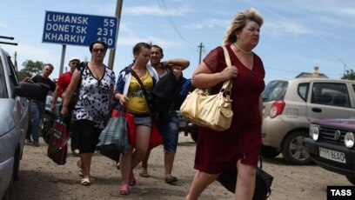
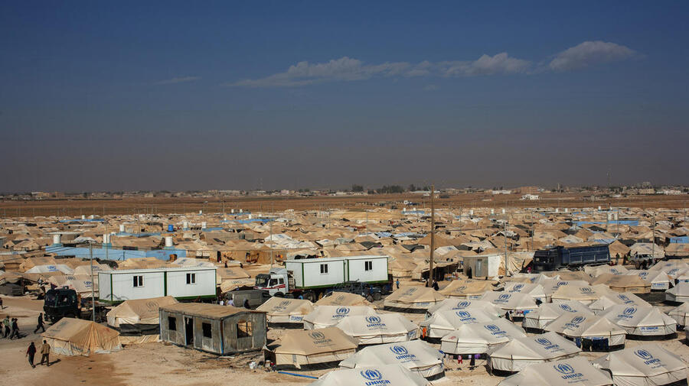
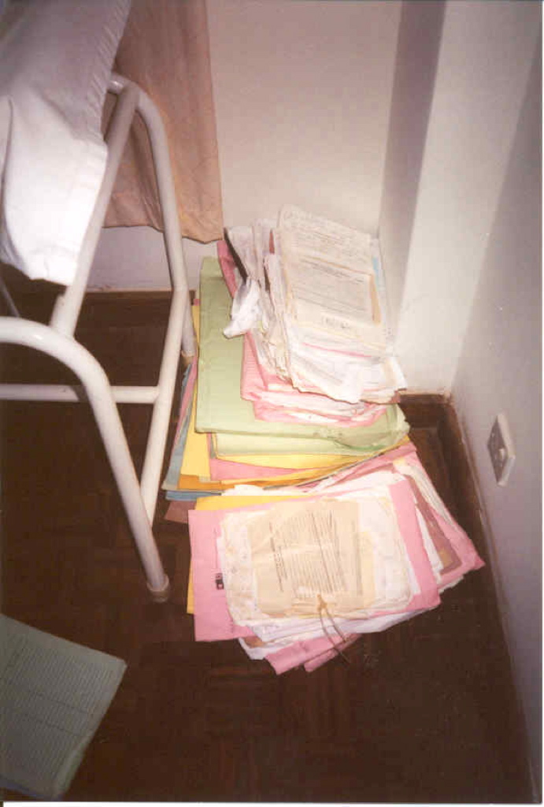
For discussion
https://www.rferl.org/a/ukraine-refugees-285000/26515471.html
https://www.unhcr.org/news/stories/jordans-zaatari-refugee-camp-10-facts-10-years

Slide 16
Why addressing NCDs in fragile environments is important?
Any questions?
Sigiriya.AebischerPerone@hcuge.ch
David.Beran@unige.ch

