Slide 1
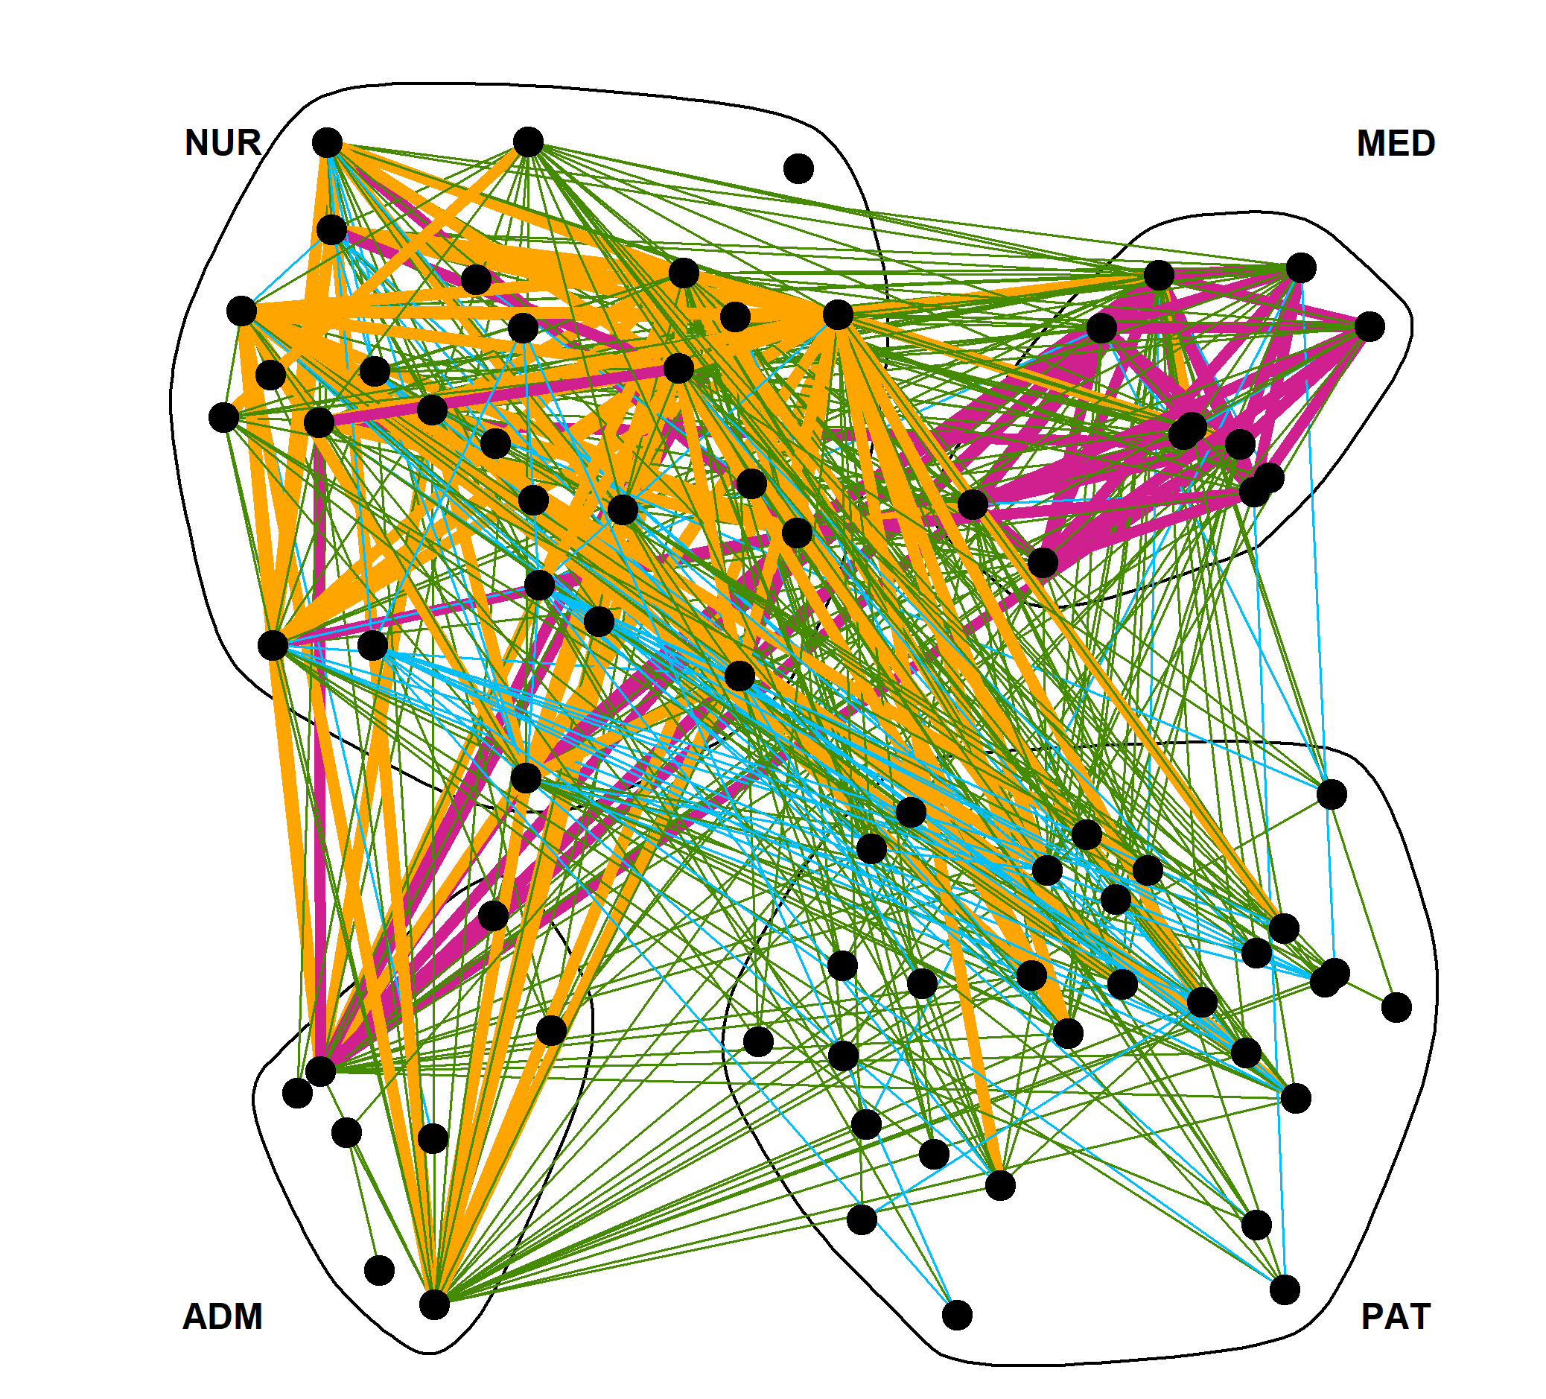

Epidemiological modelling and dynamic networks
Maria Süveges
CERN-GHF challenge
13 September 2023

Slide 2
WHAT:
MODEL THE SPREAD OF INFECTIOUS DISEASES
ON TIME-VARYING NETWORKS
WHERE:
  Small-scale: hospitals, long-term care facilities, prisons, …
  Large-scale: whole regions or countries
WHY:
  Assess and improve prevention measures of hospital-acquired infections in healthcare or other institutions
  Scenarios of outbreaks for prevention and allocation of resources
HOW:
  Fit the (existing) likelihood model to collected data on the network
  Run agent-based epidemiological simulations of different scenarios on them

Slide 3
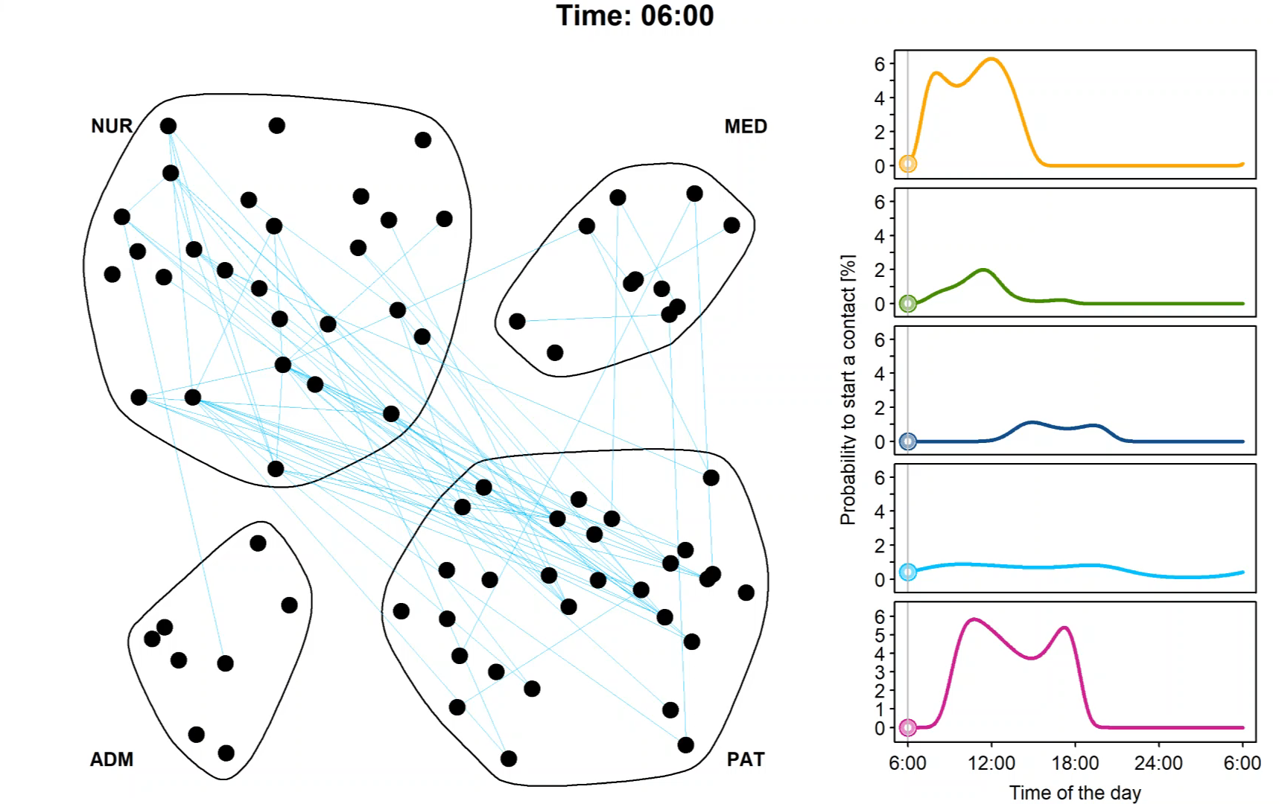
The day in a hospital ward, according to my dynamic network model

Slide 4
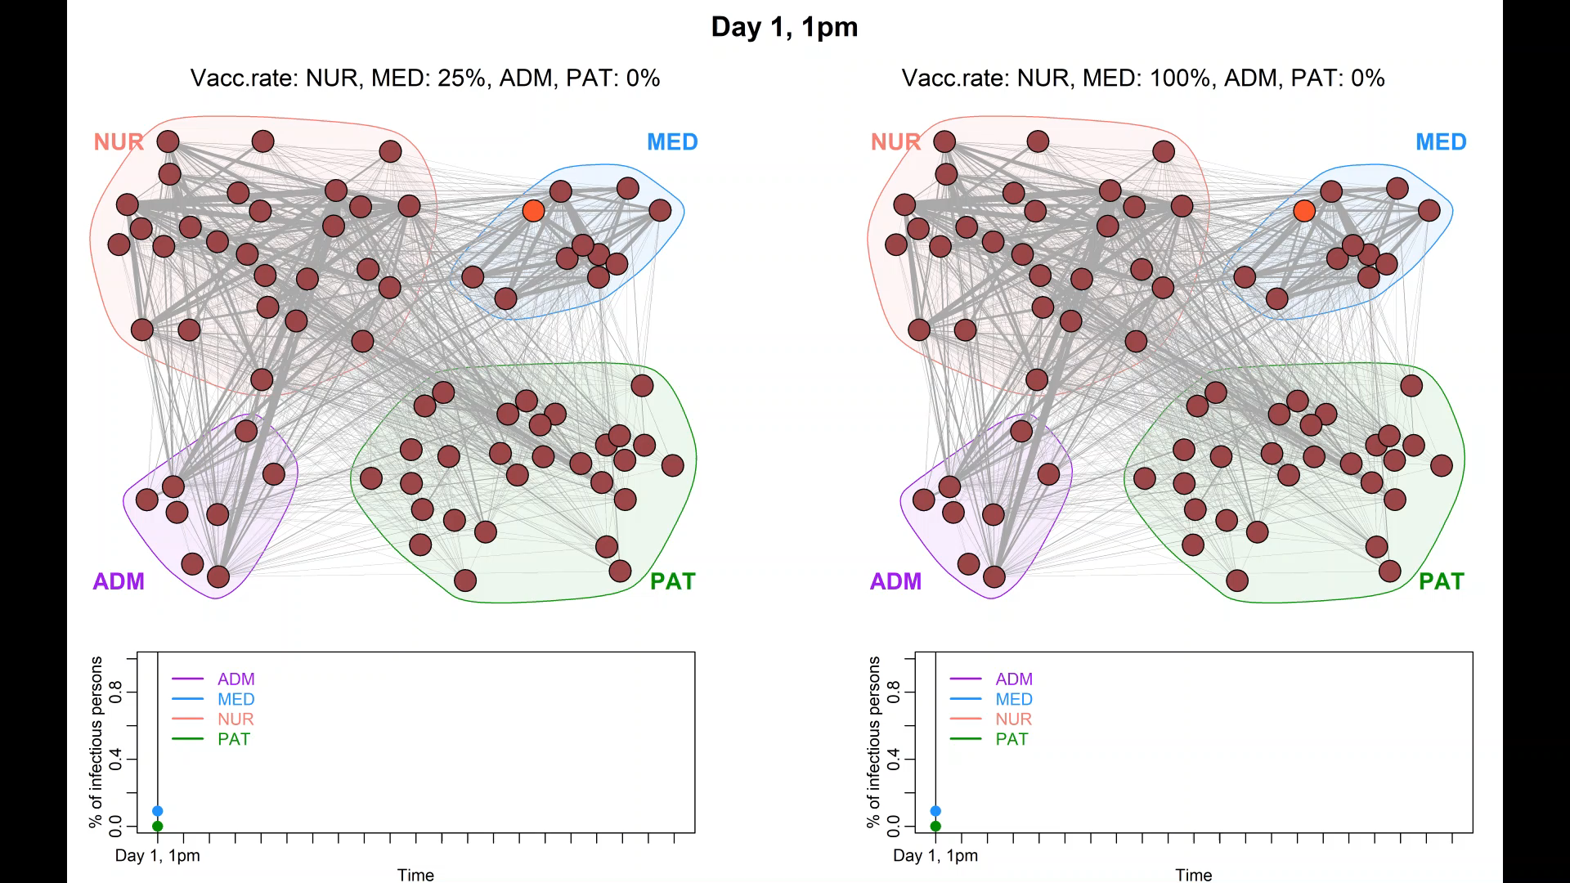
Simulate a hospital outbreak: 25% / 100% vaccinated NUR+MED
Susceptible
Exposed, but not yet infectious
Infectious
In remission or dead

Slide 5
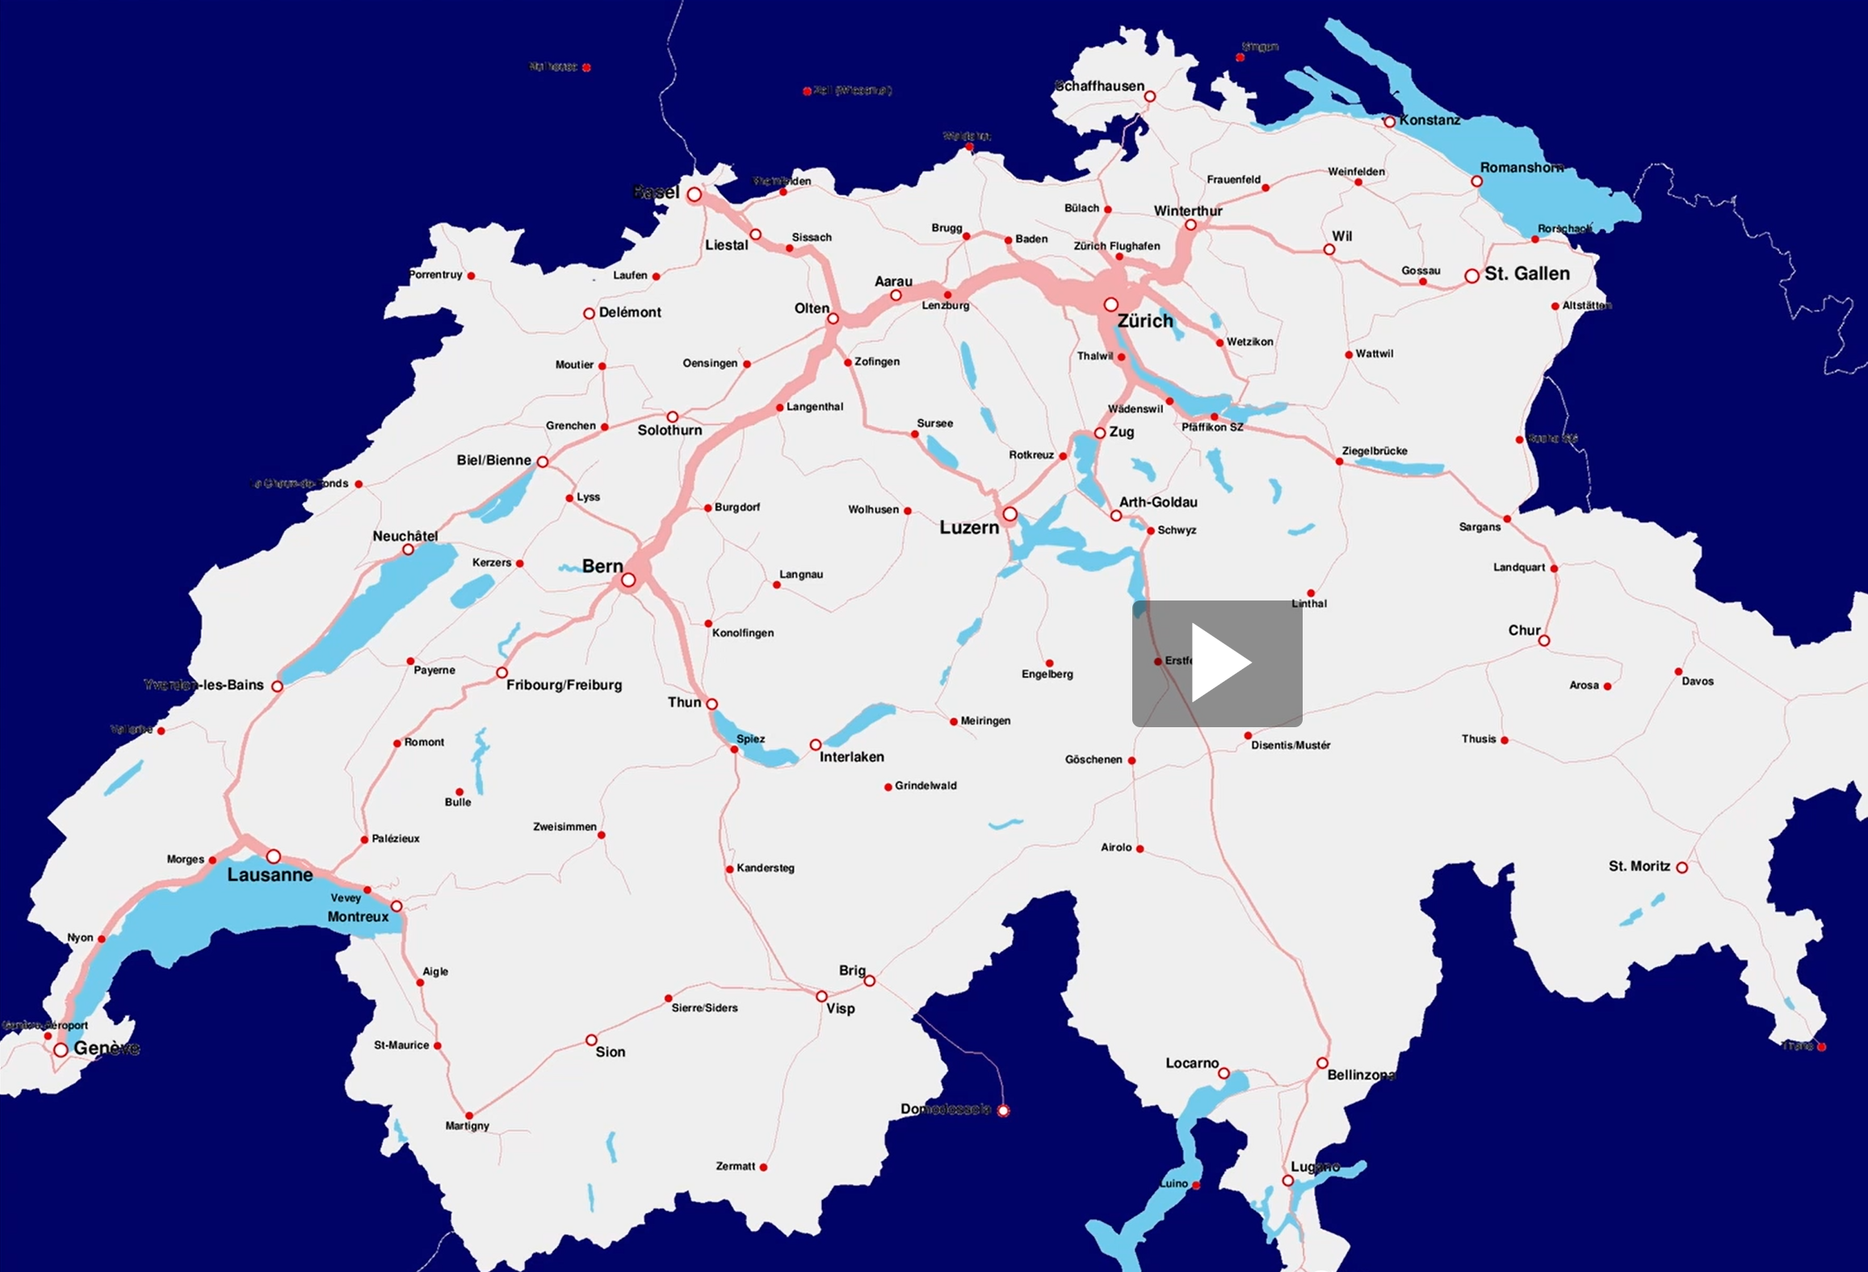
Outbreaks in larger regions
Use road and railway traffic data to help predict the spread of an infectious outbreak.
Network:
nodes represent population centers
links, the traffic between them
travel times
Hierarchical structure:
in each population center, classical epidemiological simulation
or other models
Rail traffic movie….

Slide 6

Collaboration would be very welcome on:
  Scaling up the fitting methodology (> several 1000 nodes in the network, high time resolution, change to Bayesian paradigm)
  Fast agent-based simulations
Other interested parties:
  University Hospitals of Geneva, Kantonsspital St.Gallen (confirmed)
  Universitätsspital Basel, WHO (under discussion)
  Other groups, researchers in our institute (Prof. N. Ray, Dr. J. Estill, under discussion)
https://haltian.com/resource/top-four-mesh-networks/

Slide 7
Thank you
for your attention!

