Slide 1
Alternative for Plastic
Drug Dispensing Bags

Slide 2
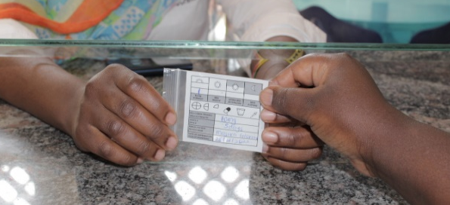

MSF & Drug Dispensing Bags
Use in operational contexts like OPD and mass drug administration campaigns
Each bag containing one type of drug only; every patient gets as many bags as the number of prescribed medicines
MSF Movement uses around 15 million plastic drug dispensing bags a year
Carol RAMIREZ

Slide 3
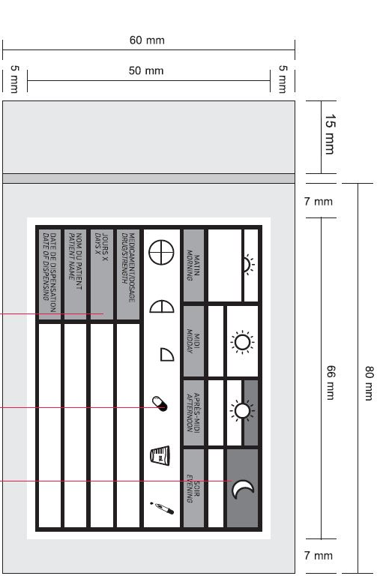
Current Drug Dispensing bag
Technical specifications
Transparent polyethylene
Dimensions: 6 cm x 8 cm
Thickness: 50 µm
Butt-welded on 3 sides
Watertight zipper closure
1 opaque side and 1 transparent side. The opaque side is printed and used to write different information

Slide 4
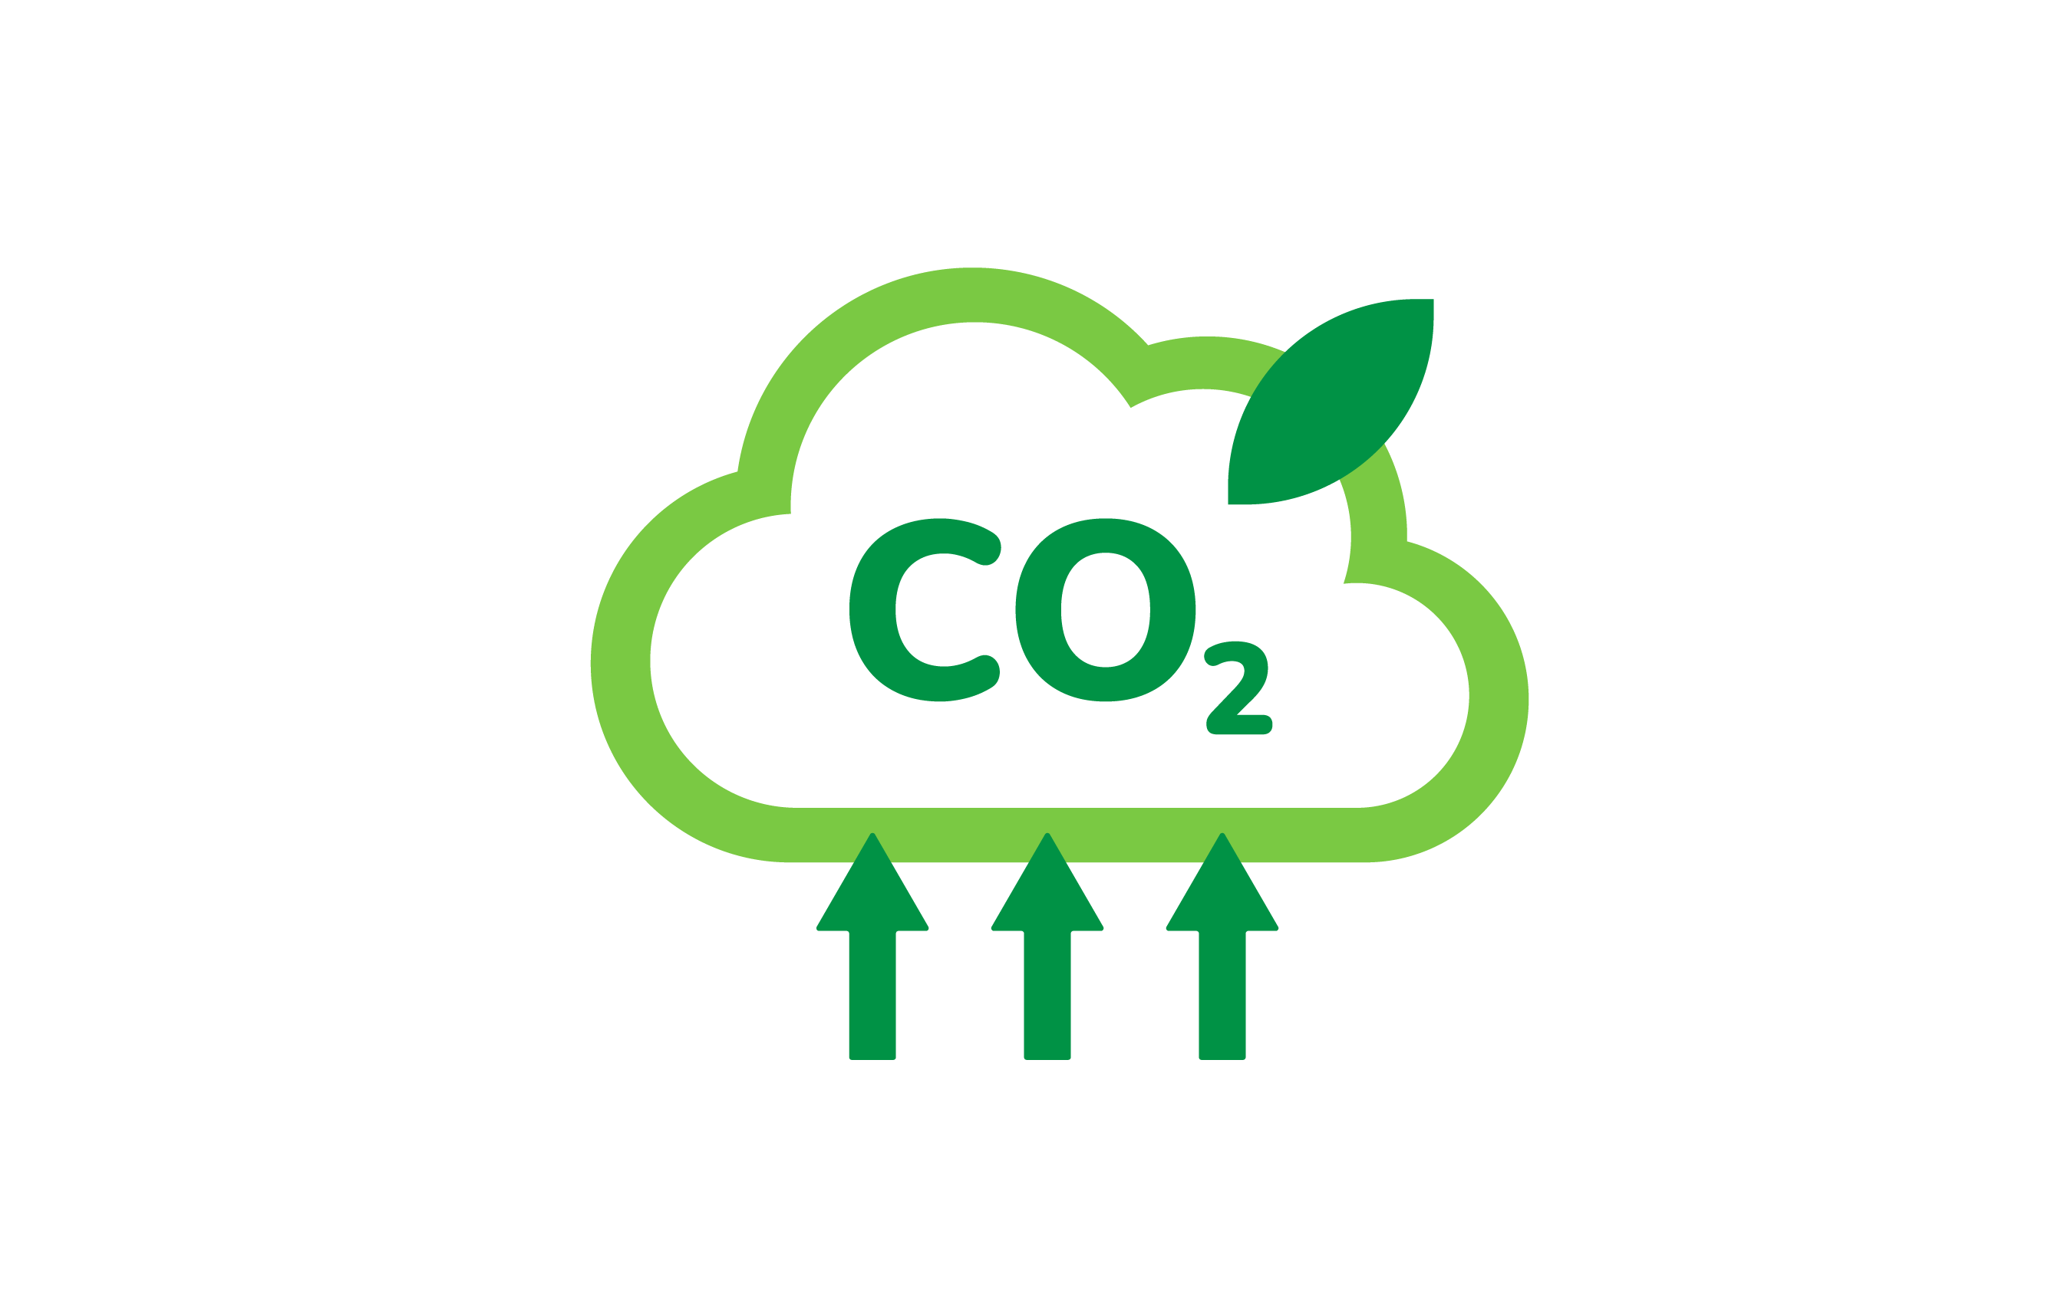
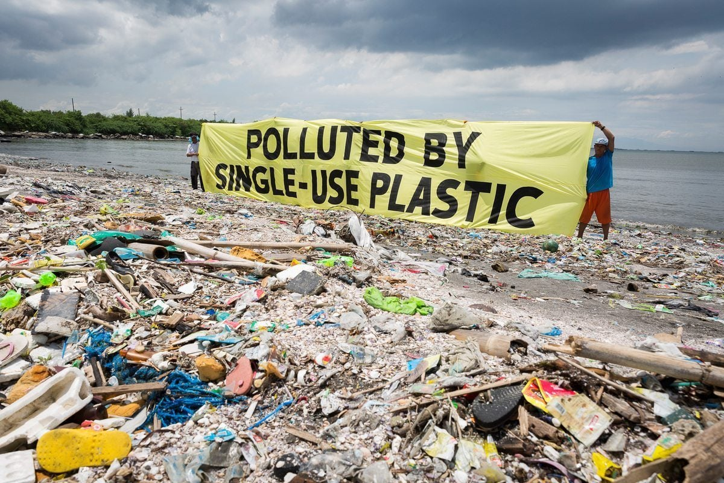
Environnemental issues
Carbon footprint
Plastic waste

Slide 5
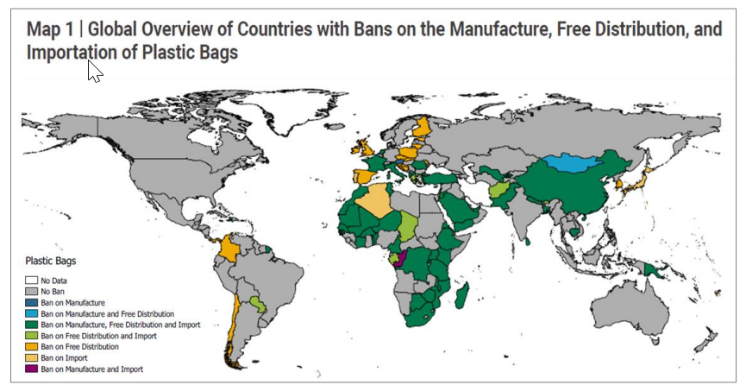
Plastic Bags Ban
Notes:
According to a research conducted in 2018 by Unitated Nations Environment Programme (UNEP); 127 countries in the world have some form of plastic bag legislation, of which 91 countries have a total or partial ban (see Map 1), being Africa the region with the greater number of countries, 32 out of 34 implementing a total ban, due to a lack of proper waste management system, funds, or awareness by producers

Slide 6
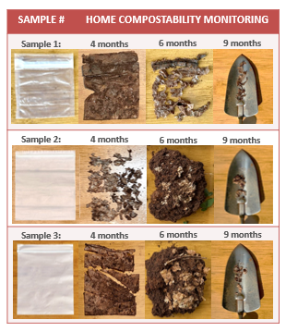
Biosource and biodegradable alternatives?
Opportunities, but…
Not manufactured in African countries (carbon emissions related to transport)
Short shelf life (<12months)

Slide 7
Challenges
Reducing environmental impact of drug dispensing bags, including carbon emissions and waste issues.
To search and propose a more environmentally friendly solution that is fit for the intended use:
  Medicine or Food Contact packaging certified
  Transparent to “Semi-transparent”
  Efficient Closure System / Resealable
  Water Resistant
  Printable & Writable (non-toxic ink)
  Shelf-life > 2 years (or competitive vs plastic)
  Competitive price

Slide 8
Thank you!

