Slide 1

Equal access of technological advancements to improve diabetes management.
Background An estimated 537 million people live with diabetes, with cases rising faster in low- and middle-income countries. DMT1 and 2 complex conditions, with all DM1 and some DM2 patients requiring insulin, equipment to monitor and regulate blood glucose, access to professional care and empowerment to manage their condition. Access to these can be more challenging in rural or remote settings, areas of conflict or insecurity, or population displacement.

Slide 2
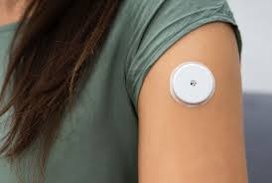
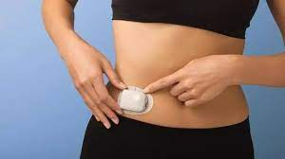
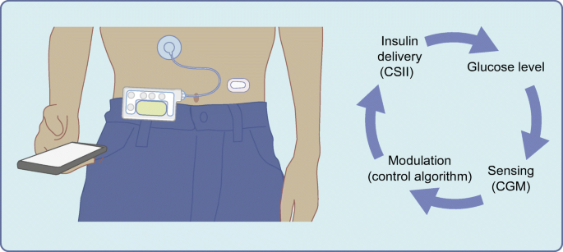
Recent technological advances
In recent years, huge advances have been made in medical technologies for diabetes management, including those to automatically detect and respond to glucose levels. ( CGM, Insulin pumps, closed loop systems)
Usually, however, such technologies remain inaccessible to patients in contexts where MSF work, meaning many who could benefit most from these advancements are unable to access them.

Slide 3
Challenges in Existing Solutions
Prices remain extremely high.
Open source solutions are emerge in some areas, however complete solutions remain commercial.
Those systems available are often ill adapted to the heat, dust or other environmental conditions of the project sites.
Many require specific internet, power or data sharing requirements.
Most are designed for a target population whose lived experience of diabetes management varies enormously from those where MSF work.

Slide 4
Situation Improvements
More accessible novel technologies which reduce the burden of diabetes management.
Solutions to diabetes management which are better adapted to the challenges of insecure contexts or lower resource / challenging contexts.

