Slide 1

Data sharing and Access to Data tools
Focus on an example of AI.
Can be a hugely useful tool for decision support, in training, triage, and in areas where access to specialist diagnosticians is scarce.
Can reduces time for treatment decision – useful when populations are remote or clinic visits are difficult / costly / dangerous.

Slide 2
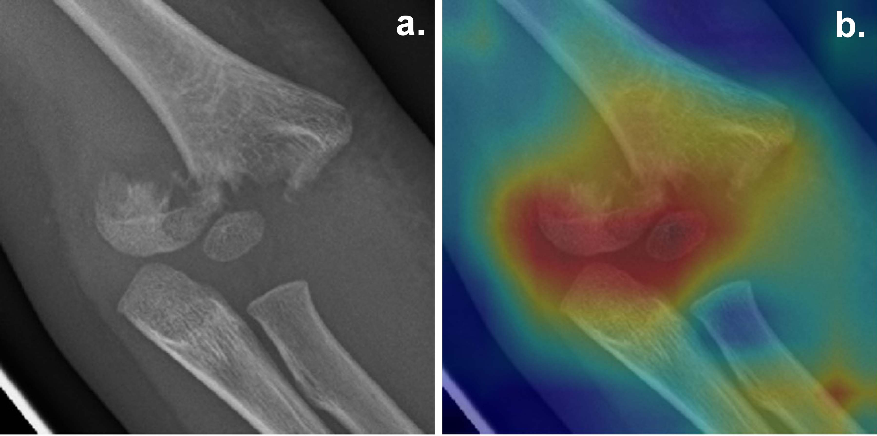
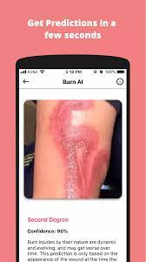

Growing field – huge number of algorithms developed and commercially available for a wide range of pathologies and applications, and which can demonstrate impressive sensitivity and specificity. The challenge is not necessarily development of further AI-

Slide 3
AI challenges
Often, expensive
Often require the transfer of data to the cloud, storage on a server which may be located in a location unacceptable to the country of data origin. Commercial company may seek to use and store data.
Data privacy regulations - which differ according to regional / national / international regulations are a huge concern and can become difficult to manage.
Algorithms often trained on data which is not representative of the patient population we work with.
Not all solutions vendor neutral – working in differing contexts with the MoH means little standardisation of equipment across the organisation in some areas.

Slide 4
Potential solutions
Develop a new model for AI which would incorporate techniques to answer some of these queries through consideration on:
  Techniques of federated learning,
  Open-source availability,
  Attention to interoperability and vendor neutral properties,
  Capacity to be adapted to different diagnostic areas.
  Develop hardware by which applications which currently work online can be captured and utilized in place without data transfer.
  Interoperability and vendor neutrality

