Slide 1
Open Science Monitoring framework
Anne Gentil-Beccot on behalf of the SIS Monitoring project WG – CERN RCS SIS
31st October 2023

Slide 2
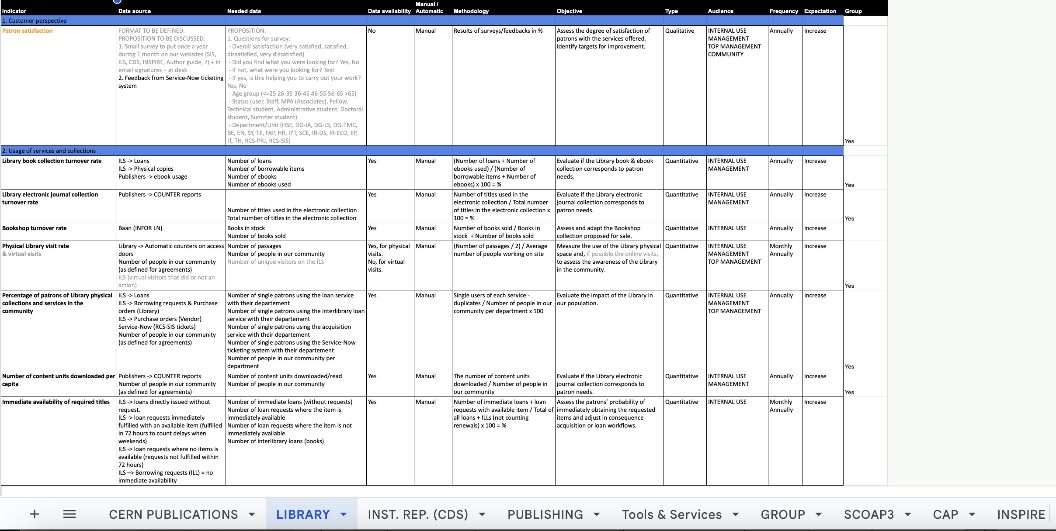
RCS-SIS monitoring project
Ongoing group wide project within SIS to create a dashboard of KPIs for all SIS activities
First step : list KPIs for all SIS services :
  Source
  Data extraction
  Visualisation and audience

Slide 3
Requirements for the technical solution
Different data sources:
  Inspire, CDS, ILS, SCOAP3 repository, Websites (Matomo), ServiceNow, Publisher’s usage statistics..
Visualisation:
  Rich enough to meet all needs: plots, table…
Features:
  Possibility to filter by year
  Export data, export visualisation to embed them in reports
Different audiences: private / public

Slide 4
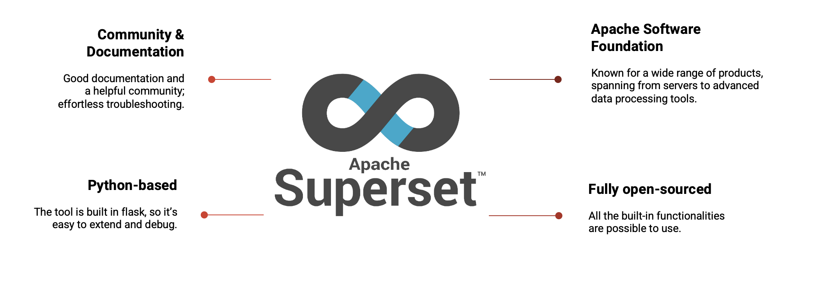
Apache Superset

Slide 5
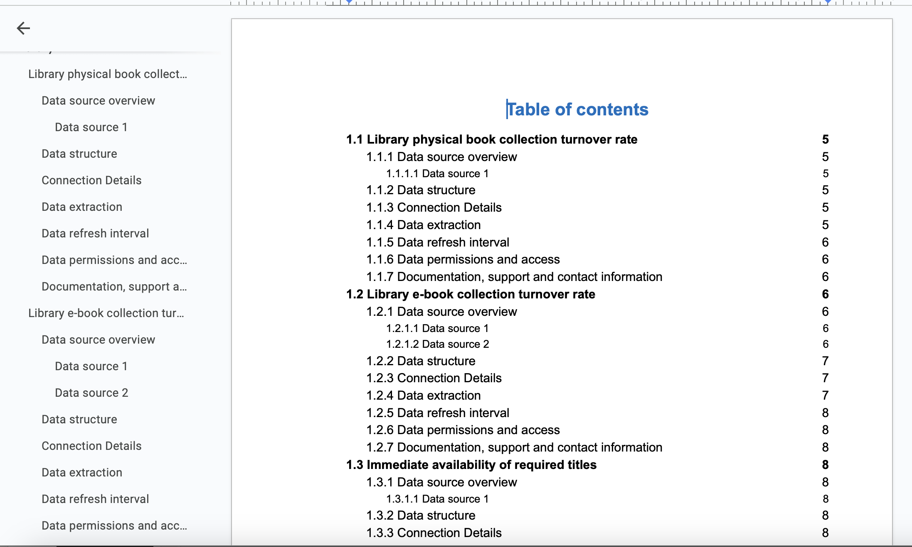
Detailed documentation of KPIs and calculation methods
Work done by an administrative student
Prioritize the KPIs
  Without letting aside the KPIs more difficult to calculate (often also more interesting)
Describe calculation methods
  Based on literature review, standards (when exist)

Slide 6
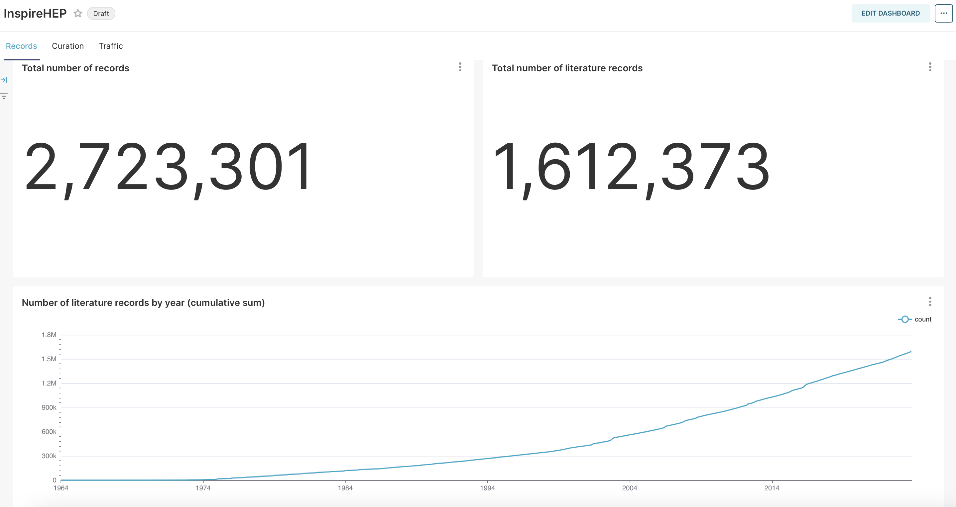
Ex. Inspire

Slide 7
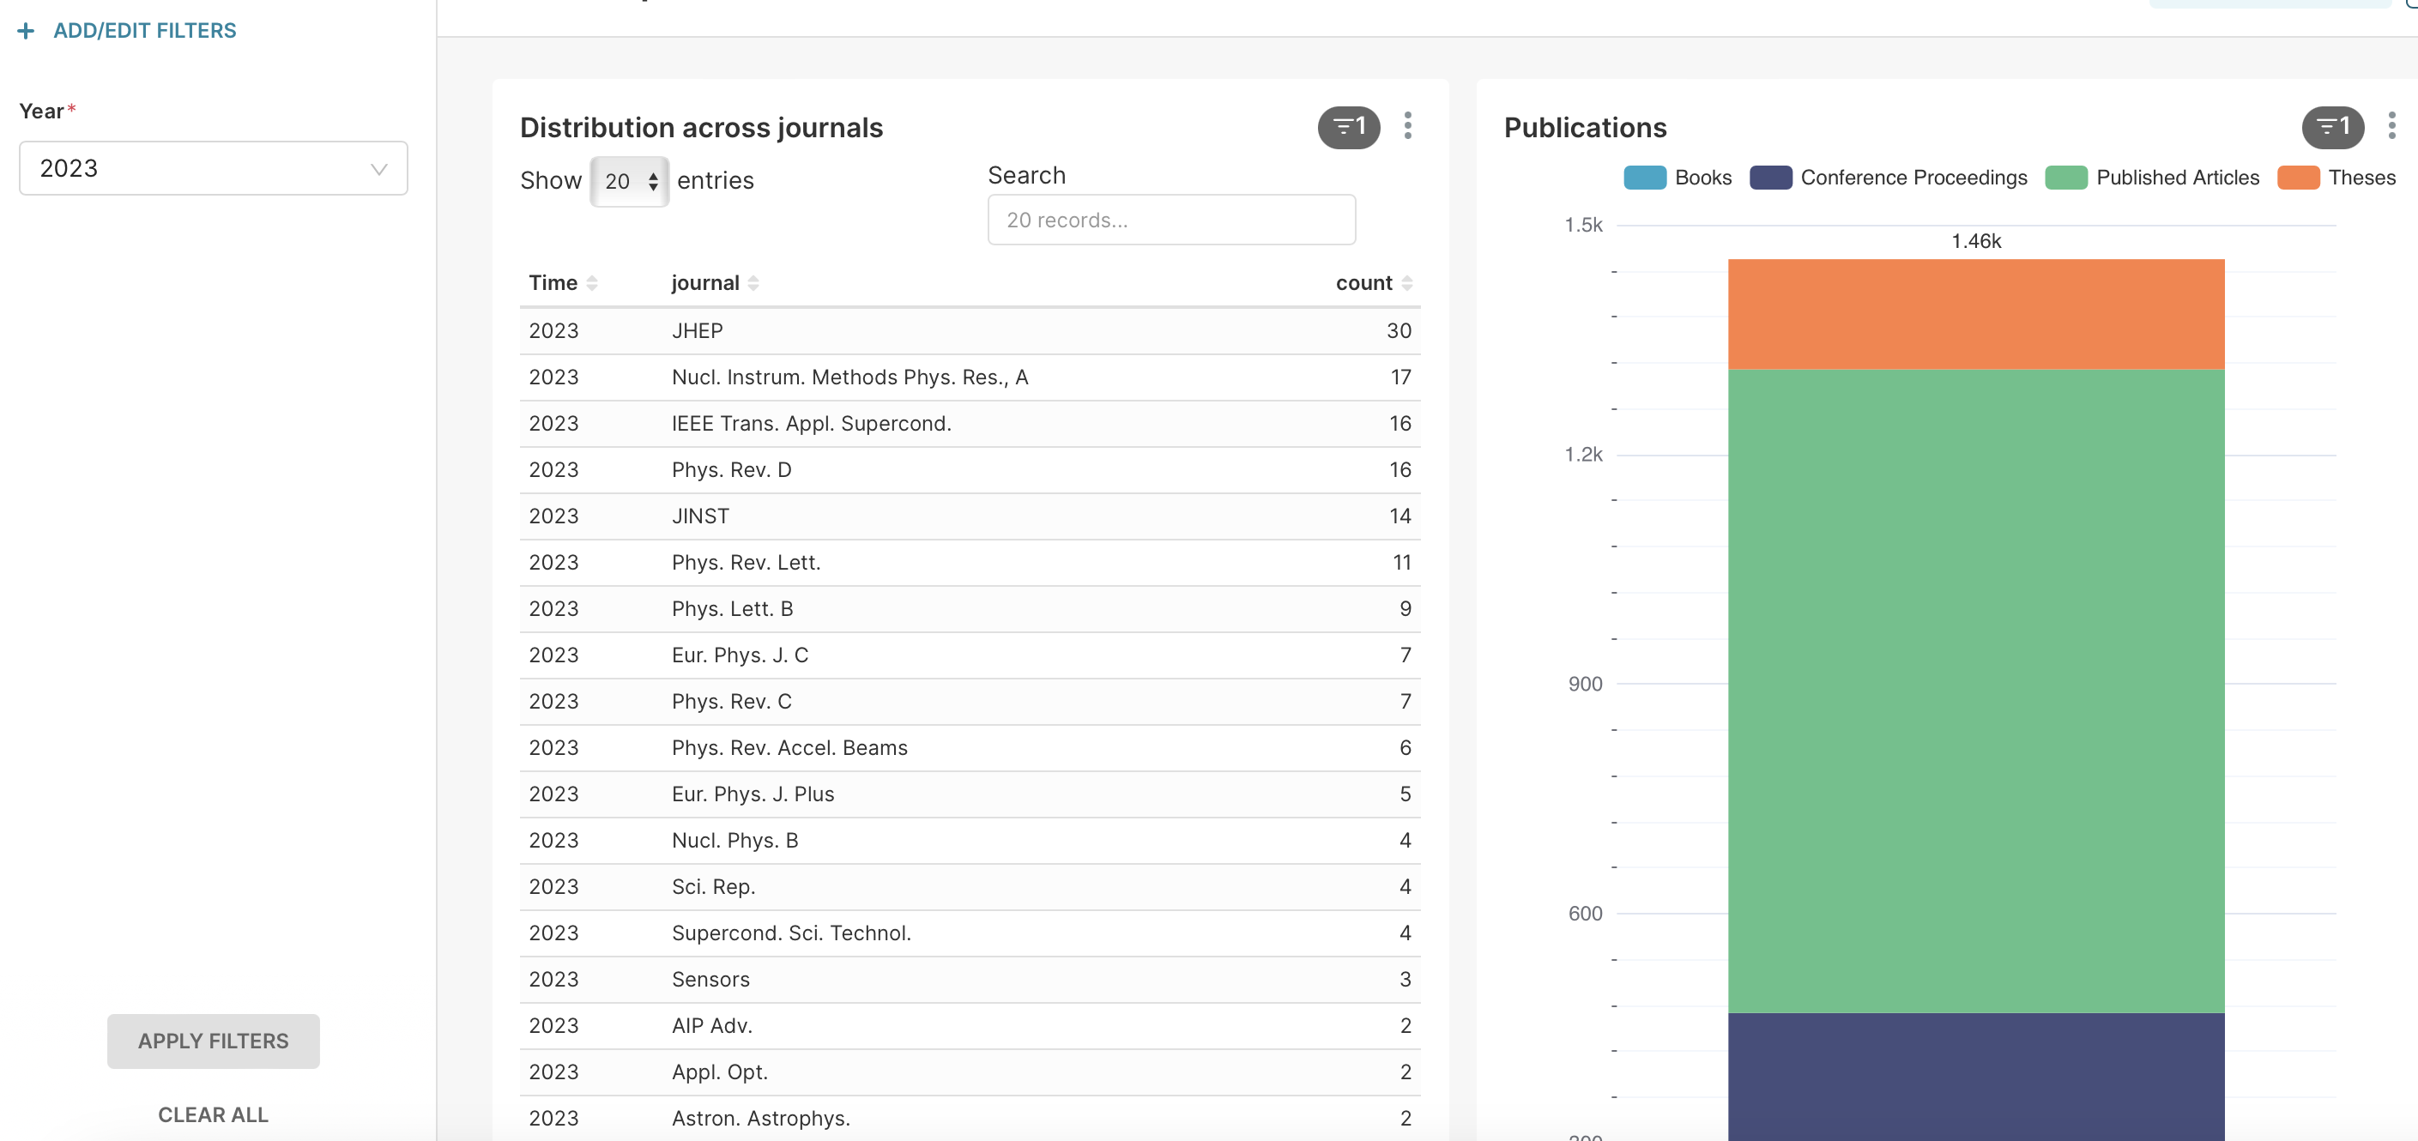
Ex. CERN Publications

Slide 8
Next steps
Integration of all SIS indicators in Superset
  Inspire In progress
  CERN Publications (and Open access availability) In progress
  Library services
  …
Creation of the dashboard(s)

Slide 9
And for other Open Science elements?
Definition of KPIs, by OS element:
  Question behind the KPI
  Data source
  Data availability and possible challenges with data extraction
  Target audience
Possible use of the Superset framework to collect and visualize those KPIs (?)

Slide 10
Anne Gentil-Beccot
anne.gentil-beccot@cern.ch

