Slide 1
Korea CMS
CERN-Korea Committee Report
Apr. 11, 2011
Inkyu PARK
Dept. of Physics, University of Seoul
as the national spokesperson of KCMS
Notes:
1

Slide 2
Contents
Korea CMS participants / Twiki page
KCMS Subgroups: 6 PAGs + 2
2010 outputs
CMS Up-scope activities
KCMS Budget & Plans

Slide 3
Korea CMS participants
Institutions: 6 universities + 3 requested
  Korea Univ., Kyungbuk Univ., Sungkyunkwan Univ.
  Univ. of Seoul, Chonnan Univ., Kangwon Univ.
    applications: Konkuk Univ., Chonbuk Univ., Cheju Univ.
Professors: 12
  CERN long-term (1), short-term (11)
Post-doc researchers: 13
  CERN long-term (6), short-term visit (7)
Graduate students: 28
  CERN long-term (14), short-term visit (14)
Staffs: 5
  Secretariat (1), SI administrator (1), technicians (3)

Slide 4
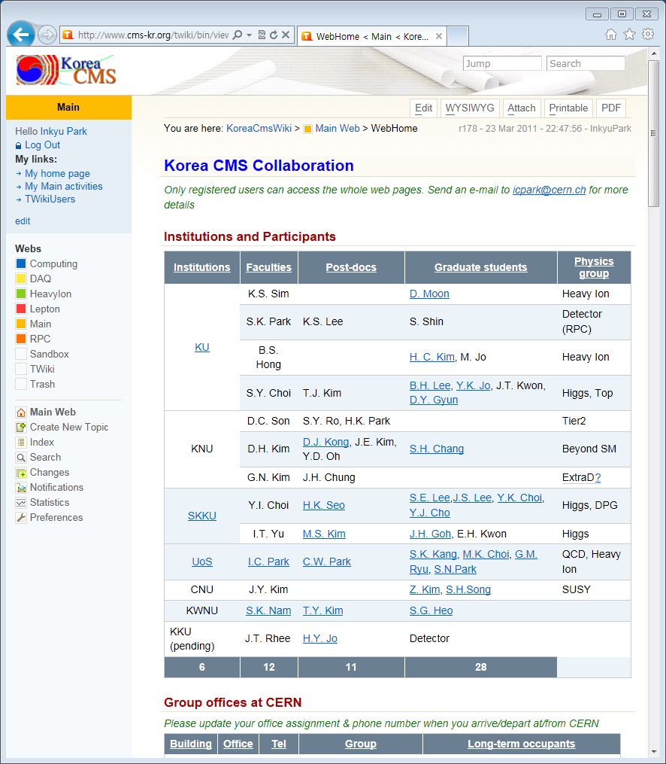
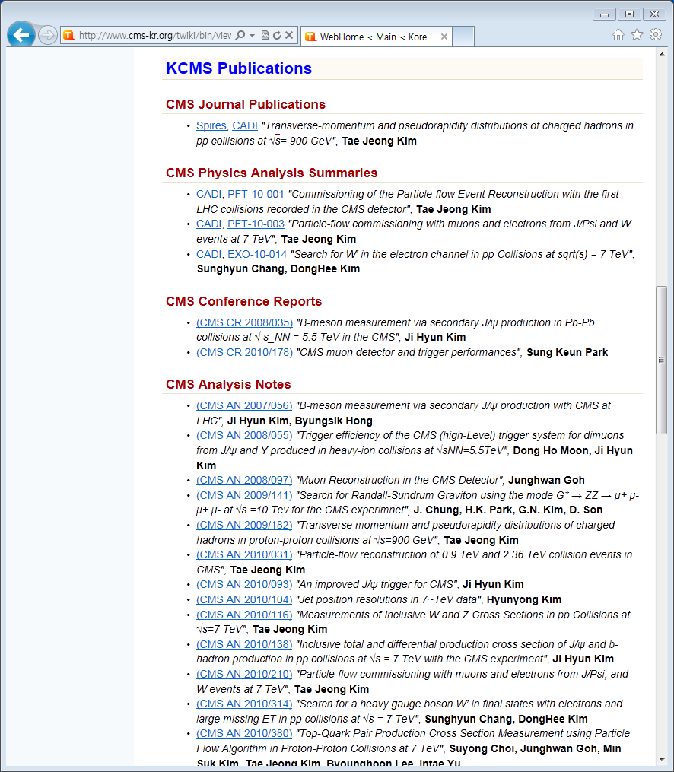
KCMS Twiki
http://www.cms-kr.org

Slide 5

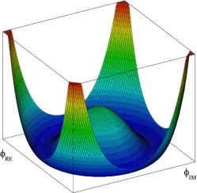
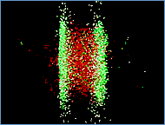
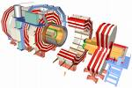
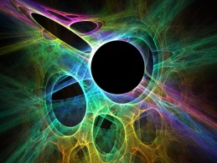
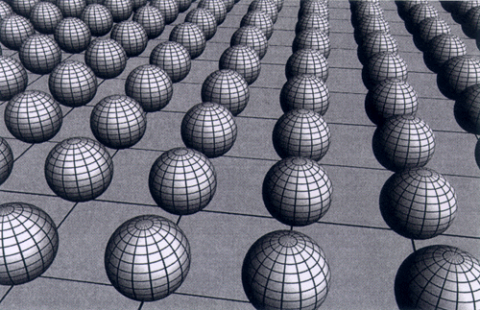
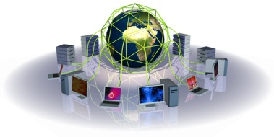
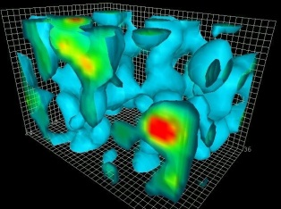
Korea CMS : subgroups
Higgs search
Heavy Ion
QCD
Detector R&D
Beyond SM
Computing
ExtraD
SUSY
Operational
Committee
MEST/NRF/CERN
CMS / Korea CMS

Slide 6
6 PAGs (Physics Analysis Group) + 2
PAG-1 : Higgs (Korea U, SKKU)
  SY Choi*, YI Choi, IT Yu, TJ Kim, HK Seo, MS Kim
    Doubly charged Higgs search
PAG-2 : Heavy Ion (Korea U)
  BS Hong*, KS Sim
    Heavy Quark production, Flow
PAG-3 : QCD (U of Seoul)
  IC Park*, CW Park
    Color coherence effect in jet
PAG-4 : Beyond Standard Model (KNU)
  DH Kim*, YD Oh, JE Kim, DJ Kim
    W’ search
PAG-5 : SUSY (CNU)
  JY Kim*
    SUSY → 3 leptons
PAG-6 : ExtraD (KNU)
  GN Kim*, SE Lee
    Graviton → ZZ → llll
DET : RPC (Korea U)
  S. Park*, KS Lee
    RE4/2, RE4/3, RE1/1
COM : Tier2 (KNU)
  D.C. Son*, HK Park, JS Suh
    Tier2, CMS center

Slide 7
2010 outputs
> 20 CMS publications
  1 Journal, 3 PAS
  15 AN, 1DN, 1IN
> 20 KPS / International Conference talks
  Korean Physical Society
  Some Asian conferences
1 Ph.D. thesis, 6 M.S. theses
  Ph.D.
    J.H. Kim: J/Psi production in pp
  M.S.
    RPC H/W, RPC S/W, Muon, Jet, ECAL, Pile-up study

Slide 8
Physics activities in detail
 | CMS DB | Authors | Title
Journal | PRL | T.J. Kim | Transverse-momentum and pseudorapidity distributions of charged hadrons in pp collisions at √s= 900 GeV
PAS | PFT10/001 | T.J. Kim | Commissioning of the Particle-flow Event Reconstruction with the first LHC collisions recorded in the CMS detector
 | PFT10/003 | T.J. Kim | Particle-flow commissioning with muons and electrons from J/Psi and W events at 7 TeV
 | EXO10/014 | S.H. Chang | Search for W' in the electron channel in pp Collisions at sqrt(s) = 7 TeV
CR | 2008/035 | J.H. Kim | B-meson measurement via secondary J/ψ production in Pb-Pb collisions at √ s_NN = 5.5 TeV in the CMS
 | 2010/178 | S. Park | CMS muon detector and trigger performances
AN | 2007/056 | J.H. Park | B-meson measurement via secondary J/ψ production with CMS at LHC
 | 2008/055 | D.H. Moon | Trigger efficiency of the CMS (high-Level) trigger system for dimuons from J/ψ and Υ produced in heavy-ion collisions at √sNN=5.5TeV
 | 2009/141 | J.H. Chung | Search for Randall-Sundrum Graviton using the mode G* → ZZ → μ+ μ- μ+ μ- at √s =10 Tev for the CMS experimnet
 | 2009/182 | T.J. Kim | Transverse momentum and pseudorapidity distributions of charged hadrons in proton-proton collisions at √s=900 GeV
 | 2010/031 | T.J. Kim | Particle-flow reconstruction of 0.9 TeV and 2.36 TeV collision events in CMS
 | 2010/093 | J.H. Kim | An improved J/ψ trigger for CMS
 | 2010/104 | H.Y. Kim | Jet position resolutions in 7~TeV data
 | 2010/116 | T.J. Kim | Measurements of Inclusive W and Z Cross Sections in pp Collisions at √s=7 TeV
 | 2010/138 | J.H. Kim | Inclusive total and differential production cross section of J/ψ and b-hadron production in pp collisions at √s = 7 TeV with the CMS experiment
 | 2010/210 | T.J. Kim | Particle-flow commissioning with muons and electrons from J/Psi, and W events at 7 TeV
 | 2010/314 | S.H. Chang | Search for a heavy gauge boson W’ in final states with electrons and large missing ET in pp collisions at √s = 7 TeV
 | 2010/380 | S.Y. Choi | Top-Quark Pair Production Cross Section Measurement using Particle Flow Algorithm in Proton-Proton Collisions at 7 TeV
 | 2010/386 | D.H. Moon | On the observation of Z bosons in Pb+Pb collisions at √s = 2.76 TeV
 | 2010/394 | I.C. Park | Azimuthal correlations of charged hadrons in Pb+Pb collisions at √s = 2.76 TeV
 | 2010/427 | J.S. Lee | Φ±± reach with 100 pb-1 and result for 36 pb-1
DN | 2010/005 | S.H. Chang | Energy Containment Studies of Ecal Endcap Crystal using 2007 H4 Test Beam Data
IN | 2010/012 | S.G. Heo | Analysis of Horizontal Cosmic Muons with the CMS Detector
Thesis | M.S. | T.J. Son | A Study of Validation for High Pt Electron selection algorithm at CMS
 | M.S. | H.Y. Kim | Performance of Jet Finder algorithms at CMS
 | M.S. | S.G. Heo | The Effects of Pileup Events with 7 TeV? Proton-Proton Collision Data in the LHC
 | M.S. | Y.K. Jo | Development of CMS RPC performance measurement software and the performance of CMS RPC detector
 | M.S. | H.Y. Chung | Feasibility study of muons in fast simulation at the CMS experiment
 | M.S. | E.S. Seo | Geometrical Acceptance Analysis for RPC PAC Trigger
 | Ph.D. | J.H. Kim | Production of J/psi in p+p collisions at √s = 7 TeV in CMS
total | 24

Slide 9
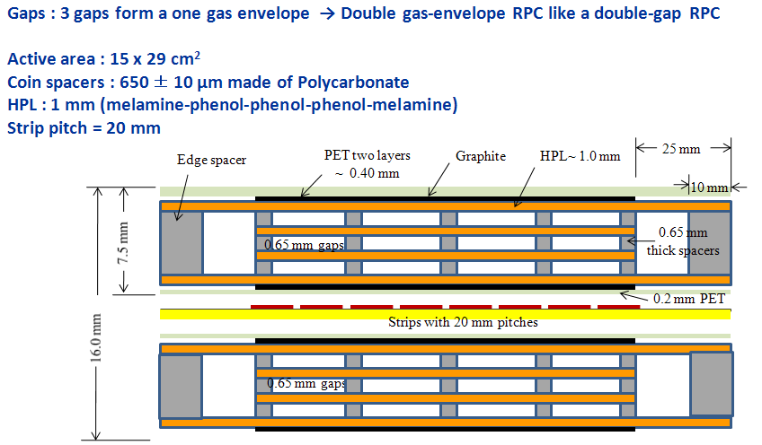
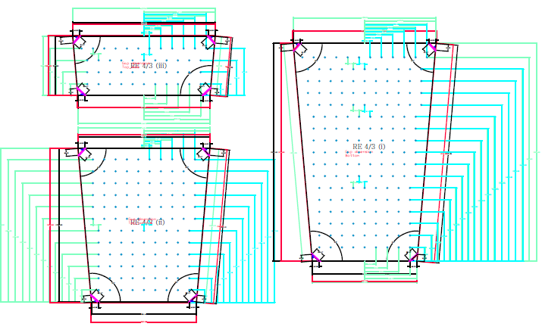
Detector activities : RPC
KCMS (funding, man-powers) / KODEL (facilities)
  CMS Up-scope: RPC RE4/2, RE4/3 production
  CMS Upgrade: R&D on multi-gap RPC for RPC RE1/1
Sample production of RE 4/2, 4/3
RE4/2 design
RE4/3 design
6-gap RPC design for RE1/1

Slide 10
Budget operation/Up-scope
M&O-A (~200K)
Travel, Subsistence, R&D ( ~ 1.4 MCHF / year)
  Including RPC-Upscope MOU (2007) : 550KCMF by 2011
    CTC2 (147K) + Up-scope 1,2,3 (403K)
Year | # of Ph.D. | M&O-A CMS (CHF) | Travel Subsistence (MWon) | M&O-B CMS (CHF) | M&O-B RPC (CHF) | RPC cash contribution (CHF)
2007 | 12 | 99,637 | - | - | - | -
2008 | 12 | 117,535 | 750 | 39,118 | - | 113,992
2009 | 12 | 112,000 | 1,500 | 31,400 | 5,000 | 57,035
2010 | 18 | 180,538 | 1,420 | - | 48,000 | 55,000
2011 | 21 | 217,620 | 1,450
2012 | 20 | ~200K | ~1,500
  CTC2 (147K) completed
  Up-scope (403K) : 132K paid, 271K left

Slide 11
KCMS Up-scope activity plan
RPC production : RE4/2, RE4/3 (from KODEL)
  # of gaps to be built: ~660
  production period: ~12 months
  Total cost : ~450KCHF (including 10% overhead)
    M/C (~180K), Labor (~144K), Q/A (~60K), Clean (~28K)
Transportation to CERN :
  Extra cost (from KODEL)
    Packing, shipping: ~85KCHF
KCMS
  KODEL should contributes to RPC up-scope
  Cost down possible with KCMS in-kind contributions
    At least labor cost.

Slide 12

Summary
2010→physics activity jumping up
  > 20 CMS publications, > 20 talks31
  successful job search, 1.Ph.D., 6 M.S.
2010→ Outreach jumping up
  CERN Visitors increased dramatically
  Enhanced Physics activities → Enhanced visibility
Need Long-term budget for CMS upgrade
  requested ~200kCHF
  over 5 years for upgrade

