Slide 1
Welcome to CERN and LER2024
9th Low Emittance Rings’ workshop, CERN 13-16/02/2024
Yannis Papaphilippou, CERN

Slide 2
9th Low Emittance Rings’ workshop 2024
Supported by I.FAST EU project Work Package 7 on High brightness accelerators for light sources
Goal: Bring together scientific communities working on low emittance lepton rings, including light source storage rings, damping rings and e+/e- circular colliders.
Workshop sessions include:
  Low emittance ring lattice design, including optics measurements and correction, low emittance tuning, non-linear dynamics (Tuesday am/pm)
  Project overviews (Wednesday am)
  Collective effects and beam stability aspects (Wednesday am/pm)
  Associated technologies for low emittance rings including magnet design, diagnostics, feedbacks (Tuesday pm) and harmonic cavities (Wednesday pm)
  Power Consumption, efficiency and sustainability, including related technologies in collaboration with I.FAST WP11 (Thursday am)
  Computing tools machine Learning and AI (Thursday pm)
  Injection, machine protection and collimation (Friday am)

Slide 3
Some numbers and instructions
Almost ~100 registered participants, new record for in-person event!
Interested colleagues can follow workshop through zoom
~70 presentations, very packed program, many thanks to chairs for ensuring strict time management
Instructions to speakers:
  Please upload your presentation to indico ASAP and no later than the end of the previous session
  Leave 2-3 minutes for discussion, more discussion time available at the end of each session

Slide 4
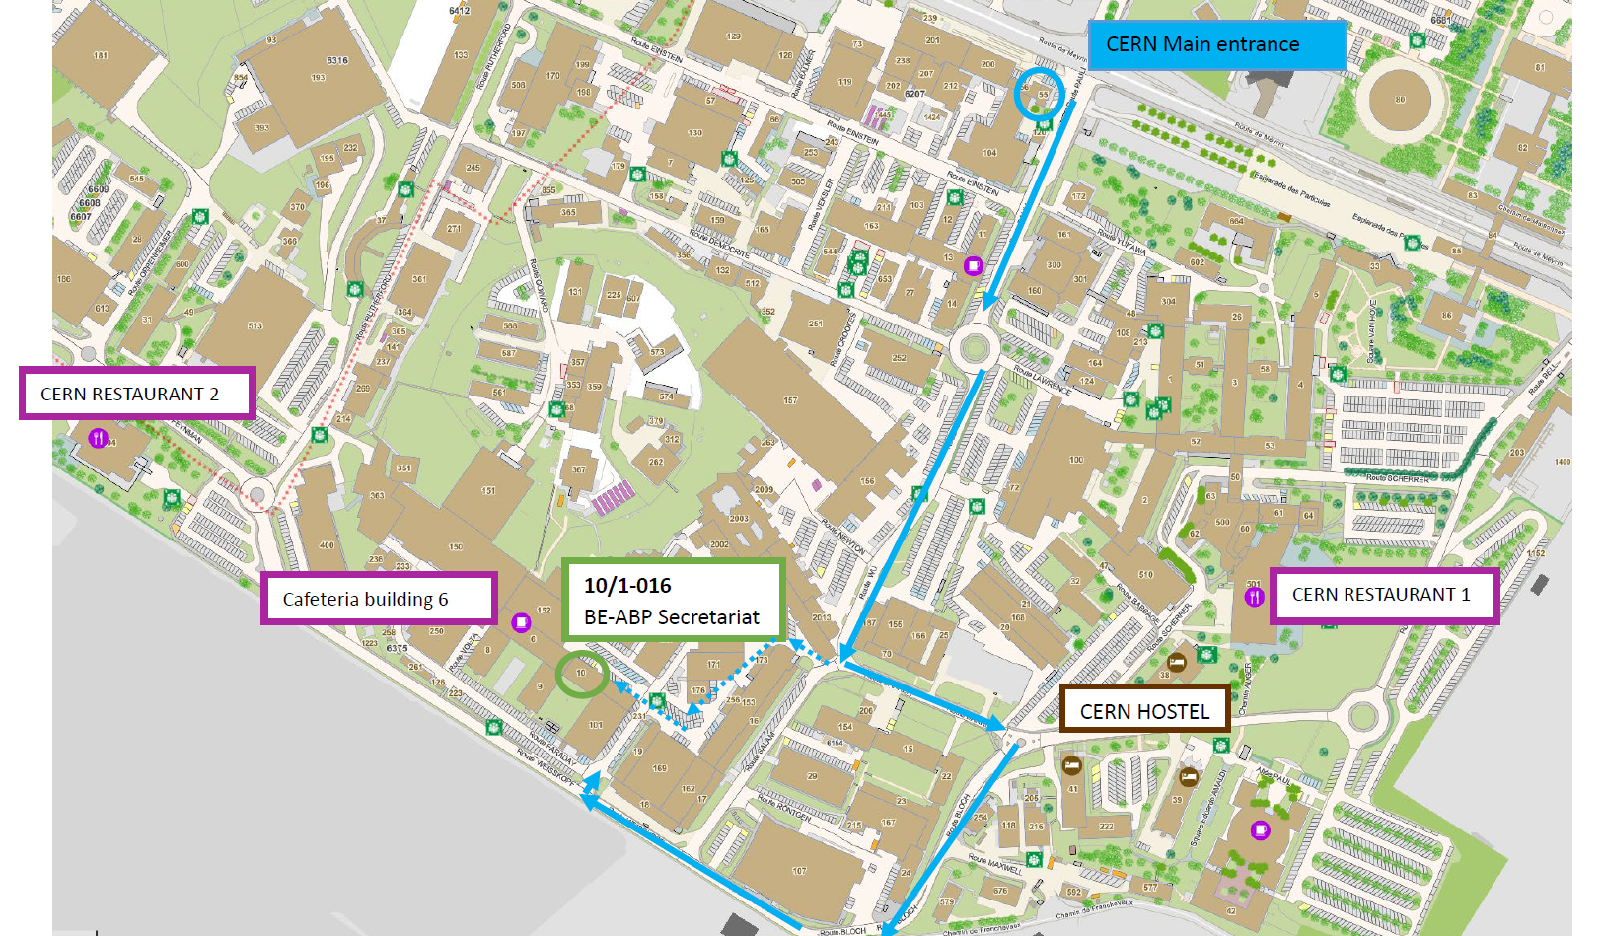
Logistics
BE Auditorium is located in 6/2-024
Coffees will be served at Blg. 6 cafeteria (1st floor)
Lunch tickets will be provided for Restaurant 2 to registered participants
Welcome drink organized at the CERN Glassbox (Restaurant 1) on Tuesday 13 February 2024 as from 19h.
Some visits (LINAC4+LEIR, CLEAR, Synchro-Cyclotron) are proposed on Friday 16 February 2024 pm

Slide 5
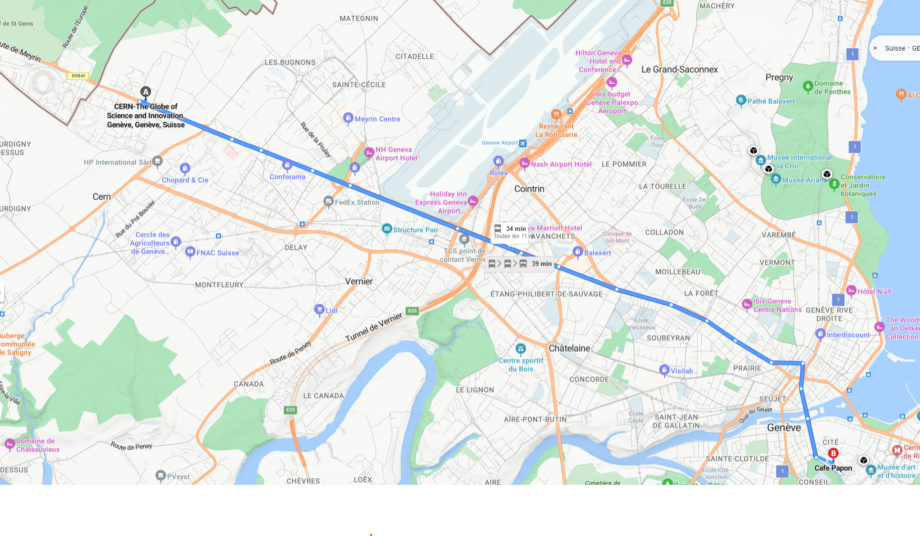
Workshop dinner
Organized in Café Papon (Rue Henri Fazy 1, 1204, Genève) on Thursday February 15th 2024 at 20h (sharp!)
Public transport: Tram 18 in front of Globe of Innovation (~30 mins trip). Stop at Place de Neuve and walk up-hill towards the old town (~5 mins.). Leave CERN by ~19:00 to be on time!
Tram tickets available through TPG application on your mobile phone or buy ticket at Tram Stop with Cash in CHF or credit card.

Slide 6
Announcements

Slide 7
Announcements

Slide 8
Thank you for your attention!

