Slide 1
Deterministic Approach to MBA lattice Design
Bettina Kuske, Paul Goslawski
iFAST – 9th Low Emittance Workshop, CERN, Switzerland,
February 13th-16th, 2024
Find the optimal solution

Slide 2
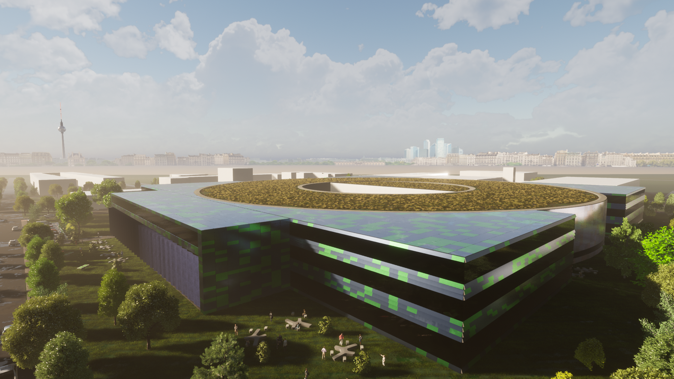
Table of contents
Deterministic Approach to MBA Lattice Design
Introductory remarks
Layout of the unit cell
Current ‘working horse’ lattice
Validation of results
Non-linear optimization
Conclusion

Slide 3
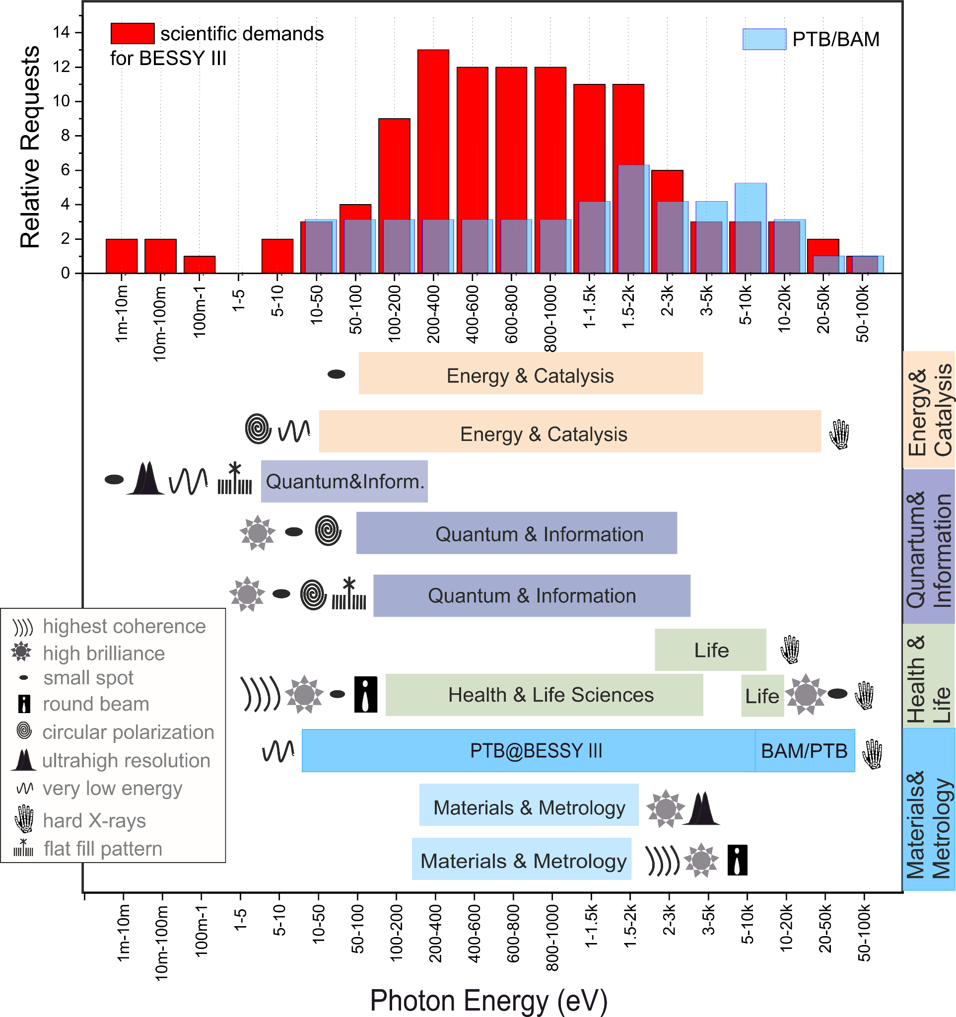
Facility parameters
Ring parameters
BESSY III Requirements & Objectives
Courtesy Paul Goslawski
1st undulator harmonics polarized up to 1 keV
from conventional APPLE-II
Diffraction limited till 1 keV
Stay in Berlin-Adlershof
Nanometer spatial res. & phase space matching
PTB/BAM metrology applications
Ring Energy 2.5 GeV (1.7 GeV)
Emittance 100 pm rad
(5 nm rad)
Circumference 350 m
16 straights @ 5.6 m
( 240 m @ 4.5 m)
Low beta straights &
maybe round beams
Metrology source
Homogenous bends
Measuring the field at the source point with a NMR probe in a volume of 10x10x10 mm
Momentum > 1.0e-4
compaction factor
Energy 2.5 GeV
Emittance 100 pm
Mom. Compaction α > 1e-4
Circumference
‘quasi green field’ ~350m
16 straights à 5.6 m
1-2 bends
per arc
Already at BESSY II, a 3rd generation without combined function bends
Courtesy K. Holldack

Slide 4
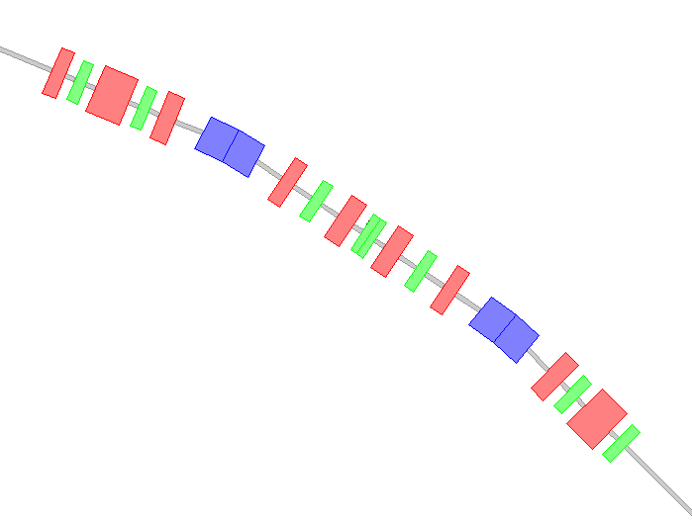
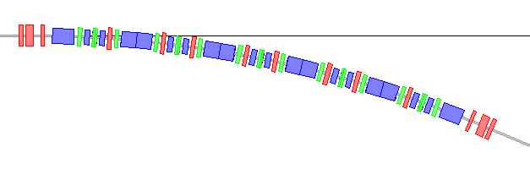

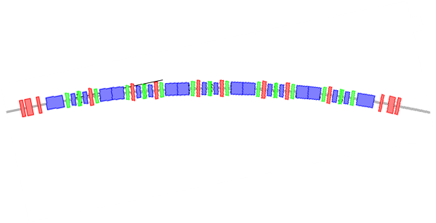
The Challenge of lattice design
3rd generation light sources
Bessy II
Lattice design is a many-parameter optimization
in a high-dimensional space.
dipole
7 quadrupoles
6 sextupoles
drifts
=> many parameters to optimize
4th generation light sources
Bessy III
6 dipoles
10 reverse bends
24 quadrupoles
19 sextupoles, octupoles?
drifts
=> too many parameters to handle easily
OPTION:
Take existing lattice and push
towards own needs and demands.
https://www.shutterstock.com/image-vector/
boys-pulling-pushing-boxes-illustration-376336384

Slide 5
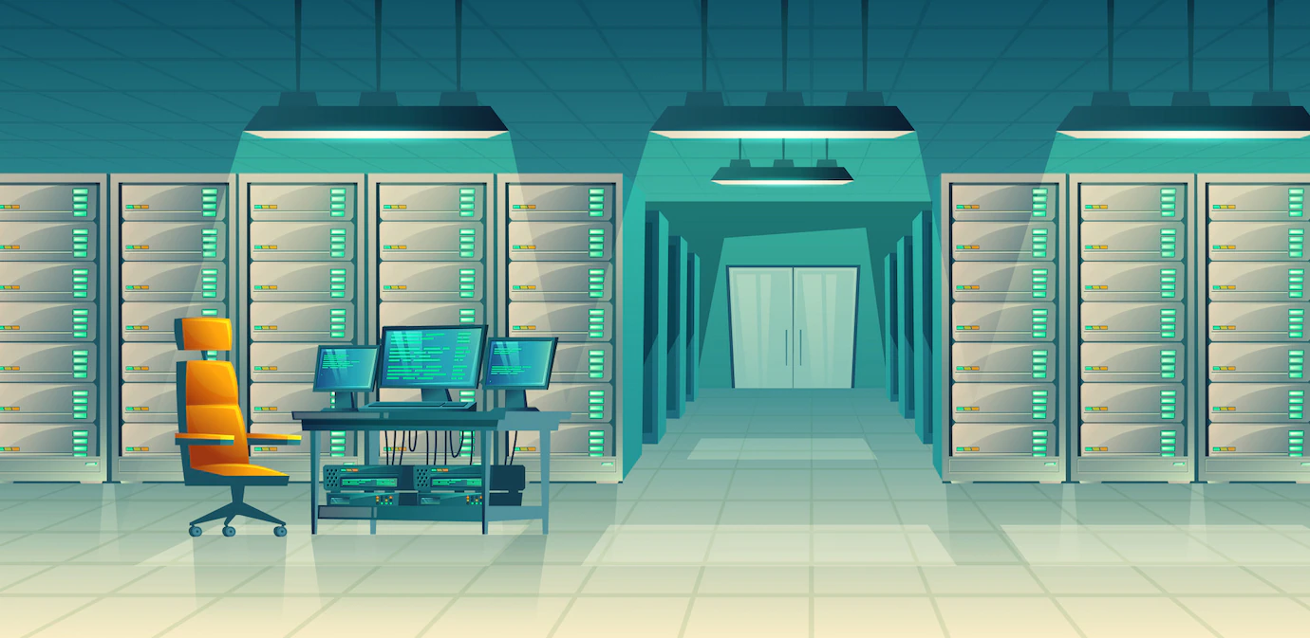


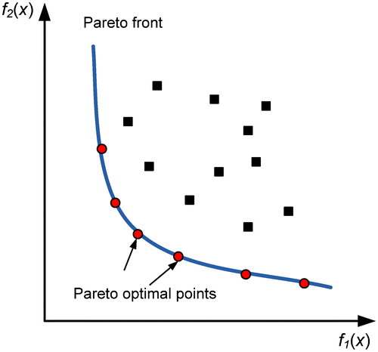
The Challenge of lattice design
OPTION:
Use multi-objective Genetic Algorithms
(MOGA) or machine learning
Drawbacks:
  Excessive computer resources
  No learning curve
  Many equivalent solutions
  ‘a’ solution – not necessarily the optimum
https://www.shutterstock.com/de/search/server-room
https://www.pngaaa.com/detail/4902300
HZB approach:
Deterministic Lattice Design (regular MBA)
Divide lattice into small, generic subsections
  Cuts down on the number of parameters per section
Optimize subsection
  Understand the functionality of each element
  Why a reverse bend? Combined function or separate function magnets? Which magnet order?
Compose baseline lattice
Injection straights, super bends …
  all regarded as perturbations that do not alter the basic design choices

Slide 6

Strategy
Premises:
MBA lattice small emittance
Reverse bend even smaller emittance,
shorter structure*
Phase matching between sextupoles
HOA, good non-linear behavior**
Keep sextupole strength low
Set up generic UC:
Modular approach
UC phase advance
UC: unit cell
DSC: dispersion suppression cell
Straight section
Drifts 10cm
QD 15cm
RB 16cm
SX 10cm
Bend: 100cm
Determines no. UC
and periodicity of the lattice
Emittance reduction
CF, RB, dipole length
Deterministic approach to
BESSY III linear lattice design
Compare magnet arrangements
Reduce SX-strength significantly
Study balance between UC-
and DSC-bend angle
Set up DSC
Full / half dipole is not the optimum
Find matching to
center of straight
Basically fixed by boundary conditions
Understand best fit parameters
Include technical limitations:
=> baseline lattices
*: A. Streun, B. Riemann, PHYS. REVI. AB 22, 021601 (2019)
**: J. Bengtsson, CERN 88-05, SLS Note 9/97
Quadruplet avoids
large β - peaks

Slide 7
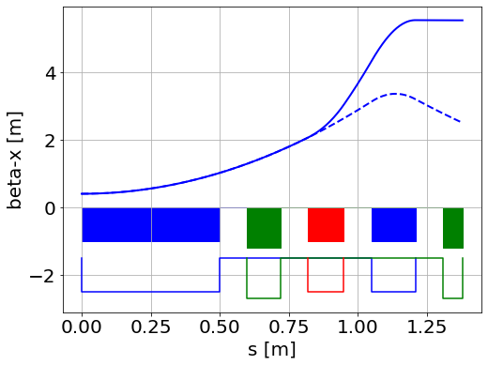
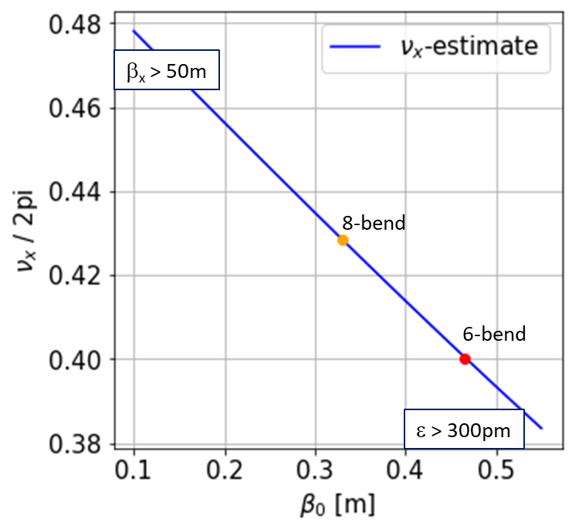
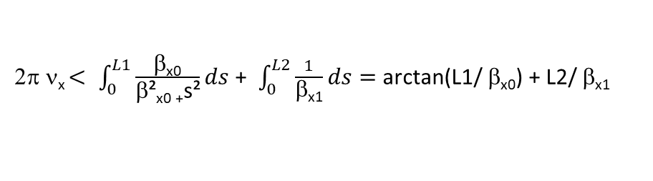
Horizontal Phase advance
Half unit cell
Phase matching for HOA:
unit cell : ν_{x,y} *(n+1) = N,
  n: no UCs, N: integers
super period: ϕ_{x,y} *p = M
  p: no. super periods, M: integer
β_{x1}
β_{x0}
L1
L2
UC |  | L(arc)* [m] | 16 periods
3 | 4*0.5 = 2 4*0.25 = 1
4 | 5*0.4 = 2 | 23.2 | 371
5 | 6*0.5 = 3 6*0.33 = 2
6 | 7*0.4286 = 3 | 28.8 | 460
S
Q
RB
S
An upper estimate for the horizontal phase advance
can be calculated for QD = 0
2π ν_{x} $< \int_{0}^{L1}{\frac{\text{b}\text{x}\text{0}}{\text{b}\text{²}\text{x}\text{0 +}\text{s}\text{²}}ds}$ + $\int_{0}^{L2}{\frac{1}{\text{b}\text{x}\text{1}}ds}=$ arctan(L1/ $\text{b}\text{x}\text{0}$) + L2/ $\text{b}\text{x}\text{1}$
ν_{x} $=f\text{(}\text{b}\text{x}\text{0}$) - 90% of phase advance accumulates before QD
*: straight = 5.6+2.8m, DSC = 1.8m, UC = 2.8m
HOA condition fixes no. of UCs and periodicity (ν_{y} = 0.1)
3 free parameters left in UC: dipole-angle and –length, RB angle

Slide 8
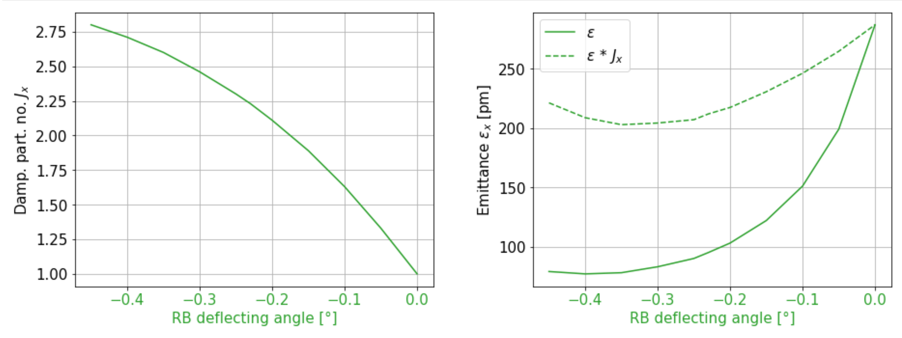
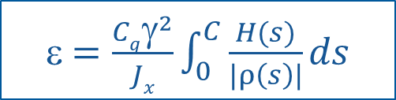
Reverse bend
Smaller emittance by increasing J_{x}: reverse bend or gradient bend?
ε $=\frac{Cqγ^{2}}{Jx}\int_{0}^{C}{\frac{H(s)}{|ρ\left(s\right)|}ds }$
${ J}_{x}=1 − \frac{I_{4x}}{I_{2x}}, I_{4x}=\int_{0}^{L}{\frac{ηx}{ρ³}}$ + $\frac{\text{2}\text{K} ηx}{ρ}$ ds, $I_{2x}=\int_{0}^{L}{\frac{1}{ρ²}}ds$
1) K<0 => gradient bend
  1) Reverse bends (RB): focusing quadrupoles, shifted from the central trajectory to create a small dipole field => combined function dipole
  Deflection angle and length ~5-10% of main bend
  ρ same order of magnitude as the main bend, ρ<0
2) ρ<0, K>0 => RB
H
J_{x}
RB: Emittance reduction
without stronger focusing!

Slide 9
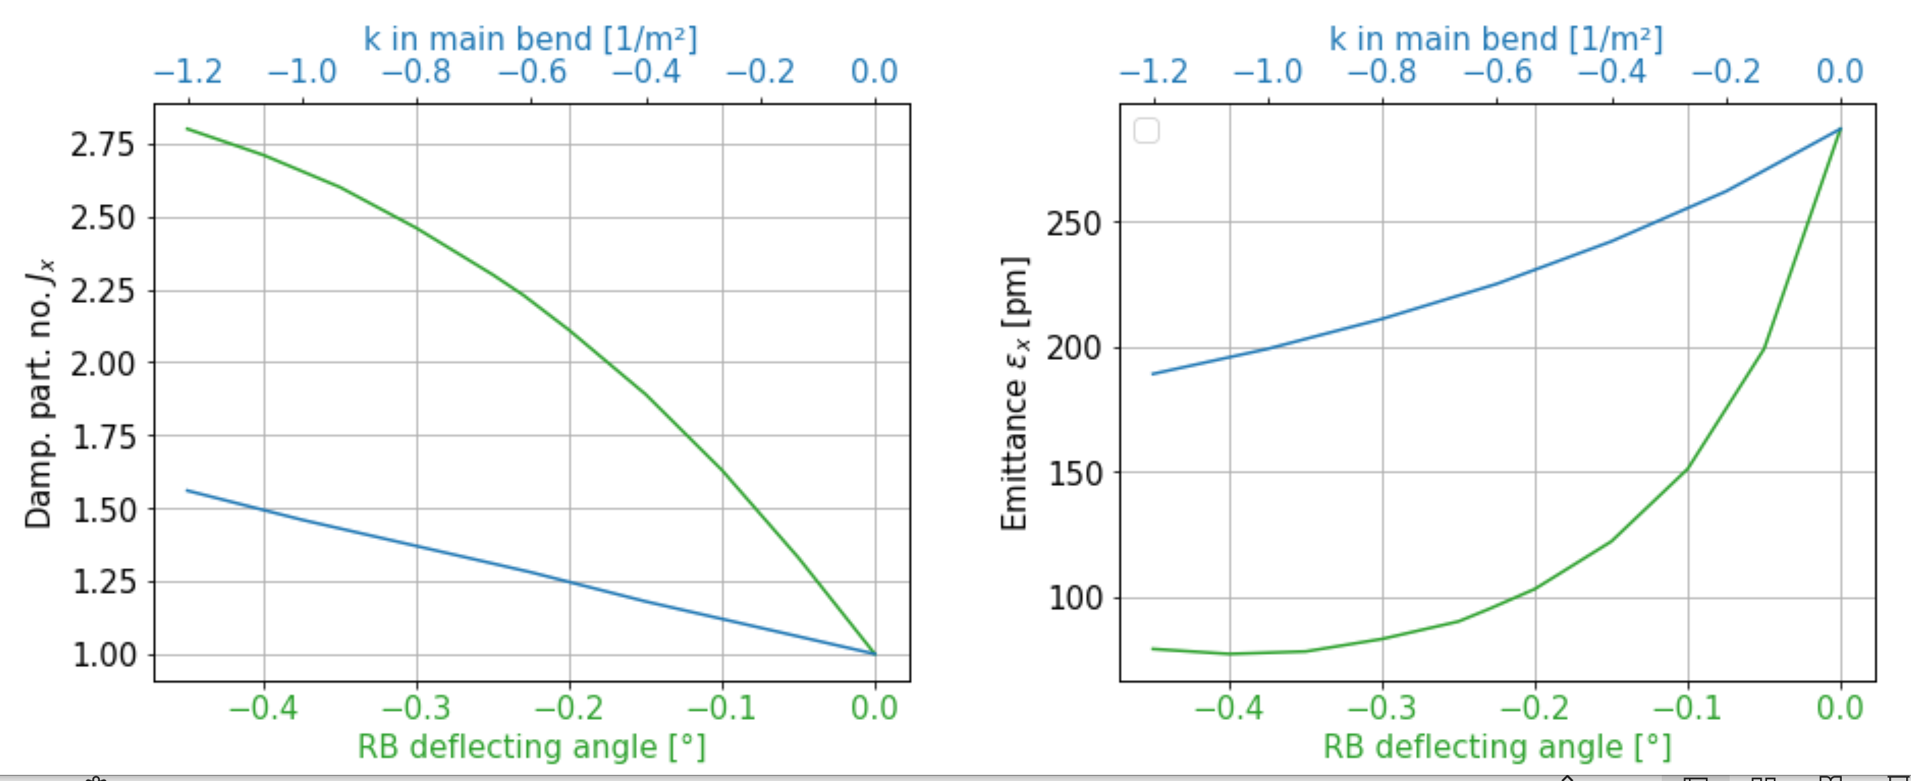
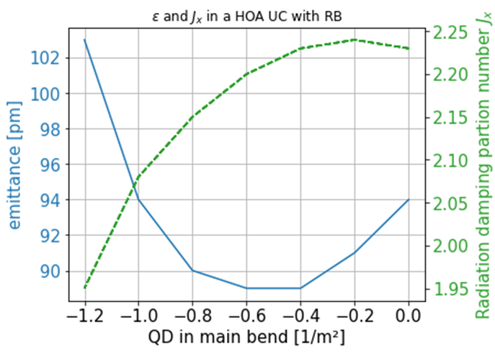
Gradient bend or homogeneous bend
2) Combined function main bend
J_{x} and emittance for: a) reverse bend, homogeneous main bend
b) no reverse bend, gradient main bend
RB larger effect on emittance than gradient bend
RB (-.23°) and gradient in bend - not beneficial
=> RB completely overtakes the role of the combined function dipole and is more efficient!

Slide 10
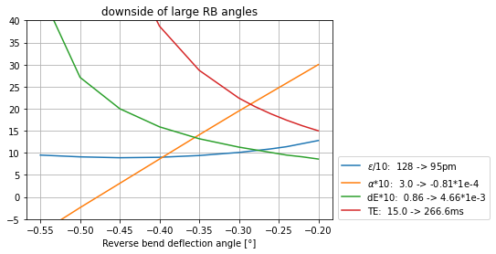
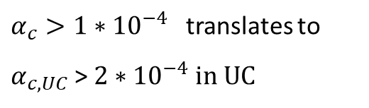
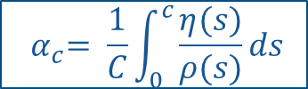
There is no such thing as a free lunch…
long. damping
time
energy spread
$${ α}_{c}= \frac{1}{C}\int_{0}^{c}{\frac{η(s)}{ρ(s)}}ds$$
emittance
Scaling factors and range
$α_{c}>1∗{10}^{−4}$translates to
$α_{c, UC}$> $2{∗10}^{−4}in UC$
momentum
compaction factor
Strong limitation of RB angle by longitudinal plane

Slide 11
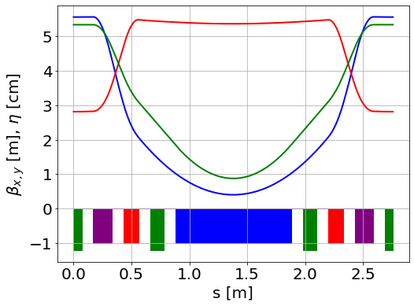
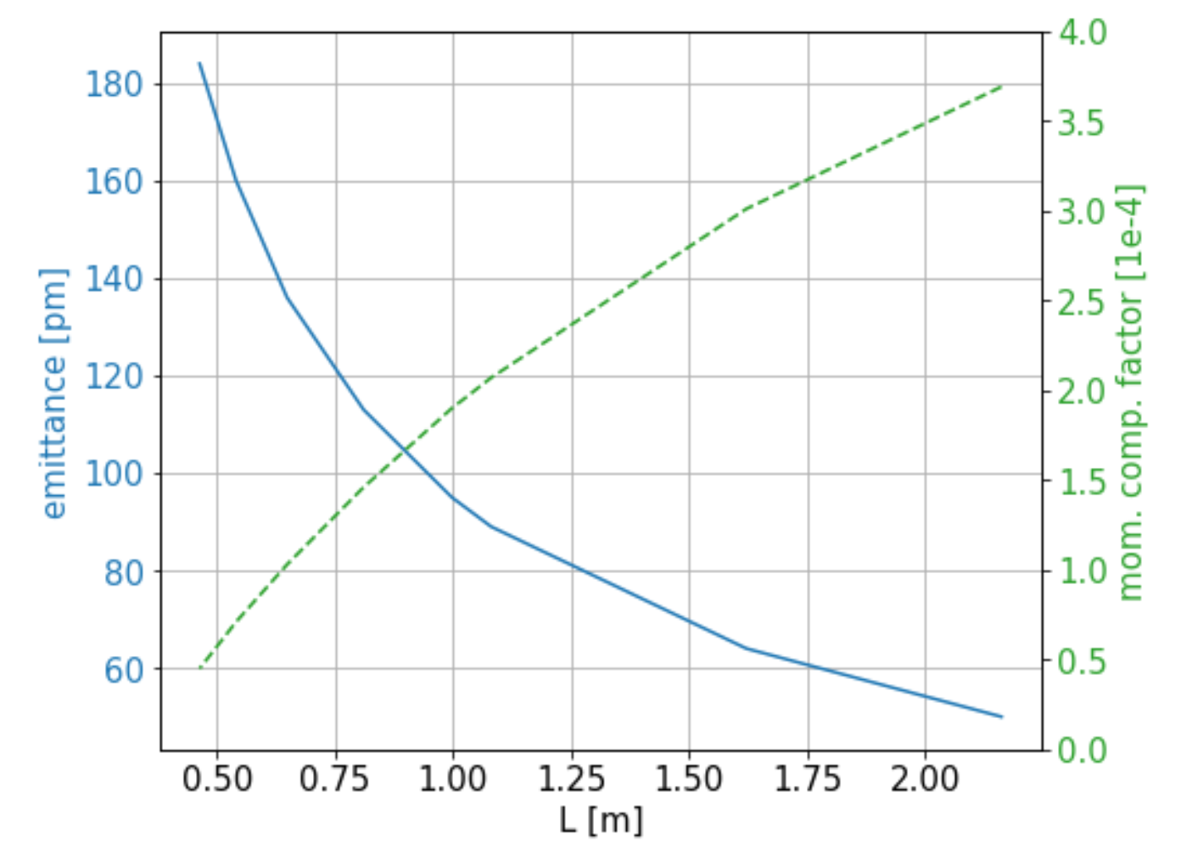
Main bend length
3 symmetry planes
Emittance reduction by MB length
Unit Cell
Quadrupoles main bend Sextupoles
QD, QF MB SF, SD
reverse bend (RB)
Longer bends decrease emittance and increase α_{c},
but limited by circumference (factor 64, 4UC *16p)
QD, QF – set by phase advance
RB angle – as large as possible, limited by α_{c,} τ_{z,} Δ_{E}
MB angle – approx. given by no. UC and super-period
MB length

Slide 12
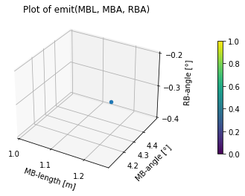
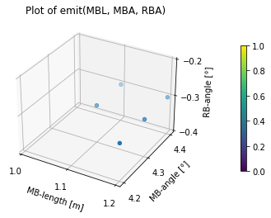
MB-length and -angle and RB angle depend on each other
ε < 100 pm, α < 2e-4
ε < 110 pm, α < 1.8e-4
ε, α - functions of MB-length and
-angle and RB-angle
Crude grid 3x3:
MB-length = [ 1.0m, 1.1m, 1.2m]
MB-angle = [ 4.2°, 4.3°, 4.4°]
RB-angle = [-0.2°, -0.3°, -0.4°]
ε < 100 pm, α < 2e-4
M-L [m] | MB-a [°] | RB-a [°] | ε [pm] | α [1e-4]
1.2 | 4.3 | -0.3 | 94 | 2.2
M-L [m] | MB-a [°] | RB-a [°] | ε [pm] | α [1e-4]
1.1 | 4.3 | -0.3 | 101 | 1.9
1.1 | 4.4 | -0.3 | 109 | 2.1
1.2 | 4.2 | -0.3 | 86 | 2.0
1.2 | 4.3 | -0.3 | 94 | 2.2
1.2 | 4.4 | -0.3 | 102 | 2.4
Standard angle distribution:
360° / 16 / 5 = 4.5° => MB = 4.5°, DSB = 2.25°
Better: MB = 4.3°, RB = -0.3°, DSB = 2.65°

Slide 13
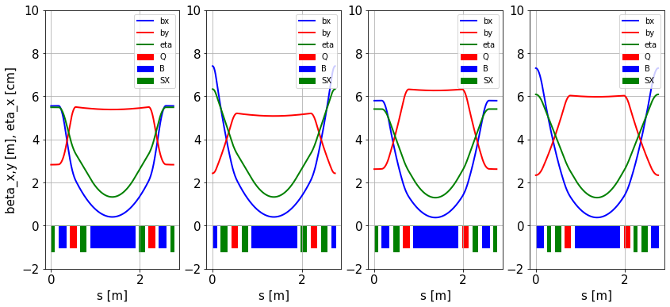
Magnet arrangement
Magnetic arrangement of the SF-Unit Cell:
4 magnet permutations
place the RB or SF at the outside
place QD or SD next to the central dipole
Drifts remain 0.1m, ν_{x} = .4, ν_{y} = .1
 | setup | ε [pm] | ξx | ξy | SD [1/m²] | SF [1/m²]
1 | SF last – SD central | 95 | -0.75 | -0.28 | -17.8 | 10.1
2 | RB last – SD central | 98 | -0.83 | -0.24 | -32.1 | 18.9
3 | SF last – QD central | 106 | -0.74 | -0.29 | -18.3 | 15.2
4 | RB last – QD central | 103 | -0.82 | -0.25 | -30.3 | 26.2
 |  | +/- 5% | +/- 6% | +/- 9% | +/- 30% | +/- 44%
UC completely analyzed =>
‘unique’ solution!!!
Magnet permutations have a moderate impact on emittance and chromaticity, but
significant impact on the sextupole strength!

Slide 14
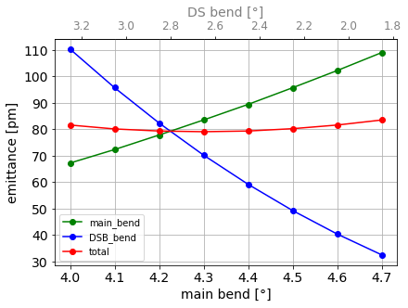
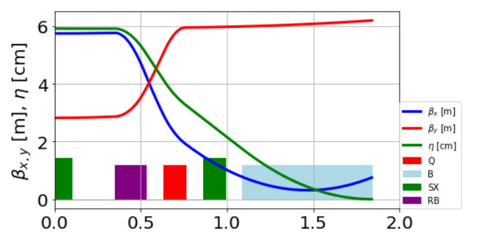
Dispersion suppression cell / matching to the straight section
Dispersion Suppression Cell:
Guideline: As close as possible to half unit cell – to keep phase matching, ε
Fitting: use RB, QD, RB-angle, B-length, drift
=> Deviation from ‘generic’ setup
Mismatch in dispersion limits angle distribution, ~4.2-4.3° / 2.85-2.65°
Gradient bend helpful for fitting
β_{x,y} , η, set by UC
α_{y} close to zero
η, η’ zero
Emittance of MB and DSB for different angle distributions. TME in main bend, 0.8T, and optimal positioning of β_{x} = 0.1 in DSB.
β_{min} 40% inside dipole
for minimal emittance

Slide 15
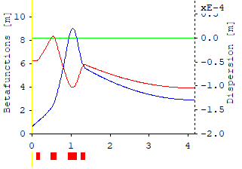
matching to the straight section
Phase matching for HOA:
unit cell : ν_{x,y} *(n+1) = N,
  n: no UCs, N: integers
super period: ϕ_{x,y} *p = M
  p: no. super periods, M: integer
Quadrupoles in straight need to fit:
β_{x,y} =3.0m
α_{x,y} = 0.0m
phase advance
Phase advance closely related to β_{x,y}
=> 4 quadrupoles
ϕ_{x} | M |  | ϕ_{y} | p_{y}
2.69 | 43 |  | 0.75 | 12
2.75 | 44 |  | 0.81 | 13
2.81 | 45 |  | 0.87 | 14
2.87 | 46 |  | 0.94 | 15
Matching to the straight section:
Offline script: scan 4 gradients and 4 drifts and select the appropriate solution
Chose tune close to HOA-condition 43.72, 12.78
fit α_{x,y} = 0, lattice tune => small mismatch in β_{x,y}
=> lattice complete
incorporate technical limitations

Slide 16
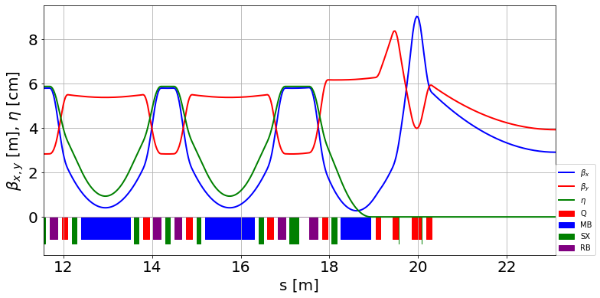
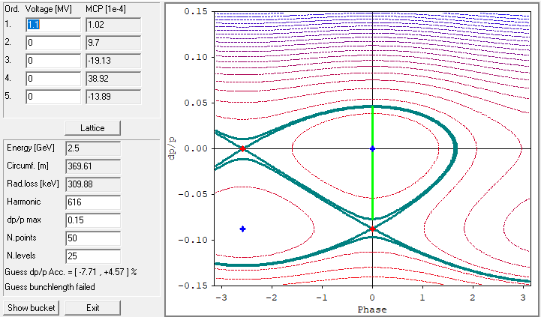
Current Top lattice
Technical design limits (conservative)
Dipoles | 1.4T
Com. func. dipoles | 0.8T, 15T/m & 30T/m
Quadrupoles | 80T/m (less for RB)
Sextupoles | 4000T/m²
Drifts | > 100mm
Bore diameter | 25mm (18mm inner vacuum)
Baseline lattice
α₀ = 1.02e-4
α₁ = 9.7
SF-lattice | 2 SX
MB, RB, DSB [°] | 4.3, -0.3, 2.65
Circumference [m] | 369.6
Emittance [pm] | 98
Mom. Comp. | 1.03e-4
Mom. Acceptance , RF @ 1.2MV [%] | 3.8, 4.7
Dyn. Aperture x,y [mm] | 2, 6
OPA-Touschek lifetime, 2% coupling, 300mA [h] | 5

Slide 17
Splitting of sextupoles
UC
UC
DSC
more than 2 families of sextupoles
Midplane
symmetry
SF
SD
SD
SF
SD
SD
SF
SD
SF1
SD1
SD2
SF2
SD3
SD4
SF3
SD5
octupole
Splitting up sextupole families:
Sextupoles in DSC most important
Single octupole reduces
2nd order vertical chromaticity
Optimization of sextupoles by
opa -> non-linear panel
No harmonic sextupoles
SF-lattice | 2 SX | 8 SX, 1 Oct.
Main bend, RB [°] | 4.3, -0.3 | 4.3, -0.3
Circumference [m] | 369.6 | 369.6
Emittance [pm] | 98 | 98
Mom. Comp. | 1.03e-4 | 1.03e-4
Mom. Acceptance, RF [%] @ 1.2MV | 3.8, 4.7 | 4.8, 4.7
Dyn. Aperture x,y [mm] | 2, 6 | 3.2, 4.5
OPA-Touschek lifetime [h], 2% coupling, 300mA | 5 | 11

Slide 18
Comparison to others
Normalized Emittance
Dynamic aperture (ΔQ_{x,y} < 0.1)
 | ε [pm] | E [GeV] | ε/E² [pm/GeV²]
MAX 4 | 336 | 3.0 | 37.3
SLS 2 | 123 | 2.4 | 21.3
Soleil 2 | 81 | 2.75 | 10.7
BESSY III | 98 | 2.5 | 15.8
 | x, y [mm] | β_{x,y} [m] | acceptance [mm mrad] | no. sx-families | Σ (b₃*L)* [1/m²] | no. octupoles
MAX 4 | 15.3, 6.2 | 9.3, 4.8 | 26.2, 8.0 | 5 | 5180 | 3
SLS 2 | 3.0, 4.4 | 3.1, 3.3 | 2.9, 5.8 | 9 | 8148 | 8
Soleil 2 | 4.6, 1.4 | 11.5, 3.2 | 1.8, 0.6 | 16 | 20278 | 12
BESSY III | 3.2, 4.5 | 2.9, 3.9 | 3.5, 5.2 | 8 | 5761 | 1
*: only chromatic sextupoles counted
Momentum acceptance (ΔQ_{x,y} < 0.1)
 | Δp/p [%] | RF [MHz] | RF–acc. [%] | Touschek (literature) [h] | opa 2% coupling, 300mA
MAX 4 | 3.6 | 100 | 7.35 | 30 | 15
SLS 2 | 5.5 | 500 | 5.7 | 4 | 6
Soleil 2 | 2.4 | 352.2 | 8.1 | 2.7 | 2
BESSY III | 4.8 | 500 | 4.7 |  | 11
The concept is ok!
Lattice compares well to other projects
Fewer non-linear elements needed
Data taken from opa-runs of lattices supplied by colleagues and from publications during
LEL 2022 - 3rd Workshop on Low Emittance Lattice Design 26-29 June 2022 , ALBA, Barcelona

Slide 19

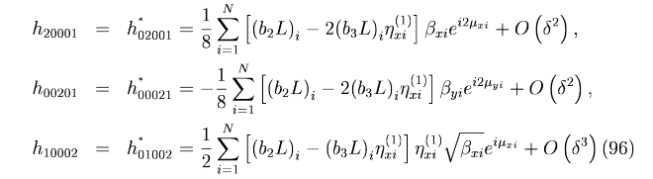
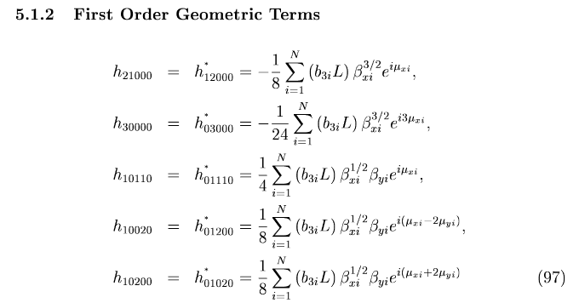
Sextupole optimization
0:
Manual optimization minimizing driving terms with opa
Strategy to set the sextupoles?
A:
Andrea Santa-Maria Garcia, KIT: use Bayesian Optimization to find
best setting of chromatic SX and optionally, add harmonic SX
and octupoles.
Optimization criterium: maximization of 3D-volume (x_{max}, y_{max}, Δp/p_{max})
J. Bengtsson, SLS note 9/97
B:
Automized minimization of Resonant Driving Terms, RDTs
Small RDTs => tune is confined for larger amplitudes and momentum offset => large apertures and long lifetime
β_{x,y,} η_{x} and μ_{x,y}– linear lattice properties
Optimize sextupoles without further lattice calculations
Minimization of local/global driving terms?*
*Jiajie Tan et al., Minimizing the fluctuation of resonance driving terms
in dynamic aperture optimization, PHYS. REV. AB 26, 084001 (2023)

Slide 20
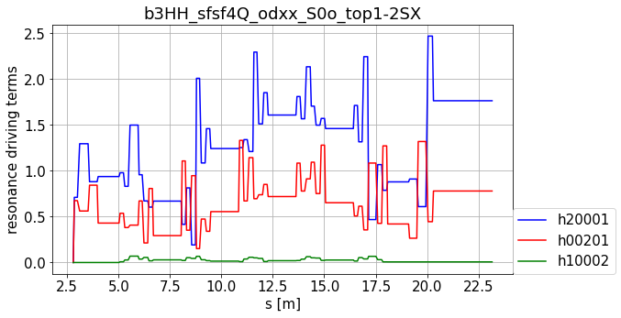
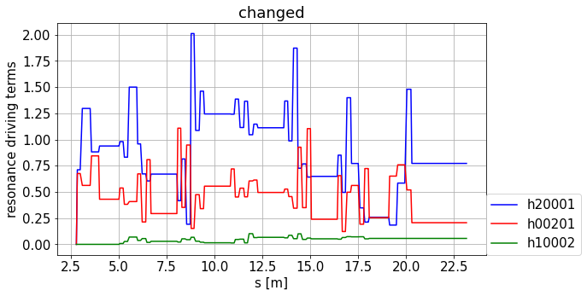
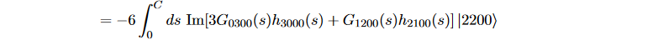

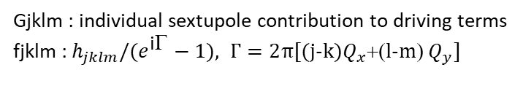

Chromatic driving terms h20001, h00201, h10002
Work in progress!
Local RDTs
Global RDTs
Minimization in local and global RDTs
insufficient to enlarge mom. acceptance
=> dominated by second order
PhD work @ HZB: Michael Arlandoo:
a_{xx}= -4/$π ($
)
local driving term
global driving terms
Gjklm : individual sextupole contribution to driving terms
fjklm : $h_{jklm}/(e^{\text{i}\text{G}}−1), Г=2$π[(j-k)$Q_{x}$+(l-m) $Q_{y}]$

Slide 21
Summary – to do List
To-do list:
Incorporate engineering demands into generic lattice without losing performance
Develop a strategy to optimize sextupoles, octupoles if necessary, hopefully analytically
Special injection insert necessary?
Error, lifetime, commissioning studies for first lattice candidate
Lattice candidate
Summary:
The deterministic approach makes much sense:
  Insight into the functionality of lattice elements
  RBs more beneficial than combined function magnets
  Different distribution of bending angles helps
  Minimization of sextupole strength eases non-linear compensation
All design parameters can be met with a minimum of non-linear elements
Based on thorough investigations, the BESSY III lattice will be unsophisticated, but competitive in the community
Thank you for your attention!

Slide 22

The team
Lattice design team: Paul Goslawski, Bettina Kuske: lattice development (tweak OPA*)
Michael Abo-Bakr: elegant, error studies, injection, special topics
Johan Bengtsson: non-linear optimization (HOA), Thor-scsi/TRACY, digital twin
Michael Arlandoo (PhD): Tribs@BESSY III, non-linear optimization, Xsuite
*: OPA, Lattice Design Code by A. Streun, PSI, https://ados.web.psi.ch/opa/
**: Xsuite, CERN initiative, https://xsuite.readthedocs.io/en/latest/
IPAC 2021
M. Arlandoo et al., “A first attempt at implementing TRIBs in BESSY IIIʼs design lattice”, IPAC21, THPOPT003
J. Bengtsson et al., “Robust Design and Control of the Nonlinear Dynamics for BESSY-III”, IPAC21, MOPAB048
P. Goslawski et al., “BESSY III & MLS II - Status of the Development of the New Photon Science Facility in Berlin”, IPAC21, MOPAB126
B. Kuske, “Towards Deterministic Design of MBA-Lattices”, IPAC21, MOPAB220
IPAC 2022
J. Bengtsson et al., “Robust design of modern Chasman-Green lattices - a geometric control theory approach”, IPAC2023, WEPL037
P. Goslawski et al., “BESSY III Status Report and Lattice Design Process”, IPAC22, TIPOMS010
B. Kuske et al., “Basic Design Choices for the BESSY III MBA Lattice”, IPAC22, MOPOTK009
LEL-workshop 2022, ALBA, Barcelona, Spain
P. Goslawski, et al. talk, “”
B.C. Kuske, talk, “Deterministic design of multi bend HOA lattices”
IPAC 2023
M. Arlandoo et al., “Further investigations of TRIBs in BESSY III design MBA lattices”, IPAC2023, WEPL109
P. Goslawski et al., “Update on the lattice design process of BESSY III: towards a baseline lattice”, IPAC23, WEPL036
P. Goslawski et al., “BESSY III - status and overview”, IPAC23, MOPA174
B.C. Kuske et al., “Further aspects of the deterministic lattice design app. for BESSY III”, IPAC23, WEPL039
FLS-workshop 2023, Luzern, Switzerland
P. Goslawski et al., talk, “The BESSY III Lattice”
B.C. Kuske, P. Goslawski, “Deterministic Lattice Design approach for BESSY III”, FLS2023, WE4P31
iFAST-Low Emittance Workshop 2024, CERN, Switzerland
P. Goslawski et al., talk, “The BESSY III Lattice”
B.C. Kuske, P. Goslawski, “Deterministic Approach to MBA Lattice Design”

Slide 23
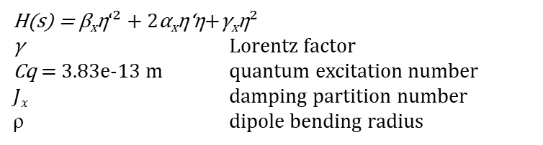

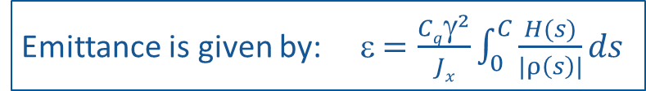

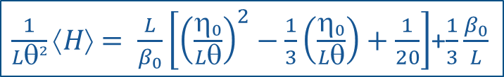

Small Emittance
Emittance is given by: ε $=\frac{Cqγ^{2}}{Jx}\int_{0}^{C}{\frac{H(s)}{|ρ\left(s\right)|}ds }$
H(s) = β_{x}η‘² + 2α_{x}η‘η+γ_{x}η²
γ Lorentz factor
Cq = 3.83e-13 m quantum excitation number
$Jx$ damping partition number
ρ dipole bending radius
For equal dipoles
ε $∝|1/$| $∗⟨H⟩∝|θ\text{|}∗⟨H⟩$
Many dipoles to reduce θ/dipole
For a homogeneous dipole and symmetric β-functions
(α_{x} =η’ = 0 at dipole center)
Theoretical Minimum Emittance -
conditions (TME) (single dipole)
$\frac{1}{Lθ²}⟨H⟩= \frac{L}{β_{0}}\left[{\left(\frac{η_{0}}{Lθ}\right)}^{2}−\frac{1}{3}\left(\frac{η_{0}}{Lθ}\right)+\frac{1}{20}\right]$+$\frac{1}{3}\frac{β_{0}}{L}$
$β_{0}=\frac{L}{\sqrt{15 }}$ , $_{0}=θ\frac{L}{6}, ε∝θ³\frac{2}{3\sqrt{15}}$
A. Streun, B. Riemann, PHYS. REV. AB 22, 021601 (2019)
$$ = half angle, L = half length
Accumulated dipole length:
BESSY II: 27.36m, 11%
BESSY III: ~ 100m, 29%
Dipoles will also be long to
manage Twiss parameters

Slide 24
4th generation light sources
MBAs
Hybrid MBAs
Ring | Energy [GeV] | lattice | Circum. [m] |  | Ring | Energy [GeV] | lattice | Circum. [m]
Max4 | 3.00 | 7-BA | 527.76 |  | ESRF-EBS | 6.00 | 7-H-BA | 844
Alba | 3.00 | 6-BA | 269.0 |  | Petra IV | 6.00 | 6-H-BA | 2300
Soleil | 2.75 | 4-BA/7-BA | 354.0 |  | APS | 6.00 | 7-H-BA | 1100
Sirius | 3.00 | 5-BA | 518.25 |  | HEPS | 6.00 | 7-H-BA | 1360
SLS 2 | 2.40 | 7-BA | 288.0 |  | ALS-U | 2.00 | 9-H-BA | 196.5
Elettra | 2.40 | 6-BA | 259.2
Diamond | 3.50 | 2*TBA | 560.574
Taiwan | 3.00 | 5-4-4-5BA | 518.4
Low-energy rings tend to have problems with momentum acceptance/Touschek lifetime with Hybrid MBAs => start with a regular MBA lattice.

Slide 25
Preliminary Commissioning simulation
Thorsten Hellert, ALS:
Commissioning tool, based on MML, used for PETRA IV and ALS-U
LEL 2022 - 3rd Workshop on Low Emittance Lattice Design, Th. Hellert,
“Toolkit for simulated commissioning”
Very preliminary results!
Input
2 families of sextupoles
Error model of ALS-U (100 seeds)
Beam threading, RF commissioning, trajectory correction, BBA
6D tracking
Results
No show-stoppers found – easy start-up
Lattice distortions can be well-recovered
Minimal dyn. Aperture degradation due to errors
CDF: cumulated distribution function

Slide 26
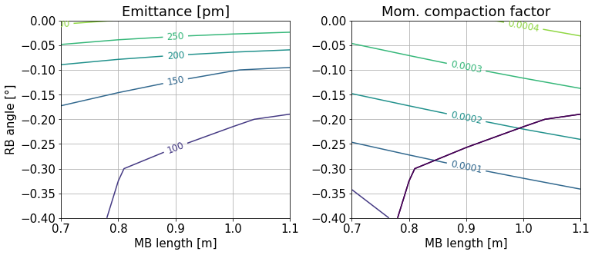
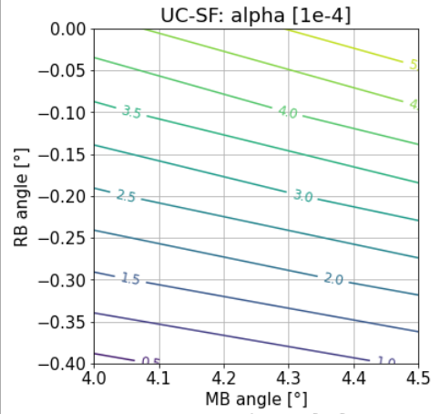
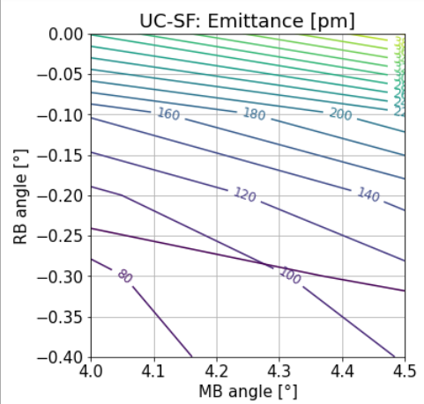
Main bend parameters
Optimal MB length, MB angle and RB angle depend on each other
MB angle = 4.3°
MB length = 1.1m
360° / 16 / 5 = 4.5° => MB = 4.5°, DSB = 2.25°
Even angle division not necessarily optimal, would need longer dipoles
=> MB = 4.3°, RB = -0.3°, DSB = 2.65°

Slide 27
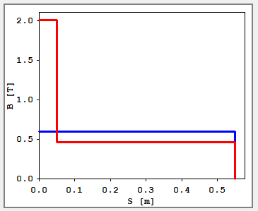
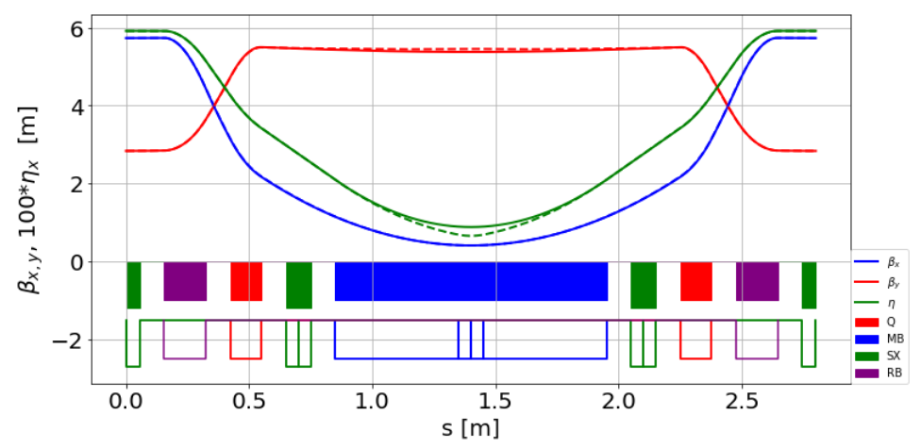
Insertion of higher field magnet
Dipole sources:
BESSY II: 0.855m, ~ 1.3 T => critical photon energy of 2.5 keV
BESSY III: 1.1m, ~ 0.669 T => critical photon energy of 2.78 keV, 1.3 T => 5.5 keV, 2.0 T => 8.3 keV
2.0T bend might replace superconducting WLS?
Solution: longitudinal gradient bend
  Different field strength in ‘one’ dipole
  Short 2T insert at center, 10cm
  Outer field 0.462T (0.669T)
  Same bending angle and length as main bend
  Fit Twiss functions at exit
  Fit β_{x,y} using QD, RB-gradient, η_{x} using RB-angle
    “plug-in solution”
Field profile of longitudinal gradient bend
2T dipoles | 0 | 1 in ring | 1 per arc
emittance | 97 | 97 | 101
alpha | 0.95e-4 | 0.95e-4 | 0.88e-4
Longitudinal gradient bends are often used to lower the emittance => β_{x0}, η_{x0} ∝ L => strong disturbance of Twiss parameters

