Slide 1
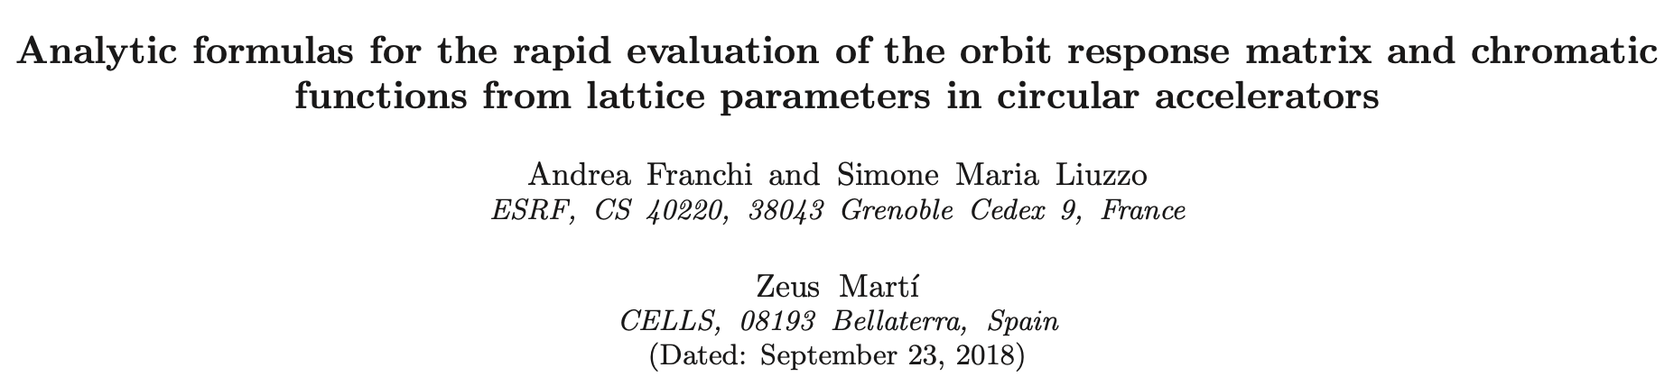
Implementation of fully analytic orbit response analysis in python
Formulas used in this slides are derived from: https://arxiv.org/abs/1711.06589v2
S.Liuzzo, A.Franchi, February 13th 2024

Slide 2
OUTLINE
Part 1: The implementation (12’)
Part 2: The repository (1’)
Part 3: outlook (3’)
time for SVD of (22082, 256): 0.15898656845092773
time for SVD of (22080, 168): 0.09135222434997559
ORM derivatives saved in: ./Janalytic.pkl
analytic J took: 105.41607213020325 seconds
RM derivative parallel computation using 128 cores on grappa
time for SVD of (22082, 256): 0.15436983108520508
time for SVD of (22080, 168): 0.07208800315856934
ORM derivatives saved in: ./Jsemi-analytic.pkl
semi-analytic J took: 112.3644368648529 seconds
RM derivative parallel computation using 128 cores on grappa
time for SVD of (22082, 256): 0.14691829681396484
time for SVD of (22080, 168): 0.07918691635131836
ORM derivatives saved in: ./Jnumeric.pkl
numeric J took: 507.92765259742737 seconds

Slide 3
OUTLINE
Part 1: The implementation (12’)
Part 2: The repository (1’)
Part 3: outlook (3’)
time for SVD of (22082, 256): 0.15898656845092773
time for SVD of (22080, 168): 0.09135222434997559
ORM derivatives saved in: ./Janalytic.pkl
analytic J took: 105.41607213020325 seconds
RM derivative parallel computation using 128 cores on grappa
time for SVD of (22082, 256): 0.15436983108520508
time for SVD of (22080, 168): 0.07208800315856934
ORM derivatives saved in: ./Jsemi-analytic.pkl
semi-analytic J took: 112.3644368648529 seconds
RM derivative parallel computation using 128 cores on grappa
time for SVD of (22082, 256): 0.14691829681396484
time for SVD of (22080, 168): 0.07918691635131836
ORM derivatives saved in: ./Jnumeric.pkl
numeric J took: 507.92765259742737 seconds

Slide 4
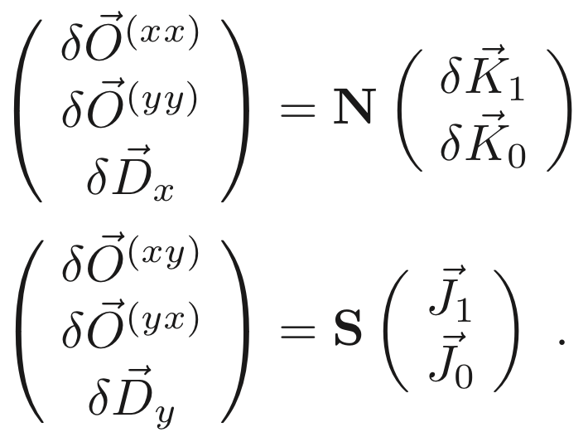
jacobian OF THE ORBIT RESPONSE MATRIX
In order to perform a linear lattice modelling and correction, the Jacobian of the ORM needs to be computed, SVD pseudo-inverted & applied to the measured ORM & dispersion.

Slide 5


jacobian OF THE ORBIT RESPONSE MATRIX
In order to perform a linear lattice modelling and correction, the Jacobian of the ORM needs to be computed, SVD pseudo-inverted & applied to the measured ORM & dispersion.
Numerical Jacobian: replicate in simulation the measurement: For each variation of the quadrupole strength, compute ORM from orbit calculations @ each steerer variation.
      Pros: accurate, can be parallelized
      Cons: time consuming, if optics or orbit unstable for quadrupole variation it can fail.
time for SVD of (22082, 256): 0.15898656845092773
time for SVD of (22080, 168): 0.09135222434997559
ORM derivatives saved in: ./Janalytic.pkl
analytic J took: 105.41607213020325 seconds
RM derivative parallel computation using 128 cores on grappa
time for SVD of (22082, 256): 0.15436983108520508
time for SVD of (22080, 168): 0.07208800315856934
ORM derivatives saved in: ./Jsemi-analytic.pkl
semi-analytic J took: 112.3644368648529 seconds
RM derivative parallel computation using 128 cores on grappa
time for SVD of (22082, 256): 0.14691829681396484
time for SVD of (22080, 168): 0.07918691635131836
ORM derivatives saved in: ./Jnumeric.pkl
numeric J took: 507.92765259742737 seconds

Slide 6
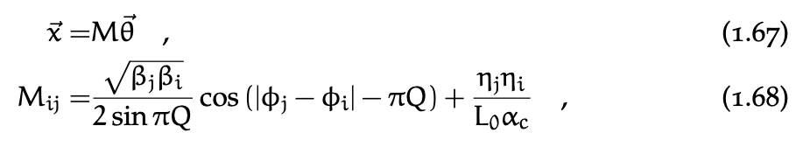
jacobian OF THE ORBIT RESPONSE MATRIX
In order to perform a linear lattice modelling and correction, the Jacobian of the ORM needs to be computed, SVD pseudo-inverted & applied to the measured ORM & dispersion.
Numerical Jacobian: replicate in simulation the measurement: For each variation of the quadrupole strength, compute ORM from orbit calculations @ each steerer variation.
      Pros: accurate, can be parallelized
      Cons: time consuming, if optics or orbit unstable for quadrupole variation it can fail.
Pseudo-analytic Jacobian: use textbook formulas to evaluate ORM after computing Twiss parameters at each quadrupole variation.
      Pros: faster than numerical, can be parallelized
      Cons: no analytic formulas for off-diagonal ORM blocks (coupling), it can fail if optics or orbit unstable for quadrupole variation.
time for SVD of (22082, 256): 0.15898656845092773
time for SVD of (22080, 168): 0.09135222434997559
ORM derivatives saved in: ./Janalytic.pkl
analytic J took: 105.41607213020325 seconds
RM derivative parallel computation using 128 cores on grappa
time for SVD of (22082, 256): 0.15436983108520508
time for SVD of (22080, 168): 0.07208800315856934
ORM derivatives saved in: ./Jsemi-analytic.pkl
semi-analytic J took: 112.3644368648529 seconds
RM derivative parallel computation using 128 cores on grappa
time for SVD of (22082, 256): 0.14691829681396484
time for SVD of (22080, 168): 0.07918691635131836
ORM derivatives saved in: ./Jnumeric.pkl
numeric J took: 507.92765259742737 seconds

Slide 7
jacobian OF THE ORBIT RESPONSE MATRIX
In order to perform a linear lattice modelling and correction, the Jacobian of the ORM needs to be computed, SVD pseudo-inverted & applied to the measured ORM & dispersion.
Numerical Jacobian: replicate in simulation the measurement: For each variation of the quadrupole strength, compute ORM from orbit calculations @ each steerer variation.
      Pros: accurate, can be parallelized
      Cons: time consuming, if optics or orbit unstable for quadrupole variation it can fail.
Pseudo-analytic Jacobian: use textbook formulas to evaluate ORM after computing Twiss parameters at each quadrupole variation.
      Pros: faster than numerical, can be parallelized
      Cons: no analytic formulas for off-diagonal ORM blocks (coupling), it can fail if optics or orbit unstable for quadrupole variation.
Fully analytic Jacobian: evaluate directly the Jacobian from Twiss parameters of the initial model (ideal or from beam-based measurements)
      Pros: coupling & dispersion included, only one computation of Twiss parameters needed, no orbit calculation needed, faster than pseudo-analytic, can be parallelized
      Cons: tedious to code.
time for SVD of (22082, 256): 0.15898656845092773
time for SVD of (22080, 168): 0.09135222434997559
ORM derivatives saved in: ./Janalytic.pkl
analytic J took: 105.41607213020325 seconds
RM derivative parallel computation using 128 cores on grappa
time for SVD of (22082, 256): 0.15436983108520508
time for SVD of (22080, 168): 0.07208800315856934
ORM derivatives saved in: ./Jsemi-analytic.pkl
semi-analytic J took: 112.3644368648529 seconds
RM derivative parallel computation using 128 cores on grappa
time for SVD of (22082, 256): 0.14691829681396484
time for SVD of (22080, 168): 0.07918691635131836
ORM derivatives saved in: ./Jnumeric.pkl
numeric J took: 507.92765259742737 seconds

Slide 8
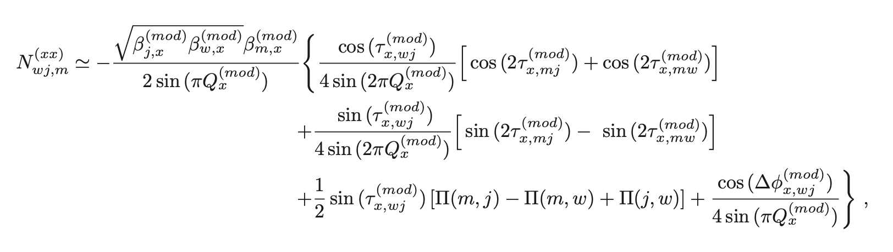
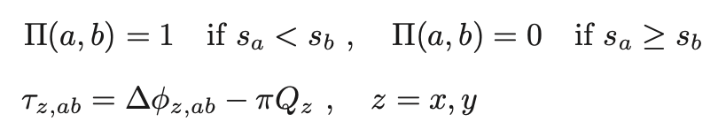
jacobian OF THE ORBIT RESPONSE MATRIX
In order to perform a linear lattice modelling and correction, the Jacobian of the ORM needs to be computed, SVD pseudo-inverted & applied to the measured ORM & dispersion.
Numerical Jacobian: replicate in simulation the measurement: For each variation of the quadrupole strength, compute ORM from orbit calculations @ each steerer variation.
      Pros: accurate, can be parallelized
      Cons: time consuming, if optics or orbit unstable for quadrupole variation it can fail.
Pseudo-analytic Jacobian: use textbook formulas to evaluate ORM after computing Twiss parameters at each quadrupole variation.
      Pros: faster than numerical, can be parallelized
      Cons: no analytic formulas for off-diagonal ORM blocks (coupling), it can fail if optics or orbit unstable for quadrupole variation.
Fully analytic Jacobian: evaluate directly the Jacobian from Twiss parameters of the initial model (ideal or from beam-based measurements)
      Pros: coupling & dispersion included, only one computation of Twiss parameters needed, no orbit calculation needed, faster than pseudo-analytic, can be parallelized
      Cons: tedious to code.
w -> steerer
j -> BPM
m -> magnet
time for SVD of (22082, 256): 0.15898656845092773
time for SVD of (22080, 168): 0.09135222434997559
ORM derivatives saved in: ./Janalytic.pkl
analytic J took: 105.41607213020325 seconds
RM derivative parallel computation using 128 cores on grappa
time for SVD of (22082, 256): 0.15436983108520508
time for SVD of (22080, 168): 0.07208800315856934
ORM derivatives saved in: ./Jsemi-analytic.pkl
semi-analytic J took: 112.3644368648529 seconds
RM derivative parallel computation using 128 cores on grappa
time for SVD of (22082, 256): 0.14691829681396484
time for SVD of (22080, 168): 0.07918691635131836
ORM derivatives saved in: ./Jnumeric.pkl
numeric J took: 507.92765259742737 seconds

Slide 9
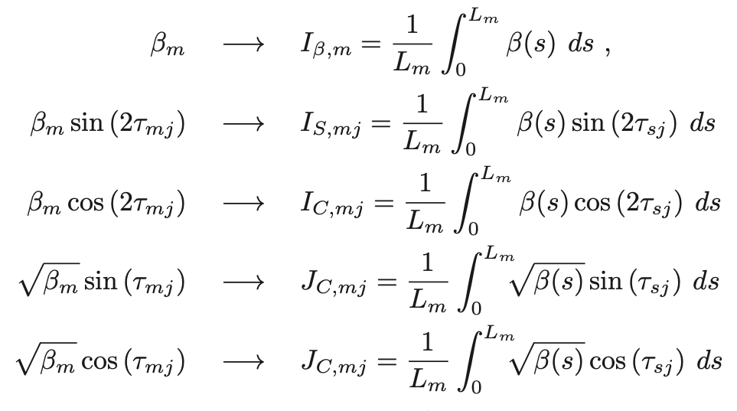
jacobian OF THE ORBIT RESPONSE MATRIX
In order to perform a linear lattice modelling and correction, the Jacobian of the ORM needs to be computed, SVD pseudo-inverted & applied to the measured ORM & dispersion.
Numerical Jacobian: replicate in simulation the measurement: For each variation of the quadrupole strength, compute ORM from orbit calculations @ each steerer variation.
      Pros: accurate, can be parallelized
      Cons: time consuming, if optics or orbit unstable for quadrupole variation it can fail.
Pseudo-analytic Jacobian: use textbook formulas to evaluate ORM after computing Twiss parameters at each quadrupole variation.
      Pros: faster than numerical, can be parallelized
      Cons: no analytic formulas for off-diagonal ORM blocks (coupling), it can fail if optics or orbit unstable for quadrupole variation.
Fully analytic Jacobian: evaluate directly the Jacobian from Twiss parameters of the initial model (ideal or from beam-based measurements)
      Pros: coupling & dispersion included, only one computation of Twiss parameters needed, no orbit calculation needed, faster than pseudo-analytic, can be parallelized
      Cons: tedious to code.
Observation: the accuracy of the two analytic approaches can be poor if thin-element model is used. Corrections to account for the variation of Twiss parameters across magnets have been included which reduce dramatically the errors w.r.t. the numerical version (see next slide).
time for SVD of (22082, 256): 0.15898656845092773
time for SVD of (22080, 168): 0.09135222434997559
ORM derivatives saved in: ./Janalytic.pkl
analytic J took: 105.41607213020325 seconds
RM derivative parallel computation using 128 cores on grappa
time for SVD of (22082, 256): 0.15436983108520508
time for SVD of (22080, 168): 0.07208800315856934
ORM derivatives saved in: ./Jsemi-analytic.pkl
semi-analytic J took: 112.3644368648529 seconds
RM derivative parallel computation using 128 cores on grappa
time for SVD of (22082, 256): 0.14691829681396484
time for SVD of (22080, 168): 0.07918691635131836
ORM derivatives saved in: ./Jnumeric.pkl
numeric J took: 507.92765259742737 seconds

Slide 10
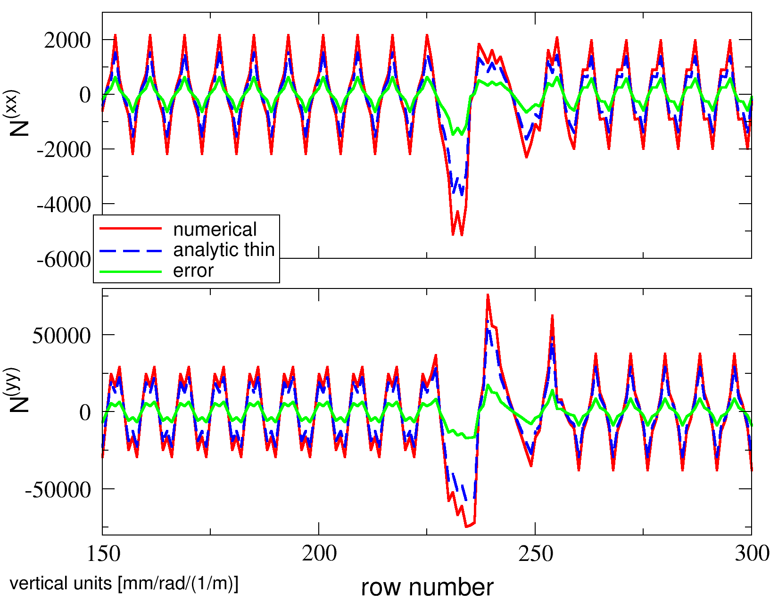
Numerical Vs Analytic jacobian OF THE ORM: Accuracy
Example: FCC quadrupole ORM Jacobian with
1600 BPMs
8 steerers
1 quadrupole QC1L1_1
THIN
time for SVD of (22082, 256): 0.15898656845092773
time for SVD of (22080, 168): 0.09135222434997559
ORM derivatives saved in: ./Janalytic.pkl
analytic J took: 105.41607213020325 seconds
RM derivative parallel computation using 128 cores on grappa
time for SVD of (22082, 256): 0.15436983108520508
time for SVD of (22080, 168): 0.07208800315856934
ORM derivatives saved in: ./Jsemi-analytic.pkl
semi-analytic J took: 112.3644368648529 seconds
RM derivative parallel computation using 128 cores on grappa
time for SVD of (22082, 256): 0.14691829681396484
time for SVD of (22080, 168): 0.07918691635131836
ORM derivatives saved in: ./Jnumeric.pkl
numeric J took: 507.92765259742737 seconds

Slide 11
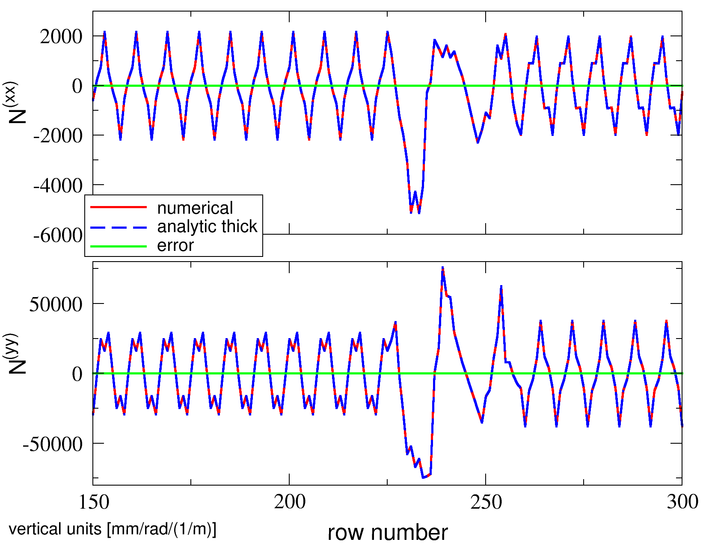
Numerical Vs Analytic jacobian OF THE ORM: Accuracy
Example: FCC quadrupole ORM Jacobian with
1600 BPMs
8 steerers
1 quadrupole QC1L1_1
THICK
time for SVD of (22082, 256): 0.15898656845092773
time for SVD of (22080, 168): 0.09135222434997559
ORM derivatives saved in: ./Janalytic.pkl
analytic J took: 105.41607213020325 seconds
RM derivative parallel computation using 128 cores on grappa
time for SVD of (22082, 256): 0.15436983108520508
time for SVD of (22080, 168): 0.07208800315856934
ORM derivatives saved in: ./Jsemi-analytic.pkl
semi-analytic J took: 112.3644368648529 seconds
RM derivative parallel computation using 128 cores on grappa
time for SVD of (22082, 256): 0.14691829681396484
time for SVD of (22080, 168): 0.07918691635131836
ORM derivatives saved in: ./Jnumeric.pkl
numeric J took: 507.92765259742737 seconds

Slide 12
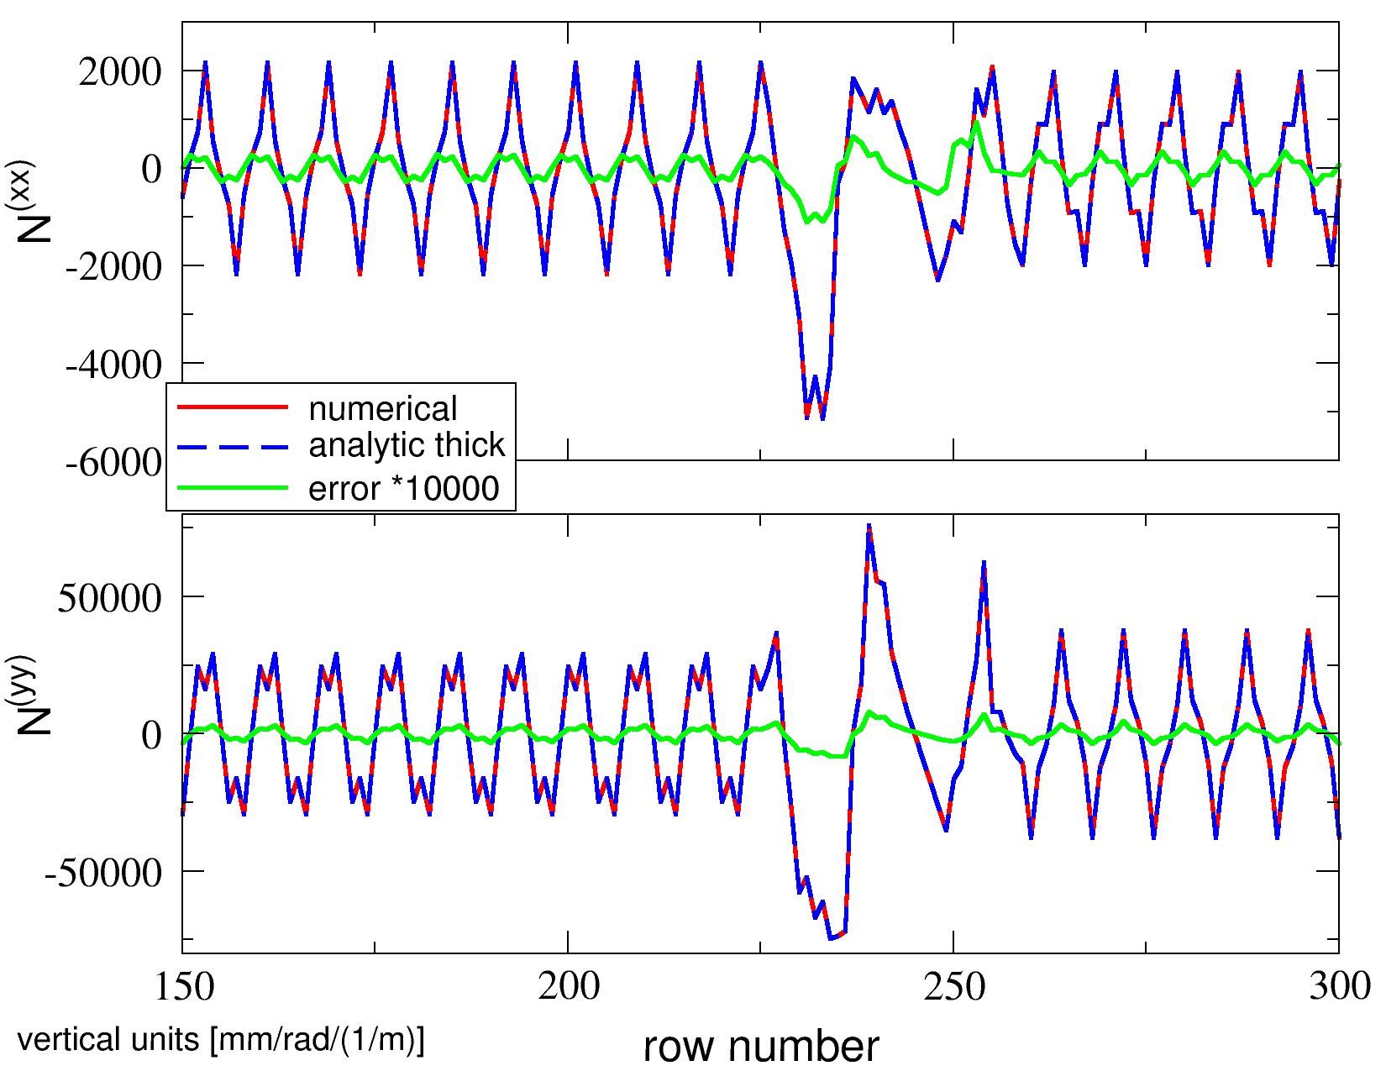
Numerical Vs Analytic jacobian OF THE ORM: Accuracy
Example: FCC quadrupole ORM Jacobian with
1600 BPMs
8 steerers
1 quadrupole QC1L1_1
THICK
time for SVD of (22082, 256): 0.15898656845092773
time for SVD of (22080, 168): 0.09135222434997559
ORM derivatives saved in: ./Janalytic.pkl
analytic J took: 105.41607213020325 seconds
RM derivative parallel computation using 128 cores on grappa
time for SVD of (22082, 256): 0.15436983108520508
time for SVD of (22080, 168): 0.07208800315856934
ORM derivatives saved in: ./Jsemi-analytic.pkl
semi-analytic J took: 112.3644368648529 seconds
RM derivative parallel computation using 128 cores on grappa
time for SVD of (22082, 256): 0.14691829681396484
time for SVD of (22080, 168): 0.07918691635131836
ORM derivatives saved in: ./Jnumeric.pkl
numeric J took: 507.92765259742737 seconds

Slide 13
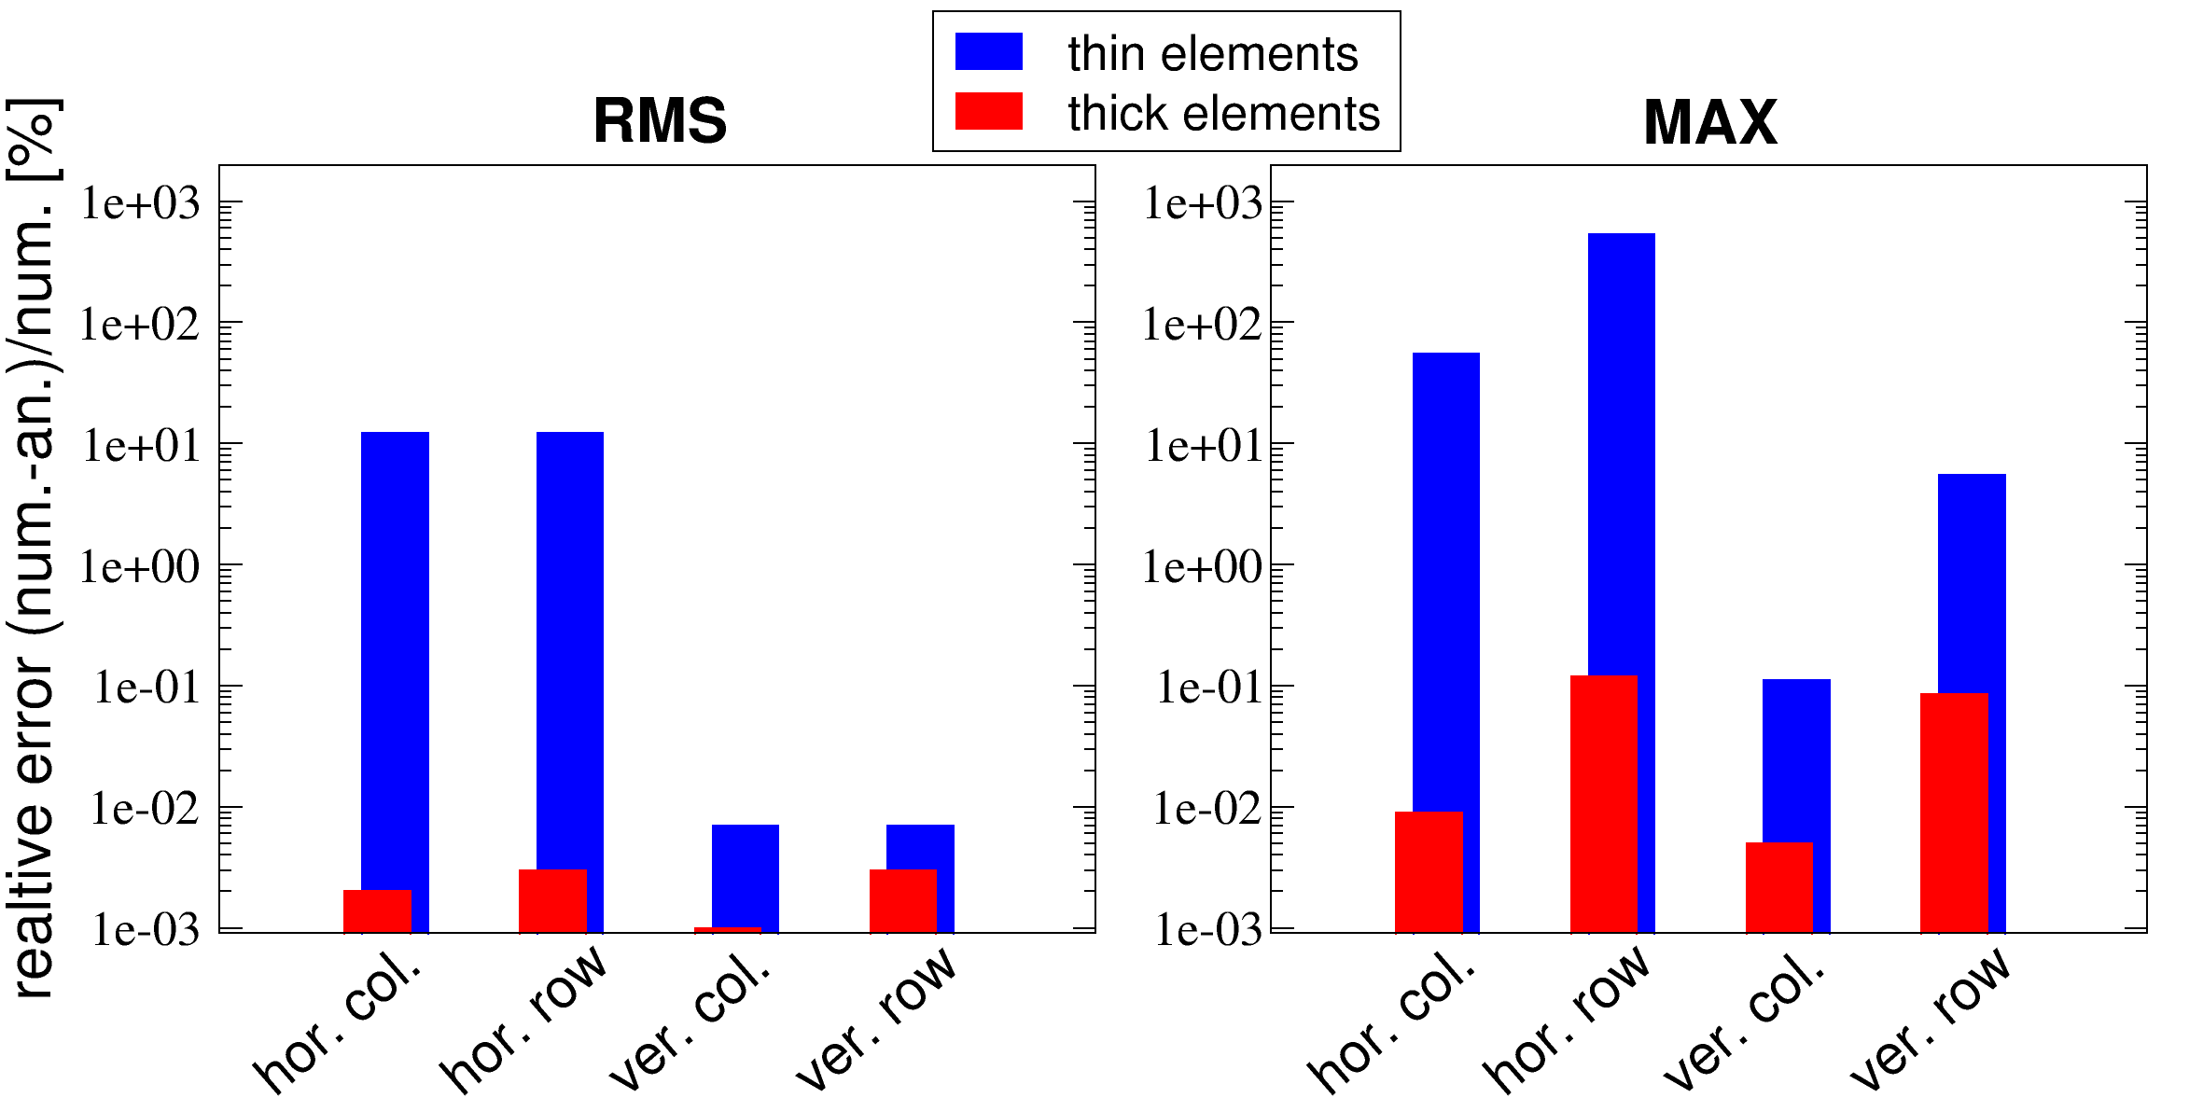
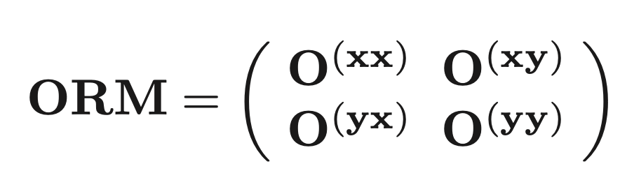
Numerical Vs Analytic jacobian OF THE ORM: Accuracy
Example: FCC quadrupole ORM Jacobian with
1600 BPMs
8 steerers
1 quadrupole QC1L1_1
RMS & MAX error computed over all columns & rows of the diagonal ORM blocks O^{(xx)} & O^{(yy)}.
time for SVD of (22082, 256): 0.15898656845092773
time for SVD of (22080, 168): 0.09135222434997559
ORM derivatives saved in: ./Janalytic.pkl
analytic J took: 105.41607213020325 seconds
RM derivative parallel computation using 128 cores on grappa
time for SVD of (22082, 256): 0.15436983108520508
time for SVD of (22080, 168): 0.07208800315856934
ORM derivatives saved in: ./Jsemi-analytic.pkl
semi-analytic J took: 112.3644368648529 seconds
RM derivative parallel computation using 128 cores on grappa
time for SVD of (22082, 256): 0.14691829681396484
time for SVD of (22080, 168): 0.07918691635131836
ORM derivatives saved in: ./Jnumeric.pkl
numeric J took: 507.92765259742737 seconds

Slide 14
Numerical Vs Analytic jacobian OF THE ORM: CPU TIME
Example: FCC quadrupole ORM Jacobian N (diagonal blocks only) with
1600 BPMs
8 steerers
360 quadrupoles parallelized over 64 cores CPUs (for both numerical and analytic tests)
Results
Numeric: 1807.1 s [100%]
fully analytic: 221.1 s [ 12%] (room for further optimization)
time for SVD of (22082, 256): 0.15898656845092773
time for SVD of (22080, 168): 0.09135222434997559
ORM derivatives saved in: ./Janalytic.pkl
analytic J took: 105.41607213020325 seconds
RM derivative parallel computation using 128 cores on grappa
time for SVD of (22082, 256): 0.15436983108520508
time for SVD of (22080, 168): 0.07208800315856934
ORM derivatives saved in: ./Jsemi-analytic.pkl
semi-analytic J took: 112.3644368648529 seconds
RM derivative parallel computation using 128 cores on grappa
time for SVD of (22082, 256): 0.14691829681396484
time for SVD of (22080, 168): 0.07918691635131836
ORM derivatives saved in: ./Jnumeric.pkl
numeric J took: 507.92765259742737 seconds

Slide 15
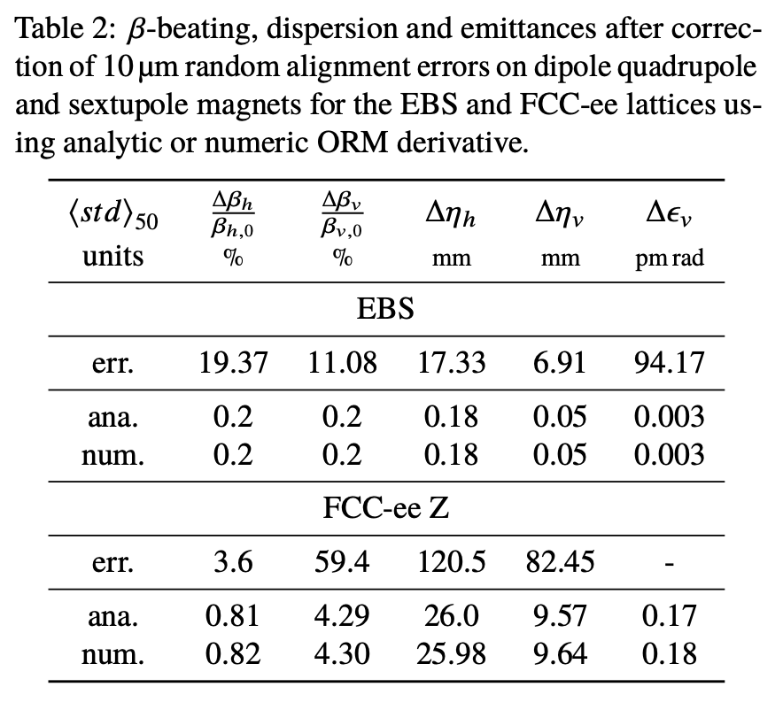
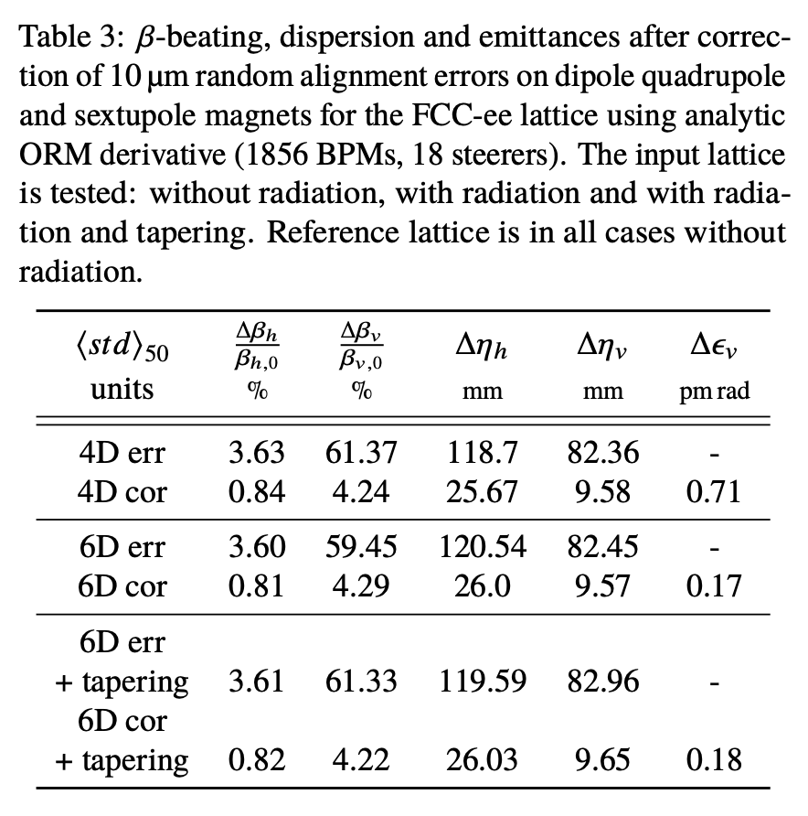
Numerical Vs Analytic jacobian OF THE ORM: optics correction
From IPAC23 MOPL069
time for SVD of (22082, 256): 0.15898656845092773
time for SVD of (22080, 168): 0.09135222434997559
ORM derivatives saved in: ./Janalytic.pkl
analytic J took: 105.41607213020325 seconds
RM derivative parallel computation using 128 cores on grappa
time for SVD of (22082, 256): 0.15436983108520508
time for SVD of (22080, 168): 0.07208800315856934
ORM derivatives saved in: ./Jsemi-analytic.pkl
semi-analytic J took: 112.3644368648529 seconds
RM derivative parallel computation using 128 cores on grappa
time for SVD of (22082, 256): 0.14691829681396484
time for SVD of (22080, 168): 0.07918691635131836
ORM derivatives saved in: ./Jnumeric.pkl
numeric J took: 507.92765259742737 seconds

Slide 16
Analytic tune variation with THICK quadrupoles
Quad: ΔQF1J=0.023%
error ΔQH (num-ana): -0.16%
error ΔQv (num-ana): 0.14%
error ΔQH (num-ana): −0.0005 %
error ΔQv (num-ana): 0.0024 %
EBS
THIN
average β function across quadrupole
THICK
From IPAC23 MOPL069
(“Thick modelling” original idea and mathematical approach : Zeus Martí , ALBA)

Slide 17
Analytic tune variation with THICK quadrupoles
Quad: ΔQFG2-1 = 0.184 %
error ΔQH (num-ana): 2.2%
error ΔQv (num-ana): 0.38%
error ΔQH (num-ana): 0.0003 %
error ΔQv (num-ana): −0.0008 %
FCC-ee
THIN
average β function across quadrupole
THICK
From IPAC23 MOPL069
(“Thick modelling” original idea and mathematical approach : Zeus Martí , ALBA)

Slide 18
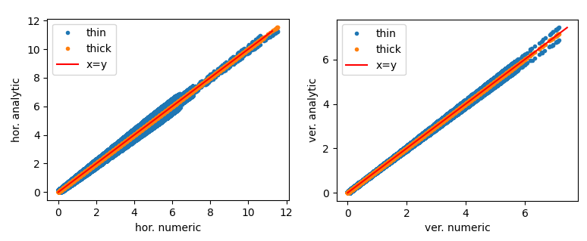
Thick steerers in classic analytic ORM formula
THIN steerers ORM
EBS
THICK steerers ORM

Slide 19
OUTLINE
Part 1: The implementation (12’)
Part 2: The repository (1’)
Part 3: outlook (3’)
time for SVD of (22082, 256): 0.15898656845092773
time for SVD of (22080, 168): 0.09135222434997559
ORM derivatives saved in: ./Janalytic.pkl
analytic J took: 105.41607213020325 seconds
RM derivative parallel computation using 128 cores on grappa
time for SVD of (22082, 256): 0.15436983108520508
time for SVD of (22080, 168): 0.07208800315856934
ORM derivatives saved in: ./Jsemi-analytic.pkl
semi-analytic J took: 112.3644368648529 seconds
RM derivative parallel computation using 128 cores on grappa
time for SVD of (22082, 256): 0.14691829681396484
time for SVD of (22080, 168): 0.07918691635131836
ORM derivatives saved in: ./Jnumeric.pkl
numeric J took: 507.92765259742737 seconds

Slide 20
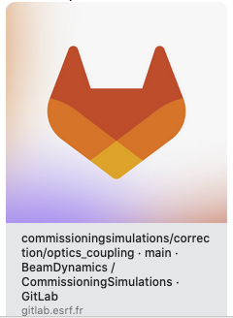
WHERE YOU CAN FIND US
https://gitlab.esrf.fr/BeamDynamics/commissioningsimulations
Commissioning tools are still poor in terms of documentation, and debugging. The inclusion into the pyAT repository is pending such extensive validation tests.
Modules for the fully analytic ORM Jacobian can be found here:
https://gitlab.esrf.fr/BeamDynamics/commissioningsimulations/-/tree/main/commissioningsimulations/correction/optics_coupling
time for SVD of (22082, 256): 0.15898656845092773
time for SVD of (22080, 168): 0.09135222434997559
ORM derivatives saved in: ./Janalytic.pkl
analytic J took: 105.41607213020325 seconds
RM derivative parallel computation using 128 cores on grappa
time for SVD of (22082, 256): 0.15436983108520508
time for SVD of (22080, 168): 0.07208800315856934
ORM derivatives saved in: ./Jsemi-analytic.pkl
semi-analytic J took: 112.3644368648529 seconds
RM derivative parallel computation using 128 cores on grappa
time for SVD of (22082, 256): 0.14691829681396484
time for SVD of (22080, 168): 0.07918691635131836
ORM derivatives saved in: ./Jnumeric.pkl
numeric J took: 507.92765259742737 seconds

Slide 21
OUTLINE
Part 1: The implementation (12’)
Part 2: The repository (1’)
Part 3: outlook (3’)
time for SVD of (22082, 256): 0.15898656845092773
time for SVD of (22080, 168): 0.09135222434997559
ORM derivatives saved in: ./Janalytic.pkl
analytic J took: 105.41607213020325 seconds
RM derivative parallel computation using 128 cores on grappa
time for SVD of (22082, 256): 0.15436983108520508
time for SVD of (22080, 168): 0.07208800315856934
ORM derivatives saved in: ./Jsemi-analytic.pkl
semi-analytic J took: 112.3644368648529 seconds
RM derivative parallel computation using 128 cores on grappa
time for SVD of (22082, 256): 0.14691829681396484
time for SVD of (22080, 168): 0.07918691635131836
ORM derivatives saved in: ./Jnumeric.pkl
numeric J took: 507.92765259742737 seconds

Slide 22
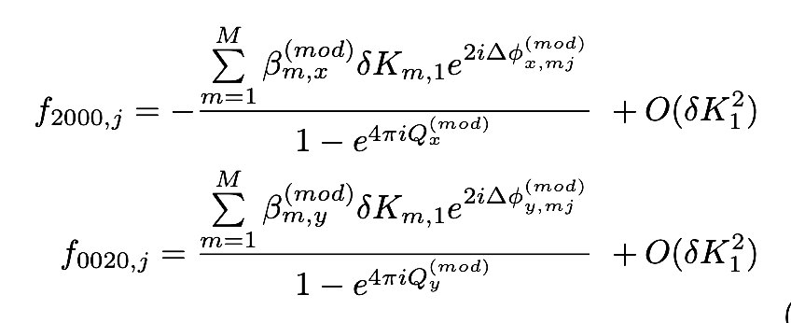
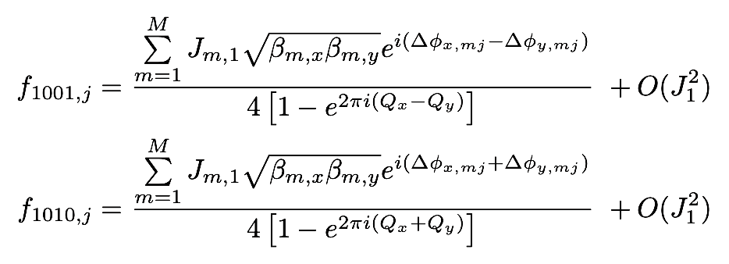
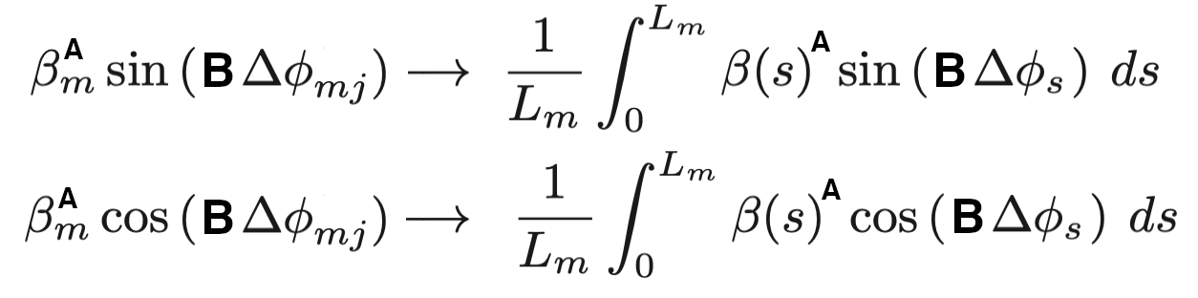
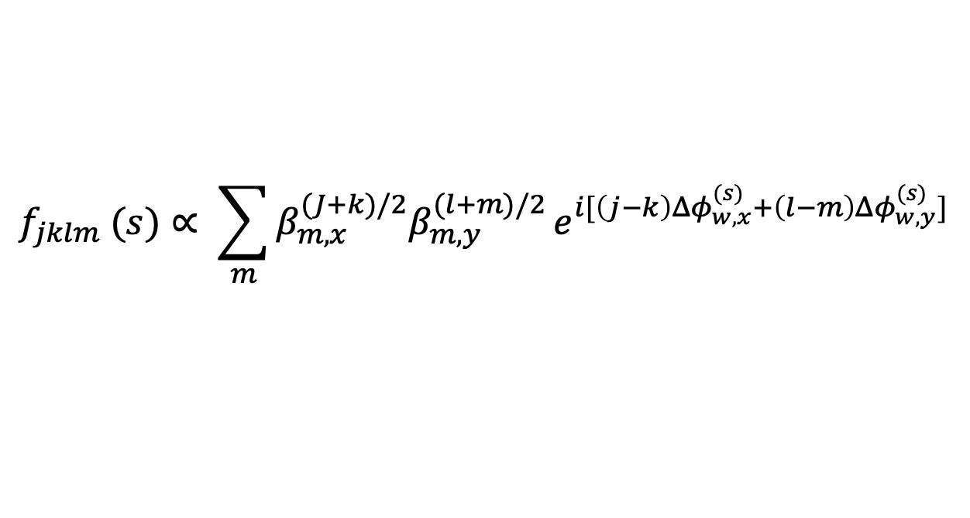
outlook: thick-element correction for RDTs
$$f_{jklm} (s)∝ \sum_{m}{β_{m,x}^{(J+k)/2}β_{m,y}^{(l+m)/2}}e^{i[\left(j−k\right){Δφ}_{w,x}^{(s)}+\left(l−m\right){Δφ}_{w,y}^{(s)}] }$$
Thick-element corrections are being implemented to RDTs

Slide 23
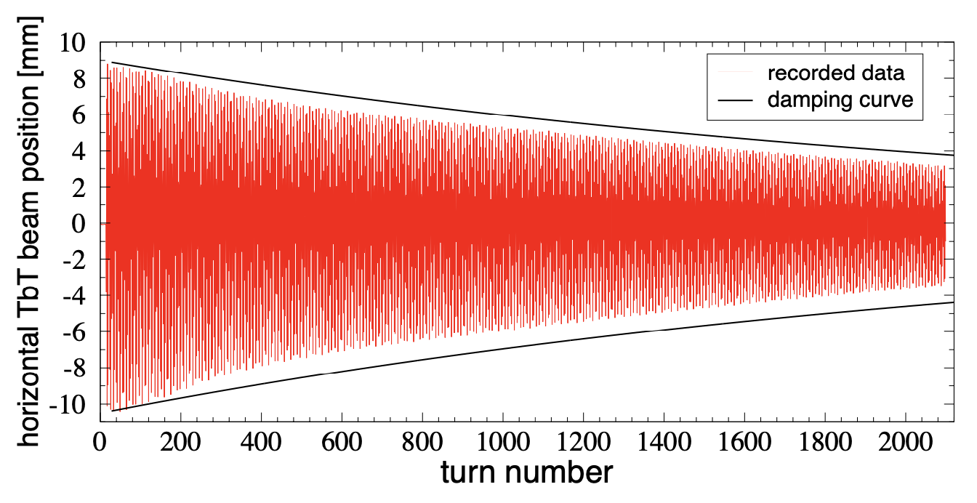
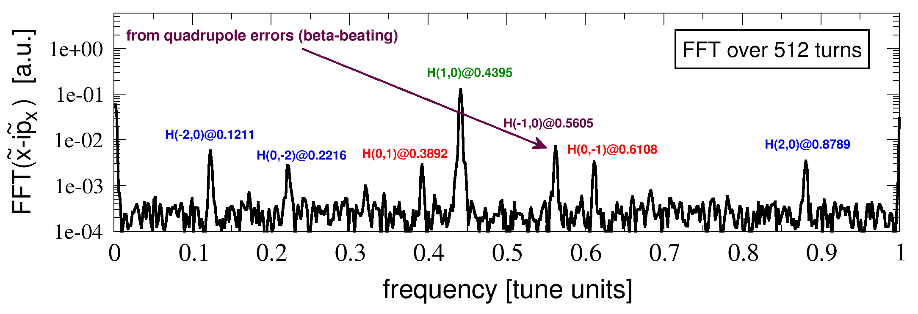
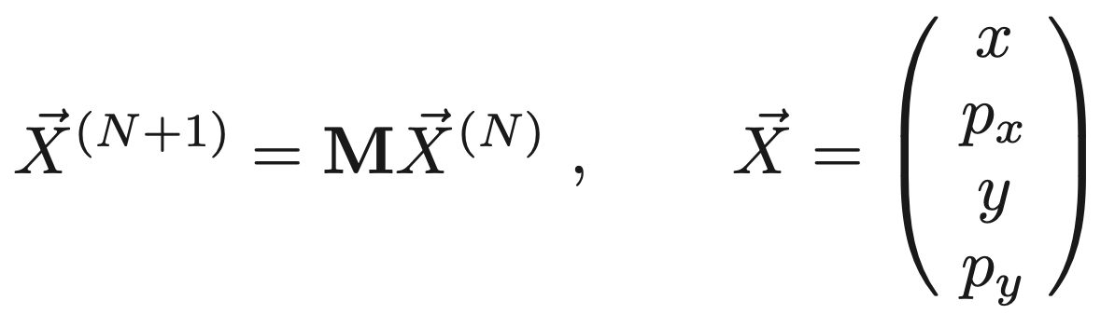
outlook: A new way to compute linear RDTs
From analytic formulas
From particle tracking + harmonic analysis
New formulas from OTM

Slide 24
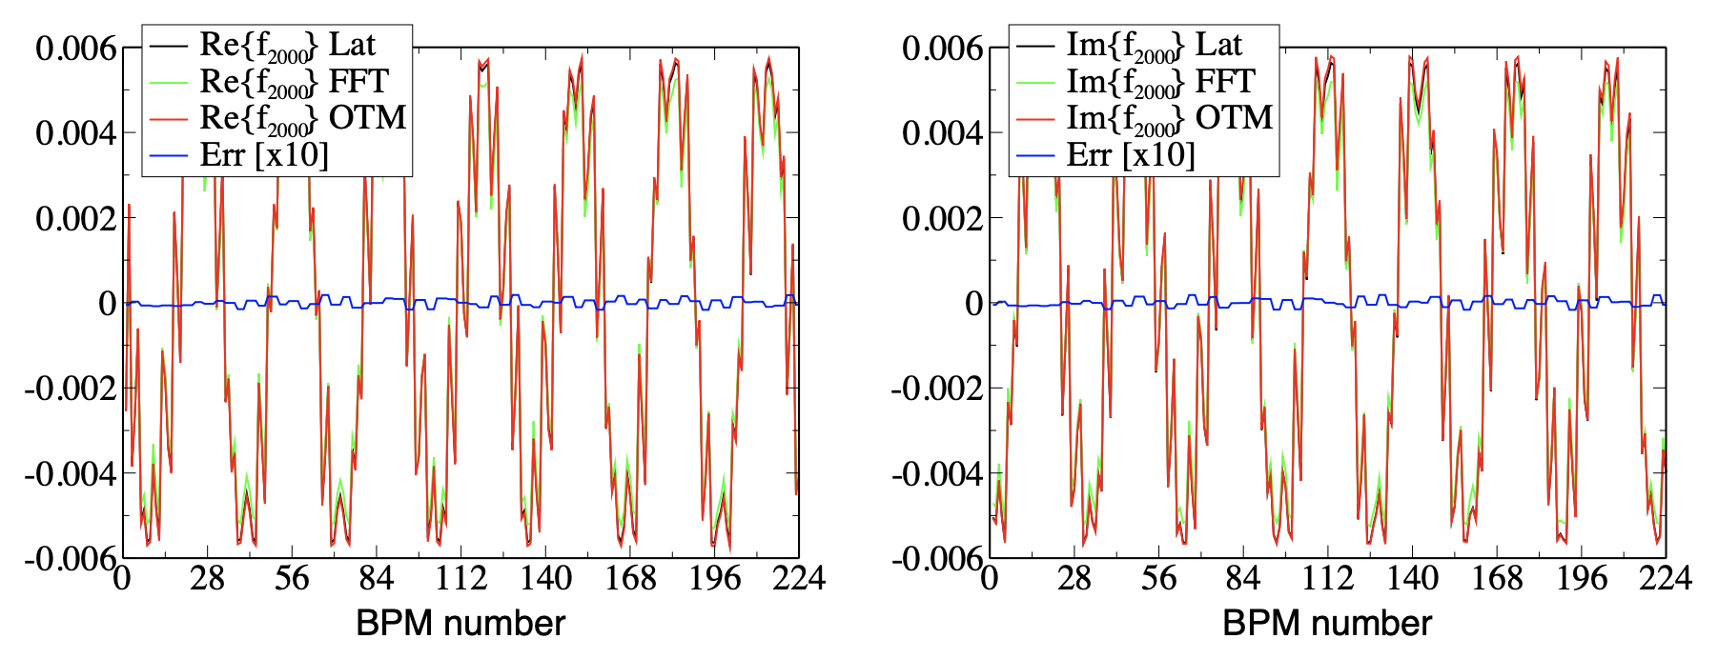
outlook: A new way to compute linear RDTs
Very accurate for single-quad error (thus ok for response matrix)

Slide 25
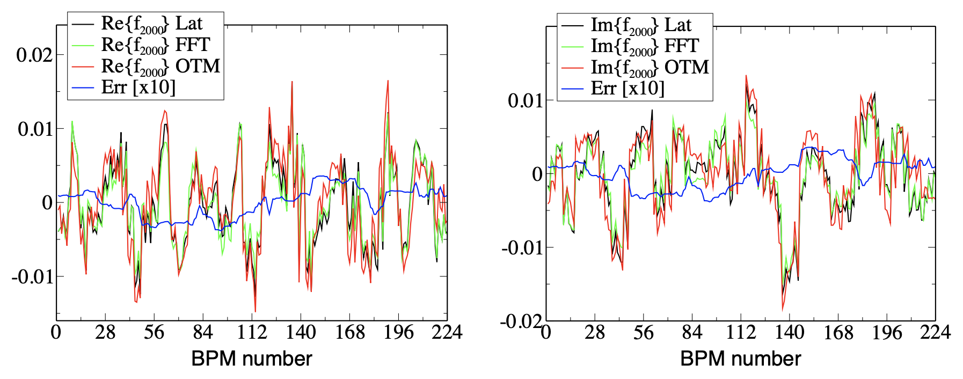
outlook: A new way to compute linear RDTs
Less accurate for distributed errors (2nd order & coupling terms)

Slide 26
outlook: A new way to compute linear RDTs
New formulas for coupling RDTs from OTM are still to be derived

Slide 27
OUTLINE
Part 1: The implementation (12’)
Part 2: The repository (1’)
Part 3: outlook (3’)
Thank you!
time for SVD of (22082, 256): 0.15898656845092773
time for SVD of (22080, 168): 0.09135222434997559
ORM derivatives saved in: ./Janalytic.pkl
analytic J took: 105.41607213020325 seconds
RM derivative parallel computation using 128 cores on grappa
time for SVD of (22082, 256): 0.15436983108520508
time for SVD of (22080, 168): 0.07208800315856934
ORM derivatives saved in: ./Jsemi-analytic.pkl
semi-analytic J took: 112.3644368648529 seconds
RM derivative parallel computation using 128 cores on grappa
time for SVD of (22082, 256): 0.14691829681396484
time for SVD of (22080, 168): 0.07918691635131836
ORM derivatives saved in: ./Jnumeric.pkl
numeric J took: 507.92765259742737 seconds

Slide 28
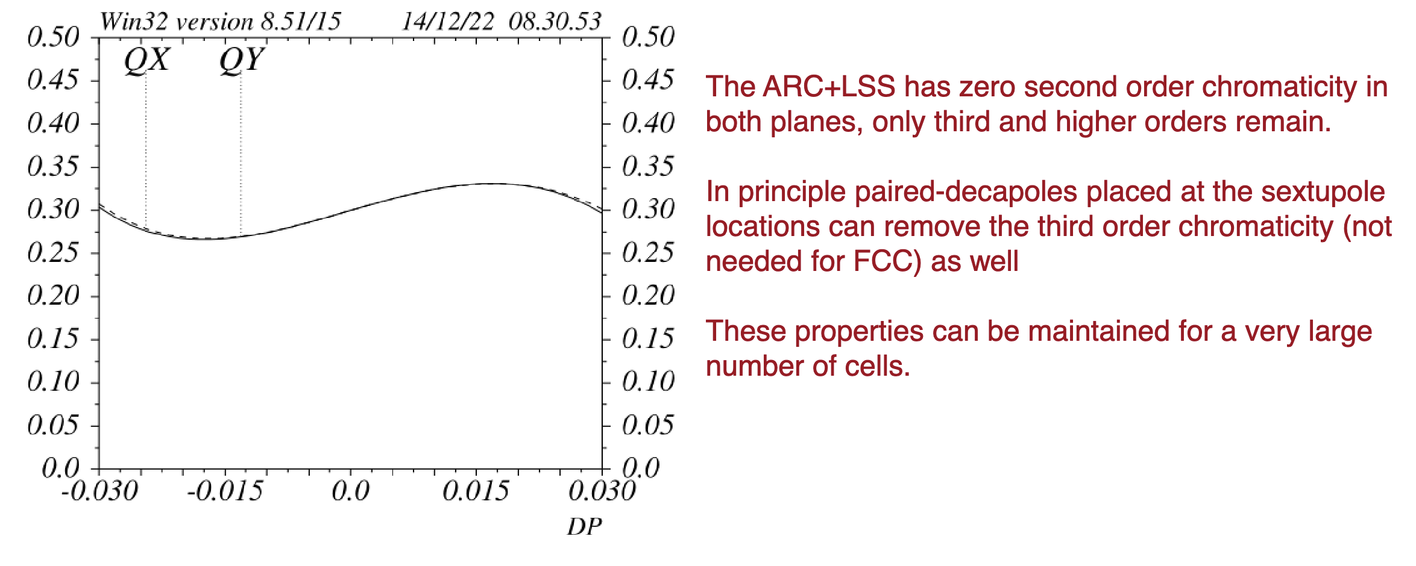
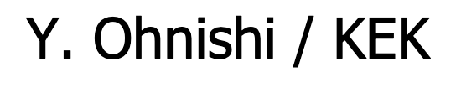
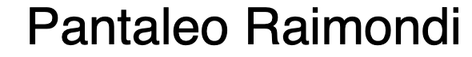
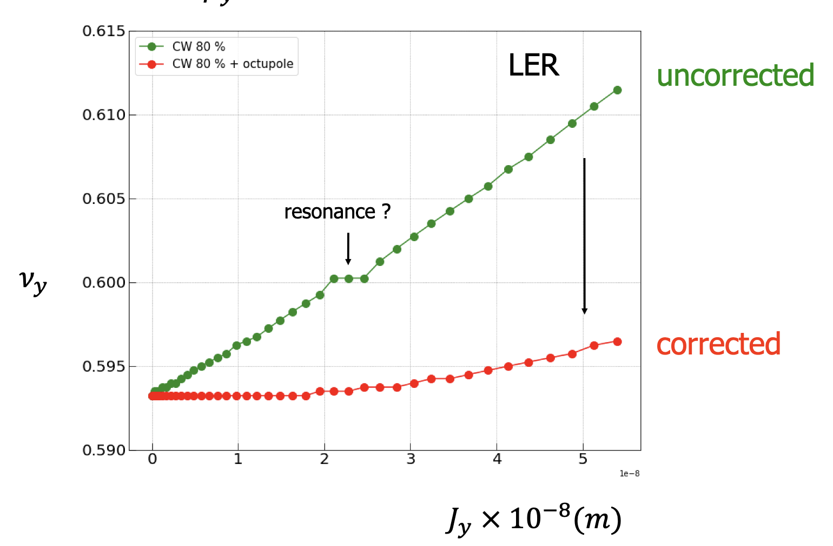
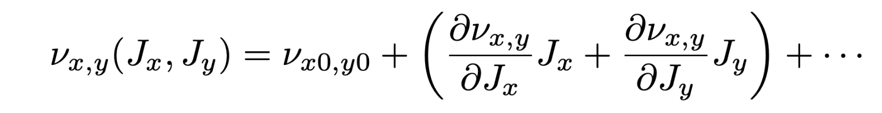
Some thoughts on non-linear optimization
minimize chromaticity
minimize detuning with amplitude

Slide 29
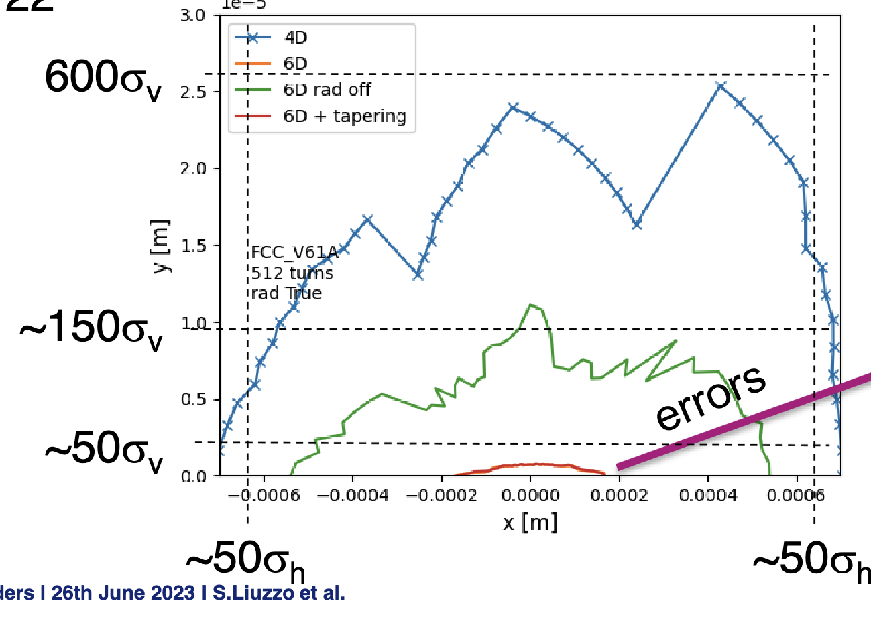
Some thoughts on non-linear optimization
minimize chromaticity
4D
6D rad off
minimize detuning with amplitude
Simone Liuzzo

Slide 30
Some thoughts on non-linear optimization
minimize chromaticity
My old-standing puzzle: Where does all this reduction of DA come from?
4D
6D rad off
minimize detuning with amplitude
Simone Liuzzo

Slide 31
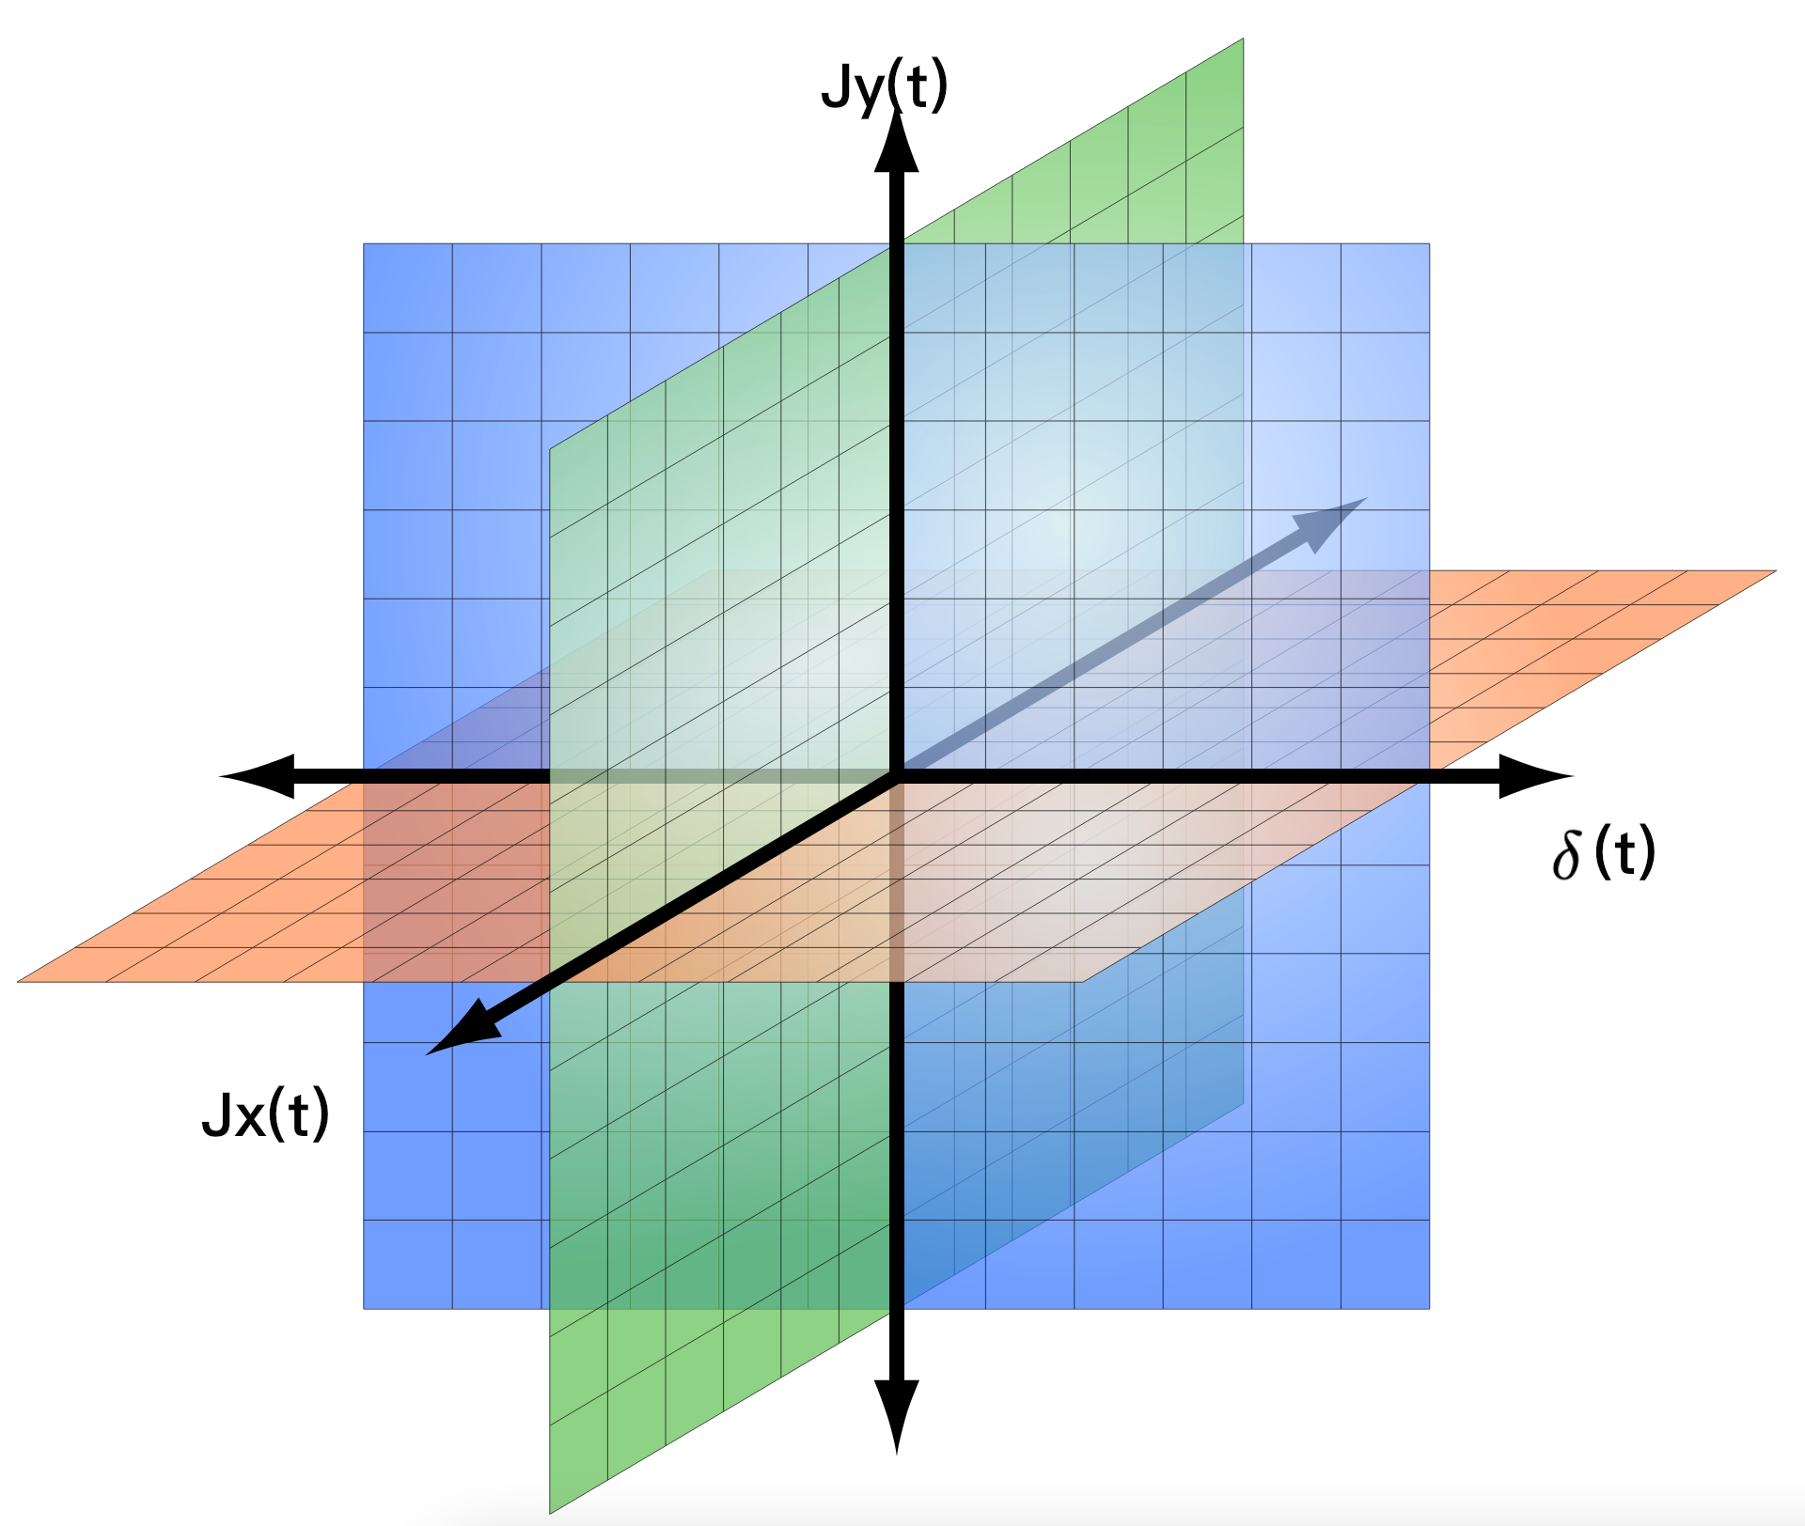
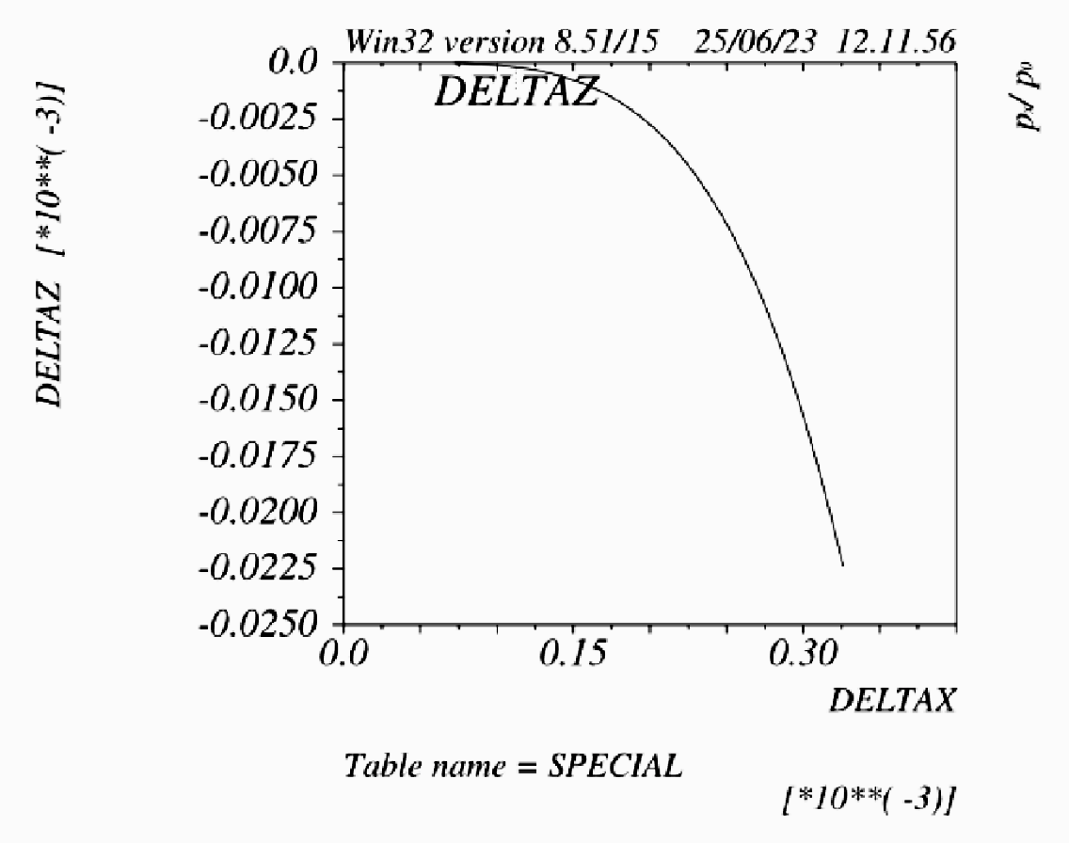
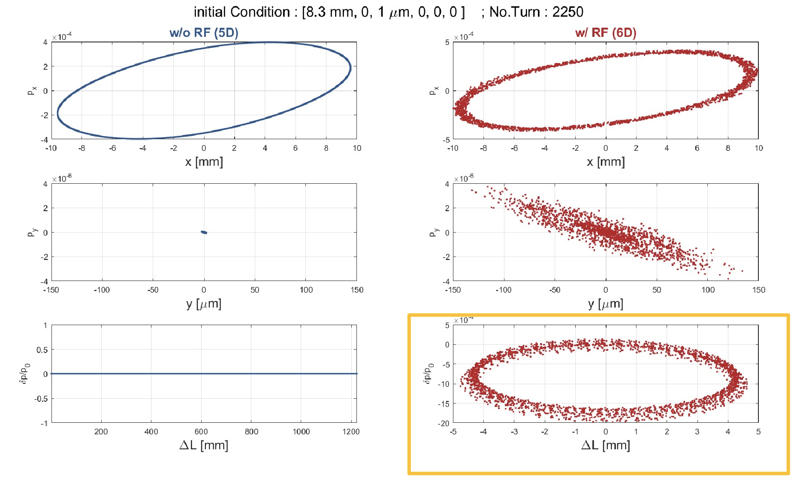
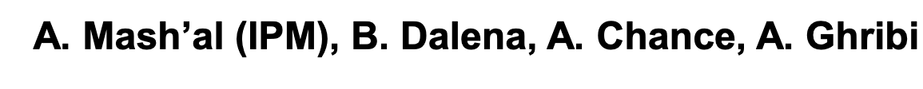
Some thoughts on non-linear optimization
My guess: Blame path lengthening and synchrotron motion for that.
hor. detuning
chroma
P. Raimondi
Jx -> δ ≠ 0
ver. detuning

Slide 32
Some thoughts on non-linear optimization
My guess: Blame path lengthening and synchrotron motion for that.
Most of the time they will be off-axis (Jx≠0) and off-energy (δ ≠ 0), thus, outside the 3 axis of the tune space.
hor. detuning
chroma
P. Raimondi
Jx -> δ ≠ 0
ver. detuning

Slide 33
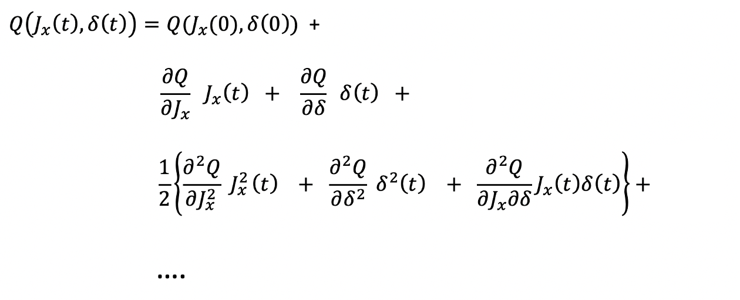
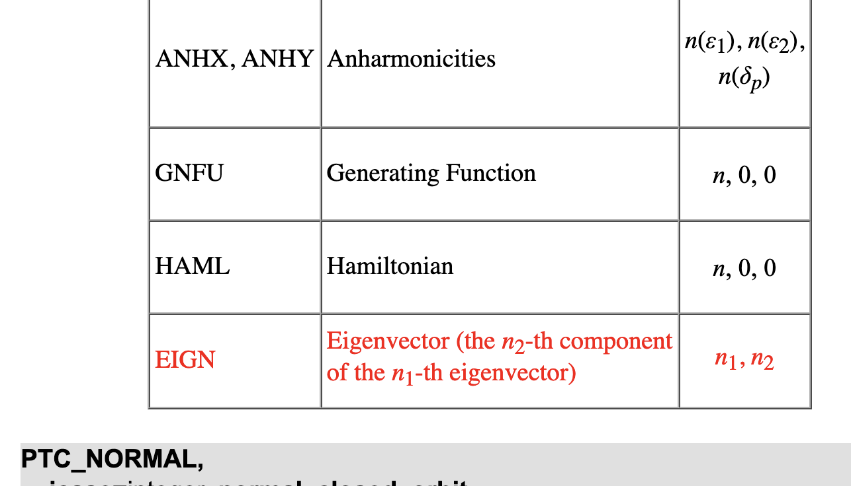
Some thoughts on non-linear optimization
Consequence: Minimizing cross-term (betatron+chromatic) detuning terms could be as much, if not more, effective than minimizing purely higher-order betatron or chromatic terms

Slide 34

Some thoughts on non-linear optimization
minimize detuning with amplitude
minimize chromaticity
Maybe we shall also minimize the cross term along with higher-order terms

Slide 35
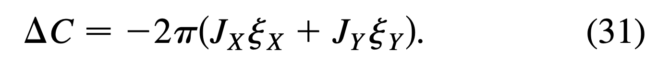
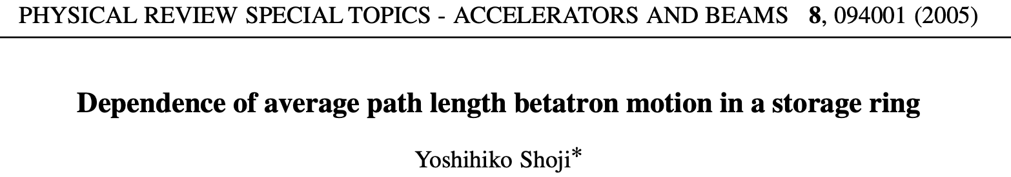
Some thoughts on non-linear optimization
Blame path lengthening: Actually, minimizing linear chroma is still very helpful, since path lengthening and chroma are highly correlated

