Slide 1

Challenges of short light pulses in 4th generation storage rings
Simone Di Mitri
Elettra Sincrotrone Trieste & University of Trieste

Slide 2
References (not exhaustive) & credits
Acknowledgments: F. Cullinan, M. Ries, L. Stingelin, M. Lonza, E. Karantzoulis
I. Martin, PhD Thesis, Wolfson College, University of Oxford, UK (2011)
Papers:
  X. Huang et al., PRAB 22, 090703 (2019); PRAB 26, 120701 (2023).
  Feng, C. & Zhao, Z. (2017). Sci. Rep. 7, 4724.
  Zholents, A., NIM A 798 (2015) 111–116.
  Evain, C., et al., NJP, 14, 023003 (2012).
  Wustefeld, G., Jankowiak, A., Knobloch, J. & Ries, M., IPAC’11, Spain, THPC014.
  Feikes, J., Holldack, K., Kuske, P. &Wustefeld, G., EPAC’04, Switzerland, WEPLT051.
  Zholents, A., Heimann, P., Zolotorev, M. & Byrd, J., NIM A 425 (1999), 385–389.
  Zholents, A. A. & Zolotorev, M. S. (1996). Phys. Rev. Lett. 76, 912–915.
  For a review and list of refs.: S. Di Mitri, J. Synchrotron Rad. 25 (2018)

Slide 3
Outline
Scientific motivations
Timing modes
Challenges @ 4GSR
Conclusions

Slide 4
Scientific motivations to timing mode
3rd gen. SRLS: high average brilliance, moderate peak intensity
  Track aerosol in free-flight, non-equilibrium states
  Map reversible dynamics of molecular systems
  Photo-electron spectroscopy
  Probe charge transfer dynamics
  Image orbital, spin, and lattice degree of freedom
  EXAFS
avoid sample damage (burning, ablation) and space charge
nano- to pico-second time scale at nanometer size
Large wavelength tuneability
4th gen. SRLS: high degree of transverse coherence in x-rays
improves lateral resolution
preserves high energy resolution (monochromators)
reduces the integrated time of measurements

Slide 5
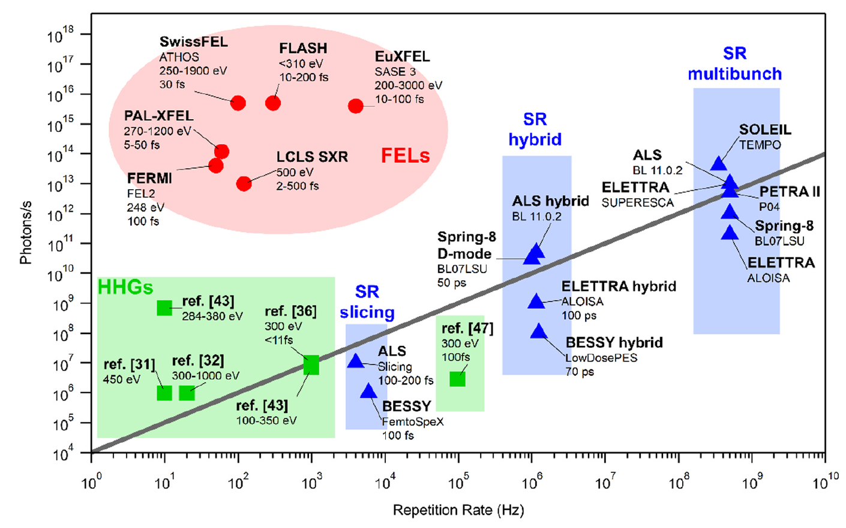
Strong and weak points
R. Costantini et al., J. Electr. Spectr. Rel. Phen. 254 (2022)
space-charge limit
too long
too weak
too low, too high

Slide 6
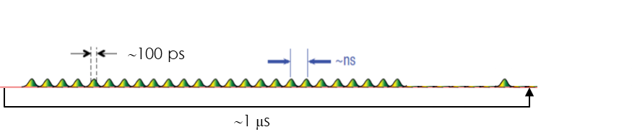
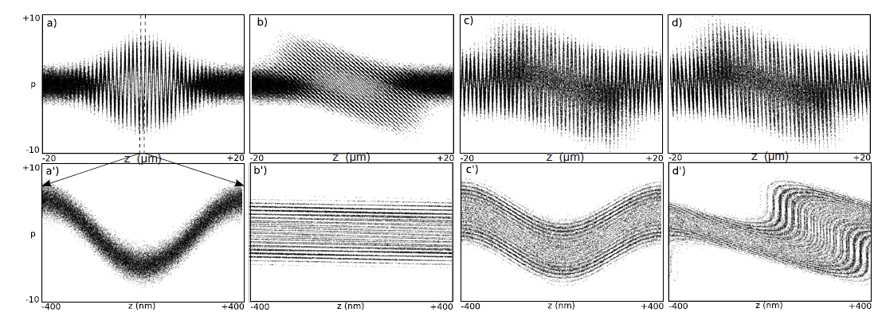
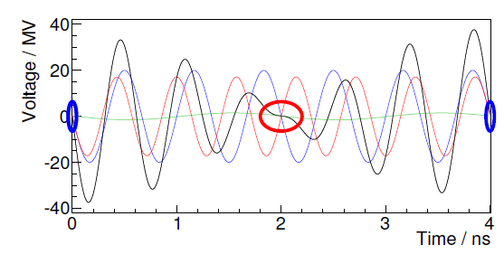
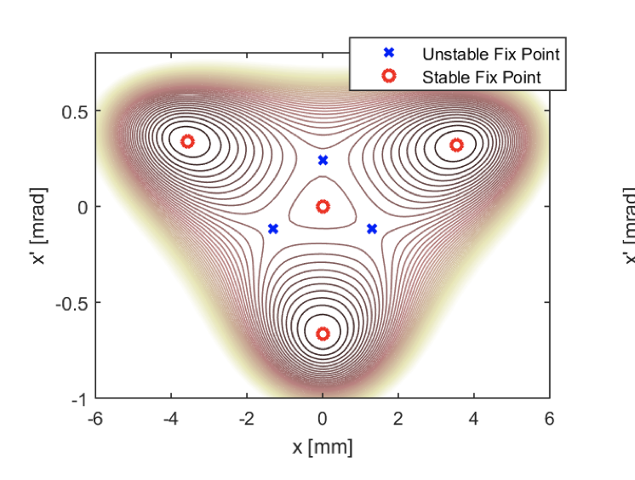
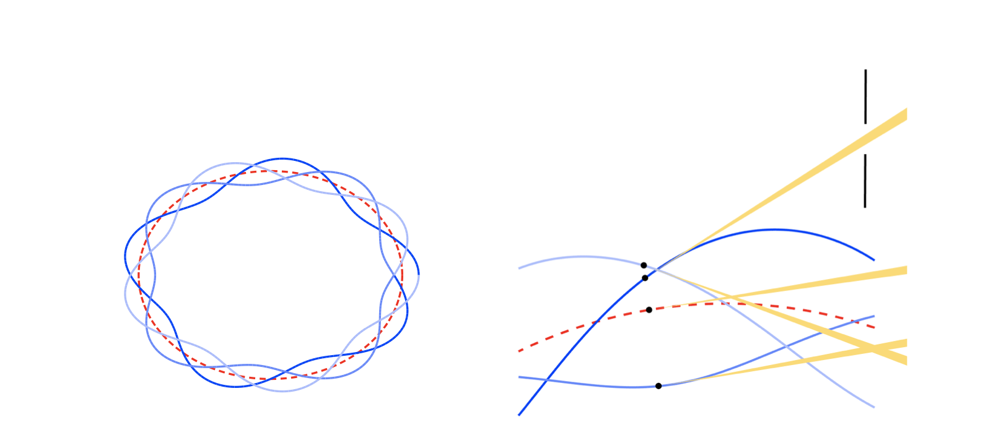
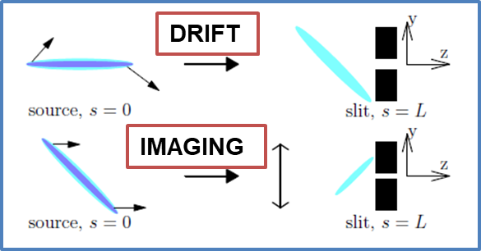
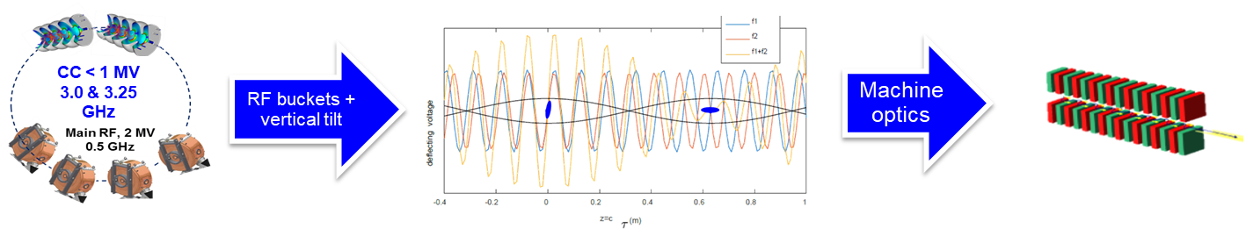
Timing modes – simultaneous to standard operation
CHG, EEHG
CAMSHAFT BUNCH (PSB)
VSR
TRIBS
LASER-SLICING
SR RF beating
CRAB CAVs

Slide 7
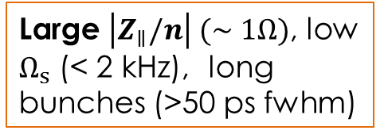
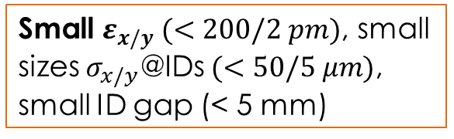
Features of 4GSR
Tight lattice, small dispersion (<60 mm), DL-optics imposes limited flexibility
Large $\left|Z_{∥}/n\right| (∼1Ω)$, low $Ω_{s}$ (< 2 kHz), long bunches (>50 ps fwhm)
Small $ε_{x/y} (<200/2 pm)$, small sizes $σ_{x/y}\text{@}\text{IDs} (<50/5 μm)$, small ID gap (< 5 mm)

Slide 8


Features of 4GSR
Tight lattice,...
Small $ε_{x/y}$,…
Large $Z_{∥}$,…

Slide 9
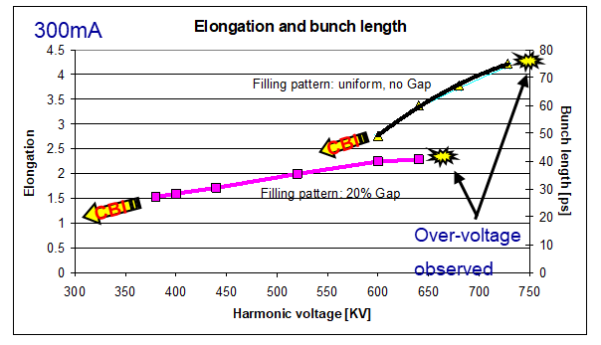

PSEUDO-SINGLE BUNCH
@ SLS
Courtesy of
M. Pedrozzi, L. Stingelin et al.
Tight lattice,...
(10% in SLS-2)
Small $ε_{x/y}$,…
MWI & IBS, large harmonic voltage, TBL & PTBL
Non-uniformity of lifetime and transverse emittance (IBS)
Ad hoc tuning of dark gap and HC. Still, good for CBI and Ion Trapping.
Large $Z_{∥}$,…

Slide 10
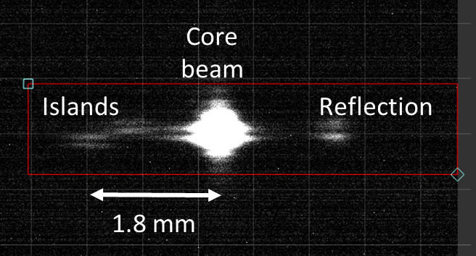
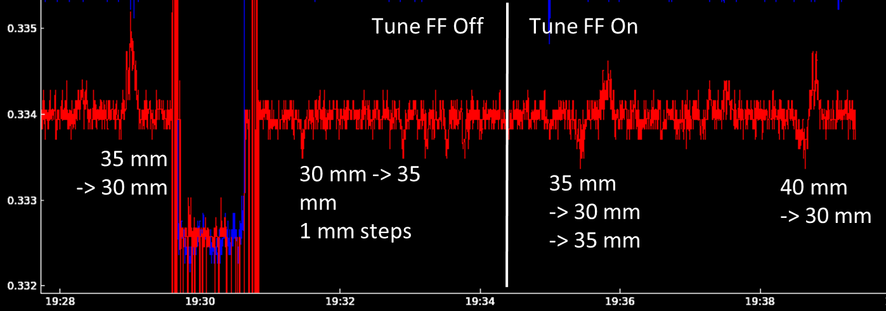

TRIBS
Courtesy of F. Cullinan
Tight lattice,...
Small $ε_{x/y}$,…
3p resonance, optimized nonlinear dynamics.
IDs’ roll-off, special compensation.
Charge diffusion, radiation background (S/N∼0.1%), intensity fluctuation (<5%), energy resolution (mono ΔE/E∼0.1%).
Tailored hybrid fill pattern for few mA’s in the islands (TBL).
Large $Z_{∥}$,…

Slide 11
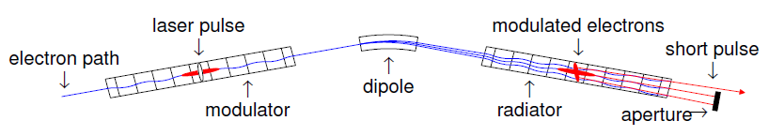
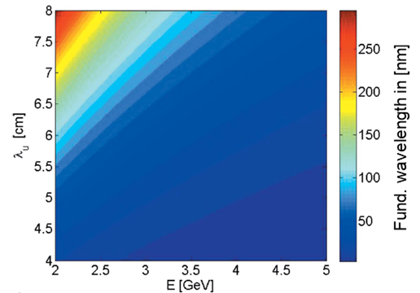
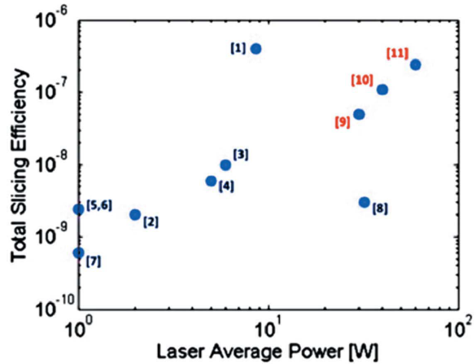
LASER-SLICING, CHG, EEHG
Tight lattice,...
S. Di Mitri, JSR 25 (2018)
S. Di Mitri, JSR 26 (2019)
Small $ε_{x/y}$,…
Large $Z_{∥}$,…
Space for MOD & RAD
Dispersion (R₅₆)
Charge dilution
Camshaft bunch (TBL)

Slide 12
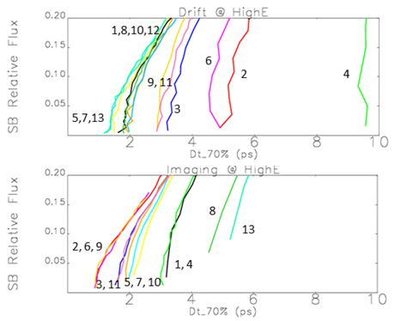
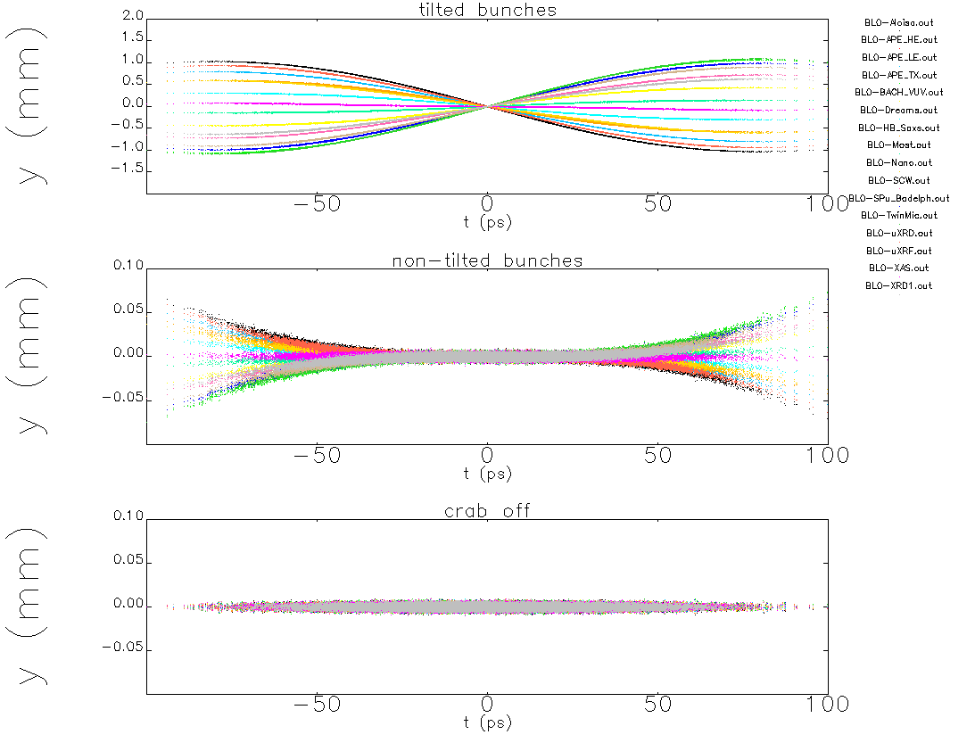
CRAB CAVITIES (TRANSV. RF BEATING)
Tight lattice,...
Small $ε_{x/y}$,…
Kicks cancellation: multiple CCs, vert. emittance
Large $Z_{∥}$,…
Vertical tune and phase advance
ID gap, deflecting voltage

Slide 13
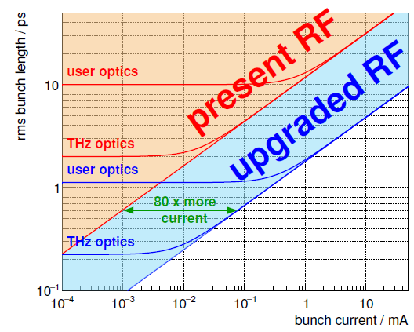
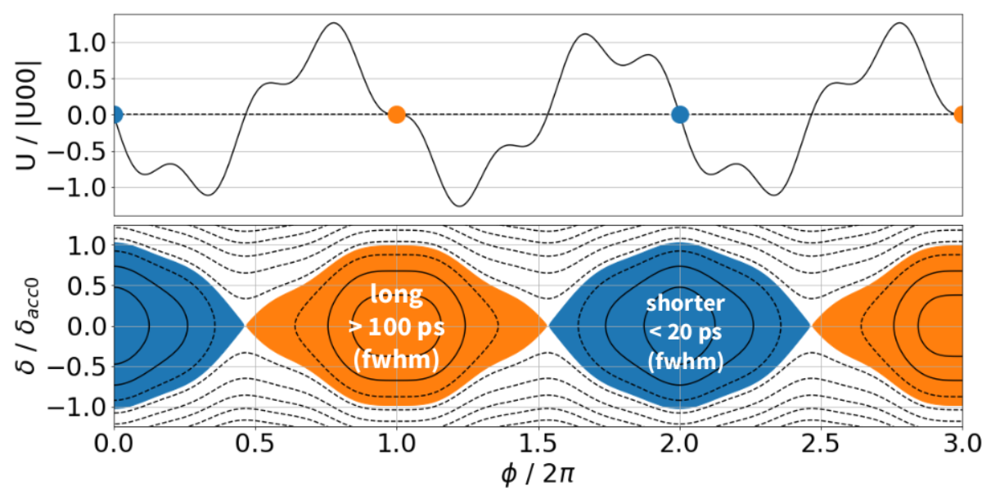

VARIABLE PULSE LENGTH (LONG. RF BEATING)
BESSY VSR TDR – SC RF
Keep length of every 2nd bunch to 10 ps-scale
Tight lattice,...
Courtesy of M. Ries – NC RF
Small $ε_{x/y}$,…
Shortening every 2nd bunch to ps-scale
Charge density, IBS & MWI (mostly for SC option)
Non-uniformity of lifetime of short and long bunches
Tailored hybrid fill pattern for pump-probe experiments (TBL)
Large $Z_{∥}$,…

Slide 14
(Sub-)Picosecond X-ray pulses
Max. Photon Pulse RR:
1
TREES workshop outcome (2018)
100 – 500 MHz
10⁻¹
1 – 100 MHz
10⁻²
Crab Cav.
VSR
Low-α
PSB (>15 ps)
Total Efficiency of Emission
CHG
10 – 100 kHz
10⁻³
10⁻⁴
1 – 10 kHz
10⁻⁵
Compatible with standard multi-bunch user mode
10⁻⁶
10⁻⁷
Laser-Slicing
0.01
0.5
1.0
5.0
10
σ_{t,ph} (RMS) [ps]

Slide 15
Complexity vs. performance
 |  | Laser-Slicing
 | PSB | TRIBS | CHG, EEHG
 |  | CRAB CAVs |  | Beam-slicing
 |  |  | VSR | Magnetic compression
> 40 ps fwhm
(sub-)ps domain
Ave. Flux/pulse duration
Complexity of implementation

Slide 16
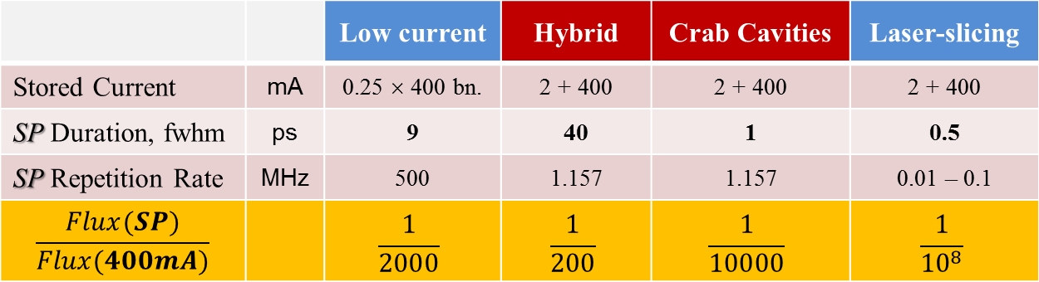
Elettra 2.0 – Options for timing mode

 |  | Low current | Hybrid | Crab Cavities | Laser-slicing
Stored Current | mA | 0.25 × 400 bn. | 2 + 400 | 2 + 400 | 2 + 400
SP Duration, fwhm | ps | 9 | 40 | 1 | 0.5
SP Repetition Rate | MHz | 500 | 1.157 | 1.157 | 0.01 – 0.1
$$\frac{Flux(SP)}{Flux(400mA)}$$ |  | $$\frac{1}{2000}$$ | $$\frac{1}{200}$$ | $$\frac{1}{10000}$$ | $$\frac{1}{{10}^{8}}$$
Total stored current in low current mode is 100 mA

Slide 17
Concluding remarks
No universal show-stoppers in 4GSR to timing modes simultaneous to standard multi-bunch operation.
TBL looks like the main challenge, both in long and short pulse modes. It challenges beam-synchronized systems, implies specific tuning of HC and dark gap.
TRIBS constraints several aspects of the 4GSR design (optics, injection).
Laser-based schemes are hardly compatible with 4GSR lattice and linear optics.
RF-based schemes look almost transparent to 4GSR optics, but still dealing with TBL and technology R&D.
Not touched in this talk:
  α-buckets, hardly compatible with nonlinear dynamics and low dispersion of 4GSR.
  Magnetic compression, suitable for swap-out footprints, but invasive + synchronization issues.
  Injection efficiency, critical for RF-schemes and depending from on-/off-axis injection.

Slide 18
Thank you for your kind attention
Comments and questions are welcome

Slide 19
FEL & SR
LCLS-II
Examples of accelerator-based X-ray sources:
0.1 – 1 keV photon energy
# of phs. at the source
FEL in short pulse mode
ESRF-MB
EU-XFEL
Elettra-MB
Elettra-SB
10¹⁷
Can a (DL)SR target
∼ sub-ps,
10 kHz,
> 10⁸ ph/s/0.1%bw or 10⁶ ph/pulse ?
10¹⁵
LCLS
SwissFEL
10⁶
10⁵
10¹³
#ph/sec/0.1%bw
10⁴
FERMI
VSR, CC
10³
What flux and pulse duration can be produced up to MHz RR ?
10¹¹
10²
10
Femto-sliciing
Rep. Rate [kHz]
10⁹
1
Lattice-invasive ?
Standard user operation ?
10⁻¹
10⁷
10⁻²
10⁻³
10⁻²
10⁻¹
1
10
10²
σ_{t,ph} [ps]

Slide 20
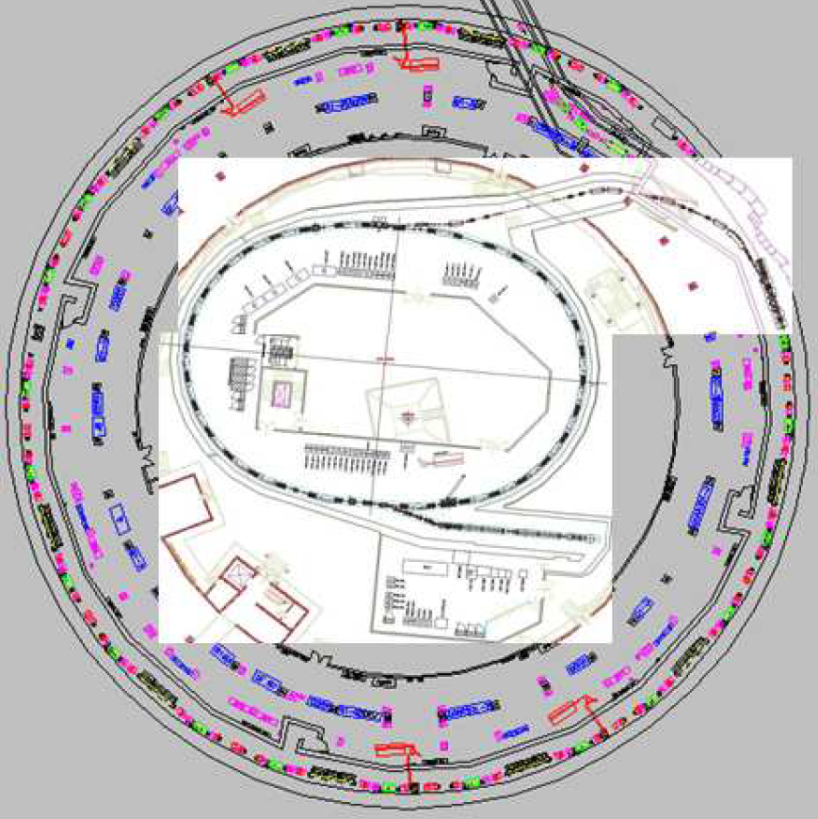
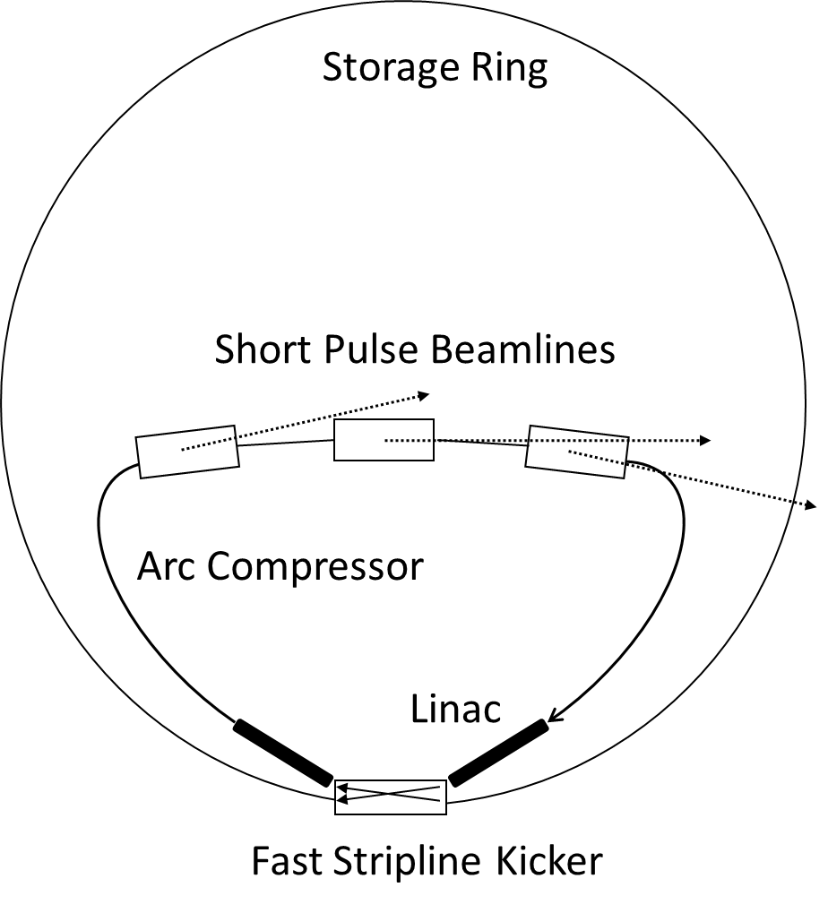
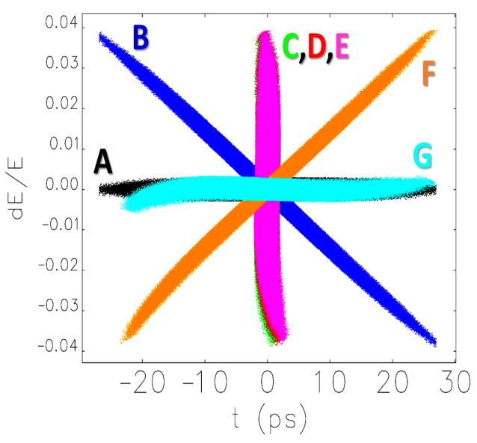
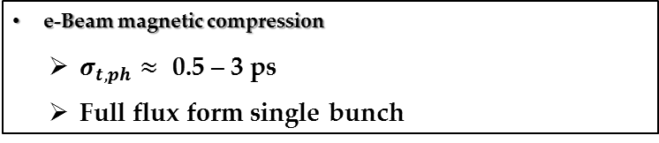
By-pass / Swap-out
e-Beam magnetic compression
  $σ_{t,ph}≈ \text{0.5 }\text{–}\text{ 3 }\text{ps}$
  Full flux form single bunch
C
D
A
Pros:
- transparent to DLSR lattice and optics
- short pulses at all the (existing) beamlines
- DLSR ∼nominal flux, but at the expense of lower spectral brilliance
new TL
E
G
B
F
Injector upgrade
Cons:
- new fast stripline kicker
- injector upgrade (0.1-2.5 GeV, ≥ 100Hz)
- new ring-to-booster transfer line
- low-α (÷3) optics in Booster
S. Di Mitri, M. Cornacchia, New J. Phys. 2015
S. Di Mitri, JSR 2018
S. Di Mitri, A. Bianco, S. Lizzit, NIM A 1051 (2023( 168197

Slide 21
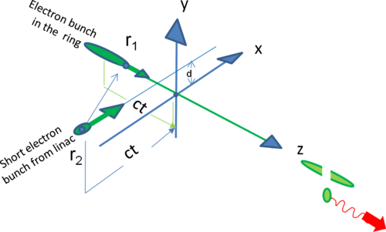
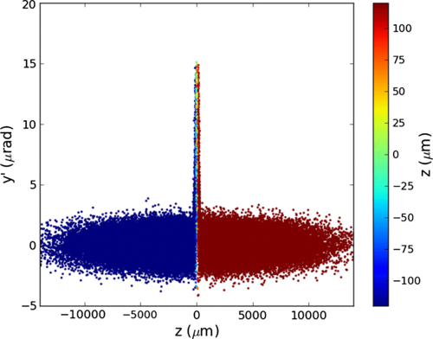
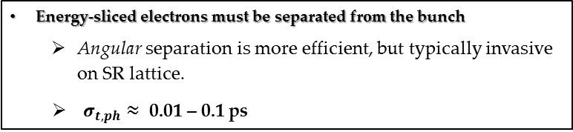


Beam-slicing
He, F. Willeke, L.-H. Yu (2014)
$$Δθ_{y}∝\frac{Q_{2}}{σ_{y,2}}\frac{1}{E_{1}}$$
$$Δt_{slice}∝\frac{Δt_{2}}{sinφ_{1,2}}$$
Energy-sliced electrons must be separated from the bunch
  Angular separation is more efficient, but typically invasive on SR lattice.
$σ_{t,ph}≈ \text{0.01}\text{ – }\text{0.}\text{1} \text{ps}$
Angular separation
R&D and limitations:
Promised slicing efficiency is 10⁻⁷
Background radiation limits the contrast ratio to ∼10
Requires kHz (NC) to 1 MHz (SC) e-Gun + Linac + Magnetic Compressor

