Slide 1
Mode 1 Instabilities in Fourth Generation Storage Rings
Francis Cullinan, Åke Andersson, Jonas Breunlin, Miriam Brosi,
Pedro Fernandes Tavares
(MAX IV Laboratory, Lund, Sweden)
I.FAST 9th Low Emittance Rings Workshop, CERN, Switzerland, February 2024.

Slide 2
Overview
MAX IV 3 GeV ring
Landau cavities
Mode 1 instability
Measurements
Parked main cavities

Slide 3
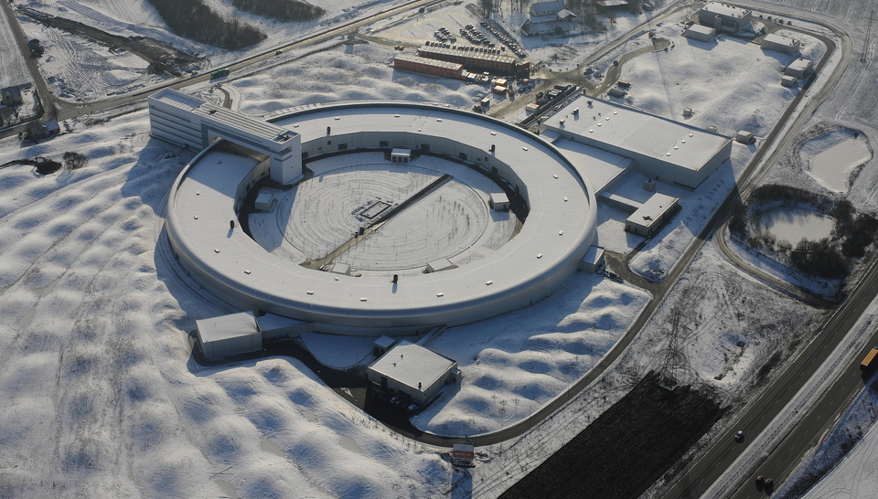
MAX IV 3 GeV Ring
Parameter | Value
RF frequency (MHz) | 100
Landau-cavity (LC) harmonic | 3
Shunt impedance per HC (MΩ) | 2.75
HC quality factor | 20800
Delivery beam current (mA) | 400
RF voltage (MV) | 1.0
Natural RMS bunch duration (ps) | 40.4
…with ideal HC lengthening (ps) | 199
Harmonic number | 176
Number of main (landau) cavities | 5 (2)

Slide 4
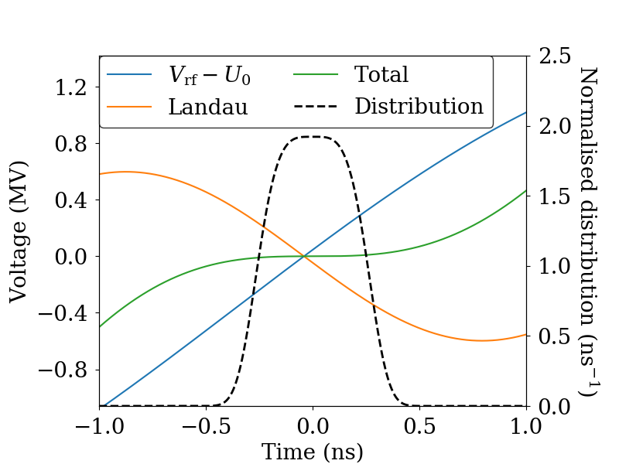
Landau (harmonic) Cavities
Landau cavities used to flatten the RF potential to lengthen the bunches
  Longer Touschek lifetime
  Less intrabeam scattering
  Reduced heating of vacuum components
J. M. Byrd & M. Georgsson, PRSTAB 4 030701 (2001)
M. Georgsson, Å. Andersson & M. Eriksson, NIM A 416 2-3 pp 465-474 (1998)
Notes:
Can also reach semi flat potential

Slide 5
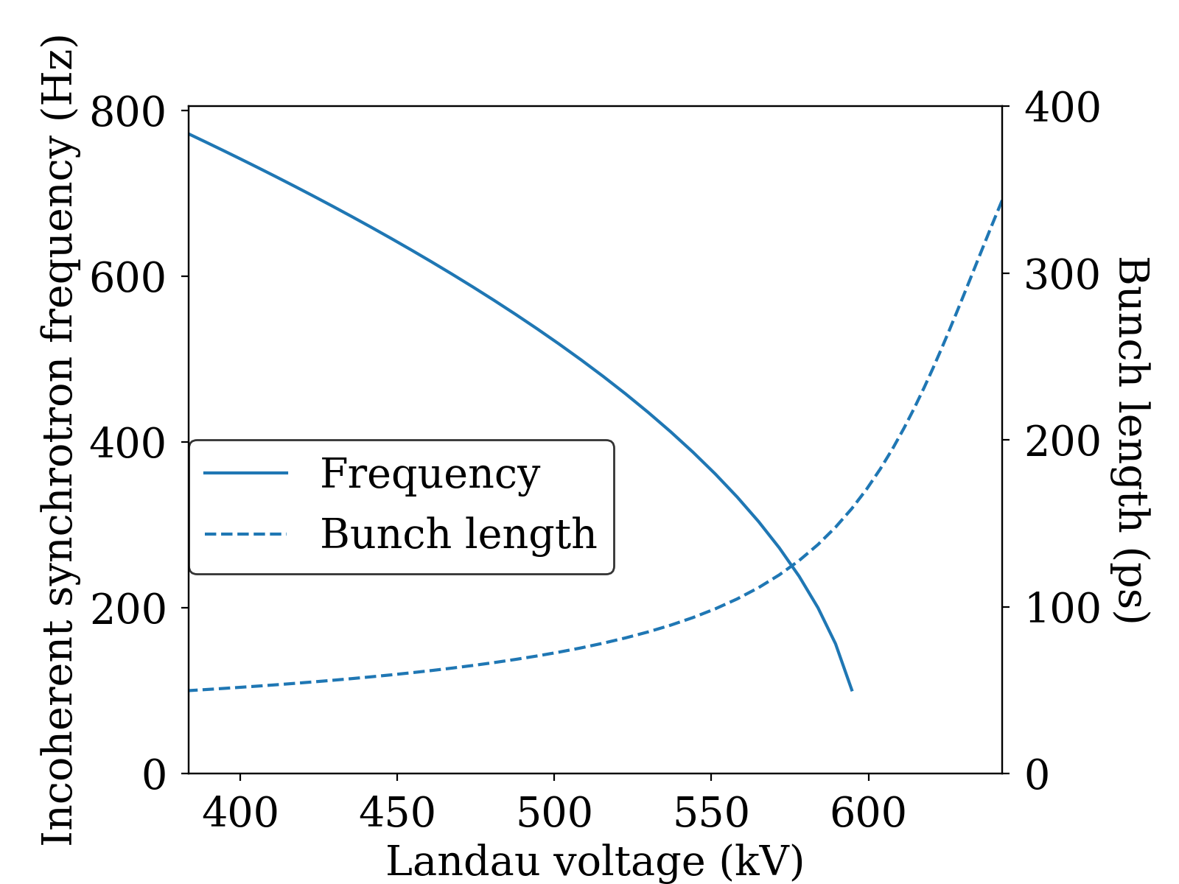
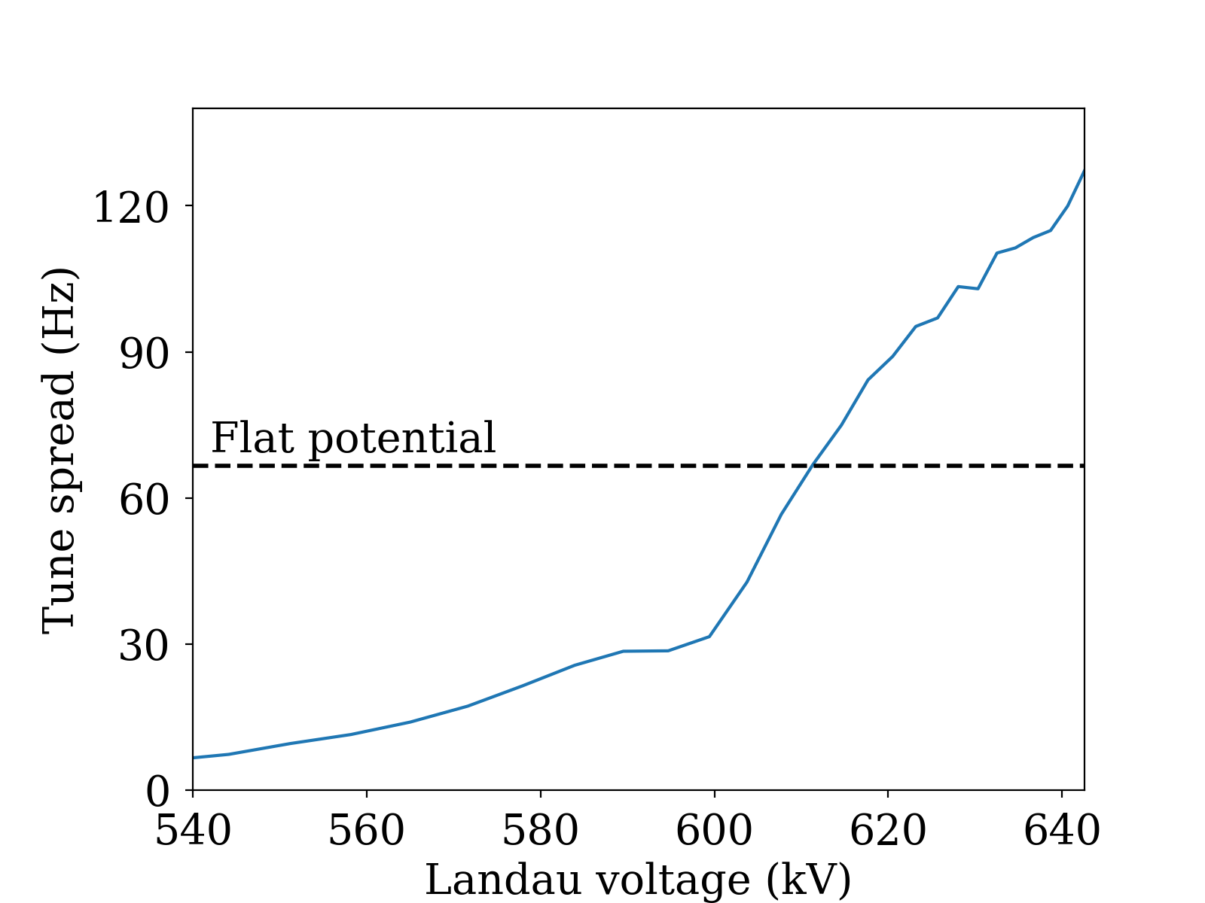
Synchrotron tune
MAX IV parameters, 500 mA current
Main RF voltage, 1.8 MV (flat potential with 3 LCs)
T. Olsson, F. Cullinan & Å. Andersson, PRAB 21 120701 (2018)
P. F. Tavares, Å. Andersson, A. Hansson & J. Breunlin, PRSTAB 17 064401 (2014)
Notes:
Plots
Incoherent synchrotron tune and intrabunch tune spread as a function of HC detuning + bunch length
Two cases: Flat potential vs. Semiflat

Slide 6
Harmonic Cavities in Fourth Generation Light-Source Synchrotrons
Survey of harmonic cavity systems carried out for discussion at FLS 2023
MAX IV 3 GeV
DIAMOND II
PETRA IV
SOLEIL-II
FLS at KEK
APS-U
BESSY III
HEPS
SLS 2.0
ESRF-EBS
ALS-U
HALF
ELETTRA 2.0
SIRIUS
ALBA II
SPS-II

Slide 7
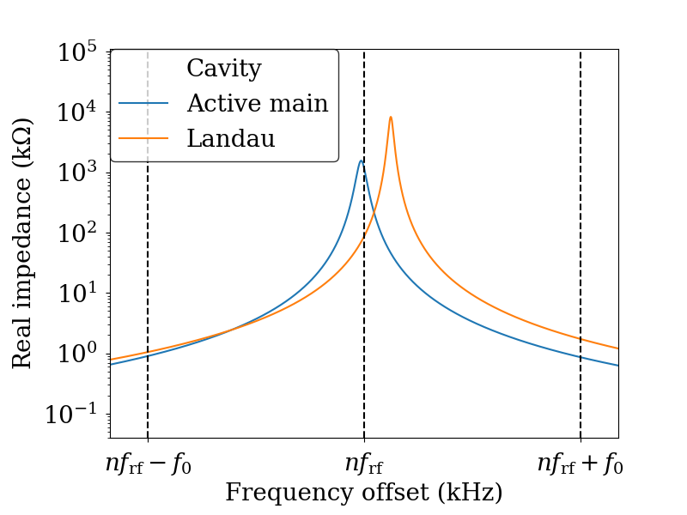
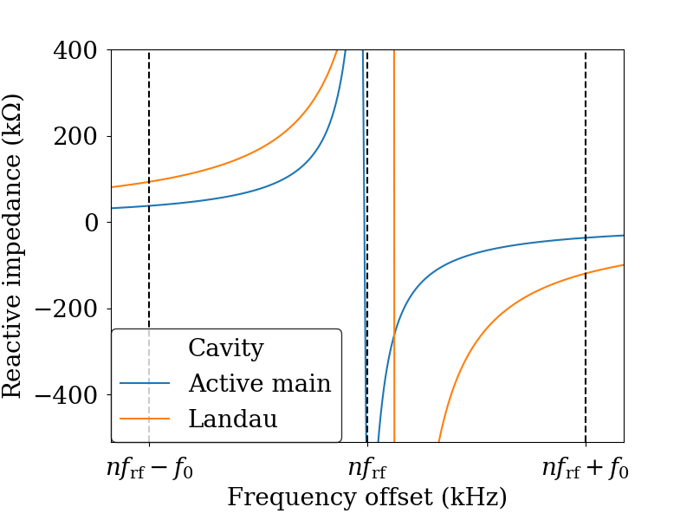
Impedances
3 Landau cavities, flat potential at 200 mA with RF voltage of 1 MV
Notes:
Check image impedances (2 or 3 Landaus?) and remove the parked main cavity

Slide 8
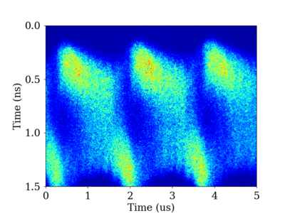
Mode 1 Instability
Characterised by low coherent frequency
Sometimes referred to as ‘periodic transient beam loading’*
R. A. Bosch, K. J. Kleman & J. J. Bisognano, PRSTAB 4 074401 (2001).
M. Venturini, PRAB 21, 114404 (2018).
*T. He, PRAB 25 024401 (2022).

Slide 9
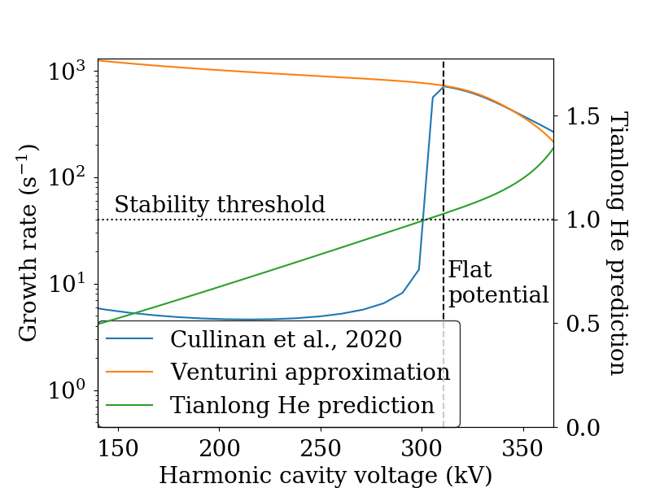
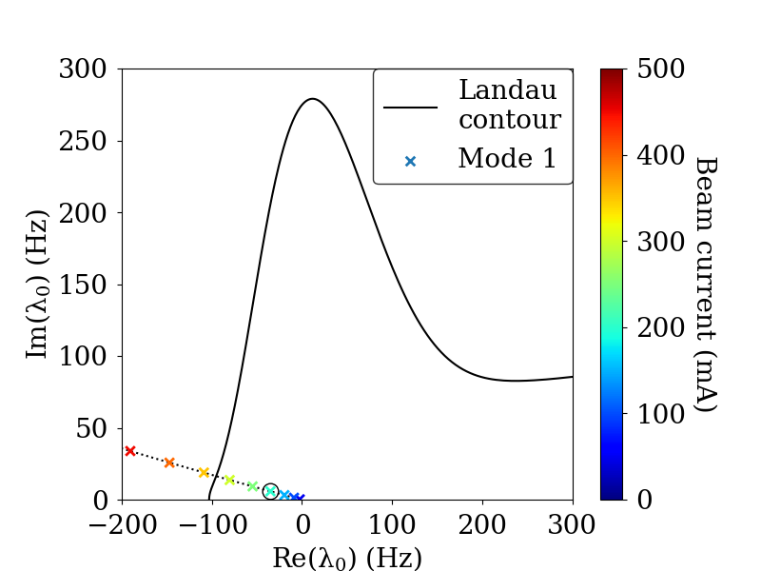
Mode 1 approximations
Landau damping
200 mA current,
Vrf=1 MV
200 mA
F. J. Cullinan, Å. Andersson & P. F. Tavares, PRAB 23 074402, (2020).
M. Venturini, PRAB, 21 114404, (2018).
T. He, W. Li, Z. Bai, and W. Li, PRAB, 26 064403, (2023).
S. Krinsky & J. M. Wang, Part. Accel. 17 109 (1985)
R. R. Lindberg, PRAB 21 124402 (2023).

Slide 10
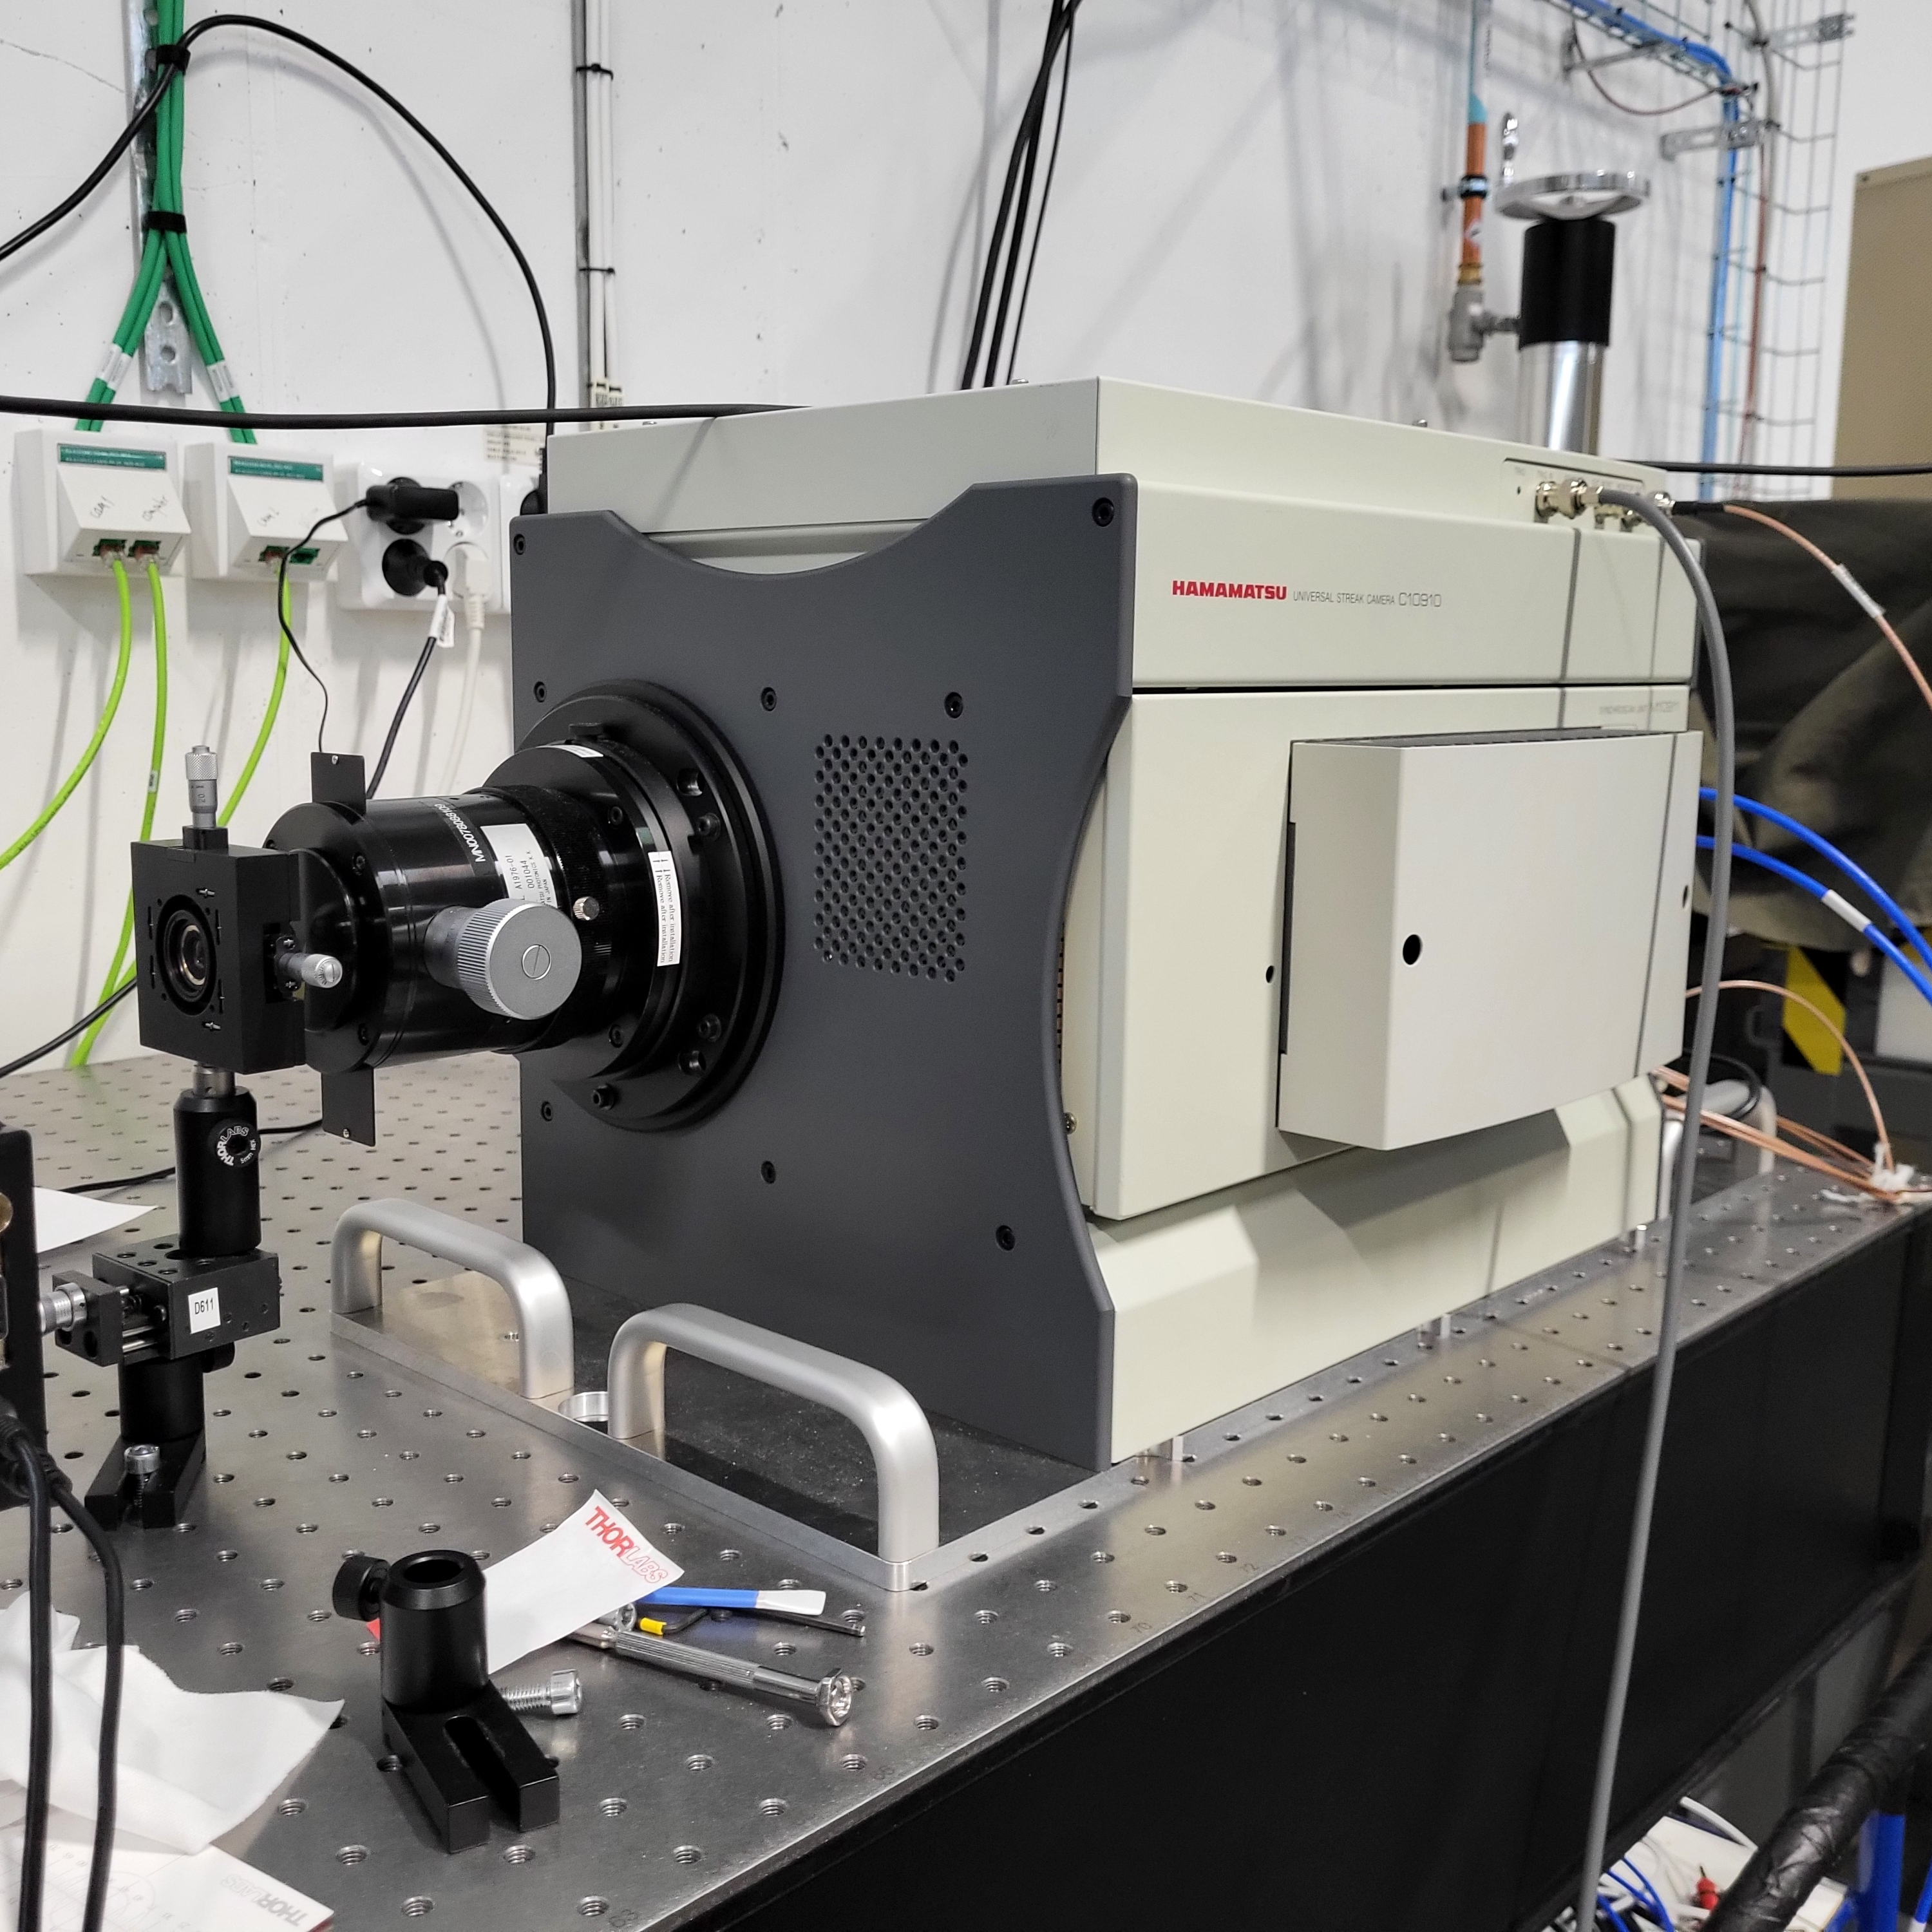
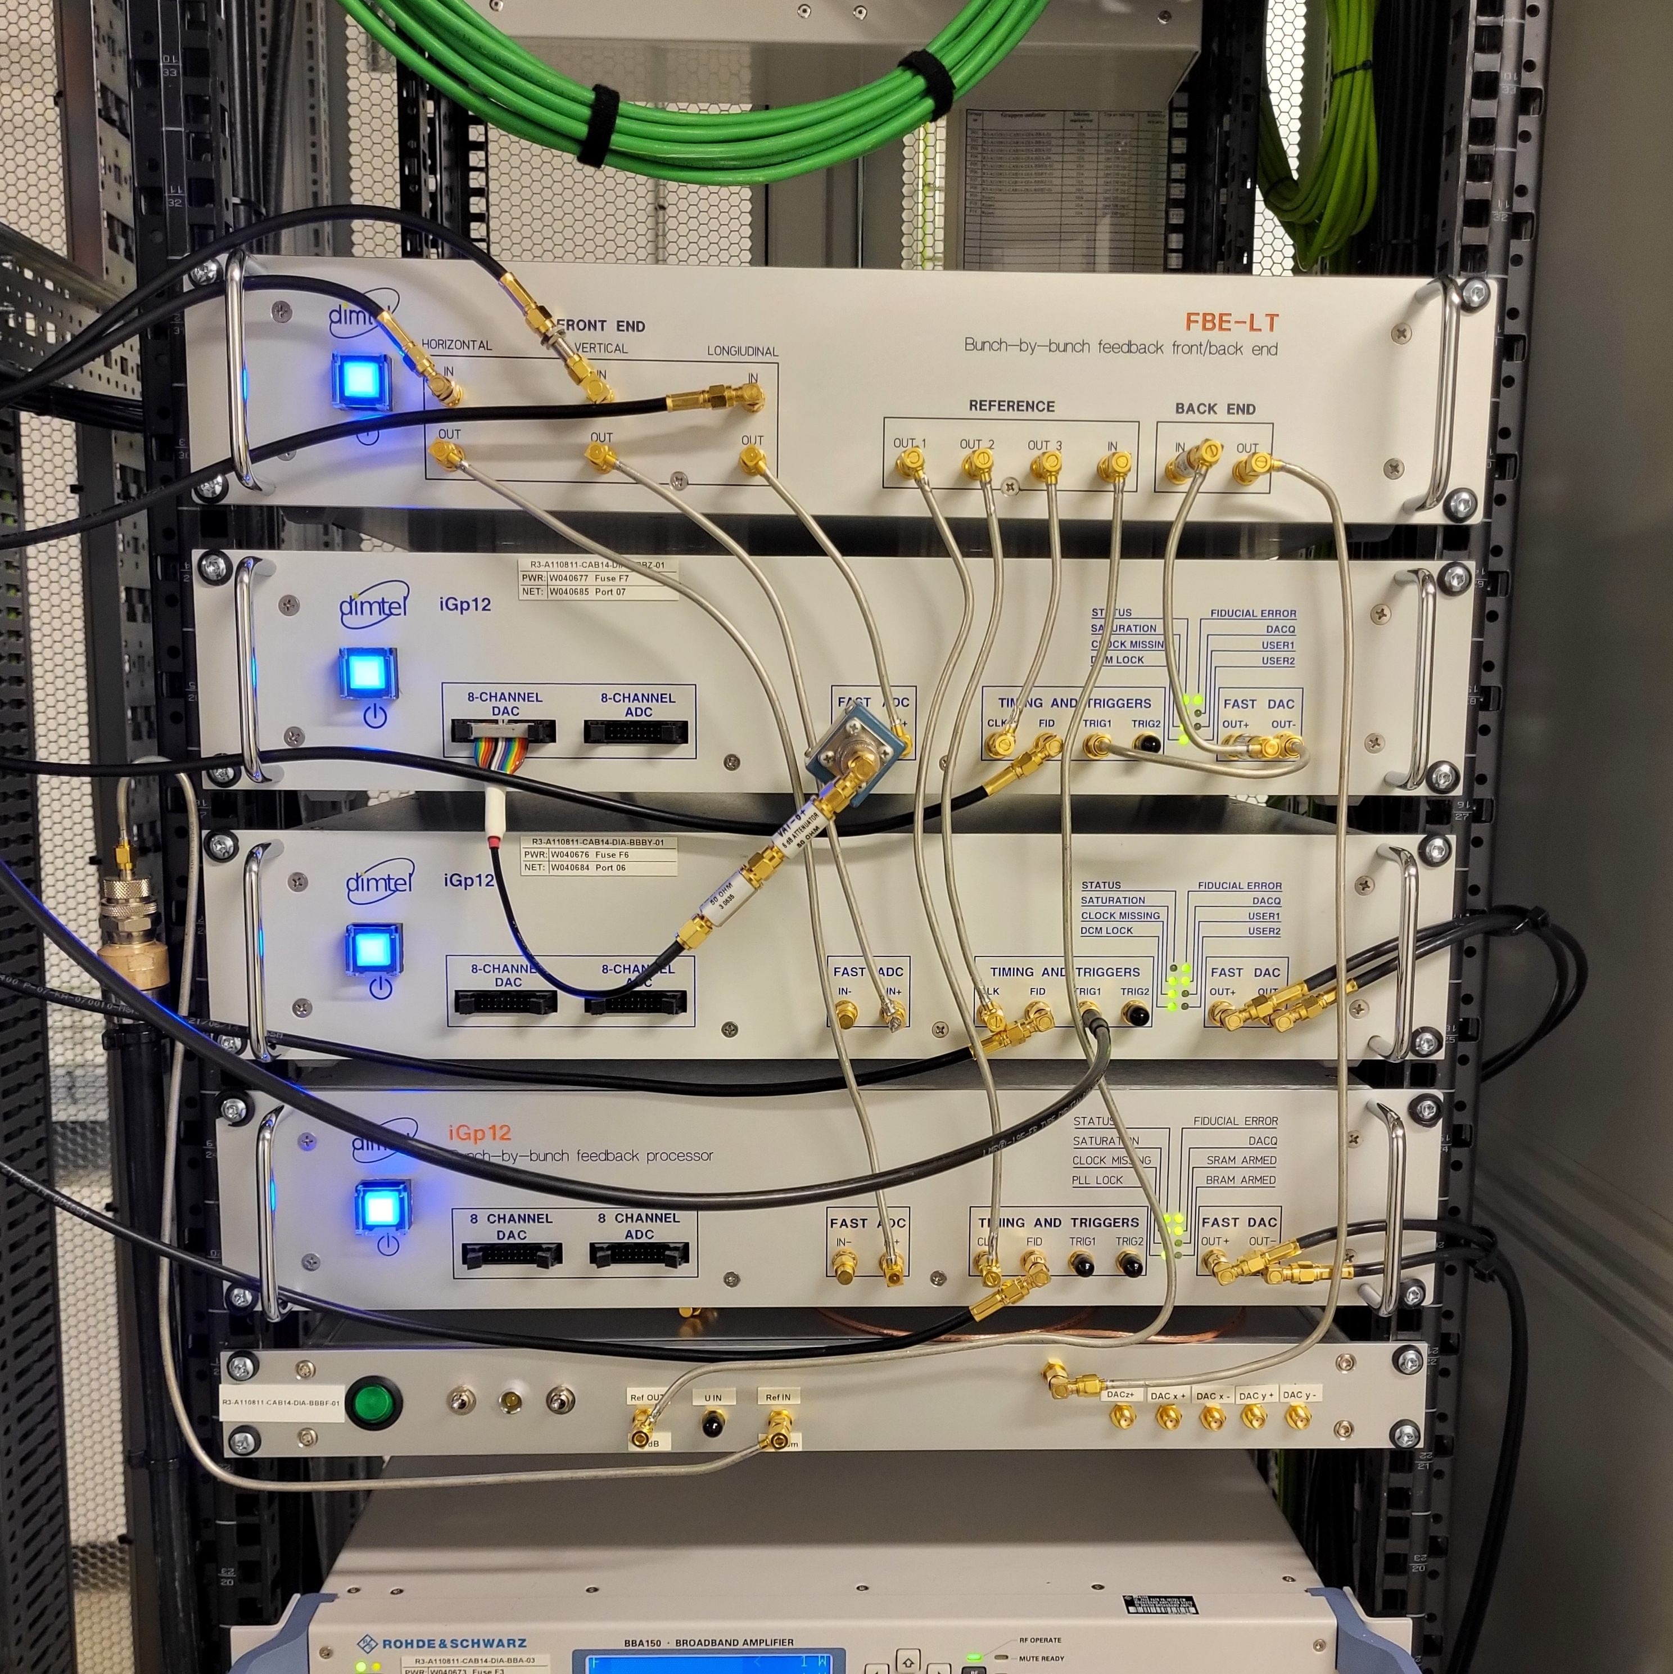
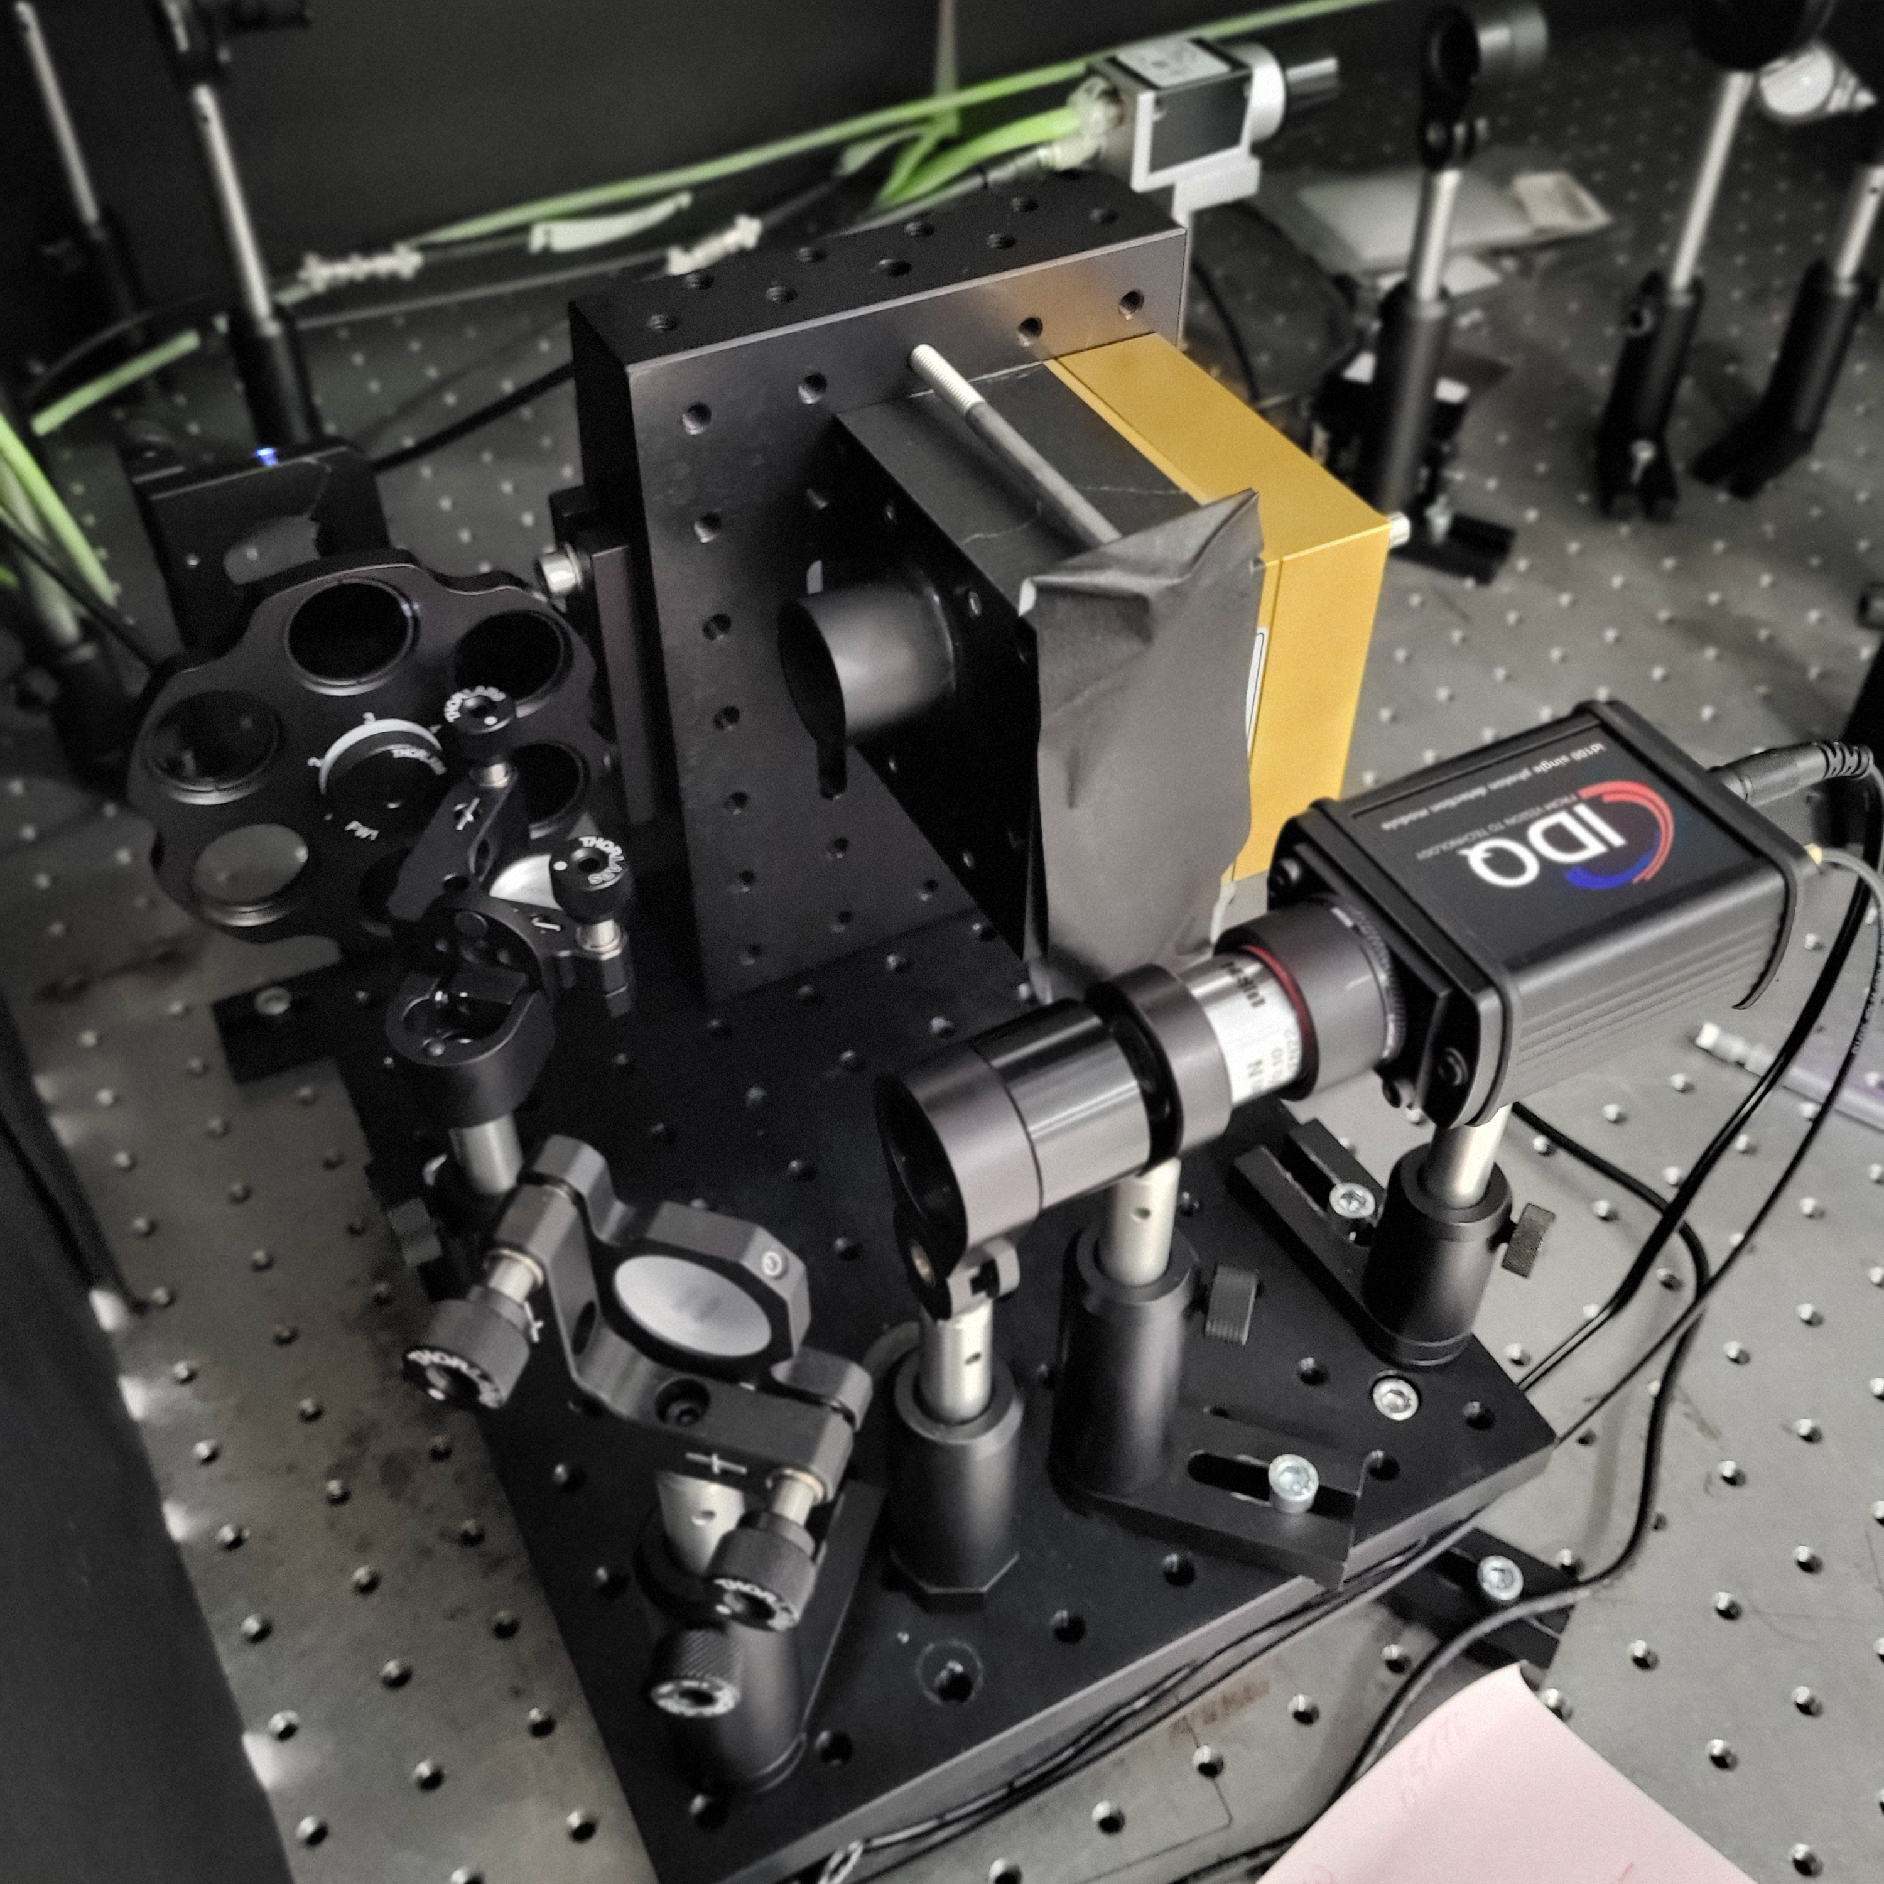
Diagnostics
Streak camera
Bunch by bunch phase detection
Fill-Pattern monitor
Hamamatsu
Dimtel Inc.
PicoQuant

Slide 11
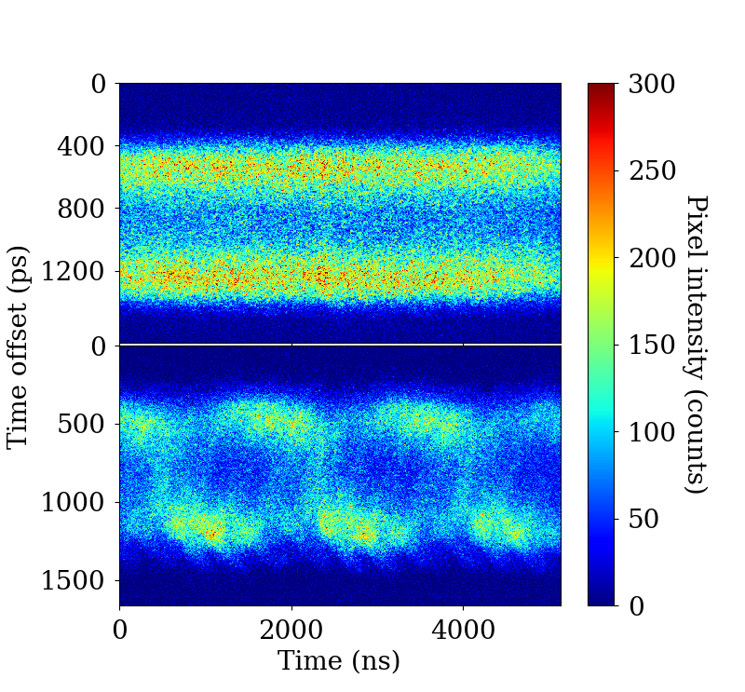
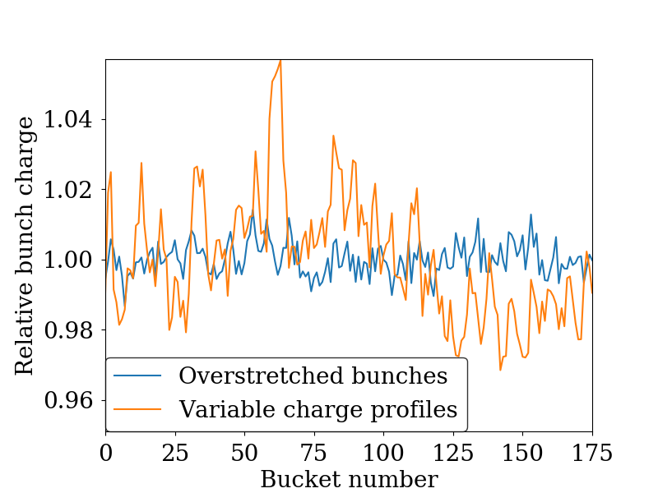
Fill Pattern Considerations
2 Landau cavities,
RF voltage of 1.13 MV,
300 mA
Inhomogeneous beam loading can look like Mode 1 instability and alter threshold

Slide 12
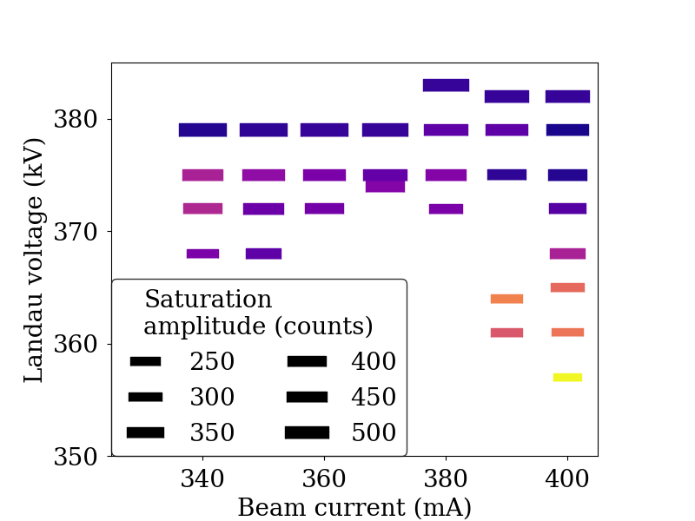
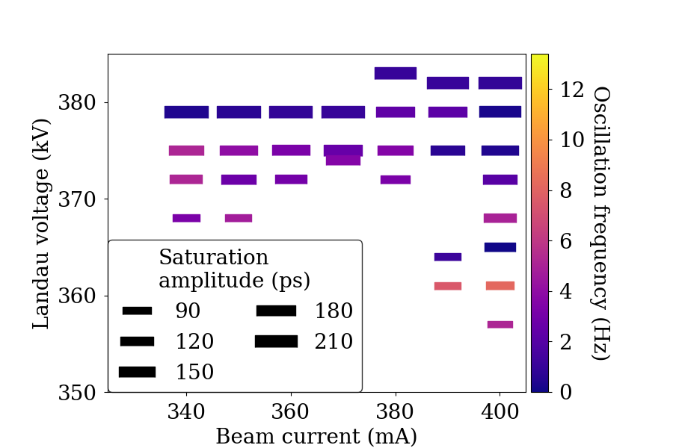
Overstretched Conditions
2 Landau cavities and an RF voltage of 1.13 MV
BBB
Streak camera

Slide 13
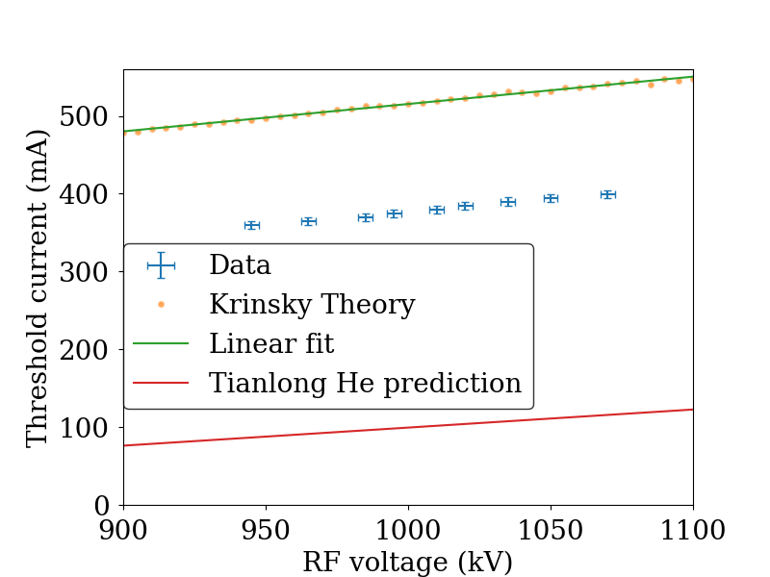
Flat potential conditions
2 Landau cavities, 1.13 MV RF voltage
Notes:
Replace with image without Tianlong He prediction

Slide 14
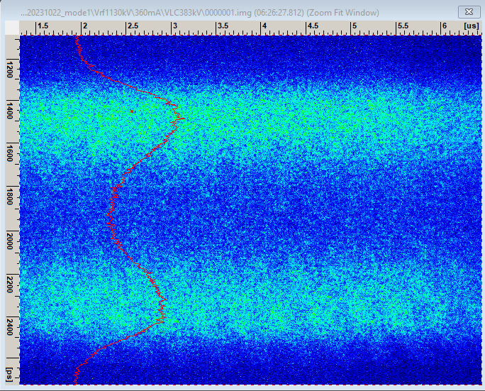
Beyond Mode 1
At a certain Landau voltage, mode 1 goes stable and overstretched bunches are reestablished

Slide 15
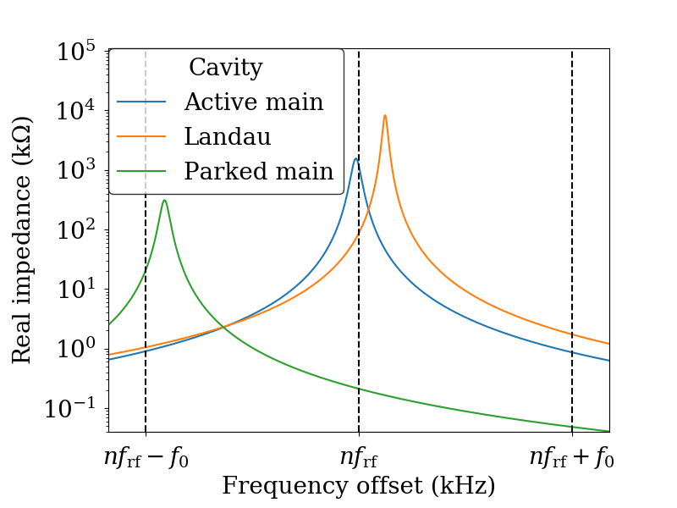
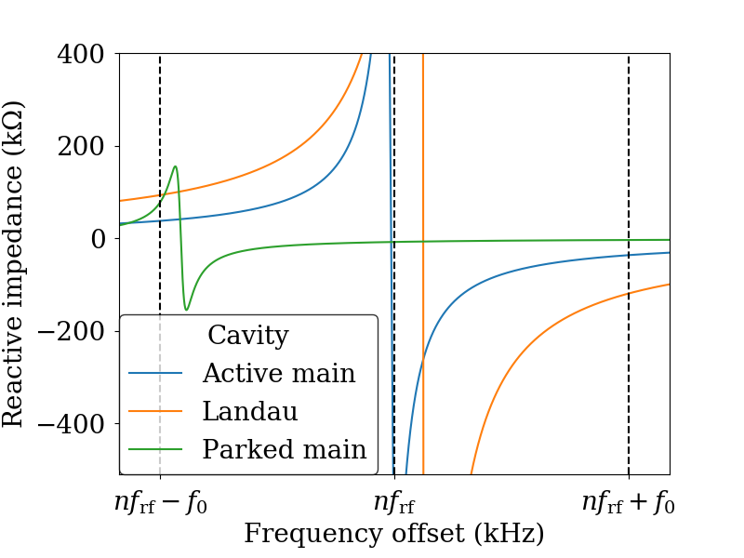
Parked main cavity
3 Landau cavities, flat potential at 200 mA with RF voltage of 1 MV

Slide 16
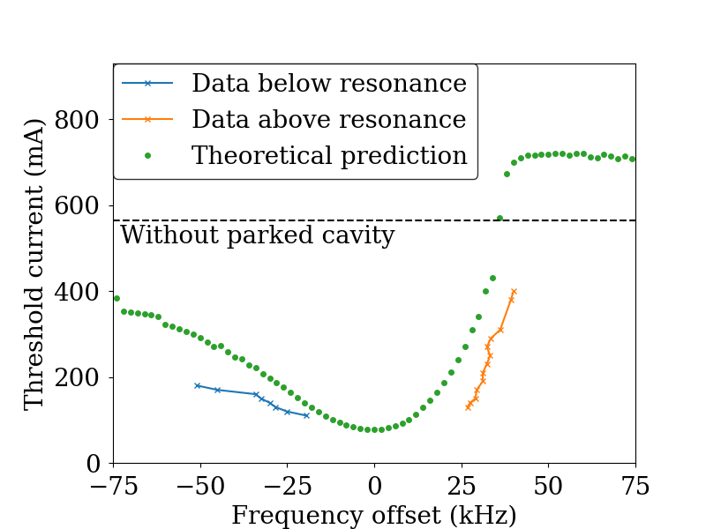
Parked Main Cavity
2 Landau cavities and an RF voltage of 1.13 MV
Can be both helpful and a hindrance

Slide 17
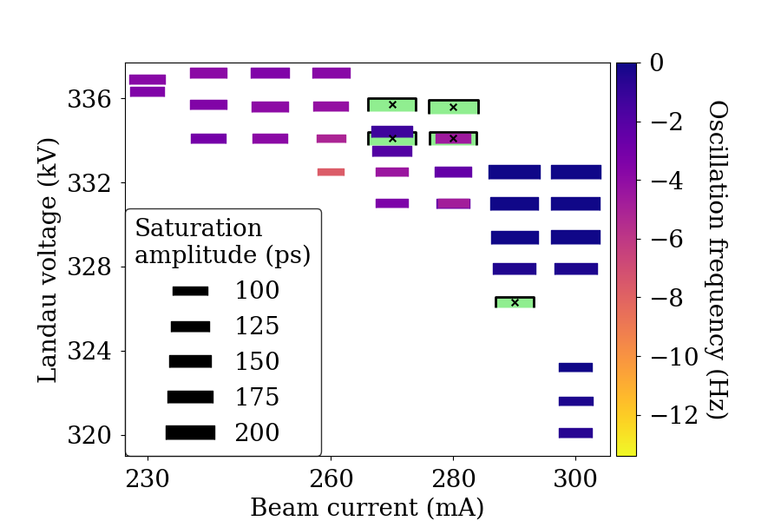
Three Landau Cavities
3 Landau cavities and an RF voltage of 1 MV

Slide 18
Conclusion
Landau cavities are essential in 4th-generation storage rings
Mode 1 stability is an important consideration
Methods that neglect Landau damping are prone to underestimate the threshold current
Extensive measurements of the mode-1 instability have been made at the MAX IV 3 GeV ring

Slide 20
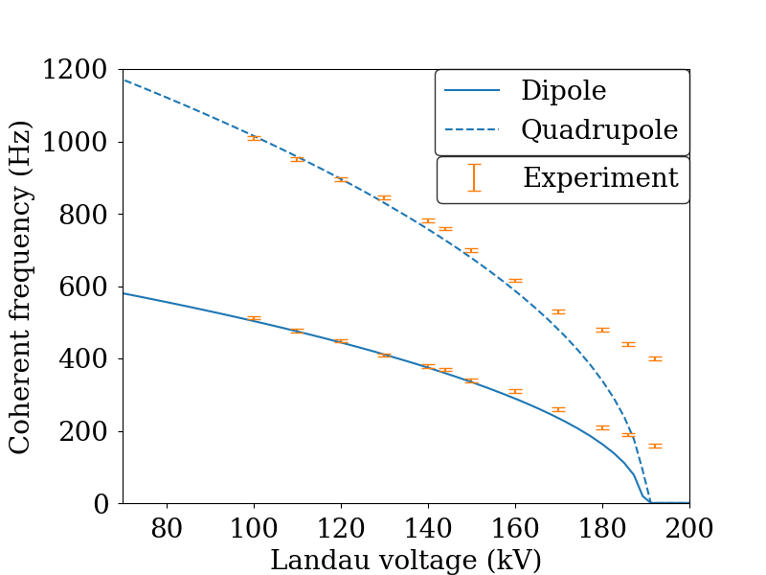
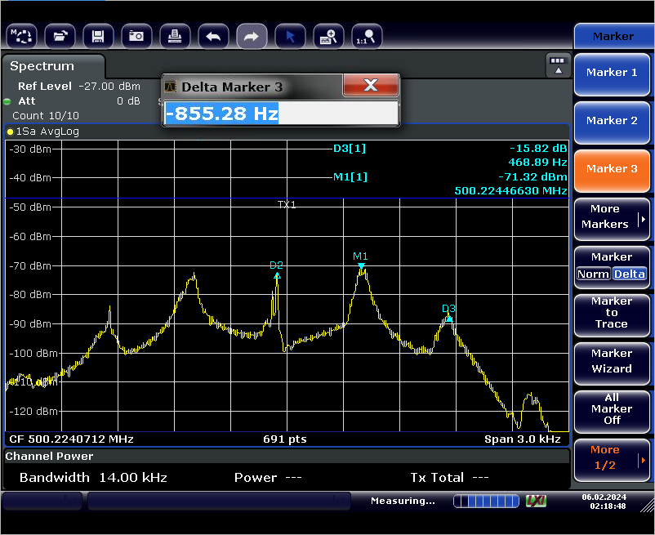
Coherent Frequency (below threshold)
90 mA, 690 kV RF voltage

