Slide 1

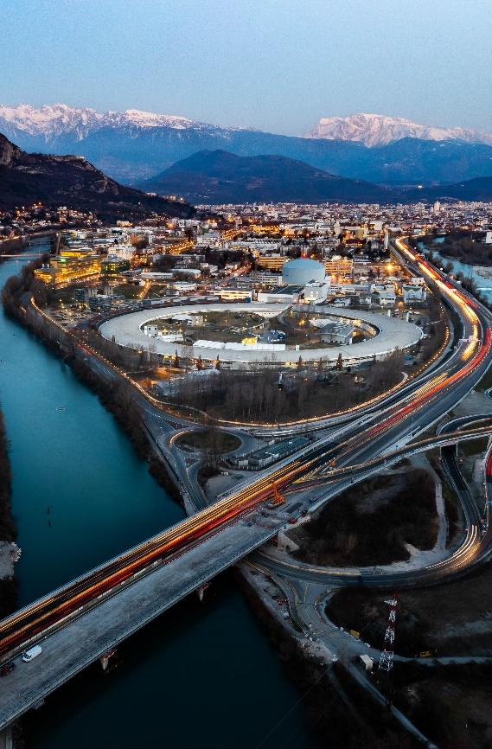
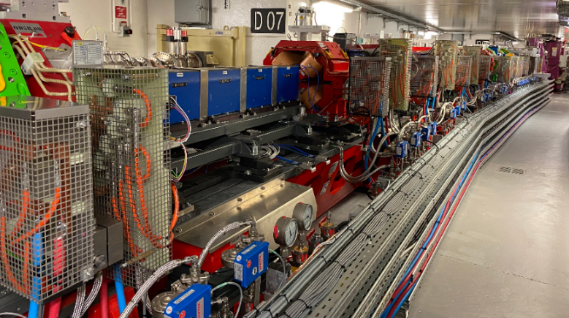

13-16 February 2024
CERN, Geneva
Sustainability and energy efficiency at ESRF
15 February 2023
Jean-Luc Revol

Slide 2
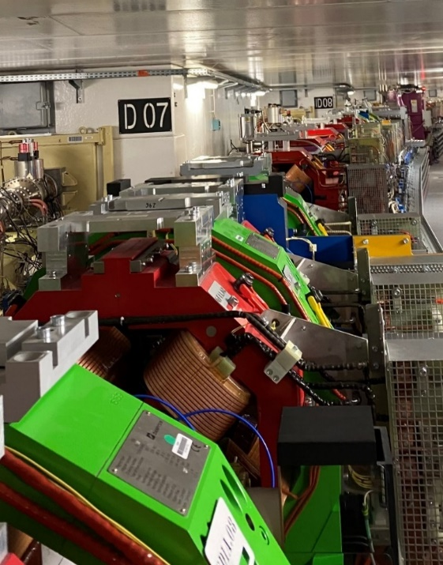

outline
Context
EBS contribution
Overall sustainability
ESSRI workshops
Conclusion and outlooks
ESSRI: Energy for Sustainable Science at Research Infrastructures
ESRF, Grenoble, 29-30 September 2022

Slide 3
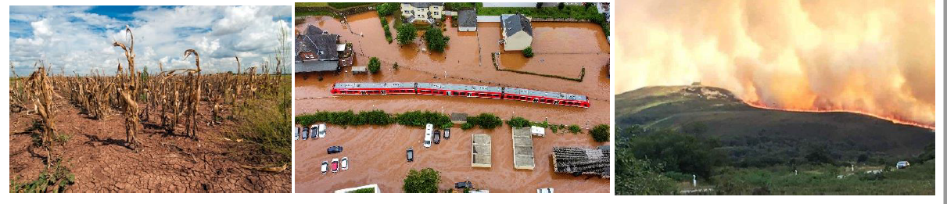
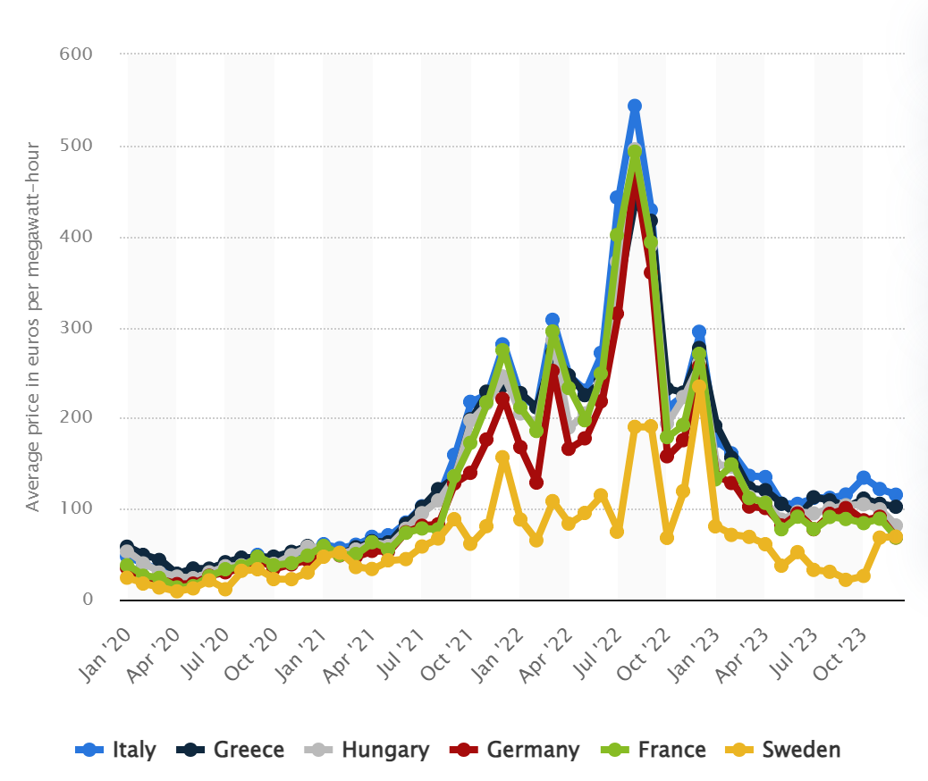
Context
But sustainability in our institutes is mostly limited to energy (and largely electricity) management driven by ……
operational cost reduction!!!
Practical experience of climate change with record temperatures, long drought periods, forest fires, floods
General inflation of energy cost: Covid19, Ukraine invasion, Unpredictable fluctuations on the energy trading exchange,..
➔ High energy prices and crisis often help and not hinder decarbonisation !!
600
500
400
300
200
100
0
Average price in euros per megawatt-hour
Some light sources were obliged to reduce user operation due to energy cost (Soleil, Elettra, Solaris…) .
ESRF was able to maintain the operation schedule for users and development but the energy has a large impact on the budget.
Italy
Germany
France
Sweden
01/20
01/21
01/22
01/23

Slide 4
regulations
Green House gas emission report
01
Periodic report (every 4 years)
Action plan required.
Decret Tertiaire
02
40% Energy consumption reduction for tertiary buildings in 2030.
Reference year to be defined
Energy saving plan
03
French initiative : 10% reduction of energy consumption in 2024 (base : 2019).
Loi Climat et Resilience
04
Car parks solar panels
Minimum 50% of parking places covered by solar panels.
EU climate law : FIT 55
05
European regulation. 47% reduction on Green House gas emissions in 2030 (base 2005)

Slide 5
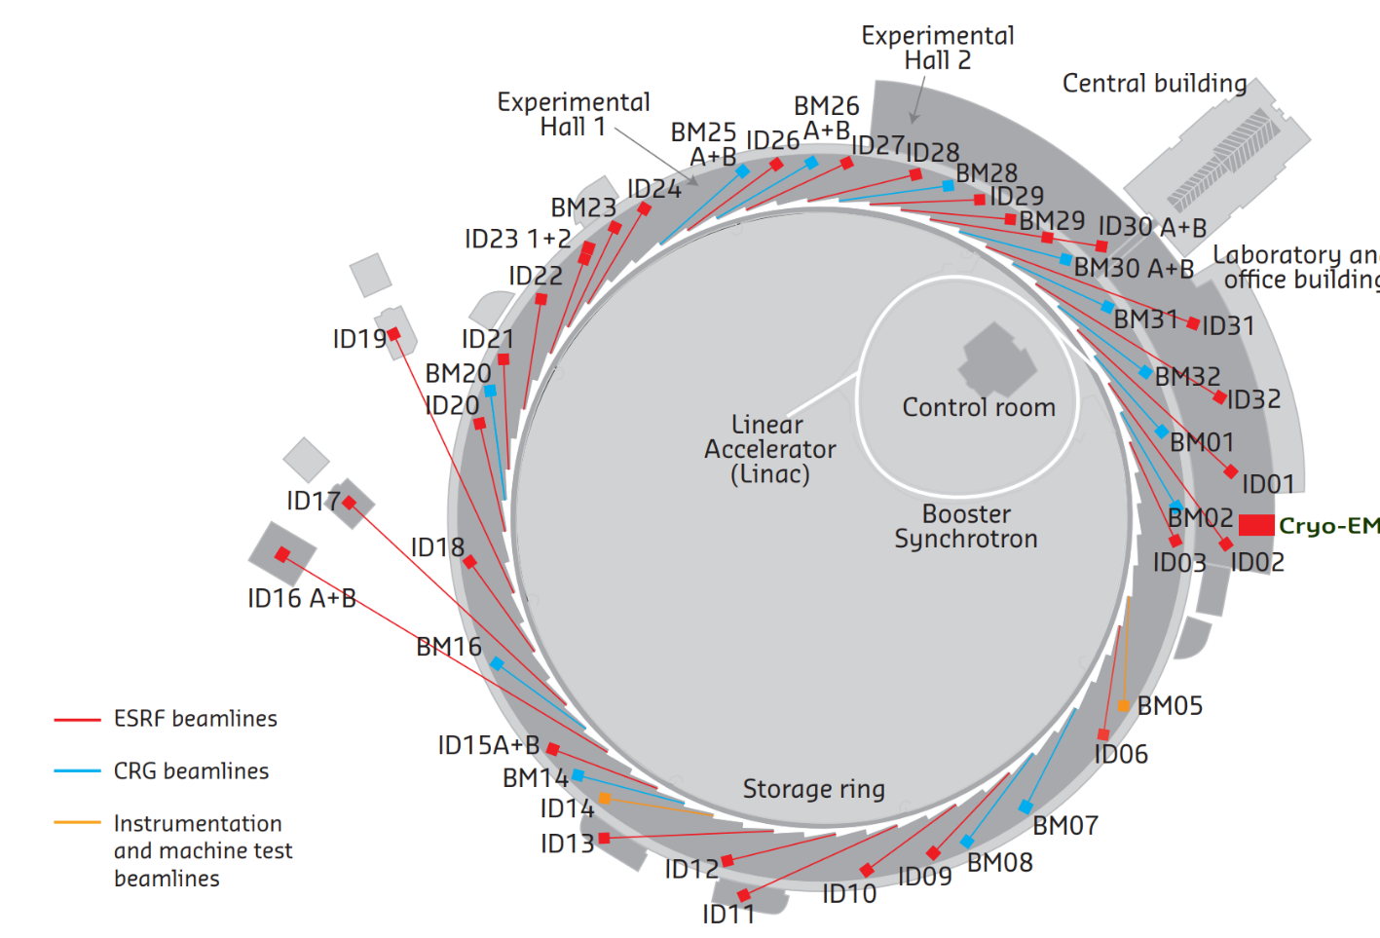
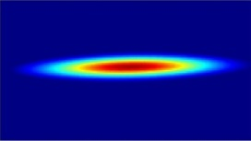

The ESRF: fact and figures
Light source in operation since 1994, Grenoble, France
22 partner nations
Budget: 115 million euros, Staff: 700 people
5500 hours of beam delivery
1500 experimental sessions
49 beamlines
Upgrade programme 2009-2023 (2 phases):
  New beamlines
  Renew infrastructures and support facilities
  New storage ring source (EBS)
E- Linac
200 MeV
Booster synchrotron
300m, 4Hz
The Extremely Brilliant Source (EBS) 2015-2020:
Decrease the horizontal emittance
Increase the source brilliance
Increase the source coherence
Keep as much as possible of the infrastructure
Minimize operation costs, particularly wall-plug power
Storage Ring
6 GeV, 200 mA
844 m, 32 cells
4000 pm.rad
133 pm.rad

Slide 6
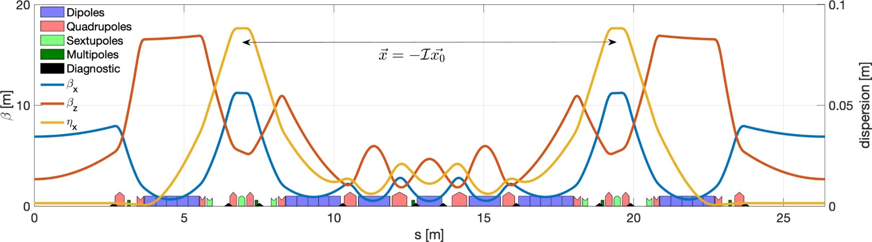
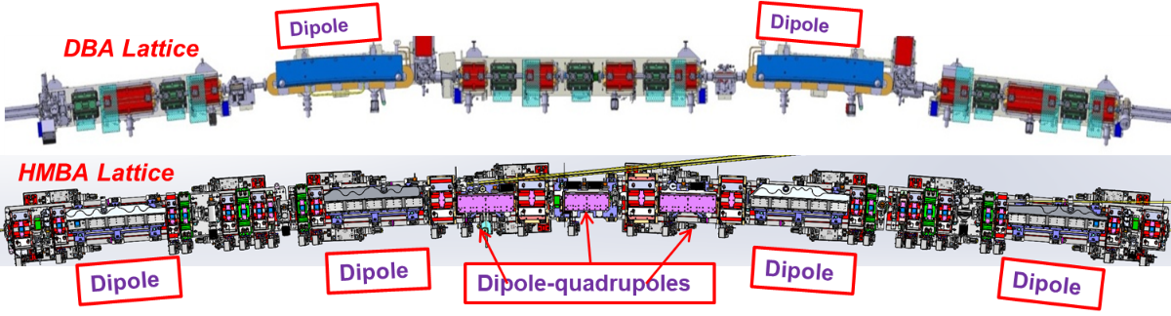
EBS upgrade lattice
Dipoles-quadrupoles
PM
PM
PM
PM
Dipole
Dipole
Dipole
Dipole
 | Units | ESRF | ESRF-EBS
Energy | GeV | 6 | 6
Circumference | m | 844.4 | 844
Lattice |  | DBA | HMBA
Current | mA | 200 | 200
Lifetime | h | 50 | 25
Emittance H | pm.rad | 4000 | 133
Emittance V | pm.rad | 4 | 10*
31 magnets per cell instead of 17
Free space between magnets (for one cell): 3.4m instead of 8m

Slide 7
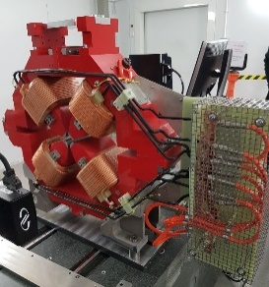
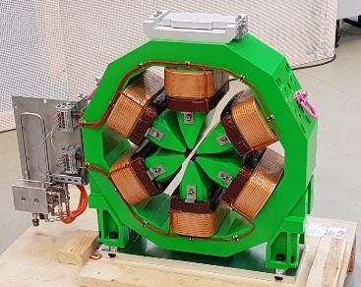
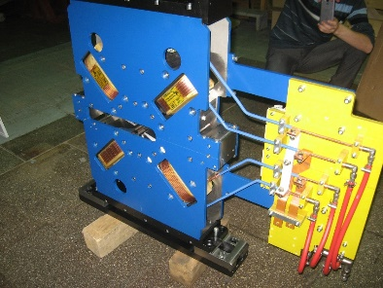
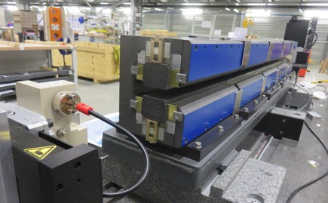
magnets optimization
Space limitation, Wall plug power, Performance, Procurement, Installation, Operation
Resistive magnets
Permanent magnets
Copper cross section adapted for reasonable current density
~ 3 A/ mm² @ nominal working point
Primarily for fixed field magnets
➔ Dipoles
Wall plug power=0
Affordable technology (and cost)
Experience with insertion device construction
High & Moderate Gradient Quadrupoles
Sextupoles
Octupoles
Sm₂C0₁₇,
➔ Also for septa
(Some) tunability and flexibility should be maintained for the lattice.

Slide 8
Power and energy consumptionfor the magnets
ESRF : | 2018 | EBS
Dipoles (D) | 720 kW | 0
Correctors and Steerers | 10 kW | 11 kW
Other magnets | 1625 kW | 1059 kW
Dipole-quadrupoles (DQ) |  | 16%
High gradient quadrupoles (HGQ) |  | 29%
Moderate gradient quadrupoles (MGQ) |  | 44 %
Sextupoles (S) |  | 10%
Octupoles (O) |  | 1%
Total | 2355 kW | 1070 kW
Energy for one year operation ( 7200 H: USM+MDT) | 16.9 GWh | 7.7 GWh
Very positive experience with Permanent Accelerator Magnet for EBS:
Works as expected, passive devices in the storage ring, no maintenance
… and no cabling, no power supply, no cooling, no vibration, easier installation and better operational reliability
Very good stability vs temperature, based on passive compensation
Electrical power required for the EBS magnets ➔ half that of the previous lattice
DQs and HGQs could be permanent magnets (no tuning required), 476 kW additional saving
Storage Ring
Total electrical power:
6350 kW [2018]
4100 kW [EBS]
Permanent magnet is convincing for operation,…but the overall sustainability is less obvious considering the extraction and production issues

Slide 9
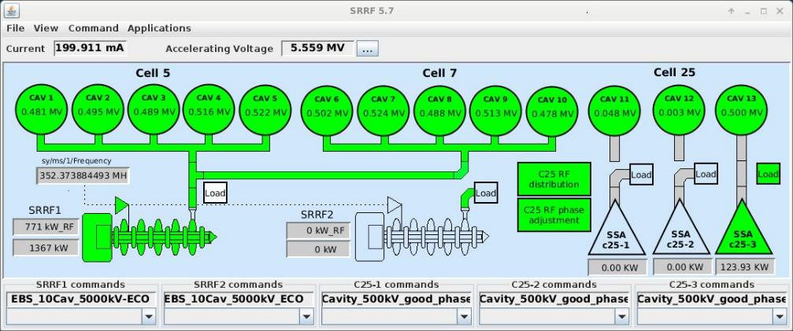
radio-frequency consumption
EBS_RF configuration
Storage Ring Total power:
1300 kW RF [2018], Radiation loss 4.88 MeV/turn+ 0.5 (ID)
5 Five 5-cell, 2 single-cell cavities
9 MV total voltage
900 kW RF [EBS], Radiation loss 2.5 MeV/turn + 0.5 (ID) 13 single-cell cavities
5.5 MV total voltage
Efficiency AC ➔ RF:
Klystron: 53%
Present SSA: 47%
New SSA (to replace Klystron): 59%
ECO mode (applied since October 2022): Reduction of total accelerating voltage from 6.0 to 5.5 MV
And Increase AC to RF conversion efficiency:
  150 kW SSA operated way below nominal power,
  at 90 …100 kW, where the efficiency was low.
  Increase the Klystron power by increasing
  Cav 1 to 10 voltage from 4.5 to 5.0 MV
  Operate with only 1 SSA at 0.5 MV
RESULT:
  200 kW AC power savings
  at 200 mA
  Same beam lifetime
  for typical ID losses
  500 kW total savings possible
  if operation at 100 mA
Storage Ring
Total electrical power:
6350 kW [2018]
4100 kW [EBS]

Slide 10
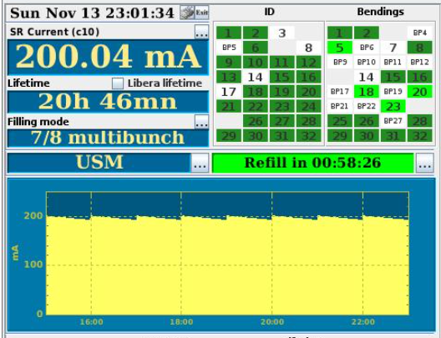
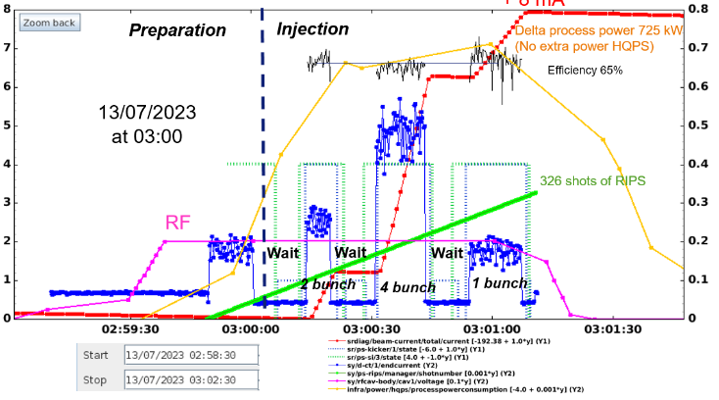
lifetime, injection efficiency and injector usage
EBS parameters:
Beam lifetime larger than 20 hours
Injection efficiency in the order of 70%
Top-up every 1 hour
Typical injection in 2022:
725 kW for the injector during 2 mn. every 1 hour
(45s for preparation, 70s for injection with only 32s beam on)
                ➔ 25 kWh
During machine development time, optimisation of the programme and guidelines is imposed for the usage of the injector.

Slide 11
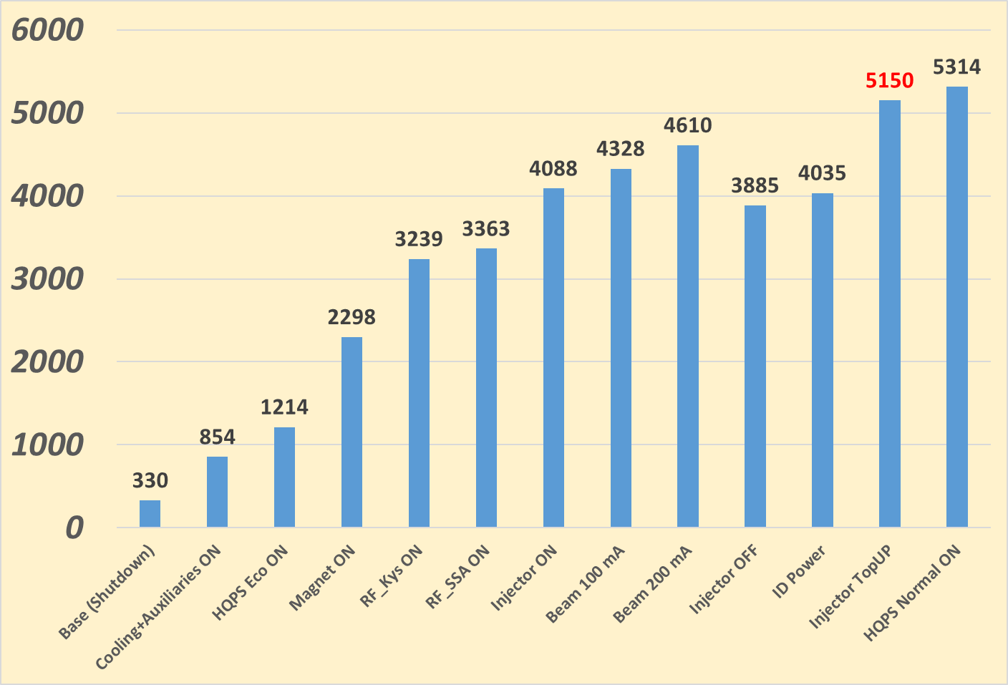
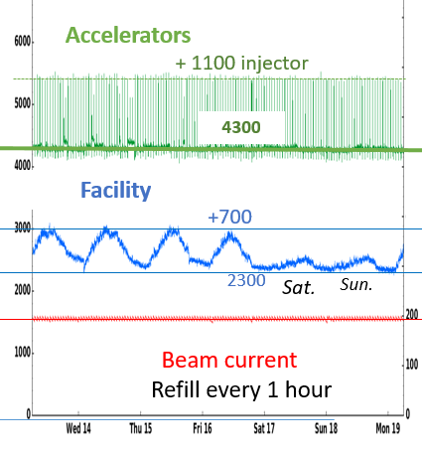
typical power consumption
854 kW Base with cooling and auxiliaries ON
Base Power in shutdown: 330 kW
360 kW HQPS consumption mode ECO:
(with transient up to 800 kW when SYRF switched ON )
In normal mode 510 kW (transient 731 kW).
2149 kW Power consumption of the storage ring
without beam:
(Magnets: 1084 kW
RF: Klystron: 941 kW SSA: 124 kW)
522 kW Beam power at 200 mA
150 kW ID power (90 kW average)
-------------
4035 kW Total for the storage ring
+725 kW Injector consumption (RF : 176 kW ; Magnets: 560 kW)
4100
One week operation:
Total electricity consumption of the institute:
4100 kW for the SR at 200 mA
+ 725 kW every hour for 2 mn for injection (1100 max with transient)
+ 2300 kW base facility consumption for labs, office, Experiments,…
+ 700 kW facility fluctuation for staff activity

Slide 12
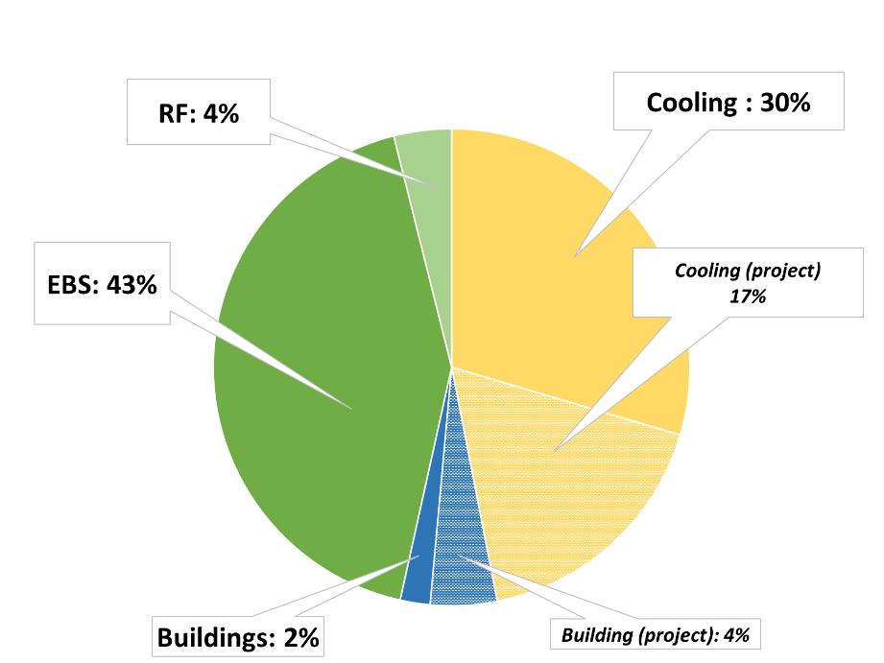
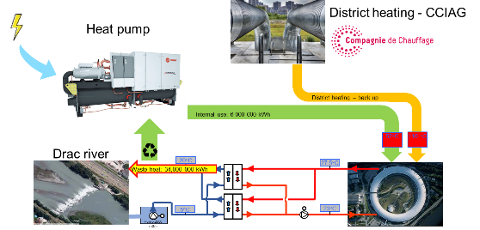
Energy management for the whole institute
Today:
Electricity consumption: 50 GWh / year
Heating consumption: 7.1 GWh / year
(District heating network)
Cooling: DRAC River
(free cooling)
Total energy savings :
25 GWh done
6.1 GWh in project
Buildings: LED lightning, insulation,…
Cooling: Pumping system, regulations, refrigerators, heating pump..
Accelerators: EBS, RF
Next:
Heat recovery from cooling which should provide
93 % of the experimental-hall heating
Installation of solar panels
Guest house wall insulation
Data centers consumption (3.5% today) will increase in the years to come (heat recovery)
Total savings
EBS: 12 GWh of electricity saving

Slide 13
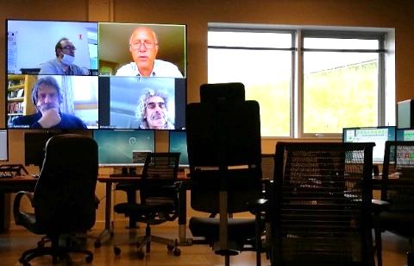
The esrf : sustainability with a reduction of travels
Full remote access possibilities for users to reduce travel
 | Number of experiments
Year | Total | Onsite | Hybrid | Remote
2018 | 2831 | 2285 | 91 (3%) | 455 (16%) | Prior EBS
2019 |  |  |  |  | Shutdown
2020 |  |  |  |  | COVID
2021 |  |  |  |  | COVID
2022 | 2295 | 1276 | 245 (11%) | 774 (34%) | EBS
Well adapted to repetitive experiments and automated beamlines (macromolecular crystallography, commercial clients..)
Hybrid access is favoured with the presence of experts on site to support the local scientists
Full remote access possibilities to the accelerators to support machine studies and for interventions
(expended since COVID pandemic but will be re-discussed due to cybersecurity)
Incitation to a reduction of the staff professional trips and the use of remote meetings

Slide 14
Conclusion for the ESRF
The use of permanent magnets for accelerator design proved to be efficient and reliable
The EBS upgrade allowed a drastic reduction of the electricity consumption and this associated to an increase of performance
Significant effort have been done on the reduction of energy consumption on the infrastructure
All the efforts vanished by the drastic increase of the energy cost, nevertheless it allowed the continuation of a normal operation program
Sustainability should not be limited to energy management, significant efforts have also been done on the user side and an action plan have been initiated for a more sustainable procurement
Life cycle is an important issue for facility upgrades (ESRF old machine was “only” treated as waste with some income)

Slide 15

Overview of sustainability for light sources
Scope 3
Specification and project design
Procurement
Travel Users
Scope 2
Subcontractors
Heating
Cooling
Travel Staff
Scope 1
Waste management
Electricity supply
Helium
Nitrogen
Daily travel to work
Telework..
Recyclability
Energy consumption reduction
Consumption monitoring
Good practice
Sustainable actions
Light sources are not the largest energy consumers but the
economical and societal aspects are today key concern for us

Slide 16
General Conclusion
The analysis of the situation is clear
Means and tools
are there
What should be next ?
Act on the climate change
Think sustainable
React to the increased energy cost
Reduce and adapt the energy consumption
Have a broader vision of the situation
Technology
(or almost there)
Methodology and tools
(or almost there)
Investment is often associated to an increase of performance
Funding from national or international agencies for efficiency and sustainability (or emerging)
Conduct new projects and new designs with efficiency and sustainability as primary specifications
Enhance flexibility in the technical, operational, experimental and human behaviour and actions
Measure the “scientific productivity” as a function of the energy consumption and the sustainability
Define sustainability metrics for field of activity

Slide 17

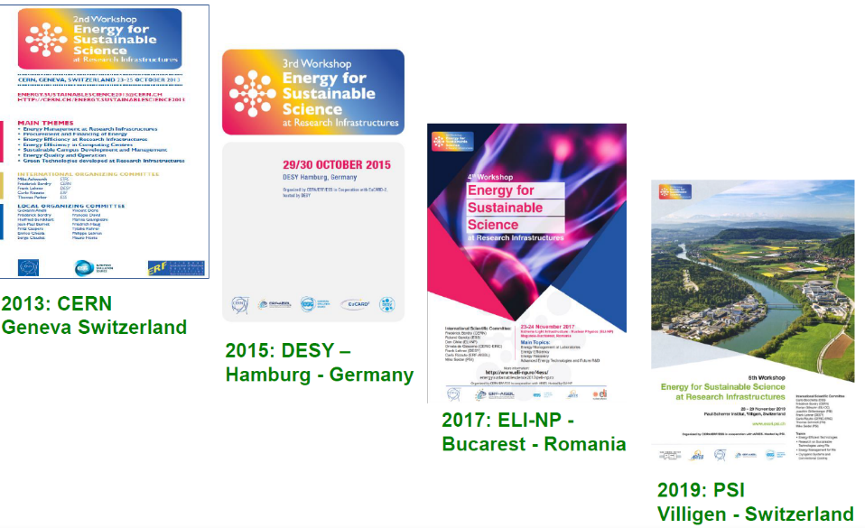
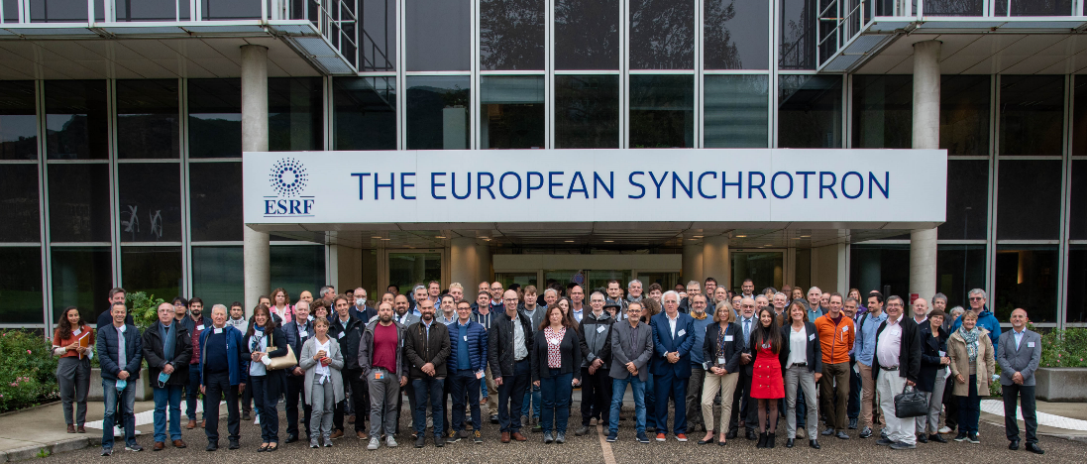
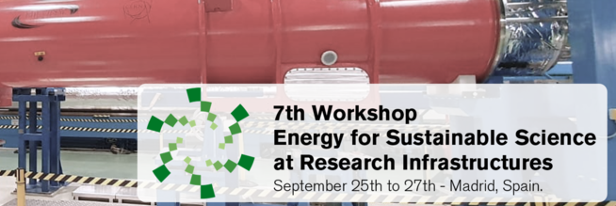
ESSRI Workshop series
The 6th ESSRI workshop in a series and was held at ESRF in Grenoble in September 2022 at the ESRF.
Main themes:
  Energy management at research infrastructures and resulting experience
  Sustainability of equipment, materials and resources
  Energy-efficient technologies
2011: ESS
Lund - Sweden
100 participants,
(a few more participants following the workshop remotely)
2024
Madrid
International Committee
29 September 2022

Slide 18
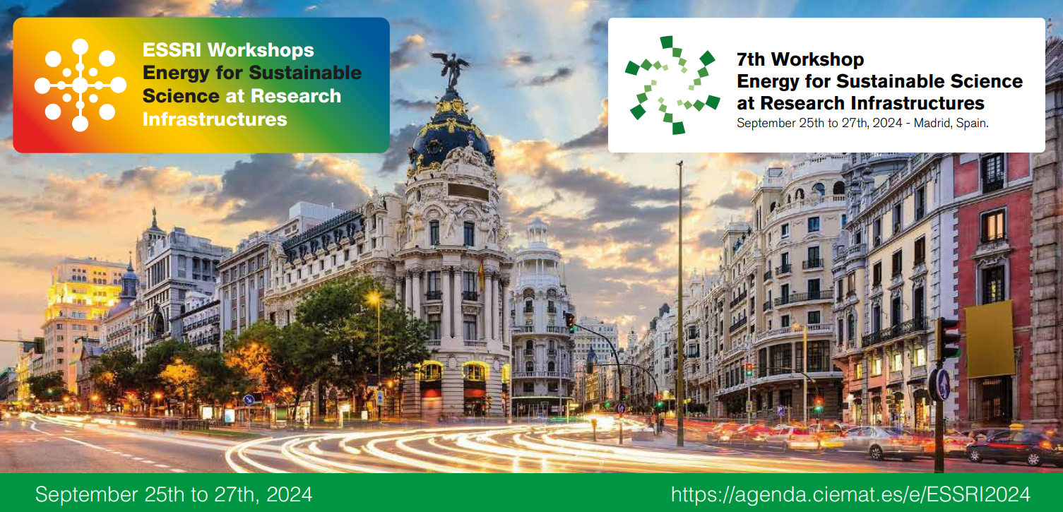
Many thanks for your attention

