Slide 1


An Integrated Beam Physics Simulation Framework
G. Iadarola, R. De Maria, S. Łopaciuk,
A. Abramov, X. Buffat, D. Demetriadou, L. Deniau, P. Hermes, P. Kicsiny, P. Kruyt, A. Latina,
L. Mether, K. Paraschou, G. Sterbini, F. Van Der Veken, CERN, Geneva, Switzerland
P. Belanger, TRIUMF, Vancouver, Canada
D. Di Croce, T. Pieloni, L. Van Riesen-Haupt, M. Seidel, EPFL, Lausanne, Switzerland
P. Niedermayer, GSI, Darmstadt, Germany
Work supported by:
https://xsuite.web.cern.ch

Slide 2
Outline
Introduction
  Motivation
  Design goals and constraints
  Architecture
  Agile development
Lattice modeling, simulation and optimization
  Lattice modeling
  Single-particle tracking
  Dynamic parameter control
  Multi-objective optimizer
Simulation of specific processes
  Particle-matter interaction
  Synchrotron radiation
  Handling of collective effects
  Space-charge
  Beam-beam
  Electron clouds
Final remarks

Slide 3
Outline
Introduction
  Motivation
  Design goals and constraints
  Architecture
  Agile development
Lattice modeling, simulation and optimization
  Lattice modeling
  Single-particle tracking
  Dynamic parameter control
  Multi-objective optimizer
Simulation of specific processes
  Particle-matter interaction
  Synchrotron radiation
  Handling of collective effects
  Space-charge
  Beam-beam
  Electron clouds
Final remarks

Slide 4
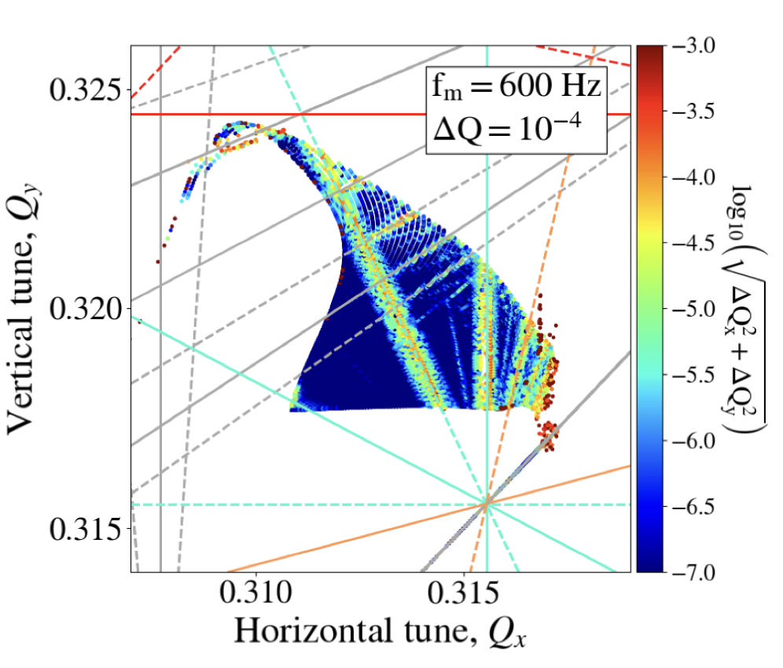
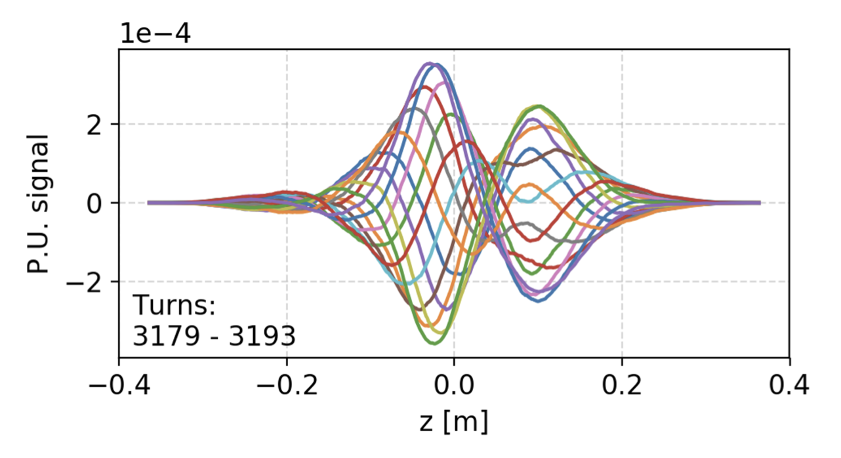
Introduction
CERN has a long tradition in the development of software tools for beam physics
Powerful tools provided to the user community:
MAD-X, standard for lattice description, optics calculation and design, tracking
Sixtrack, a fast-tracking program used mainly for long single-particle simulations
Sixtracklib, a C/C++library for single-particle tracking compatible with Graphics Processing Units (GPUs)
COMBI, for the simulation of beam-beam effects using strong-strong modelling
PyHEADTAIL, a Python toolkit for collective effects (impedance, feedbacks, space charge, and e-cloud).
Developed over decades, providing advanced features in their respective domains
4

Slide 5


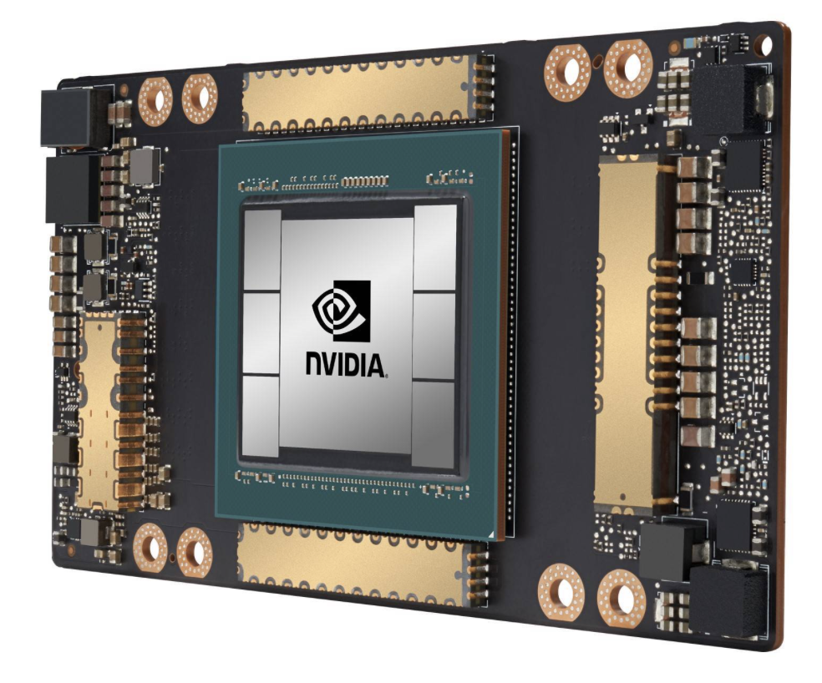
Motivation
Over the years we started to face needs that could not be easily fulfilled with legacy tools:
Integration: difficult to combine features from different codes to simulate complex heterogeneous effects
User interface: need to move away from custom interfaces (text files / ad-hoc scripting) towards standard Python packages
  Present de-facto standard in scientific computing
  Easy to combine in notebooks and or in more complex Python codes
  Allows leveraging an ever-growing arsenal of general-purpose Python libraries (statistics, linear algebra, frequency analysis, optimization, plot, etc.)
    Boosted by substantial investments from general industry (big data, AI)
GPU acceleration: mandatory for several applications but cumbersome to retrofit in the existing codes
5

Slide 6
Xsuite
This led to the launch of the Xsuite project in 2021
Main goal: bring into a modern Python toolkit the know-how built in developing and exploiting MAD, Sixtrack, COMBI, PyHEADTAIL etc.,
Designed for seamless integration among the different components and for extendability
Designed to support different computing platforms, including multicore CPUs and GPUs from different vendors
Design constraints:
Need to cover a large spectrum of phenomena and applications (flexibility!)
Need developer learning curve to be short as possible
  Features developed directly by field experts
Need to grow the code in a “sustainable” way, being managed and maintained by a small core team experts integrating (in a clean way!) contributions by a wide developer community
6

Slide 7


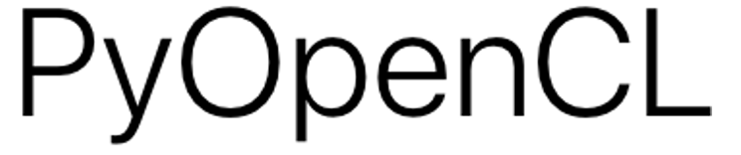



Xsuite – architecture
Xpart
generation of particles distributions
Xtrack
single particle
tracking engine
Xfields
computation of EM fields from particle ensembles
Xdeps
Dependency manager,
deferred expressions
Physics modules
Xcoll
Particle-matter interaction and collimation
Xobjects
interface to different computing plaforms
(CPUs and GPUs of different vendors)
Lower level libraries
(external, open source)
Hardware

Slide 8
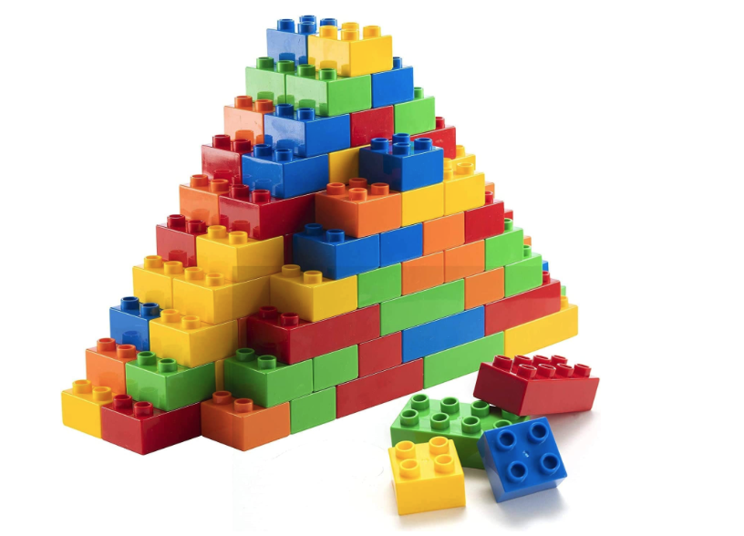
Orthogonal design
Project employs an “orthogonal” design strategy:
Ensure that each functional block remains well-isolated and interacts with the others through clearly defined interfaces
This approach has two key advantages:
  Enables contributors to modify or expand specific components without full knowledge of other parts nor of underlying software infrastructure
  Minimize codebase complexity, ensuring that it increases linearly rather than exponentially as new features are added
8

Slide 9
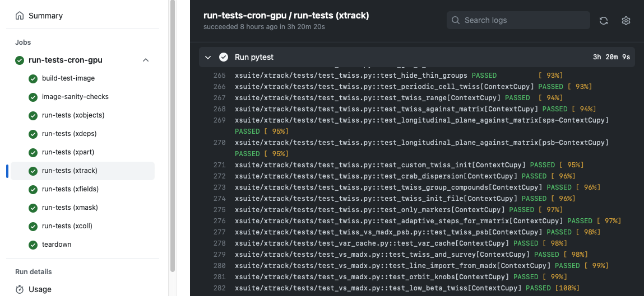
Agile development
Our development follows the agile principles:
Since early states we engaged with the user community, encouraging and supporting users to test and exploit available features in full-scale studies
Code evolves incrementally, promptly applying needed fixes and improvements
Rely on fast release cycle (new versions released multiple times per month) while ensuring no disruption due to version changes on the user’s side.
Made possible by large investment automatic testing: each version of Xsuite undergoing over a thousand automatic checks (on CPU and GPU)
9

Slide 10
Outline
Introduction
  Motivation
  Design goals and constraints
  Architecture
  Agile development
Lattice modeling, simulation and optimization
  Lattice modeling
  Single-particle tracking
  Dynamic parameter control
  Multi-objective optimizer
Simulation of specific processes
  Particle-matter interaction
  Synchrotron radiation
  Handling of collective effects
  Space-charge
  Beam-beam
  Electron clouds
Final remarks

Slide 11
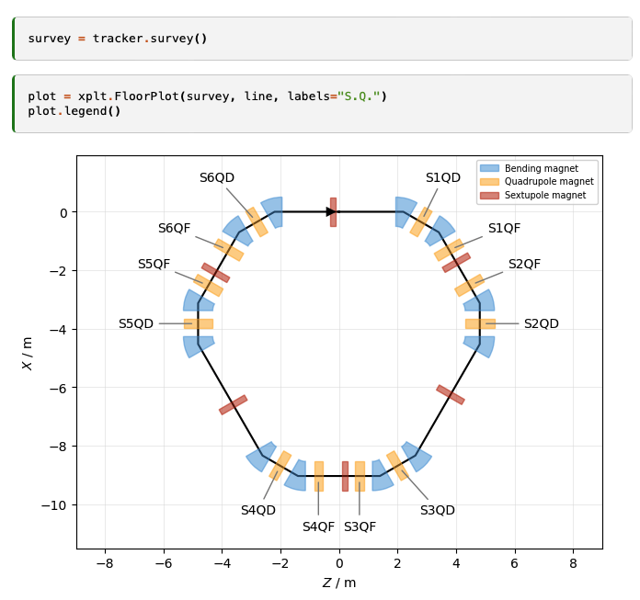
Lattice modelling
Xsuite model of a ring
(represented with the Xplt package)
The beam line is represented as a sequence of Python objects, each corresponding to an accelerator element or to other physical processes (e.g. magnets, cavities, aperture restrictions, etc.).
  Can be defined manually or imported from MAD-X
  Including tilts, misalignments and multipolar errors
We provide:
“Thin” lattice integration, largely based on the Sixtrack and Sixtracklib experience
“Thick” maps for bending and quadrupole magnets are also available:
  For bends, we provide a “full” map (appropriate for small rings), and an “expanded” map (for large rings and small bending angles).
Dipole edge effects including fringe fields can be modeled either in their linearized form or as full non-linear maps (same fringe model as in MAD-NG and PTC).
11

Slide 12
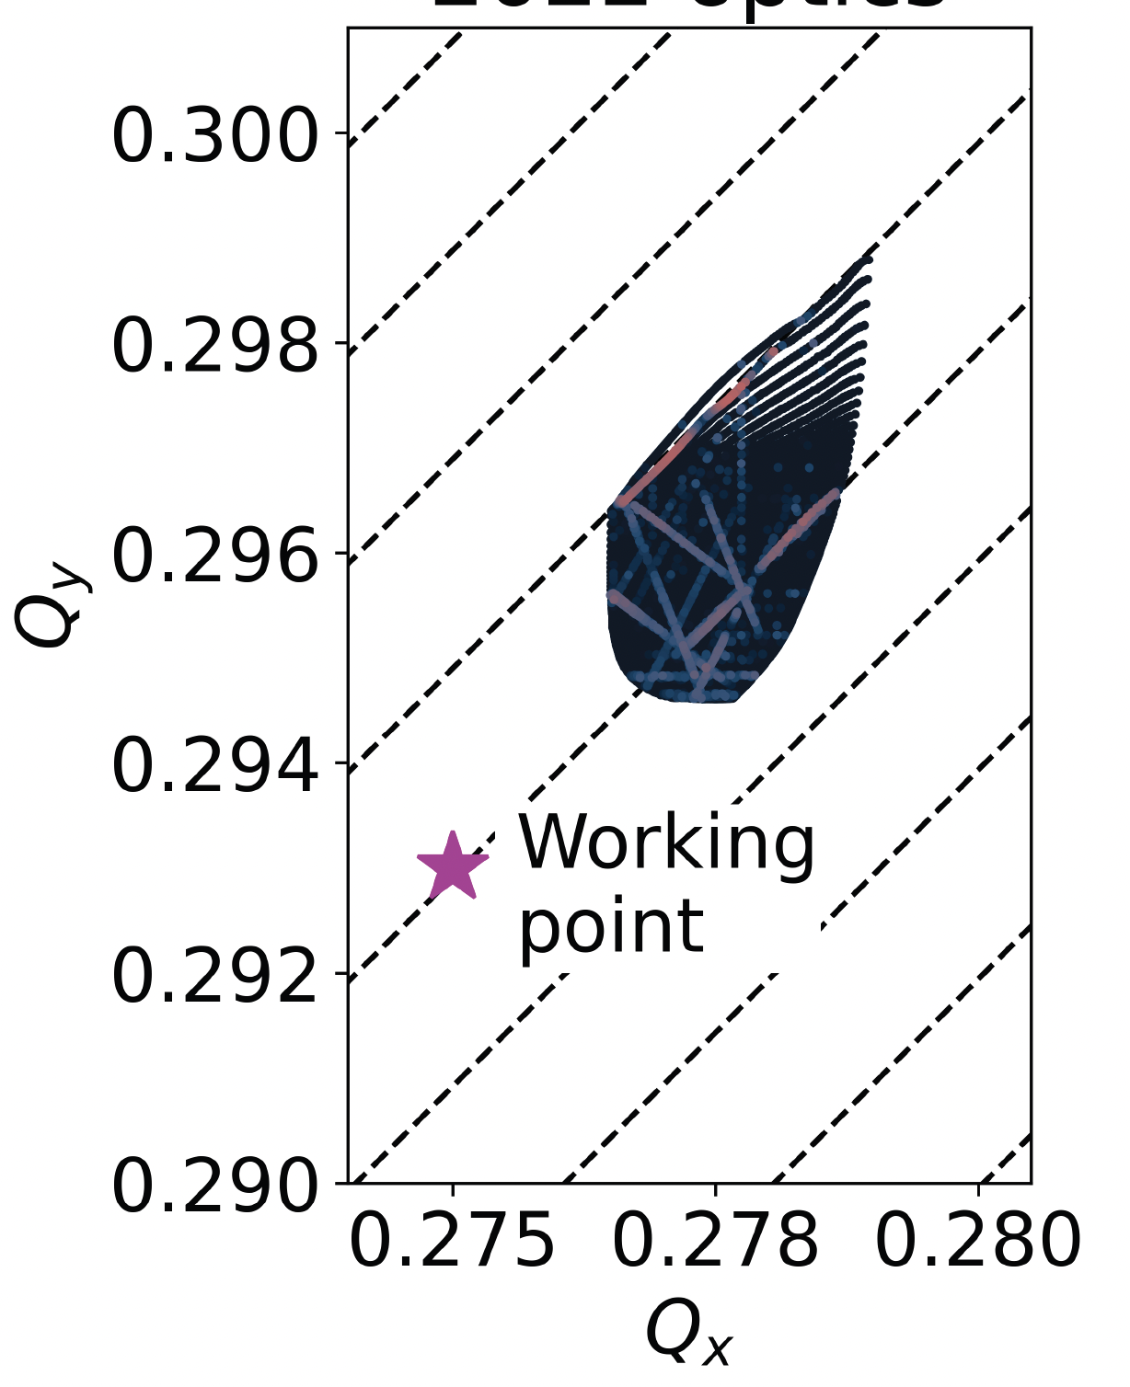
Single particle tracking
To speed up tracking simulations, Xsuite assembles and compiles a C kernel (callable from Python) optimized for the given beamline and specialized for the chosen platform (CPU or GPU)
  The tra cking speed is found to be similar to Sixtrack for single-core CPU and about two orders of magnitudes faster than that on high-end GPUs
  Developments are well advanced to deploy Xsuite on the LHC@Home volunteer computing platform
FMA produced with Xsuite
Tracking time for a typical LHC simulation
Platform | Computing time
CPU (single core) | 190 (μs/part./turn)
GPU (NVIDIA V100, cupy) | 0.80 (μs/part./turn)
GPU (NVIDIA V100 pyopencl) | 0.85 (μs/part./turn)
12

Slide 13
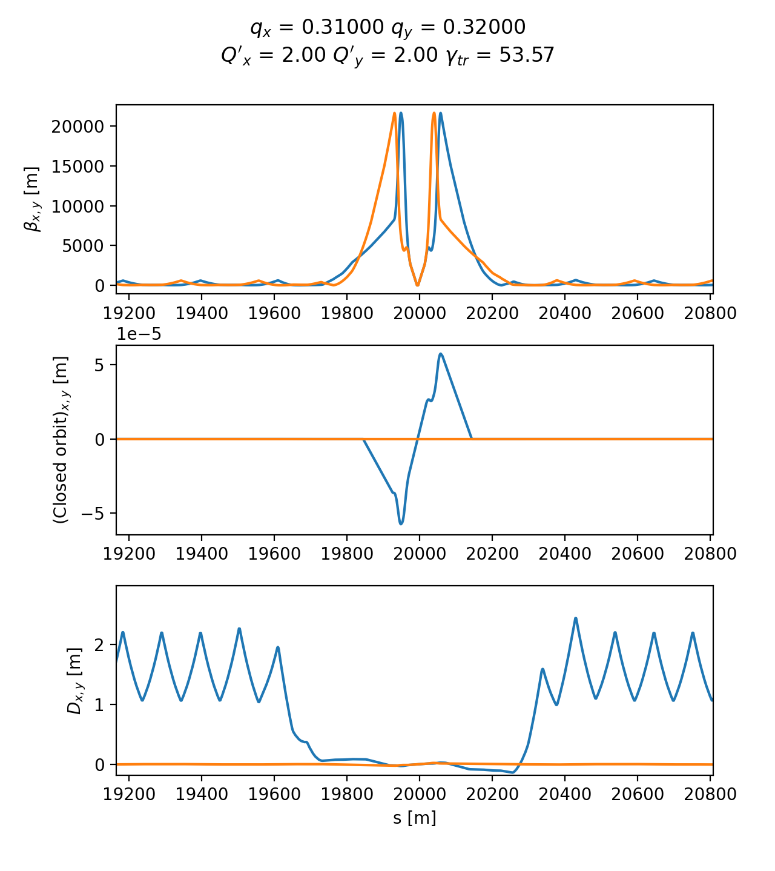
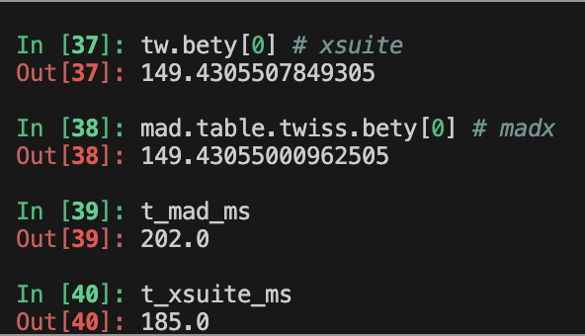
Twiss module
The Xsuite Twiss module can be used to extract lattice functions of a ring or a beamline
The calculation probes the lattice simply by tracking particles:
  Closed orbit obtained by applying a Python root finder on the tracking
  The Jacobian matrix obtained by tracking (central differences)
  Compute “Linear Normal Form” of the Jacobian matrix (diagonalization)
  Propagate eigenvectors by tracking
  Obtain from the eigenvectors Twiss parameters (𝛼, 𝛽, 𝛾) , dispersion functions, phase advances, coupling coefficients
Computation can be done with assigned beam momentum to get off-momentum beta-beating, non-linear chromaticity etc.
HL-LHC optics
Accuracy compared to MAD-X: Δβ / β << 10⁻⁴
Computation time is very similar
13
Example
13

Slide 14
Twiss module
Computation of Twiss parameters based on the tracking has two main advantages:
Any physical model included in the tracking is automatically usable in Twiss
  Without additional development effort
Twiss becomes a powerful diagnostics tool on the built tracking model
  Allows measuring directly on the tracking model tunes, chromaticities, closed orbit, beta functions, etc.
  Can be done effortlessly and without exporting or manipulating the model.
  Used daily to for validating simulation models, catching mistakes, investigating issues
HL-LHC optics
Accuracy compared to MAD-X: Δβ / β << 10⁻⁴
Computation time is very similar
14
Example
14

Slide 15
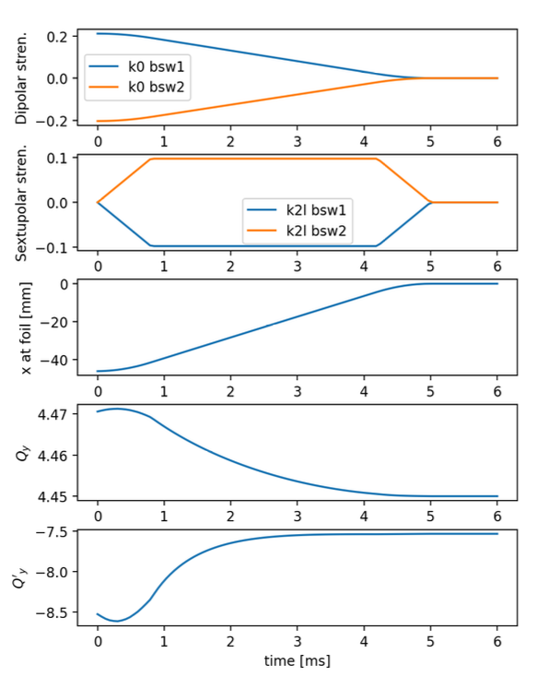
Dynamic control of beam line parameters
Simulation of a fast orbit bump used for the H⁻ injection into the CERN PS Booster
In accelerators often a single high-level parameter can be used to control groups of components with complex dependency relations. (e.g. magnets in series, groups of RF cavities, etc.)
The Xdeps module provides the capability to include such dependencies in the simulation model (as done by MAD-X deferred expressions)
Example, LHC crossing angle knob:
  At any time, the user can set:
lhc.vars[’on_x1’] = 160 # murad
  which automatically changes the strength of 40 dipole correctors to get the required crossing angle
User can also use “Time functions”, i.e. time dependent knobs that are updated automatically during the simulation
15

Slide 16
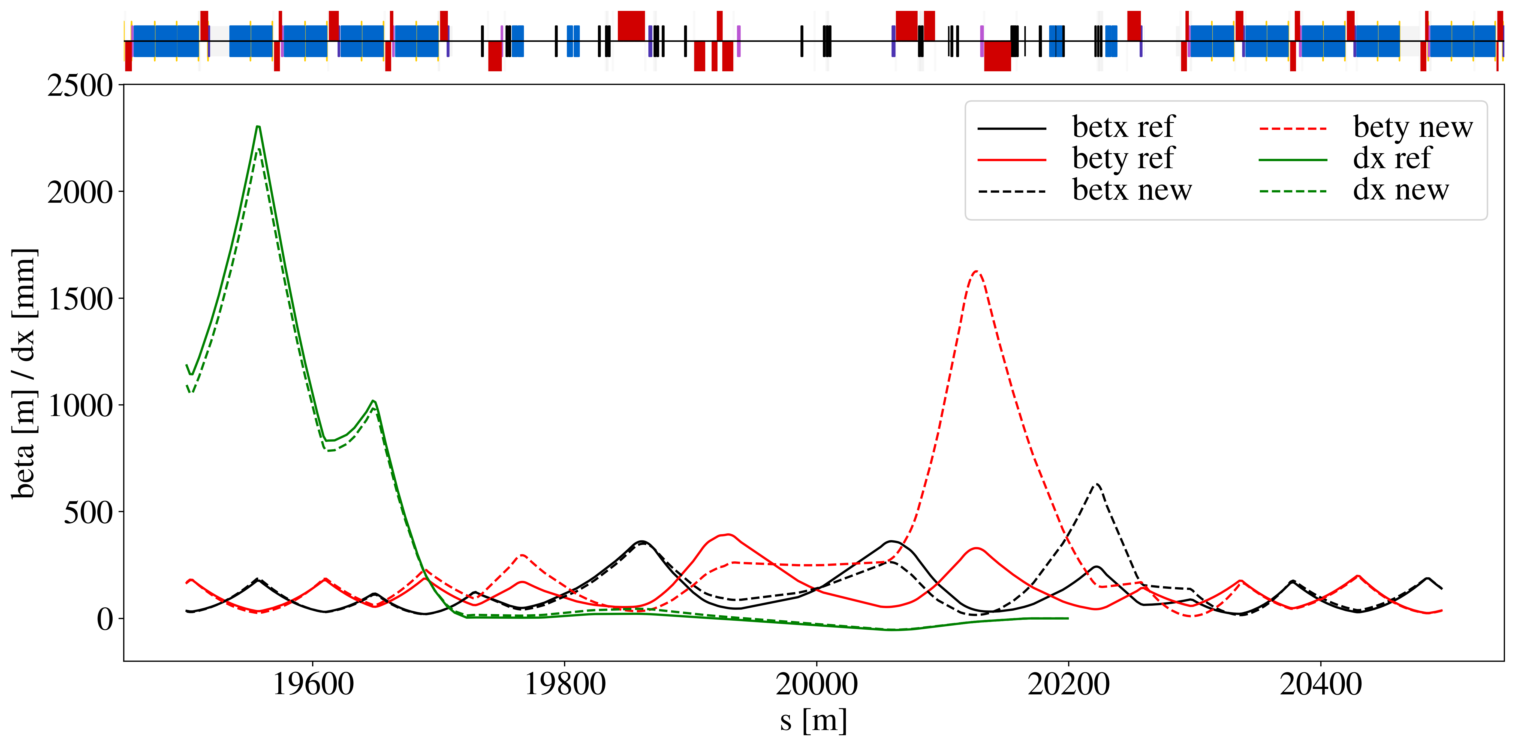
Optimizer
Xsuite provides a multi-objective optimizer to "match" model parameters to assigned constraints (e.g. control tunes, chromaticity, build orbit bumps, modify the optics)
Based on the extensive experience of MAD-X → Uses the same optimization algorithm (Jacobian, proven robustness)
The optimizer can be used to synthesize knobs
Optimizations can involve targets and knobs from multiple beam lines (colliders)
Interface designed for usage flexibility. User can intervene in the optimization by:
  Enabling/disabling targets or knobs
  Rolling back optimization steps
  Changing knob limits, target values, convergence tolerances
Optimized optics for the LHC collimation area (designed with Xsuite)
Used for optics matching of the LHC and of FCC-ee colliders
Proved capability of handling large problems with several constraints and degrees of freedom.
16

Slide 17
Outline
Introduction
  Motivation
  Design goals and constraints
  Architecture
  Agile development
Lattice modeling, simulation and optimization
  Lattice modeling
  Single-particle tracking
  Dynamic parameter control
  Multi-objective optimizer
Simulation of specific processes
  Particle-matter interaction
  Synchrotron radiation
  Handling of collective effects
  Space-charge
  Beam-beam
  Electron clouds
Final remarks

Slide 18
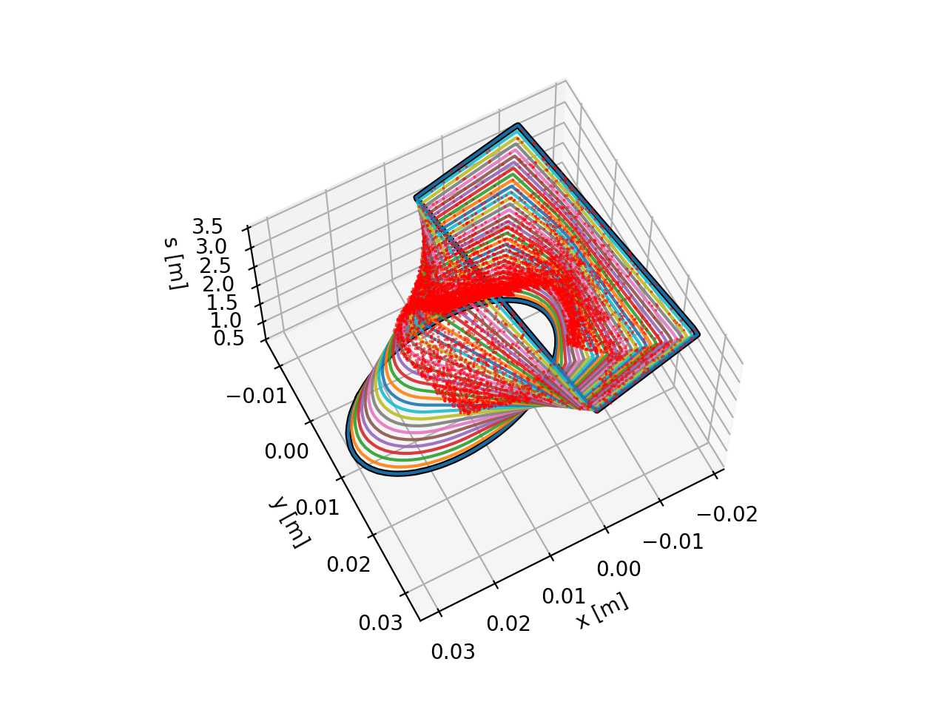
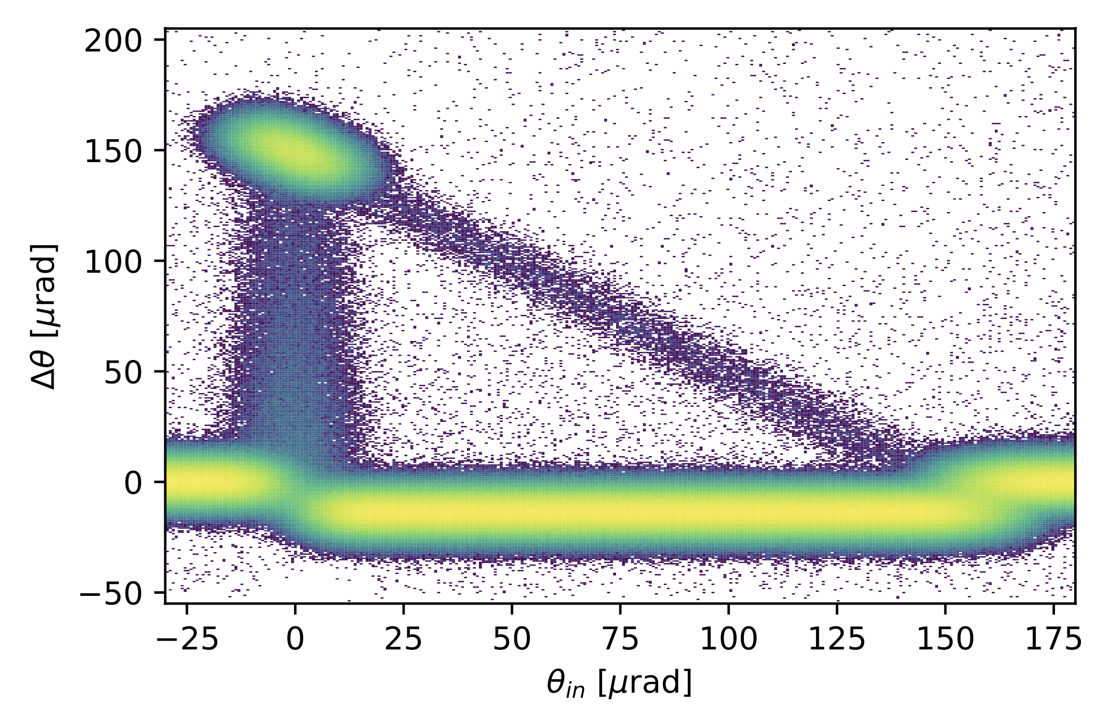
Particle-matter interaction
For collimation studies, the Xcoll module provides three engines to simulate particle-matter interactions:
The “Everest” engine embedded in Xcoll (evolution of K2 module from Sixtrack)
The “Geant 4” engine, based on an interface Xsuite-BDSIM-Geant4
The “FLUKA” engine, based on an interface with the FLUKA Monte Carlo code
To support collimation studies, Xsuite provides:
Tools to automatically install and set collimators in the simulation model
Support for complex aperture modelling and accurate localization of the lost particles along the beam line (typically within 1-10 cm)
Particle deflection from a bent crystal (Everest engine)
Localization of lost particles along a beam pipe with changing cross section
18

Slide 19
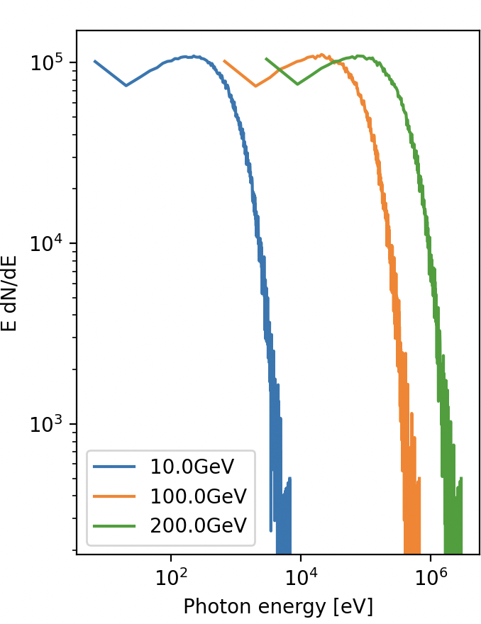
Synchrotron radiation
The effect of synchrotron radiation can be included in Xsuite tracking simulations. Two models available:
The “mean” model, for which the energy loss from the radiation is applied particle by particle without accounting for quantum fluctuations;
The “quantum” model for which the actual photon emission is simulated⁽¹⁾.
Photon energy spectrum
Plots courtesy Leon Van Riesen-Haupt, EPFL
⁽¹⁾ Based on H. Burkhardt, “Monte Carlo generator for synchrotron radiation”, 1990. Implementation ported from PLACET (A. Latina)
⁽²⁾ E. Forest, From tracking code to analysis: generalised Courant-Snyder theory for any accelerator model. Springer, 2016
19

Slide 20
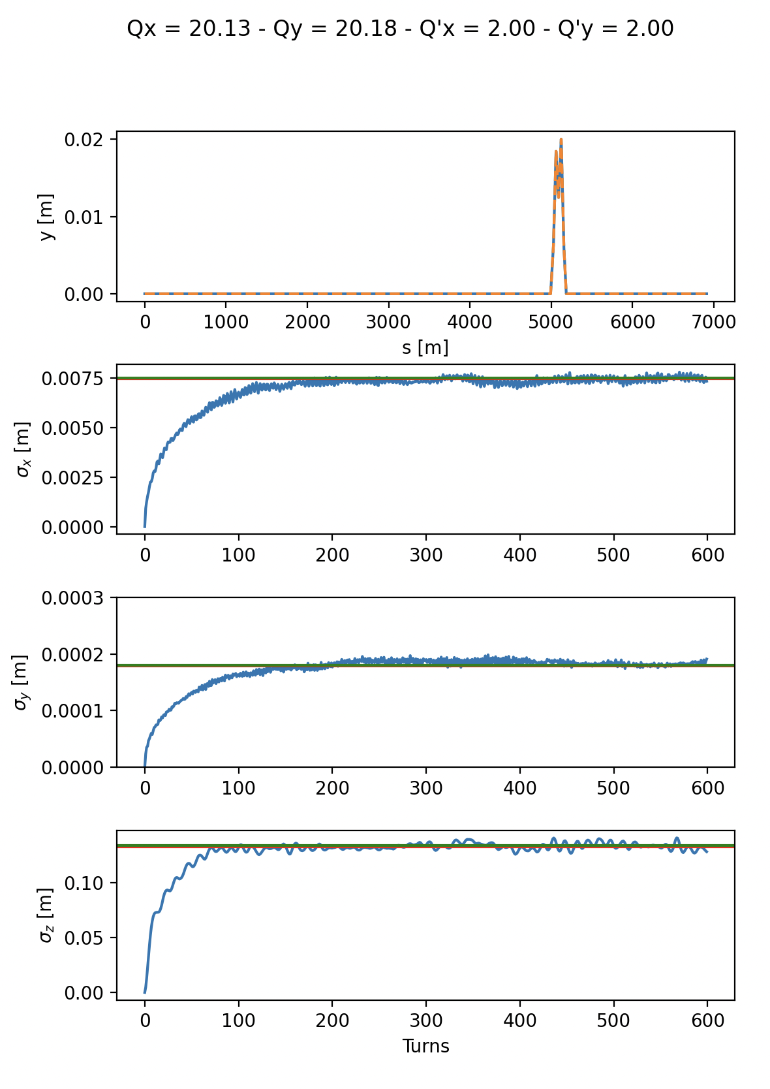
Synchrotron radiation
Equilibrium emittance (twiss vs track)
The effect of synchrotron radiation can be included in Xsuite tracking simulations. Two models available:
The “mean” model, for which the energy loss from the radiation is applied particle by particle without accounting for quantum fluctuations;
The “quantum” model for which the actual photon emission is simulated⁽¹⁾.
The Xsuite Twiss also includes:
Dedicated algorithm for non-symplectic one-turn map⁽²⁾
Computation of radiation energy loss, damping times and equilibrium emittances
An automatic tool is provided for phasing the RF cavities and adjusting magnet strengths to compensate the radiation energy loss (“tapering”)
Twiss (fast)
Twiss (full)
Tracking (300 particles)
⁽¹⁾ Based on H. Burkhardt, “Monte Carlo generator for synchrotron radiation”, 1990. Implementation ported from PLACET (A. Latina)
⁽²⁾ E. Forest, From tracking code to analysis: generalised Courant-Snyder theory for any accelerator model. Springer, 2016
20

Slide 21
Collective effects
Xsuite is designed to include collective effects in the simulations
Handling of collective elements is fully automatic → The Xtrack module identifies the collective elements and splits the sequence:
  The non-collective parts are handled asynchronously to gain speed
  The simulation of the collective effects is performed synchronously
If requested by the collective element, the particles’ data is automatically transferred from GPU to CPU and back
Space-charge, beam-beam, e-cloud (weak-strong) are handled natively
Impedances and feedback systems are handled through an interface with PyHEADTAIL
An automatic tool for the computation of stability diagrams from amplitude detuning is also provided
Space charge
Lattice
Lattice
Space charge
Space charge
Lattice
Lattice
Impedance
Damper
Collective (synchronous)
Single-particle (asynchronuos)
21

Slide 22
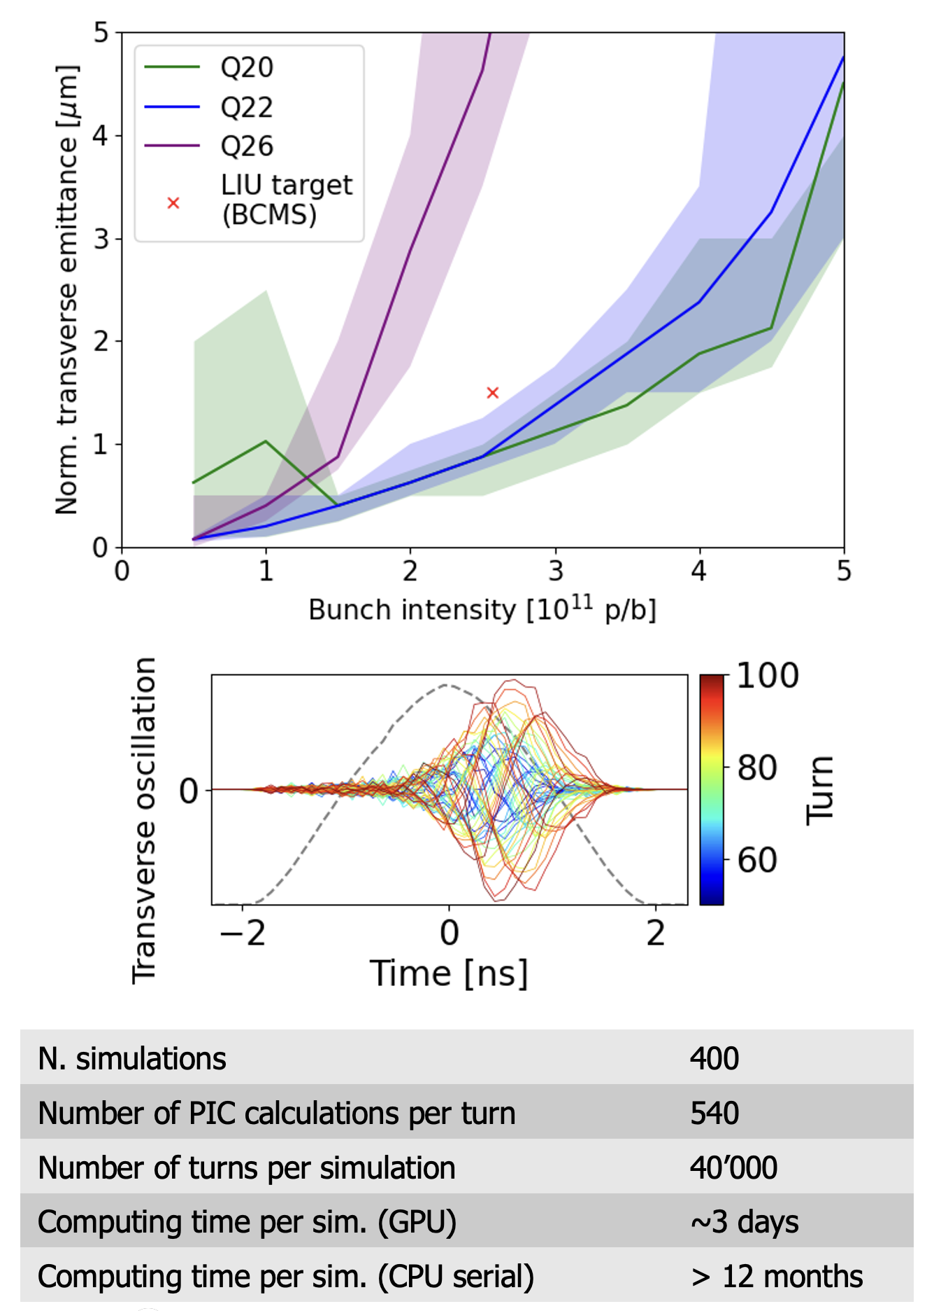
Space charge
Simulation campaign for the CERN SPS
including full non-linear lattice, space charge and wakefields
The implementation is largely based on PyHEADTAIL-PyPIC
Different space-charge models are implemented:
The “frozen” model, in which particles interact with fixed charge distributions
The “quasi frozen” model, in which the beam intensity and beam sizes are recomputed at each interaction
The “Particle In Cell (PIC)” model:
  Charge of tracked particles distributed on a rectangular grid
  Fast Poisson solver based on FFT method with Integrated Green Functions
Space charge simulations strongly profiting from GPU acceleration
Courtesy X. Buffat
22

Slide 23
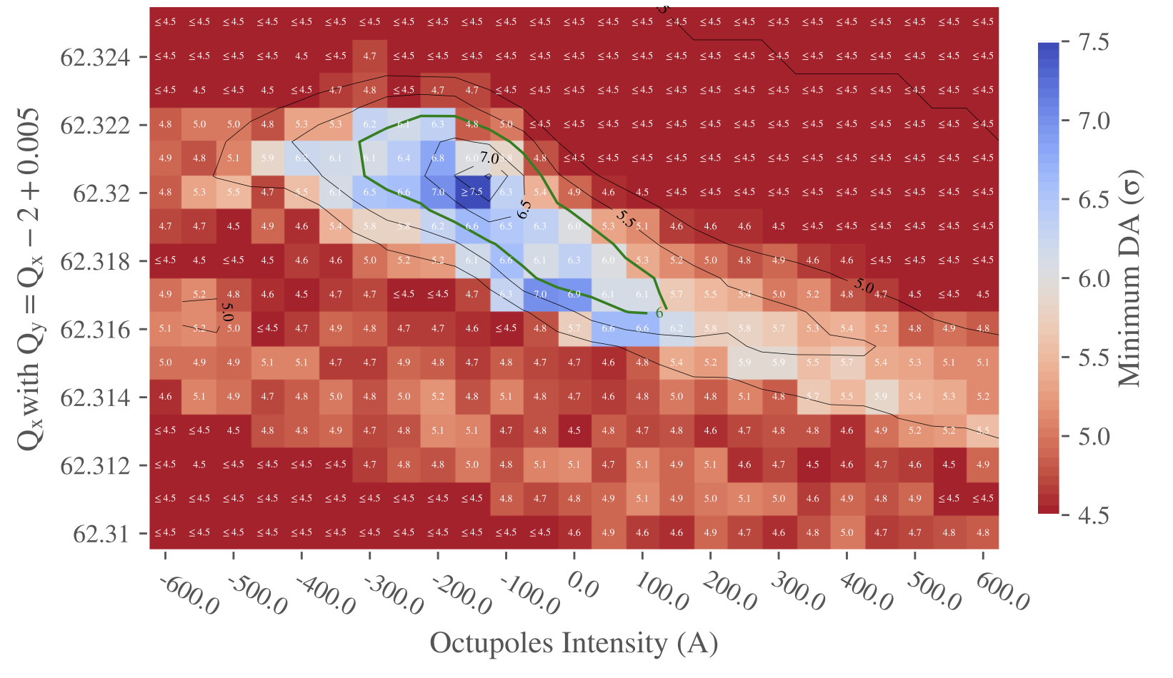
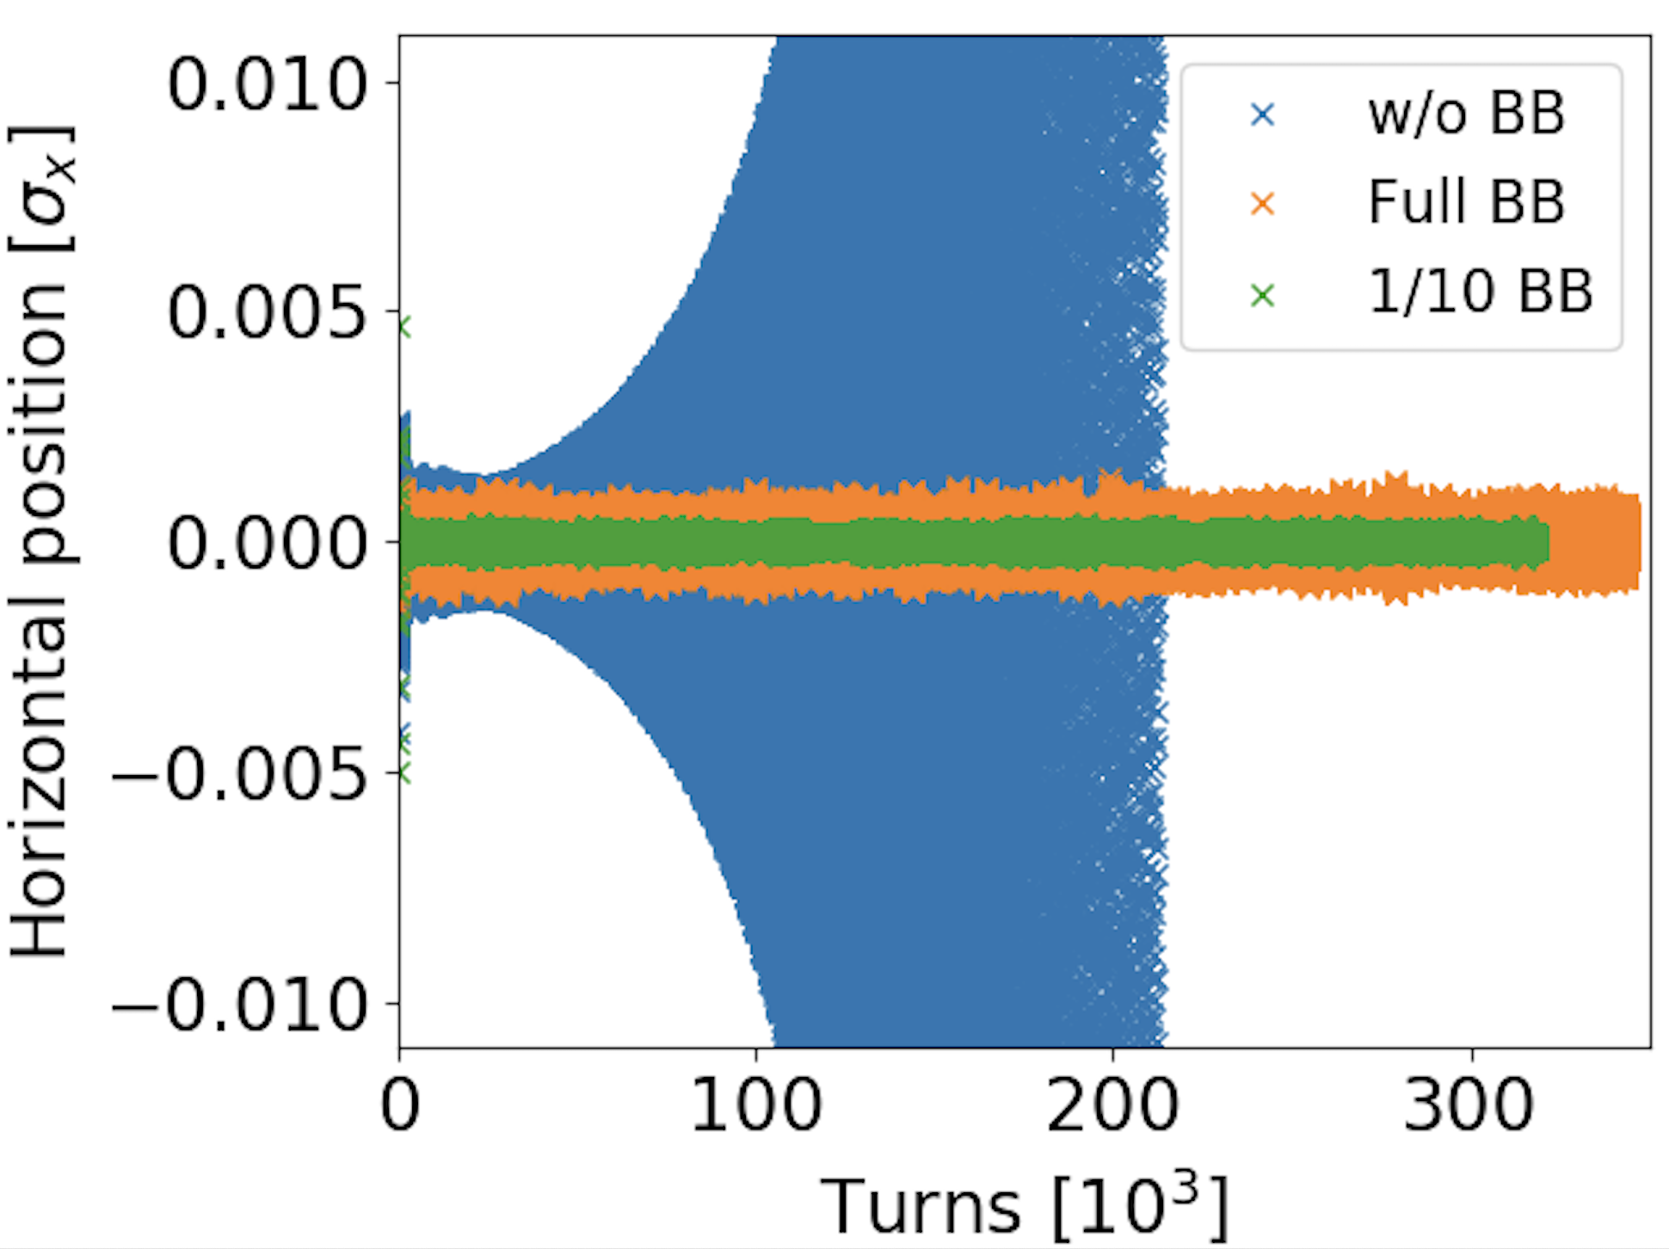
Beam beam effects
Xsuite implementation based on experience from Sixtrack and COMBI
Two models are provided:
  The “4D” model, which applies only transverse forces independent on the longitudinal motion
  The “6D” model, which applies longitudinal and transverse forces accounting for the synchrotron motion (method by Hirata et al.)
Both models can be used either in “weak-strong“ mode (fixed assigned distribution for the other beam) or in “strong-strong” mode (self-consistent two-beam simulation)
For the simulation of lepton colliders, the code can also simulate for beamstrahlung and Bhabha scattering
Strong-strong simulations are accelerated by parallel computing on HPC clusters (based on MPI)
  “Pipeline” algorithm⁽¹⁾ used to optimize workload distribution across the nodes
Dynamic aperture optimization study for HL-LHC (weak-strong modelling)
Courtesy C. Droin
Wakefield + beam-beam simulations for HL-LHC (strong-strong modelling)
23
⁽¹⁾ S. Furuseth and X. Buffat, Comput. Phys. Commun. 244 (2019)

Slide 24
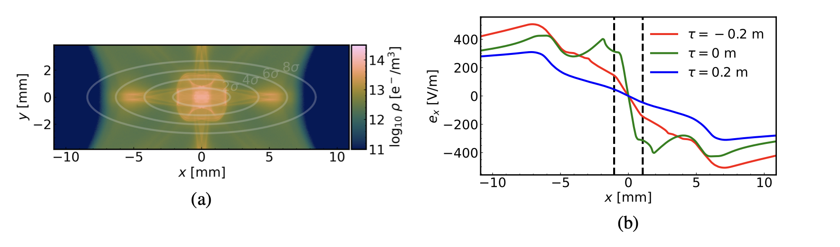
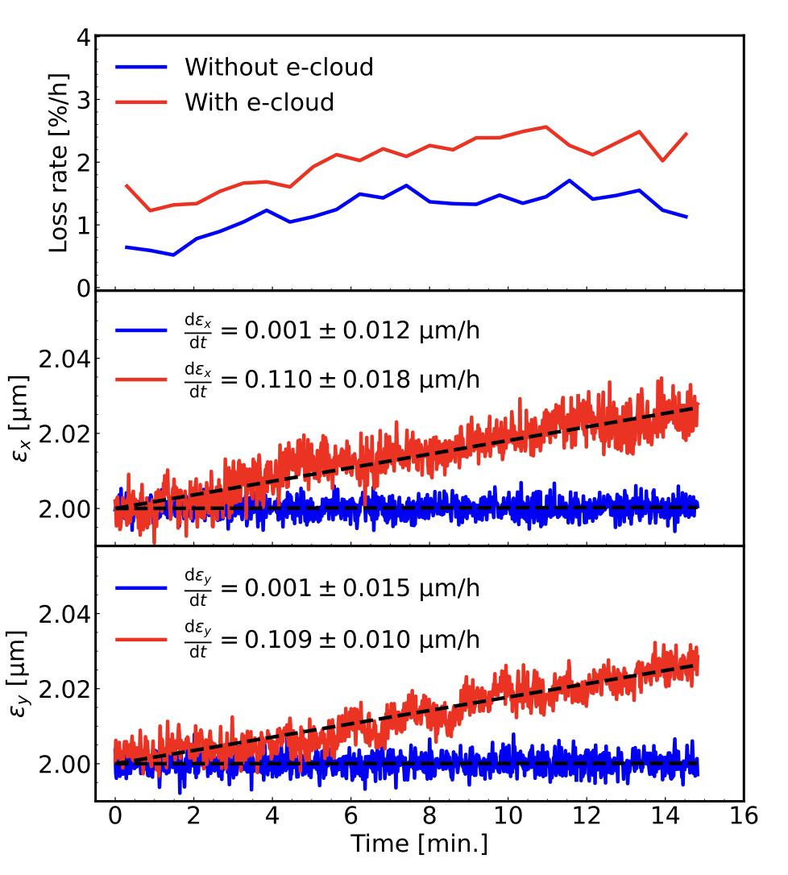
Electron cloud modeling
Xsuite has been exploited to study the effect of electron cloud on slow beam degradation (emittance growth, lifetime degradation).
Done by applying a high-order interpolation scheme to the e-cloud potential imported from a dedicated multipacting simulator.
  Scheme designed to preserve the symplecticity of the resulting map by ensuring the global continuity of the potential and required derivatives.
Use of GPUs is mandatory to simulate the required long time scales (>10⁶ turns).
See also: K. Paraschou, THBP16
24

Slide 25
Outline
Introduction
  Motivation
  Design goals and constraints
  Architecture
  Agile development
Lattice modeling, simulation and optimization
  Lattice modeling
  Single-particle tracking
  Dynamic parameter control
  Multi-objective optimizer
Simulation of specific processes
  Particle-matter interaction
  Synchrotron radiation
  Handling of collective effects
  Space-charge
  Beam-beam
  Electron clouds
Final remarks

Slide 26
The Xsuite community
[Activities that are already in production, or for which testing work is ongoing]
LHC and HL-LHC
Tracking for DA - lattice only (M. Le Garrec, E. Maclean, C. E. Montanari , T. Pugnat, D. Veres)
Crab-cavity noise studies(A. Fornara, Uni. Manchester)
Beam-beam weak-strong (G. Sterbini, S. Kostoglou, C. Droin, E. Lamb, D. Christie Uni. Manchester)
Beam-beam strong-strong (X. Buffat)
Wire compensation studies (P. Belanger, D. Kalchev TRIUMF)
Collimation studies (F. Van Der Veken, N. Triantafillou, B. Lindstrom, M. D’Andrea, P. Hermes)
Optics/orbit matching, including RDT matching (B. Lindstrom, K. Paraschou, C. Droin, S. Kostoglou, Y. Angelis)
Non-linear corrections calculation (J. Dilly)
Hollow e-lens studies (P. Hermes + students)
Incoherent e-cloud effects (K. Paraschou)
Beam instrumentation studies (D. Alves, K. Lasocha, SY-BI)
Injector complex (PSB, PS, SPS, LEAR, AD, ELENA)
Space-charge studies (F. Asvesta, T. Prebibaj)
Cooling studies (D. Gamba, P. Kruyt)
Instabilities with wakes and space-charge (X. Buffat)
Slow extraction studies at PS and SPS (P. Arrutia Sota, T. Bass, F. Velotti, SY-ABT)
Ion studies (E. Waagaard)
Beam transfer simulations (F. Velotti, SY-ABT)
MTE simulations, optics+tracking (A. Huschauer, starting)
Light sources (Petra IV, Elettra, Bessy III)
Tracking and DA
FCC
FCC-ee optics matching, tapering + RF phasing (M. Hofer, J. Keintzel, P. Kicsiny (L. Van Riesen-Haupt)
FCC-ee DA studies (M. Hofer, L. Van Riesen-Haupt, EPFL)
FCC-ee and FCC-hh beam-beam-SS&WS (P. Kicsiny, D. Di Croce, EPFL)
Beamstrahlung, Bhabha (P. Kicsiny)
FCC-ee and FCC-hh collimation studies (A. Abramov, G. Broggi)
FCC-ee vibration studies (J.P. Salvesen, M.Hofer, LAPP Annecy collab.)
Compton scattering studies (A. Abramov, I. Debrot, M. Hofer)
Collective effects (M. Migliorati, A. Ghribi - Uni Sapienza, A. Rajabi – Desy)
GSI/FAIR
Space-charge simulations (A. Oeftiger and team)
Slow extraction simulations - SIS18 and SIS100 (P. Niedermayer, C. Cortes)
BTF studies (C. Cortes)
Medical accelerators
Slow-extraction for PIMMS (R. Tailor)
Slow-extraction for MedAustron (F. Kuehteubl, E. Renner, et al.)
BNL - RHIC and EIC
Optics calculations and tracking
Collimation studies
Fermilab – Main Injector, Recycler, IOTA
Tracking studies
Impedance + space-charge simulations
Training (Universiy of Rome and EPFL)
Some numbers
Core team | 3 persons
Contributing developers | 16 persons
User community | > 100 users
Publications including Xsuite simulations (in 2022-23): | 25 papers

Slide 27
Thanks for your attention!
27

Slide 28
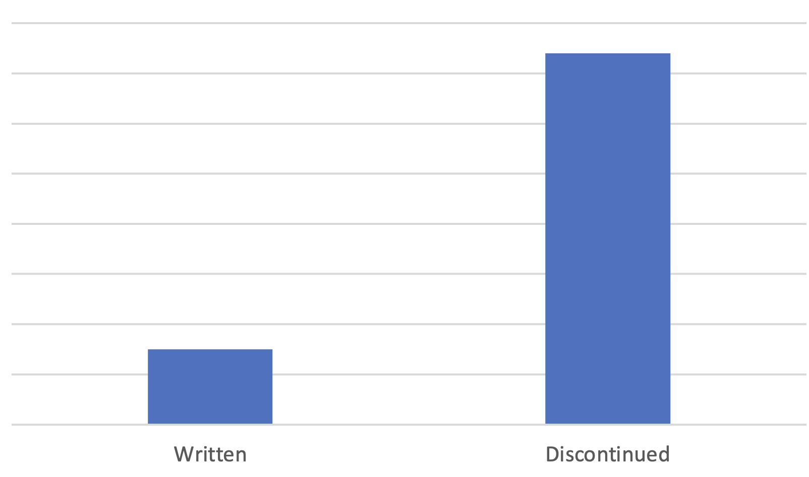
Discontinuation of legacy tools
In 2022-23 we have essentially discontinued the development and, to a very large extent, the usage of the following tools:
  Sixtrack
  Sixdesk
  Sixtracklib
  COMBI
  PySSD
  DistLib
This led to a massive simplification of our code base.
Lines of code
370k
75k
Written
(Xsuite)
Discontinued
(Legacy tools)

