Slide 1
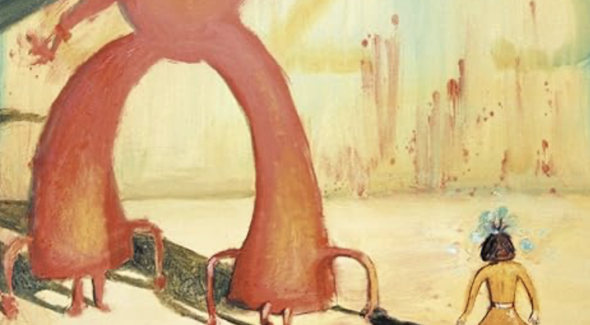
ML applications at PETRA
Ilya Agapov, LER workshop CERN 15 Feb 2024

Slide 2
Contents
Historical remarks
On-line optimization
Deep learning
Computer vision
ML/AI engineering
Outlook

Slide 3
Historical remarks
My personal experience with ML applications dates back to 2005 (HERA)
Applications included beam dynamics modelling and background data prediction (now known as “generative models” or “surrogate models”)
Difficulties along the way:
  Had to program NN libraries and backpropagation (tensorflow or pytorch not available)
  Computers were slow
  Data was extremely sparse (in hindsight)
  Neural Networks (aka deep learning) was not widely believed to be a suitable ML tool (Bayesian, decision trees, various regressions being state of the art in applications)
  No interest in ML from management (at best)
Success was extremely limited and did not go beyond proof of principle for toy problems, which in hindsight is no surprise, since proper solutions for complex facilities (such as colliders) mostly do not exist up to now even with modern tools

Slide 4
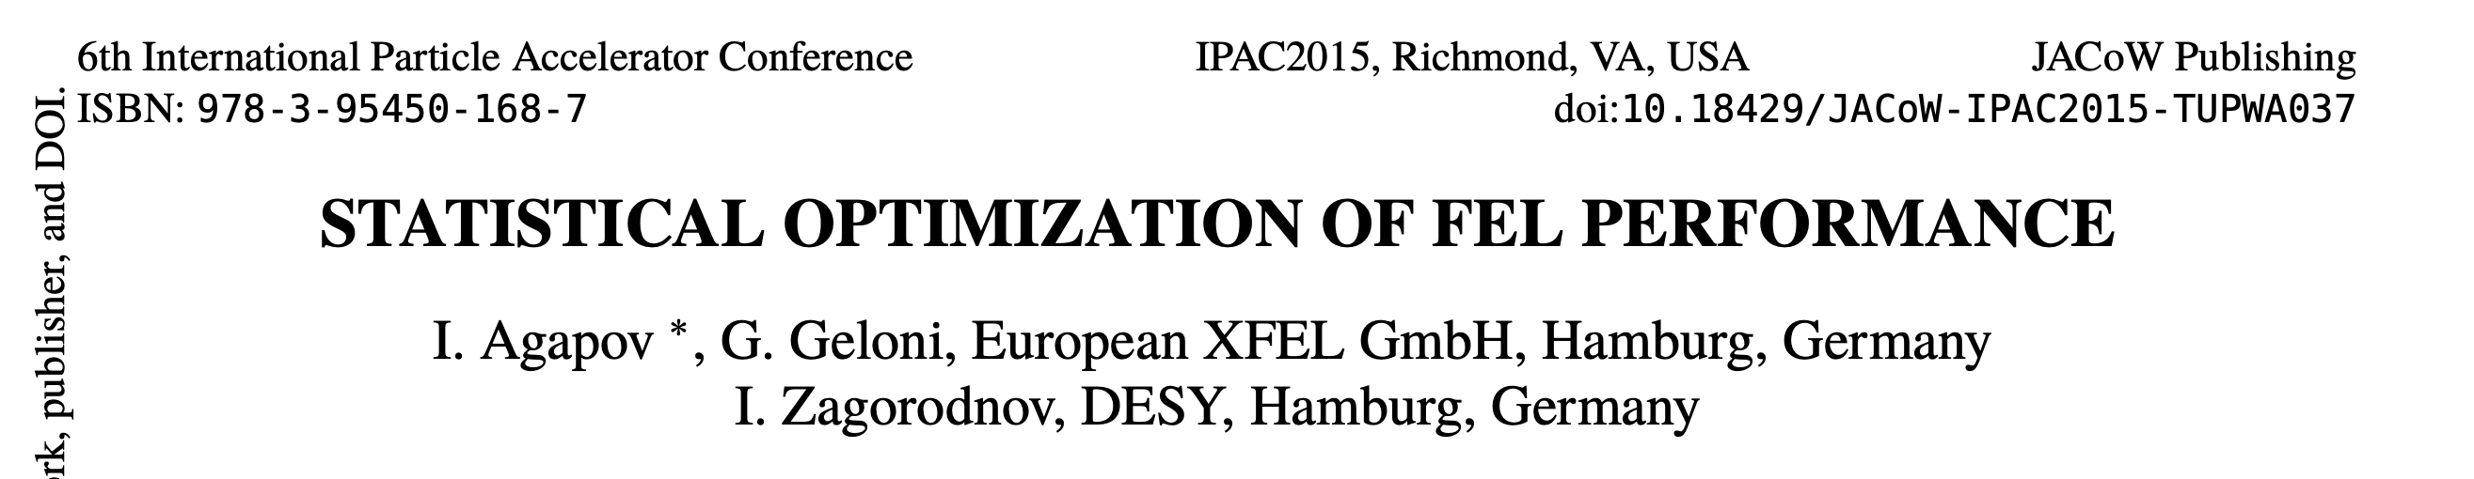
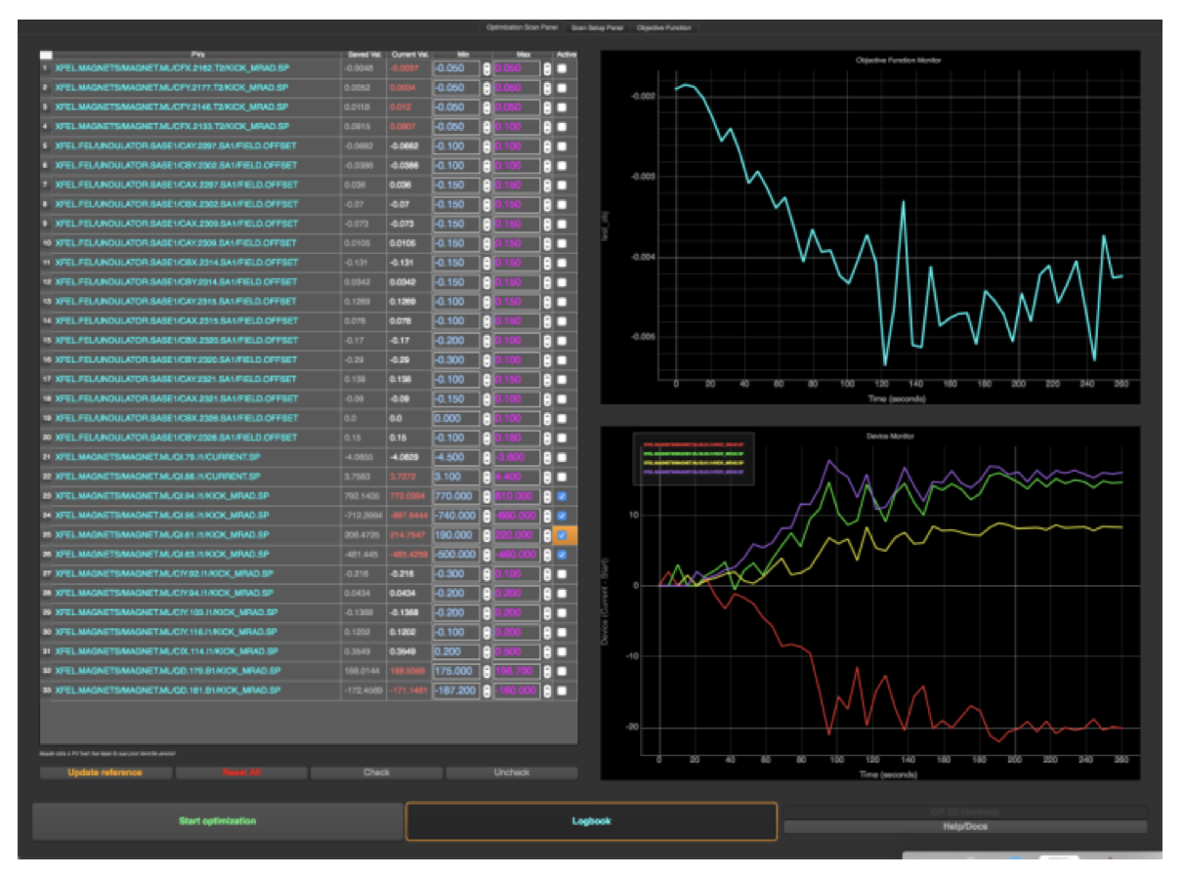
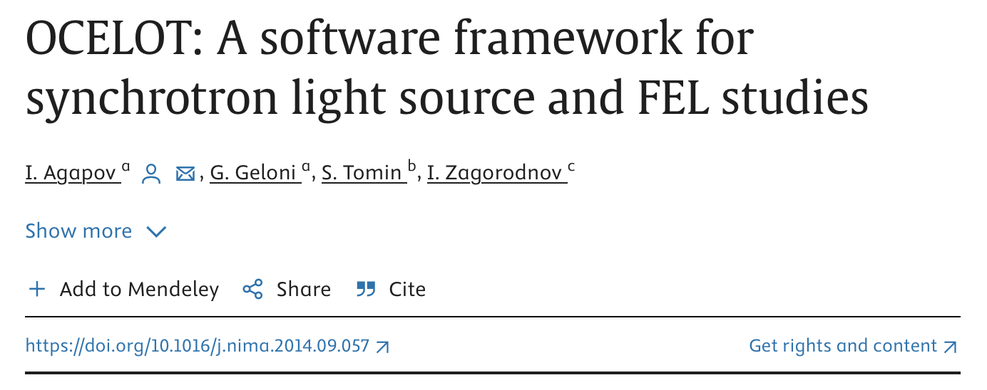
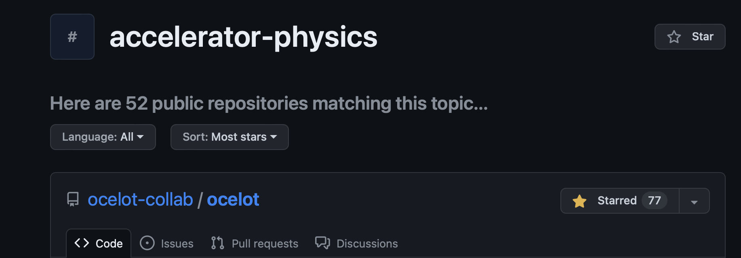
Optimizers: a decade of FEL optimization
SASE tuning at FLASH required many hours a week
First successful demonstration in 2015 for FEL SASE optimization
Deployed at XFEL.EU and widely used in commissioning and operation
Developed in collaboration with SLAC, changed to BADGER to distinguish from the simulation code

Slide 5
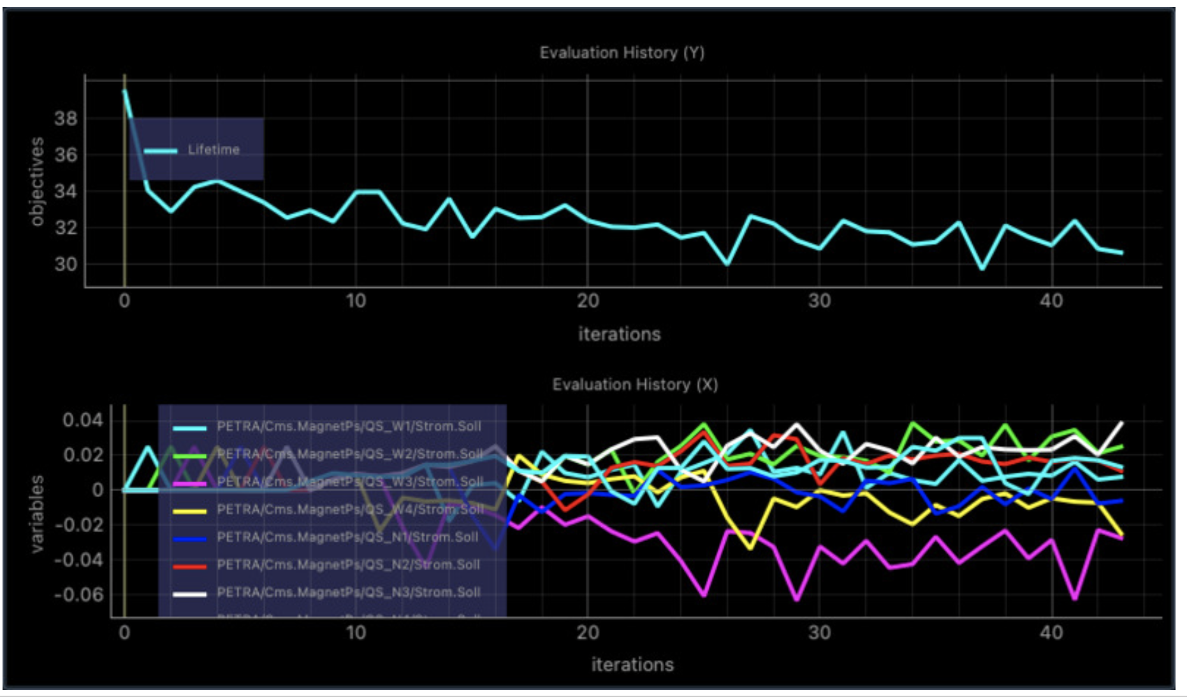
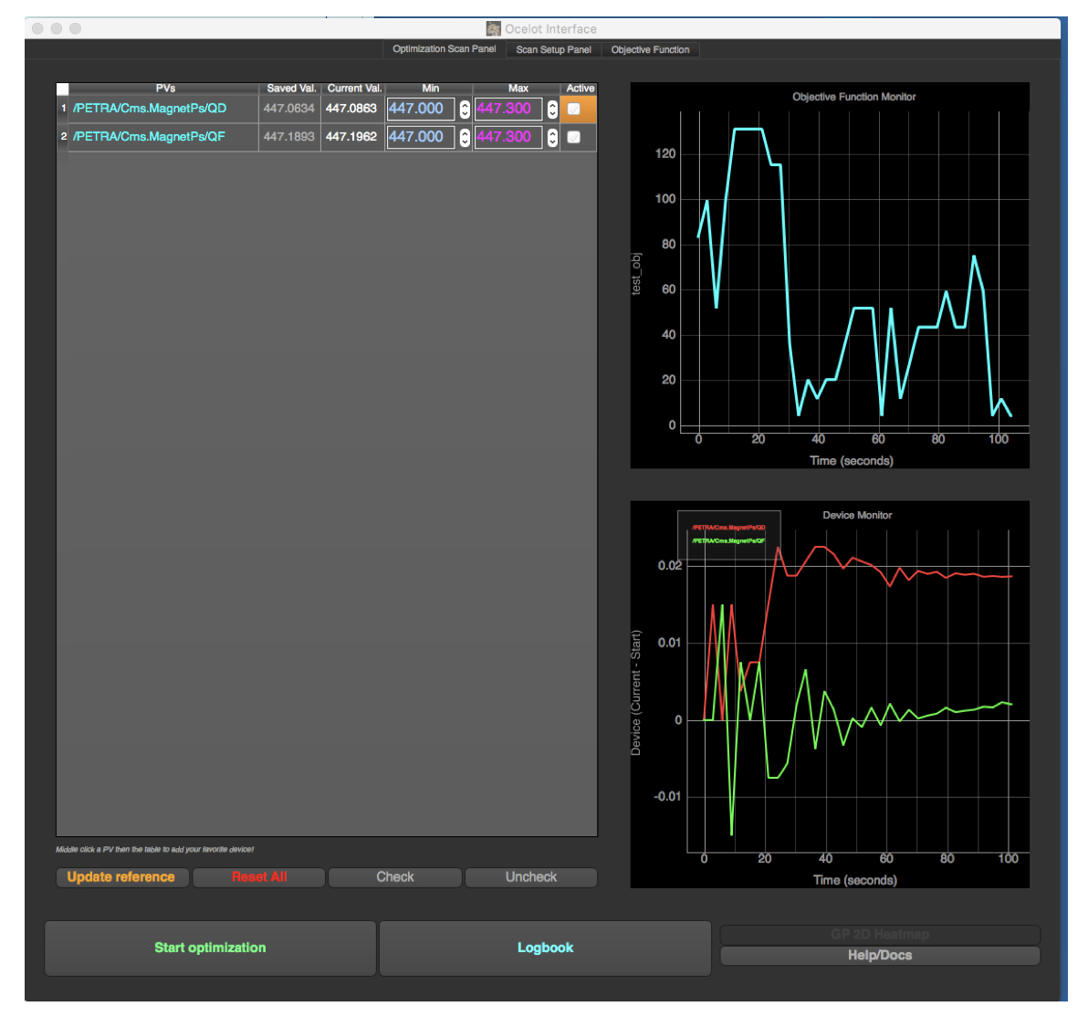
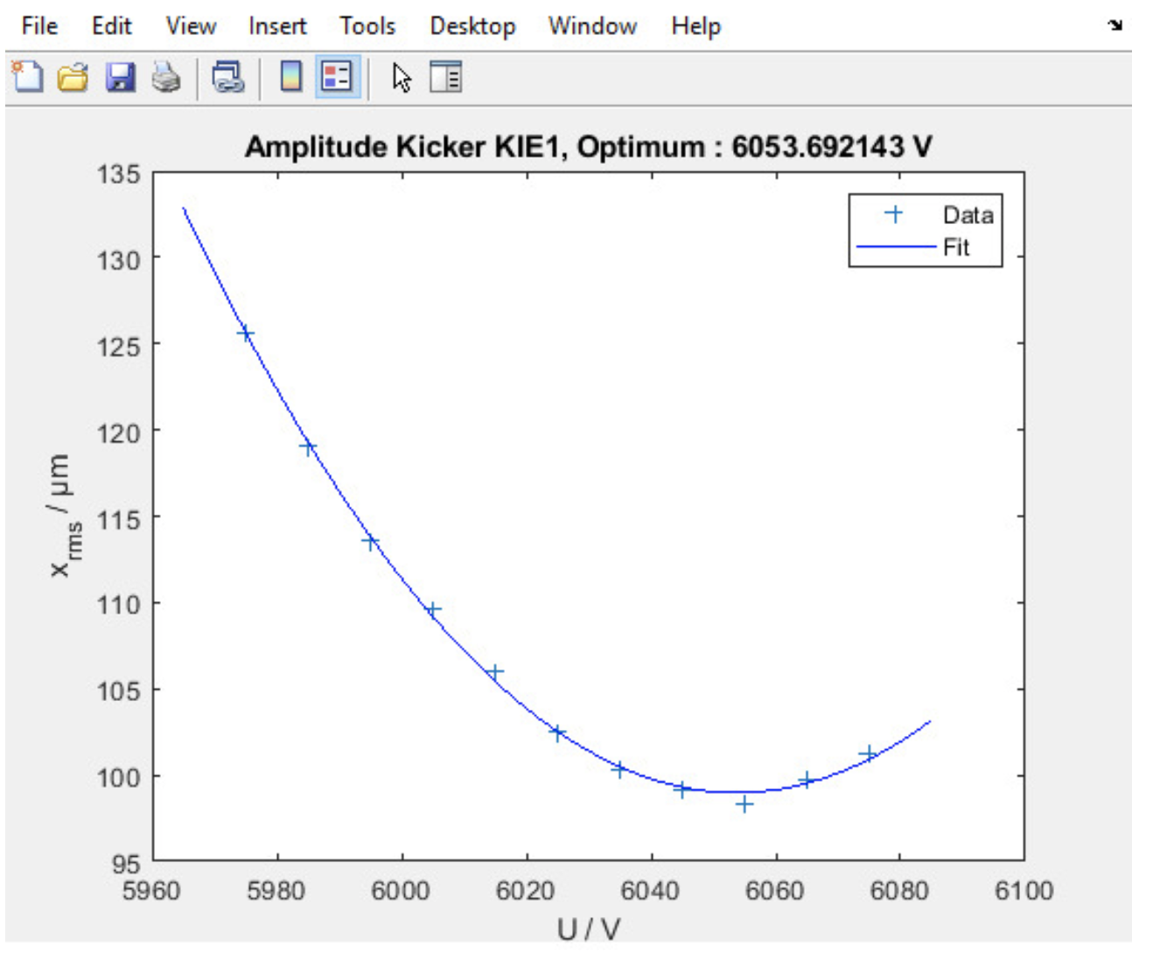
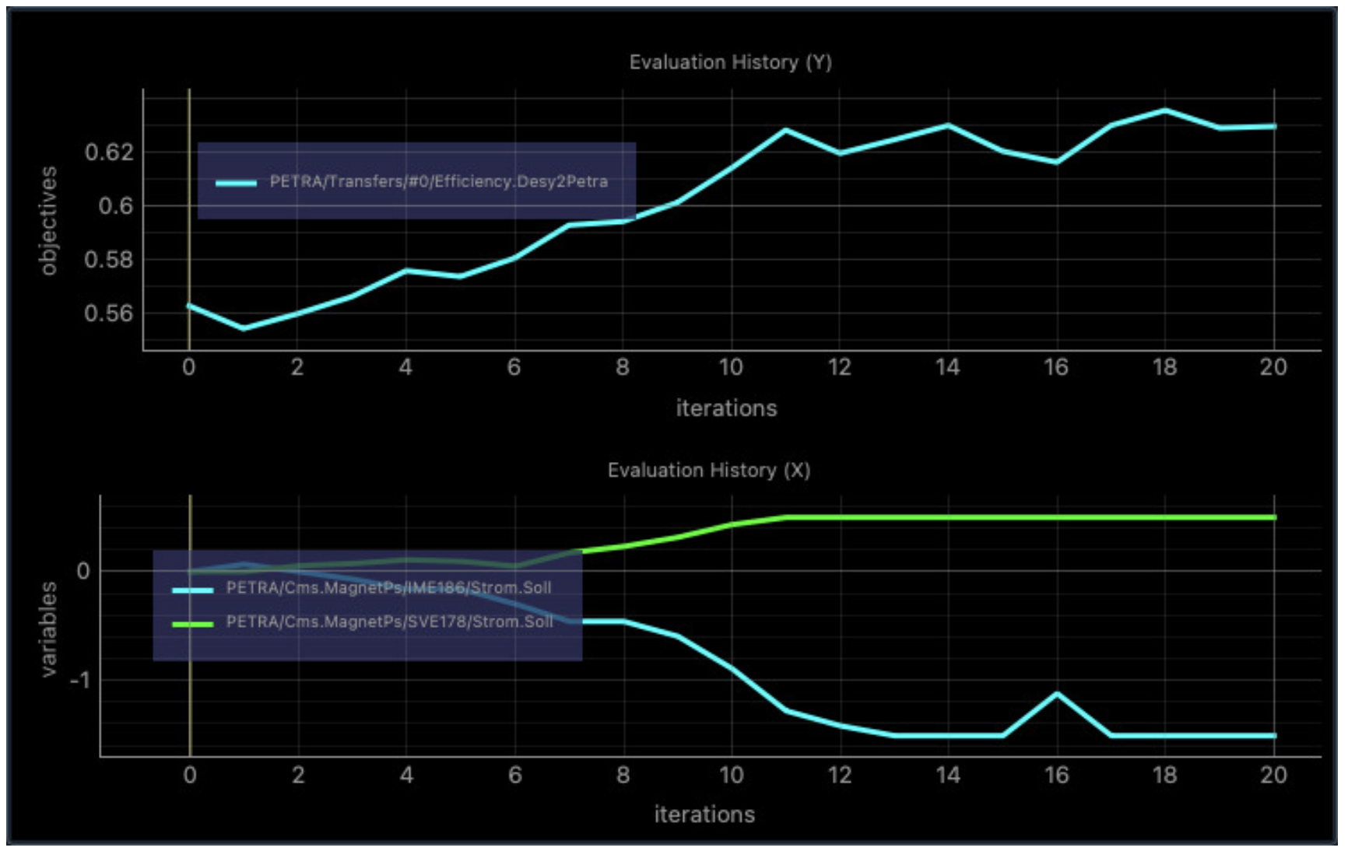
Optimizers at PETRA
Several optimizations were tested with OCELOT/BADGER at PETRA, but not used much so far. MATLAB RCDS is also available.
At EBS more sextupole families allow for efficient lifetime optimization, see talk of Simone Liuzzo
BADGER coupling 2023
OCELOT tune match 2018
RCDS kicker bump 2023
BADGER injection efficiency 2023

Slide 6
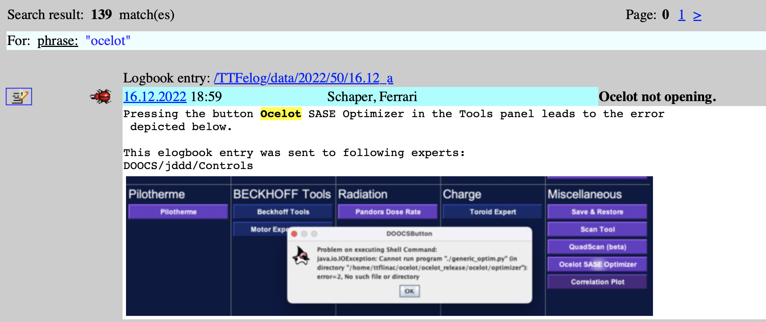
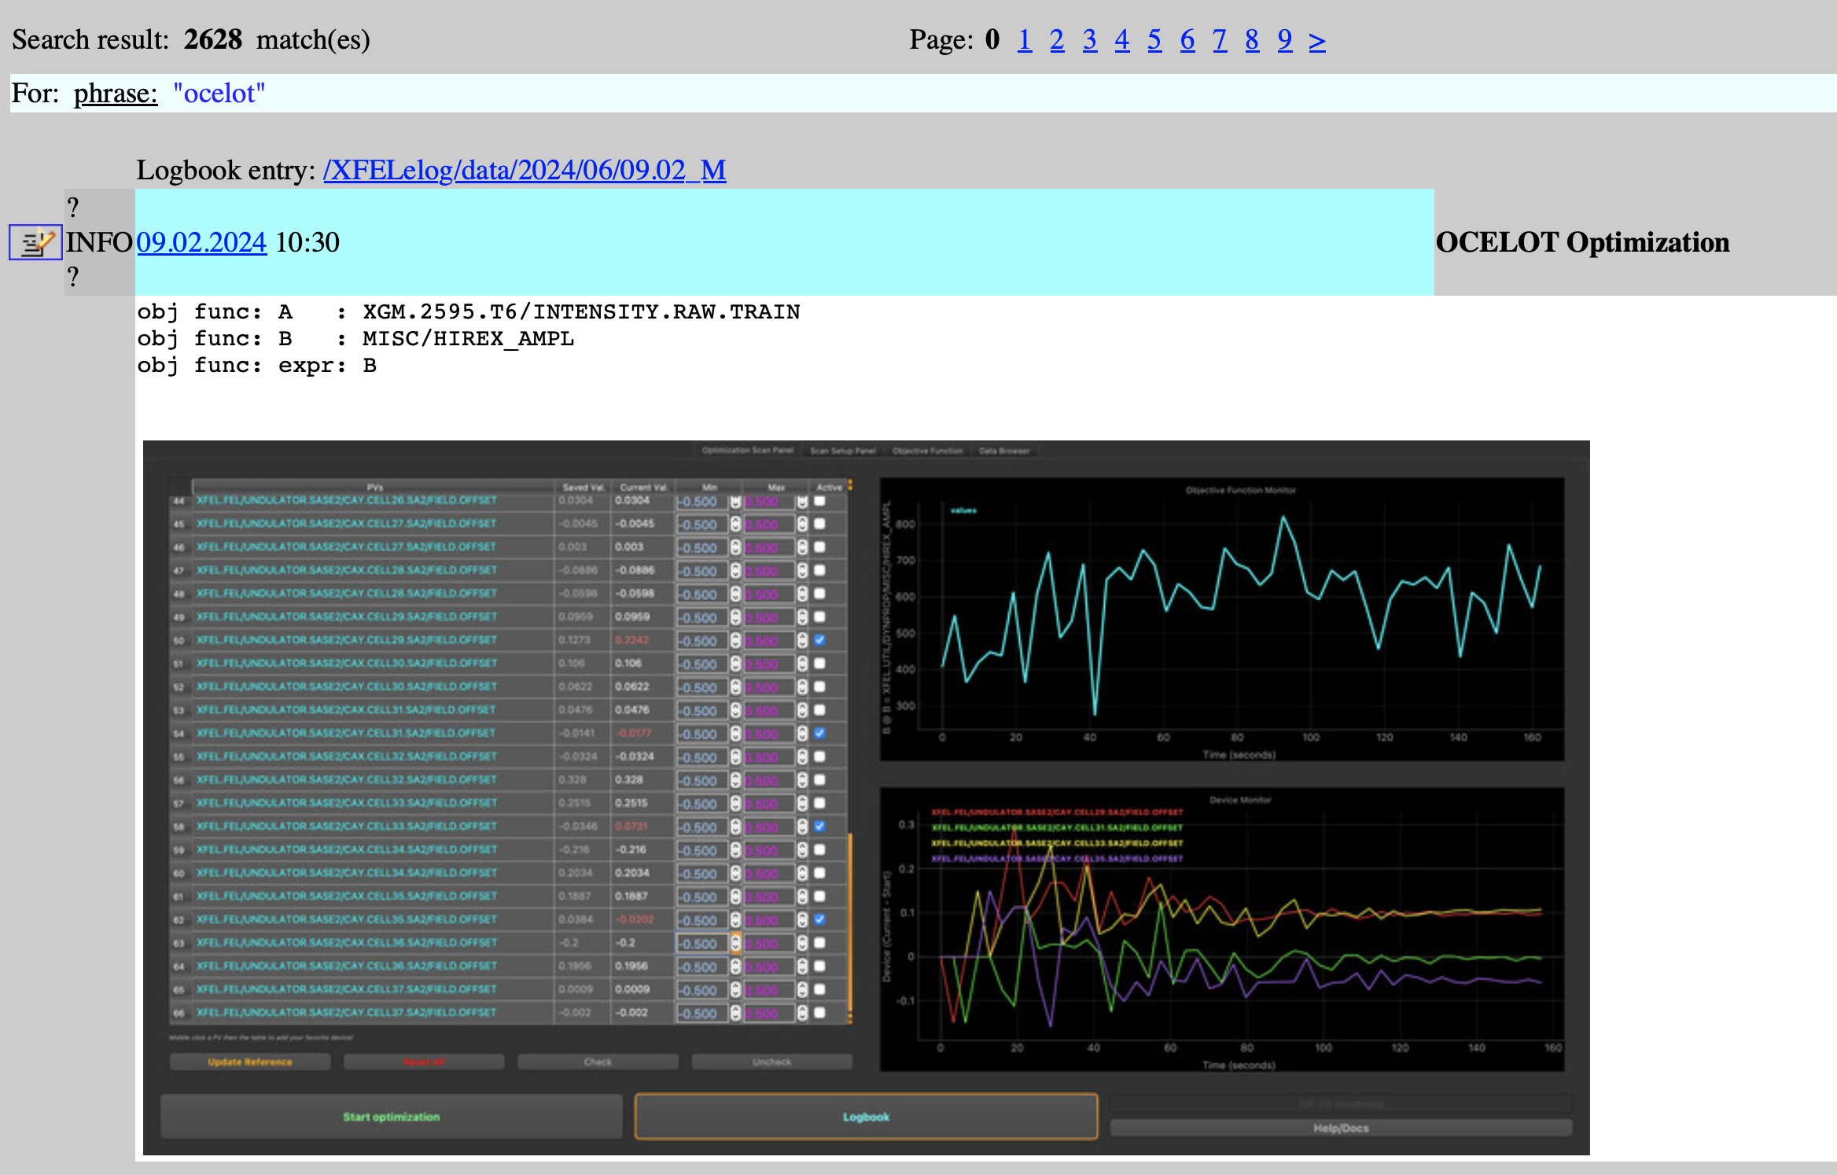
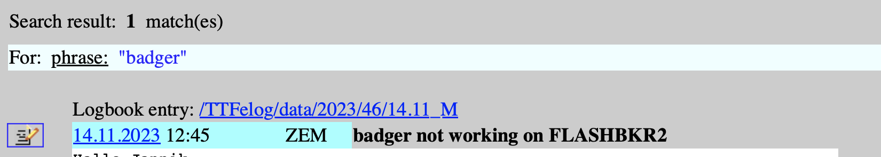
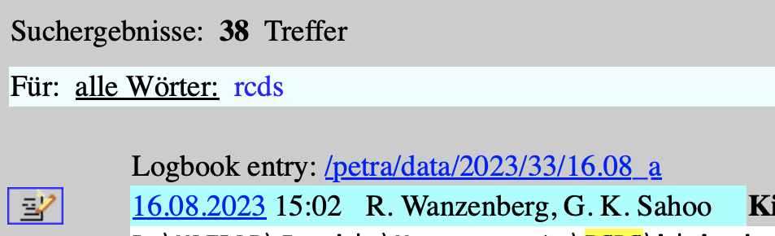
Experience with optimizers
Many factors (amount of maintenance, personal preferences, general operations planning, time-saving potential) play a role in how widely such tools are used. Software usability and UI often come before algorithm
FLASH: something went wrong and not yet fixed
XFEL: constantly used and maintained
PETRA: RCDS most used, but not too often

Slide 7
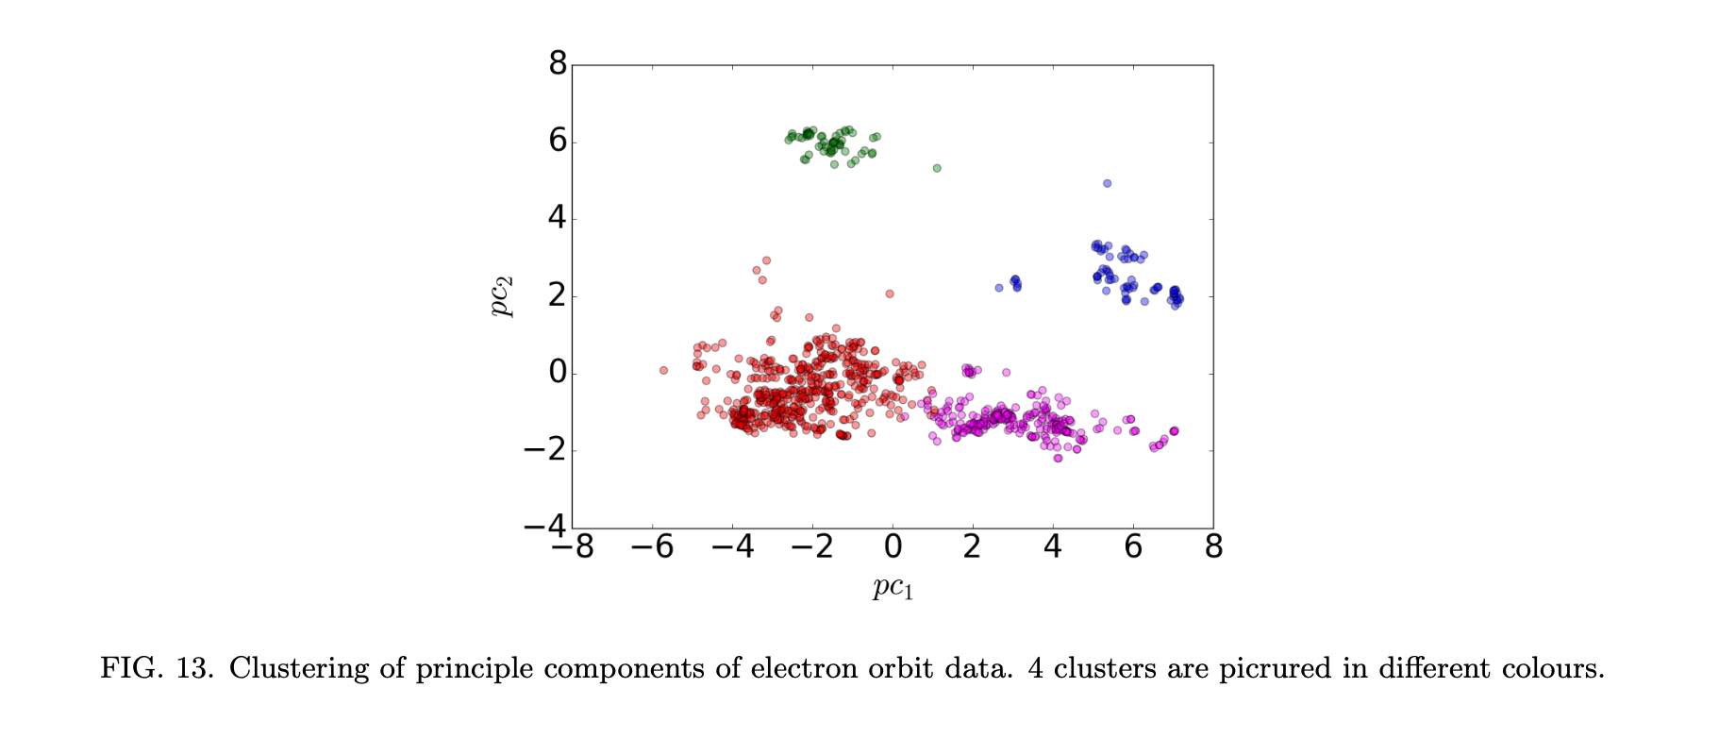
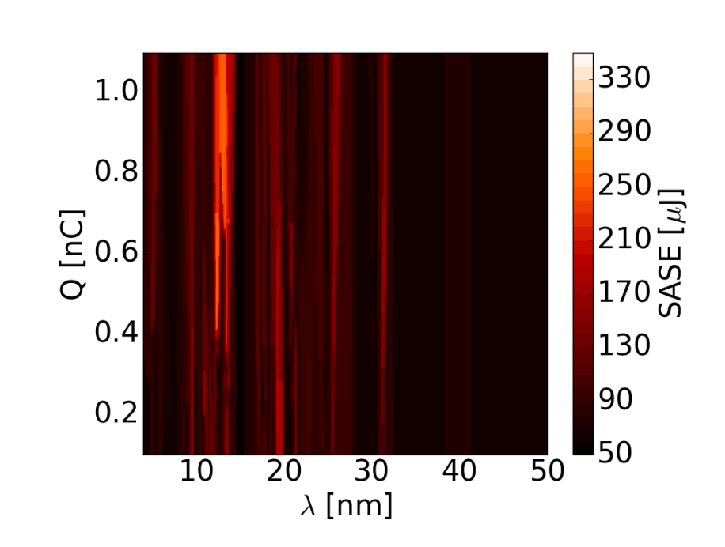
Optimizers - ML features
GP Optimizers are now commonly available (e.g. through standard python libraries ) and used in simulations and on-line optimization. They usually require dedicated setup to work efficiently and offer speedup in optimization rather than enhanced capabilities.
We explored several classical ML/data analysis tools (clustering, regressions etc.) to build models and explore data from early FLASH optimization. Practical applications were (and still are) unclear. Data quality and data processing was non-trivial.
PCA analysis of FLASH orbit data, unpublished (2016)
Regression model of FLASH radiation power, arXiv:1704.02335v1

Slide 8
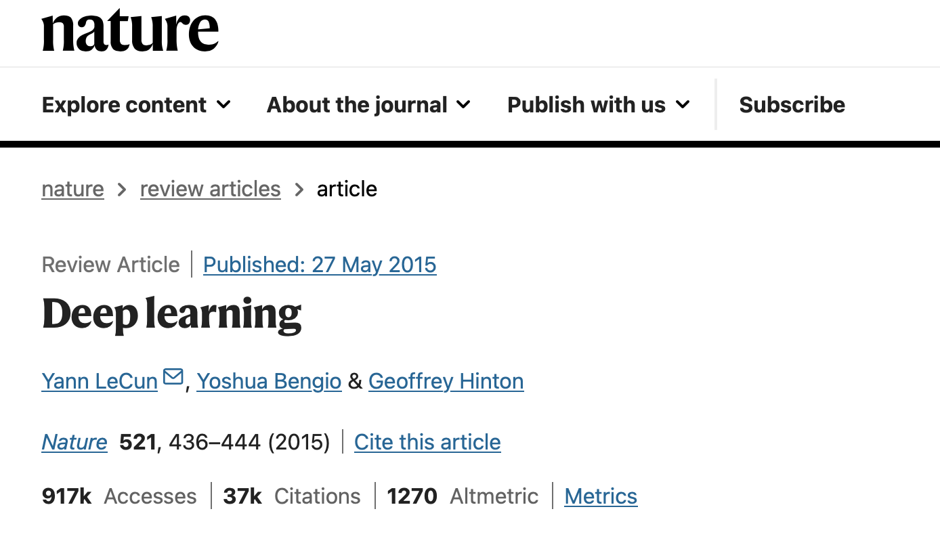
…at the same time AI revolution has happened
“Deep Learning” 2015
DeepMind founded 2010
OpenAI founded 2015
AlphaGo vs Lee Sedol 2016
“Attention is all you need” 2017
GPT 1 2017
ChatGPT 2022

Slide 9
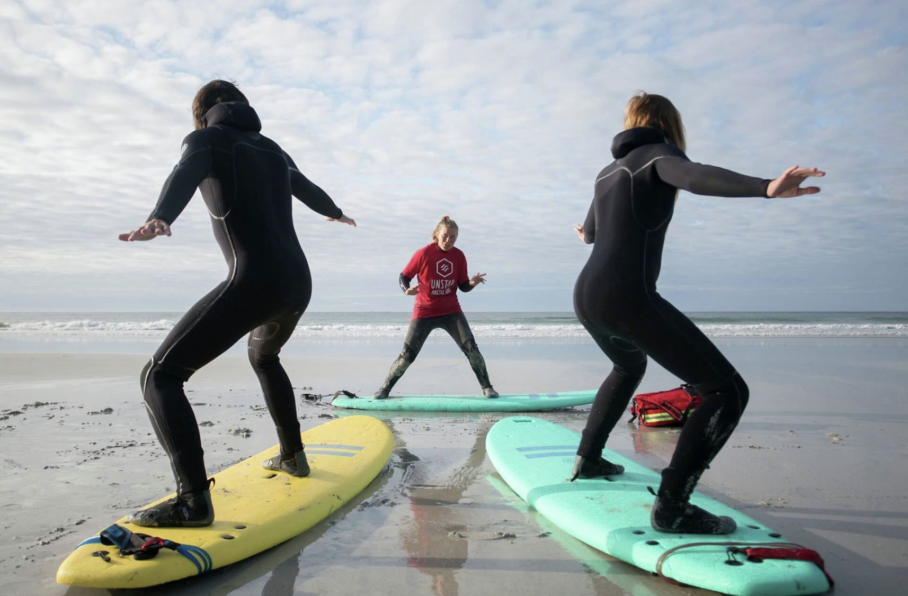
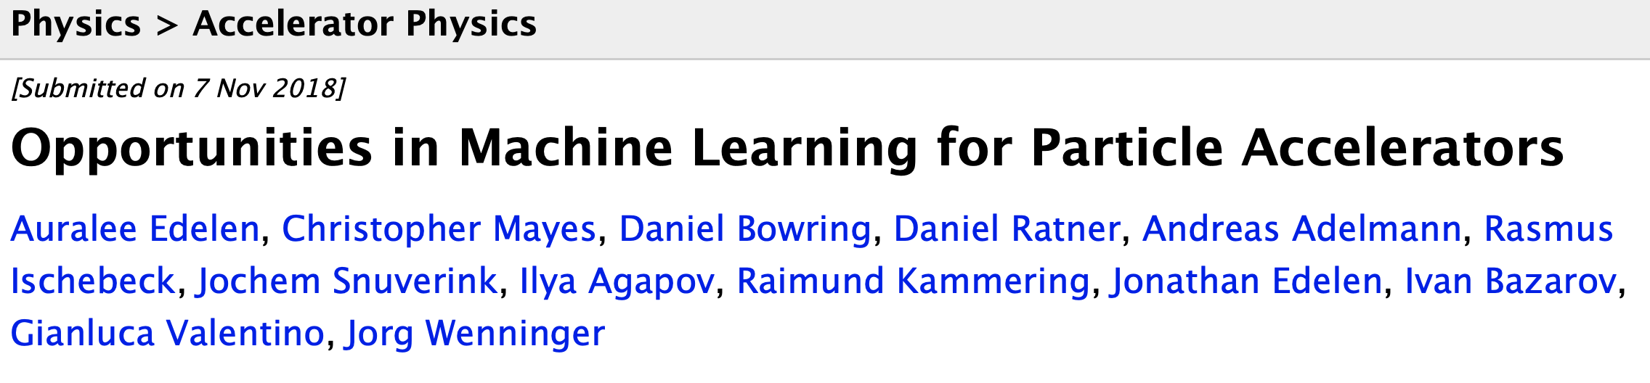
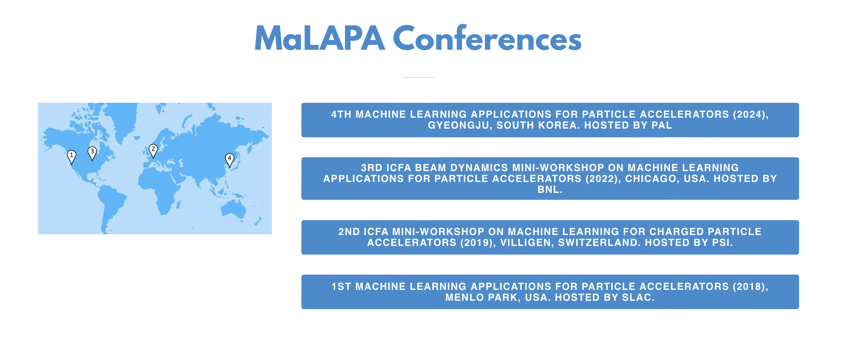
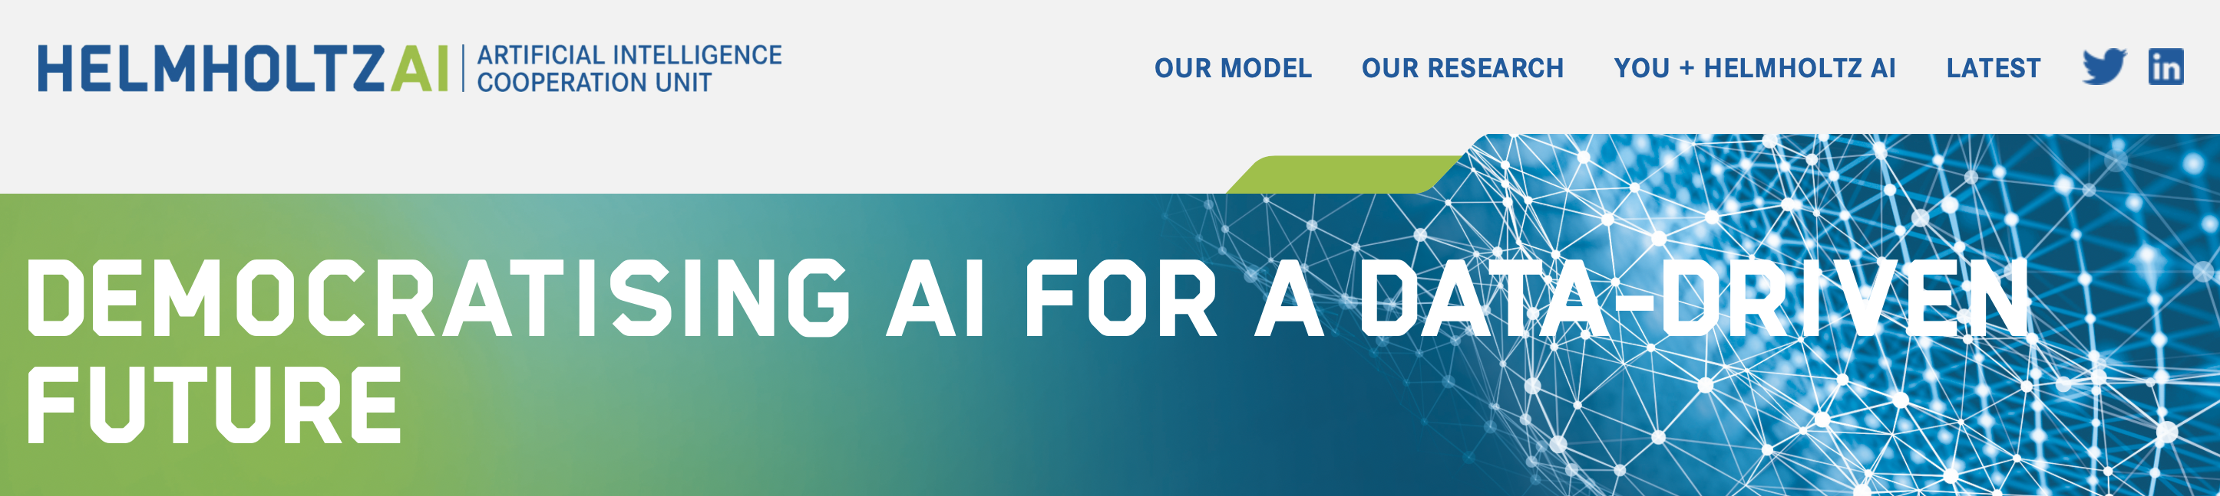
Riding the AI wave
Increased understanding of potential of AI for accelerators
White paper in 2018
ICFA ML Workshops since 2018
National platforms (e.g Helmholtz.AI since 2020)
At DESY dedicated funding to work on AI from 2019
https://visitlofoten.com/en/activity/surfing/

Slide 10
Landscape@DESY
Goals are broadly set to automation (accelerators, experiments), improved data analysis (experiments)
More specific problems
  Predictive maintenance
  Optimizers
  Control algorithms
  Reinforcement learning
  Robotics
  Data processing
  Triggers
  Generative models for simulations
The majority of ML developments at DESY are in particle physics/photon science
In accelerator division ML is mostly developed at ARES (test accelerator) and XFEL
Some examples explored at PETRA machine are shown next

Slide 11
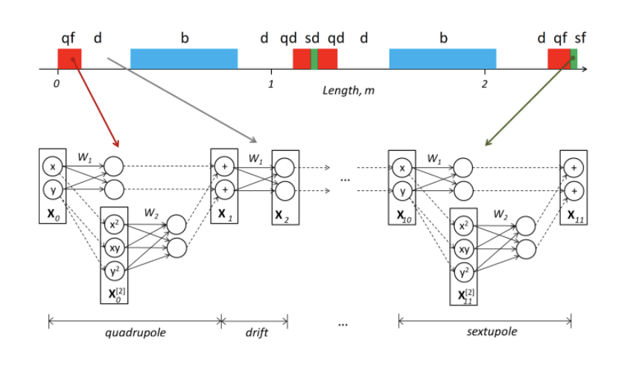
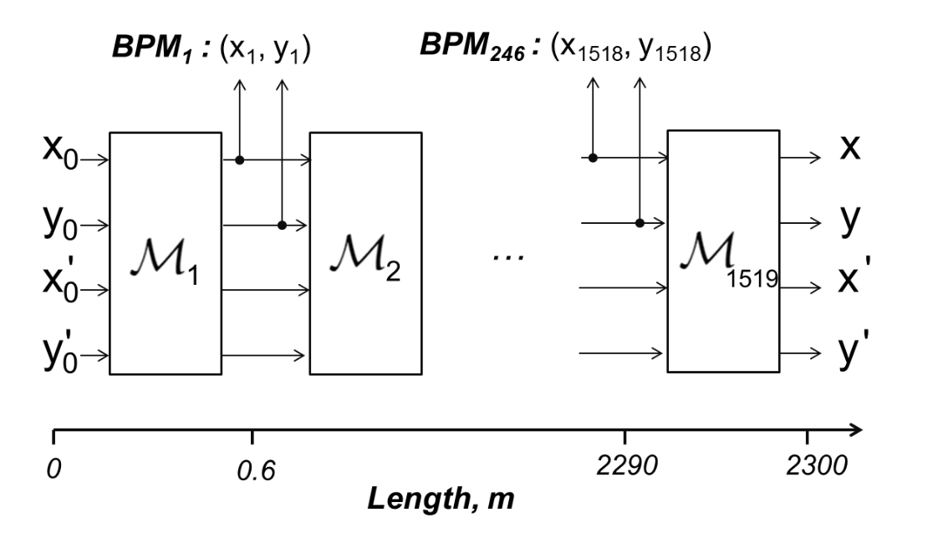
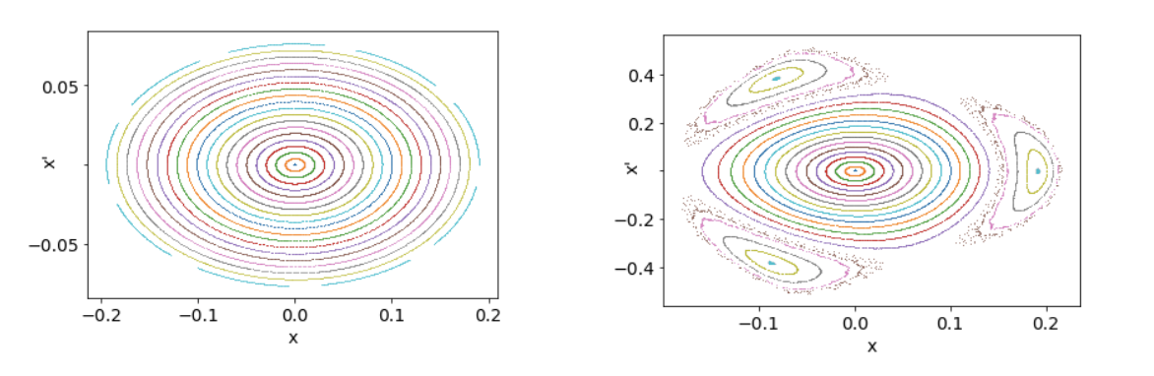
Deep Learning explored - Physics Based NN
A. Ivanov
Observation: computational graphs in tensor manipulation codes developed for deep learning can be used to compute accelerator maps (Taylor maps)
Accelerator model can be implemented as a deep neural network
Weights have direct correspondence to magnet strengths
Exact beam dynamics calculations are possible
The calculations are differentiable and training algorithms can be used for model fitting
Preserving symplecticity at training is solvable by regularization

Slide 12
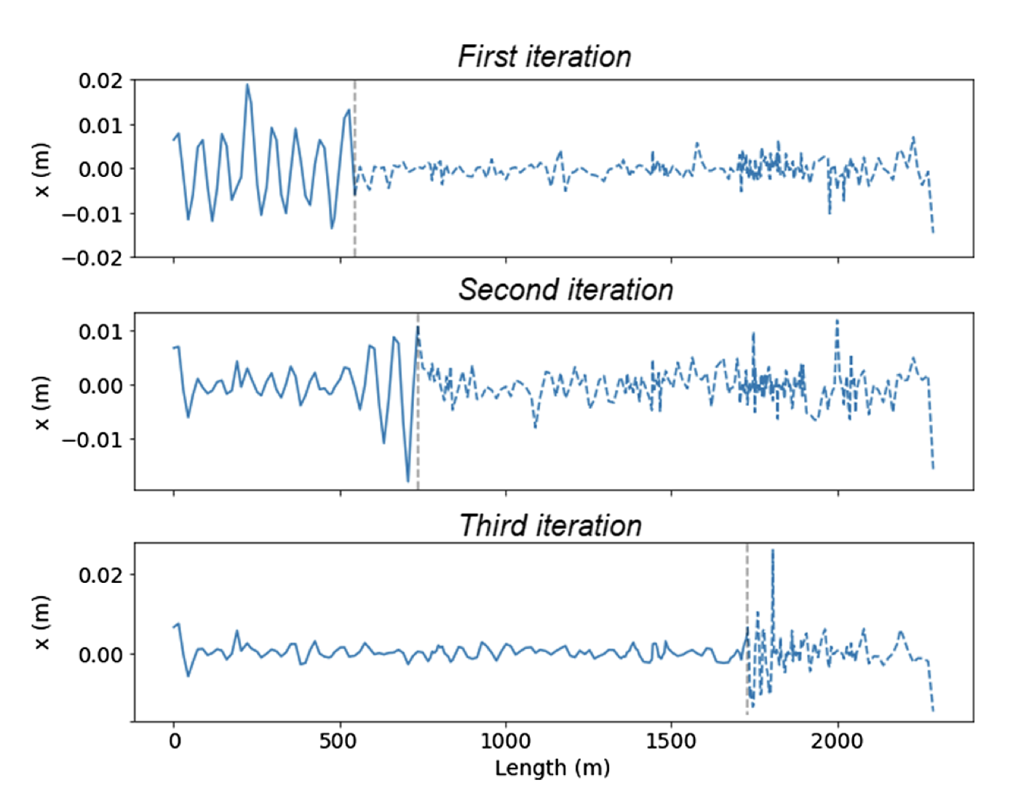
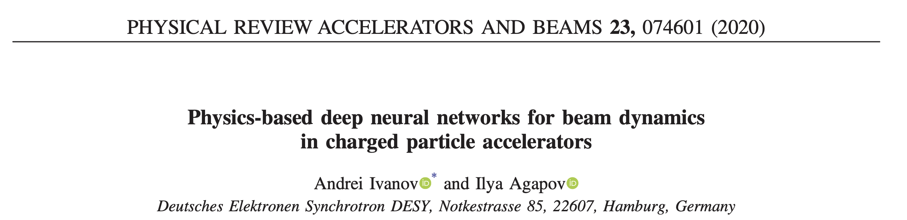
Physics Based NN applications
Developed as an add-on to ocelot
Benchmarked with elegant on PETRA III and IV lattices
Tested first-turn steering based on th code with one-shot learning at PETRA III
Developed a physics-informed RL engine for a test problem
The approach of using tensor manipulation engines (tensorflow, pytorch) has been adopted for several (student) beam optics code projects

Slide 13
Physics Based NN - outlook
Training requires substantial fine-tuning as with all NN models
Accounting for higher nonlinearity is problematic. There is little speed benefit if octupole and higher order maps are used directly, and training stability is unclear. Map truncation can be done, but leads to the ancient problem of symplectification.
Extending to account for self-consistent collective effects is non-trivial
Practical application might include linear optics matching, and real-time simulations for hardware tests such as of the fast orbit feedback if implemented on FPGA

Slide 14
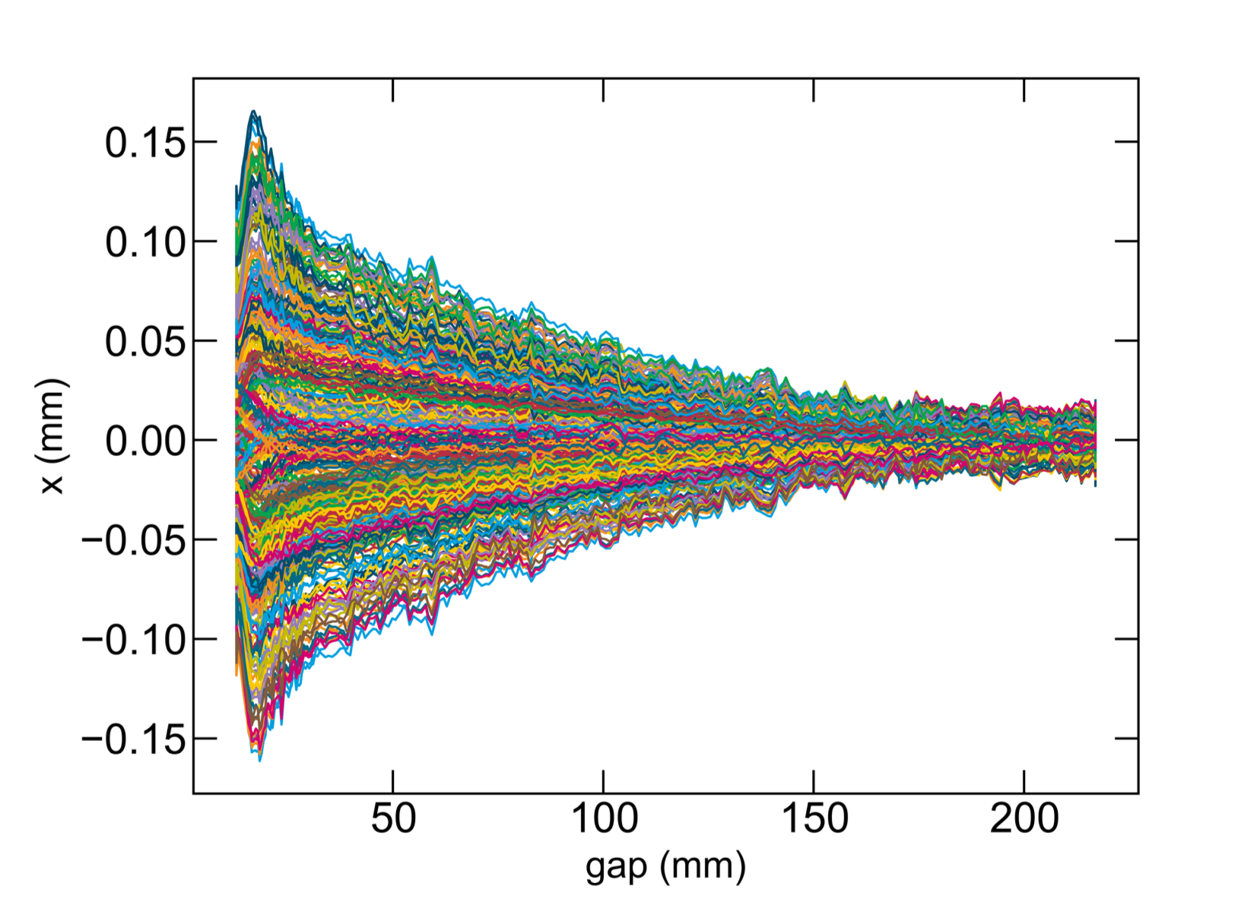
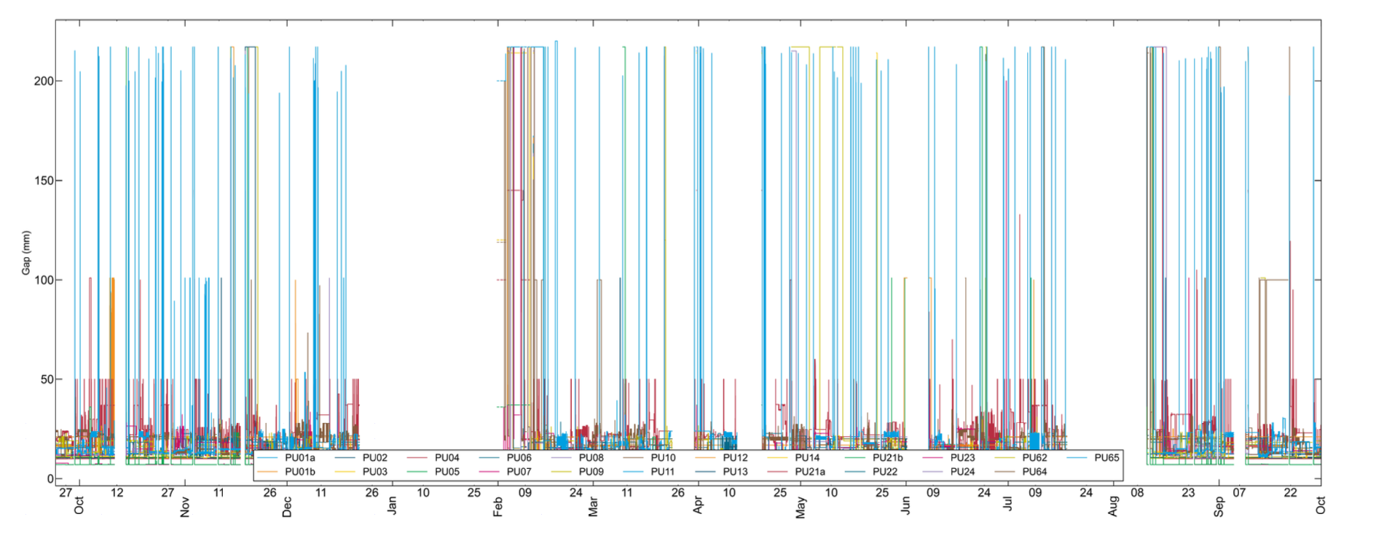
Deep Learning explored - NN-based control
B. Veglia
Moving undulator gaps creates orbit distortions, that are compensated by correctors, settings are from feed-forward tables (and additionally orbit feedback)
The gap dependency is nonlinear, and can be approximated by a NN

Slide 15
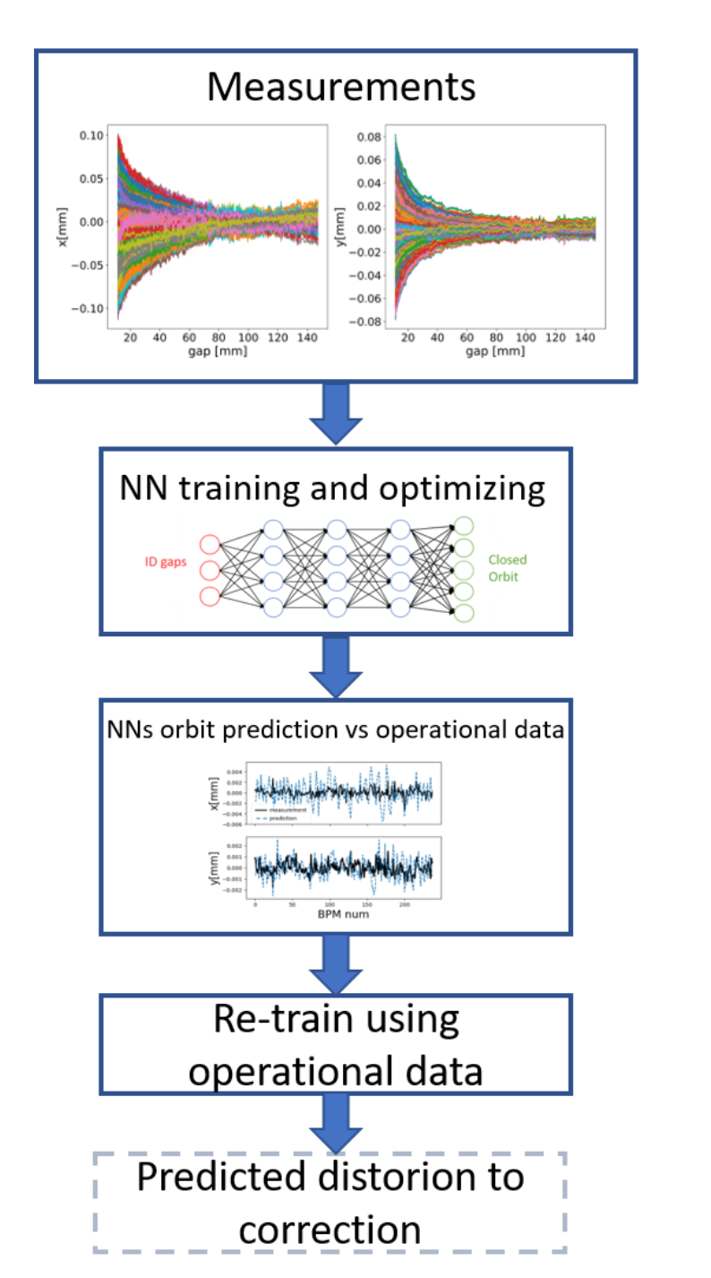
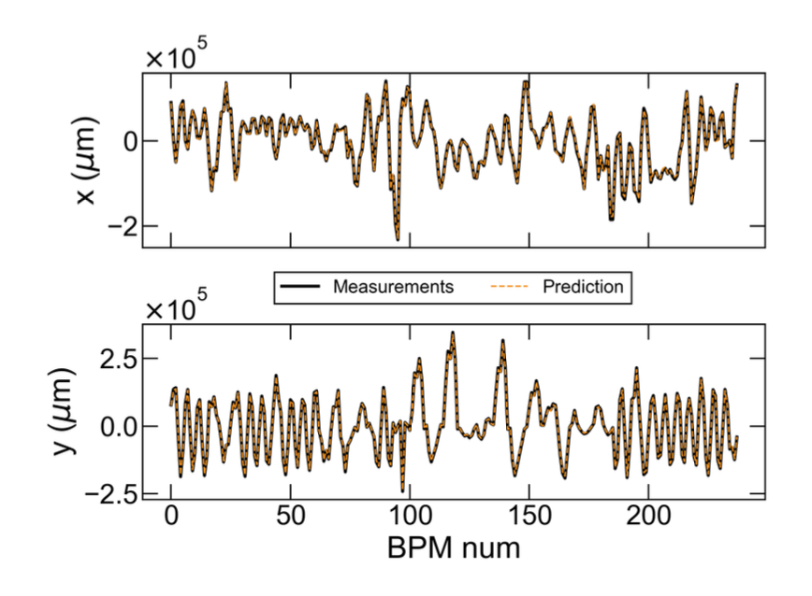
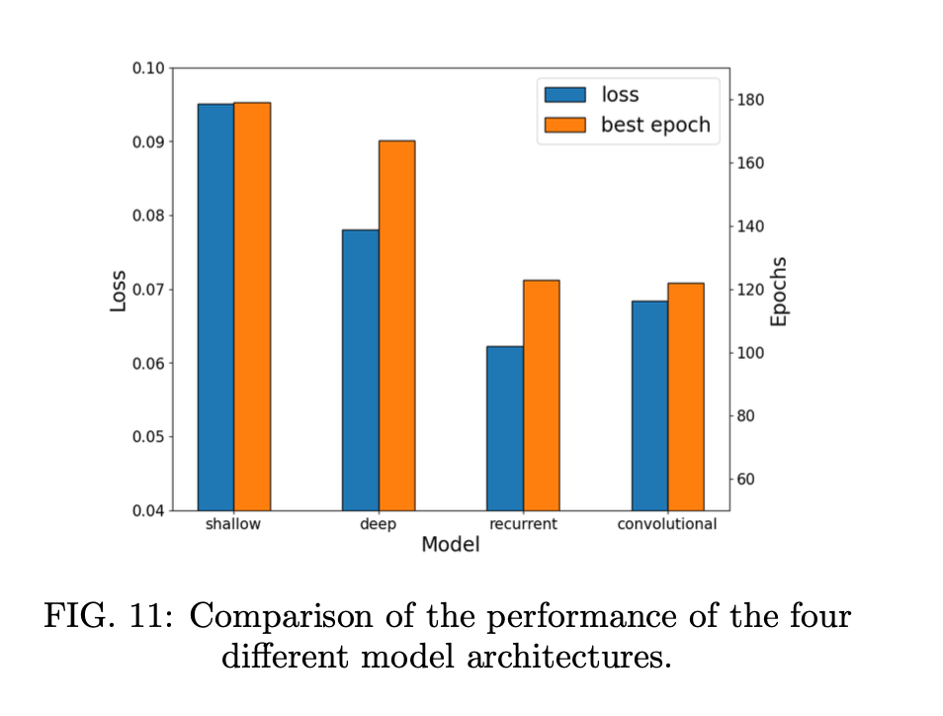
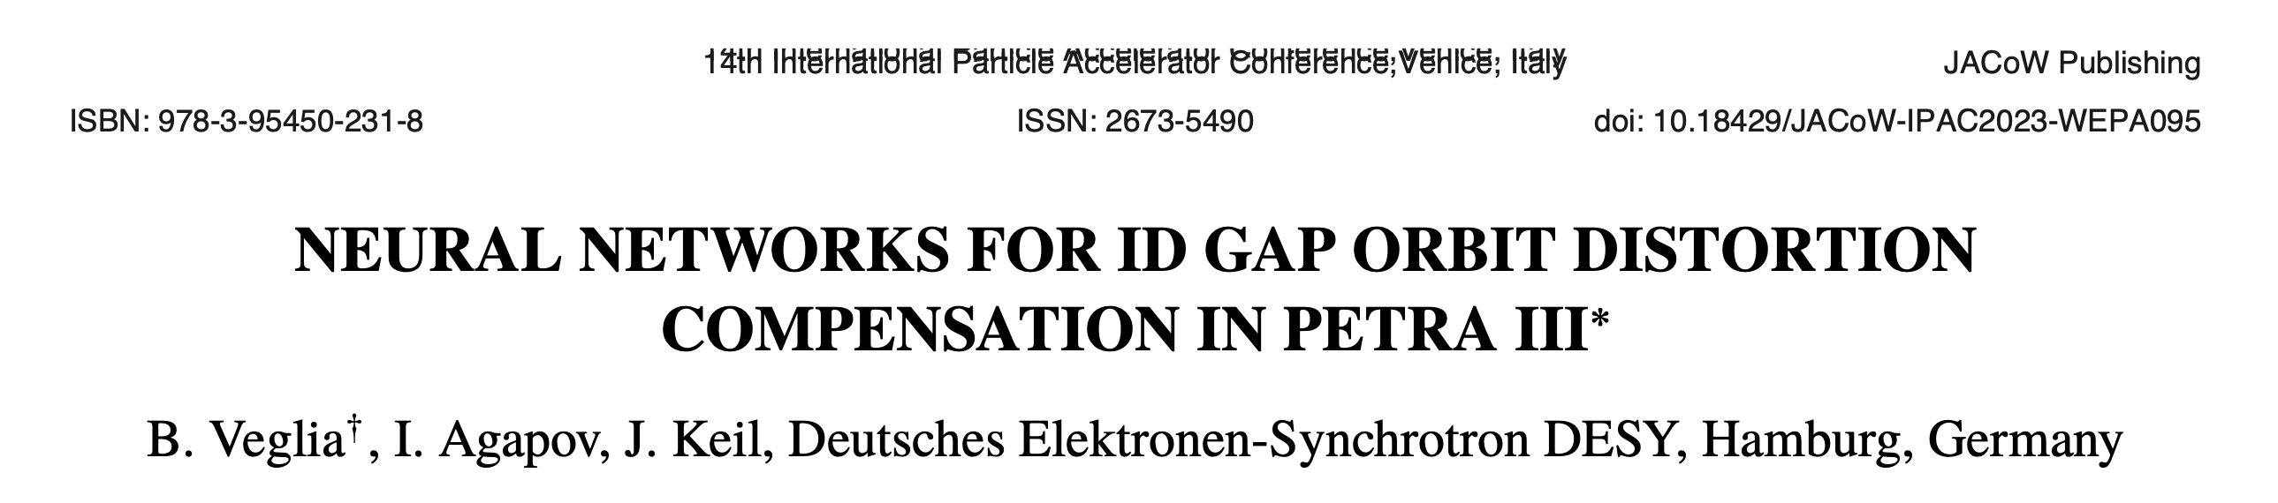
Deep Learning explored - NN-based control
B. Veglia
Several NN architectures trained on measured data
Model can be stably re-trained in operation (albeit not in user run)
Predictions are accurate and can be used in a control loop

Slide 16
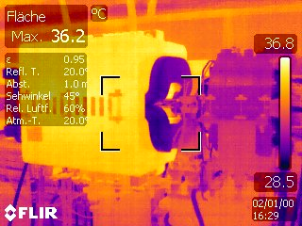
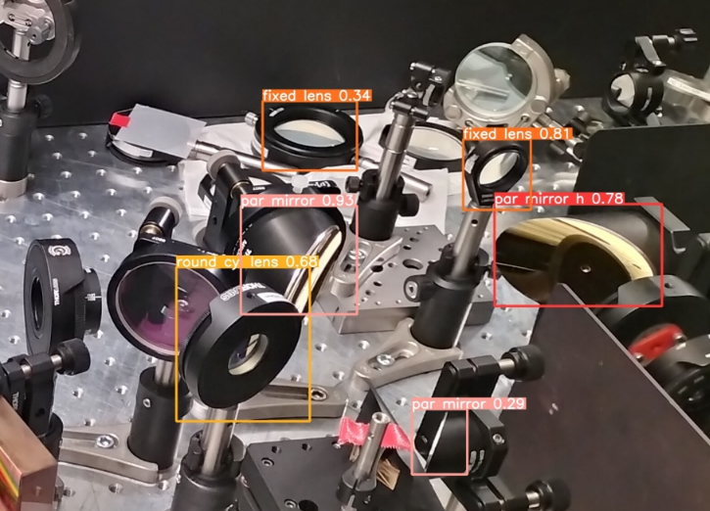
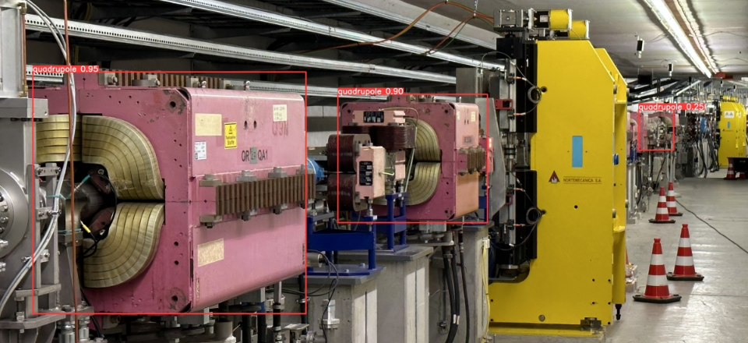
Deep learning explored - computer vision
B. Veglia
Trained DNNs to perform identification of several types of equipment in visible and IR
Possible first step towards autonomous navigation in a tunnel or laboratory
To be presented at the ICFA ML workshop in 3 weeks

Slide 17
ML engineering - concept
Can we create a system that is capable of decision-making and controlling a facility?
Created software infrastructure that allows AI agents/services to communicate
Following features were foreseen:
  Protocol of communication between various agents over a network
  Execution of control sequences by certain agents
  Triggering of AI models to retrain on HPC cluster
  Operation in simulation mode
  Mimicking a communication procedure between human operators

Slide 18
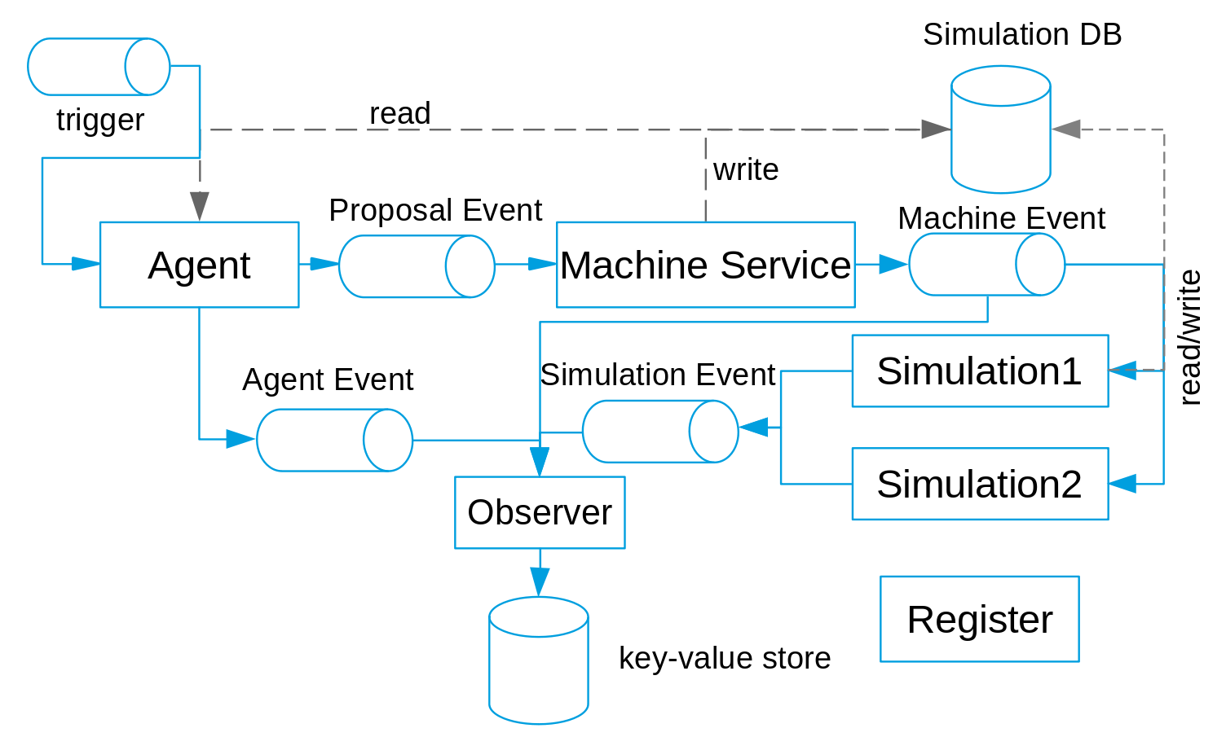
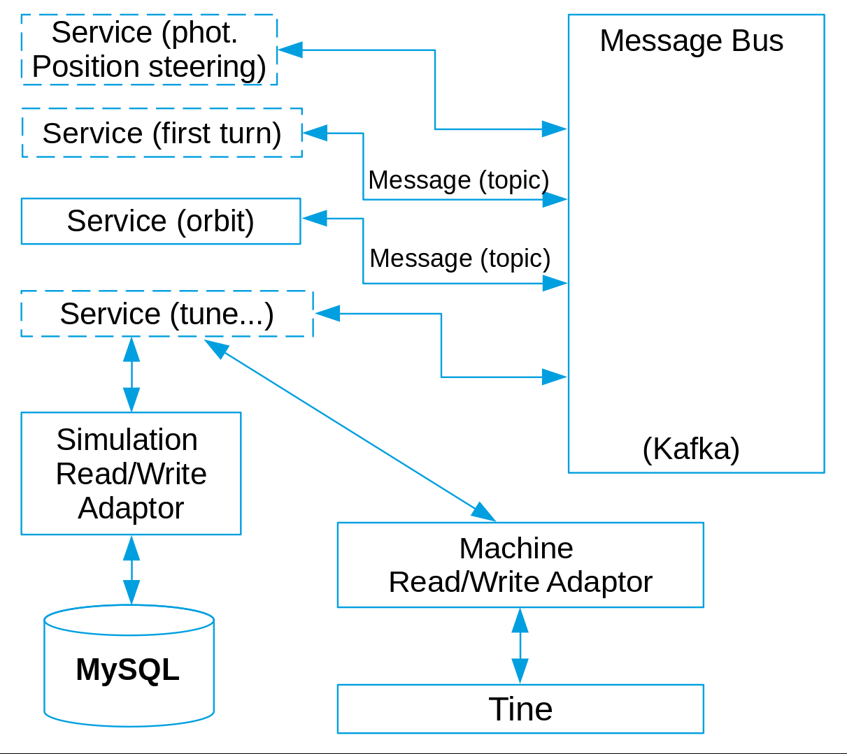
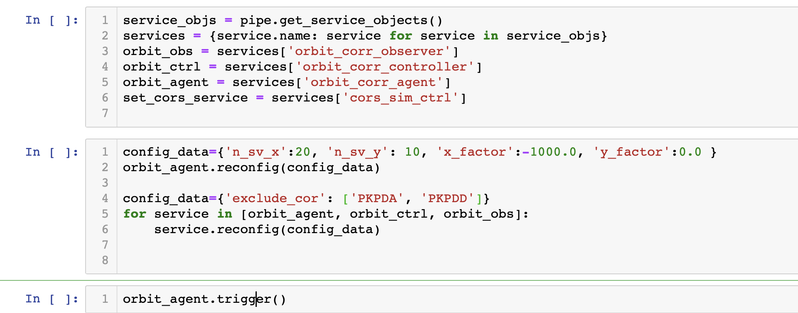
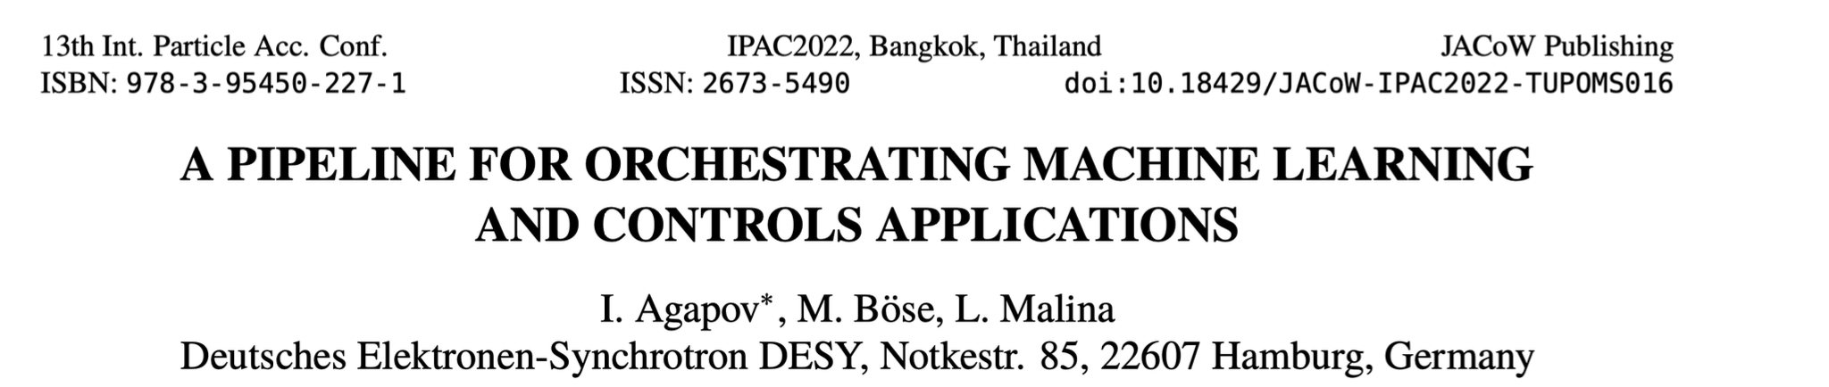
ML engineering implementation - too complex
M. Boese

Slide 19
ML engineering lessons learned and challenges
Even with very reduced functionality a complex software stack was emerging
The software stack would have been unmaintainable in operation with current workforce
The effort to bring an ML “jupyter notebook” research project to production has been becoming clear
Typical number of employees in AI-centric industries:
  DeepMind: 2000
  OpenAI: 770
  TESLA Autopilot: > 1000
Typical AI effort in accelerator laboratories: 2-5 per laboratory (1 for PETRA), mostly funded via grants with research objectives. With that, goals such as “autonomous facility” are unrealistic.
To reach future operation goals, we reverted to gradual improvement of legacy tools (“taskomat”, “save/restore”, “startup script”, etc.)

Slide 20
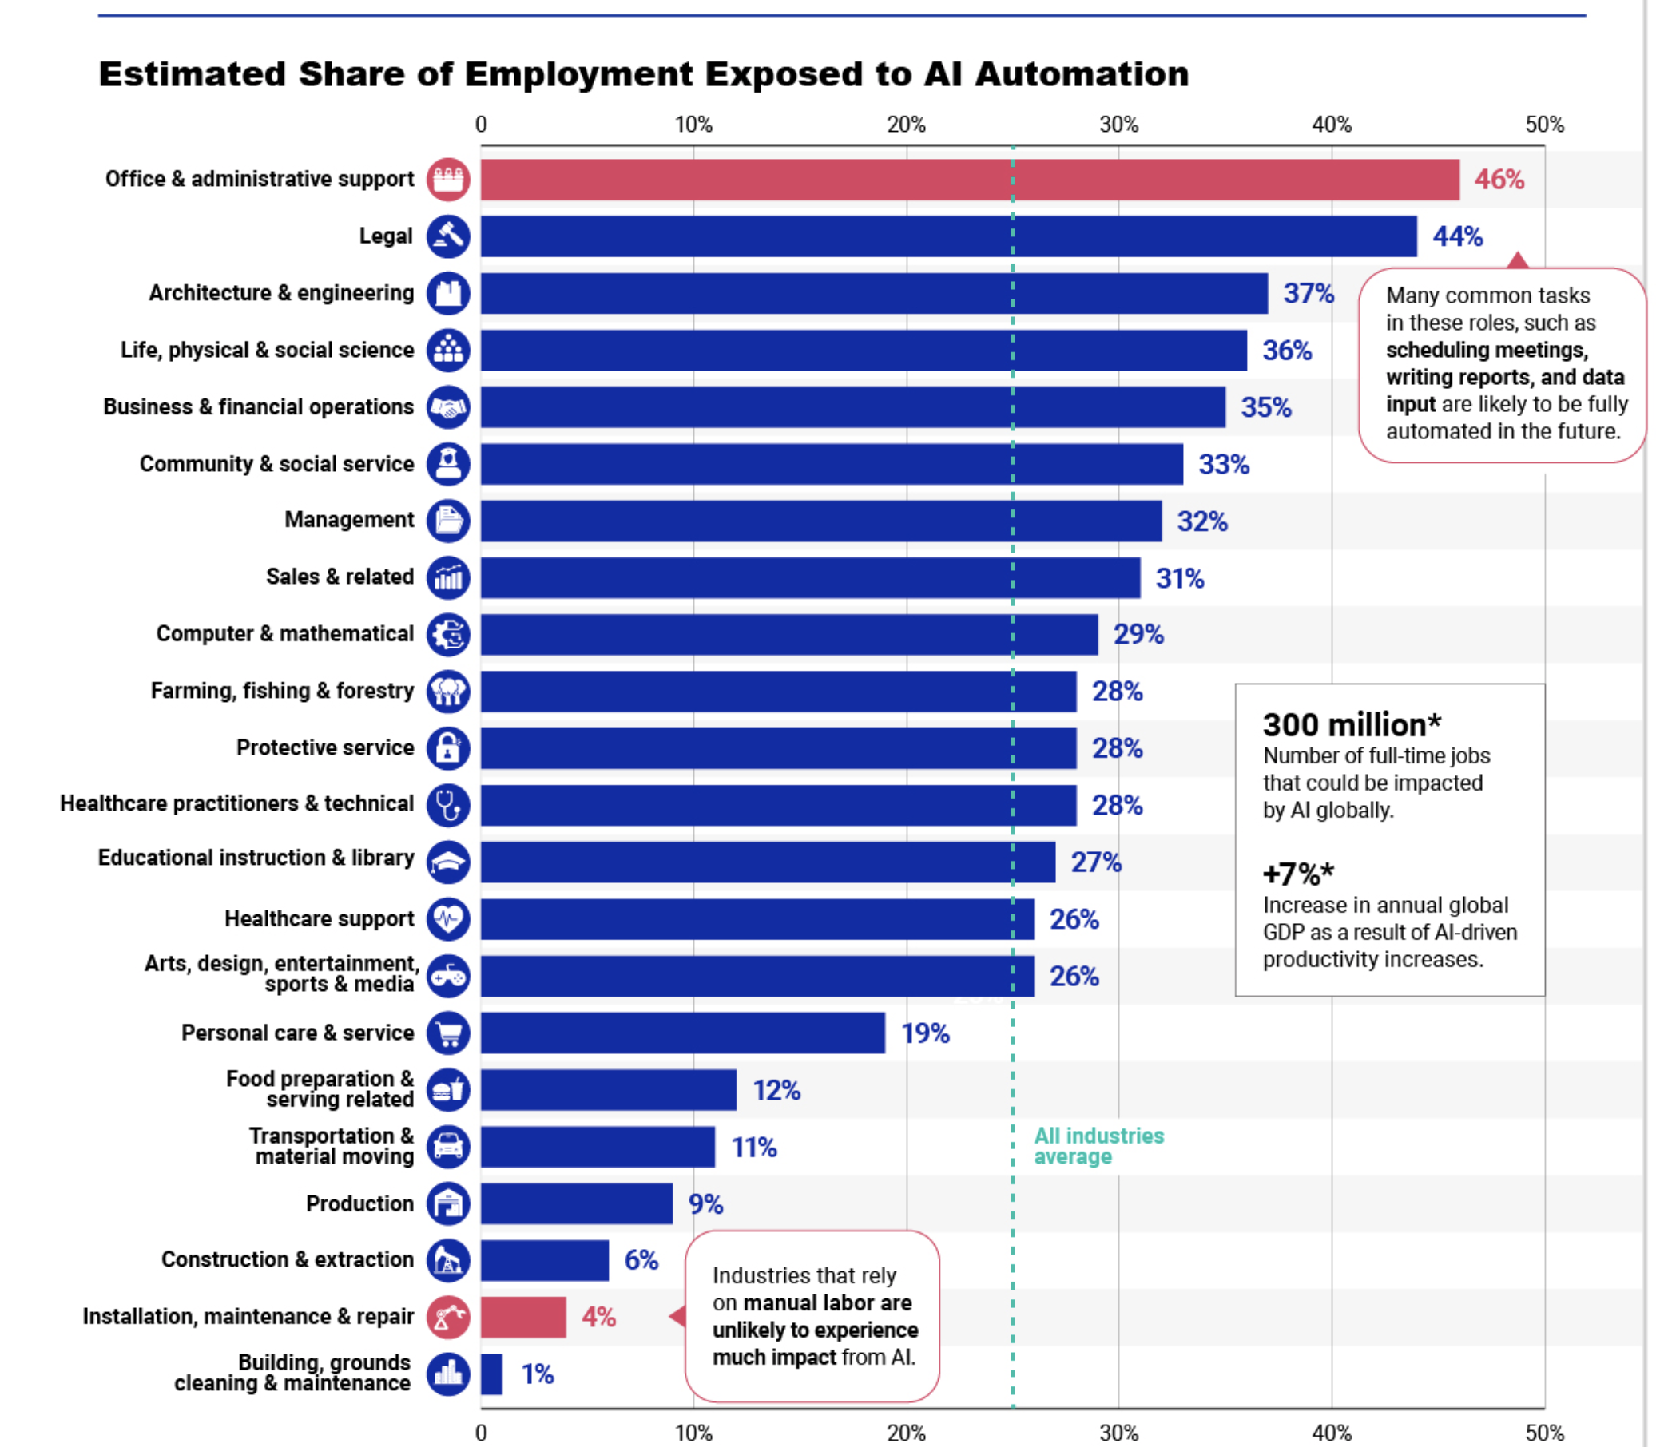
Is accelerator physics/operation easily “automatable”?
Stop to reflect:
maybe the activity is inherently too complex
to automate completely
https://writerupdated.com/2023/06/28/industries-highest-potential-for-ai-infographic/
Physics has a high potential for automation

Slide 21
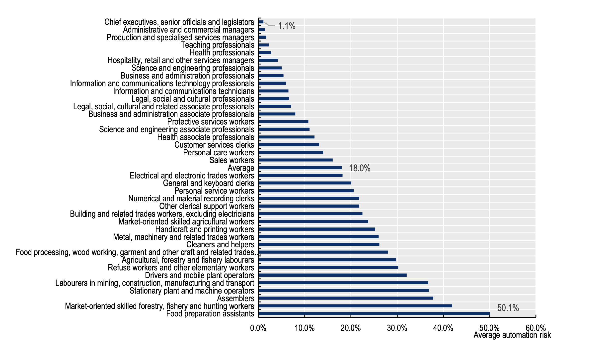
Is accelerator physics/operation easily “automatable”?
OECD Future of work:
Physics is not at risk of automation!
What are we to expect?

Slide 22
Way forward?
We can run all present facilities (even newest ones such as the EBS and APS-U) the old way (“matlab middle layer”)
ML/AI capabilities are nice to have but not essential
Economic and social impacts of AI in accelerator facilities should be better understood (cost of implementing AI system vs. running cost of a facility is high)
We are facing increasing danger of a large body of legacy operation and simulation software in danger of being unmaintainable in the future
Investing in modern computing capabilities is essential
AI/ML deployment will automatically follow
Challenge: incremental advance while keeping the effort relatively low and aligning with short-term facility goals
Side note: ChatGPT became standard tool in research (writing papers, presentation, code, information retrieval). Consequences might be profound

Slide 23
Summary and outlook
A number of applications of ML to accelerator-related problems have been demonstrated
Deployment beyond proof-of-principle has been difficult: there are no running ML/AI applications at PETRA III and no ML techniques have been used in PETRA IV design
There are no plans as of now to integrate AI into PETRA IV operation
AI techniques are now commonplace in consumer products
We need to bring state of the art software engineering to SR facilities as a first step towards successful AI deployment
But economics of that is challenging
Most promising avenue seems to be aligning with large infrastructure projects such as the FCC
Need to explore ways to incrementally incorporate advancing software technologies - e.g. via the pyML collaboration

