Slide 1

CHARACTERIZATION OF THE VERTICAL BEAM HALO
FOR REDUCED
IN-VACUUM UNDULATOR GAP
9th Low Emittance Rings Workshop 2024, CERN, Geneva (Switzerland),
13-16 of February 2024,
Mattia Stefanelli.
The Beam Dynamics Group:
Simon White, Nicola Carmignani, Lee Carver, Simone Liuzzo, Thomas Perron, Lina Hoummi.
Kees Scheidt and the Diagnostic Group for the Halo Monitors material.
The ID Group for the help in the ID31 Scan data measurements.
All the members of the Operation Group.

Slide 2
OVERVIEW
The context
Vertical Halo:
  From Touschek Scattering to Resonance Crossing
  Resonance Crossing and Emittance Growth
Strategy for Vertical Halo Reduction
Experiments:
  Halo Monitor
  Validation of the Proposed Strategy
  Determination of a New Setup with Reduced Vertical Halo
Results
Acknowledgements
MATTIA STEFANELLI

Slide 3
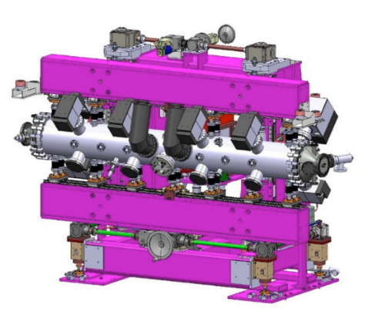
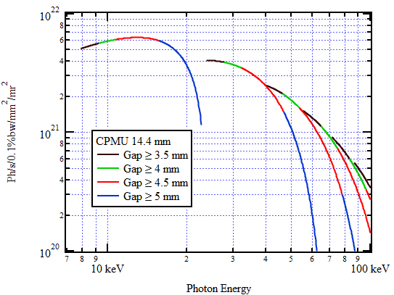
The context
ESRF-EBS is a fourth-generation high-energy synchrotron currently in operation.
In order to exploit, at its full potential, the EBS design we aim to reduce the gap of the
available In-Vacuum Undulators,
down to 4 mm, increasing the brilliance of the radiation received by the beamlines.
Although, for gaps lower than 5 mm, relevant losses are observed preventing small gap operation.
This is due to the presence of the VERTICAL BEAM HALO.
Acknowledgement to Gael Le Bec.
MATTIA STEFANELLI

Slide 4
vertical Halo
From Touschek Scattering to Resonance Crossing:
The momentum of scattered particles is transferred from the horizontal to the longitudinal plane. Particles may acquire great energy deviations (ΔE/E), being lost outside the RF bucket, but, some of them could remain in within the stable region (ΔE/E in ± 4%).
The presence of a finite dispersion and chromaticity induces, for those particles, deviations in trajectories and betatron oscillations.
This leads to the crossing of tune resonances, not encountered by the particles at nominal energy. In particular the sum resonance that introduces coupling in between the horizontal and the vertical oscillations.
This latter step could explain the arising of a complete unlike vertical distribution that extends for several millimeters of distance with respect the beam core.
MATTIA STEFANELLI

Slide 5
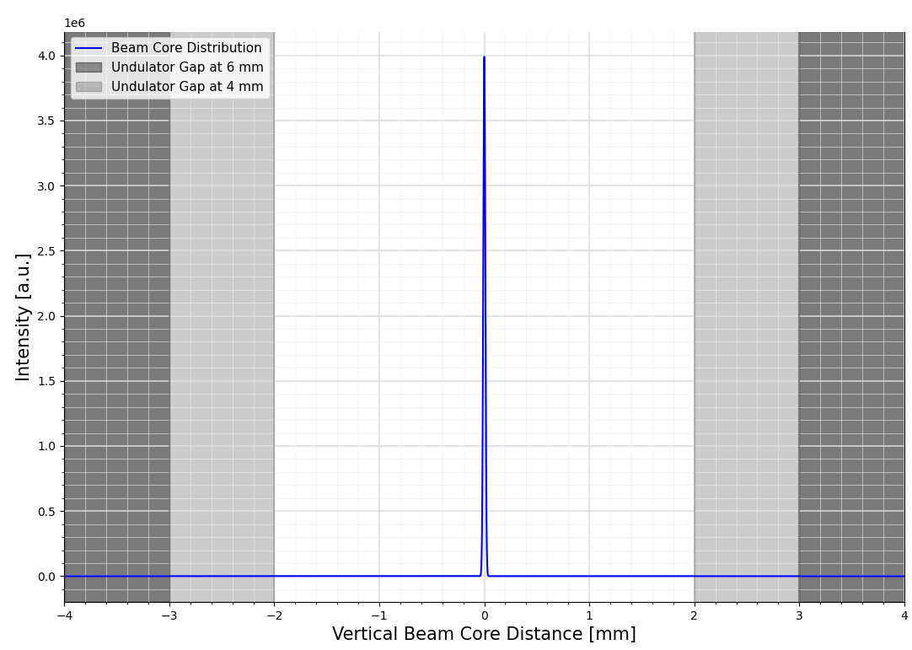
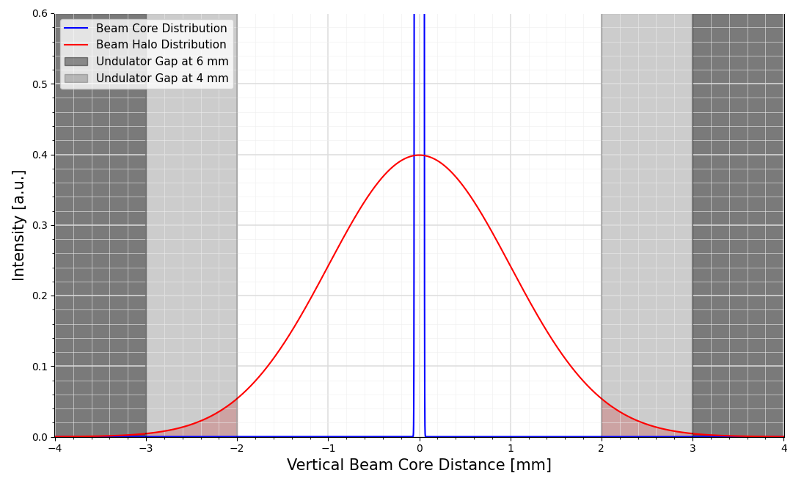
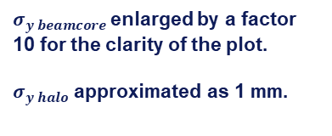
vertical Halo
Vertically, where usually the beam size is in the order of the µm, this new contribution impose a limit in the In-Vacuum Undulator gap closure, preventing the further enhancement of photon flux.
Several order of magnitude of difference
1e0
Not negligible electron population
$σ_{y beamcore}$enlarged by a factor 10 for the clarity of the plot.
$σ_{y halo}$ approximated as 1 mm.
MATTIA STEFANELLI

Slide 6
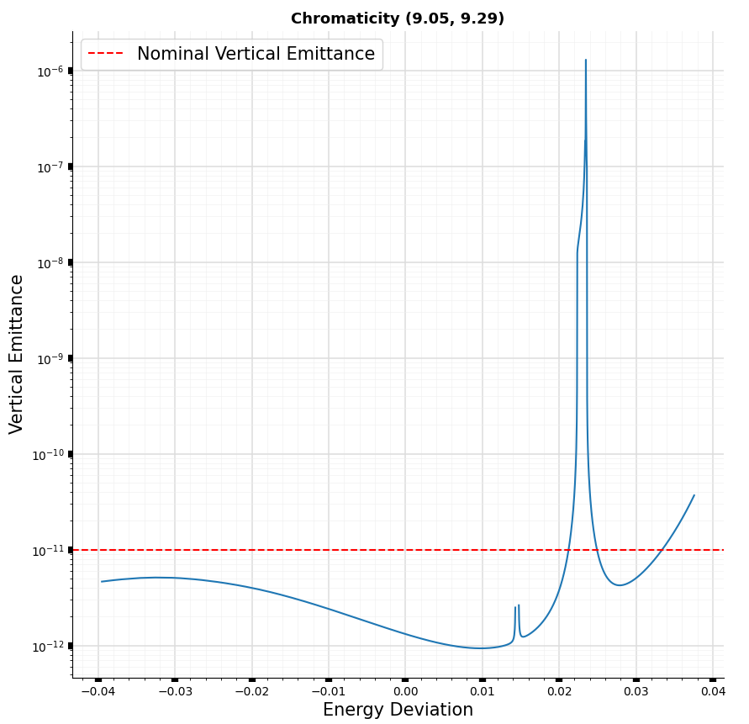
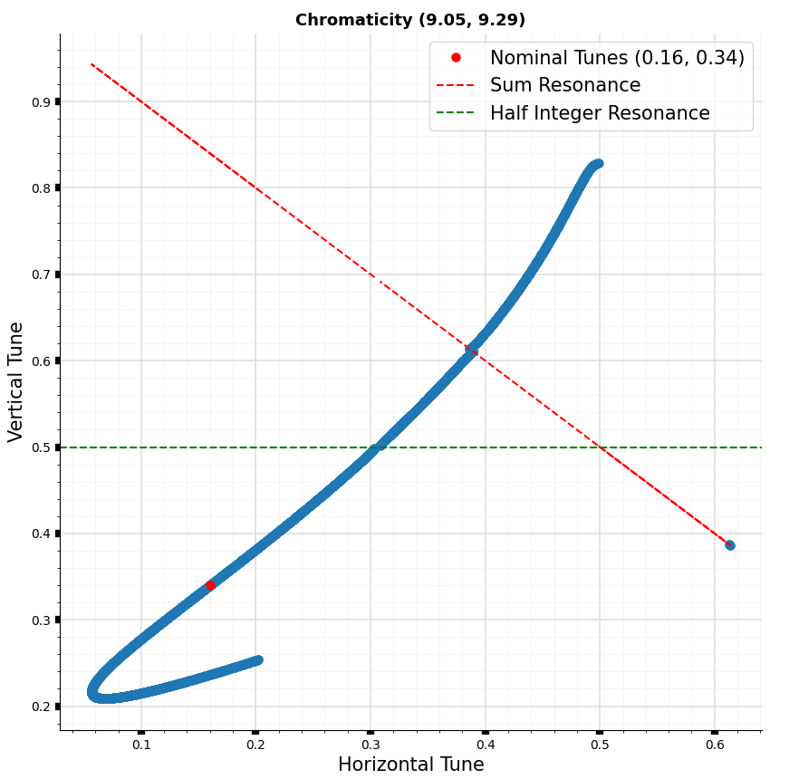
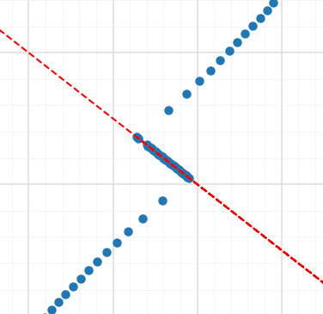
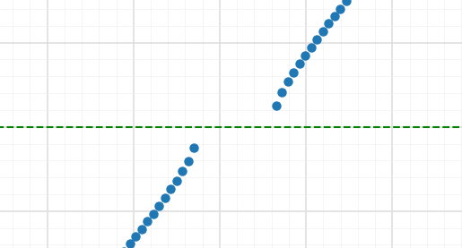

Vertical Halo
Resonance Crossing and Emittance Growth: simulation carried on in pyAT with a set of quadrupole errors satisfying the following criteria, vertical emittance = 1 pm, horizontal and vertical beta-beating = 1%, horizontal and vertical orbit distortion = 50 µm.
(b)
$$σ_{y}≈few mm$$
PARTICLES NOT LOST
(b)
(a)
(a)
MATTIA STEFANELLI

Slide 7
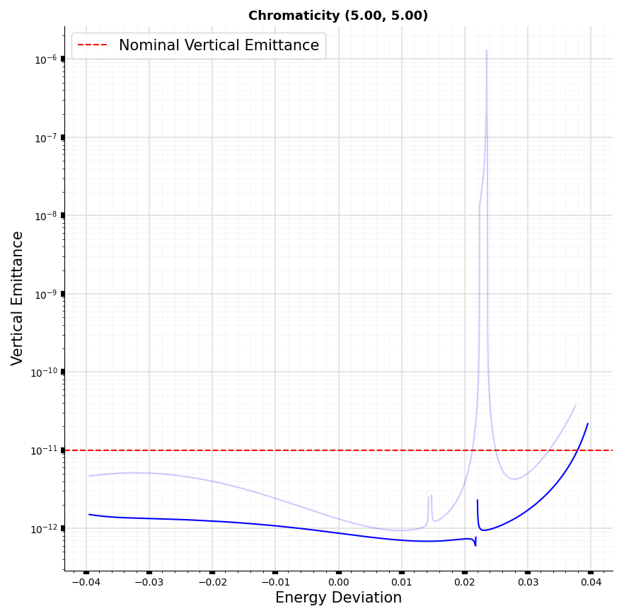
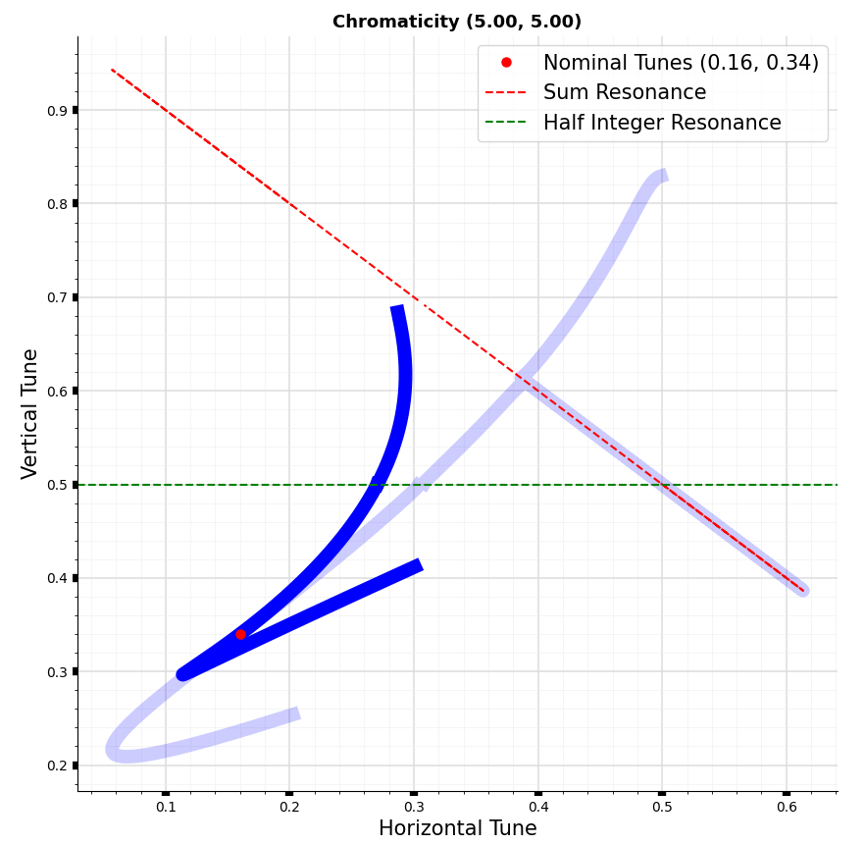

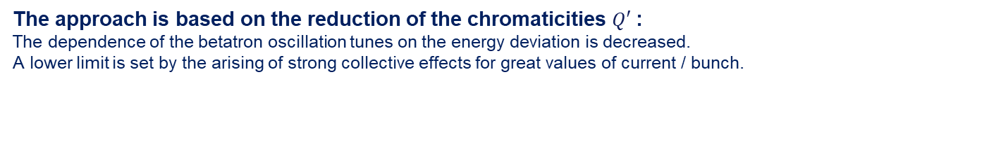
Strategy for vertical halo reduction
The approach is based on the reduction of the chromaticities $Q′$:
The dependence of the betatron oscillation tunes on the energy deviation is decreased.
A lower limit is set by the arising of strong collective effects for great values of current / bunch.
$${Q′}_{x,y}= \frac{∆ν_{x,y}}{∆δ}$$
(b)
(b)
(b)
(a)
(a)
(a)
MATTIA STEFANELLI

Slide 8
experiments
Experiments carried on have been divided in 2 steps:
Validation of the proposed strategy.
Determination of a new setup with reduced vertical halo (Low Chromaticity Setup).
Three different signals have been used for the halo detection:
HALO MONITOR SIGNAL
LIFETIME
LOCALIZED LOSSES
Non-destructive measurement.
Lifetime reduction associated with vertical scrapers closure.
Destructive measurement.
Localized losses increase with ID31 In-Vacuum Undulator gap reduction.
MATTIA STEFANELLI

Slide 9
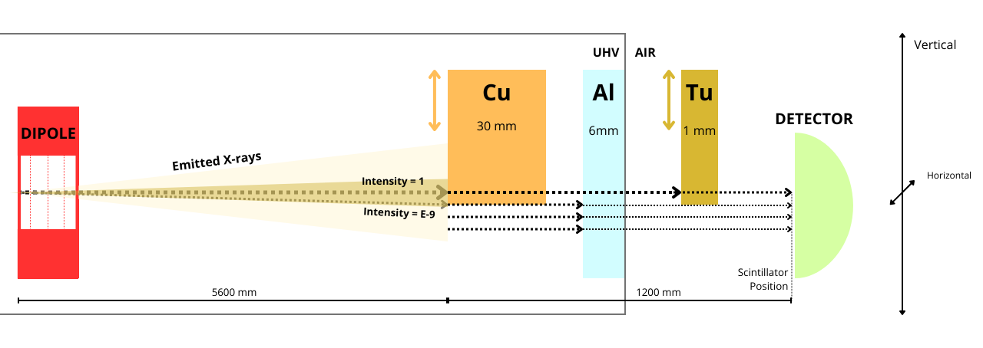
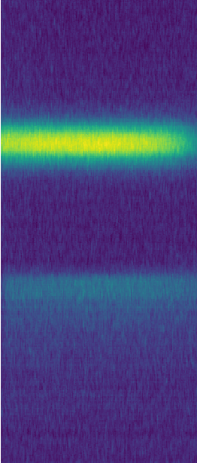
experiments
Halo Monitors:
X-rays emitted in DQ1D dipole in cell-10 and cell-11 are collected by an optical detector.
Radiation emitted by the beam core is shielded in order to make it comparable with the halo contribution, several order of magnitude lower.
Acknowledgement to Kees Scheidt.
RESIDUAL
BEAM CORE
BLIND ZONE
HALO
MATTIA STEFANELLI

Slide 10
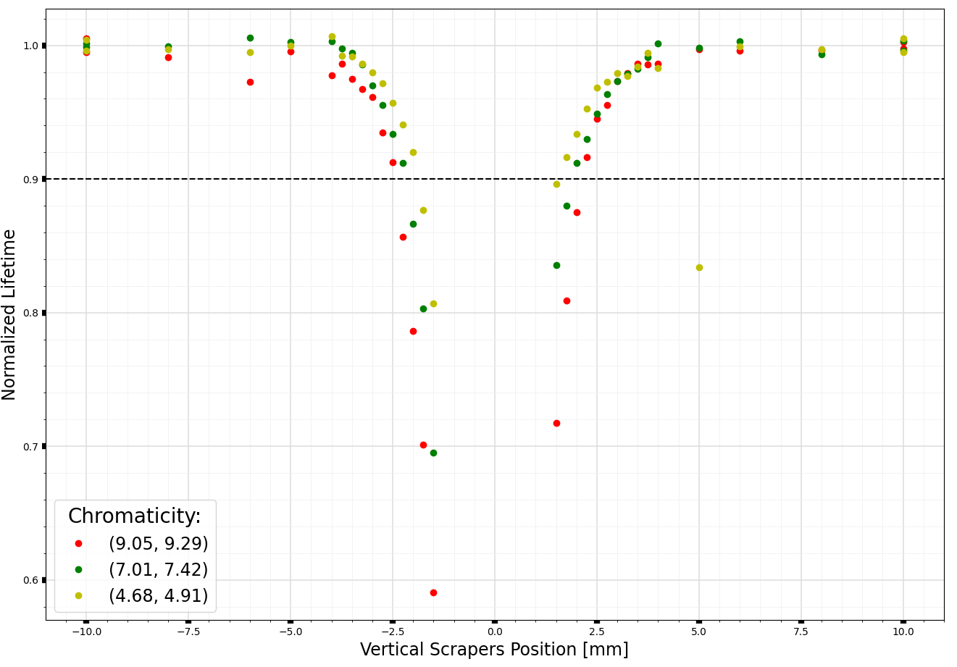
Experiments
Validation of the proposed strategy:
Normalized Lifetime with the vertical scrapers gap for different chromaticities.
Ex. Accepting a lifetime reduction of 10%:
Nominal Setup:
Aperture ≈ 5 mm
(4.68, 4.91) Setup:
Aperture ≈ 4 mm
Gap gain ≈ 1 mm
Lifetime reduction = 10%
Chromaticity
Reduction
MATTIA STEFANELLI

Slide 11
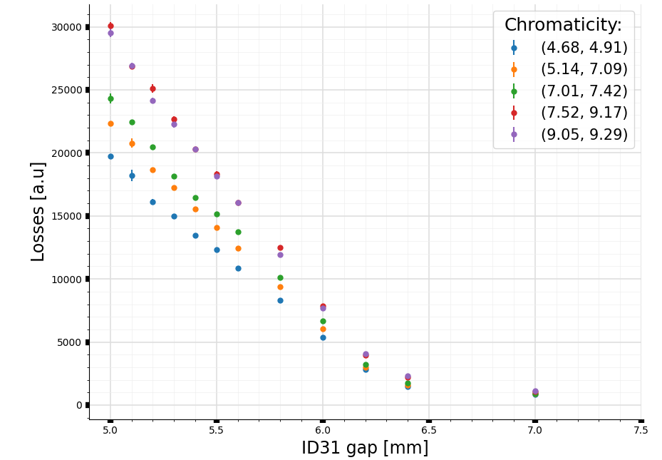
experiments
Validation of the proposed strategy:
Localized Losses at ID31 with the ID31 gap for different chromaticities.
Losses reduction at minimum gap
≈ factor 1.5
Chromaticity
Reduction
MATTIA STEFANELLI

Slide 12
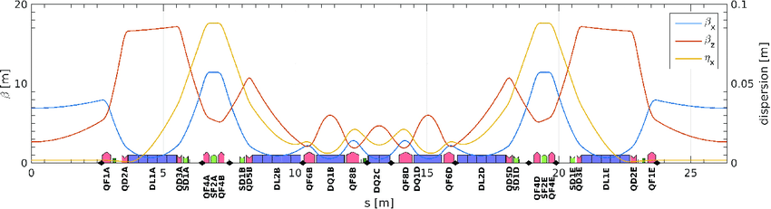
experiments
Determination of a new setup with reduced vertical halo (Low Chromaticity Setup):
BADGER, a software designed to access several optimizers, is run with the Xopt Trust Region Bayesian Optimization (TuRBO) algorithm, developed at SLAC, in order to find a better setup:
The signal detected by the halo monitors is used as reference for the optimization process while 5 families of knobs are used as observable for tune and chromaticity corrections.
Tunes correction:
Chromaticity correction:
QF1
SD1A – SD1E
QD2
SF2
SD1B – SD1D
MATTIA STEFANELLI

Slide 13
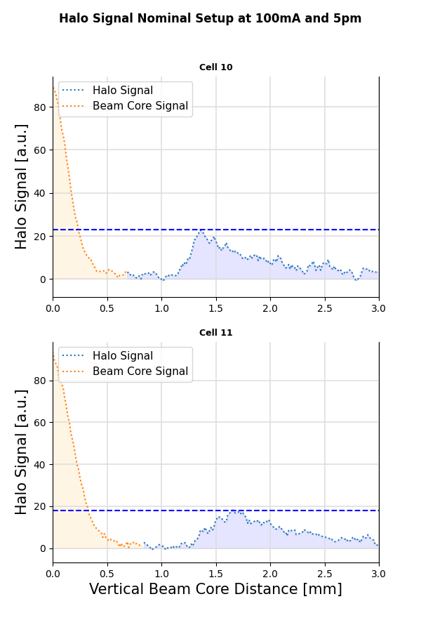
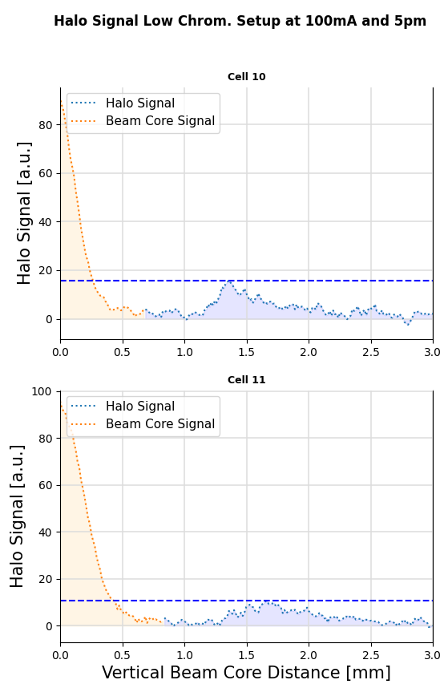
experiments
The new setup has been chosen as a compromise between halo signal reduction and high enough chromaticity to avoid too strict limitations on the possible current per bunch.
Nominal Starting Condition:
Chromaticity = (9.05, 9.29)
Tune = (0.16, 0.34)
New Low Chromaticity Setup:
Chromaticity = (7.33, 4.74)
Tune = (0.16, 0.31)
MATTIA STEFANELLI

Slide 14
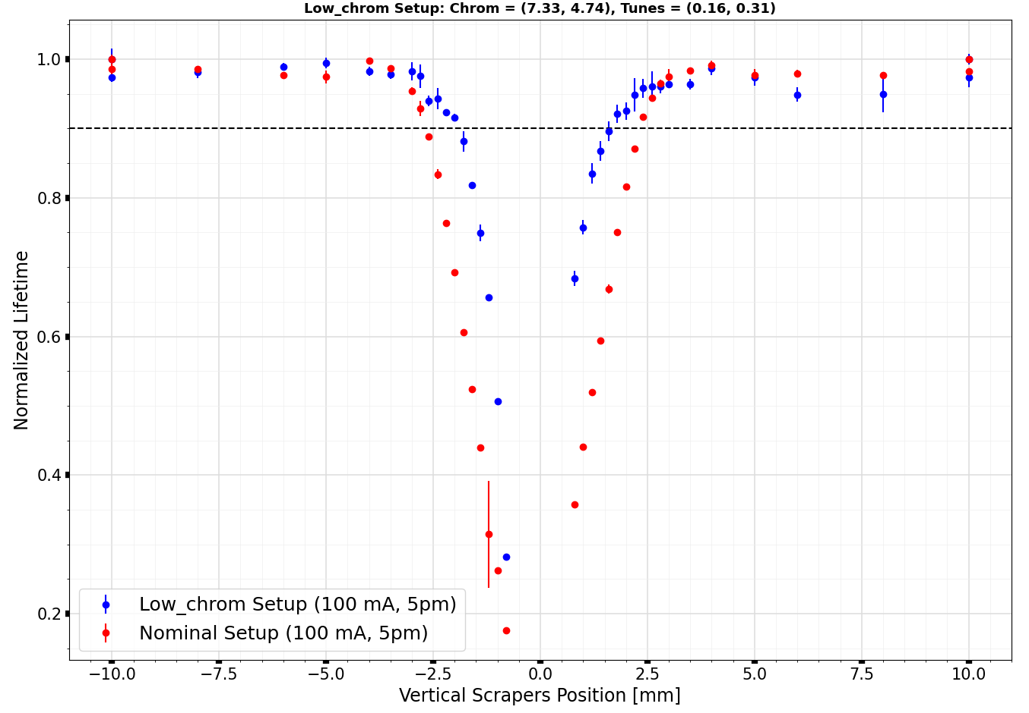
results
Validation of the proposed strategy:
Normalized Lifetime with the vertical scrapers gap for different chromaticities.
Ex. Accepting a lifetime reduction of 10%:
Nominal Setup:
Aperture ≈ 5 mm
Low_chrom Setup:
Aperture ≈ 3.5 mm
Gap gain ≈ 1.5 mm
Lifetime reduction = 10%

Slide 15
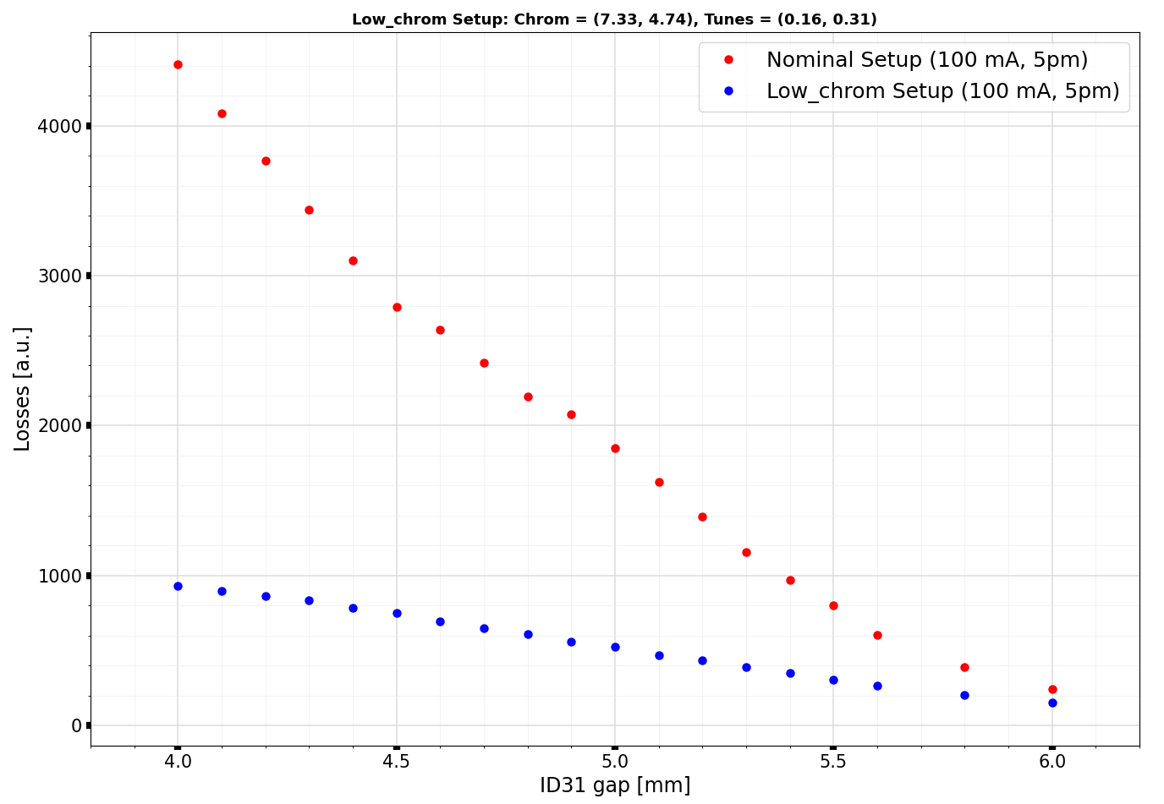
results
Validation of the proposed strategy:
Localized Losses at ID31 with the ID31 gap for different chromaticities.
Losses reduction at minimum gap
≈ factor 4
Previous result of
≈ factor 1,5
Obtained with lower horizontal chromaticity and larger gap (5 mm)

Slide 16
results
The Low Chromaticity setup was finally tested also at 200mA and 10pm of vertical emittance in 7/8 filling mode with injection efficiency and lifetime comparable with the operation file used in USM (User Service Mode).
We then inject current in the single bunch to approach the 7/8+1 USM and test the maximum current/bunch achievable without bunch-by-bunch feedback:
Max. Current/Bunch = 4.6 mA (8 mA in USM).
Uniform filling mode.
Other filling modes currently under investigation.

Slide 17
acknowledgements
The Beam Dynamics Group:
Simon White, Nicola Carmignani, Lee Carver, Simone Liuzzo, Thomas Perron, Lina Hoummi.
The Diagnostic Group for the Halo Monitors material.
The ID Group for the help in the ID31 Scan data measurements.
All the members of the Operation Group.
MATTIA STEFANELLI

Slide 18
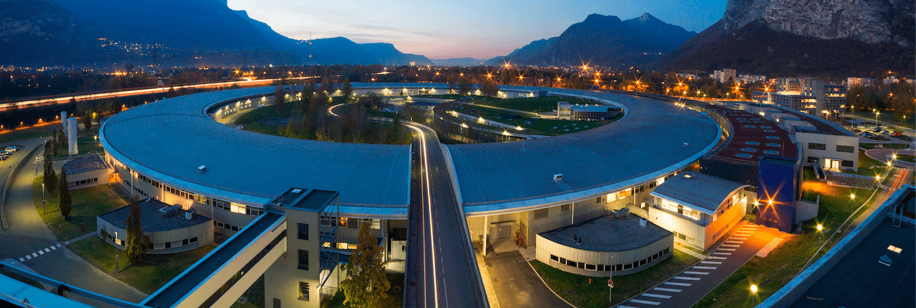
THANKS FOR YOUR ATTENTION

Slide 19
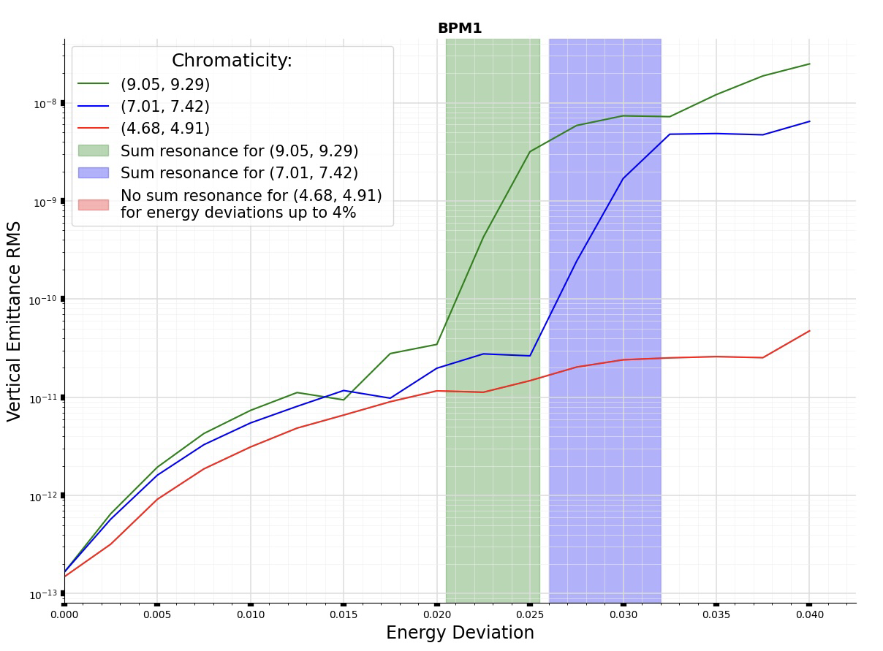
BACKUP SLIDES

Slide 20
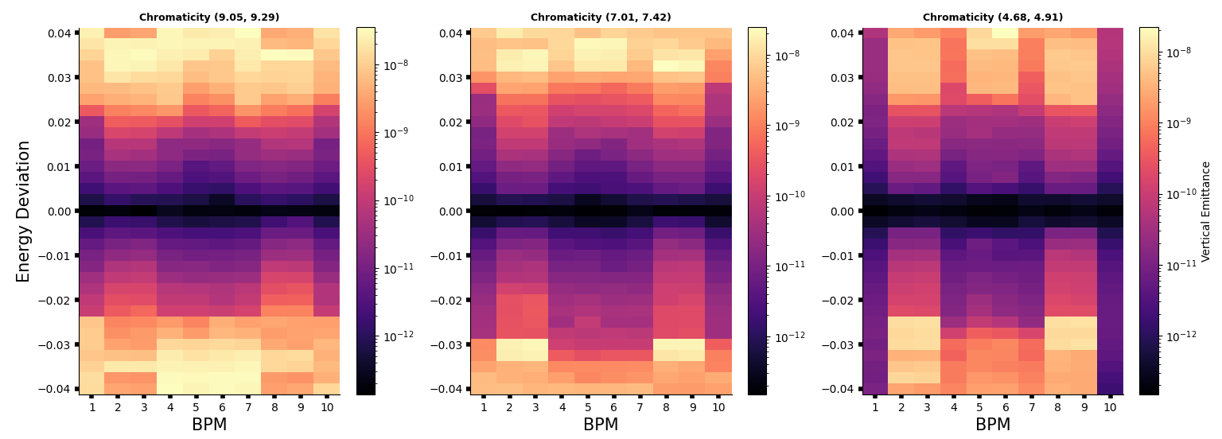
BACKUP SLIDES

