Slide 1
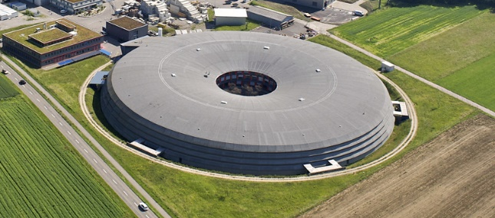
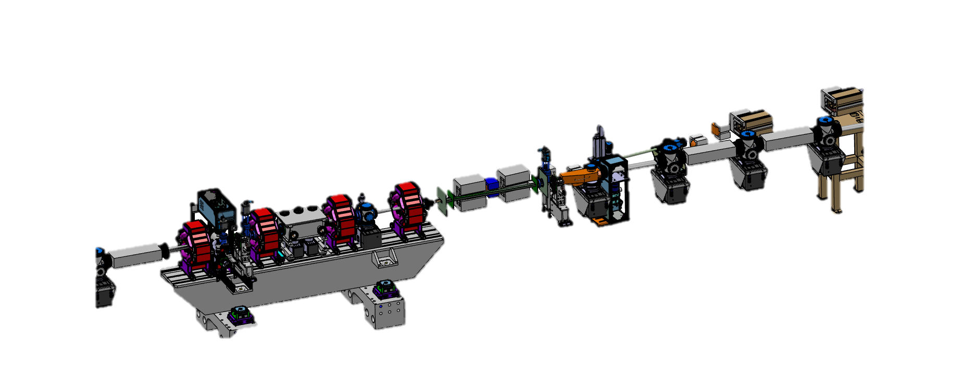
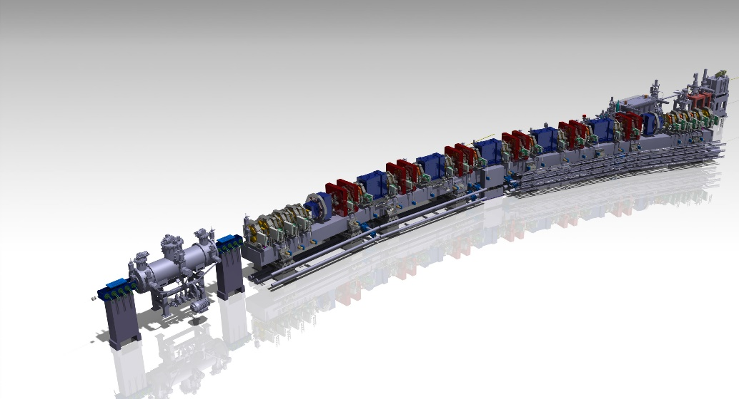
Injection Hardware Challenges of
Low Emittance Rings –
SLS 2.0 Injection Elements
M. Paraliev
Transfer line
Swiss Light Source (SLS) part of
Paul Scherrer Institute,
Switzerland
Storage ring
Beam dump
Thick septum
Thin septum
Injection straight
Fast Kickers
Straight two

Slide 2
Why is it Necessary to Upgrade Injection Hardware?
Injection in small dynamic aperture
Due to the new SLS 2.0 low emittance lattice the beam acceptance of the machine is reduced. A thin septum should make the conventional 4-kicker bump injection possible [1].
Top-up injection transparency
Advanced injection modes like fast injection and on-axis injection will improve further top-up injection transparency [2].
Beam dump
Due to the much smaller dispersion in the arcs (compared to SLS 1) an RF phase inversion-based beam dump might not be acceptable, causing beam loss and irradiation of sensitive devices like superconducting superbends and in-vacuum undulators. To avoid deterioration or damage, a dedicated beam dump magnet should deflect the beam towards well shielded beam dump.
Improved septa
Fast injection elements
Dedicated beam dump

Slide 3
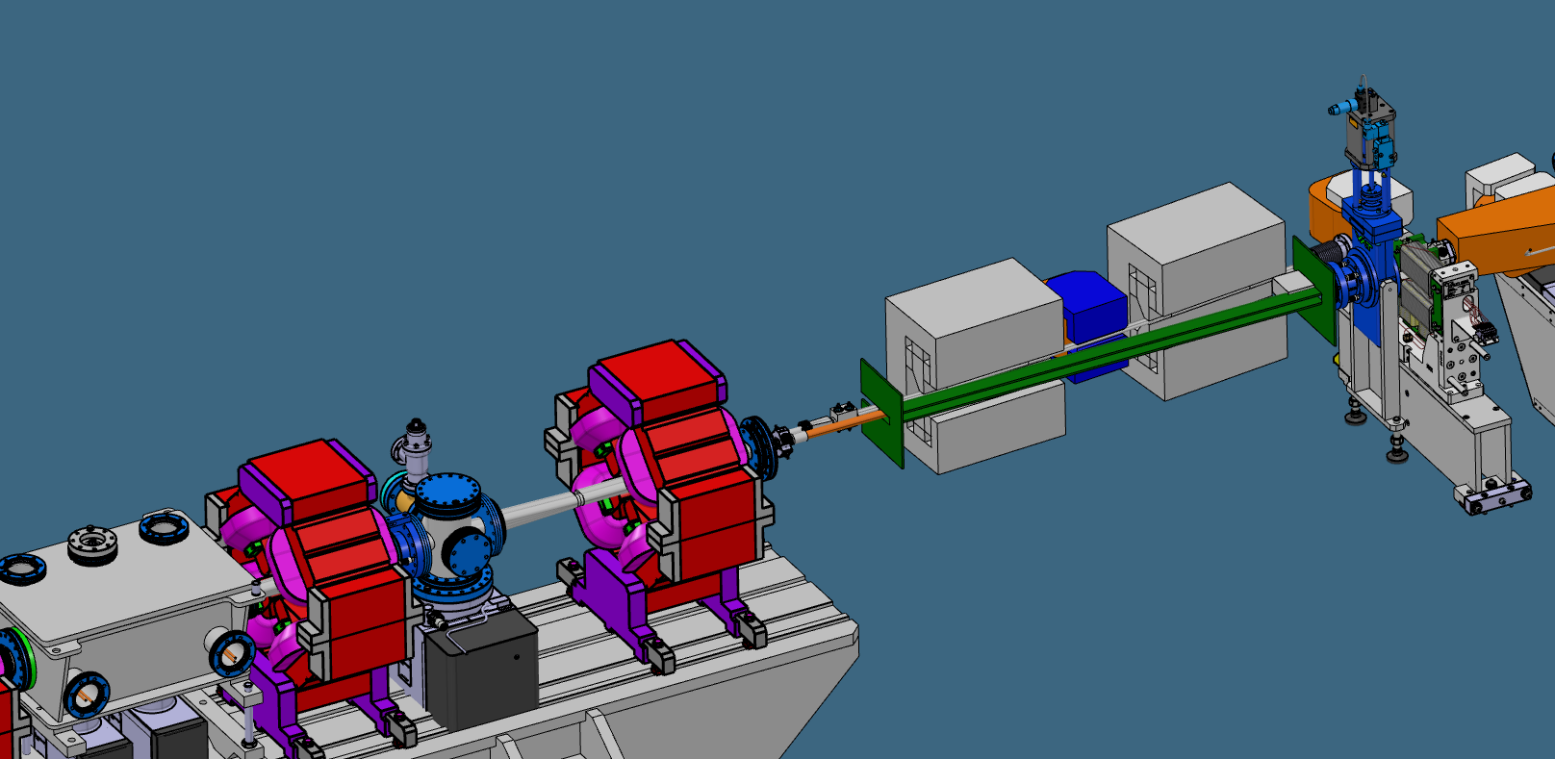
SLS 2.0 Permanent Magnet-based Thick Septum
Permanent magnet-based septum will ensure the necessary stability and deflection of the injected beam benefiting from practically maintenance-free device. Advance magnetic materials like CoFe high magnetic saturation alloys make possible to screen the dipole field in the stored beam region.
Split septum design with and electrical corrector in the middle
Soft magnetic material sandwich-shielding for the stored beam
  Thick Septum Specification
Parameter | Thick Septum
Gap, mm | 10
Magnet length, m | 2x 0.35
Bending angle, mrad | 120@2.7 GeV
Field integral, T.m | 1.1
Gap field. T | 1.57
Permanent magnets’ type | Sm₂Co₁₇
Target zero-field integral, μT.m | 50
Shielding coefficient, - | >20000
Temperature stability, ppt/K | 0.1
  Thick septum 3D model

Slide 4
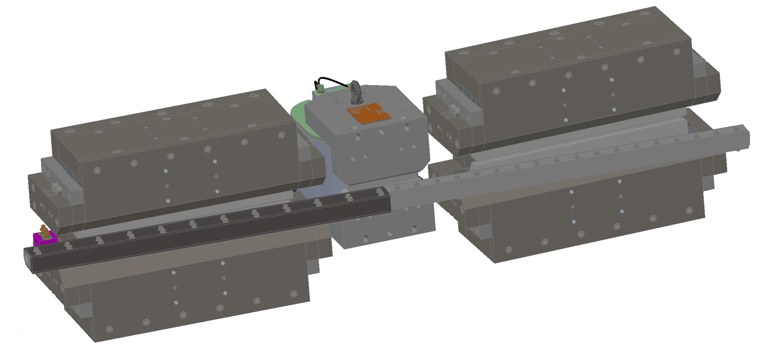
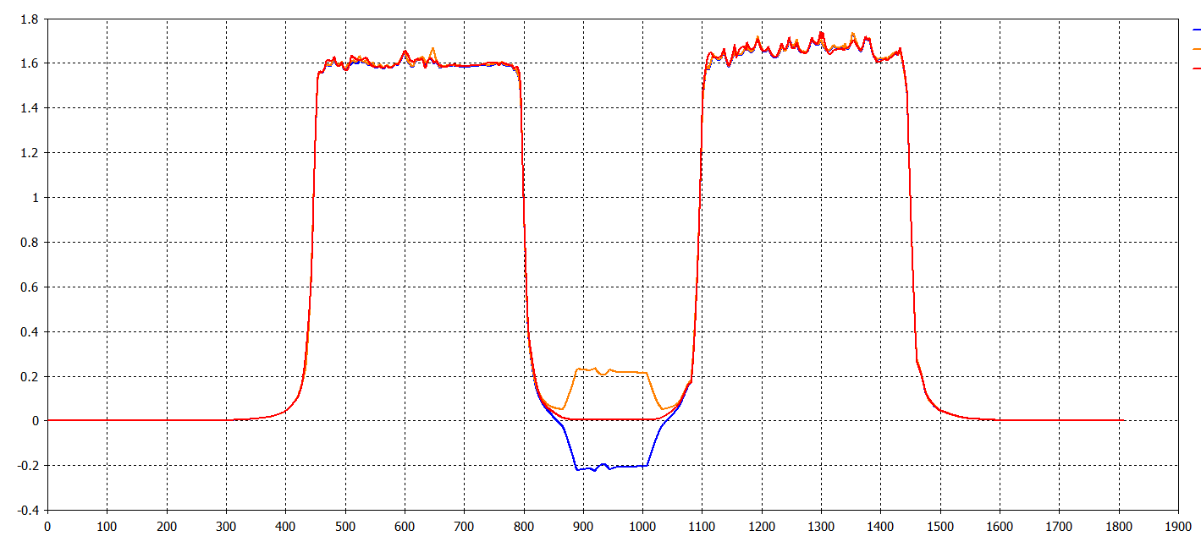
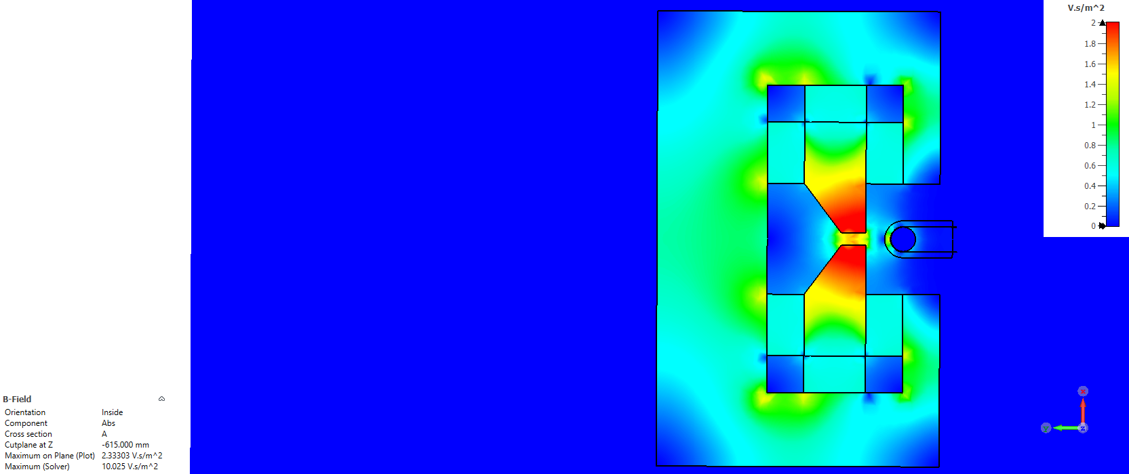
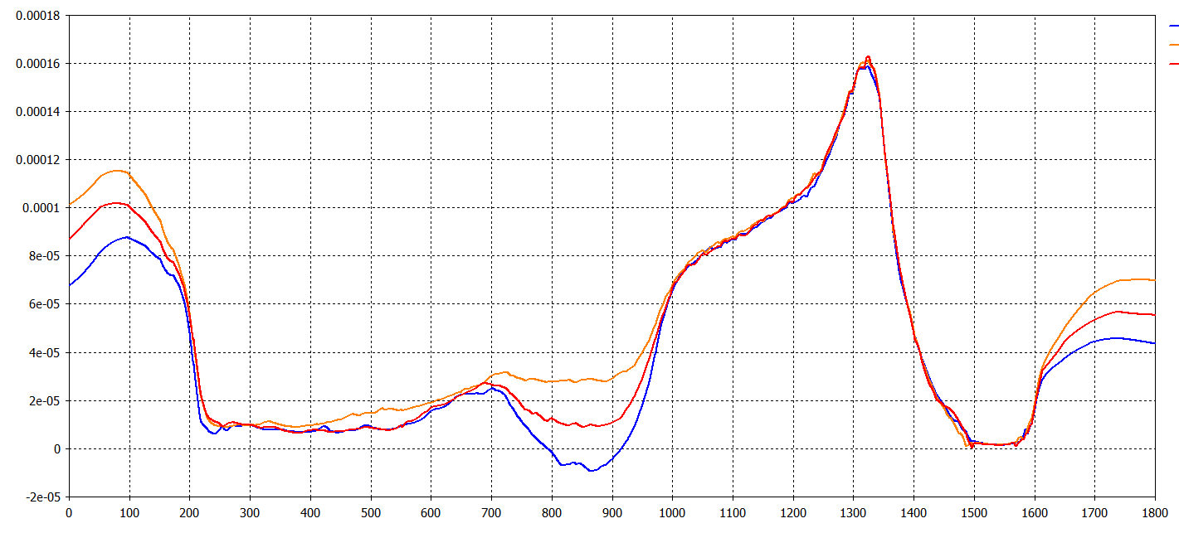
SLS 2.0 PM-based Thick Septum
Combine magnetic performance
  Main field
Field Integral
(for given corrector setting):
+5 A: 1.22 T.m (2.7%)
0 A: 1.19 T.m
-5 A: 1.15 T.m (-3.1%)
  B, T
+5A
0A
-5A
  Z, mm
  Leakage field
Leakage field Integral
(for given corrector setting):
+5 A: 94 μT.m
0 A: 84 μT.m
-5 A: 76 μT.m
Bmax = 2.2 T
  B, T
Earth magnetic field
+5A
0A
-5A
  Magnetic simulation
  Smallest distance between beams ~35 mm.
  Air gap is important.
  Z, mm

Slide 5
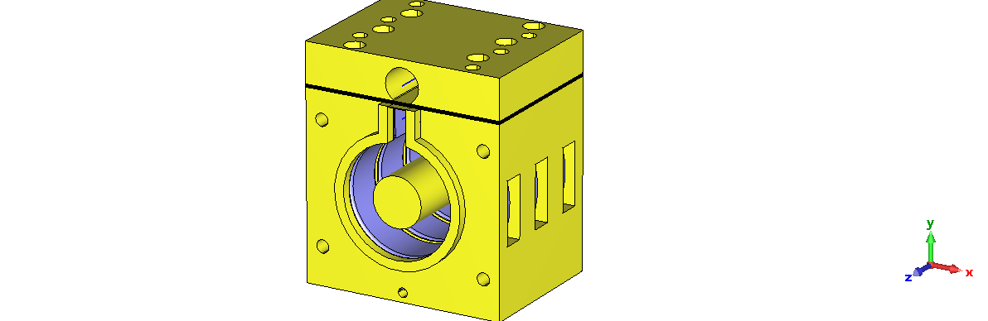
SLS 2.0 Thin Septum
Very thin eddy current septum should ensure inserting the injected beam very close to the stored beam with preferably no disturbance.
Distance between injected and stored beam only 3 mm.
Very thin septum wall - 1 mm
Good magnetic screening
  Thin Septum Specification
Parameter | Thin Septum
Septum thickness, mm | 1.0
Magnet length, m | 0.3
Gap, mm | 6.0
Magnet length, m | 0.3
Bending angle, mrad | 15@2.7 GeV
Field integral, T.m | 0.135
Gap field. T | 0.45@2.7 kA
Pulse length (period), μs | 12.5 (full sine)
Maximum zero-field integral, μT.m | 2.37
Shielding coefficient, - | >50000
Stability, ppt | 1.2
Stored beam
(Line 1)
  Cu
Septum wall
Injected beam
(Line 2)
  Cu
  Three sections of SLS 2 thin septum prototype 3D CST® magnetic model

Slide 6

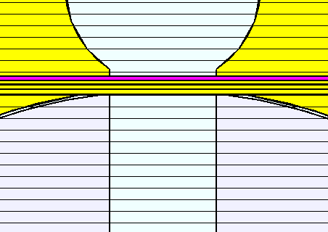
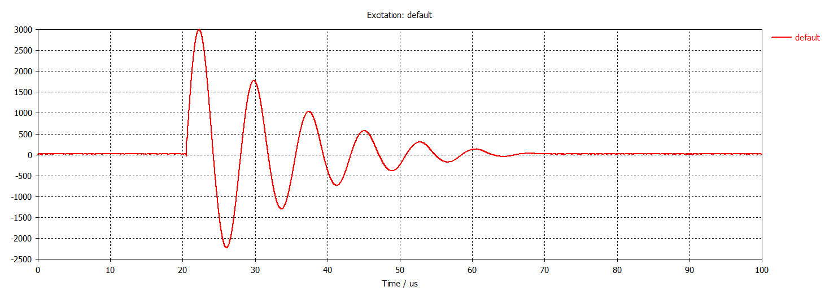
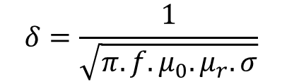
Eddy current septum numerical simulations
  Legend:
  Septum’s 4-layers
Skin depth
Powder cores are chosen for the magnetic circuit to cover the frequency and the filed strength requirements.
3D electromagnetic numerical simulations were used to optimize the screening of the thin septum.
The credibility of the simulation results depends a lot on the correct material model. Choosing the proper material model parameters proved itself difficult since this information is usually not readily available.
$$δ=\frac{1}{\sqrt{π.f.μ_{0}.μ_{r}.σ}}$$
  “0”-field
  Septum
  Main field
  Fe-powder core
  Fe-powder core
  Gap 6 mm
  Cu
  Electromagnetic model of the thin septum
  Courtesy of S. Dordevic
  Excitation pulse
  Cu
Ip = 3 kA

Slide 7

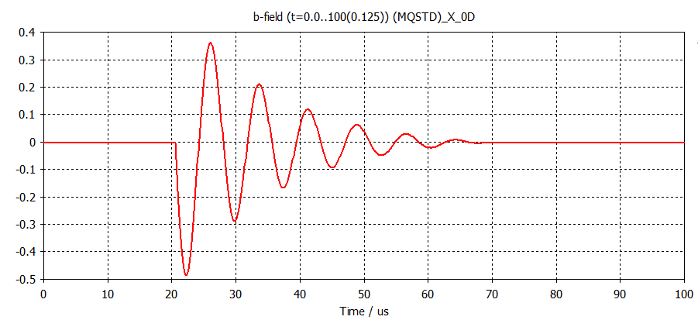
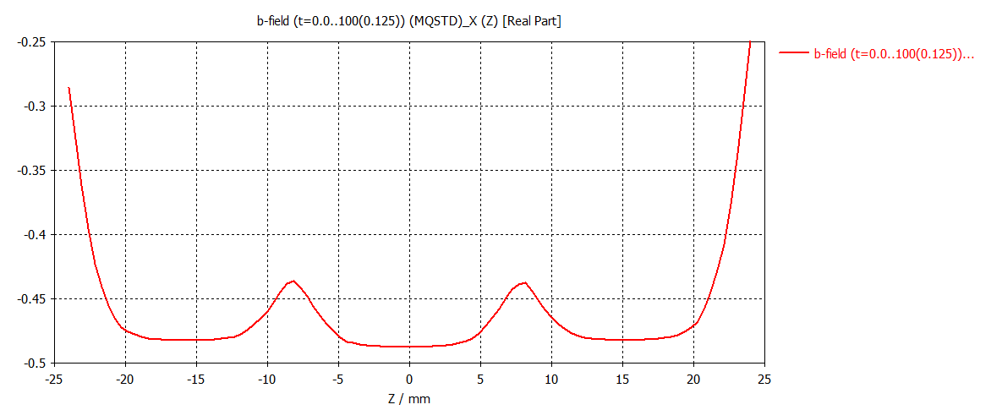
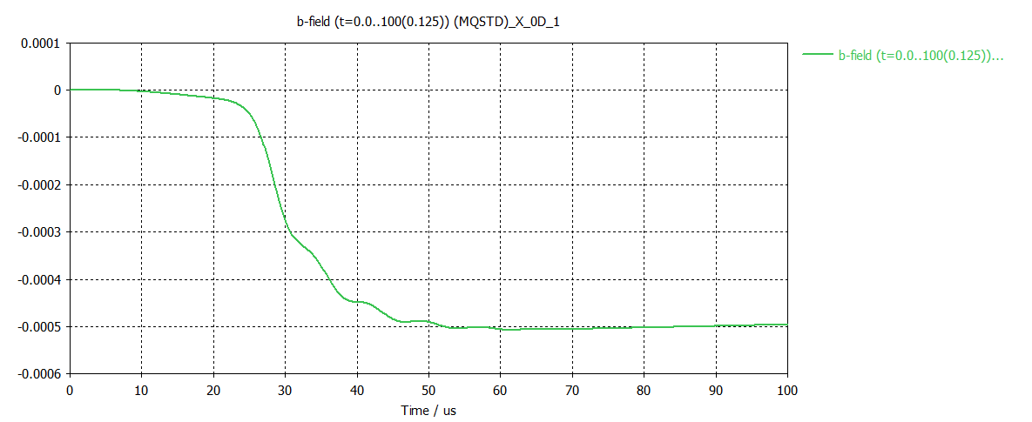
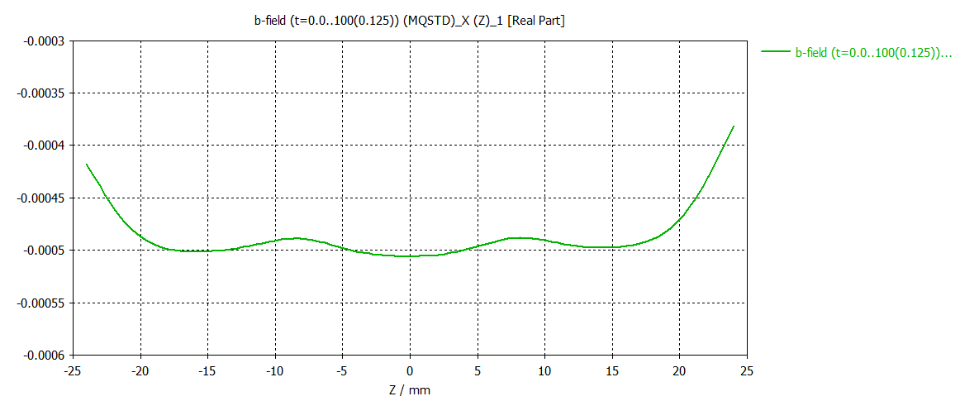
Conductivity limitation
  Legend
One mm of cooper does not provide the required screening. No other engineering material (at room temperature) could provide much better conductivity. (Silver is only ~6% more conductive and will not give significant skin depth reduction.)
Excitation
Copper, thickness 1mm
Main Field in (0/-10/0)
Main Field along curve 2 @ 22.25us
Leakage Field in (0/0/0)
Leakage Field along curve 1 @ 60us
0.5 mT or 150 µT.m

Slide 8
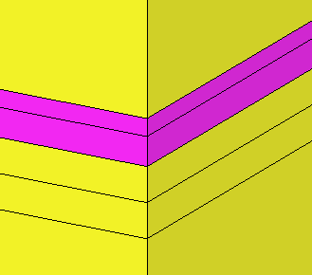
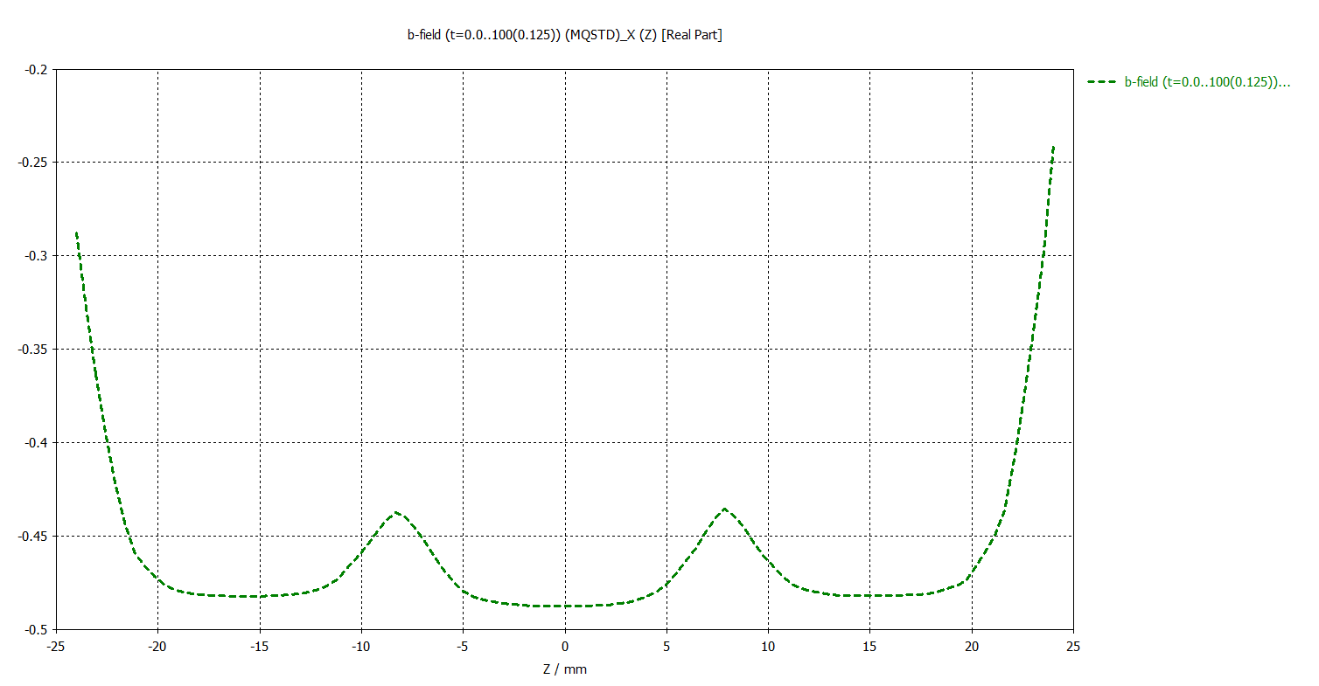
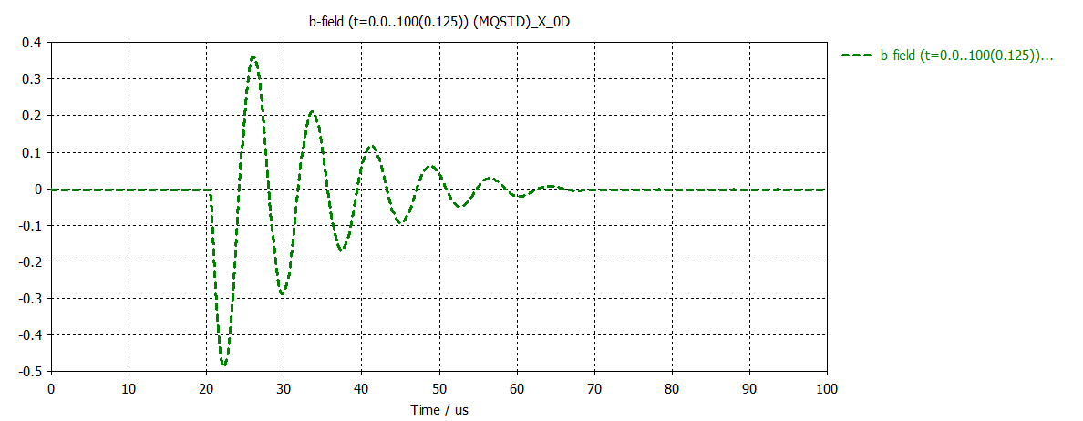
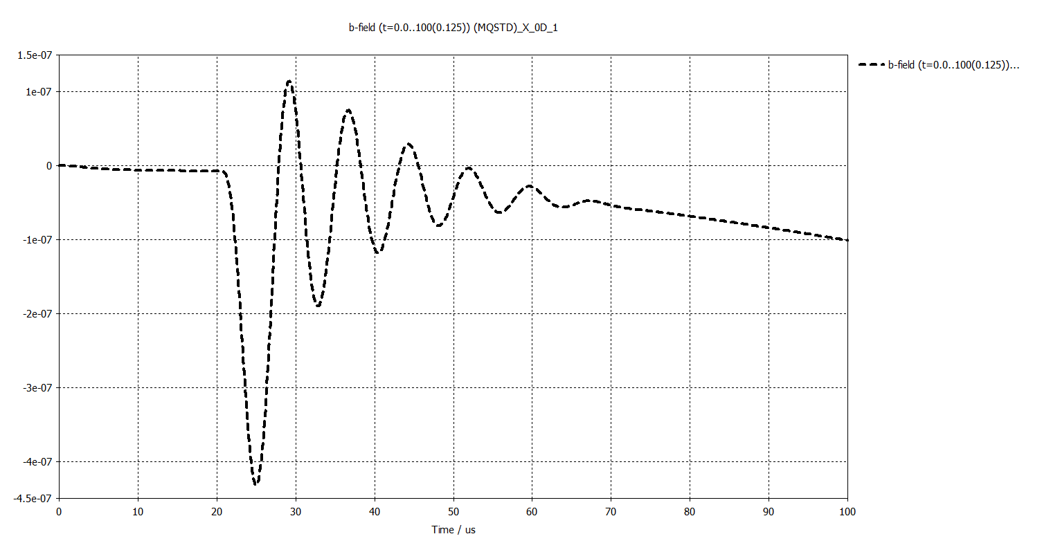
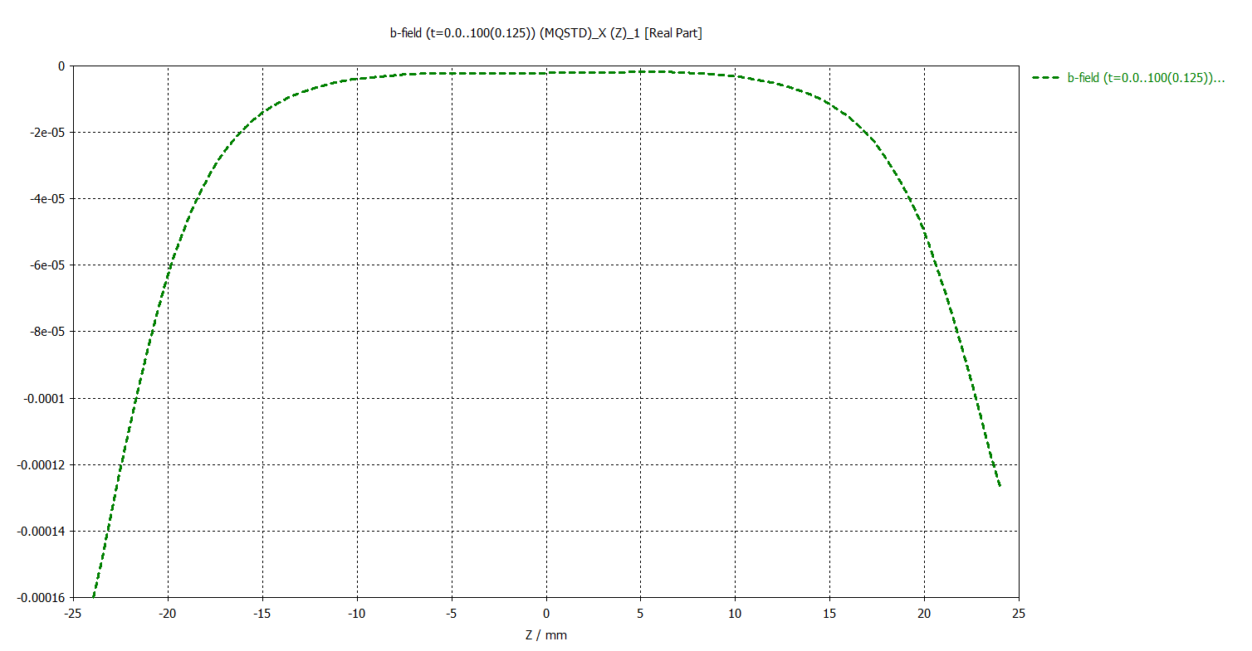
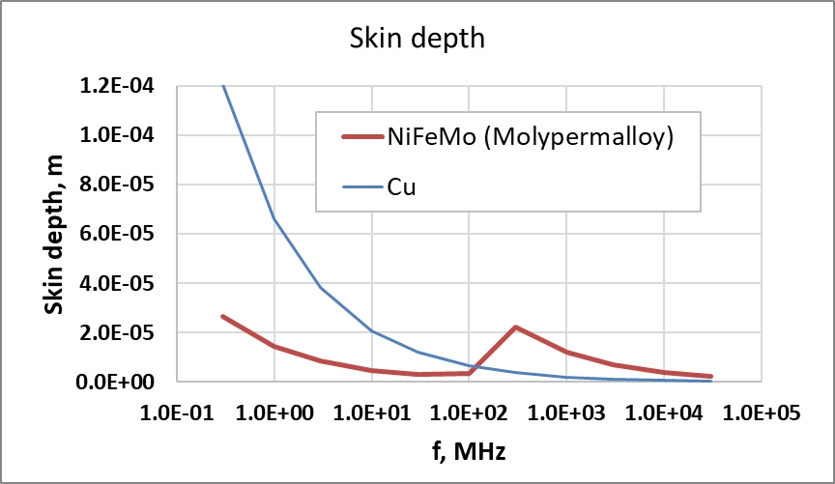
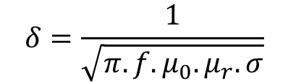
Going beyond cooper
  Legend
Cooper sheet screens the majority of the field. Adding high-µ soft magnetic material we can beat copper in the frequency range where it has available significantly large relative permeability. This compensates its lower conductivity and overall reduces the skin depth.
Excitation
µ-metal, thickness 0.15mm
µ-metal, thickness 0.25mm
Copper, thickness 0.3mm
Copper, thickness 0.3mm
Main Field in (0/-10/0)
Main Field along curve 2 @ 22.25us
Skin depth
$$δ=\frac{1}{\sqrt{π.f.μ_{0}.μ_{r}.σ}}$$
Leakage Field in (0/0/0)
Leakage Field along curve 1 @ 25.625us
0.7 µT or 0.21 µT.m

Slide 9
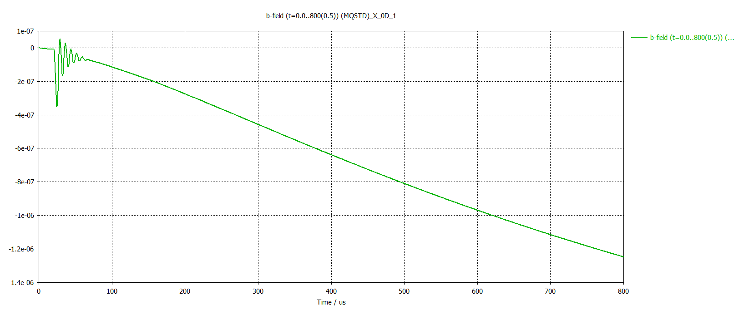
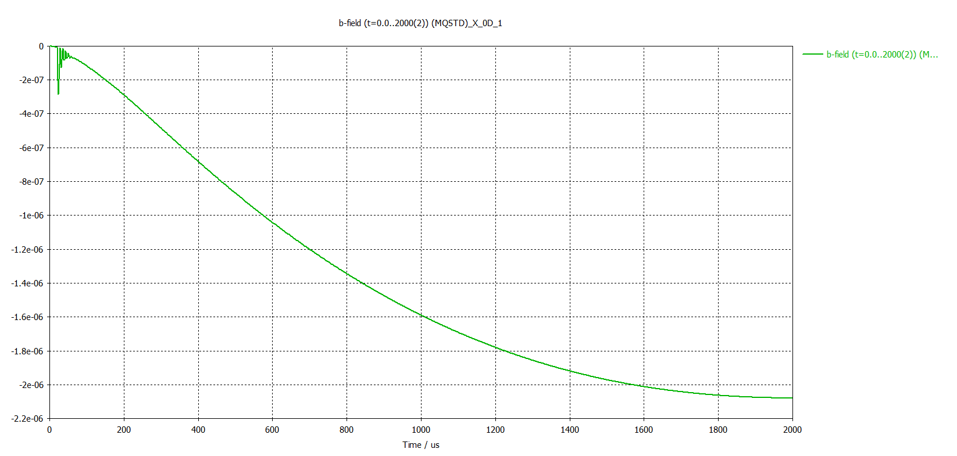
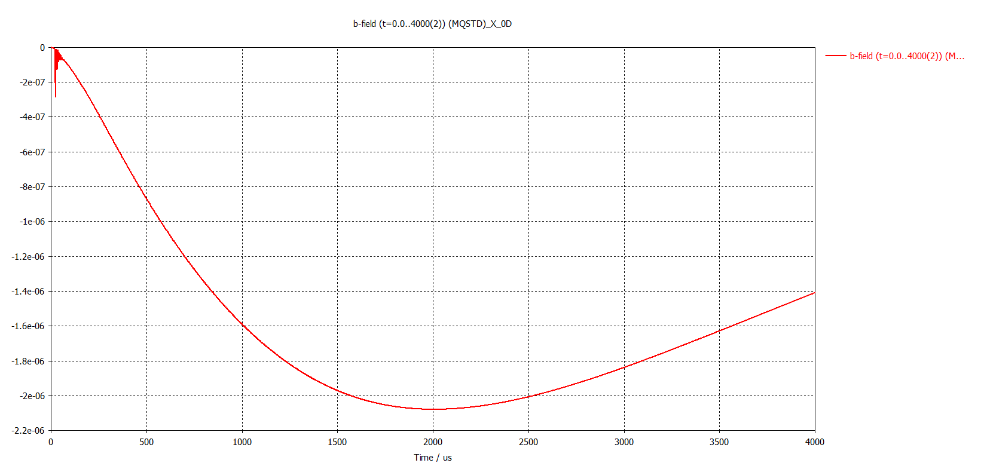
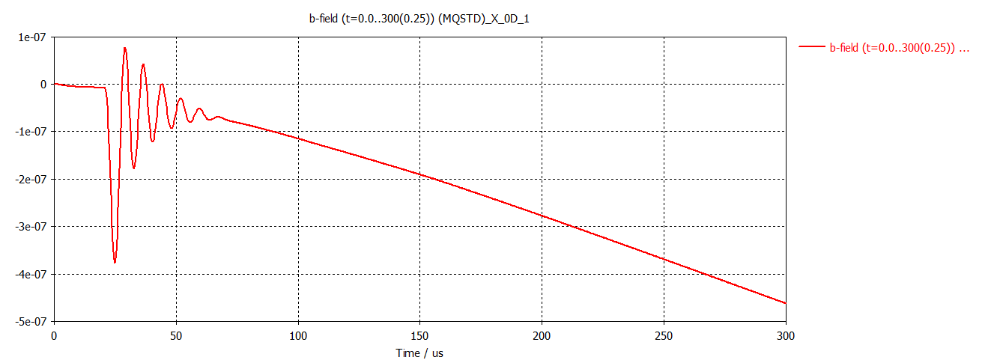
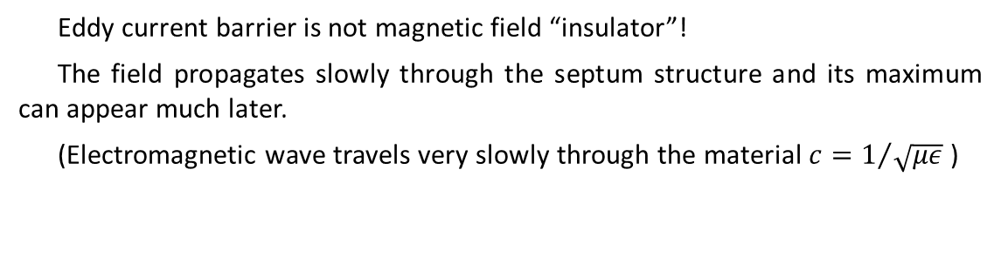
Story is a bit more complicated
  Legend
Eddy current barrier is not magnetic field “insulator”!
The field propagates slowly through the septum structure and its maximum can appear much later.
(Electromagnetic wave travels very slowly through the material $c=1/{\sqrt{με}}$ )
µ-metal, thickness 0.15mm
µ-metal, thickness 0.25mm
Copper, thickness 0.3mm
Copper, thickness 0.3mm
Leakage Field in (0/0/0)
Work in progress
2.3 µT or 0.69 µT.m
0 ms 1 ms 2 ms

Slide 10
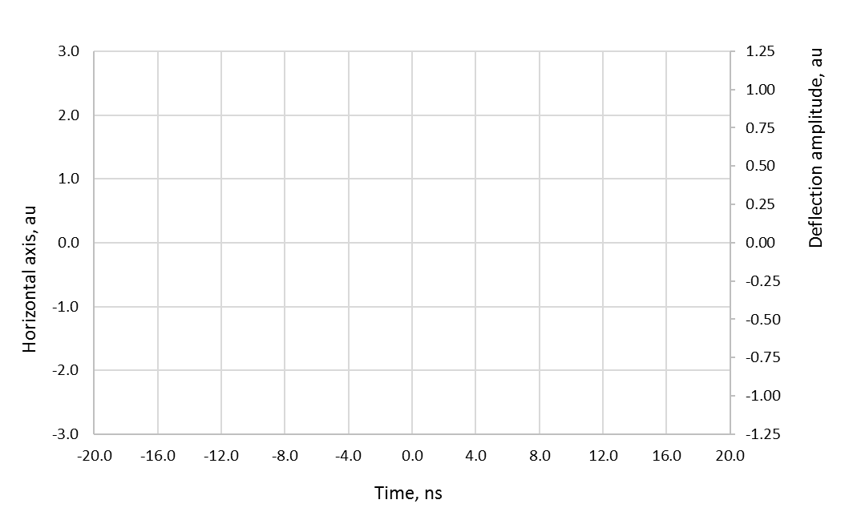
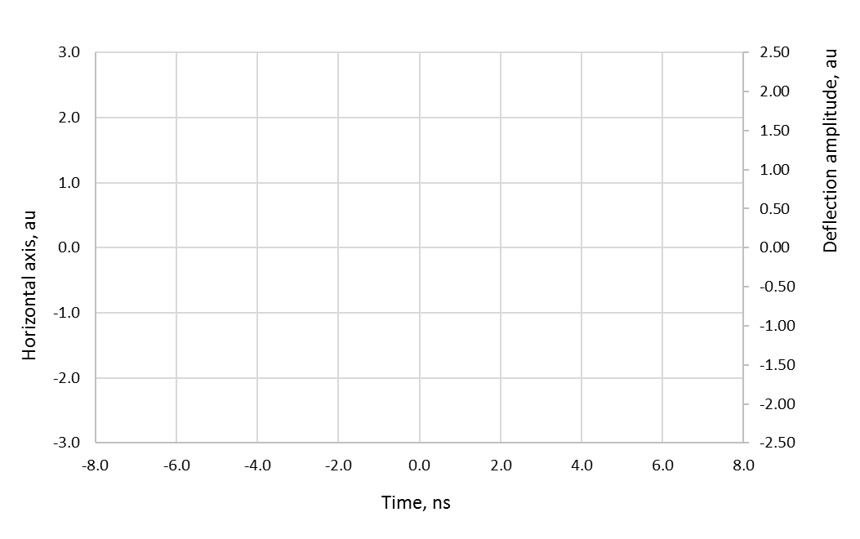
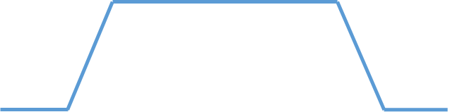

SLS 2.0 Advanced Injection Schemes
“Fast” injection scheme, aperture sharing
“Super-fast” injection scheme, on-axis
A portion of the stored beam (15 bunches in the illustration) and the injected bunch are deflected with a short kicker pulse (20..30 ns) to fit in the machine aperture. With decaying Betatron oscillation they come back on axis.
A very short kicker pulse (<2 ns) puts an off-momentum injected bunch on-axis without significantly disturbing the adjacent stored bunches. With decaying Synchrotron oscillation the injected bunch joins a stored one.
Injected bunch
Fast Pulse
Injected bunch
Super-fast Pulse
Septum
Septum
Stored beam on-axis
Injected bunch joins the stored bunch
Stored beam on-axis
Injected bunch joins the stored bunch
Simplified illustration of “Fast” injection scheme with aperture sharing (off-axis injection)
Simplified illustration of “Super-fast” on-axis injection scheme

Slide 11
Anatomy of the deflection with stripline kickers
Nanosecond-long deflections require stripline (TEM) kickers -> Small deflection angles
In order to add magnetic and electric deflection the electric pulses and the particle beam should counterpropagate (down-steam excitation).
Stripline Kicker
Injected bunch
Circulating bunches
Electric pulse
0.66/1.32 ns pulse,
0.33 ns kicker (10 cm)
1ns
1.0 ns pulse,
0.5 ns kicker (15 cm)
Time representation of a rectangular and trapezoidal pulse to inject between two bunches in 500 MHz storage ring.
Conditions for an efficient use the kicker and not disturbing adjacent bunches:
Pulse full-amplitude length ≥ 2x Kicker electrical length
Pulse total length + 2x Kicker electrical length ≤ bunches separation
Ideal: a rectangular pulse, 1 ns long and TEM kicker with 0.5 ns electrical length.

Slide 12
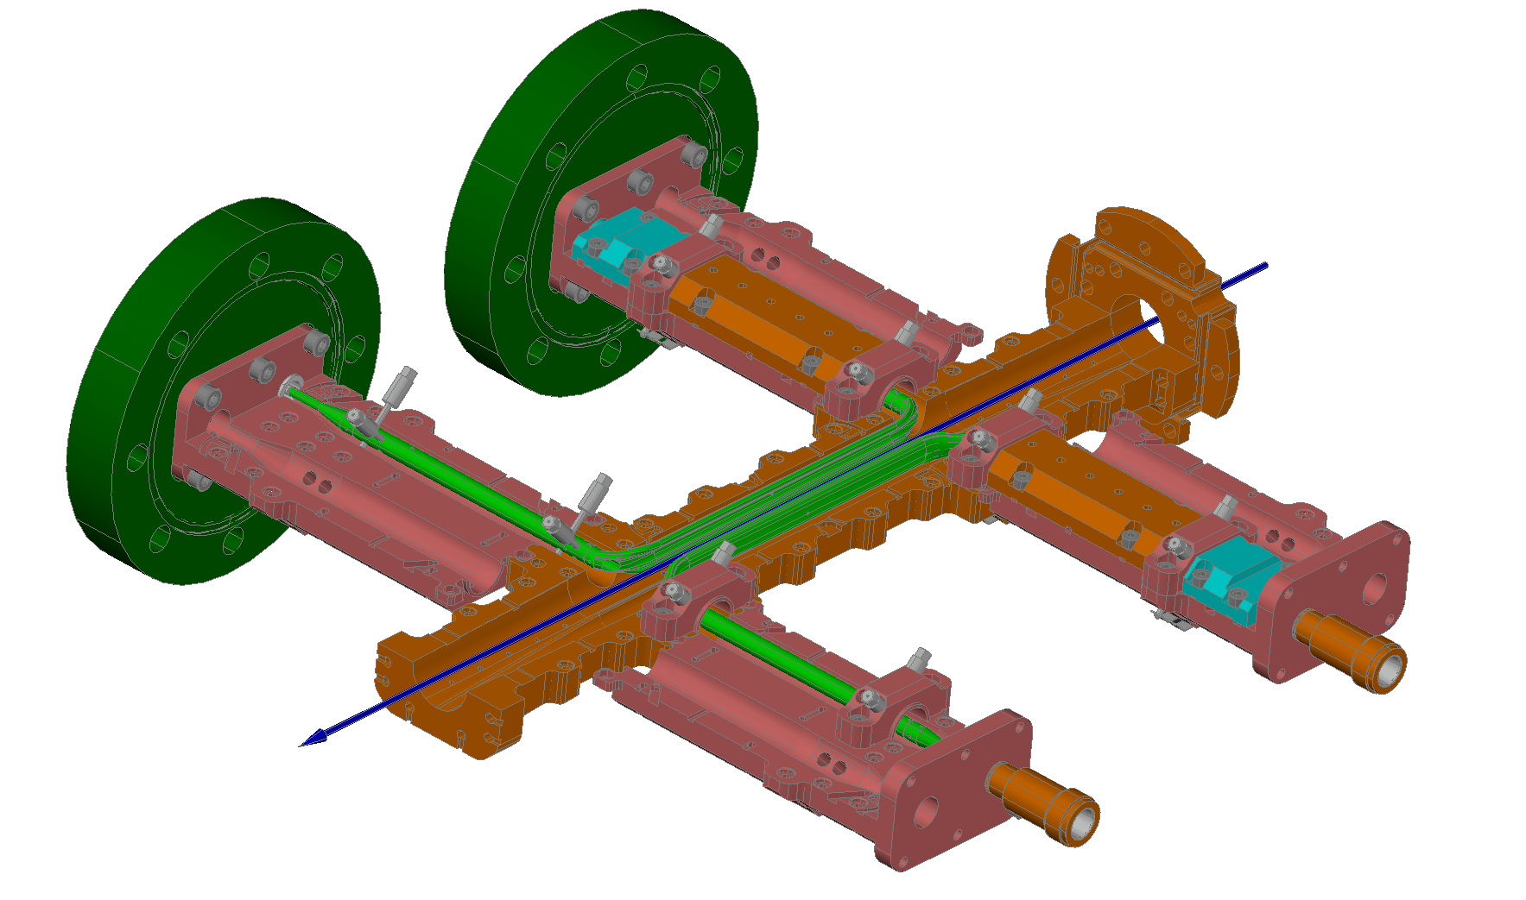
SLS 2.0 Fast Kicker requirements and single section prototype construction
Given and machine related
The technology is not matured yet – to mitigate the risks we divided the development in two phaces – Fast and Superfast.
Design of the kicker should be suitable for both phases - only the excitation pulses will be different.
Design goals:
As low excitation voltage as possible
Broad bandwidth impedance matching
Parameter | Fast | Super-fast
Beam momentum | 2.7 GeV/c
SR bunch spacing | 2 ns
Injection repetition rate | 3 Hz
Injection type | Horizontal
Number of defl. SR bunches (off-axis) | <15 | 1..3
Number of defl. SR bunches (on-axis) | NA | 0..2
Deflection angle (off-axis) | >0.35 mrad
Deflection angle (on-axis) | NA | 1.0 mrad
Horizontal aperture on axis | ±5 mm
Active kicker length | 800 mm
Derived and chosen kicker parameters
Parameter | Fast | Super-fast
Deflection type | Electromagnetic (TEM)
Kicker type | Stripline (vacuum)
Kicker section length | 100 mm
Number of sections | 8
Maximum deflection | 0.5 mrad | 1.0 mrad
Magnetic field | 2.8 mT | 5.7 mT
Electric field | 0.9 MV/m | 1.7 MV/m
Electrode voltage | ±4.3 kV | ±8.5 kV
Electrode current | ±85 A | ±170 A
Excitation pulse length | <30 ns | ~2 ns
Odd / Even el. impedance | 2x 50.0 Ω / 2x 56.0 Ω
Kicker prototype interior

Slide 13
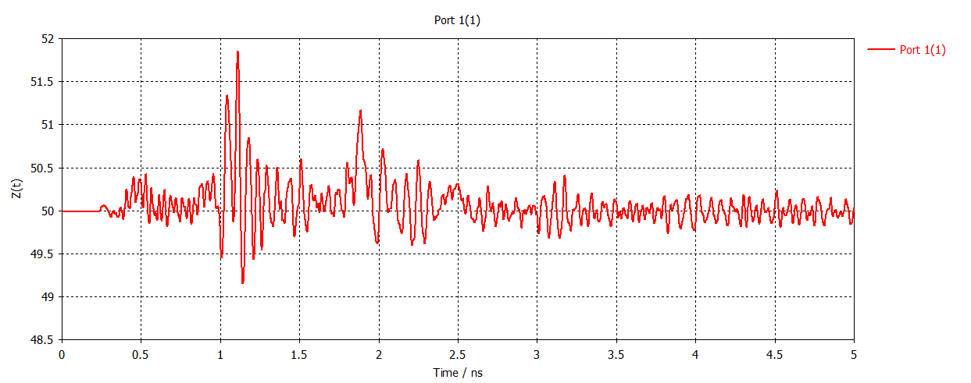
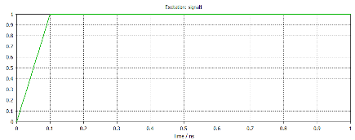
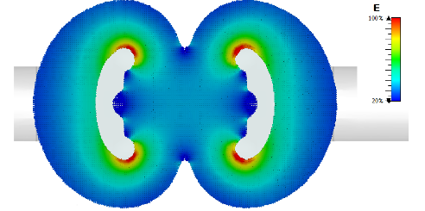
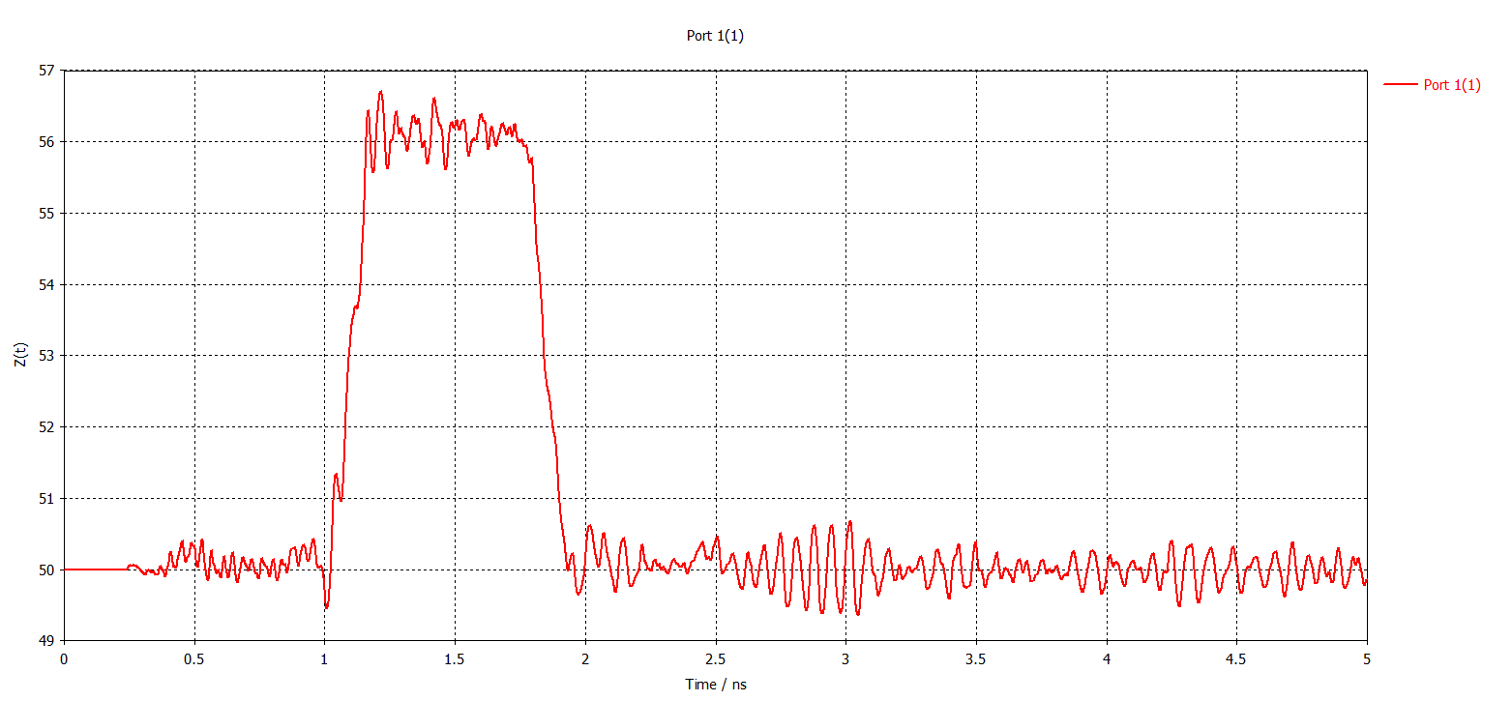
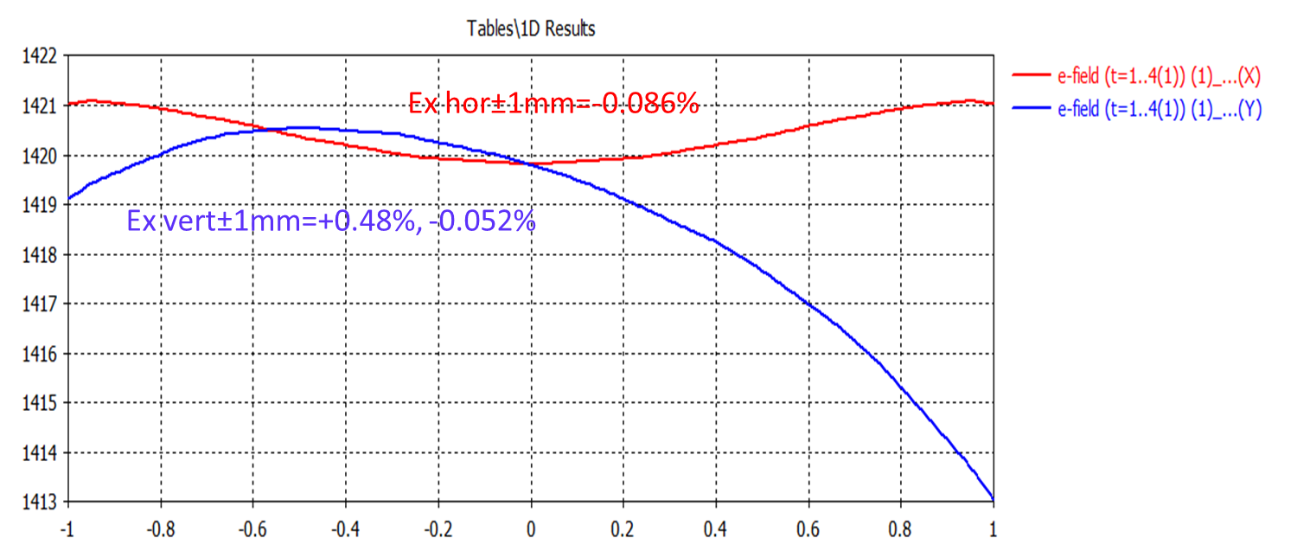
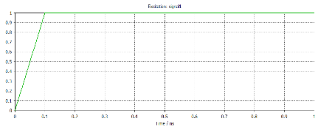
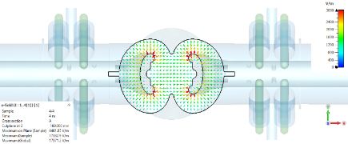
SLS 2.0 Fast Kicker prototype – Electrical Characteristics
Blades
Differential mode 100.1 Ω (Odd impedance 50.1 Ω)
The kicker electrodes were optimized to provide the necessary field and electrical impedance maximizing the clear aperture on axis. Care was taken to avoid excessive surface electric field.
12 (13) mm
100 ps rise time
Kicker blades’ cross section
Synthetic time domain reflectometry
Matched blades with increased beam space at the center
Common mode 28.0 Ω (Even impedance 56.0 Ω)
100 ps rise time

Slide 14
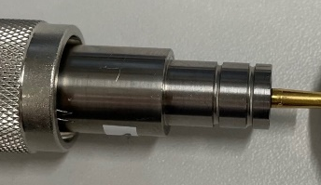
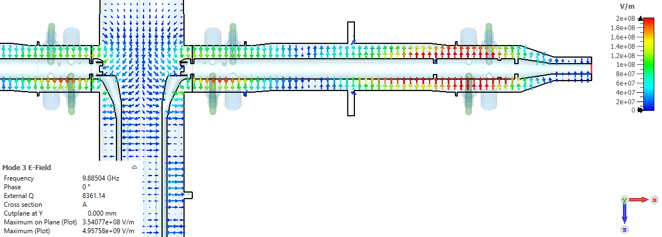
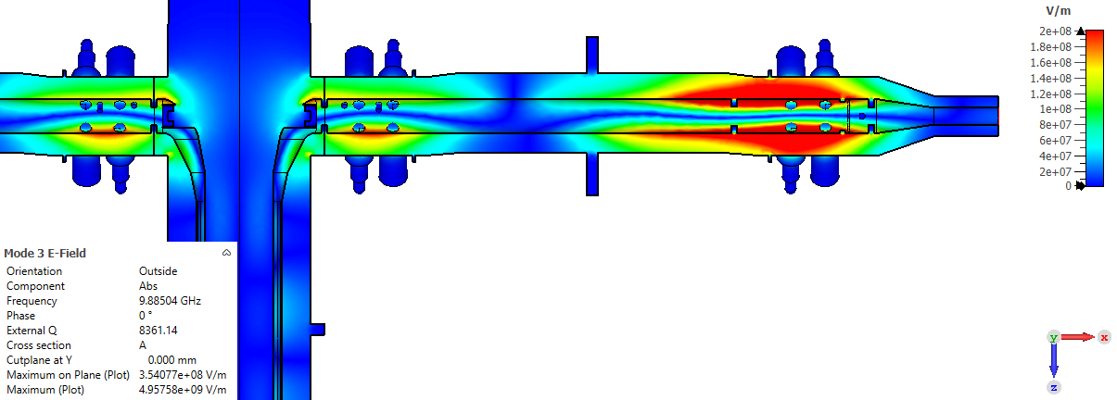
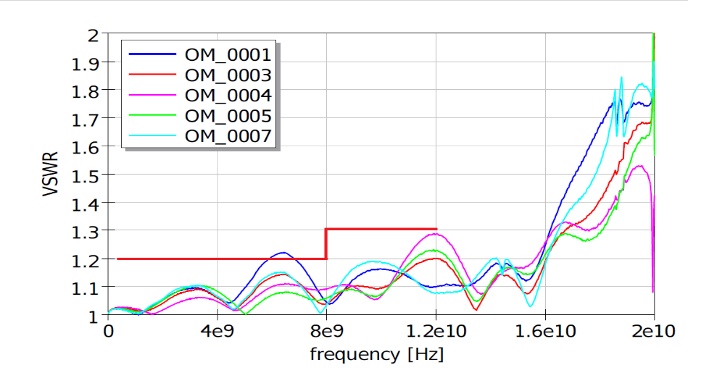
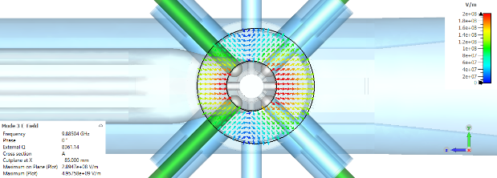
SLS 2.0 Fast Kicker Prototype – Electrical Characteristics
Coaxial line asymmetry and vacuum feedthrough
Orient microwave feedthrough.
Example of one trapped mode in the coaxial transmission line
Measured voltage standing wave ratio of OM feedthroughs

Slide 15
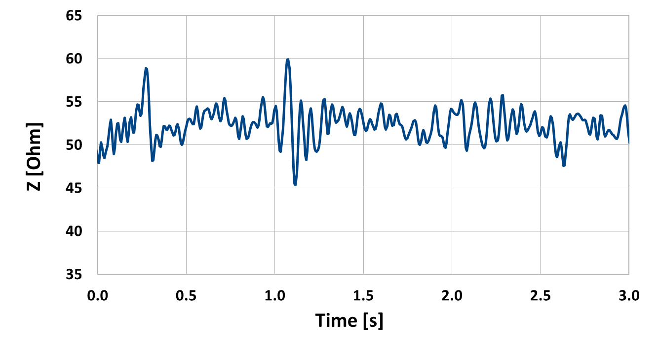
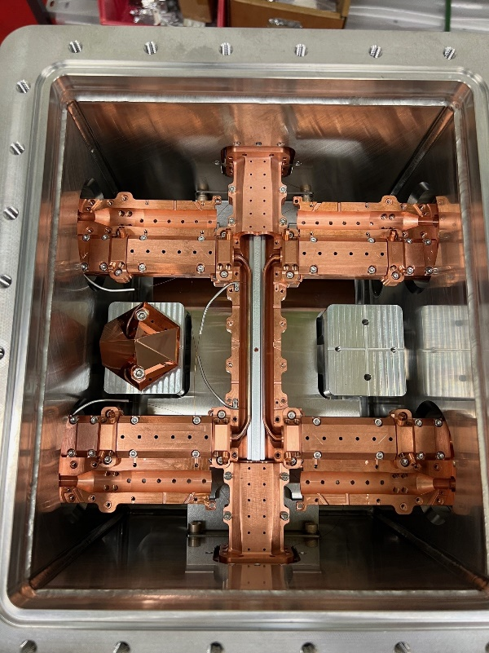
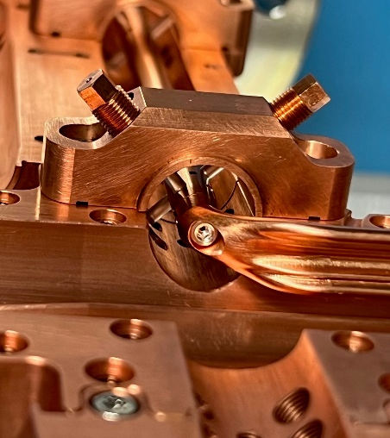
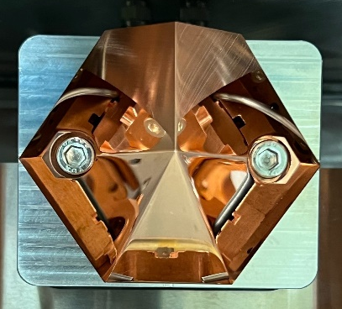
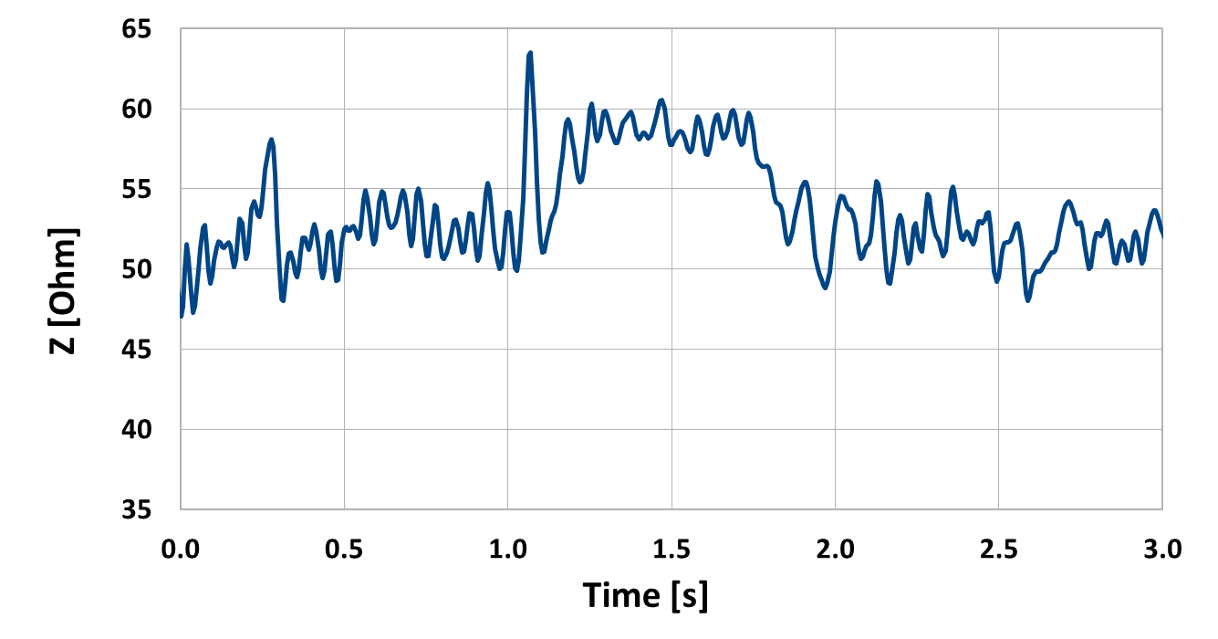
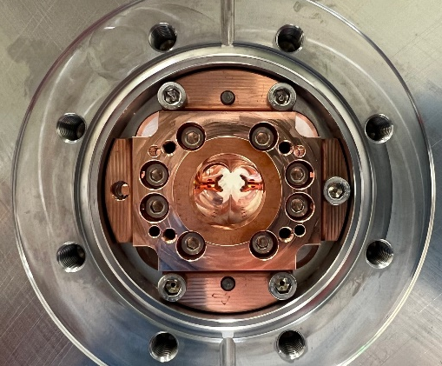
SLS 2.0 Fast Kicker prototype – construction and measurements
Blade transition and coaxial feeding line suspension
Odd impedance
Time domain reflectometry (2-port)
Even impedance
Kicker prototype in the chamber
Infrared mirror for remote blades temperature monitoring
Side view of the blades
Feedthrough
Feedthrough
Blade transition
Blade transition

Slide 16


SLS 2.0 Fast Kicker prototype – HV pulses test
No HV breakdowns were observed applying the fast excitation pulses (in air – vacuum isolation performance should be even better).
Storage ring test is planed in March. The test outcome, especially the thermal performance, is expected to provide crucial information for the design of the final SLS 2.0 fast kickers.
No good solution yet for kicker termination – a broad bandwidth attenuator that withstands high CW power (100 to 200 W) and super high single pulse peak power (0.5 to 2 MW)
20 ns/
2 kV/
1 ns/
2 kV/
“Fast” pulses (30 ns) through the kicker prototype
“Superfast” pulses (1.5 ns) through the kicker prototype

Slide 17
SLS 2.0 Dedicated Beam Dump
First touch
A dedicated beam dump magnet will be used to remove the beam in an orderly way. The beam energy ~1 kJ will be deposited at a dedicated beam dump out of copper.
The beam train is spread over a large distance to avoid local material damage.
The design is such that the copper block is one wire-eroded thick monolithic piece (can not be disassembled) to give local attenuation for the potential surface activation.
Beam dump – top view.
The yellow line indicates the beam dump surface
Beam dump – side view
Beam dump region as modelled in FLUKA.
  Courtesy of I. Besana

Slide 18
SLS 2.0 Beam Dump deflection
 | At dump | At dump [-] | At thin septum | At thin septum [-] | At thick septum | At thick septum [-] | At collimator | At collimator [-] | Elsewhere
New pulse shape 1 | 76.3% | 366 | 13.7% | 66 | 7.8% | 37 | 2.2% | 11 | 0%
New pulse shape 2 | 72.1% | 346 | 16.1% | 77 | 9.3% | 45 | 2.5% | 12 | 0%
New pulse shape 3 | 83.5% | 401 | 9.5% | 46 | 5.4% | 26 | 1.5% | 7 | 0%
New pulse shape 4 | 86% | 413 | 8.1% | 39 | 4.7% | 23 | 1.3% | 6 | 0%
Lin 5.4 kA
5 kA
6 kA
7 kA
Pulse shape 1 (Lin 5.4 kA, 1.3 us)
Pulse shape 2 (5 kA, 8.8 us)
Pulse shape 3 (6 kA, 6.7 us)
Pulse shape 4 (7 kA, 6.2 us)

Slide 19

Stored train spread for different dump magnet currents
Currents are relatively high due to the large magnetic gap (~40 mm) defined by the choice to use an in-air magnet and a ceramic chamber identical with those of the storage ring kickers (and pingers).
No overlap
x2 overlap
Lin 5.4 kA
5 kA
6 kA
7 kA
1-sigma overlap levels
x3
x2
No overlap
10 mm
10 mm
10 mm
10 mm
49
49
49
49
Bin (H) 181 um
Courtesy of J. Kallestrup

Slide 20
Deposited energy
Energy density lower than 2500 J/cm³ - no material damage is expected
Energy deposition by dumping the entire bunch train (regularly filed machine)
Energy deposition vs dept of ingle bunch 5 nC (camshaft bunch)
Energy deposition by a single bunch 5 nC (camshaft bunch)
  Courtesy of I. Besana

Slide 21
Beam dump related radiation (horizontal plane)
Radiation levels should not cause permanent magnets’ magnetic field degradation.
Neutron fluence at first (upper graph) and second (lower graph) permanent magnet-based septum dipole
  Courtesy of I. Besana

Slide 22
Conclusions and discussion
Thick septum
Rare-earth permanent magnets dipoles combined with high-saturation soft magnetic screen give a good alternative to pulsed septa. Nevertheless, the magnetic screening requires larger beam separation.
Thin septum
Combination of copper and µ-metal sheets can provide very good eddy current screening with total septum thickness down to 1 mm.
Eddy current screen is not a magnetic “insulator”. Leakage field maximum could appear after ms. Simulation and measurement of the leakage field is challenging.
Stripline kicker
Fast kickers open new perspectives for more transparent top-up injection. A fast kicker prototype is developed based on two key principles: as low excitation voltage as possible and efficient broad bandwidth matching. A beam test is planed for March.
Together with the kicker construction, a reliable generation of fast (ns) kV pulses and their termination are still very problematic.
Beam dump
First slope of 7 kA sine wave is sufficient to deflect and spread the beam over the beam dump surface. Only about 5% of the bunches are lost on the second turn.
Almost 95% of the total energy is deposited on the beam dump and the peak power density is below 2.5 kJ/cm³. The copper is expected to withstand these energy density values without damage.
The maximum neutron fluence at the septum dipoles is 3×10⁷ neutrons/cm² per dump event and it is not expected to degrade the magnets.
Beam dump magnet is still to be designed.

Slide 23
Thank you for your attention

Slide 24
[1] A. Streun, “SLS-2 Conceptual Design Report”, 2017
[2] A. Streun, “SLS 2.0, The Upgrade of the Swiss Light Source”, IPAC2022, Bangkok, Thailand, 2022
[3] F. Armborst et al., “SLS 2.0 Machine Protection”, IPAC 2023, Venice, Italy, 2023

