Slide 1
LER2024
Close-out
9th Low Emittance Rings’ workshop, CERN 13-16/02/2024
Yannis Papaphilippou, CERN

Slide 2
Announcements

Slide 3
Announcements

Slide 4
~15 years of Low Emittance Rings Workshops
1th Low Emittance Rings Workshop, 12-15 January 2010 CERN – participants 70
https://ler2010.web.cern.ch/
2th Low Emittance Rings Workshop, 3-5 October 2011 Heraklion, Crete
https://lowering2011.web.cern.ch/ – participants 80
3th Low Emittance Rings Workshop 8-10 July 2013 Oxford University
https://indico.cern.ch/event/247069/overview (EuCARD-2) – 80 participants
4th Low Emittance Rings Workshop, 17-19 September 2014, INFN-LNF Frascati https://agenda.infn.it/event/7766/ (EuCARD-2) – participants 70
5th Low Emittance Rings Workshop, 15-17 September 2015 ESRF, Grenoble https://indico.cern.ch/event/395487/overview (EuCARD-2) – 70 participants
6th Low Emittance Rings Workshop, 26-28 October 2016 • Synchrotron SOLEIL
https://www.synchrotron-soleil.fr/en/events/low-emittance-rings-workshop-2016 (EuCARD-2)
7th LER Workshop, 15-17 January 2018 CERN (ARIES)
https://indico.cern.ch/event/671745/ - 80 particpants
8th LER Workshop 26-30 October 2020 INFN-LNF Frascati (held remotely) (ARIES)
https://agenda.infn.it/event/20813/overview – 160 participants
9th LER Workshop 13-16 February 2024 CERN (I.FAST)
https://indico.cern.ch/event/1326603/ - 100 participants

Slide 5
~15 years of Low Emittance Rings Workshops
Mission of the network and workshops
Fostering networking activities, exchange of ideas and staff in the accelerator community involved in design, construction and operation of ultra-low emittance rings
Including emerging topics (Energy efficiency, sustainability, ML, AI)
(light sources, HEP: damping rings and e+/e- colliders)
via
General Workshops
Topical workshops
Prototype design and construction
Student support (and student prizes)
Supporting staff for joint experiments
engagement with industrial partners

Slide 6
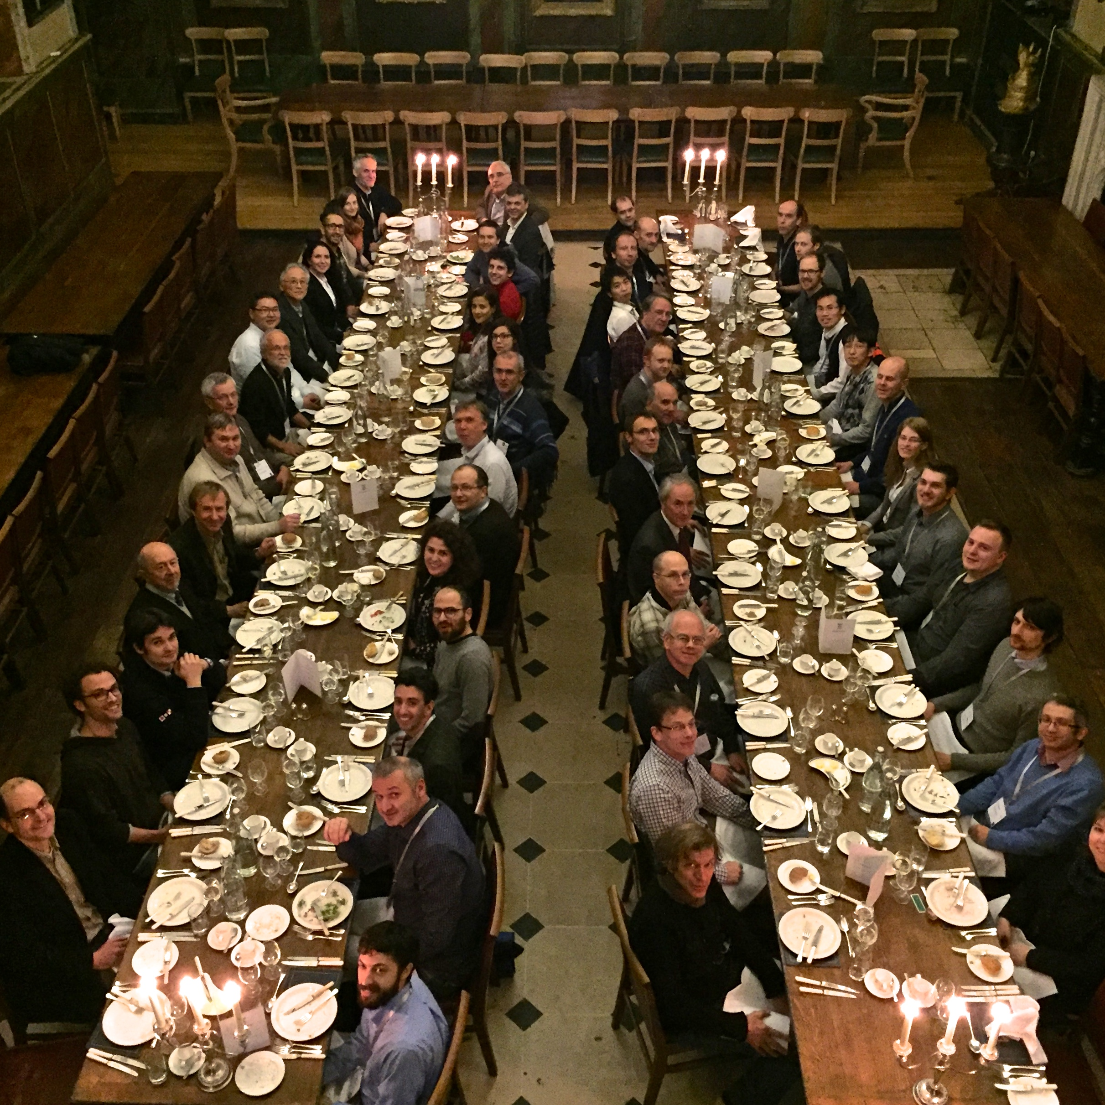
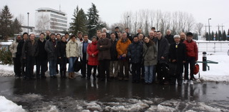
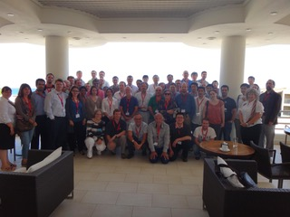
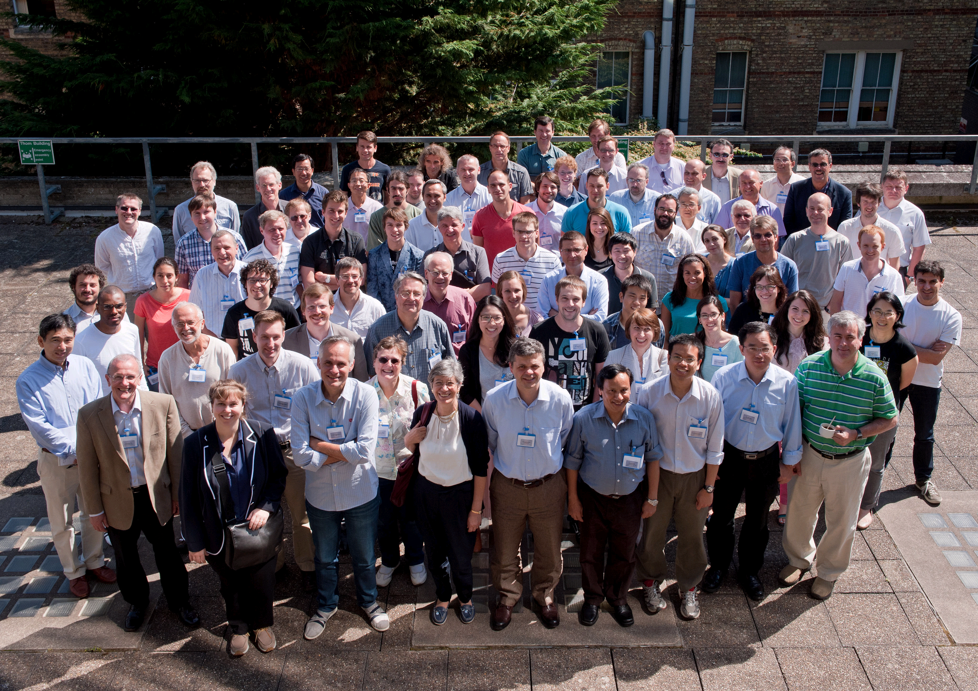
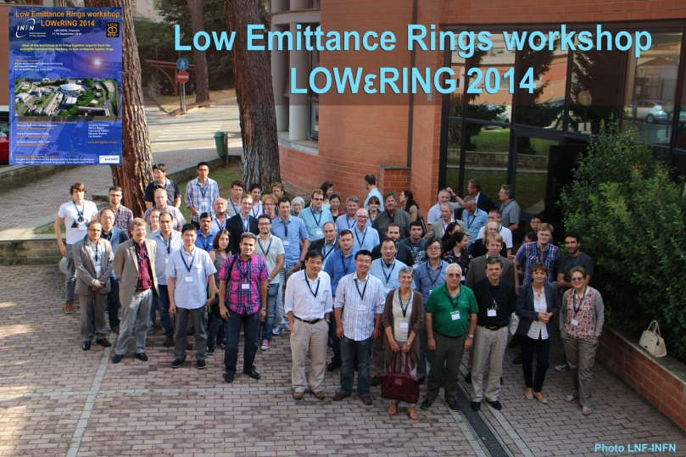
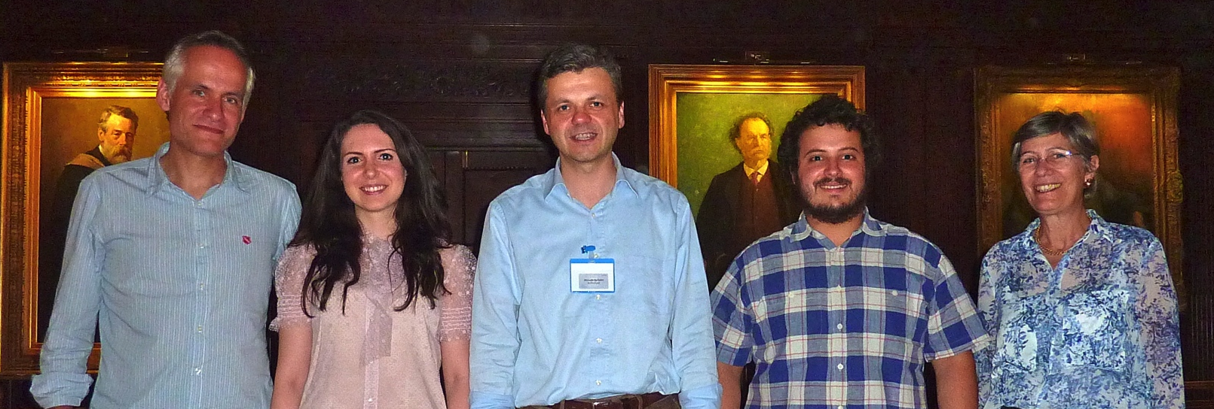
LER 2010-2018

Slide 7
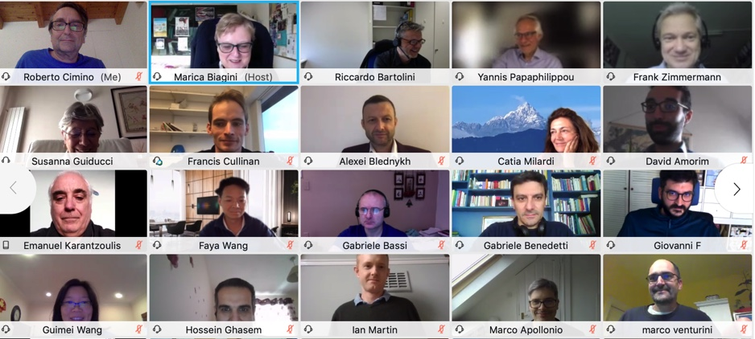
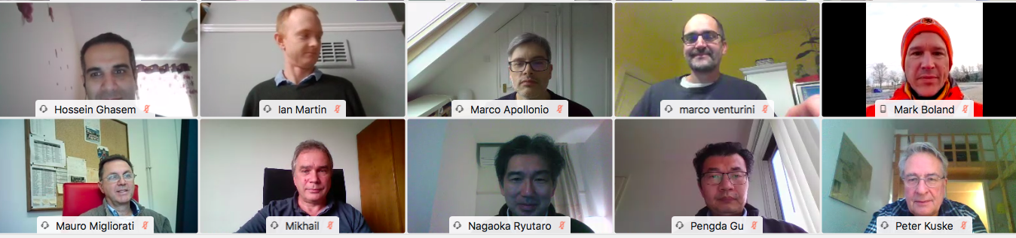
LER 2020

Slide 8
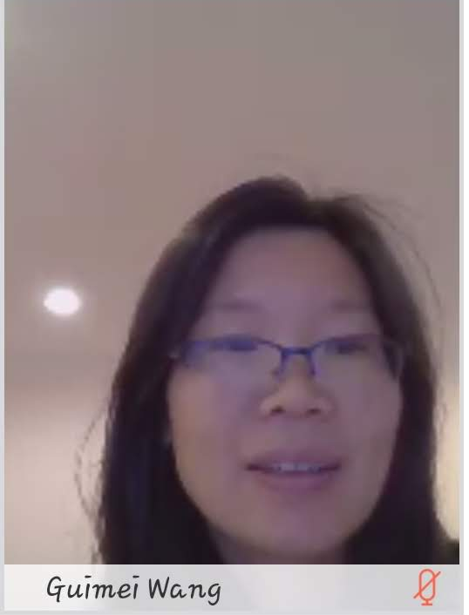
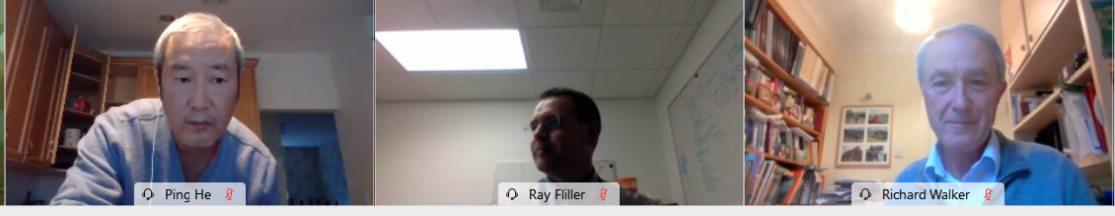
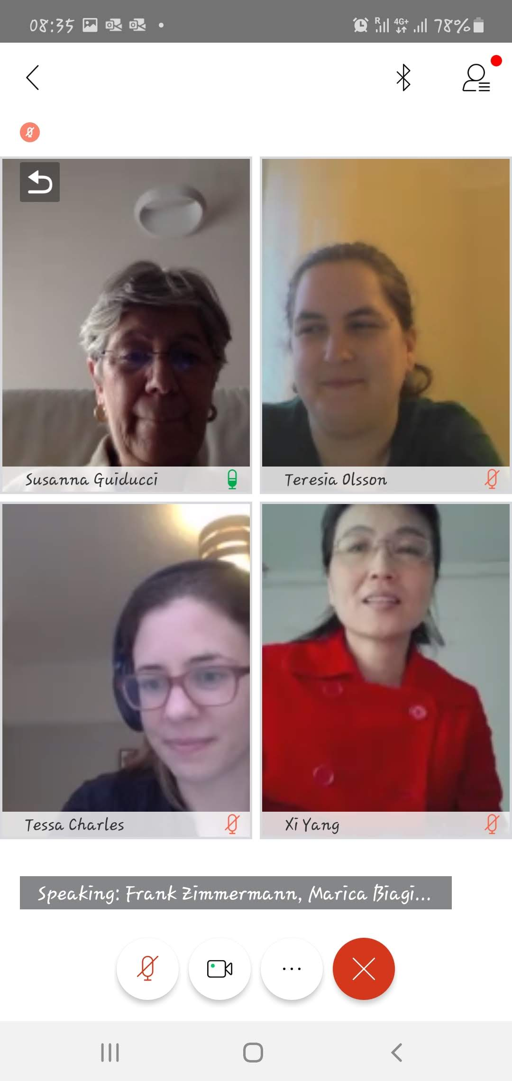
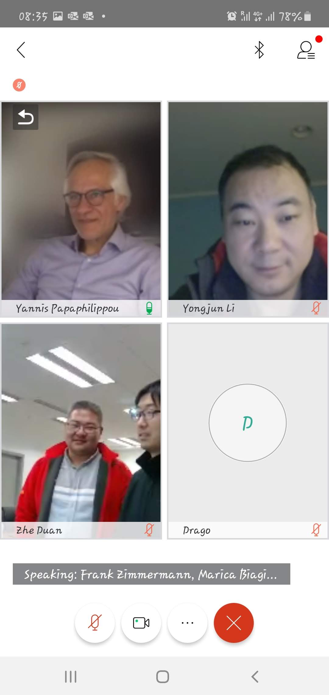
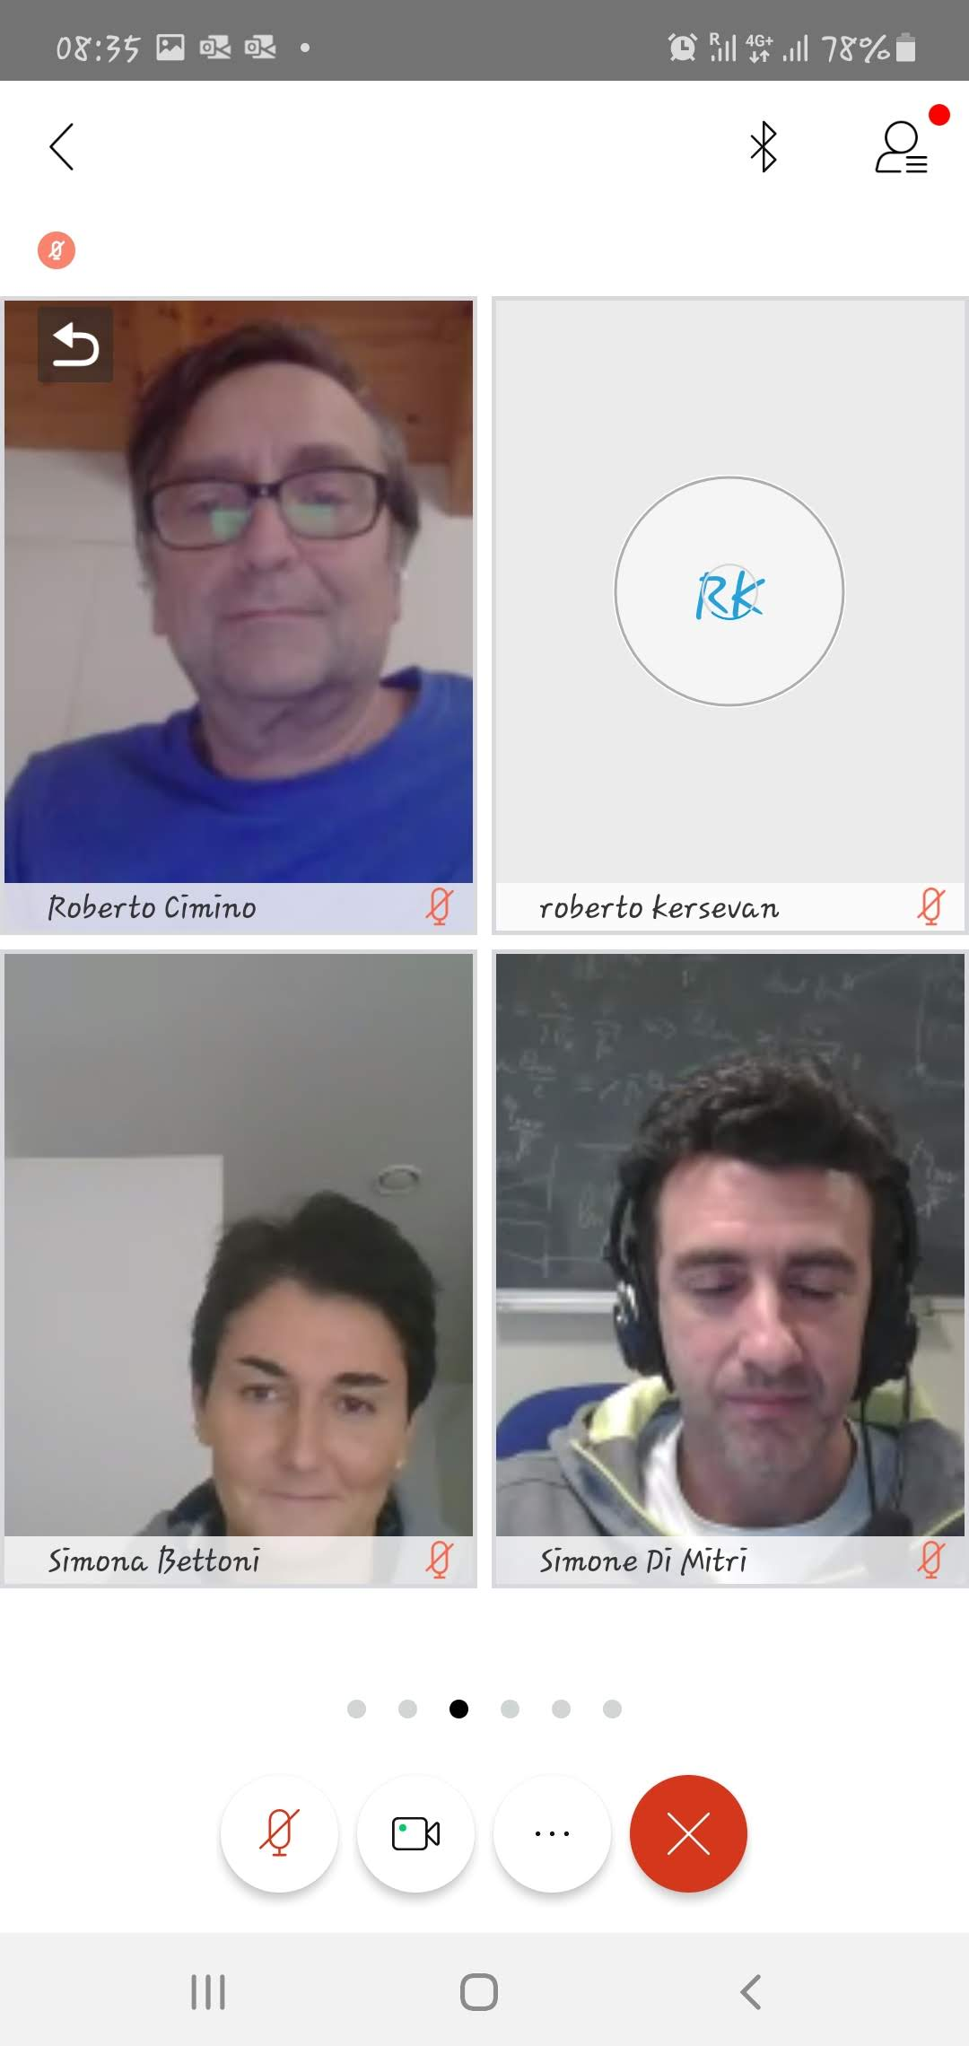
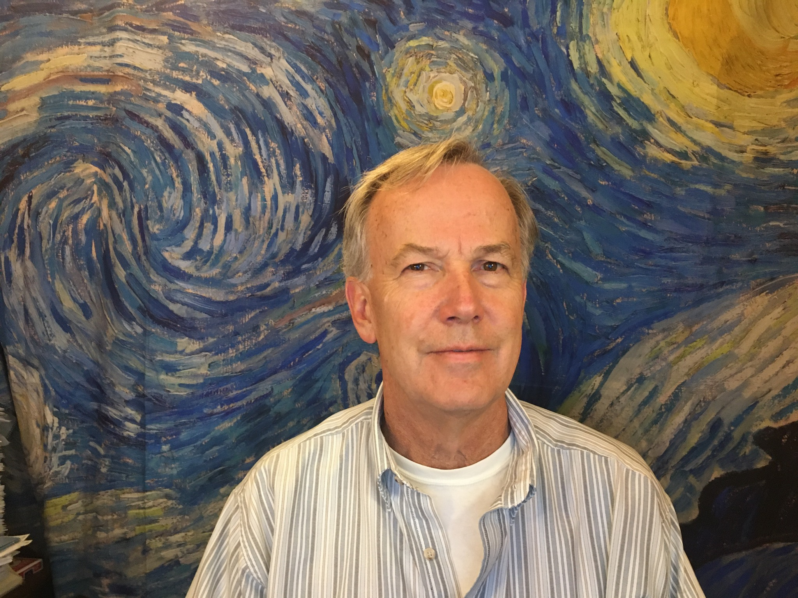
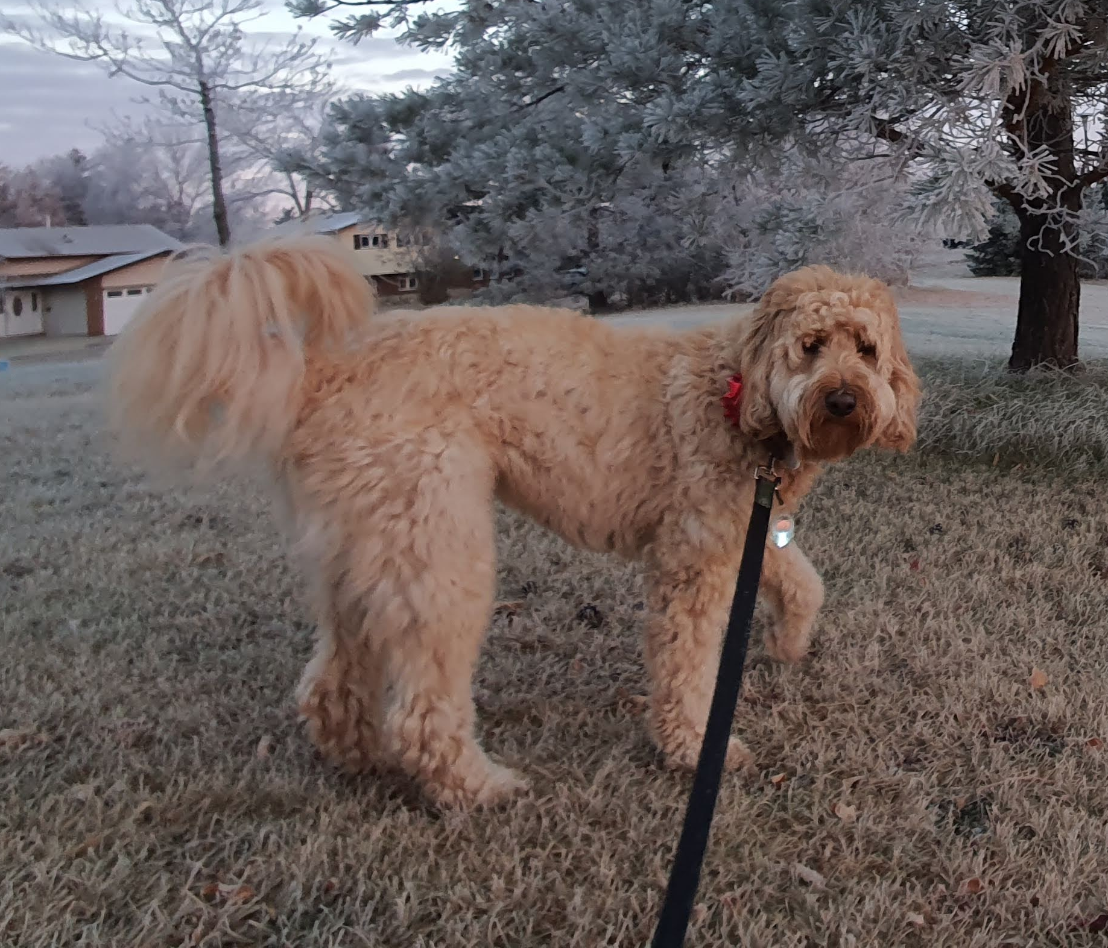
+
Jeff Dooling
Mark Boland’s dog

Slide 9
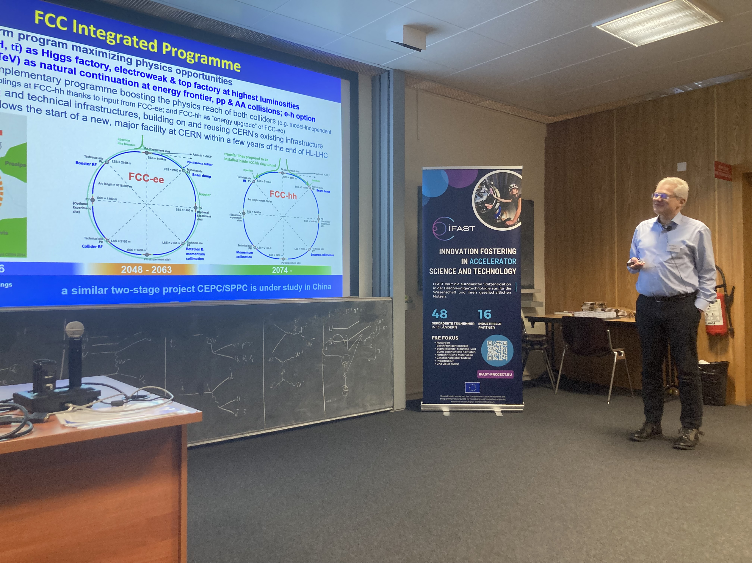
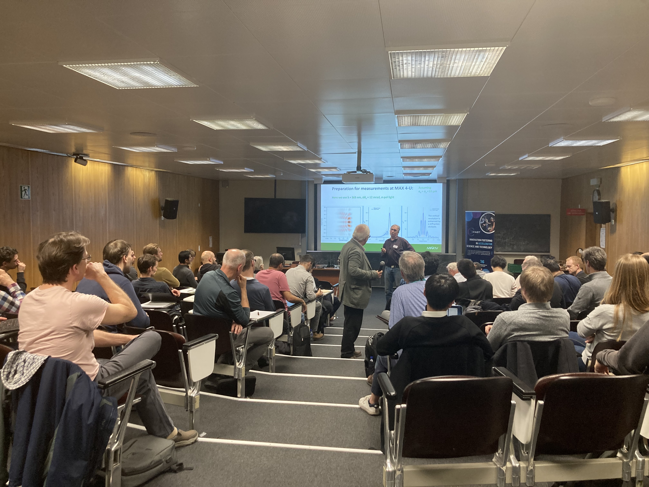
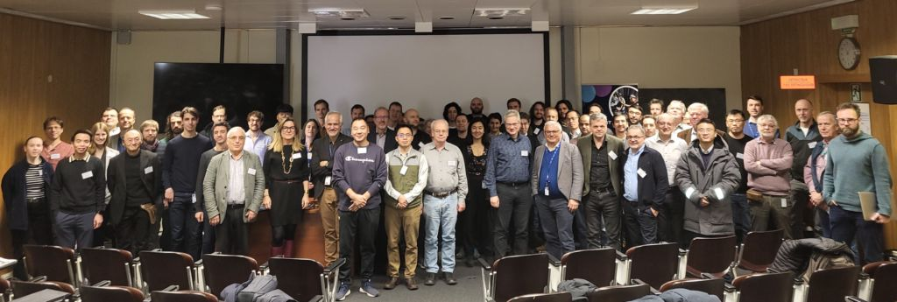
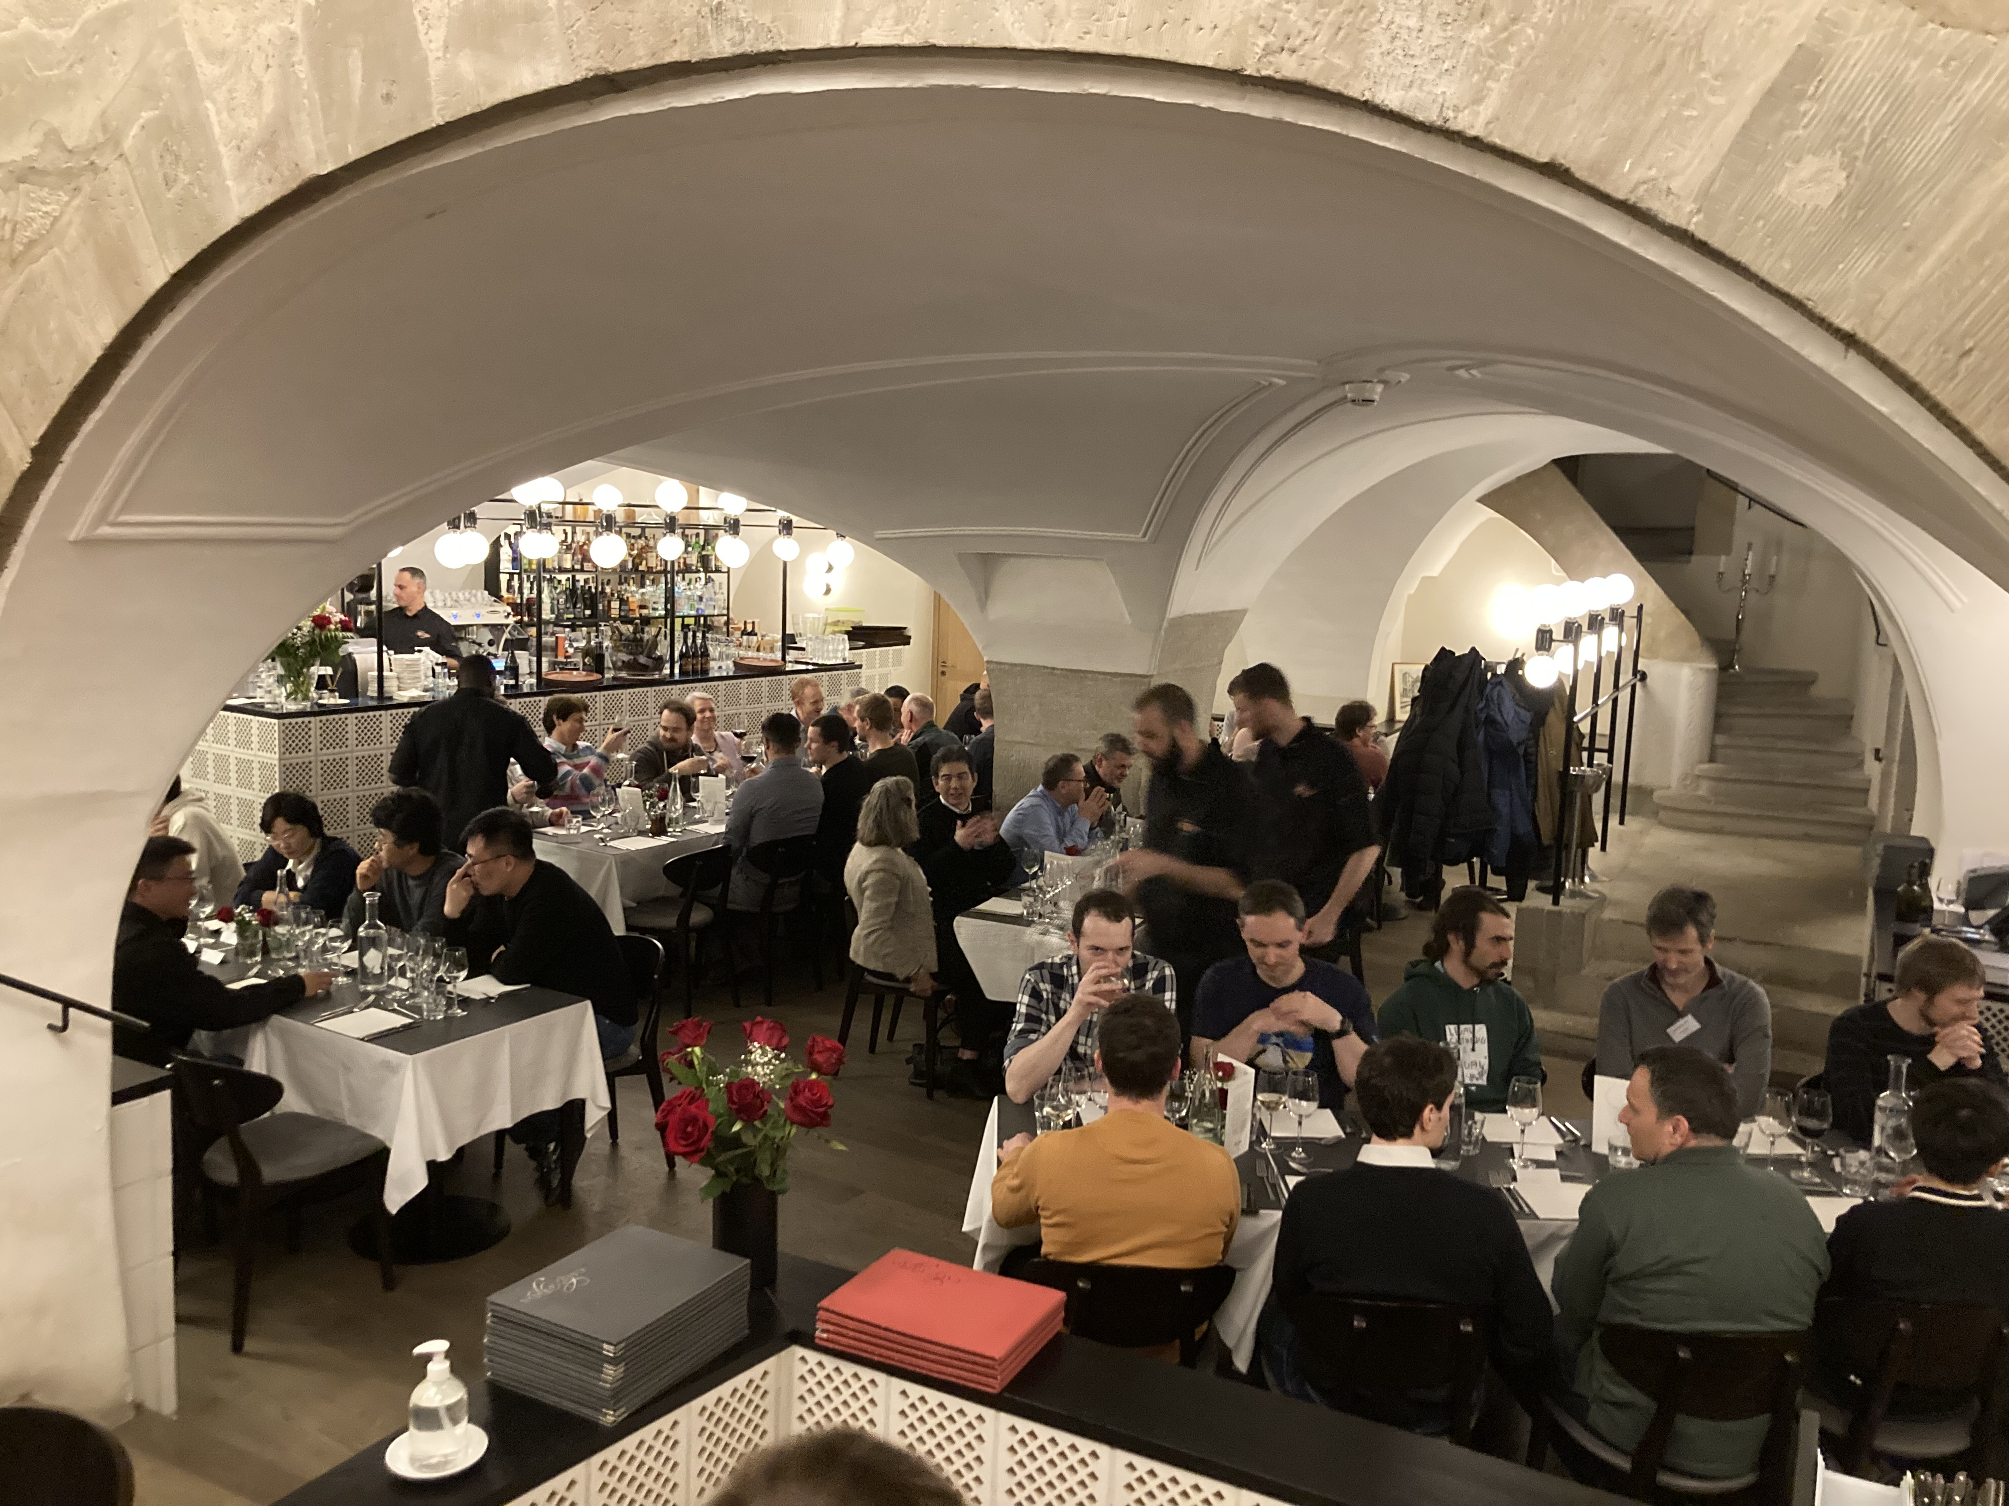
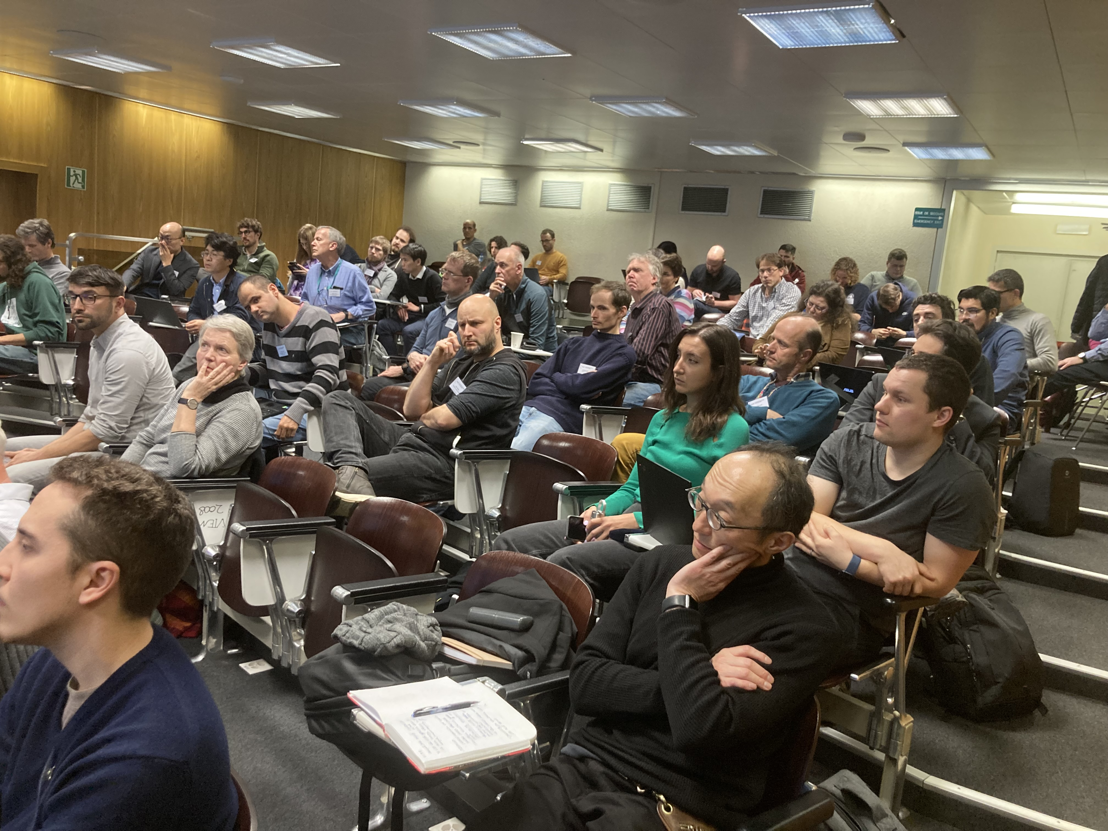
LER 2024

Slide 10
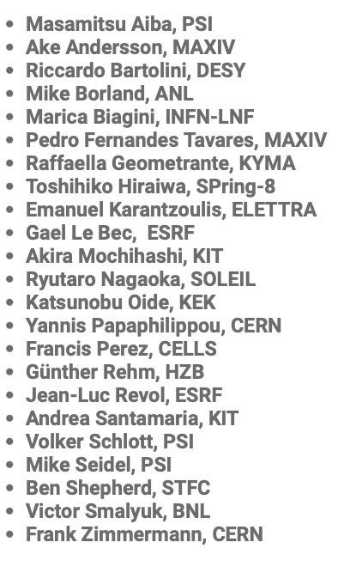
Thanks
To Maurizio Vretennar for leadership of EU projects and in particular supporting the Low Emittance Rings Community
To Riccardo Bartolini (WP7 coordinator) and Akira Motsihashi (WP7.2 Task leader) for helping in the organisation of the workshop
To the scientific program committee for shaping an excellent program
To the chairpersons, speakers and all of you for participating

Slide 11
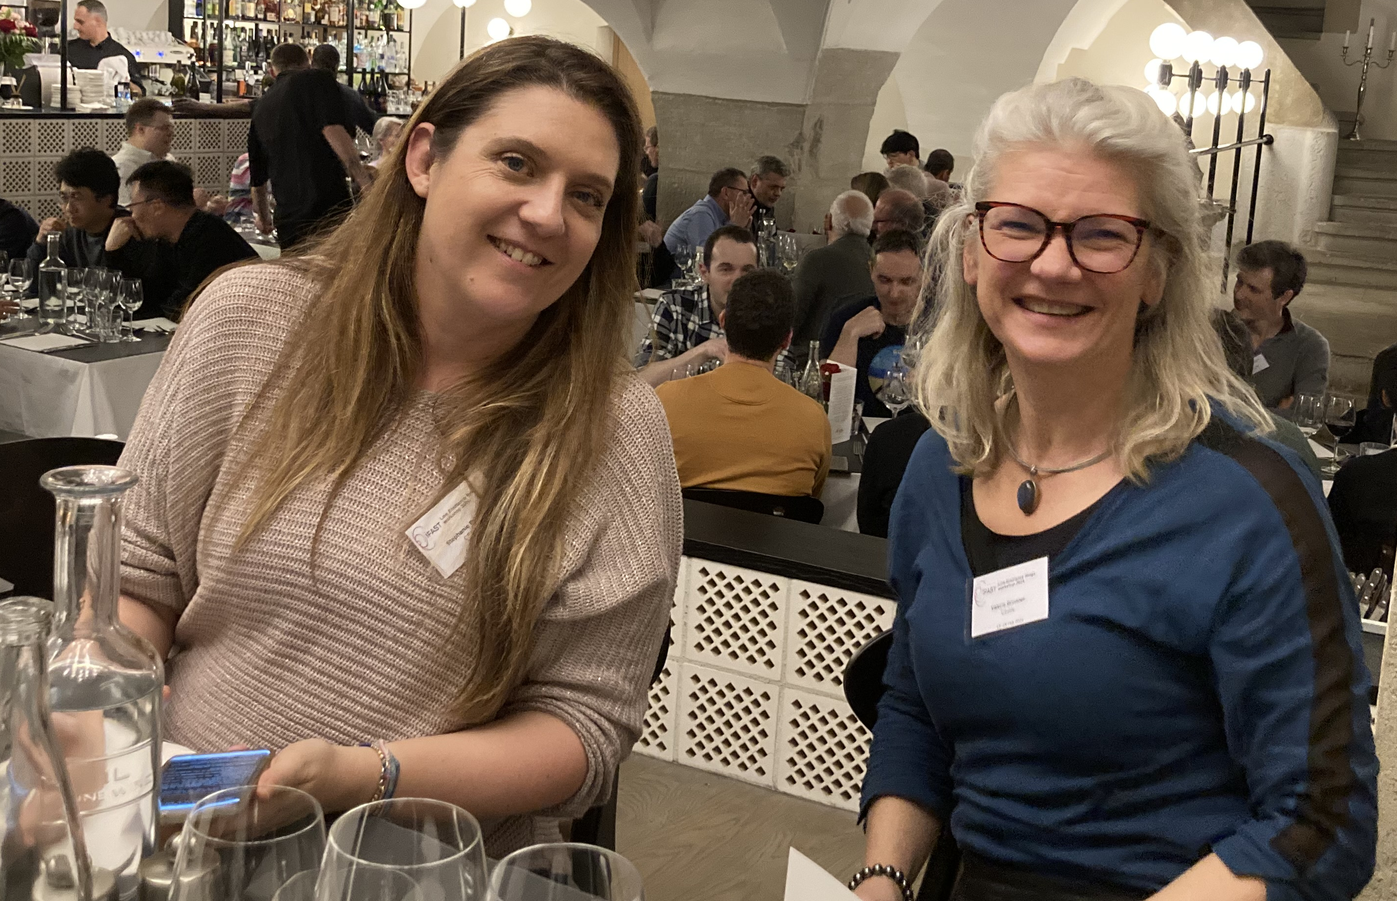
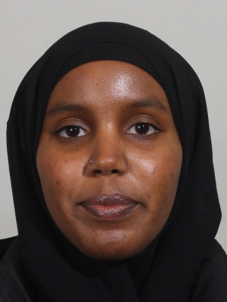
Special Thanks
To Valerie Brunner, Stephanie Palluel and Saamiya Adow
Without them nothing would have worked out!

Slide 12
See you in the 10th LER workshop!

