Slide 1
HEARTS Advisory Panel Kick-off Meeting
HEARTS Management and Communication
9 October 2023
https://indico.cern.ch/event/1326703/
Pablo Lopez
& Antoine Le Gall,
CERN

Slide 2
Management (WP1)
Pablo Lopez (CERN)

Slide 3
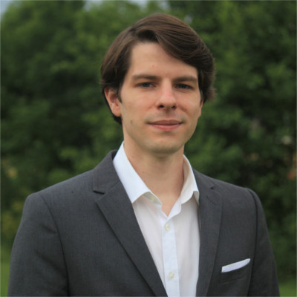
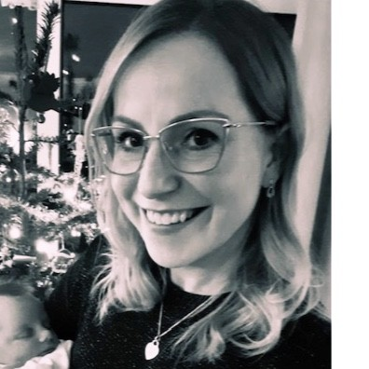
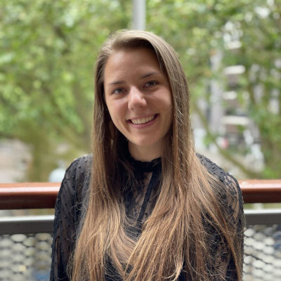
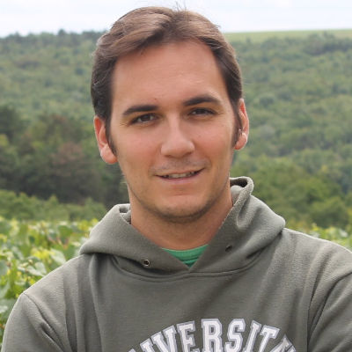
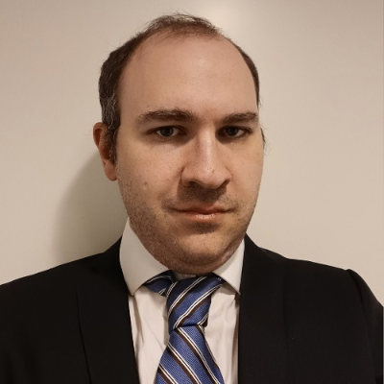
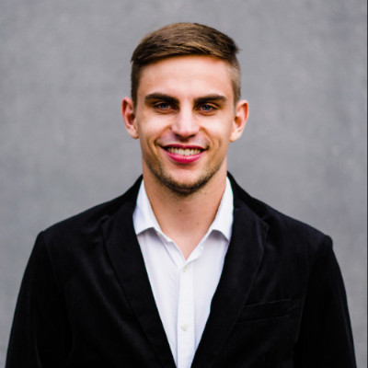
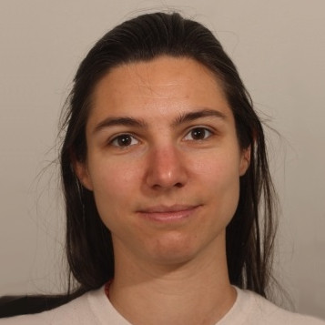
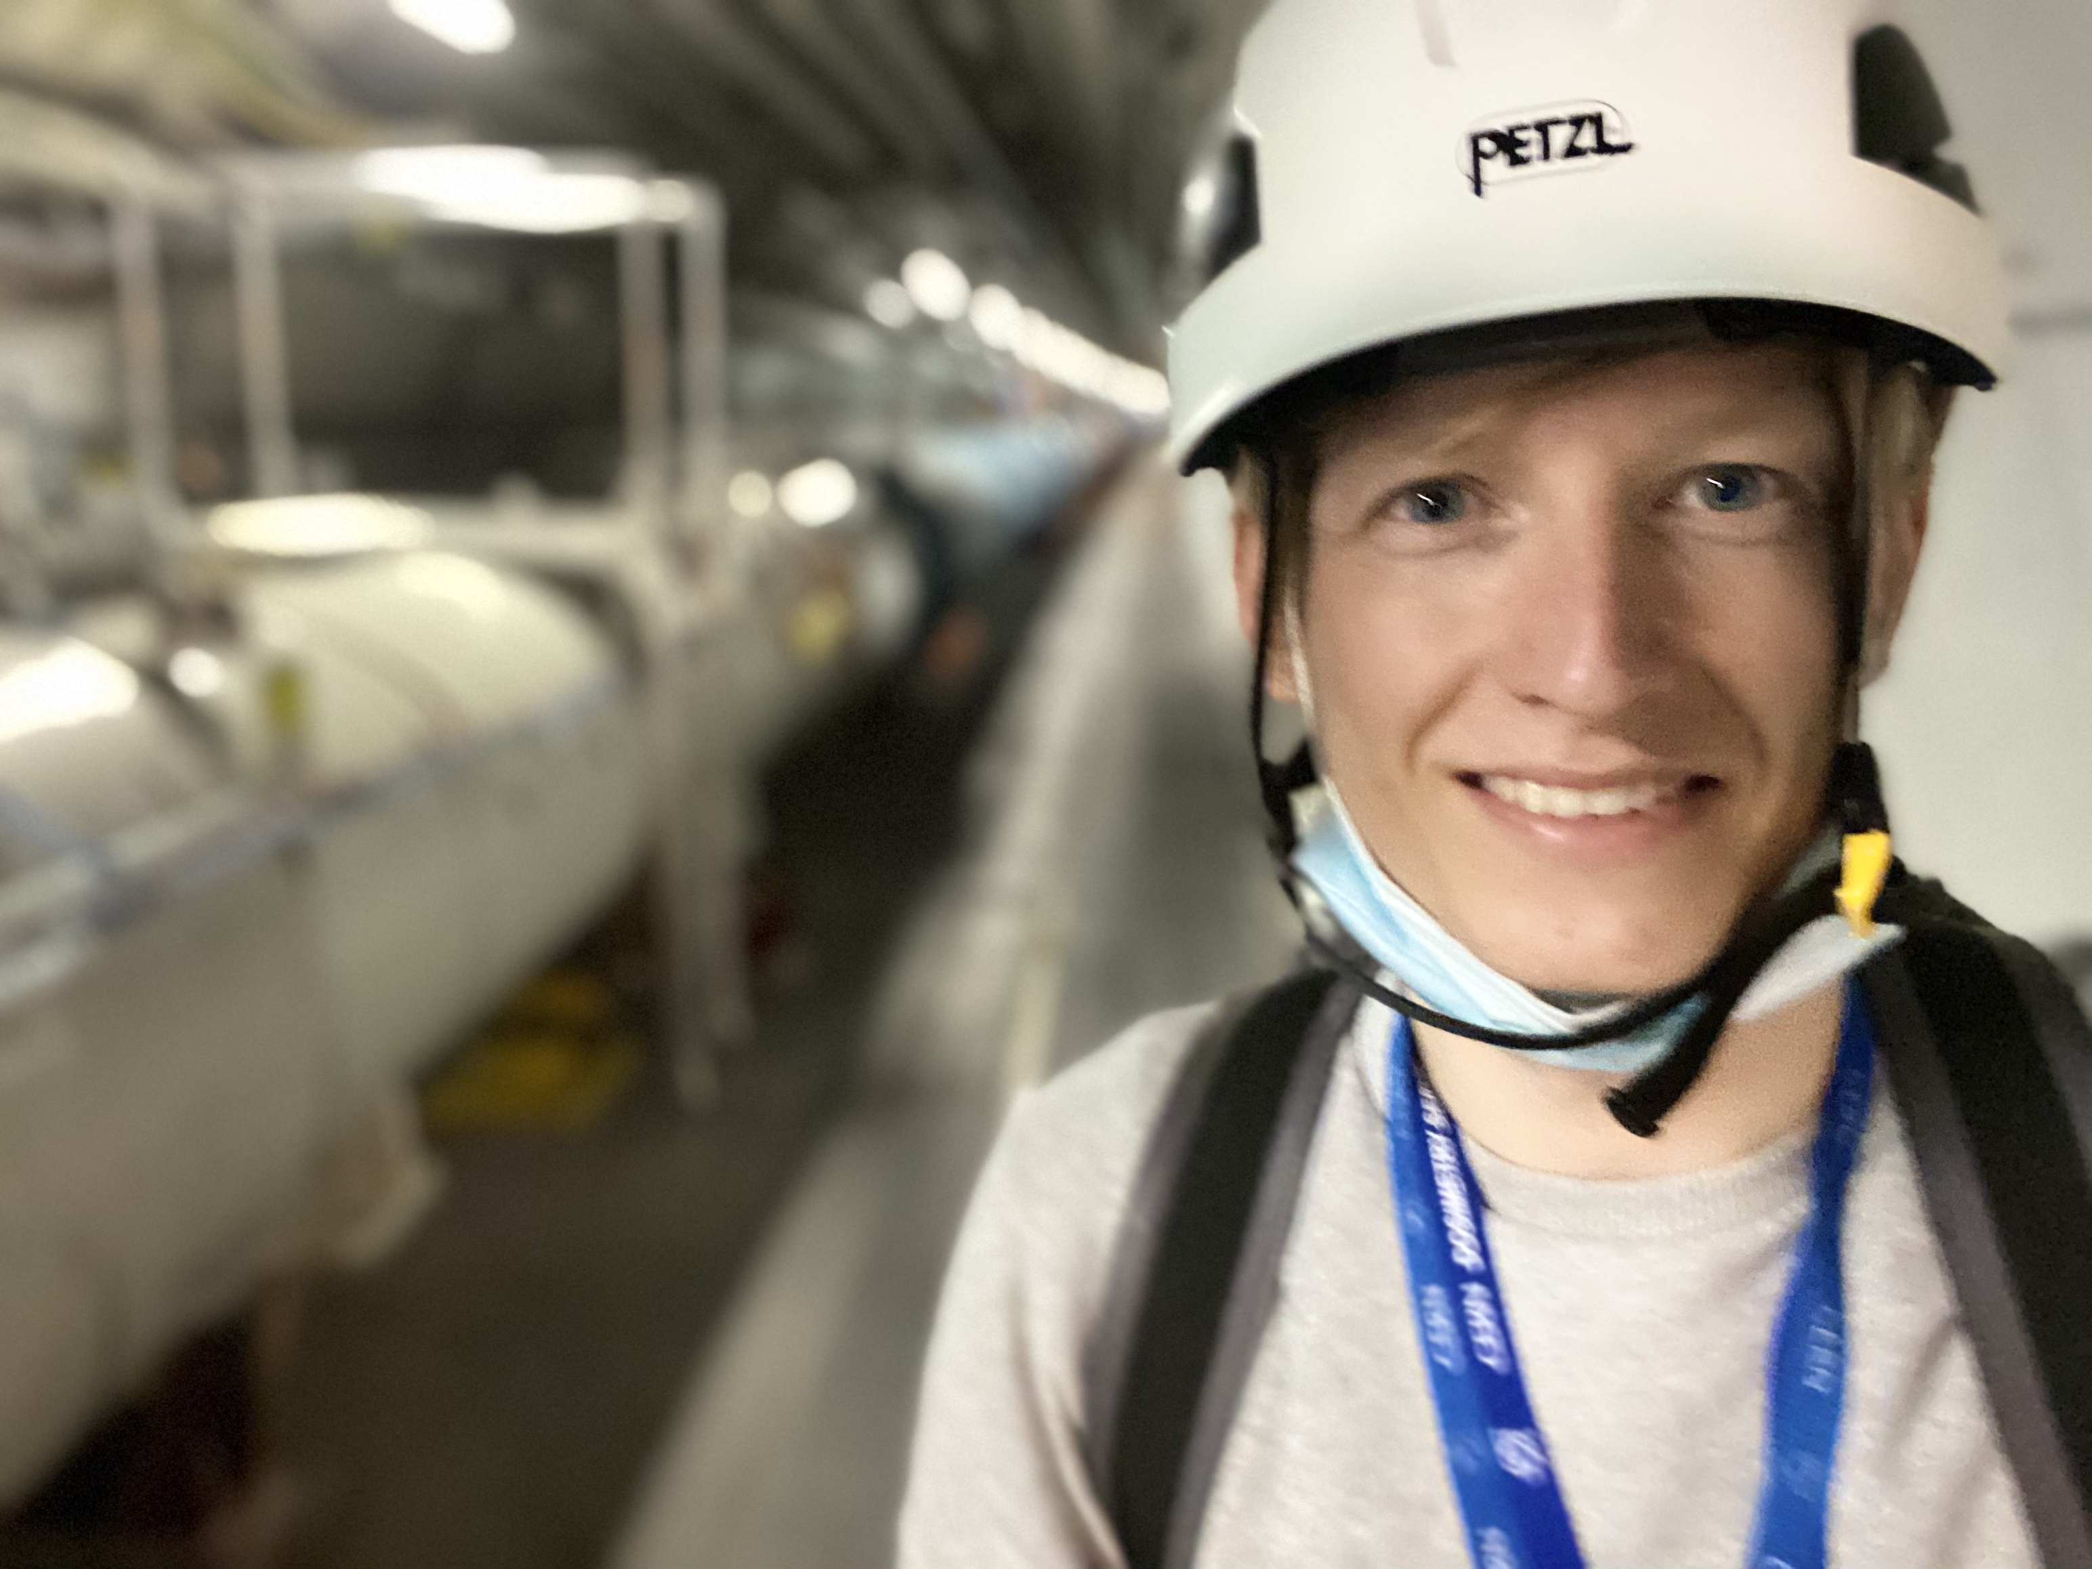
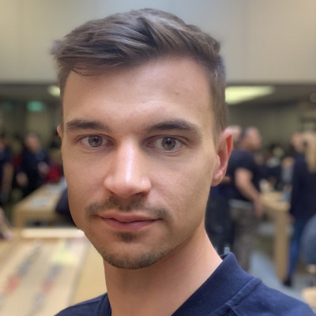
Project Office Members
Ruben GARCIA ALIA, Scientific Coordinator (CERN)
Andrea CORONETTI, Deputy Coordinator (CERN)
Pablo LOPEZ, Project Assistant (CERN)
Cloé LEVOINTURIER-VAJDA, Administrative Support (CERN)
Andreas WAETS, Scientific Secretary (CERN)
Mandy STEWART, Legal Advisor (CERN)
Julia HEILEMANN, Legal Advisor (CERN)
Viktor VARGA, Financial Support (CERN)
David LUCSANYI, Web Developer (CERN)

Slide 4
Main objectives
Central role of communication between the beneficiaries and the European Commission
Supervision and coordination of the scientific and technical progress
Supervision and coordination of the project periodic and final reporting, including use of resources and distribution of funding
Organisation of project annual meetings and consortium bodies meetings
Contractual and administrative implementation (e.g. GA amendments, NDA signature with AP members, …)

Slide 5
Consortium bodies
Governing Board (GB), decision-making body
  1 representative per Partner (6 members)
  ~ 2 meetings per year
  Examples: vote for GA amendment, or for inclusion of a new Partner in the Consortium
Work Package (WP) Leaders, lead and coordinate the technical activities
  1 representative per WP
  ~4 meetings per year

Slide 6
Consortium bodies
Project Office (PO), supervisory body, report to and be accountable to the GB
  Project leader, deputy Project leader, Project assistant, technical experts
  ~4 meetings per year
  Examples: digital tools, template for reporting, contact with the Project Officer, coordinate the execution of all WPs.
Advisory Panel (AP), advise the GB on technical and strategic matters with a focus on Exploitation, and provide independent assessment and feedback concerning the advancement of the project. One AP meeting per year is planned.

Slide 7
Project Reporting Timeline
The periodic reports to the EC includes a technical and a financial part. Beneficiaries should report on the progress of the work and costs claimed.
A more detailed timeline is available on EDMS.
1st Annual Meeting and review meeting (06-07.02.2024)
2nd Annual Meeting and review meeting
3rd Annual Meeting and review meeting
M1
M12
M14
M18
M24
M26(?)
M36
M38(?)
M48
End of Y4, P3 & Final report to EU
(31 Dec. 2026)
End of Y1
(31 Dec. 2023)
P1 report to EU
(30 June 2024)
End of Y2
(31 Dec. 2024)
End of Y3 and P2 report to EU
(31 Dec. 2025)

Slide 8
Deliverables and Milestones: 1st year overview

Slide 9
Communication (WP2)
Antoine Le Gall (CERN)

Slide 10
Main objective + target audiences
Objective (cf. GA): “Develop a new culture in which high-energy heavy ion beams are exploited for research and industrial purpose within the electronics, shielding and radiobiology communities”.
Audiences:
  Internal community.
  Industry (established + new space industrial actors).
  Research & Academia (radiation to electronics + Radiation shielding and radiobiology).
  Decision-makers.
  General public.

Slide 11





Communication channels
Project website
hearts-project.eu
Mailing lists,
including internal newsletter
External newsletter
Accelerating News (quarterly).
LinkedIn account
>220 followers
Participants channels,
including social media
Events
Workshop, conference, nights
+ Internal communication channels

Slide 12
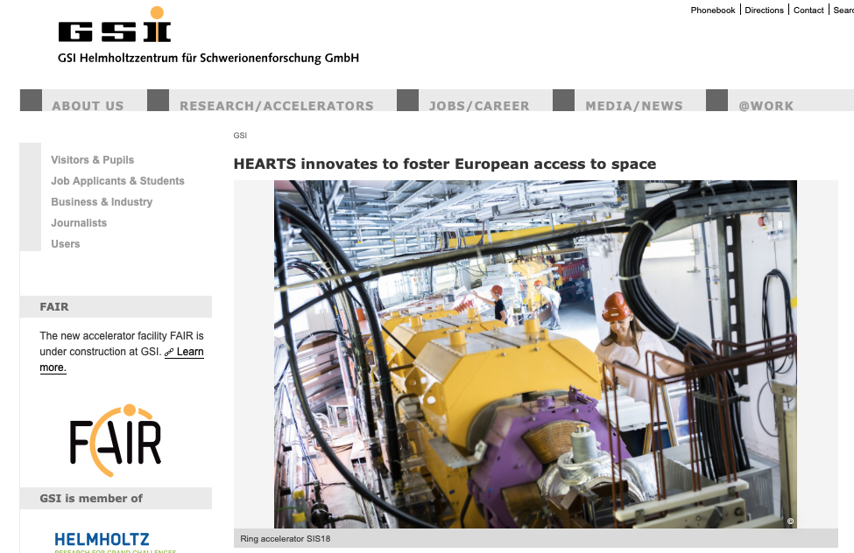
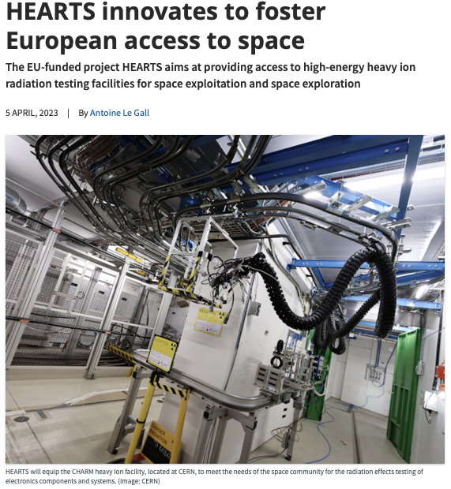
Latest news
Articles on partner channels:
  Start of HEARTS.
  Knowledge-transfer between CERN and GSI.
  Job offers.
Presence at strategic events:
  July 2023: EUCASS-CEAS.
  July 2023: NSREC.
  September 2023: RADECS.

Slide 13
A look at the future
Future plans:
  4-10 October: World Space Week (ongoing!).
  Mid-November: CERN heavy-ion run (full-scale communication on all CERN social media + press push).
One question:
  We are present at the right community events.
  But how to better reach out to our audiences online?
  (press, outlets, blogs, etc.)
For more information: consult the communication plan here.

