Slide 1
HEARTS Advisory Panel: composition and mandate
Mandy Stewart and Julia Heilemann

Slide 2
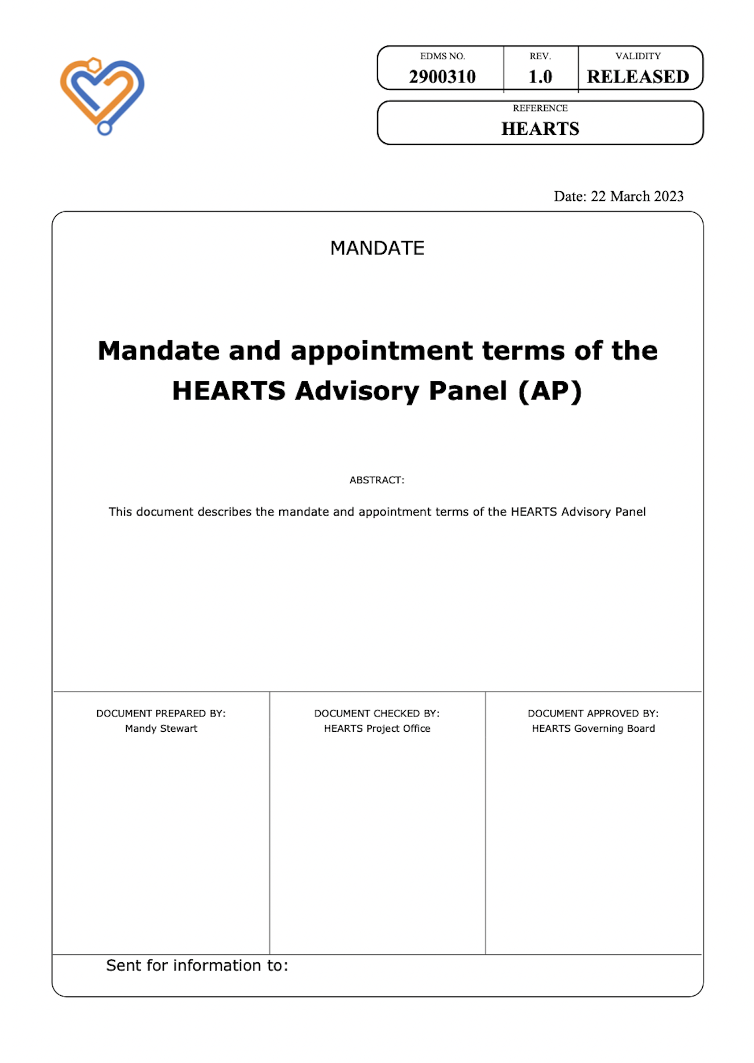
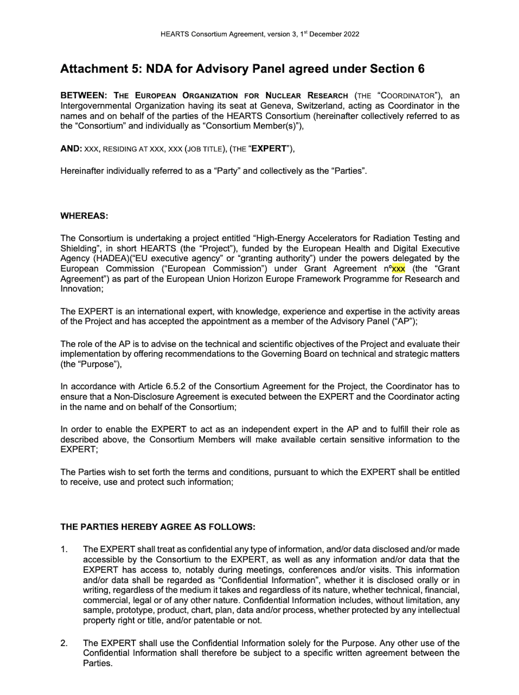

Reference documents
Consortium Agreement
Mandate
Non-disclosure Agreement

Slide 3
Consortium Agreement
Section 6.5 – Advisory Panel (“AP”)
Members of the Panel
Appointed by the GB
2/3 external experts
Tasks of the AP
Signature of an NDA between the AP member and the Coordinator

Slide 4
Advisory Panel Mandate
Composition
Agency representative
Facility representative
Scientific representatives
Industry representatives
Tasks
Attend Project meetings on invitation of the GB and Project Officer
Responsibilities
Impartial and independent
Members in their personal capacity
Signature of the NDA
No remuneration but reimbursement
Advise GB on technical and strategic matters on request of the GB and Project Officer
Independent assessment of the Project
Identification of possible shortcomings

Slide 5
Non-Disclosure Agreement
Mandated under Section 6.5 of the CA
Definition of Confidential Information
Purpose
Third party access
Duration
Return or destruction

